Slide 1
FAIR*, RHIC & LHC create pure glue matter
Early proposals for two phase transitions and two timescales in RHI-Colliders:
Svetitsky&Yaffe, Pisarski&Wilczek, Raha&Sinha, Shuryak, Kaempfer, Strickland et al…
1. CGC Gluon Supersaturation – Overoccupied, BEC
2. fast Gluon Equilibration – slow quark saturation
3. First Transition is 1.Order Phase Trans. in Yang-Mills gauge theory
4. Pure Gauge Theory Nf =0 vs.“physical” Nf 2+1QCD: Nf fct of time !
5. Second ‘Transition’: hadronization from 2+1Nf Quark-Gluon Plasma?
6. GlueBall-Hagedornstates decay in 2b-cascade: high mult pBar-p, pp pA - AA?
GB-HS, hadron ratios, <pt> vs. Multiplicity Flow & Ridge in pp, pA
Dileptons, Photons, Centauros,… vs. Multiplicity in pp, pA… +AA?
Horst Stoecker, GSI Helmholtzzentrum f. Heavy Ion Research, CCNU Wuhan, USTC,
Judah M. Eisenberg Professor Laureatus, ITP & FIAS, Goethe Univ. Frankfurt

Slide 2

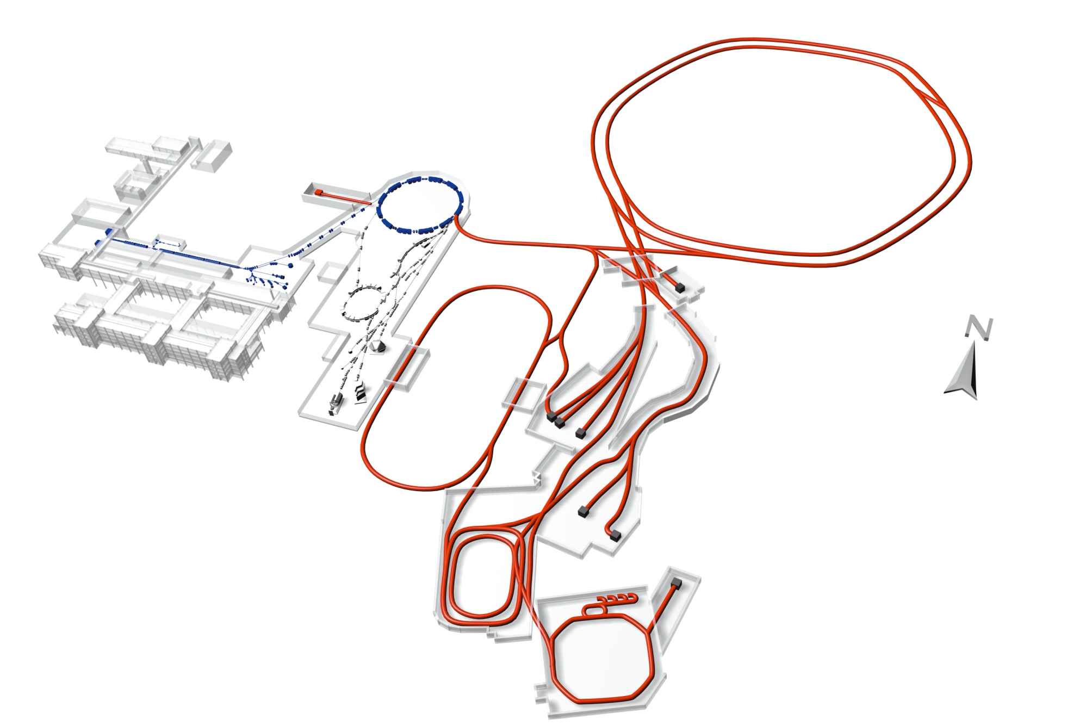

The Big Challenge ...
Gain Factors
GSI today
Beam intensities up by factors of 100 - 10000
Beam energies up by a factor 20
Production of antiproton beams – pBar-p-collider?!
Factor 10000 in beam brilliance via cooling
Efficient parallel operation of programs
SIS 100/300
UNILAC
SIS 18
ESR
Construction Period, Cost, Users
Construction of modules 1, 2, 3 until 2020 ff
Total cost 2 Giga €
Scientific users: 2500 - 3000 per year
Four pillars : APPA -CBM-NuSTAR-PANDA
HESR
Super
FRS
FAIR facility
In-Kind Financing by Internat. Shareholders
30 % international Partners 12 Countries
10 % State of Hessen
25 % Helmholtz Gemeinschaft
35 % Federal Rep. Germany
RESR
CR
100 m
NESR

Slide 3
Yes!
FAIR Council decided Sept. 29, 2015 to add 16 % to the FAIR contruction budget to built the full four scientific pillar modularized start version, in accord with the international convention between the founding nations, signed Oct. 4, 2010
APPA, CBM, NuSTAR, PANDA

Slide 4
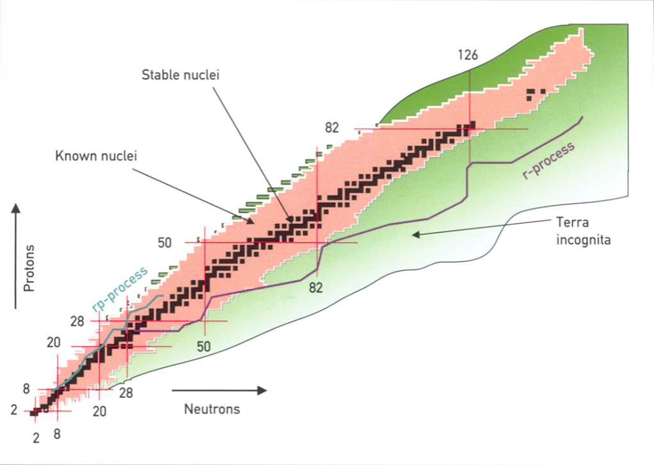
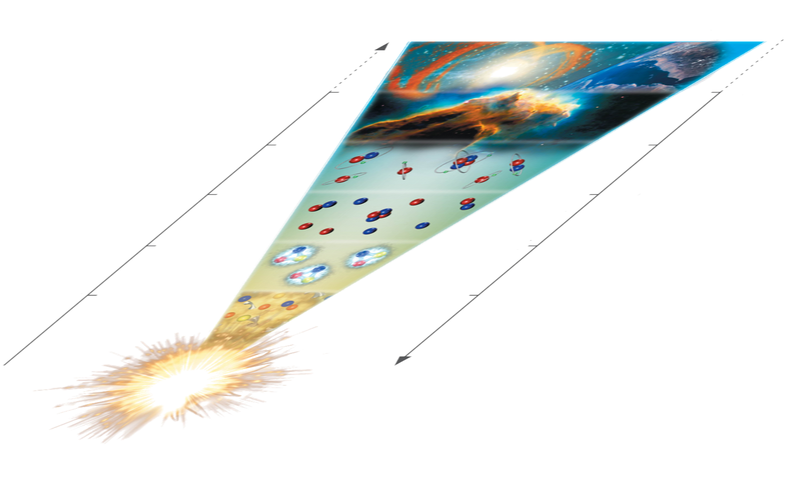
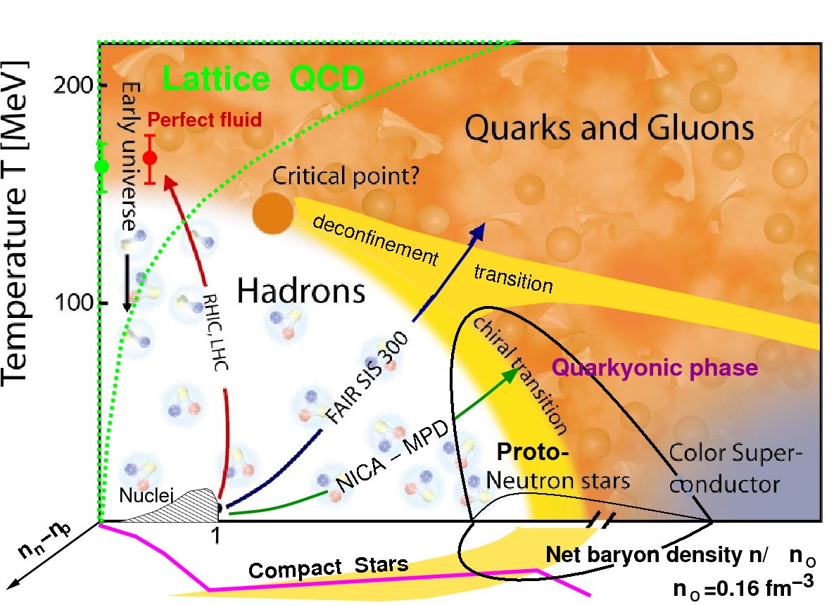
Cosmic Matter in the Laboratory
FAIR–RHIC-LHC
14 billion years
3 K
Creation of heavy elements in SN Explosions
in NS-NS-mergers: NuSTAR RIBs
1 billion years
20 K
Creation of A<60 nuclei in stars
400.000 years
3.000 K
H/He- Atoms form in ion-electron plasma
3 minutes
10⁹ K
Anti-Protons, Neutrons, Hadrons disappear
Create Anti-Baryons, Glueballs PANDA
5 microsec
Temperature
10¹² K
Gluons and quarks disappear CBM
time
Create Gluons, Quarks, Leptons…
Big Bang = Genesis
Notes:
The physics of hadrons and nuclei span a huge range in terms of
age of the universe
size of the universe
while the size of the object stays always in the ballpark of 1 fm (10⁻¹⁵m), the approx. range of the strong force
If we follow the bigbang, we can identify several regions of particular interest
Genesis of Quark
the Freeze-Out
almost Cold Hadrons
and Nuclei
The Genesis of Quarks is a different programme, so I leave it out for further discussions
All the others pose very remarkable questions
What kind of phase transition do exist in strongly interacting fundamental matter (among Quarks and Gluons) leading to the mapping of the phase diagram
The second important question is to understand quantitatively the mass of the proton (and all other hadrons) leading to the investigation of the binding among Quarks and Gluons
Finally the abundance of elements is critically defined by the dynamics of exotic nuclei, making the mapping of exotic nuclei the important challenge for understanding the appearance of our world

Slide 5
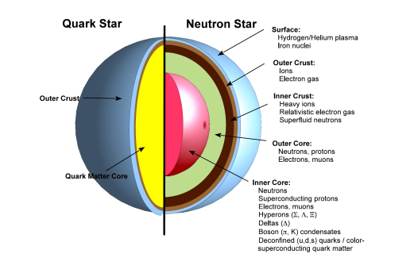
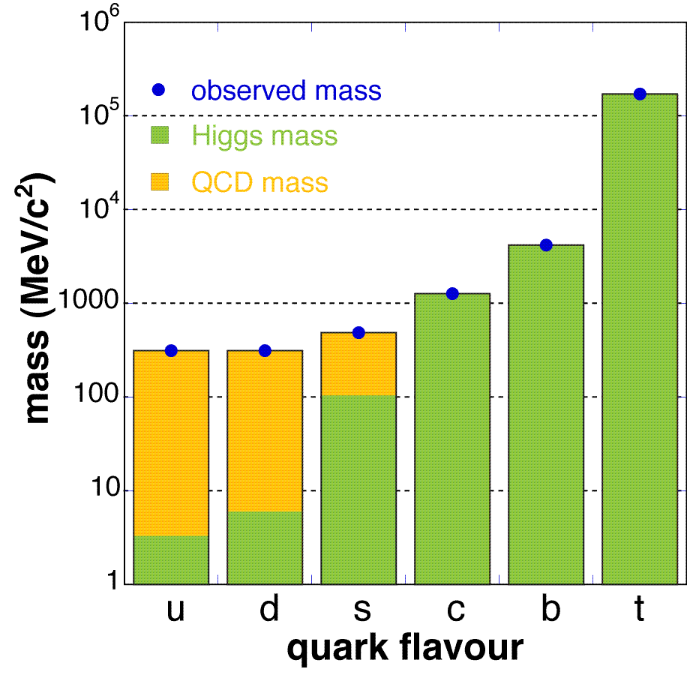
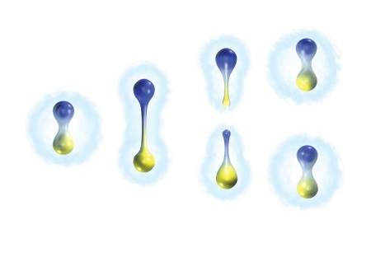
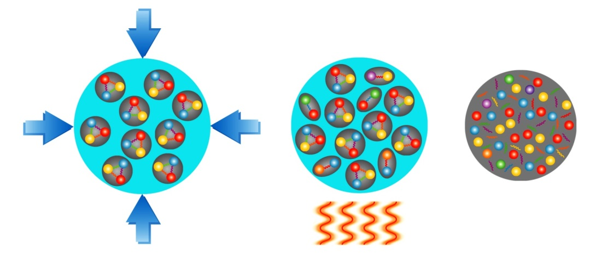
Fundamental Questions of (QCD-) Physics
➢ What is the structure of compact stars?
➢ What is the origin of the mass of the
hadrons which determine the visible
mass of the universe?
➢ Why do we not observe individual quarks,
the elementary building blocks of matter?
➢ What are the properties and the degrees-of-freedom
of nuclear matter under extreme
conditions (high temperature
and/or high density)?

Slide 6
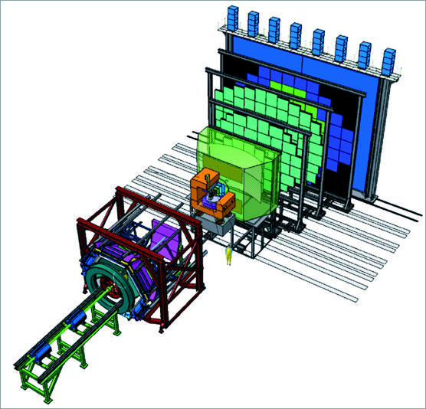
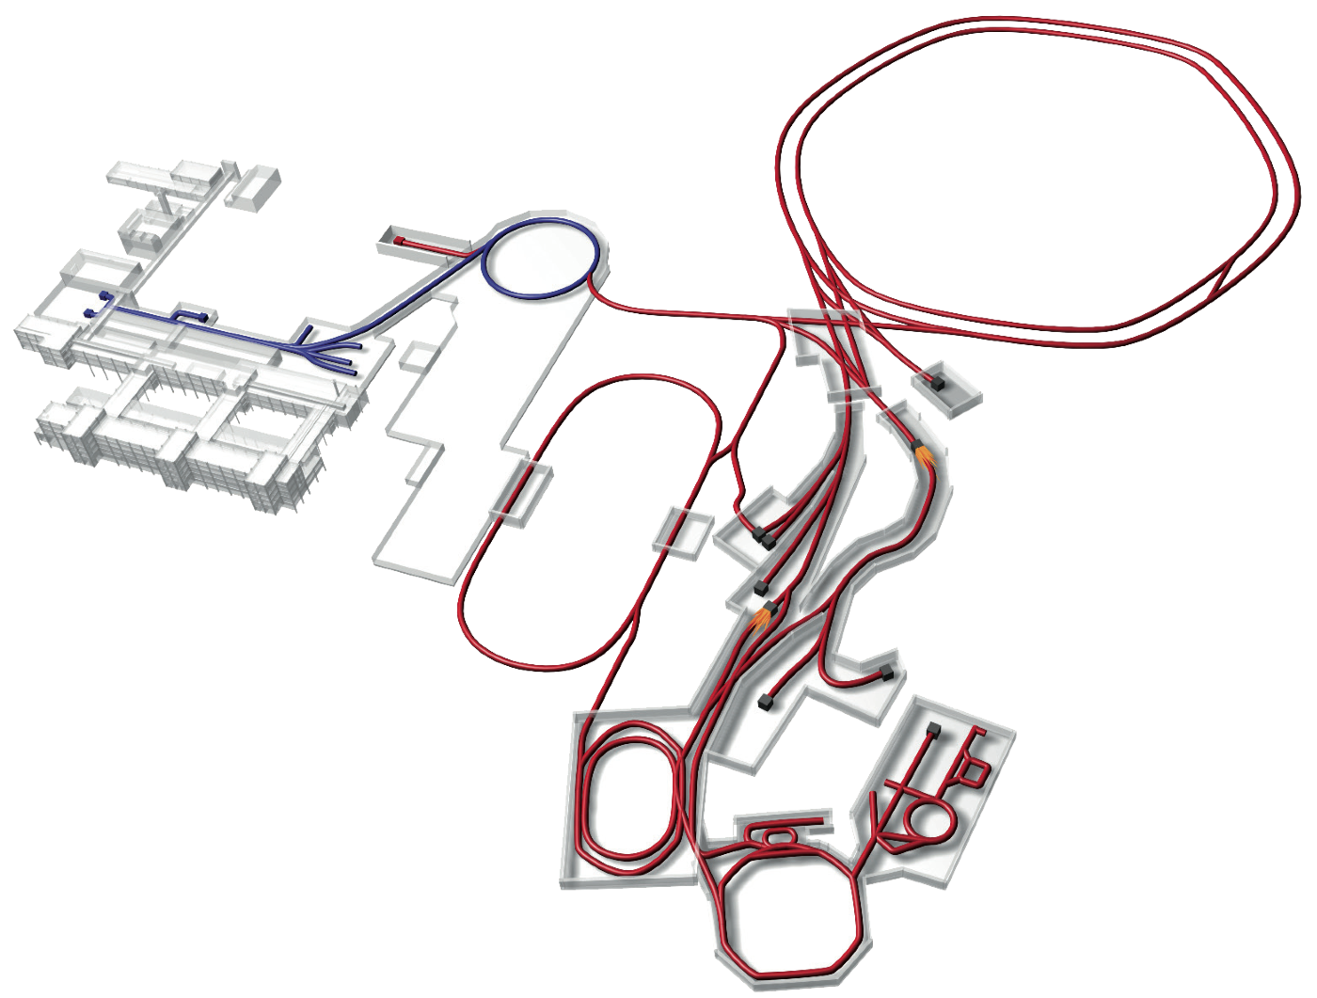
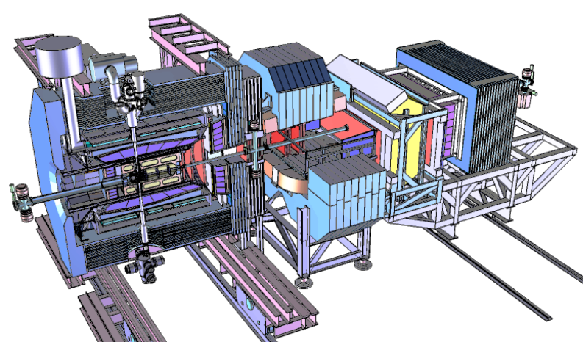
FAIR Experiments
CBM
APPA
NuSTAR
Super- FRS
PANDA

Slide 7

CBM : Big Bang and Neutron Star matter
- in the laboratory
deconfinement phase transition
Quarks => Proton
mass generation
Equation of state at neutron star densities
Multi-Strange
Quarksoup
FAIR SIS100
Highest Proton Densities in the Universe !

Slide 8
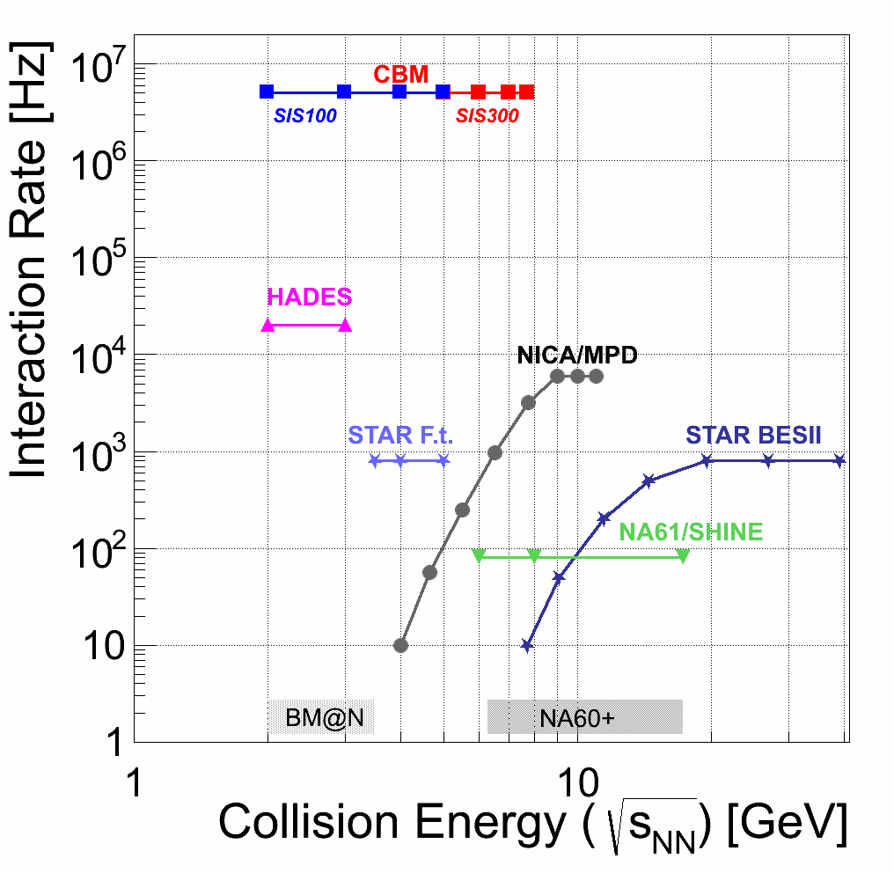
Experiments exploring superdense hot matter
Highest densities: FAIR

Slide 9
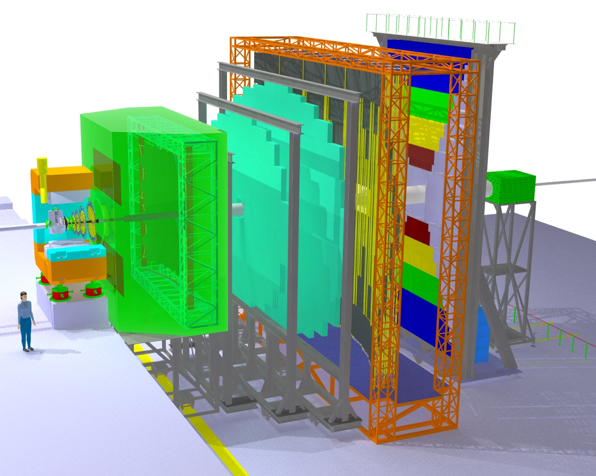
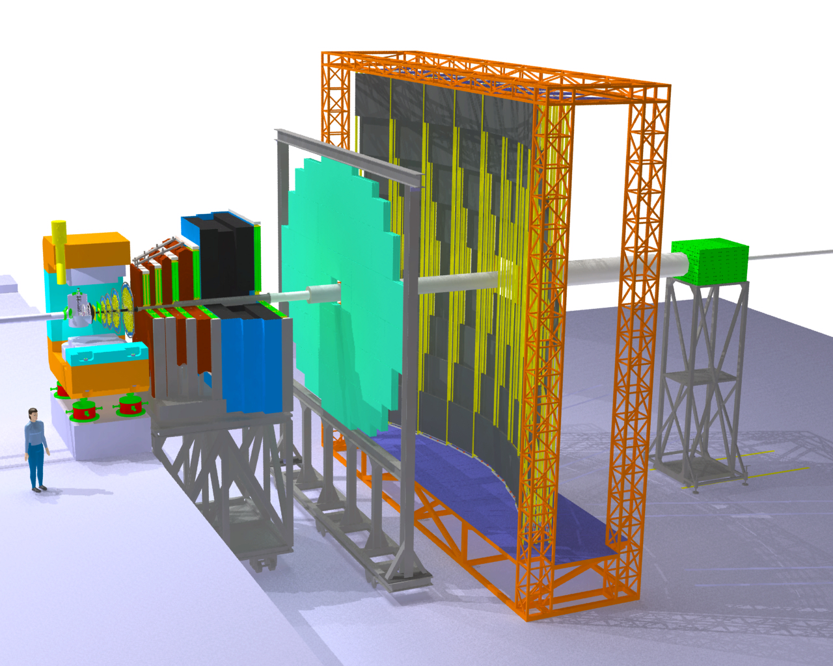
CBM: The Compressed Baryonic Matter Experiment
Transition
Radiation
Detectors
Tracking
Detector
Muon
detection
System
Electro-
magnetic
Calorimeter
Ring Imaging
Cherenkov
Detector
Silicon
Tracking
Stations
Vertex
Detector
Projectile
Spectator
Detector
(Calorimeter)
Dipol
magnet
Resistive
Plate
Chambers
(TOF)

Slide 10
FAIR Experiments
CBM
APPA
NuSTAR
Super- FRS
PANDA

Slide 11
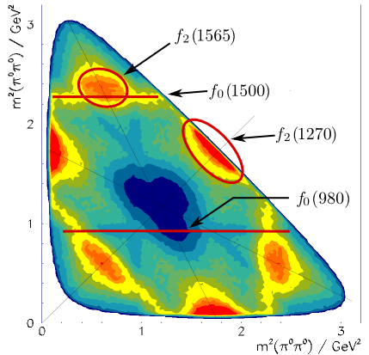
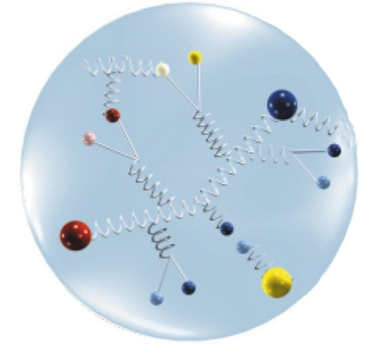
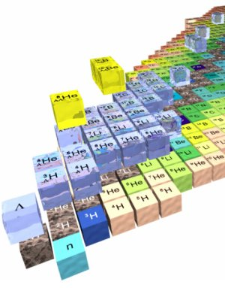
The present PANDA Physics Program
Hadron Spectroscopy
Experimental Goals: mass, width & quantum numbers of resonances
Charm Hadrons: charmonia, D-mesons, charm baryons
➔ Understand new XYZ states, Ds(2317) and others
Exotic QCD States: glueballs, hybrids, multi-quarks
Spectroscopy with Antiprotons:
Production of states of all quantum numbers
Resonance scanning with high resolution
Baryon Spectroscopy: excited ss, sss, c baryons
Hadron Structure
Generalized Parton Distributions
➔ Formfactors and structure functions, Lq
Timelike Nucleon Formfactors
Drell-Yan Process
Nuclear Physics
Hypernuclei: Production of double Λ-hypernuclei
➔ γ-spectroscopy of hypernuclei, YY interaction
Hadrons in Nuclear Medium

Slide 12
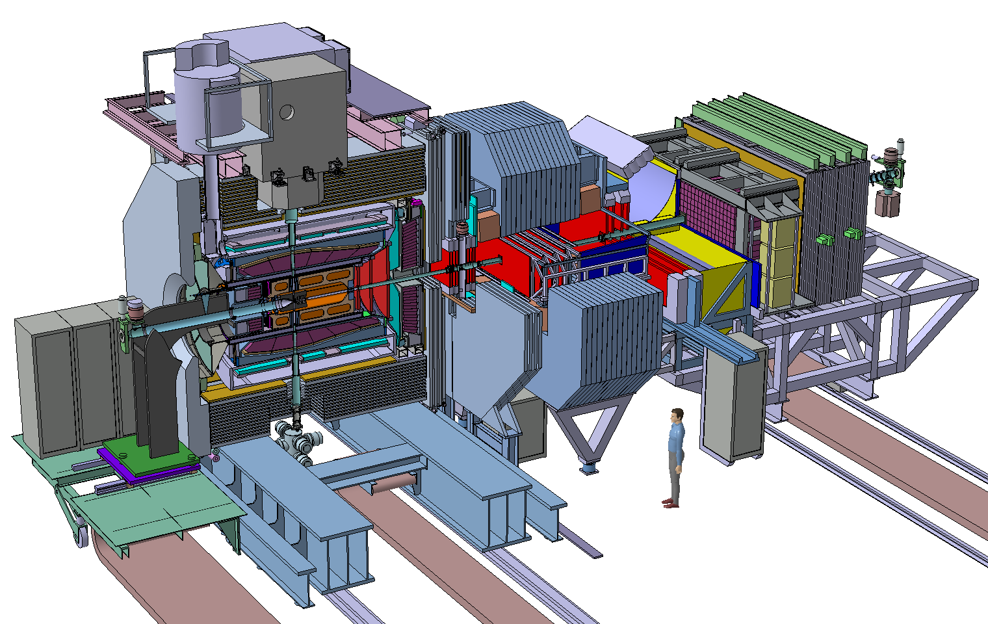
The PANDA Spectrometer at FAIR
Detector requirements:
4π acceptance
High rate capability:
2x10⁷ s⁻¹ interactions
Efficient event selection
➔Continuous acquisition
Momentum resolution ~1%
Vertex info for D, K⁰_{s}, Y
(cτ = 317 μm for D±)
➔Good tracking
Good PID (γ, e, μ, π, K, p)
➔Cherenkov, ToF, dE/dx
γ-detection 1 MeV – 10 GeV
➔Crystal Calorimeter

Slide 13
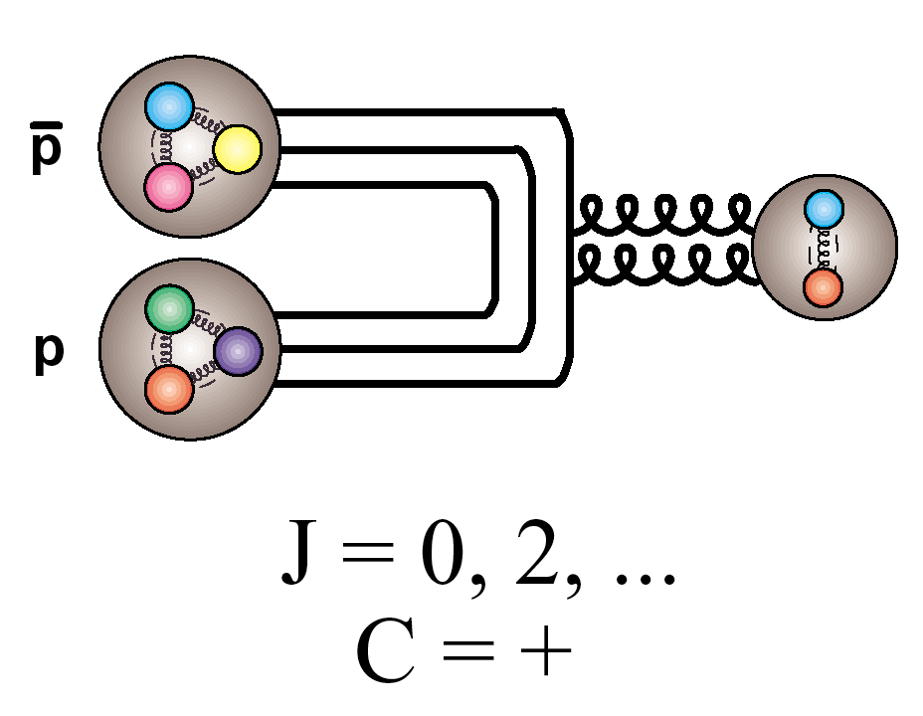
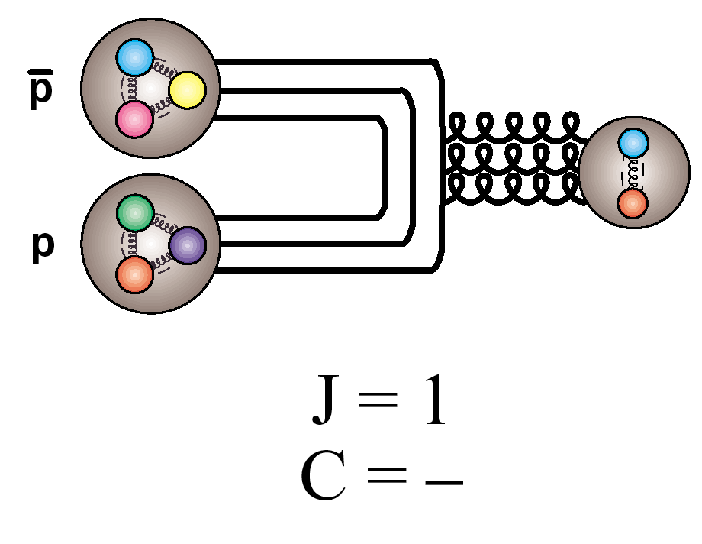
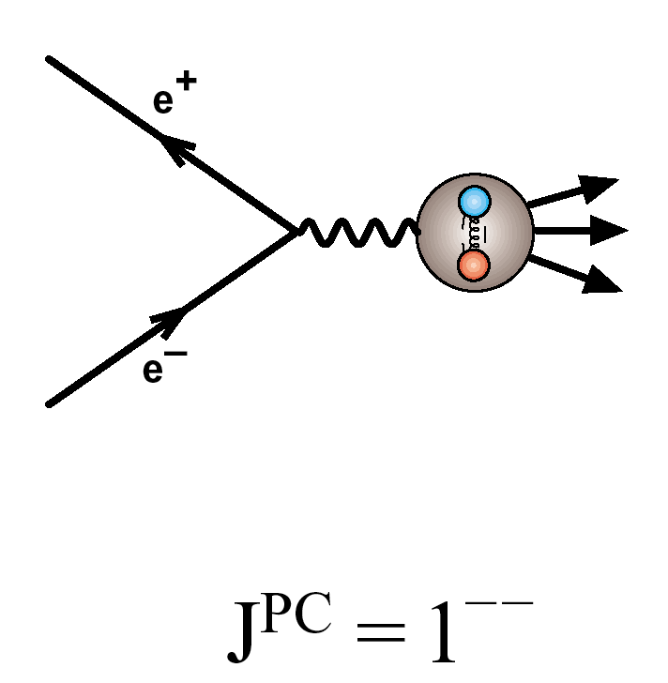
Particle production in pp collisions
_
Formation:
_
_
All J^{PC} allowed for (qq) accessible in p p
c.f.
Only J^{PC} = 1⁻⁻ allowed in e⁺e⁻
(to 1st order)

Slide 14
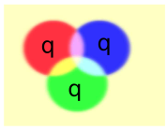
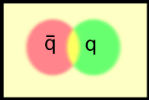
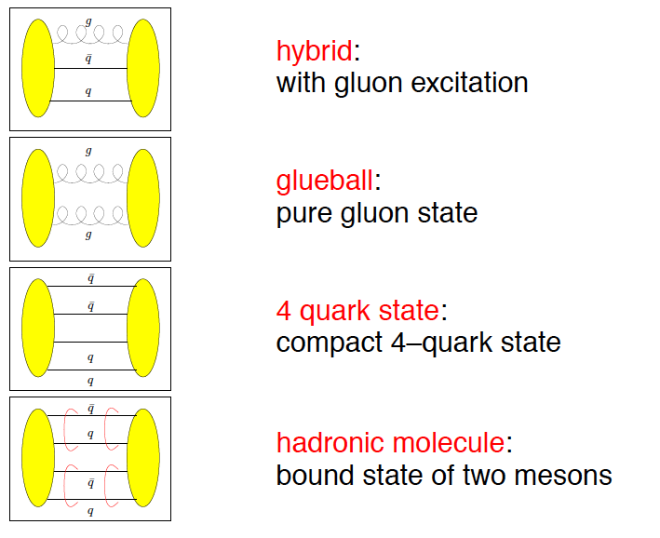
Beyond standard quark configurations
QCD allows much more than what we have observed:
Exotica
Baryons
Mesons
may have J^{PC} not allowed for qq
_
Courtesy C. Hanhart

Slide 15
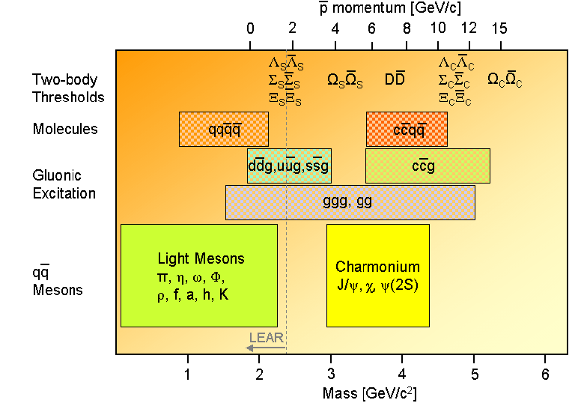
X, Y, Z, Charm-Hybrids, Penta-Quarks, Tetra-quarks, Glue-Balls
- PANDA explores their properties up to Masses ~ 5.5 GeV – 32 GeV ?!
Notes:
Am SLAC- Babar, Stanford, am KEK-Belle, Japan und am IHEP Peking wurden kürzlich Klassen von neuartigen schweren ‘Charmed Mesons’ entdeckt, PANDA wird dort eine reiche Ernte einfahren:
Dabei insb. charmed baryons, charmed hybrids, heavy glueballs, heavy charmed mesons suchen.
Antiprotonen in Kerne einlagern, multi-Hypernuclei erzeugen und vermessen, dies geht nur mit den brillianten Antiprotonenstrahlen am FAIR - HESR

Slide 16


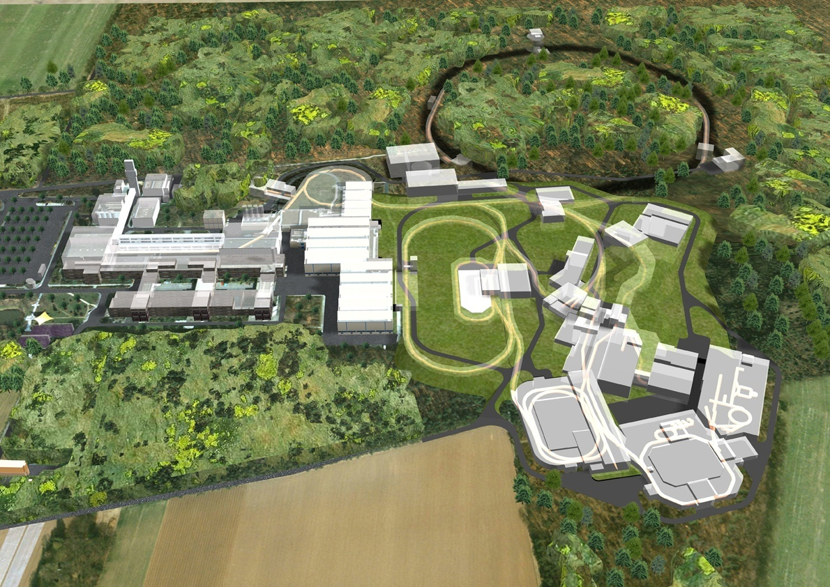
* Brilliant Anti-protons in pBar-ion Collider
Strange, Charm, Beauty cosmic matter
SIS 100/300
50 MeV
SIS18
p-Linac
30 GeV Protons
p
HESR
ESR
pBar
Cu Target
10⁷ p/s @ 3 GeV
CryRing
FLAIR
PANDA
High Energy pbars: R. Maier et al
From proton Linac 50 MeV
accelerate p in SIS18/SIS100
produce pbar on target
collect pbar in CR,
inject simultaneously pbar & ions into HESR FZJ@FAIR
as Collider : 32 GeV pure glue !
Accelerating
Cooling
Collecting
Accumulating
Precooling
RESR/CR
100m
G.Boca GSI, Germany & U. Pavia, Italy
Courtesy Jim Ritman, FZ Juelich

Slide 17
Lattice QCD vs pure YM: glueballs

Slide 18
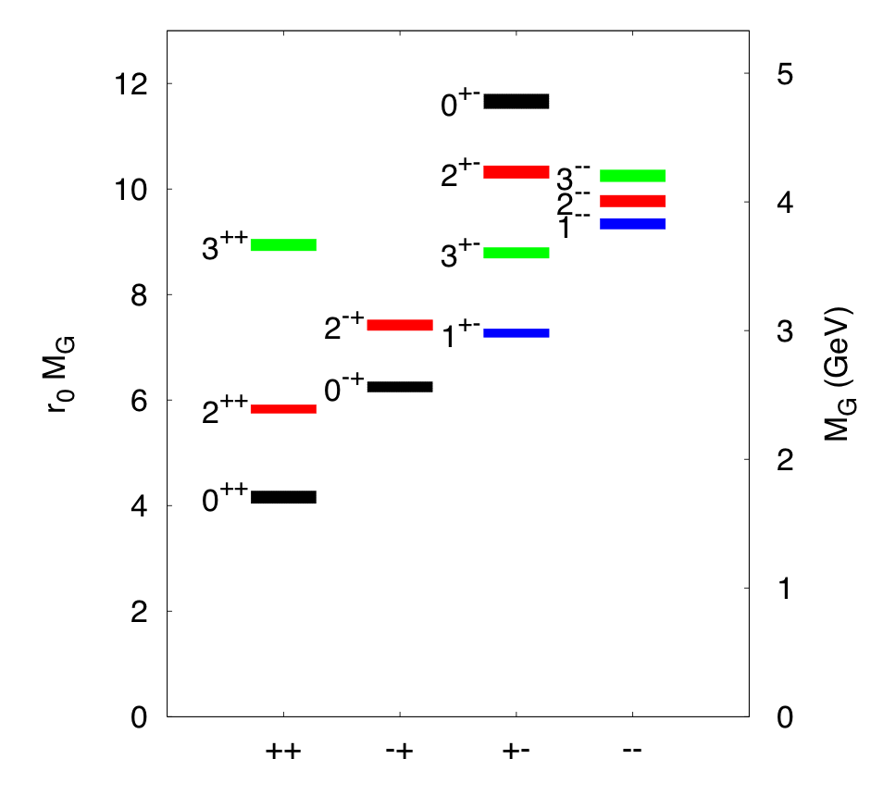
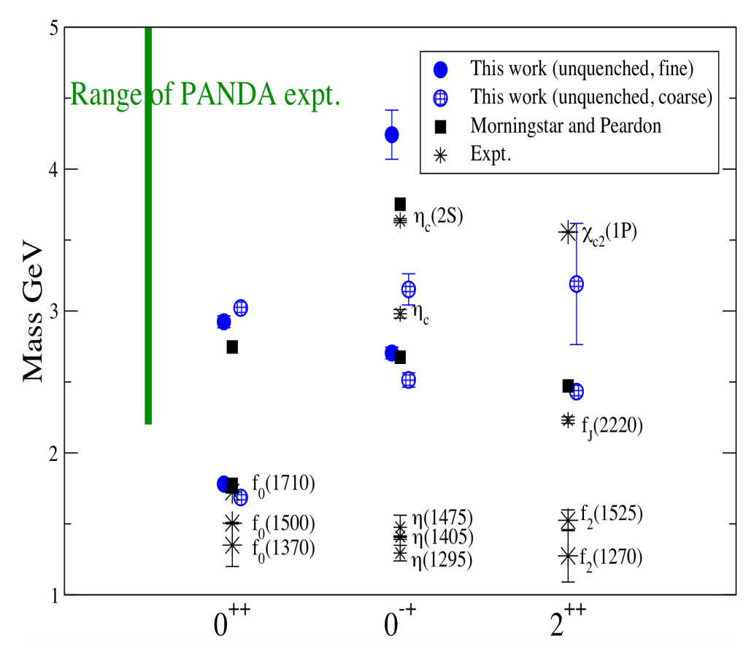
Glueball spectrum
Quenched results:
Morningstar-Peardon
Phys.Rev. D73 014516 (‘06)
First unquenched results:
pion mass 360 MeV
UKQCD coll. PRD82 (‘10) 34501

Slide 19
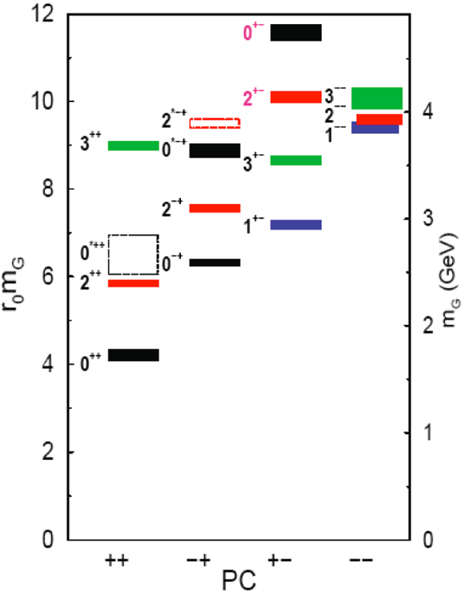
Search for Heavy Glueballs
Charmed Glueballs
  flavour blind decays
    charmed final states
  only a few charmed mesons around 3 - 4 MeV/c²
    less mixing
Exotic glueballs (oddballs), no mixing!
  m(2⁺⁻) = 4140(50)(200) MeV
  m(0⁺⁻) = 4740(70)(230) MeV
  decay modes φφ, φη, J/ψη, J/ψφ
  Narrow widths predicted
Morningstar & Peardon, PRD60(1999)34509
Morningstar & Peardon, PRD56(1997)4043 QUENCHED pure gauge Lattice theory
Wuppertal Bcoll., RBRC-Bielefeld coll, Owe Pilipsen, Goethe Uni Frankfurt

Slide 20
New Start on Old ideas !

Slide 21
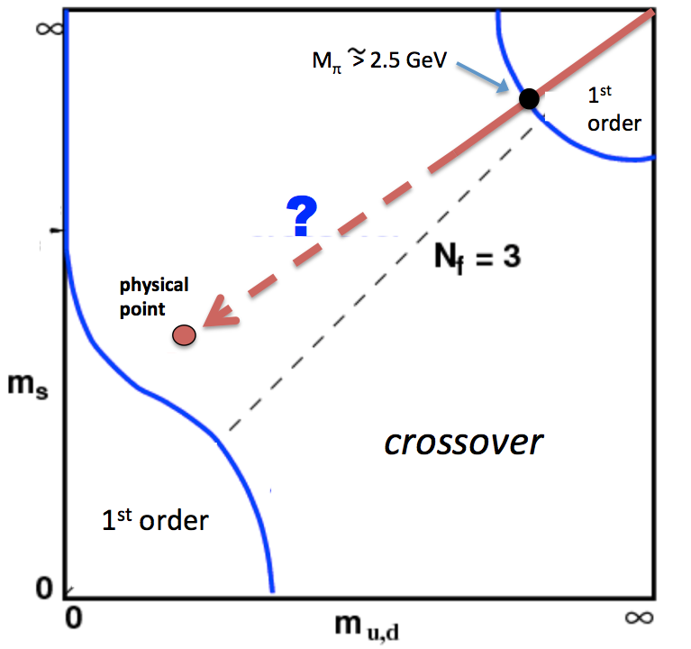
SU(3)_color Lattice Gauge Theory
Columbia Plot: Order of Phase Transition depends on quark masses
pure gauge: glue only!
t=0.1fm/c : No Quarks !
LHC & RHIC: high mult. pp & AA events
Quenched QCD glue + GlueBalls
few heavy Quarks
T_cp =250 MeV

Slide 22
Pure YM gauge theory on the lattice:
a hot glue plasma
a 1. Order PhaseTransition,
and a warm Glueball Fluid ! ?

Slide 23
New Scenario: pure gauge matter in pBar-p, pA, AA ?
Initial Color Glass Condensate Glasma thermalizes fast equilibration of Gluons, slow equil. of quarks high pressure, entropy gluon plasma fast hydrodynamic expansion of gluon plasma.
1. Order Phase Transition at T_c = 270 MeV of flavorless QCD.
Transition from glue plasma in GlueBall fluid
Glueball-Hagedornstates mix with quarks, decay into Hadrons

Slide 24
Time evolution of high multiplicity pp AA
at FAIR*, RHIC and LHC in pure YM scenario

Slide 25
The early eighties: predictions of QCD phase structure
1. two different phase transitions:
Svetitsky&Yaffe: F.O.P.T. in pure gauge YM theory:
“glueplasma – GlueBall fluid” – no quarks!
Pisarski&Wilczek: chiral massless quarks
F.O.PT QGP-Hadrons, but crossing if quark mass nonzero
2. - two chemical saturation eq. timescales in RHICs:
Raha/Sinha; Shuryak; T. Biro, B. Mueller, X.Y. Wang Transport Theory
Fast chemical saturation: pure glue! But Slow saturation: quarks !
Search for pure gauge YM F.O.P.T. at early times in colliders?
=> pBar-p, early pp, pA: Glue <=> GlueBall: new YM-QCD phase structure?

Slide 26
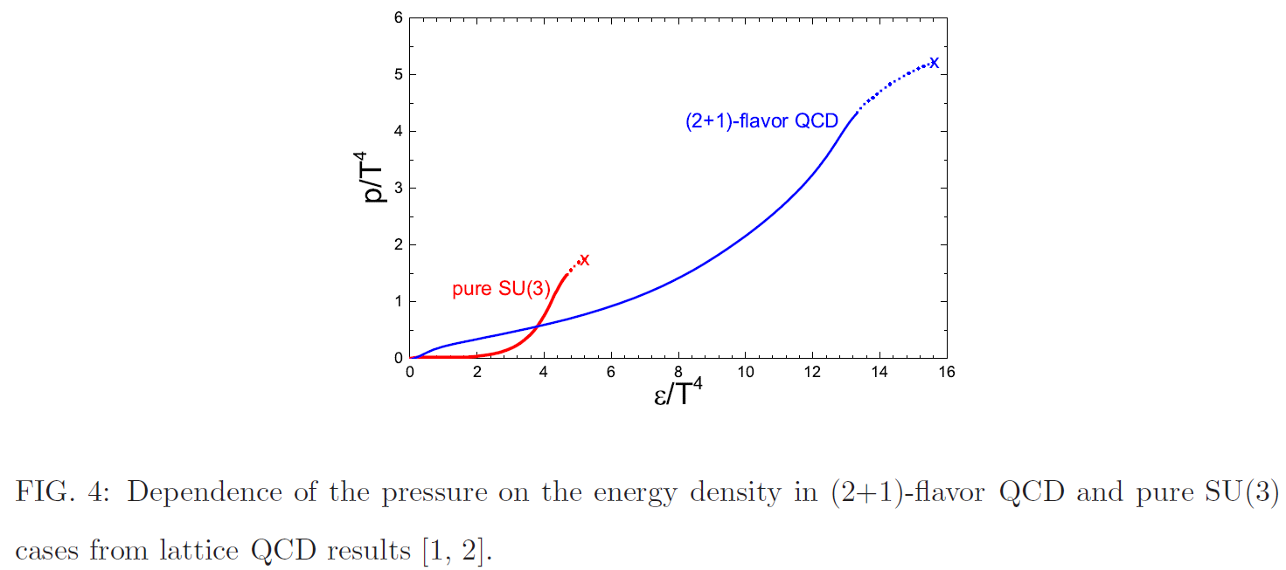

Slide 27
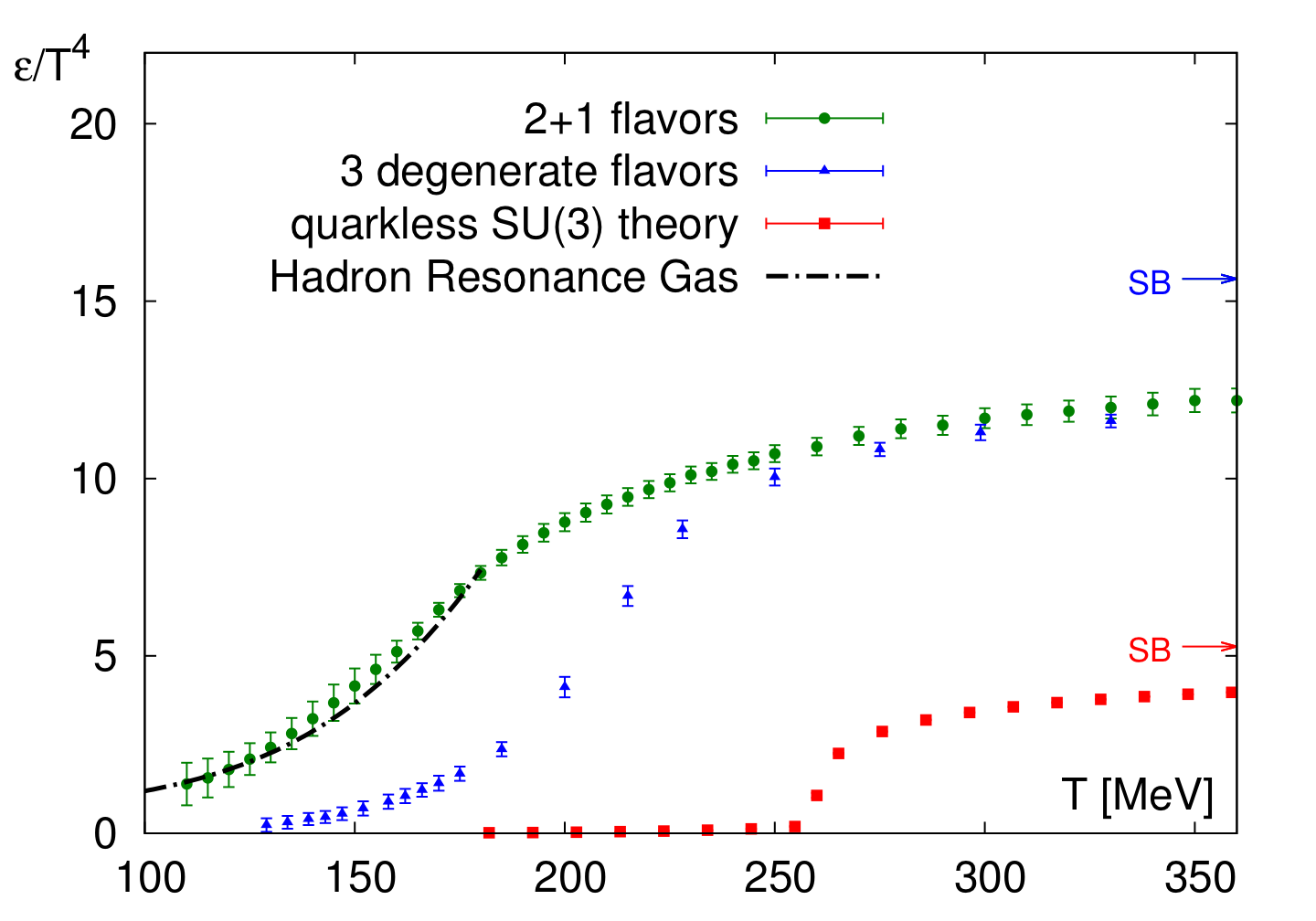
Pure YM LGT vs. 2+1 flavor Lattice QCD
Energy density (EoS) DIFFERENT for different quark masses
Energy density from
Sz. Borsanyi et al., W.P.
Wuppertal-Budapest coll
JHEP 1011, 2010,077;
PLB730, 2014, 99
“physical point” 2+1
T_c.o. = 155 MeV
N_f = 3, m_{u,d} = m_{s}
T_c.o. = 220 MeV
pure gauge YM
T_c = 270 MeV
Quenched: W.B. coll.
JHEP 1207, 2012, 056
1. O.P.Transition from glue-plasma to GlueBall-Hagedorn St.
HagedornStates decay

Slide 28
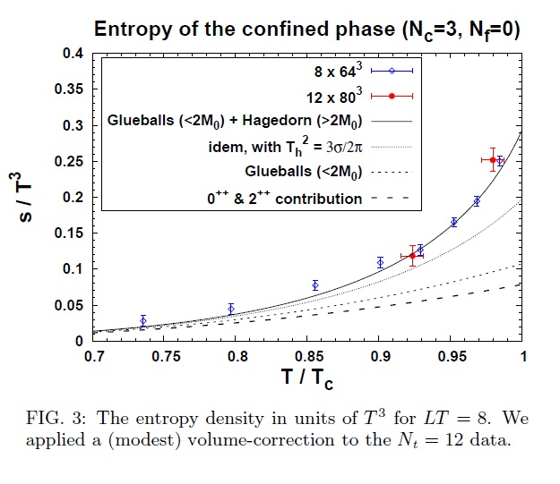
Pure LGT thermal GlueBall-matter observed at RHIC and LHC !?
Harvey Meyer, Univ. Mainz

Slide 29
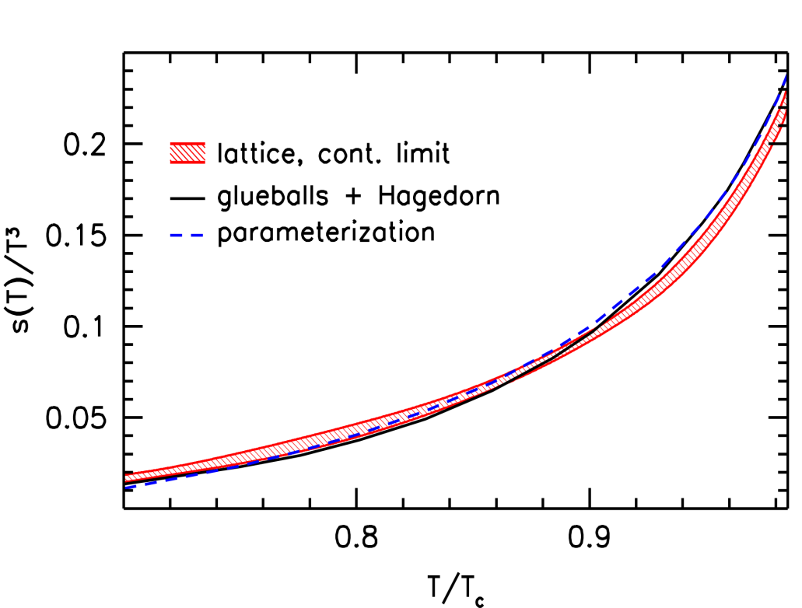
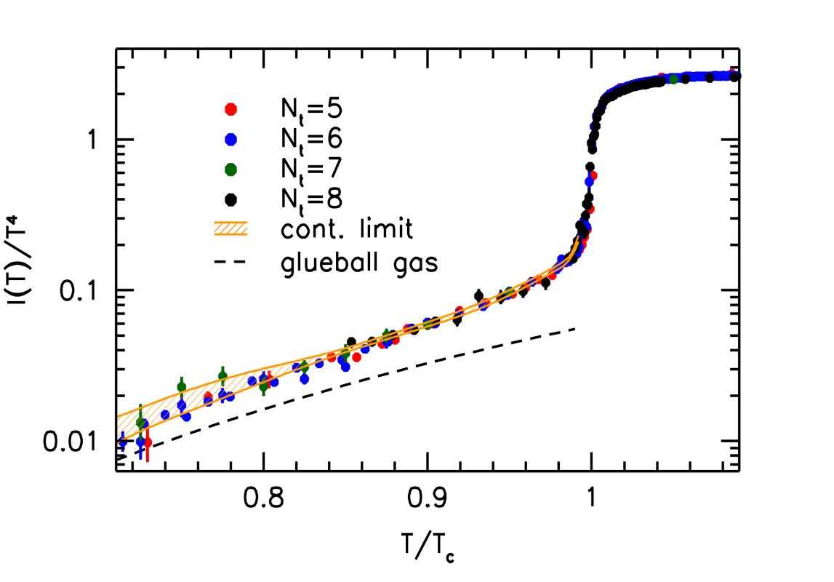
Lattice Gauge Thermodynamics of the GlueBall-matter fluid
Pure YM gauge: Glue Plasma
Glueball-Hagedorn-States
Glueball-Hagedorn-States
12 Glueballs
Wuppertal-Budapest (W.-B.)Collaboration: JHEP 1207 56 (‘12)
High precision continuum result for the quenched equation of state.
Low temperature behavior and phase transition described by Hagedorn-GlueBall spectrum.
W.-B. use 12 GlueBall states (Morningstar-Peardon) plus Hagedorn-GB towers
(as proposed by Harvey Meyer).

Slide 30
GlueBalls & Hagedorn-States: exponentially increasing Mass-Spectra, Width
Bootstrap (Max Beitel, Kai Gallmeister, Carsten Greiner)
GlueBalls+HagedornStates
p-Baryon-HagedornStates
T quite independent of charges

Slide 31
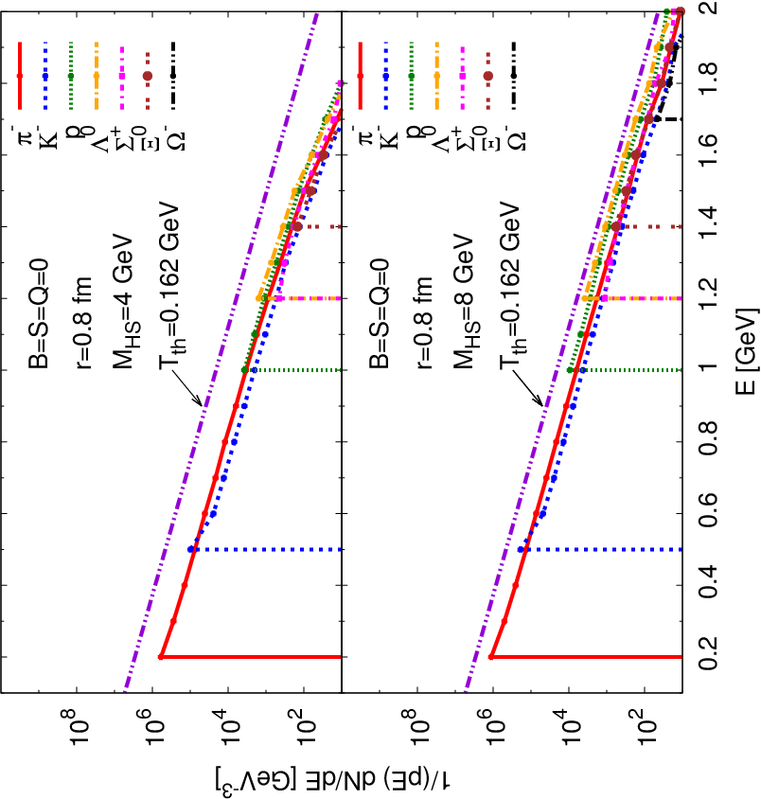
Slopes of Hadron spectra after binary decay casc. of 4 GeV GlueBall-HagedornState
Spectra/slopes of decay products of each single GB-HagedornStates with a cascade of sequential 2-body decays:
slopes look thermal !!!
slopes equal Hagedorn temperature !
slope independent of mass and radius of GB-Hagedorn State
M.Beitel, K.Gallmeister, C.Greiner, PRC 90 (2014) 045203

Slide 32
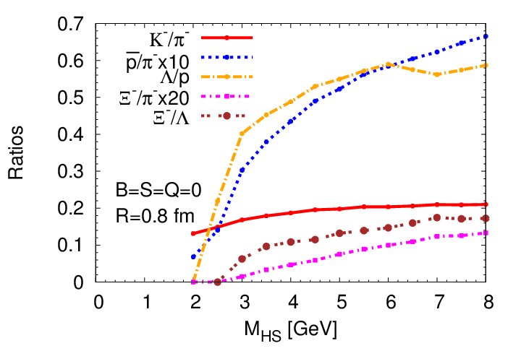
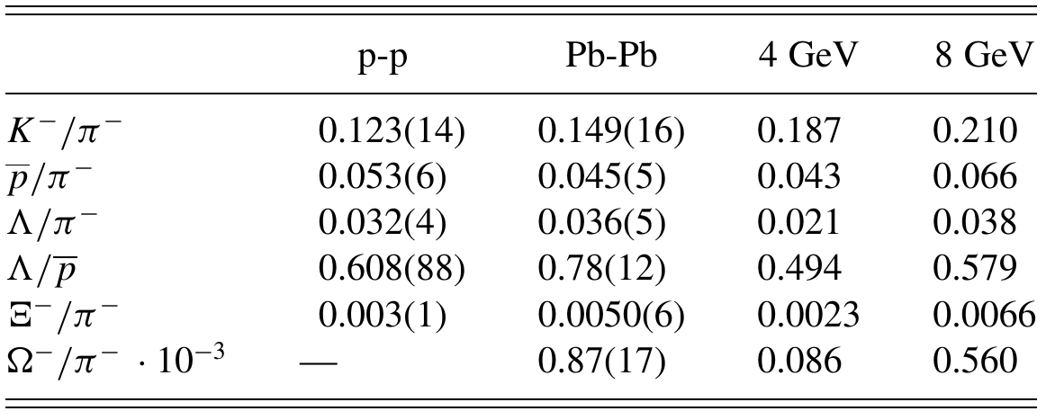
Single HS-cascade 2-body decays: yield-ratios vs ALICE
data: ALICE @ LHC
M.Beitel, KGallmeister, C.Greiner, PRC 90 (2014) 045203

Slide 33
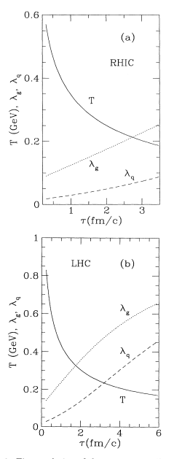
Time evolution of fugacity
of gluons and quarks (g, q)
from pQCD-based rate eq.
T. S. Biró, B. Mueller, X. Wang,
BMW , PRC48,1275 (1993)
Fast gluon saturation,
slow quark saturation

Slide 34
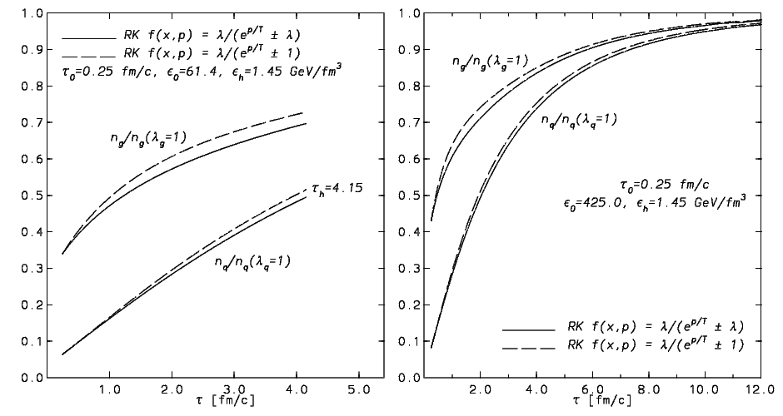
LHC
Fast gluon saturation,
slow quark saturation
Fast gluon saturation,
slow quark saturation
RHIC
Rate equation calculation
D.M. Elliott, D.H. Rischke,Nucl.Phys. A671,583 (2000)

Slide 35
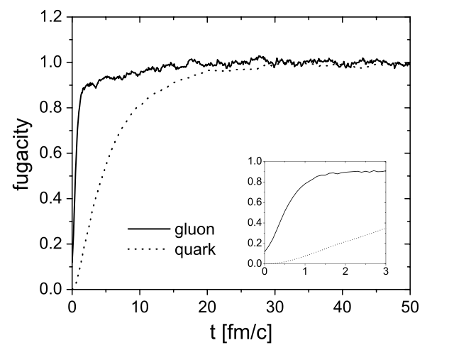
Time evolution of fugacity(g,q) - analog to Nf (t)
BAMPS Box calculation
Z.Xu, C.Greiner,
PRC71,064901(2005)
fugacity ~ ½ flavor number Nf:
Nf(t)
2
1
0.2
0.1
Fast gluon saturation,
slow quark saturation
t/fm/c

Slide 36
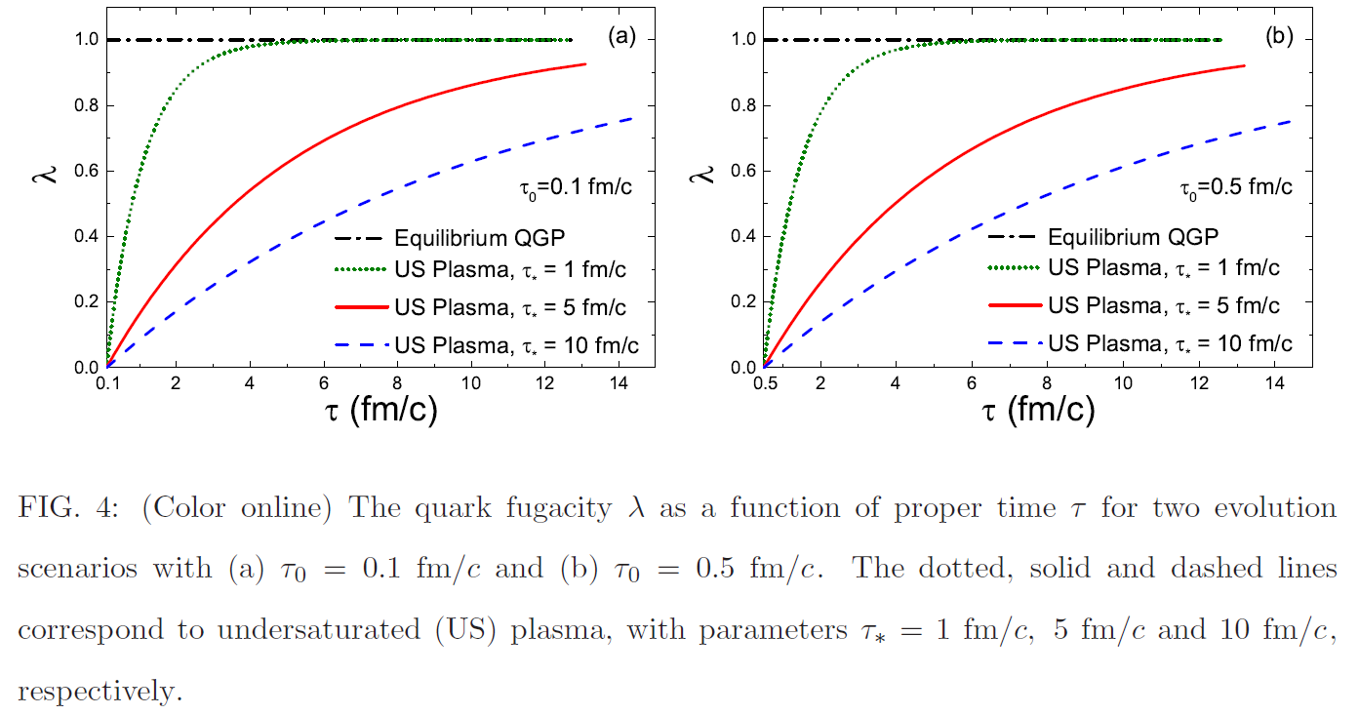

Slide 37
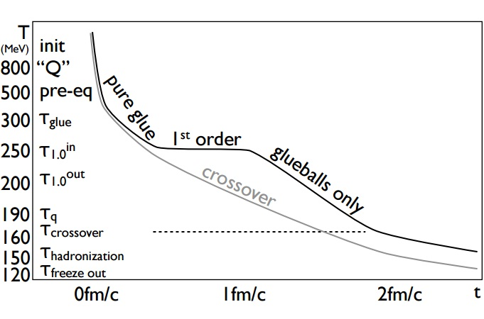
Eff.Nf(t)
0.0
0.1
0.2
0.3
0.6
0.9
GlueBalls decay
Eff. Nf(t): 0 0.1 0.2 0.3 0.6 1.2 ...
Eff. Nf(t) is U.S. – parameter : Nf = 2+1 ~ fugacity = 1

Slide 38
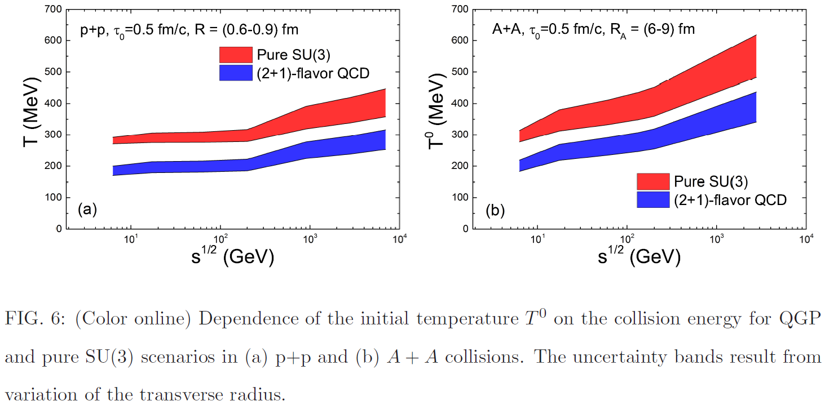
FAIR*:
HESR
p-pBaR
collider
32 GeV

Slide 39
Eff.Nf(t)
0.0
0.1
0.2
0.3
0.6
0.9
GlueBalls decay
Eff. Nf(t): 0 0.1 0.2 0.3 0.6 1.2 ...
Eff. Nf(t) is U.S. – parameter : Nf = 2+1 ~ fugacity = 1

Slide 40
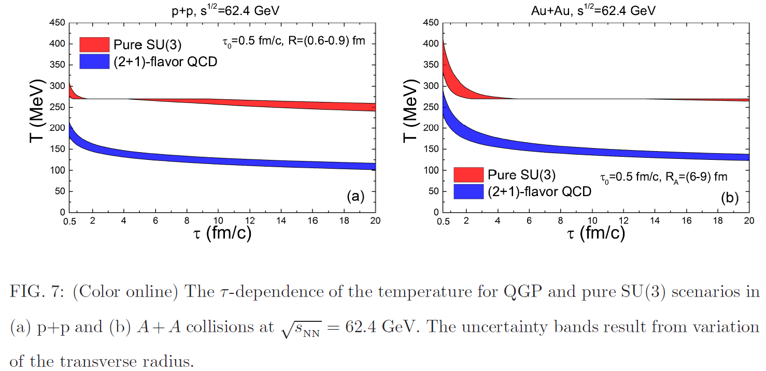
32 GeV
32

Slide 41
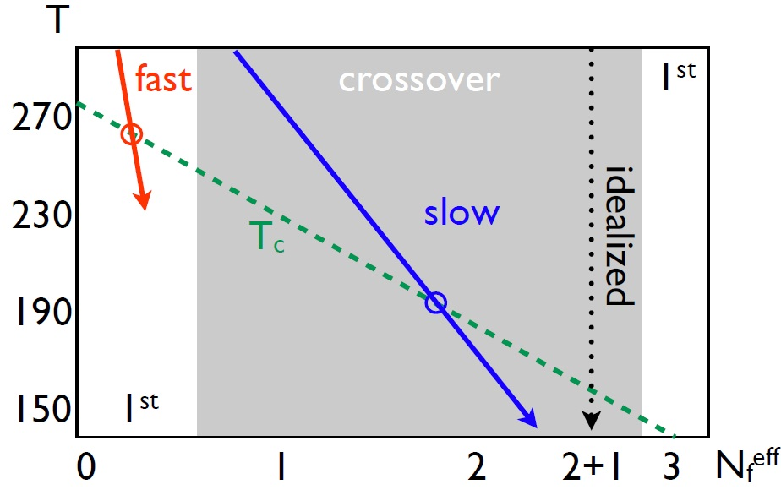
Hadronization
of GlueBalls
- HagedornStates
Hadronization of
GlueBall-Hagedorn
Hadronic Gas?

Slide 42
Time evolution of high multiplicity pp AA
at RHIC and LHC in pure YM scenario

Slide 43

Cosmic GlueBall-Matter at CERN LHC and BNL RHIC

Slide 44
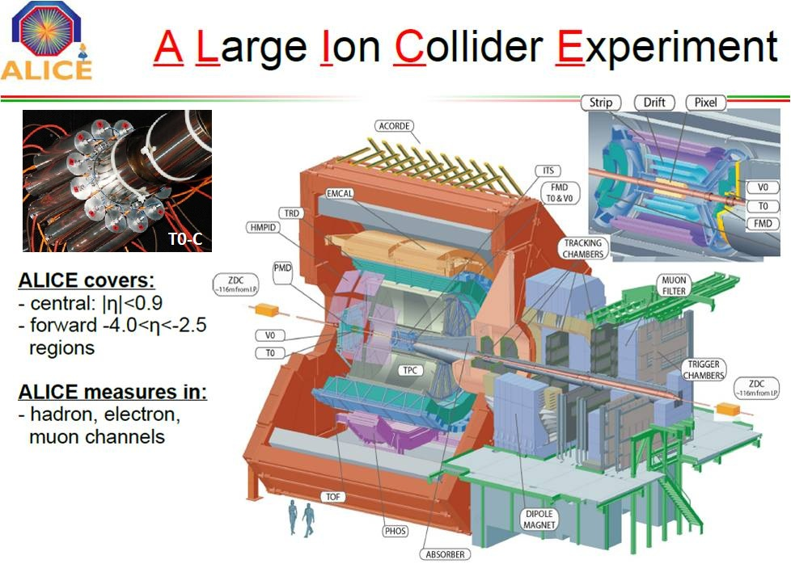
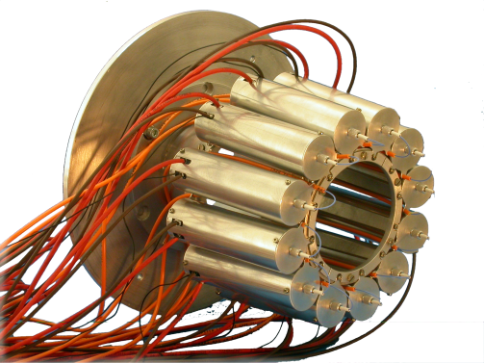
Cosmic GlueBall-Matter at CERN LHC and BNL RHIC

Slide 45
How do electromagnetic probes,
i.e. Dileptons and Photons, come out
from pure glue FOPT scenario?
V. Vovchenko, Gorenstein, Satarov, Mishustin,
Csernai, et al.

Slide 46
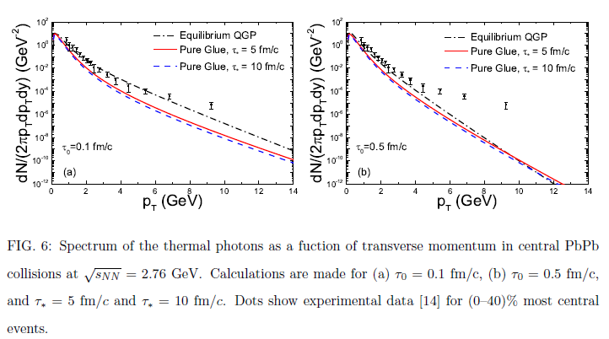

Slide 47
Signatures for pure glue->glueball scenario:
New event-class in high multiplicity pp & pA at RHIC and LHC

Slide 48
Outlook: Alternative Class of High M events in pBar-p, pA, AA
Initial Color Glass Condensate Glasma thermalizes fast equilibration of gluons, slow equil. of quarks high pressure, entropy in gluon plasma fast hydrodynamic expansion of gluon plasma.
1. Order Phase Transition at T_c = 270 MeV of flavorless QCD.
Transition from glue plasma in GlueBall fluid
Glueballs’ Hagedorn states decay directly into Hadrons

Slide 49
Identification of Glueballs
Lightest Glueball predicted near two states of same Q.N..
“Over population” Predict 2, see 3 states
Glueballs should decay in a flavor-blind fashion.
Production Mechanisms:
Certain are expected to by Glue-rich, others are
Glue-poor. Where do you see them?
Proton-antiproton
Central Production
J/ψ decays

Slide 50
Time dependence in Columbia …. FAIR*, RHIC and LHC as Glueball Factories…
violent pp (& AA) collisions
initial state at LHC:
Color Glass Condensate
t=0.1fm/c: glue thermalizes
pure glue-plasma created
Quenched Lattice SU(3)_c :
T_c =270MeV
glue plasma -> GlueBall fluid
1. Order Phase Transition
Expansion to critical point
T_cp =240 MeV t~1-2 fm/c
GlueBalls + Hagedorn States Mix
more and more quarks produced: T_co =155MeV crossover transition
Observed in ALICE:
T>T_cp: Zero e.m. radiation
Max. T~270 MeV Photons, Dileptons
T_c: v1, v2 Flow collapse ? barometer
T_cp: Critical Scattering Kurtosis fluctuats
T_H ~ 2 T_co =>
P_t(pp) ~ 2*p_t(AA)
M_GlueBalls < 2GeV: „No“ Baryons
p/pi ~ 0 : Yield p+pBar << mesons
No decays to 2 Omega, no 2 Rho
Glue Flavor blind !
K/pi~1 Yields: Kaons ~ pions

Slide 51
Acknowledgements
Transport colleagues: Kai Zhou, F. Senzel, Z. Xu, P. Zhuang, C. Greiner...
Hagedorn dynamics: Beitel, Gallmeister, C. Greiner...
FIAS: Schramm, Dietrich, Struckmeier, Vasak, ...
Early phase e-m probes colleagues: Raha, Sinha, Gorenstein, Vovchenko, Satarov, Mishustin, A. Srivastava, Csernai, Kaempfer, Strickland, Strikman, L. Frankfurt ...
Lattice colleagues: Fodor, Borsanyi, Szabo, Karsch, Philipsen...
Experimentalists: Giubellino, Harris, Oeschler, PBM, Masc..

Slide 53
Traditional picture of QCD matter in Heavy Ion Collisions
Initial Color Glass Condensate Glasma thermalizes fast equilibration of Gluons and Light flavor quarks high pressure, entropy hydrodynamic expansion flow as excellent probe of QCD matter.
Hadronization@T=155MeV: crossing of 2+1 flavor QCD.
Hadronic yields and v_n at RHIC and LHC measured ->FIT !
Comparison of HRG, T= 155 MeV, with LHC data
test of our understanding of QCD matter.

Slide 54
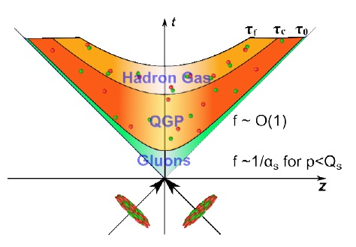


Introduction: Fast thermalization required for Hydro
how can a system evolve
to thermal equilibrium
in such a very short time?
?
?
Initially: very far from equilibrium !
2+1QCD Hydro-Onset time < 1fm/c ?

Slide 55
Introducing the Color Glass Condensate
CGC=effective field theory for hadrons at high energy limit
●
high energy
(time dilation)
fluctuation(sea partons) lifetime
internal interaction time scales
small x ( )l
gluon number increase at small x with increasing energy
●
gluon fusion
Saturation
●
Saturation momentum Qs(~GeV)
this feature can be inherited by initial
Glasma through indirect way

Slide 56

Introducing the Glasma
Glasma = non-equilibrium state in between CGC and QGP
●
using CGC as initial states for nuclei
highly anisotyopic initial glasma fields
(won't last longer than 1/Qs)
●
Instabilities -->wide range of unstable modes (up to Qs) grow exponentially untill saturation density
redistribute momentum ---> isotropization
free up quanta from classical field
initial condition amenable
for kinetic theory

Slide 57

begin time evolution with
Glasma initial condition,
Use diffusion approximation
for Boltzmann equation
Fast gluon saturation,
slow quark saturation
Jean-Paul Blaizot, Bin Wu, Li Yan, Nucl.Phys. A930,139(2014)

Slide 58







Chemical equilibration of US Plasma in homogeneous box
Initial state: pure gluon plasma ($λ=0)$
Final state: QGP ($λ=1)$
Equilibration process depends on boundary conditions
Entropy production: $\frac{S}{S_{0}}={\left(\frac{T}{T_{0}}\right)}^{3}\left(1+αΛ_{4}−βΛ_{3}ln⁡λ\right)$,$α=0.656N_{f}$, $β=0.156N_{f}$
Isothermal ($T=T_{0})$
$$\frac{S_{f}}{S_{0}}=\left(1+α\right)$$
Isoergic ($ε=ε_{0})$
$$\frac{S_{f}}{S_{0}}={\left(1+α\right)}^{1/4}$$

Slide 59




Bjorken evolution of US Plasma
Pure glue initial state: $λ=0$ at $τ=τ_{0}$
quark suppression $λ\left(τ\right)=1−\exp\left(\frac{τ_{0}−τ}{τ_{∗}}\right), τ_{∗}=1, 5, 10$fm/c saturation time
$$ε=ε\left(τ_{0}\right) {\left(\frac{τ_{0}}{τ}\right)}^{4/3}$$
Energy conservation
Temperature: $T=T_{0}{\left(\frac{τ_{0}}{τ}\right)}^{1/3}{\left(1+αΛ_{4}\right)}^{−1/4}$
Entropy density: $s=s_{0}{\left(\frac{T}{T_{0}}\right)}^{3}\left(1+αΛ_{4}−βΛ_{3}ln⁡λ\right)$
$\frac{dS}{dη}=πR_{A}^{2} sτ$
Freezeout: $T_{f}=156$ MeV, $\frac{dS(τ_{f})}{dη}=6.3{\left.\frac{dN_{π}}{dy}\right|}_{y=η}=πR_{A}^{2} s(τ_{f})τ_{f}$
$$T_{0}, { τ}_{f}$$

Slide 60

Glue plasma from pure lattice gauge theory, Bosanyi et al
V. Vovchenko et al

Slide 61



pressure
energy density
entropy density

Slide 62



pressure vs.
energy density
entropy density vs.
energy density

Slide 63

crossing from Hadronfluid to
2+1 Nf quark gluon plasma
Borsanyi et al, W.B. collaboration
F.O.P.T. from GlueBall fluid to pure glue plasma, Borsanyi et al
V. Vovchenko et al

Slide 64
Alternate Scenario: pure gauge matter in pp, pA – AA ?
Initial Color Glass Condensate Glasma thermalizes fast equilibration of Gluons, slow equil. of quarks high pressure, entropy gluon plasma fast hydrodynamic expansion of gluon plasma.
1. Order Phase Transition at T_c = 270 MeV of flavorless QCD.
Transition from glue plasma in GlueBall fluid
Glueball-Hagedornstates mix with quarks, decay into Hadrons

