Slide 1

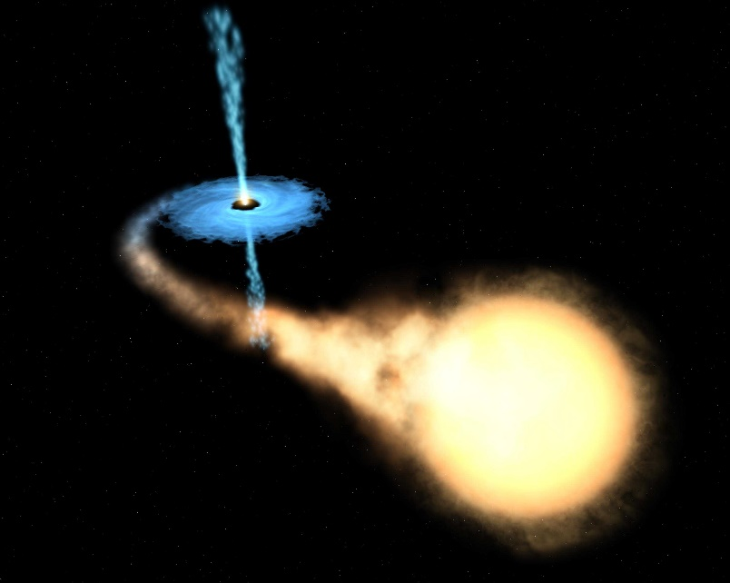
From Dripline to Dripline:
Nuclear Astrophysics in the Laboratory
Proton ‘dripline’
Zach Meisel
University of Notre Dame
FAIRNESS 2016
Neutron ‘dripline’
Z
N = A - Z
^{A}El

Slide 2
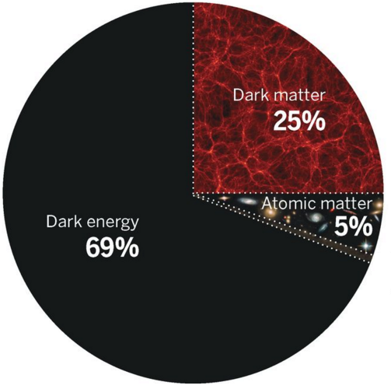
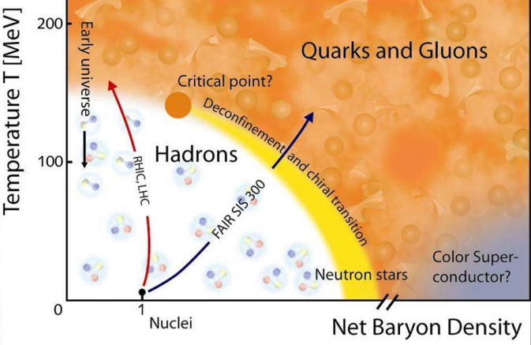
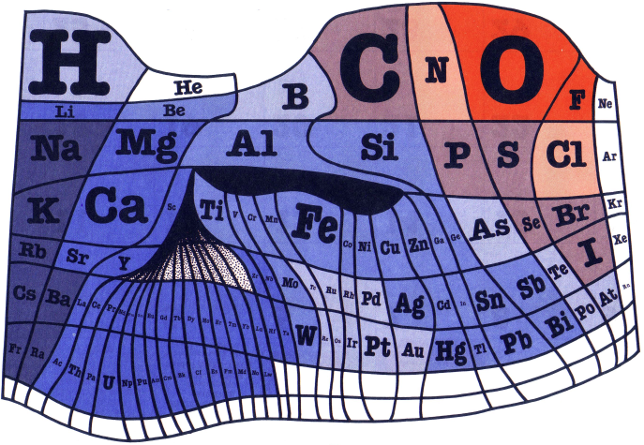
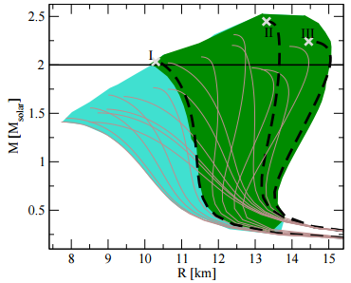
Nuclear astrophysics in the big picture
How were the elements made?
How does high-ρ, low-T matter behave?
GSI-FAIR Tech. Report 2009
D. Spergel Science 2015
E. Fraga et al. EPJA 2015
Wm. F. Sheehan Ref. Chem. 1976

Slide 3
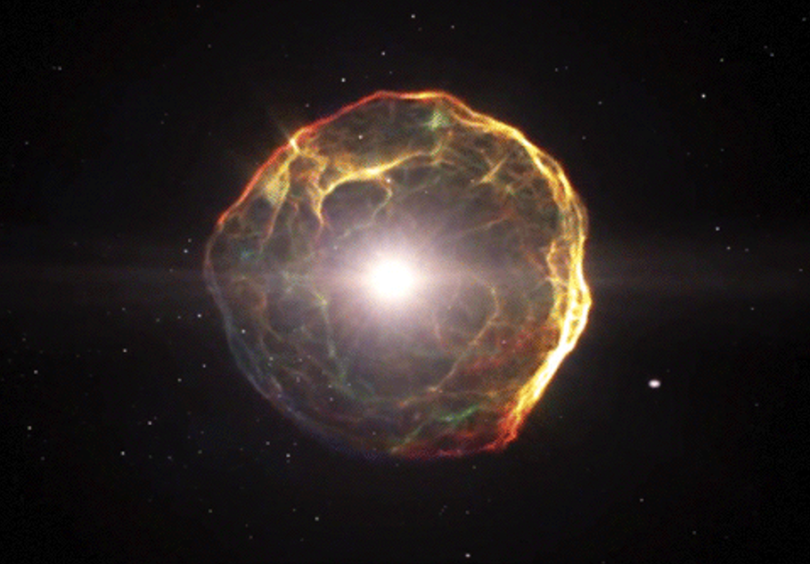
Nuclear astrophysics is the study of:
Energy generation in stars and stellar explosions
Extremely
dense matter
The origin of
the elements

Slide 4
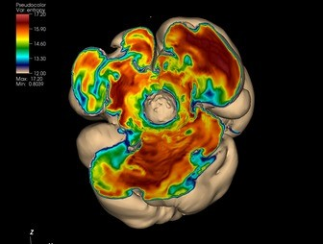
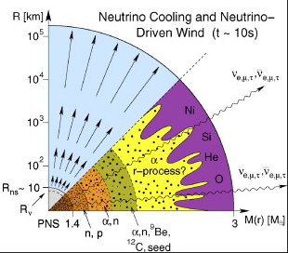
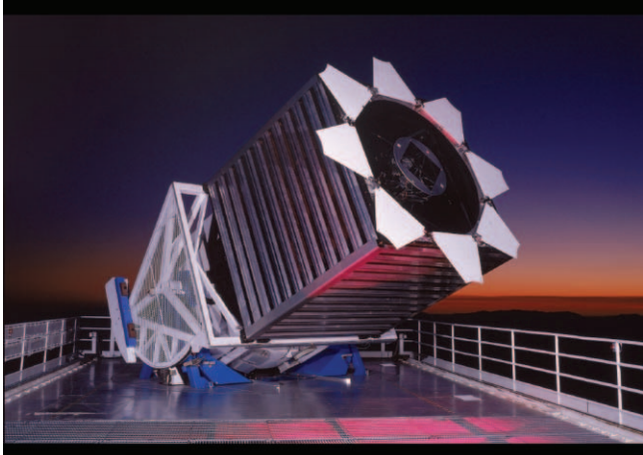
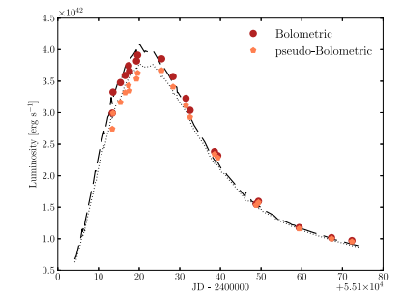
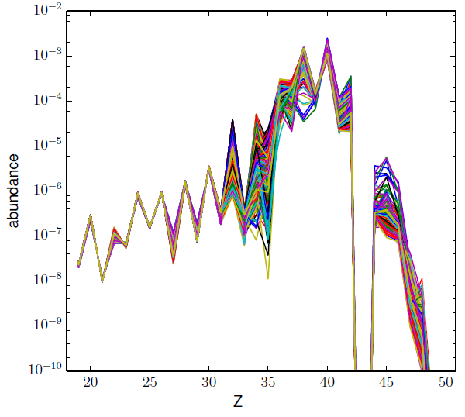
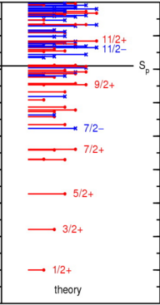
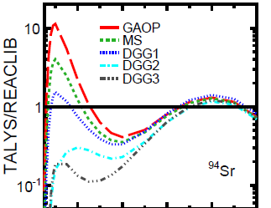
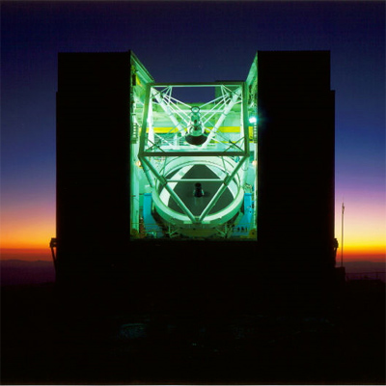
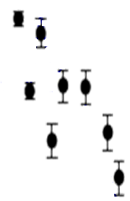
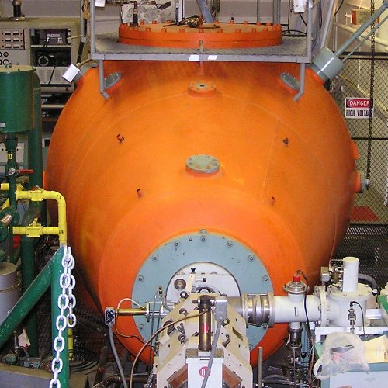

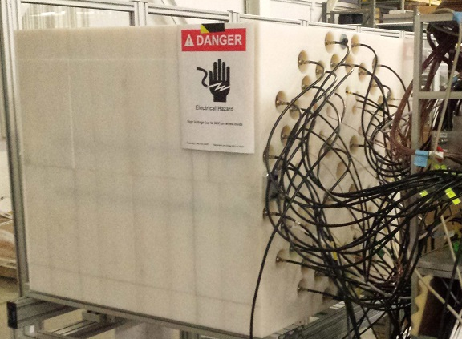
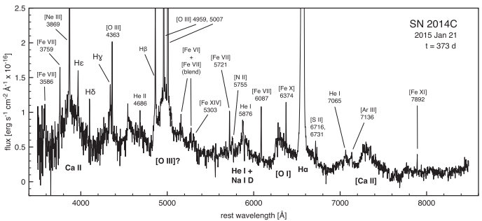
Case study: An exploding star
Sloan Telescope (New Mexico)
Luminosity →
H.-Th. Janka et al. Phys.Rep. 2007
J. Lyman et al. MNRAS 2014
J. Gunn et al. ApJ 2006
Time →
J. Bliss et al. In preparation 2016
MMT (Arizona)
HD122563
Abundance →
State Energy →
Rate Ratio →
⁹⁴Sr(α,*n)
Ca Mn Zn Br Zr Rh Sn
³¹S
Temperature→
Z. Meisel, NSCL approved expt. e14032
B.A. Brown PRC(R) 2014
D. Milisavljevic et al. ApJ 2015
Neutron
Ne
O
Fe
H
Flux →
H
Fe
He
N
Fe
He
Fe
Beam
He
Ar
Target
Recoil
S
Ca
O
O
He Na
H
Ca
Wavelength →

Slide 5
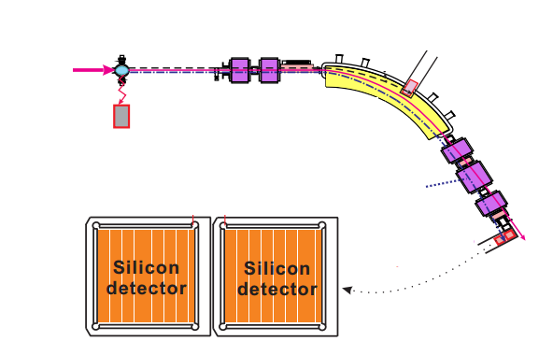
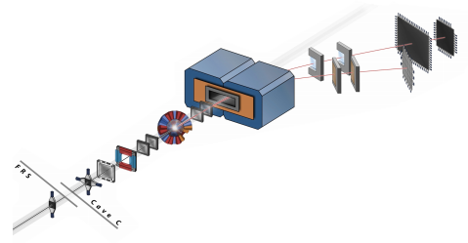
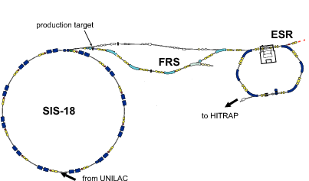


The experimental nuclear astrophysicist’s toolkit
Direct reaction measurements Indirect techniques
Target
Astrophysical reaction Laboratory reaction
p
⁹⁶Ru
³⁰S + p
γ
³⁰S
γ
Beam
Energy →
γ
³¹Cl
³¹Cl
C. Langer et al. Phys. Rev. C 2014
⁹⁷Ru
Recoil
³⁰S
B. Mei et al. Phys. Rev. C 2015
Recoil
Proton
³¹Cl
Beam
Target
R. Reifarth J. Phys. Conf. 2016

Slide 6
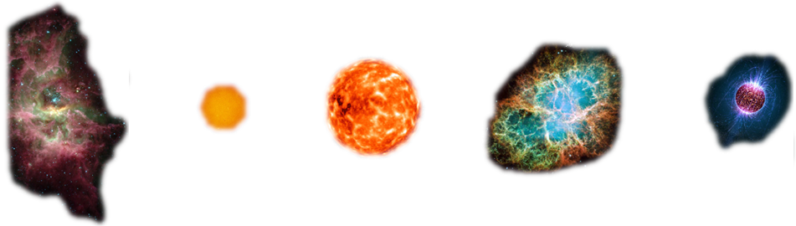

Neutron stars: The link between nuclear astrophysics and high-density, low-temperature matter
gas cloud with proto-stars
supernova remnant
evolved massive star
neutron star
massive star
atmosphere ~1cm
ocean ~100m
Nuclei accessible in the lab
outer crust ~0.5km
Exotic/theoretical matter states
inner crust ~0.5km
core
~10km

Slide 7


Accreting neutron stars: Dense matter laboratories
accretion disk
atmosphere
ocean
crust
core
neutron star
accretion disk
p,$α$-capture
¹²C-fusion,
e⁻-capture
e⁻-capture
n-emission/capture,
ρ-driven fusion
H/He-rich star
radius
~0.01 x (Earth-Sun distance)
F. Mirabel

Slide 8
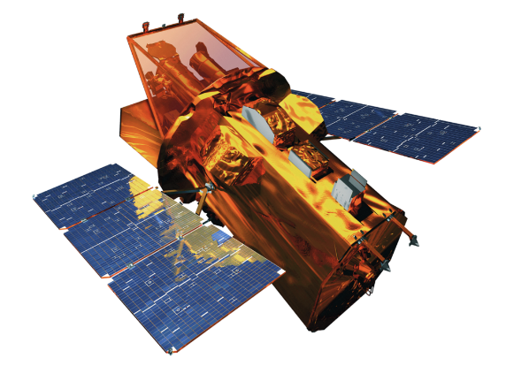
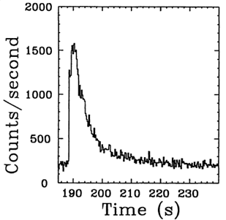
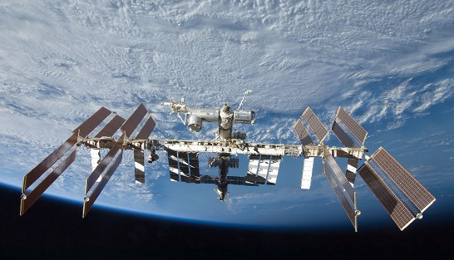
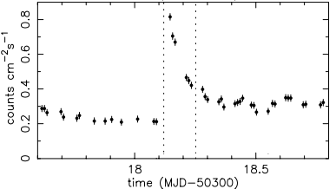
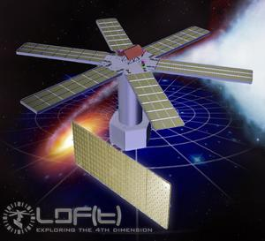
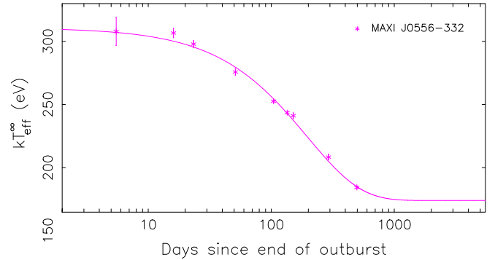
Accreting neutron stars: Dense matter laboratories
Swift (NASA/GSFC)
“X-ray bursts”
X-ray flux→
W. Lewin et al. SSRv 1993
accretion disk
atmosphere
ocean
crust
core
0 10 20 30 40
Seconds
MAXI, NICER (2016), (ISS)
“X-ray superbursts”
p,$α$-capture
¹²C-fusion,
e⁻-capture
e⁻-capture
n-emission/capture,
ρ-driven fusion
X-ray flux→
X-rays/sec→
R. Cornelisse et al. A&A 2000
LOFT (ESA) (2022?)
0 0.5
radius
Days
“Cooling transients”
X-ray flux→
J. Homan et al. ApJ 2014
10 100 1000
Days

Slide 9
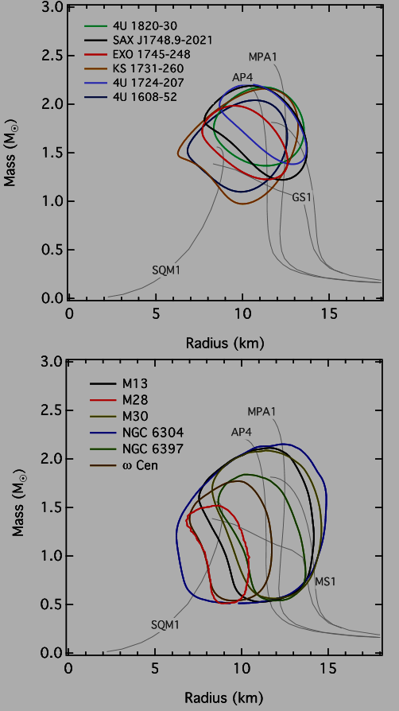
Accreting neutron stars: Dense matter laboratories
Swift (NASA/GSFC)
“X-ray bursts”
F. Özel et al. ApJ 2016
Mass→
X-ray flux→
W. Lewin et al. SSRv 1993
0 10 20 30 40
Seconds
MAXI, NICER (2016), (ISS)
“X-ray superbursts”
Radius→
X-ray flux→
X-rays/sec→
R. Cornelisse et al. A&A 2000
Mass→
LOFT (ESA) (2022?)
0 0.5
Days
“Cooling transients”
X-ray flux→
J. Homan et al. ApJ 2014
10 100 1000
Radius→
Days

Slide 10
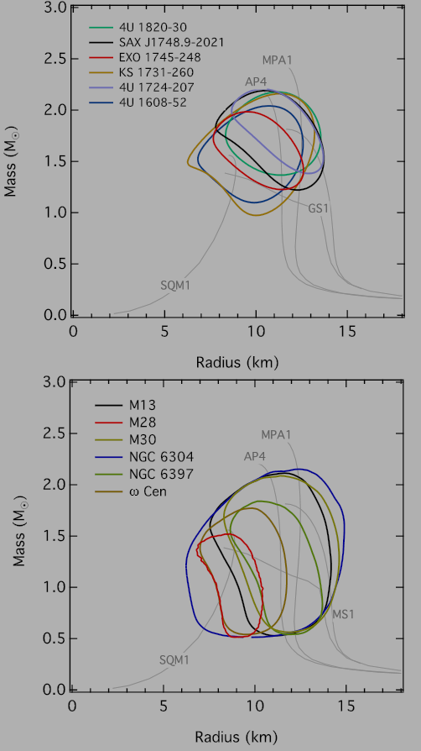
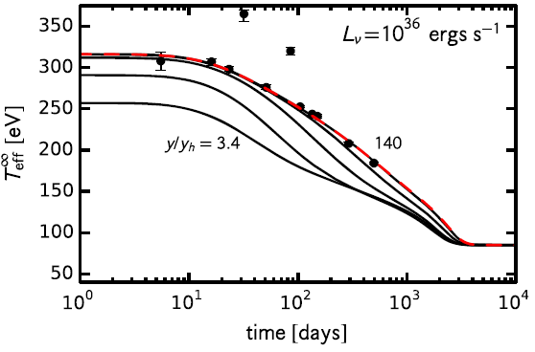
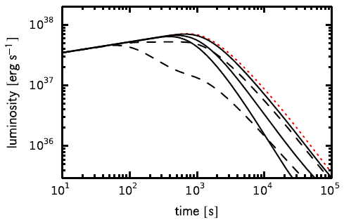
Nuclear physics uncertainties inhibit
Model-Observation Comparisons
Understanding of Nature
Observations
Models
“Cooling transients”
X-ray flux→
X-ray flux→
Mass→
J. Homan et al. ApJ 2014
10 100 1000
A. Deibel et al. Astrophys. J. Lett. 2015
Days
0 10 100 1000
Days
Radius→
“X-ray superbursts”
A. Deibel, Z. Meisel, et al. In preparation
F. Özel et al. ApJ 2016
X-ray flux→
X-ray flux→
X-rays/sec→
Mass→
R. Cornelisse et al. A&A 2000
0 0.5
10 100 1000 10000
Days
Seconds
Radius→

Slide 11
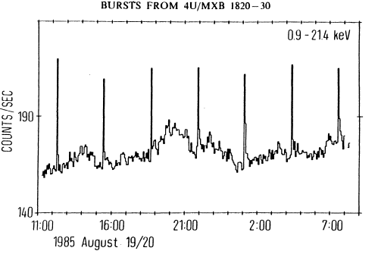


Type-I x-ray bursts:
H/He burning on the neutron star surface
accretion disk
atmosphere
ocean
crust
core
X-ray flux→
F. Haberl et al ApJ 1987
p,$α$-capture
¹²C-fusion,
e⁻-capture
e⁻-capture
n-emission/capture,
ρ-driven fusion
0 5 10 15 20
Time (hours)
W. Lewin et al. SSRv 1993
radius
X-ray flux→
F. Mirabel

Slide 12

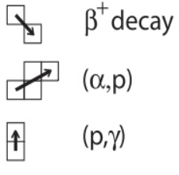
The rapid proton-capture (rp)-process:
H/He burning on the neutron star surface
W. Lewin et al. SSRv 1993
X-ray flux→
H. Schatz et al. PRL 2001
F. Mirabel
→rp-process
Reaction sequence:
3α→HCNO
→αp-process
Z
N

Slide 13
Much recent work has been done to investigate the rp-process:
Final unknown β⁺-decay rates measured
- G. Lorusso et al. Phys. Lett. B 2011
‘Waiting-point’ nuclei mostly constrained
- C. Langer et al. Phys. Rev. Lett. 2014
W. Ong In prep. 2016
X.L. Tu et al. Phys. Rev. Lett. 2011
M. Eibach & Z. Meisel NSCL approved expt. E15026
M. del Santo & Z. Meisel et al. Phys. Lett. B 2014
A. Rogers NSCL approved expt. E12024
H. Schatz et al. PRL 2001
Z
N

Slide 14


Much recent work has been done to investigate the rp-process:
Waiting point:
120
20
H. Schatz et al. PRL 2001
Z
N

Slide 15
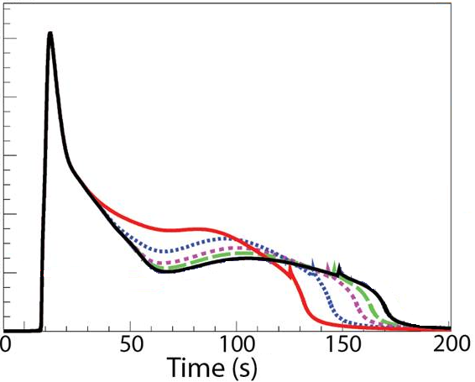
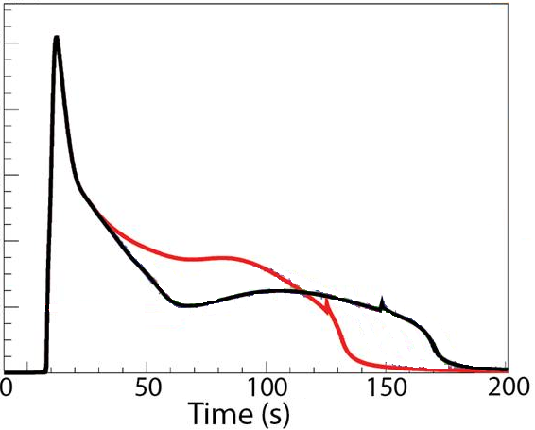
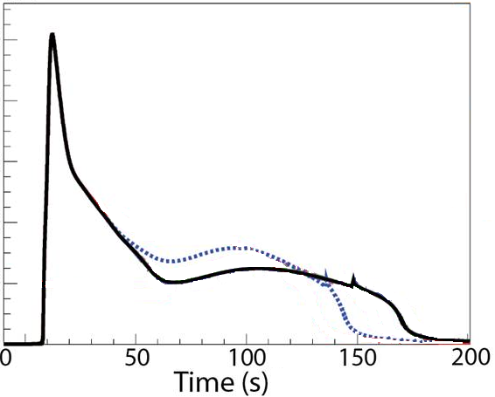
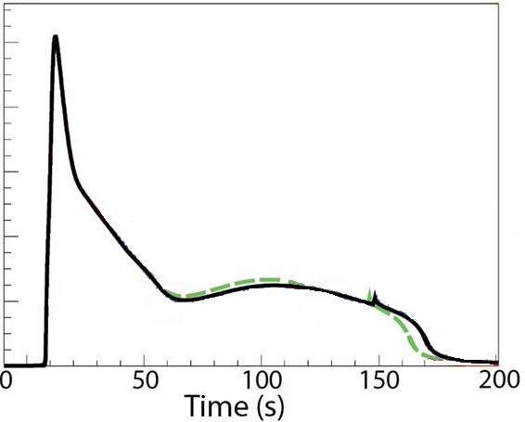
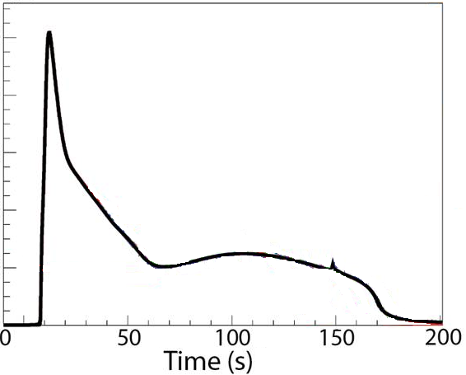
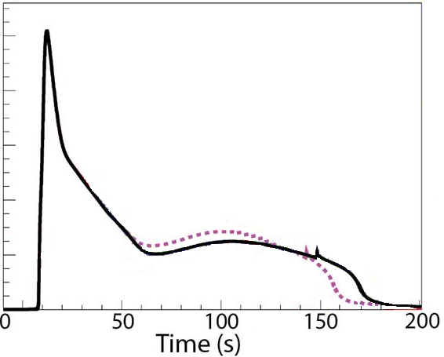
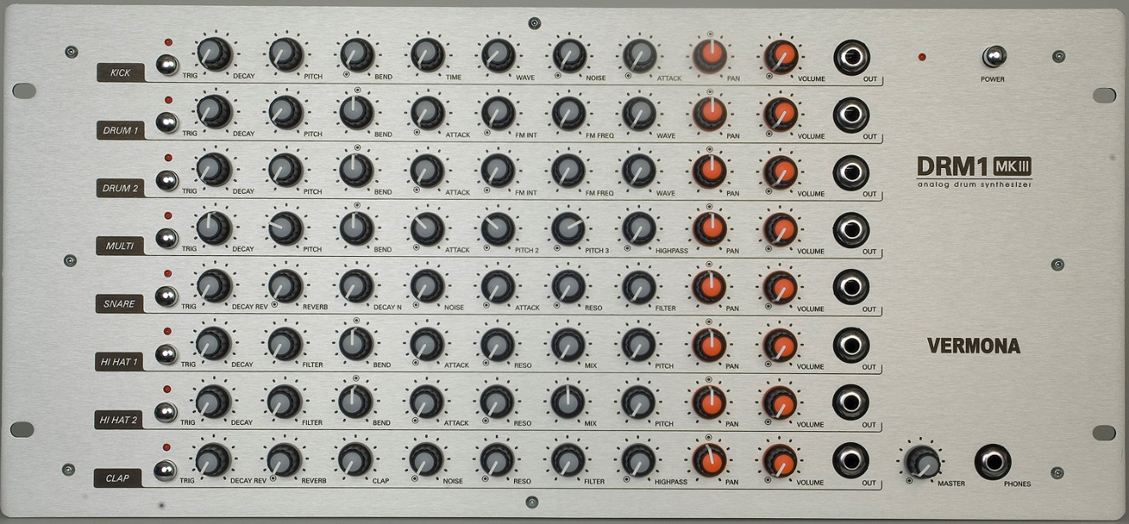
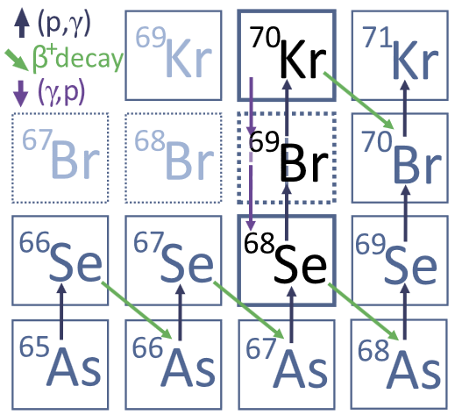
X-ray burst models require nuclear physics input
Model output:
X-ray flux→
Model:
Reaction rate adjustor:
XRB
Modeler
2000
⁶⁸Se(p,γ)⁶⁹Br
M. del Santo, Z. Meisel, et al. Phys. Lett B 2014

Slide 16
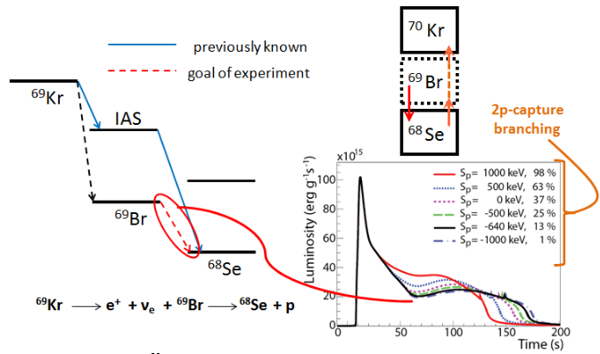
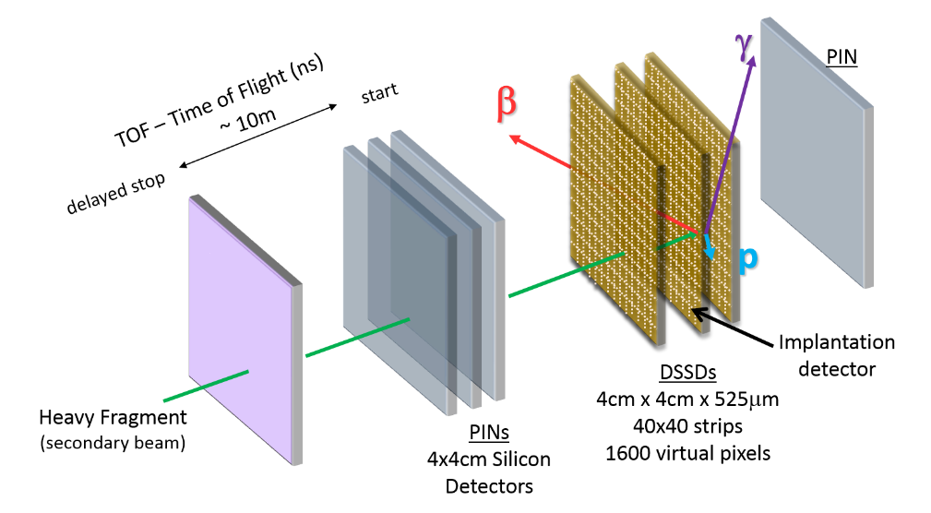
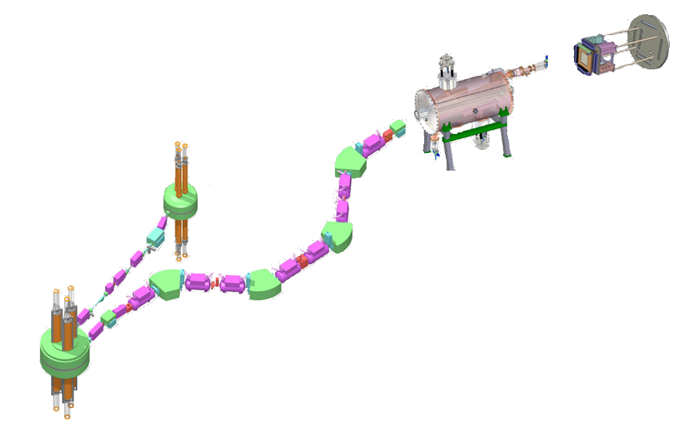

To what extent does ⁶⁸Se stall the rp-process?
Coupled Cyclotrons
Beta-counting Station
A1900 Fragment Separator
Radiofrequency Fragment Separator
Production Target
M. del Santo, Z. Meisel, et al. Phys. Lett B 2014

Slide 17
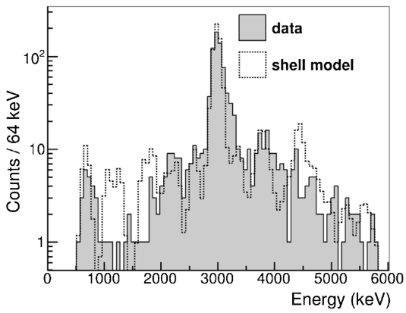
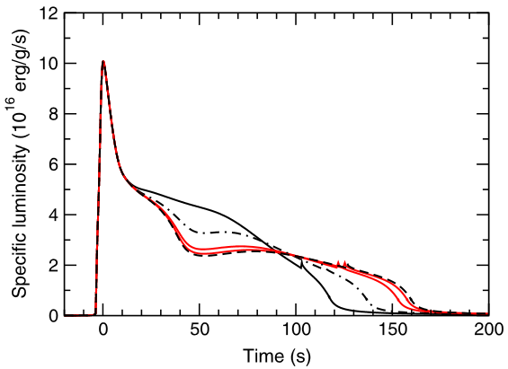

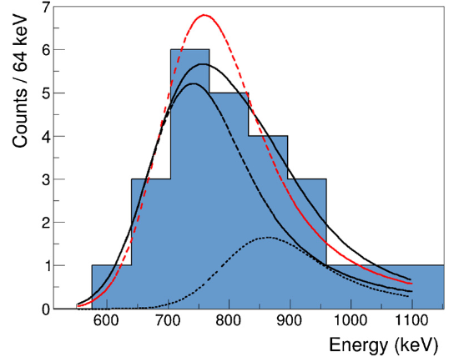
Conclusion: ⁶⁸Se substantially stalls the rp-process
⁶⁸Se substantially stalls the rp-process
Events detected
M. del Santo, Z. Meisel, et al. Phys. Lett B 2014
Before expt.
After expt.
Proton energy [keV]
X-ray flux→
E_{p} = M_{69Br} - M_{68Se}
Events detected
Proton energy [keV]

Slide 18


Remaining nuclear physics uncertainties have a large impact on the burst light-curves and ‘ash’ composition
⁵⁹Cu(p,γ) rate variation
X-ray flux→
Log(Abundance)→
R. Cyburt et al. Submitted November 2015

Slide 19


Remaining nuclear physics uncertainties have a large impact on the burst light-curves and ‘ash’ composition
Experimental work is needed near & far from stability
large impact on x-ray burst
light-curve
large impact on
x-ray burst
‘ash’ composition
(a.k.a. Neutron star surface abundances)
R. Cyburt et al. Submitted November 2015

Slide 20

Global radioactive ion beam facilities
JYFL
JINR
TRIUMF
GANIL
GSI/FAIR
ATLAS
NSCL/FRIB
SPES
NSL
ISOLDE
IMP
LLNL
CI
LNS
RIBF
JFAL
RIBRAS
*There are many more stable-isotope beam facilities worldwide also doing forefront science

Slide 21


NUSTAR at FAIR will play a critical role in solving major open questions in astrophysics
Nuclear Structure, Astrophysics, and Reactions

Slide 22






NUSTAR at FAIR will play a critical role in solving major open questions in astrophysics
Nuclear Structure:
Nuclear Reactions & Basic Properties:

Slide 23


NUSTAR will significantly expand the number of known nuclear masses
r-process abundance variation from nuclear masses:
ILIMA Collaboration report, 2005
M. Mumpower et al. Phys. Rev. C 2015

Slide 24

NUSTAR will significantly expand the number of known nuclear half-lives
Y. Litvinov et al. Phys. Rev. Lett. 2007

Slide 25



NUSTAR will measure nuclear reactions at their astrophysical energies
…which will be crucial to understanding
Target
Element formation:
Beam
Recoil
Behavior of dense matter:
B. Mei et al. Phys. Rev. C 2015

Slide 26



NUSTAR will also make significant advances in nuclear structure
Nuclear “magic” numbers evolve
^{48,49}Ar masses pinpoint disappearance of N=28
$$f_{7/2}$$
$$p_{3/2}$$
$$D_{n}\left(Z,A\right)={(−1)}^{N+1}\{S_{n}\left(Z,A+1\right)− S_{n}\left(Z,A\right)\}$$
ILIMA Collaboration report, 2005
Z. Meisel et al. Phys. Rev. Lett. 2015

Slide 27

NUSTAR will lead to major advances in nuclear structure and astrophysics
How were the elements made?
How do nucleons arrange themselves?
How does high-ρ, low-T matter behave?

Slide 28














Thanks to my collaborators:
Starting Aug. 2016
Central Michigan University:
Alfredo Estradé, Georgios Perdikakis
Institut für Angewandte Physik:
Christoph Langer
Max-Planck-Institut für Kernphysik:
Sebastian George
McGill University:
Andrew Cumming
Michigan State University:
Tony Ahn, Alex Brown, Richard Cyburt, Alexandra Gade, Wei Jia Ong, Wolfgang Mittig, Fernando Montes,
Jorge Pereira, Hendrik Schatz, Remco Zegers
University of Notre Dame:
Manoël Couder, Gwenaelle Gilardy, Luis Morales,
Mike Moran, Chris Seymour, Ed Stech, Michael Wiescher
Western Michigan University:
Mike Famiano

Slide 29
Supplemental

Slide 30

Type-I x-ray bursts:
H/He burning on the neutron star surface
Abundance
Temp. →
Z. Meisel
50
40
30
20
10
0
Time→
# Protons (Z)
Abundance
0 10 20 30 40 50
0 20 40 60 80 100
# Neutrons (Z)
# Nucleons (A)

Slide 32

Cooling transients probe thermal & compositional structure of the neutron star
accretion disk
atmosphere
ocean
crust
core
p,$α$-capture
¹²C-fusion,
e⁻-capture
e⁻-capture
n-emission/capture,
ρ-driven fusion
Temperature→
10 100 1000
density
Days since accretion turn-off
J. Homan et al. ApJ 2014

Slide 33
Buried nuclei undergo electron capture in the degenerate electron gas
accretion disk
NS surface
System Energy
E_{gs}(Z-2,A)
E_{gs}(Z-1,A)
E_{e,Fermi}
E_{gs}(Z,A)
density
(Z,A)

Slide 34
Buried nuclei undergo electron capture in the degenerate electron gas
accretion disk
NS surface
System Energy
E_{gs}(Z-2,A)
E_{e,Fermi}
E_{gs}(Z-1,A)
E_{gs}(Z,A)
density
(Z,A)

Slide 35
Buried nuclei undergo electron-capture, causing heat release
accretion disk
NS surface
E_{e,Fermi}
e⁻-Capture
heat release
System Energy
E_{gs}(Z-2,A)
E_{e,Fermi}
e⁻-Capture
E_{gs}(Z-1,A)
E_{gs}(Z,A)
density
(Z,A)⇨(Z-2,A)

Slide 36

Buried nuclei undergo electron-capture,
OR cooling
accretion disk
NS surface
E_{e,Fermi}
e⁻-Capture
E_{gs}(Z-2,A)
System Energy
E_{e,Fermi}
e⁻-Capture
E_{gs}(Z-1,A)
β⁻
ν
neutrino cooling
ν
ν
ν
E_{gs}(Z,A)
“Urca”
process
density
(Z,A)⬄(Z-1,A)
ν

Slide 37
Whether or not heating or cooling occurs depends on nuclear physics
E_{e,Fermi}
e⁻-Capture
E_{e,Fermi}
e⁻-Capture
heat release
E_{gs}(Z-2,A)
System Energy
E_{gs}(Z-2,A)
System Energy
E_{e,Fermi}
e⁻-Capture
E_{e,Fermi}
e⁻-Capture
E_{gs}(Z-1,A)
E_{gs}(Z-1,A)
β⁻
ν
neutrino cooling
E_{gs}(Z,A)
E_{gs}(Z,A)
*Cooling is often many times stronger than heating

Slide 38


Whether heating or cooling occurred for A=56 depended on the mass of ⁵⁶Sc
H. Schatz et al. Nature 2014
v
Temperature→
Mass model B
Energy
Mass model A
Mass model B
v
Mass model A
~50% increase
⁵⁶Ti ⁵⁶Sc ⁵⁶Ca
Depth into NS→

Slide 39




Mass measurement of ⁵⁶Sc by ‘time-of-flight’
Timing
measurement
Momentum measurement
# Events
Time-of-flight
Coupled Cyclotrons
S800 Spectrograph
A1900 Fragment Separator
Z. Meisel & S. George, Int. J. Mass Spectrom. 349, 145 (2013)
Z. Meisel et al., Phys. Rev. Lett. 114, 022501 (2015)
Z. Meisel et al., Phys. Rev. Lett. 115, 162501 (2015)
Z. Meisel et al. Submitted to Phys. Rev. C (January 2016)
Production Target

Slide 40

TOF mass measurements determines nuclear masses via a calibrated m/q-TOF relationship
Z. Meisel et al., Phys. Rev. Lett. 115, 162501 (2015)

Slide 41

Conclusion: Weak heating occurs due to A=56 nuclei in neutron stars
Weak heating occurs due to A=56 nuclei in neutron stars
H. Schatz et al. Nature 2014
v
Temperature→
Mass model B
v
~50% increase
Mass model A
Depth into NS→
Z. Meisel et al., Phys. Rev. Lett. 115, 162501 (2015)

Slide 42

Many more nuclear cooling pairs exist in the outer layers neutron stars
Nuclear cooling luminosity by mass number (A)
Depth into NS→
A. Deibel, Z. Meisel, et al. In preparation

Slide 43
How prevalent are other nuclear cooling pairs in neutron stars?
Strong nuclear coolers affected by ⁵⁹Cu(p,γ)
*
*
*
*
*
*
Log(Abundance)→
*
*
*
*
*
*
*
R. Cyburt et al. Submitted November 2015

Slide 44

Most significant nuclear (‘urca’) cooling pairs

Slide 45

Birth of a neutron star and heavy elements
gas cloud with protostars
supernova remnant
evolved massive star
neutron star
massive star

Slide 46

Evolution to a core collapse supernova: 1987A

Slide 47


Core-collapse supernova nucleosynthesis
H.-Th. Janka
Time

Slide 48


Unstable nuclei decay back to the valley of stability
α-decay
Fission
β⁺-decay
Z
β⁻-decay
N

Slide 49


Slide 50

Nucleosynthesis can proceed through exotic nuclei
α-decay
s -process
Fission
r -process
β⁺-decay
β⁻-decay

Slide 51


Slide 52

Core-collapse supernova nucleosynthesis
S. Wanajo, Univ. Tokyo

Slide 53


Core-collapse supernova nucleosynthesis
Arcones et al. A& A 2007
T. Fischer et al. A&A 2010
L. Hüdepohl et al. PRL 2010
L. Roberts et al. ApJ 2010
S. Wanajo, Univ. Tokyo

Slide 54



30$≲$Z$≲$50 elements’ origin is uncertain
M. Spite & F. Spite Astro.Nach. 2014

Slide 55


30$≲$Z$≲$50 elements origin: The α-process?
(α,n) reactions
Z
N
S. Woosley & R. Hoffman ApJ 1992
H.-Th. Janka

Slide 56



Does the α-process create 30$≲$Z$≲$50?
Nuclear physics uncertainties
are as important as
astrophysics uncertainties!
J. Pereira, F. Montes, A. Arcones, Z. Meisel, PoS(NIC XIII) 2014

Slide 57



(α,n) cross sections will soon be measured in inverse and direct kinematics
T. Ahn
0.30
0.25
0.20
0.15
0.10
0.05
0.0
Efficiency
Z. Meisel & F. Montes, NSCL approved experiment e14032

Slide 58


Nuclear data crucial to identifying the origin of elements with 30$≲$Z$≲$50
Approved NSCL
proposal for
⁷⁵Ga(α,n)
Z. Meisel & F. Montes, NSCL approved experiment e14032

