Slide 2
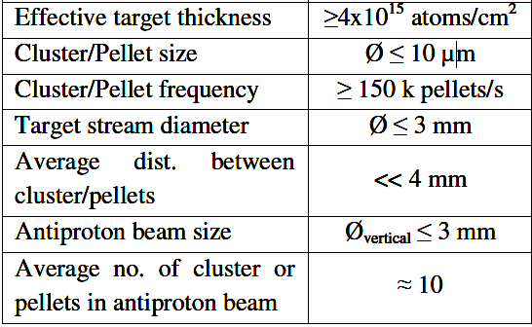
Parameters of the pellet target for PANDA
Main requirement σR/R and σv/V < 0.01%
Generation of Monodisperse
Sprays in Gas
Streams
Alfonso M. Gañán-Calvo
Action of the laser on a jet – thermocapillary instability
Rayleigh disintegration
σV/V < 0.01%
σR/R = 6 %
σV/V = 4-10 %
σR/R <0.01%
VOLUME 80, PHYS I CAL RE V I EW LETTERS 1998

Slide 4
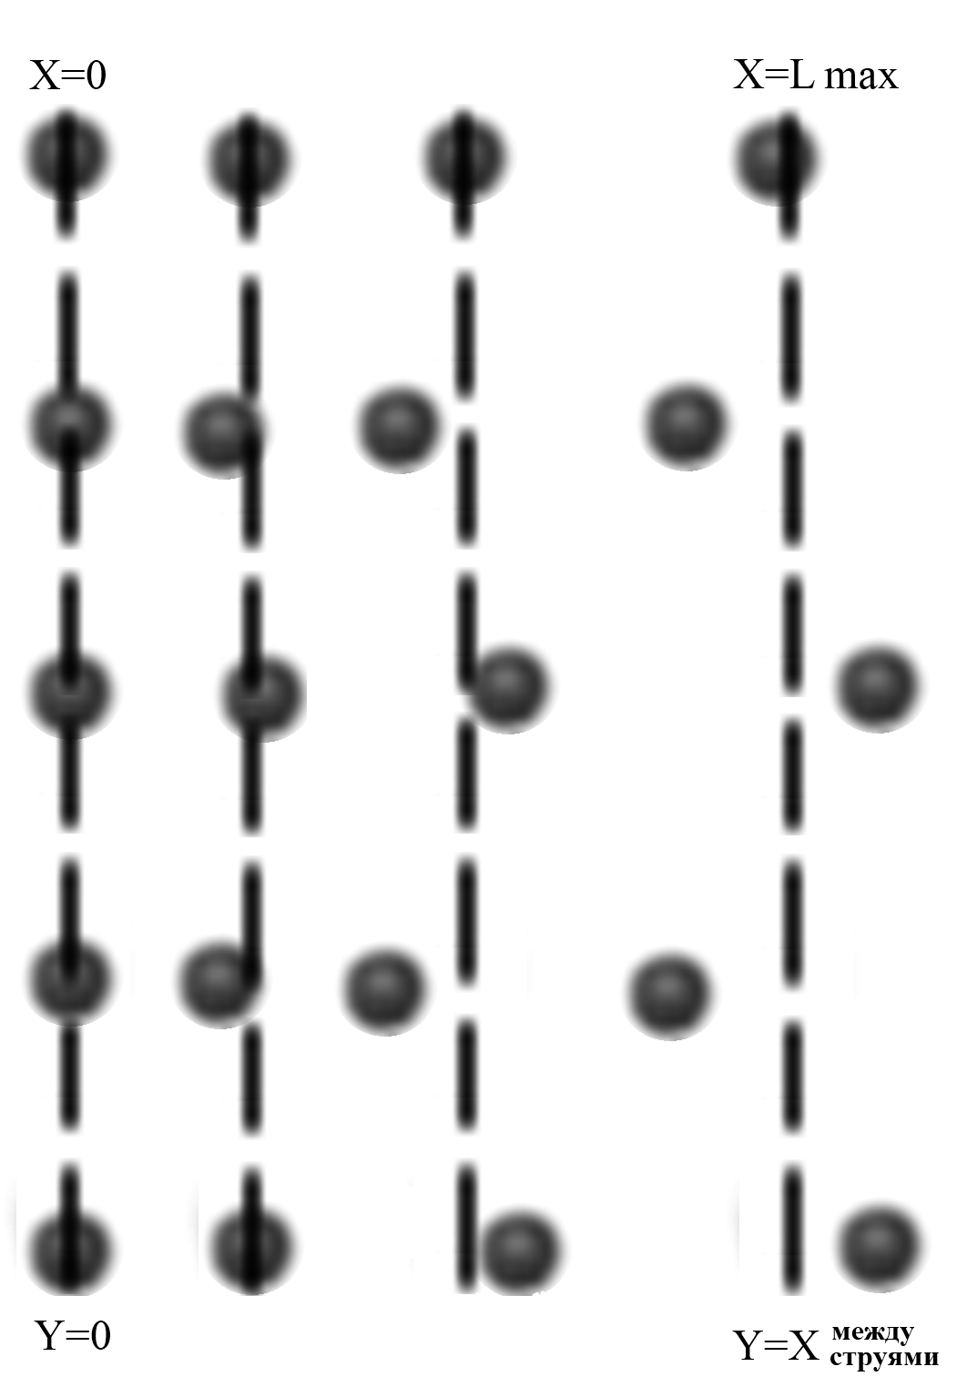
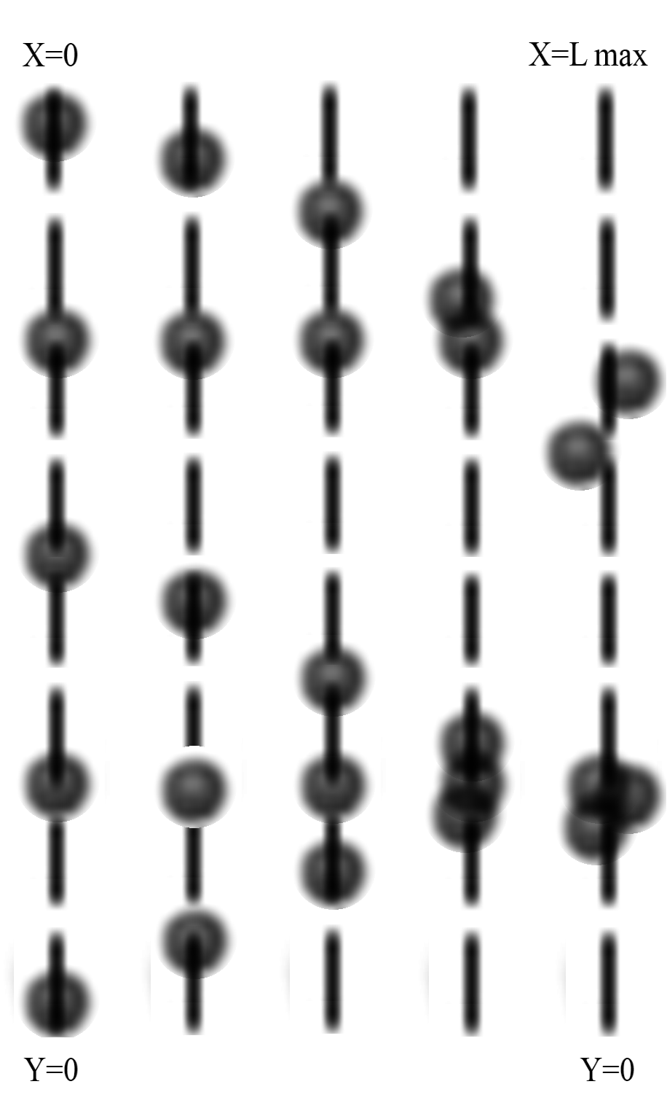
Longitudinal and cross instability of a drop stream
Cross instability
Longitudinal instability

Slide 5
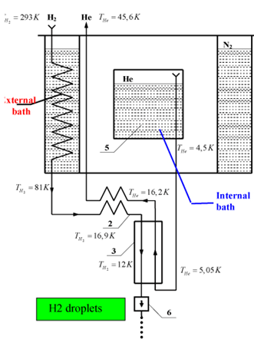
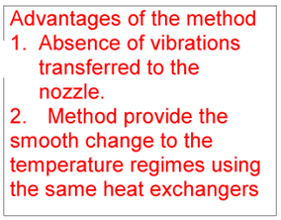
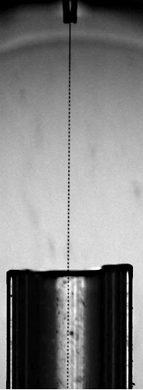
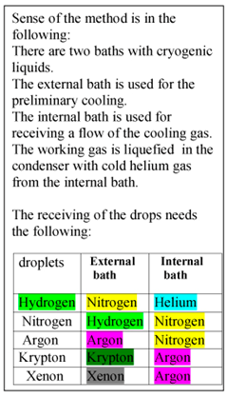
WASA Pellet
Target

Slide 6
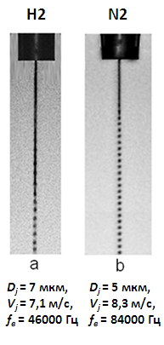
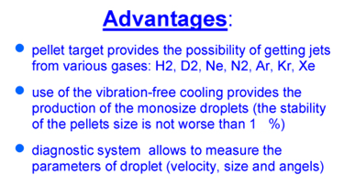
Main experimental results of 2005-2010.

Slide 7
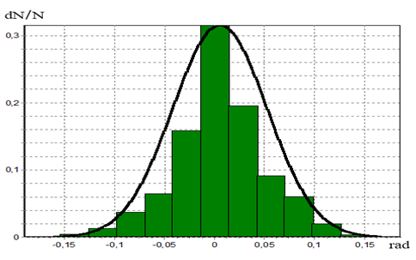
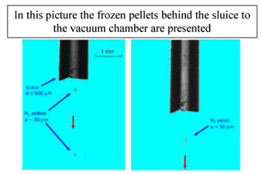
σ_{φ} = 0,0047 рад
WASA Pellet Target
σ_{φ} = 0,006 рад

Slide 8
MAIN RESEARCH AREAS 2010 - 2015
1. Creation of mono jets generators and generators of many jets
for low and high work temperatures
2.Creation of the measure methodic and software for
determination of drops parameters online
3. Development of thermodynamic model of thermophysical
processes, which take place during getting the cryogenics
corpuscular targets
4. New metal targets
5. Researhes of monodispersity limit

Slide 9
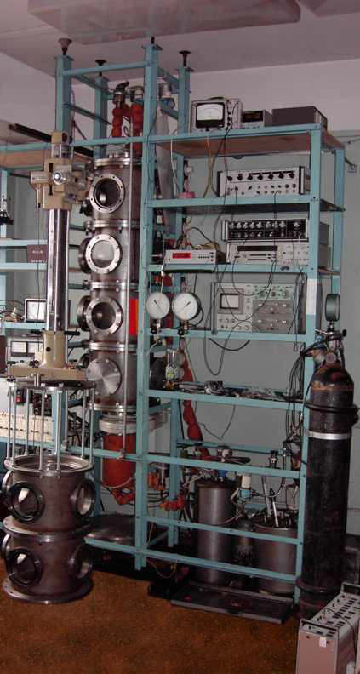
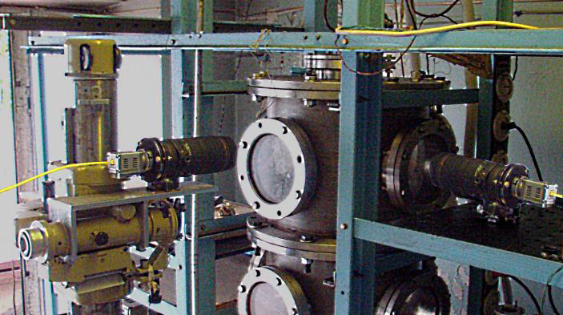
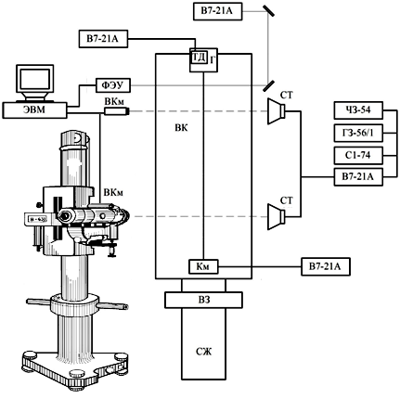
EXPERIMENTS ON DETERMINATION OF MONODISPERSE LIMIT
σ0Y ≈ σ0X ≈ 1∙10-3 %

Slide 10
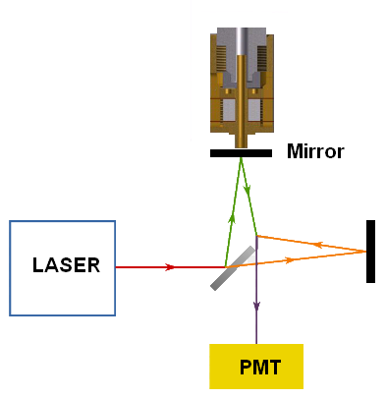
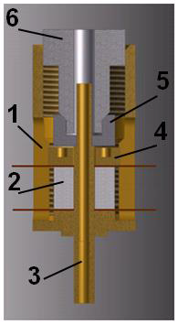
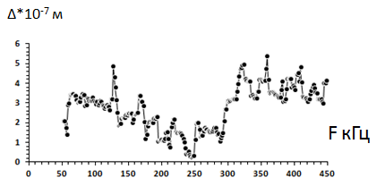
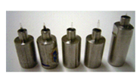
GENERATORS OF MONODISPERSE DROPS, CREATED IN MPEI
The amplitude of fluctuations from frequency is measured with the use of the interferometer.

Slide 11
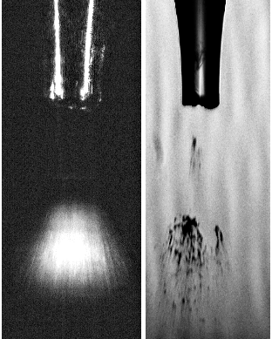
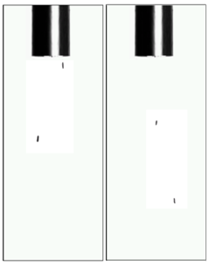
METHODIC AND SOFTWARE FOR DETERMINATION OF DROPS PARAMETRS ONLINE, MADE IN MPEI
Main techniques
Video camera (bad time resolving)
Doppler method (the big cost, impossibility to carry out an adjustment, difficult focusing)
The linear camera (impossibility to carry out an adjustment, difficult focusing)
The technique by definition of characteristics of monodisperse drops is developed: lengths of not broken up part of a jet, drops speed , drops size , forms of drops, speeds of a jet, a surface form to a jet
New technique
Good time resolving,
Small cost,
Possibility to carry out an adjustment
Simple focusing

Slide 12
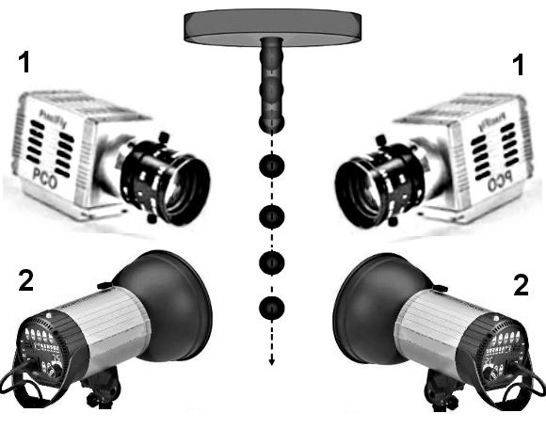
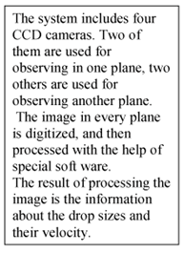
METHODIC FOR DETERMINATION OF DROPS PARAMETRS ONLINE, MADE IN MPEI
σ_{V} /V <1%
σ_{R} /R <1%
σ_{φ} = 0,003 рад

Slide 13
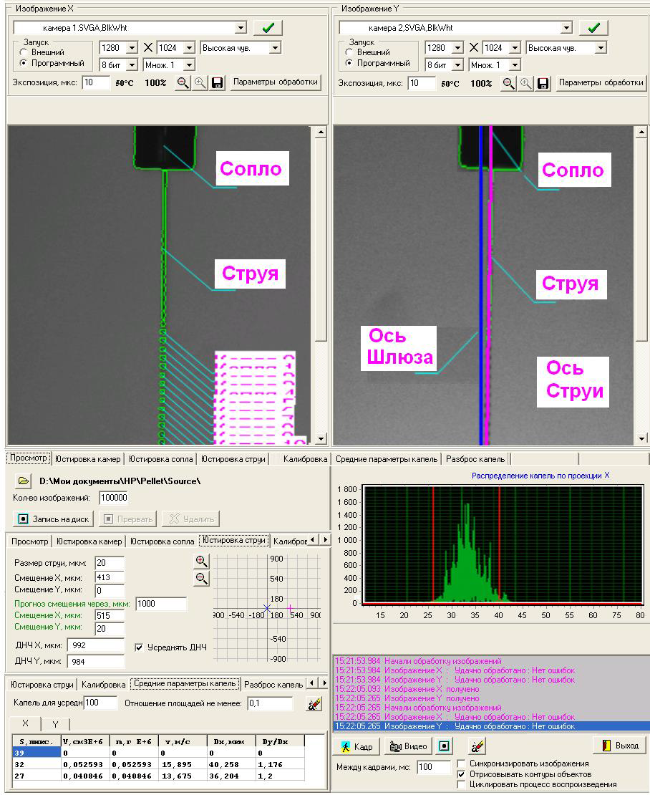
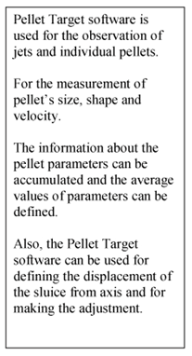
SOFTWARE FOR DETERMINATION OF DROPS PARAMETRS ONLINE, MADE IN MPEI

Slide 15
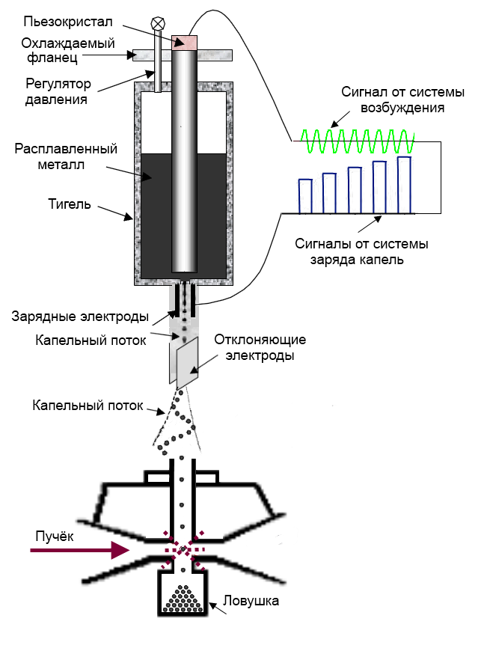
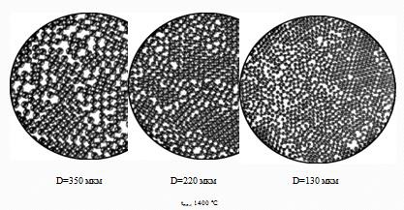
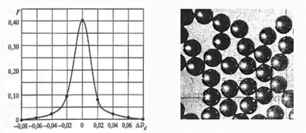
NEW TYPE OF METAL TARGETS
1. Do not need cooling
2. It is possible to get monodisperse granules with D= 0,003-1,5 мм from different metals (Li, Pb, Sn, Sb, Zn, Al, Cu, Au, Ag до U) ant their alloys. Dispersion of drops diameters and speed is less than 1%.

