Slide 1
FRRC - PANDA Meeting, Moscow / ITEP, May 26, 2015 G.Alexeev (for muon group) Muon System Status Report
* Approval of Muon TDR by FAIR Council (22 Sept. 2014) -> open way to
writing the JINR-FAIR contract (available budget ?!)
* Description of Muon System in PANDAroot:
- Barrel, End Cap, Muon Filter –> JINR, Dubna
- Forward Range System –> INFN, Torino
* Test beam activity at CERN:
- Full assembly of Range System Prototype ( wire & strip R/O, analog & digital FEE)
- Design of T9/PS/CERN beam line diagnostics upgrade (time-of-flight, Čerenkov)
- Stand alone PANDA/COMPASS DAQ at CERN
* Preparation for mass production:
- contacts with main producers (MDTs components, FEE ASIC chips, … )
* Plans for 2015:
- Preparation of the JINR-FAIR contract
- Muon System in PANDAroot – install/debug software (autumn 2015)
- Range System Prototype – put in operation (cosmic, beam test depends on PID upgrade)
- Modifications to T9 beam line diagnostic equipment ( TOF - autumn 2015, Čerenkov - ?)
- R&D @ test stand in JINR (high rate effects, new FEE ASIC chips etc.)

Slide 2
Geant4 Computer Model for the Muon System
* Geometrical description
Geant4 geometrical description of the most complex Barrel part of Muon System is practically ready; the End Cap, Muon Filter and Forward Range System are in progress
Description of the Range System Prototype (to be placed on PS T9 beam line) is ready
* Simulation of signals from the MDTs (digitization)
Algorithm based on our experience with Range System Prototype (CERN) is being implemented

Slide 3
Geant4 view of Barrel (a) and its cut at target zone (b)
Steel absober (in white)
(a)
(b)
Zero bi-layer (in blue)
MDTs inner layers (in blue)

Slide 4
Geant4 view of End Cap and Muon Filter (a) and its vertical cut (b)
MDTs layer (in red)
(a)
(b)
steel ribs
(in white)
End Cap
Muon Filter

Slide 5
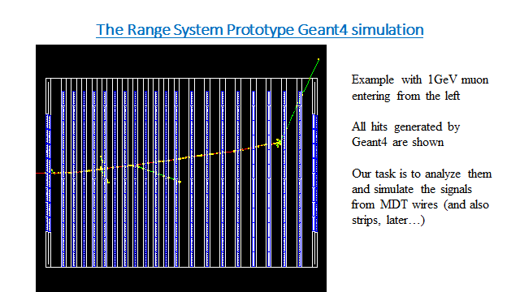
RSP model and data collected at T9/PS/CERN run 2012 are being used to tune digitization algorithm
digitization
‘chess board’ zero bi-layer
‘standard’ bi-layer

Slide 6
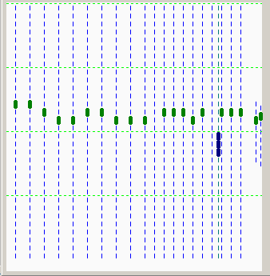
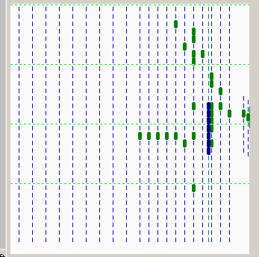
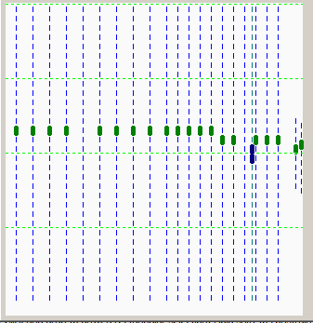
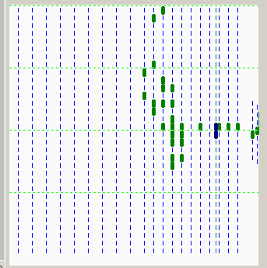
BEAM: e,µ,π,p (3 GeV/c, trigger: S1 (Ø 11,5 cm) & S2 (Ø 3,5 cm)), Range System Prototype data of T9/PS/CERN run 2012
wire hits (in green)
µ
h
µ
h
strip hits (in blue)

Slide 7
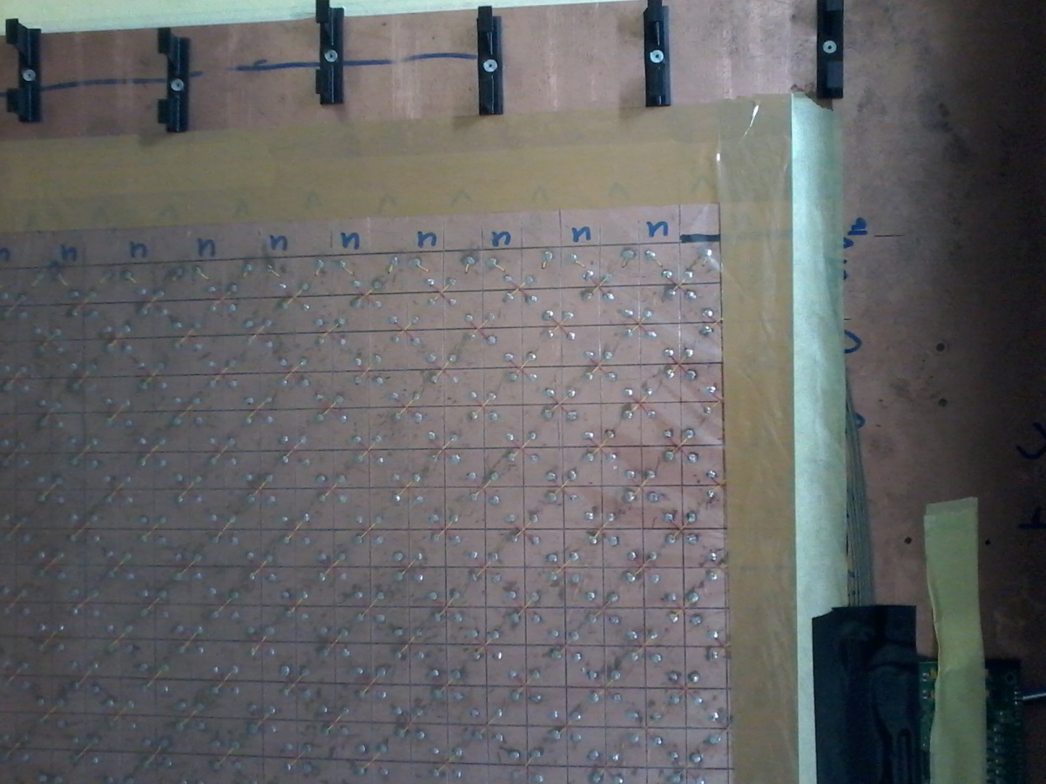
‘Chess board’ zero bi-layer (fragment)
wire direction
U-strip, -45 deg.
V-strip, + 45 deg.
Strips are formed from 2 cm x 2cm squares by soldering
Brackets to fix MDTs to strip board
MDT
tube

Slide 8
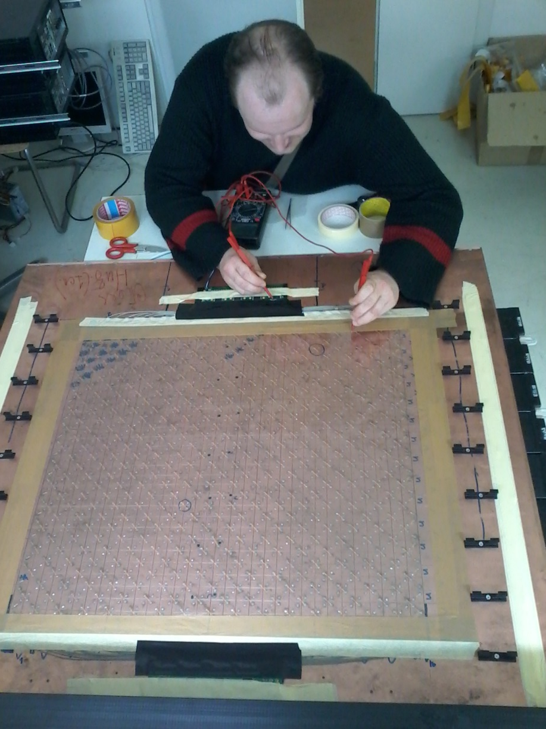
Test of ‘chess board’ zero bi-layer preamplifier A-32
A-32 board
One of two MDTs layers

Slide 9
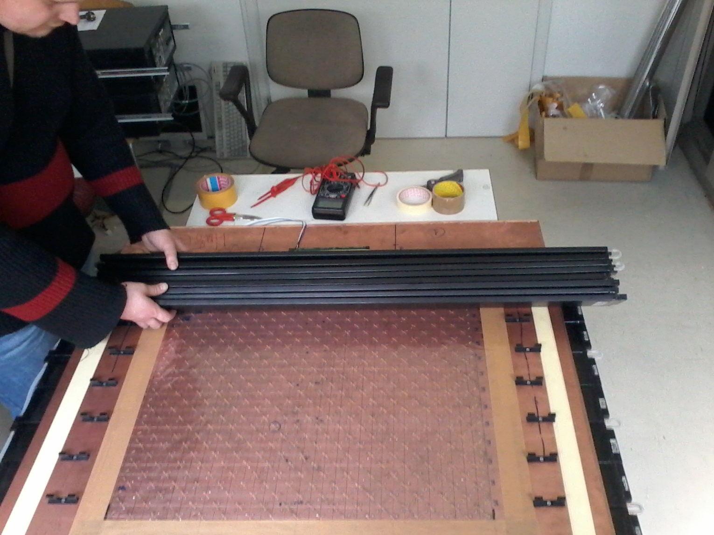
Putting second MDT layer on ‘chess board’ zero bi-layer

Slide 10
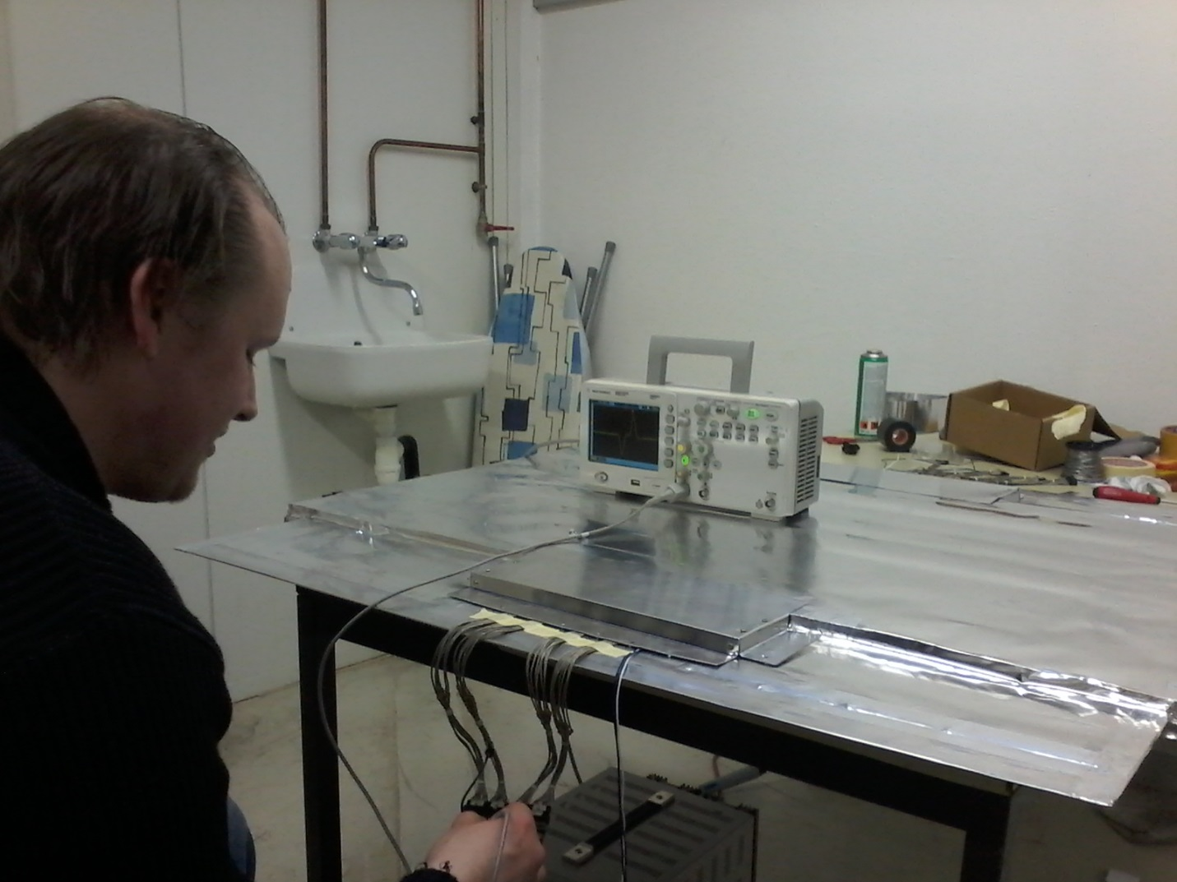
Test of ‘chess board’ zero bi-layer fully screened with aluminum foil (~ 0,1 mm thick)
A-32 preamplifier box

Slide 11
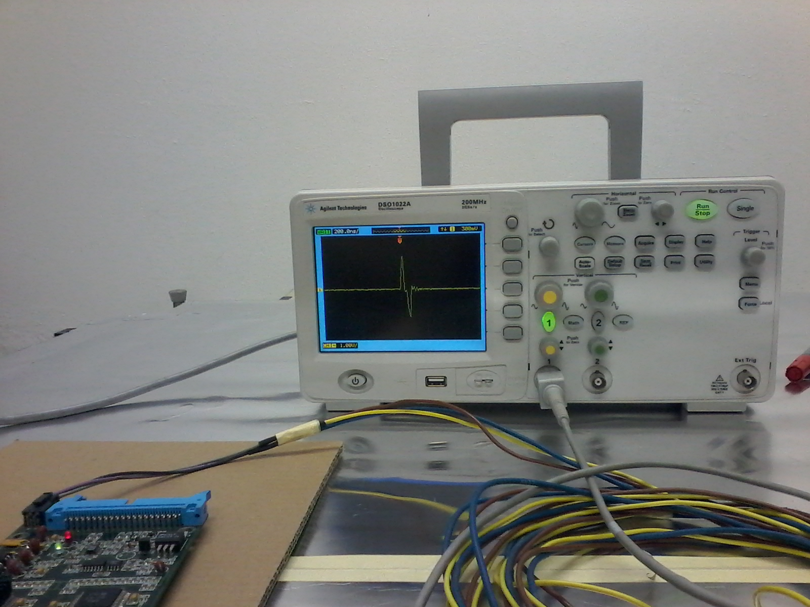
Test pulse from strips as seen after A-32 and ADB-32 amplification (induced by positive pulse on MDT wire)
No oscillation and small noise
ADB-32 card

Slide 12
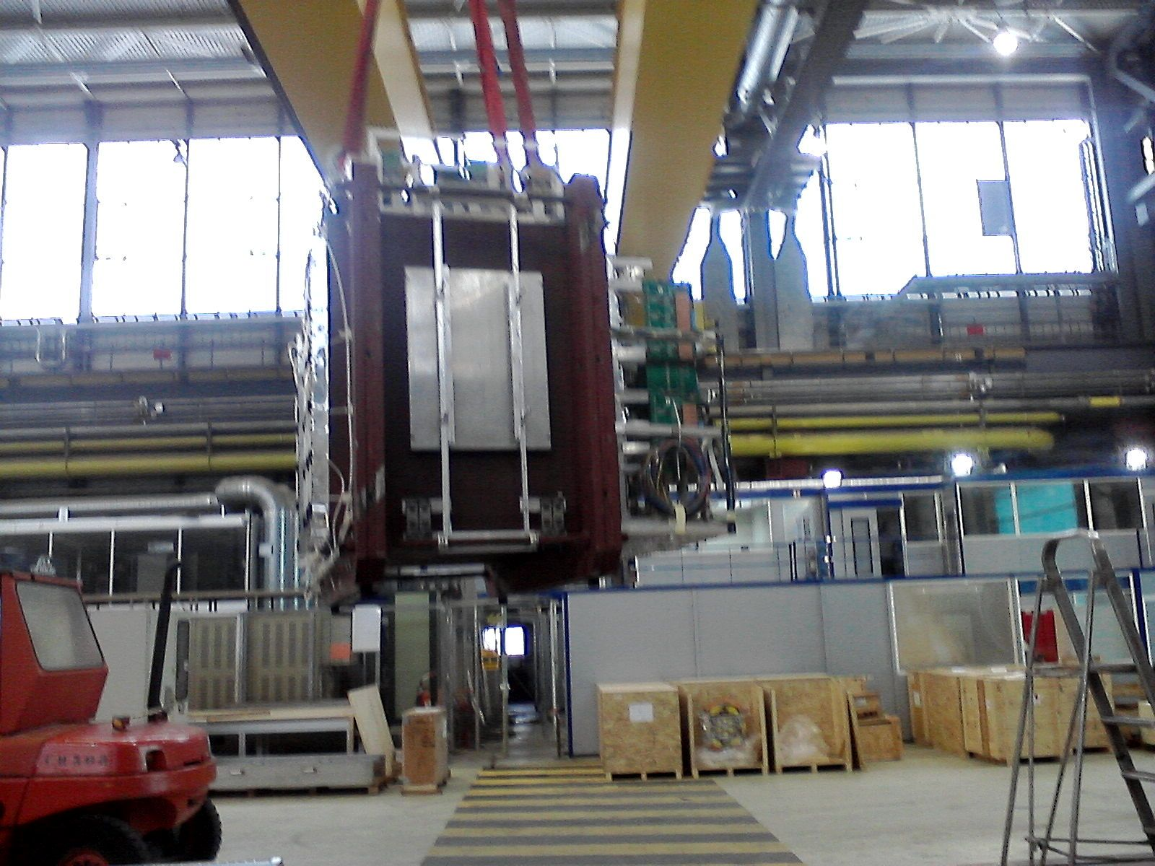
Moving of RSP by crane for putting in vertical position and further assembly with detecting planes and tests with cosmic at CERN
External surface for zero bi-layer fixation

Slide 13
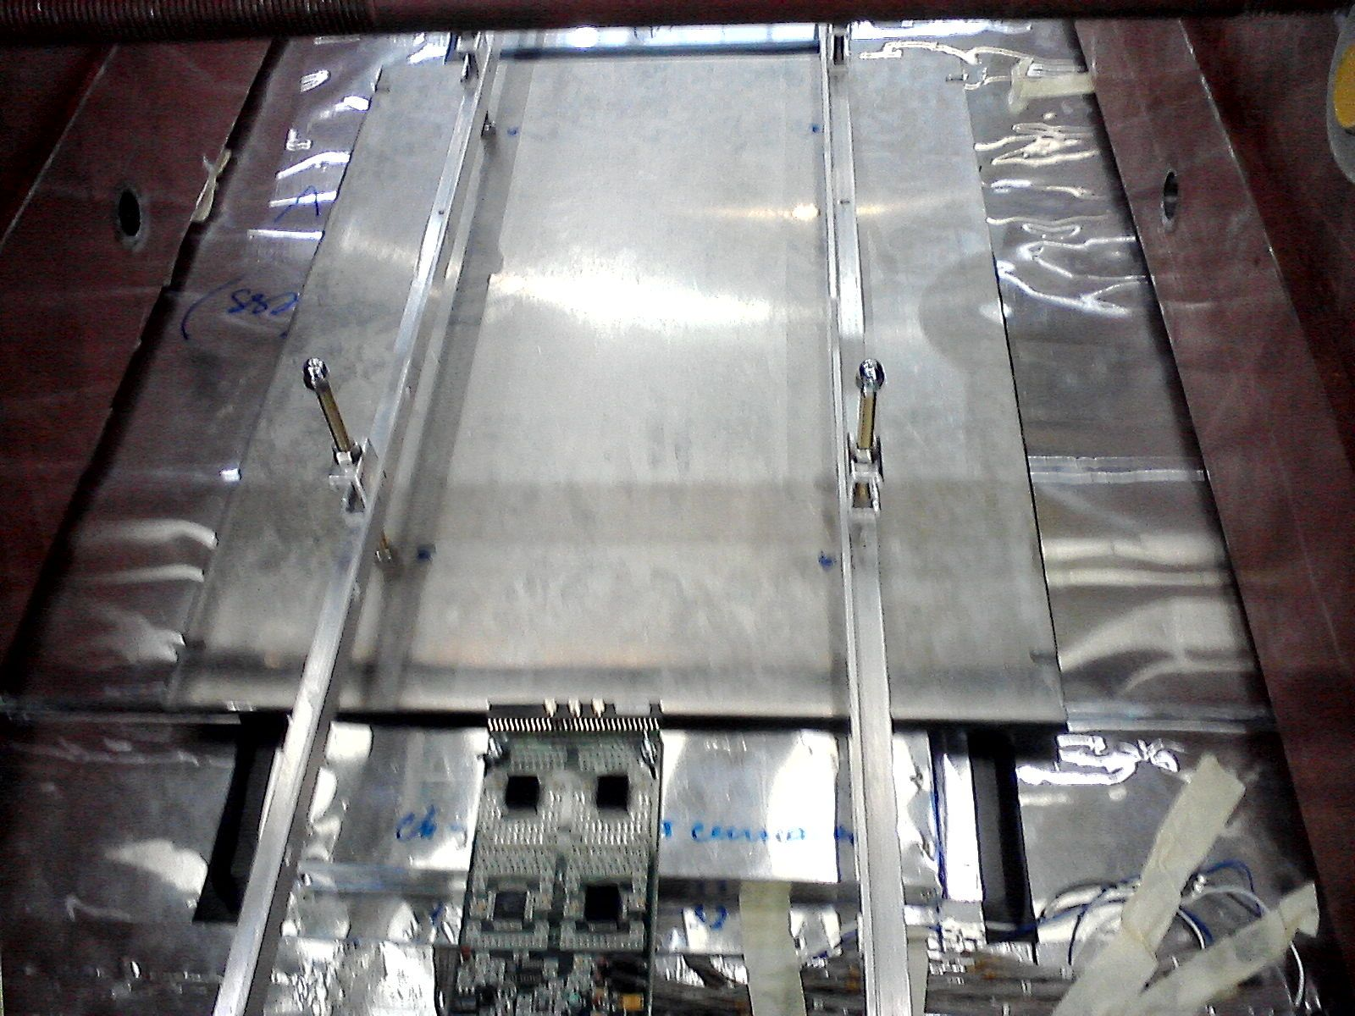
Fixation of ‘chess board’ zero bi-layer to RSP external surface
A-32 preamp shielding box
ADB-32 card

Slide 14
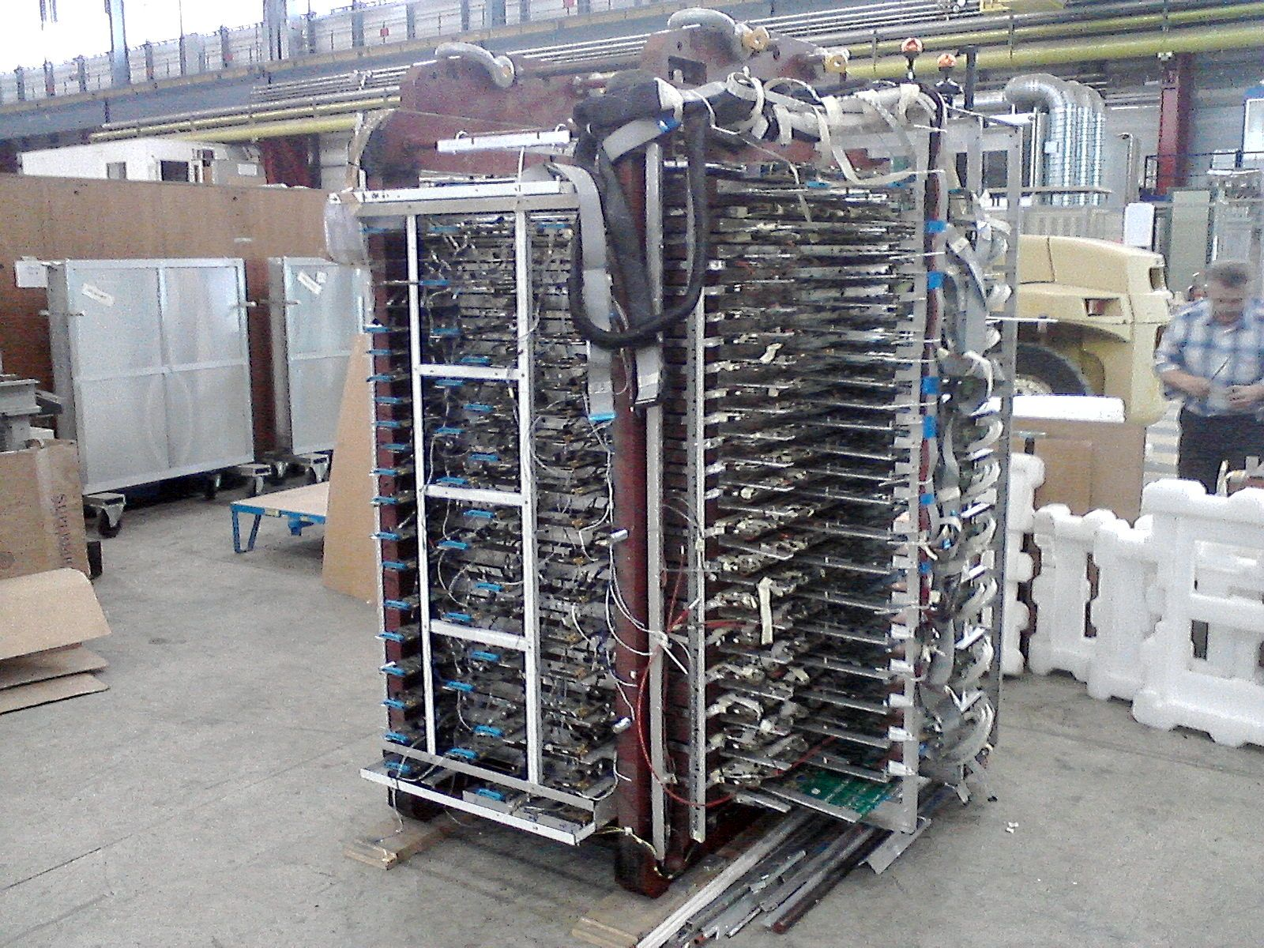
RSP equipped with all detectors and big portion of ‘on chamber’ FEE in vertical position (for cosmic tests)
A2DB-32 cards for wire R/O,
2160 channels
Strip R/O side, ADB-32 cards are removed during MDT planes insertion,
2026 channels

Slide 15
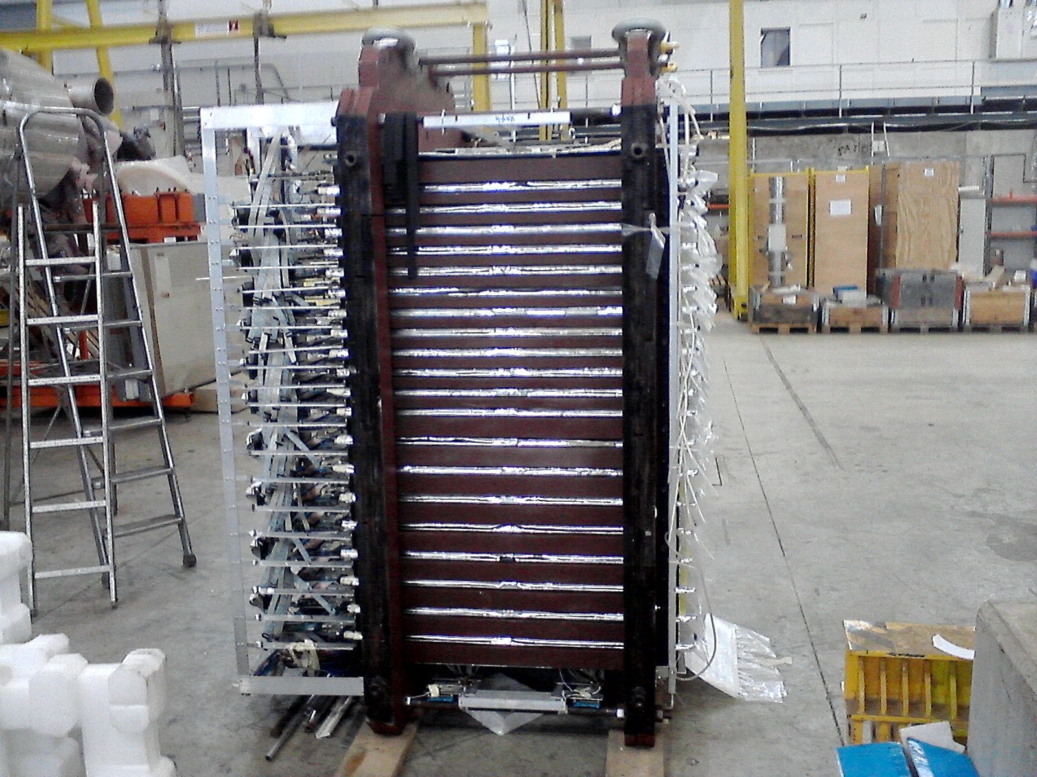
RSP in vertical (cossmic test) position ‘bottom side’ (for RSP position on beam) is pictured
Barrel structure
FRS in total
EC & MF structure

Slide 16
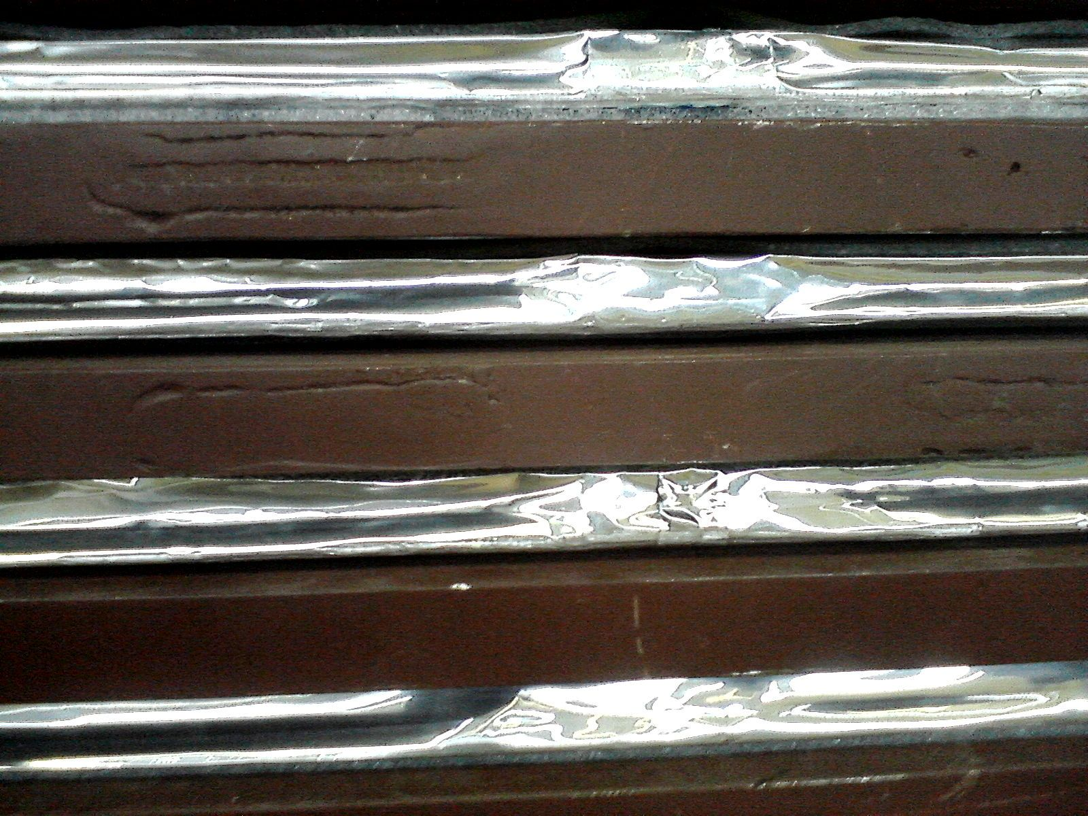
Fragment of RSP ‘bottom side’ Barrel structure (Fe/30mm + gap/30mm)
Fe
30mm
Flexible
material
Gap
30mm
MDTs & strip board
in aluminum foil

Slide 17
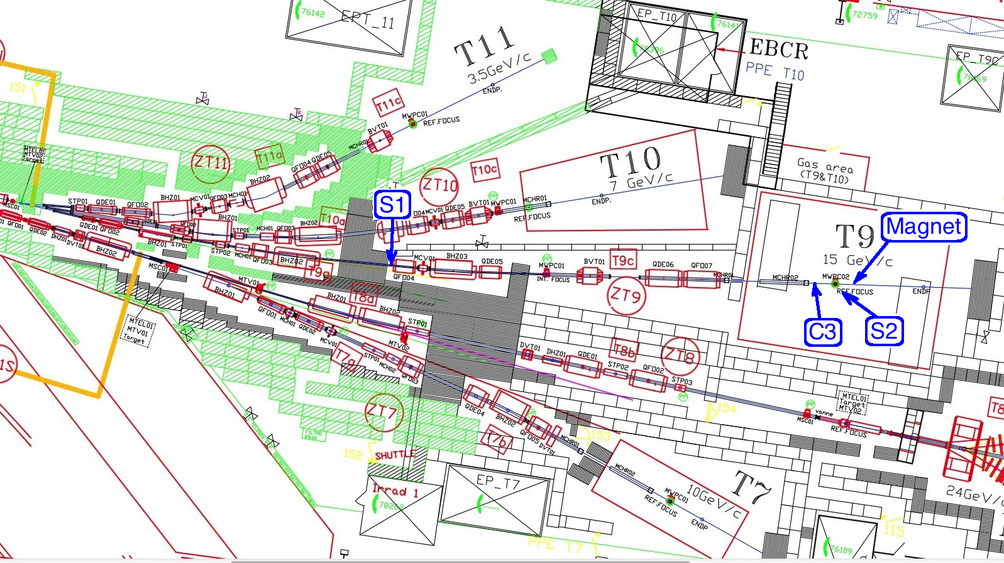
Assumed upgrades to T9 beam line for π/μ separation < 1-2 GeV/c: S1,S2 time-of-flight scintillator counters based at ~ 16-24 m to each other, pressurized (up to 60 atm) Cherenkov counter C3, magnetic analysis of incoming muon momenta with ~ +/- 1% accuracy
‘old’ position
New S1 position

Slide 18
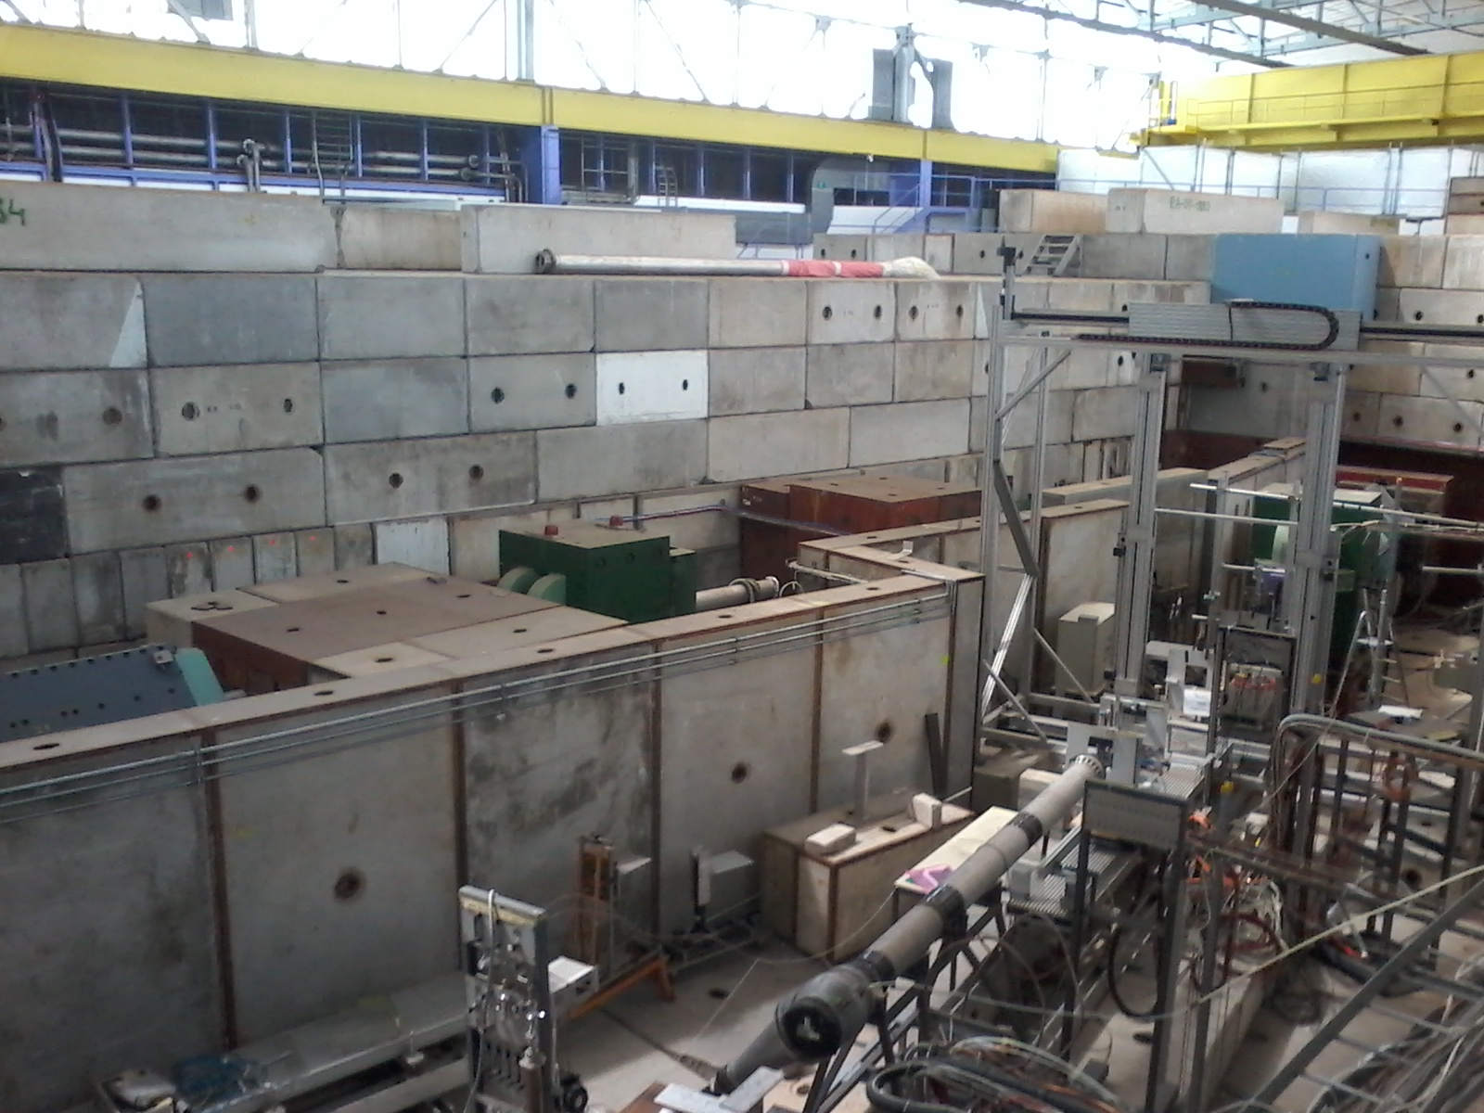
T9/PS/CERN beam line after reconstruction of 2013-14
Vacuum beam pipe interruption in T9/PS/CERN for S1 insertion
T10/PS/CERN beam zone

Slide 19
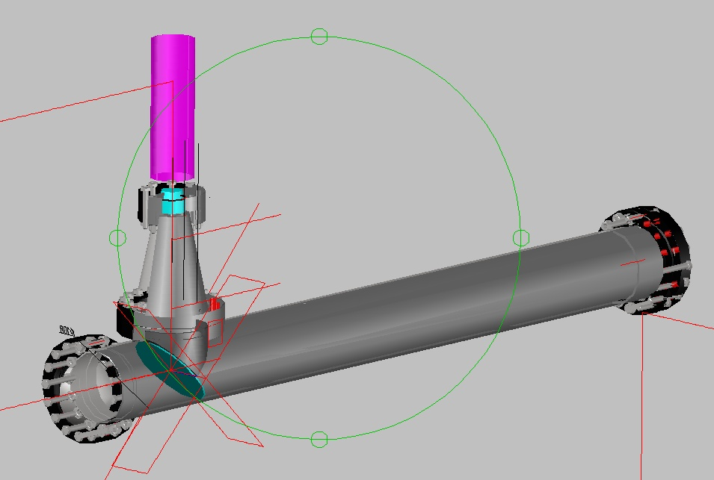
Čerenkov counter (up to 60 atm), schematic view
photo-sensor, PMT
high pressure vessel
mirror

Slide 20
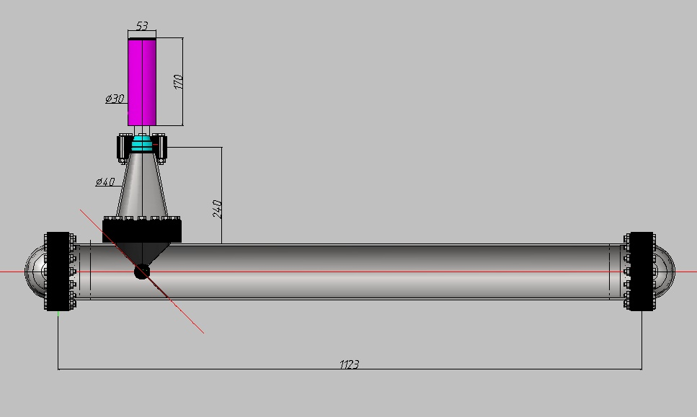
Čerenkov counter (up to 60 atm), main dimensions

Slide 21
T9 Test Beam Diagnostic Equipment (photo-detectors)
PMT XP1020UR (Čerenkov counter)
time resolution σt = 70 ps
3σ TOF µ/π separation for P≤0.9 Gev/c
MCP-PMT XP85112 (TOF counters)
time resolution σt = 36 ps
3σ TOF µ/π separation for P≤1.3 Gev/c

Slide 22
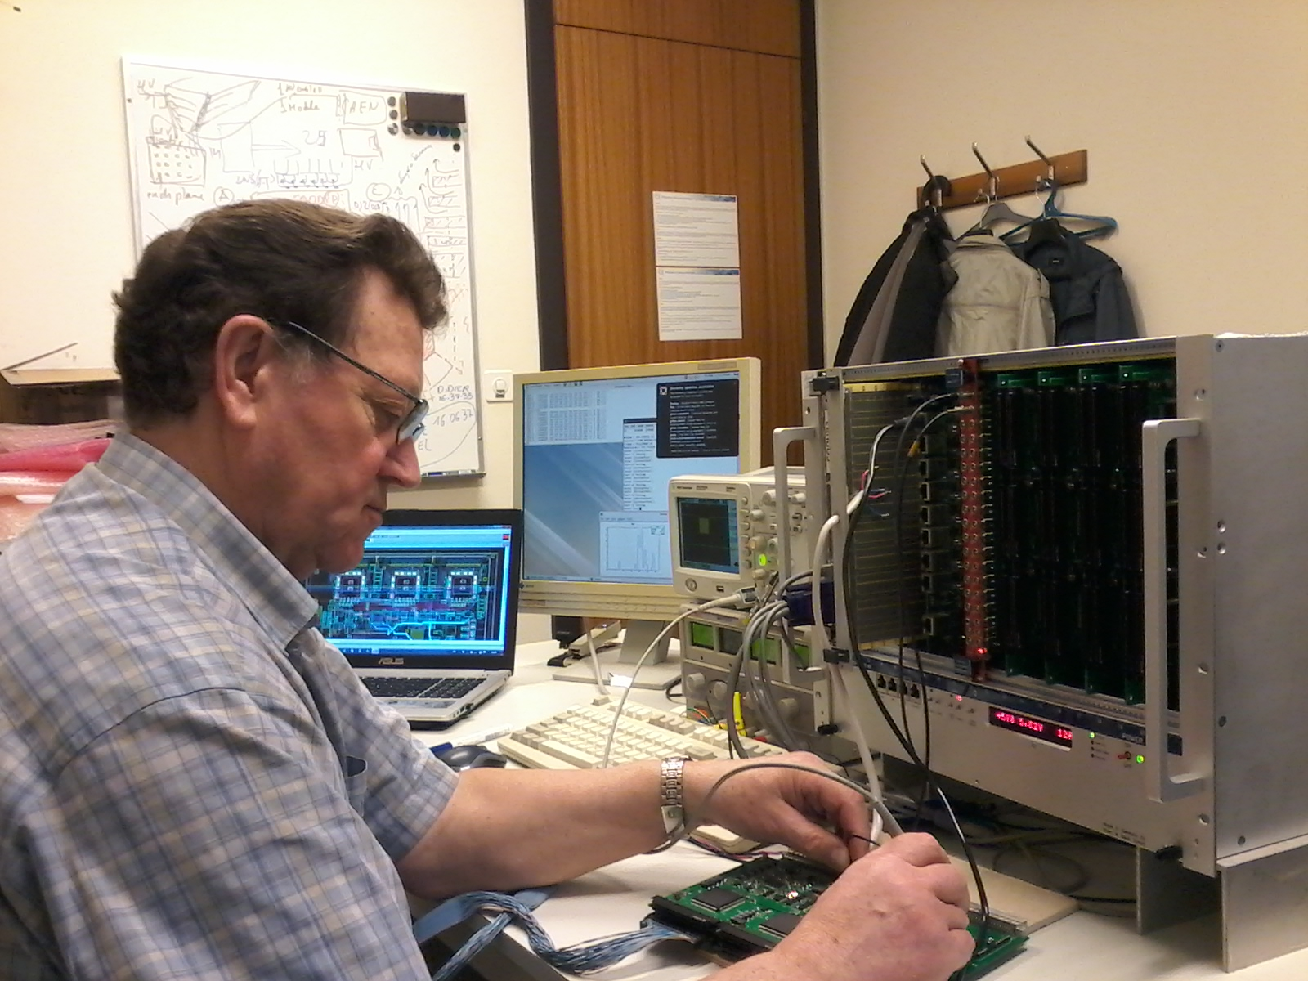
Test stand for digital R/O cards MWDB at CERN 21 cards (4032 ch) were tested/debugged/repaired
MWDB card (192 ch)

Slide 23
Stand-alone DAQ Block-diagram
(version 5, developed and completed in cooperation with COMPASS DAQ experts)
3 crates (VME 6U)
MWDB (RJ-45)
T0=1ch.
BOS
(NIM)
EOS
(NIM)
RW
(RJ-45)
8
8
8
2
`
SBC
TCS
GeSiCA
GeSiCA
GeSiCA
MUX
(master)
DAQ crate (VME 6U)
port
1÷8
port
1÷8
port
1÷8
port
1÷8
VP-917/012-16
1
1
1
Mem 1GBx2
fiber
TRIGGER
(NIM)
ODIN
rear card
Ethernet
1Gb Switch
PC
Spill Buffer
Slink (optical fiber)

Slide 24
Stand-alone DAQ units status
1). VME crate x 3 (received & tested)
VME64 crate; 8U; 21 slots; fan; +5V 115A/230A;
+/-12V 46A
2). 6U VME Single Board Computer VP 917/012-16 x 2 units (received & tested)
2-core 2.5 GHz i7-3555LE; 16GB DRAM; 2PMC/XMC slots;
Ethernet port; 2.5 “HDD SATA-III 500GB;
Splitter cable for VGA/Keyboard/Mouse/COM-Port/USB
3). 6U VME Single Board I/O Register V977 x 2 units (received & tested)
16 channels; NIM or TTL Input/Output signals
4). 6U VME GeSiCA x5 units + MUX x 2 units (Control and Acquisition unit)
readout-driver (received, to be tested with DAQ): 8 front-end serial interfaces (Rj-45); 512 MB internal FIFO memory; S-Link output interface
5). TCS module x 2 units (offer is being paid, to be tested with DAQ units)

Slide 25
Simplified Schematic of Xilinx FPGA Prototype R/O Module (192ch) (to be tested with Range System Prototype at CERN; if results will be positive, the Artix 7 chip may be regarded as basis for the final PANDA/DAQ)
SETUP
LVDS
LVTTL
HCPL-2400
MAX9173
X 48
(192ch)
Artix 7
CLK
Analog Electronics, ADB-32
DS92LV222
COMPASS DAQ
Thresh
DAC
AD8842
XC7A200T-2FBG676I
TRIGGER
DS90C032
DATA
CY7B923
(6)
JTAG
N25Q256A
Config. Mem.
Part to be replaced with respect to final PANDA DAQ
Conservative part, to be kept to final PANDA DAQ

Slide 26
Contacts with industry
* MDTs components:
- ALU profile -> Agrisovgaz (www.agrisovgaz.ru), reliable partner,
Kaluga Region, Russia
- End plugs (active & passive) -> Mars, reliable partner, Erevan,
Armenia
- Plastic envelope (Noryl) -> in search for partner, two companies
study the technology to extrude Noryl
plastic (Mars, Erevan and EPPI limited,
Moscow
* Front End Electronics:
- ASIC chips -> Integral, reliable partner, Minsk, Belorussia
- Assembly of cards -> Marathon, reliable partner, Moscow,
Russia
* Mechanical structures: pending clarity with magnet

Slide 27
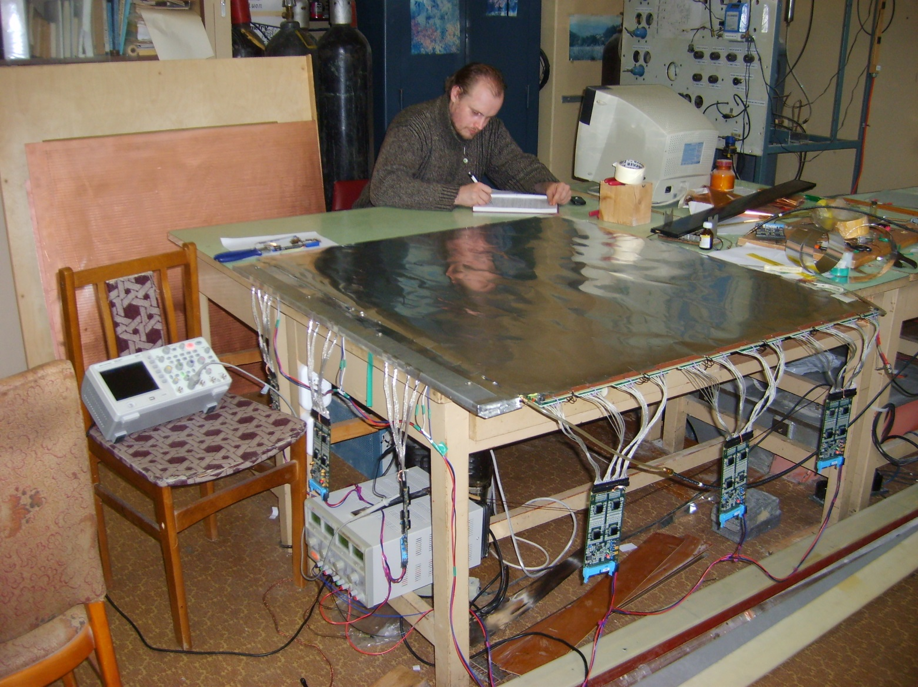
Final variant of detector plane shielding developed at Dubna test stand – was implemented in Range System Prototype at CERN
All results of shielding tests were applied to this final detector plane version
Preamplifier shielding box consists of several Al plates which provide:
shielding of A-32 cards (from detector and each other),
shielding of input strip-to-preamp-wires
preamplifier GND connections
Shielding free edges
Preamplifier shielding box
HV/S-8 cover (GND bus)
ADB-32 cards
Fully equipped detector plane was tested for a month – no performance changes were observed

Slide 28
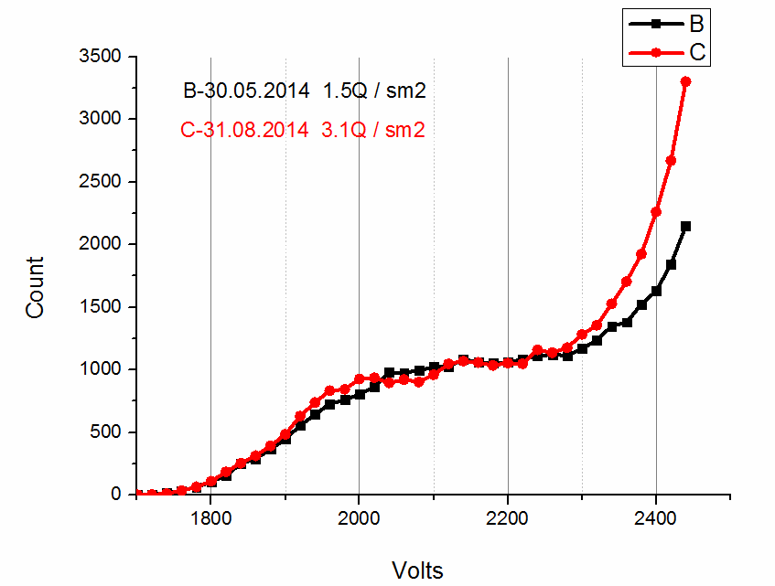
MDT counting characteristics after irradiation by 1.5 and 3.1 Coulomb / cm2 NO AGEING !
Collected charge is increased by factor 3 compared to ‘threshold value’ in 1 C/cm presented for ECE referees last year

Slide 29
High rate performance (wires & strips) studied at Dubna test stand

Slide 30
Backup slides

Slide 31
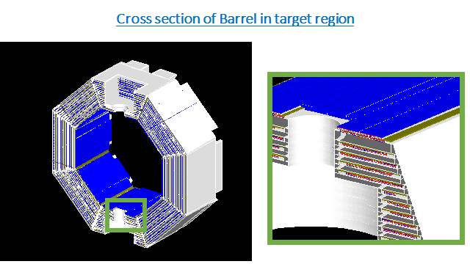
Zero bi-layer
MDTs layer

Slide 32
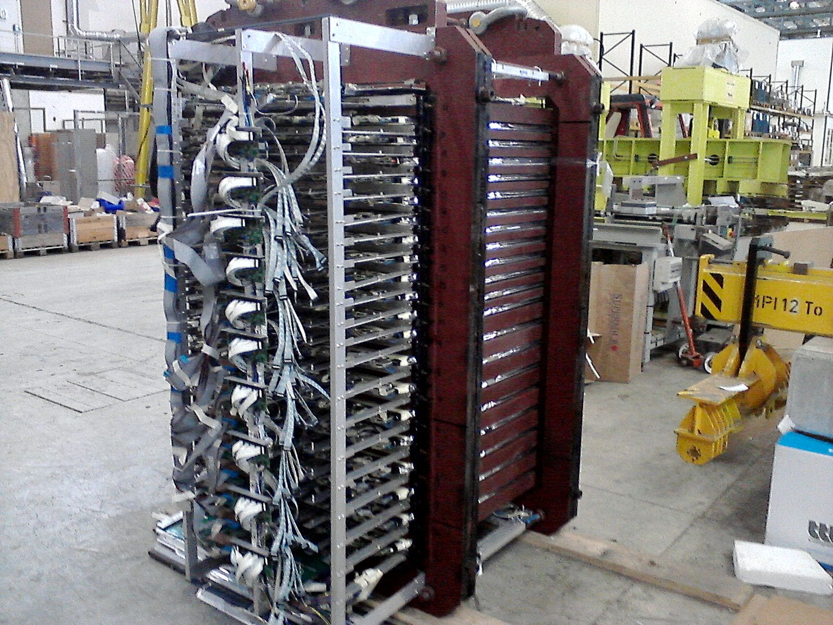
RSP in vertical position (for cosmic test)
A2DB-32 cards for wire R/O

Slide 33
DAQ Status Summary
1). The final version of the stand-alone DAQ is ready
2). Hardware for DAQ was mostly received, last unit is expected in summer 2015
3). The development of the DAQ software/firmware is currently in progress
at CERN, ready/tested code is expected in autumn 2015

Slide 34
Table of conditions for written events; T9/PS/CERN run 2012
P[Gev/c] | Trigger | Composition | N of events | file # , Comments
Spectrum | S3*S4 | cosmic | 635 | f39, S3 & S4 on RSP top
Spectrum | S3*S4 | cosmic | 8375 | f41,S3 on top & S4 on bottom
0.5 | S1*S2 | - (e,μ,π) | 6575 | f85, strips on
0.5 | S1*S2 | + (e,μ,π,p) | 27374 | f83, strips on
1 | S1*S2 | + (e,μ,π,p) | 3087 | f65
1 | S1*S2*vetoC1 | + (μ,π,p) | 90 000 | f68
2 | S1*S2 | + (e,μ,π,p) | 3161 | f80, strips on
2 | S1*S2+Pb | + (μ,π,p) | 1087 | f81, 2.5 cm Pb brick in beam, strips on
3 | S1*S2 | + (e,μ,π,p) | 11766 | f77
3 | S1*S2*C2 | + (e,μ) | 3283 | f78
3 | S1*S2*C2+Pb | + (μ) | 299 | f79, 2.5 cm Pb brick in beam, strips on
5 | S1*S2 | + (e,μ,π,p) | 9702 | f56
5 | S1*S2*C1*C2 | + (e) | 2181 | f57
5 | S1*S2*C1*C2 | + (e,μ) | 1217 | f58
5 | S1*S2*C1*C2 | + (e,μ) | 200 000 | f59
5 | S1*S2 | + (e,μ,π,p) | 6407 | f69, strips on
5 | S1*S2*C2 | + (e,μ) | 3201 | f70, strips on
5 | S1*S2*C2 | + (e,μ) | 13266 | f71, strips on
7 | S1*S2 | + (e,μ,π,p) | 11940 | f75, strips on
7 | S1*S2*C2 | + (e,μ) | 3492 | f76, strips on
10 | S1*S2 | + (e,μ,π,p) | 9899 | f72, strips on
10 | S1*S2*C2 | + (e,μ) | 1213 | f73, strips on
10 | S3*S4 | + (e,μ,π,p) | 7405 | f74, beam + halo, strips on

