Slide 1

Status of the PANDA Magnet
Joint Institute for Nuclear Research (Dubna)
Presented by E. Koshurnikov
FRRC, Moscow
May 26, 2015

Slide 2
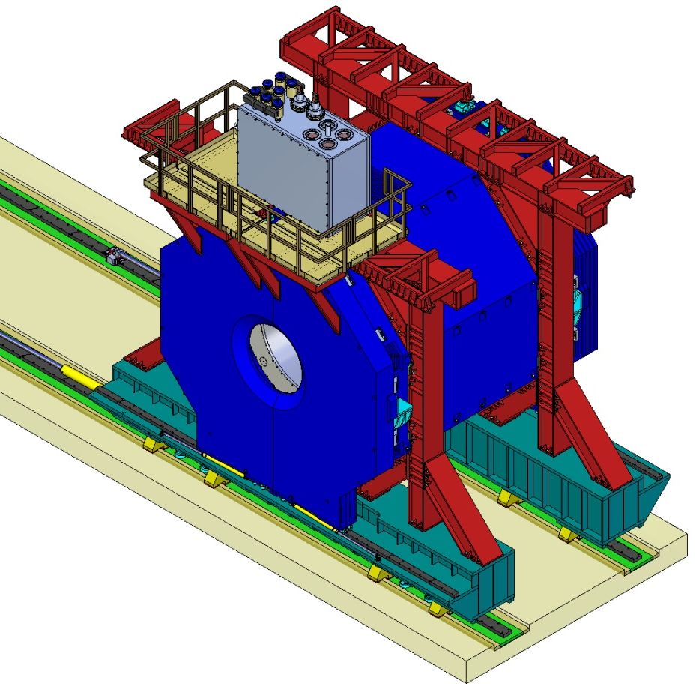
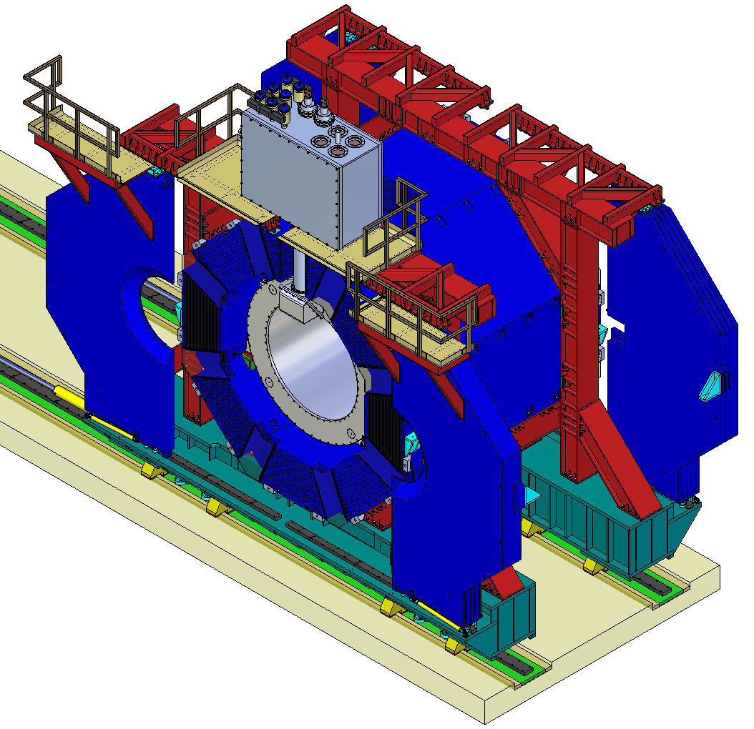
General view of the Target Spectrometer magnet

Slide 3
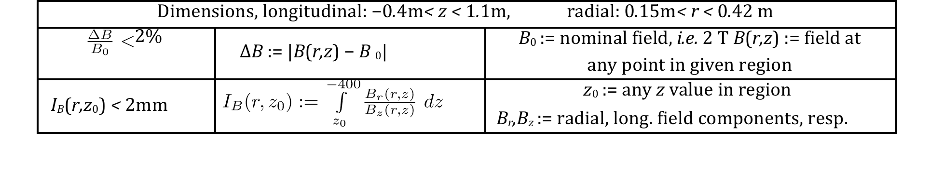
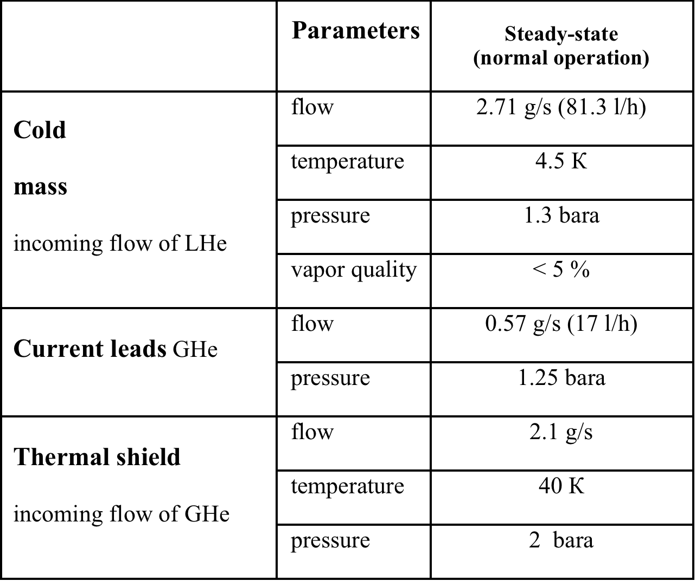
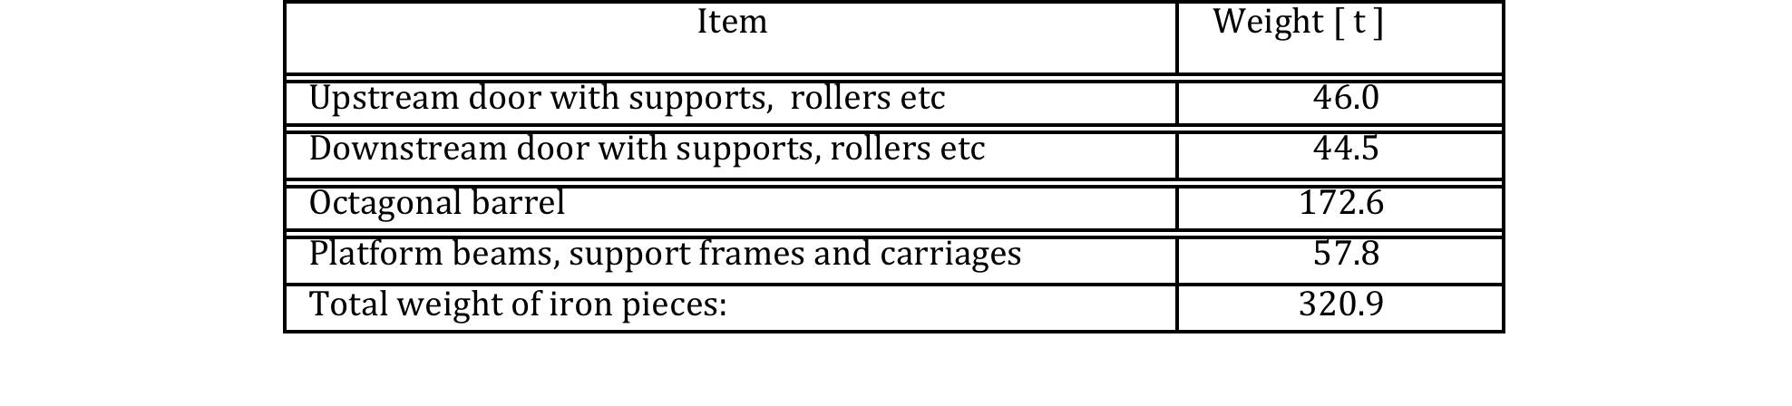
Main TS magnet parameters
Requirements to the magnetic field in the tracker area
Summary of dimension
  Diameter of aperture, mm 1900
  Interpolar distance, mm 4070
  Length of the magnet, mm 4875
  Width of the magnet, mm 4900
  Maximal high of the magnet, mm 8225
Parameters of the helium flows
Summary of weights of the individual yoke parts

Slide 4
Participants of the TS magnet project and the area of their responsibility
Design
  JINR – Yoke, Cryostat including Control Dewar
  CERN – Cold mass including test of the solenoid
  GSI – Helium refrigerator, power supply, Rail track,
  Hydraulic equipment?
Construction and Commission
  Yoke – a Russian firm (SMZ, Savelovo ?)
  Cryostat – BINP (Novosibirsk)
  Cold mass - ? + CERN
  Cryostat assembly – CERN
  Magnet assembly – JINR + SMZ?
  Test of the magnet – JINR, CERN, GSI

Slide 5
Status of the Magnet Yoke
Assembly drawings of the main units and 3D model of the Yoke have been prepared
Yoke Technical Description and Technical Specification have been prepared
Preliminary discussions with the supposed yoke producers have been started

Slide 6
Documentation of the yoke technical design
The documentation is placed at CERN EDMS service (FAIR Project, PANDA, Magnets, Solenoid yoke ID = 1064509)
Technical Description (7 MB)
https://edms.cern.ch/document/1387740/1
Technical Specification (0.7 MB)
https://edms.cern.ch/document/1387741/1
  Yoke CAD 3D model (24 MB)
  https://edms.cern.ch/file/1064509/2/Solenoid12d_3D100_Yoke_Full_Reduced_stp.zip
Yoke CAD model, simplified (16 MB)
https://edms.cern.ch/file/1064509/2/Solenoid12d_3D100_Yoke_Full_Reduced_WB_stp.zip

Slide 7
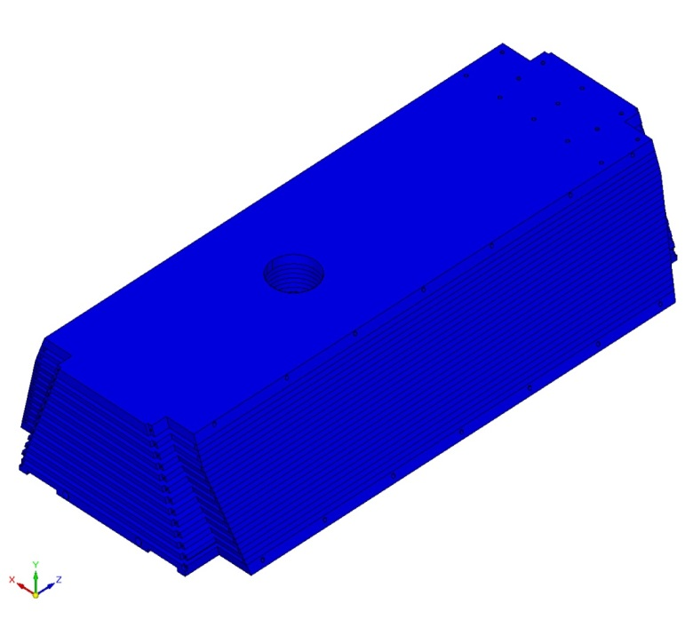
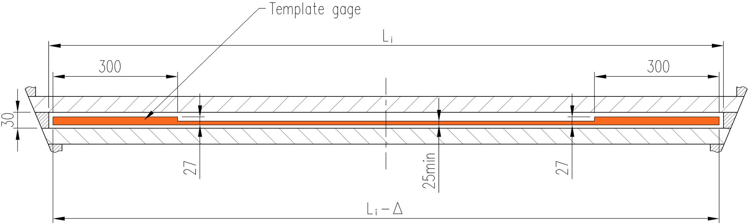
The cost of manufacturing depends on the production technology of the magnet beams and doors which in turn depends on the dimensions of the go-gauges

Slide 8
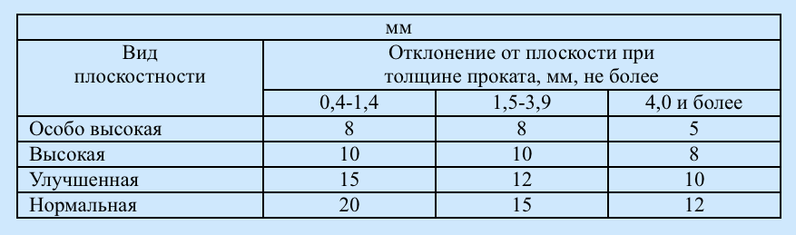
Deviations from planarity to 1 m of length of the rolled sheets should not exceed the limits specified in the table
Hot rolled sheets. Assortment GOST 19903-74
Sheets with Very High Flatness is produced by agreement with the manufacturer

Slide 9
Further activities relating to the yoke
JINR will continue discussions with potential producers to find an optimal decision - optimal price, quality and ease of interaction
GSI should initiate discussions with local producers of hydraulic equipment and local civil engineering firms which could be responsible for rail track mounting. Technical Specifications for the hydraulic equipment and for the magnet rail track have been prepared by JINR.
Some magnet interfaces continue to be at the stage of coordination. In this connection some additional design changes are expected.

Slide 10
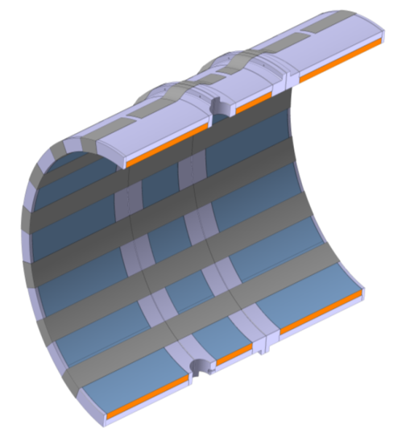
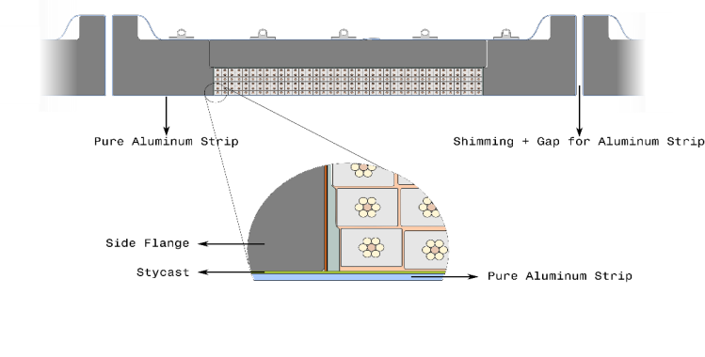
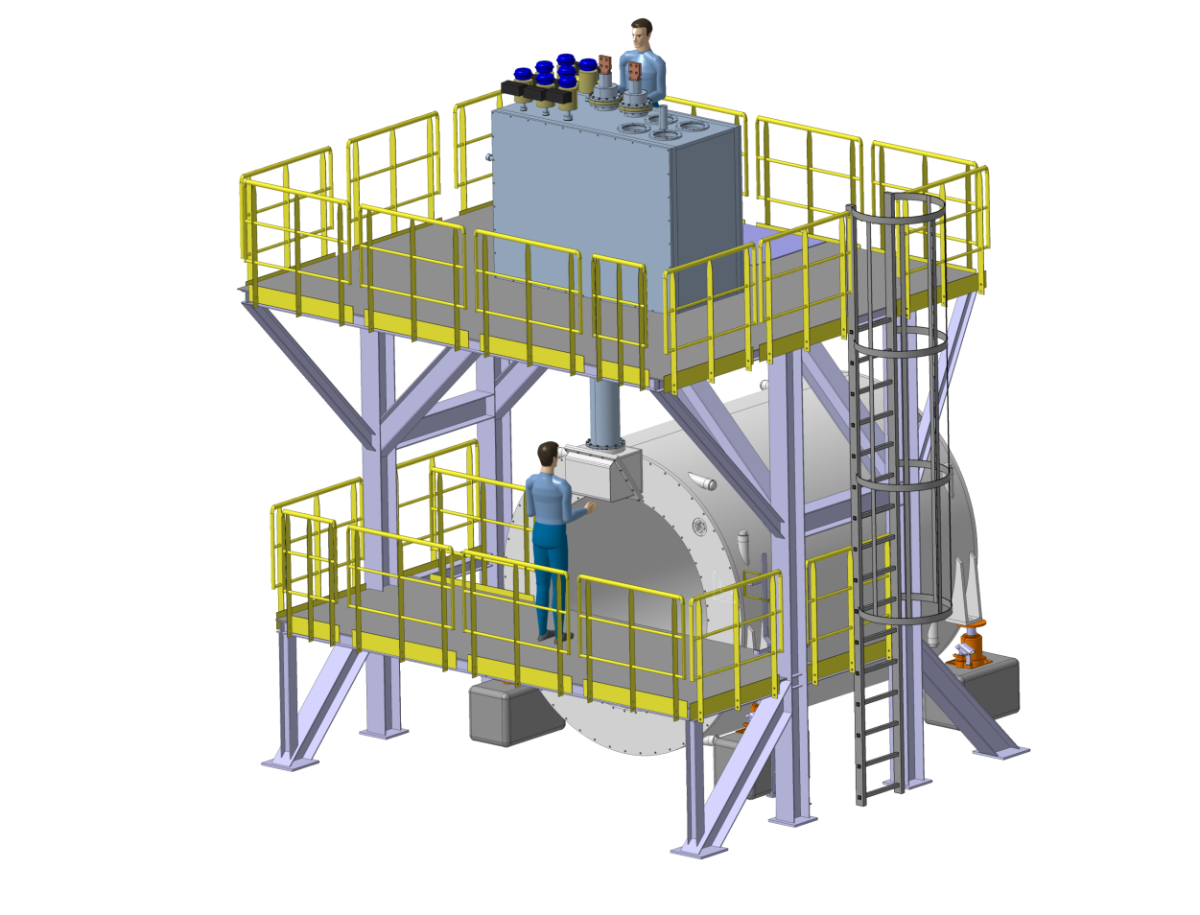
Cold mass (CERN responsibility)

Slide 11
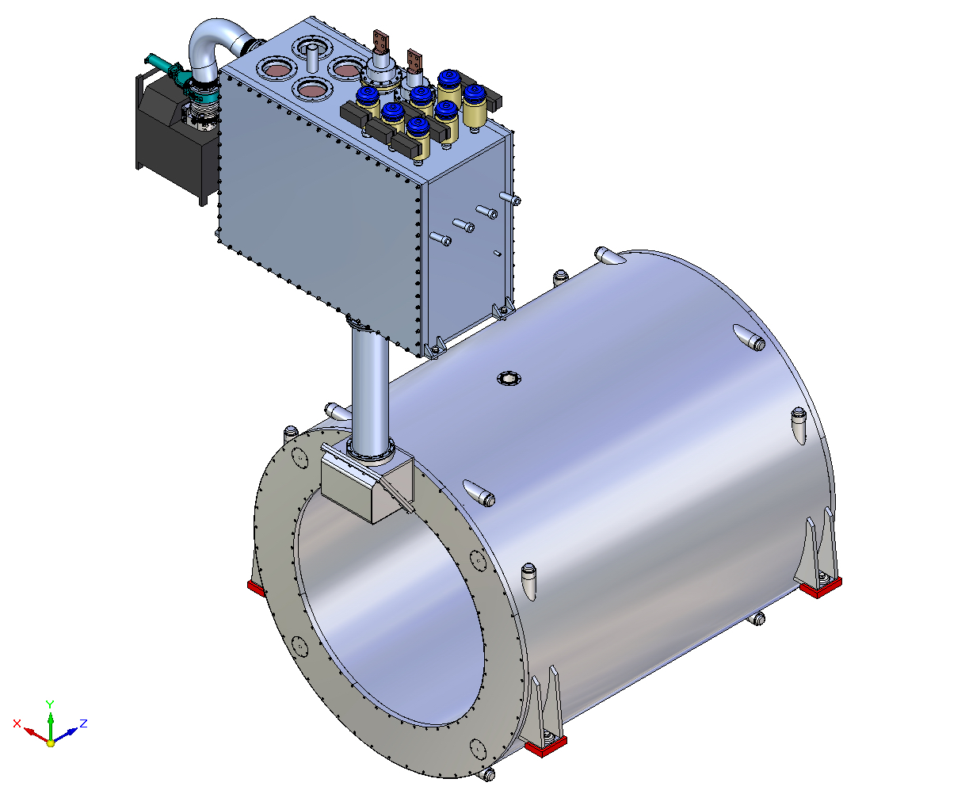
General view of the Cryostat and Control Dewar

Slide 12
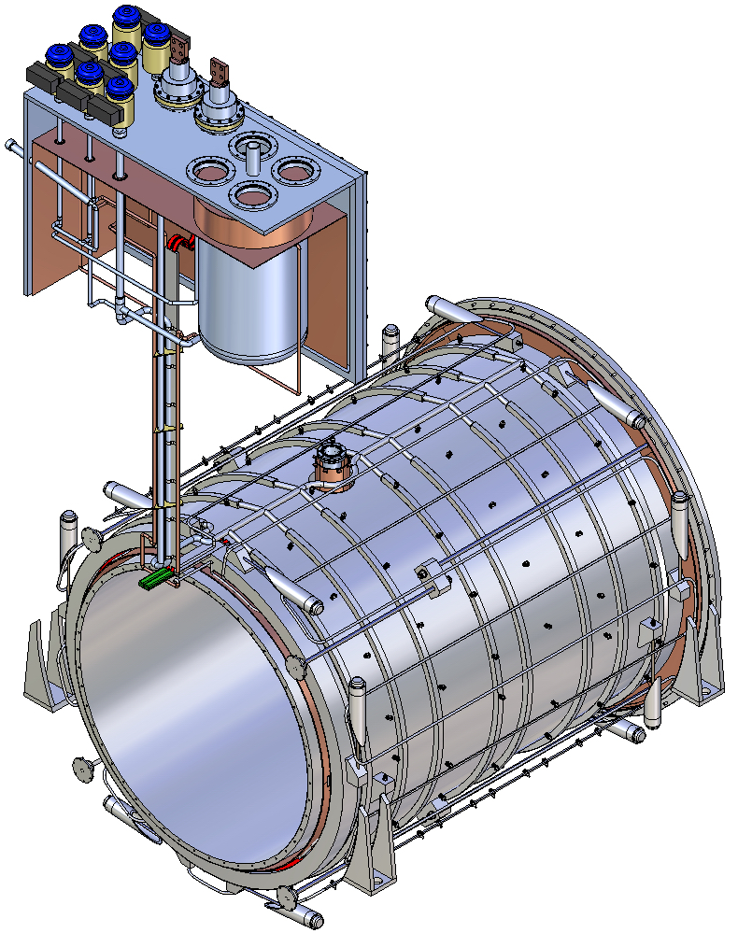
Process Flow Diagram (PFD) of the PANDA cryogenic system

Slide 13
Work performed in the beginning of 2015
  Some important design changes were implemented in accordance with the results of the mechanical analysis of 2014, in particular:
      Rigidities of the suspension units were increased to ensure the requirements for permissible space deviations of the cold mass position under action of the magnetic forces
      Safety factors for the suspension units were increased to take into account possible unequal distribution of loads between the individual suspension ties.
      Safety factors of suspension units were corrected taking into account the technological deviations in the process of manufacturing and installation.
  3D model of the cryostat with the cold mass developed at CERN is placed at EDMS service:
    https://edms.cern.ch/file/1458626/1/Solenoid12d_3D100_Cryostat_Full_Update-1_stp.zip
Stress analysis of the suspension system with improved stiffness was performed

Slide 14
Status of the Cryostat
Preliminary discussions with the supposed manufacturer of the Сryostat and control Dewar (BINP) started;
3D model of the cryostat with the cold mass developed at CERN was transmitted to BINP. Starting from September they are going to begin study of the design

Slide 15
The work that must be performed to complete the project
  Some steps of coordination of the cold mass and cryostat interface;
  Mechanical and thermal calculations to refine the magnet parameters;
  Final correction of the 3D model;
  Development of the assembly drawings of the main units of the cryostat;
  Development of assembly technology of the cryostat and the cold mass with pre-bending of the suspension rods;
  Development of procedure of the cryostat adjustment relative the Iron Yoke;
  Preparation of the Technical description of the cryostat and Control Dewar;
  Some steps of coordination of the magnet and the equipment of the TS detectors;
  Detailed discussions with supposed manufacturers of the Сryostat and the Iron Yoke and possible changes in the design.

Slide 16
THANK YOU
FOR YOUR ATTENTION!

