Slide 1
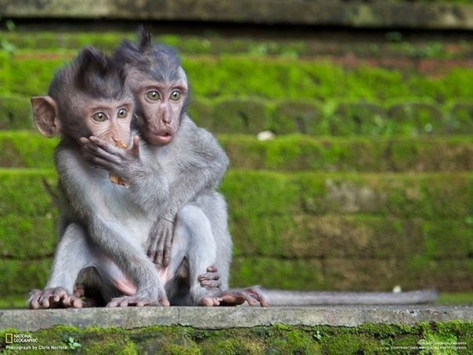
New exotic and conventional charmonium
at Belle
New charmonium below open flavor threshold
Charmonium states above open flavor threshold
Exotic states at the threshold
Exotic states above the threshold
Conclusion
P. Pakhlov (ITEP), for Belle Collaboration
Panda-Russia Workshop, ITEP, May 26, 2015

Slide 2
Many states observed last 12 years
mostly by B-factories
 | M(MeV) | Γ(MeV) | J^{PC} | decay mode | production mode | experiment | status
h_{c} | 3525.41±0.16 | <1 | 1⁺⁻ | η_{c} γ | ψ(2S) → π⁰ h_{c} | CLEO | ***
η_{c} (2S) | 3638.9±1.3 | 10±4 | 0⁻⁺ | KKπ, KKπππ | B→Kη_{c}(2S), γγ→η_{c}(2S) | Belle | ***
ψ₂(1D) | 3823.5±2.8 | <14 | 2⁻⁻ ? | J/ψγ | B→Kψ₂(1D) | Belle | *
Χ_{c2} (2P) | 3927.2±2.6 | 24±6 | 2⁺⁺ | DD | γγ→χ_{c2} | Belle | ***
X(3940) | 3942±9 | 39⁺²⁷₋₁₇ | 0⁻⁺ ? | DD* | ee→J/ψX | Belle | **
X(4160) | 4156⁺²⁹₋₂₅ | 139⁺¹¹⁰₋₃₇ | 0⁻⁺ ? | D*D* | ee→J/ψX | Belle | **
X(3872) | 3871.68±0.17 | <1.2 | 1⁺⁺ | J/ψππ, DD* | B→KX, pp→KX | Belle | ***
X(3915) | 3917.5±2.7 | 27±10 | 0?^{?+} | J/ψω | B→KX, γγ→KX | Belle | ***
Y(4260) | 4263⁺⁸₋₉ | 95±14 | 1⁻⁻ | J/ψππ | ee→γ_{ISR}Y | BaBar | ***
Y(4350) | 4361±13 | 74±18 | 1⁻⁻ | ψ(2S)ππ | ee→γ_{ISR}Y | BaBar | ***
Y(4660) | 4664±12 | 48±15 | 1⁻⁻ | ψ(2S)ππ | ee→γ_{ISR}Y | Belle | ***
Y(4140) | 4146±3 | 18±8 | ?^{?+} | J/ψϕ | B→KY | CDF | **
Z⁺(3900) | 3899.0±5.6 | 46±23 | ? | J/ψπ, DD | ee→Zπ(γ_{ISR}) | BES/Belle | ***
Z⁺(4050) | 4051⁺²⁴₋₂₃ | 82⁺⁵¹₋₂₉ | ? | χ_{c1}π | B→KZ⁺ | Belle | *
Z⁺(4250) | 4248⁺¹⁸⁵₋₄₅ | 177⁺³²⁰₋₇₂ | ? | χ_{c1}π | B→KZ⁺ | Belle | *
Z⁺(4200) | 4443⁺²⁴₋₁₈ | 107⁺¹¹⁰₋₇₀ | 1⁺ | ψ(2S)π, J/ψπ | B→KZ⁺ | LCHb/Belle | **
Z⁺(4430) | 4443⁺²⁴₋₁₈ | 107⁺¹¹⁰₋₇₀ | 1⁺ | ψ(2S)π, J/ψπ | B→KZ⁺ | Belle | ***
Some can be conventional charmonium, but much more are poorly consistent with quark model
Panda meeting, ITEP, 19 May, 2015
P. Pakhlov

Slide 3
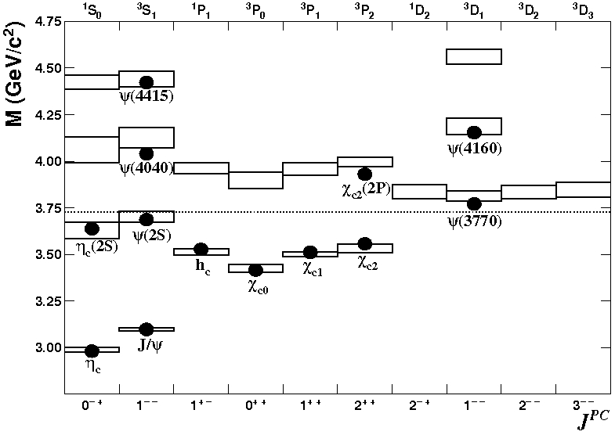
Conventional charmonium
Exotic charmonium-like states
–
Multiquark states
  Molecular state
  two loosely bound charm mesons
    quark/color exchange at short distances
    pion exchange at large distance
  Tetraquark
  tightly bound four-quark state
Charmonium hybrids
  States with excited gluonic degrees of freedom
Hadro-charmonium
  Specific charmonium state “coated” by excited light-hadron matter
Threshold effects
  Virtual states at thresholds
  Charmonium states with masses shifted by nearby D_{(s)}^{(*)}D_{(s)}^{(*)} thresholds
Rescattering
  Two D-mesons, produced closely, exchange quarks
c
c
π
u
–
u
–
c
u
–
u
c
c
–
–
c
c
c
J = S + L
P = (–1)^{L+1}
C = (–1)^{L+S}
n^{(2S+1)}L_{J}
n radial quantum number
S total spin of QQbar
L relative orbital ang. mom.
g
π
c
–
c
π
–
u
c
c
–
u
Panda meeting, ITEP, 19 May, 2015
P. Pakhlov

Slide 4

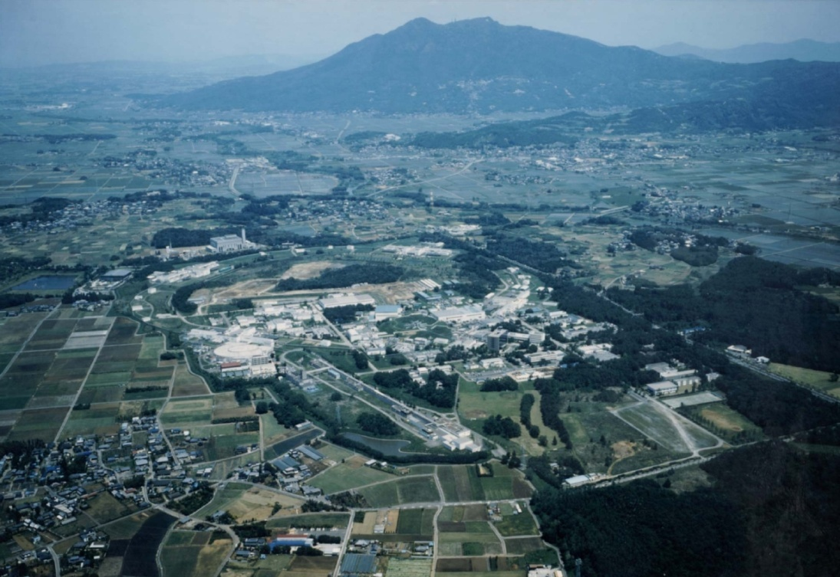
Mt. Tsukuba
Belle experiment at KEKB
KEKB
3.5 × 8 GeV
8 GeV (e–) × 3.5 GeV (e⁺)
designed luminosity: 10.0×10³³cm^{–2}s^{–1}
achieved 21.2×10³³cm^{–2}s^{–1} (>2 times larger!)
Belle
~1 km in diameter
Completed data taking on June, 2010
to start SueprKEKb/Belle II upgrade
Panda meeting, ITEP, 19 May, 2015
P. Pakhlov

Slide 5
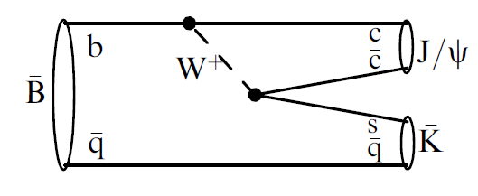
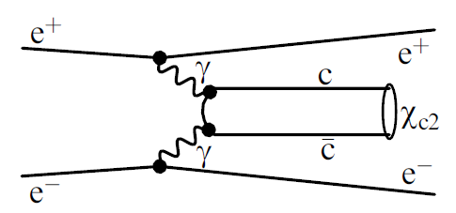
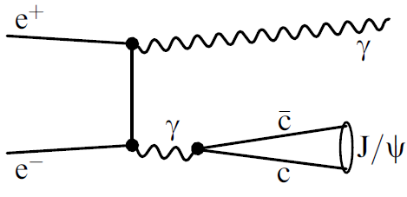
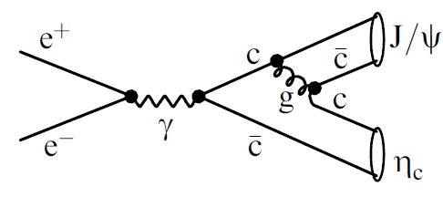
Charmonium (+like) production at B factories
many various mechanisms
B-decays
γγ fusion
Any quantum numbers are possible, can be measure in angular analysis (Dalitz plot)
J^{PC} = 0 ⁺, 2 ⁺
–
–
⁺
⁺
annihilation with initial state radiation
double charmonium production
in association with J/ψ only J^{PC} = 0 ⁺ seen
–
J^{PC} = 1– –
⁺
Panda meeting, ITEP, 19 May, 2015
P. Pakhlov

Slide 6

New conventional charmonium
Panda meeting, ITEP, 19 May, 2015
P. Pakhlov

Slide 7
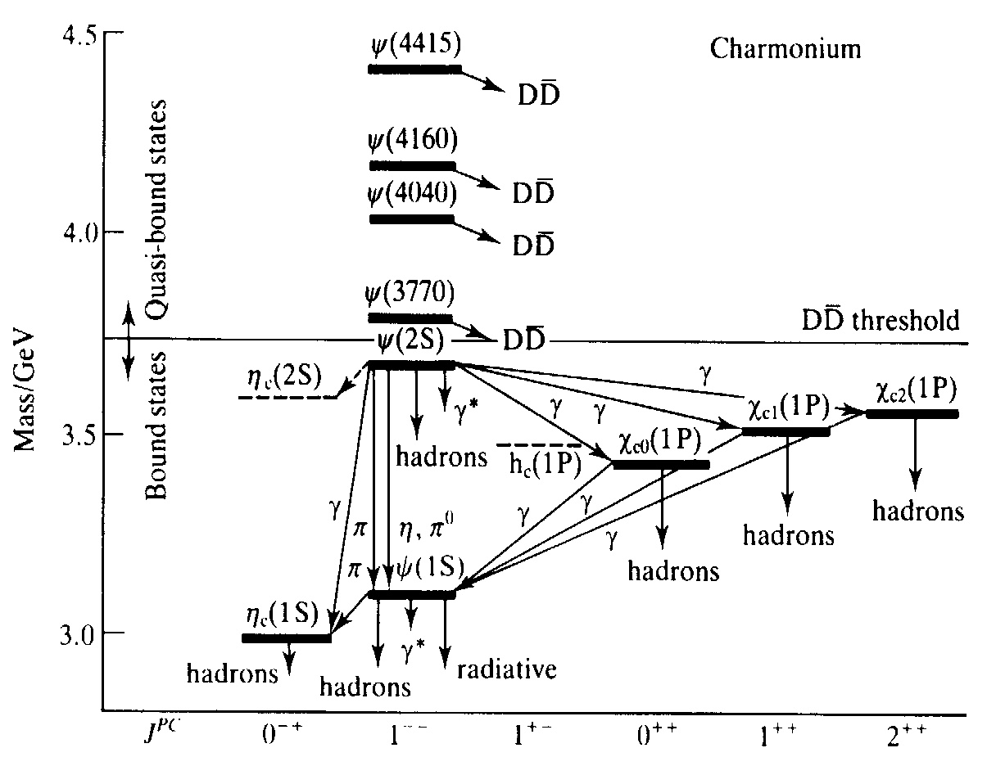
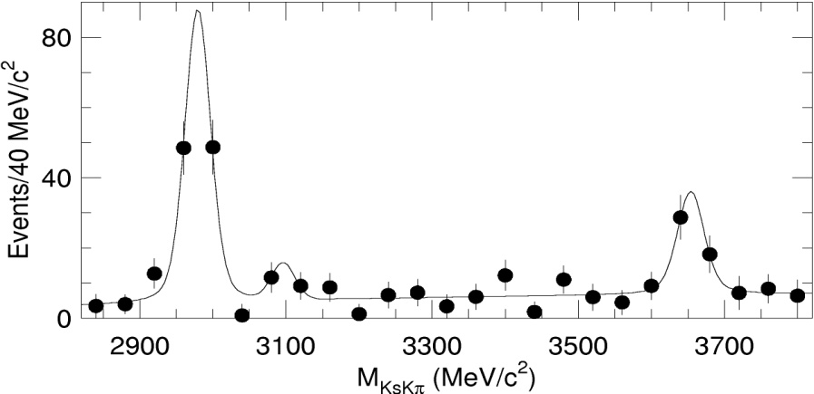

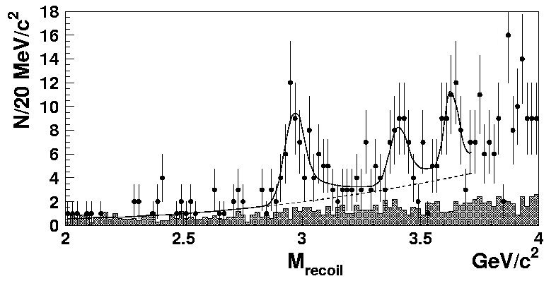
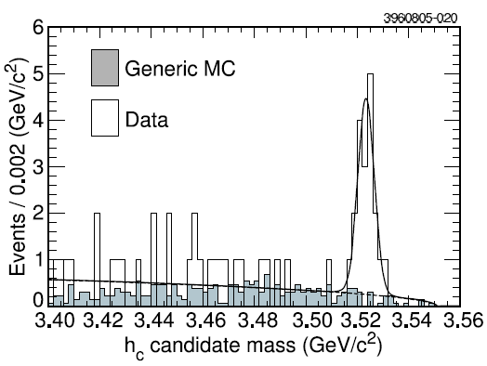
Observation of h_{c} and η_{c}(2S)
PRL 89, 102001 (2002)
  B→ η_{c}(2S) K→(K_{S}Kπ)K
M=(2654±10) MeV
Γ<55MeV
PRL 89, 142001 (2002)
η_{c}(2S)
e⁺e⁻→ J/ψ η_{c}(2S)
M=(2630±12) MeV
PRL 95, 102003 (2005)
ψ(2S) → π⁰h_{c} → π⁰γη_{c}
M=(3524.4±0.6±0.4) MeV
confirmed by CLEO, BaBar & Belle in γγ
For both the properties are in good agreement with the potential model expectations (mass, total width, decays modes, γγ-width)
Charmonium table below DD threshold is complete!
Panda meeting, ITEP, 19 May, 2015
P. Pakhlov

Slide 8
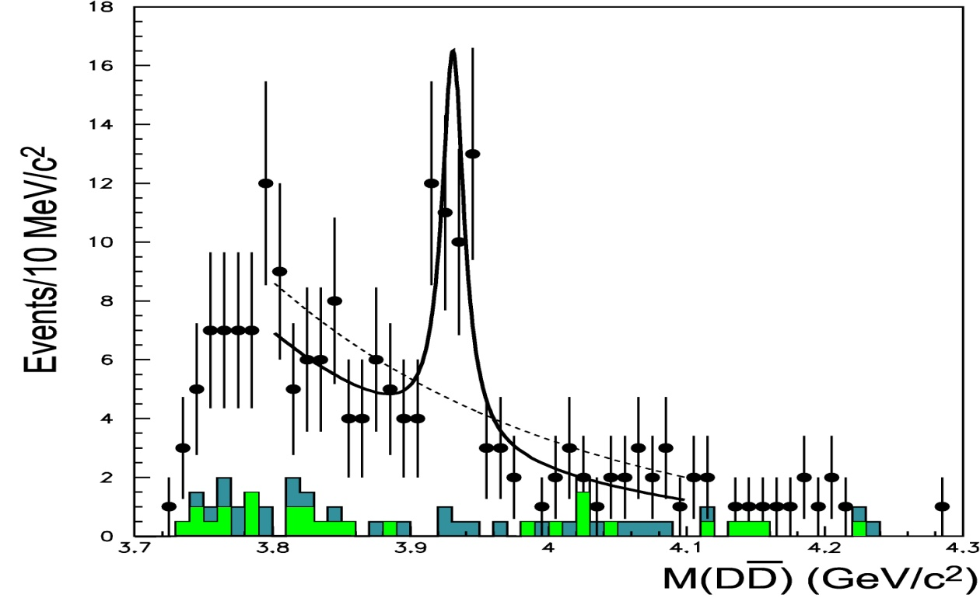
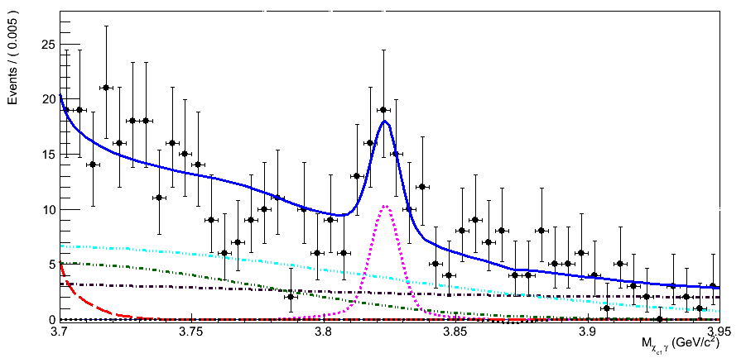
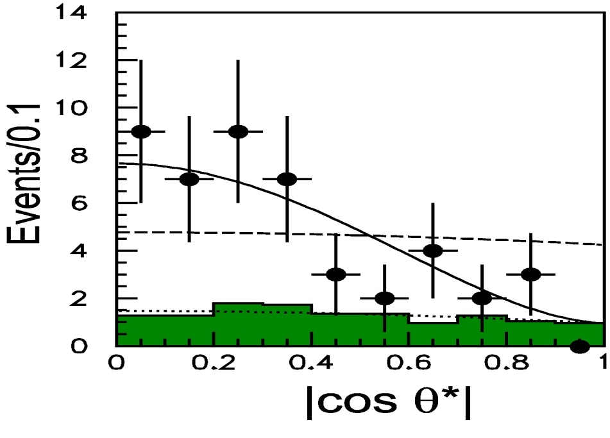
χ_{c2}’ and ψ_{2D}
M=(3931±4±2)MeV Γ=(20±8±3)MeV
B⁺ → ψ_{2D} K⁺ → (χ_{c1} γ) K⁺
γγ→χ _{c2}‘→DD
PRL 96, 082003 (2006)
ψ_{2D}
4.2σ
PRL 111, 032001 (2013)
(2J+1)Γ_{γγ}×Br_{DD}
=(1.13±0.30)keV
Helicity distribution favors spin = 2 while J=0 disfavored
M = 3823.5 ± 2.8 MeV
Γ = 4 ± 6 MeV, <14 MeV @90%CL
Expectations:
decay to DD is forbidden due to unnatural spin-parity → small Γ
decay to χ_{c1}γ should be prominent (E1)
Γ(χ_{c1} γ ) ~ O(10KeV) – typical for charmonium
confirmed by BaBar
γγ width, total width, decay mode in good agreement with expectations, however, the mass is ~100 MeV lighter than expected
Panda meeting, ITEP, 19 May, 2015
P. Pakhlov

Slide 9
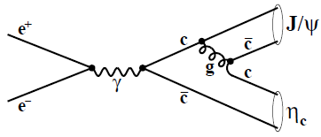
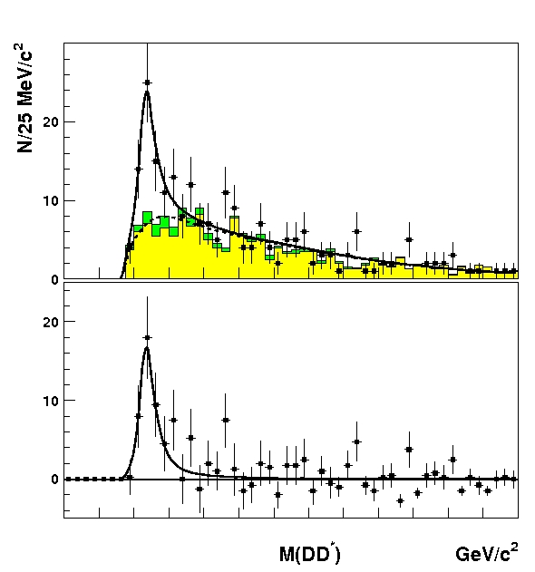
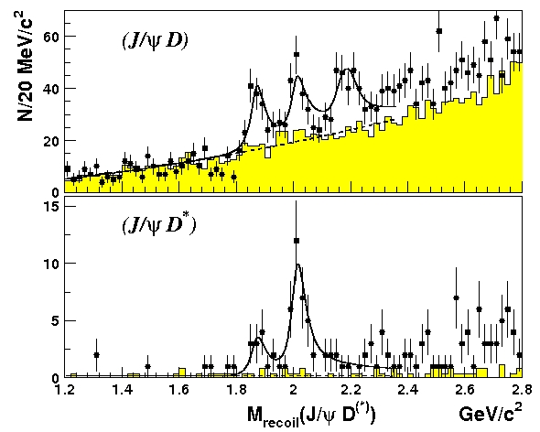
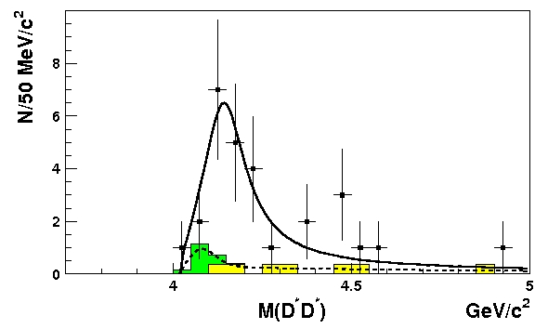
New states in e⁺e⁻ → J/ψ D^{(*)}D^{(*)}
PRL 100, 202001(2008)
M = 3942 ±6 MeV
Γ_{tot} =37 ±12 MeV
+7
-6
+26
- 15
D*
X(3940) → DD*
D
D*π
+25
−20
M= 4156 ±15 MeV
Γ_{tot}= 139 ±21 MeV
+111
−61
D*
X(4160) → D*D*
D
Both observed states decay in open charm final states like “normal” charmonium.
Possible assignments are η_{c}(3S) and η_{c}(4S). But in both cases the masses predicted by the potential models are ~100-250 MeV higher than observed.
Theory probably needs more elaborated model to take into account charmonium coupling to charmed meson pairs.
Panda meeting, ITEP, 19 May, 2015
P. Pakhlov

Slide 10
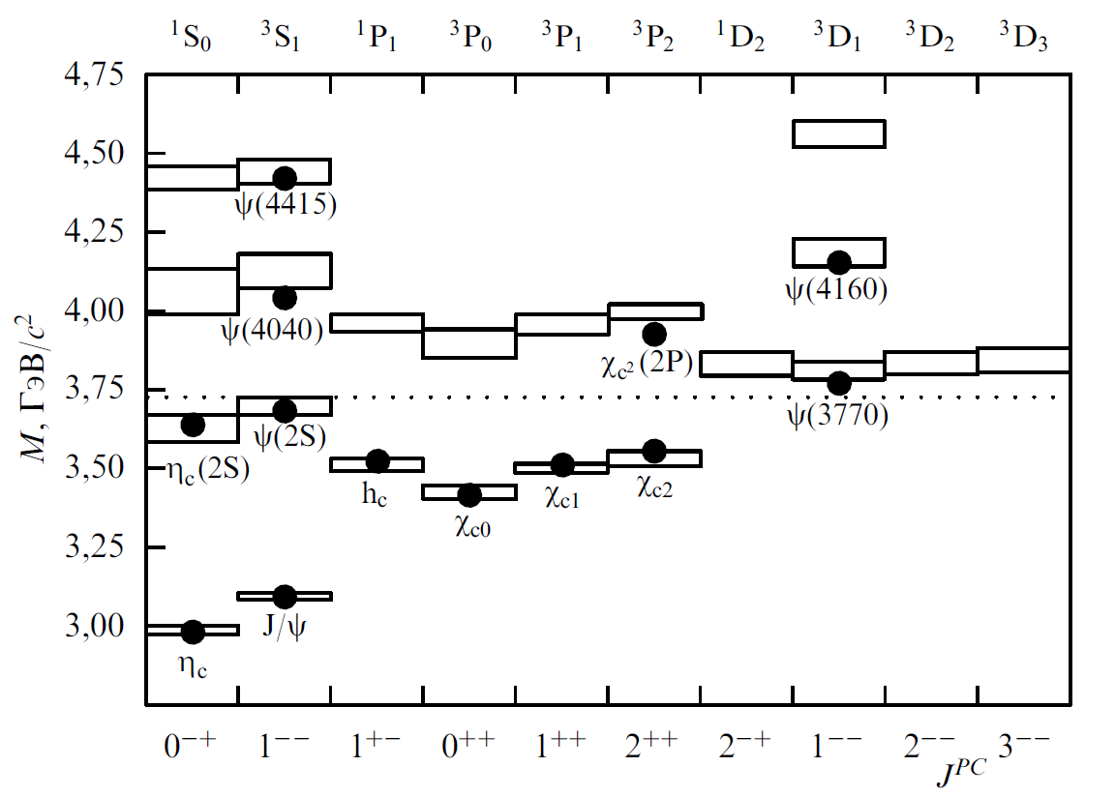
6 observed states can fit* into charmonium table
X(4160)
X(3823)
X(3940)
* However, not easily: potential models need to be elaborated to describe new masses
What about others?
Panda meeting, ITEP, 19 May, 2015
P. Pakhlov

Slide 11

E x o t i c s t a t e s
Panda meeting, ITEP, 19 May, 2015
P. Pakhlov

Slide 12
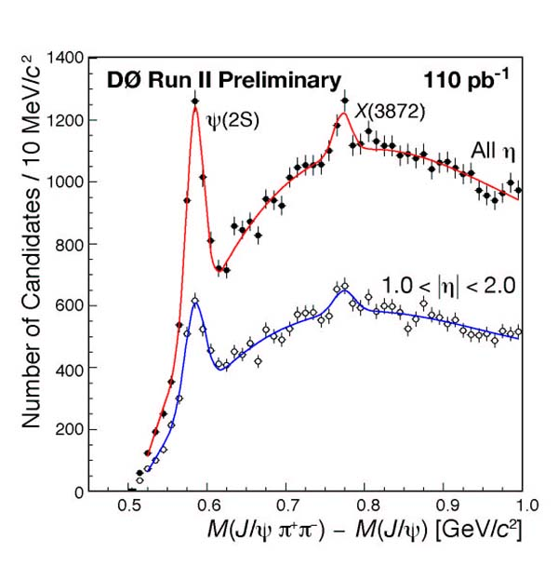

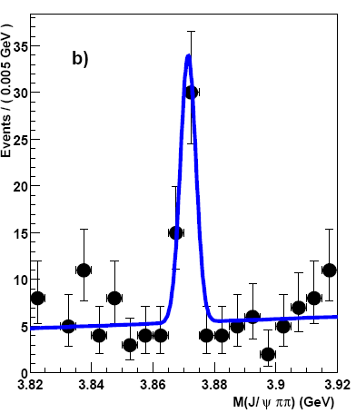
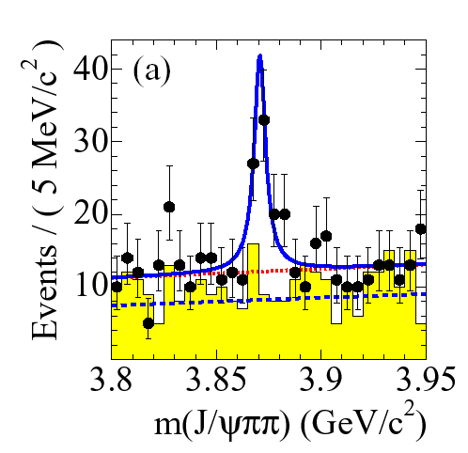

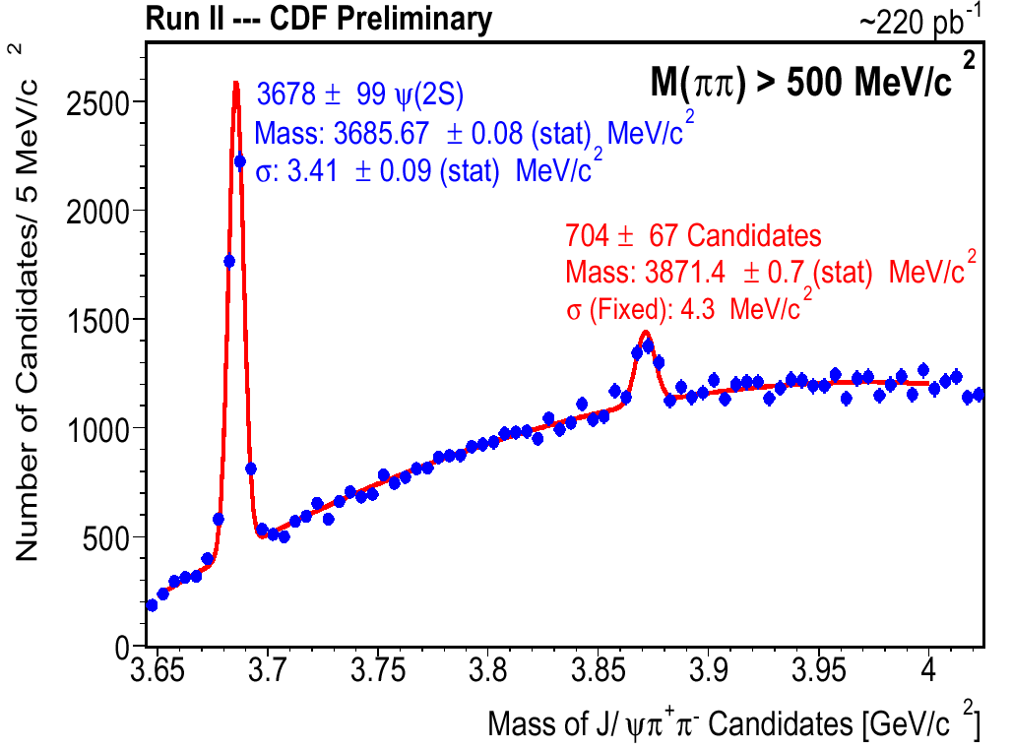

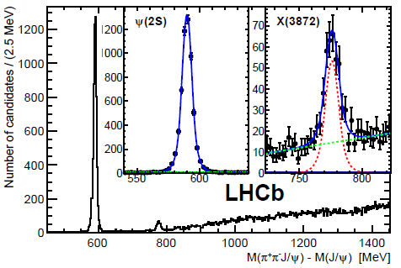

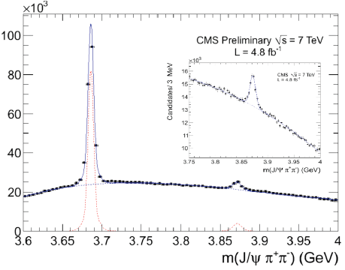

Belle’s top 1000+: X(3872)
PRL91, 262001 (2003)
first observed by Belle in B→K J/ψπ⁺π–
first
PRD73, 011101 (2006)
10σ
PRL93, 162002 (2004)
M(J/ψππ)
EPJ C72 1972 (2012)
PRL93, 072001 (2004)
Hadronic collisions:
produced mostly promptly; only
0.263±0.023±0.016 from B-decays (CMS)
JHEP 04, 154 (2013)
M_{X} close to D⁰D^{*0} threshold M = 3871.68 ± 0.17 MeV
(not clear below or above: Δm = – 0.16 ± 0.32 MeV)
surprisingly narrow: Γ_{tot}< 1.2 MeV at 90% CL
Panda meeting, ITEP, 19 May, 2015
P. Pakhlov

Slide 13
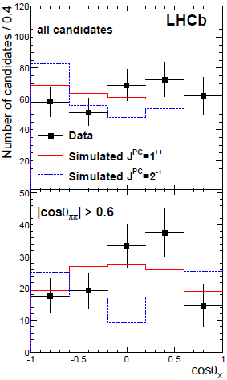
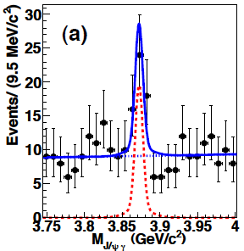
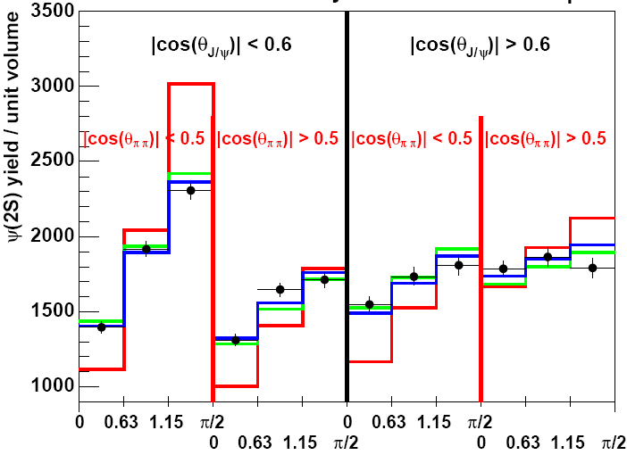
X(3872) quantum numbers:
10 years of hard work
LHCb 2013: 5D angular analysis
PRL 110 (2013)
X(3872)→J/ψγ: C-even
Angular analysis:
Belle 2006: J^{PC} = 1⁺⁺ or ≥2
CDF 2028: J^{PC} = 1⁺⁺ or 2^{–+}
Belle 2011: J^{PC} = 1⁺⁺ or 2^{–+}
J^{PC} = 2^{–+} is excluded (8σ)
J^{PC} = 1⁺⁺
finally established
Panda meeting, ITEP, 19 May, 2015
P. Pakhlov

Slide 14
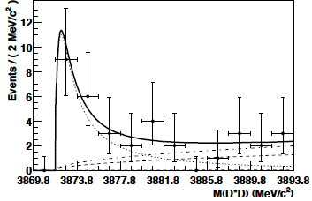
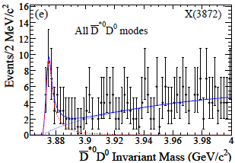
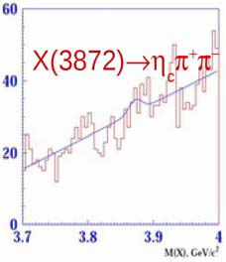
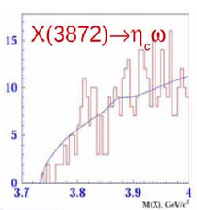
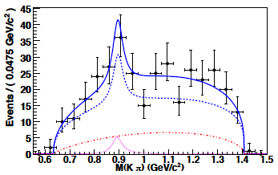
X(3872): other decay modes
C = −1; ππ = ρ. Isospin violation!
X(3872) → J/ψω is seen: confirms isospin violation
B(X(3872) → J/ψω)/B(X(3872) → J/ψππ)=0.8±0.3
Radiative decays: Belle&Babar good agreement for X →J/ψγ; not consistent for X →ψ(2S)γ. LHCb confirms BaBar’s not vanishing X →ψ(2S)γ.
X(3872) → DD* - dominant mode
PRD77,011102(2008)
X(3872) → η_{c} ππ/ω no signal found
B→X(3872)Kπ non-resonant Kπ dominates! (cf. Br(B → χ_{c1} K*) ~ 40%Br(B → χ_{c1} Kπ)
B→K + inclusive: Br(X(3872) → J/ψρ⁰) > 1.0% (90% C.L.)
Panda meeting, ITEP, 19 May, 2015
P. Pakhlov

Slide 15
X(3872): charmonium vs exotics
Conventional charmonium χ_{c1}′ (J^{PC}=1⁺⁺)
expected Γ(χ_{c1}′→J/ψγ)/Γ(χ_{c1}′→J/ψππ ) ~ 30, measured ratio <0.2
~ 100MeV heavier then expected
60 MeV splitting with χ_{c2}′ cf. 1P: 40MeV
D⁰D^{*0} molecular state: (the most popular option)
M_{X} ~ M_{D0} + M_{D*0} is not accidental
J^{PC}=1⁺⁺ (D⁰D^{*0} in S-wave)
DD* decay
Small rate for decay into J/ψγ is expected
Problems:
  too large X(3872) → ψ(2S)γ
  too small binding energy: D⁰ and D^{*0} too far in space to be produced in high energy pp collisions
Possible solution: Mixture of DD* molecule and χ_{c1}′ charmonium state?
Tetraquark (cq)(cq):
+ 3 states (cu)(cu), (cd)(cu), (cd)(cd) with a few MeV mass splitting
no evidence of neither neutral doublet nor charged partner
PRD 71, 031501 (2005)
Spires’ vote:
B⁰
B⁻
X(3872)–
X(3872)–
M(J/ψπ–π⁰)
M(J/ψπ–π⁰)
X(3872) is a well studied state, however, its nature is determined in a democratic way: by vote
Panda meeting, ITEP, 19 May, 2015
P. Pakhlov

Slide 16
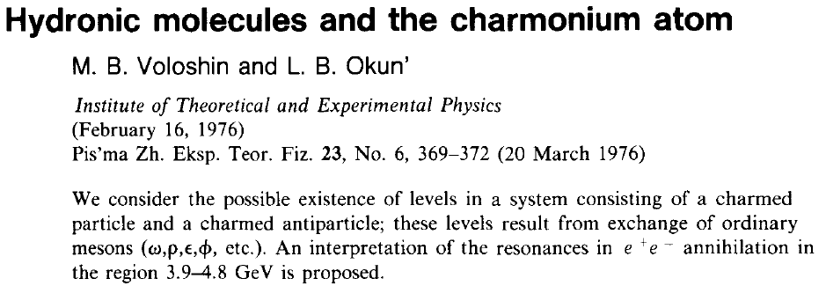
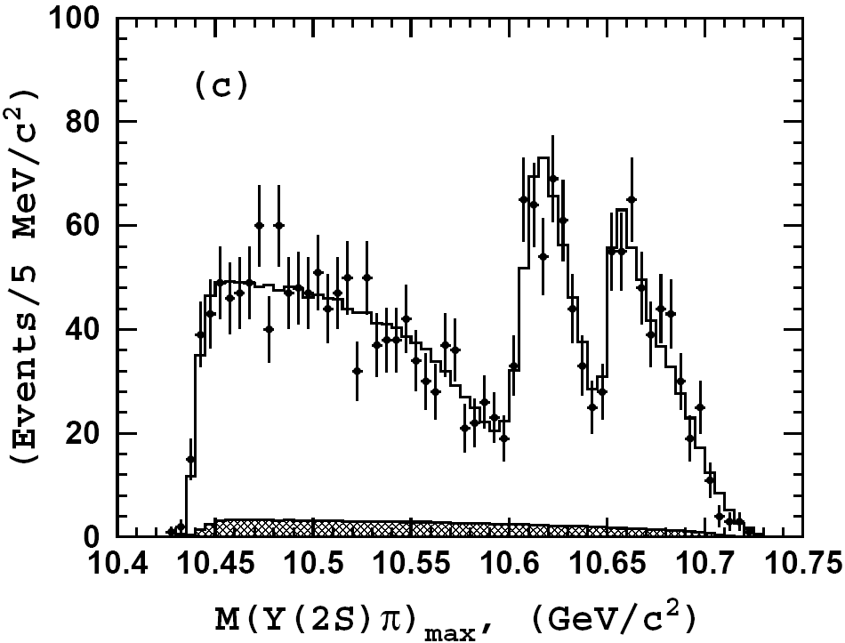
If X(3872) is charm mesons molecule, are there a B-mesons molecules as well?
they do exist!
they are observed by Belle
Although existence of meson molecule with heavy quarks is not possible to prove theoretically, for the case m_{Q}→∞ molecular states must exist!
If X(3872) is a molecular state of relatively light D-mesons, B-mesons molecules should also reveal themselves.
Note: M(D⁺) and M(D⁰) differ by 4.8 MeV – much greater than expected binding energy ~ 1MeV → only lightest combinations D⁰D⁰, D⁰D*⁰ can from molecular states – large isospin violation!
B-mesons: ΔM(B⁺- B⁰) = 0.32 ± 0.06 MeV → all combinations (including charged) possible
ϒ(2S)π⁺
Panda meeting, ITEP, 19 May, 2015
P. Pakhlov

Slide 17

Y(3940)
PRL 94, 182002 (2005)
B→YK →J/ψωK
8.1σ
 | Mass, MeV | Width, MeV
B → YK B → YK | 3943 ± 11 ± 13 3914.6 ± 2 ± 1.9 | 87 ± 22 ± 26 34⁺¹²_{–8} ±6
Mass above DD and DD* thresholds but seen only in J/ψω mode
PRL 101, 082001 (2008)
B± →YK±
N_{B0}/N_{B+}=0.27
~3σ below isospin expectations
B⁰→YK⁰_{S}
+0.28 +0.04
−0.23 −0.01
J/ψω partial width (assuming Br(B→YK)~10⁻³)
Γ_{ωJ/ψ} (X) ~ 1 MeV is too large for conventional charmonium
Panda meeting, ITEP, 19 May, 2015
P. Pakhlov

Slide 18
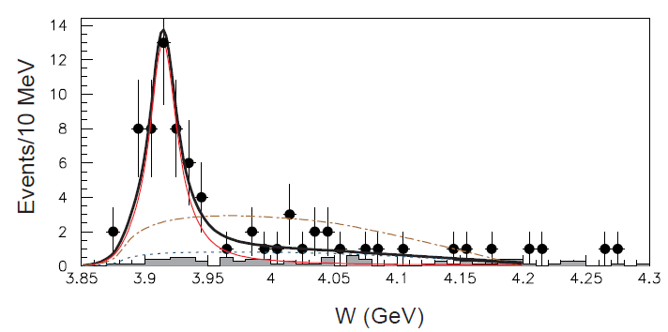
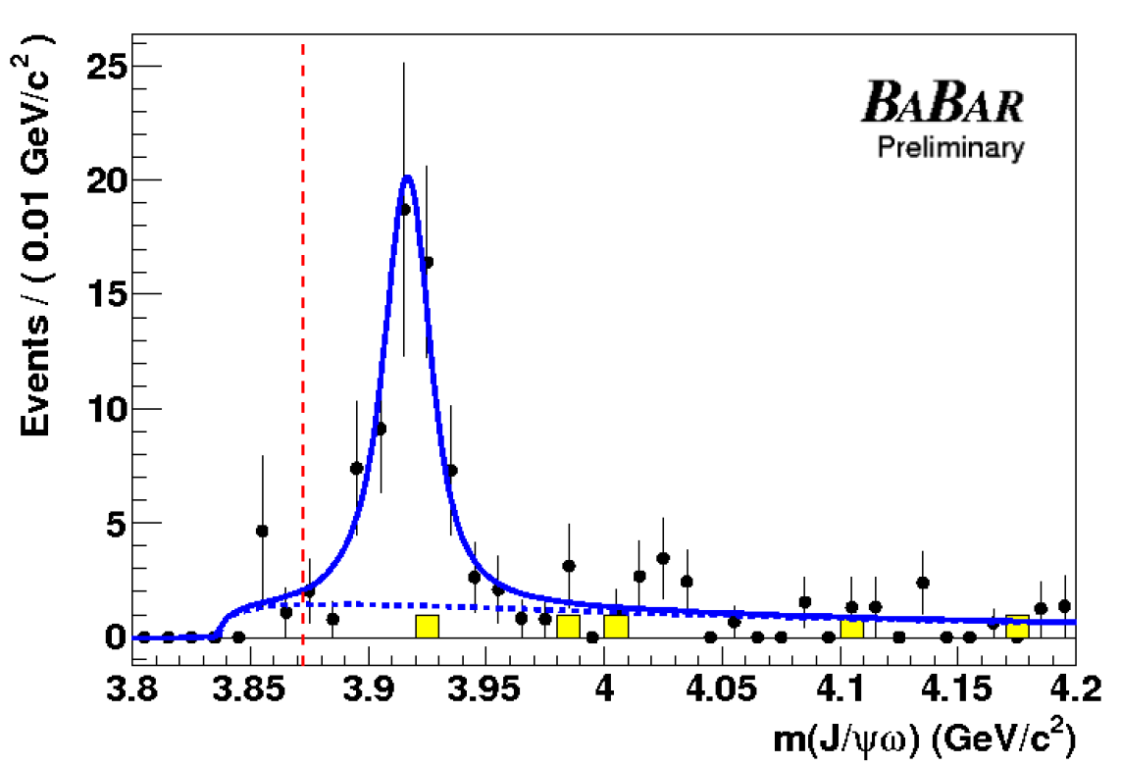
γγ → Y(3940) → ωJ/ψ
PRL 104, 092001 (2010)
χ_{c1}(2P) 1⁺⁺
BW + background
e⁺
e⁺
γ
J/ψ
fit without resonance
γ
X
ω
e–
e–
J = 0, 2 only
non-ωJ/ψ background
M(ωJ/ψ)
 | Mass, MeV | Width, MeV
B → YK(Belle) B → YK(BaBar) | 3943 ± 11 ± 13 3914.6 ± 2 ± 1.9 | 87 ± 22 ± 26 34 ⁺¹²_{–8} ±6
γγ → Y(Belle) γγ → Y(BaBar) | 3915 ± 3 ± 2 3919.6 ± 2.2 ± 1.6 | 17 ± 10 ± 3 13 ± 6 ± 3
 | Γ_{γγ} Br (J=0) | Γ_{γγ} Br (J=2)
Belle BaBar | 61 ± 17 ± 8 52 ± 10 ± 3 | 18 ± 5 ± 2 10.5 ± 1.9 ± 0.6
Γ_{γγ}(X) × Γ_{ωJ/ψ} (X) ~ 10³keV
for Γ_{γγ}(X) ~ 1keV (typical for charmonium)
Γ_{ωJ/ψ} (X) ~ 1 MeV is too large
BaBar confirms Belle
Panda meeting, ITEP, 19 May, 2015
P. Pakhlov

Slide 19
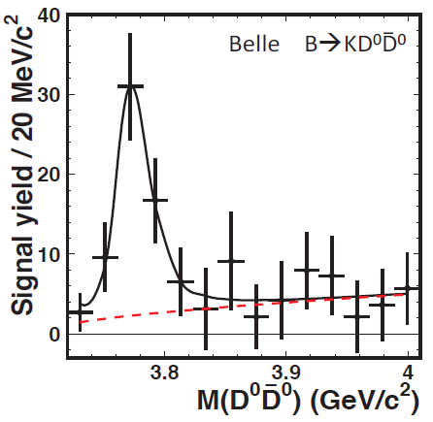
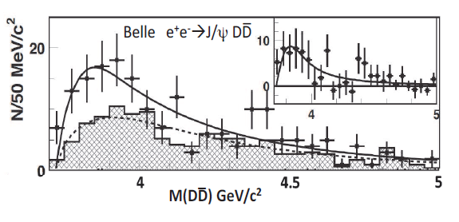
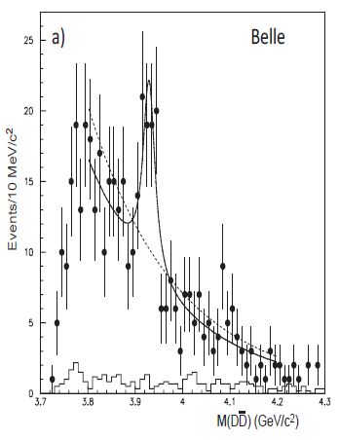
Is Y(3940) = χ_{c0}’?
PDG ascribe Y(3940) to vacant χ_{c0}’ state, based on BaBar’s measurement of J=0 in γγ → Y(3940) → ωJ/ψ
strongly criticized by theoreticians
χ_{c0}’ production in two body B decays suppressed
χ_{c0}’ → DD should be dominant, but not seen in B decays and γγ
there is a better candidate for χ_{c0}’!
γγ→DD
χ_{c0}’?
Theory does not like conventional interpretation, but suggests no good explanation for Y(3940)…
Panda meeting, ITEP, 19 May, 2015
P. Pakhlov

Slide 20
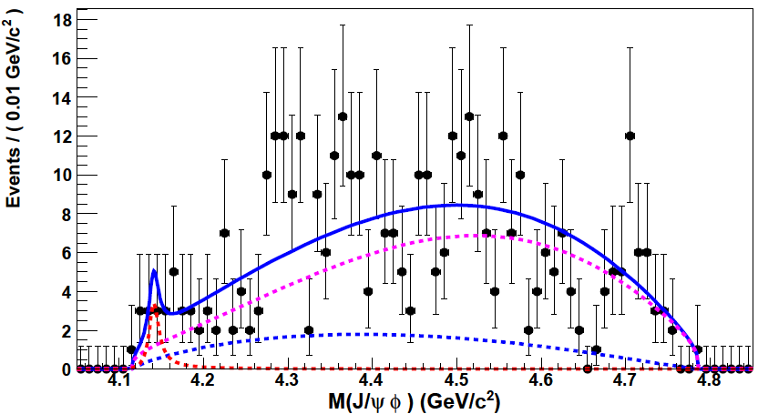
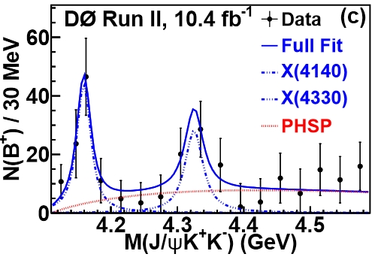
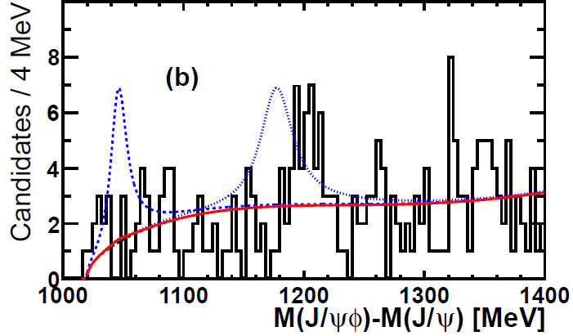
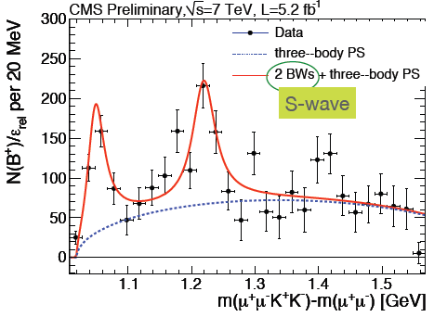
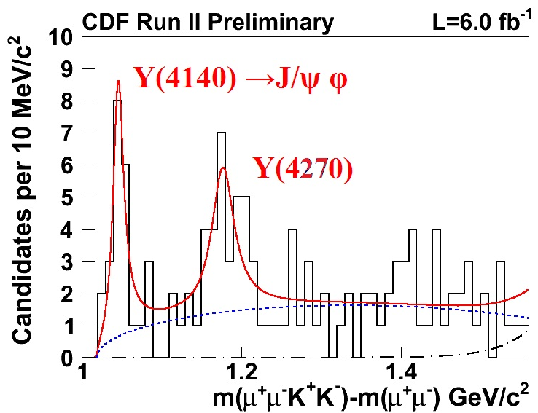
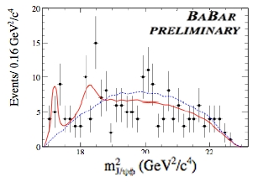
Y(4140) still alive?
PRL102, 242002(2009)
B→YK →J/ψϕK
3.8σ
1.9σ
14 ± 5 ev
PRD89, 012004 (2014)
PRD85, 091103 (2012)
M(J/ψϕ) – M(J/ψ)
PLB 734, 261 (2014)
Panda meeting, ITEP, 19 May, 2015
P. Pakhlov

Slide 21

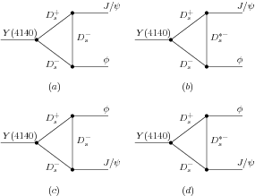
it is alive and breeds
(+Y(4270)+Y(4500)+…)!
What’s this?
Tetraquark?
D_{s}^{(*)} D_{s}^{(*)} molecule?
Belle and Babar have very low efficiency of reconstruction at threshold (soft kaons);
only LHCb’s result really casts into doubts the existence of Y(4140).
But! D0, new CDF and CMS have obviously significant peaks at 4140 MeV.
Moreover, another structure at 4270 MeV is significant in each of them.
Even more: there is a hint on the third structure at 4500 MeV – not significant at any particular experiment, but obviously very significant if sum all (including Belle/BeBar/LHCb).
How it’s produced?
How it decays?
–
c
s
–
s
c
Panda meeting, ITEP, 19 May, 2015
P. Pakhlov

Slide 22
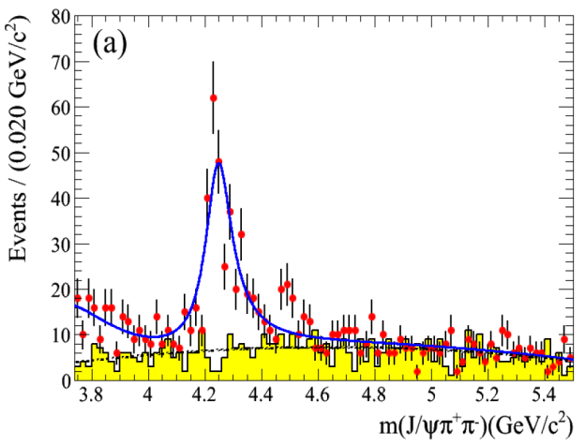

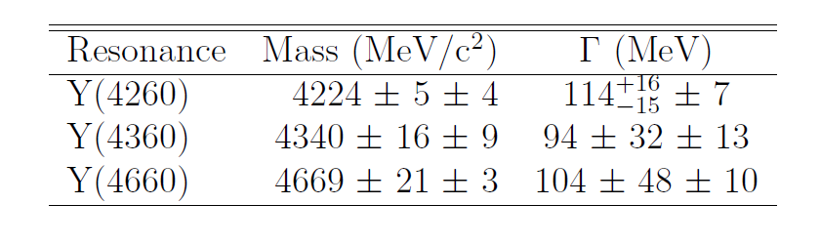
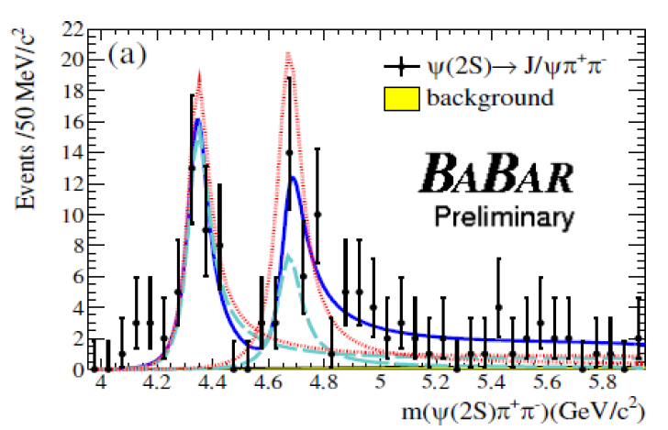

e⁺e–→ J/ψπ⁺π– γ_{ISR} Y(4260)
arXiv:1204.2158
PRL99, 182004 (2007)
PRL99, 182004 (2007)
211 fb⁻¹
Y(4260)
Y(4260)
Y(4260)
Y(4260)
Y(4008)?
Y(4008)
Y(4008)?
Y(4008)
550fb⁻¹
550fb⁻¹
464 fb⁻¹
M(J/ψπ⁺π–), GeV
M(J/ψπ⁺π–), GeV
M(J/ψπ⁺π–), GeV
M(J/ψπ⁺π–), GeV
NO vacant 1– – charmonium places for Y
NO open charm modes
Anomalous partial width to charmonium + light hadrons
  Γ(Y → ψ ππ) > 1 MeV
PRL 99, 142002(2007)
e⁺e–→ψ(2S)π⁺π– γ_{ISR}
Y(4360), Y(4660) ...
Y(4360)
PRL 99, 142002(2007)
PRL98, 212001(2007)
Y(4360)
Y(4660)
Y(4360)
Y(4360)
Y(4660)
Y(4660)?
Y(4660)
530 fb⁻¹
670 fb⁻¹
298 fb⁻¹
670 fb⁻¹
M(ψ(2S)π⁺π–), GeV
M(ψ(2S)π⁺π–), GeV
M(ψ(2S)π⁺π–), GeV
M(ψ(2S)π⁺π–), GeV
Panda meeting, ITEP, 19 May, 2015
P. Pakhlov

Slide 23



Exotics structures in Y(4260) decays
PRL 110, 252001 (2013)
PRL 110, 252002 (2013)
J/ψπ – mass from Y(4260):
peaking at DD* threshold
arXiv:1410.7641
ψ(2S)π – mass from Y(4360) subsample: 3.2σ significance
Panda meeting, ITEP, 19 May, 2015
P. Pakhlov

Slide 24


Observation of e⁺e⁻→J/ψη γ_{ISR}
arXiv:1210.7550
Observe peaks of ψ(4040) and ψ(4160)
No sign of any Y state
Partial width in J/ψη is ~ 1MeV
ψ(4040)
ψ(4160)
6.0σ
Not only exotic, but those states, that was considered as conventional states, have too large partial width to charmonium + light hadron(s)
6.5σ
980 fb⁻¹
Do we understand conventional charmonium above DD threshold, in particular ψ-states?
In fact, we even have not measured their parameters reliably…
Panda meeting, ITEP, 19 May, 2015
P. Pakhlov

Slide 25

e⁺e–→hadrons
D*D*
Y(4008)
Y(4260)
ψ(4040)
ψ(4160)
PRL98, 092001(2007)
Y(4360)
DD*
PRD77,011103(2008)
DD
?
PRL100,062001(2008)
ψ(4415)
DDπ
DD*π
PRD 80, 091101(2009)
ψ(4040) & ψ(4160) are seen in ee→D*D*
Y(4260) is seen as a dip
ee→DD – peak at 3.9 GeV
ψ(4415) is seen in ee→DDπ
PRL101,172001(2008)
Y(4660)
Λ_{c}⁺Λ_{c}–
Panda meeting, ITEP, 19 May, 2015
P. Pakhlov
25/37

Slide 26












DD
DD*
D*D*
DDπ
Sum all measured
DD*π
Λ⁺_{c} Λ⁻_{c}
Panda meeting, ITEP, 19 May, 2015
P. Pakhlov

Slide 27

e⁺e–→Λ_{c}⁺Λ_{c}– γ_{ISR} &X(4630)
Threshold effect?
similar to those seen in B→pΛ_{с}π, J/ψ→γpp
PRL 101,172001(2008)
e⁺e–→Λ_{c}⁺Λ_{c}– γ_{ISR}
different from the structure seen in ee→ΛΛ, ee→pp
X(4630) ≡ Y(4660)? J^{PC}=1⁻ ⁻
Panda meeting, ITEP, 19 May, 2015
P. Pakhlov

Slide 28

Z(4430)⁺ first charged
charmoniumlike state
???
Cannot be conventional charmonium or hybrid
M²(ψ(2S)π), (GeV² )
B → KZ, Z(4430)⁺ → π⁺ψ(2S)
K=K–, K⁰_{s} ; ψ(2S) →ℓ⁺ℓ–, π⁺π–J/ψ
Fit: S-wave BW + phase space like function
M = (4433 ± 4 ± 2) MeV
Γ = (45⁺¹⁸_{–13}⁺³⁰_{–13}) MeV
K*(1430)
after K* veto
K*(890)
M²(Kπ), (GeV² )
PRL 100, 142001 (2008)
Br(B→KZ) × Br(Z→ψ(2S)π) = (4.1 ± 1.0 ± 1.3)× 10^{–5}
Shows up in all data subsamples
6.5 σ
Could the Z(4430) be due to a reflection from the Kπ channel?
  S- P- & D-waves cannot make a peak (+ nothing else)
M(π⁺ψ(2S))
Panda meeting, ITEP, 19 May, 2015
P. Pakhlov

Slide 29
BaBar search
for the Z(4430)–
B^{–0} → J/ψπ–K⁰⁺ ; B^{–0} → ψ(2S)π–K⁰⁺
M²(K⁰π–)
M²(ψ(2S)π), (GeV² )
Detailed study of K π– reflections into the J/ψ π– and ψ(2S) π– masses (S, P, D waves) to describe background for both J/ψ and ψ(2S) modes
S-wave
P-wave
D-wave
M²(K⁺π–)
PRD79:112001 (2009)
Fit to J/ψπ– and ψ(2S) π– distributions: background + BW (free mass & width). Observe ~2σ fluctuations below/above background in J/ψ and ψ(2S) modes
At M = 4430 MeV/c² & Γ = 45 MeV
Br(B⁰→Z–K⁺, Z–→ψ(2S)π–) < 3.1 × 10⁻⁵ @ 95% CL
4430
“For the fit … equivalent to the Belle analysis…we obtain mass & width values that are consistent with theirs,… but only ~1.9σ from zero; fixing mass and width increases this to only ~3.1σ…”
Panda meeting, ITEP, 19 May, 2015
P. Pakhlov

Slide 30


Belle performed 4D-fit, that confirms Z and measured quantum numbers: J^{P}=1⁺,
however for the main question
“Does Z exist?”
548 fb⁻¹
Need referee (LHCb) to resolve
+
M(ψ(2S)π⁺), GeV
Belle and BaBar data look very similar; conclusions are different:
Belle: observation of Z resonance
BaBar: after taking into account many Kπ waves the peak is not significant
And LHCb has resolved the bet in favor of Belle
Panda meeting, ITEP, 19 May, 2015
P. Pakhlov

Slide 31



Z(4430) at LHCb
PRL 112, 222002(2014)
4D-fit: Dalitz+angular variables
Significance is >14σ
phase motion consistent with resonance (Breit-Wigner)
parameters (including quantum numbers) are consistent with the Belle’s result
+ another peak at 4200MeV with significance ~5σ
Panda meeting, ITEP, 19 May, 2015
P. Pakhlov

Slide 32

Z⁺ as rescattering
D
π
Consider decay B → D_{sJ} D^{(*)}
D_{sJ} decays to D^{(*)}K at time scale << D* lifetime
velocity of c-quark in D^{(*)} and ψ-mesons is ~ (0.2-0.5) c; comparable with D-meson velocities in DD* rest frame at mass ~ 4.4GeV (0.5 c)
Overlapping of wave functions of (DD*) and (ψ'π) should not be negligible, although it is color suppressed.
B
ψ’
D*
K
Pakhlov, PLB702, 139(2011)
Br(B → DD*K) ~ 1%
Br(B → ZK) ~ 0.001%
DD* → ψ(2S) π allowed with both sides of the reaction in S-wave
=> ψ(2S) π system has J^{P}=1⁺; B → 1⁺ 0–(K) the final state with positive parity, therefore only B → D^{(*)}D_{sJ} (→ DD* K) decays with positive parity can contribute!
The decay B → DD_{s}(2S) is expected to be large ~0.5% and matches parity constrain
D_{s}(2S) – is radial excitation of ground state D_{s};
predicted M~ 2.6-2.63 GeV (based on observed D_{s}*(2S) M=2715±11±14 MeV)
expected decay mode D*K
Another candidate is B → D*D_{s}*(2S)
Panda meeting, ITEP, 19 May, 2015
P. Pakhlov

Slide 33



Z⁺ as rescattering
Predicted in 2011:
quantum numbers; another peaking structure at M~4200 MeV, excess at the endpoint
Naïve sum of two parity allowed contributions describes LHCb data not so bad!
B → DD_{s}(2S) → DD* K → ZK
arXiv:1408.5295
phase motion comes from D_{s}(2S) BW amplitude
can predict D_{s}(2S) (not measured so far) parameters
Panda meeting, ITEP, 19 May, 2015
P. Pakhlov

Slide 34



Z(4200) at Belle
4D-fit: Dalitz+angular variables
B → K–π⁺ J/ψ(→ℓ⁺ℓ–ψ)
PRD 90, 112009 (2014)
Model: sum of all K(*(*)) + Z
New Z_{c}⁺ is found (J^{P}=1⁺), 6.2 σ with systematics
M = 4196 MeV; Γ = 370 MeV
Exclusion levels (other J^{P}=0‒, 1‒, 2‒, 2⁺): 6.1σ, 7.4σ, 4.4σ, 7.0σ.
Z_{c}⁺(4430) is significant (though via negative interference): 4.0 σ evidence for new decay modes → J/ψ π
No signal of Z_{c}⁺(3900)
+31
‒29
+17
‒13
+70
‒70
+70
‒132
Panda meeting, ITEP, 19 May, 2015
P. Pakhlov

Slide 35
A lot of new states observed last 12 years. Main suppliers of new discoveries in this field are B-factories
 | M(MeV) | Γ(MeV) | J^{PC} | decay mode | production mode | experiment | status
h_{c} | 3525.41±0.16 | <1 | 1⁺⁻ | η_{c} γ | ψ(2S) → π⁰ h_{c} | CLEO | ***
η_{c} (2S) | 3638.9±1.3 | 10±4 | 0⁻⁺ | KKπ, KKπππ | B→Kη_{c}(2S), γγ→η_{c}(2S) | Belle | ***
ψ₂(1D) | 3823.5±2.8 | <14 | 2⁻⁻ ? | J/ψ γ | B→Kψ₂(1D) | Belle | *
Χ_{c2} (2P) | 3927.2±2.6 | 24±6 | 2⁺⁺ | DD | γγ→χ_{c2} | Belle | ***
X(3940) | 3942±9 | 39⁺²⁷₋₁₇ | 0⁻⁺ ? | DD* | ee→J/ψX | Belle | **
X(4160) | 4156⁺²⁹₋₂₅ | 139⁺¹¹⁰₋₃₇ | 0⁻⁺ ? | D*D* | ee→J/ψX | Belle | **
X(3872) | 3871.68±0.17 | <1.2 | 1⁺⁺ | J/ψππ, DD* | B→KX, pp→KX | Belle | ***
X(3915) | 3917.5±2.7 | 27±10 | 0?^{?+} | J/ψω | B→KX, γγ→KX | Belle | ***
Y(4260) | 4263⁺⁸₋₉ | 95±14 | 1⁻⁻ | J/ψππ | ee→γ_{ISR}Y | BaBar | ***
Y(4350) | 4361±13 | 74±18 | 1⁻⁻ | ψ(2S)ππ | ee→γ_{ISR}Y | BaBar | ***
Y(4660) | 4664±12 | 48±15 | 1⁻⁻ | ψ(2S)ππ | ee→γ_{ISR}Y | Belle | ***
Y(4140) | 4146±3 | 18±8 | ?^{?+} | J/ψϕ | B→KY | CDF | **
Z⁺(3900) | 3899.0±5.6 | 46±23 | ? | J/ψπ/DD | ee→Zπ(γ_{ISR}) | BES/Belle | ***
Z⁺(4050) | 4051⁺²⁴₋₂₃ | 82⁺⁵¹₋₂₉ | ? | χ_{c1}π | B→KZ⁺ | Belle | *
Z⁺(4250) | 4248⁺¹⁸⁵₋₄₅ | 177⁺³²⁰₋₇₂ | ? | χ_{c1}π | B→KZ⁺ | Belle | *
Z⁺(4200) | 4443⁺²⁴₋₁₈ | 107⁺¹¹⁰₋₇₀ | 1⁺ | ψ(2S)π, J/ψπ | B→KZ⁺ | LCHb/Belle | **
Z⁺(4430) | 4443⁺²⁴₋₁₈ | 107⁺¹¹⁰₋₇₀ | 1⁺ | ψ(2S)π, J/ψπ | B→KZ⁺ | Belle | ***
Some of charmonium states fit theoretical models well: important to verify regions where theory is reliable!… but many other states remain puzzling for many years.
Panda meeting, ITEP, 19 May, 2015
P. Pakhlov

Slide 36

Summary
Obviously, quarkonium physics is in deep crises now: many observed states remain puzzling and can not be explained for many years
And this very good! We live in a very interesting time. It is stimulating and motivating for new searches and new ideas in theory
Belle/Babar data analysis is still ongoing; LHC experiments can provide more information (mostly in charged modes)
Super-B factory, Belle-II, will start the data taking soon
Panda can provide important complimentary information and new discoveries
Theorists should work at least as hard as experimentalists to catch up with avalanche of puzzles
Panda meeting, ITEP, 19 May, 2015
P. Pakhlov

Slide 37
t H A n K S !
and good luck for Panda

