Slide 1




Status report for R³B NeuLAND
Tanja Heftrich Thomas Aumann
Konstanze Boretzky Christoph Caesar
Igor Gasparic Michael Heil
Ken Miki Heiko Scheit
Haik Simon
(Goethe Universität Frankfurt, TU Darmstadt, GSI, ….)
for the R³B and GSI-S438 collaboration
Notes:
neuland FAIR

Slide 2






current NeuLAND (funding) partners for the production
GSI, Darmstadt, Germany
Goethe Universität Frankfurt, Germany
PNPI, Gatchina, Russia
(ATOMKI, Debrecen, Hungary)
TU Darmstadt, Germany
Univ. of Cologne, Germany
TU Dresden, Germany

Slide 3
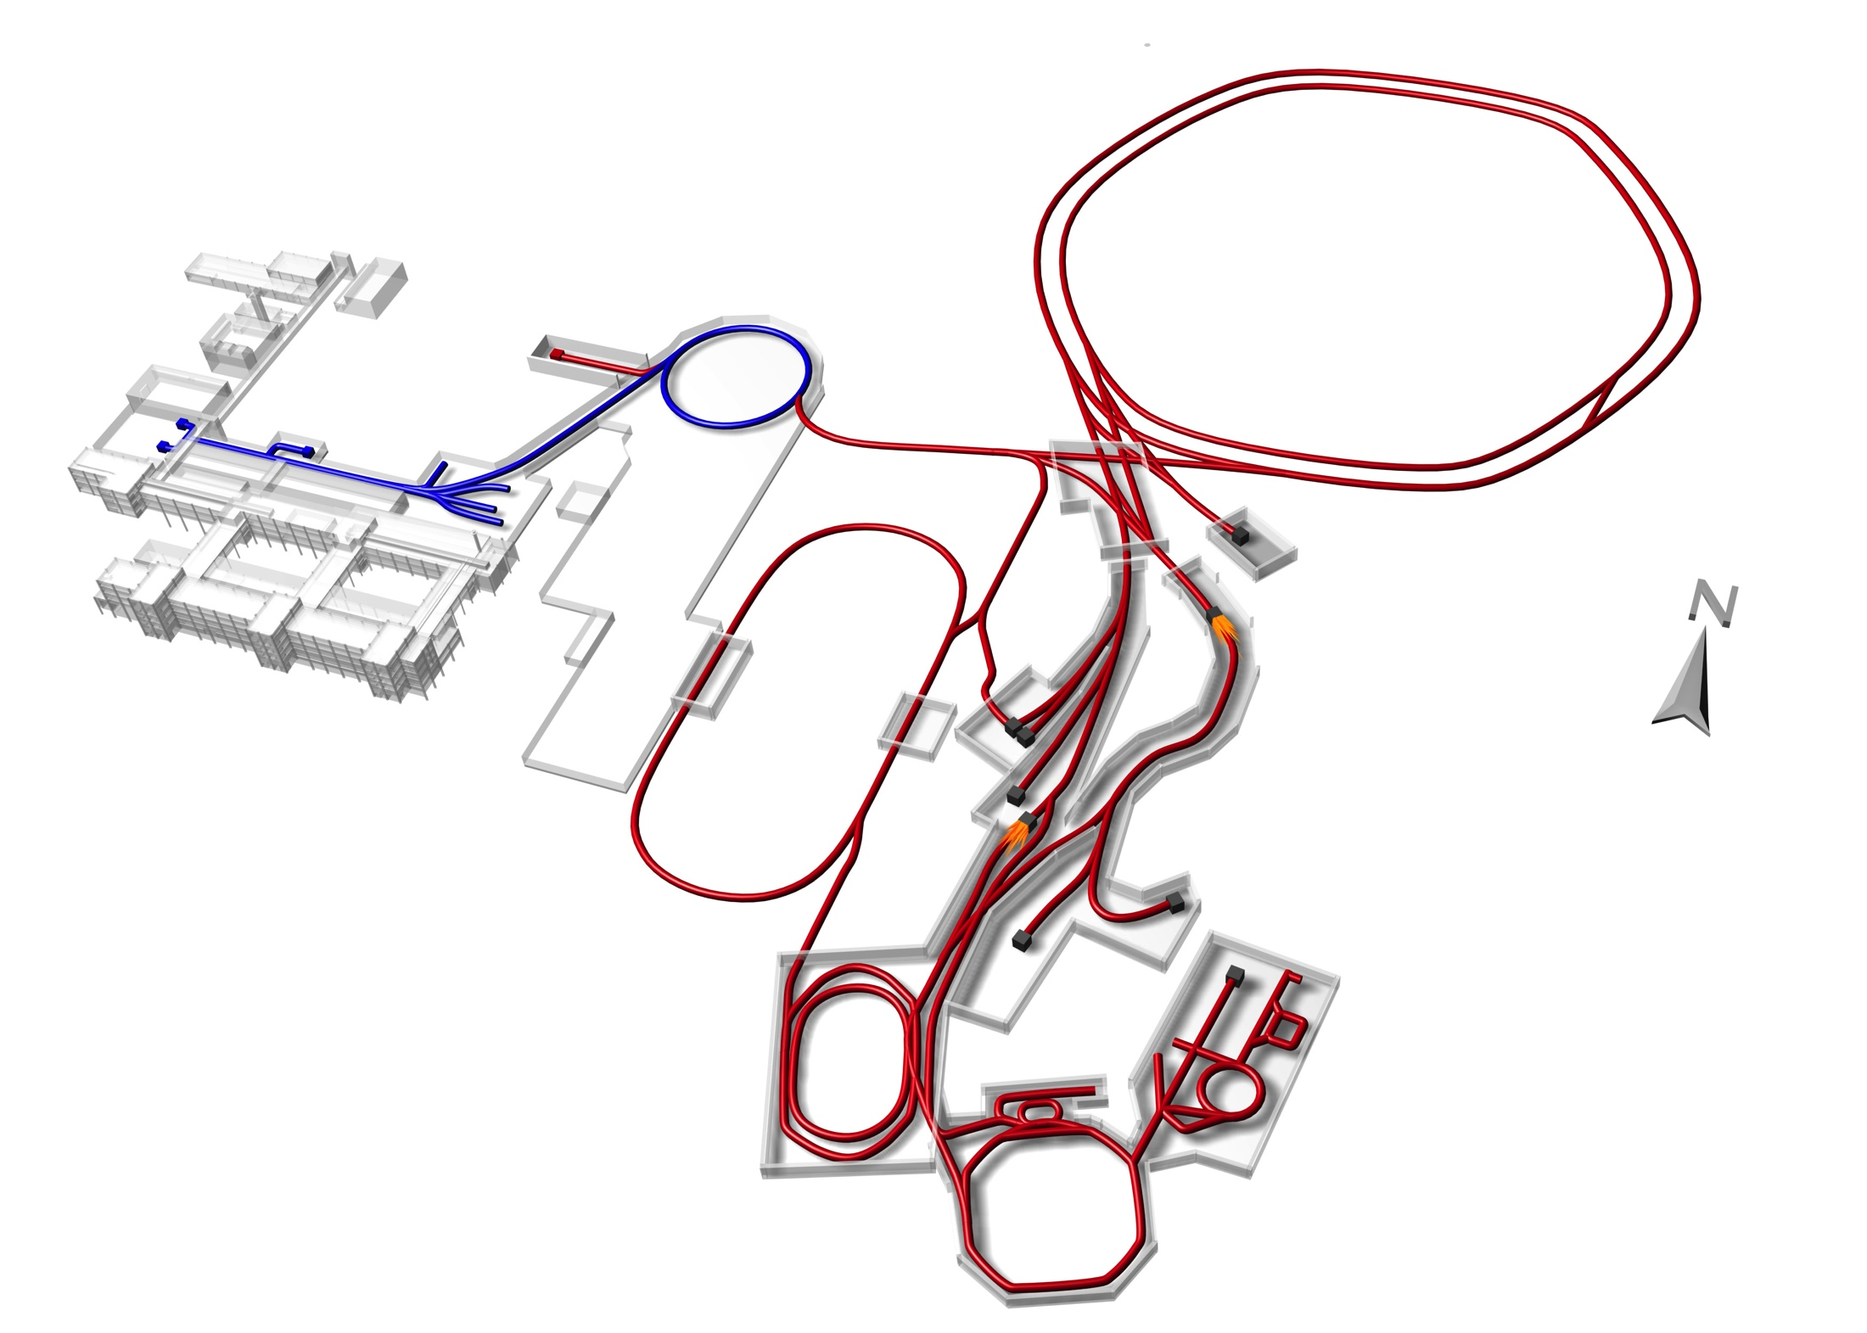
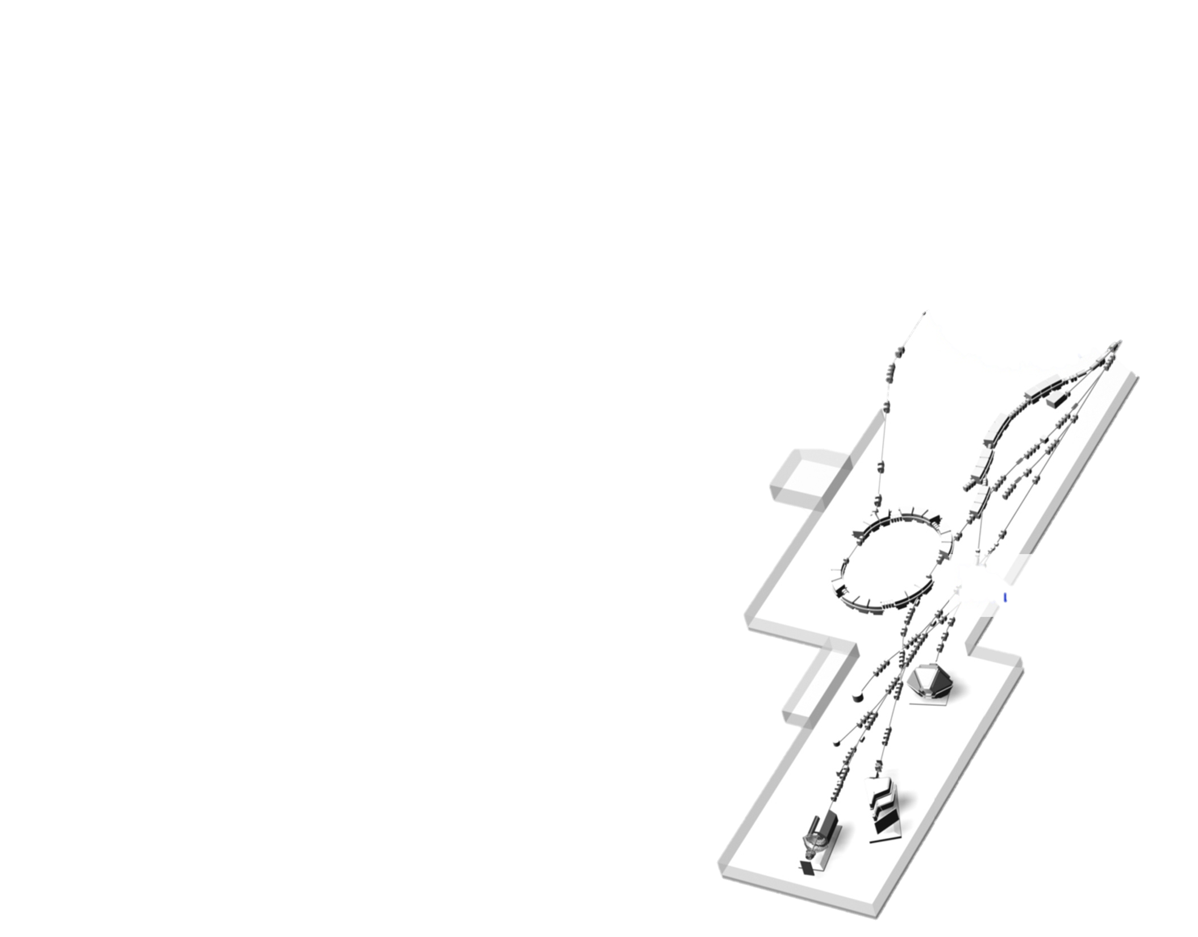
R³B
R³B/LAND
www.gsi.de
Notes:
schmeatische Übersicht

Slide 4
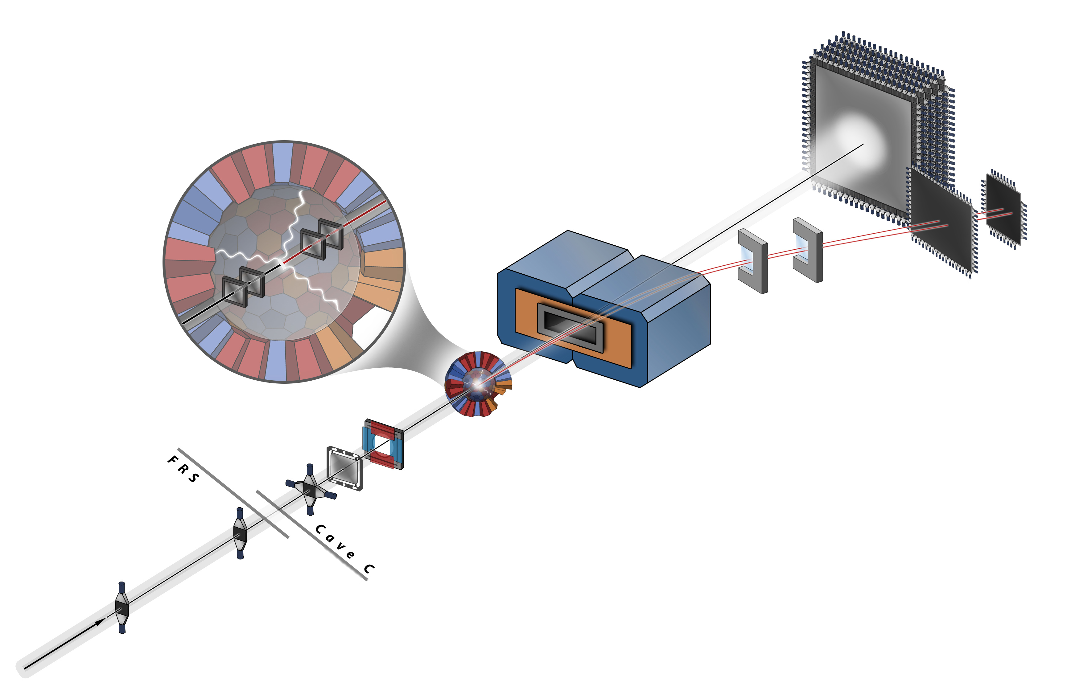
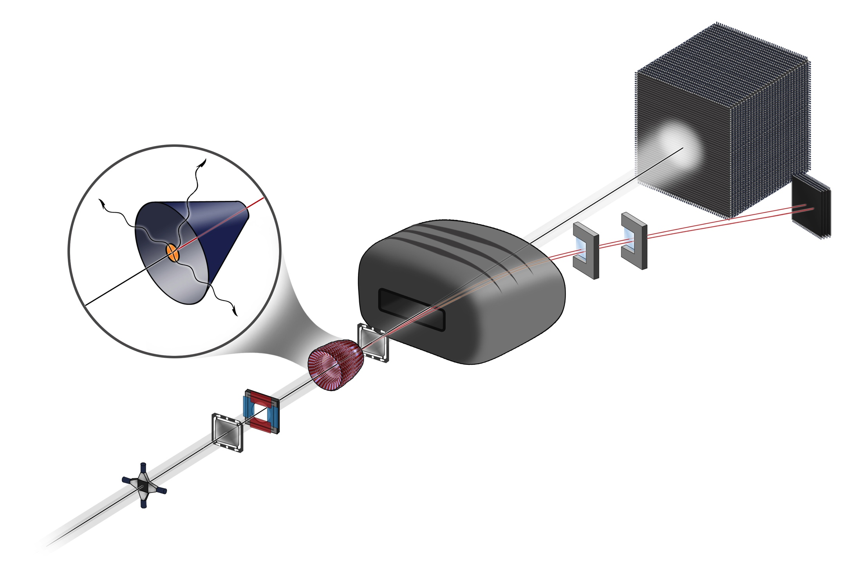

features
kinematically complete measurements
of nuclear reactions in inverse kinematics
high beam energies 100 – 1000 MeV/u
physics
nuclear astrophysics
structure of (exotic) nuclei
neutron-rich matter
nuclear reactions
nuclear fission ......
Reactions with
Relativistic
Radioactive
Beams
Notes:
Si Tracker sitzt in CALIFA hinweisen
----- Besprechungsnotizen (10.04.15 08:53) -----
superconducting
----
technique of measurements

Slide 5
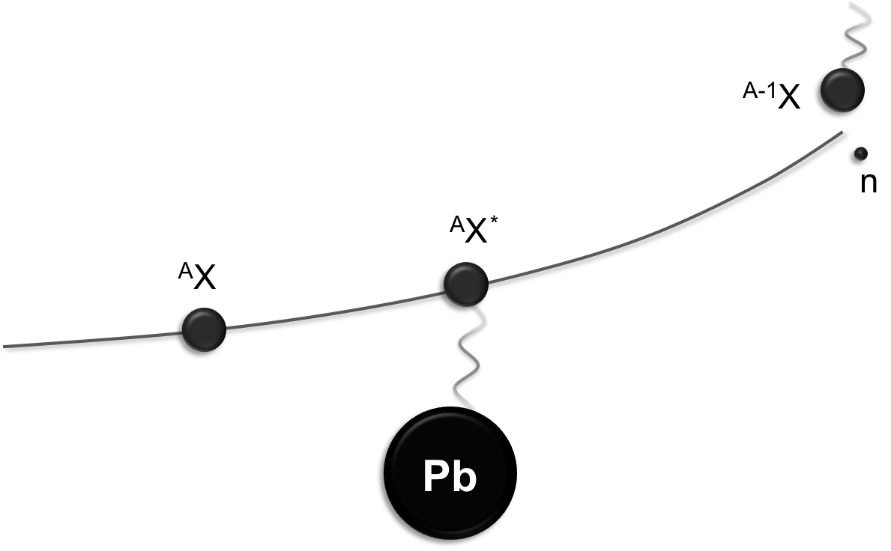
coulomb excitation
E*
  ToF, position and ΔE for all outgoing species
  E*
Notes:
the resonstruction relies cirtically on the resolution and efficiency of the detectors for the measurement of the outgoing species

Slide 6
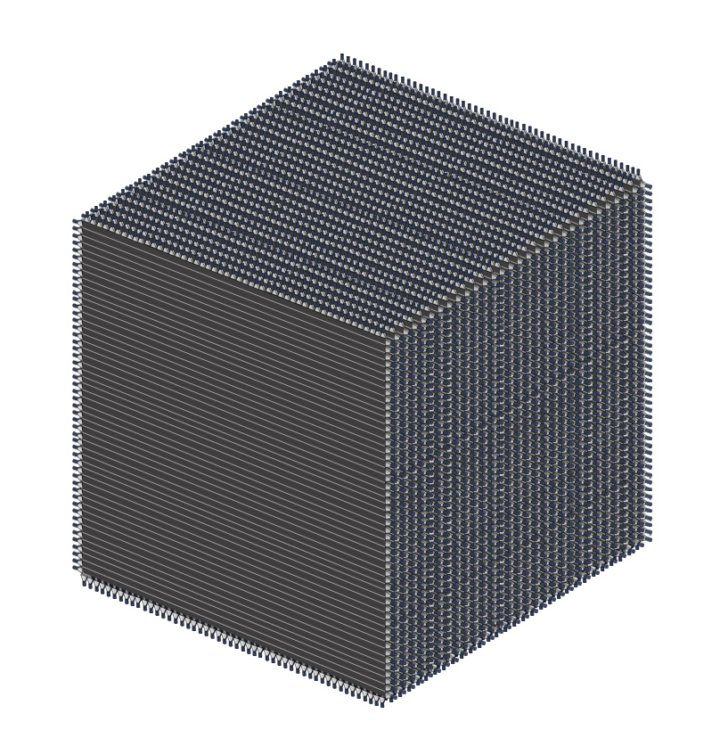
design goals of NeuLAND
NeuLAND
- full active detector -
σ_{x,y,z} ≈ 1.5 cm
σ_{t} < 150 ps
ε > 90% for 0.2 - 1.0 GeV neutrons
  multi-hit capability for up to 5 neutrons
  M_{inv} resolution: ∆E < 20 keV @ E_{rel} = 100 keV above S_{n}
6
Notes:
spatial resolution = 1/sqrt(12)*5cm
properties
aus größerer Segmetnierung im Flugweg => bessere Auflösung
-> Ort ist wichtig für Impuls des neutrons
5Doppelebenen bei LAND
Warum höhere Effizienz? Wegen besserer Auflösung?

Slide 7
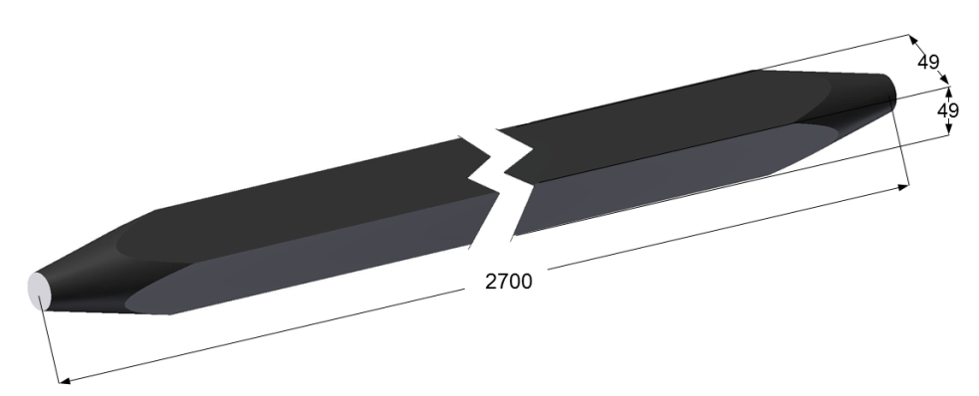
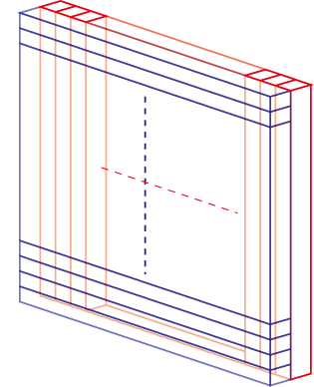
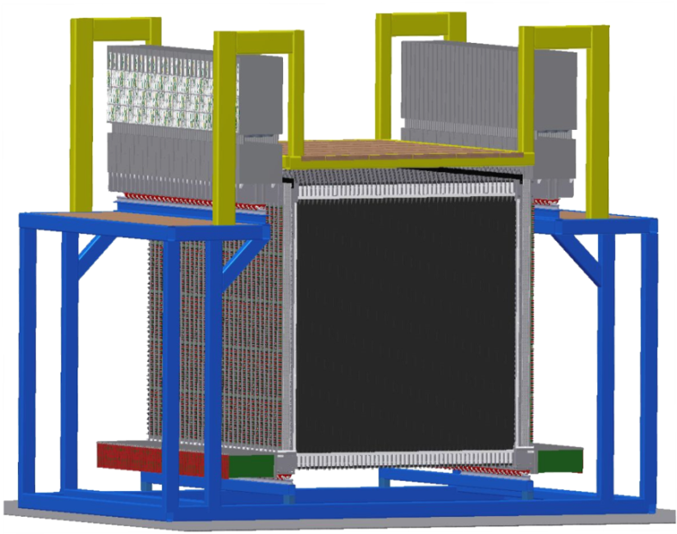
NeuLAND assembly
NeuLAND submodule
250 (270 incl. light guides) x 5 x 5 cm³
50 horiz. + 50 vert. submodules
build one double-plane
30 double planes
build up NeuLAND
face size 250 x 250 cm²
active depth 300 cm

Slide 8
performance examples (simulation) efficiency
high multi-neutron detection efficiencies
generated
% | 1n | 2n | 3n | 4n | 5n
1n | 89 | 12 | 1
2n | 7 | 78 | 23 | 3
3n |  | 8 | 63 | 26 | 5
4n |  |  | 12 | 63 | 40
5n |  |  |  | 7 | 46
6n |  |  |  |  | 8
high efficiency for low neutron energies
detected
E_{n} [MeV] | efficiency [%]
50 | 79
100 | 94
150 | 95
200 | 91
(E_{rel} = 500 keV)

Slide 9
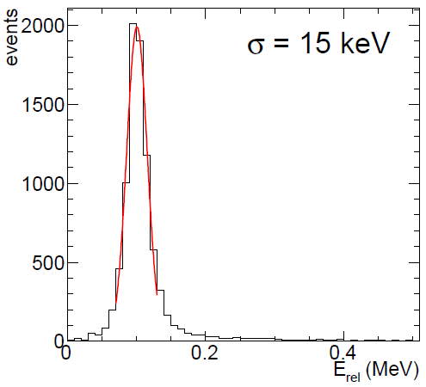
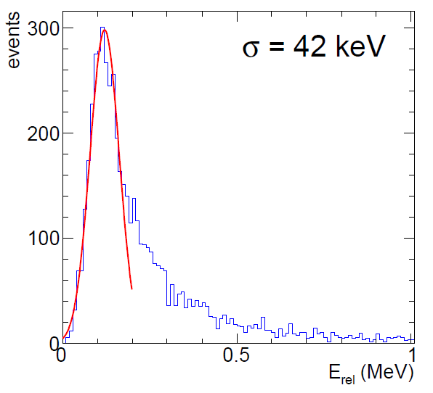
performance examples (simulation) invariant-mass resolution
35 m distance to target
E_{rel} =100 keV
600 MeV
1 neutron
4 neutrons
„tetra-neutron“
Notes:
response of NeuLAND
----- Besprechungsnotizen (09.04.15 09:20) -----
A key feature is the Minv resolution which can be derived with NeuLAND

Slide 10
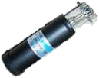
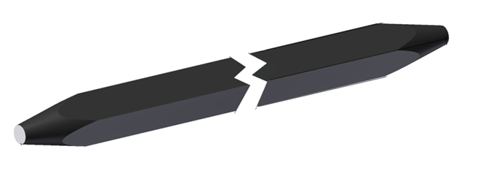

timeline of NeuLAND
 | 2012 | 2013 | 2014 Q1 | 2014 Q2 | 2014 Q3 | 2014 Q4 | 2015 Q1 | Future Plan
production
experiment
scint. quality test
electronics
standard bar
bar 29 (Aug.13)
counts
LED
97%
Cosmic rays to test light production
Cosmics
122%
LED to check
light transmission
charge [ch.]
Criterion: L_{test}/L_{std.} > 90%

Slide 11
timeline of NeuLAND
 | 2012 | 2013 | 2014 Q1 | 2014 Q2 | 2014 Q3 | 2014 Q4 | 2015 Q1 | Future Plan
production
experiment
scint. quality test
Prototype
(Vert.150 bars)
s406

Slide 12
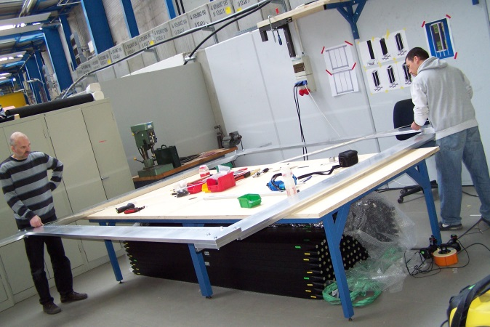
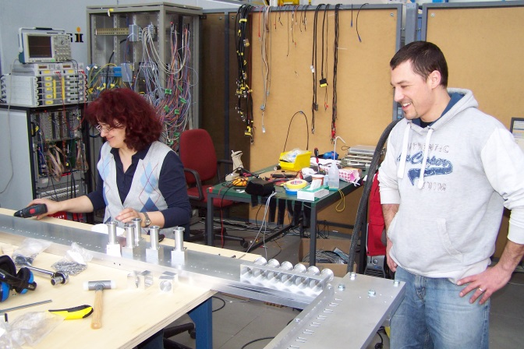
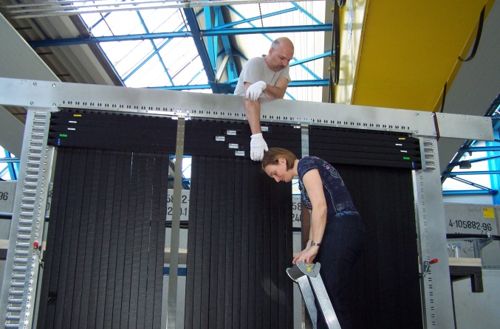
timeline of NeuLAND
 | 2012 | 2013 | 2014 Q1 | 2014 Q2 | 2014 Q3 | 2014 Q4 | 2015 Q1 | Future Plan
production
experiment
scint. quality test
double plane constructions
Prototype
(Vert.150 bars)
s406

Slide 13
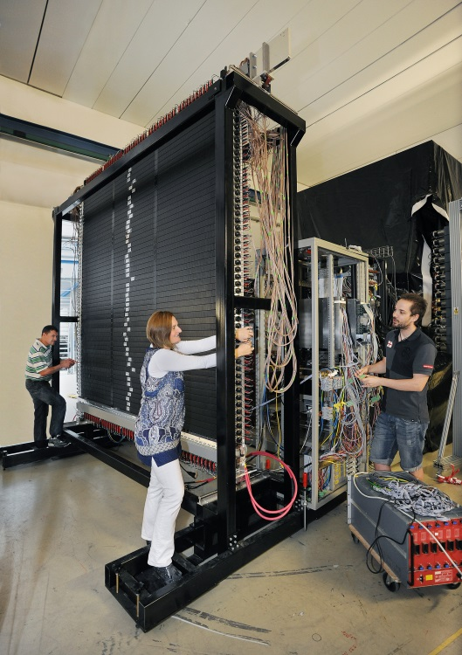
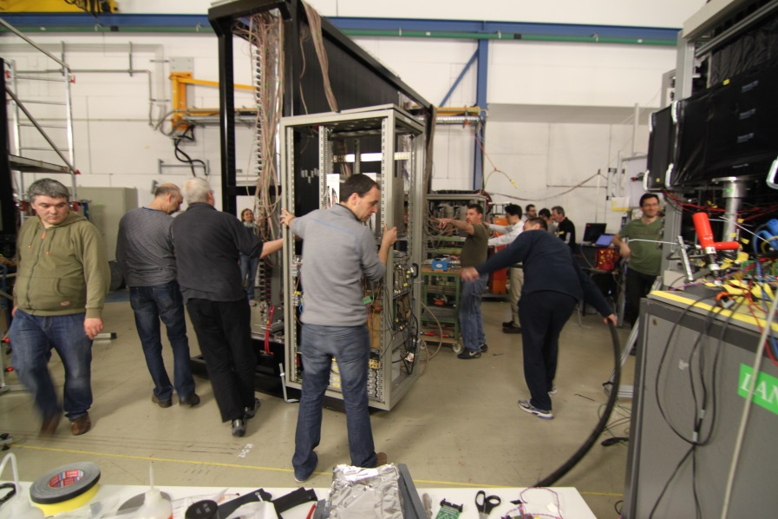
timeline of NeuLAND
 | 2012 | 2013 | 2014 Q1 | 2014 Q2 | 2014 Q3 | 2014 Q4 | 2015 Q1 | Future Plan
production
experiment
scint. quality test
double plane constructions
Prototype
(Vert.150 bars)
1 DP
s406
s438a (Comm.)
arrangement of
1 double plane
in Cave C @ GSI
Foto Gaby Otto

Slide 14
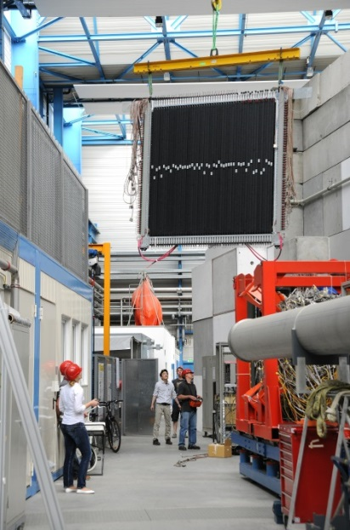
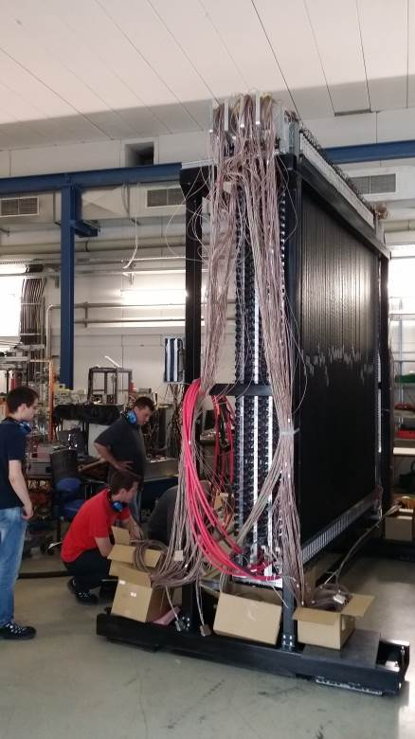
timeline of NeuLAND
 | 2012 | 2013 | 2014 Q1 | 2014 Q2 | 2014 Q3 | 2014 Q4 | 2015 Q1 | Future Plan
production
experiment
scint. quality test
double plane constructions
Prototype
(Vert.150 bars)
1 DP
4 DP + 2 SP
(Demonstrator)
sS406
s438a (Comm.)
s438b (Comm.)
s438c (Parasite.)
4 double plane
+ 2 single plane
(1/6 of full detector)
Mounting and Arranging
NeuLAND Demonstrator
around Cave C

Slide 15
timeline of NeuLAND
 | 2012 | 2013 | 2014 Q1 | 2014 Q2 | 2014 Q3 | 2014 Q4 | 2015 Q1 | Future Plan
production
experiment
scint. quality test
6 DP completed
double plane constructions
Prototype
(Vert.150 bars)
1 DP
4 DP + 2 SP
(Demonstrator)
4 DP
RIKEN:Phys.
(Oct-,2015)
s406
Sent to
RIKEN
s438a (Comm.)
s438b (Comm.)
s438c (Parasite.)

Slide 16
timeline of NeuLAND
 | 2012 | 2013 | 2014 Q1 | 2014 Q2 | 2014 Q3 | 2014 Q4 | 2015 Q1 | Future Plan
production
experiment
continuous
production
scint. quality test
6 DP completed
Double plane constructions
Prototype
(Vert.150 bars)
1 DP
4 DP + 2 SP
(Demonstrator)
4 DP
RIKEN:Phys.
(Oct-,2015)
s406
Sent to
RIKEN
s438a (Comm.)
GSI:Comm.
(2017)
s438b (Comm.)
s438c (Parasite.)

Slide 17
timeline of NeuLAND
 | 2012 | 2013 | 2014 Q1 | 2014 Q2 | 2014 Q3 | 2014 Q4 | 2015 Q1 | Future Plan
production
experiment
continuous
production
scint. quality test
6 DP completed
Double plane constructions
Prototype
(Vert.150 bars)
1 DP
4 DP + 2 SP
(Demonstrator)
4 DP
RIKEN:Phys.
(Oct-,2015)
s406
Sent to
RIKEN
s438a (Comm.)
GSI:Comm.
(2017)
s438b (Comm.)
s438c (Parasite.)

Slide 18
s438 experiments in 2014
  bring NeuLAND into operation
  check timing resolution and efficiency
  check background condition
s438a
R³B commissioning
Apr. 15 – 20
500 – 800 MeV/u ⁵⁸Ni
Target: Pb
1 DP
Notes:
----- Besprechungsnotizen (09.04.15 09:34) -----
calcium
----- Besprechungsnotizen (09.04.15 09:37) -----
carbon

Slide 19
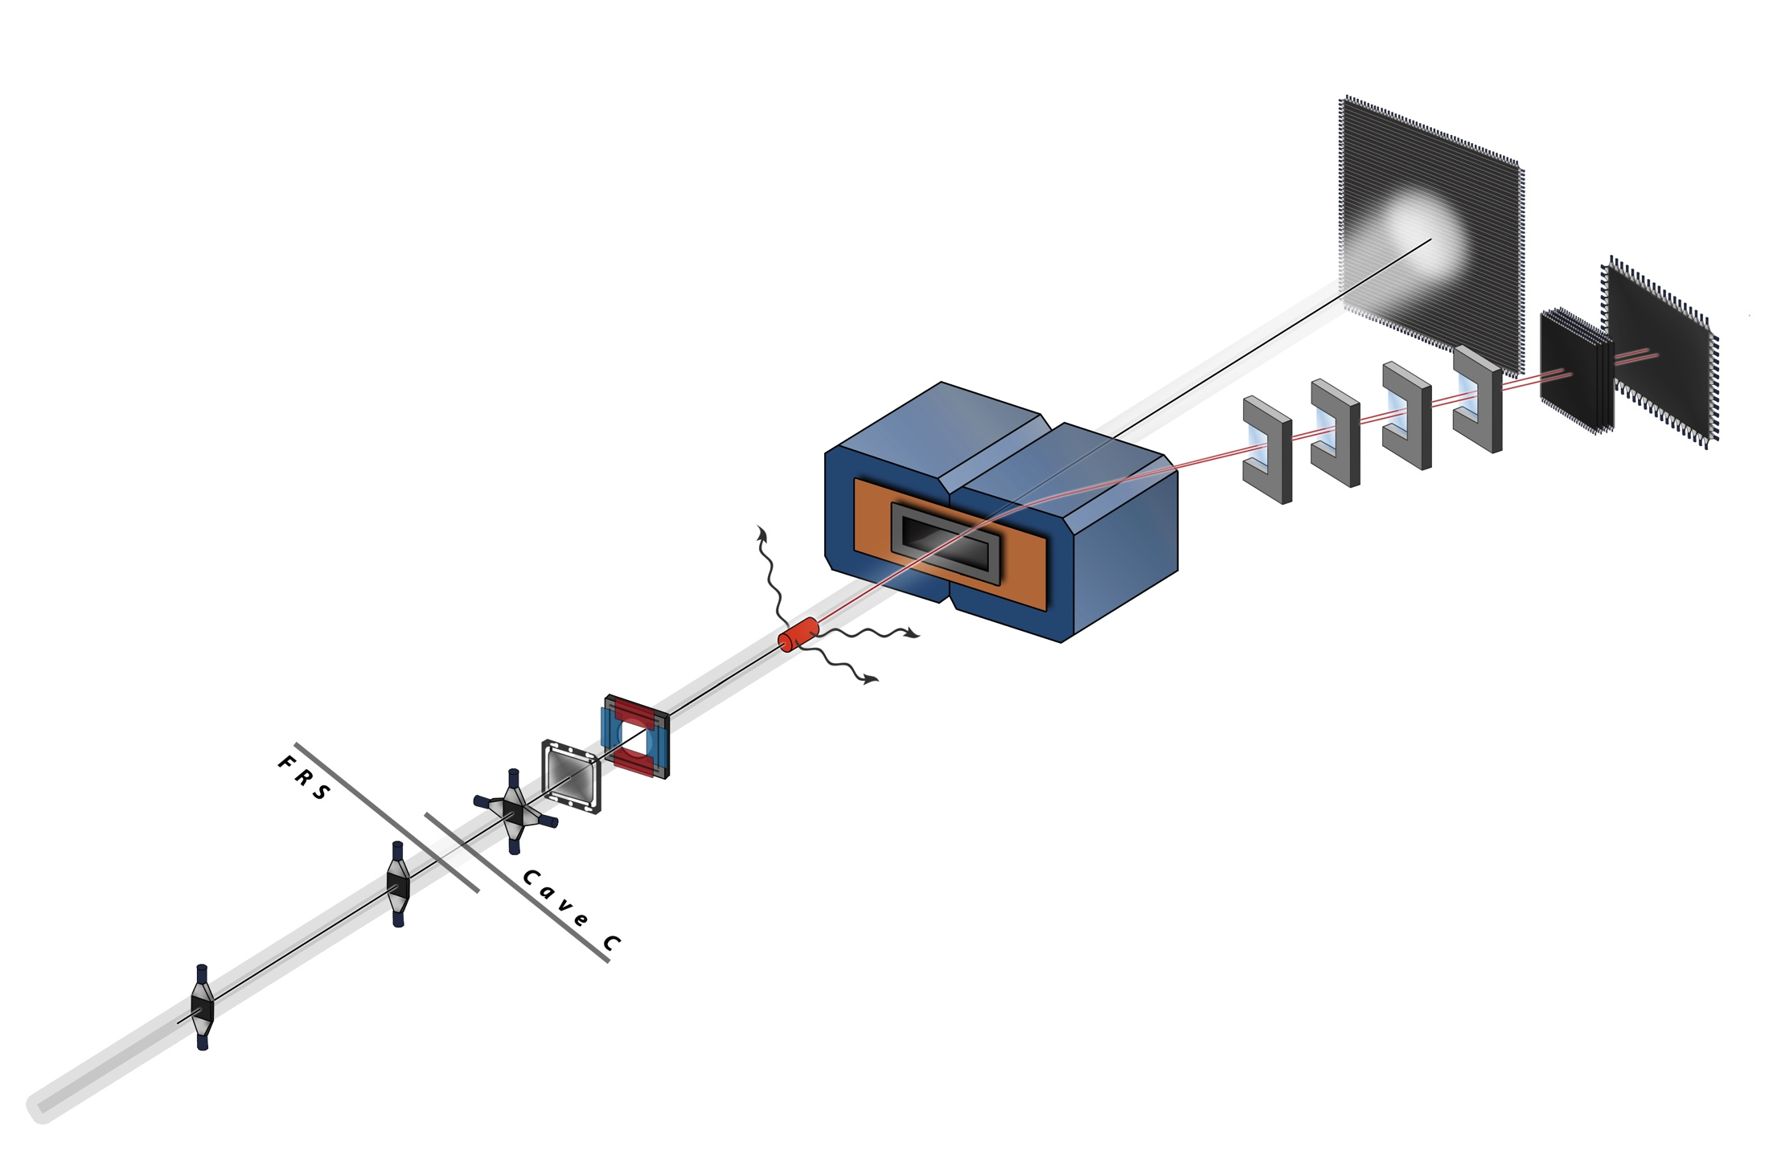
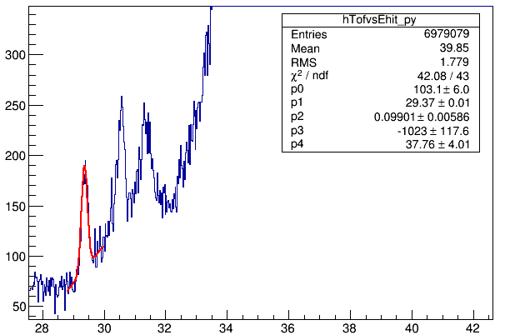
s438a: ⁵⁸Ni + Pb
NeuLAND
1 DP
timing resolution
Counts
σ_{t} ≈ 100-150 ps
TOF [ns]
⁵⁸Ni 500-800 MeV/u
Notes:
neutron flight path length 10.25m

Slide 20
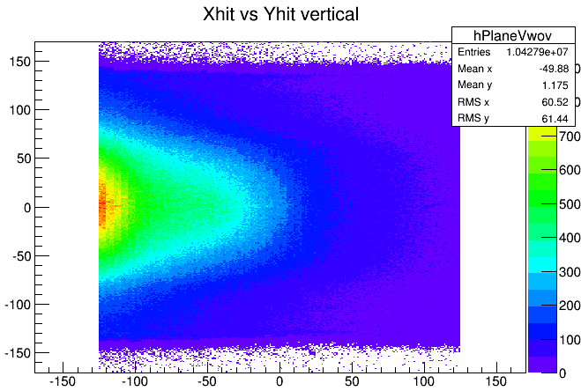
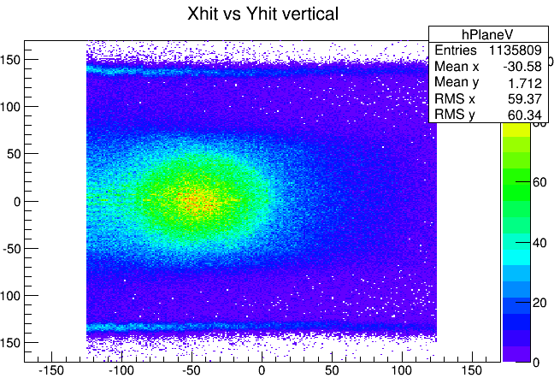
s438a: ⁵⁸Ni + Pb
background
2nd plane
no CP VETO
condition
Y [cm]
2nd plane
CP VETO
condition
X [cm]
Y [cm]
X [cm]
Notes:
nice neutron distribution
----- Besprechungsnotizen (09.04.15 09:47) -----
scatter into NeuLAND

Slide 21
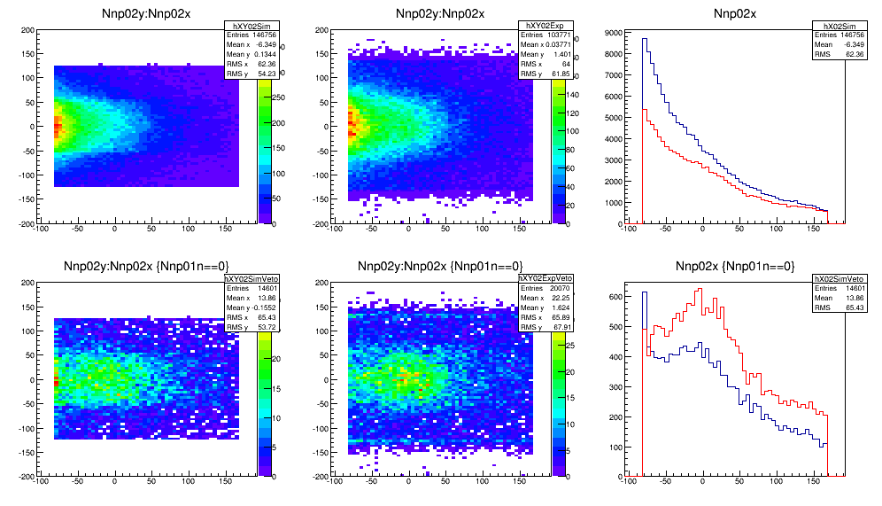
background study
simu.
exp.
Y [cm]
Y [cm]
X [cm]
X [cm]
Simu.
qualitatively reproduced within a factor of 2
background: target, air, detector, ...
better design of the experiment
Counts
Exp.
X [cm]
21
Notes:
R³BROOT
Geant 4-9.6.2
----- Besprechungsnotizen (09.04.15 09:47) -----
assumption

Slide 22
s438 experiments in 2014
  bring NeuLAND into operation
  check timing resolution and efficiency
  check background condition
s438a
s438b
R³B commissioning
Oct. 2 – 9
450 – 650 MeV/u ⁴⁸Ca
Target: C, Pb
2 SP + 4 DP
Apr. 15 – 20
500 – 800 MeV/u ⁵⁸Ni
Target: Pb
1 DP
R³B commissioning
Notes:
----- Besprechungsnotizen (09.04.15 09:34) -----
calcium
----- Besprechungsnotizen (09.04.15 09:37) -----
carbon

Slide 23
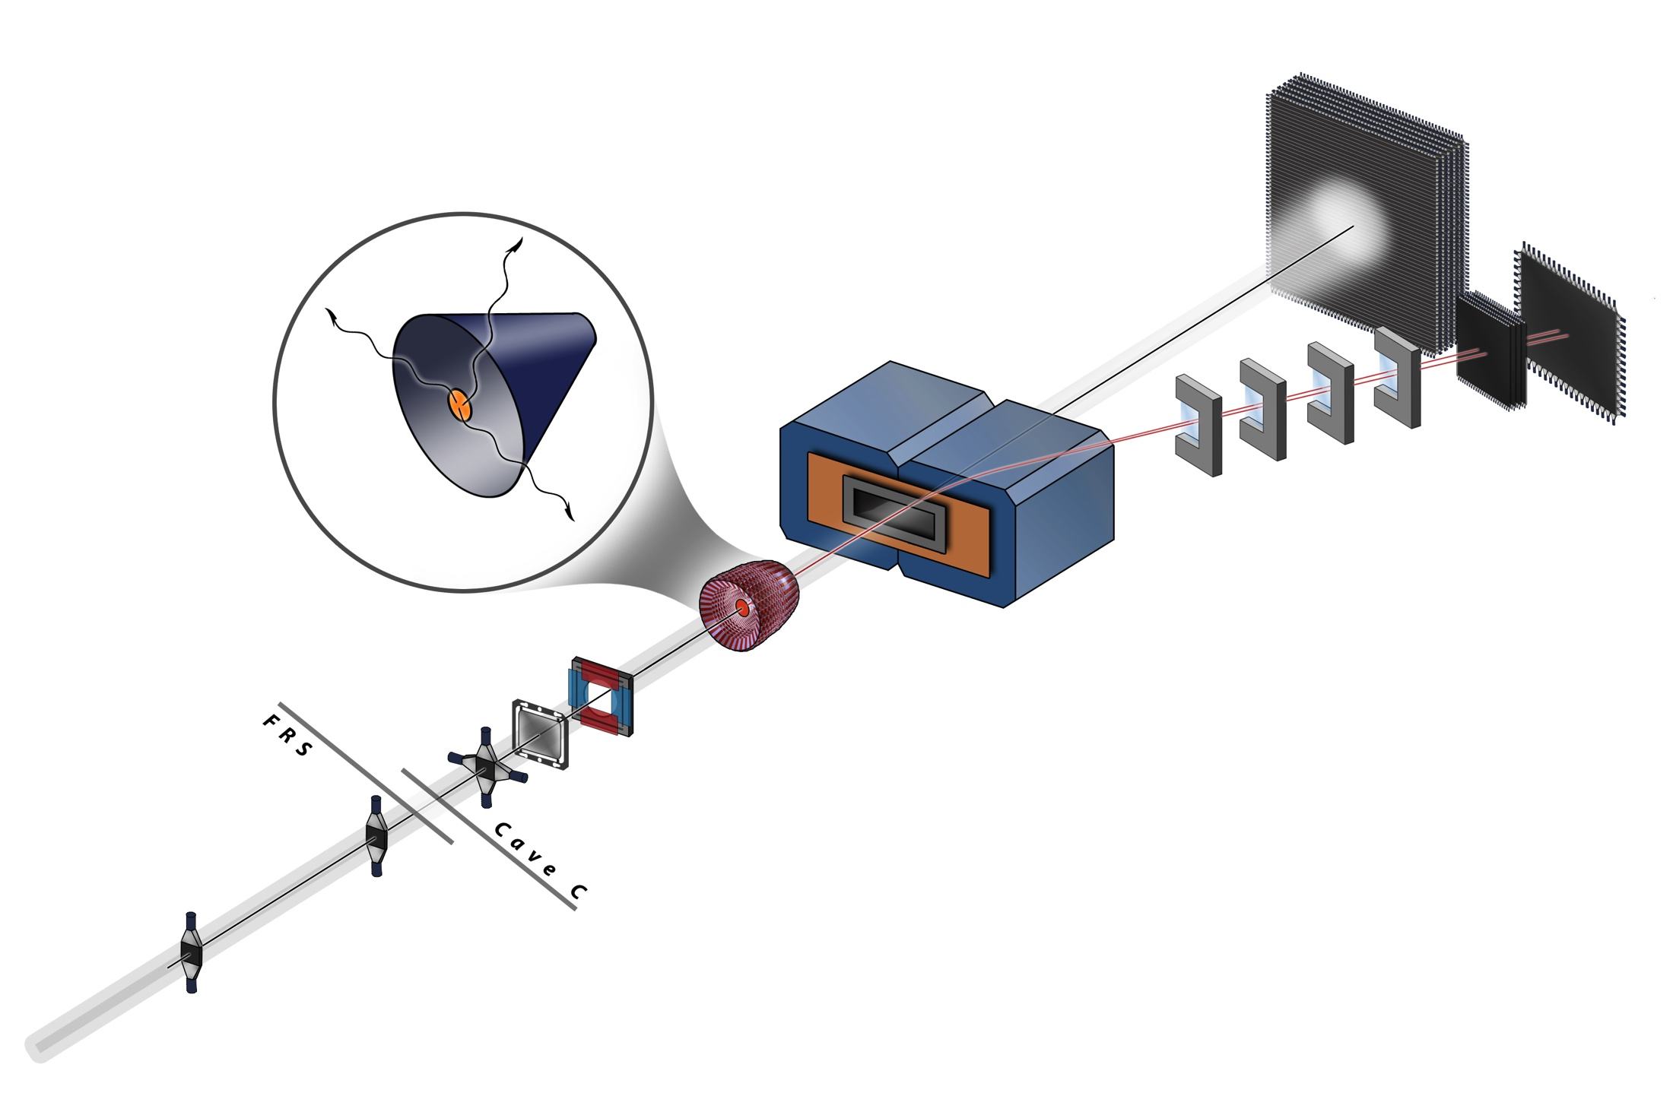
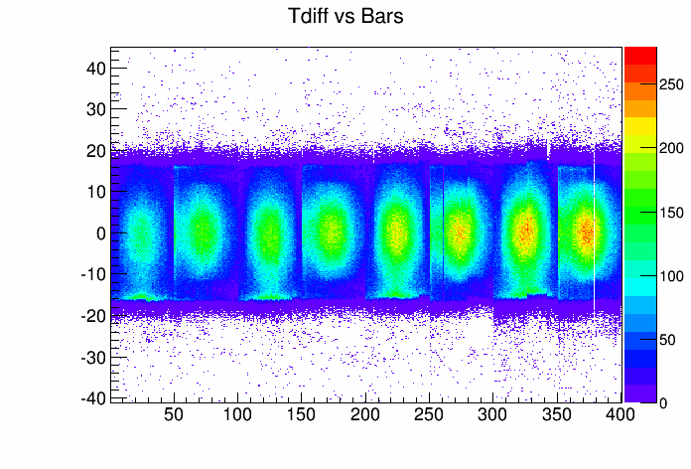
s438b: ⁴⁸Ca + C
NeuLAND
4 DP & 2 SP
double plane
1 2 3 4
confirmed good time resolution
background in accordance to simulation
hit pattern studies
time difference of 2PMTs [ns]
bar number
Notes:
ausläufer erklären

Slide 24
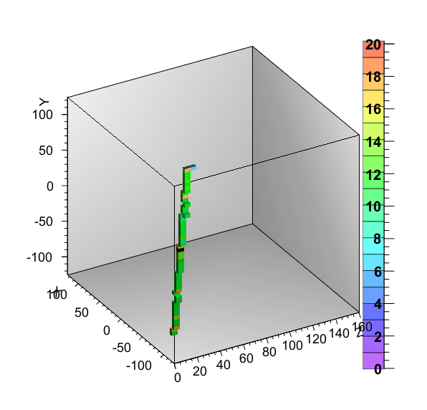
cosmic rays
⁴⁸Ca beam (550MeV/u) + C
beam direction
gates:
Trig = 2 (off-spill)
# of hit bars > 20
# of hit bars in Plane 1,8 = 0 (to select vertical rays)
ΔE in each bar > 2 MeV
Y
X
Z
ΔE
4 DP

Slide 25
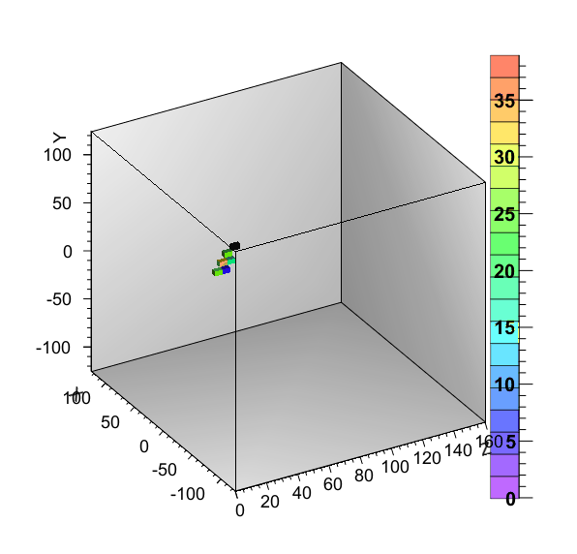
neutron hits
⁴⁸Ca beam (550MeV/u) + C
beam direction
Y
gates:
Trig = 1 (on-spill)
# of cluster == 1 && cluster size >= 7
ΔE in each bar > 3 MeV
CP Veto
X
Z
ΔE
4 DP

Slide 26
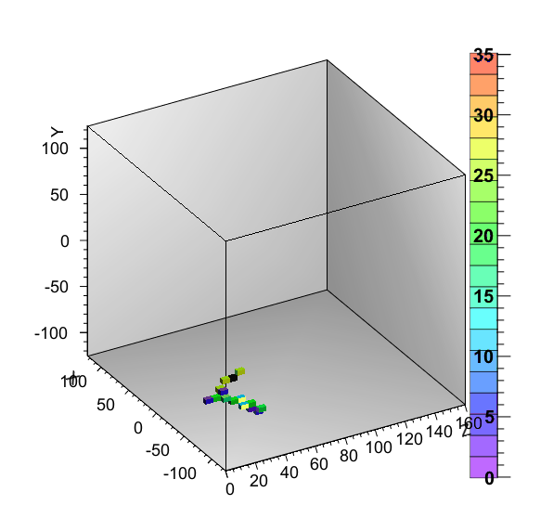
neutron hits with branch
⁴⁸Ca beam (550MeV/u) + C
beam direction
gates:
Trig = 1 (on-spill)
# of cluster == 1 && cluster size >=15
ΔE in each bar > 3 MeV
CP Veto
Y
X
Z
ΔE
4 DP

Slide 27
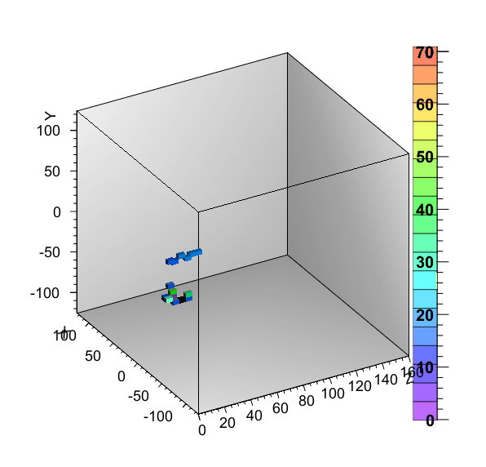
2 neutron hits
⁴⁸Ca beam (550MeV/u) + C
gates:
Trig = 1 (on-spill)
# of cluster == 2 && cluster size >=7
ΔE in each bar > 3MeV
CP Veto
causality
beam direction
Y
T₁
X
two hits are separated
beyond the causality
Z
ΔE
d
4 DP
d > c x | T₁-T₂ |
T₂
reject the multiple hit by one neutron

Slide 28
s438 experiments in 2014
  bring NeuLAND into operation
  check timing resolution and efficiency
  check background condition
s438a
s438b
s438c
R³B commissioning
Oct. 2 – 9
450 – 650 MeV/u ⁴⁸Ca
Target: C, Pb
2 SP + 4 DP
Oct. 17 – 25
700 – 1000 MeV/u
^{236,238}U,¹⁸⁷Tl,¹⁹⁴Bi,²⁰⁷Fr
Target: Pb, U
2 SP + 4 DP
Apr. 15 – 20
500 – 800 MeV/u ⁵⁸Ni
Target: Pb
1 DP
R³B commissioning
Parasite of SOFIA run
Notes:
----- Besprechungsnotizen (09.04.15 09:34) -----
calcium
----- Besprechungsnotizen (09.04.15 09:37) -----
carbon

Slide 29
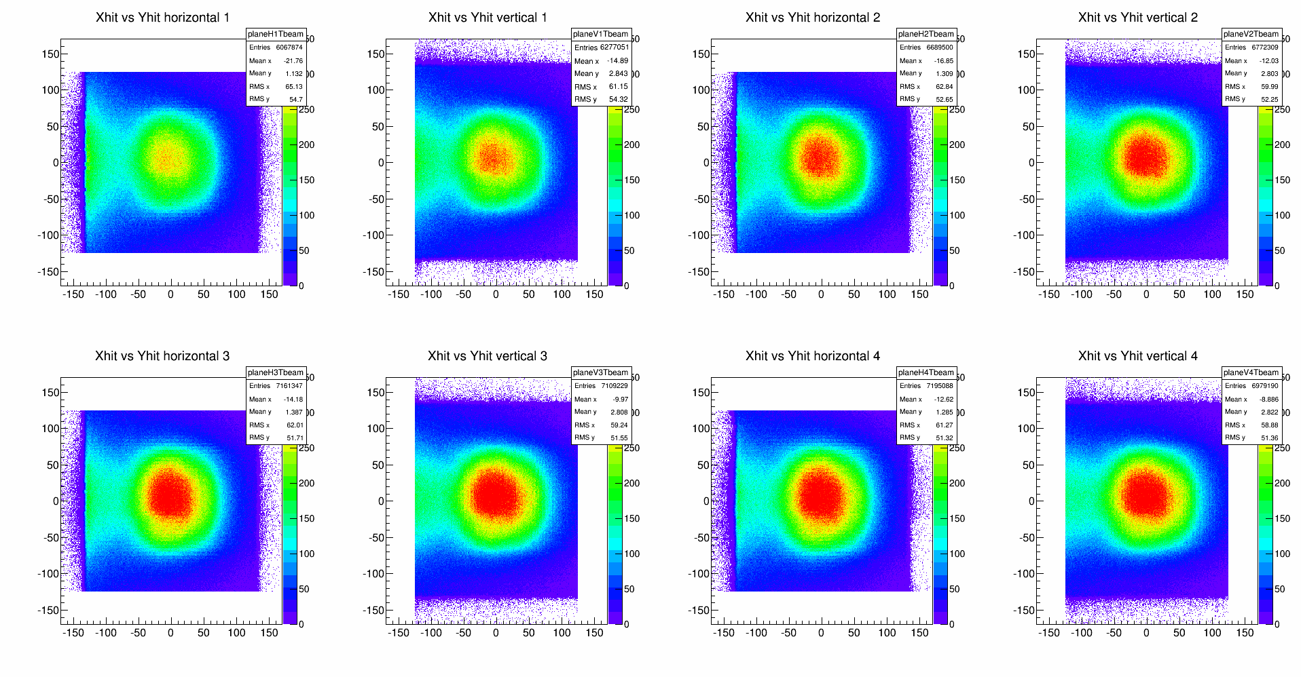
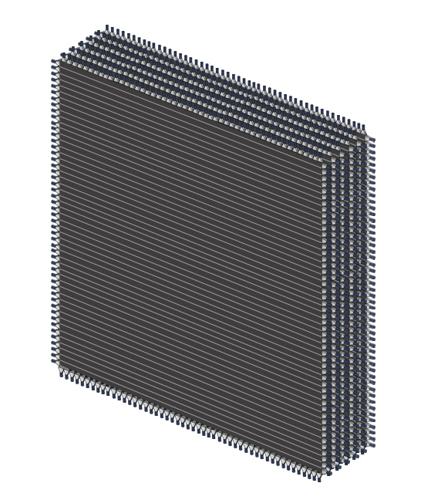
s438c: coulex fission by ²³⁶U+U
SOFIA setup
1
2
3
4
Y [cm]
5
6
7
8
X [cm]
little background due to fission trigger
all 800 modules functional and well calibrated
pattern studies of multi-neutron events
Notes:
neutronen events untersuchen

Slide 30

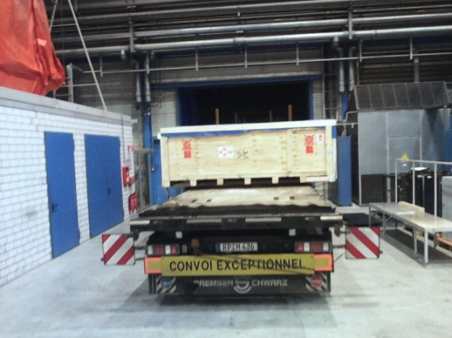
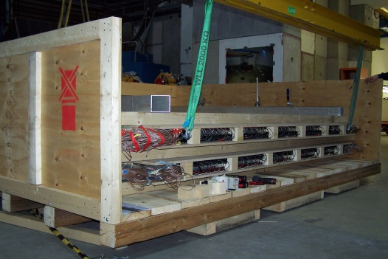
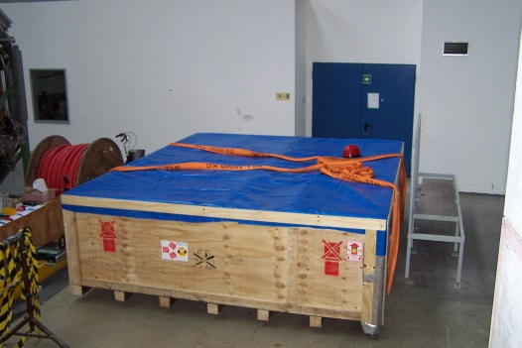


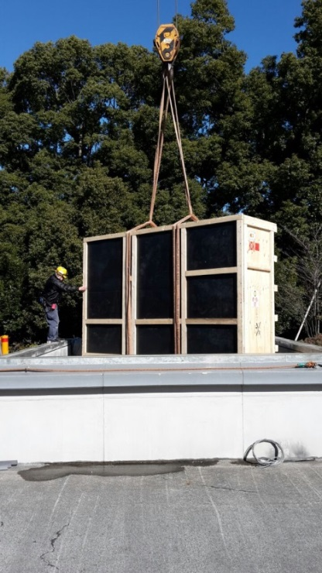
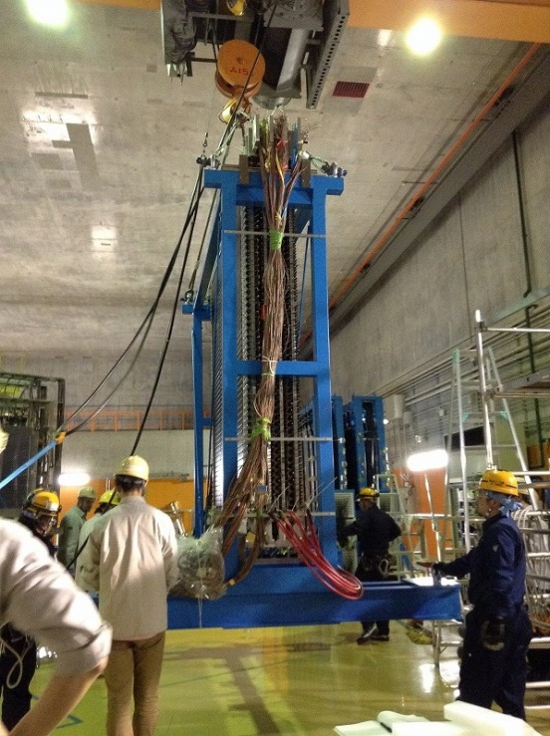
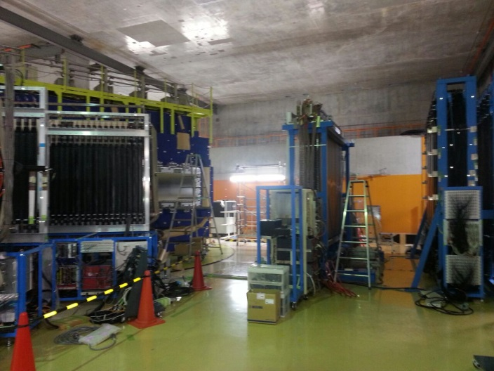

GSI → RIKEN
4 double planes sent to RIKEN for 2 years
transport box
401 x 344 x 128 cm³
5.75 tons
in collaboration
with
SAMURAI Team
(TITECH, RIKEN,...)
key roles in several
experiments 2015-2017
Notes:
neutronendetektor (NEBULA) @ ??? ergänzt performance
energien zu niedrig

Slide 31
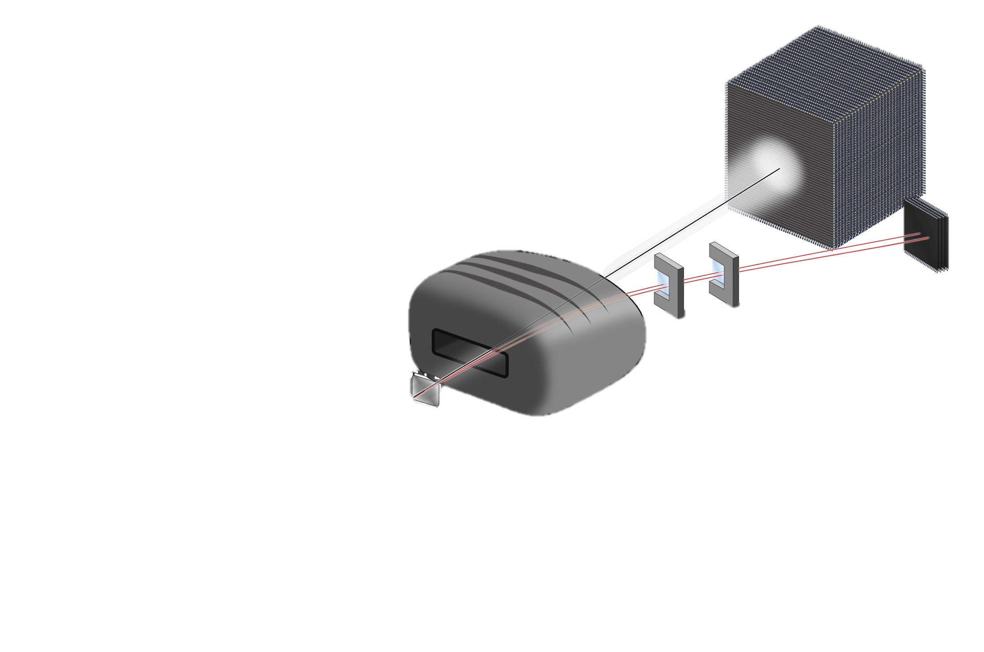
summary
NeuLAND 6 DP have been built up (250 x 250 x 60 cm³)
NeuLAND demonstrator (1/6 of full detector) was tested @ GSI
  all channels were successfully working
  reasonable neutron hit distribution
  good timing resolution <~ 150 ps
4 DP are now in RIKEN
physics run will be started from next autumn
construction is continuously performed
he commissioning @ GSI will be the end of 2017 again

Slide 34
Backup

Slide 35
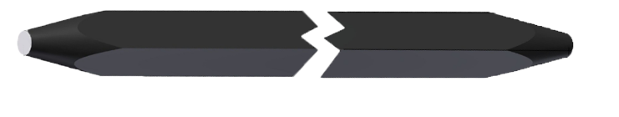
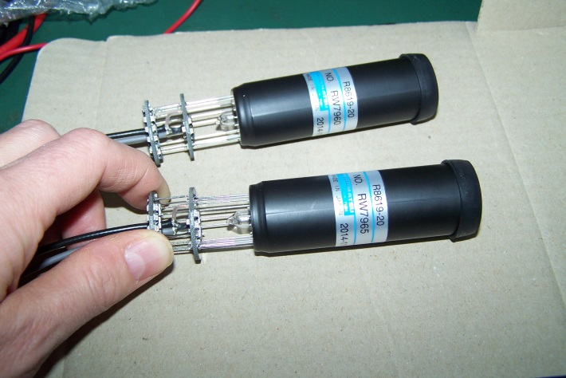
NeuLAND Submodule
Scintillator
3000 bars needed
Currently:
930 bars ordered, 610 in house
(RP/BC408 compatible)
PMT
6000 PMTs needed
Currently:
1600 PMTs in house
(Hamamatsu R8619)
Future option:
Development with Si-PM in progress

Slide 36
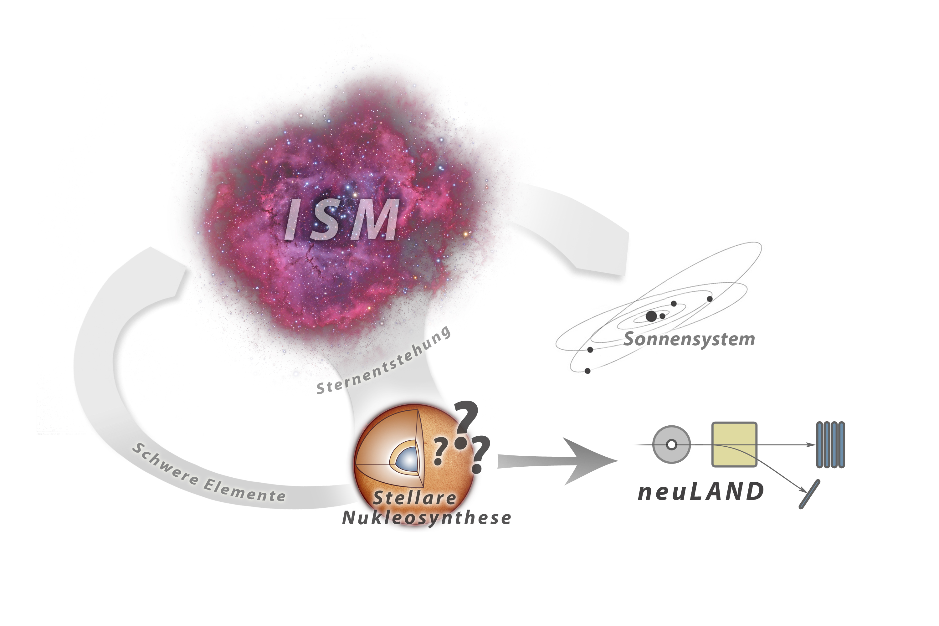
Notes:
wofür Fragezeichen – Raten messen und Wirkungsquerschnitte messen, die zu stellaren Raten führen

Slide 37
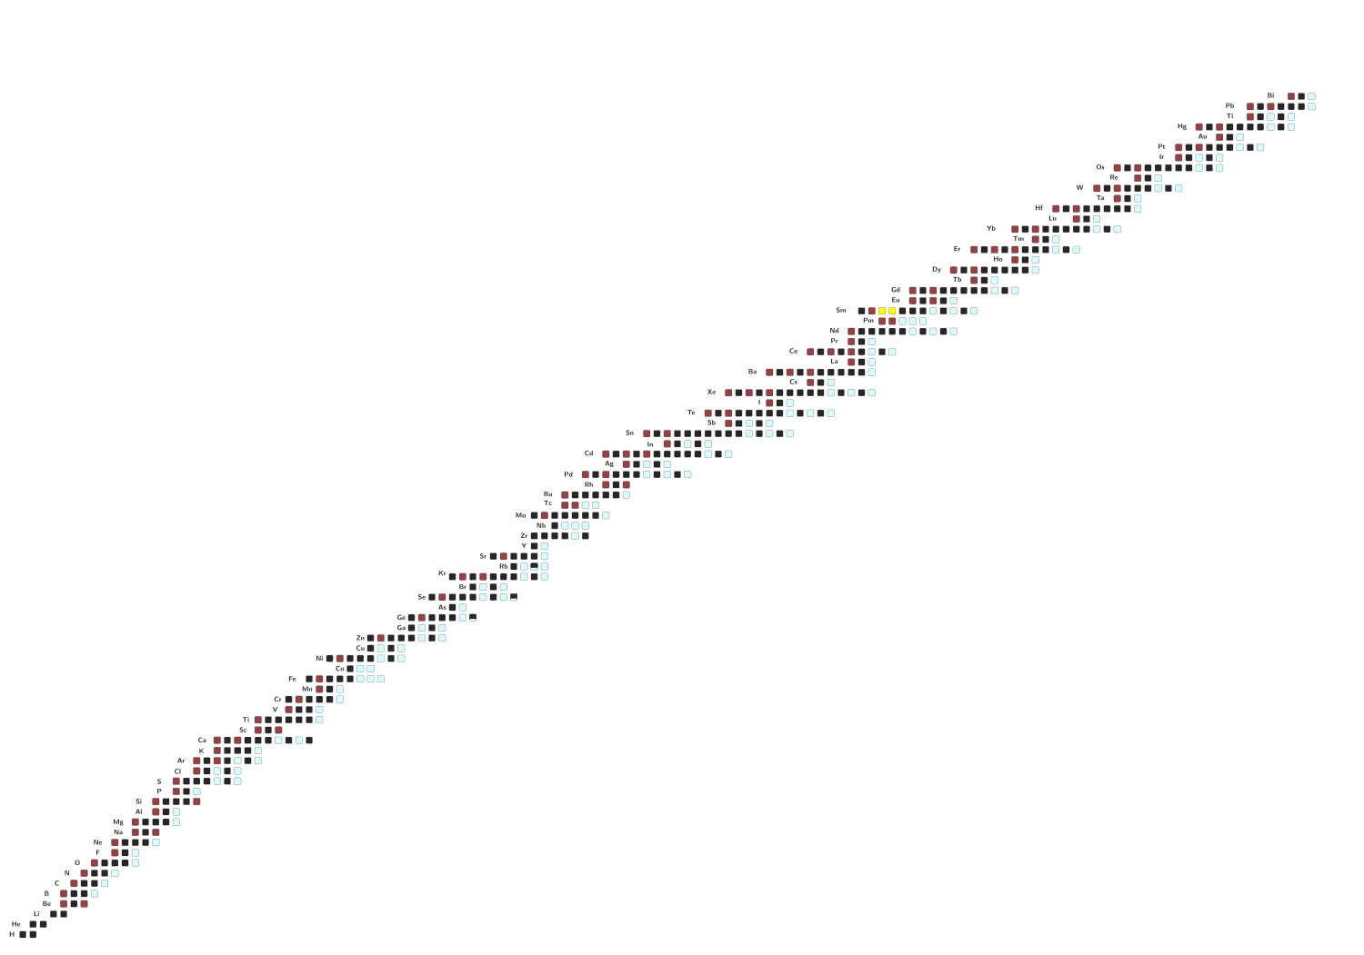
Nukleosyntheseprozesse
p-Prozess
(γ,n) und β⁺
s-Prozess
r-Prozess
(n,γ) und β⁻
Notes:
Farben umkehren für Prozess
und rotbraun heller machen
Nuklidkarte beschreiben bzw Protonen und Neutronen hinschreiben

Slide 38
(γ,n) Reaktionen
Notes:
Pfeilefarben ändern!!

Slide 39
(n,γ) Reaktion
⁵⁹Fe(n,γ) ⁶⁰Fe
Notes:
Farben ändern!! ÜBERGANG
um Prozesse zu verstehen: Kenntnis über (n,g) und (g,n) Reaktionen an radioaktiven Kernen
Beides an der GSI/FAIR möglich: Beispiel 59Fe(n,g)

Slide 40

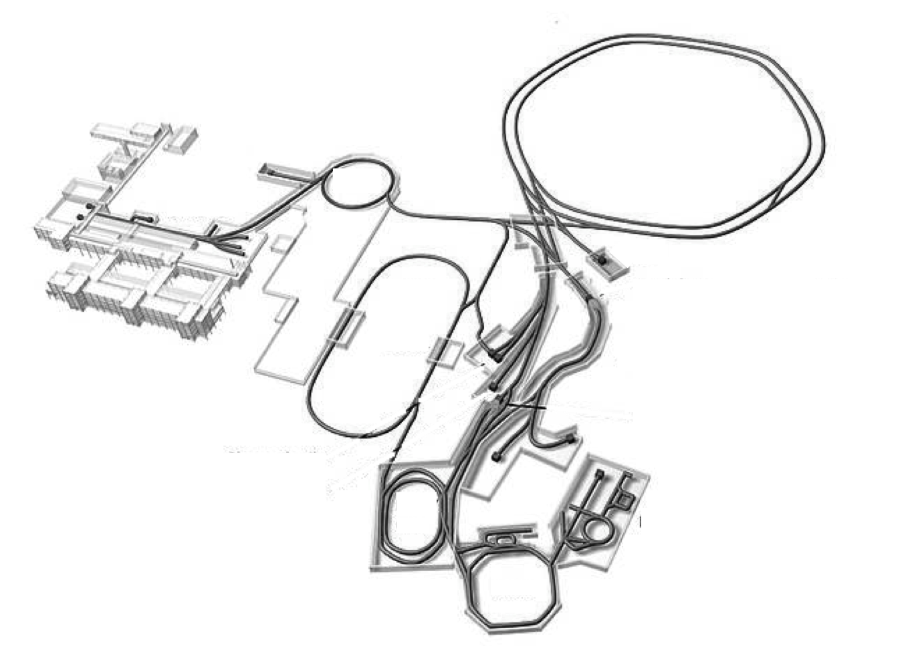
γ(⁶⁰Fe, n+⁵⁹Fe)
⁵⁹Fe(n,γ) ⁶⁰Fe
⁵⁹Fe(n,γ) ⁶⁰Fe
Notes:
quasi Photonentarget
von links unten nach rechts oben

Slide 41
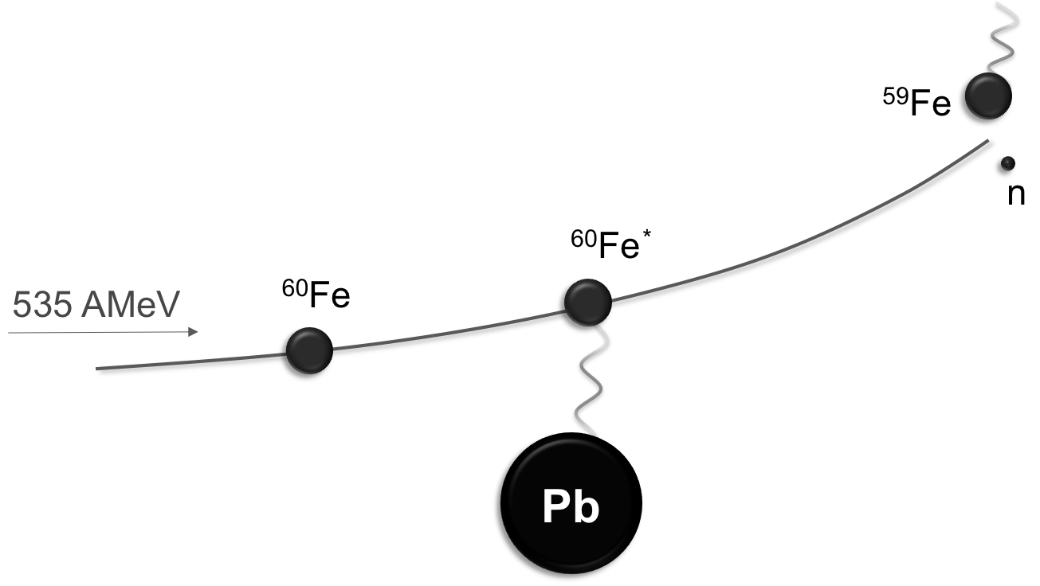
Coulomb-Aufbruchmethode
  Messung von Flugzeit, Position and ΔE
  Anregungsenergie
Notes:
Strahl oder Kern statt Teilchen
hohes Z

Slide 42
R³B/LAND
www.gsi.de
R³B
Notes:
schmeatische Übersicht

Slide 43
© Mario Weigand, Goethe-Universität Frankfurt
R³B
Reactions with
Relativistic
Radioactive
Beams
Notes:
Si Tracker sitzt in CALIFA hinweisen

Slide 44
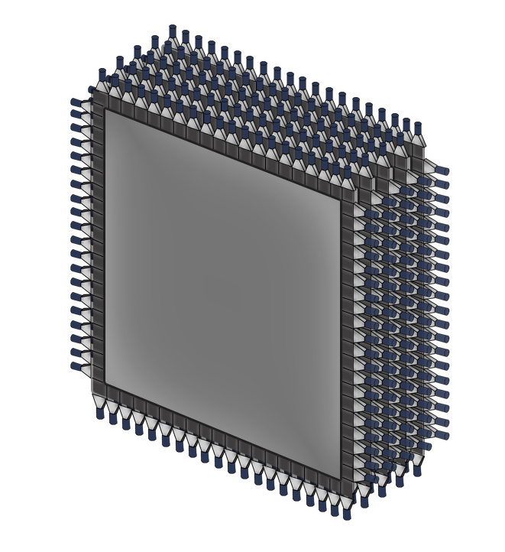
30 Doppel-
ebenen
10 Ebenen
NeuLAND
σ_{x} ≈ 1,5 cm
LAND
σ_{x} ≈ 3 cm
50 Module
(5 × 5 × 250) cm³
20 Module
(10 × 10 × 200) cm³
Notes:
aus größerer Segmetnierung im Flugweg => bessere Auflösung
-> Ort ist wichtig für Impuls des neutrons
5Doppelebenen bei LAND

Slide 45
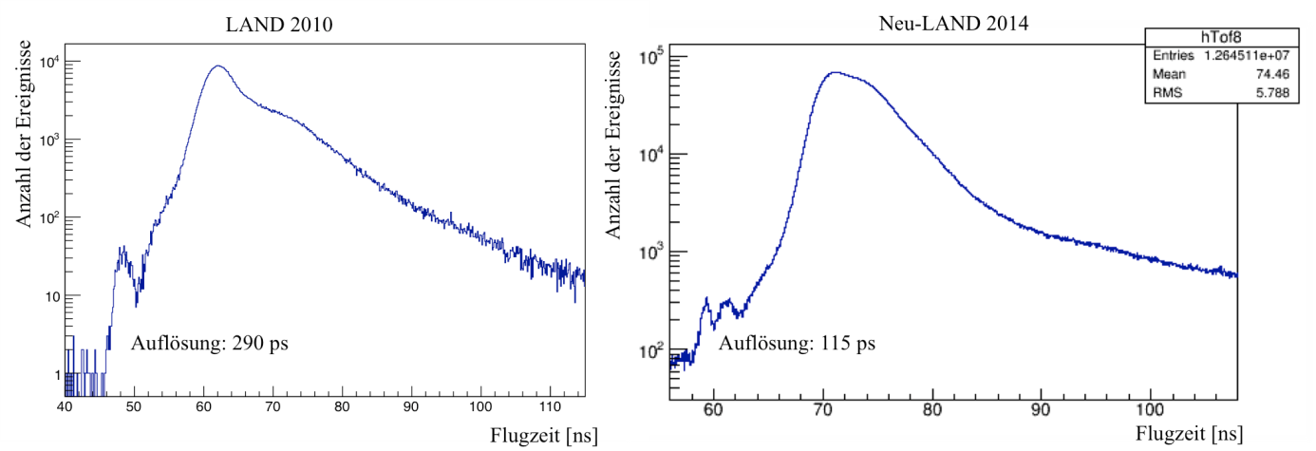
Ereignisse
Ereignisse
ToF [ns]
NeuLAND
σ_{t} ≈ 115 ps
ToF [ns]
LAND
σ_{t} ≈ 290 ps
Notes:
2te peak nachhaken
Foliennummern!!!!

Slide 46
NeuLAND
ε_{1n} ≈ 95%
ε_{4n} ≈ 60%
LAND
ε_{1n} ≈ 85%
ε_{2n} ≈ 65%
Notes:
2n Effizienz neuland
Übergang!!!

Slide 47
dσ/dE [mb]
LAND: 200 keV
NeuLAND: 20 keV
Anregungsenergie [MeV]
Notes:
pProzess2-3 MeV
sProzess 500 keV schwache s-Prozess

Slide 48
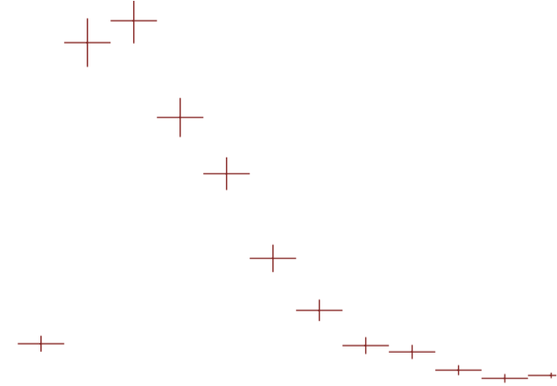
Zusammenfassung
bis zu 4n detektierbar
(γ,n) Reaktionen
weitab des Stabilitätstals
R³B
Auflösung von 20 keV

Slide 49
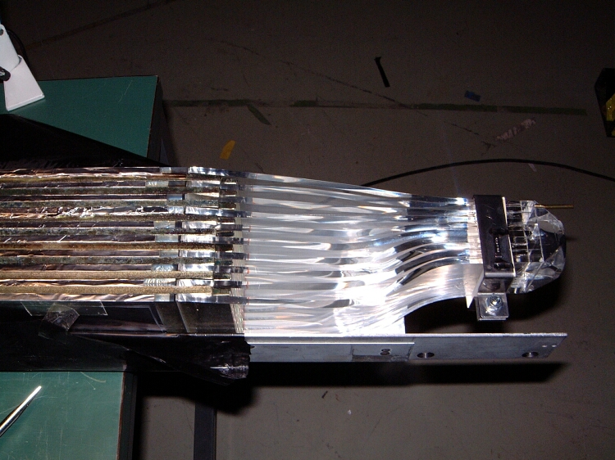
One paddle contains 11 sheets of iron, each 5 mm thick (the two outer ones have a thickness of 2.5 mm) and 10 sheets of scintillator with a thickness of 5 mm
The scintillation light is read out at both ends od the scintillator with photomultipliers.

Slide 50
Coulomb-Aufbruchmethode
^{A-1}X
n
^{A}X*
535 AMeV
^{A}X
Pb
σ_{COULEX} = σ_{Pb} - σ_{nuklear}
Notes:
Strahl oder Kern statt Teilchen
hohes Z

Slide 51
⁶⁰Fe excitation spectrum
virtual photon theory
detailed balance
E_{γ}
2(2J_{60Fe}+1)
1
²
σ_{(n,γ)}=
σ_{(γ,n)}
(2J_{59Fe}+1) (2J_{n}+1)
μc²
E_{rel}

Slide 52







Readout Electronics (Developed in GSI)
TacQuila (have been used also for LAND)
  TAC-based TDC + QDC
  Limitation: multi-hit incapable
TAMEX (new generation, under development)
  FPGA-based TDC + QTC
  Advantage: multi-hit capable
TRIPLEX
QDC
FEE
TacQuila
QTC+comparator
new FEE
TRIPLEX
Rearrangement in progress.

