Slide 1

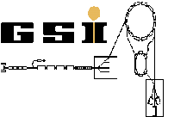






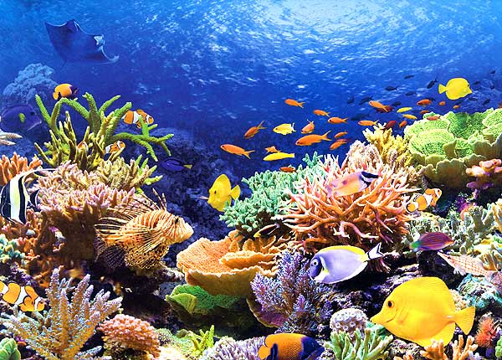
Status of the CBM – MVD…
…and what it has to do with this picture.
M. Deveaux, GU Frankfurt
for the CBM-MVD collaboration.

Slide 2
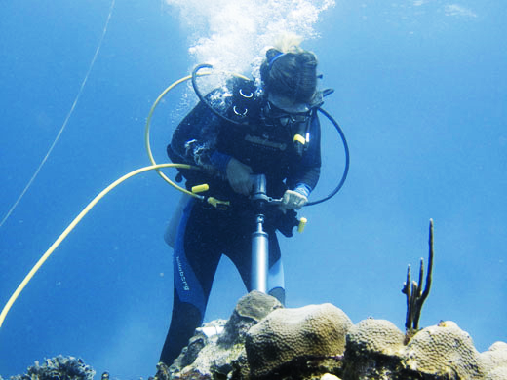
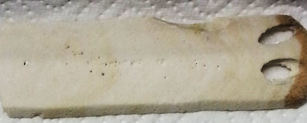
HIC for FAIR in climatic science
Corall reefs form annual rings.
Distance and density [g/cm³] depends on climax..
Idea:
Take proves from reefs
Reconstruct climax data
Challenge:
Rings hard to see by eye.
Density information needed.
=> Needs calibrated X-ray

Slide 3
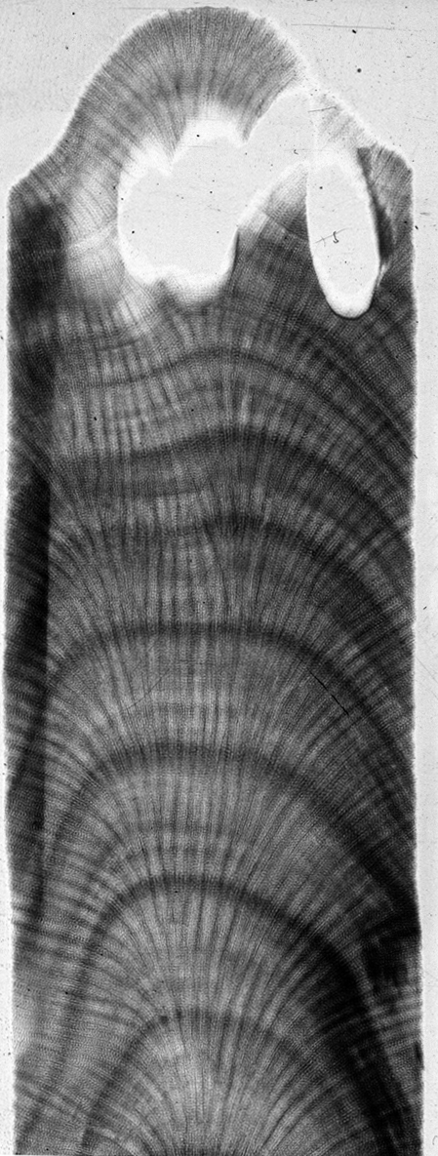
Standard X-ray
Visual
Standard X-ray
Rings easy to see, but
Uses standard X-ray tube => Contineous spectrum.
Uses standard X-ray film => Non-linear and non-trivial response.
Use monochromatic source (e.g. Am-241 => 59.9 keV)
Use single particle counting (e.g. scintillator detector)
Raster scan probe with high resolution
Together with Prof. E. Gischler (Geology GU Frankfurt), supported by DFG
B.E. Chalker, D.J. Barnes,
„Gamme sensitometriy for the measurement of skeletal density“,
Coral Reefs (1990) 9:11-23

Slide 4
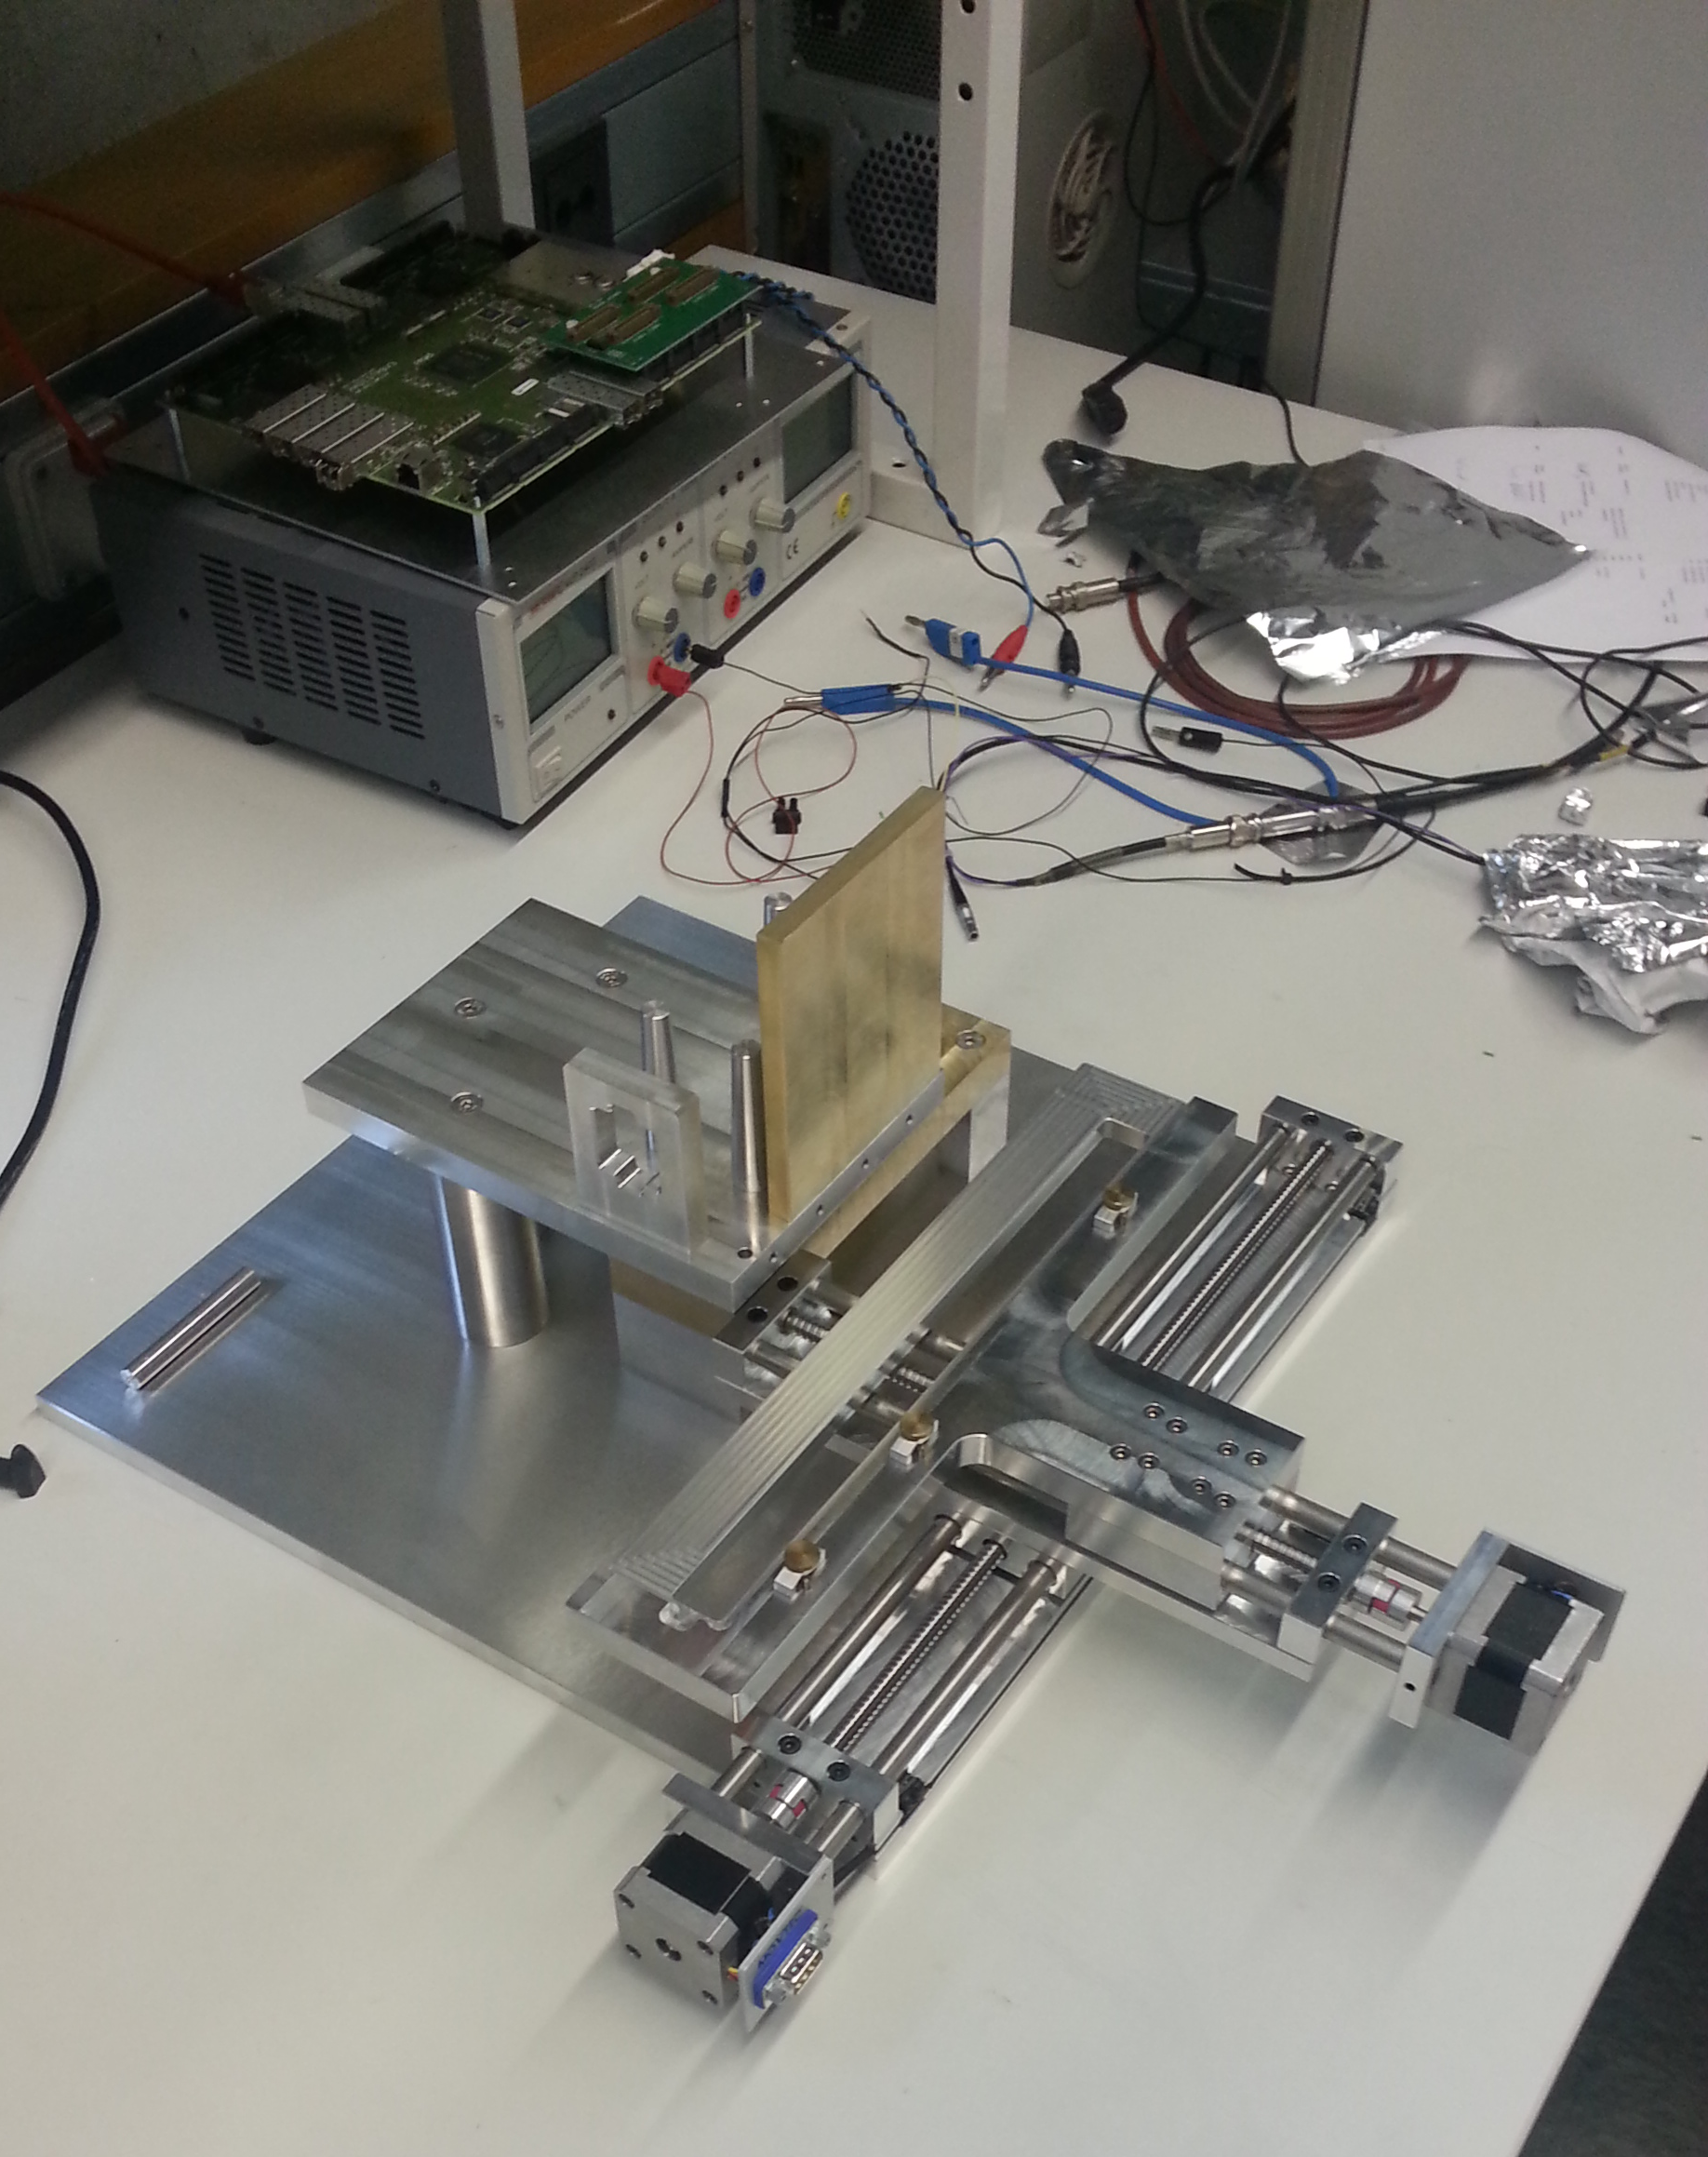
A dedicated X-ray
²⁴¹Am
Probe
Collimator
Scintillator
PMT
FAIR – Electronics
PADIWA Board
known from
CBM – RICH
PANDA – DIRC

Slide 5
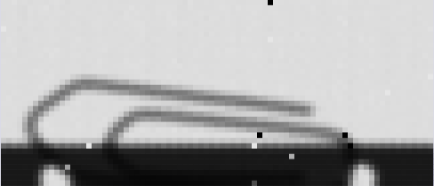
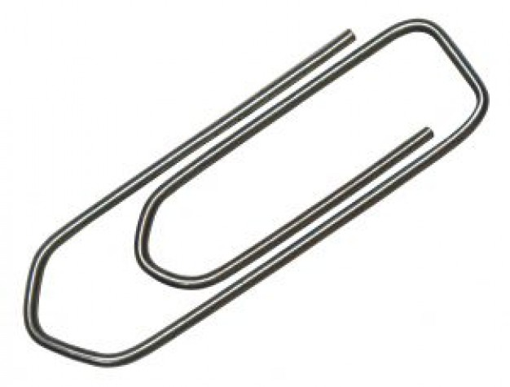
First results
Linearity
„Pixel“: 500x500 µm²
Spatial resolution

Slide 6
First results
Density Scan (this work)
Visual
Standard X-ray
Looks promising. More to come, stay tuned.
Note: HIC for FAIR is doing climate science ☺

Slide 7
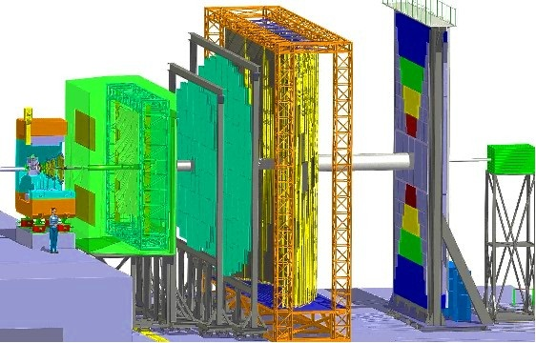
Back to CBM
We are here

Slide 8
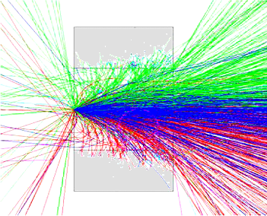
Open charm reconstruction: Concept
z
Reconstructing open charm requires:
Excellent secondary vertex
resolution (~ 50 µm)
=> Excellent spatial resolution (~5 µm)
=> Very low material budget (few 0.1 % X₀)
=> Detectors in vacuum
Target
(Gold)
Detector2
Detector 1
Primary Beam: 25 AGeV Au Ions (up to 10⁹/s)
Primary
vertex
Secondary
vertex
A good time resolution to distinguish
the individual collisions (few 10 µs)
Short lived particle
D⁰ (cτ = ~ 120 µm)
Reconstruction concept for open charm
Very good radiation tolerance
(>10¹³ n_{eq}/cm²)
Central Au + Au collision (25 AGeV)

Slide 9
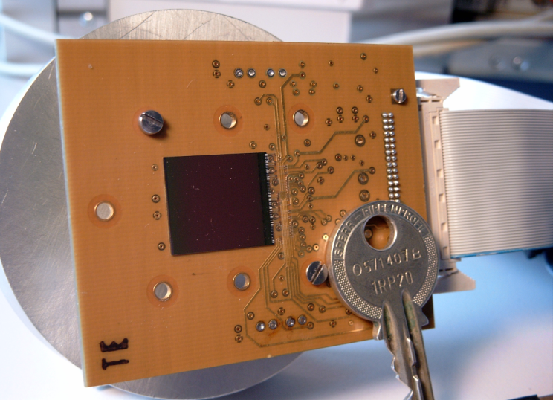
Performances of MAPS (2003)
MAPS provide an unique compromise between:
sensitivity
high rate capability
R&D is needed on radiation tolerance and read-out speed.
 | Required | Hybrid pixels
Single point res. [µm] | ~ 5 | ~ 30
Material budget [ X₀ ] | ~ 0.3% | 1%
Time resolution [µs] | few 10 | 0.025
Rad. hardness [n/cm²] | > 10¹³ | >> 10¹⁴
CCD
~ 5
~0.1%*
~100
<< 10¹⁰
MIMOSA-5 (2001)
3.5
~0.1%*
~25000
~ 10¹²
*Sensor only

Slide 10

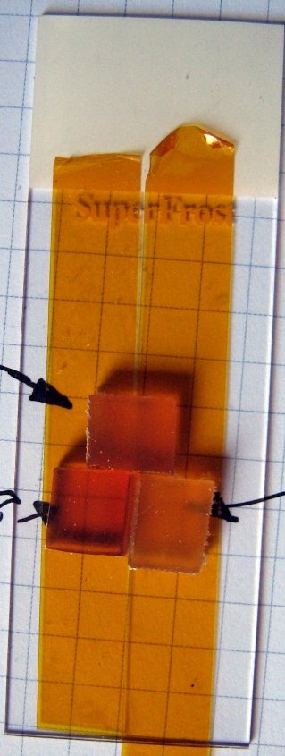
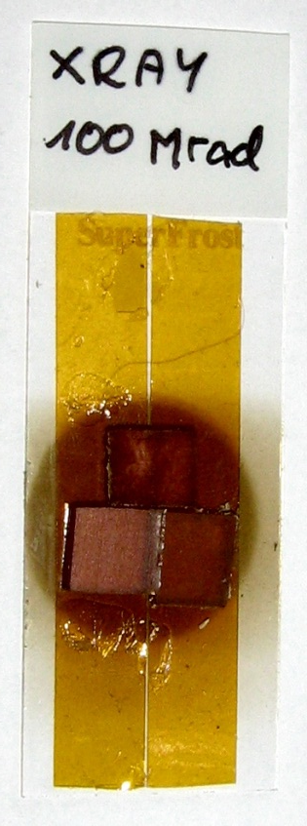
CBM activities: Grilling glue with X-rays
+
=
Before grilling.
After grilling.

Slide 11
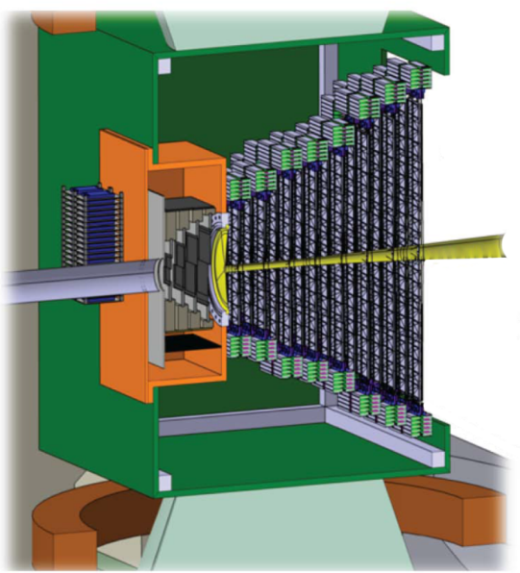
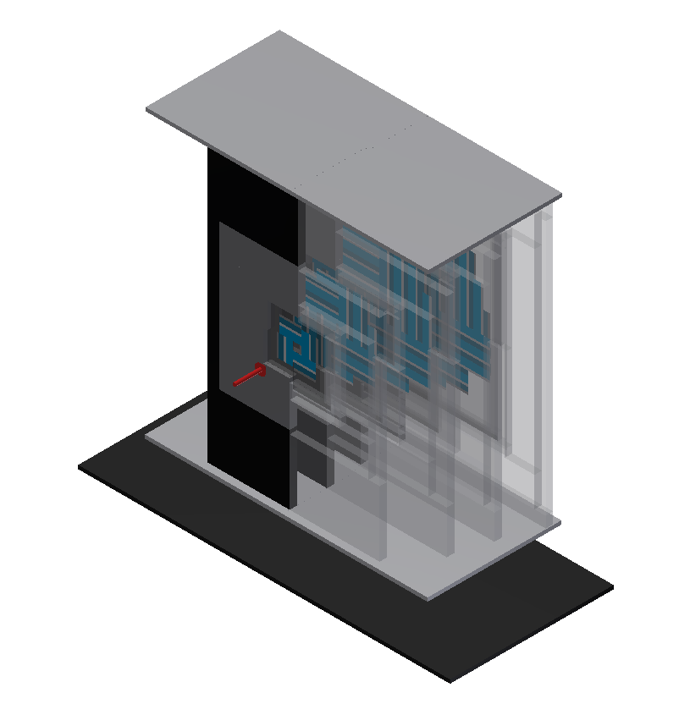
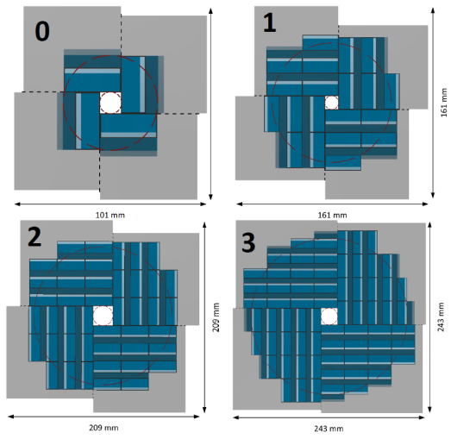
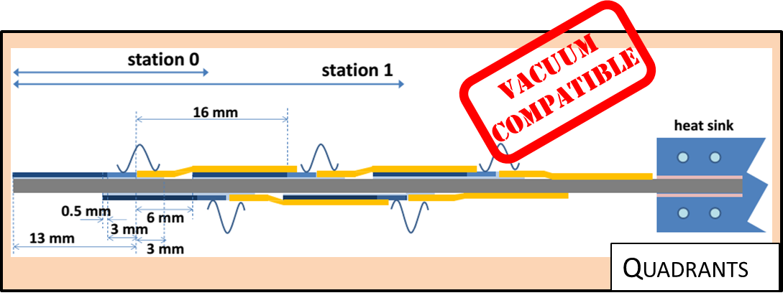
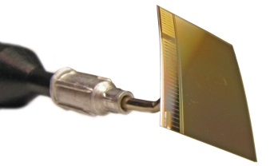
Why grilling glue?
2
3
MVD
CAD model
1
0
The CBM-MVD
Station
MAPS
Monolithic Active Pixel Sensor
Ladder

Slide 12

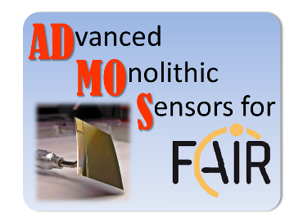
Progresses in Sensor R&D
From D. Doering,
PhD – defense, 31.03.2015
Sensor R&D is being continued… almost there. But how to glue them?

Slide 13

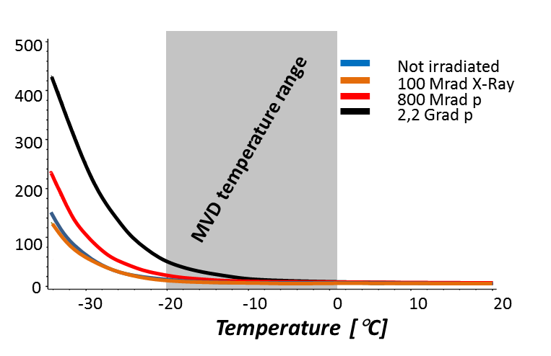
Study on gluing sensors
Glue requirements | Epoxy based | Silicone based
Radiation tolerance | Yes | Limited
Easy to rework | No* | Yes
Low material budget | Yes | No
Strength | Yes | Medium
Low outgassing | Yes | No
Soft at -20 C | No* | Yes
High thermal conductivity | No* | No
RAL-247 features:
Glass temperature (Tg) @ -45 °C
viscosity of below 100 mPa.s.
curing time 48h @ +50 °C and more than a week at 20 °C.
Tolerance to radiation ?
Development at the Rutherford Appleton Laboratory (RAL)
Synergy with the ATLAS expreiment
Not very convincing.
What to do?
Develop your own glue.
Novel glue seems to match CBM-MVD requirements

Slide 14
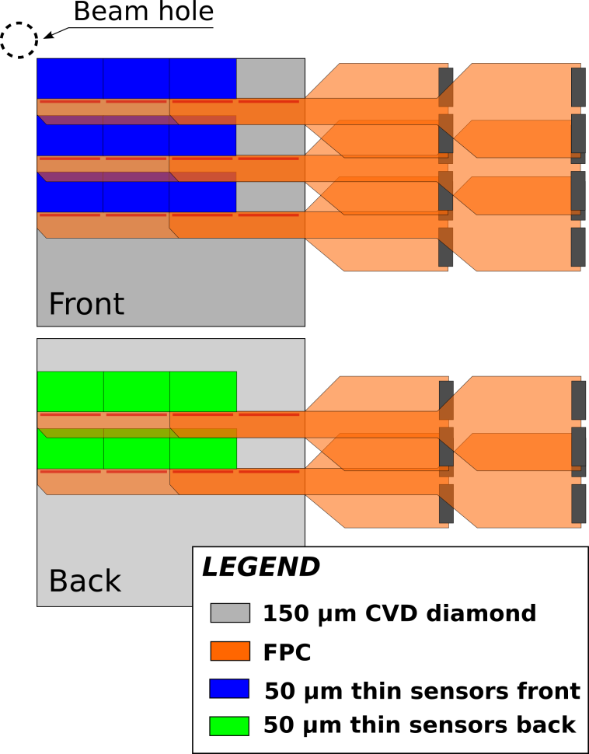
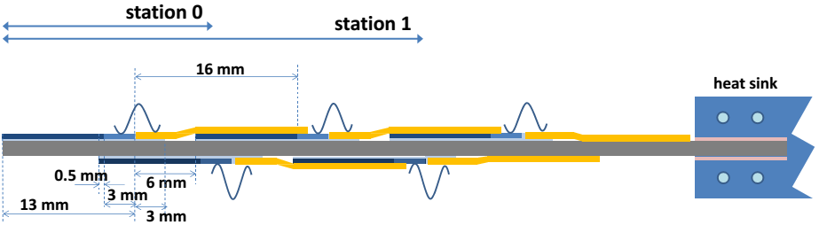
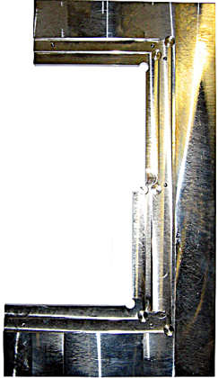
PRESTO: PREcurser of the Second sTatiOn
PRESTO:
15 Sensors (MIMOSA26AHR)
  50µm thick
  33 MPixel of 18.4x18.4µm²
150µm thin CVD – diamond support
Novel ultra-thin cables
New DAQ system
Needed / Study:
Sensor commisioning
10 FPCs
Support
Adhesive
R/O electronics
Cooltec®
Heat-sinks

Slide 15

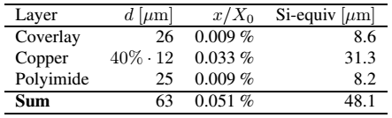
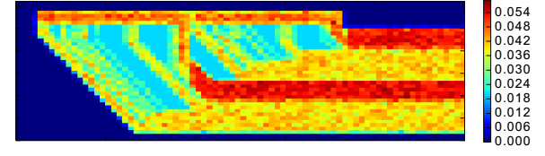
New cables – Material budget
x/X₀ [%]
1st tests: it works !!!
Quality: under investigation
PRESTO material budget:
Maximum ≈ 0,35-0.40% x/X₀
Average ≈ 0.25-0.30% x/X₀
Benchmark for station >0 = 0.5% x/X₀
Hypothetical Al-based FPC material budget (max) ≈ 0.31-0.35% x/X₀

Slide 16
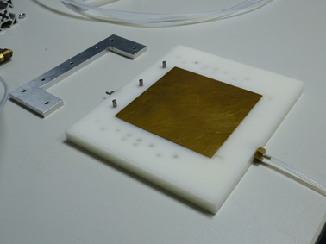
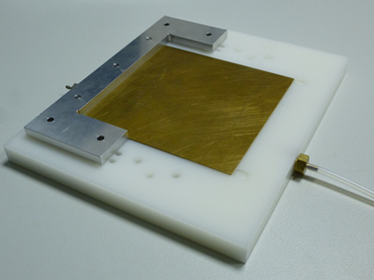
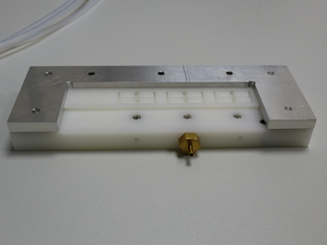
PRESTO - Integration

Slide 17
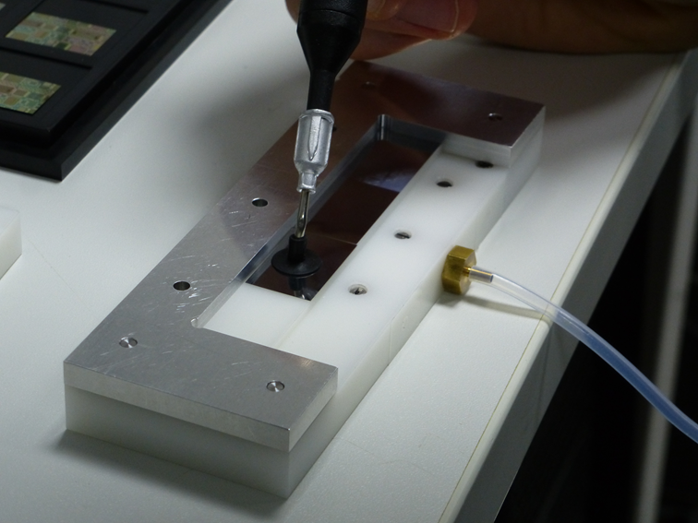
PRESTO - Integration

Slide 18
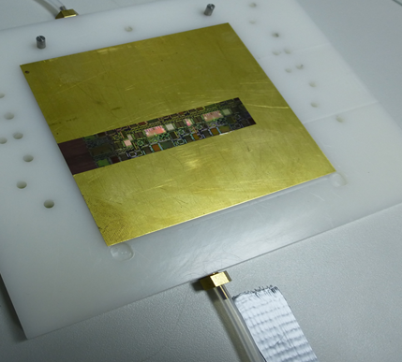

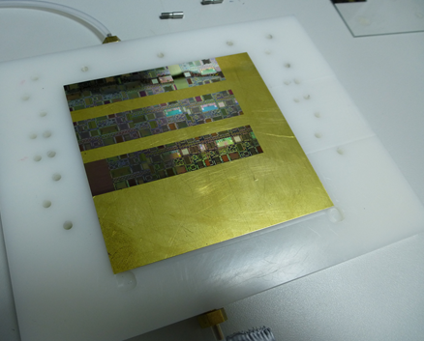
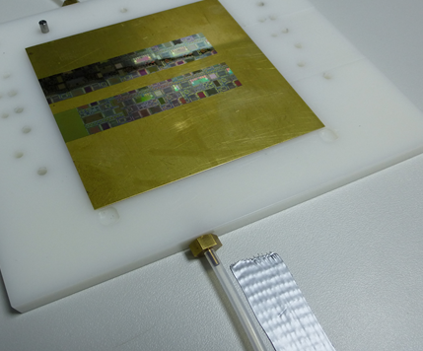
PRESTO - Integration

Slide 19
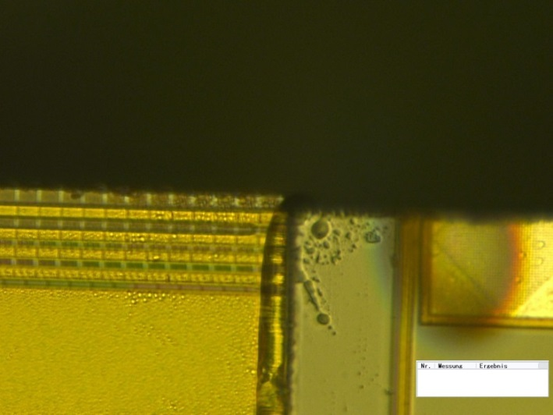
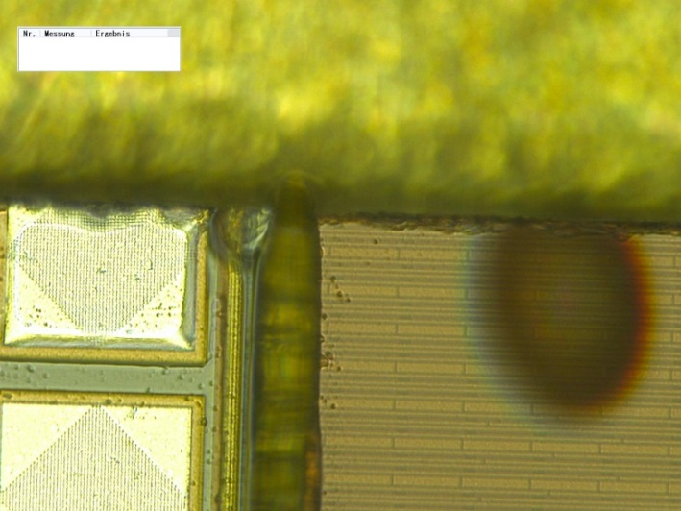
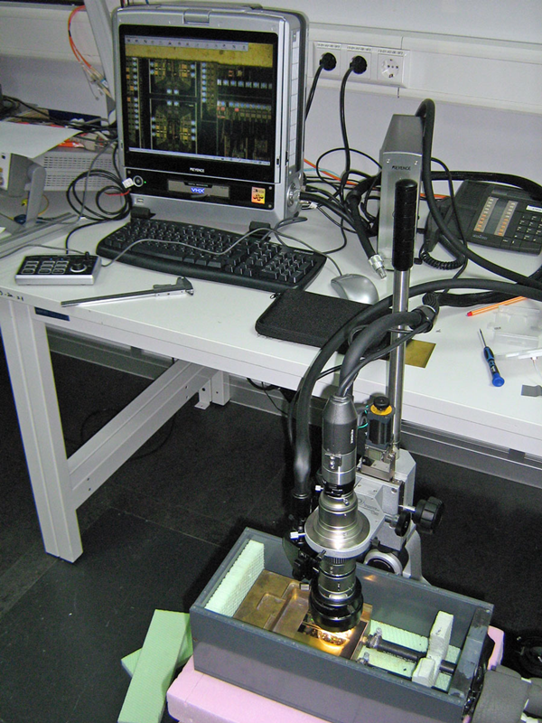
PRESTO – Precision of Integration
Misaligned sensors
# entries
Measured edge-to-edge distance [µm]
Keyence microscope
Effective resolution ~1 µm
Alignment precision much better then goal ( ~100 μm)

Slide 20
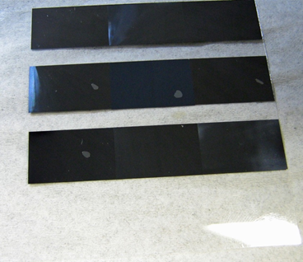
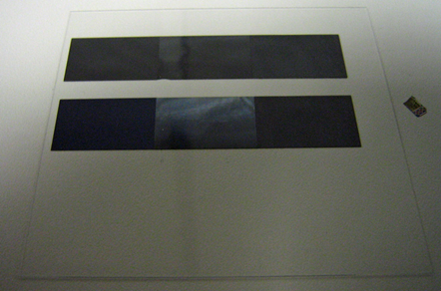
PRESTO – Vacuum compatible gluing
Task: Find procedure for vacuum compatible gluing (no bubbles)
Solution (dummy chip on glas):
Keep glue 1 hour in desiccator (remove bubbles)
Use defined amount of glue
5 µl
4 µl
3 µl
Perfect results with 5µl/sensor
Bubble (too few glue)
Procedure for vacuum-compatible gluing of 50 μm thin sensors was established.

Slide 21
The CBM MVD digitizer
Digitizer - Represent:
Response of sensors.
Precise geometry of MVD.
Limitations of internal bandwith.
Misallignment.
Eventually raw data.
Use on green cube one day:
Should be data parallel.
Should be suited for parallel processing.
Adapt to progress in sensor R&D
Flexible implementation needed.
Should be easy to exchange/extend models.
2
3
MVD
CAD model
1
0

Slide 22
Where are we parallel?
CbmMvdSensor
CbmMvdSensor
DataSheet
TGeo-
Manager
CbmMvdGeoInformation
Tasks (Methods like digitizer)
MVD
CAD model
1
2
3
MVDPlugin
0
Buffers (Local data handling)
Data parallel:
All data required for computing is kept by CbmMvdSensor
Tasks of Sensor => 1 Sensor – 1 Threat (shared memory needed).
No conflicting RAM-access during processing.
Flexible:
MVD-Detector = Array of CbmMvdSensor.
Plugins may be exchanged - even during run time.
Using multiple sensor models in parallel is straight forward.

Slide 23
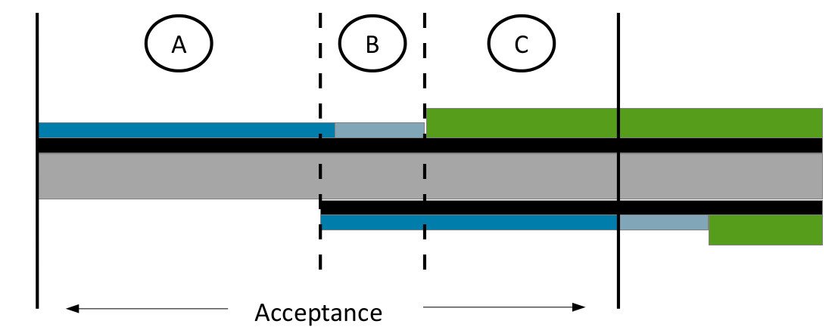
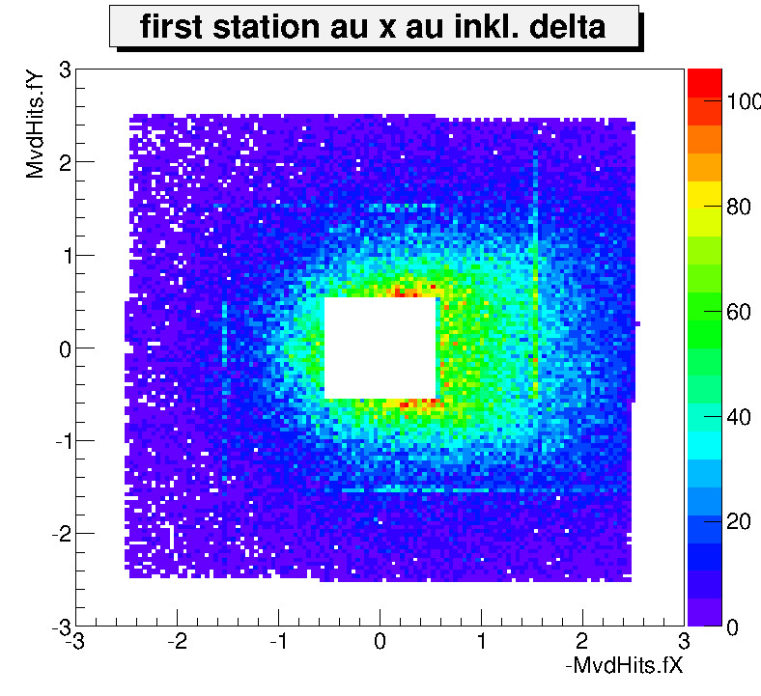
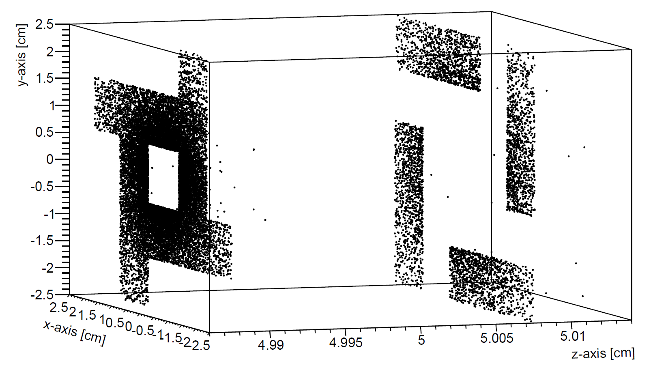
Where is the progress?
Old Geometry
New Geometry
Beam
Beam
Front- and back-side of
station are separated.
Sensor overlap
is represented.

Slide 24
What did we learn (so far)?
Sensor
3 cm
Pixels
Pixels
Pixels
Pixel
Column
1 cm
A
CDS
ADC
SUZE
DATA OUT
0.3 cm
SUZE-02
SUZE-02
SUZE-02
FSBB
FSBB
Limitations per FSBB
3x454x300 pixels,
pitch 22x33 μm
30 μs integration time
6 windows per 32 columns
9 windows per 256 columns
18 windows per sline (454 columns)
640 data packets per frame
Row (30 bit)
+ Window (30 bit)
0
1
2
3
4
UrQMD
GEANT3
MVD Digitizer
SUZE-2

Slide 25
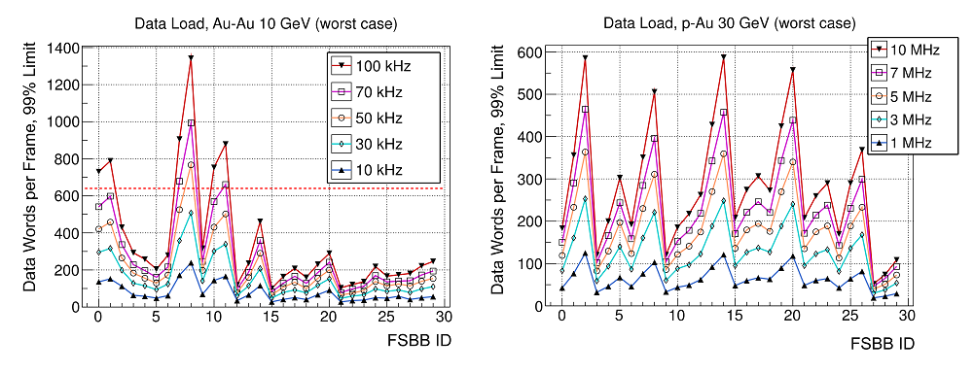
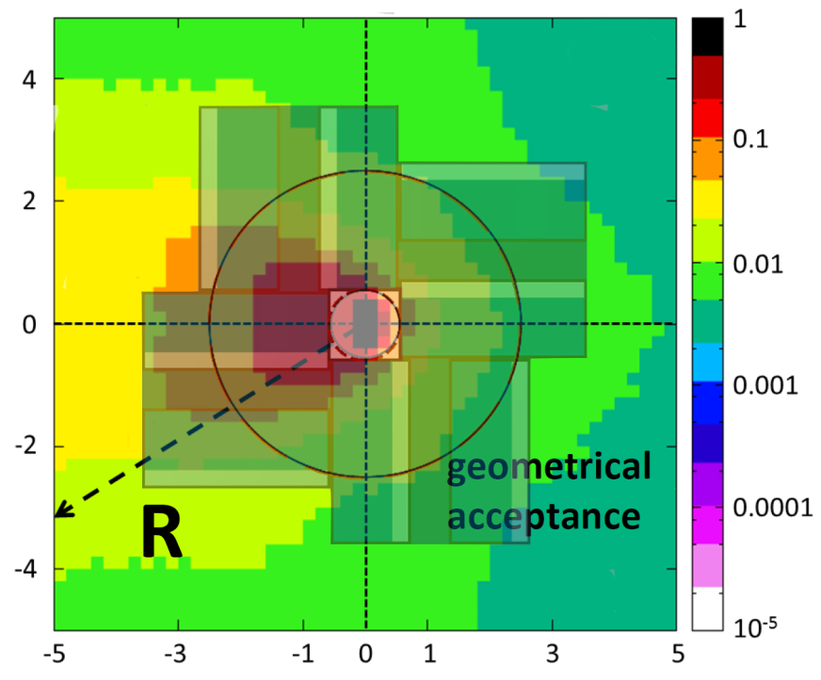
What did we learn so far?
N_{eq} [1/Ai Ion/cm²
Generated data words per frame which produce the bandwidth limit.
Current bandwidth (FSBB) is suited for:
10 MHz p-A (first station at 5 cm)
100kHz A-A (first station at 10 cm)

Slide 26
Background rejection with the MVD
Goal:
Probe fireball with light vector mesons (ρ, ω and ϕ) decaying to e+/e- - pairs.
Challenge:
Need to reduce background.
Charge, Momentum
Track segment
π⁰ -> γ e⁺ e⁻
γ_{medium} -> e⁺ e⁻
Global track
No MVD
Idea:
Use MVD to find second decay partner.
Eliminate identified background pairs.
Track fragment
STS
RICH
…
Charge,
Momentum,
ID
Tracking of low momentum tracks, helps to suppress background (mainly from conversion) as being e.g. well established by HADES collaboration.
GeV/c²
0-0.15
0.15-0.6
0.6-1.2
ω→ e⁺ e⁻
φ→ e⁺ e⁻

Slide 27
Summary and Conclusion
Wide range of activities towards the CBM-MVD
Precursor of station 2 in 2015
Flexibility to adopt to physics case
The CBM sensors is almost defined, tuning w.r.t. R/O stage, synergy with other experiments, mainly STAR (running!) and ALICE upgrade
TDR expected in 2015
Sometimes, research works
in mysterious ways.

