Slide 1


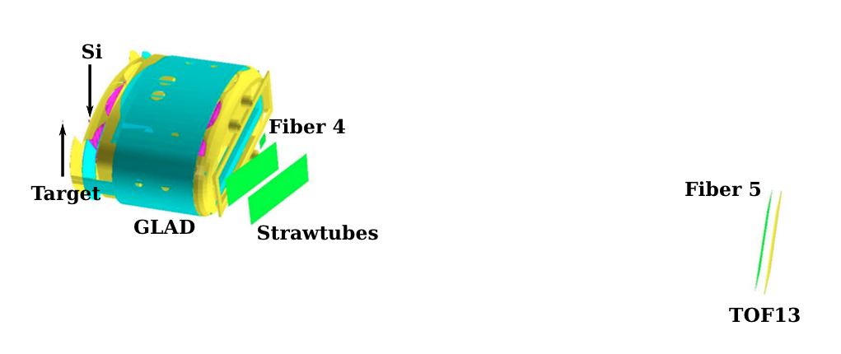


The in-beam tracking detectors for R³B
Stefanos Paschalis
Michael Heil, Jacob Johansen, Anatoly Krivshich, Thomas Aumann, Heiko Scheit,
the R³B in-beam tracking working group and
the R³B collaboration

Slide 2
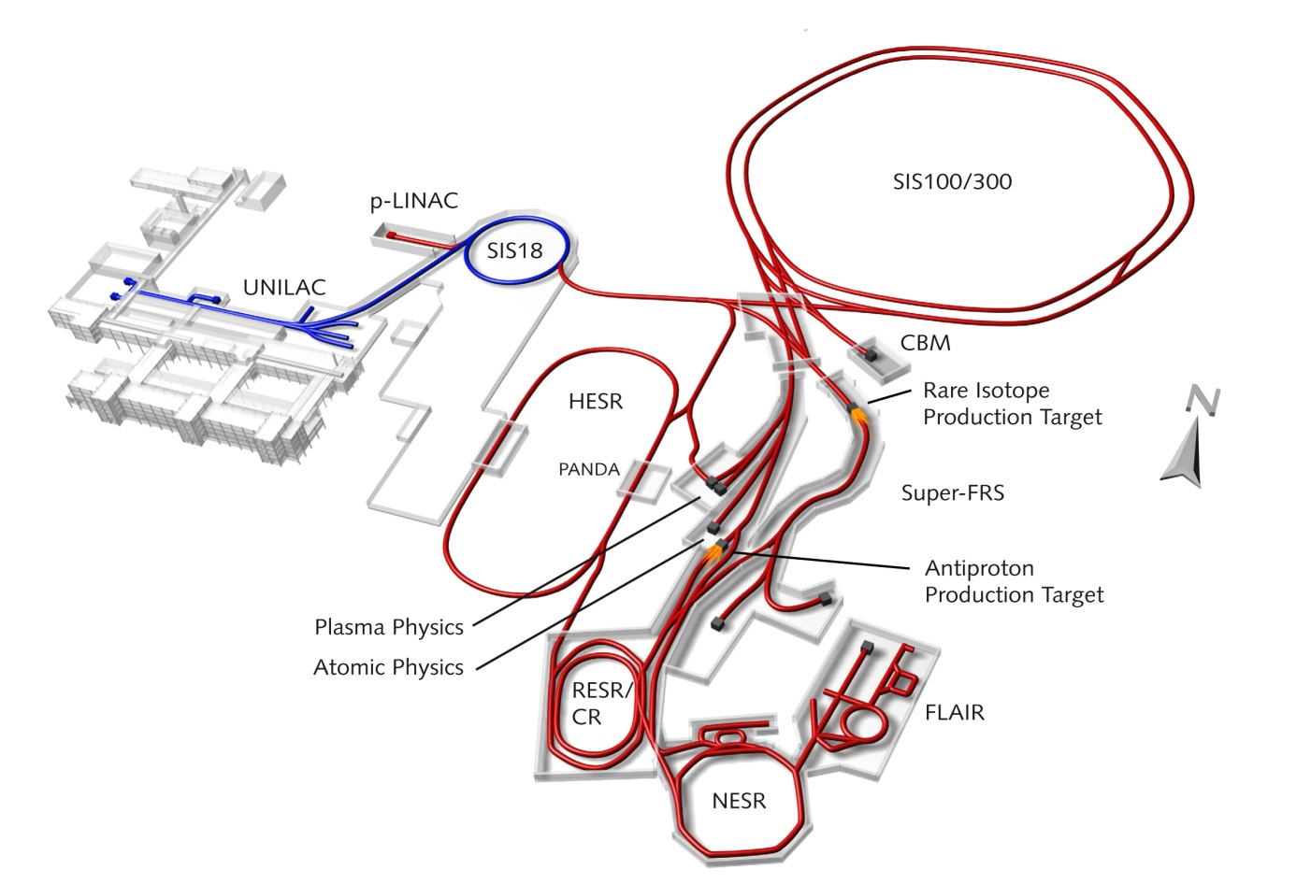
The FAIR facility
Existing
Primary beams
Faster cycling (3Hz instead of 0.3Hz)
10¹²/s 1.5-2 GeV/u ²³⁸U²⁸⁺
10¹⁰/s 35 GeV/u ²³⁸U⁷³⁺
Secondary beams
1.5-2 GeV/u
Beam intensity improvement FRS – Super-FRS: 10² to 10⁵
To be built
Notes:
The R3B experiment is located at the FAIR facility. Current GSI facility in Darmstadt and the planned/under construction FAIR facility. The FAIR facility offers higher beam energies and much higher intensities. State of the art experiments are prepared for proton-antiproton, heavy-ion collision, applied research and nuclear physics. Besides the low energy stable-beam nuclear physics experiments at UNILAC, most of the action for nuclear physics takes place after the accelerated high energy beam impinges on the production target. The reaction products are selected and identified by the fragment separator and then sent to the experimental apparatuses. With the new fragment separator a gain of 100 to 100000 in beam intensity will become possible.

Slide 3
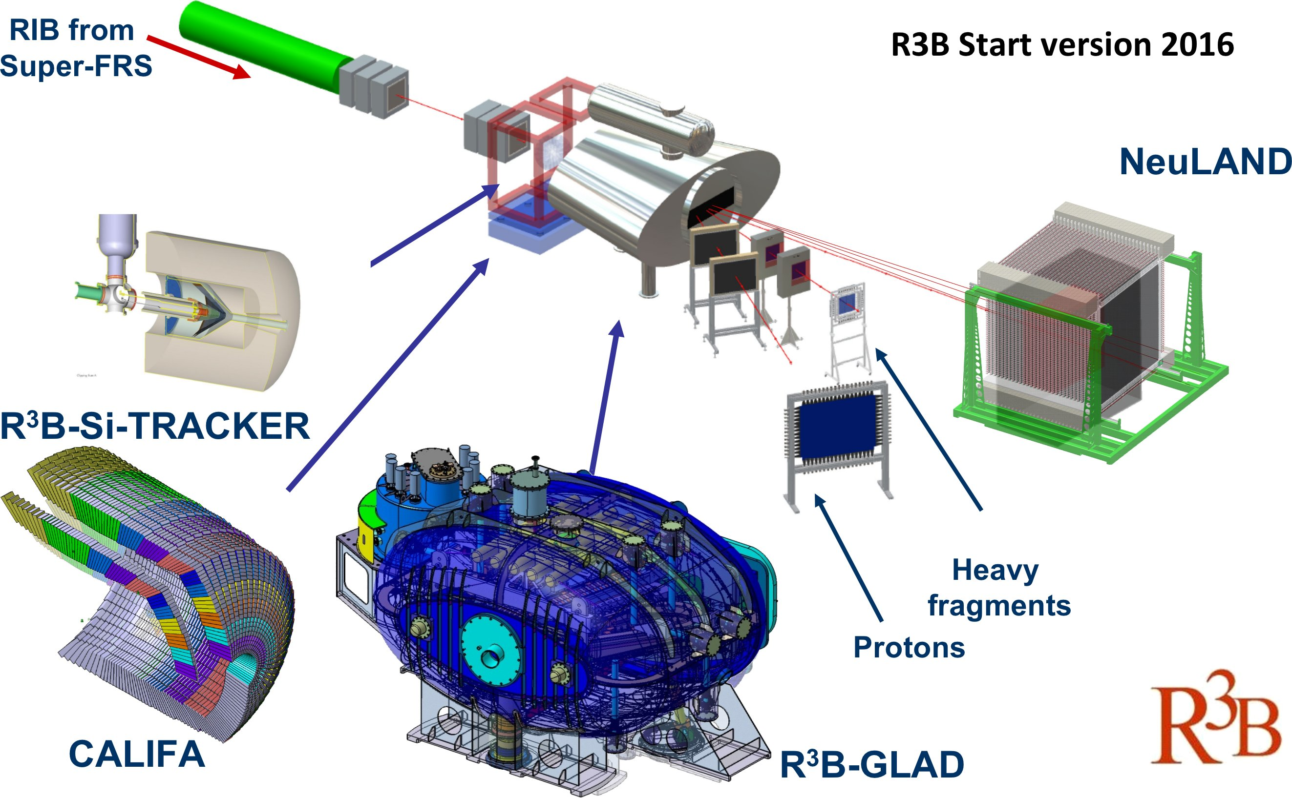
Reactions with Relativistic Radioactive Beams
R³B – setup
R³B Start version
Notes:
The secondary beam from the FRS reacts with the secondary target at the entrance of the experimental hall. The beam-like fragments fly through the large superconducting dipole magnet and are bended to the fragment arm. Target recoil detectors (Si tracker and CALIFA calorimeter) around the target register the prompt gamma rays and light particles scattered at large angles.
The daughter nuclei after reaction can also be in an unbound states and decay via particle evaporation which then flies with beam velocity through the magnet. Most commonly neutrons and protons are evaporated and detected in the Large area time-of-flight neutron spectrometer and at the proton arm respectively. This talk is about the fragment and proton arm detection systems.

Slide 4
In-beam tracking detectors
10 m
neutrons
e, t, x, y
dipole magnet
target
incoming beam
e, t, x, y
heavy fragments
e, t, x, y
protons
e, t, x, y
Notes:
Coming back to the specific subject of the this talk. The future in-beam tracking detectors of R3B. The same setup from a top view. The incoming angle, time and energy loss of the secondary beam from the fragment separator is measured before the target. After the target the beam-like charged fragments are tracked through the dipole magnet with a series of position, time-of-flight and energy loss measurements. Again evaporated protons are bended into the proton arm.

Slide 5
In-beam tracking detectors
Energy loss ➔ Nuclear charge Z
Time of Flight + Trajectory ➔ Mass identification, momentum
10 m
neutrons
e, t, x, y
target
incoming beam
e, t, x, y
heavy fragments
e, t, x, y
protons
e, t, x, y
Notes:
From the energy loss measurements we obtain the charge of the ions and from the time of flight and positions one determines the trajectories and thus mass identification and momentum.

Slide 6
Specifications
Charge of heavy fragments with a resolution of ∆Z/Z ∼ 0.5% (σ)
Mass and momentum with a resolution ∆A/A ∼ ∆P/P ∼ 10⁻³ (σ)
High-rate mode of up to 1 MHz
Multi-hit capability
Large momentum acceptance of up to 20%
Total tracking detection efficiency > 85%
Notes:
The specifications for the complete tracking system is to achieve an charge resolution of …. mass resolution of … high rate ……

Slide 7
Specifications
Charge of heavy fragments with a resolution of ∆Z/Z ∼ 0.5% (σ)→∆E/E ∼ 1.0%
Mass and momentum with a resolution ∆A/A ∼ ∆P/P ∼ 10⁻³ (σ) → ∆Tof ∼ 20 ps, → ∆x ~ 100 um
High-rate mode of up to 1 MHz → Fast plastic scintillators
Multi-hit capability → High-granularity detectors
Large momentum acceptance of up to 20% → Large-area detectors
Total tracking detection efficiency > 85% → High-efficiency detectors
Notes:
These specifications set the requirements for the tracking detectors to have an energy resolution of 1%, a timing resolution of …and position resolution of ….
To be able to perform at high beam rates we need fast detectors, to enable mulit-hit detection high granularity is required …..

Slide 8
Specifications
Charge of heavy fragments with a resolution of ∆Z/Z ∼ 0.5% (σ)→∆E/E ∼ 1.0%
Mass and momentum with a resolution ∆A/A ∼ ∆P/P ∼ 10⁻³ (σ) → ∆Tof ∼ 20 ps, → ∆x ~ 100 um
High-rate mode of up to 1 MHz → Fast plastic scintillators
Multi-hit capability → High-granularity detectors
Large momentum acceptance of up to 20% → Large-area detectors
Total tracking detection efficiency > 85% → High-efficiency detectors
Minimum material budget X/X0 ~ 0.05% - 0.3% / detector
Notes:
These specifications set the requirements for the tracking detectors to have an energy resolution of 1%, a timing resolution of …and position resolution of ….
To be able to perform at high beam rates we need fast detectors, to enable mulit-hit detection high granularity is required …..

Slide 9
In-beam tracking detectors
Energy loss ➔ Nuclear charge Z
Time of Flight + Trajectory ➔ Mass identification, momentum
10 m
fiber detectors
plastic
detector
target
Si & fiber
detectors
strawtube detectors
plastic paddles wall
Notes:
In order to meet these specifications and also based on the existing know how within the collaboration we work on the construction and optimization of a combination of detectors ranging from Si to plastic scintillator material and gas detectors.

Slide 10
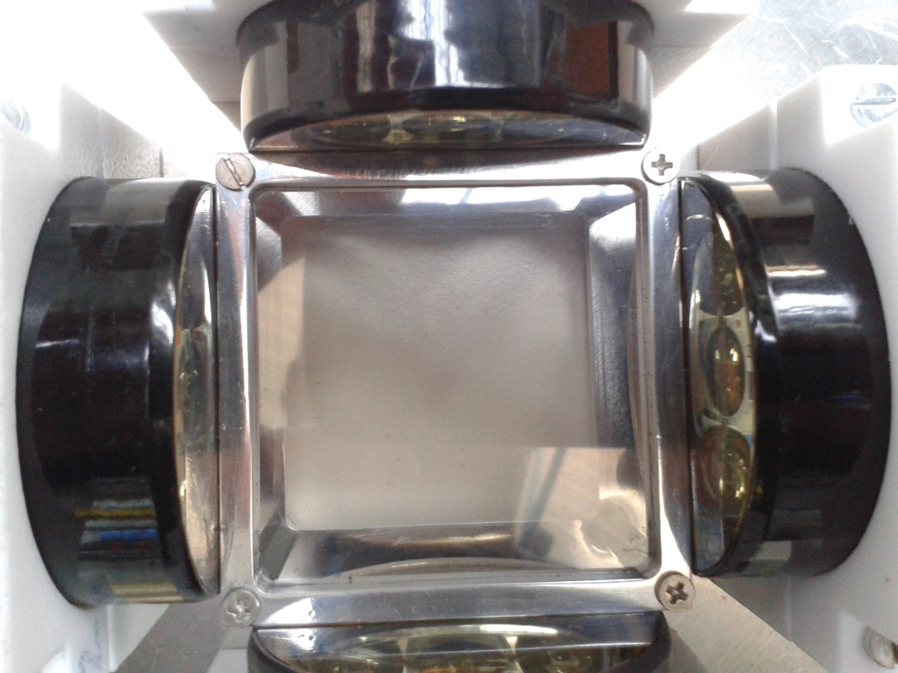
Start-timing detector (plastic scintillator foil)
Timing
10 m
plastic
detector
5 cm
Thickness 50 – 500 um foil
Size 5x5 cm²
Notes:
More specifically the so called start timing detector is the simplest of the detectors and constitutes only by a thin file with sizes that match perfectly the diameter of the PM tubes in order to optimize the light collection and thus time of flight.
Its position being close to the target means that the beam is rather focused in the target region and thus 5x5 cm suffice.
The thickness of the foil is chosen in order to have adequate light output with the minimum material. For the heavier beams thicknesses of just about 50 um are enough.

Slide 11
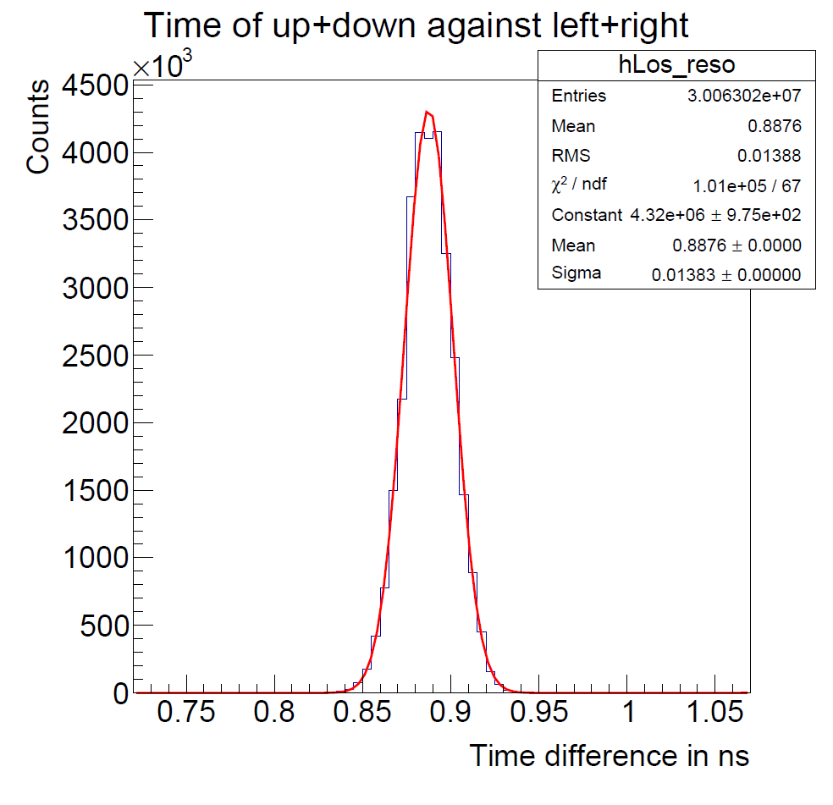
Start-timing detector: in-beam time resolution
⁵⁸Ni @ 500MeV/u
5x5 cm²
0.5 mm thick
EJ230 plastic scintillator foil
Measured ∆t between PM pairs: σ_{t} = 14 ps
➔ time resolution for the full detector: σ_{t} = 7 ps
Ham. R9779-20 PM tube
Tested with Mesytec MCFD16-PMT CFD
and PADI + VFTX readout
M. Heil

Slide 12
Si detectors
Energy loss ➔ Nuclear charge Z
2D position ➔ Trajectory
10 m
`
fiber detectors
10 cm
Si detectors
Thickness 100 – 300 um
Double sided – position sensitive 32 strips/side and non pos. sens. 128 strips/side
Size 5x5 cm² – 10x10 cm²
~ 450 channels
Notes:
Also around the target area we foresee a series of Si detectors for charge identification and position measurement. For example for the detector after the target where the fragment distribution can
be rather broad we foresee a fairly large-area Si detector of 10x10 cm and thickness ranging from 100-300 um to optimize charge measurement and minimum material in the beam line.
The detectors that we foresee are of position sensitive type and micro strip type with a pitch of about 700um.

Slide 13
Si detector: in-beam charge resolution
Beam
Z=20
E₂ (a.u.)
5 cm
⁴⁸Ca @ 500MeV/u
Single sided
position sensitive 16-strip detector
300 um thick
MPR-16 Mesytec preamp
FEBEX digitizer
E₁ (a.u.)
Ca (Z=20) fragmented beam
Z-resolution of σ_{Z} = 0.18 z-units (0.9%)

Slide 14
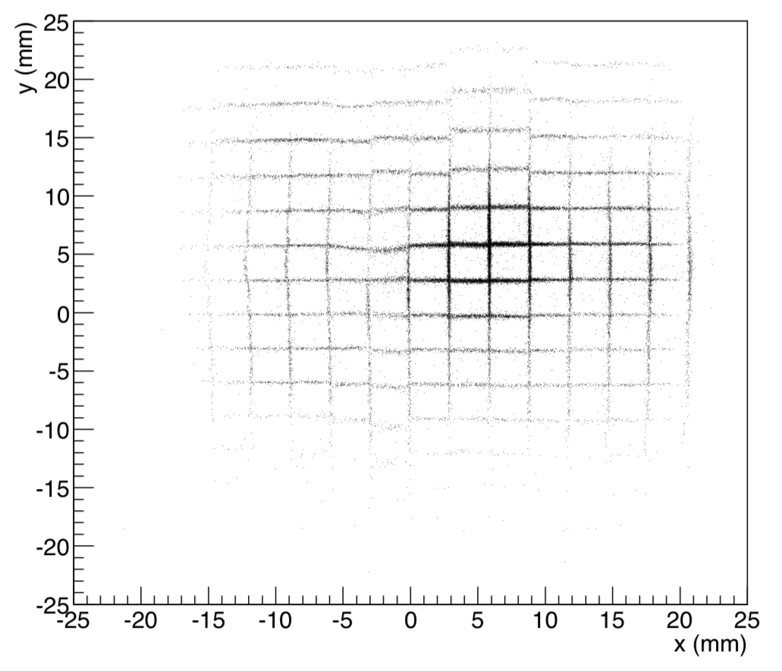
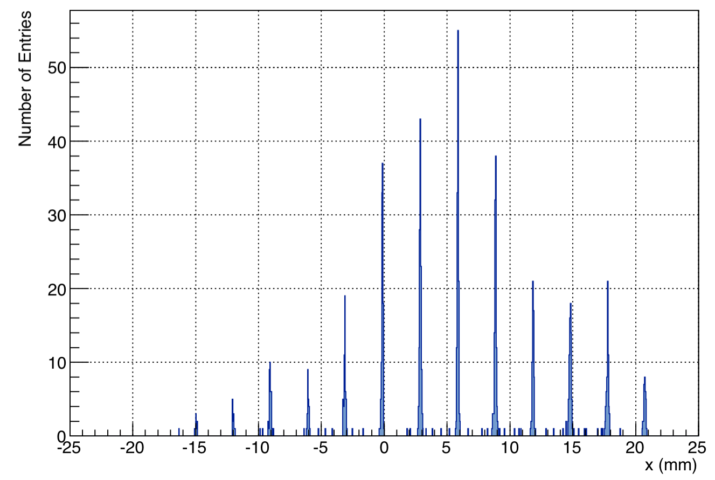
Si detector: in-beam position calibration
Beam
selecting
interstrip
events
5 cm
3.1 mm
Single sided
position sensitive 16-strip detector
300 um thick
MPR-16 Mesytec preamp
FEBEX digitizer
demonstrates <100 um resolution and enables online position calibration !!
⁴⁸Ca @ 500MeV/u

Slide 15
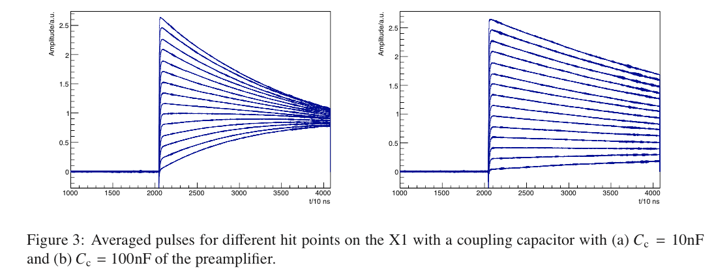
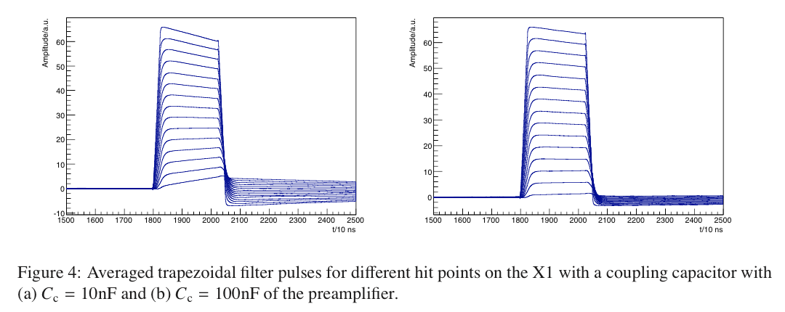
Flash ADC readout allows for detailed pulse-shape analysis
preamp.
signal
integrated
signal

Slide 16
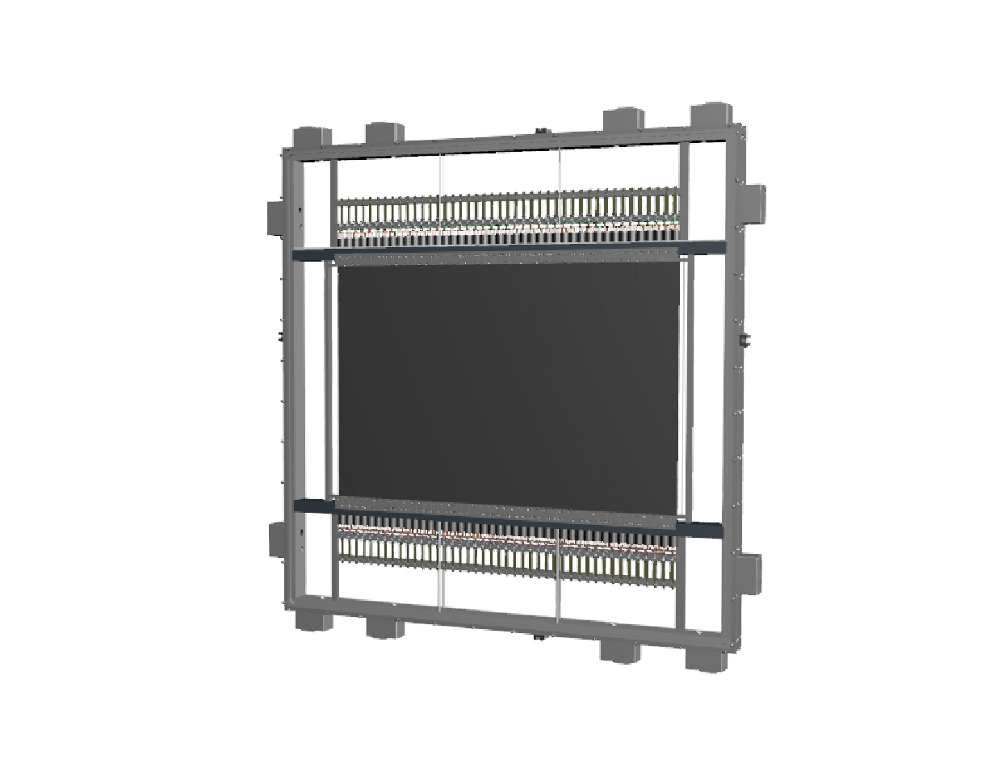
Time-of-flight wall (plastic scintillator paddles)
Energy loss ➔ Nuclear charge Z
Timing
10 m
120 cm
4 layers
44 paddles/layer
Thickness 3 – 5 mm
Size 120x80 cm²
~ 350 channels
strawtube detectors
plastic paddles wall
Notes:
At the end of the flight path a large area time of flight wall made out of plastic scintillator paddles is foreseen. Each paddle has a thickness in the range of 3-5mm and they are placed vertically to cover a total area of … … four layers of paddles is foreseen to guarantee an excellent timing and energy loss measurement.

Slide 17
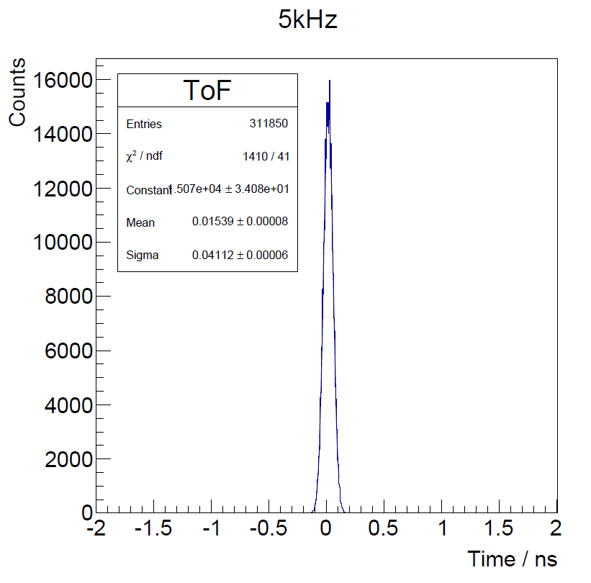
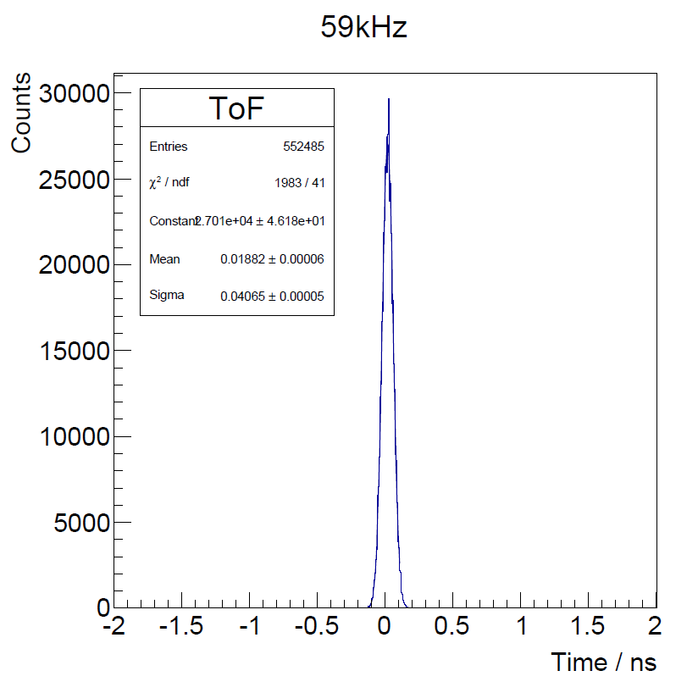
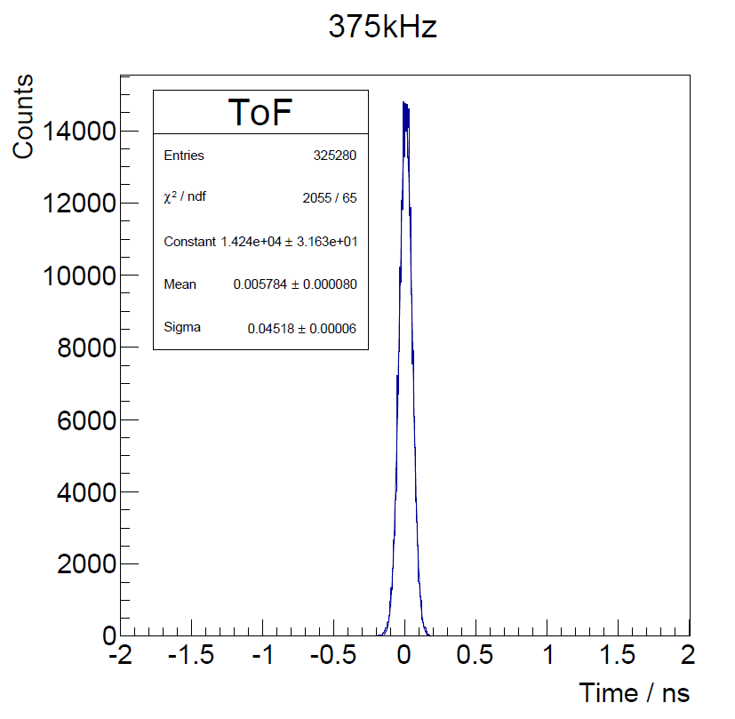
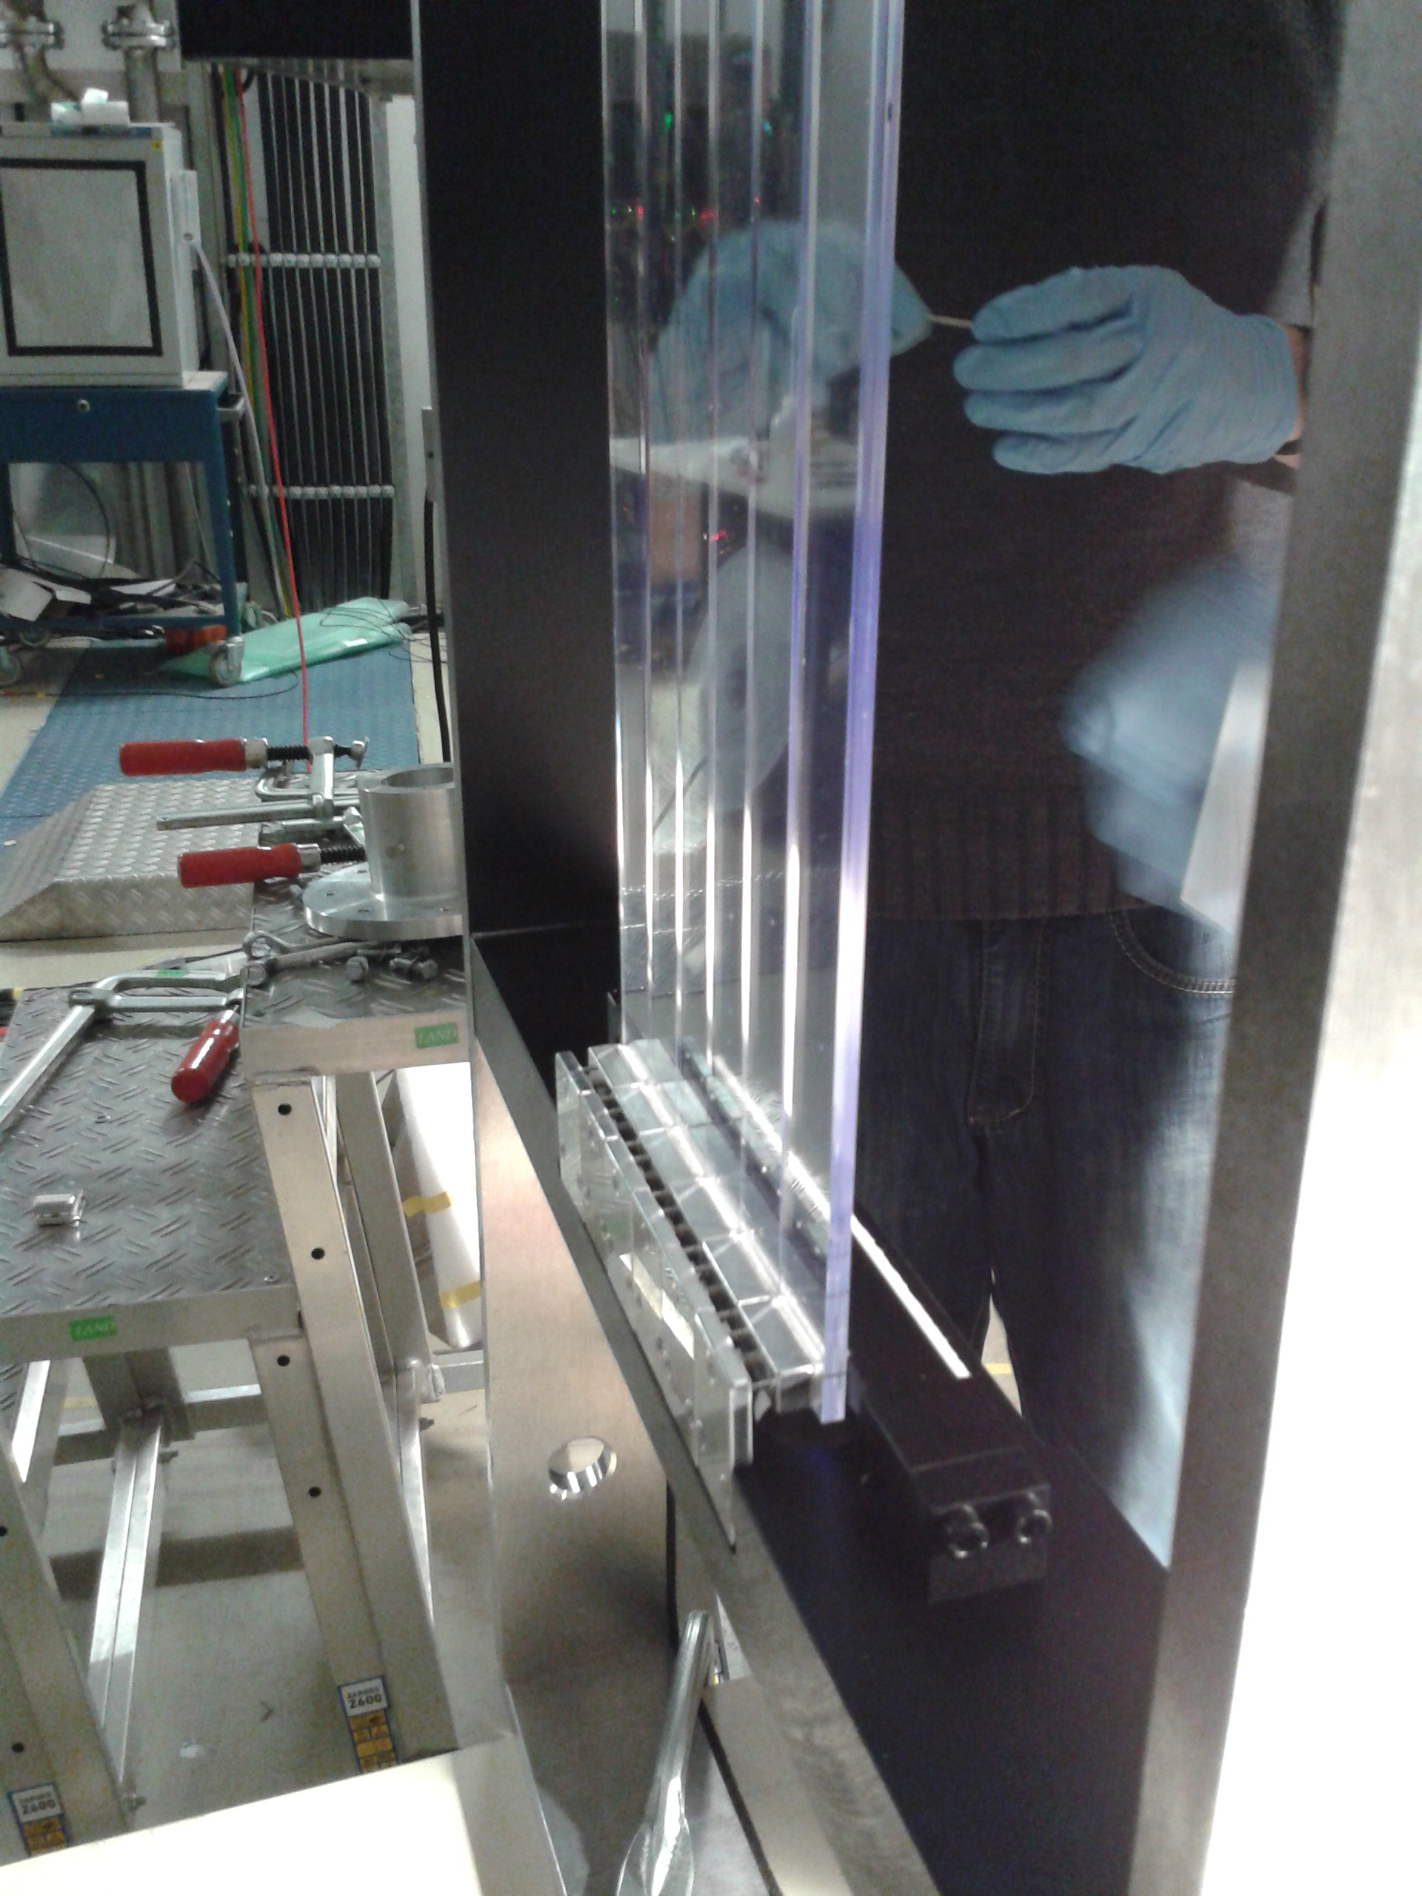
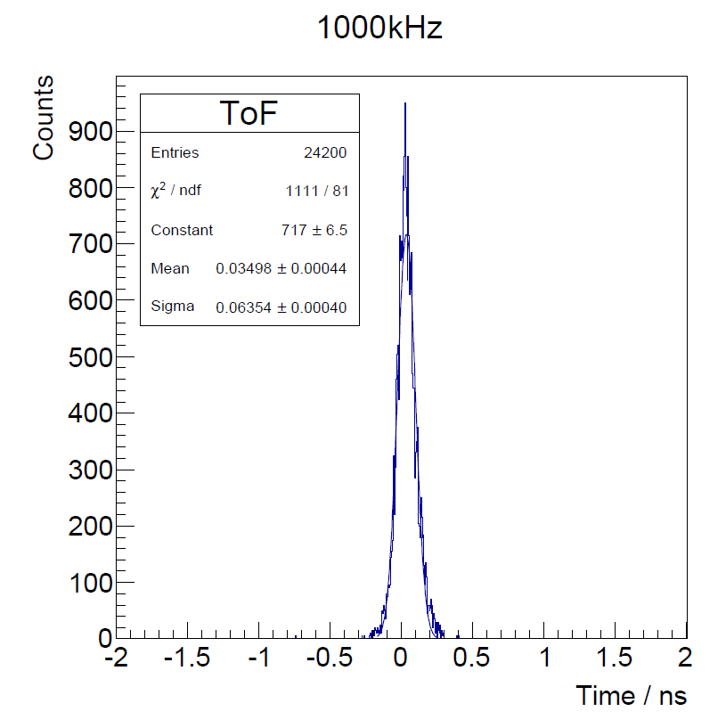
Time-of-flight wall:
in-beam time resolution and high rate
σ_{t} = 41 ps
σ_{t} = 41 ps
σ_{t} = 45 ps
Measured ∆t between 2 paddles: σ_{t} = 38 ps
➔ time resolution for the full detector σ_{t} = 14 ps.
σ_{t} = 64 ps
2.7x80 cm²/paddle
3 – 5 mm thick
EJ204 plastic paddles
PM R8619 (with fully active base)
M. Heil

Slide 18
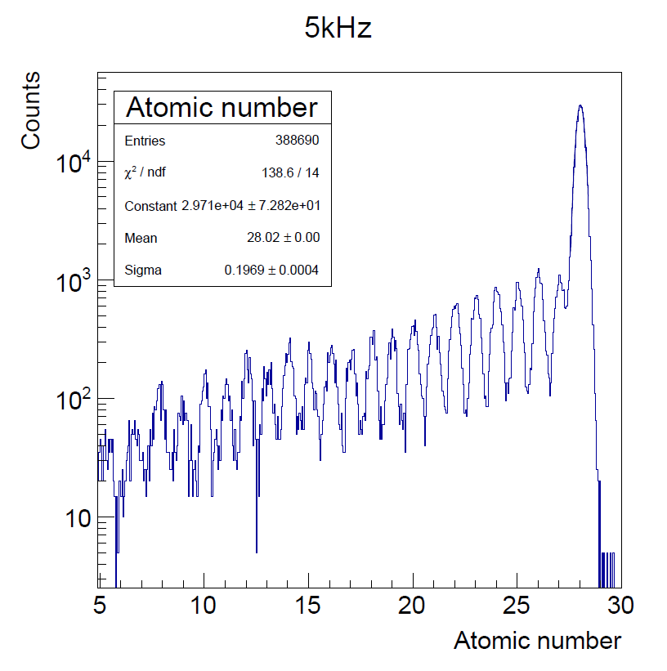
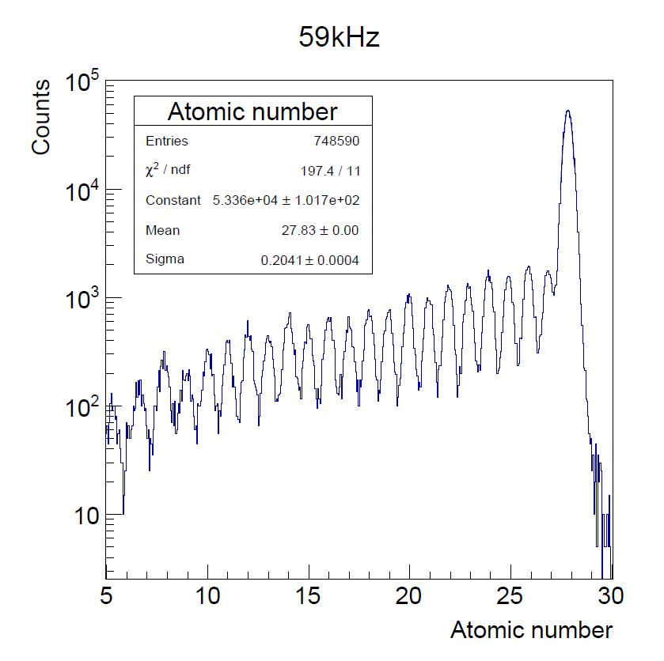
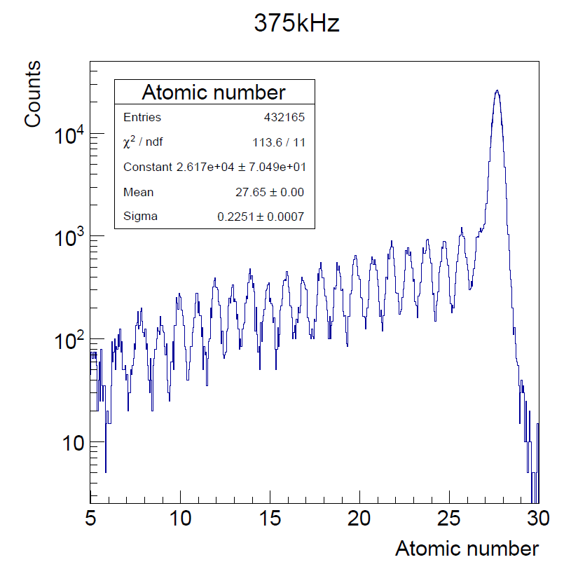
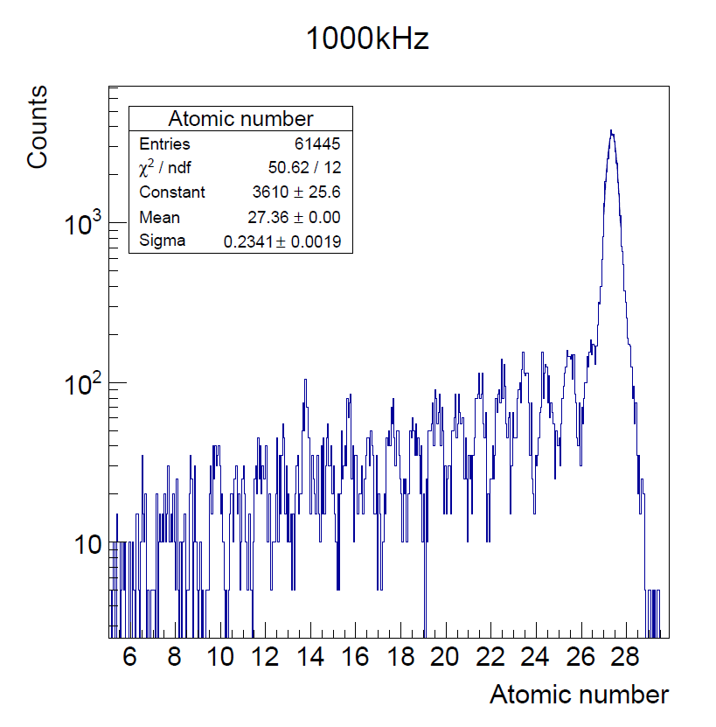
Time-of-flight wall:
in-beam charge resolution and high rate
Ni (Z=28) fragmented beam
Z-resolution of σ_{Z} = 0.20 z-units (0.7%)
up to1 MHz beam rate
2.7x80 cm²/paddle
3 – 5 mm thick
EJ204 plastic paddles
PM R8619 (with fully active base)
M. Heil

Slide 19
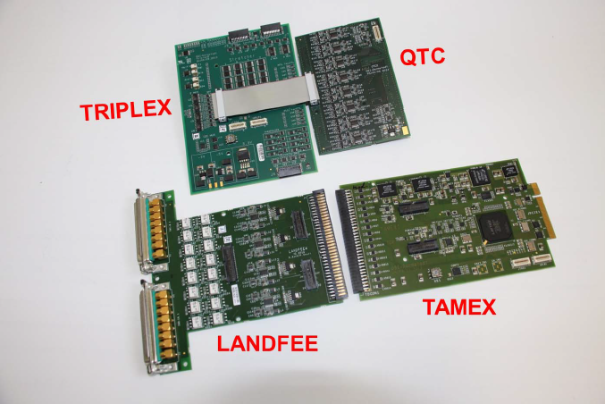
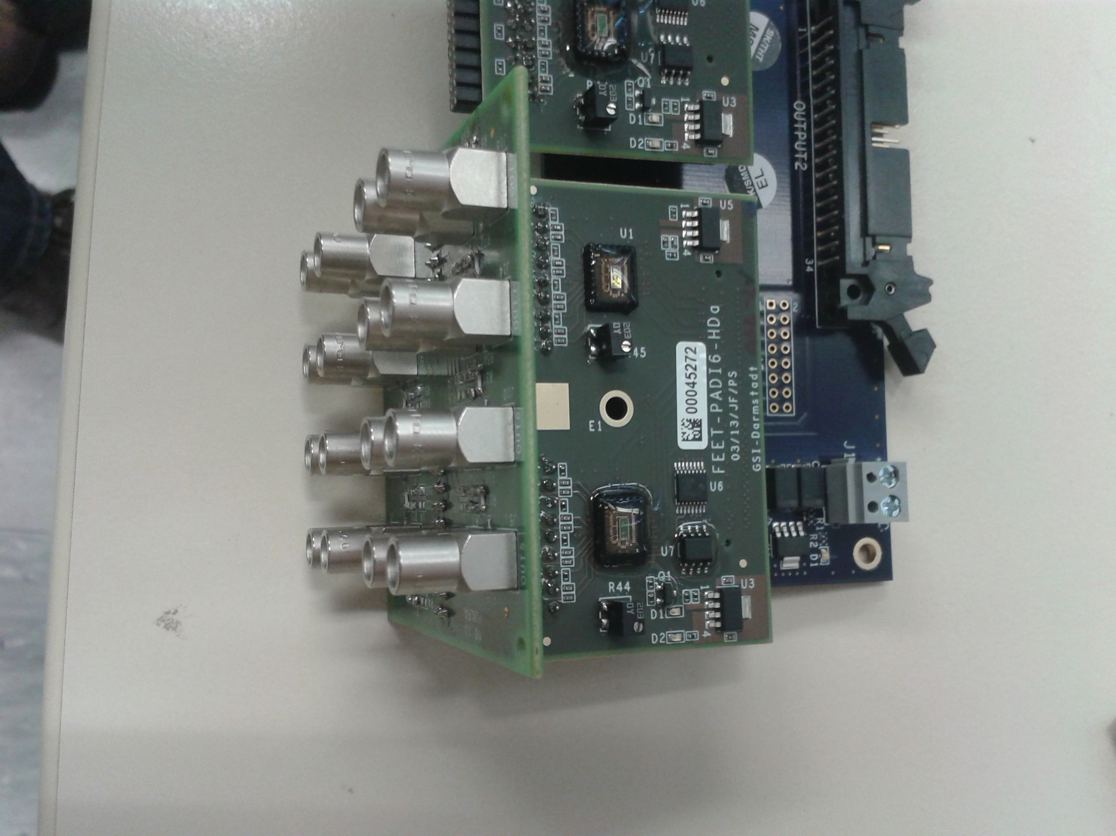
New Electronics
New electronics will be a combination of PADI and TAMEX
less cards, lower costs (PADI)
PADI
QTC
new FEE
TAMEX2
TRIPLEX

Slide 20
Tracking detectors (plastic scintillating fibers)
Position ➔Trajectory
10 m
fiber detectors
10 cm wide
40 cm wide
120 cm wide
Notes:
For the position measurements after the target where the beam distribution is large, we foresee large area fiber detectors ranging from 40 cm up to 120 cm wide. Before the target smaller fiber detectors are foreseen to replace the position measurement of the Si detectors in the case of experiments where the beam rate is very high as I will discuss in more detail later.
Fiber detectors are made of a sequence of square fibers with 200um cross section placed next to each other.

Slide 21
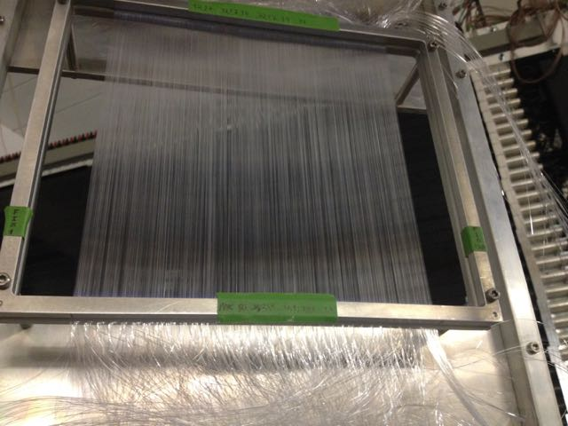
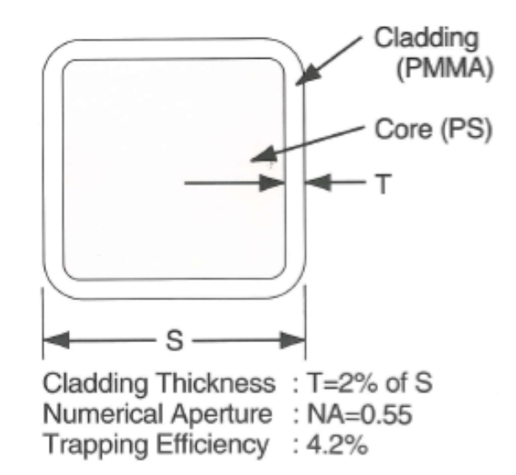
Tracking detectors (plastic scintillating fibers)
Position ➔Trajectory
10 m
fiber detectors
20 cm
10 cm wide
40 cm wide
Square fibers 0.2x0.2 mm² → 60 um resolution
Number of fibers ~ 10⁴ fibers
120 cm wide
Notes:
For the position measurements after the target where the beam distribution is large, we foresee large area fiber detectors ranging from 40 cm up to 120 cm wide. Before the target smaller fiber detectors are foreseen to replace the position measurement of the Si detectors in the case of experiments where the beam rate is very high as I will discuss in more detail later.
Fiber detectors are made of a sequence of square fibers with 200um cross section placed next to each other.

Slide 22
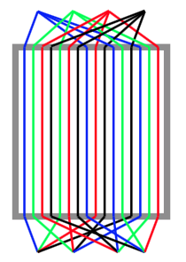
Two Fiber detectors tested in beam
Fiber detector 1
Fiber detector 2
MPPC
+
TUDa in-house preamp
+
FEBEX (50 MHz digitizer)
Individual fiber readout
With MAPMT
+
readout chip (n-XYTER)
on GSI GEMEX board
20 cm
Beam
Bundling to reduce the number of channels ( 32 → 1 )
test-detector widths 20-25 cm
1000 square fibers 0.2x0.2 mm²
1000 square fibers 0.25x0.25 mm²

Slide 23
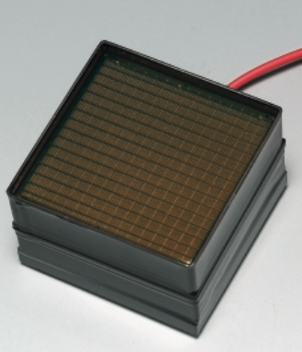
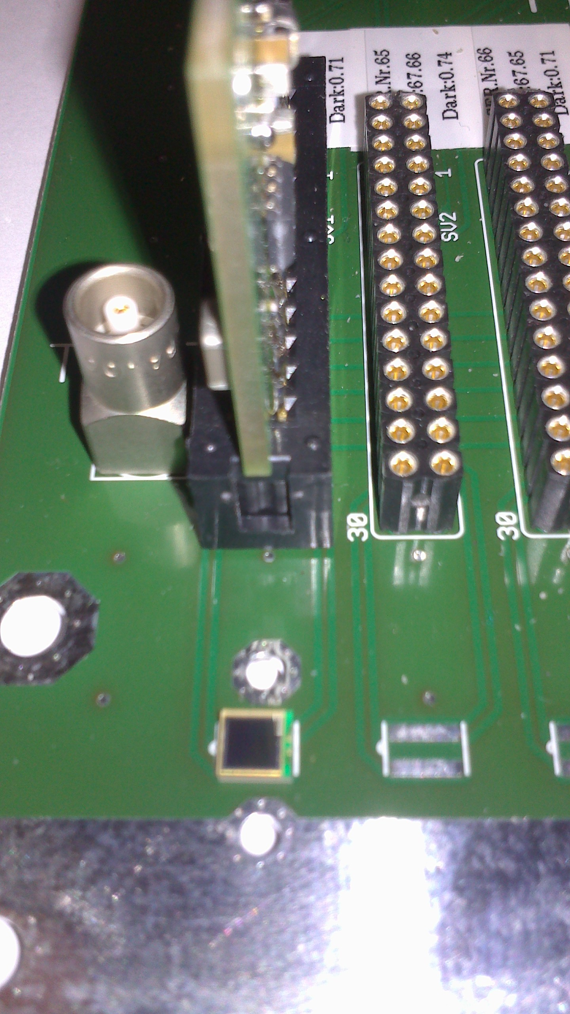
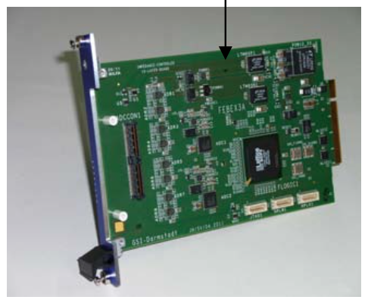
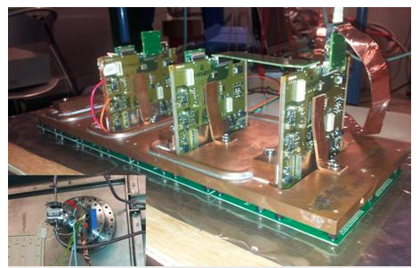
Two Fiber detectors tested in beam
Fiber detector 1
Fiber detector 2
MPPC
+
TUDa in-house preamp
+
FEBEX (50 MHz digitizer)
Individual fiber readout
With H9500 MAPMT
+
readout chip (n-XYTER)
on GSI GEMEX board
20 cm
Beam
test-detector widths 20-25 cm
1000 square fibers 0.2x0.2 mm²
1000 square fibers 0.25x0.25 mm²

Slide 24
Fiber detectors:
in-beam position correlations
Fiber det. 1 with 200 um vs fiber det. 2 with 250 um
fiber det. 2
20 cm
Beam
good correlation
noise/bad reconstruction
fiber det. 1
test-detector widths 20-25 cm
1000 square fibers 0.2x0.2 mm²
1000 square fibers 0.25x0.25 mm²
MPPC + In house preamp + FEBEX
MAPMT + n-XYTER readout chip

Slide 25
Readout electronics for Fibers
Tested solutions:
    MPPC + In house preamp + FEBEX (bundling→ total ~1000 readout channels)
      But:
      bundling complicates analysis,
      reduces multi-hit capability,
      requires tedious fiber sorting
    MAPMT + n-XYTER readout chip in GEMEX board (total ~10⁴ readout channels)
        But:
        Needs large attenuation to match the chip’s dynamic range
        Current version GEMEX boards very prone to noise
  Other:
    More dedicated chips (CITIROC, TOFPET, STiC…) for MPPC (SiPM), MAPMT
    But:
    require new developments, know-how…

Slide 26
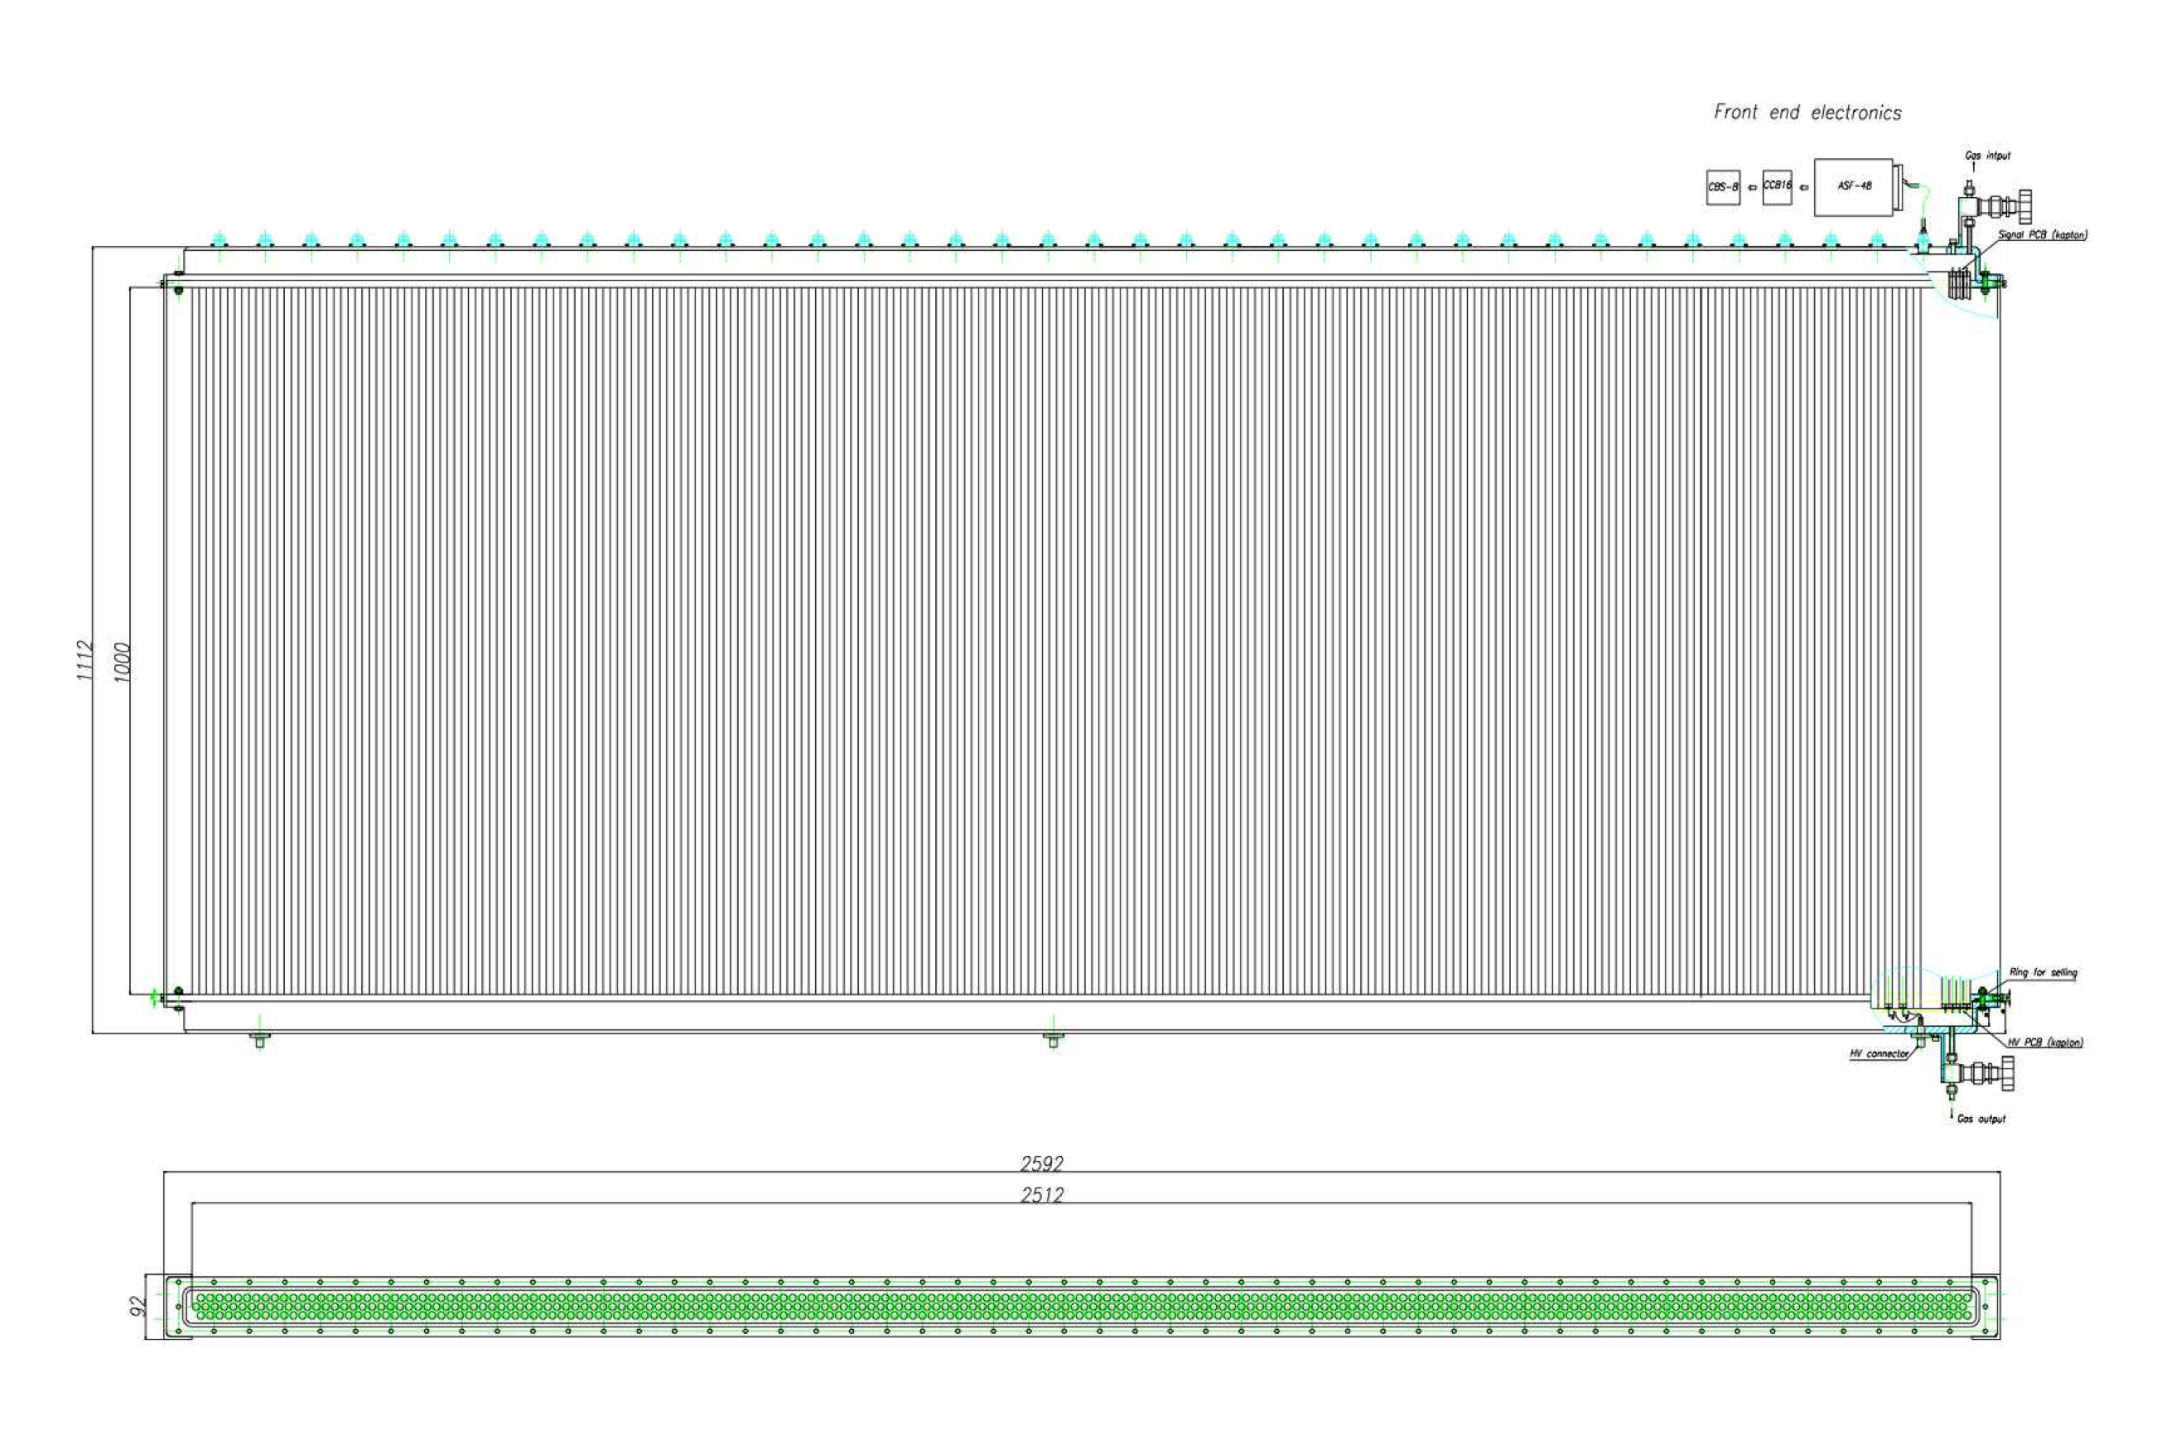
Proton detectors (strawtube gas detectors)
2D position ➔ Proton trajectory
10 m
2.5 m
Vacuum compatible
Kapton and Al tubes
Straw length : 1 – 2.5 m
Diameter : 10 mm
strawtube detectors
Notes:
Finally the evaporated protons can have a very large angular and momentum distribution and detectors with a few square meters of active area are required for effective detection. For this purpose we are building 4 stations of gas detectors based on the straw tube technology. The size of the detectors in the dispersion plane are planned to be up to 2.5 m. Each detection station is responsible for x or y measurement. All detector stations will be placed in the vacuum. The first detection station will be of thin Kapton wall and the rest of the detectors out of thin Al walls.

Slide 27
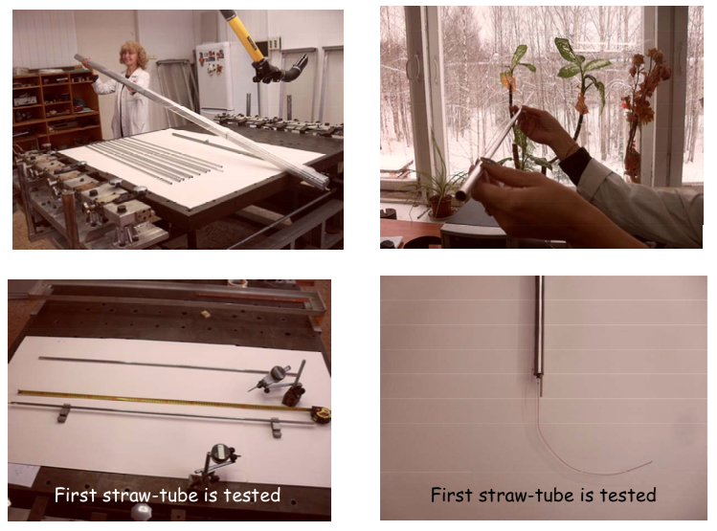
Strawtube prototype detector construction

Slide 28
Strawtube detector readout electronics
CROS3 electronics developed at PNPI
        ASD-8 amplifier-shaper discriminator ASIC
WASA straw-tube electronics
…. other options?

Slide 29
Three main modes of operation
high-resolution mode: tracking of heavy ions (Z >50, A >100)
high-acceptance and multi-hit mode: tracking of multi-particle (fragment-breakup) decays and in-flight proton evaporation
high-rate experiments (∼1 MHz): less exotic beams
target
incoming beam
e, t, x, y
protons
e, t, x, y
heavy fragments
e, t, x, y
Notes:
In order to meet the demanding specifications we have designed a versatile system that can be optimized in three main modes to obtain high resolution… high acceptance … high rate….

Slide 30
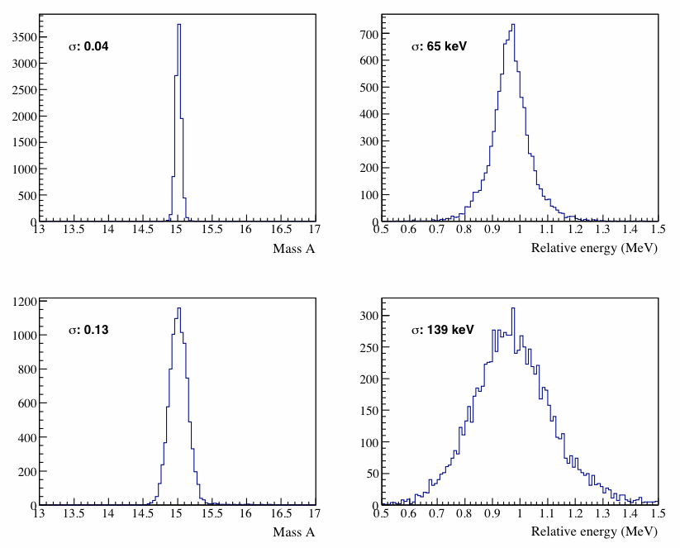
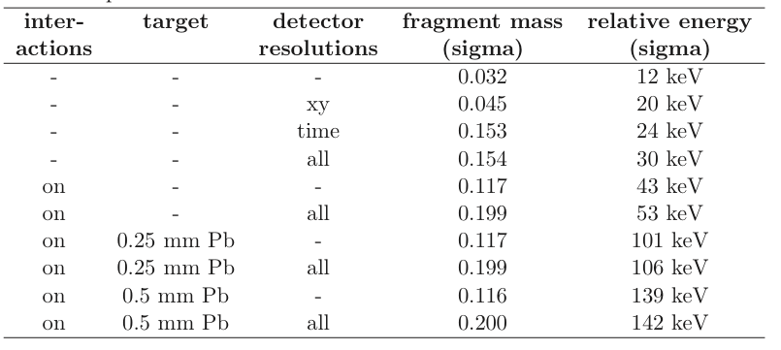
High-resolution mode: simulations
proposed setup
existing setup
Sn + proton @ E_{rel}= 1MeV
¹⁵O + proton @ E_{rel}= 0.9598 MeV
(decay of the J^{π} = 2⁻ state in ¹⁶F)
Simulations and analysis
by R. Plag, M. Holl, F. Wamers
Notes:
We have performed a complete Geant simulation of the designed system to demonstrate the expected performance of the system. For example this table shows the fragment mass resolution obtained for a Sn ion and the relative energy reconstructed for a proton + Sn system.
The first column states with or wout material the second includes the target material and the third column sates if the resolutions are turned on and off.
What is of interest from this table is that the most important factor in the time-of-flight resolution. The next dominant factor is the material budget of the detectors and last is the position resolution of the detectors. In the case of the relative energy reconstruction the thickness of the target can be the dominant factor in the resolution.
A second example has been examiined and compared to existing data from our existing setup. In particular the ¹⁵O + proton system has been simulated with the proposed setup. The improvement in the mass resolution is a factor of three and in the reconstructed relative energy a factor of two.

Slide 31
Summary
A new design for the in-beam tracking detectors of R³B has been proposed
Capable of resolving up to the heaviest isotopes, combining high-rate and multi-hit capability
In-beam tests with prototype detectors shows good performance with the selected technology

Slide 32
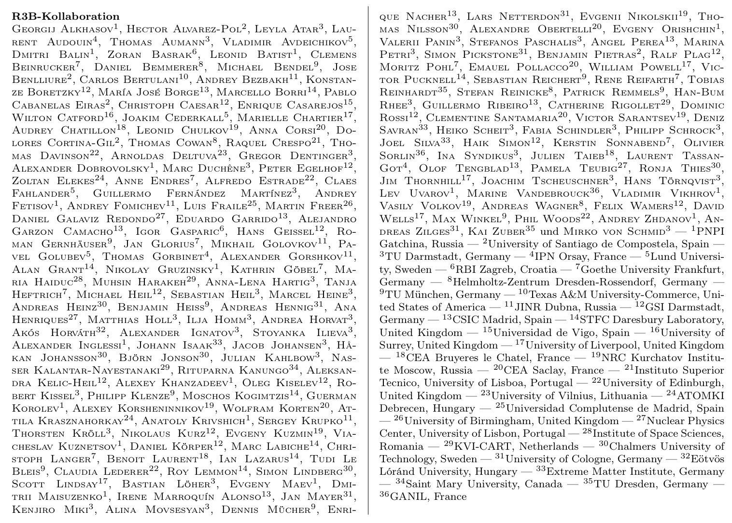

Slide 33
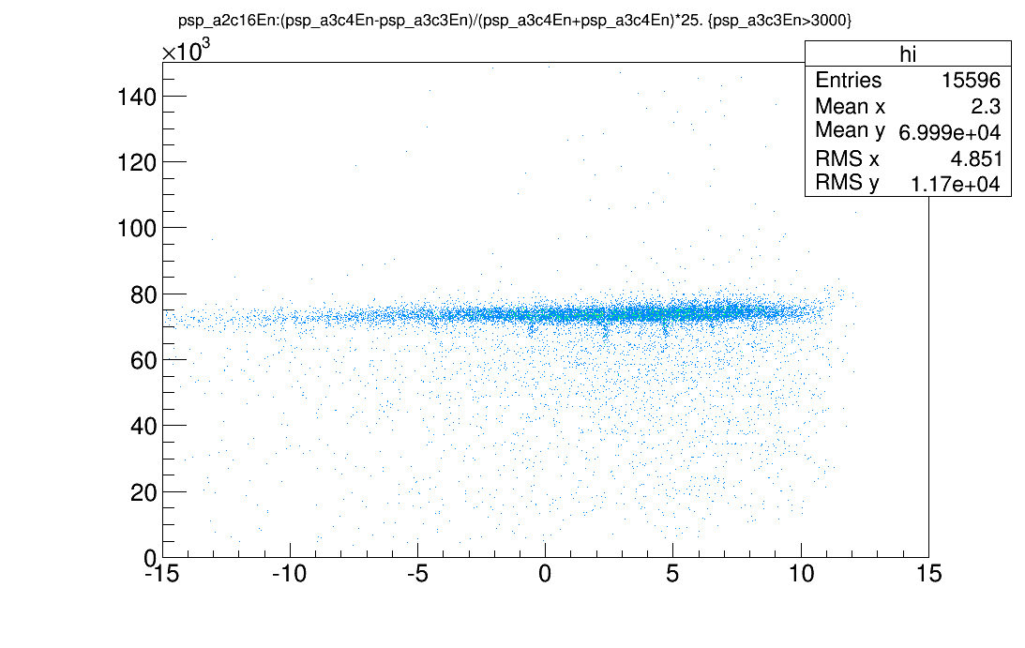
E
Position from vertical detector (mm)

Slide 34
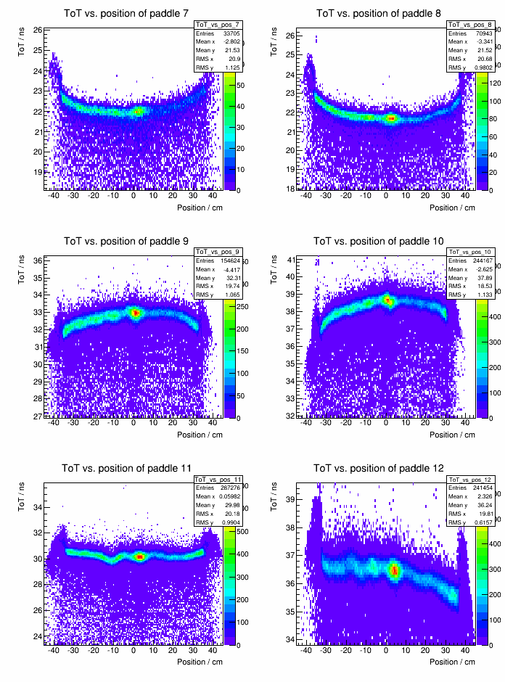
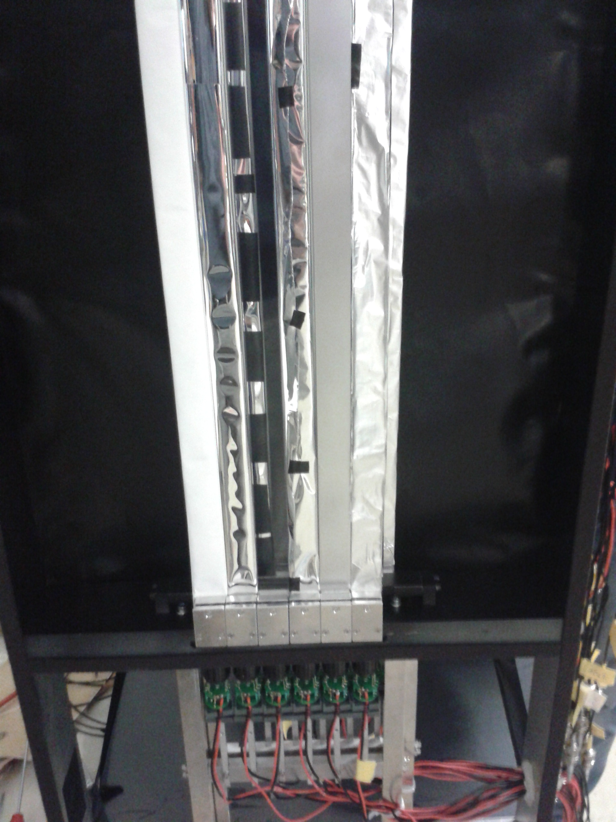
Ca beam with different wrapping materials
no wrapping
Test of wrapping materials Tyvek, ESR, Al-foil, ...
ESR delivers almost a factor of 2 more light.
Tyvek shows variations with position.
ESR
Tyvek
M. Heil

