Slide 1
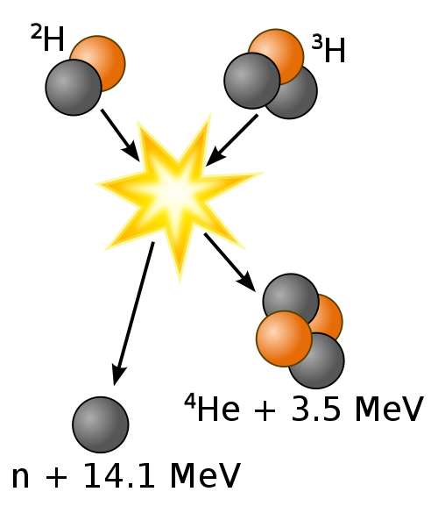
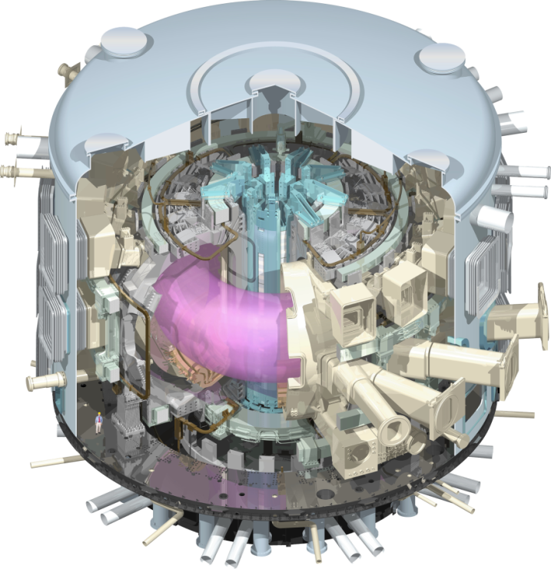
ITER Status of In-Kind Procurement
Deuterium
Tritium
Helium (3,5 MeV)
Neutron (14,1 MeV)
Ken Blackler
Construction Management
Notes:
This template can be used as a starter file for a photo album.

Slide 2
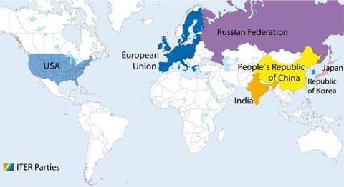
ITER Key Facts
Introducing
7 Members: China, EU, India,
Japan, Korea, Russia & US
Designed to produce 500MW of
fusion power for an extended period of time
10 years construction, 20 years operation
Cost reported to be 15 billion Euros*
RF
CN
KO
European Union
JP
IN
US
* TGV line from Marseille to Nice (16bn€)
London Olympics 2012 (14bn€)

Slide 3
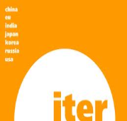


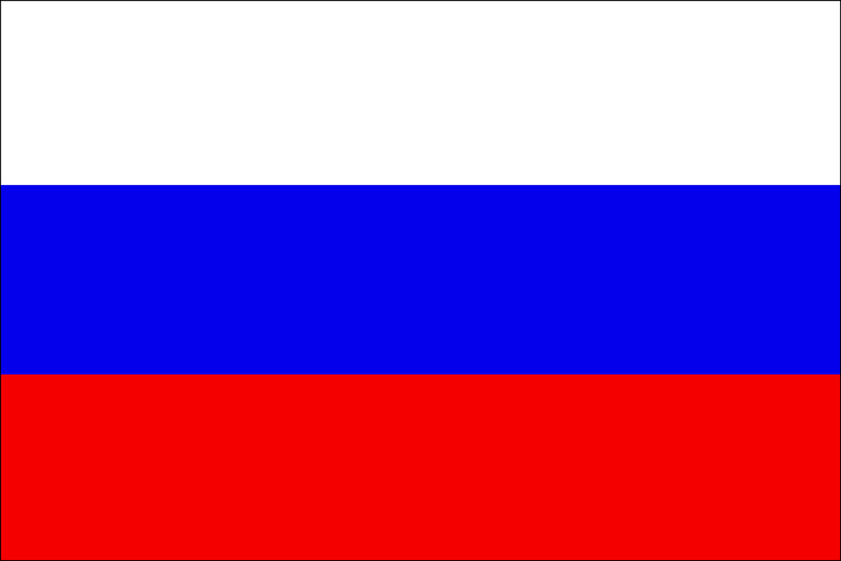




ITER: an integrated project:
Central Team & Seven Domestic Agencies
IO
The 7 ITER Members make cash and in-kind contributions (90%) to the ITER Project. They have established Domestic Agencies to handle the contracts to industry.
The ITER Organization Central Team manages the ITER Project in close collaboration with the 7 Domestic Agencies.
The ITER Members share all intellectual Property generated by the Project.
US
CN
ITER Project
RF
EU
KO
IN
JA

Slide 4
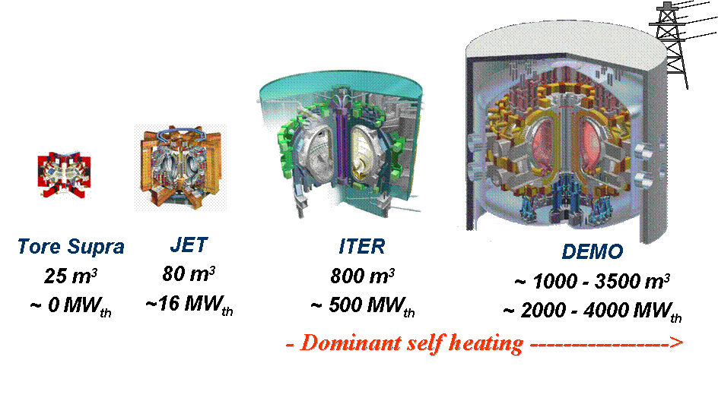
Path Towards Fusion
ITER: Demonstrate the technological feasibility of fusion as an energy source
DEMO: The next step will be to demonstrate commercial power generation

Slide 5
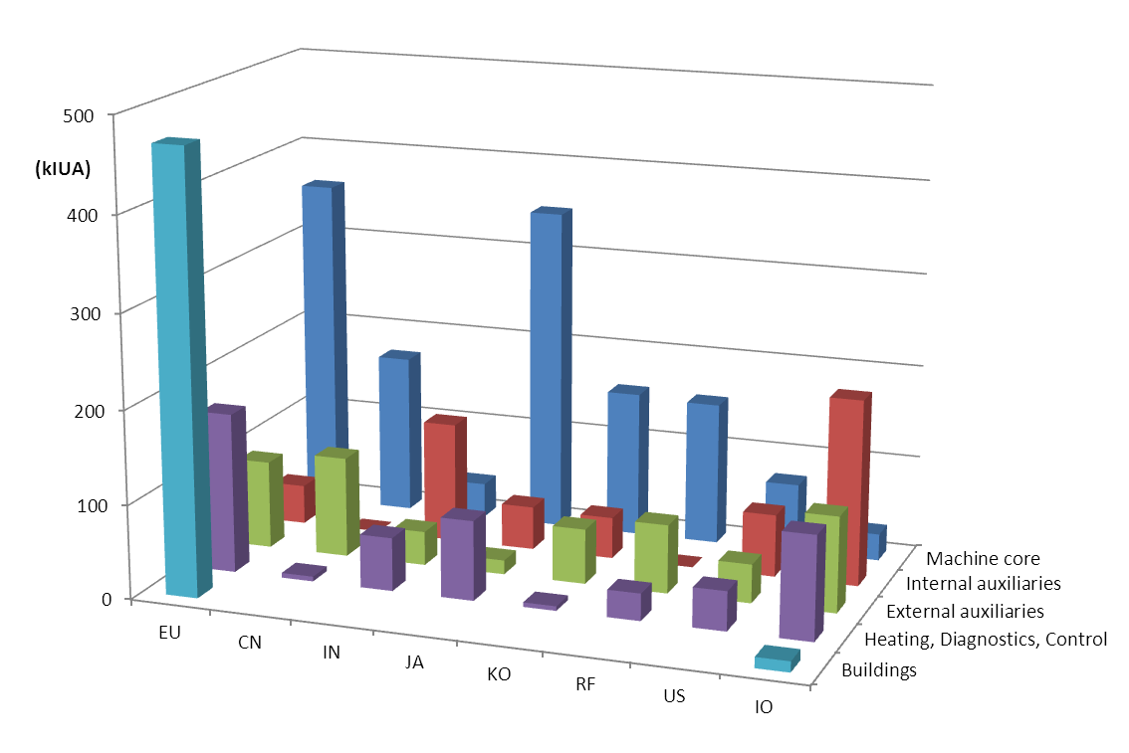
In kind Contributions
Almost all of the components will be provided to the ITER
Organization through in-kind contributions from the seven Members
China, India, Japan, Korea, Russia and the United States have responsibility for ~ 9% of procurement packages.
Europe’s share, as Host Member, is ~ 45% (construction and manufacturing).

Slide 6
ITER Currency
ITER has defined an ITER Unit of Account (IUA)
  Project uses EURO for financial accounts/cash
  Member contributions, lifecycle expressed in kIUA (1IUA ≈ 1700 €₂₀₁₄)
  Avoid multiple currencies with fluctuations and eliminate inflation
  Members do not report actual cost, nor does the IO manage their costs
Parties provide 84% in-kind, 16% in-cash
Real cost may be several times kIUA cost….

Slide 7
Procurement Arrangement
“Contractual-like” document between ITER Organisation and Member’s Domestic Agency
  DA is procurement body within Member state
  Contractual body for in-kind supplies
Main -> General & Special Conditions
Annex A -> Management Conditions
Annex B -> Technical Specifications

Slide 8
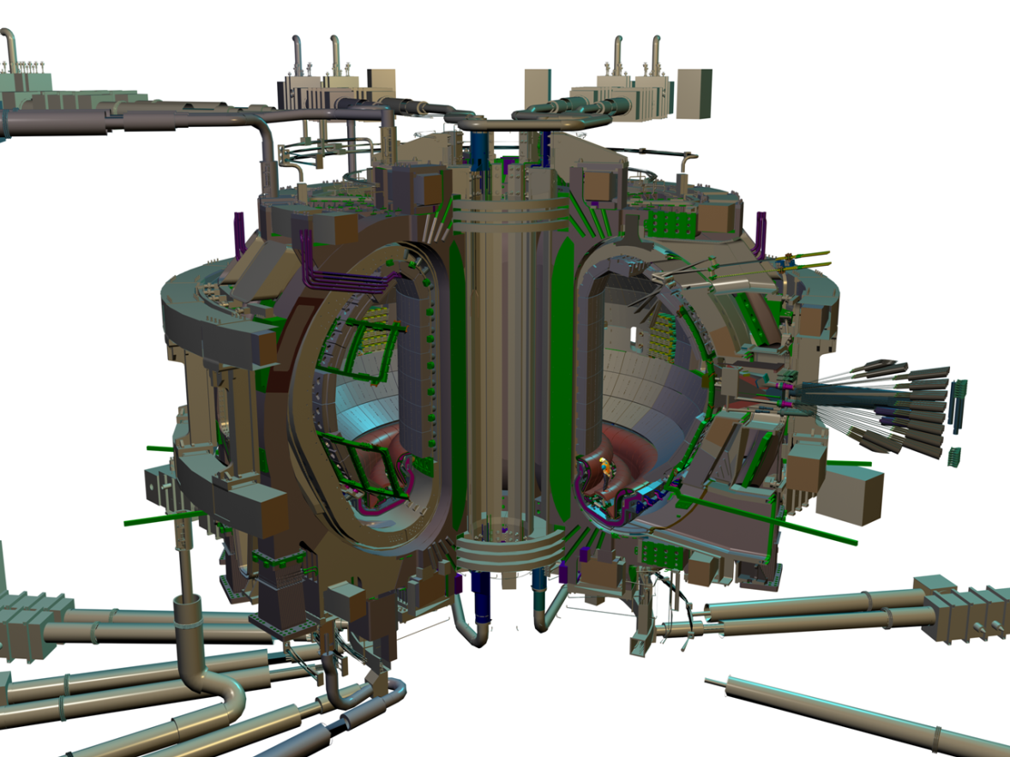
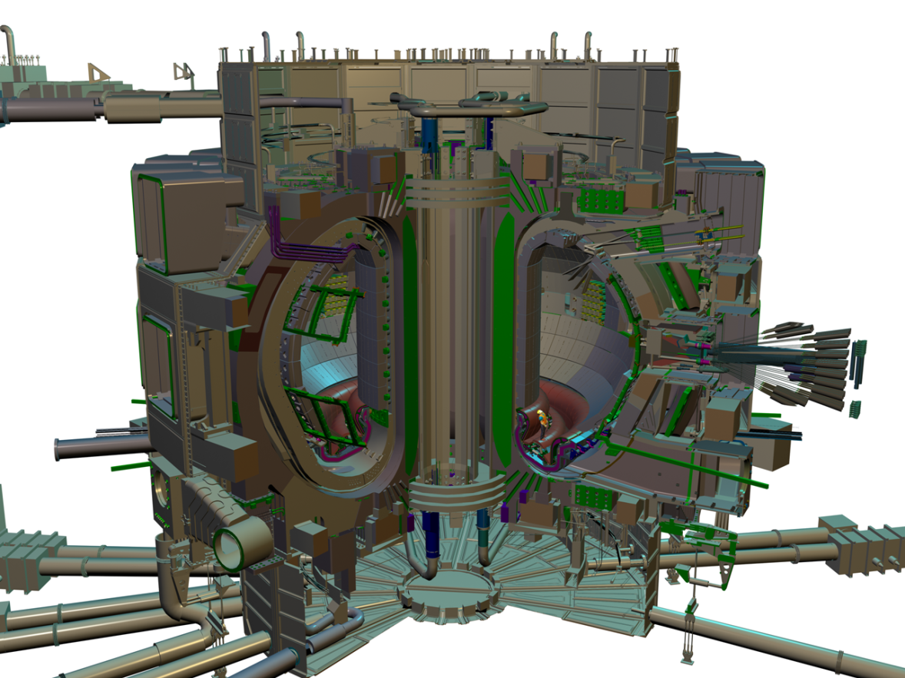
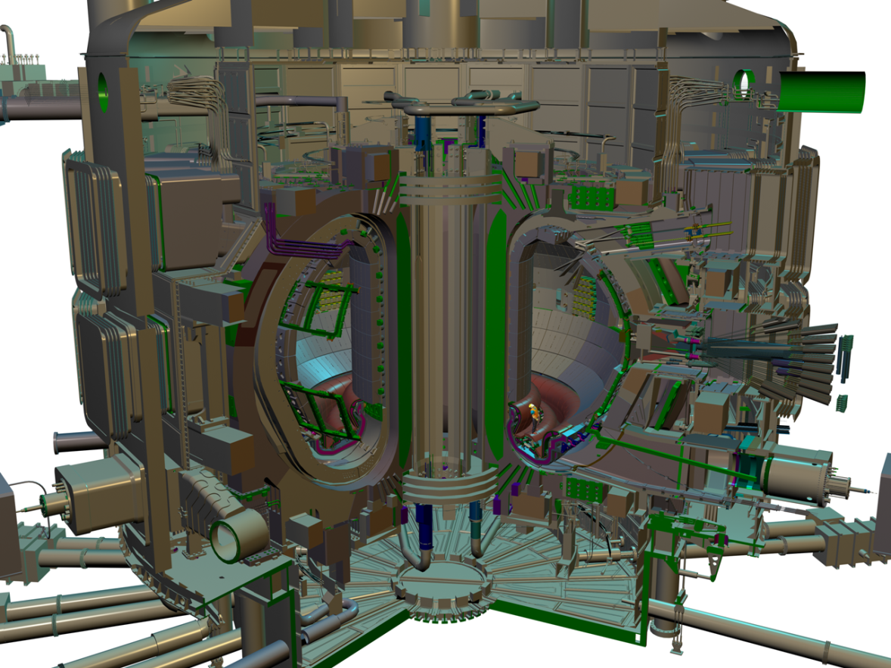
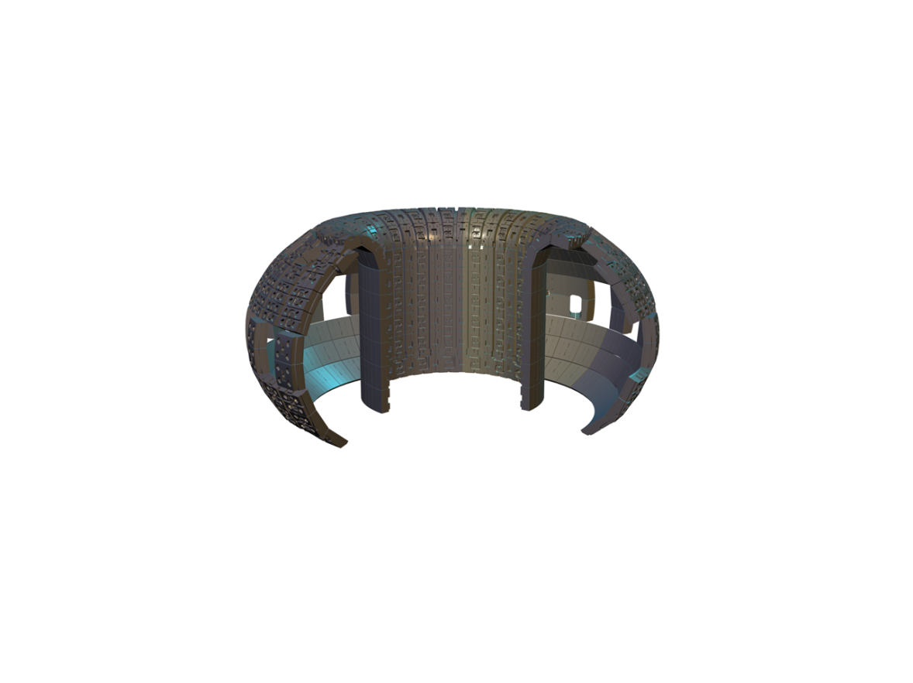
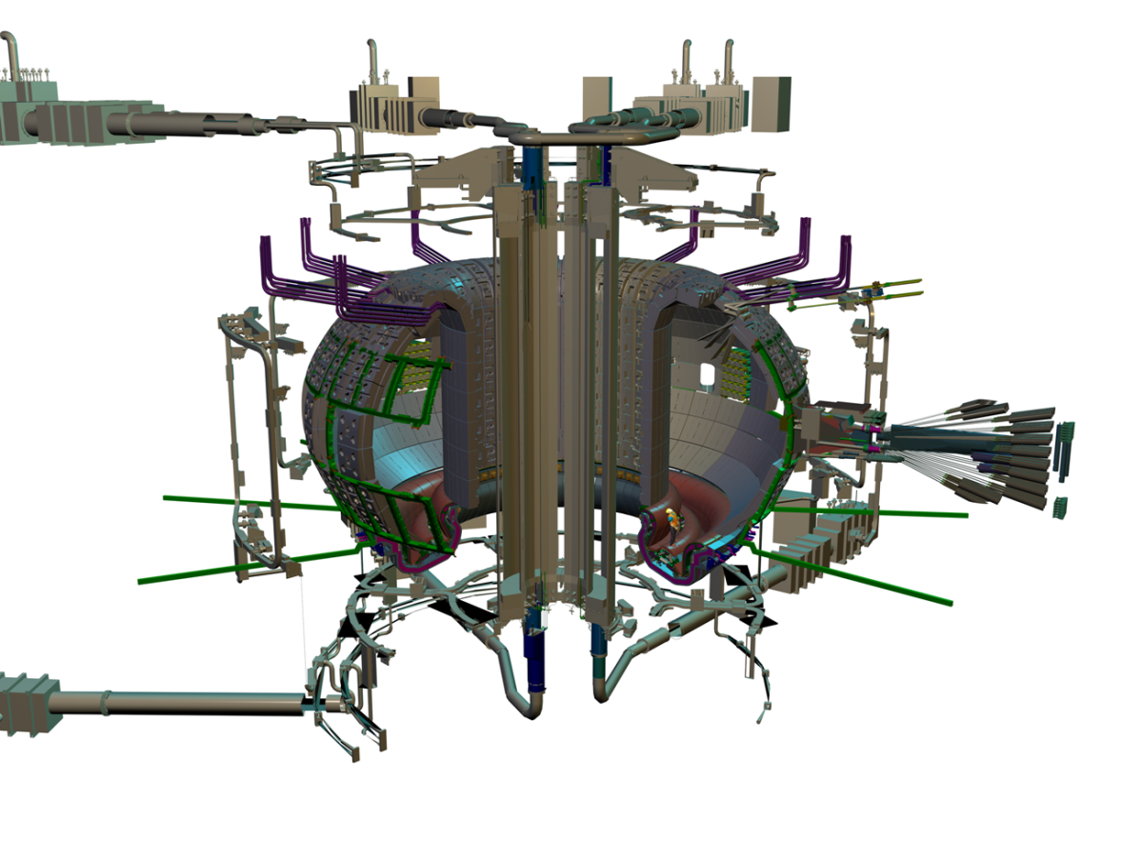
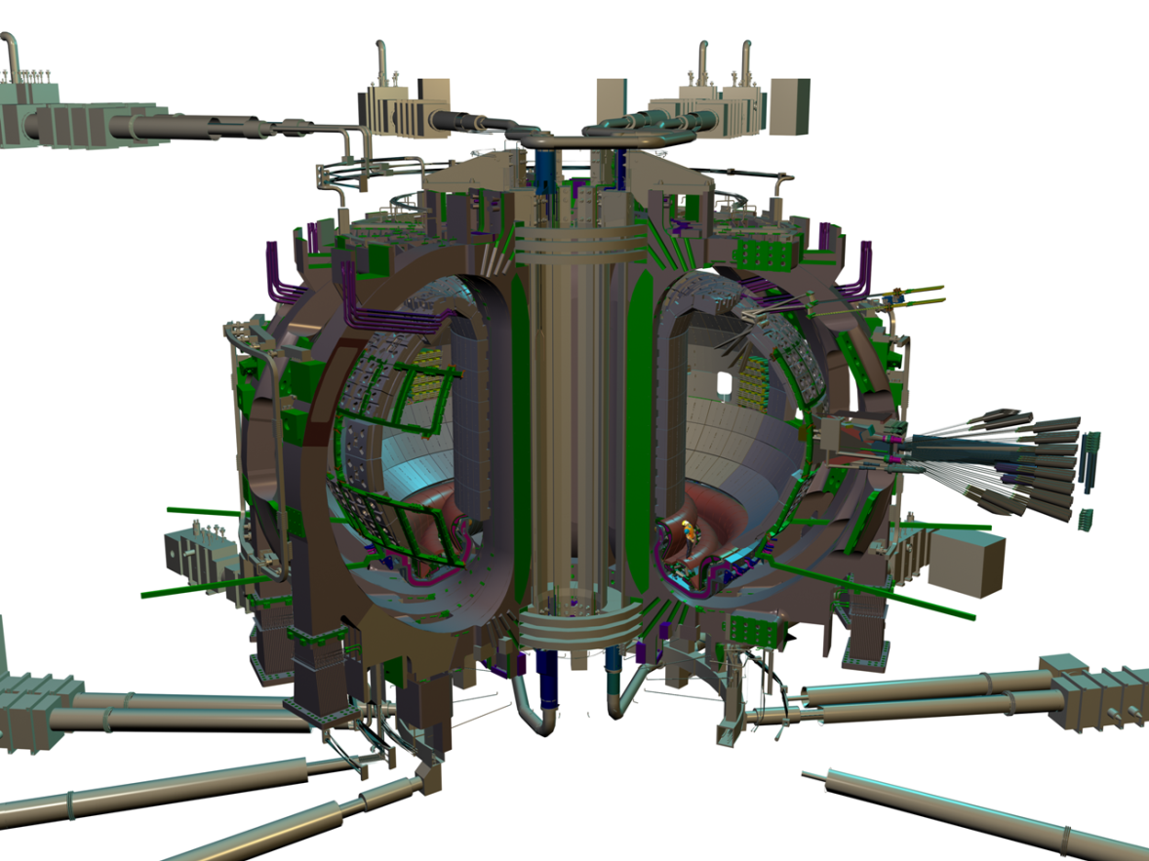
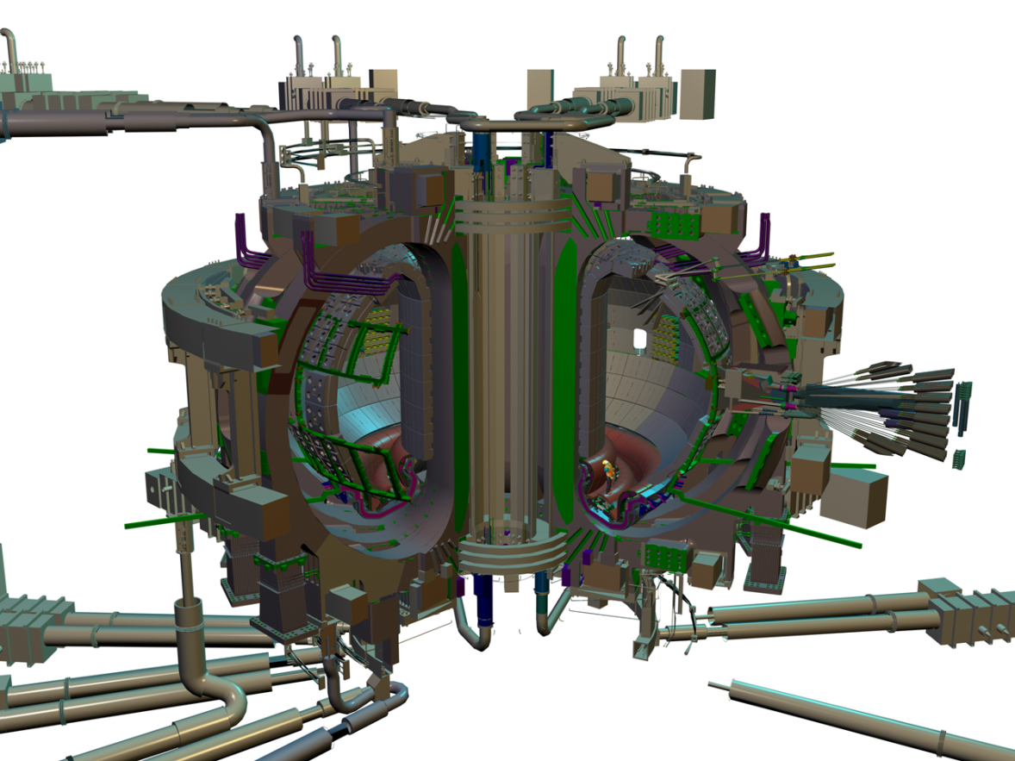
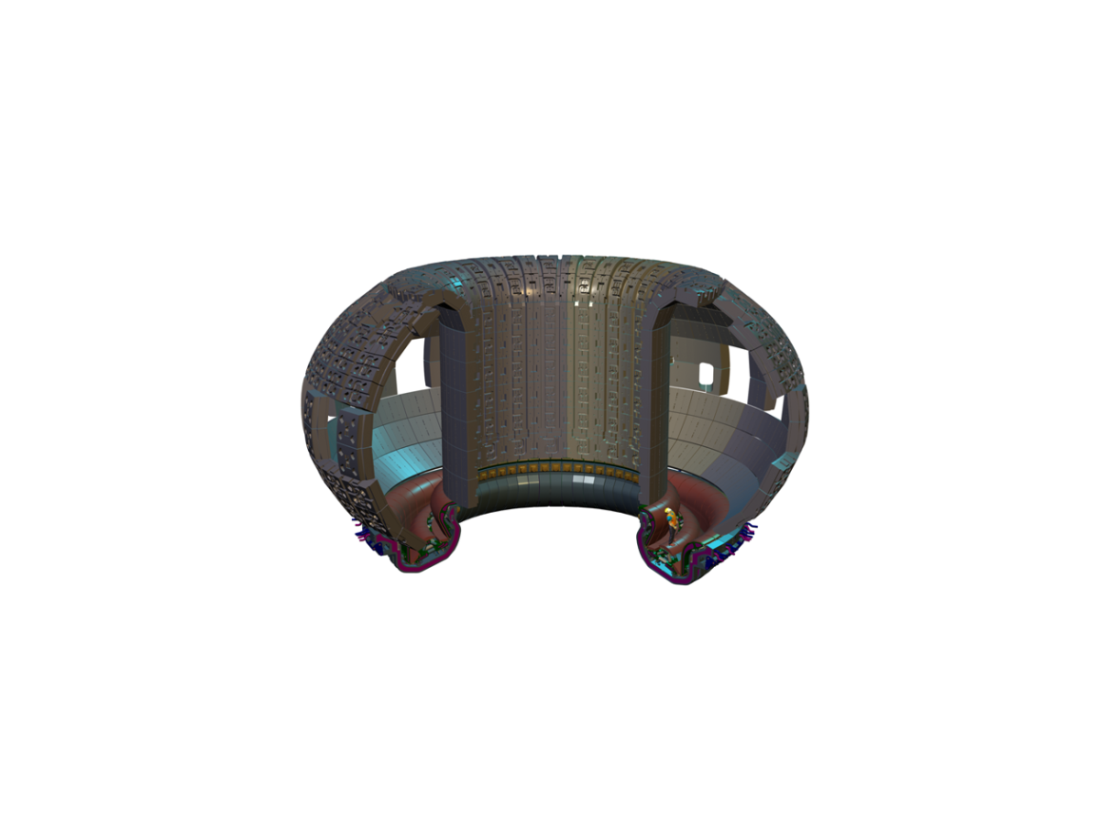
ITER Machine

Slide 9
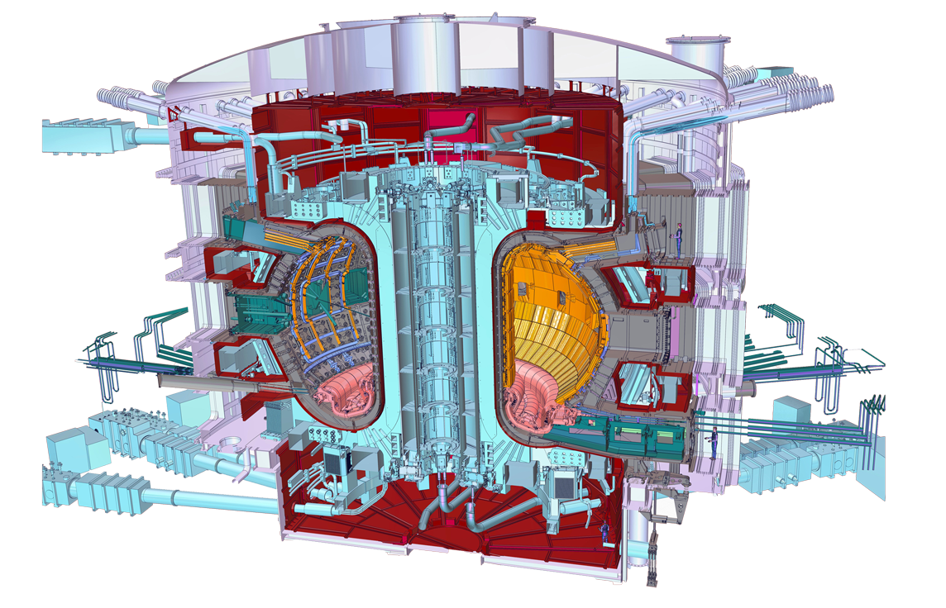




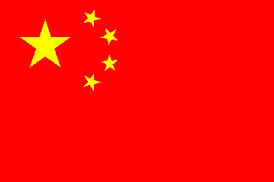
Who Manufactures What?
Central solenoid
Cryostat
Thermal shield
Internal coils
Blanket modules
Correction coils (18)
Poloidal field coils (6)
Toroidal field coils (18)
Cooling water system
Vacuum vessel
Divertor

Slide 10
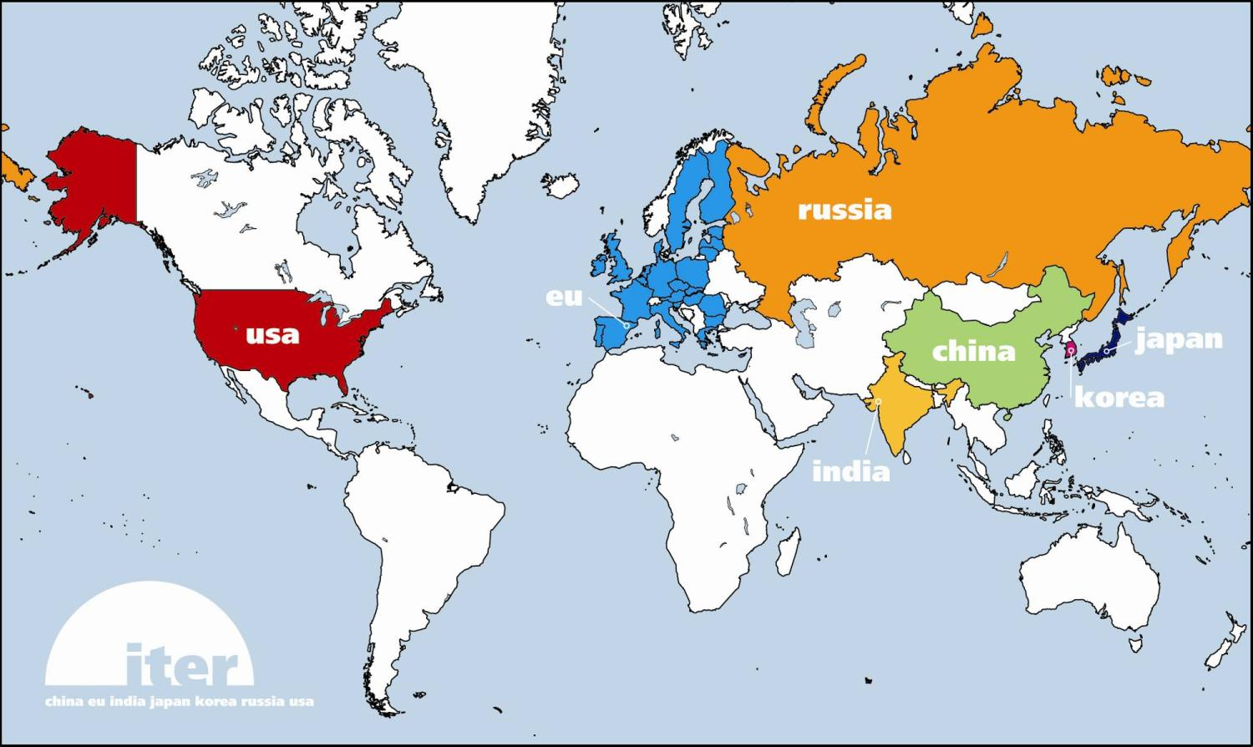
TF Coil
TF coil cases
Conductor
Japan
Japan
China
Russia
Europe
South Korea
United States
Japan
Europe

Slide 11
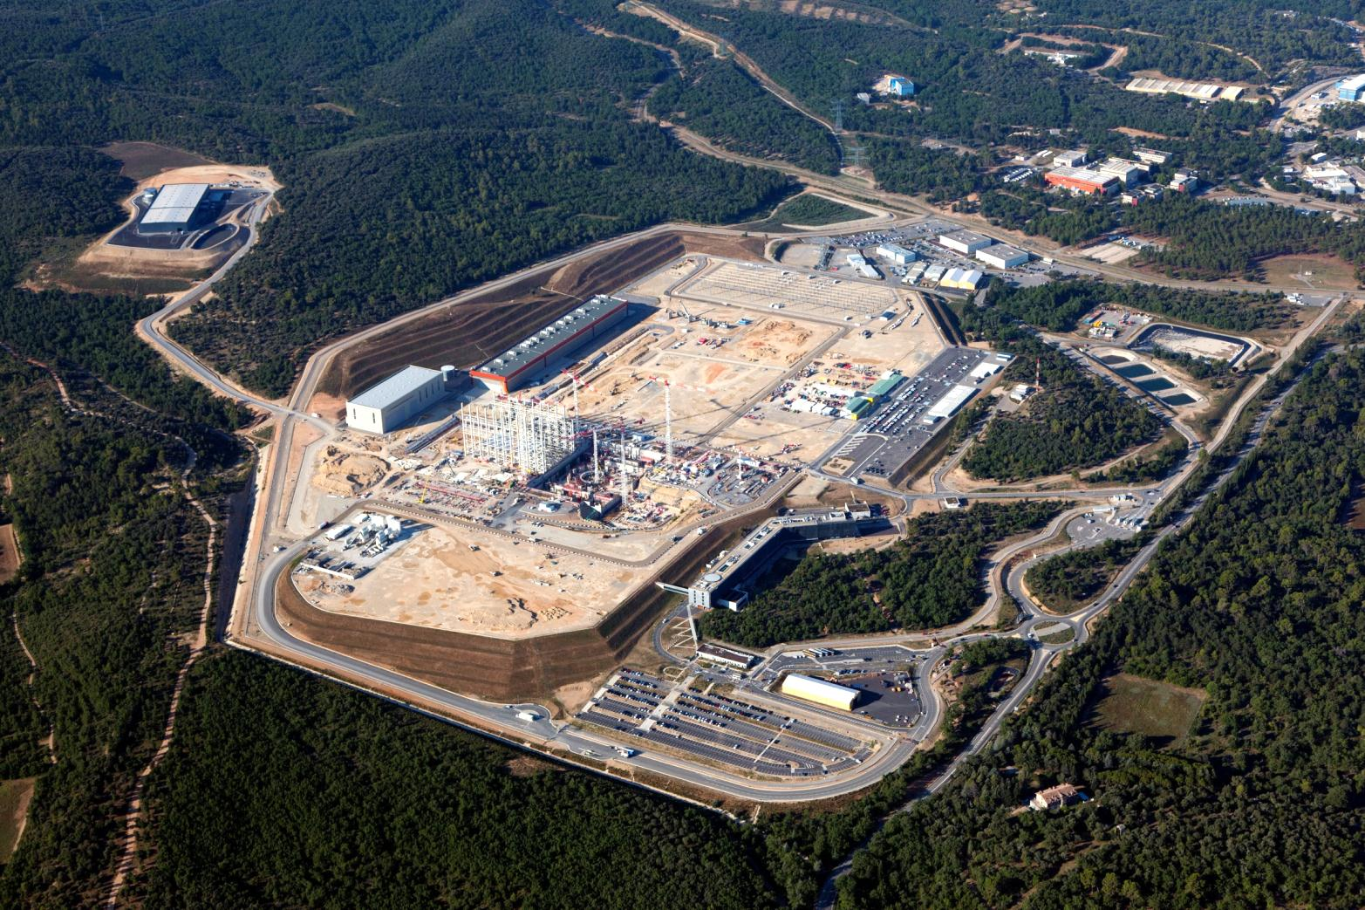
Worksite Progress
Storage Area 2
Under Installation
Transformers
PF Coils Building
400 kV Switchyard
Tokamak Complex
(Under construction)
Storage Area 3
Assembly Hall
(Under construction)
Subcontractors Area
Cryostat Workshop
Preparatory Works
Cryogenics Building
Preparatory Works
RF Heating Building
Batching Plant
HQ Extension
Preparatory Works
Cooling Water Building
Storage Area 1
ITER HQ
Preparatory Works
Control Building
August 2015

Slide 12
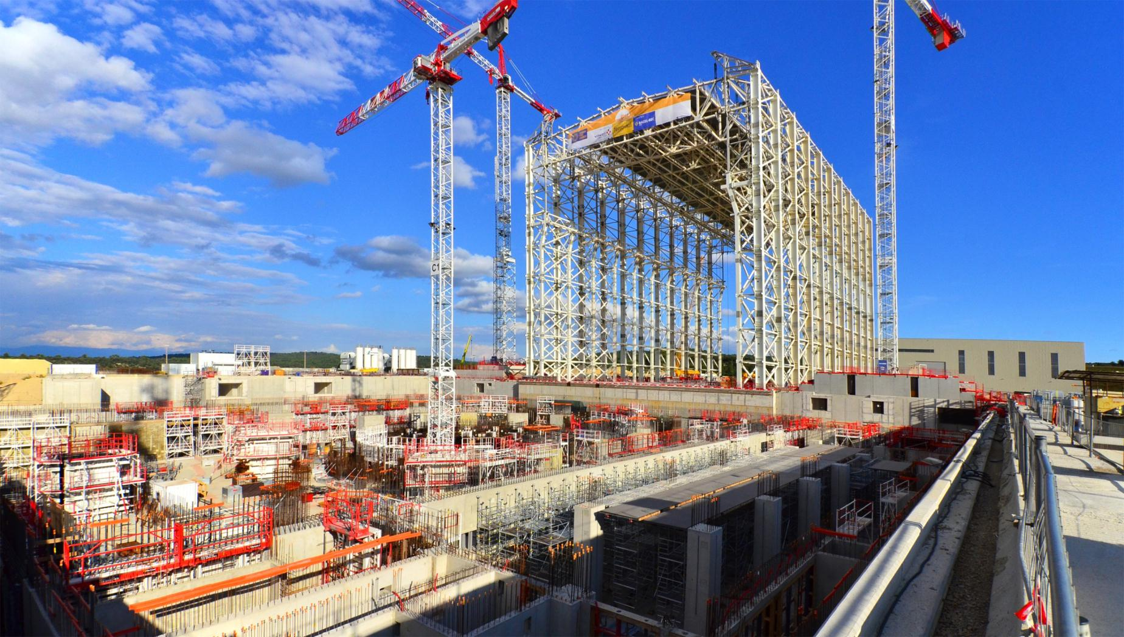
Assembly Hall
Components will be pre-assembled in this 60-metre high building prior to their integration into the machine. Lifting operations for the 730-ton roof were completed on 10 Sep. 2015

Slide 13
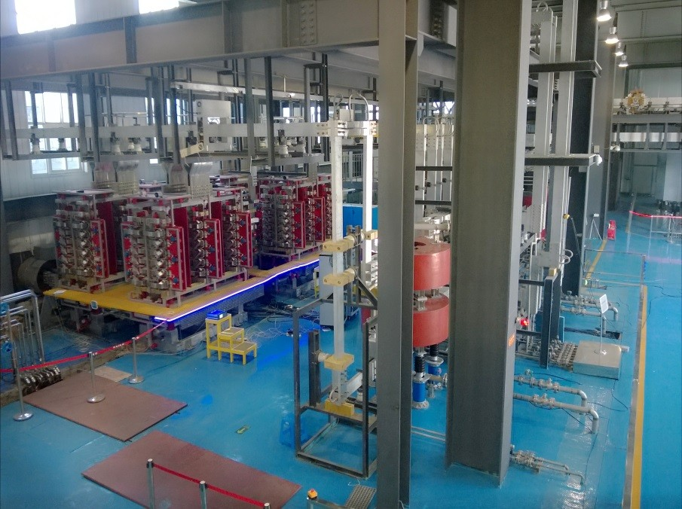
Manufacturing Progress
China
China is responsible for the procurement of 14 poloidal field AC/DC converter units that will provide reliable, controlled DC power to the ITER poloidal field magnetic coils. In February 2015, a prototype converter unit was successfully tested, opening the way to future batch production.

Slide 14
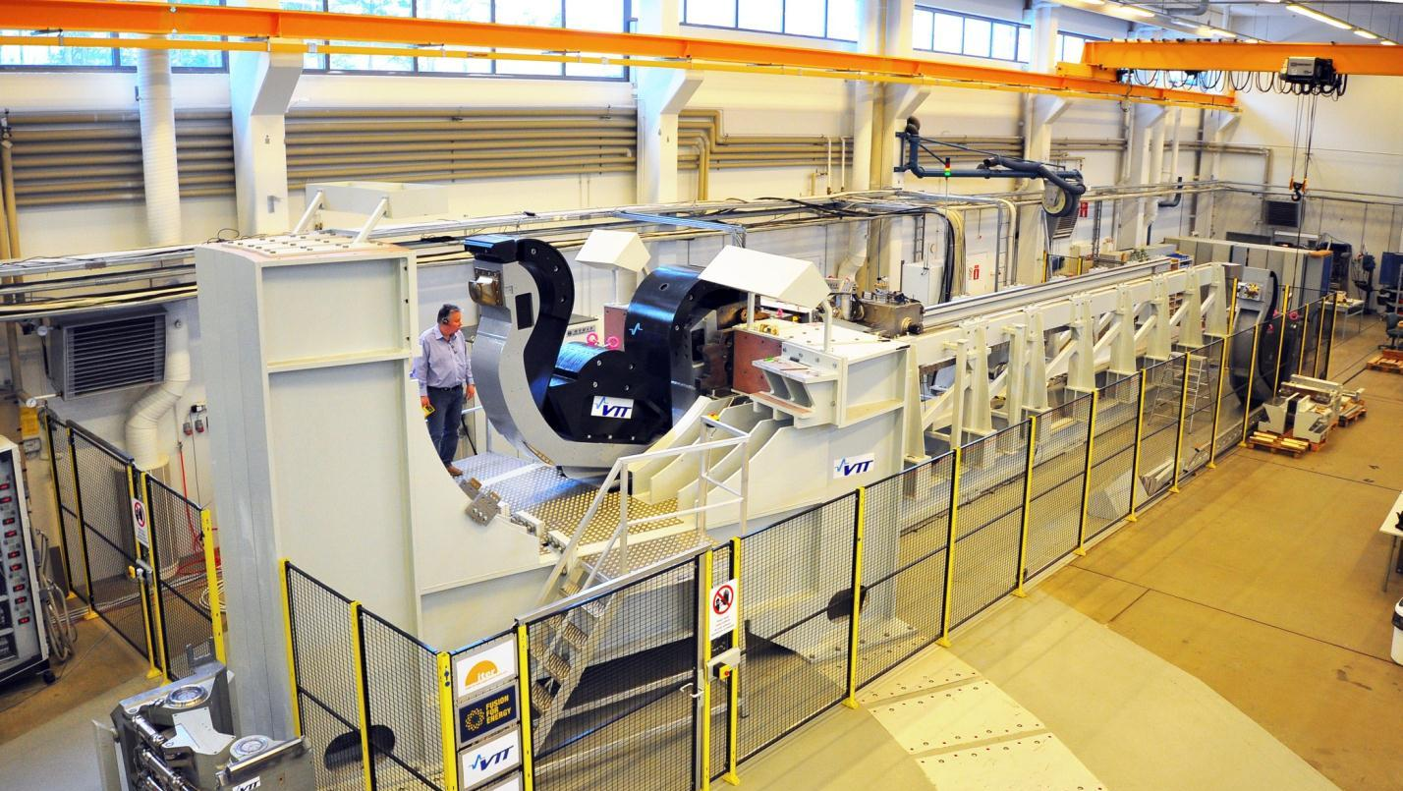
Manufacturing Progress
Europe
Europe is responsible for delivering remote handling systems for the divertor, the neutral beam system, in-vessel viewing and metrology, and the cask transfer system for activated components—in all, about EUR 250 million of investment. At the Divertor Test Platform facility hosted by the VTT Technical Research Centre in Finland, the final demonstration of the divertor cassette remote handling system was carried out in February 2015.

Slide 15
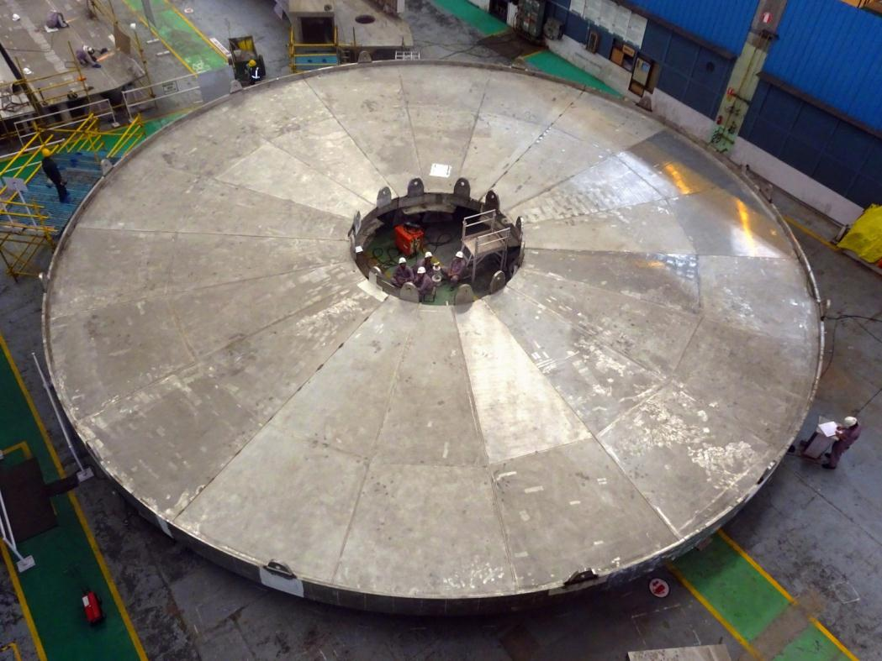
Manufacturing Progress
India
India is responsible for the fabrication and the assembly of the 30 x 30 m. ITER cryostat. Pictured, six 60° base plates are temporarily assembled at the factory in order to check tolerances prior to shipment to ITER. The first cryostat elements are scheduled to arrive at ITER in November 2015.

Slide 16
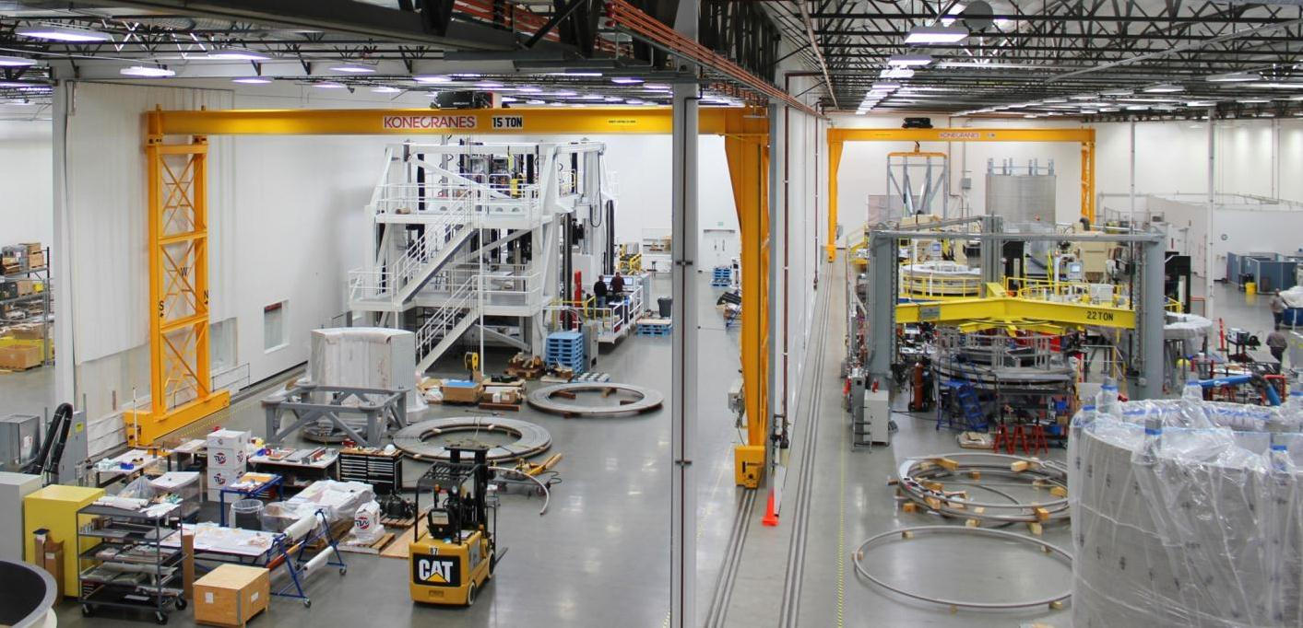
Manufacturing Progress
USA
The US is responsible for the design, R&D, and manufacturing of the main central solenoid magnet (using conductor supplied by Japan), as well as the associated structure and tooling. At General Atomics’ Magnet Technologies Center in Poway, California, winding operations began in April 2015 on a mockup module.

Slide 17
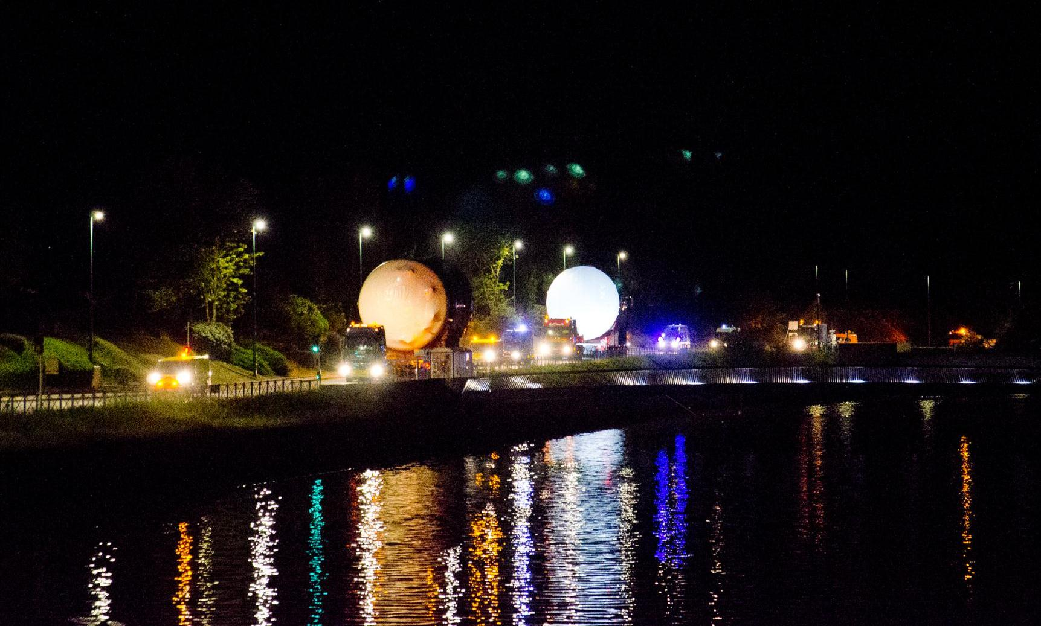
Door-to-door Delivery
14 January 2015: First of four 90-ton transformers procured by the US and manufactured in Korea
20 March 2015: Detritiation tank (20 tons), procured by Europe
2 April 2015: Detritiation tank (20 tons), procured by Europe
20 April 2015: Second of four 90-ton transformers procured by the US and manufactured in Korea
7 May 2015 (pictured): Two 80-ton, 61,000-gallon drain tanks for the tokamak cooling water system, procured by the US

Slide 18
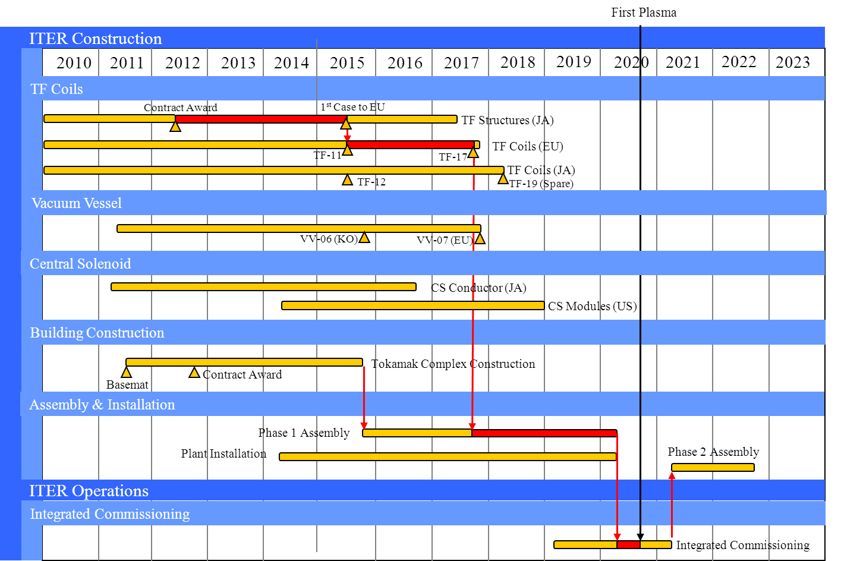
Baseline Schedule
1st Plasma
Assembly and testing
Buildings and Infrastructure

Slide 19
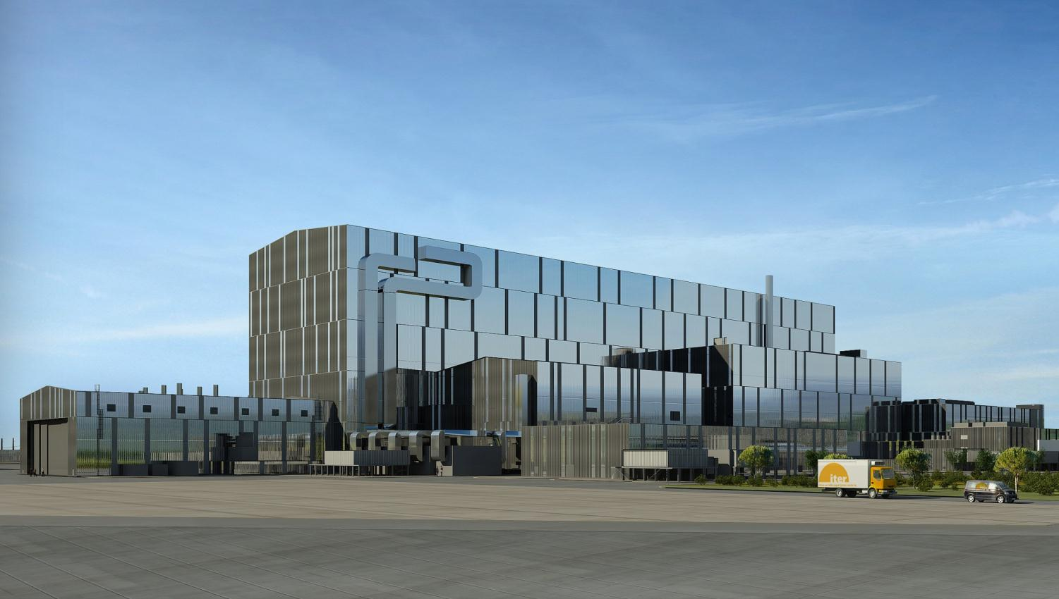
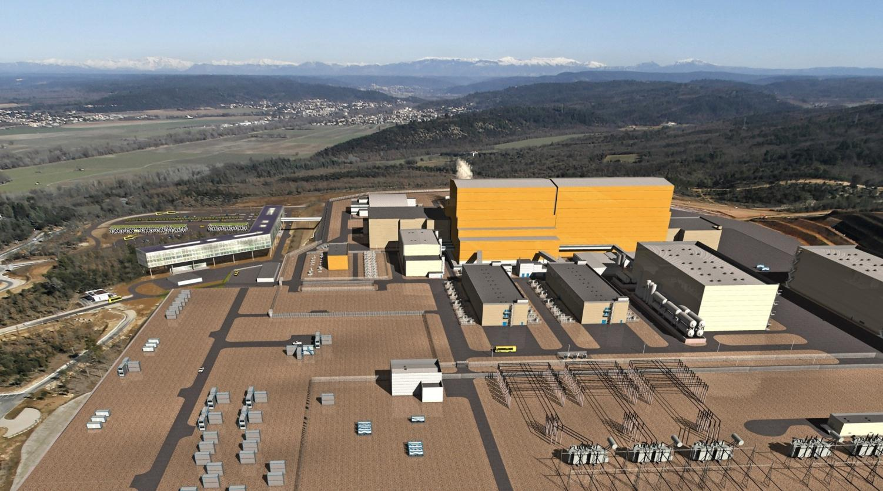
Establishing a New Schedule
Assembly: 2015 - …
First Plasma: …
DT Operations : …
An updated reliable schedule
to build the Tokamak till
First plasma, with the detail
of the necessary resources,
will be presented, for validation,
to ITER Council on November 2015
Notes:
Investigatiing the impact on ITER construction of the earthquake and tsunami in Japan
the Capped Value

Slide 20
2015 Changes
New senior management team appointed
  DG and 2 Deputies (COO and RCO)
  Simpler departmental organization
Action plan approved by ITER Council
  Project Management improvements
  Greater flexibility in re-organization
  Increased authority of DG over DA
  Mitigation actions for in-kind complexities

Slide 21
Mitigation - Project Team
Large success factor is efficiency of multiple party decision making (Supplier, DA, IO)
In key areas Project Teams created
  Buildings and Vacuum Vessel
  Combine IO and DA resources
  Formal letters of assignments from home organization
  Delegated management authority for PA activities
ITER
DA
Contractor
IO and DA
Contractor

Slide 22
Mitigation – Reserve Fund
IO baseline includes no contingency
Decisions to solve technical and procurement issues often imply cost increases for Domestic Agencies
Creation of Reserve Fund with decision making powers given to IO DG
  Allows technical decisions affecting cost to be implemented without delay
  Strict allocation rules, for changes, missing scope and recovery actions
  Not for “cost increases”

Slide 23
Mitigation - Centralization
Key areas of in-kind complexity identified
Centralization by return scope to IO Central Team
  Tokamak Cooling Water System (large number of interfaces)
  Standard Piping (between services and each client)
  Cabling (procurement and installation)
  Nuclear Safety System (central design, licencing and procurement)
  Installation activities (where DA agrees)

Slide 24
Other Issues Lessons Learnt
Control of Deliveries
  Global Logistics Provider
  Multi-party procurement rules
Customs/Duties/Taxes
  Location of clearance
  International organization privileges
Transfer of Responsibility, Ownership
  Complications of commitments as Member vs. responsibilities as supplier
Warrantees
  Longer schedules means warrantees expire before operations
CE Marking
  Education of industry, and identification of “manufacturer”

Slide 25
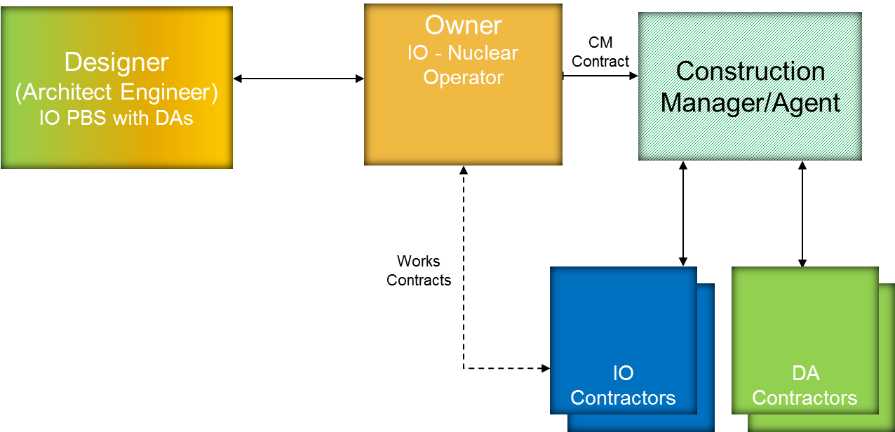
Construction
New Construction Department created in 2015
  Construction Management as Agent
  Contract strategy approved and procurement process started

Slide 26
Contract Map
ITER Organization
Construction Manager-as-Agent
CMA
Machine Assembly Works
Mechanical & Piping
Works
Electrical, I&C Works
Specialized Works
Super Conducting Joints
Cryogenics
Special Techniques
LFT
Lifting & Handling
SCF
Domestic Agency
Works Contractors
Scaffolding
APH
Access, Plant Hire
CIV
Civils & Finishing
ASY
MCP
EIC
SPx
Tokamak
Balance of Plant
Works Contracts
Support Contracts

Slide 27
Industry Fair - Construction
Information Day held in May 2015
Over 200 representatives from 160 companies
Purpose: Inform and motivate industry to participate in upcoming tenders
Following this, the IO has met companies (market survey):
  Opportunity to listen to the companies’ feedback and lessons learned from similar contracts, for example regarding organization and site management;
  Meetings held throughout June and July;
  The IO has included the market survey outcome in the technical specifications as well as in the contract.

Slide 28
Market Survey – Construction Manager as Agent (CMa)
Main discussion related to:
  Lessons learned, success factors
  Contract type, major risks and risk sharing
  Proposed organizational structure, roles and responsibilities
  Mobilization period, early engagement
  Core team, continuity of key staff, flexibility
  Payment scheme, incentivisation, key performance indicator (KPI)
  Information required to prepare clear and comparable tender offer, such as policies, schedule, scope and volume of work to be managed.
40 companies nominated for tender
Companies combined to make consortia
Pre-qualification complete. Tender launch end of November

Slide 29
Market Survey - Works
Good industrial capacity for conventional works (electrical, cabling, mechanical & piping)
Market conditions favourable at this time
Support to centralization of cabling, combining pre-manufacturing with installation of piping;
Main discussion related to:
  Information required to prepare clear and comparable tender offer, bills of quantity, definition of scope;
  Contract form and pricing structures (Lump Sum, Rates, Cost Plus);
  Methods of reimbursement, incentivization, KPI;
  In-house and local industrial workshop facilities;
  Centralization of cable procurement, pre-manufacturing;
  Mobilization strategy, early engagement.
Tenders early 2016

Slide 30
Conclusions
ITER has experienced many challenges due to in-kind nature of project
Highly complex procurement allocation has increased challenges
Separation of Domestic Agencies from Central Team has led to slower decision making
Mitigation Actions driven by new management implemented and Updated Schedule prepared to reflect new strategy

Slide 31
