Slide 1
In-Kind FAIR
David Urner

Slide 2
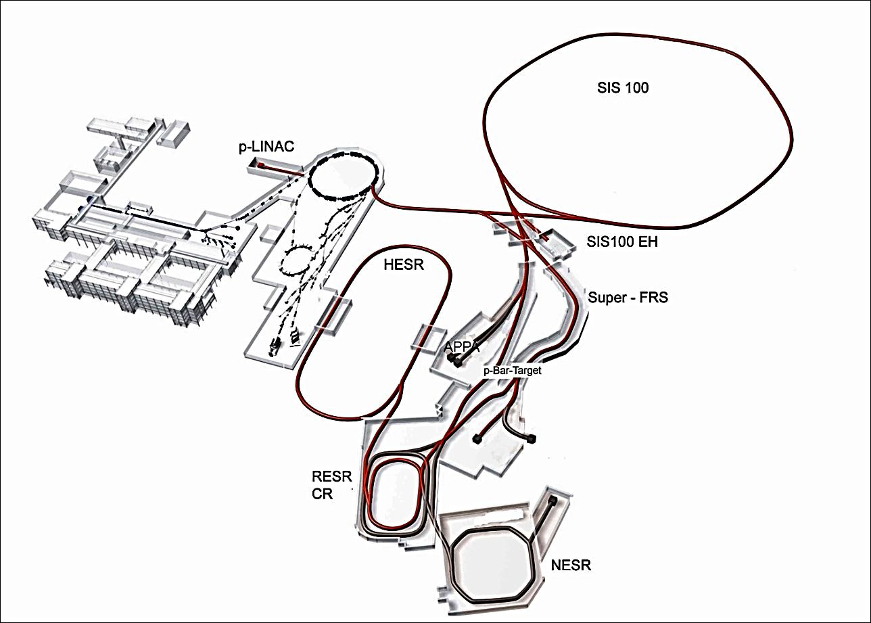
Overview
Existing Facility
HEBT
High Energy
Beam Transport
SIS100
heavy (Schwer) Ion Syncrotron
CBM/HADES
Condensed Baryonic
Matter Experiment
HESR
High Energy
Storage
Ring
SFRS
Super Fragment Separator
CRYRING
APPA
Atomic Physics, Plasma Physics Application
p-bar target
PANDA
anti-Proton Annihilation at DArmstadt
CR
Collector
Ring
NuSTAR
Nuclear Structure Astrophysics and Reactions
FAIR Costs:
1.027 billion in 2005 CB Euros
Later Modules

Slide 3
International Collaboration
Sweden
Slovenia
Finland
Germany
France
Poland
Romania
Russia
India
UK

Slide 4
FAIR-Convention
Contributions to FAIR:
Total cost: 1027 M€ (2005)
Contribution to accelerator:
total cost: 386M€ (FAIR Council)
Oversubscribed
Costbook: first com first served
Contribution to experiments:
Total cost: ~200 M€
Limited to 78 M€ by FAIR Council Decision
Undersubscribed
Rest responsibility of Collaborations
Civil Construction

Slide 5
FAIR-Convention
Contributions to FAIR:
Total cost: 1027 M€ (2005)
Contribution to accelerator:
total cost: 386M€ (FAIR Council)
Oversubscribed
Costbook: first com first served
Contribution to experiments:
Total cost: ~200 M€
Limited to 78 M€ by FAIR Council Decision
Undersubscribed
Rest responsibility of Experiments
Civil Construction
Further rules established by Council:
Every country must contribute 25% to Civil Construction unless
>75% contribution to accelerator
Accelerator Elements that are not picked up by any country:
FAIR Tender
Reduces total acc. in-kind contributions
Currently ~20 M€
Money that cannot be contributed by in-kind needs to be paid in cash, inflation corrected
(e.g. civil construction)

Slide 6
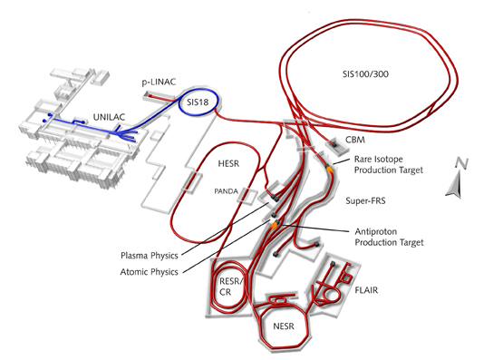
FAIR Structure
FAIR GmbH:
Steering Company
Project Management
Management of sub-project Construction
Management of sub-project Experiment
GSI:
Existing Facility (operation, maintenance, preparation for FAIR)
Overall technical Responsibility for accelerator
Management of sub-project Accelerator
Technical Responsibility (design, assembly, commissioning) of HEBT, SIS100, Targets, p-Linac
Follow up of procurement and Quality Assurance
Acceptance tests
Coordination of assembly and Comissioning
FZ Jülich:
Technical Responsibility for HESR
BINP (Budker Institute for Nuclear Physics):
Technical Responsibility for CR

Slide 7
Challenges
Project:
Very Complex
Many different small to medium size accelerators
large number of experiments with diverse user community
high activation areas, 2 production target areas
Politics:
2 Company model
Project Management at FAIR GmbH has no line of command for sub-project Accelerator (design and implementation)
Current Developments
Merger underway, but needs international treaty
Effective Merger by common Management and Project management
international collaboration
transition needed from national laboratory

Slide 8
Accelerator
Costbook:
Should contain all elements needed for Accelerator
>2000 items
Each item (PSP number) has a value (2005) and number of pieces required.
Experience with valuation:
Fairly good for items similar to existing items at GSI
Insuficient funds planned for superconducting magnets
In particular underestimation of costs of testing

Slide 9
Shareholders
Each country needs to name one or several shareholders, who are responsible to
Request items from Costbook
Find a Provider
Supply enough funds to the Provider to finish in-kind item
This usually requires to deal with funding agencies of the respective country.
Supply item to FAIR.
Install item in tunnel.
Finally get credit for item delivered in-kind

Slide 10
Assigning Item to a Shareholder
Usually Shareholder makes Expression of Interest (EoI) to reserve item and sets out to find Provider
Once situation is clarified Shareholder will request item via In-Kind Review Board (IKRB)
IKRB will
Check suitability of proposed Provider
unless a tender is foreseen
Resolve conflicts between requests
Recommend assignments to Council
Follow up assignments
Current process is to transform IKRB to do mostly this task
Council will assign item to Shareholder
About 87% in value of the Costbook is assigned

Slide 11
Special Situation Russia:
Russia decided to contribute all in cash.
With the understanding that
Russian institutions can request items in a similar procedure as used with the in-kind assignments.
The Russian institution will be payed by FAIR and will receive the inflation corrected Costbook value.
Effect:
Safety for Russian partner in terms of Cost
Relatively few requests by Russian institutions
Danger that smaller than expected amount of money will be spend in Russia.
Once contract is closed, the fact that FAIR pays gives additional measure of control.

Slide 12
In-Kind Contracts
3 Party Contracts
Shareholder
Provider
FAIR
Specifications from GSI
Not party in the contract!
GSI has limited number of designers
FAIR consists of many smaller accelerators > large design effort!
Shareholder often only now realises the fine print
Funds needed are often larger than CB + inflation
Only with specifications the real requirement of funds becomes clear
In-kind Coordination task:
Negotiate with Shareholder to supply enough funds
Negotiate with Provider to supply at minimal cost
Negotiate with GSI to minimize requirements for item
Rule out technical and commercial issues
Currently about 35% of CB value is contracted.

Slide 13
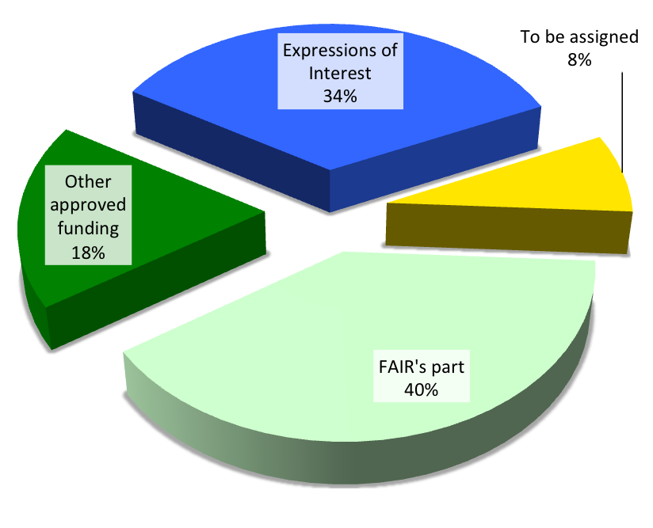
Experiments’ Costs (4th RRBs, 16th Council)
Cost estimate Jan 2015, Collaborations’ input to 4th meetings of the Resources Review Boards (RRBs)
245 M€ (2015 prices) = 196 M€ (2005 prices)
Funds foreseen (2005 prices)
78 M€ in FAIR budget (cf. Council Dec. II.15.5, XVI.12.1-2)
Remainder to be sought externally
Breakdown (2005 prices)
FAIR’s part: 78 M€
Other approved funding: 35 M€
Expressions of Interest: 68 M€
To be assigned: 15 M€

Slide 14
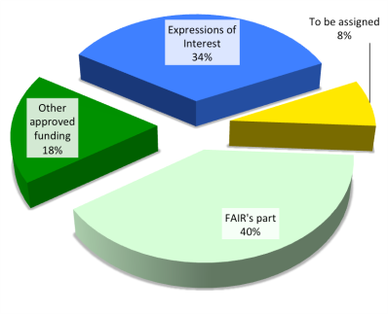
In-Kind for Experiments
Only 40% provided by FAIR.
Each Country decides which Collaboration will get how much and what it is used for.
Experimental Costbook:
Only listed items can be assigned as FAIR contribution
Each experimental component is assessed by the Expert Committee Experiment (ECE) and approved in form of a TDR.
Upon request of the collaboration and Shareholder the Scientific director will submit a component to the Council for assignment as a FAIR contribution.
The collaboration is responsible to supply the specification to FAIR
FAIR will then conclude a contract between
FAIR, Shareholder, Provider
Collaborations are not party of contracts!
14

Slide 15
Thank you for your attention

Slide 16
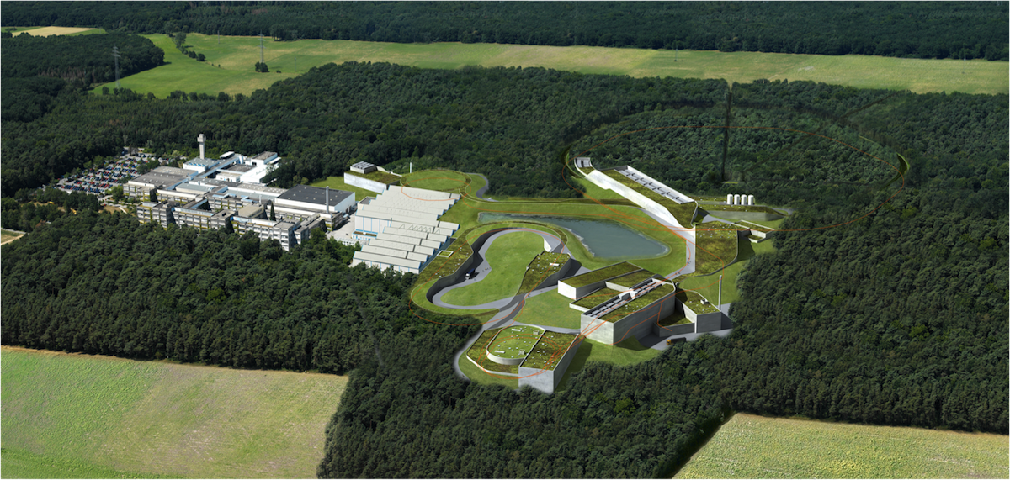
The 4 Scientific Pillars of FAIR
APPA: Atomic, Plasma Physics and Applications
CBM: Compressed Baryonic Matter
NUSTAR: Nuclear Structure, Astrophysics and Reactions
PANDA: Antiproton Annihilations at Darmstadt
APPA
ions, antiprotons
CBM
relativistic nuclear collisions
PANDA
antiproton beams
NUSTAR
radioactive ion beams

Slide 17
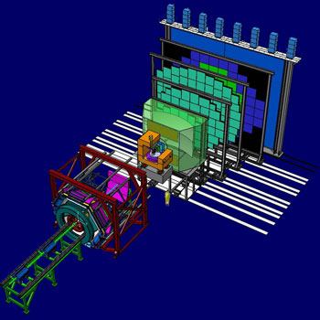
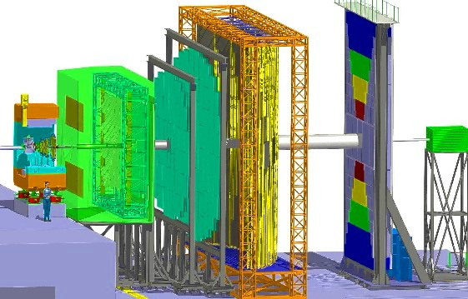
CBM Compressed Baryonic Matter Experiment
The mission
Explore the properties of super-dense nuclear matter.
The physics
Fundamental aspects of Quantum-Chromo-Dynamics (QCD) and astrophysics.
The challenge
Measure rare and penetrating probes
Heavy-ion collisions at rates of up to 10 Million reactions per second.
The technique
Tracking and vertex reconstruction
Electron identification
Muon identification
High speed signal processing and data acquisition.
Beam
High energy heavy Ions, high flux

Slide 18
APPA - Atomic Physics, Plasma Physics Application
BIOMAT (basic research to BIOlogial MATerial and medical applications)
e.g. Biological effects of heavy ions needed for space exploration
SPARC (Stored Particles Atomic Research Collaboration)
The new instrumentation will permit to investigate the dynamics of multi-electron continua
in target and projectile
Strong collisions of highly charged heavy ions in ESR and HESR
FLAIR (Facility of Low energy Antiproton Research)
Access to atomic structure and atomic collision dynamics
using CRYRING@ESR
Plasma Physic: 30 Proposed experiments
Understanding interior of massive planets like Jupiter
Warm and dense plasmas
WDM (Warm Dense Matter)
Radiative Properties of Warm Dense Matter (WDM) produced by intense heavy ion beams
Warm and dense plasmas: Equation of State, transport properties, etc.,
Fusion: do we understand the basic physics?
HEDgeHOB (High Energy Density Matter generated by Heavy Ion Beams)
Studying bulk properties of matter in high energy density states

Slide 19
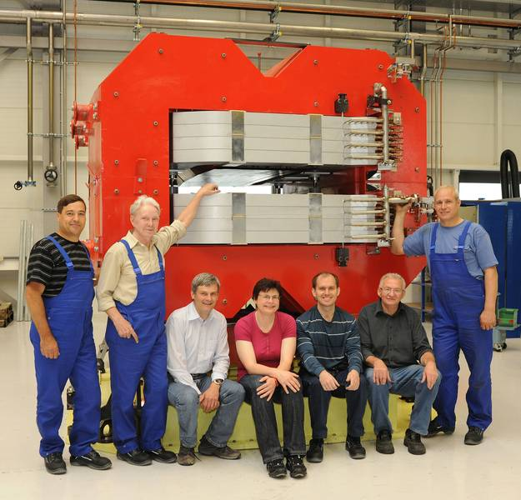
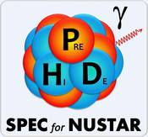
NUSTAR NUclear STructure, Astrophysics and Reactions
The mission
studying nuclear structures, astrophysics and reactions
employing radioactive ion beams for exploiting exotic states of matter and investigate:
ground state properties and decay properties of exotic isotopes
the structure of their excited states and their reaction mechanisms
The physics
study the structure of exotic atomic nuclei, to investigate reactions of these nuclei and to apply the results for answering astrophysical questions
The challenge
use of Radioactive Ion Beams (RIB’s) species separated and identified by the central “instrument” the large-acceptance Superconducting FRagment Separator (Super-FRS)
several experiments with different aspects
Beam
use of RIB’s in three branches
high energy branch: RIBs at relativistic energies (300-1500 MeV/u)
low energy branch: beams in the range of 0-300 MeV/u
later: ring branch: cooled and stored beams
Prototyp of NC-magnet from
BINP for testing at GSI

Slide 20
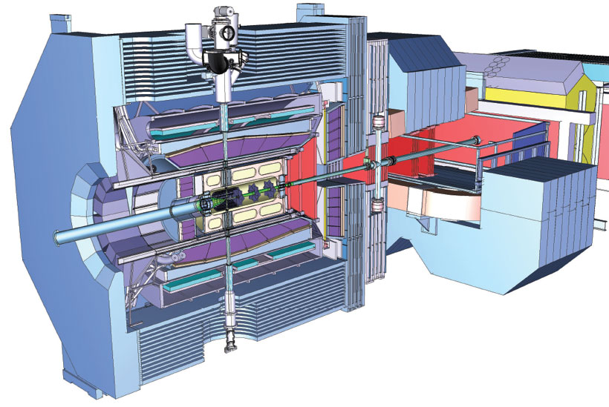
Panda - “anti-Proton ANnihilation at DArmstadt”
The mission
Study precisely how mass is generated by strong interaction acting between the quarks
Basic research on weak and strong forces, exotic states of matter and the structure of hadrons
The physics
Hadron spectroscopy
The challenge
Production of high flux of antiprotons
Complexity of data analysis required
e.g. by producing glueballs and measure
their masses and other properties
Large multi-purpose detector, large data rate
The technique
full coverage of the solid angle together with good particle identification and high energy and angular resolutions for charged particles and photons:
Beam
High energy antiprotons, high flux

