Slide 1










Unraveling stellar alchemy with NUSTAR From ideas to in-kind
Alexander Herlert
FAIR
2nd In-kind Contributions Workshop (IKCW 2015)
GSI/FAIR Darmstadt, November 4, 2015
Finland
France
Germany
India
Poland
Romania
Russia
Slovenia
Sweden
UK

Slide 2
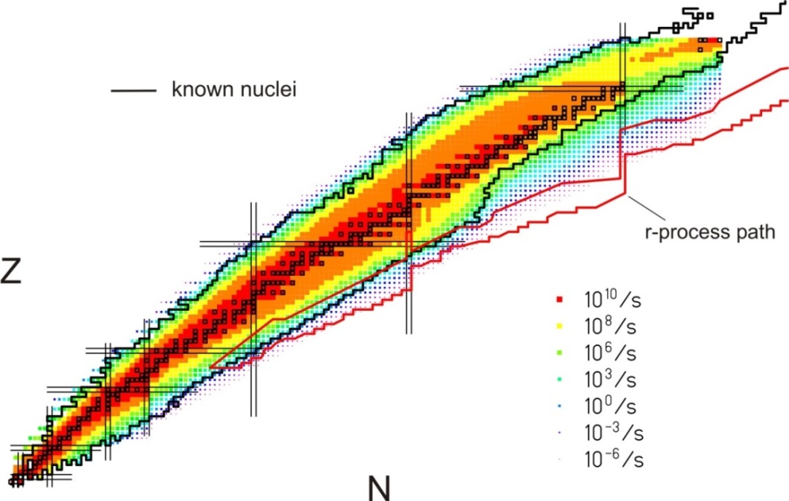
NUclear Structure, Astrophysics and Reactions
What are the limits for existence of nuclei?
  Where are the proton and neutron drip lines situated?
  Where does the nuclear chart end?
How does the nuclear force depend on varying proton-to-neutron ratios?
  What is the isospin dependence of the spin-orbit force?
  How does shell structure change far away from stability?
How to explain collective phenomena from individual motion?
  What are the phases, relevant degrees of freedom, and symmetries
  of the nuclear many-body system?
How are complex nuclei built from their basic constituents?
  What is the effective nucleon-nucleon interaction?
  How does QCD constrain its parameters?
Which are the nuclei relevant for astrophysical processes
and what are their properties?
  What is the origin of the heavy elements?

Slide 3
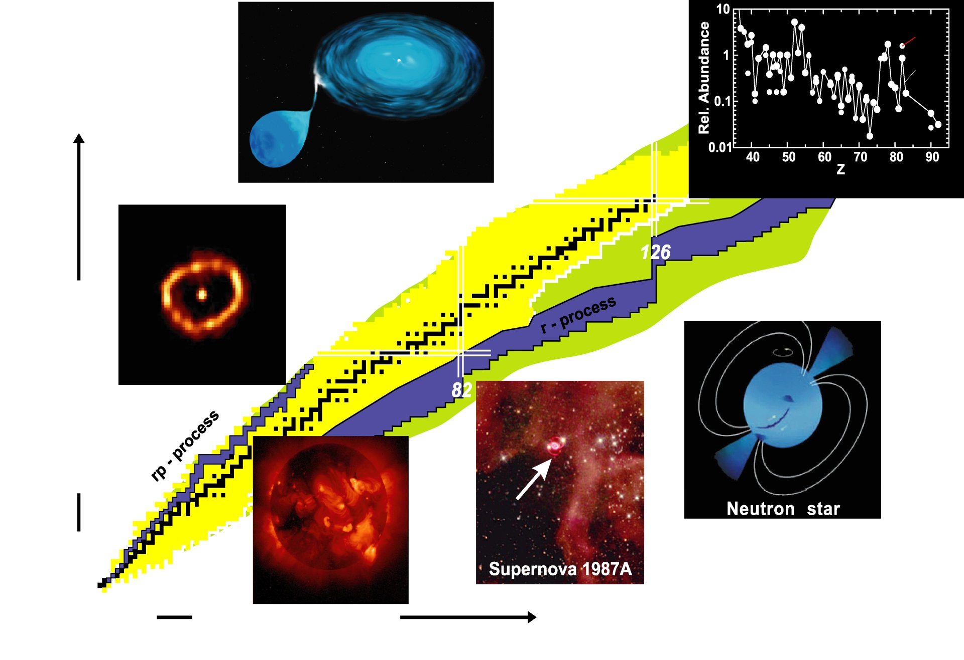
Nuclear physics in the universe
For the understanding of nucleosynthesis and stellar dynamics we need to know properties of many exotic nuclei.
X-ray burst
Accreting white dwarf
S_{p}=0
Elements in our solar system
S_{n}=0
Proton number Z
Nova Cygni 1992
Sun
Neutron number N

Slide 4
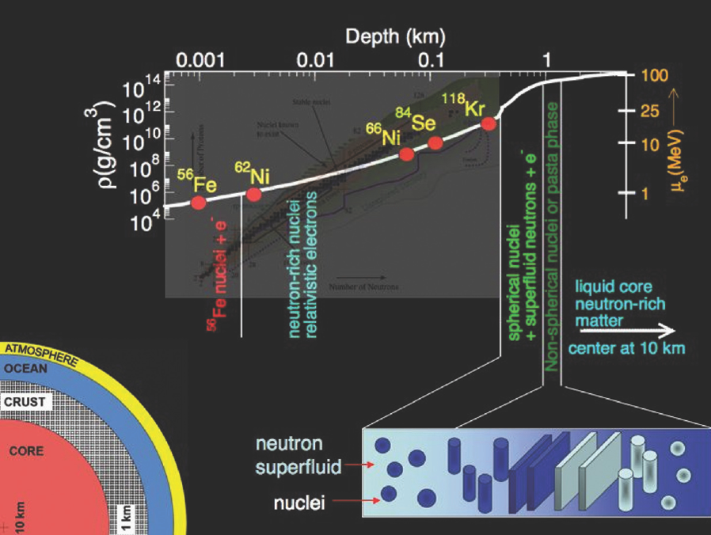
Nuclei in neutron stars

Slide 5
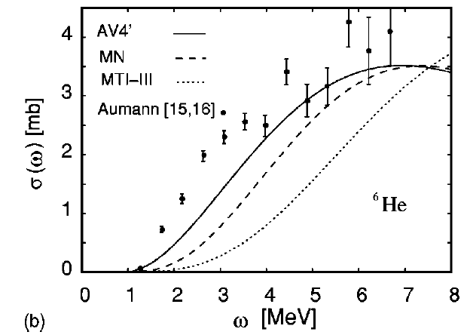
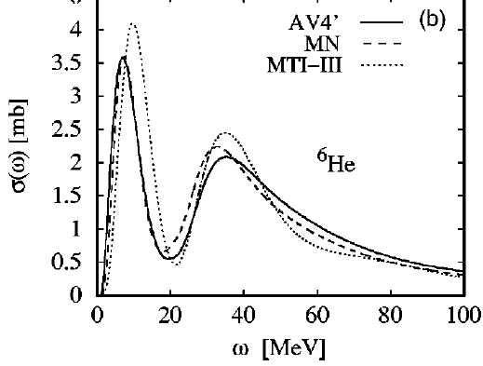
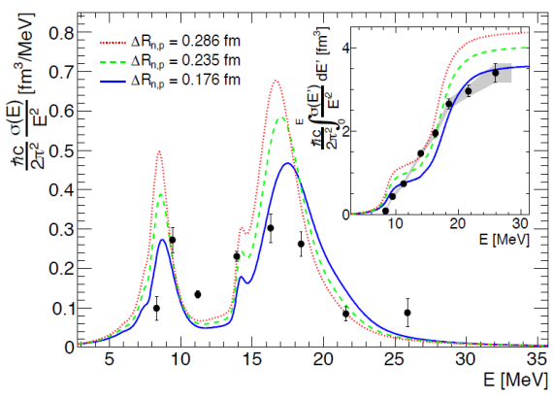
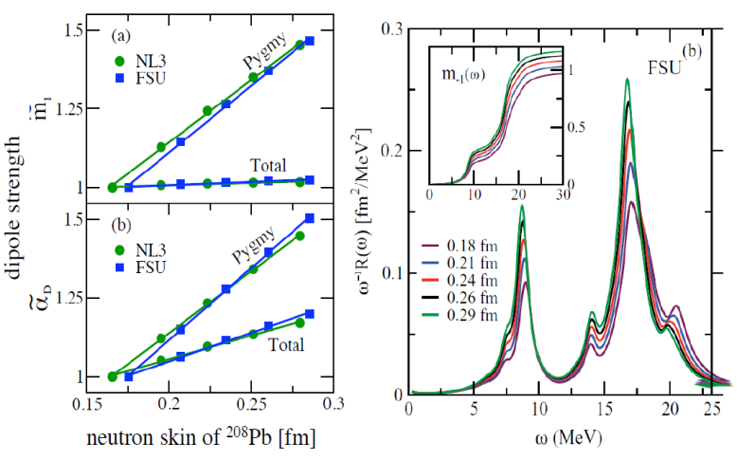

Dipole strength distributions in heavy neutron-rich nuclei
core vs. neutron skins & halos → density / asymmetry
access to EoS (e.g. neutron star) & low lying E1 strength (r-process)
to be measured
with R³B
➔ high energy
~1 A GeV
@ 240 A MeV
S. Bacca et al.
PRL 89 (2002) 052502
PRC 69 (2004) 057001
Pb chain &
N=126 isotones
~1 A GeV →
bare ions
Fragment
identification
D. Rossi et al.
PRL 111 (2013) 242503
skin thickness ⁶⁸Ni
0.175(21) fm
J. Piekarewicz, PRC 83 (2011) 034319

Slide 6
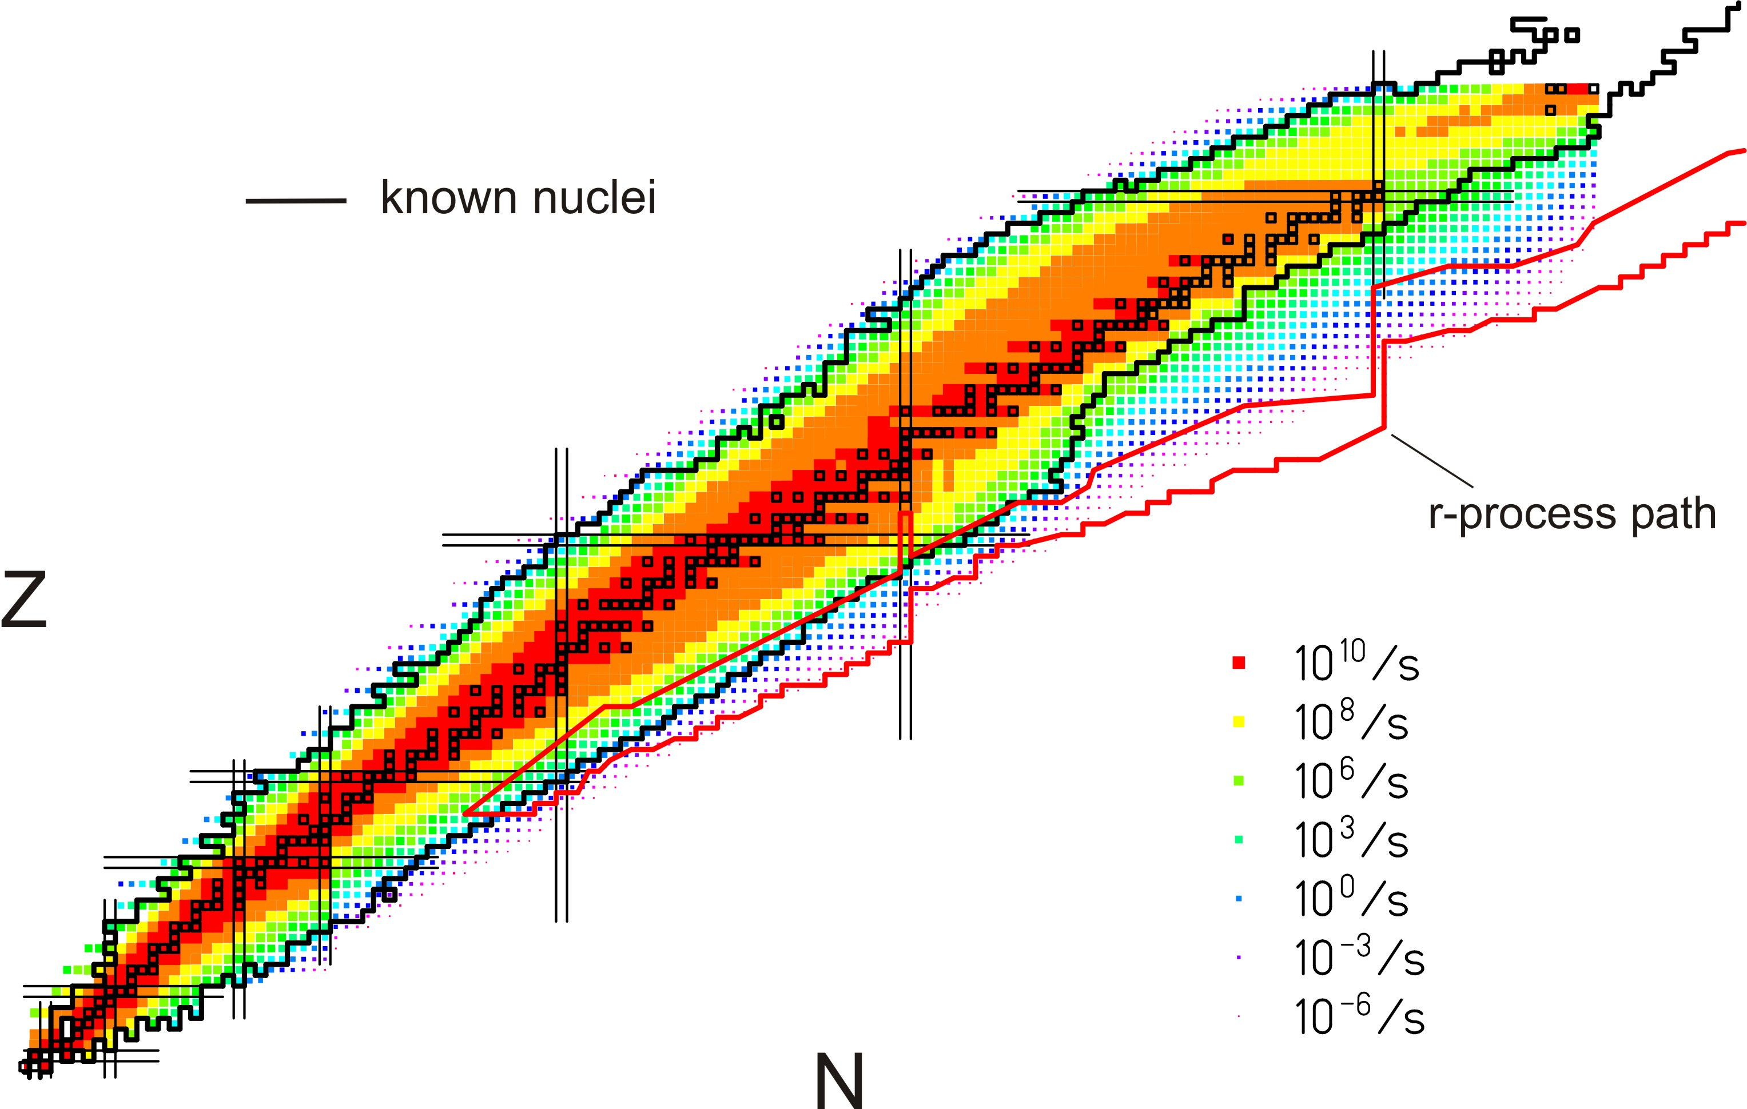
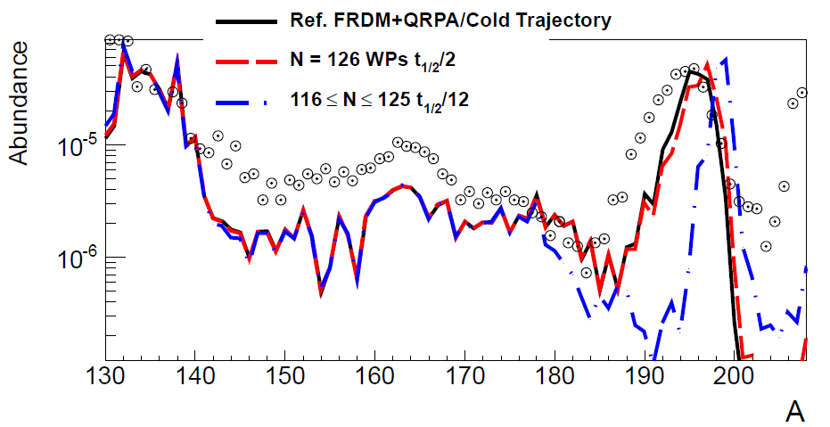
The N=126 physics case
Previous GSI measurements contradict earlier lifetime predictions!
→ Mass abundance not understood!
GSI
Phase-0
Phase-1
old T_{1/2} predictions
new T_{1/2} predictions
Phase-2
3rd waiting point
r-process path
NUSTAR aims to measure:
- masses
- β-lifetimes
- neutron-branchings
- strength distributions
- level structure
Important unique NUSTAR-LEB experiment
Mass abundance depends on the detailed structure
of N=126 nuclei around the 3rd r-process waiting point

Slide 7
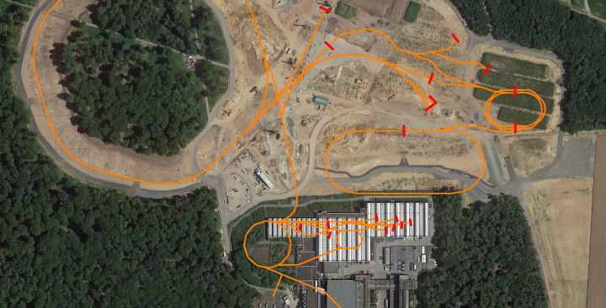
NUSTAR @ FAIR
Super-FRS at new FAIR facility
GSI facility

Slide 8
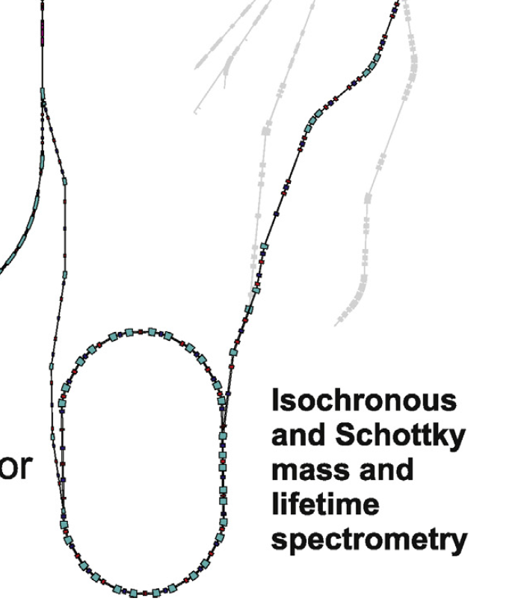
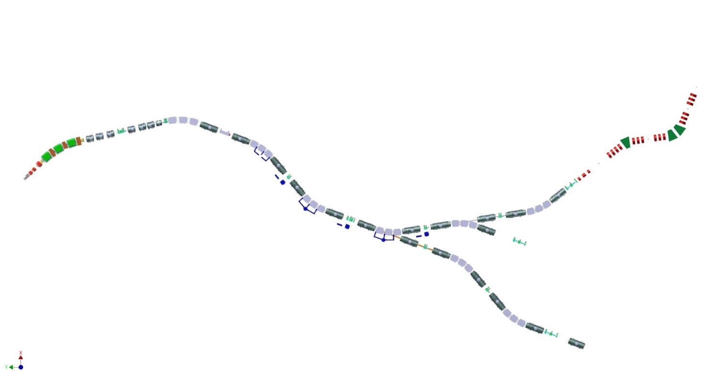
NUSTAR @ FAIR
MATS & LaSpec
HISPEC/DESPEC
Low energy branch
Super-FRS
High energy branch
R³B
ILIMA
production
target
Ring branch

Slide 9
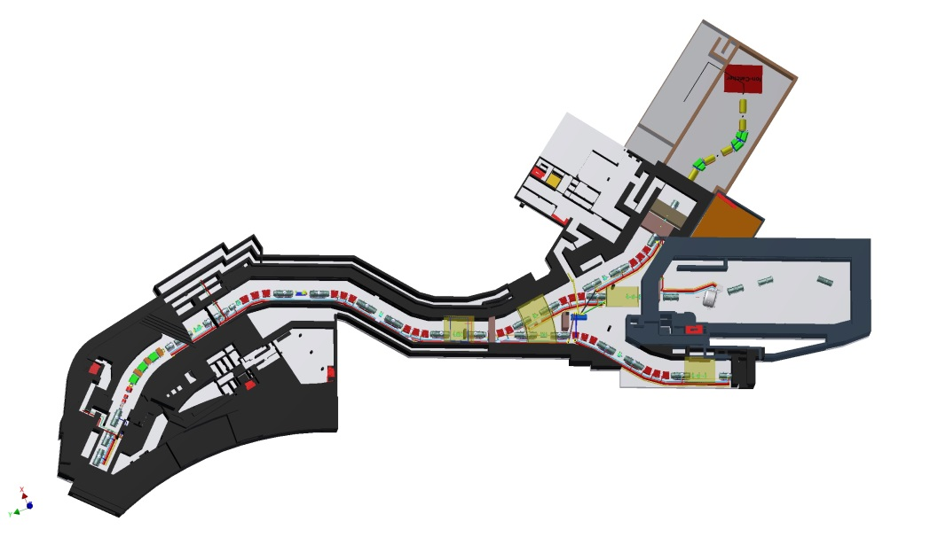
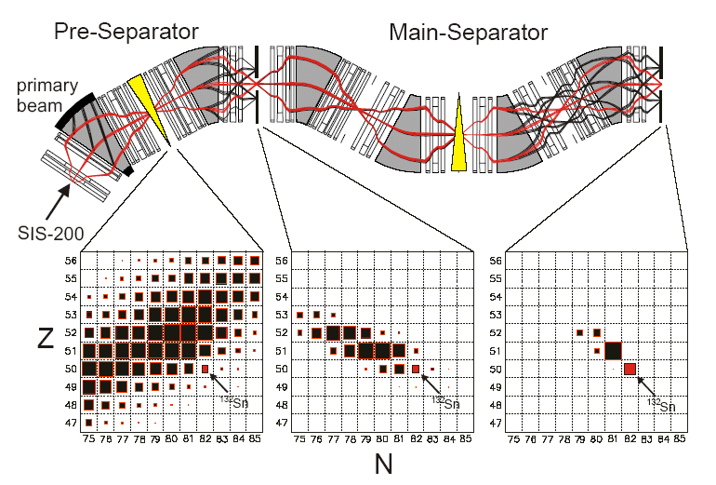
RIB production and experiments
MATS /
LaSpec
LEB Super-FRS
Selection /
Identification
HISPEC/
DESPEC
R³B
Super-FRS collab.
parts from HISPEC / R³B
to storage rings
ILIMA, EXL,...
Production
beam

Slide 10
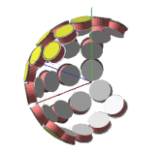


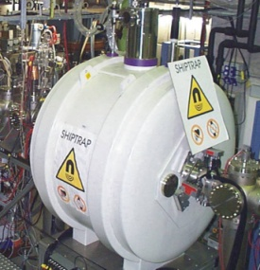
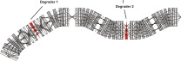

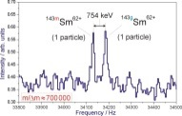
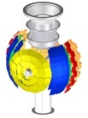
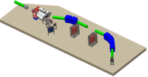

Complementarity of NUSTAR experiments
Super-
FRS
HISPEC/
DESPEC
LaSpec
MATS
R³B
ILIMA
SHE
ELISE
EXL

Slide 11
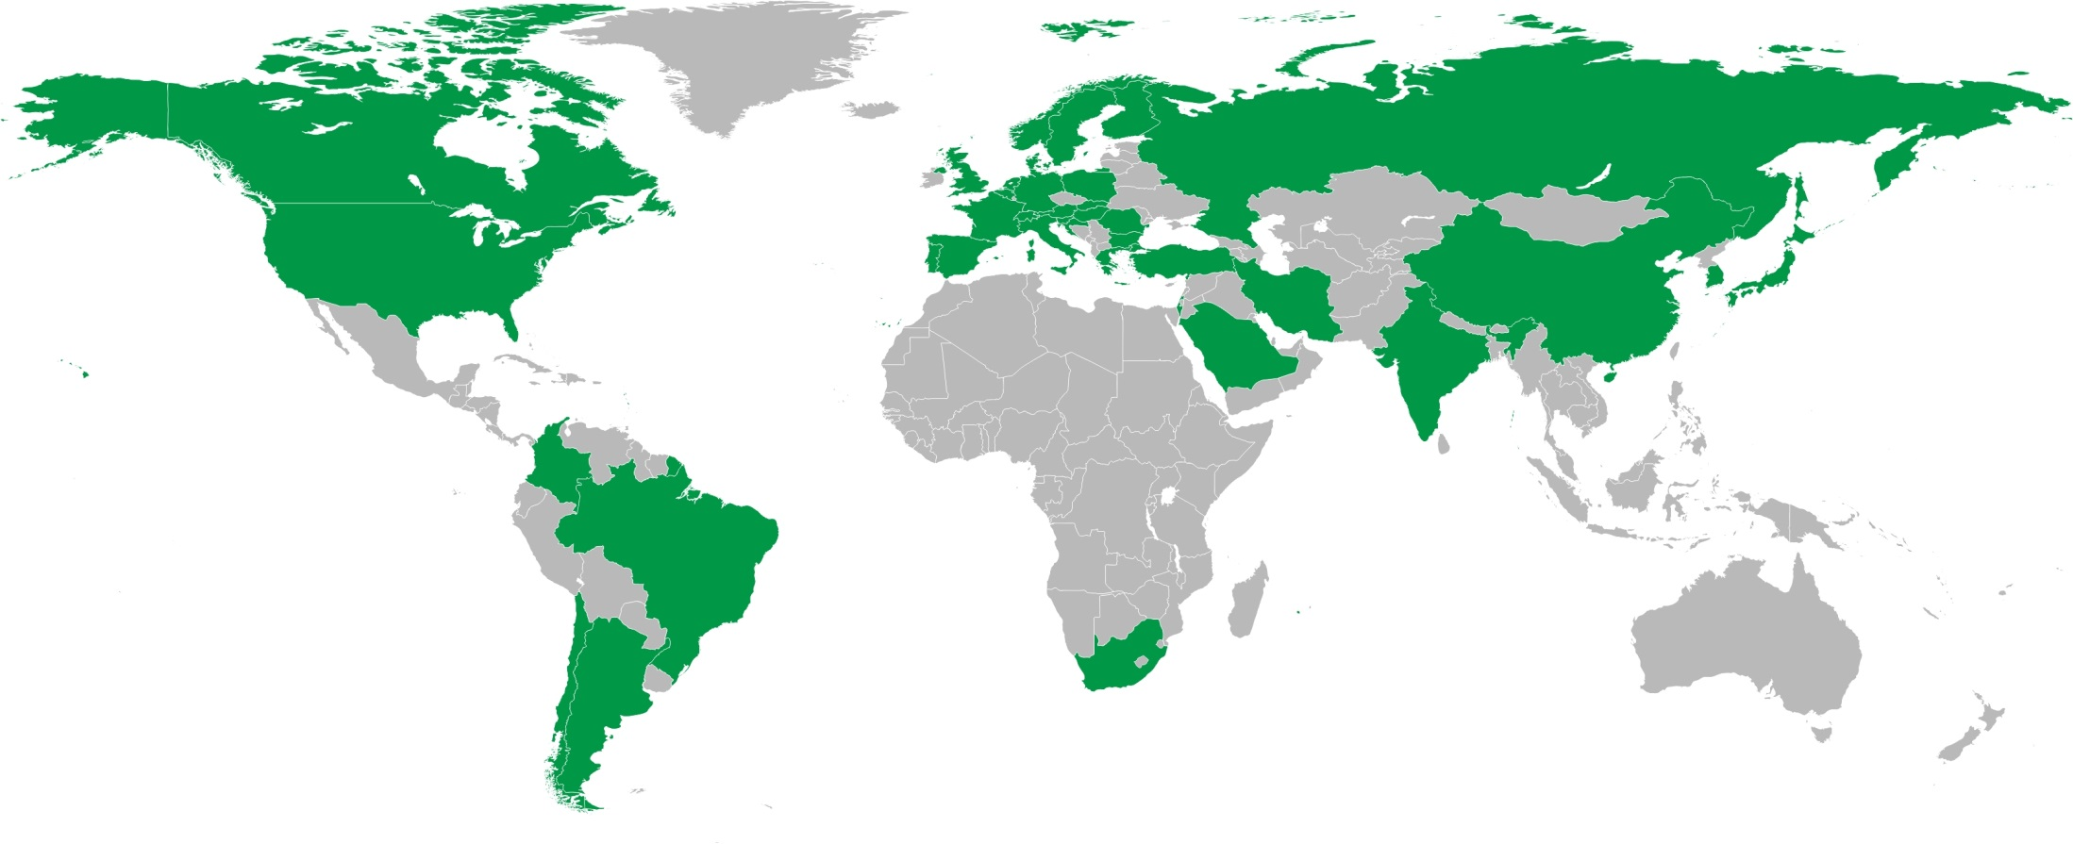
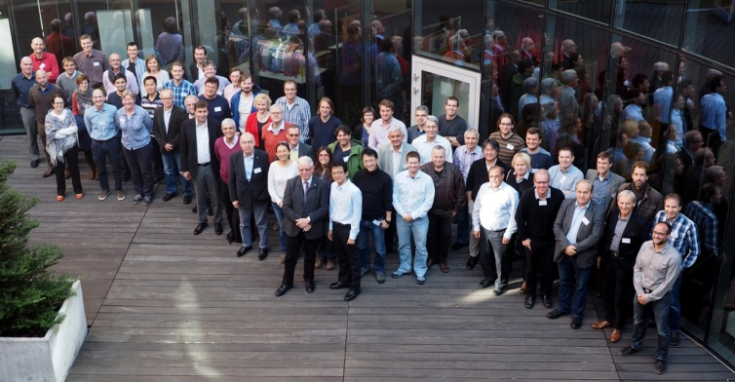
NUSTAR Collaboration
850 registered “interested”
scientists in NUSTAR
database
39 countries and more than 180 institutes
NUSTAR Week 2015, Warsaw

Slide 12
Organizational structure
Reference data:
members and institutes
work packages
organization … etc.
NUSTAR
MoU
MoU Sub-collaboration 1
MoU Sub-collaboration 2
MoU Sub-collaboration 3

Slide 13
From the idea to in-kind
Technical proposal
Technical design report (TDR)
Identification of partner institutes
Funding requests
Delivery of in-kind contributions

Slide 14
Different types of funding
FAIR budget (1/3)
“external” funding (2/3)
In-kind contract
MoU
order
institute
industry
material
manpower
equipment
owned by FAIR
owned by institute
usage to be regulated by MoU

Slide 15
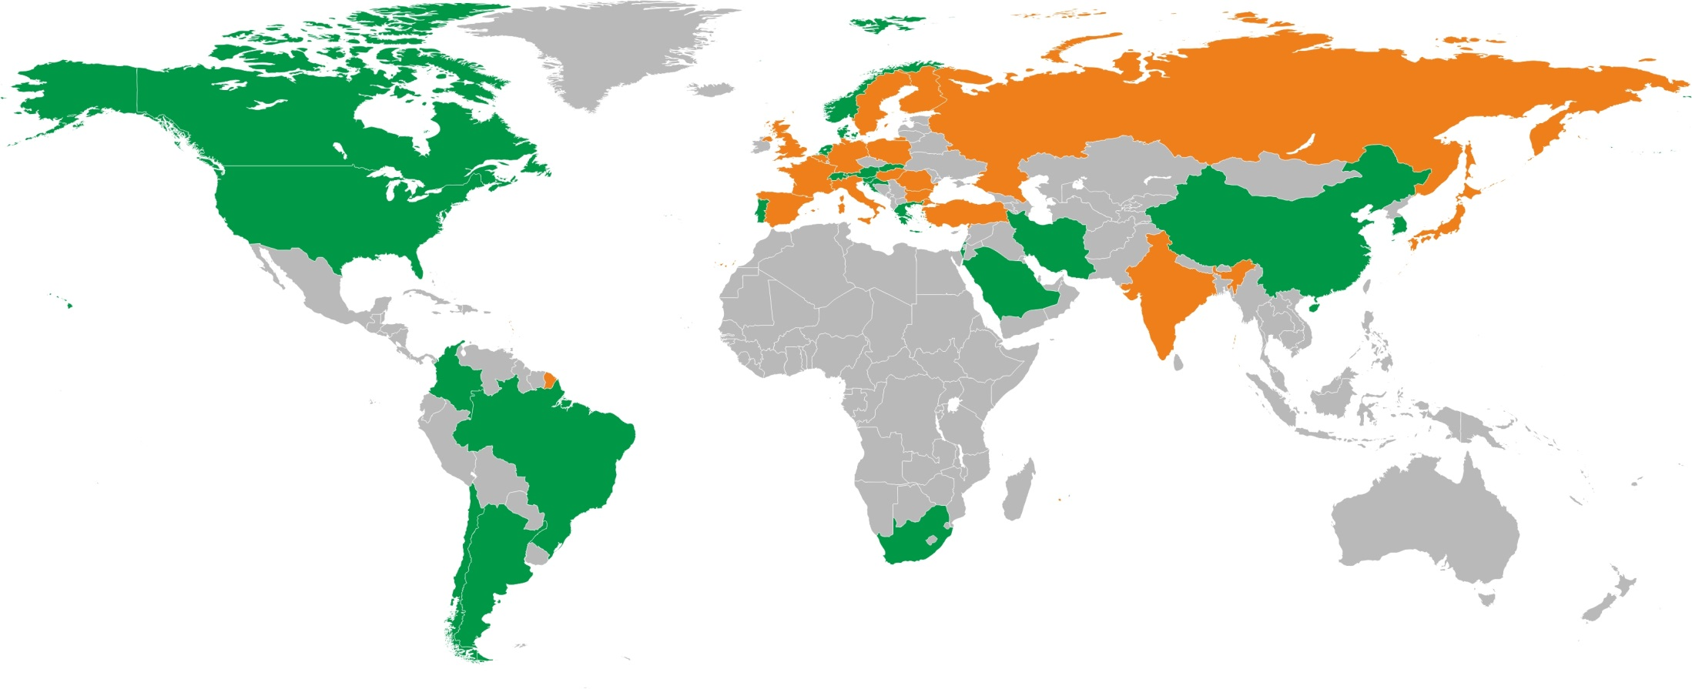
NUSTAR Collaboration – funding
Secured funding and expression of interest in funding
(status: July 2015)
16 countries (incl. 9 FAIR partner countries)

Slide 16

Comparison: funding vs. senior scientists
16 countries
59 institutes
39 countries
>180 institutes
Finland
France
Germany
India
Poland
Romania
Russia
Slovenia
Sweden
UK

Slide 17
Different types of collaborative work
one provider only
work
packages
several providers
independent production
specialized sub-systems
experiments
co-funding

Slide 18
NUSTAR project structure
Modularized Start Version (MSV)
1.2.1 | LEB Super-FRS
1.2.2 | HISPEC/DESPEC
1.2.3 | MATS
1.2.4 | LaSpec
1.2.5 | R³B
1.2.6 | ILIMA
1.2 NUSTAR
Extending or beyond MSV
1.2.8 | ELISe
1.2.9 | EXL
initially NESR required – alternative/intermediate „operation“ within MSV under discussion
New experiments
1.2.10 | Super-FRS Experiments
1.2.11 | SHE
„operation“ within MSV planned

Slide 19
Work packages of NUSTAR
>220 sub work packages
66 Work packages
10 Experiments
6 experiments
monitored
so far
described by
34 TDRs

Slide 20
NUSTAR work packages (63 with TDR)
HISPEC/ DESPEC |  |  |  |  |  |  |  |  | ?
 | 1.2.2.1 | 1.2.2.2 | 1.2.2.3 | 1.2.2.4 | 1.2.2.5 | 1.2.2.6 | 1.2.2.7.1 | 1.2.2.7.2 | 1.2.2.8 | 1.2.2.9 | 1.2.2.10 | 1.2.2.11 | 1.2.2.13 | 1.2.2.14 | 1.2.2.15 | 1.2.2.16.1 | 1.2.2.16.2 | 1.2.2.16.3 | 1.2.2.17 | 1.2.2.18
MATS
 | 1.2.3.1 | 1.2.3.2 | 1.2.3.3 | 1.2.3.4 | 1.2.3.5 | 1.2.3.6 | 1.2.3.7 | 1.2.3.8.1 | 1.2.3.8.2 | 1.2.3.8.3 | 1.2.3.9 | 1.2.3.10 | 1.2.3.11 | 1.2.3.12 | 1.2.3.13
 | TDR approved
 | TDR submitted
 | TDR in preparation
 | No TDR expected
LaSpec
 | 1.2.4.1 | 1.2.4.2 | 1.2.4.3 | 1.2.4.4 | 1.2.4.5 | 1.2.4.7 | 1.2.4.8
LEB/ Super-FRS
 | 1.2.1.1 | 1.2.1.2 | 1.2.1.3
R³B
 | 1.2.5.1.1.1 | 1.2.5.1.1.2 | 1.2.5.1.1.3 | 1.2.5.1.2.1 | 1.2.5.1.2.2 | 1.2.5.1.2.3.1 | 1.2.5.1.2.3.2 | 1.2.5.1.2.4 | 1.2.5.1.2.5 | 1.2.5.1.2.6 | 1.2.5.1.3 | 1.2.5.1.4 | 1.2.5.1.5 | 1.2.5.2.1 | 1.2.5.2.2 | 1.2.5.2.3
ILIMA
 | 1.2.6.1 | 1.2.6.3 | 1.2.6.4 | 1.2.6.5 | 1.2.6.6
Described by 34 TDRs

Slide 21
NUSTAR project structure: example R³B
1.2.5.1 R³B (stage I)
1.2.5.1.1 Magnets
GLAD
Multiplet
1.2.5.1.2 Detectors
Tracking
1.2.5.1.3 Vacuum
1.2.5.1.4 DAQ
1.2.5.1.5 Infra-structure
CALIFA
Si tracker
(target recoils)
NeuLAND
Staged construction

Slide 22
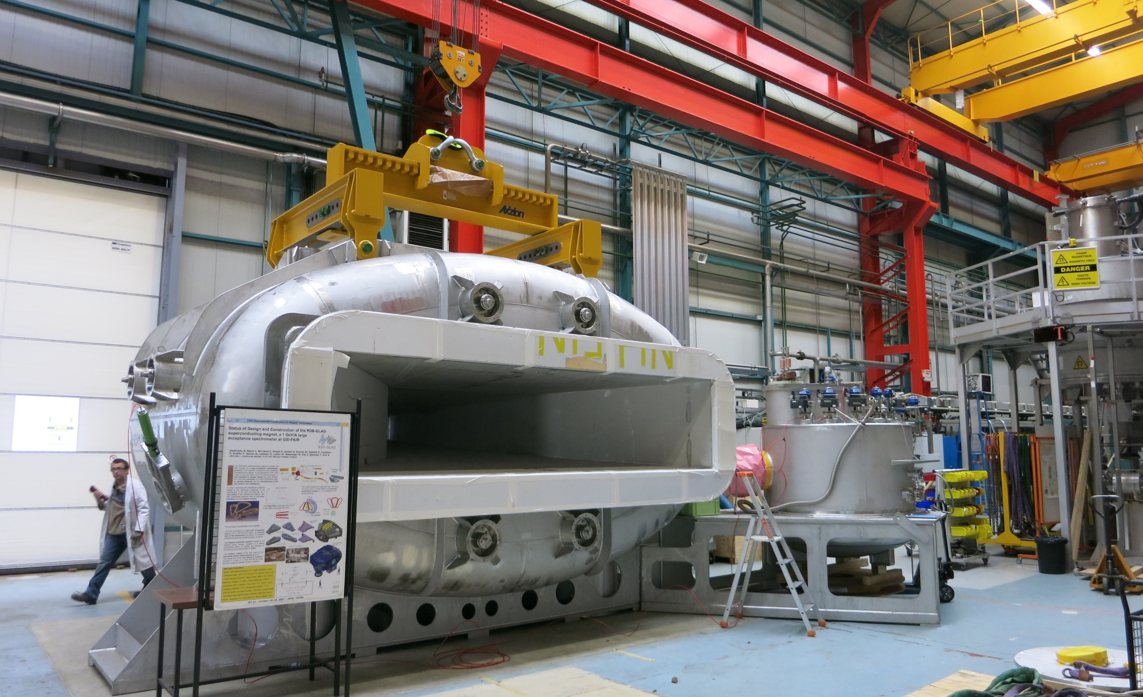
GLAD magent @ CEA Saclay

Slide 23
R³B – GLAD construction cost
GLAD magnet construction cost (July 2015)
  Detailed cost overview (CEA Saclay + GSI local cost) in kEUR 2005
CEA
GSI
3612
2558
manpower
6170
material
5870
CEA
construction
cost
material
2935
2935
CEA
GSI
1008
manpower
???
GSI
local cost
CEA
2935
GSI
3943
invest
6878 kEUR
2530
2530
cost sharing
ext (EC)
ext (CEA)
FAIR budget
ext (EC)
ext (GSI)

Slide 24
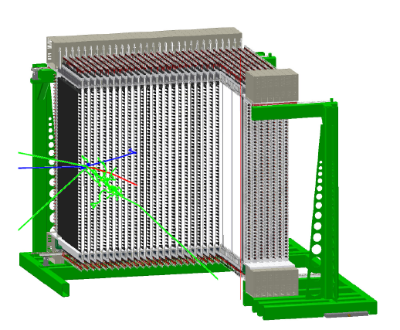
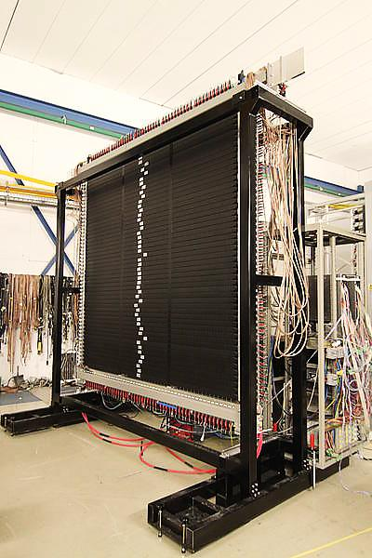
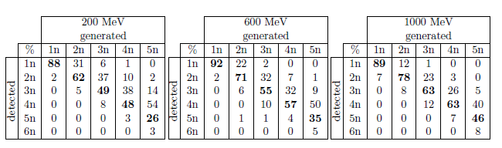
NeuLAND neutron detector
30 double planes
  100 x 100 scintillator bars x 30 planes
  6000 PMTs
excellent multi-neutron capability

Slide 25
Work packages and funding: NeuLAND
NeuLAND
stage 1
stage 2
stage 3
TU Darmstadt
HV system
PNPI
PNPI
Univ. Frankfurt
GSI
Univ.
Cologne
FAIR
shareholder
contribution
„external“ funding

Slide 26
Definition of NUSTAR experiment phases
Phase 0
  R&D and experiments to be carried out with present facilities and FAIR/NUSTAR equipment
Phase 1
  Core detectors and subsystems completed
  First measurements with FAIR/Super-FRS beams
    Carry out experiments with highest visibility as part of the core program and within the FAIR MSV
Phase 2
  FAIR evolving towards full power
  Completion of experiments within MSV
    Essentially the full program of MSV can be performed
Phase 3
  Moderate projects, which have been initiated on the way (outside MSV) can be included (e.g. experiments related to return line for rings)

Slide 27
Phases of HISPEC/DESPEC – funding
Description |  | Beam tracking and identification detectors | HISPEC/DESPEC Beamline | Mechanics + installation | Common EDAQ | Safety | Cabling and related (HISPEC/AGATA) | Active target (MINOS) | Active target (India) | AGATA | HYDE | LYCCA | Plunger | AIDA | DEGAS | FATIMA | BELEN | MONSTER | NEDA | DTAS | Isomeric Moments
TDR |  |  |  |  |  |  |  |  |  | ?
PSP code |  | 1.2.2.1 | 1.2.2.2 | 1.2.2.3 | 1.2.2.4 | 1.2.2.5 | 1.2.2.6 | 1.2.2.7.1 | 1.2.2.7.2 | 1.2.2.8 | 1.2.2.9 | 1.2.2.10 | 1.2.2.11 | 1.2.2.13 | 1.2.2.14 | 1.2.2.15 | 1.2.2.16.1 | 1.2.2.16.2 | 1.2.2.16.3 | 1.2.2.17 | 1.2.2.18
phase | 0 |  |  |  |  |  |  |  |  | X |  | X |  | X | X | X | X |  |  | X
 | 1 | X | X | X | X | X | X |  |  | X |  |  | X |  | X | X |  | X
 | 2 |  |  |  |  |  |  |  |  | X |  |  |  |  | X |  |  | X | X
 | 3 |  |  |  |  |  |  |  | X |  | X |  |  |  | X |  |  |  |  |  | X
(status: July 2015)

Slide 28
Secured funding, EoIs, and to be assigned
FAIR shareholders and associates
  Finland
  France
  Germany
  India
  Poland
  Romania
  Russia
  Sweden
  UK
Additional funding from:
  Belgium
  Bulgaria
  Hungary
  Israel
  Italy
  Japan
  Spain
  Turkey

Slide 29
Evolution of NUSTAR project funding (RRBs)
Without GLAD

Slide 30
NUSTAR experiment funding – phases
Draft
MEUR (2005)
Full NUSTAR
Phase 0
Phase 1
Phase 2
Phase 3
July 2015 - iteration within NUSTAR Collaboration ongoing

Slide 31
Scenario for phase 0 and phase 1 operation
2015 | 2016 | 2017 | 2018 | 2019 | 2020 | 2021 | 2022 | 2023
Super-FRS
construction and installation
commissioning
operation
NUSTAR caves
civil construction
Phase 0
Phase 1
NUSTAR experiments
construction and operation „outside“ FAIR
installation
commissioning
operation at FAIR
31

Slide 32
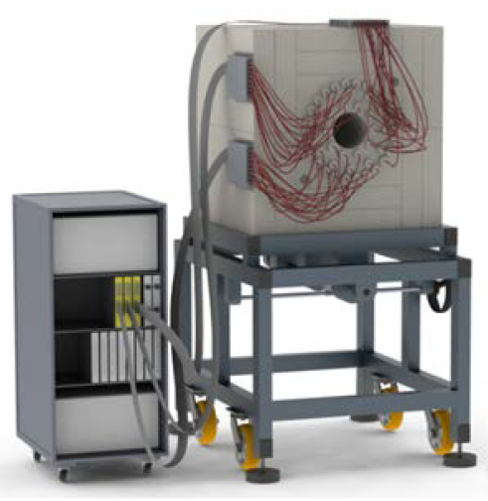
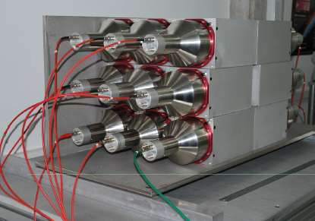
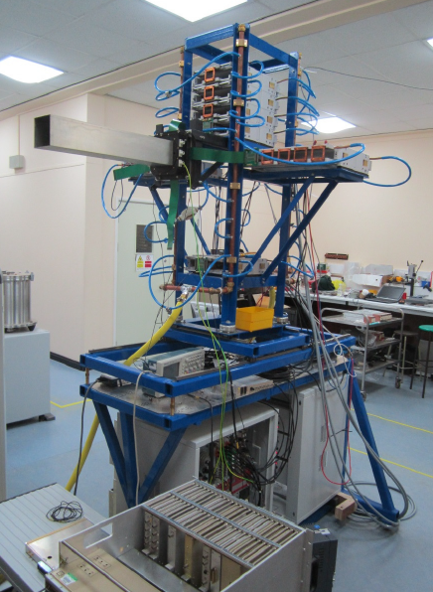
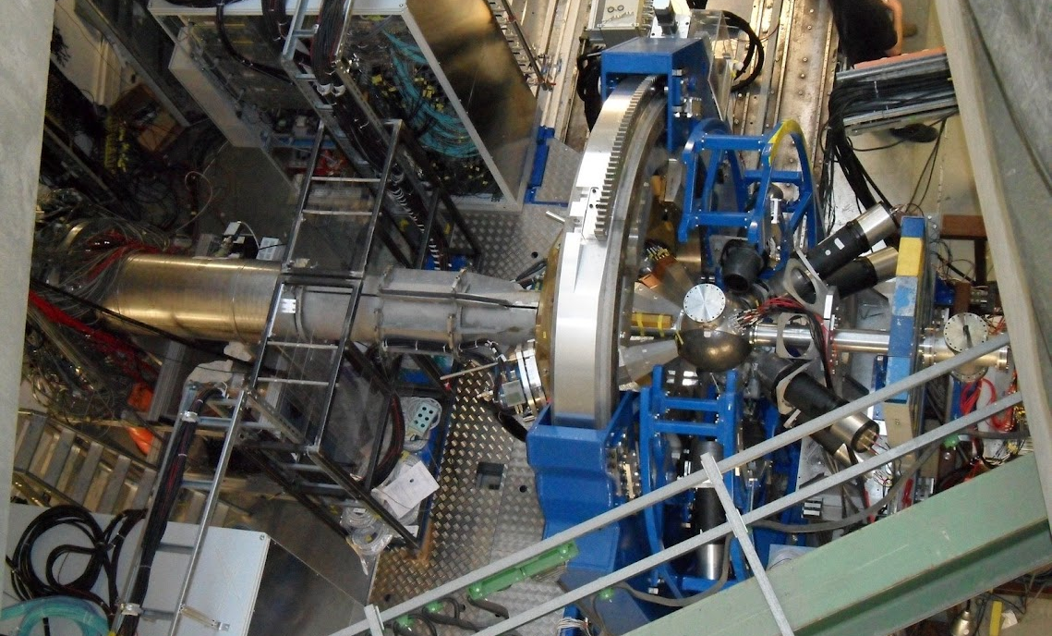
HISPEC/DESPEC – ready for operation
BELEN
DTAS
LYCCA
AIDA
AGATA

Slide 33
With in-kind from international partners …
… the NUSTAR project aims at studying exotic nuclei ...
Physics subject
to understand the formation of the elements and to finally describe the atomic nucleus
Instrumentation
a multitude of novel particle and radiation detectors with sophisticated electronics and data acquisition systems
Applications
many new devices and methods for medicine, security, industry other research areas
... and is on a good way!

