Slide 1
Overview of the FAIR Accelerators
P. Spiller,
In-kind Contribution Workshop
4.11.2015

Slide 2
Outline
Overview of GSI and FAIR Accelerators
GSI accelerator’s (injector) upgrade
FAIR Primary Beam Accelerators
FAIR Secondary Beam Production and Separation
(Super-FRS, pbar-Separator)
FAIR Storage Rings
2

Slide 3
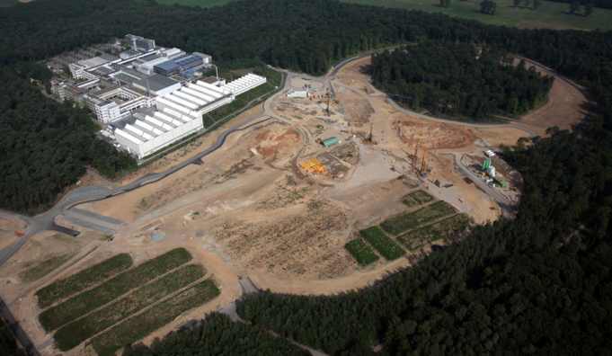
FAIR Start Version - Overview

Slide 4
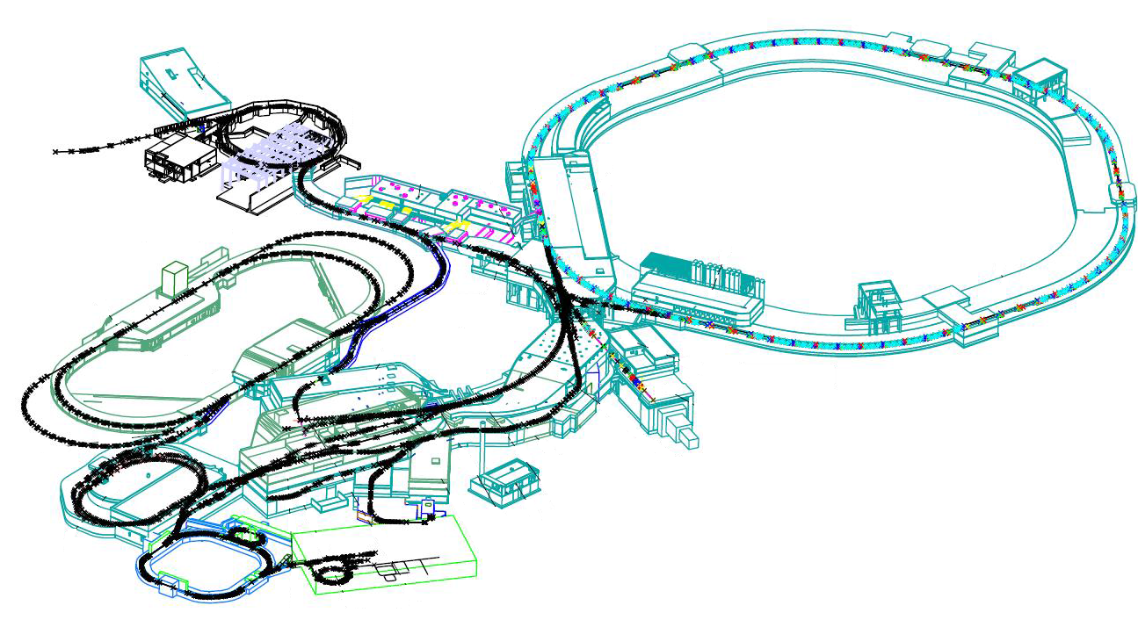
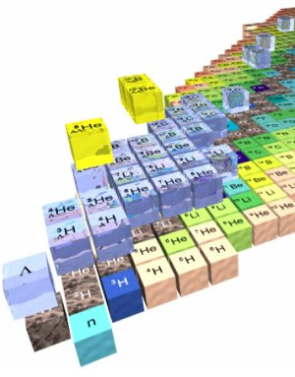
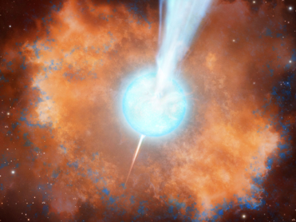
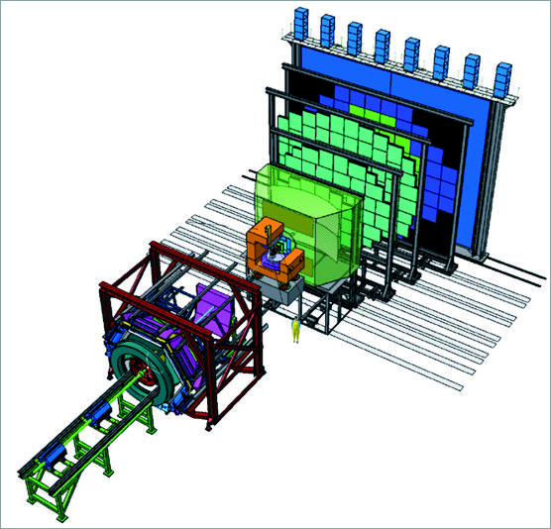
Heavy Ion Accelerator Chain
SIS18
SIS 100
NuSTAR
Collector Ring
CBM
Super-FRS
CBM
4

Slide 5
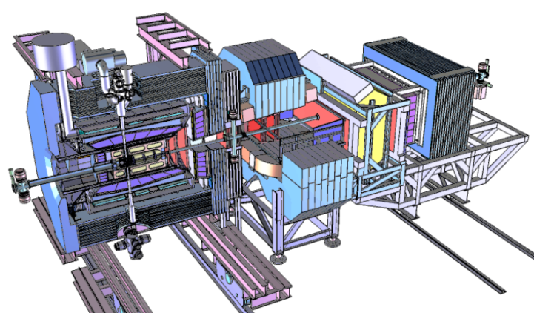
Anti Proton Accelerator Chain
p-Linac
SIS18
SIS 100
PANDA
HESR
p-bar target
Collector Ring
5

Slide 6
FAIR ACC Beam Performance
/cycle
/cycle
6

Slide 7
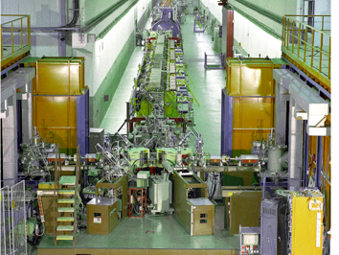
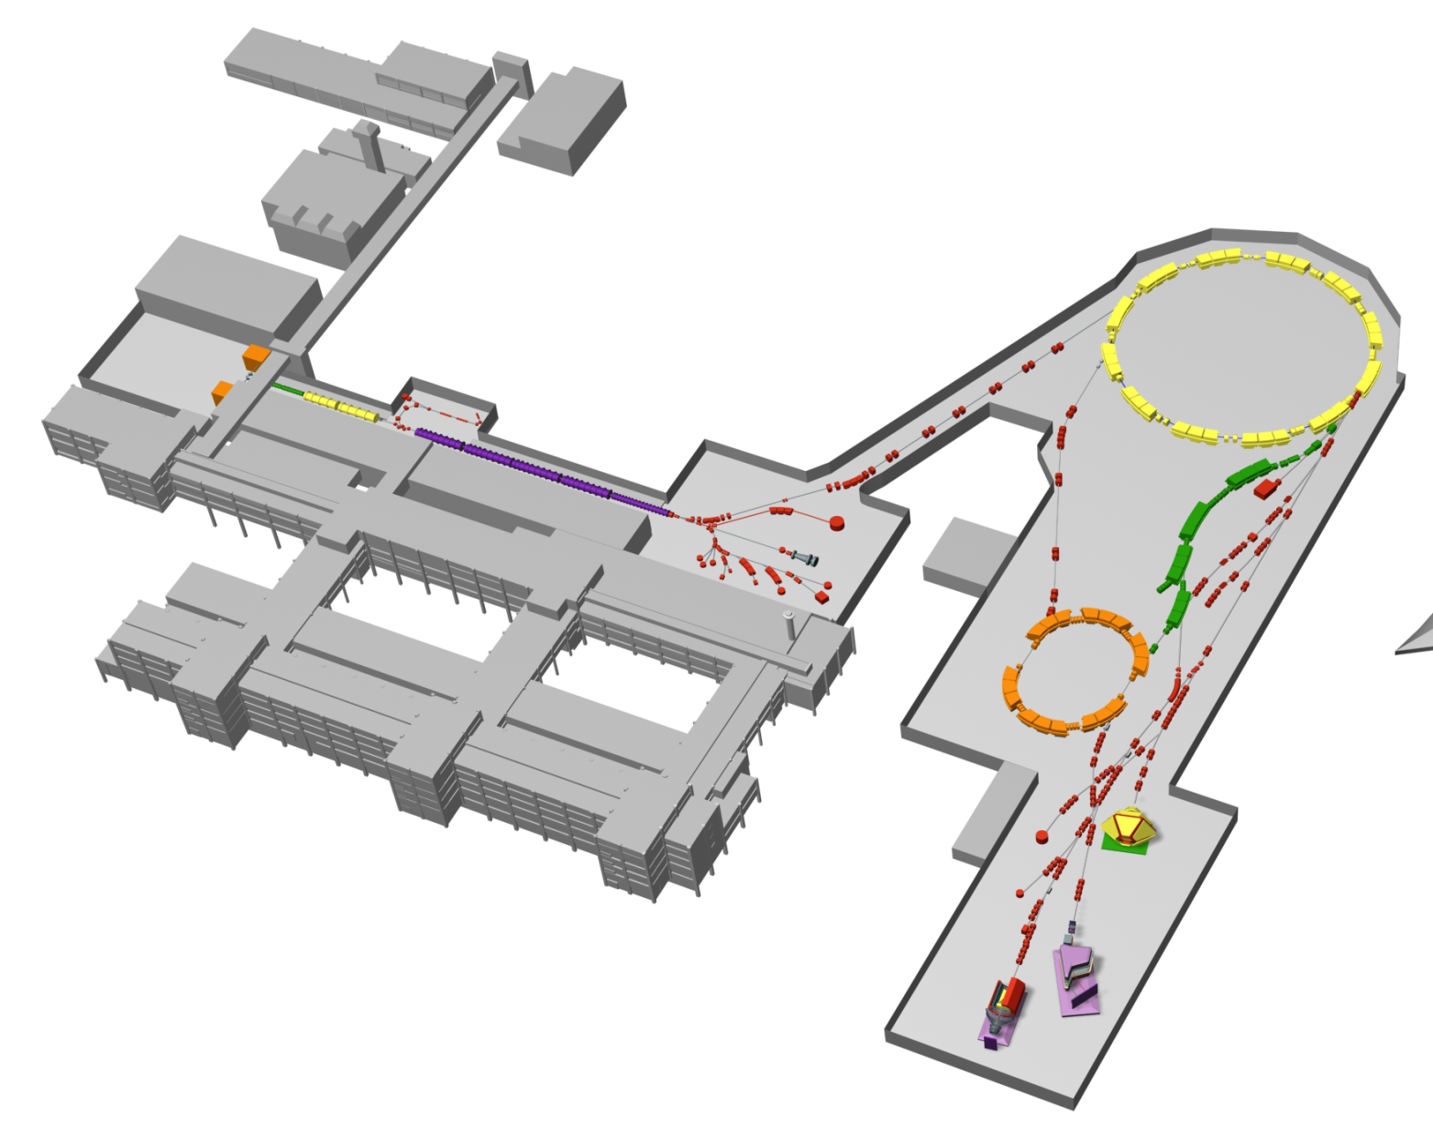
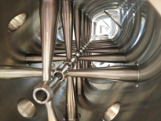
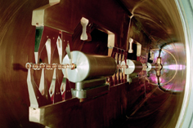
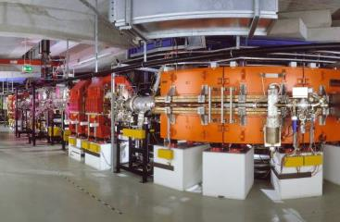
FAIR Injectors: UNILAC, p-Linac and SIS18
p-Linac
Coupled CH cavity
Ion sources
SIS-18
upgrade
for FAIR
SIS18
UNILAC
IH structure
beams to SIS100
ESR
UNILAC: world’s highest beam power (MW)
for heavy-ions!
SIS18: world’s highest number of heavy-ions
per cycle (> 10¹⁰) !
7

Slide 8
GSI Accelerator Upgrade
Exchange of the 40 years old Alvarez accelerator with modern Rf- structures
Higher intensities (medium mass range)
→ 28 GHz ECRIS
UNILAC upgrade
High power (high intensity),
short pulses, system reliability
Increase of beam brilliance (Beam current / emittance), EMTEX
Increase of transported beam currents
Improvements of high current beam diagnostics / operation
SIS18 upgrade
Fast ramping, enhanced intensity
per pulse, improved vacuum system
Increase of injection acceptance
Improvement of lifetime for low-charged U-ions
Increase of beam-intensity per time due to reduction of SIS18- cycle time
8

Slide 9
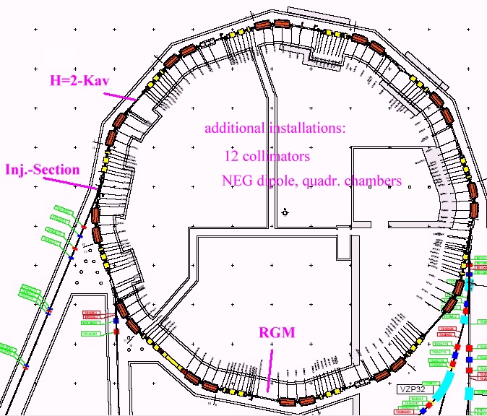
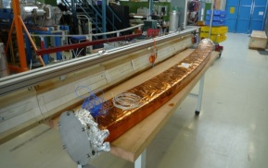
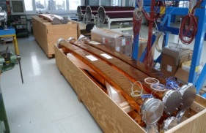
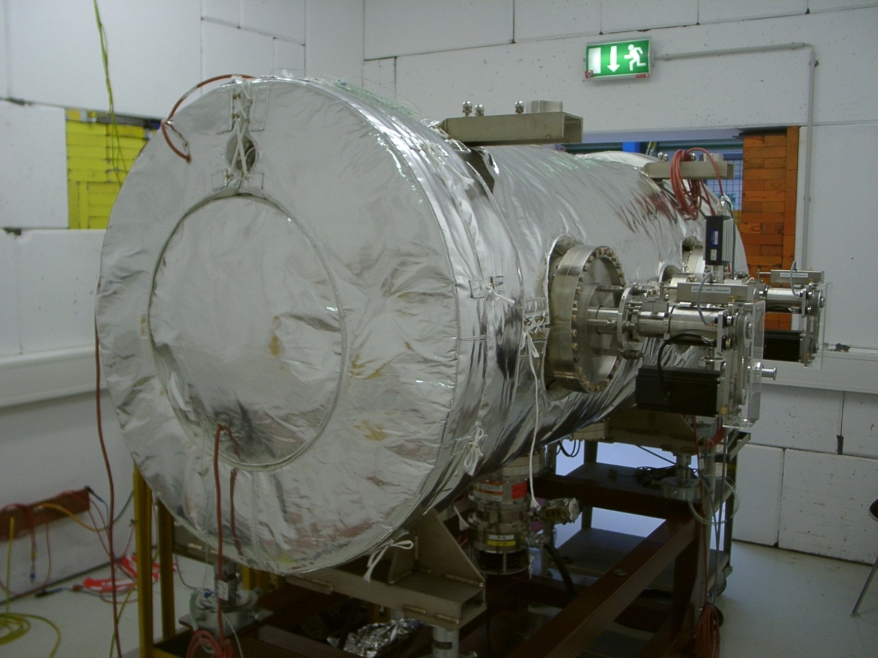
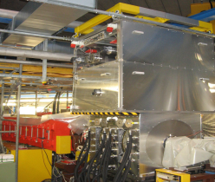
SIS18 Booster Upgrade
Main upgrade measures:
New injection system
Enhanced pumping and beam loss control
  NEG coating, Baking at 300 K
  Ion catchers and collimators
Bunch compression cavity
Fast beam monitor (RGM)
Close to be completed (present shutdown):
Main dipole power supply
New h=2 acceleration cavities
for fast ramping with 10 T/s.
The SIS18 developments were a pre-condition for the design and layout of SIS100.
9

Slide 10
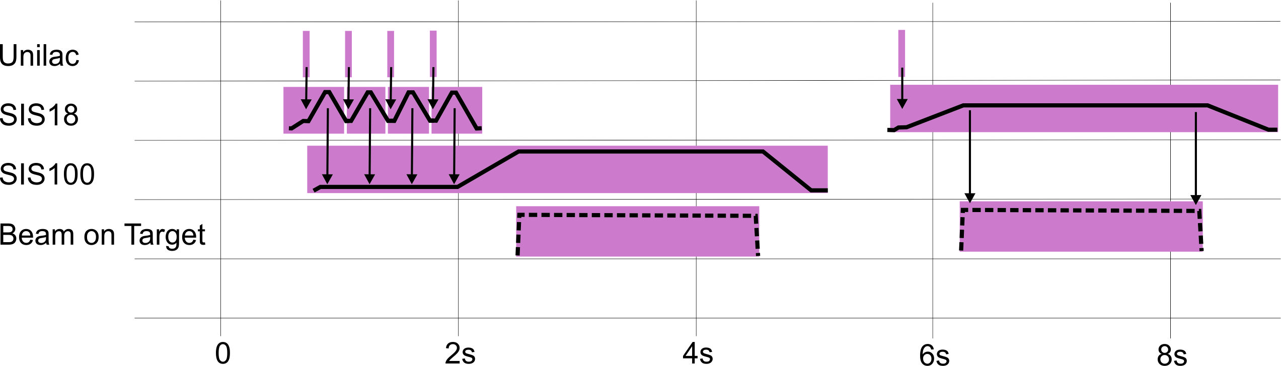
Intensity Requirements for FAIR
(SIS18 Booster Operation)
FAIR module (green paper) | Today | Module 0+1 (SIS100 + CBM, APPA) | Module 2 (Super-FRS, RIBs for NUSTAR) | Module 3 (pbar, CR, HESR, PANDA)
Reference ion | U⁷³⁺ | U⁷³⁺ | U²⁸⁺ | U²⁸⁺
Maximum energy | 1 GeV/u | 1 GeV/u | 0.2 GeV/u | 0.2 GeV/u
Max. intensity / cycle | 4x10⁹ | 2x10¹⁰ | 1.25x10^{11 (*)} | 1.25x10¹¹
Repetition rate | 0.3 – 1 Hz | 1 Hz | 1 Hz | 2.7 – 4 Hz
SIS100:
5x10¹¹ U²⁸⁺ ions per cycle
3x10¹¹ U²⁸⁺ ions per second

Slide 11
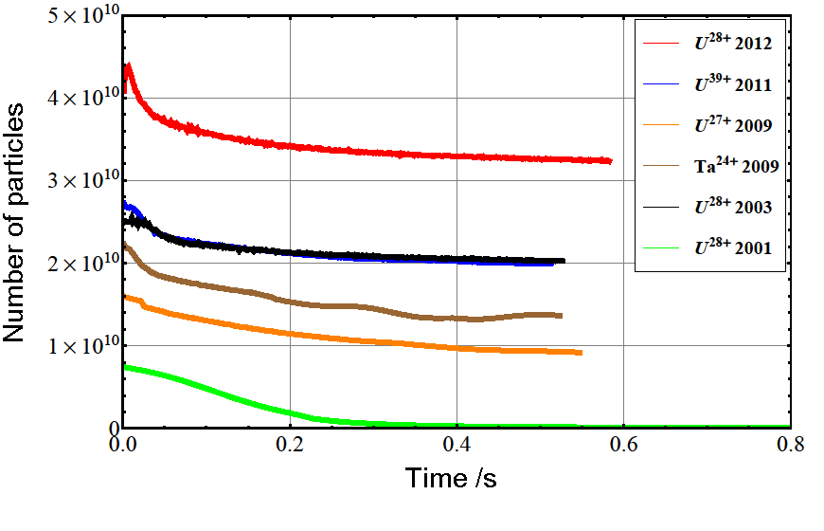
SIS18 Beam Intensity Progress
World record intensity per cycle for low charge state heavy ions has been achieved in SIS18.
World record !
2001 FAIR conceptual design report (FAIR proposal)

Slide 12
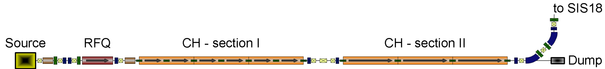
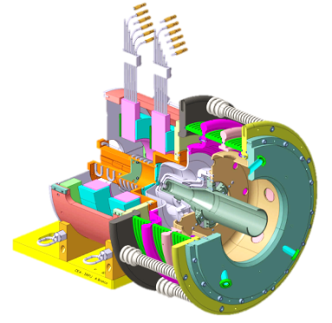
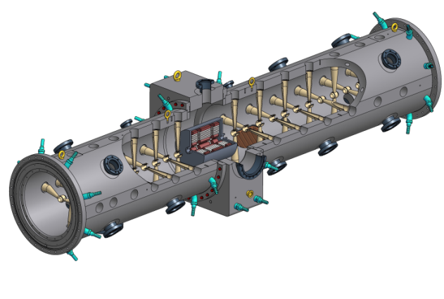
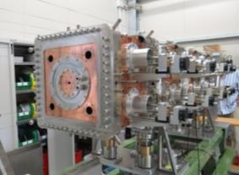
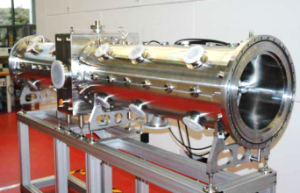
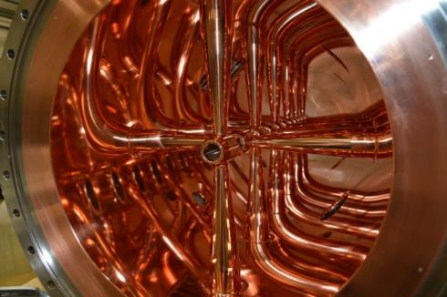
The Proton-LINAC
70 MeV, 35 mA
Status:
  ECR ion source and LEBT commissioned at CEA Saclay
  Collaboration foreseen on 4-vane RFQ between GSI, INFN and CEA
  First prototype Cross bar (CH) cavity succesfully copper plated and ready for power tests
  Rf power modulator received from CERN and commissioned
Critical items:
  RFQ beam dynamics design and procurement
  CH cavities procurement & production
12

Slide 13
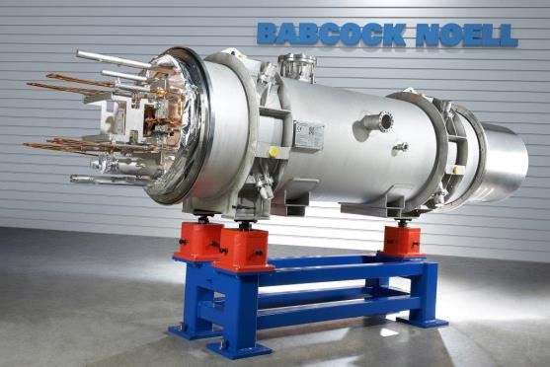
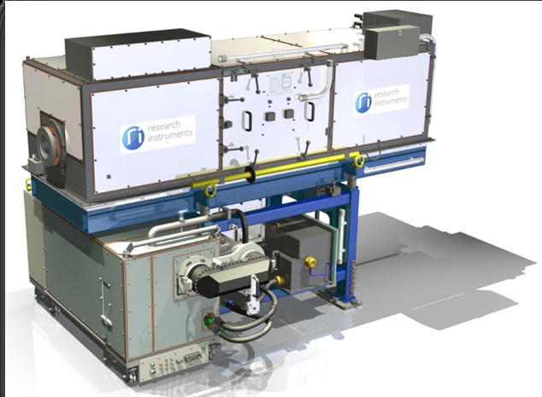
Heavy Ion Synchrotron SIS100
Status:
  More than 50% of the SIS100 value bound in contracts.
  All large series contracted (s.c magnets and Rf).
  System engineering for SC-modules almost completed.
  FOS s.c. dipole magnet (German inkind) delivered
  Accurate mechanical (µm) and magnetic field measurements done
  → manufacturing process optimized and yoke rebuild
Critical items (in terms of schedule):
  Quadrupole units for the SIS100 quadrupole modules.
  MDR takes place in this week.
  Modules production and testing at JINR until Q1/2020
  → Integration into modules will be tendered by GSI
  → Cold test of integrated modules (evtl. in Salerno)
13

Slide 14
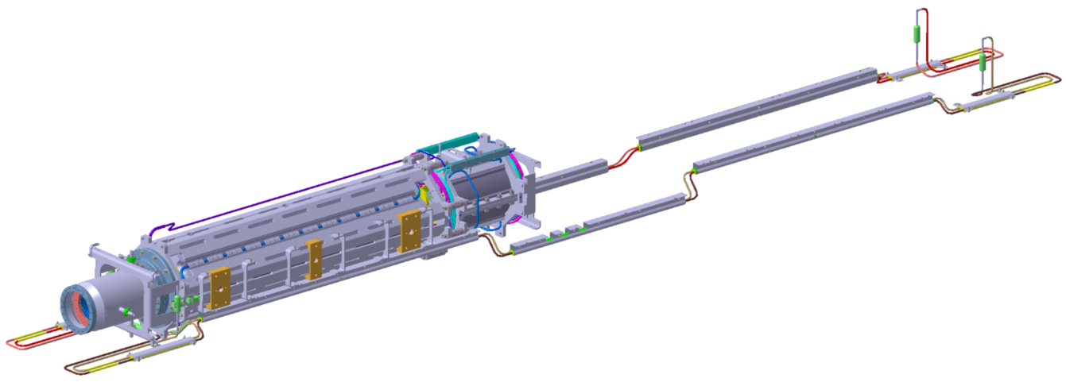
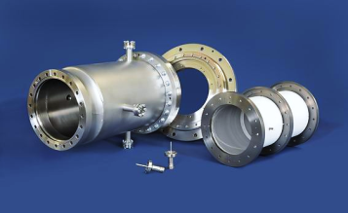
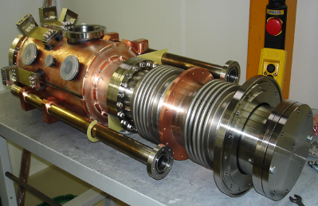
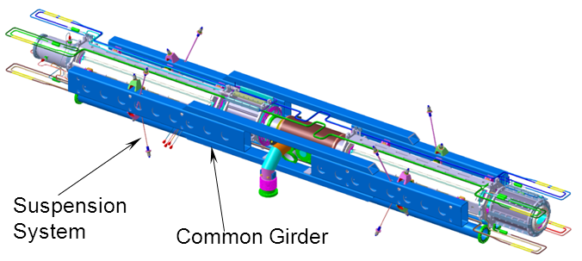
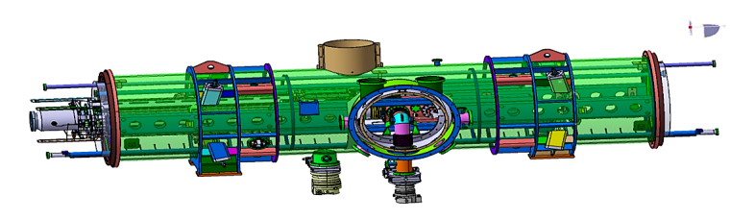
S.C. Quadrupole Modules
Quadrupole units comprise quadrupoles, sextupoles, steerer and BPMs
Arc modules contain cryo-catcher
Quadrupole units installed on a common girder
Inkind- and R&D contracts signed with JINR
14

Slide 15
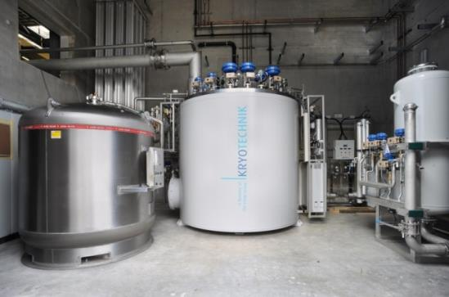
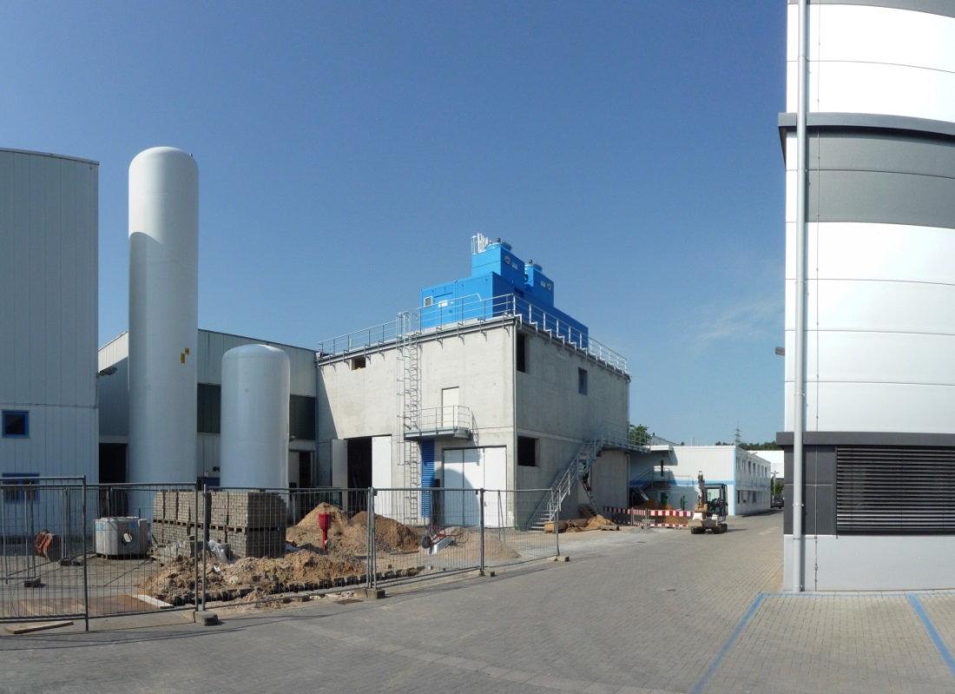
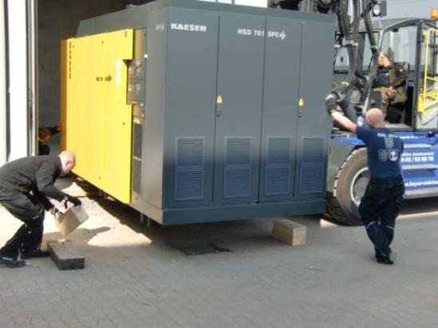
Series Dipole Test Facility at GSI
Civil construction including media supply completed
Cryogenic components are installed and commissioned
STF ready for testing in spring 2015
HTS current leads received and tested
1.5 kW@4 K cold box
450 kW compressor
15

Slide 16
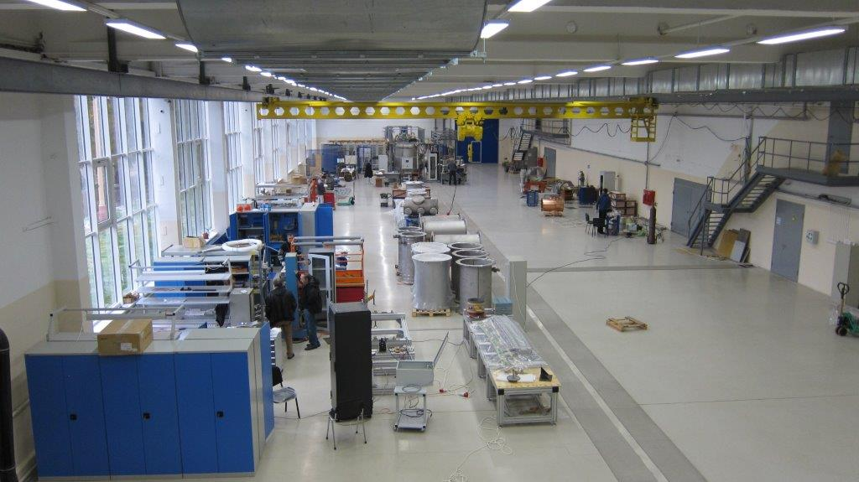
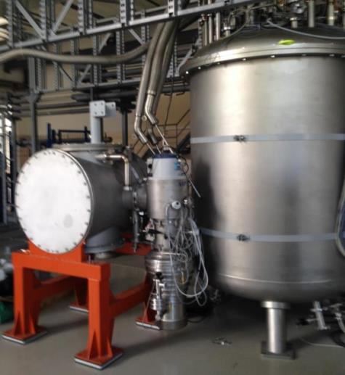
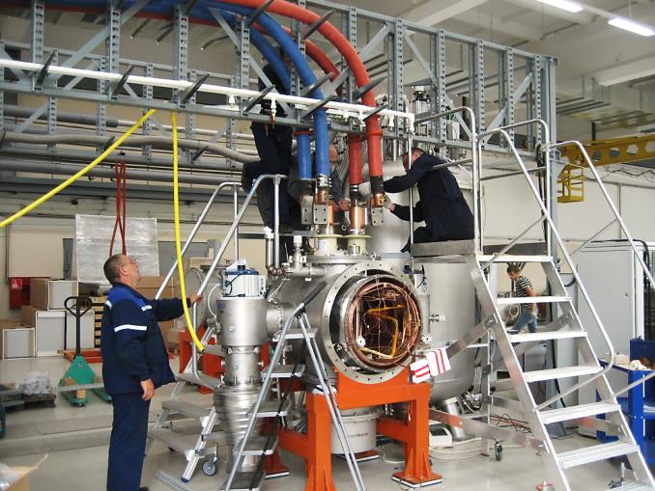
Series Quadrupole Unit Tests at JINR
Test infrastructure at JINR in preparation
1600 m² main hall
700 m² auxiliary facilities
R&D contract on magnet test facility signed.

Slide 17
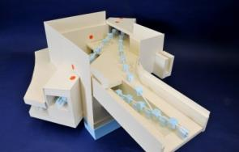
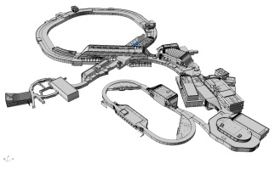
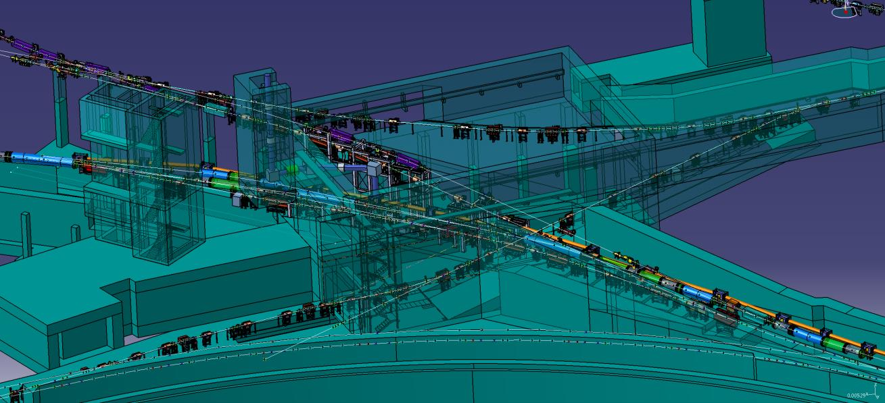
High Energy Beam Transport
Central Transfer Building H0705A
branching and crossing point for 8 beam lines (full version)
several beam lines inclined
components of many other beam lines are transported through this building
pbar, APPA
SIS18
SFRS
CBM
SIS100/300
SIS100/300
17

Slide 18
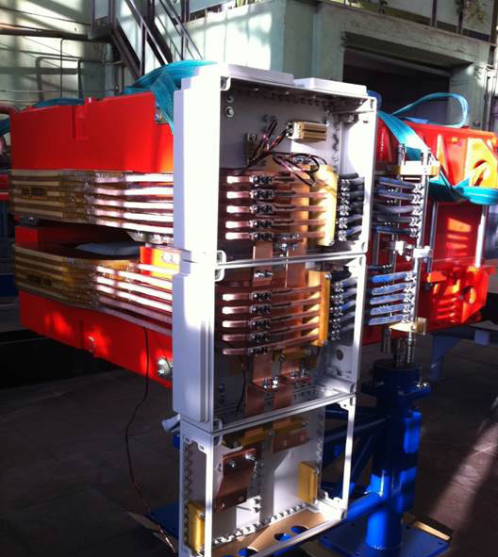
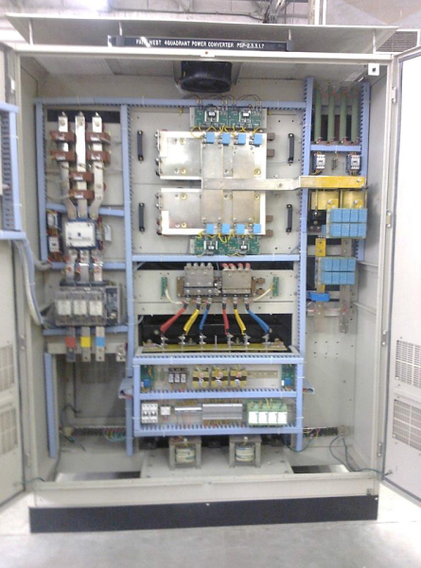
High Energy Beam Transport
Status:
  Three batches for magnet series production incl.
  prioritization according to the planned set-up →
  Batch 1: EFREMOV institute (magnets)
  and Budker Institute (vacuum chambers)
  Production of first FOS dipole incl. UHV chamber
  completed.
  Batch 2 + Batch 3 specifications completed.
  Collaboration contract with BINP signed.
  In-kind contract with India (Bose Institute),
  for quadrupole power converter (78 pieces) for 18/13 Tm beam
  lines. Second contract with Bose Institute in preparation (117 pieces).
  Indian inkind contribution for beam instrumentation chambers.
  Contract on HEBT Beam Instrumentation,
  DAQ, pneumatic drives and controls signed with Slowenia.
Critical items:
  Schedule magnet production and vacuum chambers
18

Slide 19
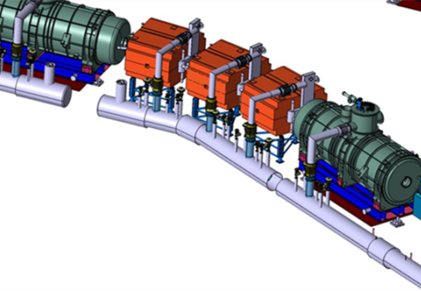
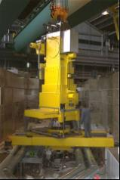
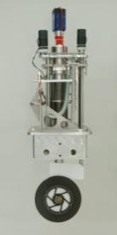
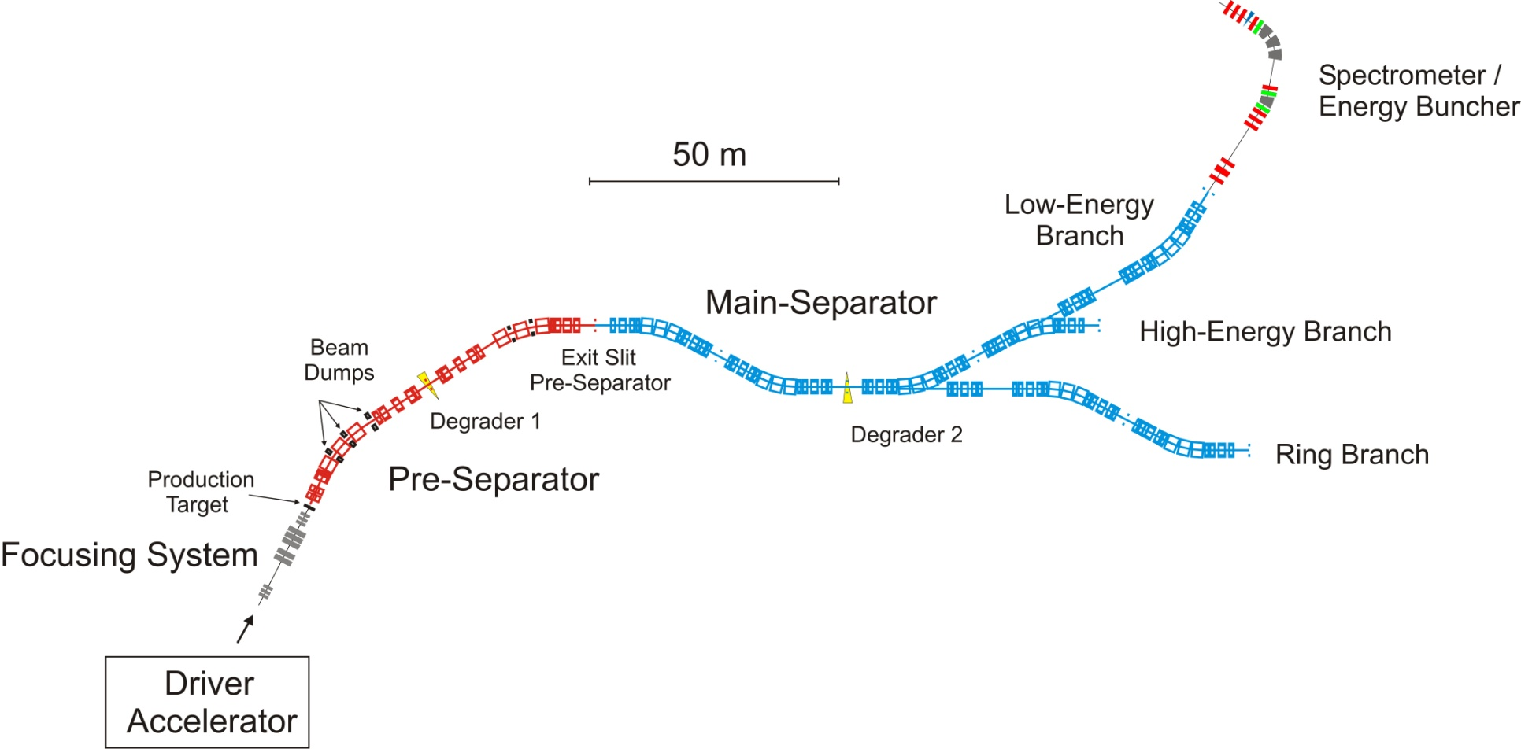
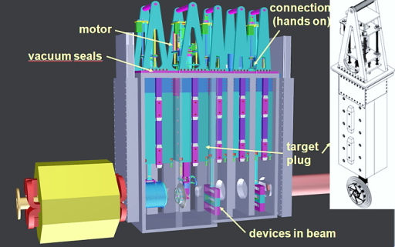
Super-Fragment Separator
Remote target handling
Target wheel
Local Cryogenics by WRUT
Target chamber with plug inserts
  Target chamber & plug inserts
  German in-kind in collab. with KVI-CART
  Study with Siempelkamp Nukleartechnik
19

Slide 20
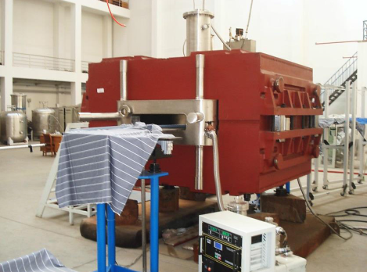
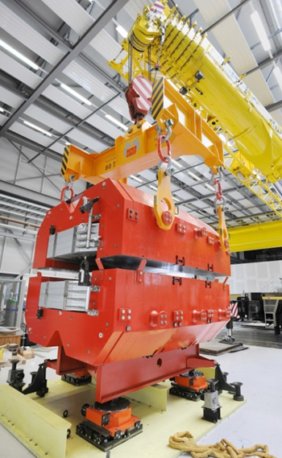
Super-Fragment Separator
Status:
  Prototypes build for radiation hard dipoles
  for pre-separator and superferric dipole for
  main separator.
  S.c. multiplets → awared to ASG Italy
Critical items (schedule):
  Superferric dipole magnet production and testing
  → Specification under preparation by CEA/Saclay
  Tender delayed. By FAIR expected for Q2/2016
25 long multiplets , 8 short multiplets
S.c dipole prototype
Radiation hard dipole prototype
20

Slide 21
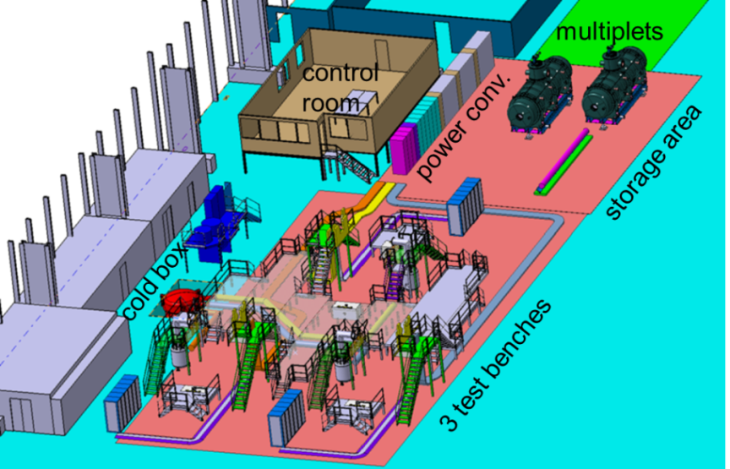

Super-FRS Magnet Testing at CERN
Layout of planned test facility at CERN (building 180) ready
Cryogenic-infrastructure with 2 pre-cooler
CERN controls and data acquisition
3 test benches in Q3/2016
cooling and test time ~45 days/unit
21

Slide 22






Pbar Target and Separator
pbar separator
target
target station (250t) with remote handling
magnetic horn
shielding flask (25 t)
Status:
  Detailed concept for handling of activated components finished (KAH). Positive response from authorities.
  Draft specification for magnetic horn system available. Detailed system design study required.
  Specifications for most magnets available. Main magnets are identical to CR.
Critical items:
  Magnetic horn pulser (400 kA), switches (semi-conductors).
  .
22

Slide 23



The FAIR Storage Rings
SIS100
CR
circumference 221 m
magn. rigidity 13 Tm
acceptance ε_{x,y} =
240 (200) mm mrad
Δp/p = ± 2.7 (1.5) %
BINP
23

Slide 24

The Collector Ring:
Large Aperture Storage Ring
Status:
  Technical supervision of CR → Budker Institute
  CR-Rf system (debuncher cavities): First cavity delivered.
  Pick up tank prototype of stochastic cooling system available
Critical items:
  Dipole magnets, specs ready, collaboration contract not yet signed
  No system design freeze yet. System integration difficult.
24

Slide 25




The High Energy Storage Ring – HESR
Status:
  Steel for vacuum chambers ordered. First magnets have been delivered and accepted, series production launched.
  Kickers ordered, tanks under construction
  Stochastic cooling tank in production, amplifiers in tendering process
Critical items:
  Momentum spread of beam pulse from CR
  HESR components will be available for installation in 2017 → storage of components
Length 575 m
Arc 132 m
Straight 155.5 m
25

Slide 26

Status Cryogenic Supply and Distribution
Status:
  Two industry studies successfully performed by Linde and Air Liquide
    confirmation on space and budget requirements
    confirmation on time scheduling
    no technical risks on the cryo plants observed
  Start configuration for the cryogenic supply for SIS100 and Super-FRS fixed
  Specifications for a 25 kW plant and a cool down unit are in preparation
    preparation status 90%
  Technical study on the distribution system of SIS100
  successfully performed
    reliable statements on prize
    and delivery time
Critical items:
  Civil construction building milestones
  (commissioning, warranty)
  Reliability on heat loads
picture from Linde KT
26

Slide 27
Summary
The FAIR accerelator complex consists of a large number of machine subprojects, various test facilities and common systems.
The FAIR accelerator complexes comprises accelerators based on quite different and challenging technologies.
Design, production and testing of the devices is distributed among several countries, especially the FAIR member states.
For most of the technical key systems prototypes or FOS devices have been build.
Series production has been started for long lead items. First deliveries of components ready for installation are arriving.

