Slide 1
I-DESIGN perspective of FAIR in-kind contribution: Challenges and opportunities for Indian industries
4th November, 2015

Slide 2
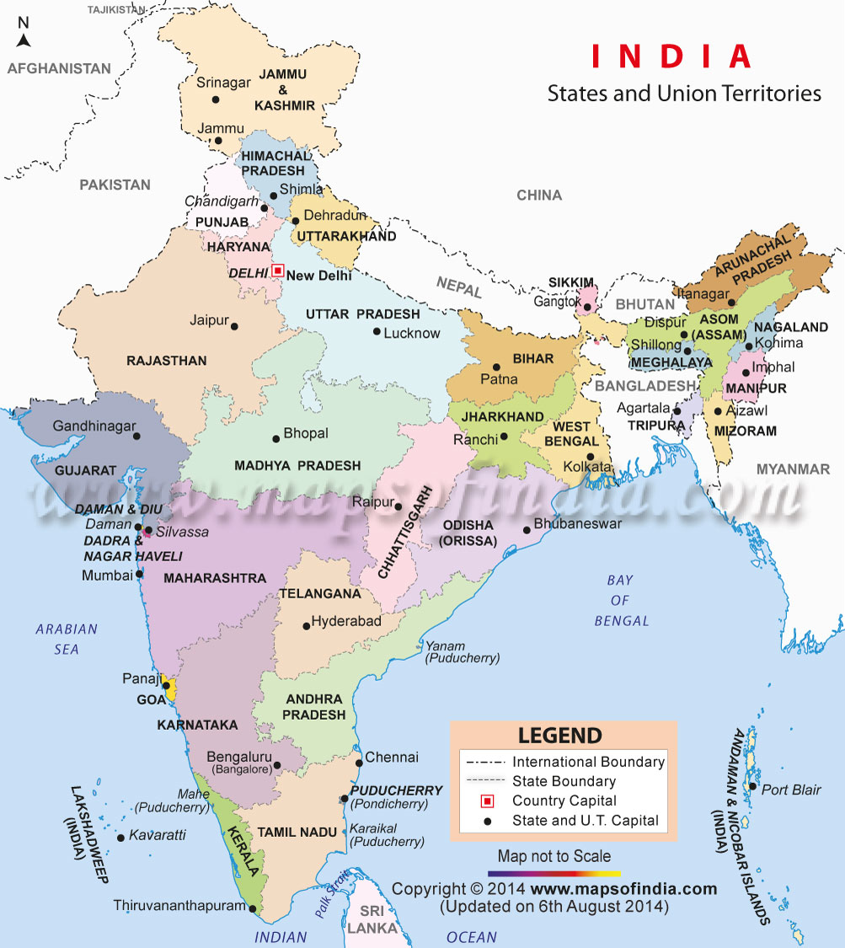
Indian Economy – Some Facts
Seventh largest in the world by nominal GDP
3100 Technology start-ups in 2014-15
Fourth largest Start-up Hub in the World
Major exporter of IT services
  USD 73.1 Billion in 2014-15
One of the largest Automotive industry – 23.37 Million
vehicles produced in 2014-15
A large Retail Market – USD 600 Billion in 2015
Fastest growing E-commerce market
Young and Large English speaking population

Slide 3
Indian Economy – Some Statistics
Nominal GDP as of October 2015- USD 2.382 Tl
GDP growth- Average 7 %
Sectoral growth
  Agriculture 16 %
  Industry 31 %
  Services 53 %
Inflation ( as off Sept 2015) 3.66%
Labour force502.3 Mn ( 2014 est.)
  Agricultural 49%
  Industry 20%
  Services 21%

Slide 4
Indian Economy – Foreign Trade
India is a net importer perennially
Major export items are petroleum
products, Gems and Jewellery, Textile
products, Chemical products etc.
Steady forex reserve

Slide 5
Indian Industries - opportunities
Large domestic market – demand for all kind of products and services
Abundant availability of natural resources like minerals, water, land etc.
Availability of large pool of technical and scientific manpower – Large no of
technical universities
Adequate infrastructure – Rail, Road, Port & Air connectivity
Pro-industry Government policies – since liberalization in 1992
Reasonably low labour cost
PPP – Public Private Partnership in major projects
Entrepreneurial attitude of young technocrats/ engineers

Slide 6
Indian Industries - Challenges
Outside dependence on latest manufacturing
technologies and processes
High interest cost of borrowed capital
High fluctuation in inflation index
Low labour productivity
Complex tax structures

Slide 7
I-DESIGN !
I-DESIGN Engineering Solutions Ltd.

Slide 8
I-DESIGN at a glance
I-DESIGN was an integral part of RSB transmissions as R&D division of the company.
Started as a separate entity in 2002 to cater to R&D needs of RSB and other
automotive customers.
In year 2009 diversified its service portfolio to vacuum and cryogenic and special
equipment manufacturing.
Capable of Product designing from scratch , mathematical modeling with CAE and
CFD , Instrumentation and control engineering , Prototype building, manufacturing
engineering , Product Testing etc.
Total 2500 man years of experience with 150 Engineers and scientists and 50
technicians.
Divisions of I-DESIGN:
  Automotive Engineering Division ( AED )
  Special Equipment Division ( SED )
  Vacuum and Cryogenics Division ( VCD )
  Blue Bastion Laboratory ( BBL )

Slide 9
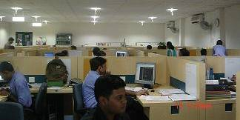
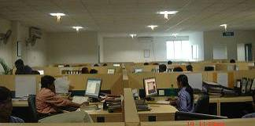
Infrastructure
Design facility occupies about 15,000 sq. ft., Product validation facility spread over 50,000 sq. ft,
special equipment manufacturing facility is spread over 20,000 sq. ft. area
Facility for Vacuum and Cryogenic spread over 16000 sq. ft. area. Out of which UHV chamber
manufacturing facility consists of
  Class 10,000 clean room,
  Automated welding machines
  Full fledged dimensional inspection and vacuum testing facility
  DM water plant, Ultra sound cleaning and baking facility
Dedicated Tool Room and assembly area.
Real Time electronic Data Acquisition facility

Slide 10
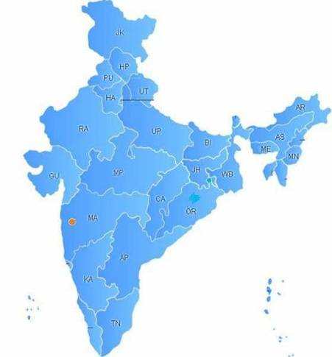
Location
 | Headquarter
 | Branch Office
 | Future Expansion
Pune

Slide 11
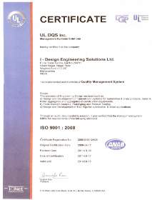

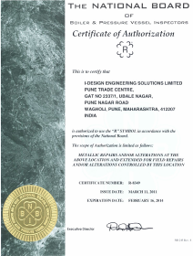
Certifications
ISO 9001:2008
U-Stamp
NB
R-Stamp

Slide 12






Collaborating Institutions
I-DESIGN has collaborated with several prestigious Institutions of India and Abroad for technical assistance
IIT Mumbai
IIT Kharagpur
IMMT Bhubneshwar
Colorado School of Mines, US
NIT Rourkela
IISc Bangalore

Slide 13



Software capability
Detailing (2D modeling)
3D Modeling/ Assembly
Thermal Analysis Welding study
Structural Analysis
Fatigue Analysis
Computational Fluid Dynamics
PLC Programming
Load data analysis
Product Life cycle management
Homologation
Prototyping
Product validation
Testing
Prototyping
CAE
Testing
Design
Styling
CAD/
Designing
Complete product cycle
Expertise area
Non expertise area
Concept

Slide 14
Milestones
2002 : Beginning of I-DESIGN Engineering Solutions at Pune as a separate company
2004: I-DESIGN Established at Jamshedpur, Jharkhand
2007: Formed dedicated testing area for Tata Motors, Pune
2008: Got ISO 9001:2000 Certified
2009: Got into listed vendors list of DRDO for its development Projects.
2009: Associated with IPR for its various product development programme and Study
2010: I-DESIGN Opens a new Office at Bhubaneswar
2011: Got U-Stamp Certification from ASME
2011: Got R-Stamp Certification from National board of boiler & Pressure Vessel.
2013: Bagged EBMF project from NFC
2014: Bagged PMF project from NFC
2015: Started Blue Bastion laboratory for advance technology development.
2015: Nominated by Govt. of India for supply of UHV chamber to FAIR

Slide 15
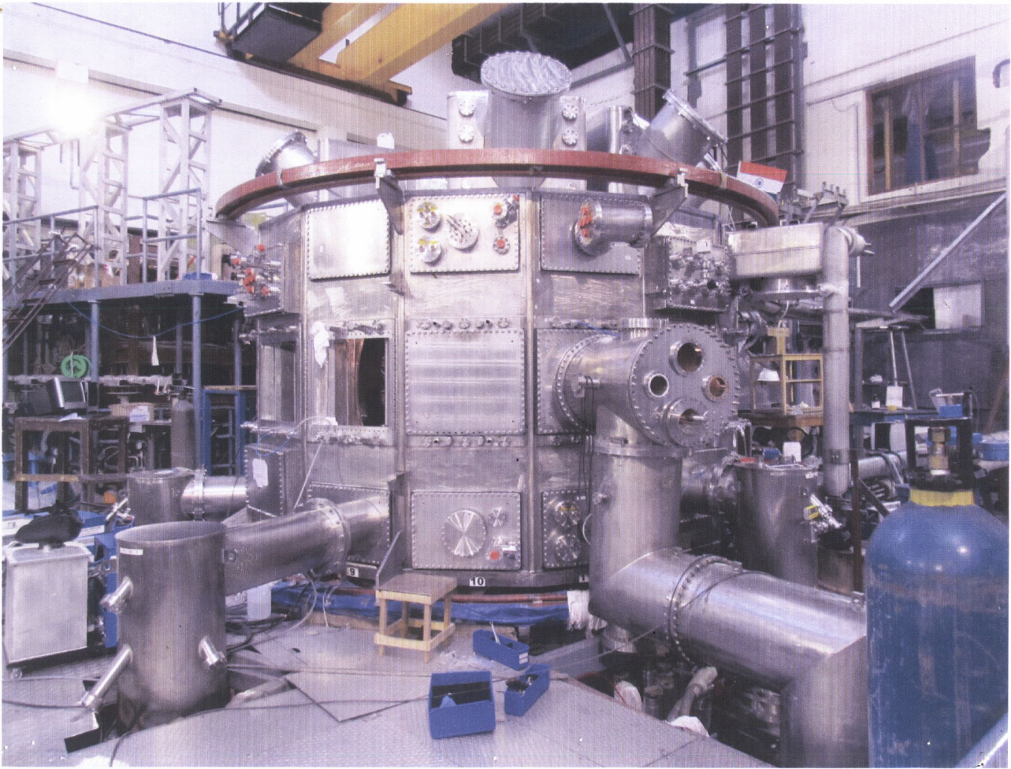
Projects in Vacuum and Cryogenics field.

Slide 16
Typical projects in Vacuum and Cryogenics field.
Manufacturing of Ultra High Vacuum components.
Design and Development of Thermal / Radiation shields.
Thermo-vac chambers for space lab application.
Vacuum chambers and cryostats for SC magnets
Super conductor cables in close conduit
Hydrogen Pallet extruders and injectors.
Computational Fluid Dynamics analysis of cryo systems
Design and Development of cryo pumps.
Development of adhesives for fixing micro porous carbon on the cryo pump panels.
Development of micro porous carbon of different surface area and types
Pumping speed of different gases at low temperature.
Design and development of electron beam guns.

Slide 17
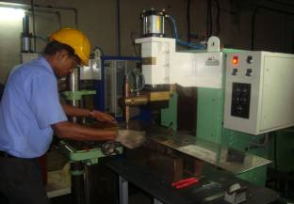
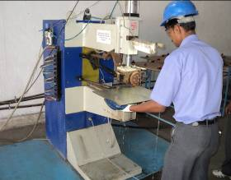

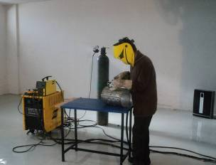
Welding Facilities at I-DESIGN
Seam Welding station
Spot welding station
CO2 welding station
TIG welding station

Slide 18
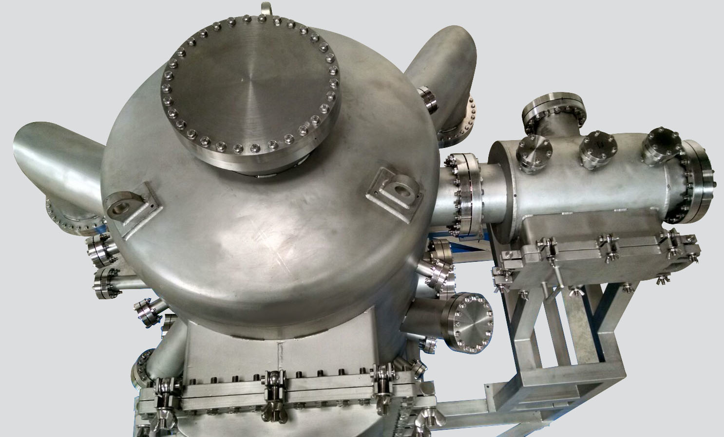
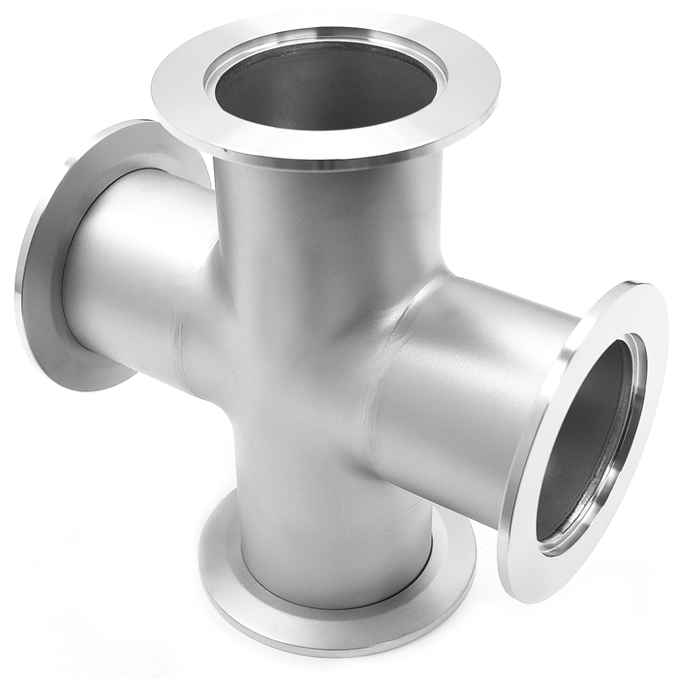
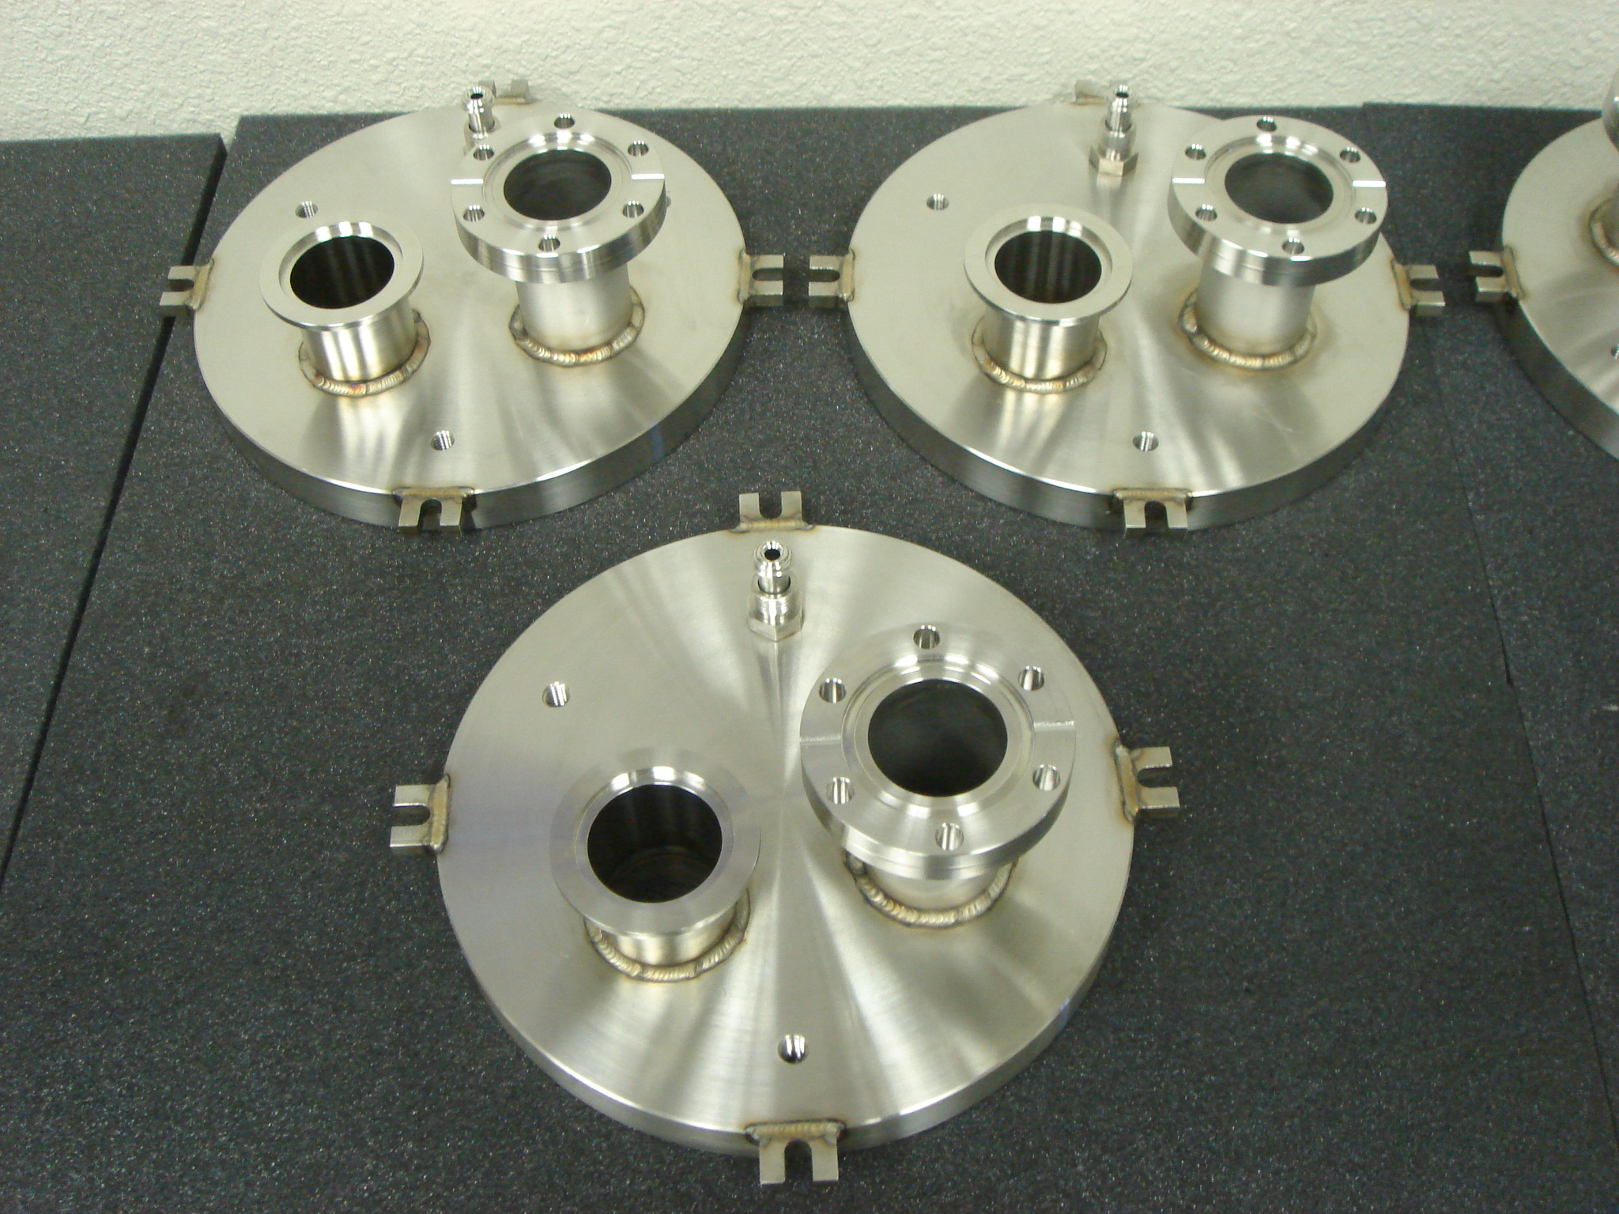
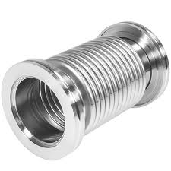
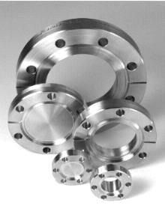
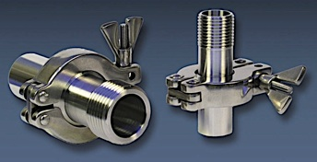
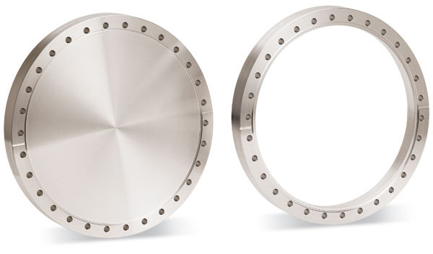
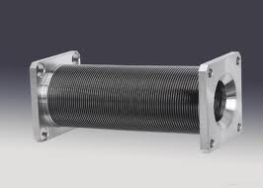
Vacuum chamber and components
RRCAT

Slide 19
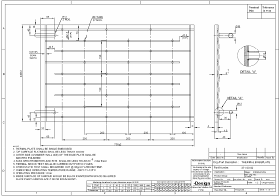
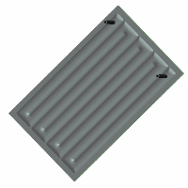
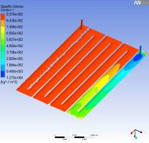
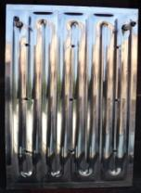
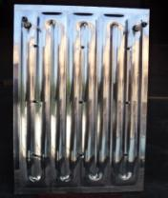
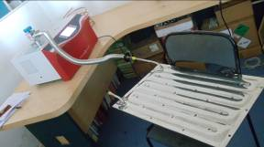
Design of Thermal shield
Continued…..
IPR, SAC, Tranter

Slide 20
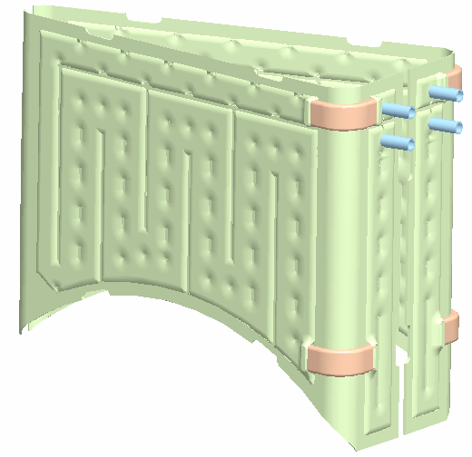
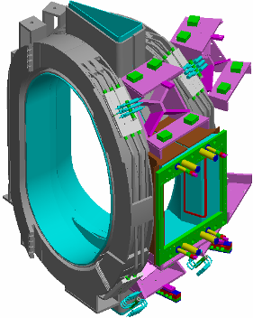
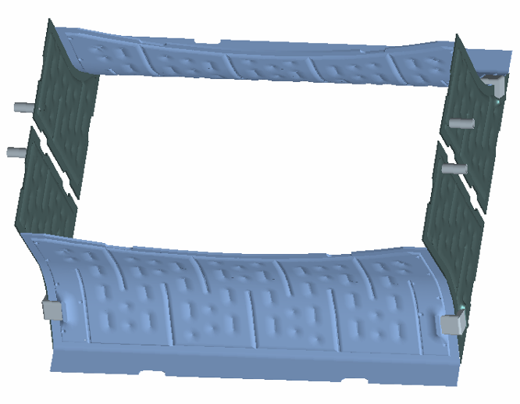
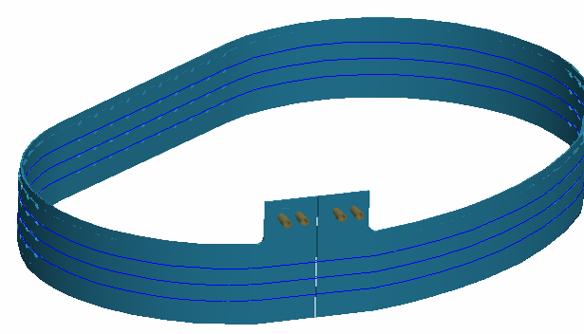
Design and Development of 80K and 4K Panels
IPR, Ahmedabad

Slide 21
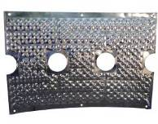
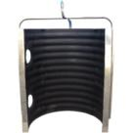
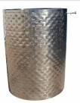
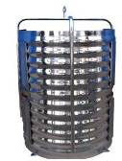
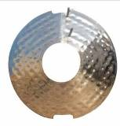
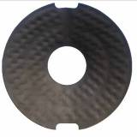
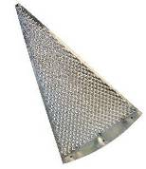
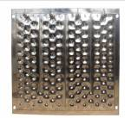
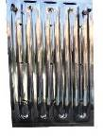
Types of Thermal shields
Single embossed panel
Double embossed panel
Charcoal coated panel
Coated panels (Aeroglaze /Al₂O₃)
Panels to suit cooling up to 4 K
Different shapes (Radiation/
thermal/ Active cooling Shields)
Low out gassing and low leak panels
(upto 1x 10⁻¹⁰ mbar L/s)
Material of
Stainless steel
Aluminium
Copper
IPR, SAC, Tranter

Slide 22
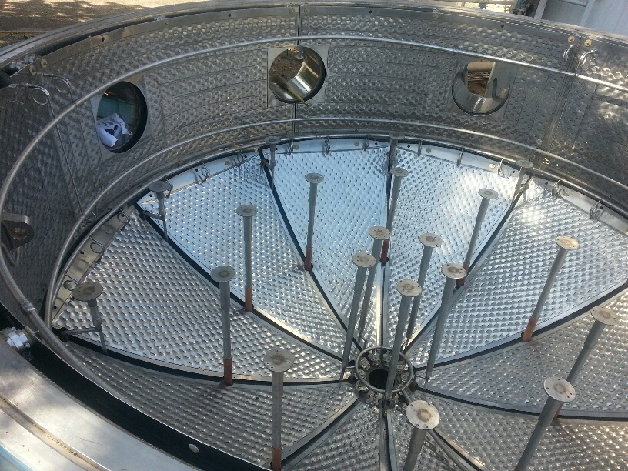
Large scale integration of thermal shields
IPR, 4.5 M Cryostat

Slide 23
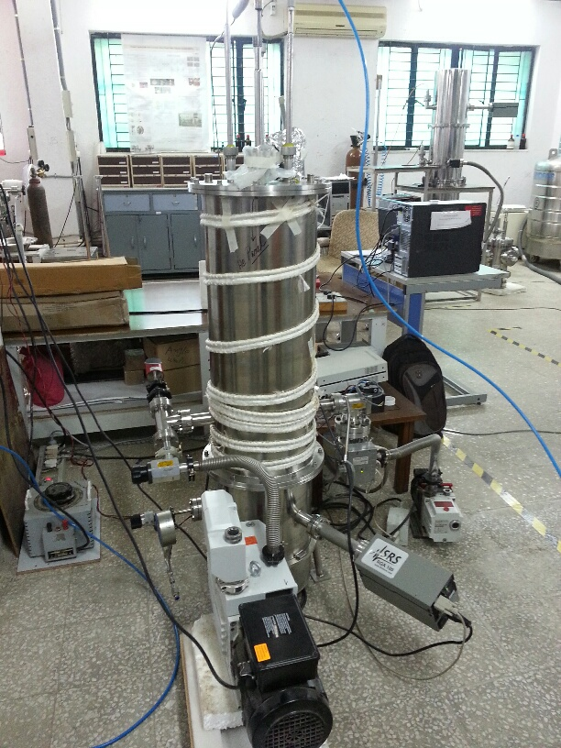
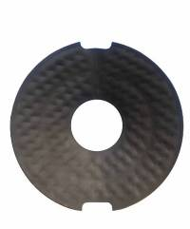
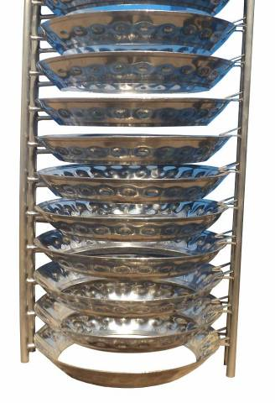
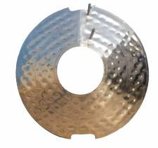
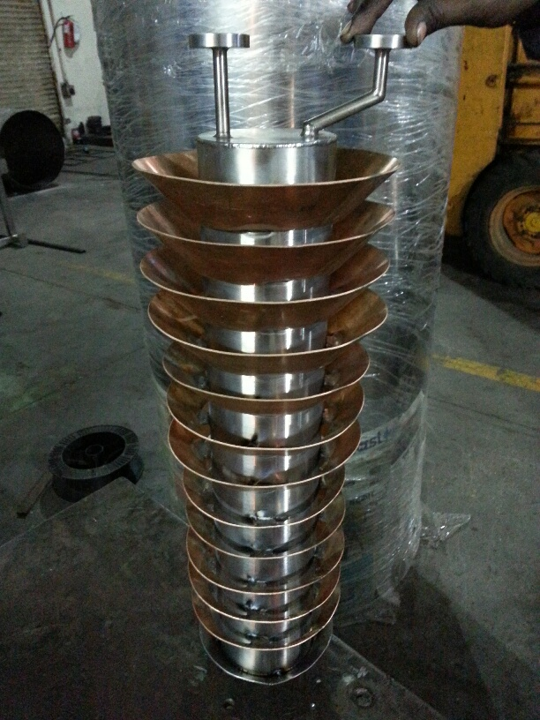
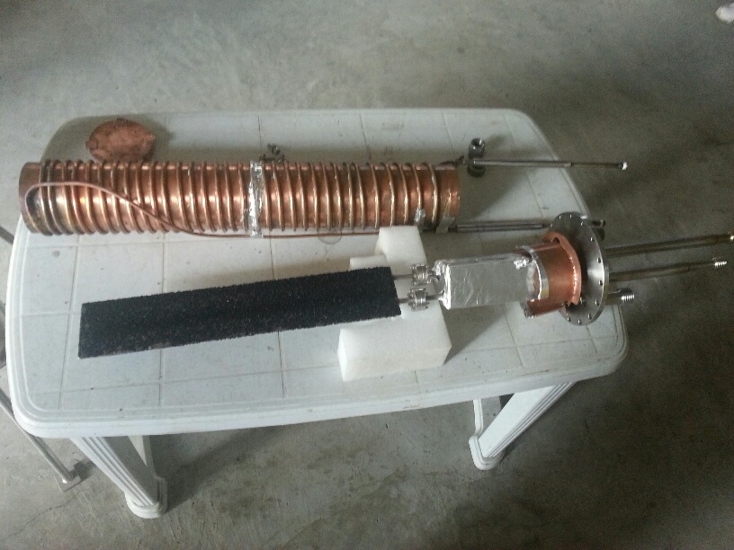
Cryo pumping study
Aeroglaze coated Baffle
IPR, Ahmedabad

Slide 24
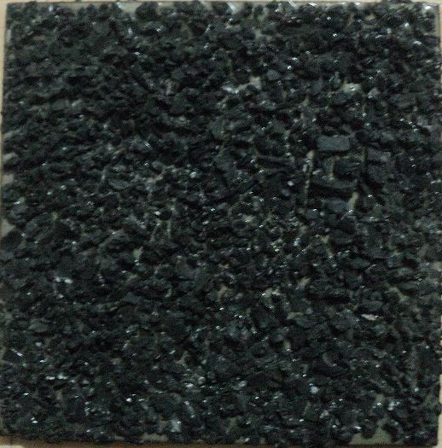
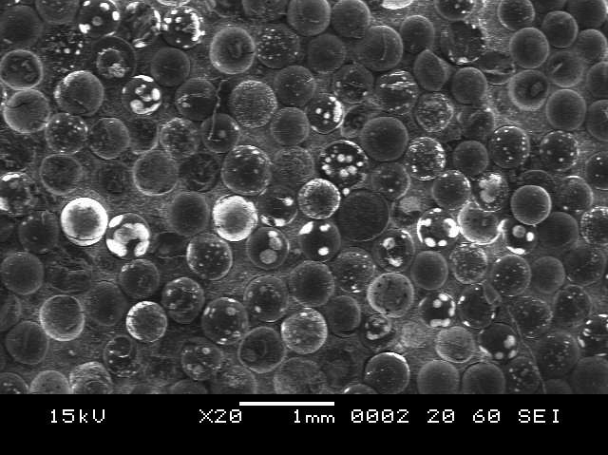
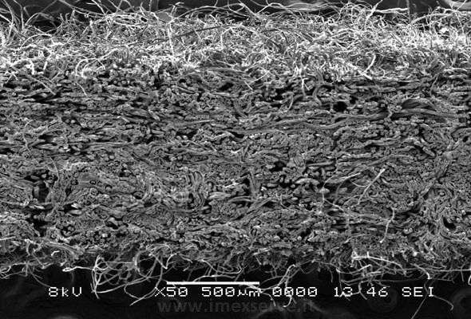
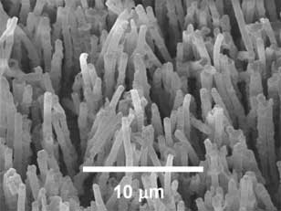
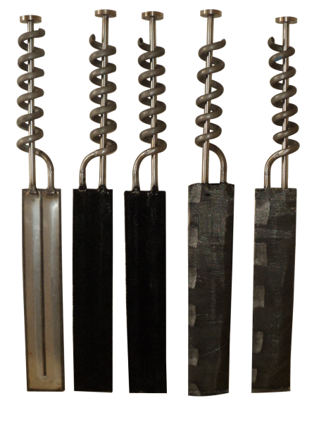
Development of Activated Carbons for Cryo-pumping
Granule 800m²/g
Globule 1400m²/g
Fibers 1300m²/g
Micro fiber 2000m²/g
I-DESIGN is now working on development of Activated Charcoal nano fibers 3000m²/g
with increased thermal conductivity
50 mm
IPR, Ahmedabad

Slide 25
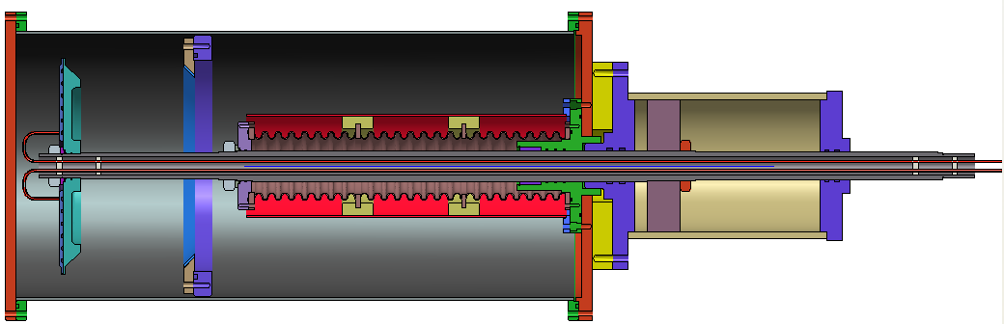
Design and of Valve for Cryo. Pump
BARC, VECC

Slide 26






Design and Dev. Of cold Helium Circulator
IPR, Ahmedabad

Slide 27



Design and Manufacturing of LHe Cryostat
BARC, VECC

Slide 28




CICC integration work at IPR
Continued…..

Slide 29

CICC integration work at IPR
IPR, Ahmedabad

Slide 30



Manufacturing of Plasma Facing Components
IPR, Ahmedabad

Slide 31



Plasma Facing Components after integration in Tokomak
Continued…..

Slide 32


Other facilities at I-DESIGN
Vacuum Furnace
Mass Spectrometer Leak Detector

Slide 33
Activities at Special equipment division ( SED)

Slide 34



Electron beam melting furnace design
Continued…..
2 x 150 kW EB Gun
Ultimate vacuum up to 1 x 10⁻⁵ mbar
1 ton capacity ingot retraction
Twin feeder (Bar & chunklet)
Continuous operation up to 48 hrs
NFC, Hyderabad

Slide 35




Manufacturing of EBM Furnace
NFC, Hyderabad

Slide 36

Design and Manufacturing of EBM Furnace
Continued…..
NFC, Hyderabad
Vacuum pumping system of EBMF

Slide 37


Design and Manufacturing of Plasma Melt Furnace
Continued…..
250 kW single plasma gun
Ultimate vacuum up to 1 x 10⁻⁵ mbar
1.2 ton capacity Cu Hearth
Online feeder unit
Continuous operation up to 48 hrs

Slide 38






Testing and Test Rig Development
Gear box Test Rig for Synchronizer
FUDP test rig
Submarine seal test rig
Mud seal test
Hub bearing testing
Drive axle test rig
Steering System test rig
Plasma melting furnace
Notes:
38

Slide 39


Instrumentation Capabilities
Design and Integration of Electronic Control System for Test Rigs.
Programming on various brands of PLC including Allen Bradley, Messung .
Development of SCADA programs.
Data acquisition by using hardware from National Instruments and Advantech.
Data acquisition hardware includes NI Compact Field Point , COMPACT RIO, PCI 6221,USB 9215, Advantech PCI 1716.
Programming on National Instruments Lab VIEW for latest versions 8.5, 8.2, 8.0, 7.1, Report Generation Toolkit, PID Toolkit, Application Building.
Field testing & data acquisition using 32 channel recorder.

Slide 40
CAE projects

Slide 41





Computer Aided Engineering (CAE)

Slide 42




Computational Fluid Dynamics (CFD)
Secondary Steel melting furnace
Cold Circulator Impeller
Cryogenics radiation shield
Football Stadium

Slide 43
Activities at Automotive Engineering Division (AED)

Slide 44









I-DESIGN developed products
High energy impactor for trucks
5 speed automotive transmission
Thermo-vac chamber shroud
Pressure vessel for under sea system testing
Die tools for Commercial vehicle Driven axles
Vibration Isolators for drive shafts

Slide 45








Some Examples of Product Development
Product Designing, Development & Validation for noise reduction in the Tractor
Continuous Variable Transmission Drive
Design, Development & validation has been done by I-DESIGN
Trailers

Slide 46




Testing facilities at I-DESIGN, Dighi

Slide 47

Testing Facilities at I-DESIGN
Structural dynamics laboratory

Slide 48




Glimpses of testing facility
Control mechanism environmental test set-up
Gear box efficiency test set-up
Gear Box endurance test set-up
Axle beam test set-up

Slide 49




Glimpses of testing facility
Continued…..
Synchrocone test set-up
Drive shaft test set-up
Hub Bearing test set-up
Oil Seal test set-up

Slide 50






Glimpses of testing facility
Continued…..
Rock Shaft Test System
Propeller shaft Test System
Hub Bearing Test System
Transmission Test System
Steering Test System
Brake Test System

Slide 51
Activities at Blue Bastion Laboratory ( BBL)

Slide 52


Layout of I-DESIGN, Dighi premise

Slide 53




Blue Bastion laboratory , I-DESIGN
Space for FAIR project
Lab space for superconductivity , ultra high vacuum and cryogenics

Slide 54




FAIR team visit to I-DESIGN
Assessment by FAIR and INDIAN team on 19th January, 2015

Slide 55






Axial tack (60 mm) welding without side weld (Three faces fixed)
Tack weld 60 mm
Tack weld 60 mm
R. Stress after cooling
60X Zoom

Slide 56






Barrel – Nozzle fusion welding outside (180˚) One face fixed
R. Stress after cooling
Date: 28/10/15
Notes:
56

Slide 57





Barrel – Nozzle fusion welding outside (360˚) three end faces fixed
R. Stress after cooling
Date: 28/10/15
Notes:
57

Slide 58




Automated welding trials at I-DESIGN

Slide 59
Documentation: Process Sheets
I-DESIGN | Internal Testing |  | Rev No: 02
 |  |  | Date: 31-Oct-2014
Process Id | Process Description | Fixtures/ Equipments/ Methods | Control Parameters/ CTQ's
IT-10 | Mounting of chamber Assembly on the test fixture | Manual loading on Fixture | Use of hand gloves, No hand touching, Use of SS tools
IT-20 | Fitting of blank flanges & gate valves | Blank flanges & gate valves | Use of hand gloves, No hand touching, Use of SS tools
IT-30 | Fitting of dry pumps, dry MSLD, RGA & Ion gauges | MSLD, RGA, TMP, Scroll pump, Ion gauge, Pirani gauge, gate valves | Use of hand gloves, No hand touching, Use of SS tools
IT-35 | Local Leak Detection | MSLD equipment | Max Leak rate 1X 10^-10 mbar l/s
I-DESIGN | CF Flange - 150 |  | Rev No: 03
 |  |  | Date: 17-Jan-2015
Process Id | Process Description | Fixtures/ Equipments/ Methods | Control Parameters/ CTQ's
F-10 | Procurement of SS 316 LN round bars | Refer. Technical Guideline 2.6e (1.4429) | Chemical composition, Inclusion rating, Mechanical properties, Magnetic properties, Intergranular Corrosion. Labelling of material.
F-20 | Billet cutting | Use of mechanical saw/ Shearing | Labelling of material.
F-30 | Forging of blanks | Use of RSB Group's forging facility with new dies | Checks for Dimensional & Multi-dimensional grain flow. Labelling of material.

Slide 60
Documentation: Route Card
I-DESIGN |  | ROUTE CARD for UHV CHAMBER MANUFACTURING |  |  |  |  |  | Card No.
 |  |  |  |  |  |  |  | Page | _____of _____
A. | Part Details:
 | 1) Part No: |  |  |  | 2) Part Description:
 | 3) Drawing No: |  |  |  | 4) Revision No:
 | 5) Child Parts used: | 6) Description |  | 7) Part No./Drawing. No |  |  | 8) Rev No. | 9) Route Card No ( If applicable)
B. | Incoming Material Control |  | Process ID: |  |  |  | Reviewer/ Executer details
 | Doc/Record |  | Ref No |  |  | Rev no. | Name | Date | Signature
D.1 | WI for GRN Preparation |  |  |  |  |  | ____No Fill___
D.2 | WI for Supplier TC Verification
D.3 | WI for GIN Preparation
R.1 | Goods receipt note No: ( GRN )
R.2 | Good Inspection note No: (GNN )
R.3 | Stores Location ID
R.4 | Supplier test certificates |  | TC No |  |  | TC Date

Slide 61
Advantages: In-Kind Contribution
Country Advantages:
  Involvement of country’s scientific community in project design, manufacturing,
  testing and erection
  Development of manufacturing capability and infrastructure for frontier
  technologies
  No Forex outflow
Industry Advantages:
  Participation with large International scientific projects
  Learning thru’ interactions with scientific community (both domestic and
  international)
  Opportunity to move up in the technology value chain
  Help upgrade quality systems and practices

Slide 62
Challenges
Sourcing of materials for tubes – Non-standard sizes and small quantities
Special grade material for CF Flanges - SS316LN thru’ ESR process and MDF
route – Sourcing due to small quantity requirements
High welding distortion in tubes – Due to small thickness and multi nozzle
configuration and full penetration welding of end cover from out side
Maintaining specified Geometrical tolerances after welding

Slide 63
THANK YOU
I-DESIGN Engineering Solutions Limited.
Pune Trade Centre, 2337 / 1, Ubale Nagar, Nagar Road, Wagholi, PUNE # 412207. Maharashtra, INDIA.
Ph # + 91 20 65611559 / 60. Fax # + 91 20 66032995. URL: WWW.idesign.co.in

