Slide 1
Making Difficult Decisions
in a Transparent Way –
Building the ESS Target Wheel
www.europeanspallationsource.se
4 Nov 2015

Slide 2
Outline
Target Station overview
In-Kind approach and goals
Process for securing In-Kind Partners
Securing the “right” partner for the Wheel
Concluding Remarks

Slide 3
Target Station Overview - High Level Functions
Generate neutrons via the spallation process using protons produced by the accelerator
Slow the neutrons to energies/wavelengths useful for neutron scattering
Direct neutrons to neutron scattering instruments
Safe, reliable operation with high availability
Active cells
High bay
Target monolith
Utilities
Proton beam transport hall

Slide 4
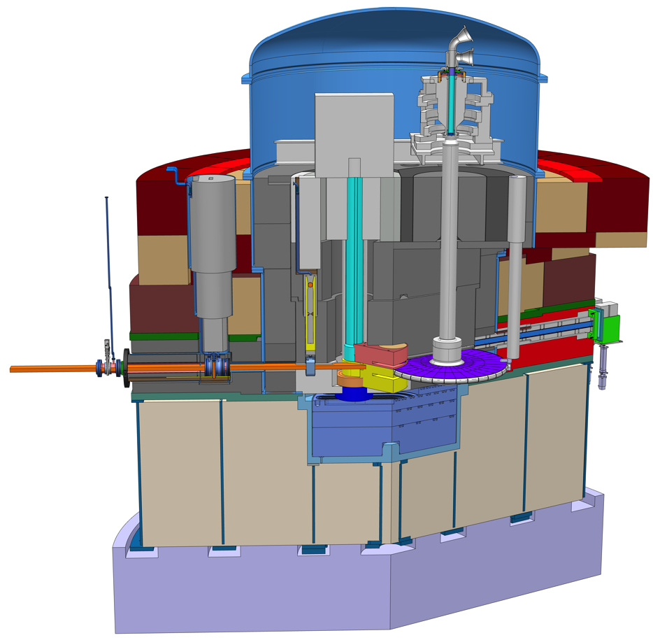
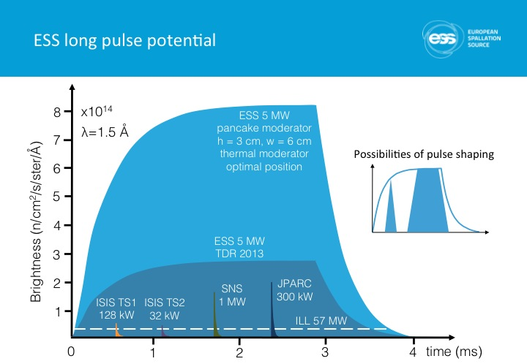
Target Station incorporates unique features
Target Monolith
Rotating W target
He cooling for target
High brightness neutron moderators
Monolith Vessel
Proton Beam Window
Moderator & reflector plugs
Target Wheel

Slide 5
In-kind opportunities were maximized within each Target Work Package (“Target Cost Book”)
Developed baseline resource loaded schedule (Nov 2013) based on self-execution of all work at the ESS-Lund office
Identified all possible in-kind work, line-by-line, in project plan
Packaged In-Kind work into logical units
This gave us a well defined scope, cost, and schedule for each In-Kind package
Worked with ESS Communications and External Relations Division to communicate opportunities and manage partnering process
Held Target Collaboration Meetings starting in June 2014 to release packages and secure partners for specific packages
Widely publicized within ESS partner country institutes
Very open and transparent process
Openly shared all design, cost estimating, and schedule planning information with parties who expressed interest

Slide 6
ESS Target In-Kind Packages
22 In-Kind packages
Start date defined based on schedule demands and readiness to partner
Total In-Kind value > 100 M€, out of 155 M€ total budget
The only efforts retained by the ESS Lund team are:
Management and integration
Neutronics analysis
Safety related work

Slide 7
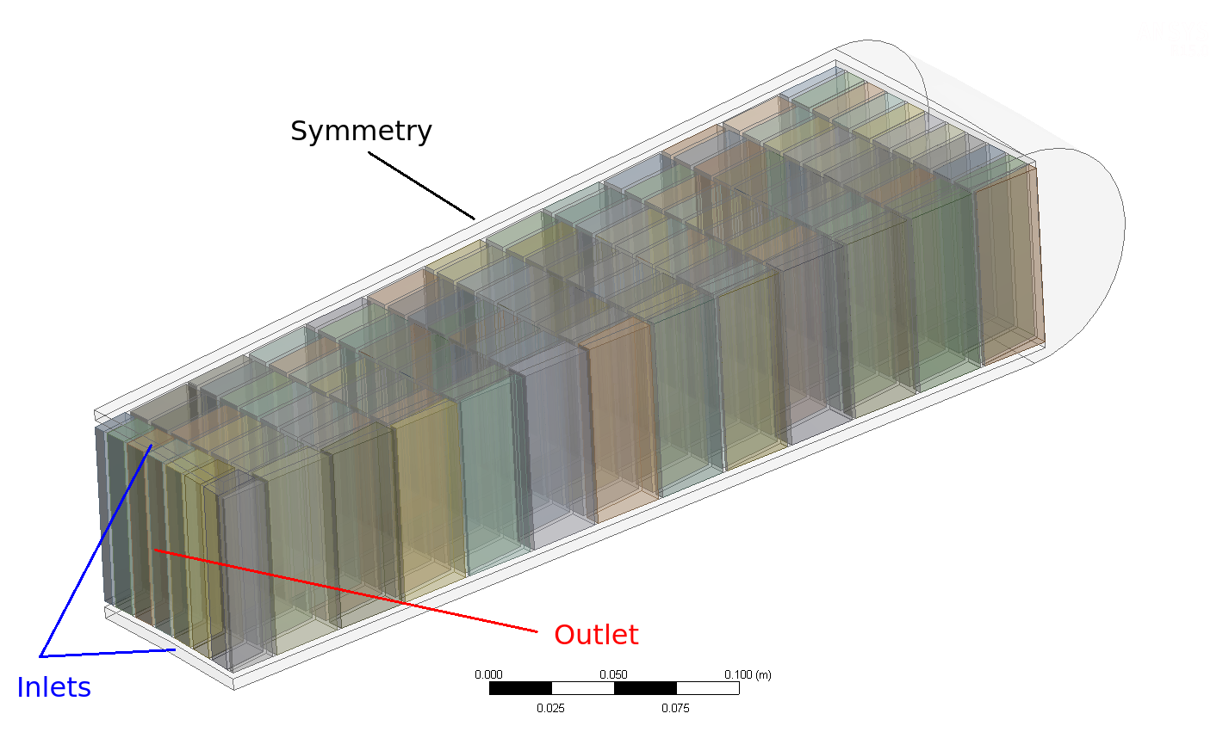
The Target Wheel is First-of-a-Kind Approach Taken to Deal with the World’s Highest Power Proton Beam
Features:
He-cooled tungsten plates integrated in a wheel
~ 60 n/p for 2 GeV p on W
2.5 m diameter wheel on 5 m long shaft with rotational speed ~ 0.4 Hz
Lifetime ~ 5 years (@ 5 MW)
Target Wheel “cost book” value: ~ 9 M€
Detailed Design, Build, Test, and Deliver

Slide 8
Response to ESS Target IKC Partnering Opportunities
Some of the packages are attractive to potential partners (e.g. target wheel, neutron moderator and reflector), some are less interesting (e.g. bulk shielding)
We have had multiple partners submit partnering responses for three packages
Three institutes responded affirmatively to request for partnering on the target wheel
Nobody in the world has built a spallation target wheel, but all three were judged to be qualified, and capable of designing and building the wheel
So how could we decide between the three qualified and highly motivated partners?

Slide 9
Partner Selection Process
Developed selection process consistent with high level ESS partnering mandates and processes
Communicated process and selection criteria in a special meeting with representatives from the three institutes
Shared everything we had with all three institutes, including details of cost and schedule estimates
Technical scope: Design reports, analysis reports, CAD models, …
Cost: vendor contact info, design manpower estimates, design reports and analyses, …
Schedule: logical sequence of more than 100 activities with estimated durations
Encouraged the teams to seriously look at the baseline design, cost and schedule, and consider partnering together
Wanted partners to commit with their “eyes wide open”

Slide 10
Selection criteria were built into simple partnering response form
Courtesy of Gábor Németh

Slide 11
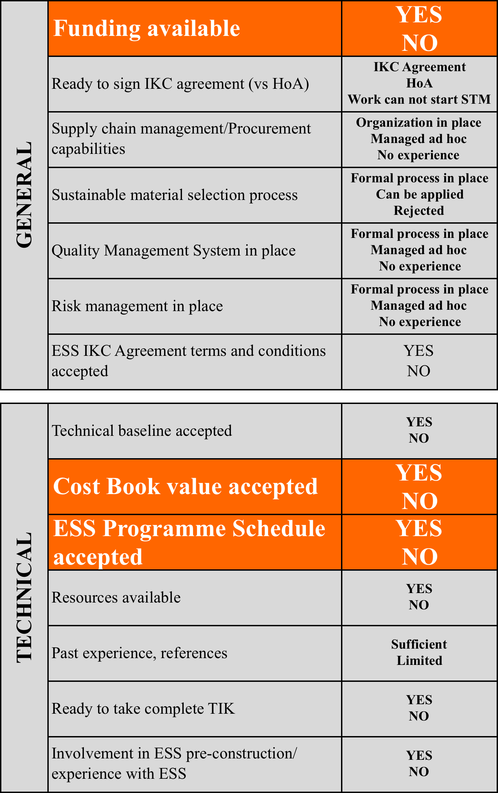
Selection Criteria
3 most critical criteria:

Slide 12
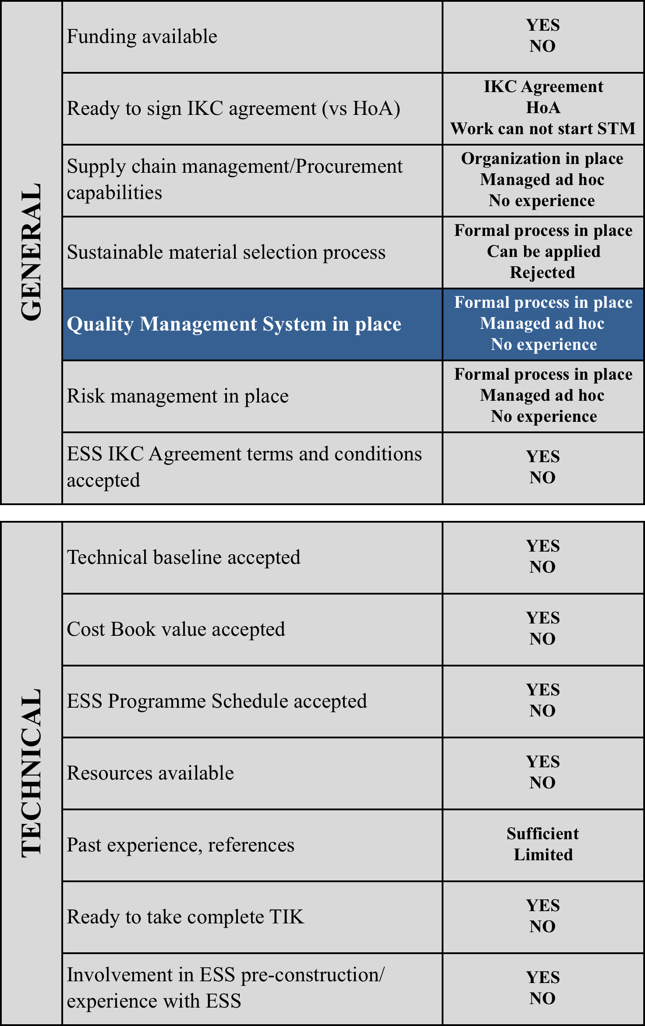
Example of one criteria / requested input
Documented process/organization in place
Experience exist but no formal process in place
No previous experience
Requested input:
Feedback from Partner
Documented process/organization in place
Experience exists but no formal process in place
No previous experience

Slide 13
Summary of In-Kind Partner responses received from three institutes
All three institutes submitted serious, well-researched responses
Institute A responded affirmatively to all items, but took minor exception to cost book value and significant exception to schedule
Institute B responded affirmatively to all items except the cost book value
Institute C (ESS-Bilbao) responded affirmatively to all items, accepting both the cost book value and schedule
ESS-Bilbao selected, and communication to all institutes was straightforward because of the transparency of the process
Contacted senior members of all institutes and their proposed leads to inform them of our selection
Although institutes not selected were disappointed, they understood the need to stick to the cost book value and schedule and appreciated the openness of the process

Slide 14
Concluding Remarks
Selection process (with more than one candidate institute) has been successfully invoked for three Target In-Kind packages
ESS Target Project is making good progress towards meeting its In-Kind goals
So far, we have secured highly qualified partners for 16 IKC packages representing 80% of cost goal
Keys to success include:
Clearly defining In-Kind packages
Communicating opportunities
Sharing all relevant information
Conducting an open and transparent selection process
Special thanks to ESS Communications and External Relations Division for working with us on this challenging task

