Slide 1
Delivery of FAIR In-kind items (feedback from India)
Subhasis Chattopadhyay
VECC-Kolkata
&
BI-Kolkata

Slide 2
Process of decision making in India
1. FAIR related works are being co-ordinated by the Indo-FAIR coordination
Centre (IFCC) at Bose Institute (shareholder)
2. The Executive council of BI-IFCC is co-chaired by the Heads of funding agencies
(Secretary-Department of Atomic Energy &
Secretary-Department of Science and Technology)
3. The Technical Advisory committee monitors technical aspects
Members: Heads of accelerator centres in India
4. Project monitoring committees to monitor individual in-kind projects

Slide 3
Identified Indian in-kind contributions so far
Total: 27MEuro (2005 price)
Power converters (HEBT, SIS, Super-FRS..)
SC magnets (LEB)
Beam stopper (Super-FRS)
Vacuum chambers (Beam diagnostics)
Power cables (expected !)
Experiments

Slide 4
The procedures being followed to find a ‘Provider’ and further monitoring:
BI-IFCC examines the R&D component involved in the in-kind item
As In-kind fund does not provide R&D, so seeks funds from authorities
Examines if the R&D and production can be undertaken in a national lab
If not, advertisement is given in newspaper seeking EOI from Indian industry
Evaluation committee is formed
Based on technical and financial evaluation, ‘provider’ is selected
Triparty contract (FAIR, shareholder, provider) is to be signed…
7. Monitoring committees formed for all projects separately to review the progress,
sanction of fund is linked with the review.
We have started this procedure from 2011

Slide 5
Power converters for FAIR (how many??)
Electronics Corporation of India (ECIL) has been selected as the “provider” by the prescribed procedure
2. A bi-party contract was signed between BI and ECIL with a scope of 560 PCs
(10% fund releassed for ECIL to perform R&D and work for tri-party contract, 2012).
3. After contract, ECIL have already built infrastructure, completed R&D in collaboration with 2 accelerator labs in India
4. Scope got modified from FAIR end (< 560 PCs, hope total allocation remains unchanged, trouble with the contract already signed)!!!
5. Triparty contract signed for 70 PCs ONLY (May 2014)
6. Signing of the 2nd triparty is pending for more than a year, ECIL is asking for money as per contract, No solution!!
Request to FAIR/GSI: Please streamline the process, shareholder is ending up with all sorts of troubles with the Provider

Slide 6
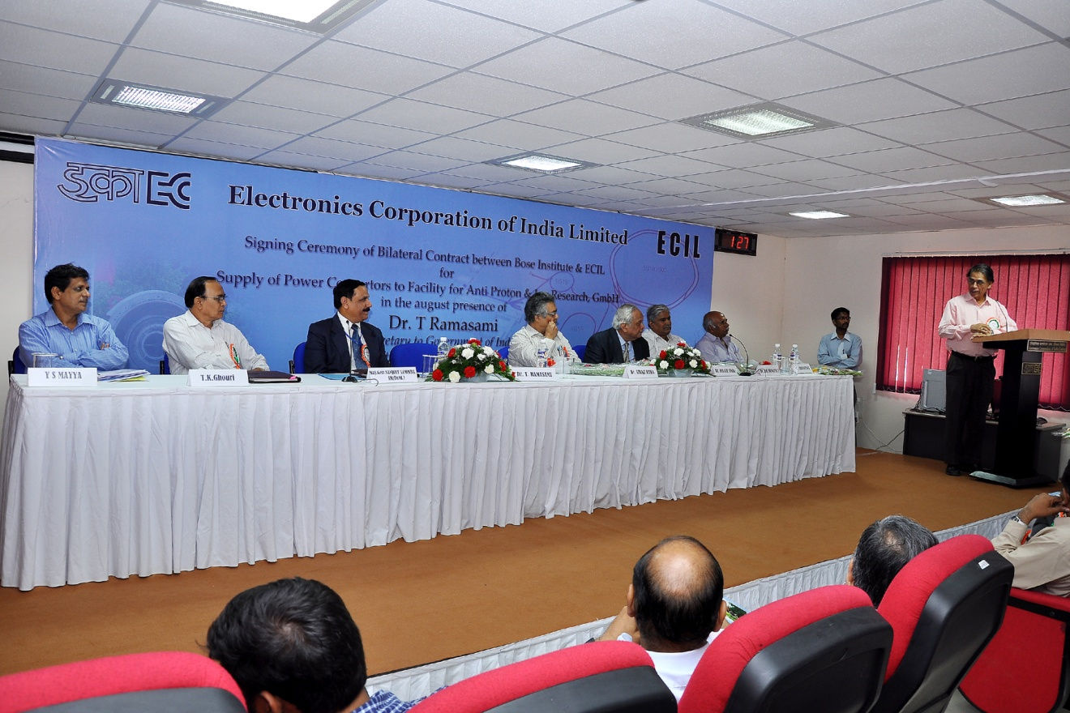
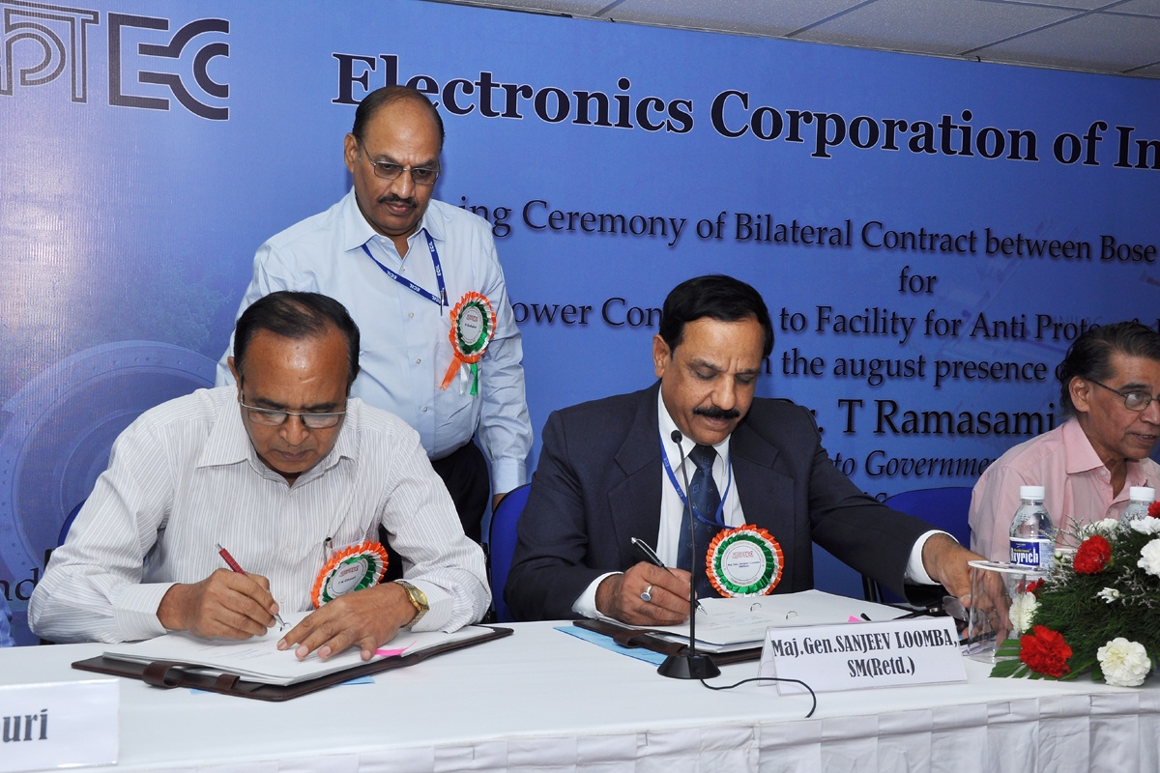
Contract signing ceremony

Slide 7
VACUUM CHAMBERS
EOIs sought by newspaper advt twice
Evaluation committee + FAIR experts visited the shortlisted industries.
One company found technically suitable
Quoted cost considerably higher compared to the
cost book + inflation. No way to provide additional fund!!
Special provision made and ‘LOI’ sent to iDesign (present in the meeting today) (Two-step contract: prototype + production)
The process took about two years!!
Joint team (FAIR+BI) will monitor the progress
Request to FAIR: Pl. provide technical helps

Slide 8
Superconducting magnets for LEB
Design (physics and engineering) completed at VECC
Sought quotations from Indian and outside vendors
Budgetary price is higher by 2.5 to 6 times the cost-book price + inflation!!
FAIR in the process of modified layout, not yet completed
Our engineers are involved in design for several years, no clear decisions from FAIR team.
Once the designs are completed , will seek price from industry and based on that will take final decision on production, if to be taken up…
The cost-difference is hard to defend to the funding agencies
The project is not well-defined and no clear direction.

Slide 9
Beam stopper
Requires extensive R&D (No provision of R&D fund in cost-book)
Special project given to a lab and work is progressing well
in collaboration with GSI.
Advts given in newspaper seeking EOI for vendor to build the
system

Slide 10
Power cables
Samples sent by an Indian Industry has been cleared by FAIR
Need ‘clear specs and timelines’ from FAIR for the shareholder to start the procedure of finding a “Provider”.
Request to FAIR: Please finalise the specs and cost-book value

Slide 11
General statements
In India the procurement procedures are very elaborate and time consuming
It is therefore extremely important that specs are finalised as soon as possible.
We are facing real problem in finding R&D fund which is part of almost all projects
(in-kind contributions)
Higher cost (as compared to the cost-book value) is highly
worrisome (LEB magnet is extreme example : 3-6 times)
We make commitment with industry and then changes in FAIR schedule and
non-availability of specs brings the shareholder in financial and legal trouble
Without early contract signing, things are liable NOT to be delivered
in time, we therefore go for ‘early bi-party contract’ and end up with ‘no-triparty’
contract
WE EARNESTLY REQUEST FOR A WELL-DEFINED MECHANISM AND PERSONS
TO HELP SHAREHOLDERS ON IN-KIND ISSUES.

