Slide 1
Update on PANDA solenoid design and analysis
Gabriella Rolando
Helder Pais Da Silva
Herman ten Kate
Alexey Dudarev
3 November 2014

Slide 2
Outline
Part I
Conductor procurement status
New conductor layout
New coil layout
Field quality & pressure on the coils
Eddy current loss in the coil windings
Eddy current loss in the casing
Temperature distribution in the cold mass
Shear stress at the coil-casing interface
Part II
Coil cross-section
Coil winding
Coil and support cylinder analytic stress assessment
Support cylinder dimensions
Pro’s & con’s of the new coil design
Conclusion
2

Slide 3
Part I
Conductor procurement status
New conductor layout
New coil layout
Field quality & pressure on the coils
Eddy current loss in the coil windings
Eddy current loss in the casing
Temperature distribution in the cold mass
Shear stress at the coil-casing interface
3

Slide 4
Conductor procurement status
Furukawa’s price offer of August 29 of 191 $/m; still 36% higher than expected.
Furukawa reported the unit length (max 3200 m ) as main price driver.
New quotation requested for 4 x 1600 m and 1 x 1500 m unit lengths on September 17.
On October 1, Furukawa replied that price will decrease further towards the expected target (120-140 $/m), although it would probably not reach the cost of the DS1 conductor (Mu2e experiment) due to the larger cross-section area. However, a number was not given.
A budgetary offer has been requested on October 21; for the 6-around-1 conductor. According to Furukawa price will likely not vary due to R&D required for Al-stabilized 6-around-1 conductor.
On October 31 , Furukawa replied and stated no significant cost reduction expected on 6-a-1 cable (no experience, R&D required). We will now propose the new conductor size with an 8 strands Rutherford cable instead.
For starting of real tender, still waiting for confirmation of tendering partner and budget.

Slide 5
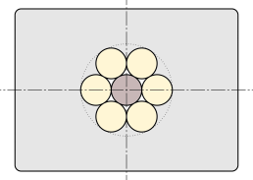
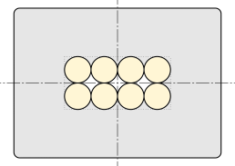
New conductor layout
Driving factors in conductor design:
Minimize the risk of quenches temperature margin ΔT ≈ 2.4 K.
Ease the coil winding low height-to-width ratio conductor
Parameter | TDR | Modified TDR | 6-around-1 |  | New Rutherford
Layout | -
N. of strands | 20 | 26 | 6 + 1 core* | 8
Strand diameter [mm] | 0.8 |  | 1.5 | 1.4
Cu : nonCu ratio | 1.5 | 1.2 | 1.0 | 1.0
Cable dimensions [mm] | 8 x 1.15 | 9.7 x 1.5 | Ø 4.5 | 2.6 x 5.3
Conductor bare dimensions [mm] | 24.6 x 3.4 |  | 7.9 x 10.9
ΔT [K] | 1.8 | 2.4 | 2.3 | 2.4
* Core material options: Cu, Al, SS

Slide 6
New coil layout
Parameter | TDR | Modified TDR | 6-around-1 | Rutherford
I_{op} [kA] | 5 |  | 4.98
Inner radius [mm] | 1050.0 |  | 1050.1
Outer radius [mm] | 1100.0 |  | 1099.9
Layers / coil | 2 |  | 6
Up-stream coil | -1025.0 < z < -143.4 [mm] |  | -1024.9 < z < -143.5 [mm]
 | Turns = 464 |  | Turns = 468
Center coil | 157.4 < z < 552.6 [mm] |  | 162.9 < z < 547.1 [mm]
 | Turns = 208 |  | Turns = 204
Down-stream coil | 853.4 < z < 1735.0 [mm] |  | 853.5 < z < 1734.9 [mm]
 | Turns = 464 |  | Turns = 468

Slide 7
Field quality & pressure in the coils
Design |  | B_{peak} [T] | |δ|_{max} [%] | Int_{max} [mm]
Criterion: |  | - | < 2.0 | < 2.00
Modified TDR |  | 2.9 | 1.69 | 2.05
New design | 6-around-1 | 2.71 | 1.67 | 1.75
 | Rutherford | 2.75 | 1.60 | 1.76
Comparison of field quality in tracker region for the different conductor designs.
6 layers layout result in better field quality and lower peak field.
Maximum axial and radial pressure on a sub-coil.
TDR values are confirmed.
Design |  | Max F_{axial} [MN] | Max P_{axial} [MPa] | Max F_{radial} [MN] | Max P_{radial} [MPa]
Modified TDR |  | 4.0 | 11.8 | 17.2 | 2.9
New design | 6-around-1 | 3.9 | 11.6 | 17.2 | 2.9
 | Rutherford | 3.9 | 11.6 | 17.2 | 2.9

Slide 8
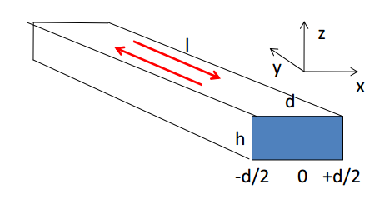
Eddy current loss in the coil windings
Eddy currents in a rectangular thin plate
Parameter | TDR design | New design
B_{peak} [T] | 3 | 3
ρ_{Al} @ 4.5 K [Ω·m] RRR = 1000 | 2.480 e-11 | 2.480 e-11
t_{ramp} [s] | 1500 | 1500
P_{eddy} [W] | 5.2 | 0.6
t_{ramp} [s] | 2000 | 2000
P_{eddy} [W] | 2.9 | 0.3
Conservative estimate:
B = B_{peak} on all the turns
No magneto-resistance
The low height-to-width ratio conductor features practically zero loss for every ramp time.
Eddy current loss with TDR design add an extra 30% on top of casing loss.
What is the required current ramp time?

Slide 9
Eddy current loss in the casing
$$P= \frac{V^{2}}{R_{casing}}$$
$$V=M∙\frac{dI}{dt}$$
Parameter | TDR design | New design
I [kA] | 5 | 4.98
ρ_{Al-5083} @ 4.5 K [Ω·m] | 3.03e-8 | 3.03e-8
t_{ramp} [s] | 1500 | 1500
P_{eddy} [W] | 17.4 | 17.2
t_{ramp} [s] | 2000 | 2000
P_{eddy} [W] | 9.78 | 9.7
Eddy currents in the casing produce the main loss contribution during ramp & slow dump.
Eddy current power loss is reduced of ~ 2 when ramp time increases from 1500 s -> 2000 s.

Slide 10
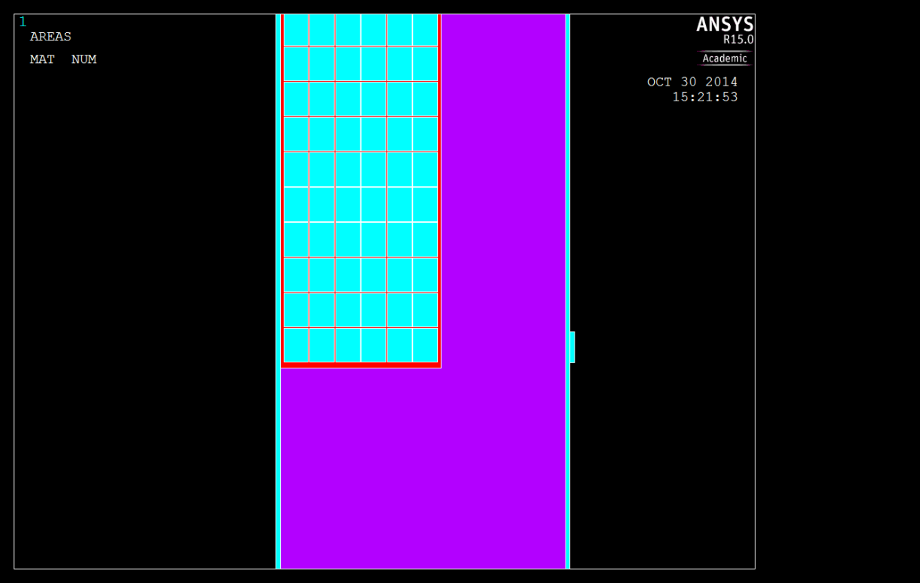
Temperature distribution in the cold mass
Cooling channels
Steady-state thermal model of the cold mass during ramp up & slow dump
coil
coil
coil
casing
Pure Al strip
Features
6 cooling channels
1.5 mm thick high purity Al strips in thermal contact with the cooling channels and surrounding the 3 sub-coil modules
Insulation

Slide 11
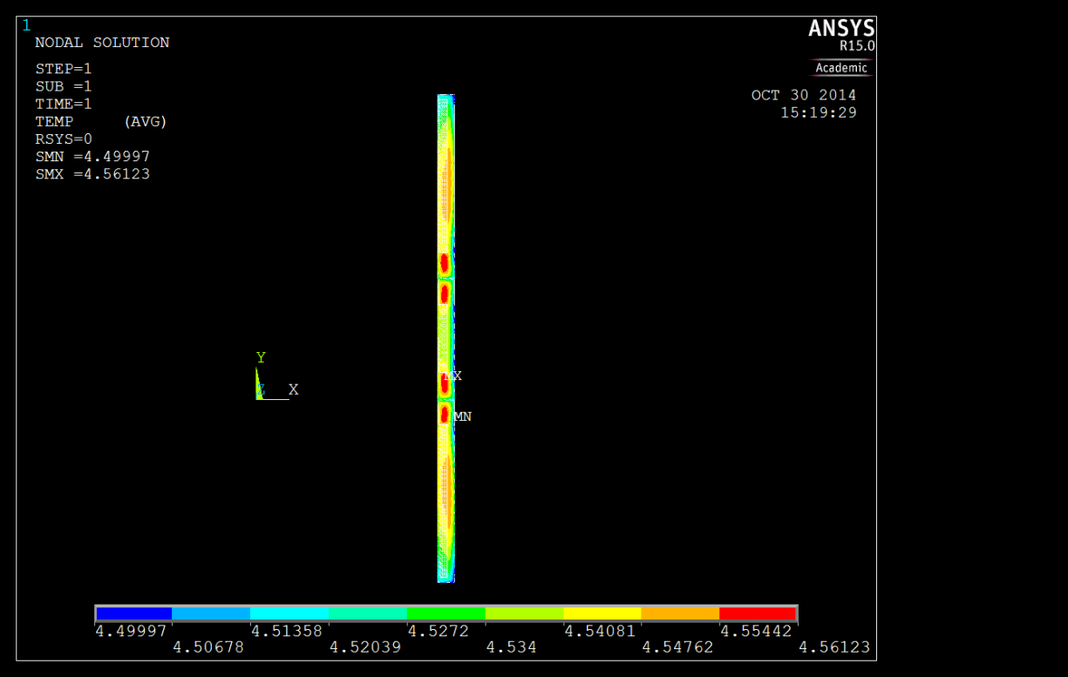
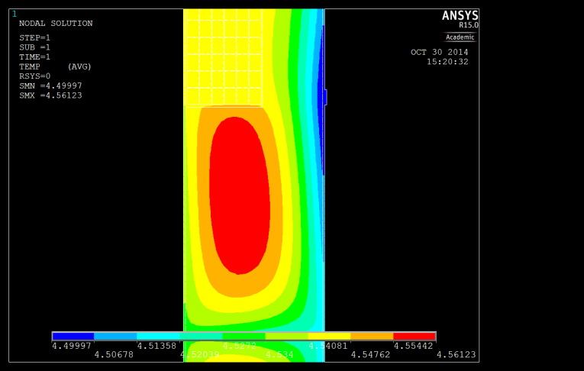
Temperature distribution in the cold mass
Loads
Eddy current loss in the conductor
Eddy current loss in the casing
Radiation heat flux 0.12 W/m²
(based on ATLAS CS data)
Design | T_{ramp} [s] | T_{peak} [K]
TDR | 1500 | 4.57
TDR | 2000 | 4.54
New | 1500 | 4.56
New | 2000 | 4.54
The thin high purity Al strip in thermal contact with the cooling ribs ensures minimal increase of the cold mass temperature during current ramp up and slow dump of the magnet.

Slide 12
Shear stress at the coil-casing interface
Magneto-structural model of the cold mass at operating current
Design | Peak shear stress at coil-casing interface [MPa]
With spacers | 3
Without spacers | ≈10
casing
coil
coil
coil
casing
coil
coil
coil
Maximum epoxy shear stress 30 MPa.
Maximum shear stress at coil-casing interface below epoxy limit even without spacers between the coils.
TDR values are confirmed.
Shear stress distribution in the cold mass

Slide 13
Part II
Coil cross-section
Coil winding
Analytic stress assessment
Support cylinder dimensions

Slide 14
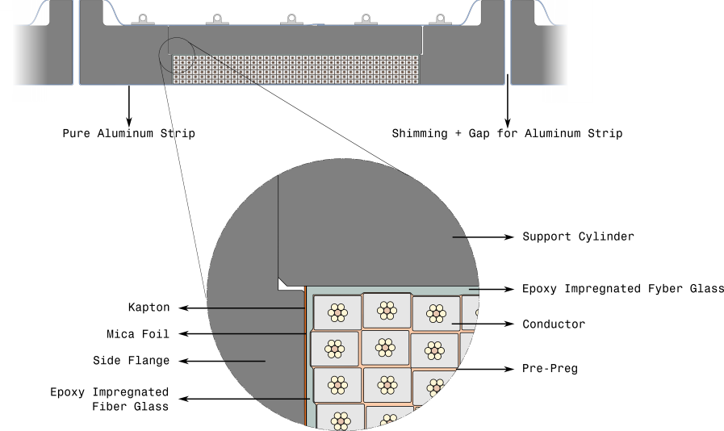
Coil cross-section 1/2
Update:
Two flanges and one support cylinder per sub coil
Layer of G10 to compensate for winding and cable tolerances
Sliding interface between coil and flanges

Slide 15
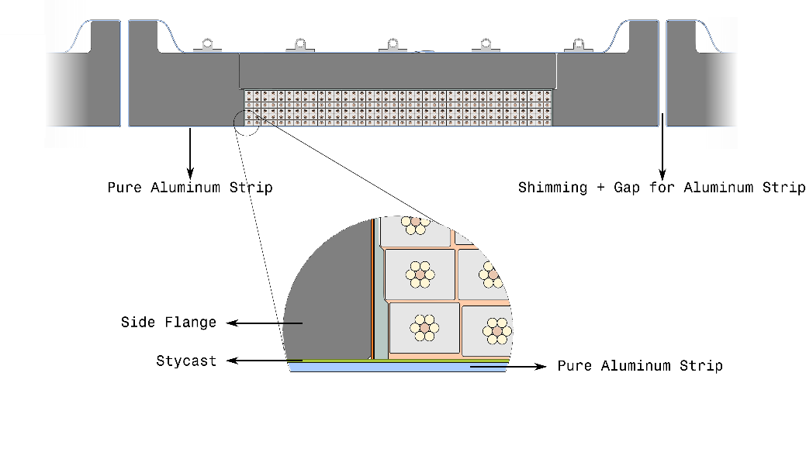
Coil cross-section 2/2
Update:
Two flanges and one support cylinder per sub coil
Layer of G10 to compensate for winding and cable tolerances
Sliding interface between coil and flanges
High purity aluminum strips to improve cooling

Slide 16
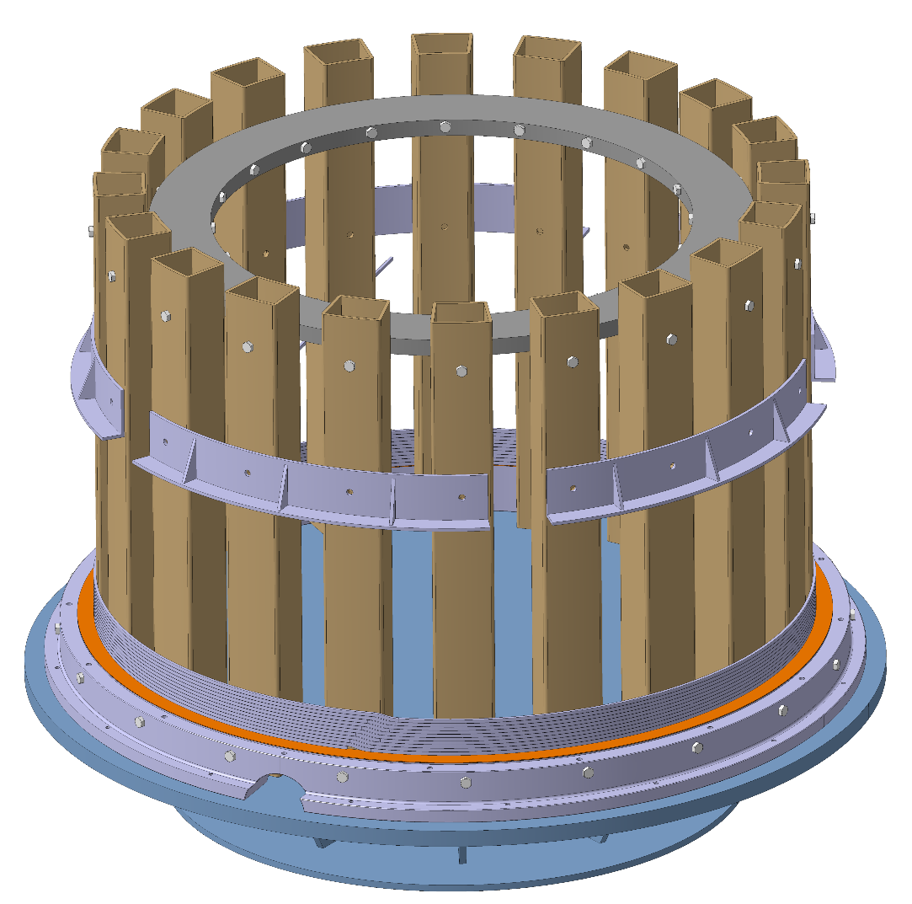
Coil winding
A vertical winding set-up is preferable.
A simple collapsible mandrel will be designed for our purpose.
One of the coil flanges will be connected initially to the winding mandrel.
The cable winding is “transposed”, using joggles in every turn.

Slide 17
Analytic stress assessment 1/3
Bare coil under radial magnetic force
Parameter | Value
Hoop stress $R_{i}$[MPa] | 62
Hoop stress $R_{o}$ [MPa] | 59
Radial stress $R_{i}$ [MPa] | -2.9
Radial stress $R_{o}$[MPa] | 0
Max. von Mises stress [MPa] | 64
Safety factor | 0.63
Without external support the coil windings will yield.

Slide 18
Analytic stress assessment 2/3
40 mm support cylinder with no contact pressure at cold
Parameter | Coil | Casing
Contact pressure [MPa] | 1.240
Hoop Stress $R_{i}$[MPa] | 34 | 33
Hoop Stress $R_{o}$ [MPa] | 35 | 33
Radial Stress $R_{i}$ [MPa] | -2.9 | 1.2
Radial Stress $R_{o}$[MPa] | -1.2 | 0
Max. von Mises stress [MPa] | 36 | 35
Safety factor | 1.1 | 4.1
$ΔR_{i}$[mm] | 0.47 | 0.48
$ΔR_{o}$[mm] | 0.48 | 0.47
Support Cylinder
Coil
Contact Pressure
A 40 mm thick support cylinder allows operating the coil close to yielding of the conductor.

Slide 19
Analytic stress assessment 3/3
40 mm support cylinder with 0.7 mm overlap
Support Cylinder
Coil
Contact Pressure
 | Warm Magnet |  | Cold Magnet |  | Energized Magnet
 | Coil | Support Cylinder | Coil | Support Cylinder | Coil | Support Cylinder
Overlap [mm] | 0.7 |  | 0.5 |  | 0.5
Contact Pressure [MPa] | 0.90 |  | 0.73 |  | 1.97
Max. von Mises stress [MPa] | 20 | 26 | 16 | 21 | 20 | 56
Safety factor | 1.5 | 5.6 | 2.4 | 7.0 | 2.0 | 2.6
 | Warm Magnet |  | Cold Magnet |  | Energized Magnet
 | Coil | Support Cylinder | Coil | Support Cylinder | Coil | Support Cylinder
Overlap [mm] | 0.7 |  | 0.5
Contact Pressure [MPa] | 0.90 |  | 0.73
Max. von Mises stress [MPa] | 20 | 26 | 16 | 21
Safety factor | 1.5 | 5.6 | 2.4 | 7.0
 | Warm Magnet |  | Cold Magnet |  | Energized Magnet
 | Coil | Support Cylinder | Coil | Support Cylinder | Coil | Support Cylinder
Overlap [mm] | 0.7
Contact Pressure [MPa] | 0.90
Max. von Mises stress [MPa] | 20 | 26
Safety factor | 1.5 | 5.6
Pre-stress required to increase the safety factor to 1.5 is small.
The thickness could be reduced, but 40 mm is ideal for assembly purposes.
Required $Δ$T between bodies for assembly ≈90 K.

Slide 20
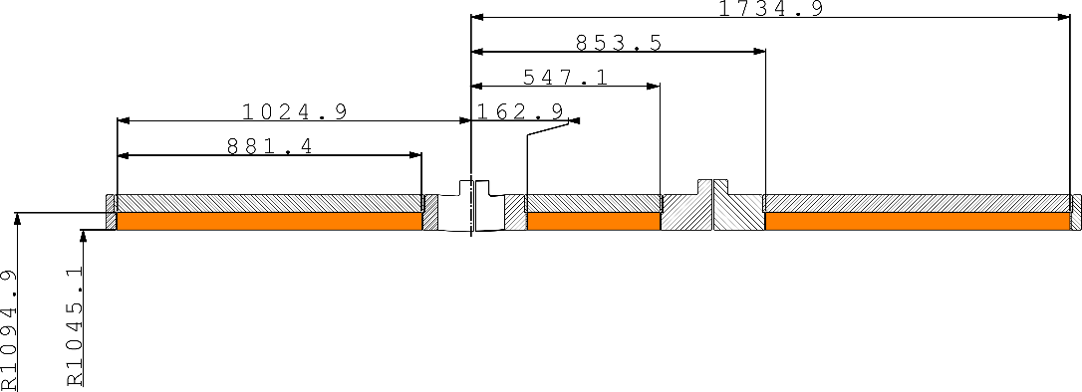
Support cylinder dimensions
Cold dimensions of the coil and cylinder depend on:
Material properties
Initial dimensions of the components
Interference length
 | Coil |  | Cylinder
 | $R_{i}$ [mm] | $R_{o}$ [mm] | $R_{i}$ [mm] | $$R_{o}$$ [mm]
Energized magnet | 1045.1 | 1094.9 | 1094.9 | 1134.7
Cold magnet | 1044.6 | 1094.4 | 1094.4 | 1134.2
Cold separated components | 1044.8 | 1094.7 | 1094.2 | 1134.0
Warm | 1049.3 | 1099.4 | 1098.7 | 1138.7
Winding radius (10 MPa tension) | 1049.8 | 1099.9 | - | -
Notes:
The warm dimensions and interference of the components will be adjusted to compensate for non-conformities.
A 3D FEM stress analysis is needed to assess behavior near the coil ends.
A dummy coil will be first produced to test the coil winding and assembly procedure.

Slide 21
Pro’s & con’s of the new coil design
Pro’s
Easier co-extrusion process.
Easier winding and cheaper winding tooling.
Lower loss in the conductor during ramp up and slow dump.
Improved field quality on tracker region.
Lower peak field on the conductor.
Con’s
Potentially higher temperature gradient on the coil due to the higher number of layers
…but
The issue is not relevant when the sub-coil modules are surrounded by thin high purity Al strips in thermal contact with the cooling ribs.

Slide 22
Conclusion
The 6 layers winding solution is recommended as it allows easier manufacturing and cost reduction.
The presence of a high thermal gradient over the winding during current ramp up/down is effectively avoided by surrounding the sub-coil modules with a thin high purity Al strip in thermal contact with the cooling ribs.
The TDR value for the maximum axial and radial pressure on a sub-coil are confirmed.
The TDR value for the maximum shear stress at the coil-casing interface is confirmed.
The eddy current loss during ramp up and slow dump are assessed and in agreement with the TDR value for t_{ramp} = 2000 s and a coil former thickness of 30 mm.
A budgetary offer for the 6-around-1 conductor has been requested to Furukawa. Price is comparable to 26 strands Rutherford.

