Slide 1

Status of work (cryostat, control Dewar, cooling system)
Joint Institute for Nuclear Research (Dubna)
Evgeny Koshurnikov
CERN
November 03, 2014

Slide 2
Topics of the presentation
Cryostat
  Design of vacuum shell, thermal screen, suspension system and target entry unit;
  interfaces of the cryostat
  Loads applied to the vacuum shell
  Computations of vacuum shell stability, stress analysis of the suspension units
Valve box and Chimney design
Cooling system of the solenoid
  Computations of natural convection mode;
  Efficiency of the coil cooling
  Helium flows of the refrigerator for different operation modes of the solenoid;

Slide 3
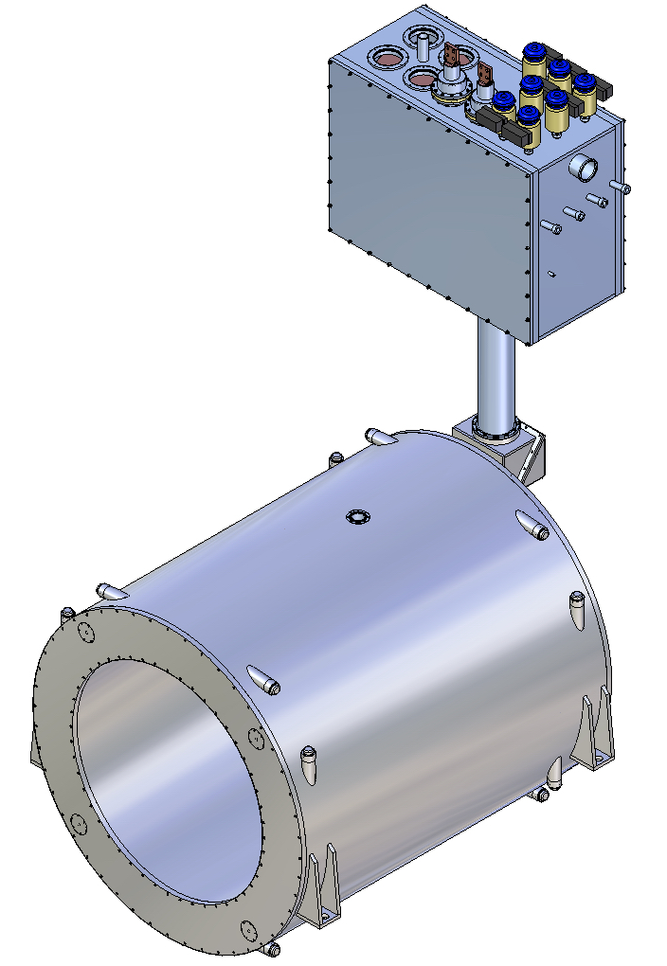
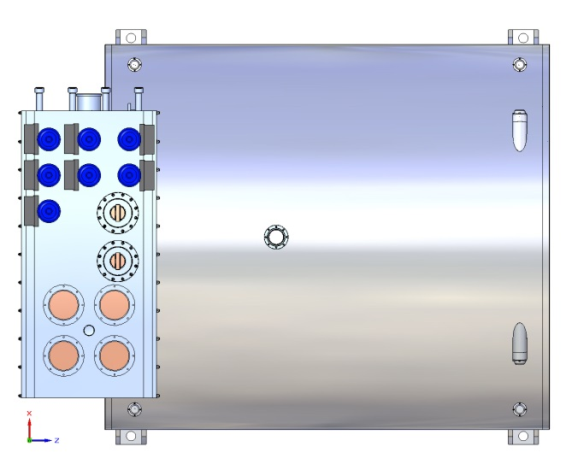
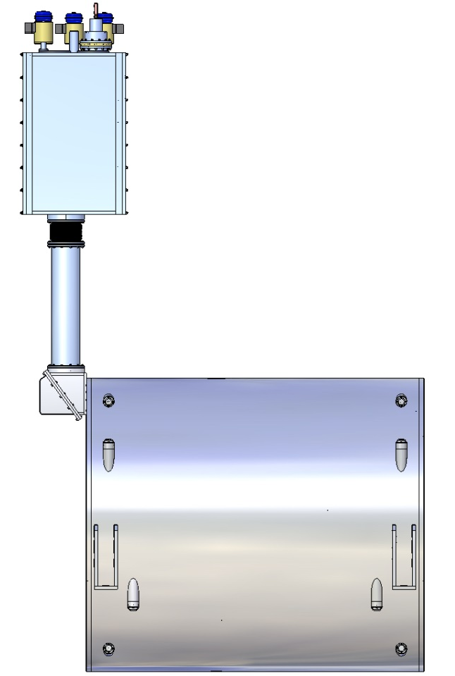
Assembled cryostat and control Dewar

Slide 4
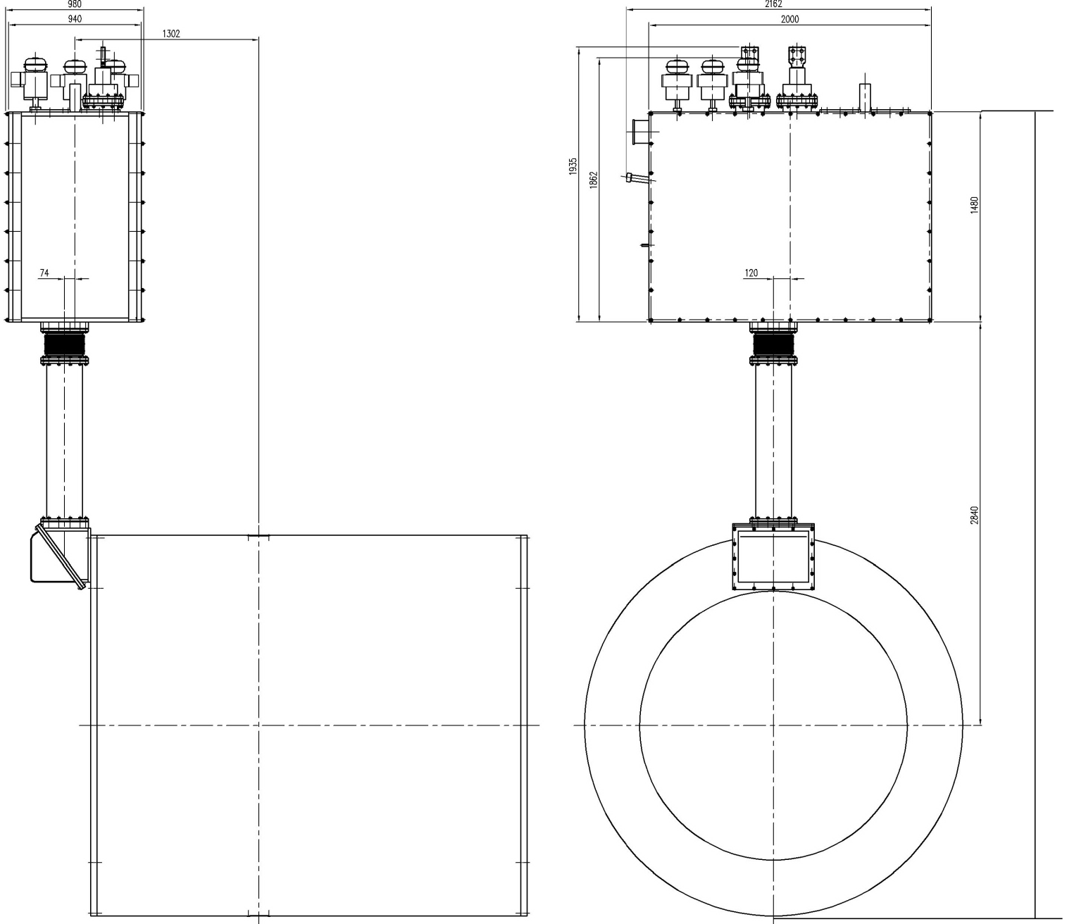
Overall dimensions of the solenoid and control Dewar
5660

Slide 5
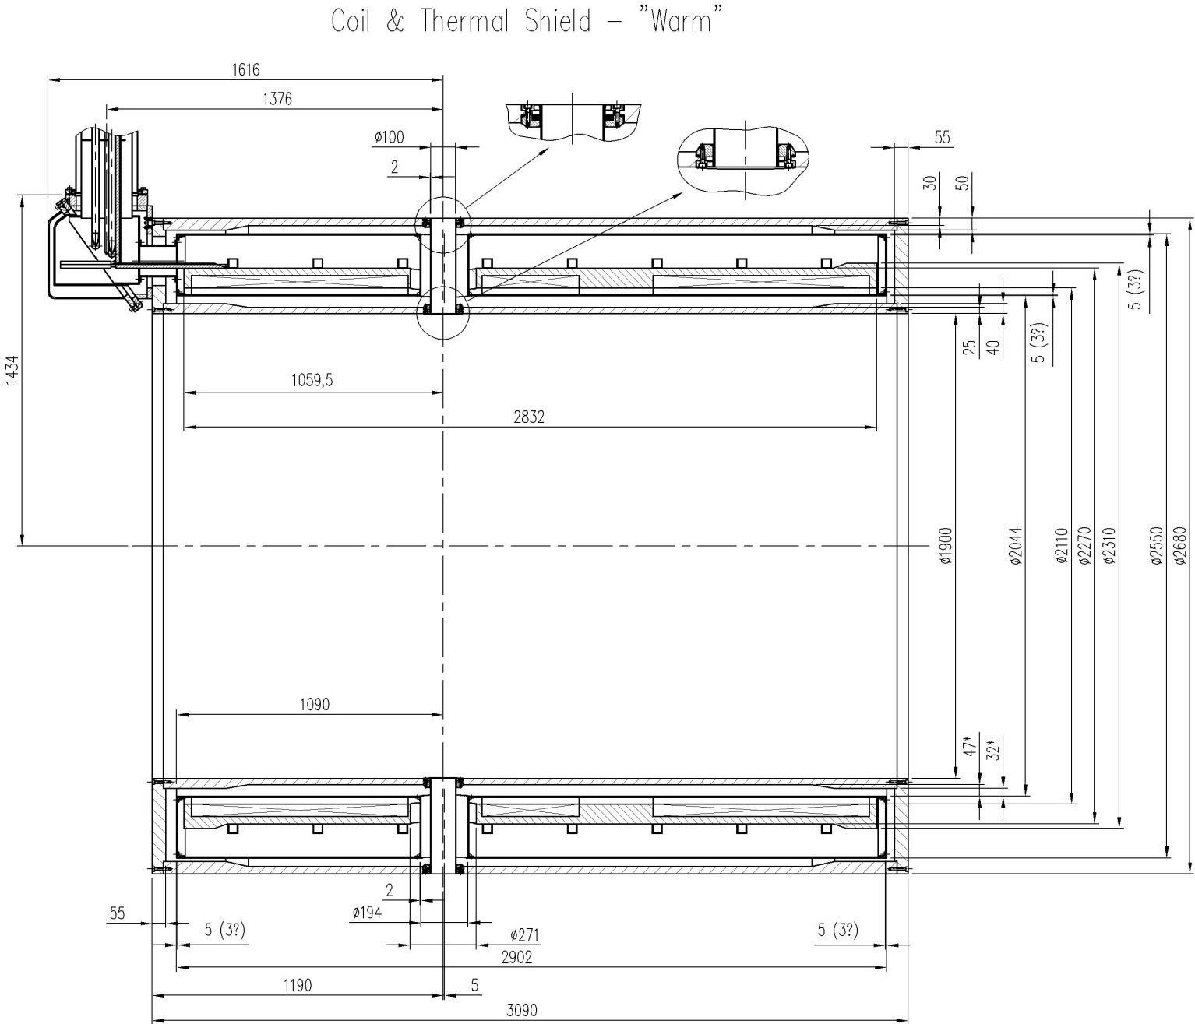
Cryostat main dimensions

Slide 6
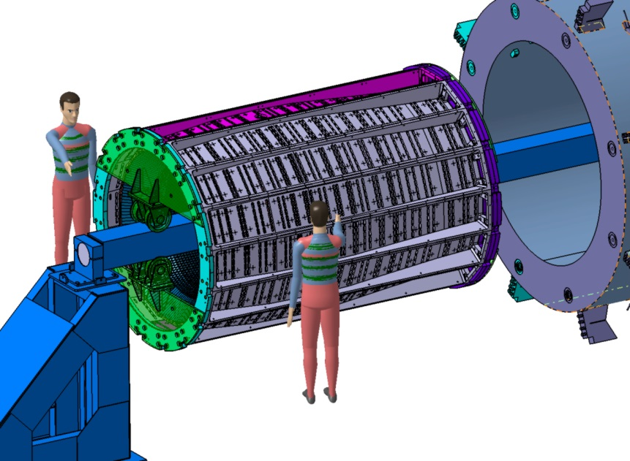
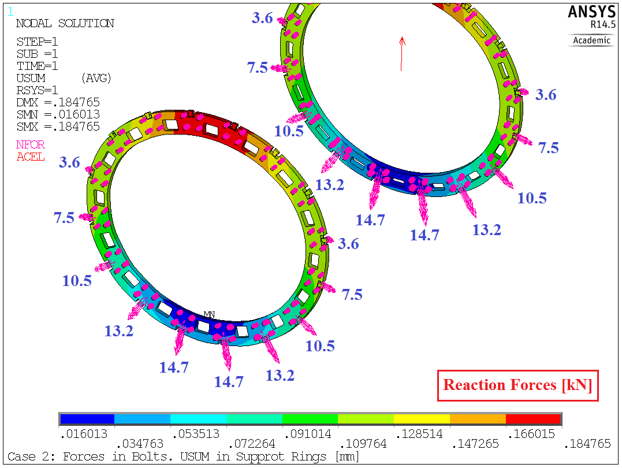
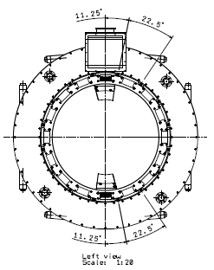
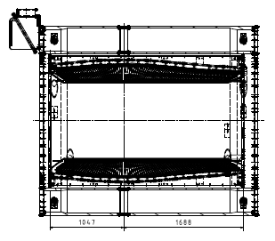
Cryostat interface with the barrel EMC
Barrel weight – 220 kN 140 kN
Positions of the barrel EMC supports on the inner vacuum shell of the cryostat

Slide 7
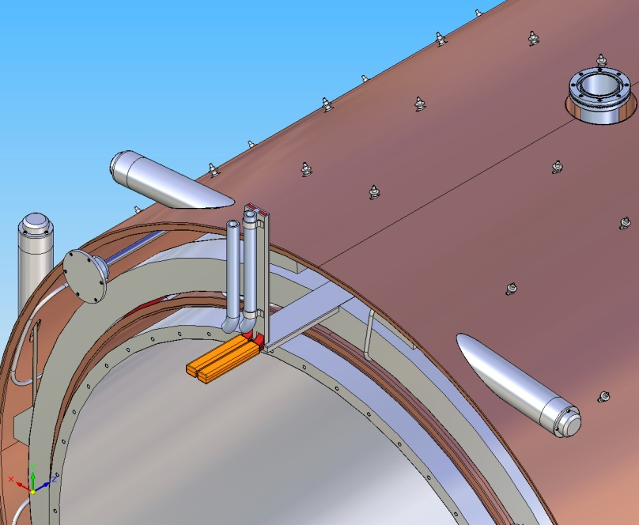
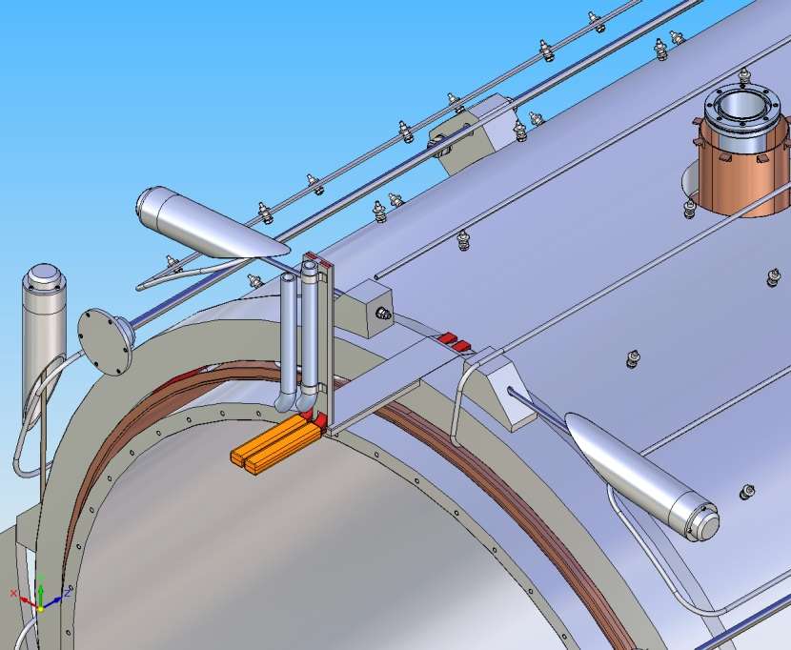
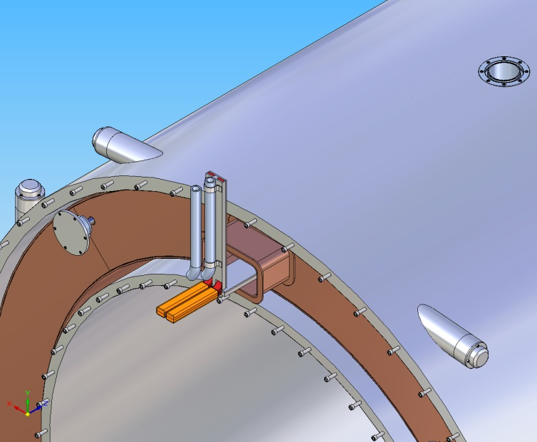
Thermal screen of the cryostat
Screen supports
Heat exchanger serpentine of the outer screen shell
Material of the thermal screen aluminium 1100
Shell thickness t=3 (5?) mm,
Number of radial supports ~192
Mass M=377 kg
Material of the heat exchanger tube aluminium 1100
Length of the heat exch. tube L= 157 m
Diameter 10x1 mm
Distance between the serpentine branches 700 mm
Maximal pressure drop ΔP_{max} = 6 bar
Maximal helium flow rate G= 2.5 gr/sec
Mean temperature T_{mean} = 60 K

Slide 8
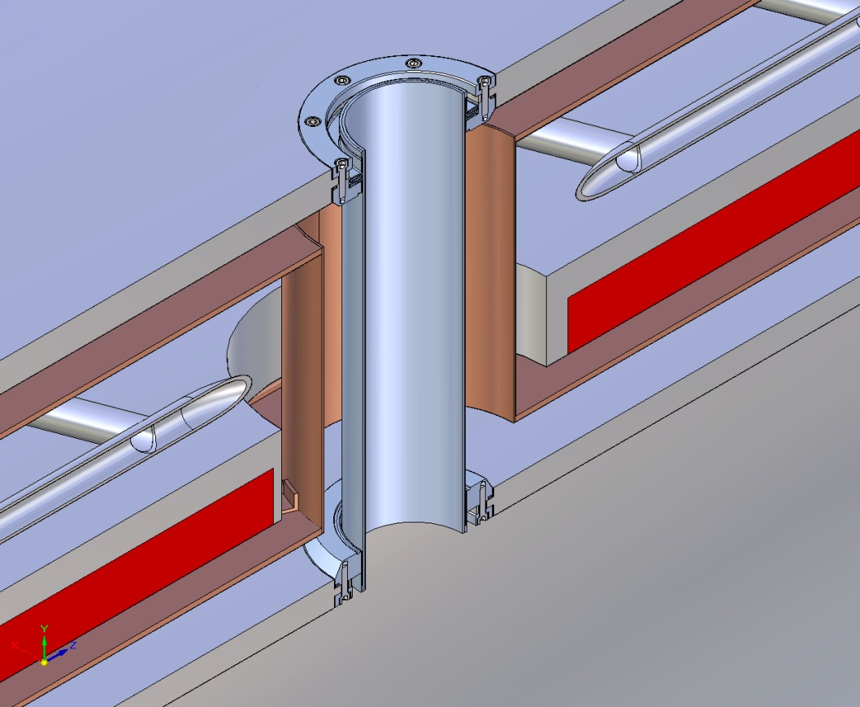
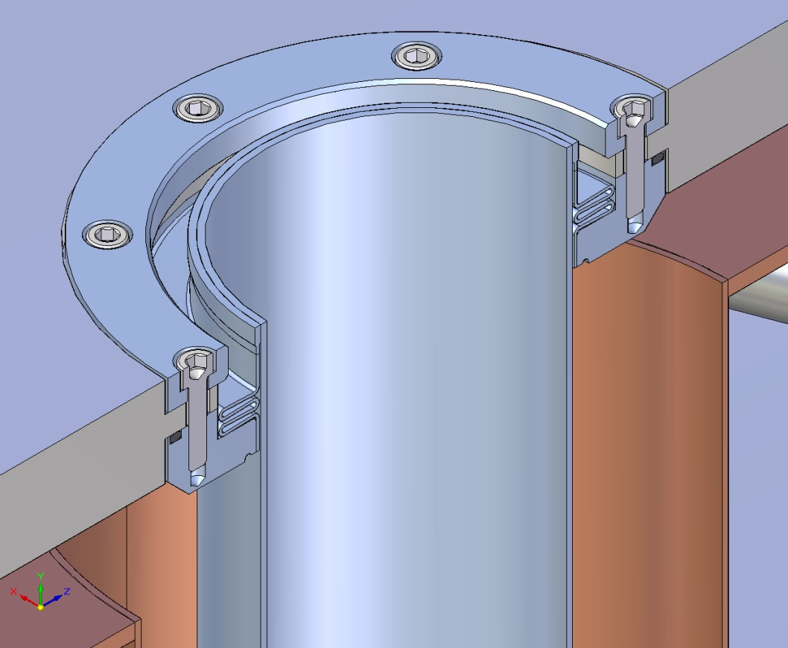
Passageways for Target
It takes to cut four weld seams to disassemble the cryostat
Accepted design allows several re-welding of the seams
It is planned to change the design to avoid cutting of the weld seems

Slide 9
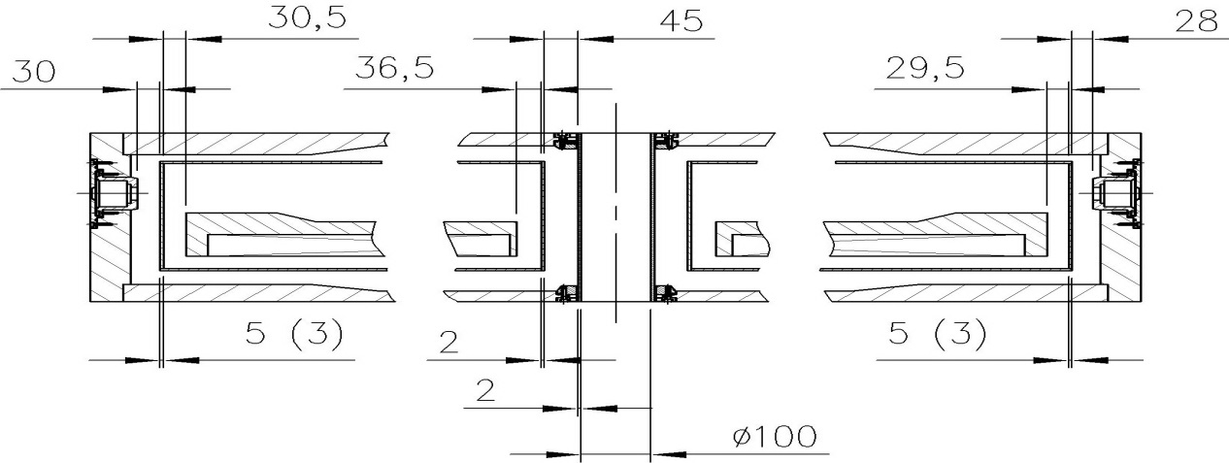
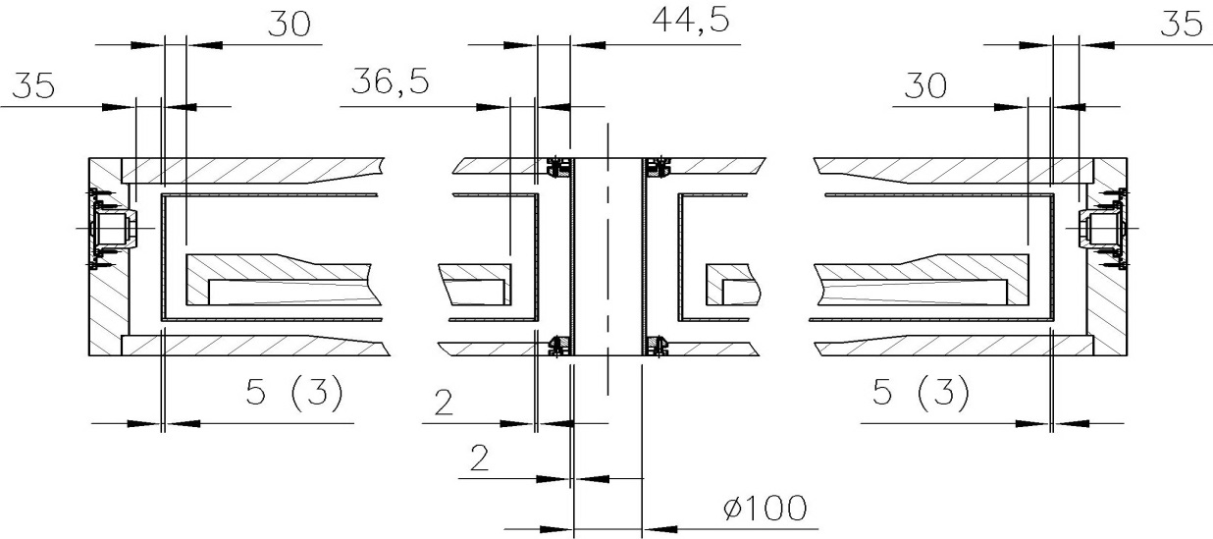
Interface of the cryostat and cold mass in nominal position
Cold mass and thermal shield are warm
Cold mass and thermal shield are cold

Slide 10
Possible causes of axial deviation of the magnetic center of the solenoid
Incorrect installation of the coil with respect to the cryostat
Magnetic center of the coil can be shifted with respect to its geometrical center because of non-uniform winding density or wrong number of the turns in the subcoils

Slide 11

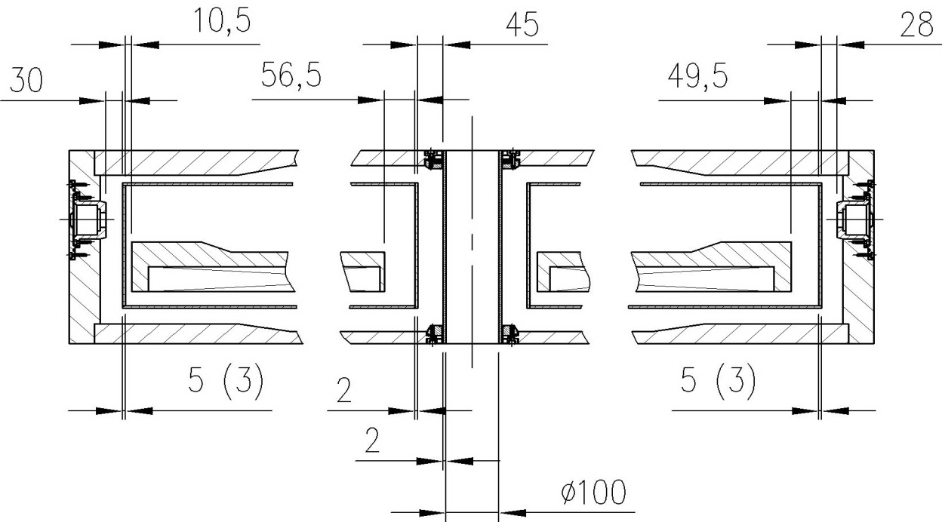
Interface of the cryostat and cold mass in shifted positions
Cold mass and thermal shield are cold
and shifted 20 mm downstream
Cold mass and thermal shield are cold
and shifted 20 mm upstream

Slide 12
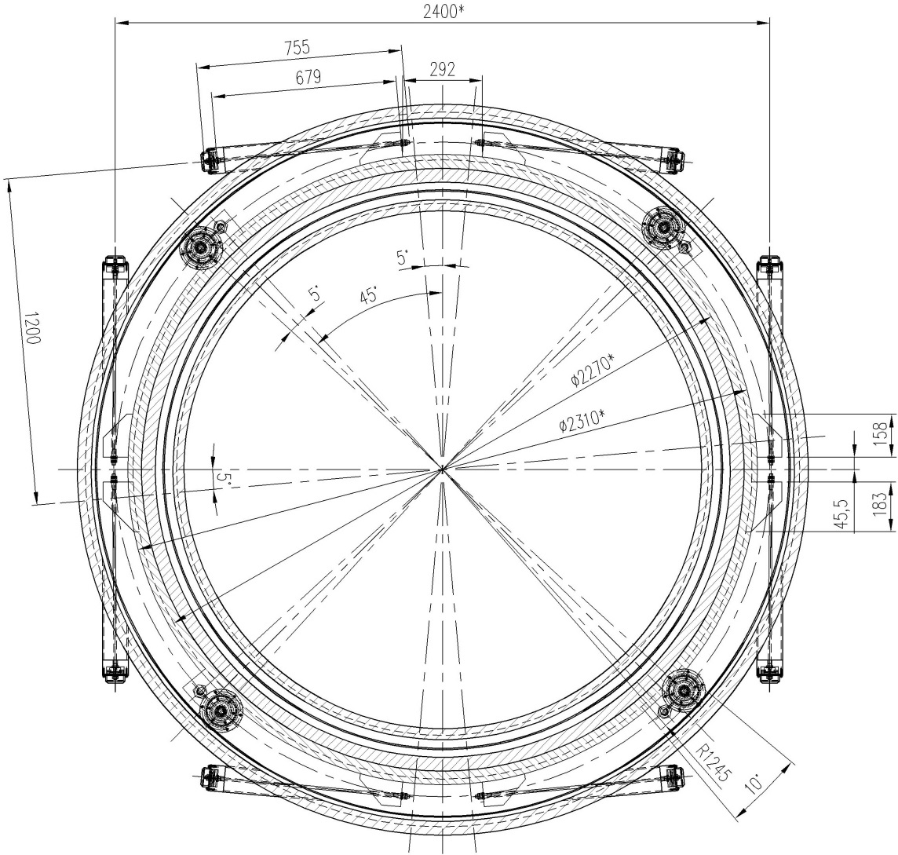
Positions of the radial supports

Slide 13
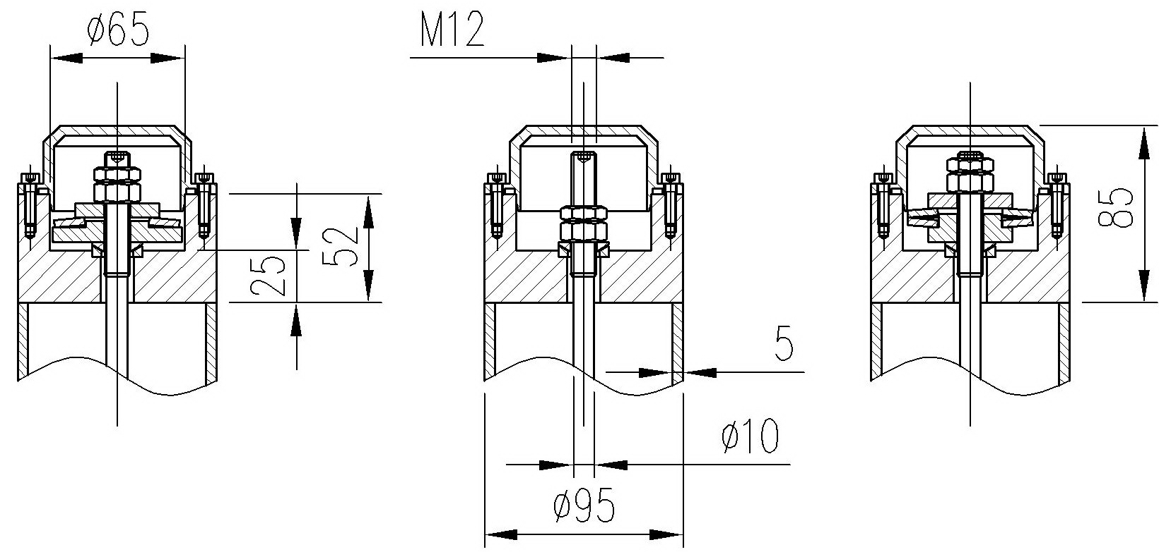
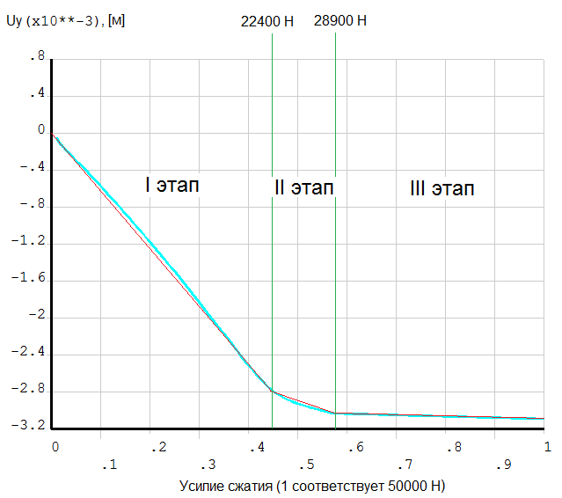
Head parts of the radial ties
Bottom vertical ties
Horizontal ties
Upper vertical ties
Characteristic of the head part of a bottom vertical tie

Slide 14
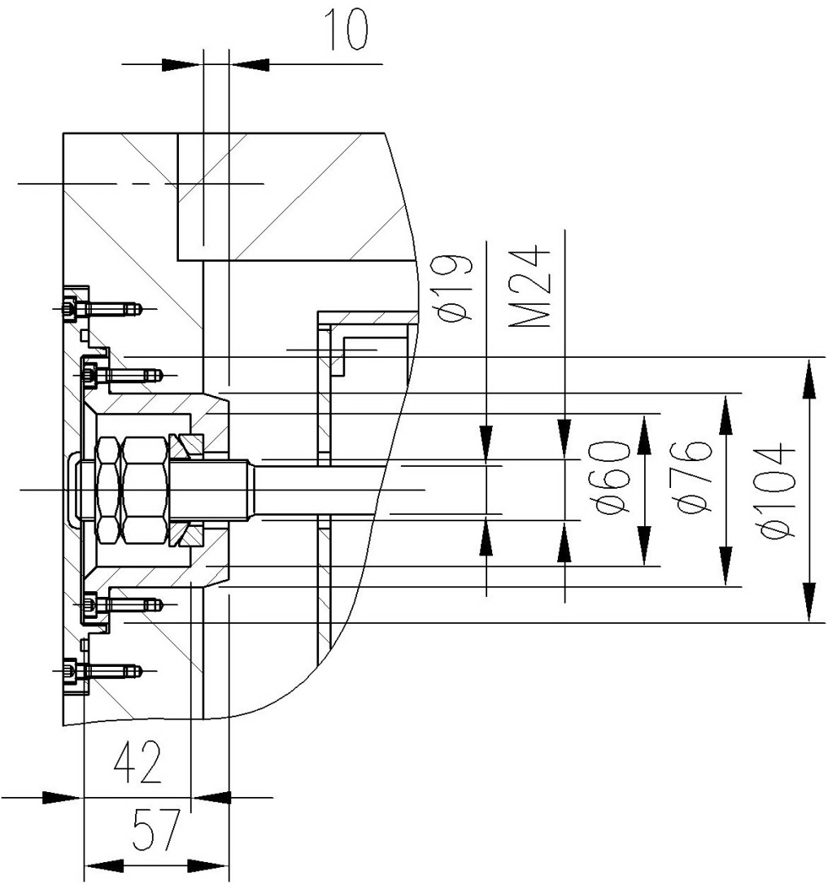
Head parts of the axial ties

Slide 15
Loads on the vacuum shell of the cryostat
Radial loads
  Weight of the cold mass ~42 kN
  Weight of the thermal screen 3.77 kN
  Weight load of the barrel EMC and inner detectors 140 kN
  Pre-stress from the barrel EMC support system 6.6 kN
  Maximal radial decentering magnetic force 51 kN
  Seismic load a_{sx} = 0.075 g
  Dynamic loads during lifting and lowering a_{y}= ±1.4 g
Axial loads
  Magnetic load -47±108 kN
  Seismic load a_{sz} = 0.075 g
  Tightening force of the axial rods Q_{tz}=2.6 kN
Loads on the vacuum shell
  External pressure on the vacuum shell 0.1 MPa
  Internal pressure in an emergency 0.05 MPa

Slide 16
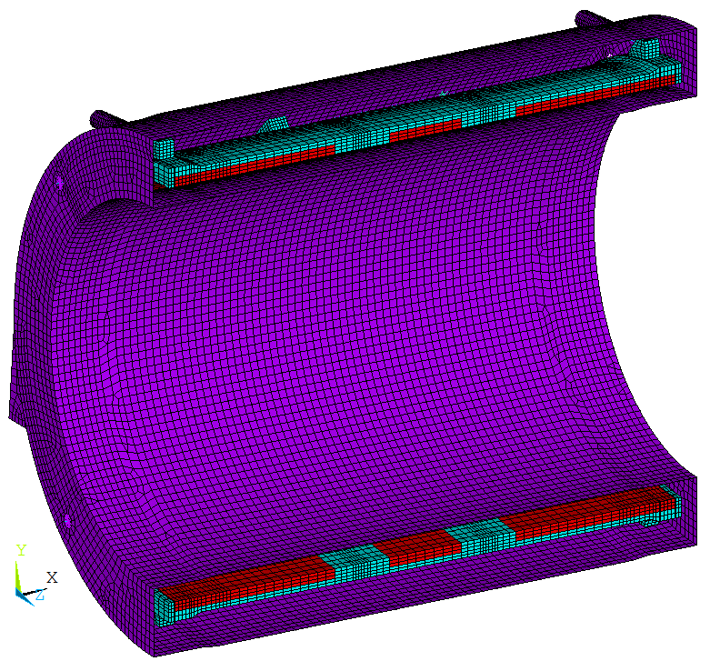
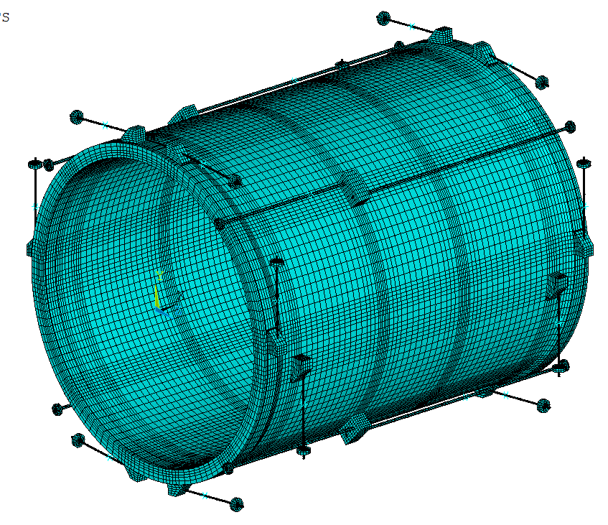
Design model of the cryostat with cold mass

Slide 17
Load cases of the suspension system
Load Case | Description of the load cases
1 | Initial tightening of the suspension ties
2 | Loads of the load case 1 and application of the weight loads + external pressure on the shell
3 | Loads of the load case 2 + temperature loads
4 | Loads of the load case 3 + decentering axial and radial magnetic forces F_{mz} = -140 kN and F_{mx} = 45 kN , seismic load a_{sz}= 0,075 g

Slide 18
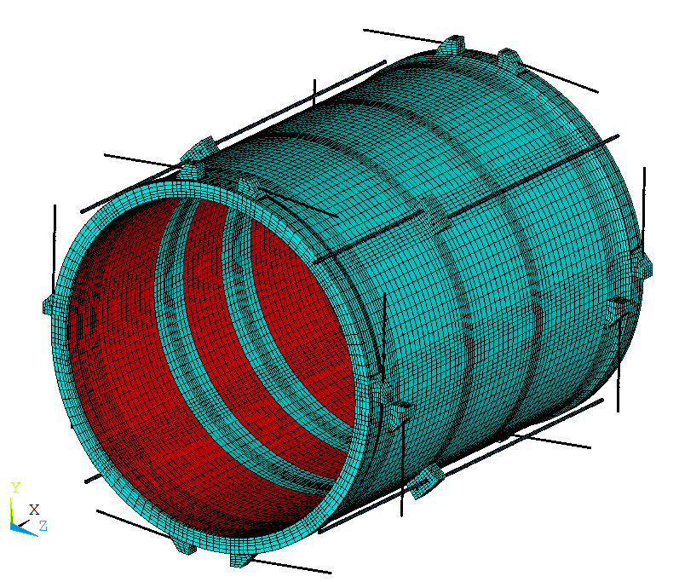
Ties | Load cases
 | 1 | 2 | 3 | 4 | SF | 4 (77 К in centre) | SF
RV1_top | 85 - | 188 - | 385 580 | 495 707 | 1,25 1,15 | 391 583
RV2_top | 85 - | 188 - | 388 646 | 499 786 | 1,24 1,03 | 390 639
RV3_top | 85 - | 188 - | 388 646 | 499 786 | 1,24 1,03 | 392 642 | 1.26
RV4_top | 85 - | 188 - | 386 581 | 495 707 | 1,25 1,15 | 394 581
RV1_bot | 85 - | 54 - | 248 391 | 215 347 | 2,83 2,0 | 108 199
RV2_ bot | 85 - | 54 - | 251 440 | 220 404 |  | 114 243
RV3_ bot | 85 - | 54 - | 251 440 | 219 403 |  | 113 242
RV4_ bot | 85 - | 54 - | 248 391 | 214 348 |  | 107 199
RG1_top | 85 - | 80 - | 275 429 | 271 429 | 2,3 1,65 | 167 293
RG2_top | 85 - | 80 - | 278 486 | 275 490 |  | 171 342
RG3_top | 85 - | 80 - | 278 486 | 275 490 |  | 172 343
RG4_top | 85 - | 80 - | 276 429 | 271 429 |  | 169 296
RG1_bot | 85 - | 88 - | 267 437 | 270 431 | 2,3 1,7 | 165 293
RG2_ bot | 85 - | 88 - | 269 487 | 273 489 |  | 169 341
RG3_ bot | 85 - | 88 - | 269 487 | 273 489 |  | 167 342
RG4_ bot | 85 - | 87 - | 267 437 | 270 431 |  | 165 294
Stresses in the radial ties
RG3_top
RV3_top
RG2_top
RG4_top
RV4_top
RV2_top
RG1_top
RV2_bot
RG2_bot
RG4_bot
RG1_bot
RV1_bot
RV1_top

Slide 19
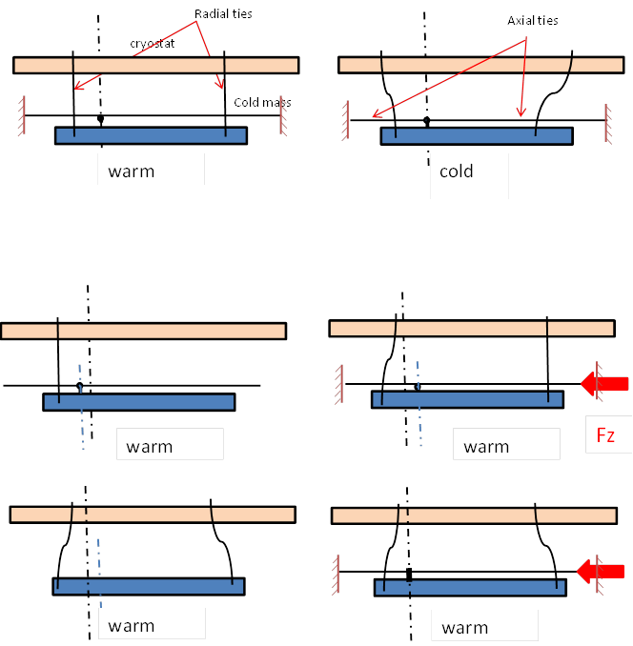
Pre-bending of the radial ties to decrease the bending stresses after cool down
1.
2.
Current design of the suspension system
1.
2.
Pre-bending of the ties
3.
4.
5.
cold

Slide 20
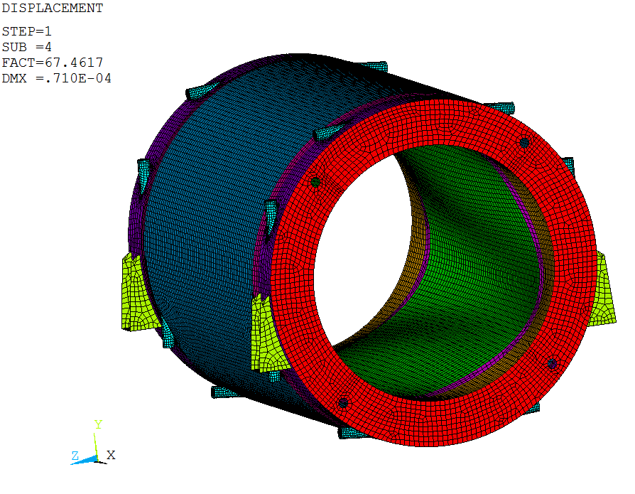
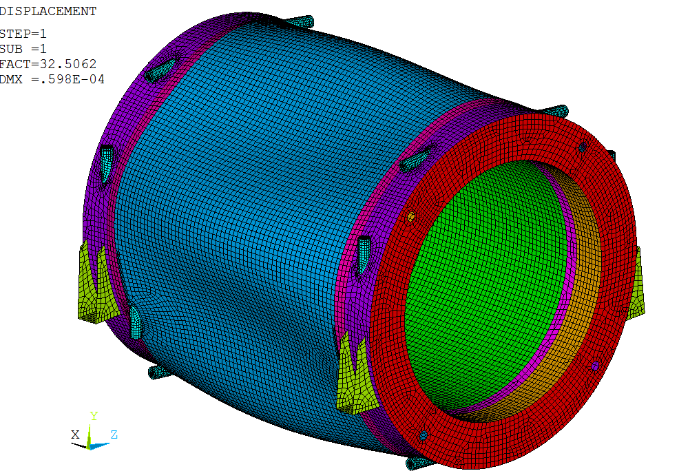
Stability of the cryostat shells
The first form of loss of stability of the cryostat shell from exposure to external pressure.
Pcr = 3.25 MPa. Safety factor for the external pressure of 0.1 MPa is equal to 32.5.
The first form of loss of stability of the cryostat shells from exposure to internal pressure
P_{cr} = 3.37 MPa. Safety factor for the internal pressure of 0.05 MPa is equal to 67.5.

Slide 21
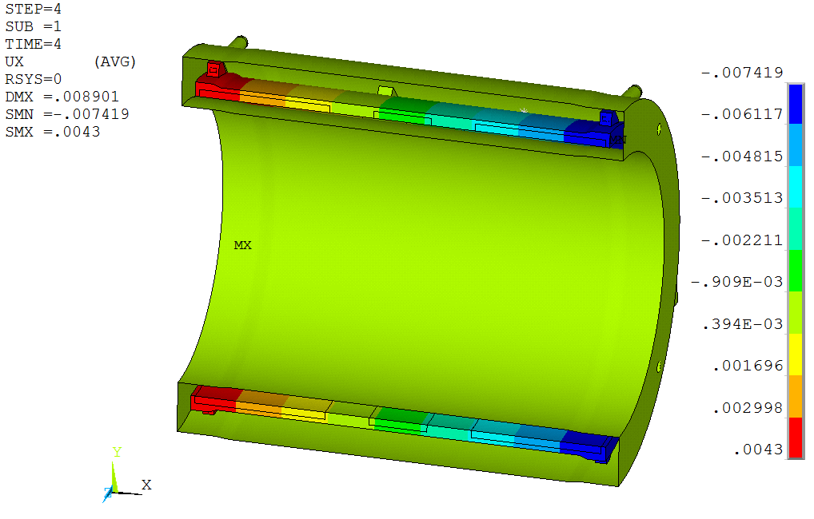
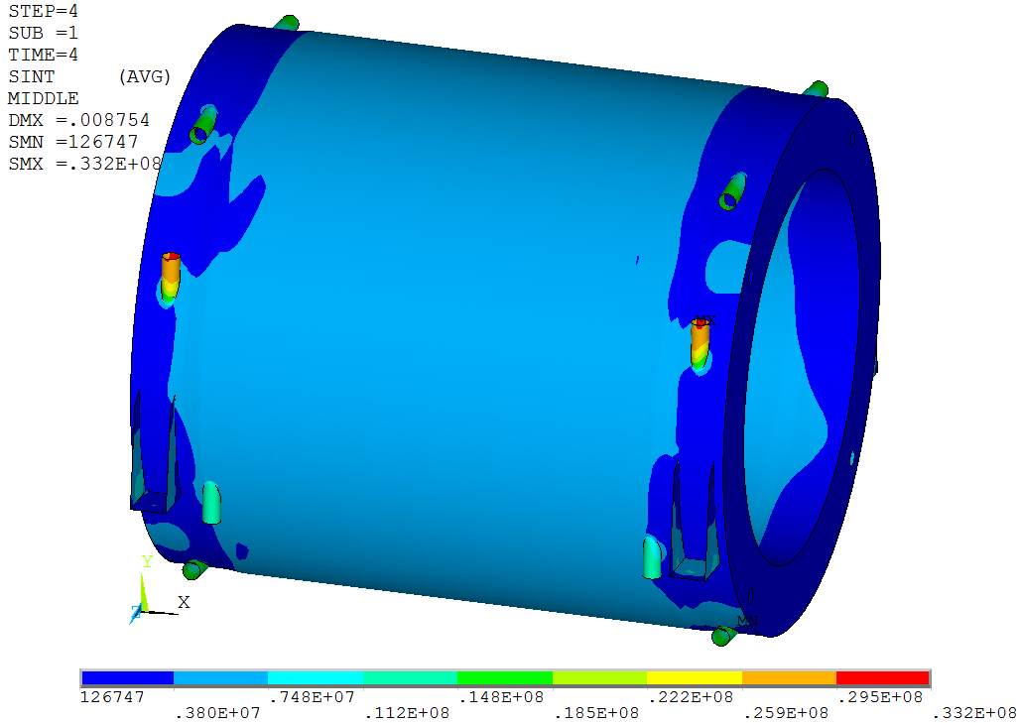
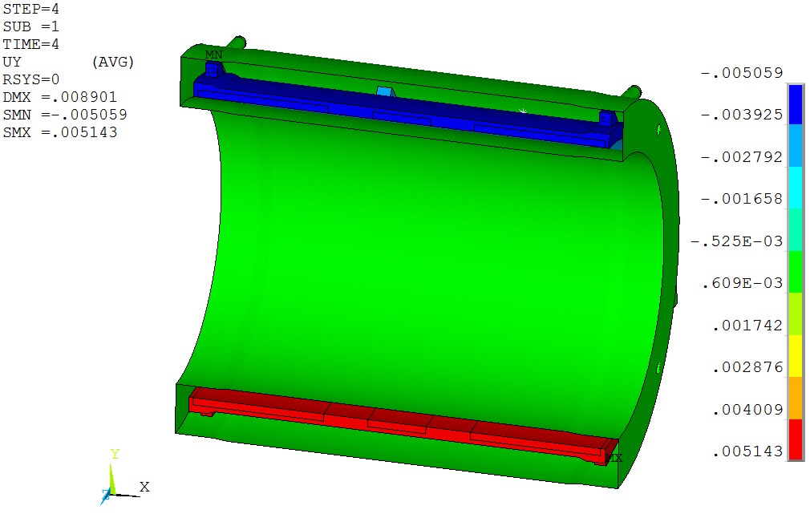
Deformations and stresses of the cryostat

Slide 22
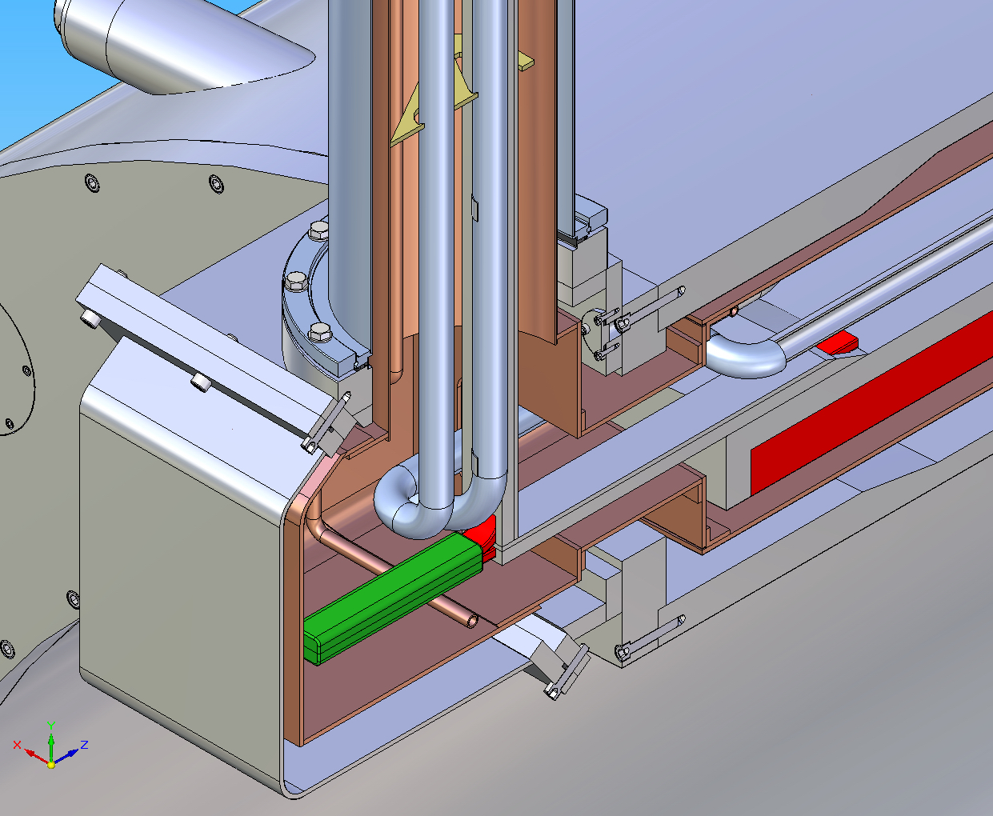
Cryostat interface box
Feeding LHe tube
Temperature intercept
Flexible connections of four pipes in the interface box.
The aluminium bars are connected in the interface box.
Flexible connections of the current buss bars with the current leads in the control Dewar.
Aluminium bars

Slide 23
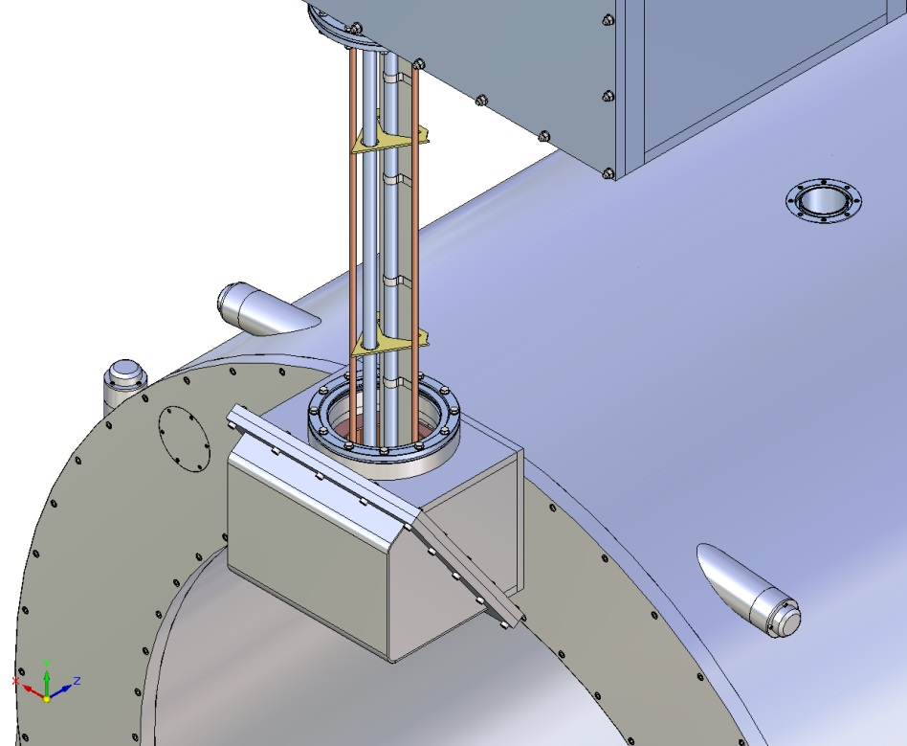
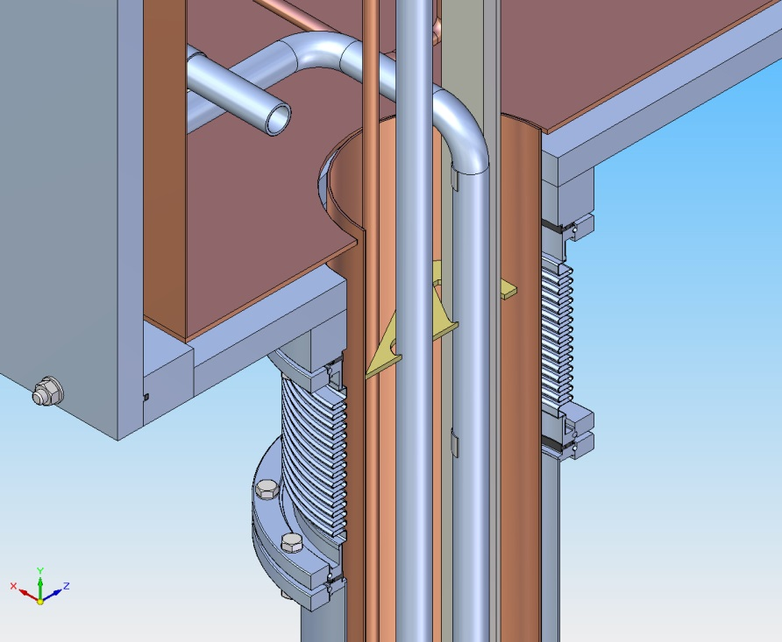
Chimney
Thermal screen of the chimney is fixated in the control box
The 77 K tubes are rigidly fixated to the thermal screen (the return tube is thermally connected with the screen)
Two 4.5 K tubes in chimney are rigidly connected with control Dewar piping and can slip relative the spacers in the chimney.
Feeding LHe tube provides heat interceptions on the aluminium bar by pure aluminium flexible tapes

Slide 24
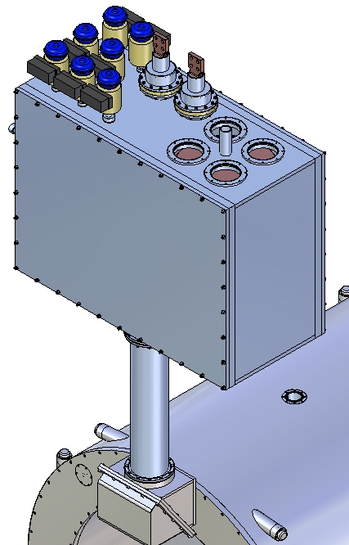
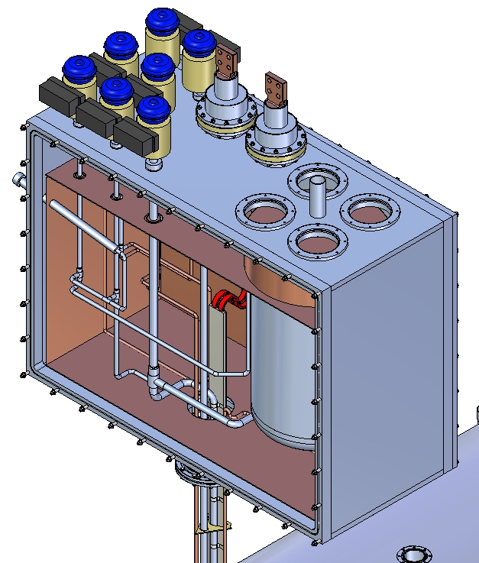
Control Dewar
CV5
CV9
CV4
CV2
CV1
CV8
CV3
Helium vessel volume 300 liters
Mass of the equipped Control Dewar and Chimney ~4000 kg

Slide 25
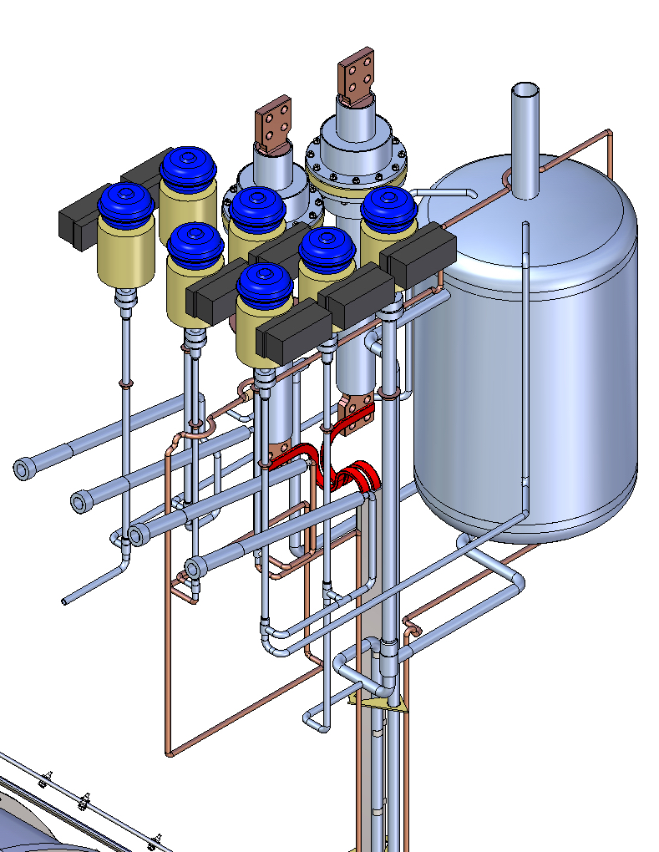
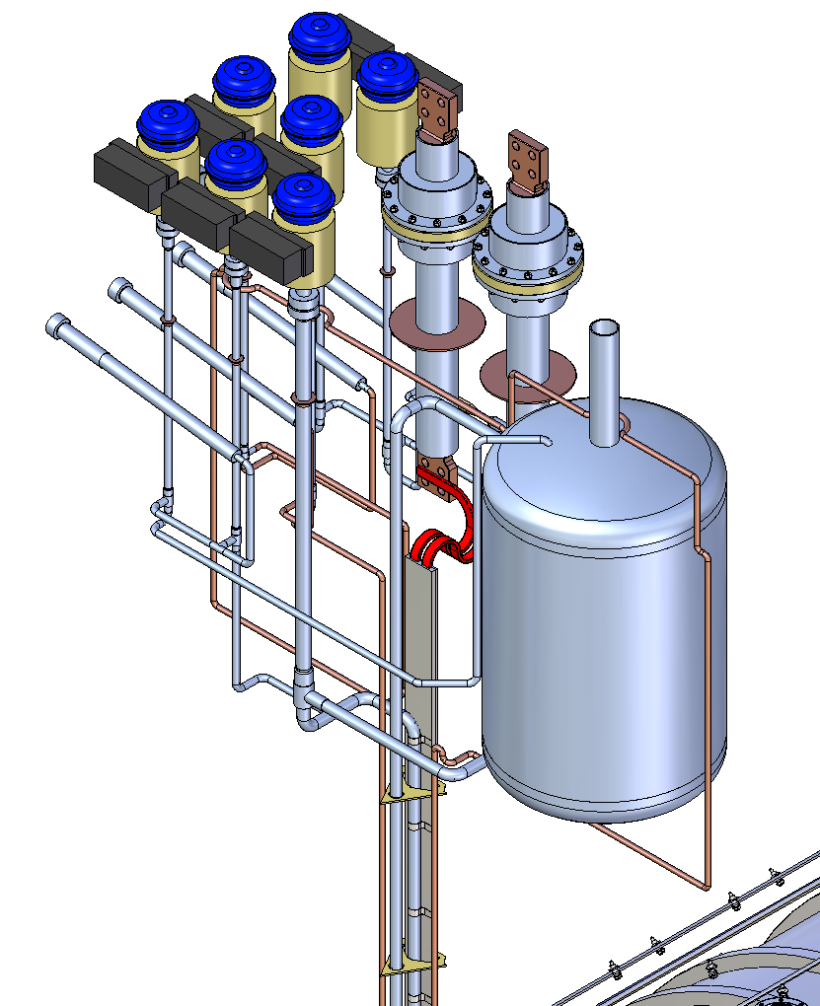
Valves and tubing of the Control Dewar
CV5
CV9
CV4
CV2
CV8
CV1
CV3

Slide 26
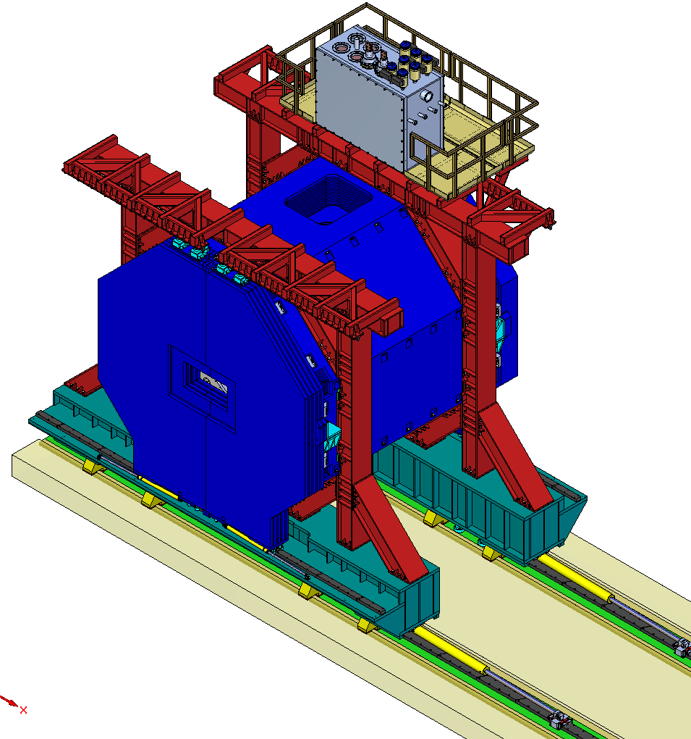
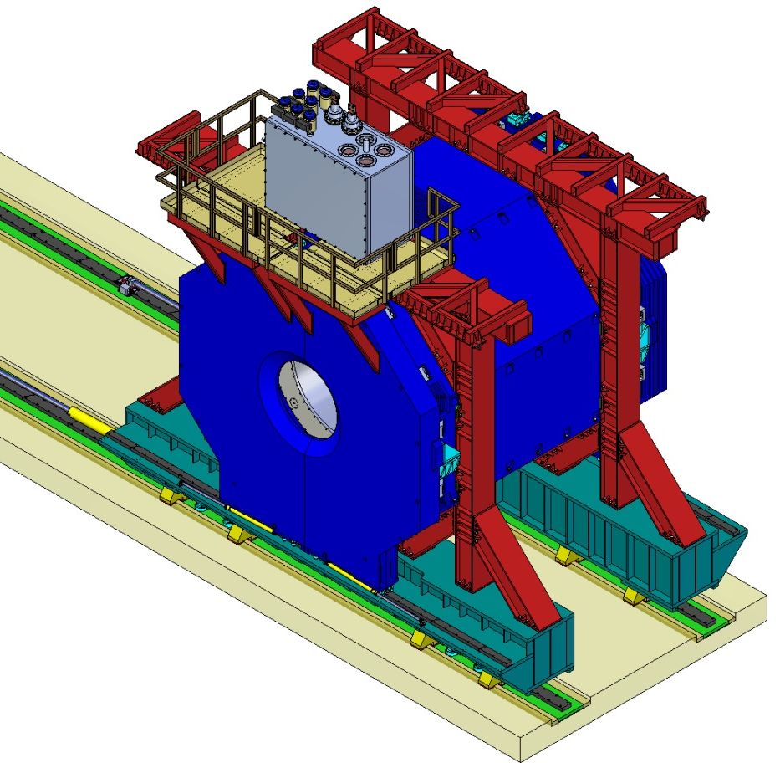
Assembled TS magnet

Slide 27
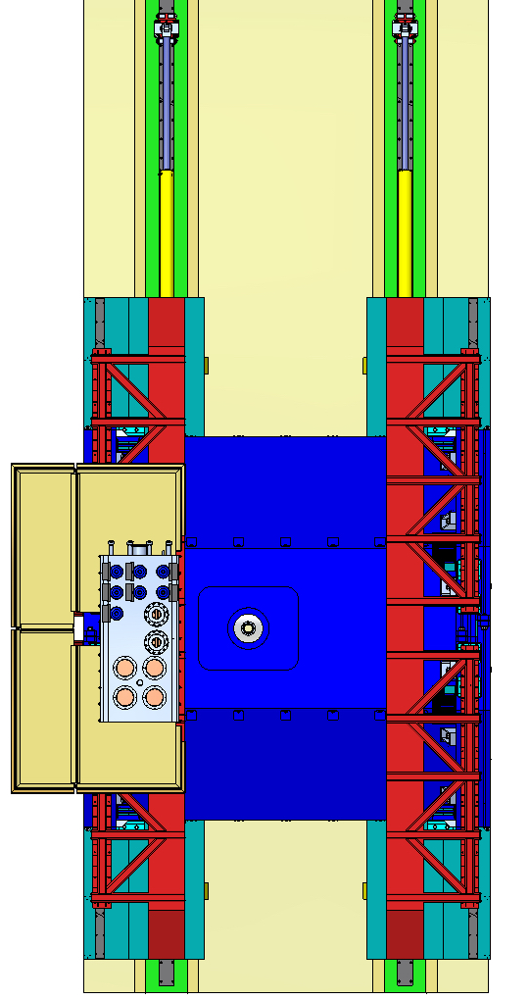
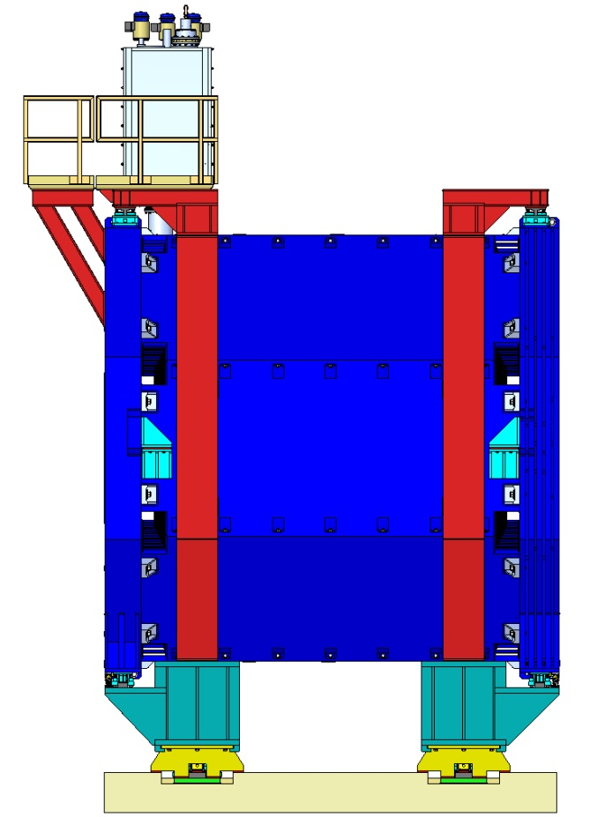
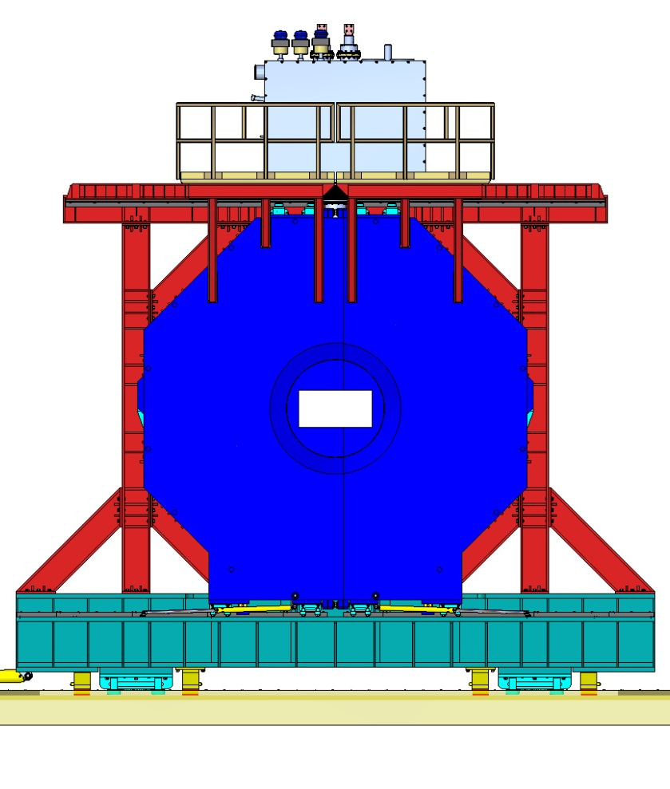
Assembled TS magnet

Slide 28
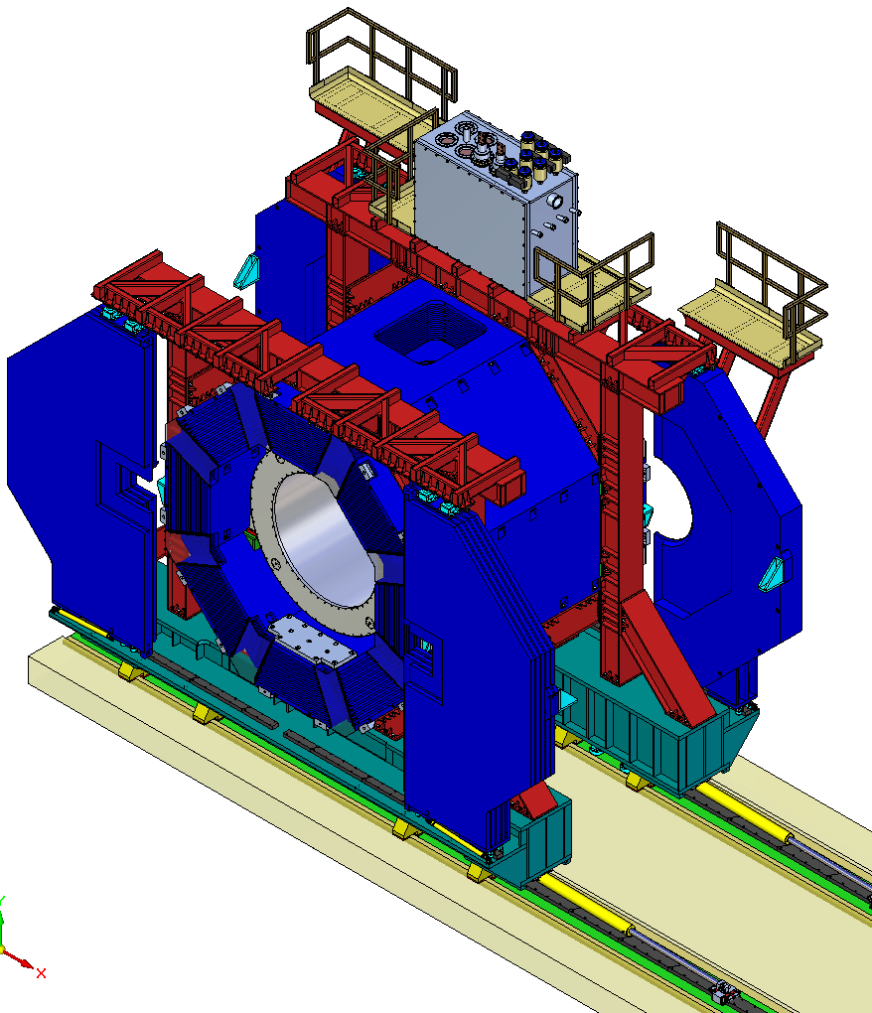
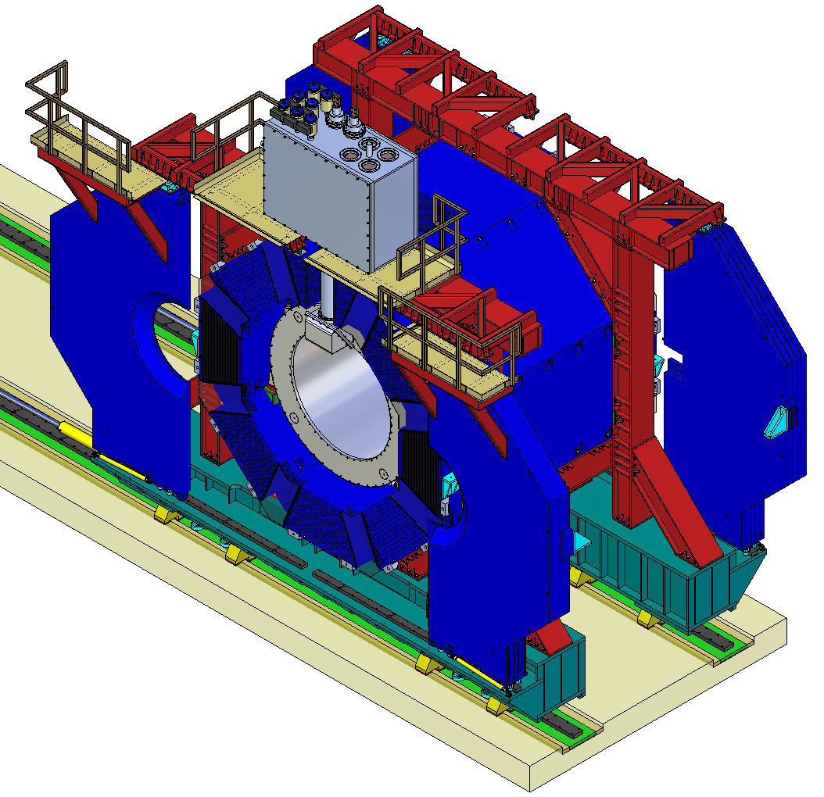
Assembled TS magnet (doors are opened)

Slide 29
Heat influxes to the cold mass and thermal shield
T=4.5 K | Thermal load, W
Radiation (0.07 W/m² x 44 m²) | 3.1
Heat intercepts of the coil supports | 2.1
Cryogenic chimney and Control Dewar | 10
Conductor joints | 3.5
Gas load | 1
Eddy current losses in the Al cylinder | 10
Total (normal/transit regime): | 19.7/29.7
With safety factor 2 | 39.5/59.5
Current leads (without safety factor)
without current | 6.2 (10 l/h)
with current | 10.5 (17 l/h)
T=60 K
Radiation (1.3 W/m² x 44 m²) | 57
Heat intercepts of the coil supports | 12.6
Shield supports | 115
Gas load | 2
Eddy current losses | 10
Wires | 1
Total: | 198
With safety factor 2 | 396

Slide 30
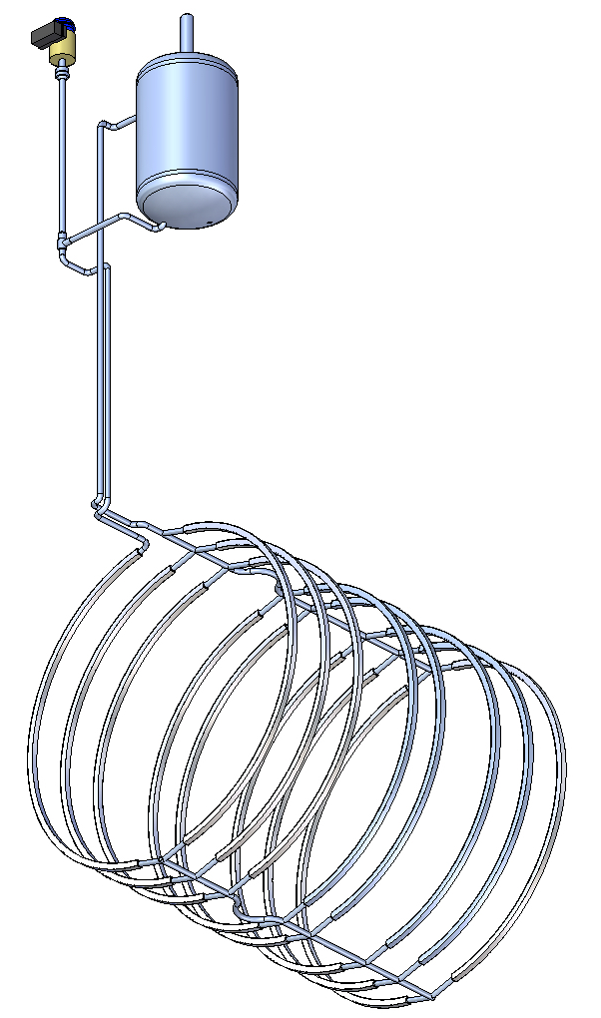
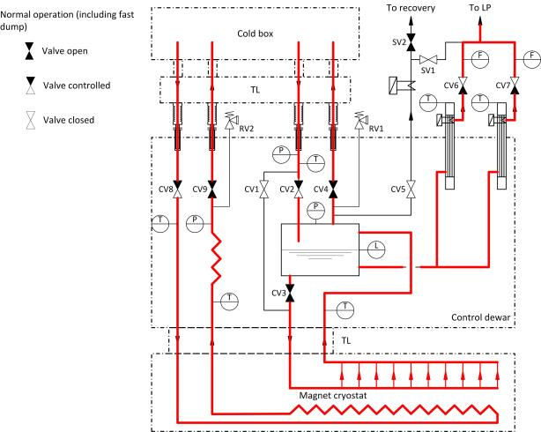
Natural circulation mode

Slide 31
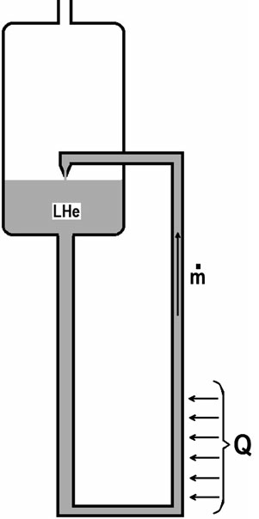
Natural circulation cooling
Schematic of a conventional natural circulation loop
Driving force
density of the liquid helium in the supply tube
mean density of the liquid-vapor mixture in the heated tube
mean density of the liquid-vapor mixture in the return tube
2. The driving force balances against the pressure drops (friction and fluid acceleration)
- the acceleration pressure drop
H3
(D₃, F₃)
H1
(D₁, F₁)
G – flow of the helium, kg/sec
- density of the saturated vapor helium, kg/m³
- density of the saturated liquid helium, kg/m³
- vapor quality at the outlet of the heated tube
- vapor quality at the inlet of the heated tube
H2
(D₂, F₂)

Slide 32
Friction pressure drop
Friction pressure drops in the supply tube and in the return tube
– friction factor in the supply or return tube for liquid helium
f_{i}=f (Re, G)
Friction pressure drop in the heated tube
- the two-phase friction multiplier
viscosity of the saturated liquid helium, Pa*s,
viscosity of the saturated vapor helium, Pa*s

Slide 33
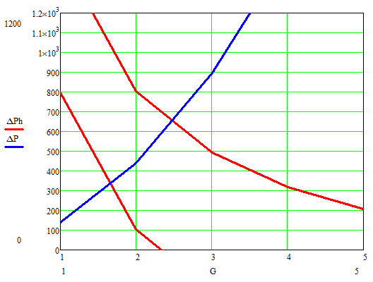
Computation of the mass flow rate circulated in natural convection mode
Flow for one rib of the heat exchanger
h_{LHe}=700 mm
(Pa)
h_{LHe}=100 mm
, g/sec
Total flux for all ribs in transient regime 38 g/sec (h_{LHe}=700 mm)
25 g/sec (h_{LHe}=100 mm )

Slide 34
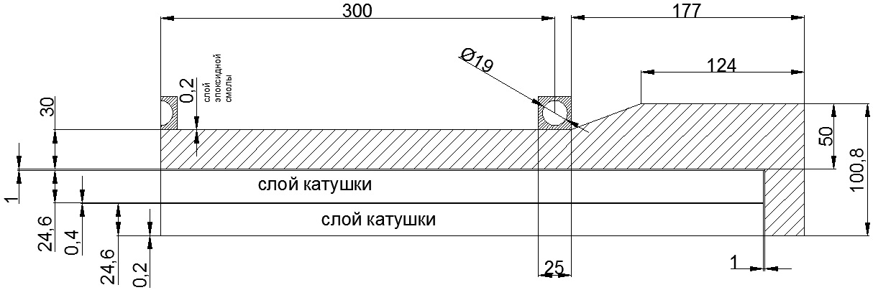
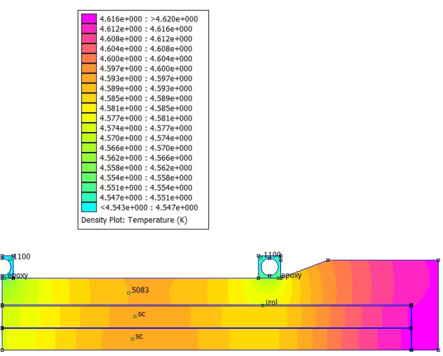
Maximal temperature in the superconducting coil
The maximum temperature
of the superconducting coil 4,62 K
in the steady state regime at
Minimal level of LHe in the bath

Slide 35
Optimization of the cooling efficiency
№ | Mode of solenoid operation | Heat influx to the cold mass, W | Sizes of the heat exchanger rib, mm | Level in helium bath, mm | Helium mass flow in a rib, g/s | Maximal temperature in the coil, K | Temperature increase, above 4.5 K, K | Temperature drop on the glue connection of a rib, K
 | Steady state | 19.5 | 15x15, d=10 | 100 | 0.6 | 4.64 | 0.14 | 0.04
 |  |  |  | 700 | 0.8 | 4.63 | 0.13 | 0.04
2. | Steady state | 19.5 | 25x25, d=19 | 100 | 1.0 | 4.62 | 0.12 | 0.03
 |  |  |  | 700 | 1.8 | 4.61 | 0.11 | 0.03
3. | Current ramping | 39.5 | 15x15, d=10 | 100 | 0.75 | 5.05 | 0.55 | 0.16
 |  |  |  | 700 | 0.95 | 5.04 | 0.54 | 0.16
4. | Current ramping | 39.5 | 25x25, d=19 | 100 | 1.65 | 4.96 | 0.46 | 0.10
 |  |  |  | 700 | 2.5 | 4.94 | 0.44 | 0.10

Slide 36
Factors influencing the efficiency of the coil cooling
Bigger rib side of the heat exchanger provides smaller temperature drop in the coil. Increase of the rib side from 15 to 25 mm gives decrease of the temperature drop to 23%.
Temperature rise in the coil grows proportionally the thickness of the glued connections of the ribs. For a thickness of 0.2 mm it can reach 20-30% of the temperature rise
Variations of the level in the helium vessel (from 100 mm to 700 mm) has practically negligible effect on the maximum winding temperature.

Slide 37
Parameters of the helium fluxes in the transfer lines from refrigerator
Object | Stream | Parameters | Regimes
 |  |  | Steady-state (normal operation) | Cool-down/ Warm-up | Slow dump (refrigerator failure)
Cold mass | Incoming flow | Gas/liquid | saturated liquid | helium gas | -
 |  | Flow | 3.8 g/s (107 l/h) | 5 g/s | -
 |  | Temperature | 4.5 К | 300 – 4.5 К | -
 |  | Pressure | 1.3 bara | ≤ 10 bara | -
 |  | Vapor quality | < 5 % | - | -
 | Return flow | Gas/liquid | saturated vapor | helium gas | -
 |  | Flow | 3.2 g/s | 5 g/s | -
 |  | Temperature | 4.45 К | 300 – 4.5 К | -
 |  | Pressure | 1.25 bara | ≈ 1.5 bara | -
Current leads | Return flow (to compressor suction) | Gas/liquid | helium gas | - | helium gas
 |  | Flow | 0.6 g/s (17 l/h) | - | 0.6 g/s (17 l/h)
 |  | Temperature | ≈ 300 К | - | ≈ 300 К
 |  | Pressure | 1.25 bara | - | 1.25 bara
Thermal shield | Incoming flow | Gas/liquid | helium gas | helium gas | -
 |  | Flow | 1.0 g/s | up to 2.5 g/s (6 bar) | -
 |  | Temperature | 40 К | 300 – 40 К | -
 |  | Pressure | 2 bara | 6 bara | -
 | Return flow | Gas/liquid | helium gas | helium gas | -
 |  | Flow | 1.0 g/s | - * | -
 |  | Temperature | 80 К | 300 – 80 К | -
 |  | Pressure | 1.4 bara | ≈ 1.5 bara | -
Recovery line | Return flow | Gas/liquid | - | - | helium gas
 |  | Flow | - | - | 3.0 g/s
 |  | Temperature | - | - | 4.45 К
 |  | Pressure | - | - | 1.25 bara

Slide 38
THANK YOU
FOR YOUR ATTENTION!

Slide 39


PANDA Target Spectrometer

Slide 40

PANDA magnet in the experimental building (in-beam and in-parking positions)
LHe transfer line
Cold box of the liquefier and Buffer Dewar
Helium compressor
Radiation shield

Slide 41

Space allocated for the Control Dewar
Radiation shield
2345

Slide 42


Slide 43


Control Dewar. Sizes for computation of the thermo-siphon

