Slide 1
Oleksiy Dolinskyy
23rd October , 2014
The Collector Ring project at FAIR

Slide 2
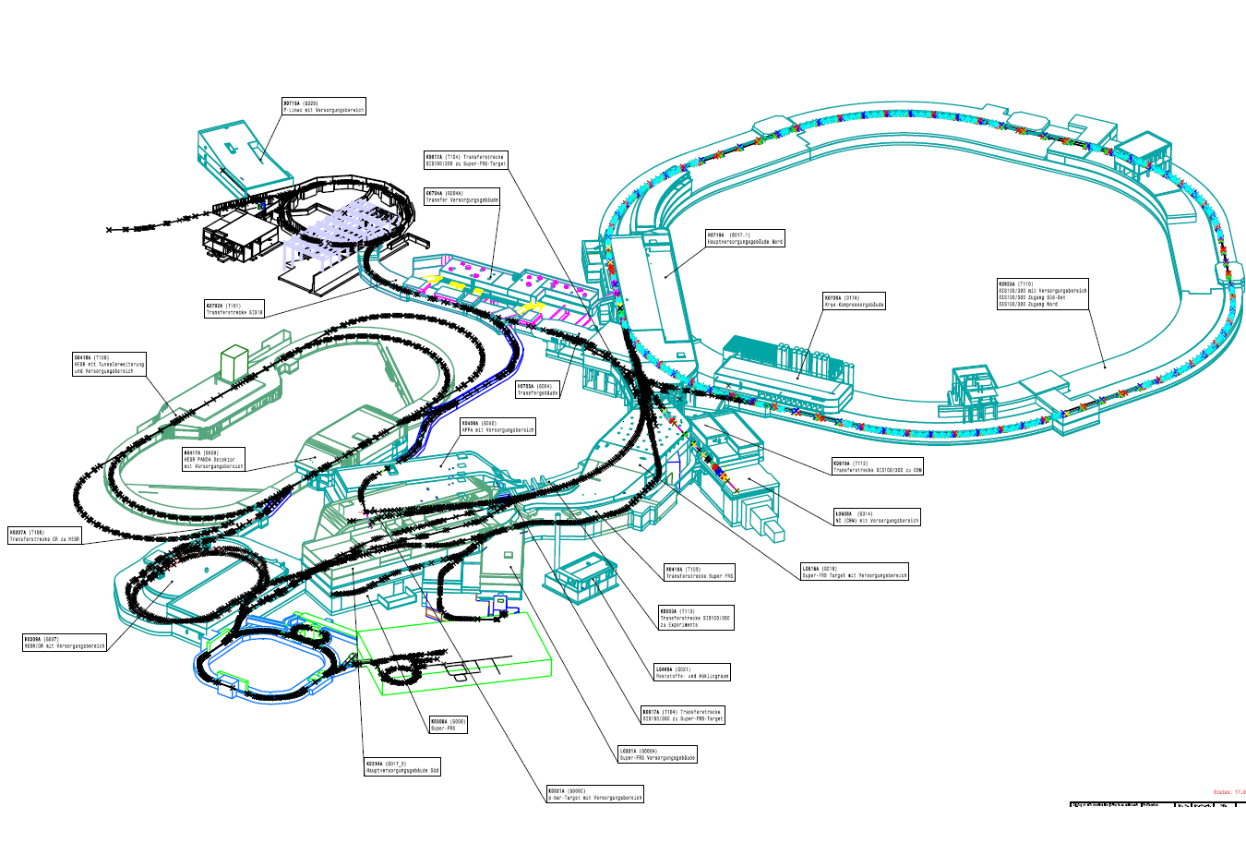
FAIR layout of accelerators
Collector Ring

Slide 3
Outline
Why do we need the Collector Ring.
The features of this ring.
Present layout.
The main components.
Experimental devices.
Present status and plans.

Slide 4
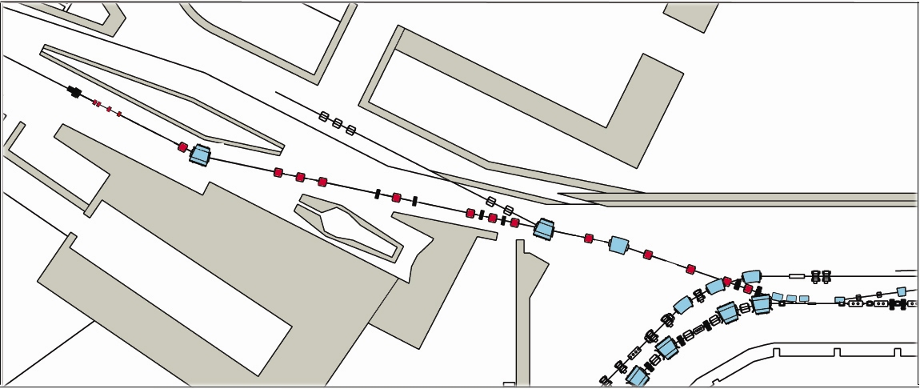
Beams from separators
Secondary ions are needed for experiments
antiprotons (pbar)
radioactive ion beams (RIB)
29 GeV protons from SIS100
740 MeV/u RIBs
From the SupeFRS
target station
3 GeV antiprotons
CR

Slide 5
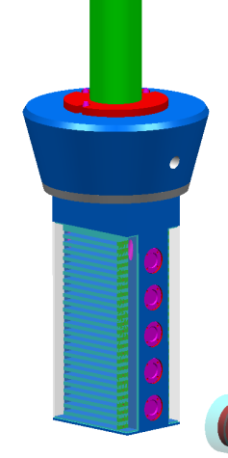
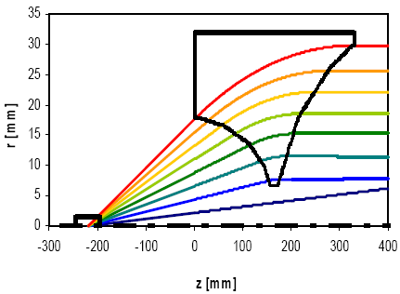
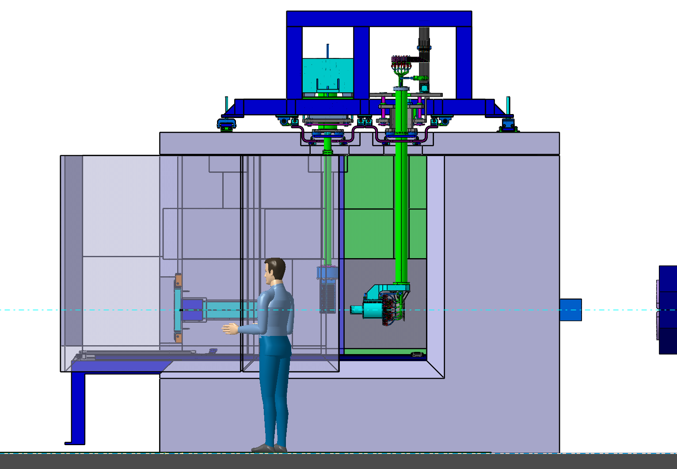
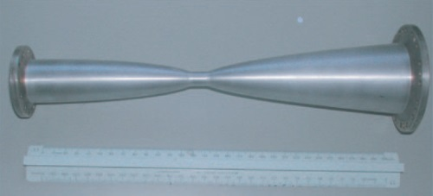
Target station for antiproton production
Ti window
inside: Ni rod (r = 15 mm, L = 10 cm) within graphite cylinder (r = 1 cm)
target
20 mrad < θ < 80 mrad can be collected
I = 400 kA
Distance target center - lens: 220 mm
more simple and reliable, less expensive
29 GeV Protons from SIS100
antiprotons
First quadrupole
of separator
horn

Slide 6
Production yield of antiprotons
Phase space after horn lens
pbars in the ellipse
yield =
primary protons
11 cm Ni target (d = 3 mm) in a graphite container, 0.62 mm (rms) beam spot.
240 mm mrad
E(p), E(pbar) | 29 GeV, 3 GeV
acceptance | 240 mm mrad, 6%
protons / pulse | 10¹³
pulse length | single bunch (50 ns)
cycle time | 10 s
Less then 7 % of produced particles on the target can be trapped by the pbar separator and the CR

Slide 7
Production yield of antiprotons
Simulations predict a yield of 2 × 10⁻⁵ pbar/p.
( For 10¹³ protons one gets 2x10⁸ pbars (only target/horn))
Considering 50% of losses due to nonlinear beam dynamic of pbar-separator and the CR one expects 10⁸ pbars in a single bunch.
Pbar beams have huge momentum spread (6%)and emittance (240 mm mrad)
For PANDA experiments in the HESR 10¹¹ pbars are required.
3 order of magnitude of pbars must be somewhere accumulated.
Before accumulation the beam must be cooled.
For beam cooling the CR will be used.
For accumulation the RESR was planned.
In this context the storage ring complex was planned:

Slide 8
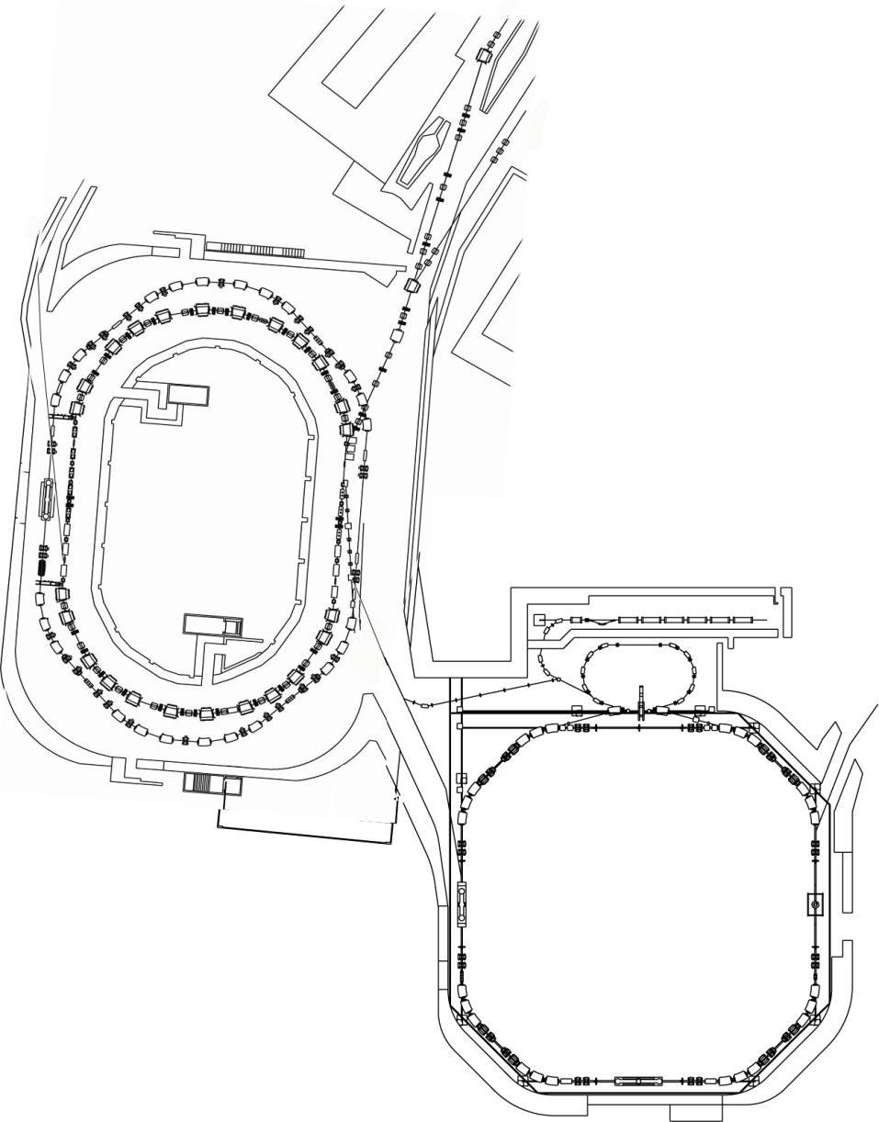
Storage Rings of the FAIR
Super-FRS
Separators
Production and delivering of pbar and RIBs to the CR
CR – Collector Ring
fast pre-cooling of the hot ion beams
RESR – Recycled Experimental Storage Ring
accumulation of antiproton beams
fast deceleration of rare isotopes
NESR – New Experimental Storage Ring
experiments with stored ion beams
deceleration of antiproton beams
Pbar-separator
RESR
CR
BR=13 Tm
NESR

Slide 9
accumulation of pbars
In MSV 0-3 of FAIR project the RESR and NESR will not be build
The cooled beams from the CR will be transferred directly to the HESR, where the accumulation takes place.
Because of the small momentum acceptance of HESR only 10¹⁰ pbars will be accumulated.

Slide 10
Main task of Collector Ring
- Fast pre-cooling of the hot ion beams coming from separators
- The ring has been designed specially to have efficient cooling of the very hot ions

Slide 11
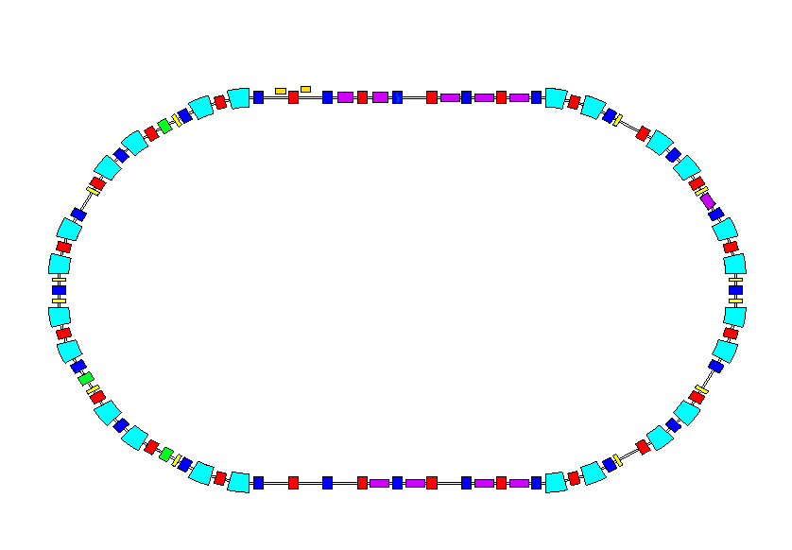
Tasks of the CR
1. Cooling of secondary beams of radioactive ion beam (RIB)
ε⊥=200 mm mrad
Δp/p=3 %
CR
ε ⊥ ≤ 0.5 mm mrad
Δp/p ≤ 0.05 %
Injection RI beams from the Super-FRS
extraction RI beams to the HESR
 1.5 sec
2. Cooling of antiproton beams (Pbar)
CR
ε ⊥ ≤ 5 mm mrad
Δp/p ≤ 0.1 %
ε⊥ =240 mm mrad
Δp/p=6 %
extraction Pbar to the HESR
Injection from antiproton separator
 10 sec
3. Mass spectrometer of radioactive ions RI (TOF)
CR
ε ⊥ =100 mm mrad
Δp/p=1 %
Δf
Injection RI beams from the Super-FRS
 few turns

Slide 12
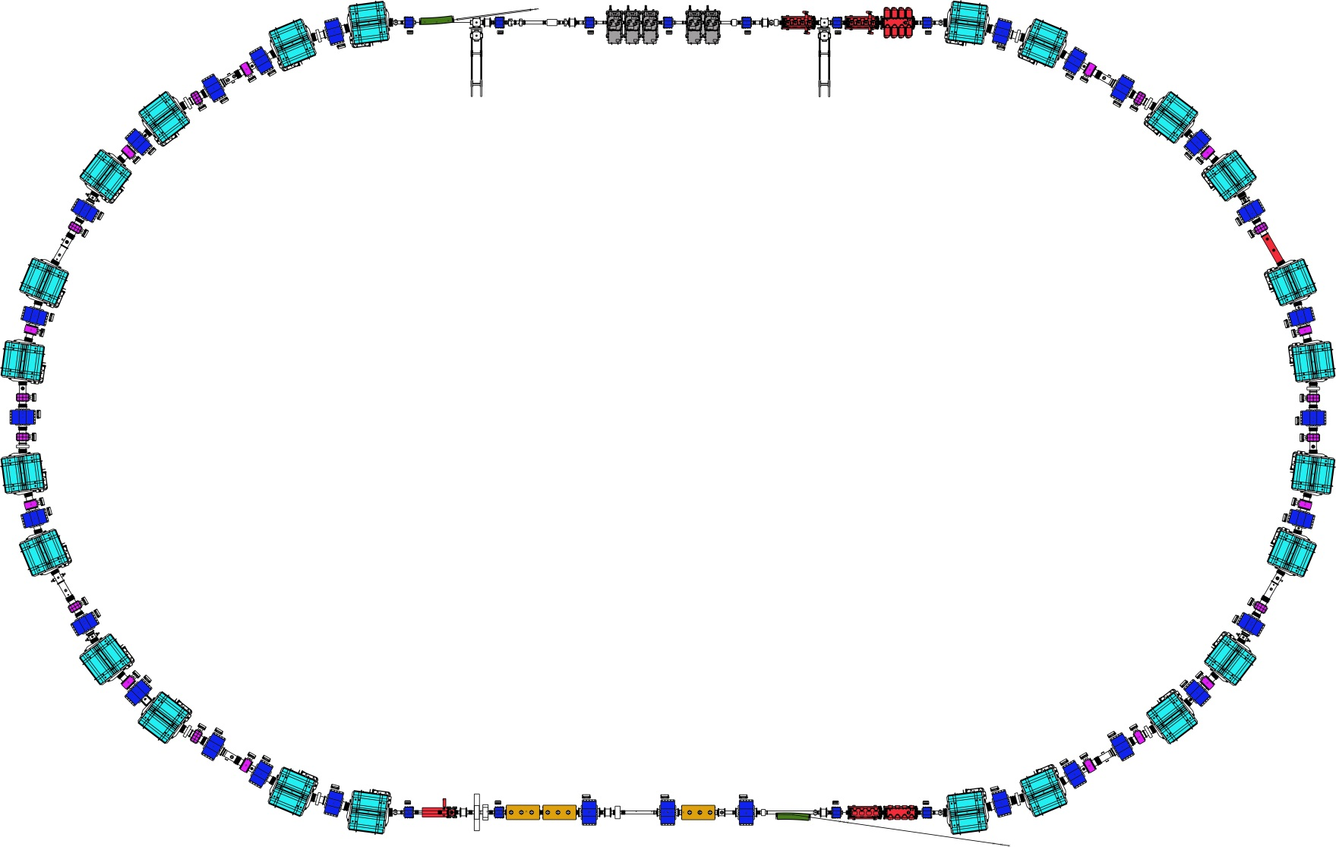
Present layout of the CR and main components
RF – cavities
Stochastic cooling
Pick-Up
Injection Kicker
magnets
Stochastic cooling
Kickers

Slide 13
The basic features of the CR
The large momentum (up to 6%) and transverse (up to 240 mm*mrad) acceptances require large aperture magnets (up to 400 mm).
Operation at the static maximum filed level corresponding to the bending power of Bρ=13 Tm.
It is dedicated ring, which design is optimized to perform fast cooling.
4. Using the same hardware the cooling system is build for cooling of both antiproton and heavy ion beams.
5. Mass measurement in isochronous mode operation.
6. Variability of the optics at ring. Three basic optics are applied.

Slide 14
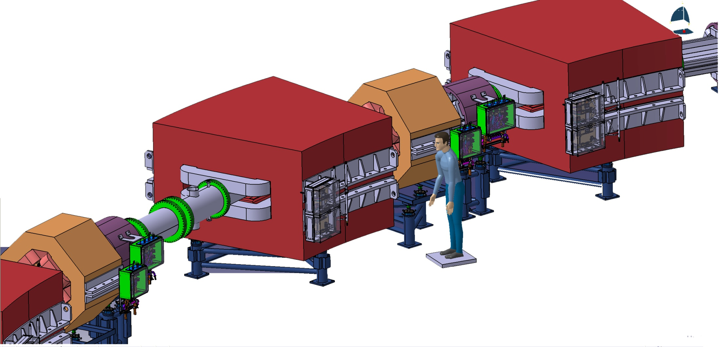
CR magnets in arcs
The BPM is embedded in the wide aperture quadruople magnet
The Vertical corrector coil is embedded in the sextupole. The technical design is under development. 3 mrad kick strength is required.

Slide 15
CR for cooling
CR is designed to have optimal cooling for all ions using the same hardware
The cooling is performed by two steps:
1. Fast bunch rotation to reduce only the
momentum spread by factor of 3.
2. Stochastic cooling to reduce both the
momentum spread and transverse beam
emittance.

Slide 16
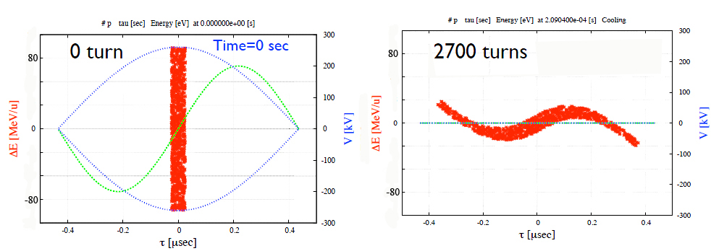
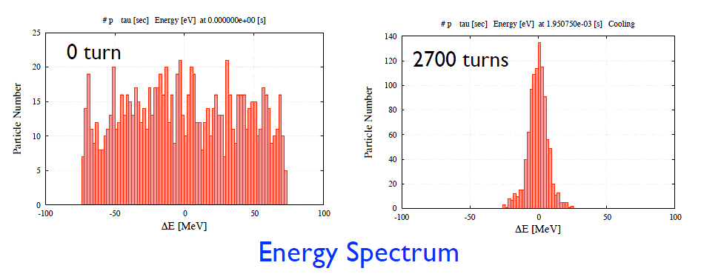
First step of cooling-
RF bunch rotation
Using bunch rotation RF cavity the momentum spread is reduced
from 6% to the less than 2%. Time of such cooling is about 3 ms
Δp/p=6%
Δp/p=2%
Δp/p=6%
Δp/p=2%

Slide 17
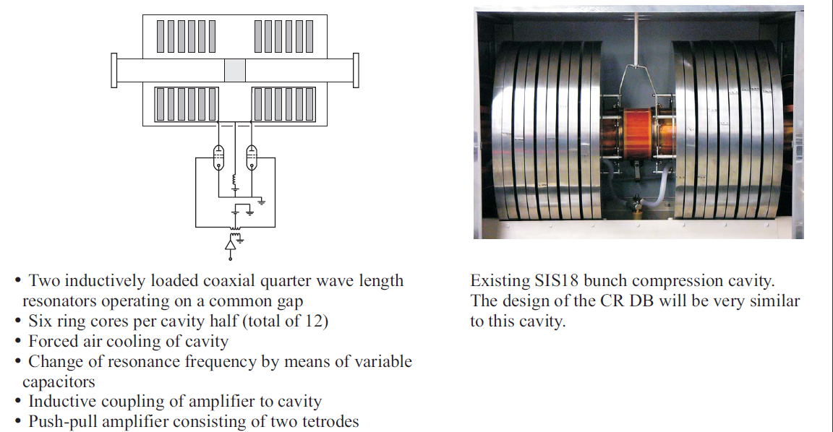
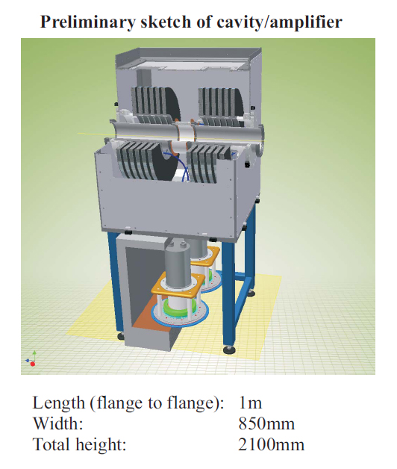
RF Cavity for bunch rotation
Total voltage (5 cavities) | 200 kV
Peak voltage per cavity | 40 kV
Peak dissipation per valve | 393 kW
Peak dissipation per valve into ring cores | 648 kW
Peak power per valve | 1040 kW

Slide 18
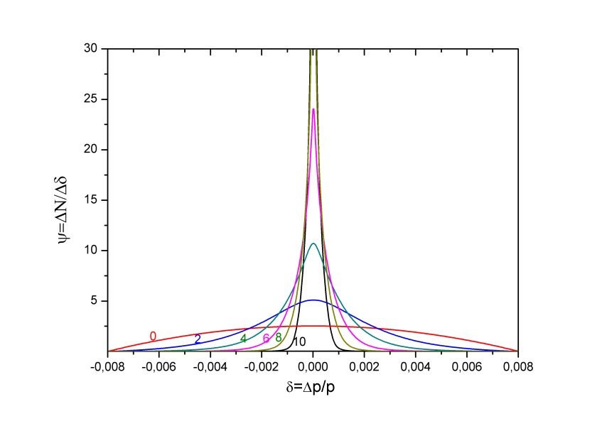
Second step of cooling-
Stochastic cooling
After bunch rotation Stochastic cooling is applied to reduce
both the beam emittance and momentum spread
Momentum spread is reduced from 2% to 0.1%
Cooling time for antiproton beam is about 10 s

Slide 19
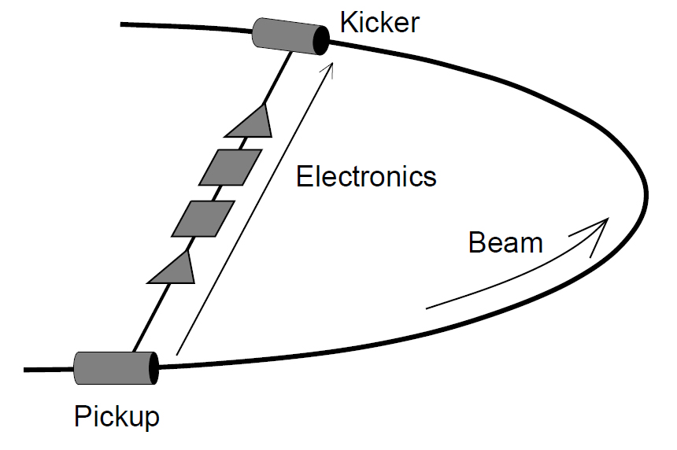
Stochastic cooling
Pickup – to detect the beam parameters
(Energy deviation with respect to the reference energy; transverse deviation with respect to the reference orbit )
Kicker – to correct: the energy; particle angle.
Electronics – to proceed the signal, (amplify and transfer to the kicker)
There are specific requirements to the ring
to have efficient cooling:

Slide 20
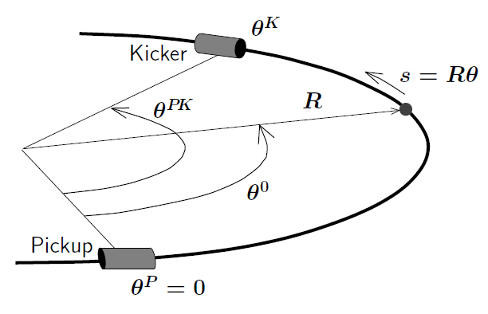
Stochastic cooling
Phase advance must be 90⁰ or plus
a multiple of 180⁰.
On can say:
The quantum number of a phase between Pickup and Kicker is required.
This is one of the main requirements to
storage ring to cool ion in the transverse
phase space.
n=0,1,2…

Slide 21
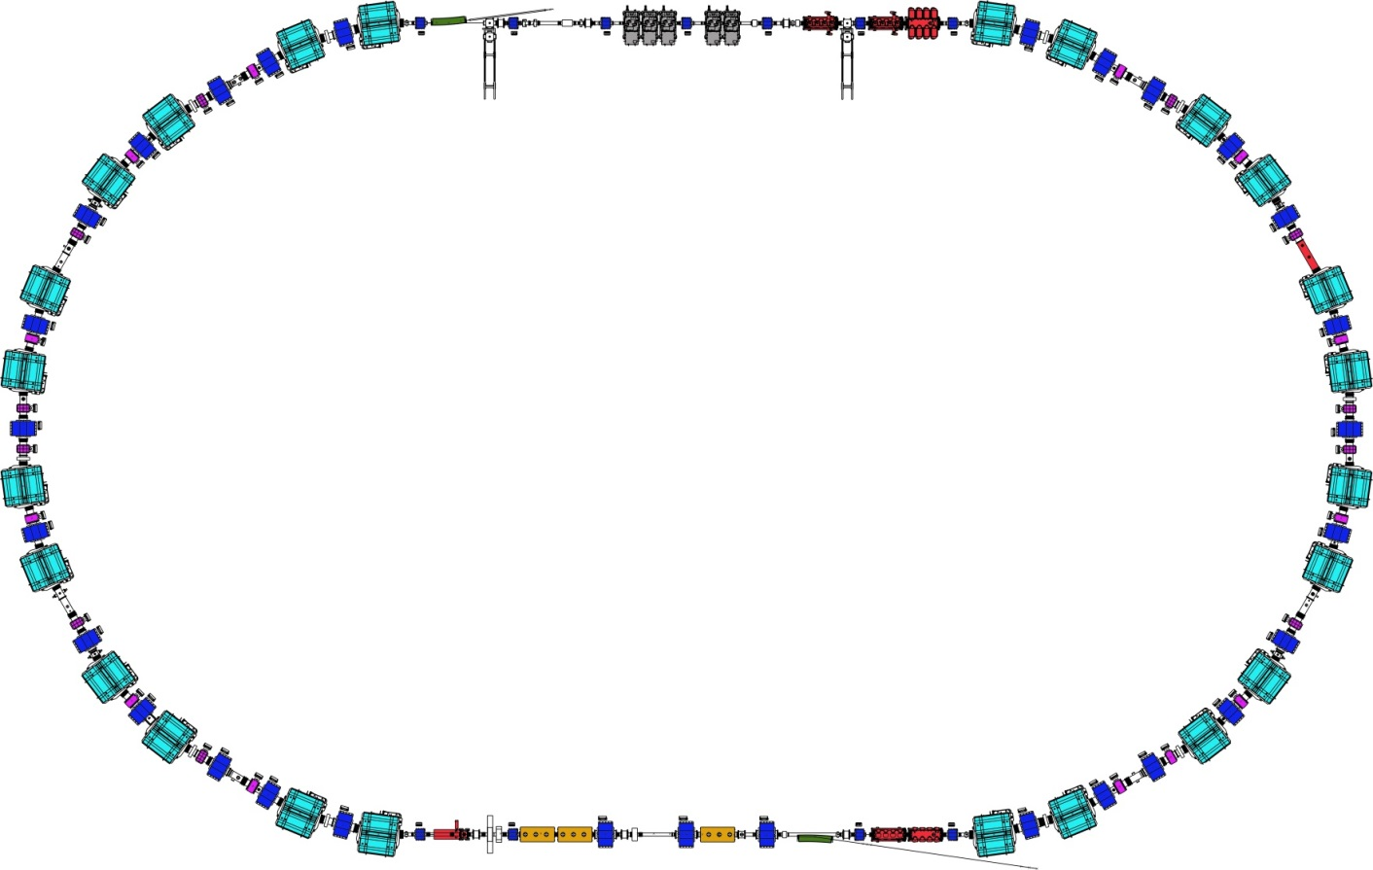
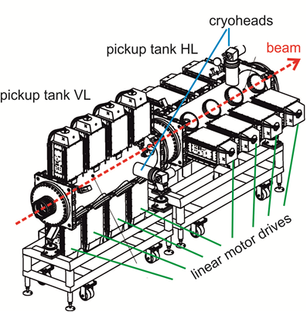
Stochastic cooling in the CR
Filter cooling PU (1-2 GHz)
Palmer cooling PU
Good mixing
Bad mixing
CR upgrade: 2-4 GHz cooling system
η=0.01 (pbars)
η=0.18 (RIBs)
η=0.0 (Isochron)
The CR is designed to have required η parameter both for antiproton and RIB beams. Optic and positions of PU and KI are optimized to have required phase advances between all pairs of PU-KI.

Slide 22
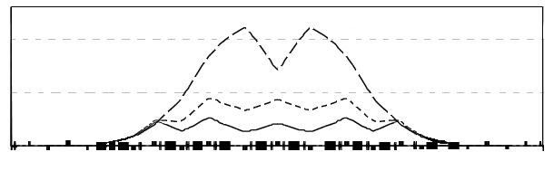
CR: Requirements to the rings optics
The ring lattice should be adjustable to different slip factors (gamma-tr).
dispersion function over a half of the ring
Rib mode (gamma-tr=2.7), gamma=1.8
Pbar mode (gamma-tr=3.8) gamma=4.2
Isochronous mode (gamma-tr=1.8, gamma=1.8
0 10 20 25
D_{x} (m)
0
path length s (m)
111
pick-up
kicker
One needs 13 independent power supplies for quadrupole magnets to have
a flexibility in optic variation

Slide 23
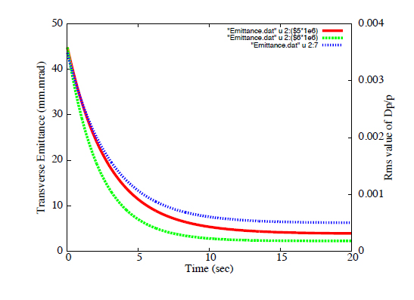
Stochastic cooling
Evolution of the Rms values of the Emittances and Momentum spread during SC cooling in the CR for the antiproton beam
Cooling time
Δp/p
Rms Emittance
ε_{x,y}

Slide 24
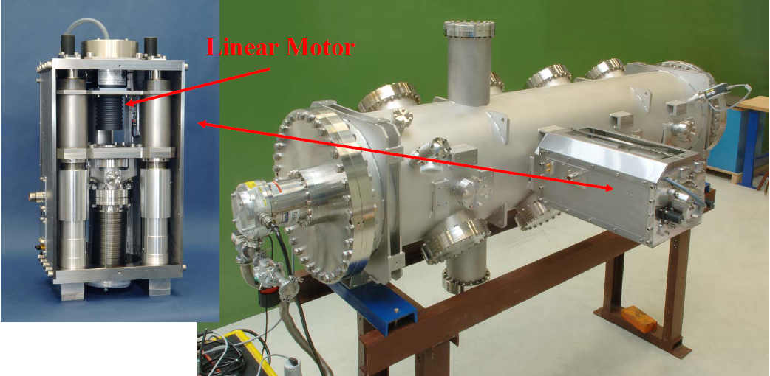
Stochastic cooling:
Prototype Pickup tank at GSI

Slide 25
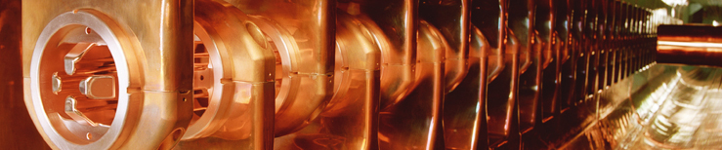
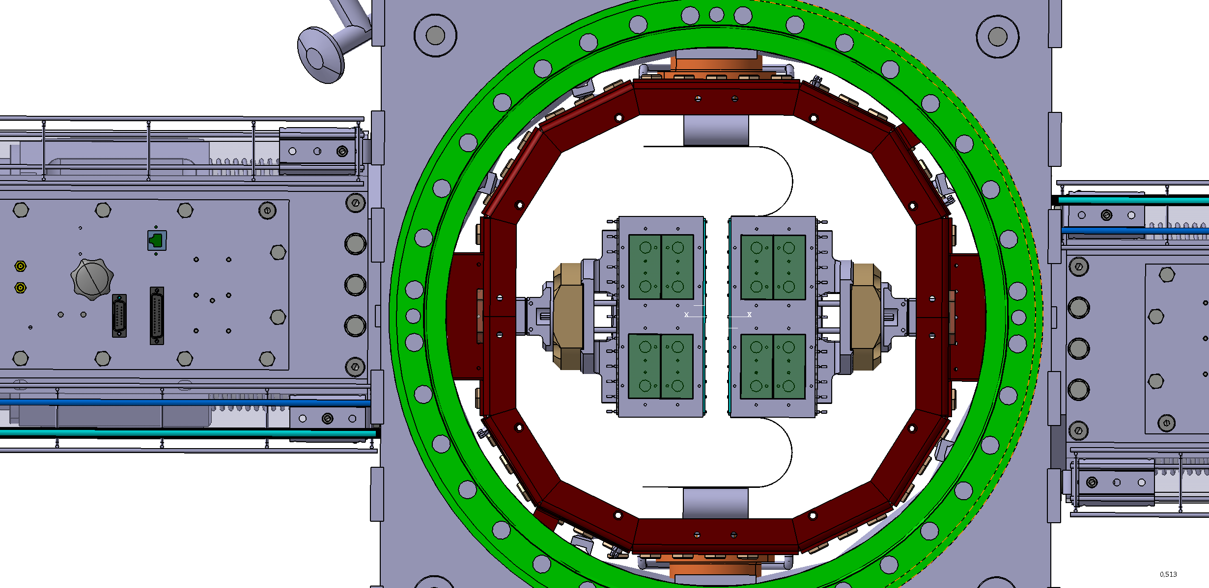
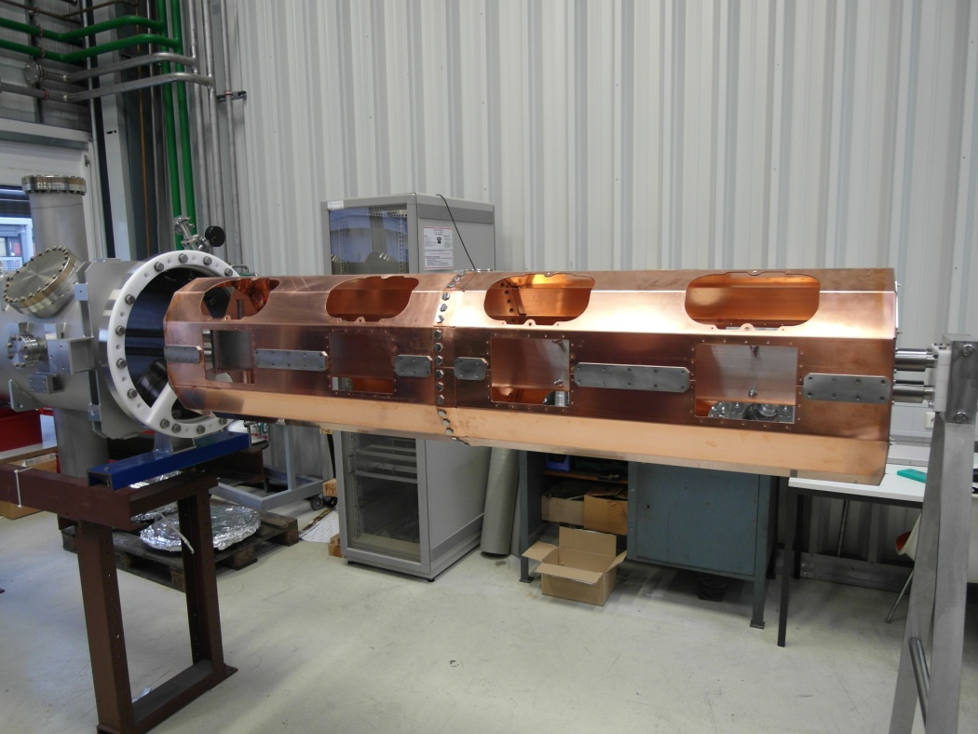
CR Stochastic cooling:
Prototype Pick-up tank at GSI
technical challenge cryoshield:
made of oxygen-free copper,
gilded galvanically
to reach very low thermal emmissivity
(expected < 2% from measurements
performed on speciments in our lab)
Electrode
double-module
flexible BeCu
sheet at 30 K
Motor
drive
unit
cryoshield at 80 K
Cu-cryoshield succesfully mounted
in the prototype pick-up tank
Fall 2013: gilding of the cryoshield by contractor
4 half-shells, each 1 m long

Slide 26
Other CR main components:
Dipole magnets
Quadrupole magnets
Sextupole magnets
Experimental devices

Slide 27
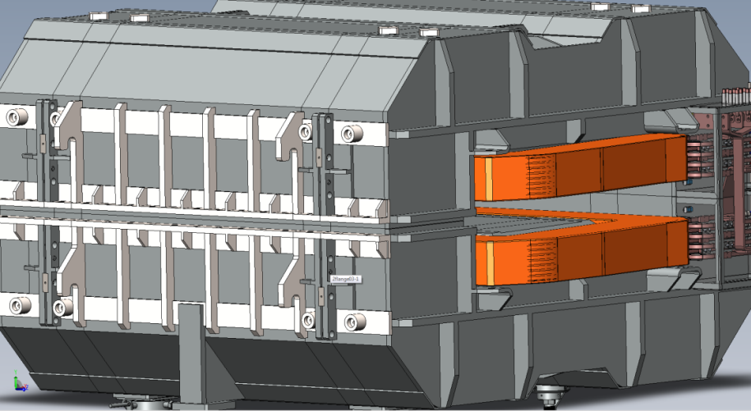
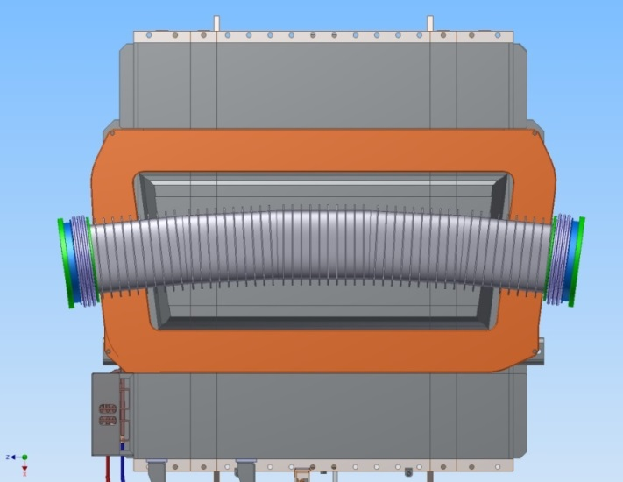
Dipole magnet and its vacuum chamber
  The final specifications for the laminated dipole magnets has been agreed with BINP experts and officially approved. The contract between FAIR and BINP for the dipole production can be established.
  The preliminary specifications for dipole vacuum chamber have been prepared.

Slide 28
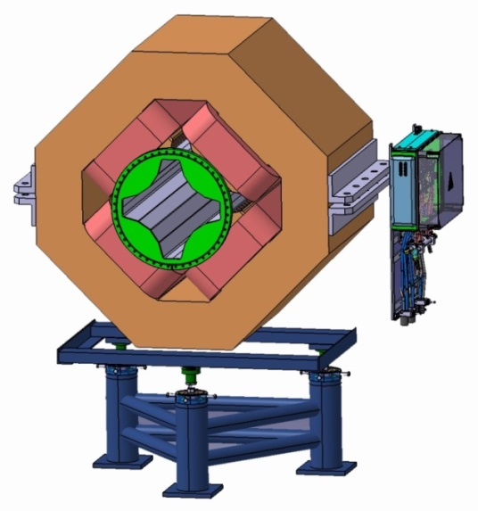
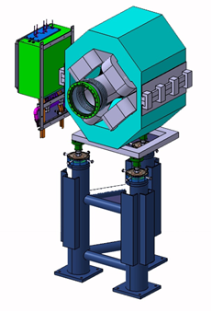
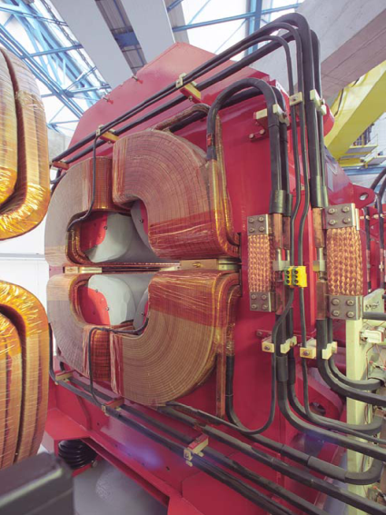
CR planned quadrupole
ESR quadrupole | Long | Short
effective length | 1.27 m | 0.83 m
Pole radius | 150 mm | 150 mm
horizontal aperture | 300 mm | 300 mm
vertical aperture | 300 mm | 300 mm
Maximum gradient | 6.2 T/m | 6 T/m
CR quadrupole | wide | narrow
effective length | 1 m | 0.5 m
Pole radius | 156 mm | 95 mm
Required horizontal aperture | 400 mm | 180 mm
Required vertical aperture | 180 mm | 180 mm
Maximum gradient | 4.9 T/m | 9 T/m

Slide 29
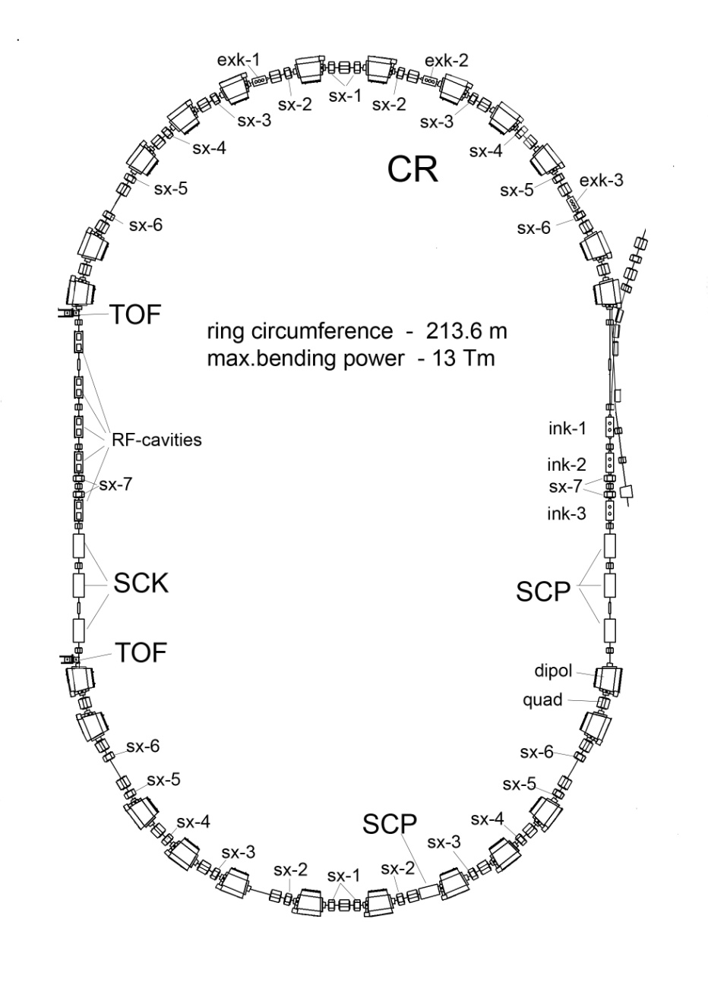
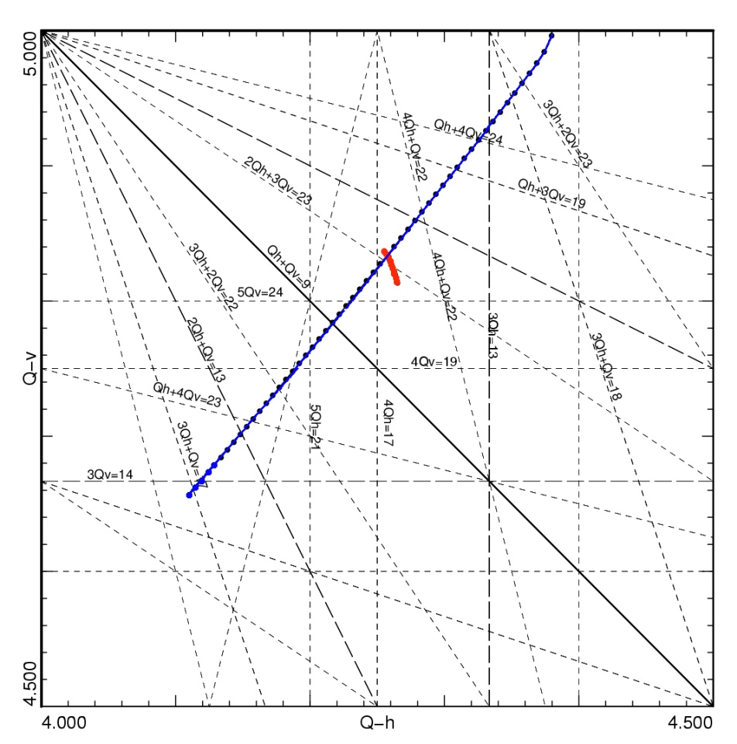
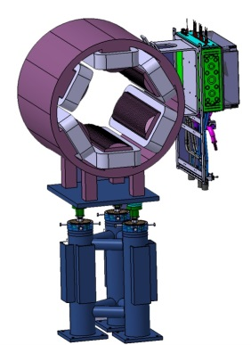
Sextupole magnets for
nonlinear correction
24 sextupole magnets (6 families) are needed for :
* Chromaticity correction
* Control of the dispersion function
* Avoiding synchrobetatron coupling
8 octupole correctors (2 families )
for minimizing of the fringe field effect of quadrupoles in the isochronous mode operation
24 sextupole magnets
(6 families)
without correction
after correction
ΔQ_{h,v}≈ 0.02 in Pbar mode
ΔQ_{h,v} ≈ 0.02 in RIB mode

Slide 30
Experimental devices

Slide 31
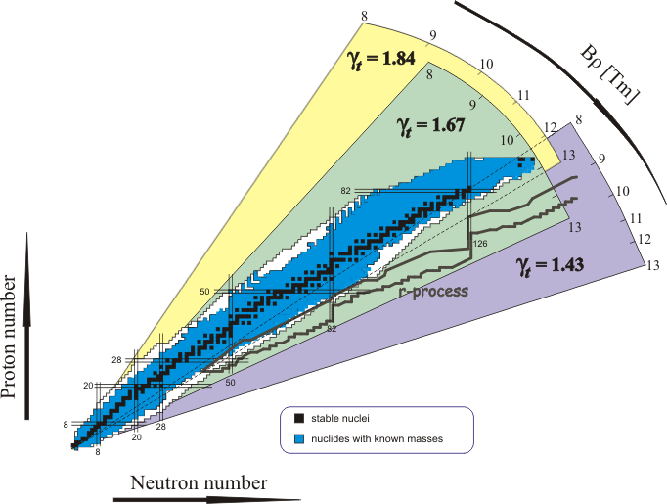
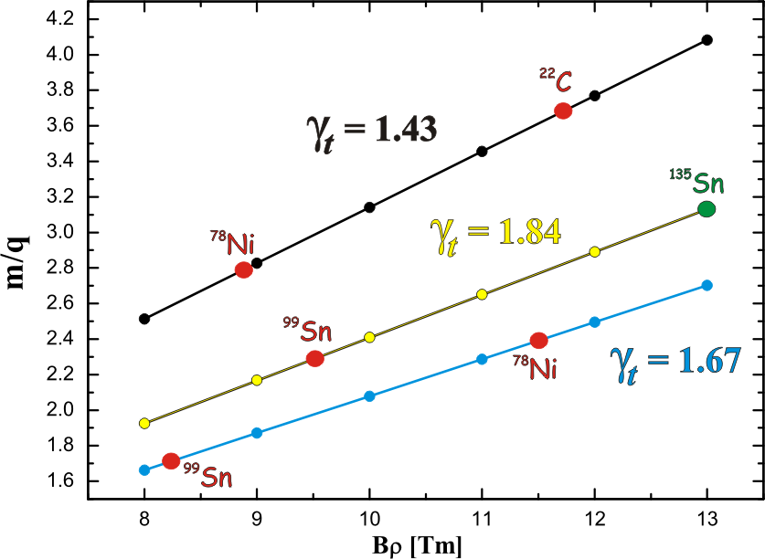
Isomeric beams, Lifetimes and Masses
1. γ_{t} = γ = 1.84 (E = 782.5 MeV/u)
2. γ_{t} = γ = 1.67 (E = 624.1 MeV/u)
3. γ_{t} = γ = 1.43 (E = 400.5 MeV/u)
Isochronous mode ( γ_{tr} = γ ) is required for fast mass measurements.
Isochronous Mode of the CR

Slide 32
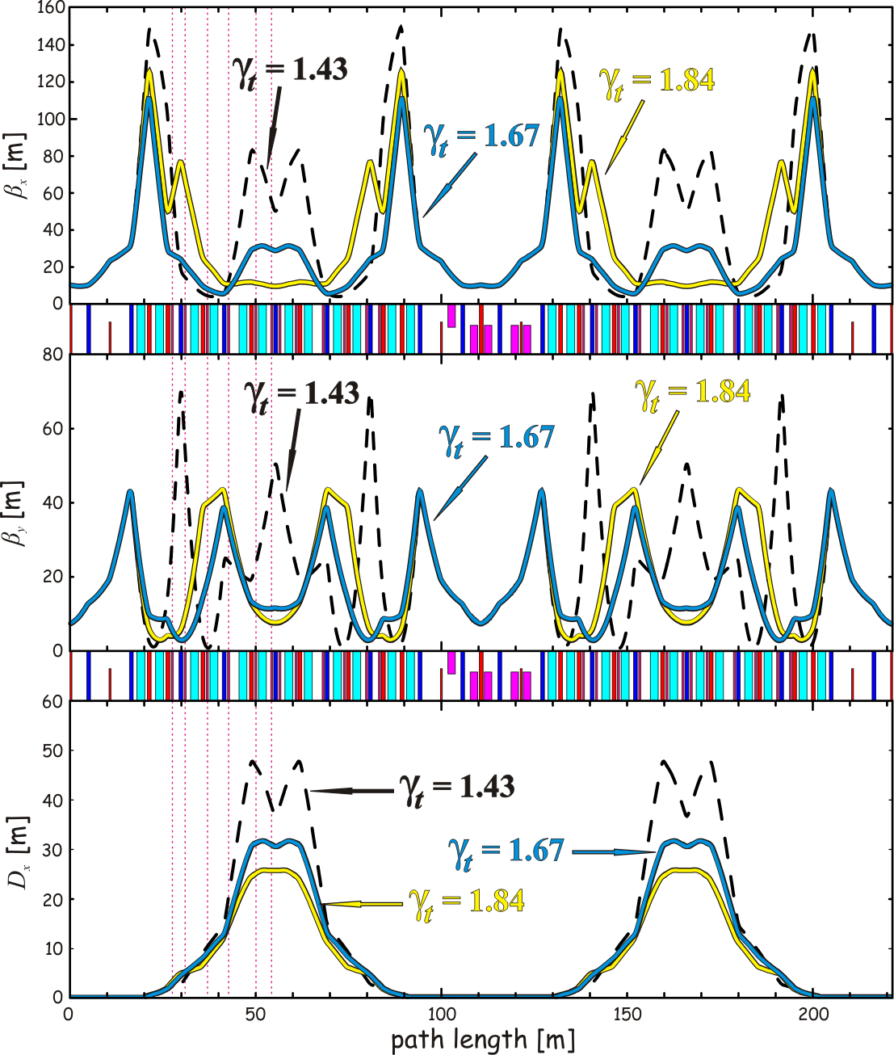
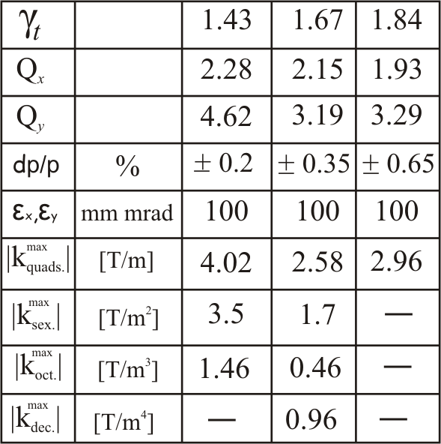
Isochronous mode
Optic parameters in the isochronous mode

Slide 33
Isochronous condition at CR
≈0
≈0
Ideal isochronicity can be guarantied only
for one m/q ion applying correction scheme
(sextupole, octupole, decapole correctors).
Frequency calibration by velocity measurement with
two TOF detectors.

Slide 34
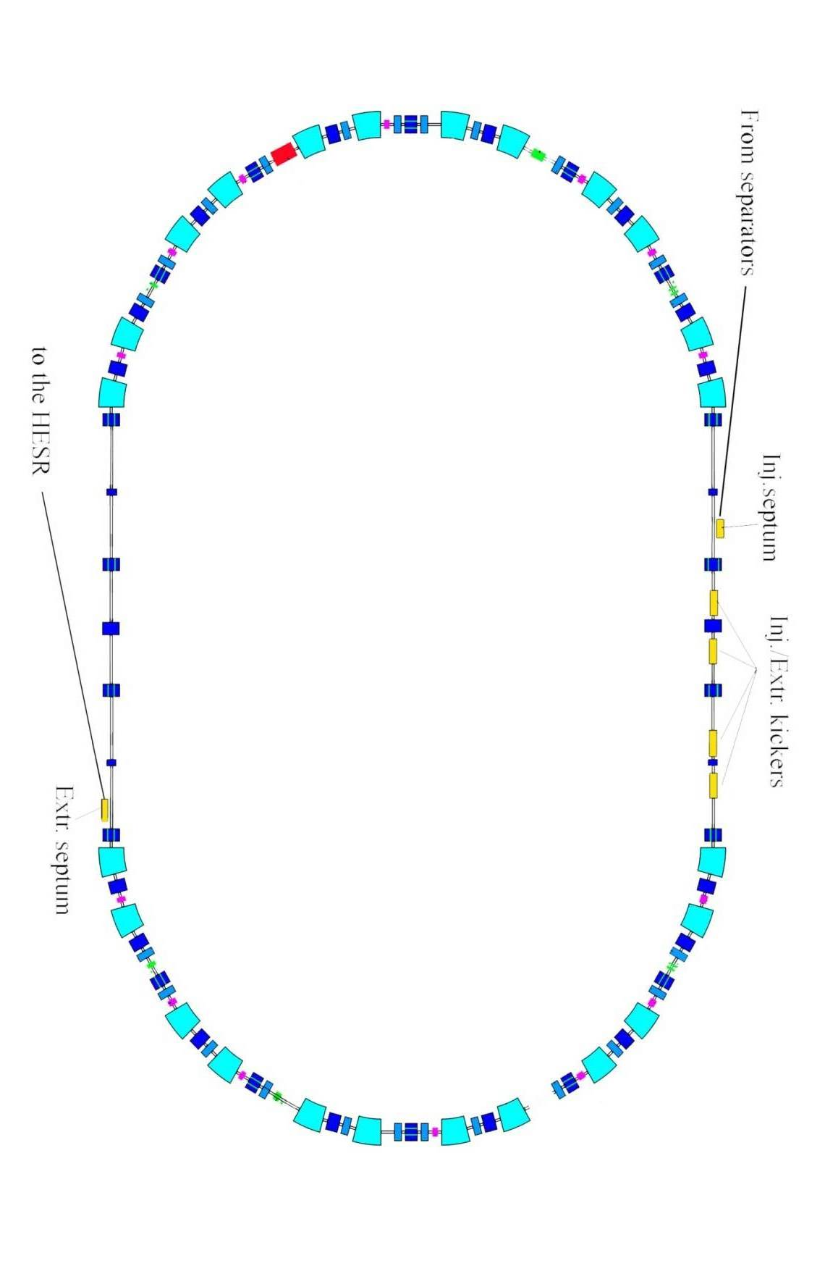
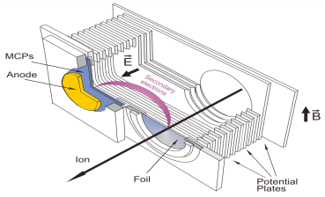
TOF detectors
H. Geissel and Yu. Litvinov, J. Phys. G31 (2005) S1779--83
Good isochronous conditions are fulfilled only
in a small range.
One has to reduce momentum acceptance!
or use 2 TOF detectors for velocity measurement!

Slide 35
Isochronous conditions at CR
≈0
≈0
Field errors of the magnets
Stability of magnet power converter (mainly dipole)
Closed orbit distortion
Large transverse acceptance (100 mm*mrad)

Slide 36
Schottky detectors
Using Schottky detectors one can measure a frequency of short lived single ions within 10 ms.
The dedicated design of the Schottky detectors for CR is ongoing within the ILIMA collaboration.
The beam intensity can be measured simultaneously with a frequency detection.
To correct non-isochronous conditions the velocity or magnet rigidity of each particle can be measured . For this a special transversal detector is being developed by ILIMA.
To have a good resolution of measurements several detectors will be installed in the CR.

Slide 37
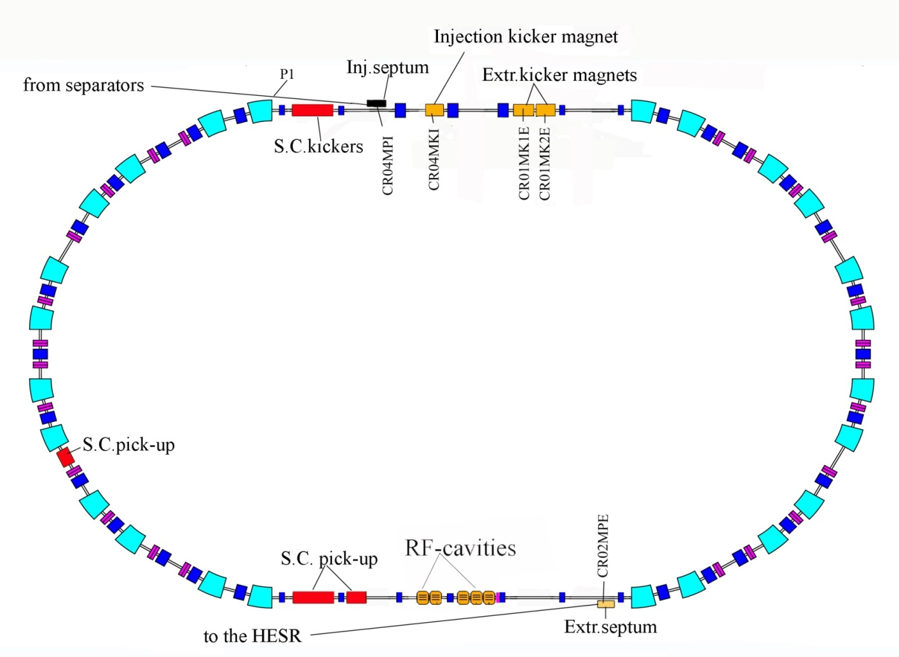
Experimental devices
15 Schottky resonators in the ring

Slide 38
Experimental devices
There is interest in the determination of beta delayed particle emission (like beta-delayed neutrons or two neutron emission)
To measure the life-time of short lived nuclides coming from Super-FRS the two particle detectors will be installed in the ring
The design of the detectors is ongoing within ILIMA collaboration.
To have high resolving power the detectors should be placed at high dispersive place of the CR (in the middle of arcs)

Slide 39
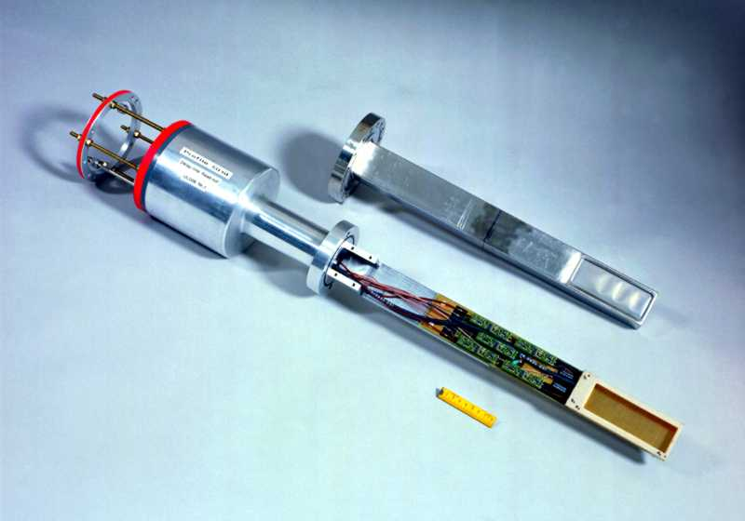
Experimental devices
2 Pocket detectors
CR04EKD1
CR02EKD1

Slide 40
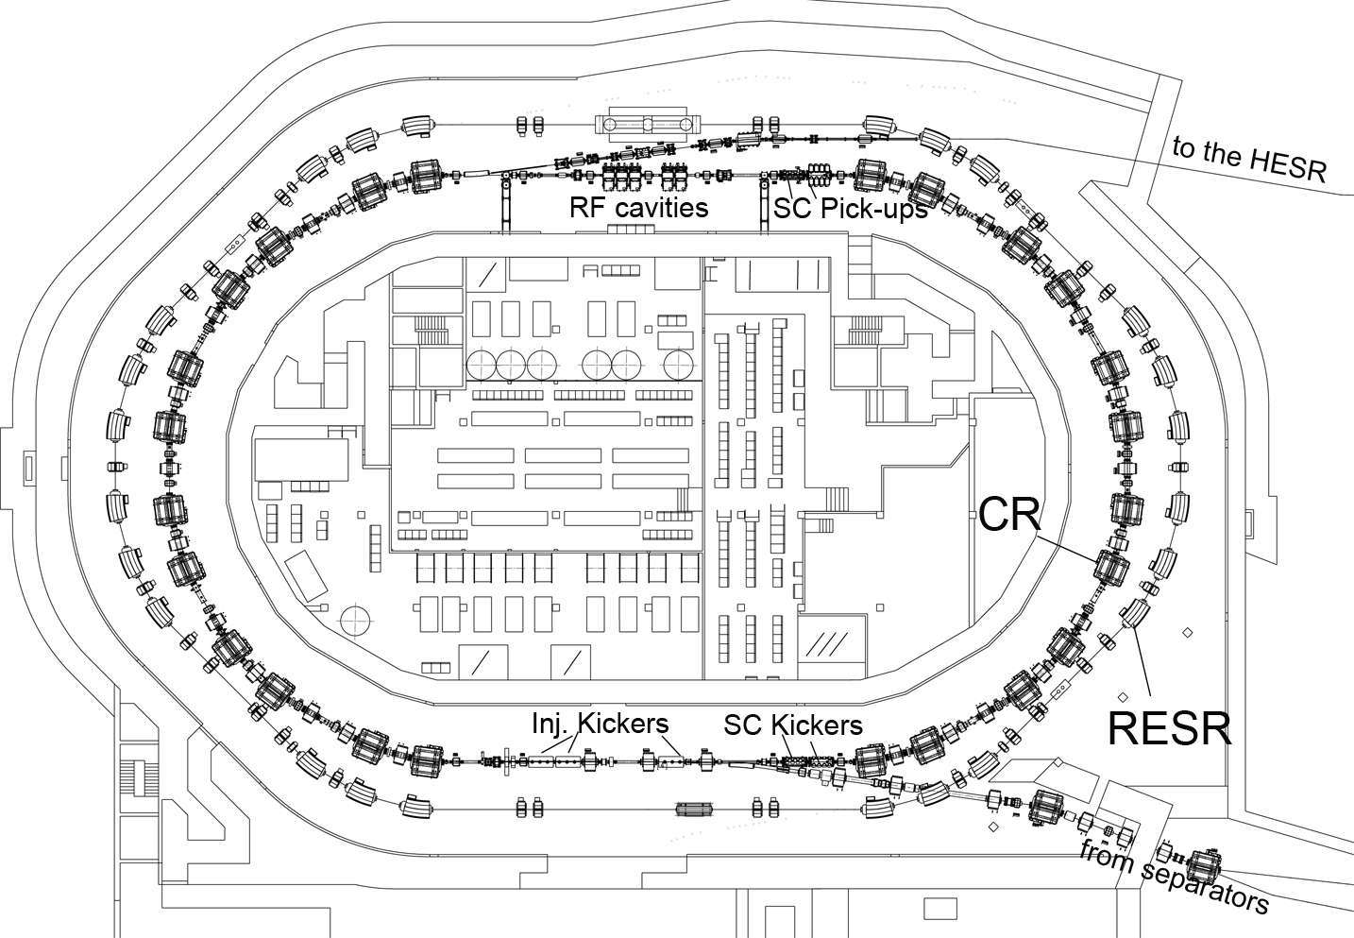

Civil construction
For civil construction planning major assumptions have been made.
Detailed requests for the supply room conditions were specified and delivered to the building planers
3D CATIA model of the ring and building is continued and completed
Major collisions have been identified and removed.
Coordination of external companies is ongoing permanently

Slide 41
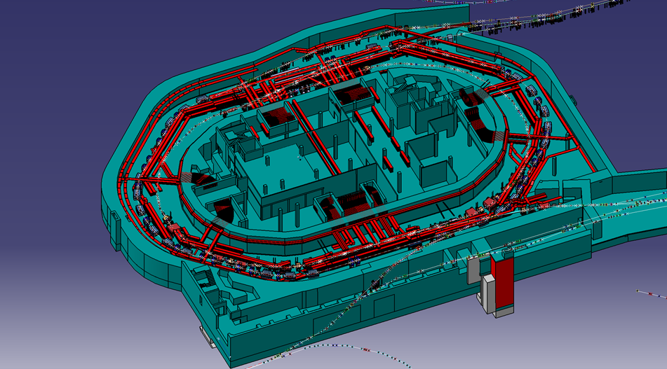
CR cable routes (first approach)
Müller & Bleher Firma makes design of the cable routes

Slide 42
Overview
The CR is a special ring that is designed for fast cooling both RIB and antiprotons.
Stochastic cooling is an essential task of the CR
The optical layout of the ring is chosen such to meet the requirements for most efficient stochastic cooling
The flexibility in setting the transition energy γ_{tr} to an optimal value is extremely important.
Furthermore: the injection/extraction elements, RF cavities, SC elements must be placed also at appropriate locations
One should remember that one needs to install enough diagnostic instruments, experimental devices to meet their specific requirement.
To realize the CR project the international collaboration is established....

Slide 43
CR Project at BINP
  Last year FAIR, GSI and BINP had discussion to transfer the technical supervision of the CR to BINP (Novosibirsk, Russia).
  It is agreed that the major part of the Collector Ring will be constructed at BINP
  MoU signed on a visit in
  Novosibirsk

Slide 44
Present status of the CR project
  IKRB meeting (01.04.20014) assigns a major part of the CR components (63 %) to the BINP
  FAIR and GSI have signed updated collaboration contract, where the major part of responsibility for CR (which is foreseen for BINP) is returned back to FAIR.
  FAIR Council decision was positive on 9 July 2014.
  Collaboration Contract for technical coordination of Construction of CR between FAIR and BINP was signed in August 2014.

Slide 45
In-kind for main components
RF cavities (GSI in-kind)
Stochastic cooling system (GSI in-kind)
All Magnets (BINP, Russia in-kind)
Power supply (BINP, Russia in-kind)
Kicker magnets (BINP, Russia in-kind)
Vacuum system (BINP, Russia in-kind)
Diagnostic devices (BINP/ITEP/GSI in-kind)
Experimental set-up (GSI in-kind)
Civil construction and cable planning (FAIR Site&Building)

