Slide 1
Solenoid Windings and Cold Mass Options (to make it cost efficient and fast)
Alexey Dudarev , Gabriella Rolando, Herman ten Kate, Helder Da Silva

Slide 2
“Ideal” Cold Mass
Coils are perfectly impregnated
Coils are pre-stressed (R and Z)
Coils are fully bonded to coil casing (4.5 K)

Slide 3
Options
From inside or from outside?
Vacuum Impregnation or “Prepreg”?
Modularity or single body?
Pre-stressed or not (bare coil)?
On wide or narrow side (two layers or more)?

Slide 4
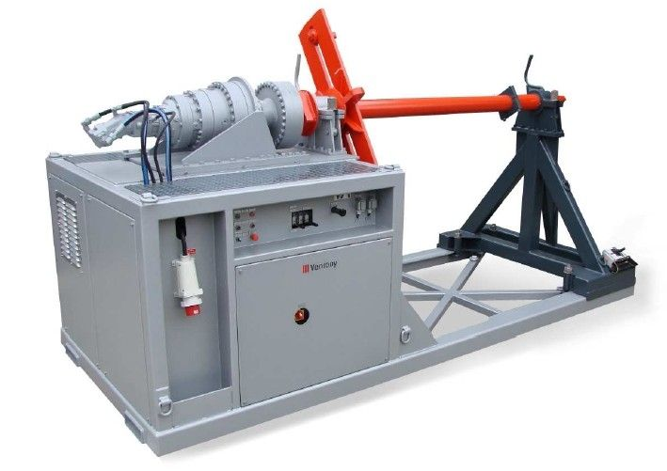
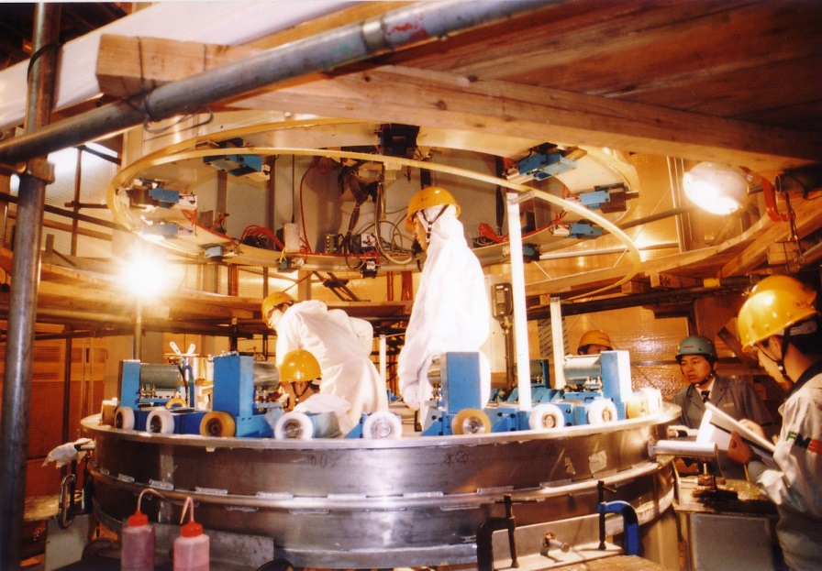
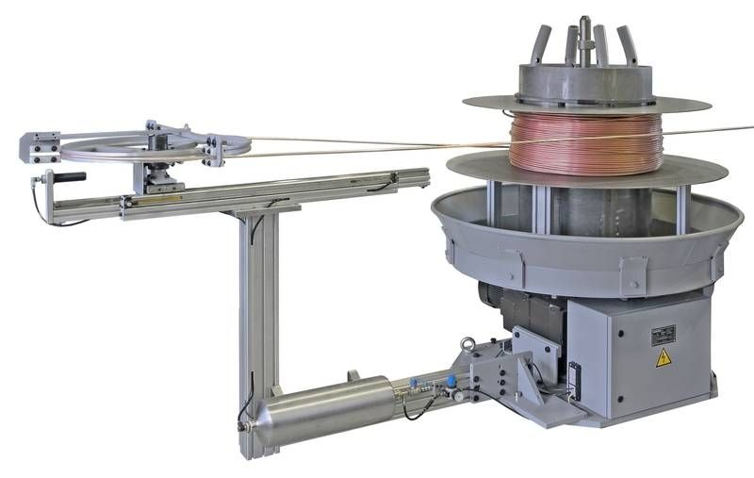
Inside or Outside?
Complicated
Tooling has to be developed and built (30% of coil cost and 18m)
Very little choice of companies

Slide 5
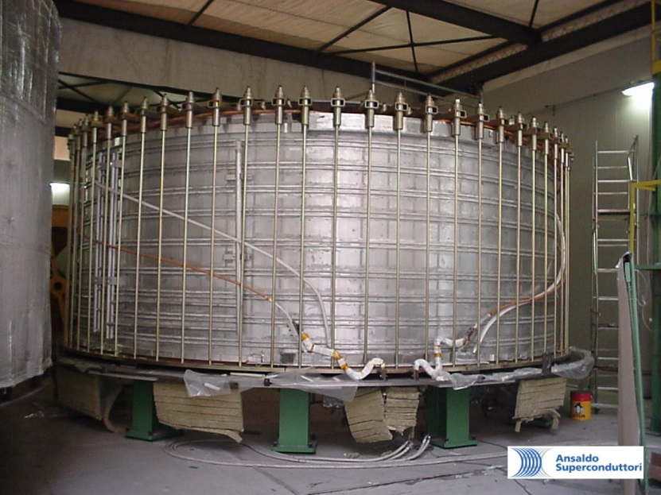
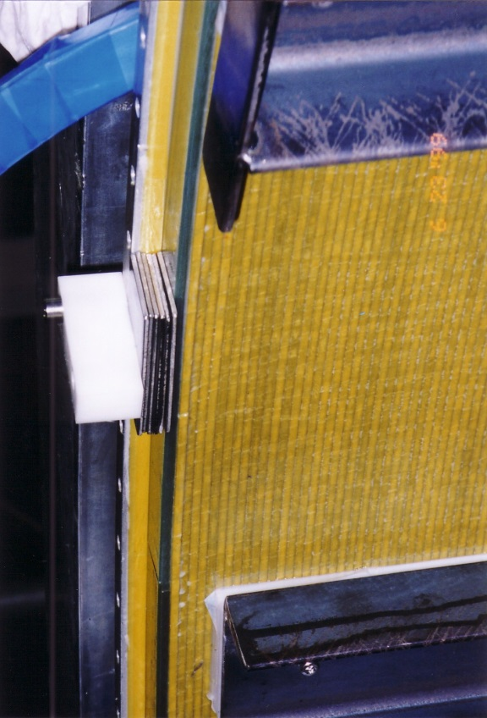
Vacuum Impregnation or “Prepreg”
Vacuum impregnation tooling means and extra step and extra cost

Slide 6
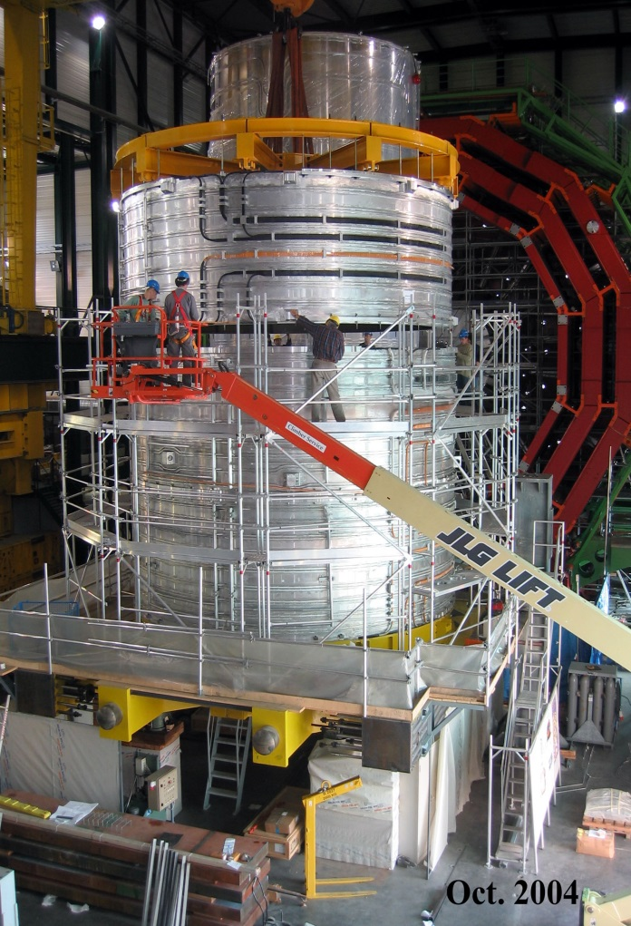
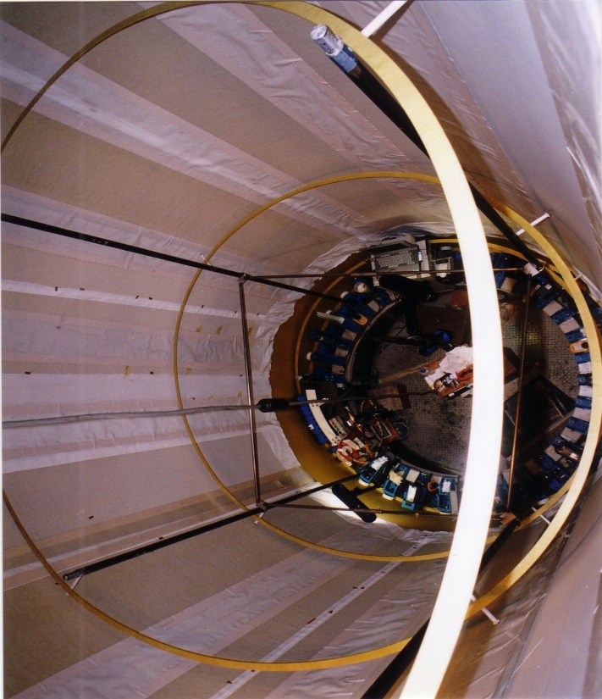
Modularity or single body
Not easy to work inside cylinder
Joints, spacers etc.
No way for corrections
In the case of failure, repair is more costly

Slide 7
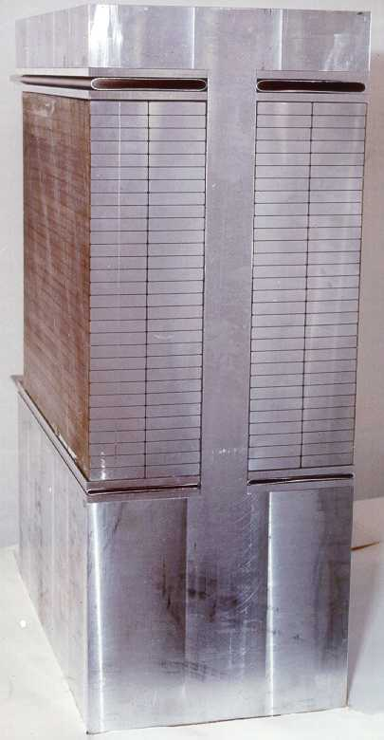
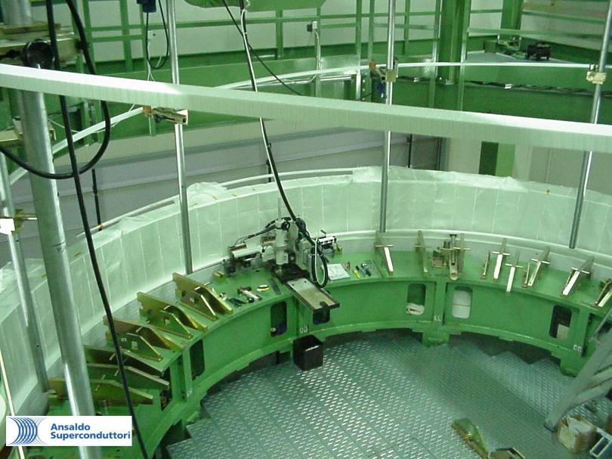
Pre-stressed (bare coil) or not
Pre-stress is not possible (or rather tricky) when coil is impregnated together with its casing.

Slide 8
On wide or narrow edge (two layers or more)
Winding from inside
CELLO, ALEPH, DELPHI, ATLAS CS - one layer
BABAR – two layers
CMS – four layers
Winding from outside
Is there any good reason to keep two layers?

Slide 9
“Cost - and schedule efficient” (low cost and fast)
Winding from outside
“Prepreg”
3 coil modules
Not pre-stressed
On wide edge ?

