Slide 1
Panda Solenoid
Content
Interface Box
Cold Mass Layout
Cooling Lines
Assembly Procedure

Slide 2
1. Interface box
Designed for easy opening and easy access to allow pipe welding; conductor soldering and instrumentation
Conductor connection block is fixed to the cold mass.
Flexible interface lines between solid cold mass and turret cooling pipes.
Thermal Shield
Aluminium plates
Flexible Lines
Conductor
joints

Slide 3
1. Interface box
Feed-through Connector
Connectors for most of the instrumentation wires.
Shape of the box provides good access to the interior for pipe welding, conductor soldering, instrumentation works
Fixed point transfer line is at the top, at the interface with the control dewar.
Welds
Vacuum Weld

Slide 4
2. Cold mass layout
3 units modular structure.
Radial supports closer to ends.
Conductor joints are praying hand type and about 1 m long.

Slide 5
Cold mass layout
Cooling pipes system based on the thermo-syphon method with parallel paths.

Slide 6
3. Cooling lines
SS316 return pipe
Designed for minimum risk
2 parallel sets, ½ shell type Al alloy pipes cooling circuits.
Both sets are manufactured, welded, tested and then put on the cold mass surface
Al-Al welds between ½ circle cooling pipes and distribution and collector pipes.
4 bimetallic Al-ss joints.
ss-ss welds in the feed and return lines.
Al6000 series cooling
pipes on cold mass
SS316 feed pipe
Al-ss bimetallic junction

Slide 7
3. Cold mass cooling lines
Minimum the risk.
Both cooling circuits are tested independently before assembly.
Each circuit is leak tested and thermally cycled.
The Al-Al, more difficult joints are tested before assembly.
Only ss-ss welds are made on site to connect the two ½ circuits.
Cooling lines attached to the support cylinder by gluing and bolting.

Slide 8
4. Assembly procedure
Cryostat and thermal shield as received put on a cantilever beam and supports to the floor.

Slide 9
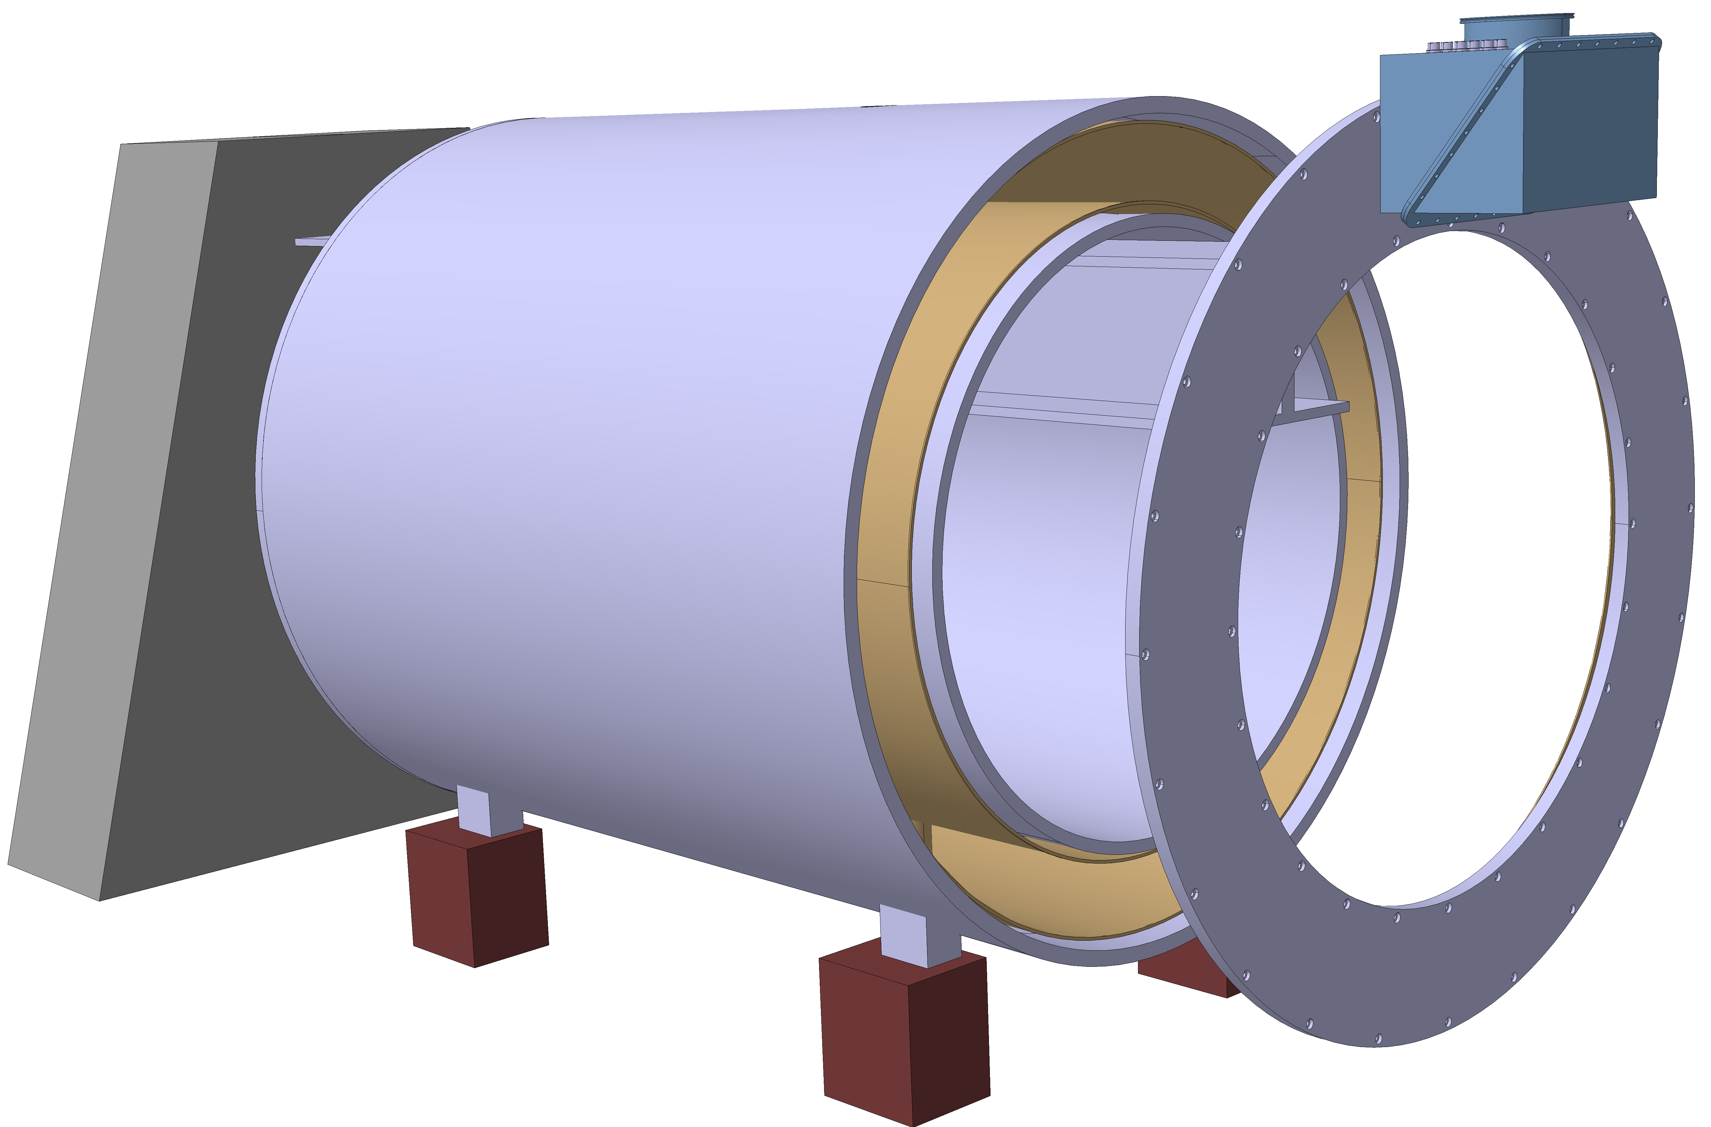
4. Assembly procedure
Cryostat and thermal shield as received on a cantilever beam
Open the cryostat
Remove front flange and interface box
Remove shield elements
Remove back flange, access the bore tube

Slide 10
Assembly procedure
Cryostat and thermal shield as received on a cantilever beam
Open the cryostat
Remove front flange and interface box
Remove shield elements
Remove back flange, access the bore tube
Remove cryostat outer cylinder
Start assembly: insert cold mass

Slide 11
Assembly procedure
Cryostat and thermal shield as received on a cantilever beam
Open the cryostat
Remove front flange and interface box
Remove shield elements
Remove back flange, access the bore tube
Remove cryostat outer cylinder
Start assembly: insert cold mass
Insert outer cryostat cylinder and connect radial supports.
Put the inner cryostat cylinder on the beam.

Slide 12
Assembly procedure
Cryostat and thermal shield as received on a cantilever beam
Open the cryostat
Remove front flange and interface box
Remove shield elements
Remove back flange, access the bore tube
Remove cryostat outer cylinder
Start assembly: insert cold mass
Insert outer cryostat cylinder and connect radial supports.
Put the inner cryostat cylinder on the beam.
Slide cold mass and outer cryostat shell over the inner shell
Put the end flanges thermal shield in place.

Slide 13
Assembly procedure
Cryostat and thermal shield as received on a cantilever beam
Open the cryostat
Remove front flange and interface box
Remove shield elements
Remove back flange, access the bore tube
Remove cryostat outer cylinder
Start assembly: insert cold mass
Insert outer cryostat cylinder and connect radial supports.
Put the inner cryostat cylinder on the beam.
Slide cold mass and outer cryostat shell over the inner shell
Put the end flanges thermal shield in place.
Finish axial supports and close the end flanges
Remove cantilever beam

