Slide 1
Status of work on the cryostat design
Joint Institute for Nuclear Research (Dubna)
Evgeny Koshurnikov
CERN
September 19, 2014

Slide 2
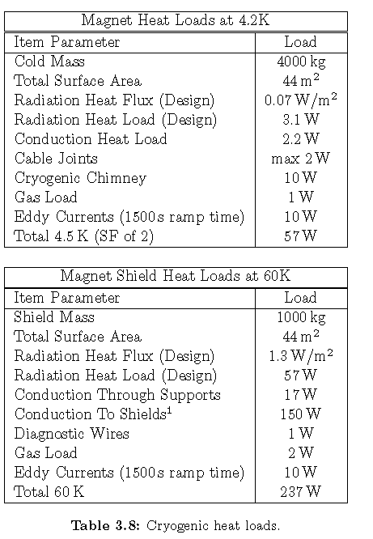
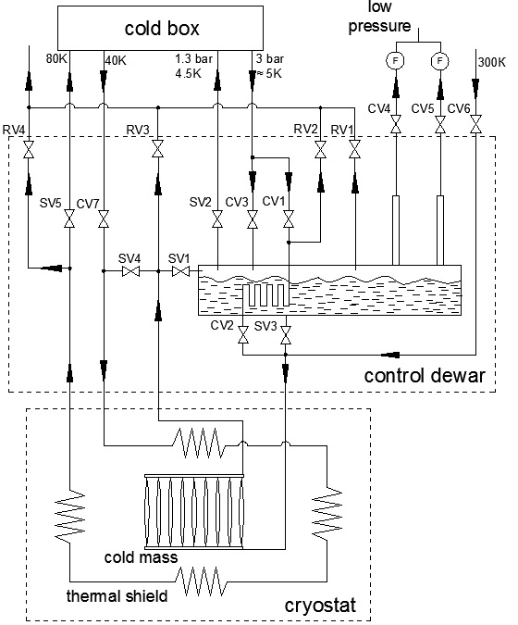
Cryogenic scheme
17 l/hour (0.6 g/sec) - cooling of the current leads
SF of 1.5

Slide 3
Cooling Mode

Slide 4
Forced flow cooling

Slide 5
Natural convection

Slide 6
Natural circulation cooling
Schematic of a conventional natural circulation loop
Driving force
density of the liquid helium in the supply tube
mean density of the liquid-vapor mixture in the heated tube
mean density of the liquid-vapor mixture in the return tube
2. The driving force balances against the pressure drops (friction and fluid acceleration)
- the acceleration pressure drop
H3
(D₃, F₃)
H1
(D₁, F₁)
G – flow of the helium, kg/sec
- density of the saturated vapor helium, kg/m³
- density of the saturated liquid helium, kg/m³
- vapor quality at the outlet of the heated tube
- vapor quality at the inlet of the heated tube
H2
(D₂, F₂)

Slide 7
Friction pressure drop
- the friction pressure drop in the supply tube
– friction factor in the supply tube for liquid helium
f₁=f (Re, G)
- the friction pressure drop in the heated tube
- the two-phase friction multiplier
viscosity of the saturated liquid helium, Pa*s,
viscosity of the saturated vapor helium, Pa*s
- the friction pressure drop in the return tube

Slide 8
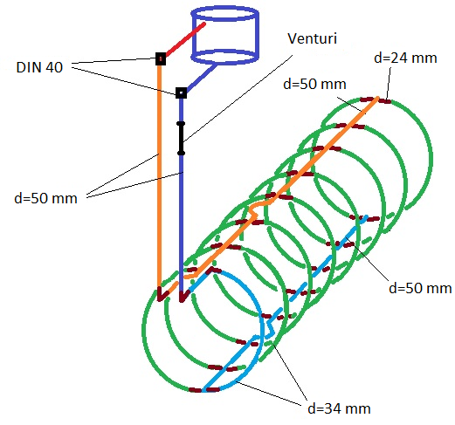
Computation of the mass flow rate
Flow for one rib of the
heat exchanger with local singularities of the loop
(Pa)
16.6 (36.6) W
Total flux for all ribs = 68 g/sec
, g/sec

Slide 9
Assembled solenoid and control Dewar

Slide 10
Cooling system

Slide 13
Tubes of upper and bottom collectors. Radial suspension ties (top view)
Can we allow the unfixed cryogenic side of the cold mass with current leads and tubing to move a few millimeters while cooling?
~4.5 mm

Slide 14
Tubes of upper and bottom collectors. Radia and axial suspension ties

Slide 15
Control Dewar

Slide 16
THANK YOU FOR YOUR ATTENTION!

Slide 17
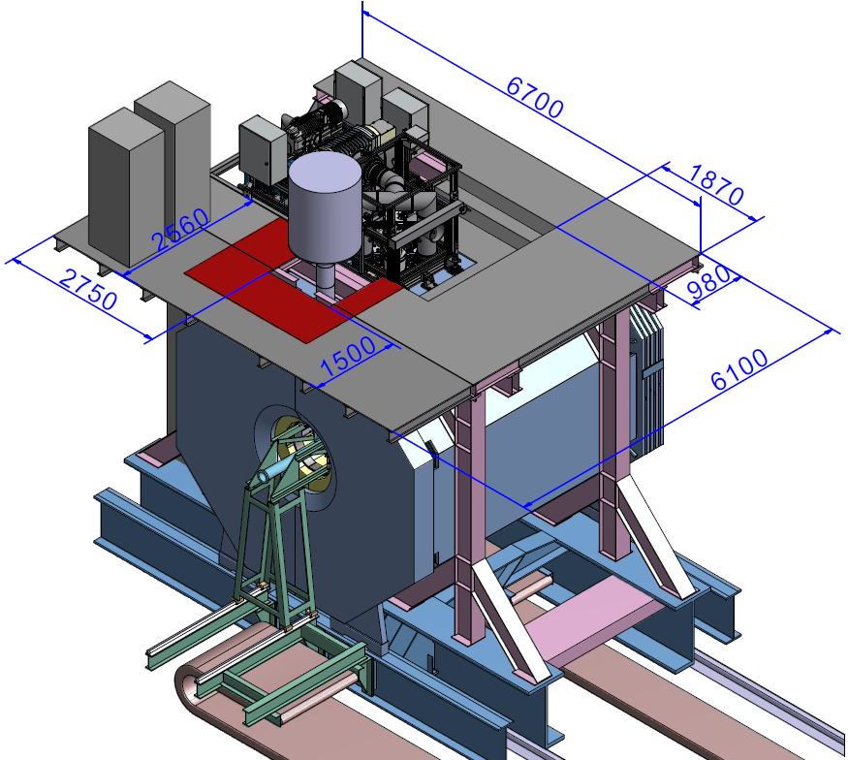
PANDA Target Spectrometer

Slide 18
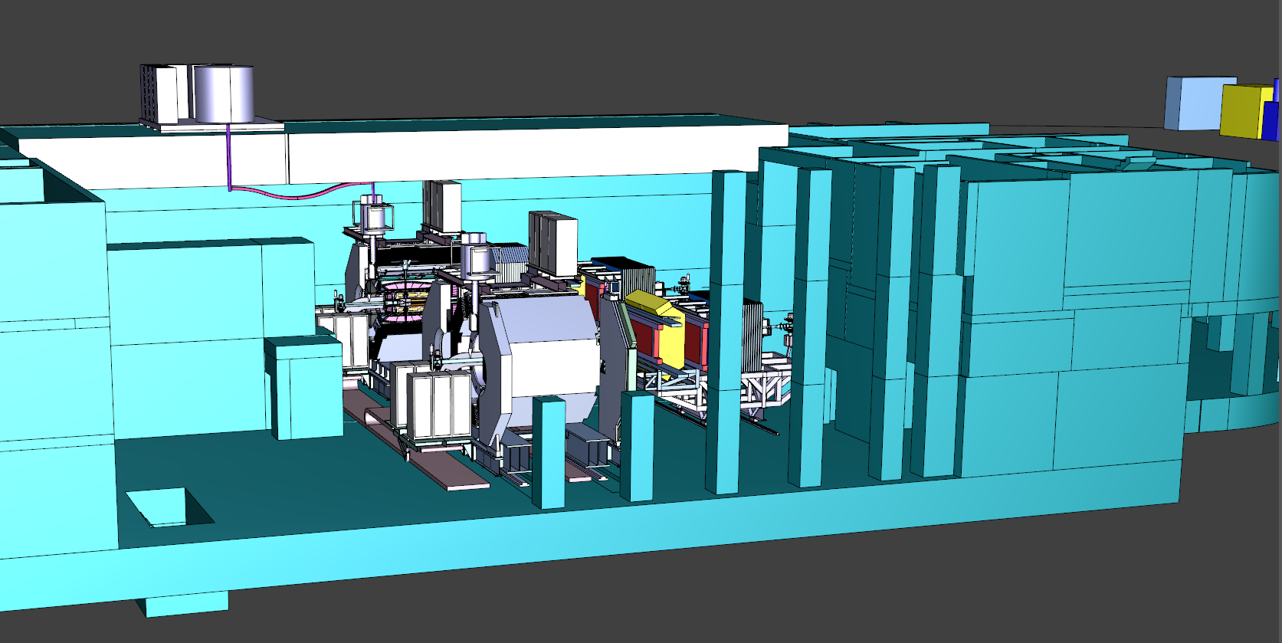
PANDA magnet in the experimental building (in-beam and in-parking positions)
LHe transfer line
Cold box of the liquefier and Buffer Dewar
Helium compressor
Radiation shield

Slide 19
Space allocated for the Control Dewar
Radiation shield
2345

Slide 20
Parameters of the axial suspension
Material of ties | Inconel 718
Number of ties | 2 x 4 =8
$[σ]$ , MPa | 477
Ø, mm | 20
 | Estimate | 3D FE computations
σ_{temp ,}MPa | 373 (78.2%) | 326.8
σ_{prestr,} MPa | 8.2 (1.7%)
σ_{mag.force,} MPa | 63.6 (13.3%)
$\frac{σ_{temp}+σ_{prestr}+ σ_{mag.force}}{[σ]}$ % | 93.2%
Q_{4.2} , W | 1.05
Q₇₇ , W | 6.2
Axial shift of the center, mm | 0.39 | 0.46
*

Slide 21
Parameters of the radial suspension
Material of the ties | Inconel 718
Number of ties | 2 x 8 =16
$[σ]$ , MPa | 477
Using Belleville springs | Yes
Ø, mm | 10
σ_{temp ,}MPa | 335 (70%)
σ_{prestr,} MPa | -
σ _{weight+mag.force,} MPa | 138.5 (29%)
$\frac{σ_{temp}+σ_{prestr}+ σ_{mag.force}}{[σ]}$ % | 99%
Q_{4.2} , W | 1.1
Q₇₇ , W | 6.6
Axial shift of the center under action of the magnetic decentering force, mm | 0.24

