Slide 1
PndSttCellTrackFinder Update
| Tobias Stockmanns, Jette Schumann

Slide 2
Basic Algorithm
Generation of tracklets in STT
Primary tracklets: use of cellular automaton
Combination of tracklets: use of Riemann Fit
Faulty: Fit to midpoints of the tubes
Correction of STT-Hits based on event time
Correct points for Riemann Fit by calculating tangents to the isochrones
→PndSttCellTrackletGenerator
→PndSttHitCorrector

Slide 3
PndSttCellTrackletGenerator Example – STTHit-Data

Slide 4
PndSttCellTrackletGenerator Example – STTHit-Data

Slide 5
PndSttCellTrackletGenerator Example – First Stage

Slide 6
PndSttCellTrackletGenerator Example – Second Stage

Slide 7
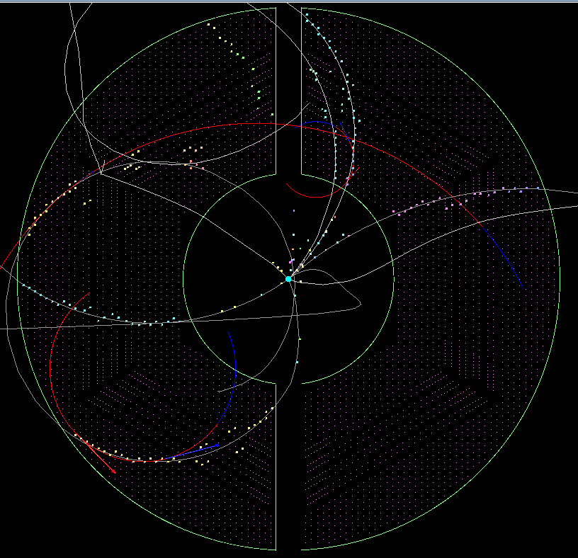
PndSttCellTrackletGenerator Resulting Riemann Tracks
Tracks are fitted to the midpoints of the tubes
difficult to assign MVD-Hits
Fit to more precise points
PndSttHitCorrector

Slide 8
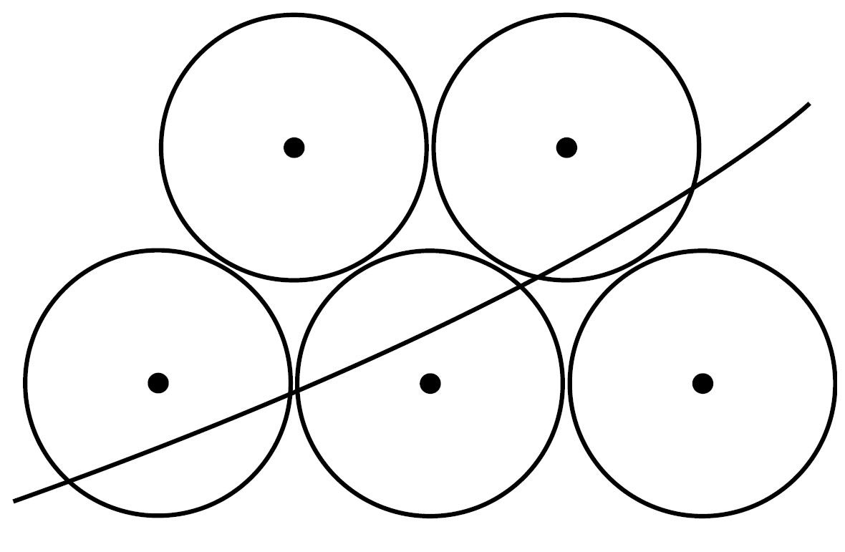
PndSttHitCorrector Example

Slide 9
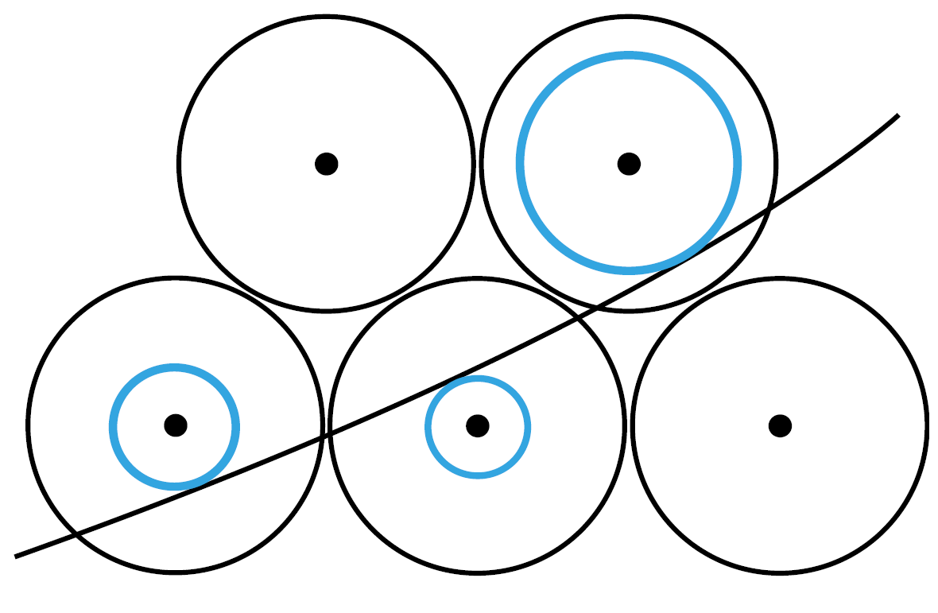
PndSttHitCorrector Example

Slide 10
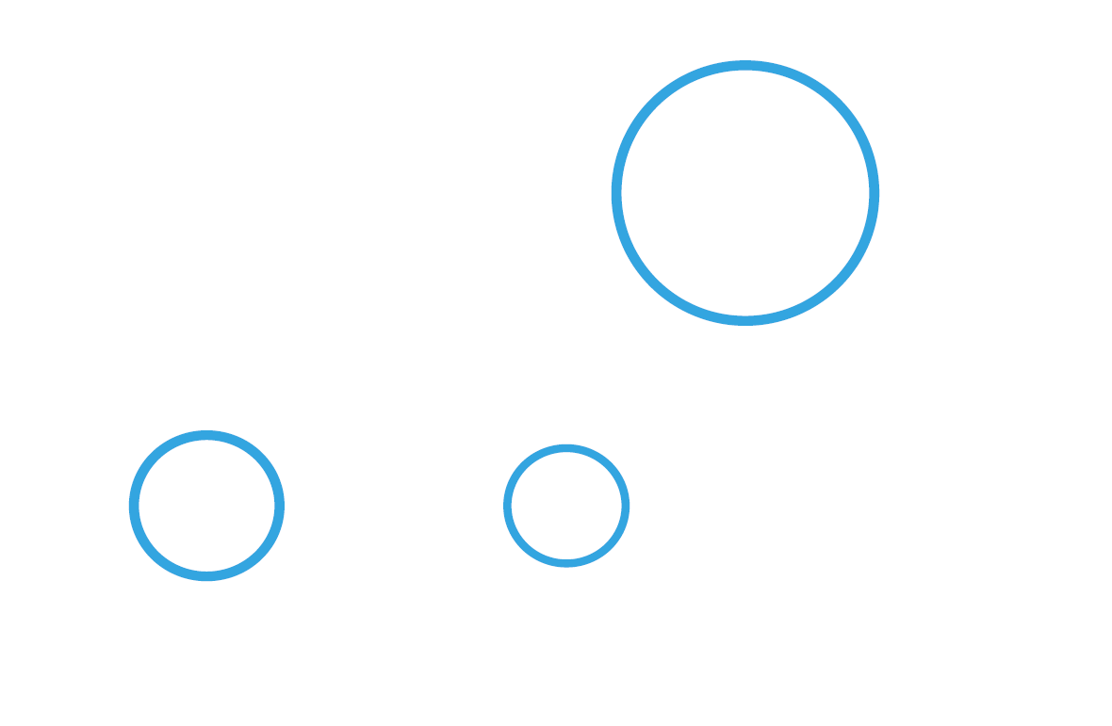
PndSttHitCorrector Example

Slide 11
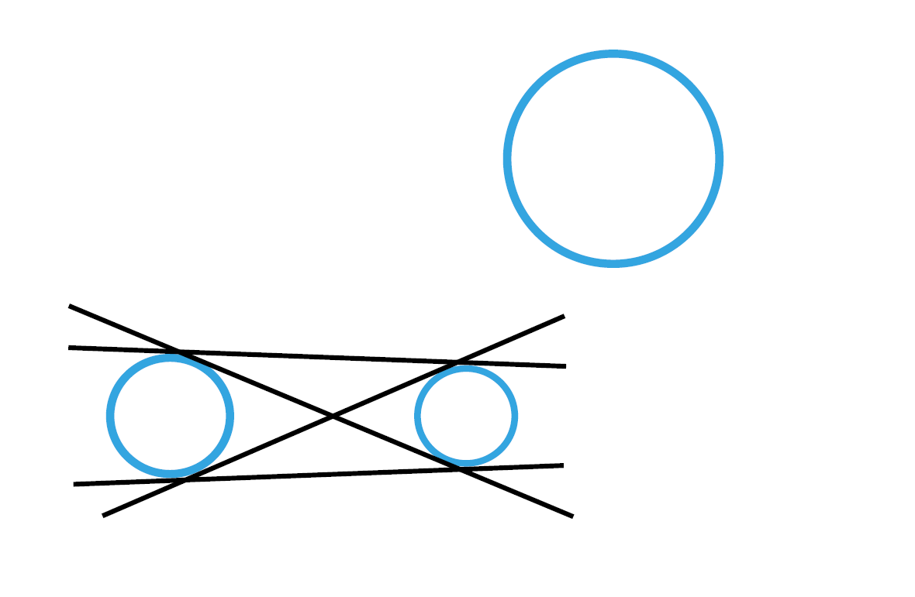
PndSttHitCorrector Example

Slide 12
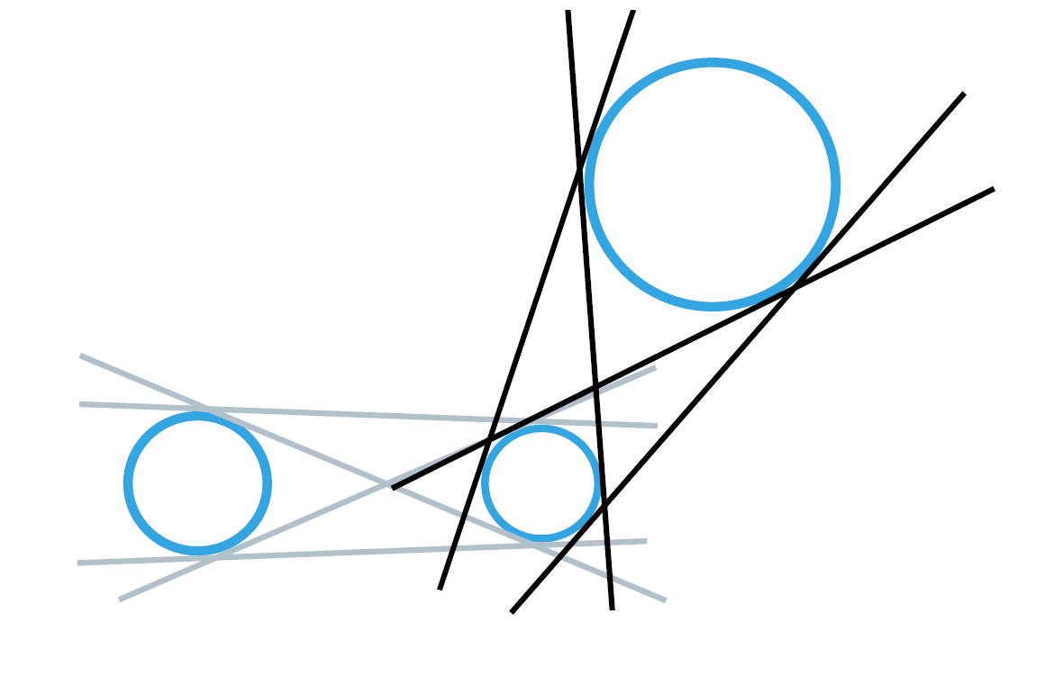
PndSttHitCorrector Example

Slide 13
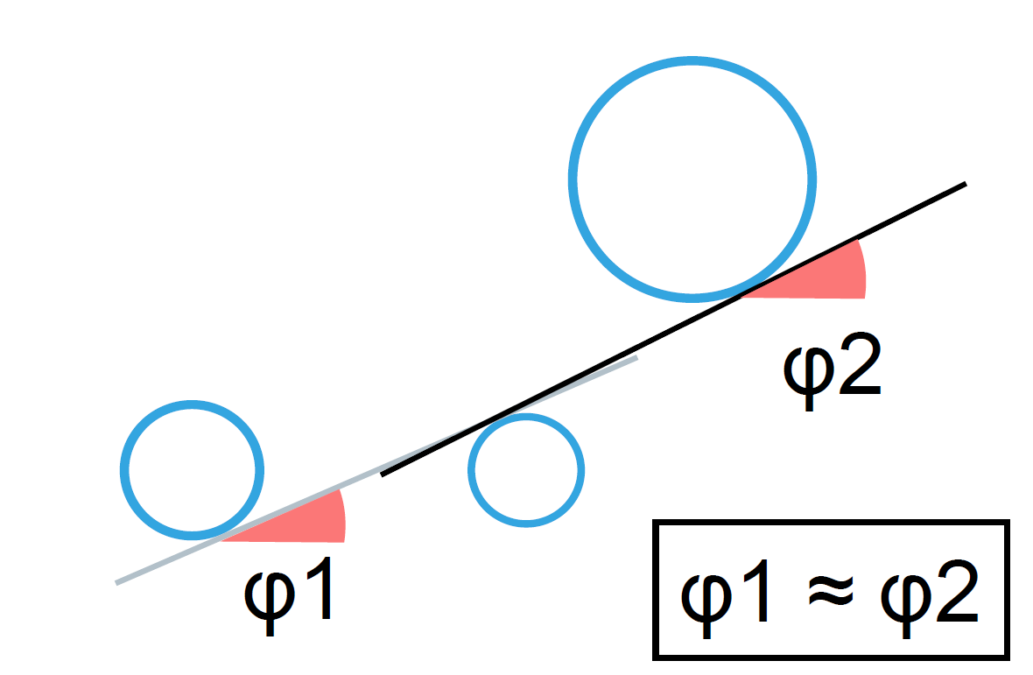
PndSttHitCorrector Example

Slide 14
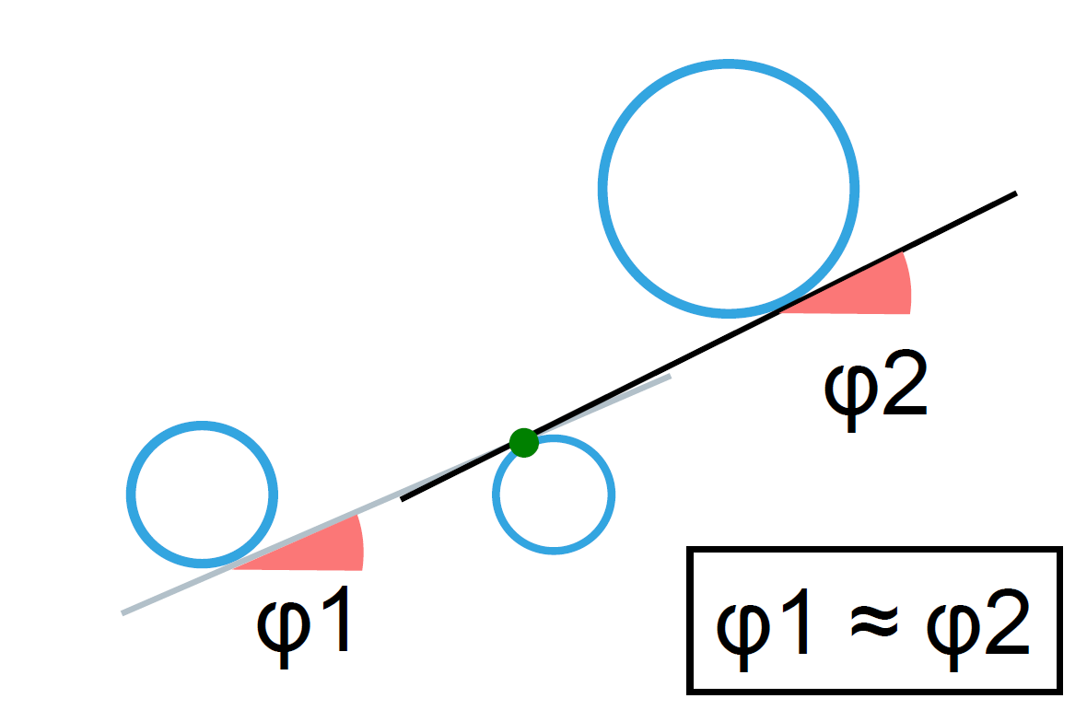
PndSttHitCorrector Example

Slide 15
PndSttHitCorrector Example

Slide 16
PndSttHitCorrector Basic Idea
Assumptions:
tracks are linear between two isochrones
consecutive lines have nearly the same direction
Idea:
calculate inner and outer tangents for neighboring isochrones
store (tangent)angles with respect to the x-axis
find most similar ones
calculate Riemann Track to intersection point of the best tangent instead to the midpoint of the tube

Slide 17
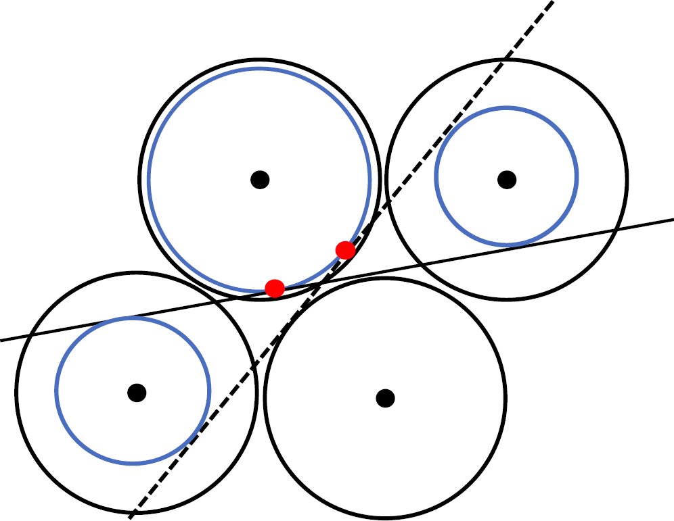
PndSttHitCorrector Problems
Ambiguities:
More than two active neighbors :
Compare with which one?
Calculation overhead

Slide 18
PndSttHitCorrector Algorithm
1. Initialization
Calculate tangent angles for tubes with 2-3 active neighbors and find the unambiguous ones
2. Adaption
Search for unambiguous neighbors for tubes with 2-4 active neighbors
try to adapt the tangent angles based on geometry of the neighboring isochrones
Repeat until angles change no more

Slide 19
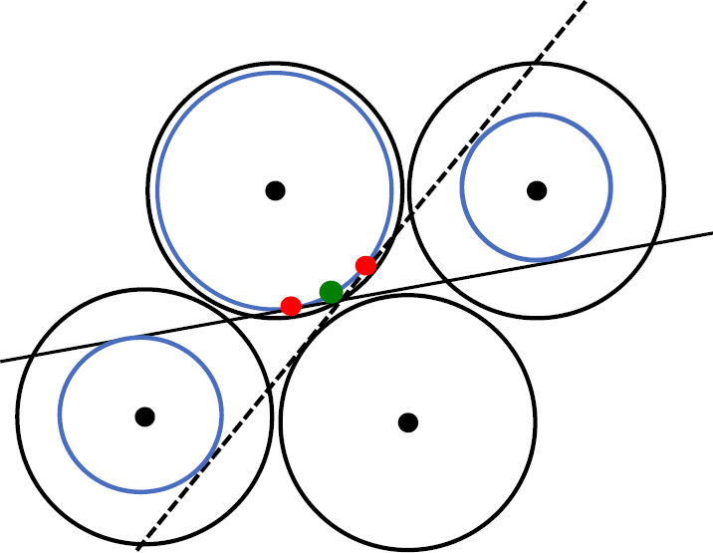
PndSttHitCorrector Algorithm - Initialization
For tubes with two active neighbors:
Keep two values
make a decision later
Keep mean value if difference < δ

Slide 20
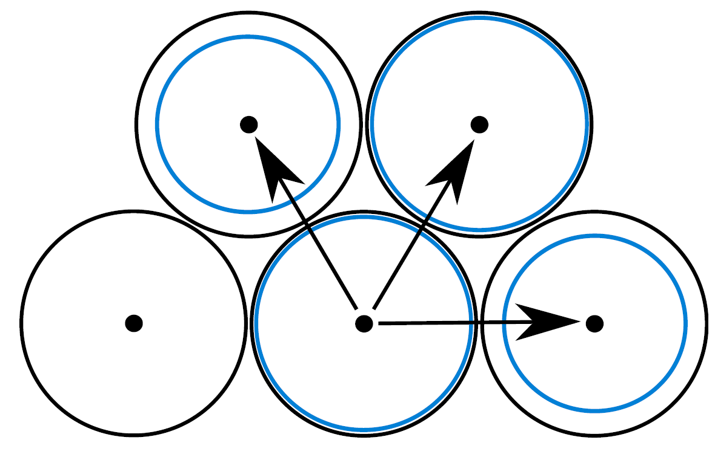
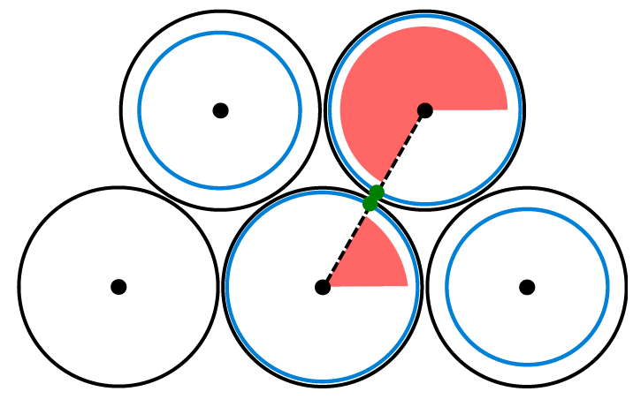
PndSttHitCorrector Algorithm - Initialization
For tubes with three active neighbors:
Search for this special constellation of active neighbors
calculate angle of the direction of the connecting line to the opposing neighbor
contrary angle for opposing neighbor

Slide 21
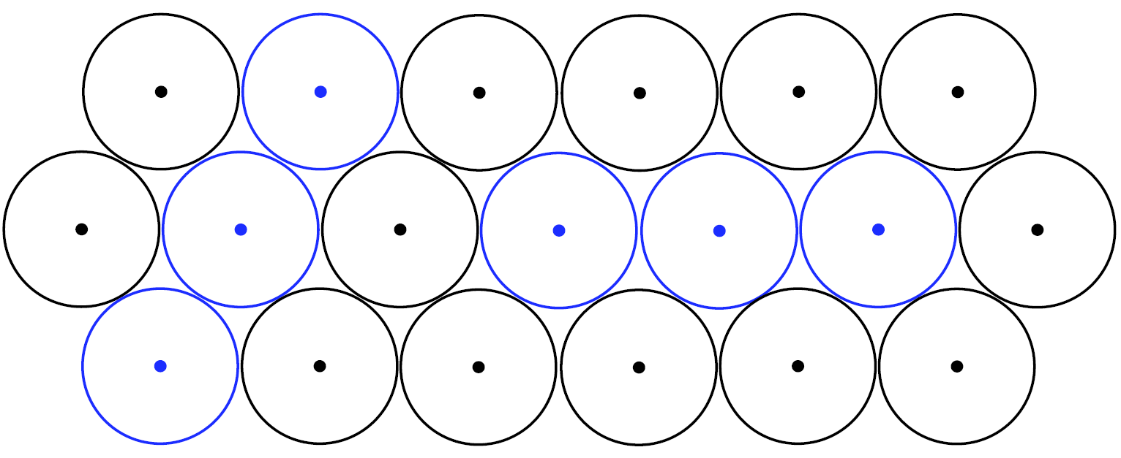
PndSttHitCorrector Algorithm - Adaption
Decision can be made if unambiguous neighbor is in a „straight line“
Tubes that form a straight line:

Slide 22
PndSttHitCorrector Algorithm - Adaption
Distinction regarding the isochrone-radius of the considered tube
not the smallest one
smallest one

Slide 23
PndSttHitCorrector Algorithm - Adaption
→ If isochrone is not the smallest one, tracks passes on the same side of the isochrones
A B C
B: two possible values
C: unambiguous value
B: keep similar one
C: next one to adapt

Slide 24
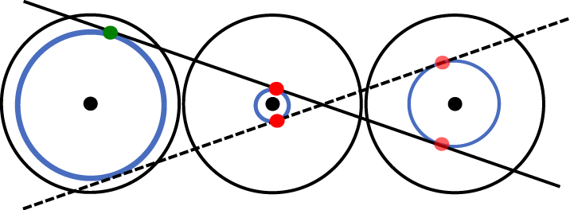
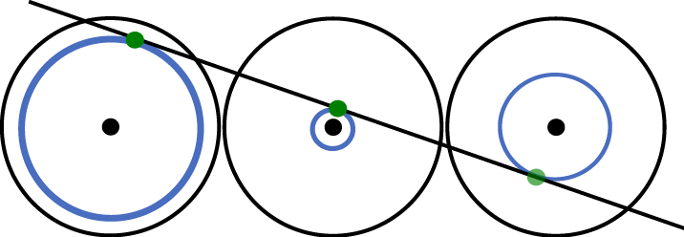
PndSttHitCorrector Algorithm - Adaption
otherwise: isochrone is the smallest one
track changes the side
A B C
A: biggest isochrone,
unambiguous value
B: two possible values
B: keep similar one, because A has biggest isochrone
C: next one to adapt

Slide 25
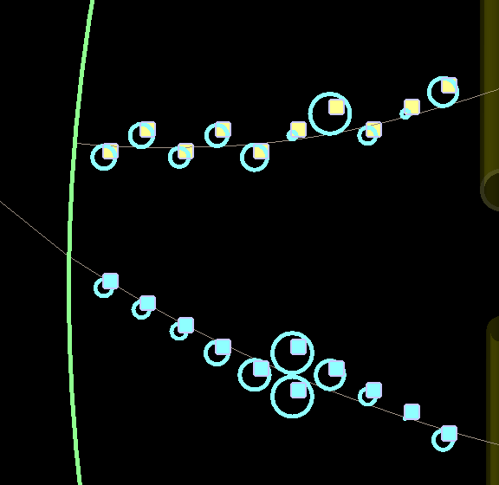
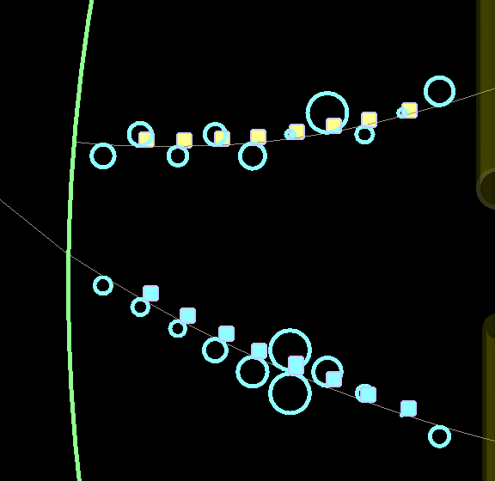
PndSttHitCorrector Example
Midpoints
Corrected points

Slide 26
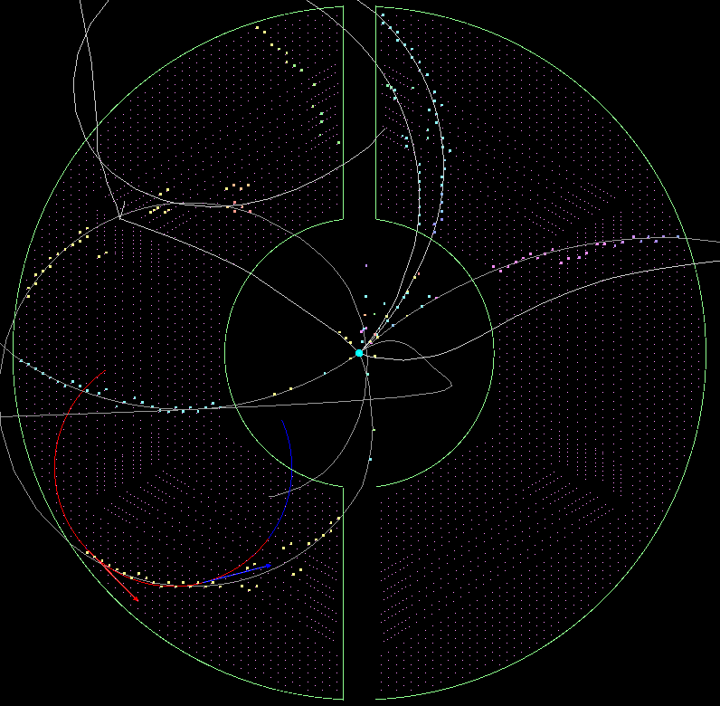
PndSttHitCorrector Trackfit before

Slide 27
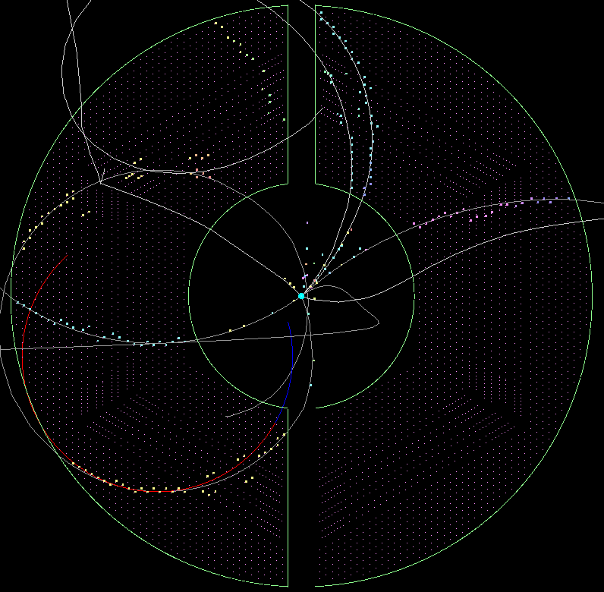
PndSttHitCorrector Trackfit after

Slide 28
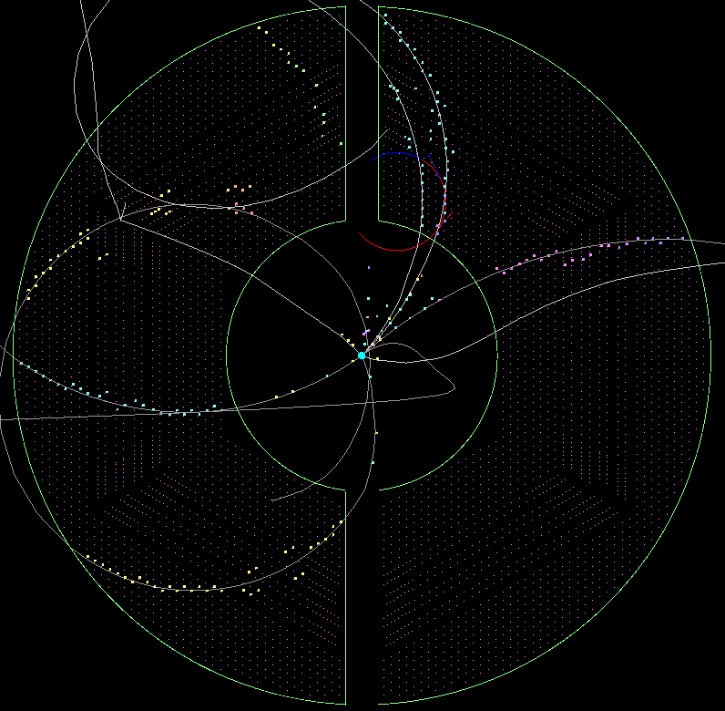
PndSttHitCorrector Trackfit before

Slide 29
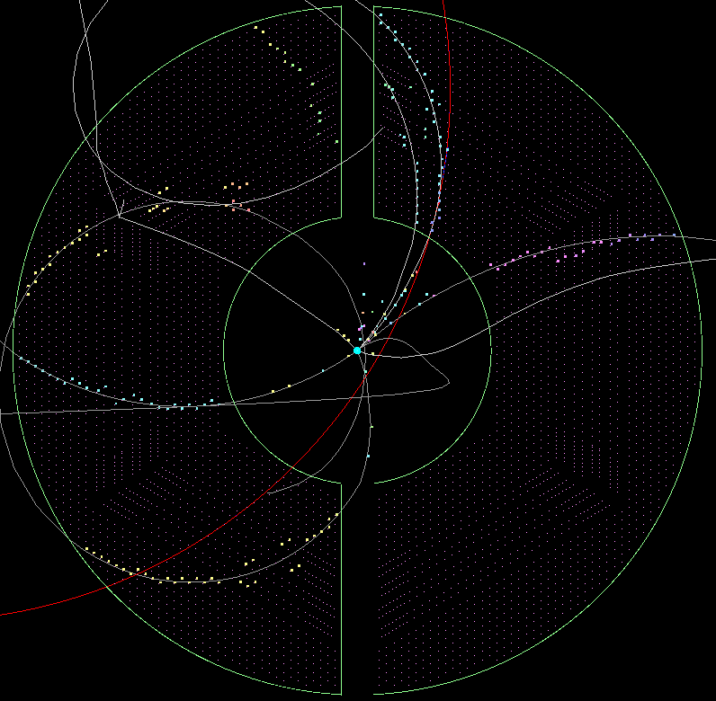
PndSttHitCorrector Trackfit after

Slide 30
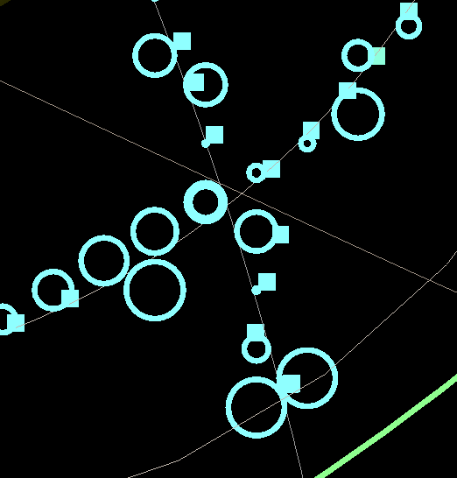
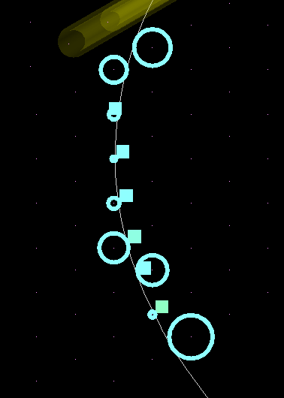
PndSttHitCorrector Faulty correction
Crossings
Special cases

Slide 31
Outlook
Involving MVD-Hits
Time based simulation
Handling of skewed straws
Calculation of boundary points → take a look at the neighbors of the neighbor
Implementation on GPU

Slide 32
Thank you very much for your attention!

Slide 33
PndSttCellTrackletGenerator
Subdivision in three stages:
1. Generation of primary tracklets
2. Combination of tracklets
3. Add of remaining hits
Use of a cellular automaton
Use of a Riemann fit
Selection of the best fitting track

Slide 34
First Stage Cellular Automaton
Abstract discrete model for dynamic systems:
Definition by:
Cell
Discrete number of states
Neighbourhood relations
Transition rules
Simultaneous changes

Slide 35
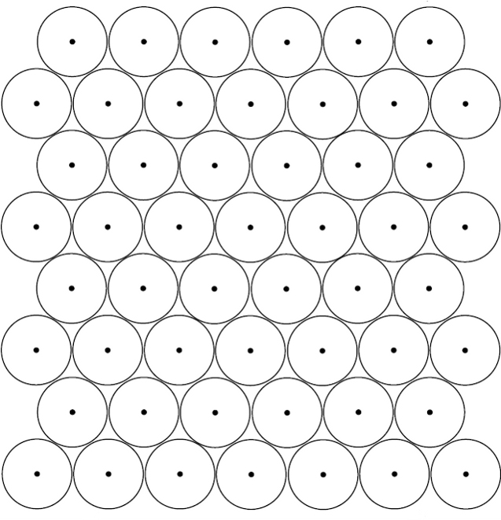
Cellular Automaton Adoption to STT

Slide 36
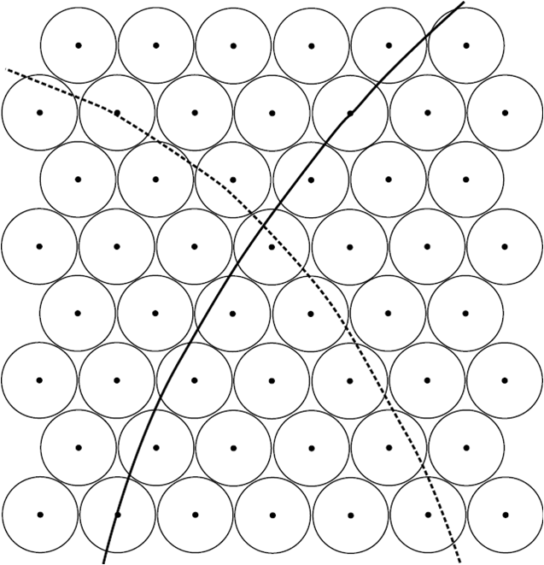
Cellular Automaton Adoption to STT

Slide 37
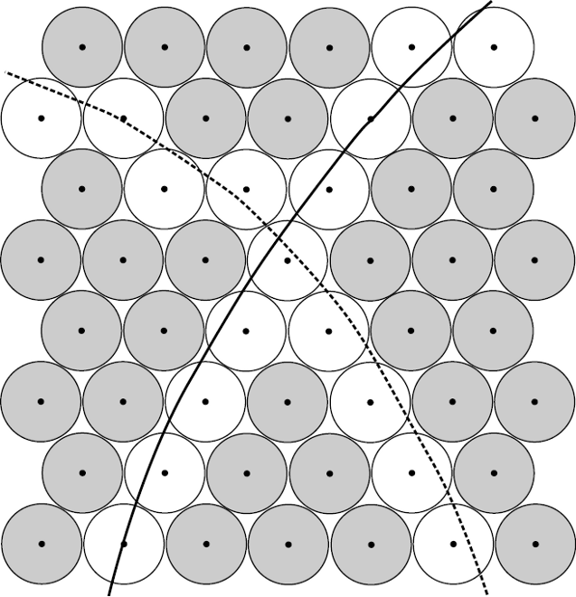
Cellular Automaton Adoption to STT

Slide 38
Cellular Automaton Adoption to STT
Number of Neighbours:
1
unambiguous
2
> 2
ambiguous

Slide 39
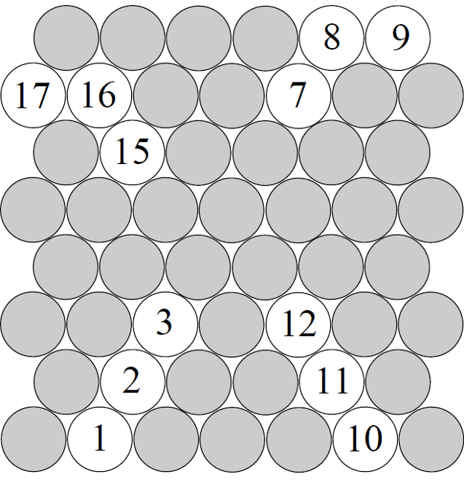
Cellular Automaton Adoption to STT
Cell: Straw with hit and one or two neighbours
Rule: Compare your status with the status of your neighbours and take the smallest one

Slide 40
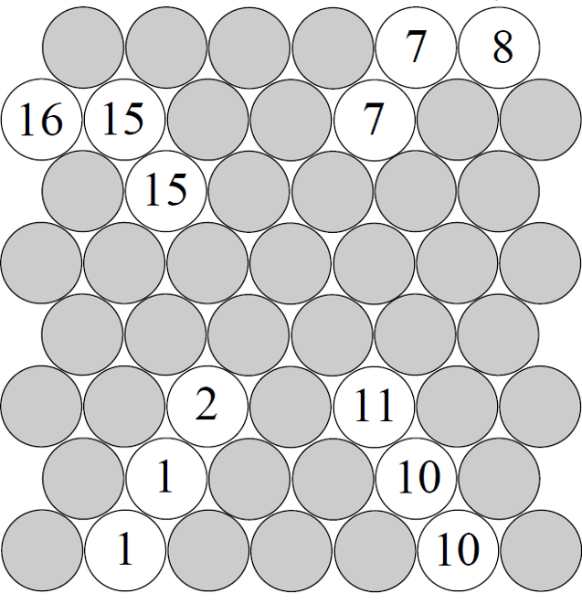
Cellular Automaton Adoption to STT
Cell: Straw with hit and one or two neighbours
Rule: Compare your status with the status of your neighbours and take the smallest one

Slide 41
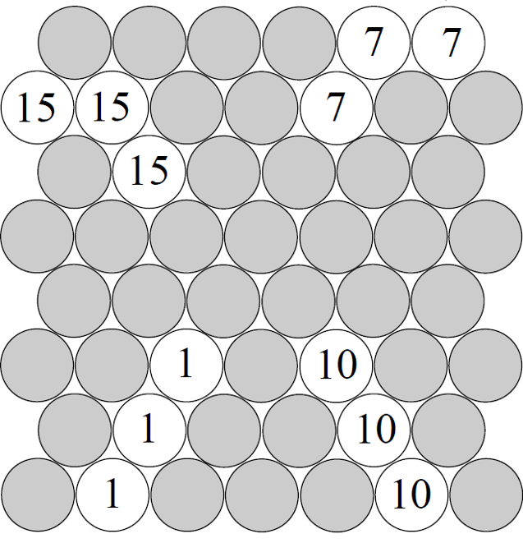
Cellular Automaton Adoption to STT
Cell: Straw with hit and one or two neighbours
Rule: Compare your status with the status of your neighbours and take the smallest one

Slide 42
Cellular Automaton Adoption to STT
Cell: Straw with hit and one or two neighbours
Rule: Compare your status with the status of your neighbours and take the smallest one

Slide 43
Cellular Automaton Adoption to STT
Cell: Straw with hit and more than two neighbours
Rule: Copy the status of all your neighbours into your status

Slide 44
Cellular Automaton Adoption to STT
Cell: Straw with hit and more than two neighbours
Rule: Copy the status of all your neighbours into your status
15
7
1
10

Slide 45
Cellular Automaton Adoption to STT
Cell: Straw with hit and more than two neighbours
Rule: Copy the status of all your neighbours into your status
7/15
7/15
1/10 7/15
1/10
1/10

Slide 46
Cellular Automaton Adoption to STT
Cell: Straw with hit and more than two neighbours
Rule: Copy the status of all your neighbours into your status
1/10 7/15
1/10 7/15
1/10 7/15
1/10 7/15
1/10 7/15

Slide 47
Second Stage Combination of tracklets
The tracks of particles in the x-y-projection follow (in an ideal case) a circle line
Steps:
Find all combinations of tracklets
Circle fit via Riemann
Benchmark the fit
Accept / Reject combination

Slide 48
Picture after second stage
1/10 7/15
1/10 7/15
1/10 7/15
1/10 7/15
1/10 7/15

Slide 49
Third stage Adding missing hits
Assignment of hits with ambiguities and small tracklets
Selection of best tracklet via distance from circle
Does not work for skewed straws at the moment!

Slide 50
Advantages
No complicated fitting needed at the first stage
Algorithm highly parallelizable
Already in CPU version pretty fast
No constraints on tracks (works for Lambda-decays as good and fast as for primary particles)
Riemann takes all straw tubes into account
Riemann exists already as GPU version

Slide 51
Outlook
Handle skewed straws
Handle of a continuous data stream (time based)
Implementation on GPU
Combine with other detectors: MVD and GEM via Riemann track fit

