Slide 1
New Implementation FairLinks
and a Fast Event Builder
| Tobias Stockmanns

Slide 2
Current Implementation Event Based
EntryNr
MC Track
MVD Point
Pixel Digi
Pixel Cluster
Pixel Hit
1
2
…
FairLink (FileID / EntryNr / BranchID / Index / Weight)
DataObject (FairLink / Data)

Slide 3
Current Implementation
Each DataObject contains a set of links to the objects used to create the DataObject
Set of links stored in each DataObject
MC match between reconstructed hit and MC: follow the links (Hit->Cluster->Digi->Point)
Works well for event based data
For time based data it works but it is extremely slow!

Slide 4
Current Implementation Time Based
EntryNr
MC Track
MVD Point
Pixel Digi
Pixel Cluster
Pixel Hit
1
…
20
…
32
…

Slide 5
Future Implementation
DataObjects not anymore in same entry
Follow FairLinks needs permanent switch between entries ➔ very time consuming
Solution: store in each DataObject all FairLinks to previous data (not only to stage directly before)
Drawback: Memory and disk storage consumption rises

Slide 6
Future Implementation
Current
Future
Data
Data
FairLinks Manager
FairLinks
TRef
+
FairLinks stored in object
Always on
FairLinks
Selector:
Which links to store
Which to ignore
Separate Branch
Can be disabled

Slide 7
Results
MCTrack
Cluster
MCPoint
Digi
37 : MVDHitsPixel
0 : [(-1/0/1/4/2) (-1/0/36/0/1) (0/0/3/0/2) (0/20/25/0/1) (0/20/25/17/1) ]
1 : [(-1/0/1/3/4) (-1/0/36/1/1) (0/0/3/7/4) (0/20/25/1/1) (0/20/25/3/1) ]
2 : [(-1/0/1/0/1) (-1/0/36/6/1) (0/0/3/14/1) (0/20/25/12/1) ]
3 : [(-1/0/1/4/3) (-1/0/36/2/1) (0/0/3/2/3) (0/20/25/2/1) (0/20/25/19/1) (0/20/25/22/1) ]
4 : [(-1/0/1/3/2) (-1/0/36/4/1) (0/0/3/6/2) (0/20/25/9/1) (0/20/25/20/1) ]
…
(-1/0/1/4/2)
FileID
EventID
BranchID
Index in
TClonesArray

Slide 8
Summary
New concept for storage of FairLinks to better cope with TimeBased simulation
All FairLinks directly available in each DataObject
Storage of FairLinks separated from Data
Connection via persistant TRef
FairLinks can be disabled
FairLinksManager to select what to store and what not
Where to get it?
Is part of FairRoot in the latest releases of the trunk in Git repository

Slide 9
TimeGapEventBuilder
Looks for time gaps in data stream of one sub detector
Selects hits between gaps and groups them into “pseudo event”
Takes time width of “pseudo event” to select data of other sub detectors depending on their time resolution to build complete event
MVD
STT
Event 1
Event 2
Event 3

Slide 10
Simulation Results
400 DPM events
50 ns average time between events complete time based simulation
MVD Pixel as event builder, MVD Strip and STT as addition detectors

Slide 11
Time Width of Event Data

Slide 12
Event Quality
0) Number of merged events
1) All hits in one pseudo event from one real event
2) More the one real event in pseudo event
5) Data of one event in more than one pseudo event

Slide 13
Number of Events in PseudoEvent
Events per PseudoEvent
Events per PseudoEvent
Events per PseudoEvent

Slide 14
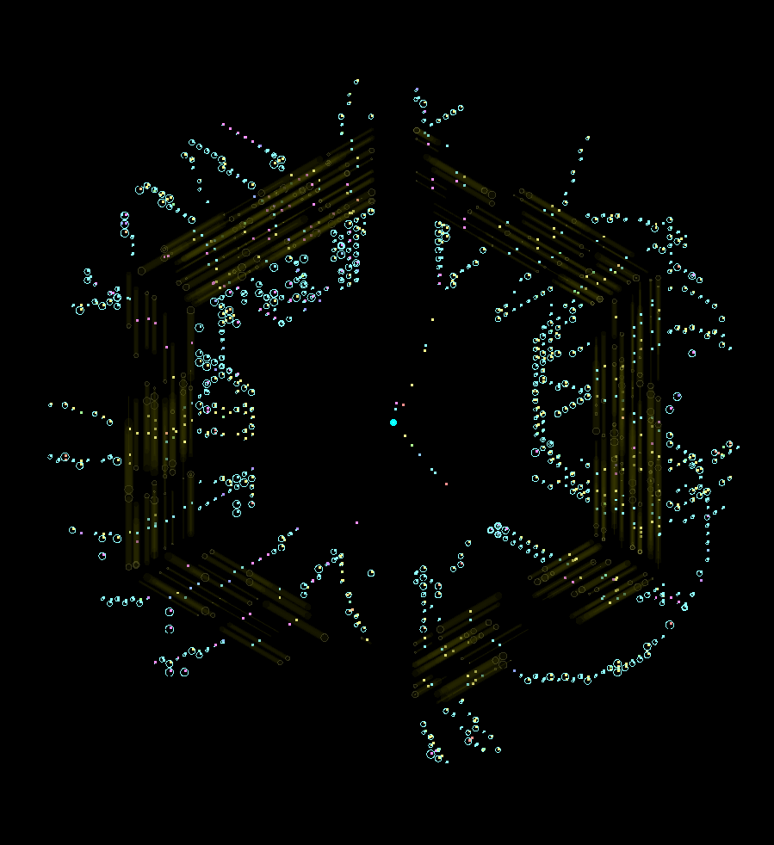
Event Display

Slide 15
Summary and Outlook
TimeGapEventBuilder very simple event builder for first stage of processing
Already quite good for MVD (> 50% clean events for MVD)
Possible to use different sub-detectors as start event builders
Possible to vary window size to improve purity or completeness of events
Can be used for all type of detectors

