Slide 1
Frascati September 8th, 2014
Improvements in the
offline Pattern Recognition
in the 20 MHz
interaction rate environment
Universita’
di Pavia
Italy
Gianluigi Boca
Universita’ di Pavia and INFN, Italy

Slide 2
Outlook of the talk
Efficiency of the Pattern recognition code with the use of both a road finding and a Hough transform algorithms has been shown to be satisfactory many times in the past in the ideal situation when no
pileup caused by the 20 MHz interaction rate.
Since basically last March I have been working in improving the code performances in the pileup situation. In fact initially the efficiencies were much worse because of the extra spurious hits
present from background DPM events.
In the following I will sketch schematically the modifications to the
code and the performances.
G.Boca U. Pavia & INFN, Italy

Slide 3
Fighting the negative effect of pileup DPM events
Essentially two negative effects :
the efficiency of finding all true hits belonging to a track
decreases and the presence of spurious hits increases;
2) many ghost tracks found.
Today I will concentrate on the first point.
As far as the ghost tracks are concerned I already wrote a class time
ago (the ‘Cleanup’ procedures) and I will perfection them after
point 1) has been finished.
G.Boca U. Pavia & INFN, Italy

Slide 4
Most important changes in the Pattern Recognition
code since last collaboration meeting
XY plane fit procedure :
- add another iteration after first Mvd hits association and fit;
- change Mvd and Stt axial hits error in conformal space fit;
- Sci Til hits association criterion a bit looser now (1.5 cm);
- now any axial Stt hit can belong to more than a track;
(arbitration later will take care of possible ghost tracks);
- fix a couple of bugs;
ϕZ space fit procedure :
- maximum allowed distance of Mvd hits from trajectory in
ϕZ space set to 1.5 cm; set Skew error to 0.5 cm/sin(3°) = 9.55;
- arbitration when two Mvd hits have the same ϕ;
- try fit with a Mvd hit less (fight against spurious Mvd hits);
- fix a couple of bugs;
G.Boca U. Pavia & INFN, Italy

Slide 5
Performance :
Track Reconstruction
Efficiency
G.Boca U. Pavia & INFN, Italy

Slide 6
Performance : Track Reconstruction Efficiency
MC Box Generator; % of reconstructed tracks (‘reconstructed track’ means tracks
found associated to a MC truth track);
Events with Background ( == pileup) at 20 MHz interaction rate
P GeV/c | tracks per event | # good gen. tracks | % rec. Tracks
0.3 | 1 | 3981 | 99.1
0.3 | 4 | 3986 | 98.8
0.3 | 8 | 3983 | 97.6
1.0 | 1 | 3871 | 99.4
1.0 | 4 | 3874 | 98.9
1.0 | 8 | 3892 | 98.5
performance excellent in efficiency !
G.Boca U. Pavia & INFN, Italy

Slide 7
Performance : Track Reconstruction Efficiency
MC Box Generator; % of reconstructed tracks (‘reconstructed track’ means tracks
found associated to a MC truth track);
Events with Background ( == pileup) at 20 MHz interaction rate
P GeV/c | tracks per event | # good gen. tracks | % rec. Tracks
2.0 | 1 | 3875 | 99.6
2.0 | 4 | 3858 | 99.4
2.0 | 8 | 3866 | 98.8
5.0 | 1 | 3872 | 99.5
5.0 | 4 | 3831 | 99.5
10.0 | 1 | 3886 | 99.5
performance excellent in efficiency !
G.Boca U. Pavia & INFN, Italy

Slide 8
Performance :
Hit Reconstruction
Efficiency
G.Boca U. Pavia & INFN, Italy

Slide 9
A reminder : the average MC truth hit type per track
P GeV | tracks per event | ave. || Stt hits per track | ave. Skew Stt hits per track | ave. Stt hit per track | ave. Pixel hits per track | ave. Strip hits per track | ave. Mvd hits per track
0.3 | 1 | 16.7 | 8.2 | 24.9 | 1.8 | 1.9 | 3.7
1.0 | 1 | 15.6 | 7.8 | 23.4 | 1.8 | 1.9 | 3.7
2.0 | 1 | 15.9 | 7.8 | 23.7 | 1.8 | 1.9 | 3.7
5.0 | 1 | 15.9 | 7.8 | 23.7 | 1.8 | 1.9 | 3.7
10.0 | 1 | 15.9 | 7.8 | 23.7 | 1.8 | 01.9 | 3.7
G.Boca U. Pavia & INFN, Italy

Slide 10
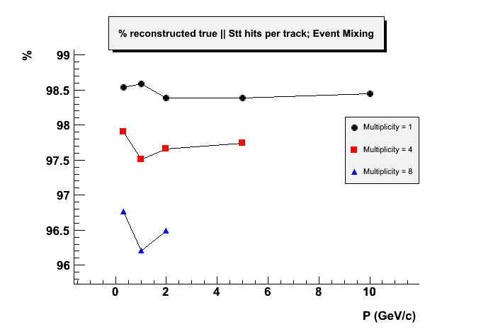
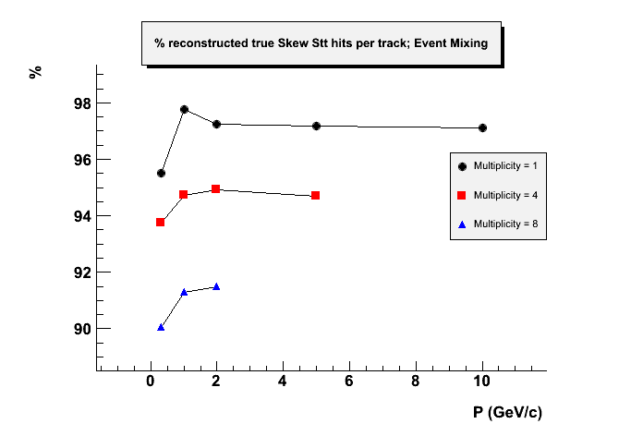
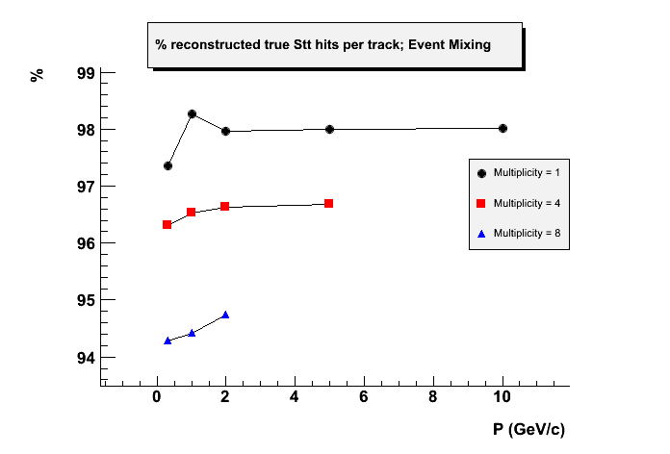
Performance : Stt Hit Reconstruction Efficiency
Excellent performance of the
code even for high multiplicity
events

Slide 11
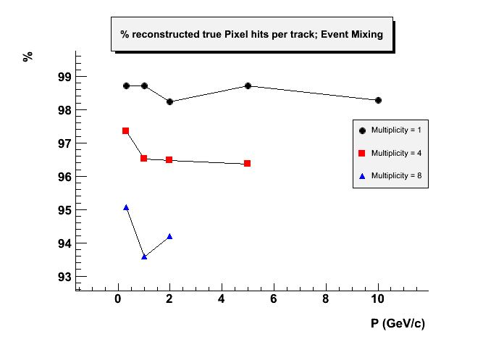
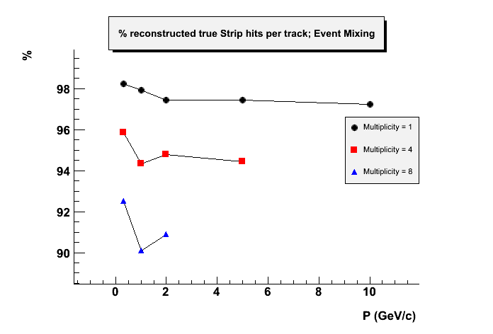
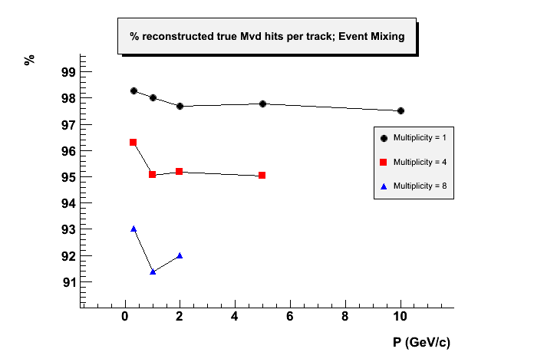
Performance : Mvd Hit Reconstruction Efficiency
Excellent performance of the
code even for high multiplicity
events

Slide 12
Performance :
Spurious Hits in
Reconstructed
Tracks
G.Boca U. Pavia & INFN, Italy

Slide 13
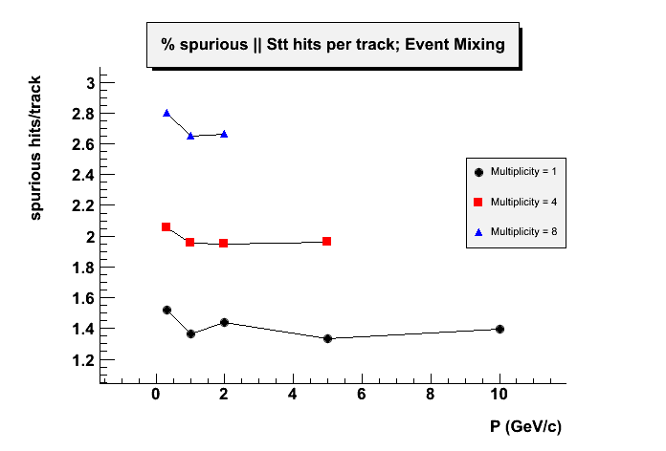
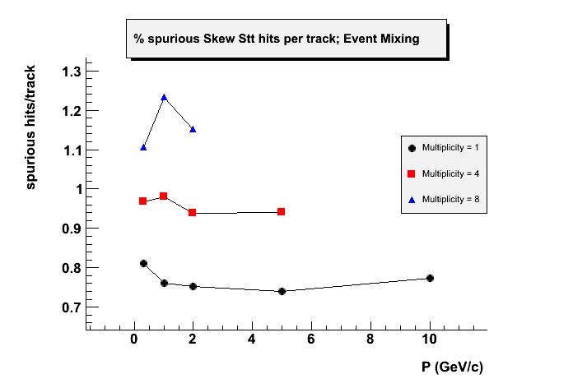
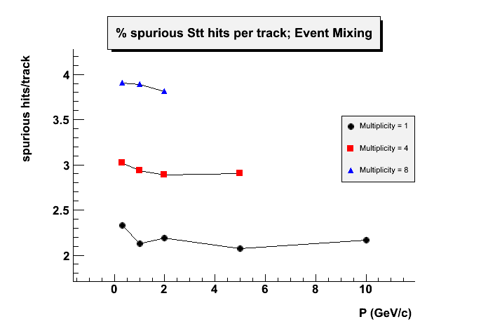
Performance : spurious Stt hits in reconstructed track
Perhaps still too many spurious
hits in the (surprisingly!) axial
hits especially at high multiplicity

Slide 14
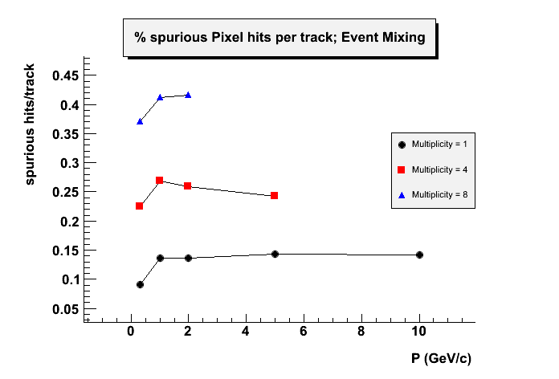
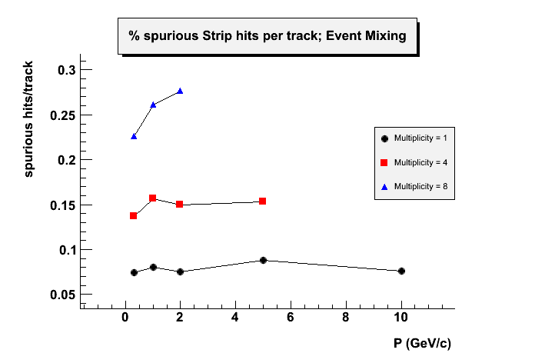
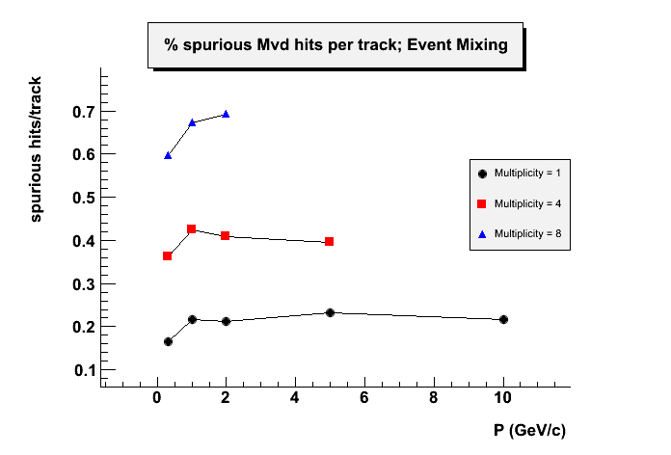
Performance : spurious Mvd hits in reconstructed track
Less problems with the Mvd
spurious hits

Slide 15
Performance :
what about the cputime/track?
G.Boca U. Pavia & INFN, Italy

Slide 16
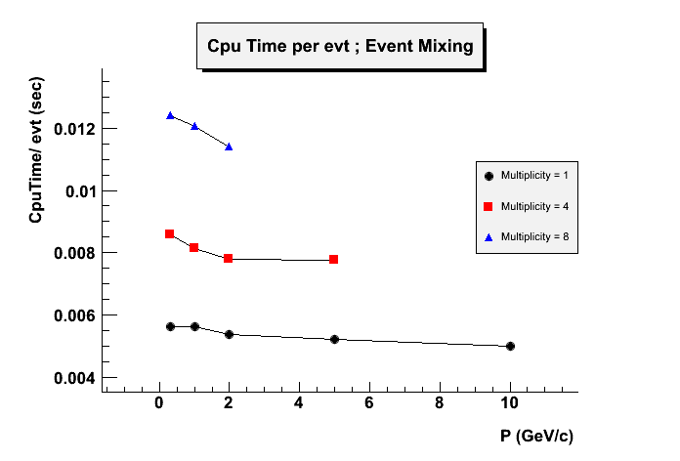
… more or less the same 5 msec/track
Cpu times measured on an Intel i7-2600K CPU @ 3.4 GHz 64 bit
G.Boca U. Pavia & INFN, Italy

Slide 17
Conclusions and future steps
The efficiency of the code in finding the true hits in a track in a 20
MHz environment is very good both for Stt and Mvd hits in the
central tracker.
The cputime per track hasn’t changed much : more or less it is
the usual 5 msec/track in a conventional Cpu.
A problem remains with the axial Stt spurious hit presence and
hopefully I will fix it nextly.
After that I will revert to the refinement of the Cleanup procedure.
After that the code will be parallelized.
G.Boca U. Pavia & INFN, Italy

