Slide 1

FAIR – Facility for Antiproton and Ion Research
Inti Lehmann
Facility for Antiproton and Ion Research
Darmstadt, Germany
2nd PhD Science Day @ GSI 2014 – 11 August 2014

Slide 2
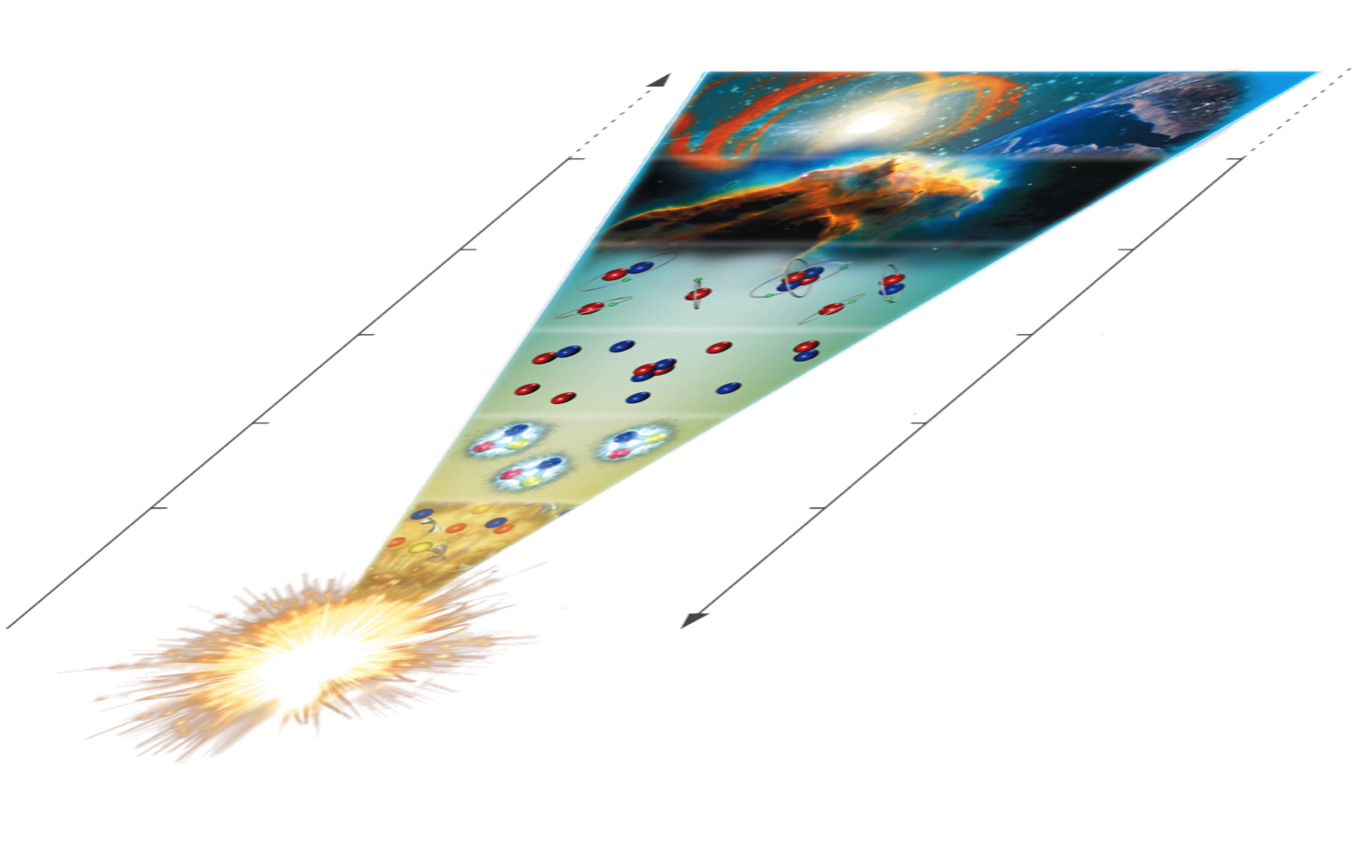
FAIR Science Sketch
time
Atomic, applied and
plasma physics - APPA
Astrophysics and
nuclear structure
- NUSTAR
Hadron structure
- PANDA
QCD phase transition - CBM
temperature
big bang

Slide 3
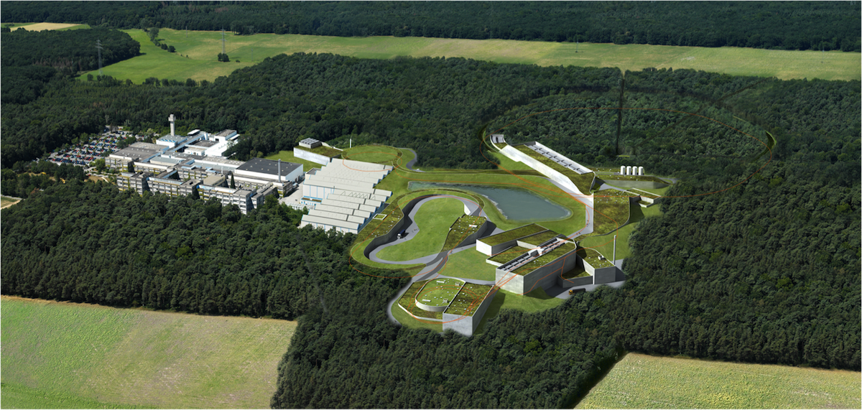


The FAIR Project
APPA
  ions, antiprotons
  CBM
  relativistic nuclear collisions
PANDA
antiproton beams
NUSTAR
  radioactive ion beams

Slide 4
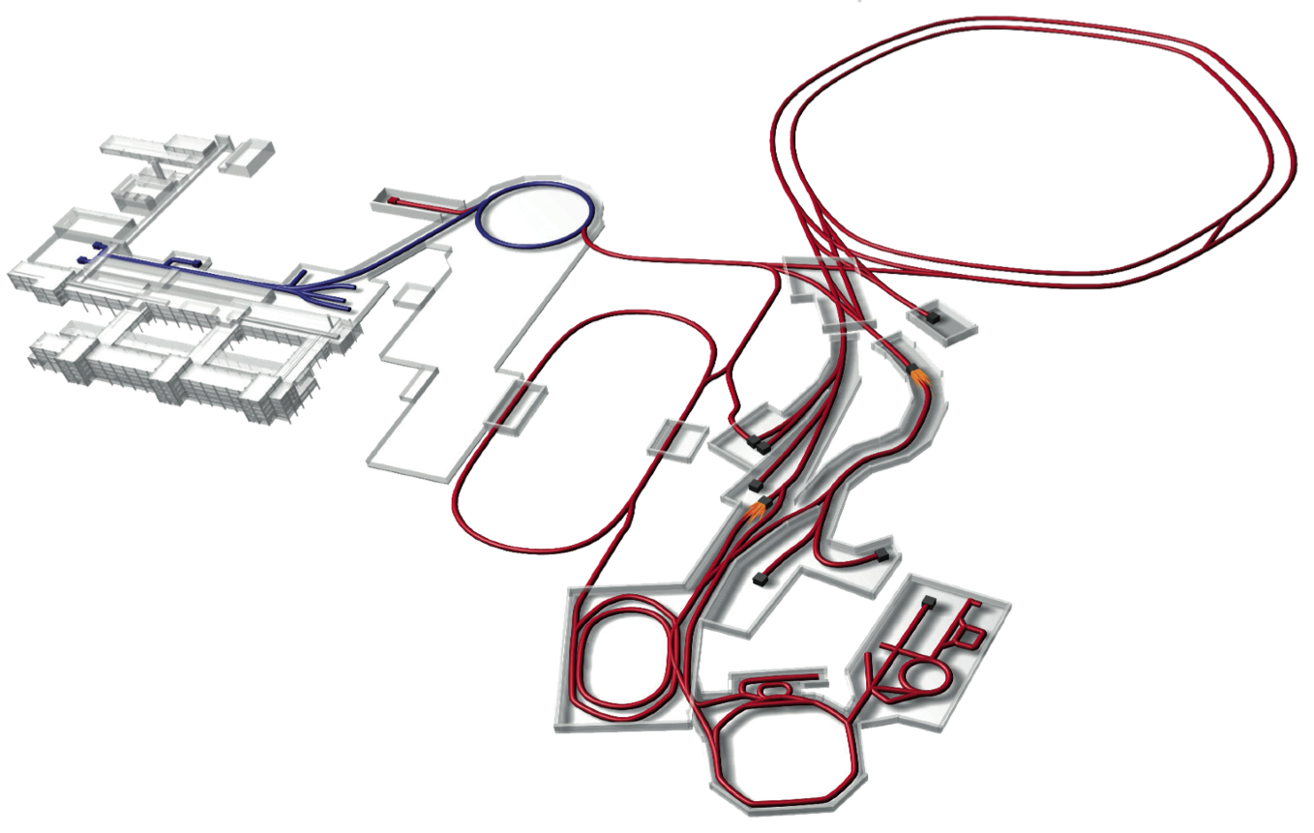
Facility for Antiproton and Ion Research
p-Linac
SIS18
SIS100/300
UNILAC
HESR
Rare-Isotope
Production Target
Anti-Proton
Production Target
CR &
RESR
Cryring
NESR
100 m

Slide 5
Facility for Antiproton and Ion Research
Primary Beams
10¹²/s; 1.5 GeV/u; ²³⁸U²⁸⁺
10¹⁰/s ²³⁸U⁷³⁺ up to 35 GeV/u
3x10¹³/s 30 GeV protons
p-Linac
SIS18
SIS100/300
UNILAC
Secondary Beams
range of radioactive beams up to
1.5 - 2 GeV/u; up to factor 10 000 higher in intensity than presently
antiprotons 3 - 30 GeV
HESR
Rare-Isotope
Production Target
Anti-Proton
Production Target
Storage and Cooler Rings
radioactive beams
10¹¹ antiprotons 1.5 - 15 GeV/c,
stored and cooled
CR &
RESR
Cryring
NESR
100 m
Technical Challenges
cooled beams, rapid cycling superconducting magnets

Slide 6
The 4 Scientific Pillars of FAIR
APPA: Atomic, Plasma Physics and Applications
CBM: Compressed Baryonic Matter
NUSTAR: Nuclear Structure, Astrophysics and Reactions
PANDA: Antiproton Annihilations at Darmstadt

Slide 7
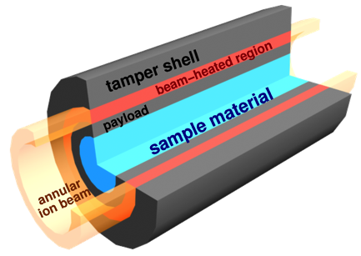
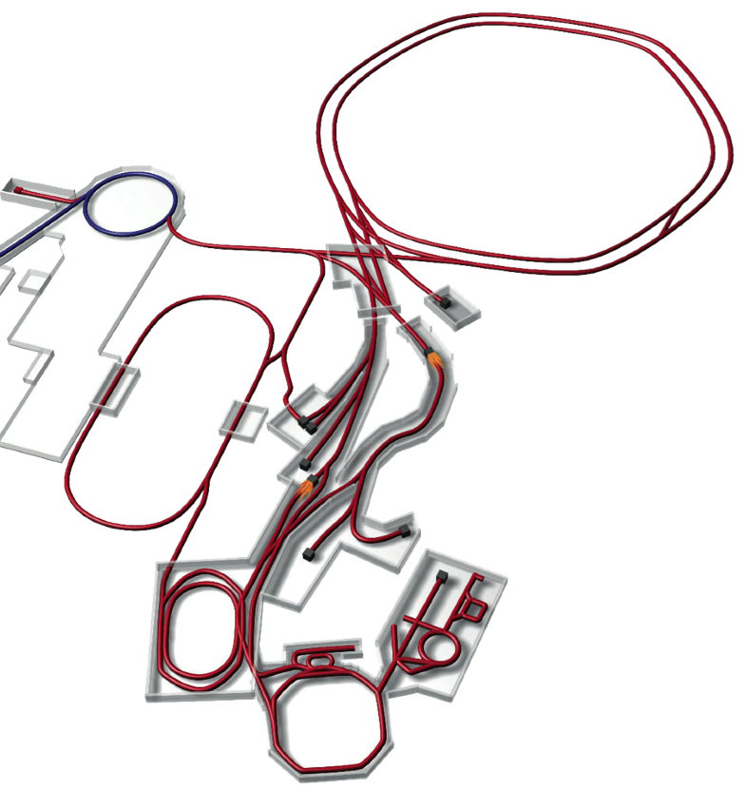
APPA
Atomic, Plasma Physics and Applications
  About 700 members
  Wide field of science
    basic research to material, biological and medical applications
APPA
Atomic Physics
SPARC: 284 members from 26 countries
FLAIR: 144 members from 15 countries
Plasma Physics
HEDgeHOB & WDM: 175 members from 16 countries
Materials Research and Biophysics
BIOMAT: 110 members from 12 countries

Slide 8
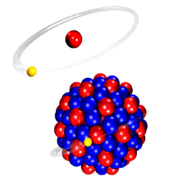
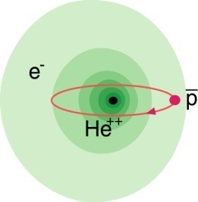
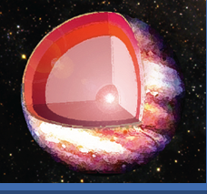
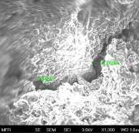
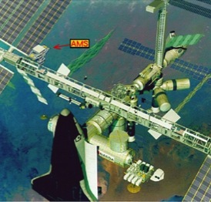
APPA Science Case
Atomic Physics
Plasma
Materials
Bio
SPARC
FLAIR
HEDgeHOB/WDM
MAT/BIOMAT
BIO/BIOMAT
strong field research
... probing of fundamental laws of physics
anti-matter
... matter / anti-matter asymmetry
planetary interiors
... states of matter common in astrophysical objects
extreme conditions
... radiation hardness and modification of materials
aerospace engineering
... radiation shielding of cosmic radiation
Highest Charge States Extreme Static Fields
Relativistic Energies Extreme Dynamical Fields and Ultrashort Pulses
High Intensities Very High Energy Densities and Pressures
High Charge at Low Velocity Large Energy Deposition
Low-Energy Anti-Protons Antimatter Research

Slide 9
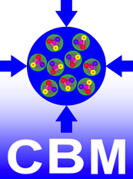
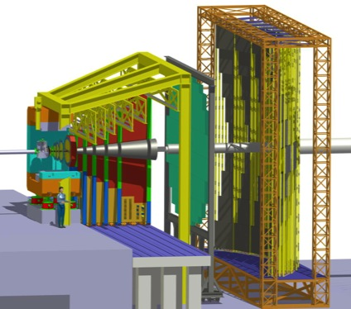
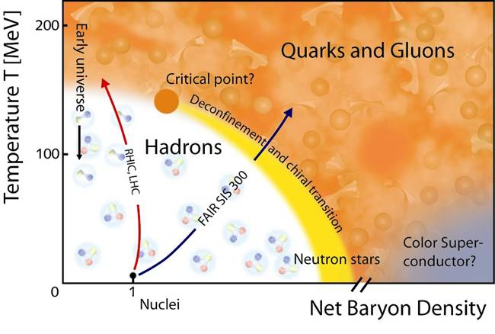
CBM
Compressed Baryonic Matter
  About 400 members
CBM

Slide 10
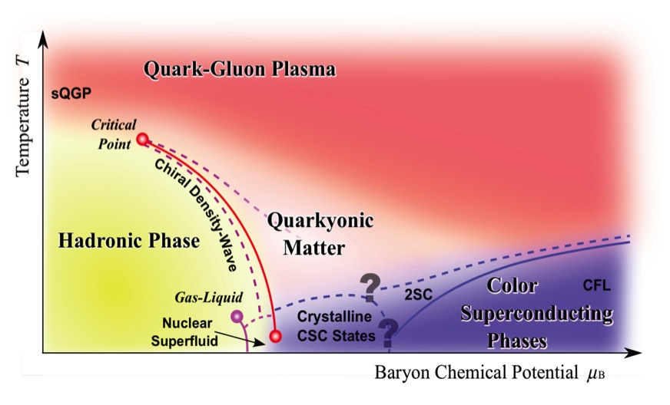
CBM Physics Case
The equation-of-state at high baryonic density
New phases of strongly-interacting matter
Deconfinement phase transition at high baryonic density
QCD critical endpoint
Onset of chiral symmetry restoration at high baryonic density
Strange matter
RHIC, LHC
FAIR
Courtesy of T. Hatsuda

Slide 11
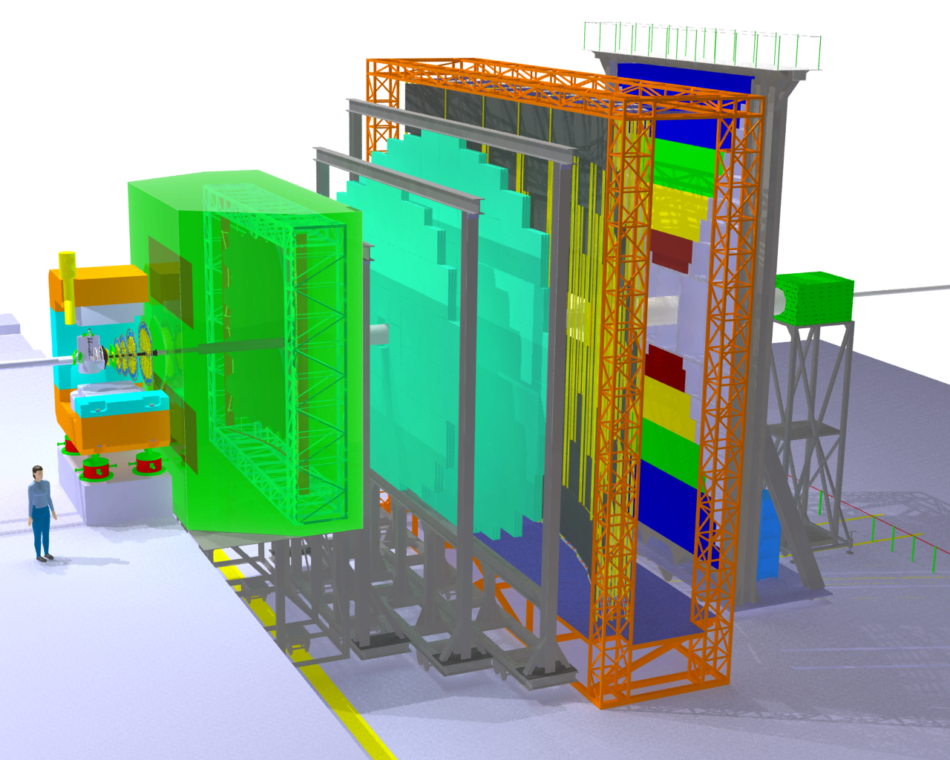
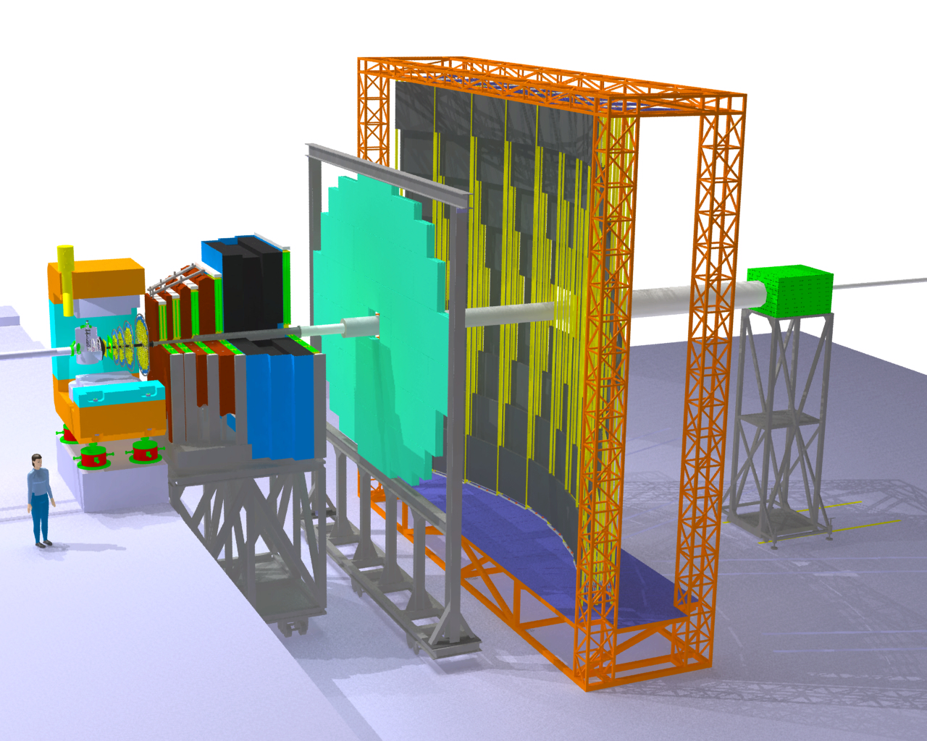
CBM Detector
Transition
Radiation
Detectors
Tracking
Detector
Muon
detection
System
Electro-
magnetic
Calorimeter
Ring Imaging
Cherenkov
Detector
Silicon
Tracking
Stations
Vertex
Detector
Projectile
Spectator
Detector
(Calorimeter)
Dipol
magnet
Resistive
Plate
Chambers
(TOF)

Slide 12

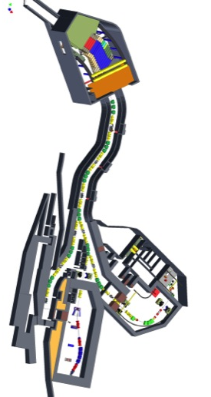
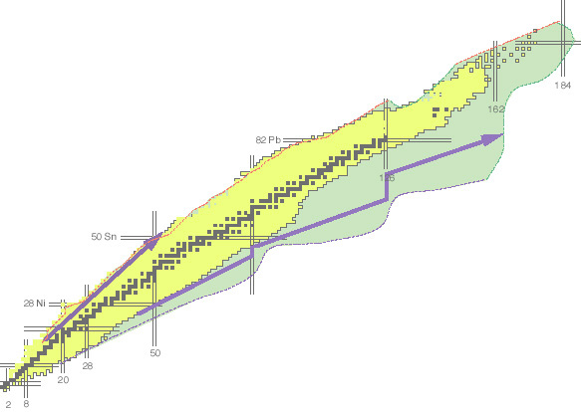
NUSTAR
Nuclear Structure, Astrophysics and Reactions
  About 800 members
Super-FRS
NUSTAR

Slide 13
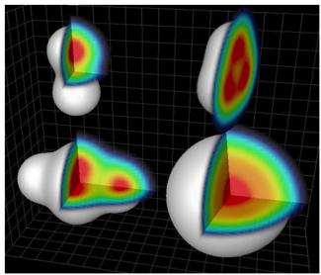
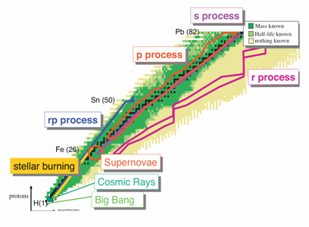
NUSTAR – Physics Case
Nuclear structure
Underlying QCD structure → complex nucleon-nucleon force
Study of exotic short lived nuclei far off stability
(proton/ neutron skins or halos, new magic numbers...)
→ Pave way for theoretical framework with predictive power for nuclei beyond experimental reach
Astrophysics
Origin of the heavy elements?
Physics of stellar explosions (core-collapse,
thermonuclear supernovae, nucleosynthesis)
Compact objects and the explosions on
their surfaces (x-ray bursts)

Slide 14
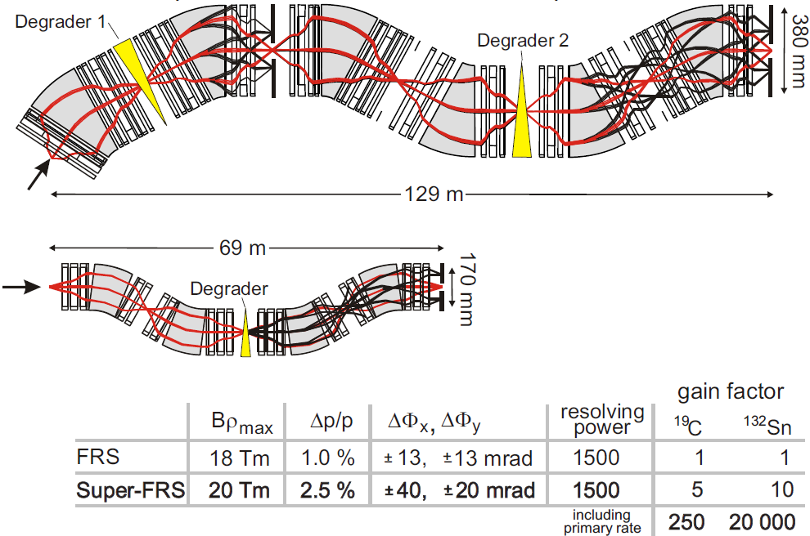
GSI FRS → FAIR Super-FRS
Super-FRS
FRS
1000 7500

Slide 15

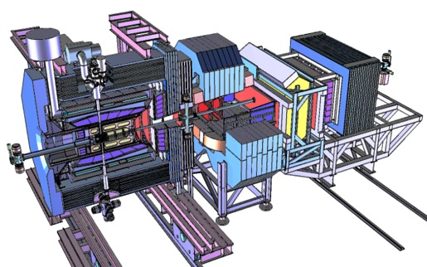
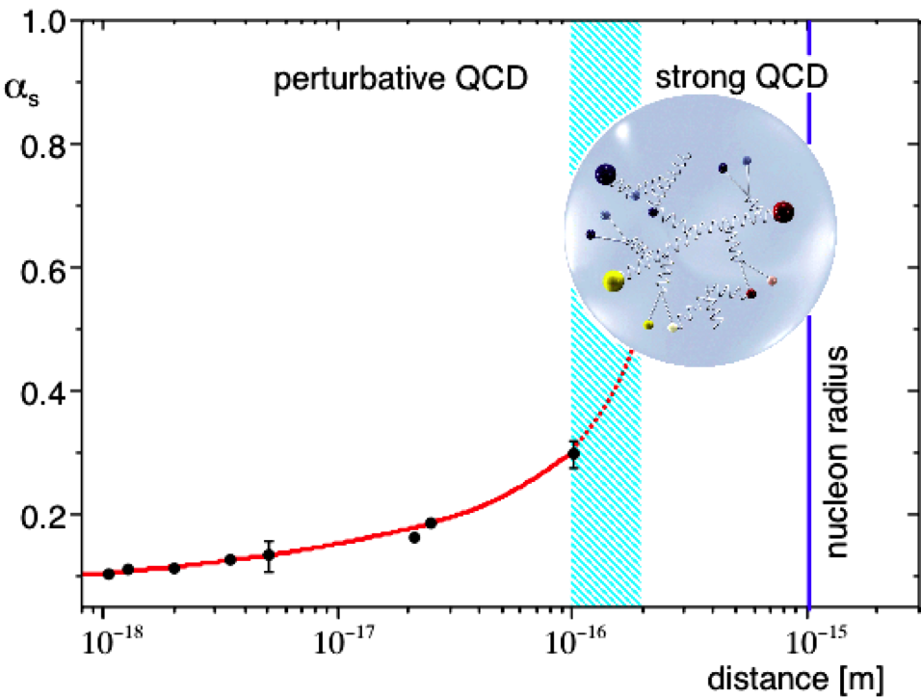
PANDA
Antiproton Annihilations at Darmstadt
  About 500 members
PANDA

Slide 16
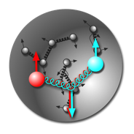
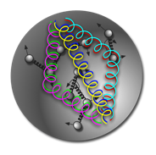
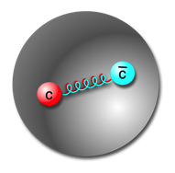
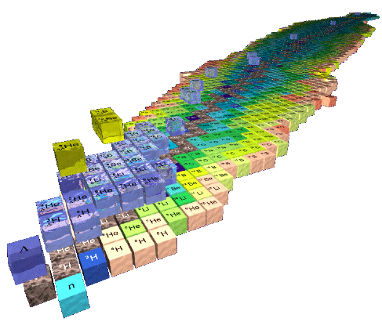
PANDA Physics Case
Gluonic excitations
  Hybrids, glueballs
Charmonium states
  Precision spectroscopy
Time-like
  Form factors, nucleon structure
In medium mass modifications
  Extension to the charm sector
Extension of nuclear chart
  Double hypernuclei
And much more...
π⁻
25 MeV
π
π⁺
K
K⁺
100 MeV
K⁻
D
D⁻
D⁺
50 MeV

Slide 17
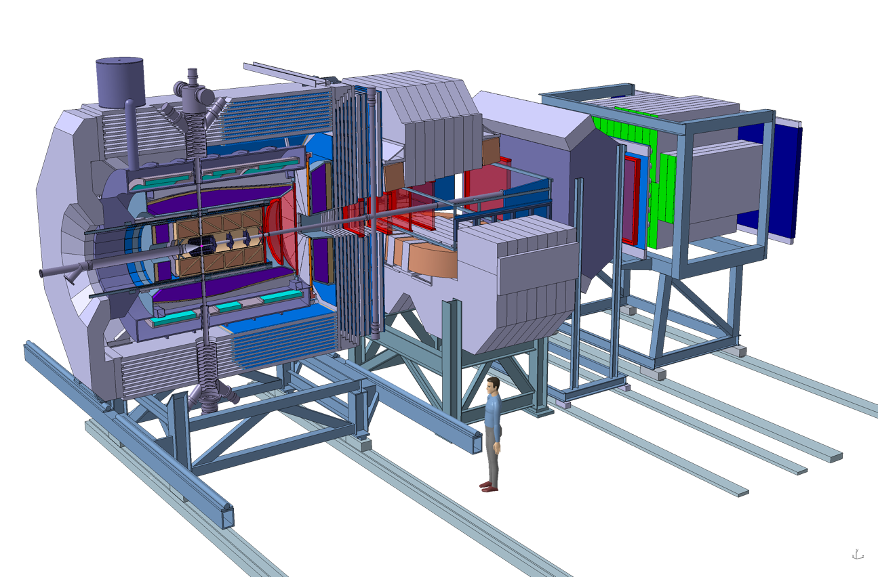
PANDA Experimental Set-Up
Fixed target magnetic spectrometer experiment
Target Spectrometer
Forward Spectrometer
Beam
Dipole
Solenoid
Interaction
point

Slide 18
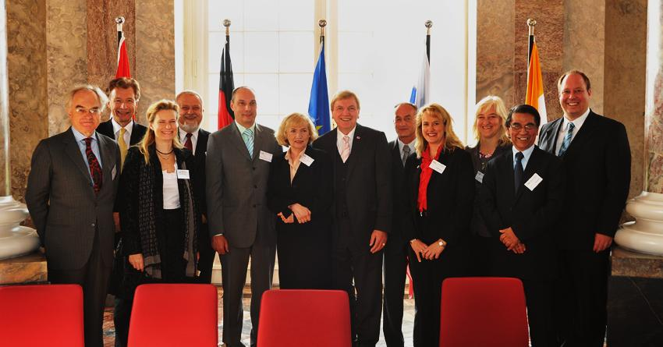










FAIR GmbH
Steering company
International Convention
Partners
Wiesbaden, 2010
Finland
France
Germany
India
Poland
Romania
Russia
Slovenia
Sweden
UK
Convention in force since March 2014

Slide 19
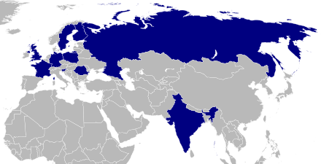
Partners and Funding
Contracting Party | Contribution (in 2005 M€)
Finland | 5.00
France | 27.00
Germany | 705.00
India | 36.00
Poland | 23.74
Romania | 11.87
Russia | 178.05
Slovenia | 12.00
Sweden | 10.00
Total | 1.008,66
All numbers in 2005 €
escalation until 2018 ca. +50%
i.e. about € 1.6 billion
Most contributions in-kind
Discussions with Spain and Italy on-going
Interested parties
  ESA, Saudi Arabia, Netherlands, China, Turkey, Brazil, Ukraine, S Korea, Japan, USA

Slide 20
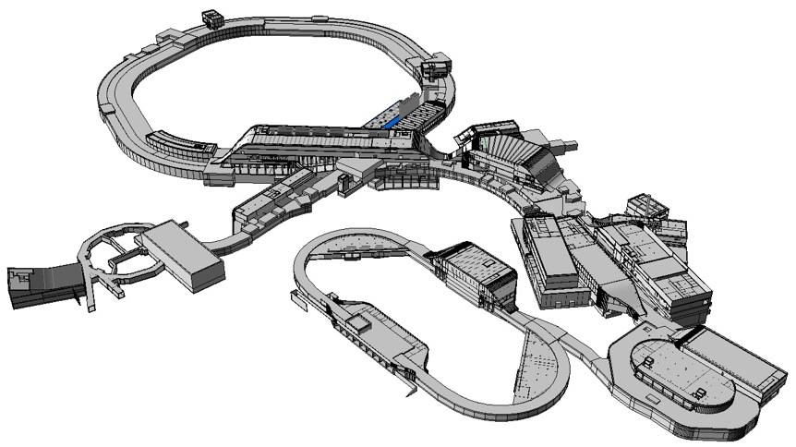
Civil Construction
Synchrotrons: 1.1 km
HESR: 0.6 km
With beamlines: 3.2 km
Existing SIS 18
All building permits granted as of May 2014
Total area > 200 000 m²
Area buildings ~ 98 000 m²
Usable area ~ 135 000 m²
Volume of buildings ~ 1 049 000 m³
Substructure:~ 1500 pillars, up to 65 m deep

Slide 21
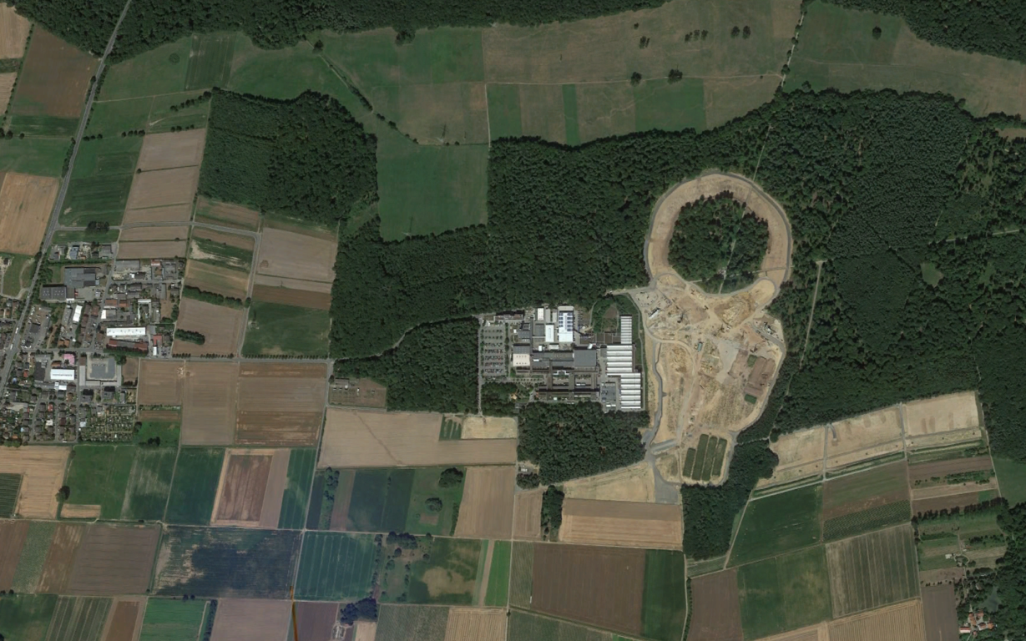
Civil Construction: Satellite’s View
Type |  |  | Mass (t)
 |  |  | 5.835.000
Soil out | 1.154.000 | m3 | 2.077.200
Soil in | 1.078.000 | m3 | 1.940.400
Concrete | 519.000 | m3 | 1.283.400
Reinforcement steel | 34.000 | t | 34.000
Other | 500.000 | t | 500.000
2.5 km
Google Earth for FAIR 7.12.2013

Slide 22
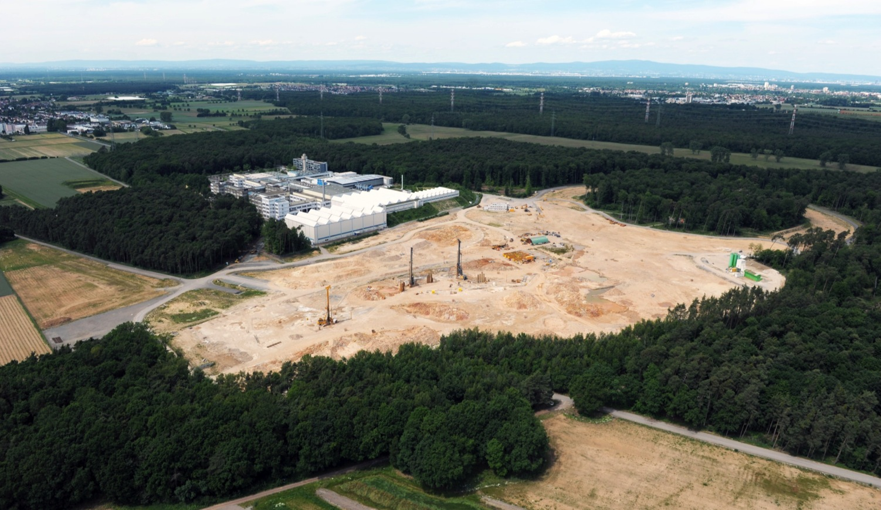
Bird’s View

Slide 23
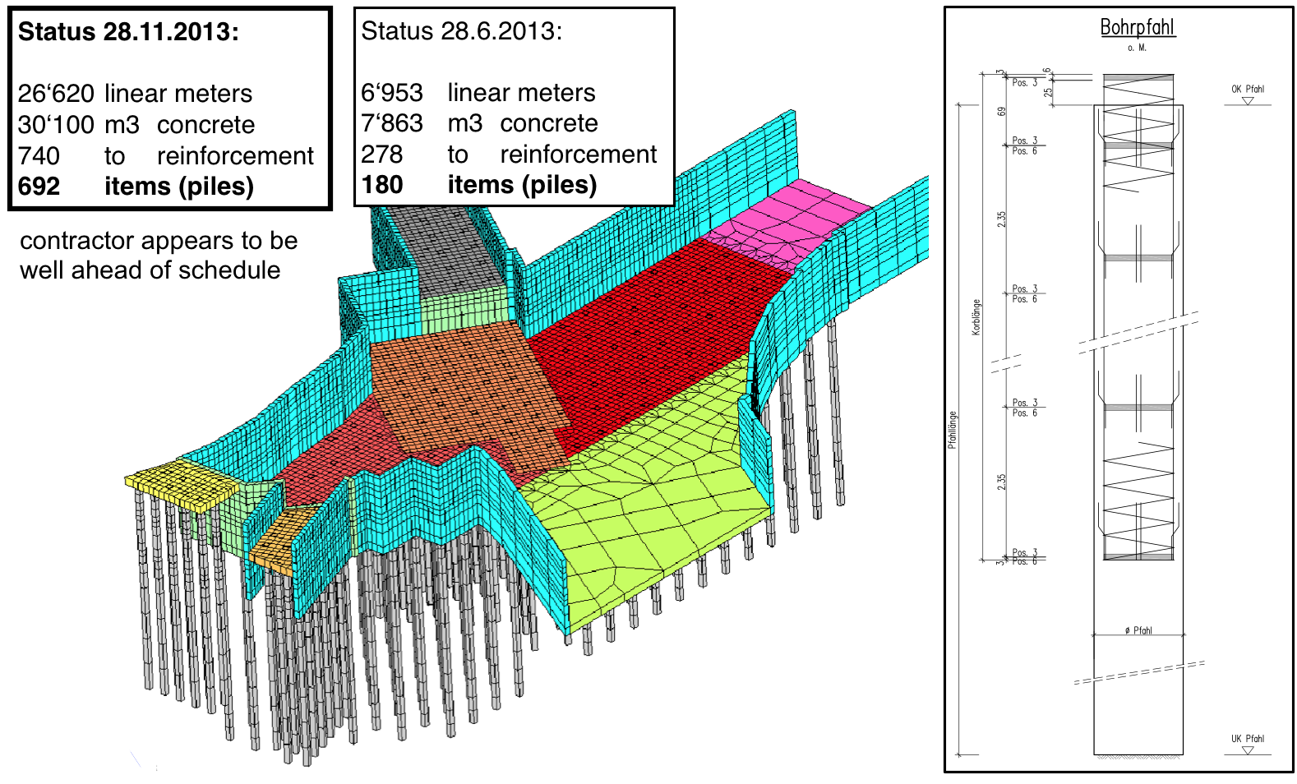
Piles
Finished
May 2014 1350 piles

Slide 24
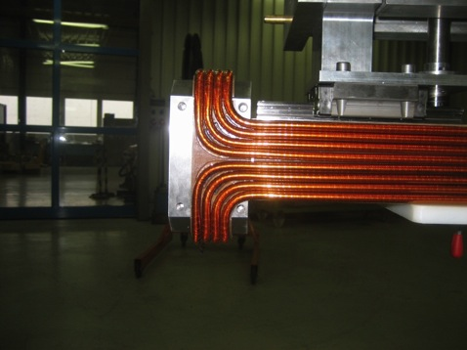
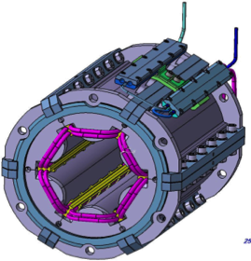
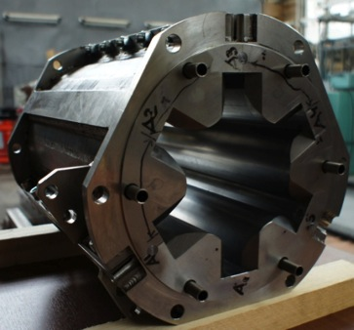
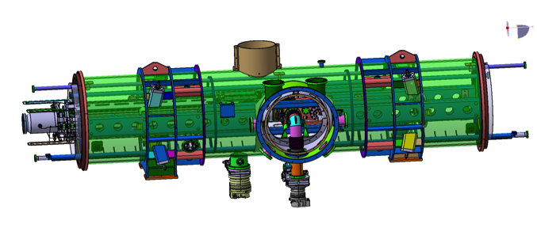
Accelerator’s Status
Progressing well
SIS 100 dipoles
  First series del.+tested
SIS 100 sextopoles
  Dubna prototype
HEBT magnets
  Efremov, St Petersburg
SIS 100 quadrupoles
  JINR, Dubna

Slide 25
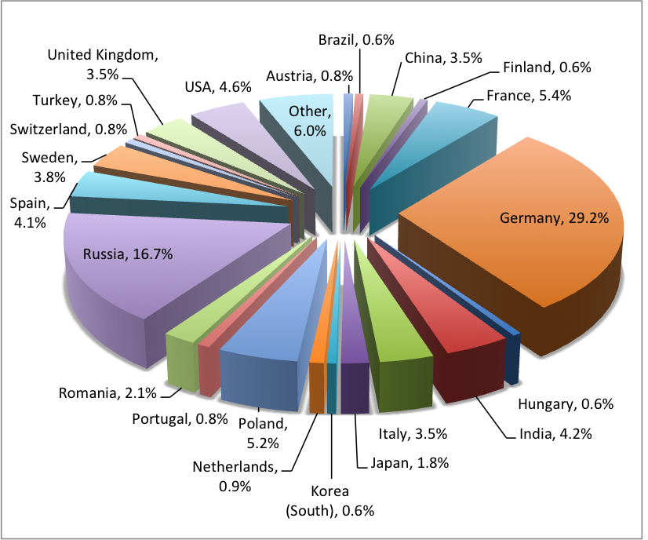
Collaboration Members by Country

Slide 26
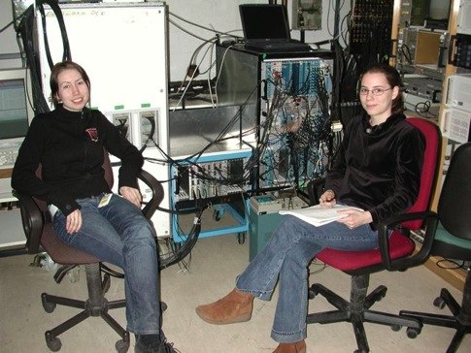
How to Work for/at FAIR
Many opportunities in the future
  3000 researchers world wide
  Facility will grow
  Many scientists will be needed in the coming years
  Opportunities after merger (next year)
What to do now as researcher – my personal view
  Join international research group engaged in FAIR
  About 150 groups
  In 51 countries
  At the heart of science
  Cutting edge developments

Slide 27
From 2019 onwards
Understand more
about:
life,
the universe...
...and everything!
time
Atomic, applied and
plasma physics - APPA
Astrophysics and
nuclear structure
- NUSTAR
Hadron structure
- PANDA
QCD phase transition - CBM
temperature
big bang

