Slide 1
FPGA Helix Tracking Algorithm for PANDA
Yutie Liang, Martin Galuska, Thomas Geßler, Jifeng Hu, Wolfgang Kühn, Jens Sören Lange, David Münchow, Björn Spruck, Milan Wagner
II. Physikalisches Institut, JUSTUS-LIEBIG-UNIVERSITÄT GIESSEN
13.05.2014

Slide 2
Outline
1. Introduction
PANDA, DAQ, STT
2. Tracking algorithm
3. Performance study with C++
Implementation in VHDL
5. Summary and outlook

Slide 3
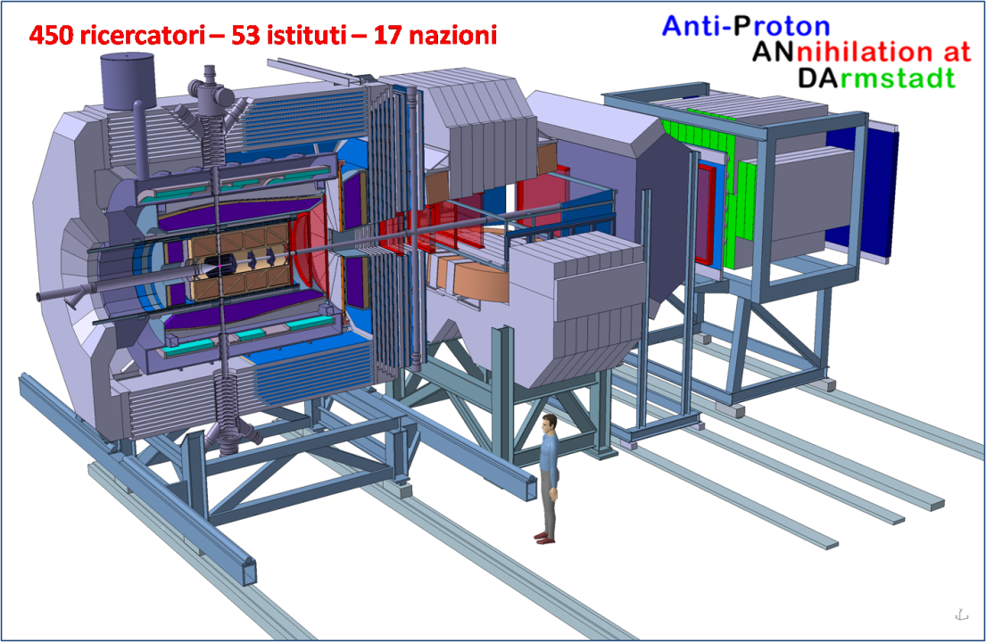
The PANDA experiment
Physics: Strong interaction studies with antiprotons
Beam of anti-proton with 15 GeV/c on proton fixed target
2*10⁷ annihilations /s
→ 2.5*10⁴ events/s to storage, online reduction factor of ~ 1000

Slide 4
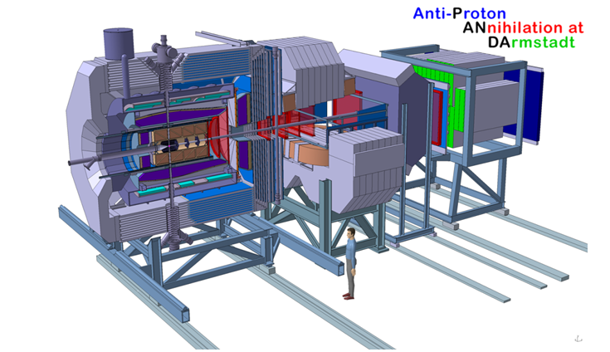
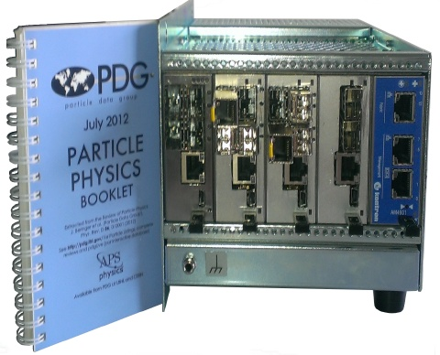
The Structure of PANDA TDAQ
Time Distribution System – provide clock for hit timestamps
Concentrators/Buffers – buffering and on the fly data flow manipulation
L1 Compute Nodes – mark hits which might belong to the same event (time slice)
L2 Feature Extraction Nodes – combine detector information to extract physical signatures (momentum, …)
L3 Event Selection Nodes – event selection based on a complete reconstruction (PID, vertex, invariant mass, …)
Prototype Trigger-less
Data Acquisition
by Milan Wagner

Slide 5
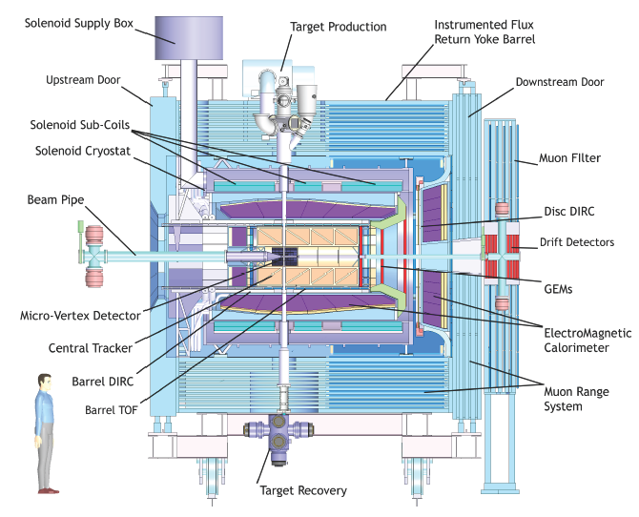
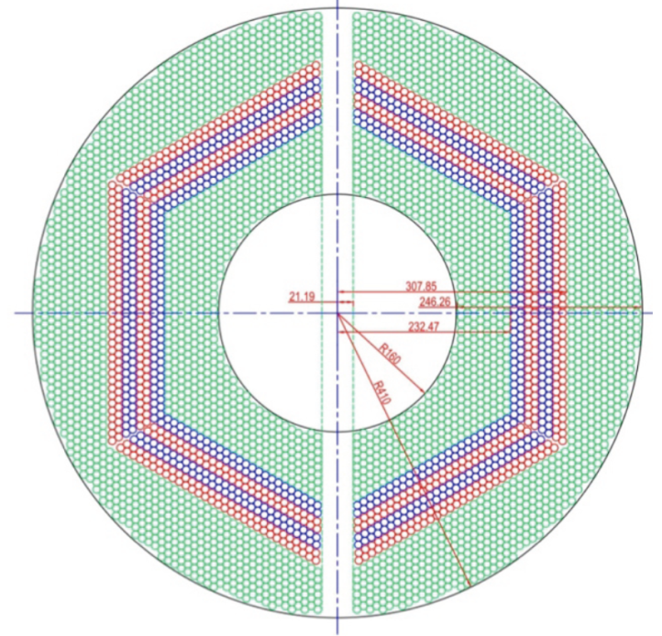
Straw Tube Tracker (STT)
4636 Straw tubes
23-27 planar layers
15-19 axial layers (green) in beam direction
4 stereo double-layers for 3D reconstruction,
with ±2.89 skew angle (blue/red)
From STT : Wire position + drift time

Slide 6
Tracking Algorithm -- Road Finding
Layer_ID
Hit
Hit
Hit
Hit
Hit
Hit
Hit
Hit
Hit
Hit
Hit
Tube_ID
Hit: Seg_ID(3 bits) + LayerID(4 bits) + Tube_ID (6 bits) + Arrival time
1: Start from inner layer
2: Attach neighbour hit to tracklet layer by layer
Boundary between two segments.
Number of neighbor: 4

Slide 7
Tracking Algorithm -- helix parameters calculation
Known : x_{i} , y_{i} , d_{i}
Question: To determine a circle,
x² + y² + ax + by + c = 0
Method: Minimize the equation
E² = ∑(x_{i}² + y_{i}² + a x_{i}+ b y_{i} + c)² (1/d_{i})²
y
x
1) Circle para.
S_{x} = ∑x_{i} …
S_{xx} = ∑x_{i}x_{i} …
S_{xxx} = ∑x_{i}x_{i}x_{i} …
2) Track quality.

Slide 8
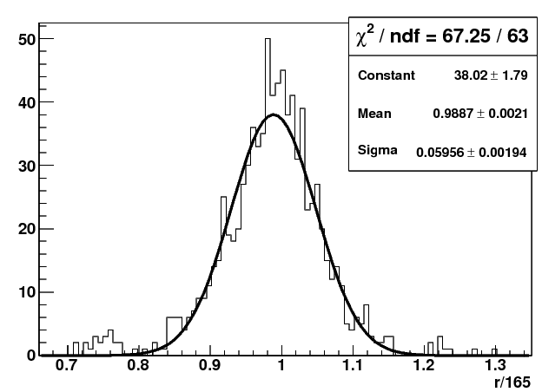
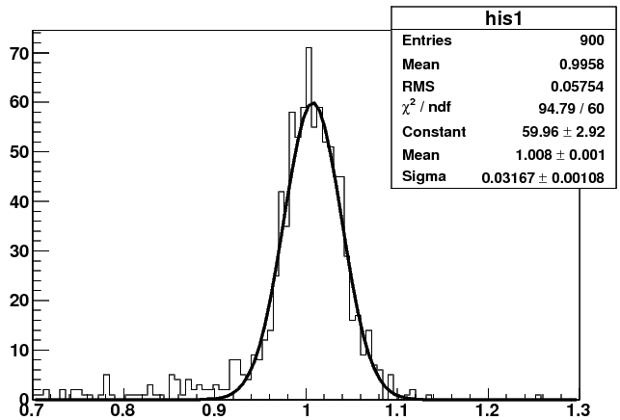
To Improve the Momentum Resolution -- using a 2nd iteration
y
Pt(input) 1st iteration 2nd iteration
0.2GeV/c : 0.195 ±0.0068 0.195±0.0068
0.5GeV/c : 0.5 ±0.0212 0.5 ± 0.0164
1.0GeV/c : 0.99 ±0.0595 1.0 ± 0.0317
2.0GeV/c : 1.85 ±0.213 2.0 ± 0.073
x_{c}, y_{c}, R
x
1st iteration
2nd iteration
Pt(GeV/c)
Pt(GeV/c)

Slide 9
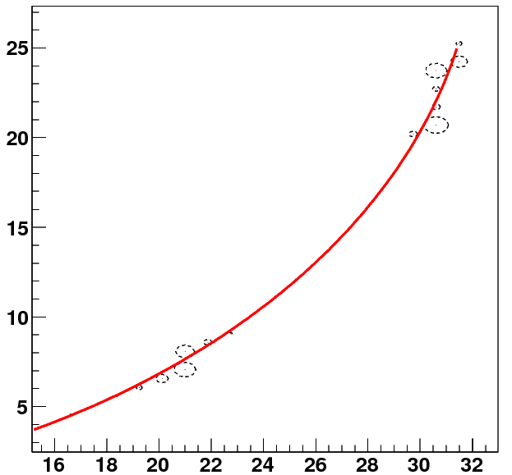
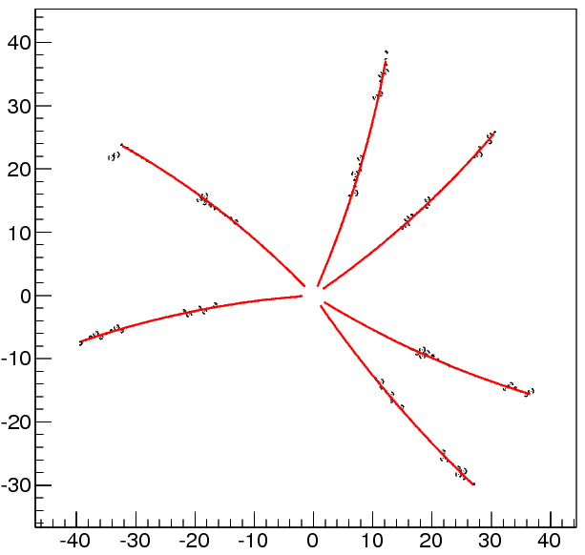
Performance Study -- single/multi-track
Single track, 0.2GeV
Multi-track
y(cm)
y(cm)
x(cm)
x(cm)

Slide 10
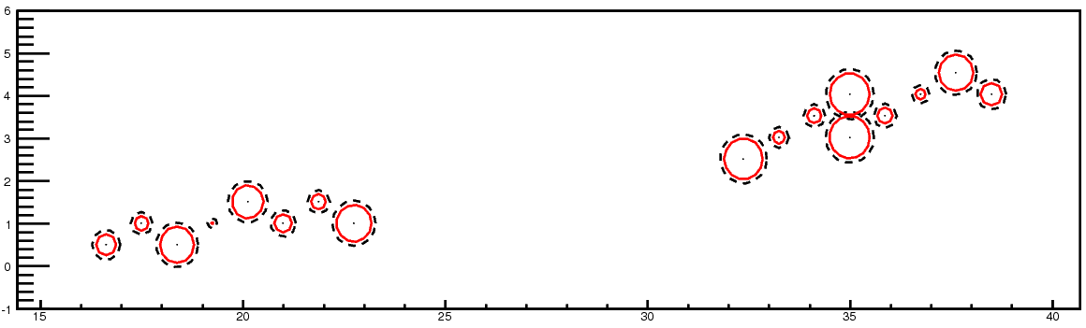
Event Structure -- pile-up
20 MHz
2000 ns revolution time
200 ns gap
T_{Mean} between 2 events: 50 ns
Drift time: ~200 ns
Event pile-up
Wrong T0 → Wrong drift circle → bad track quality

Slide 11
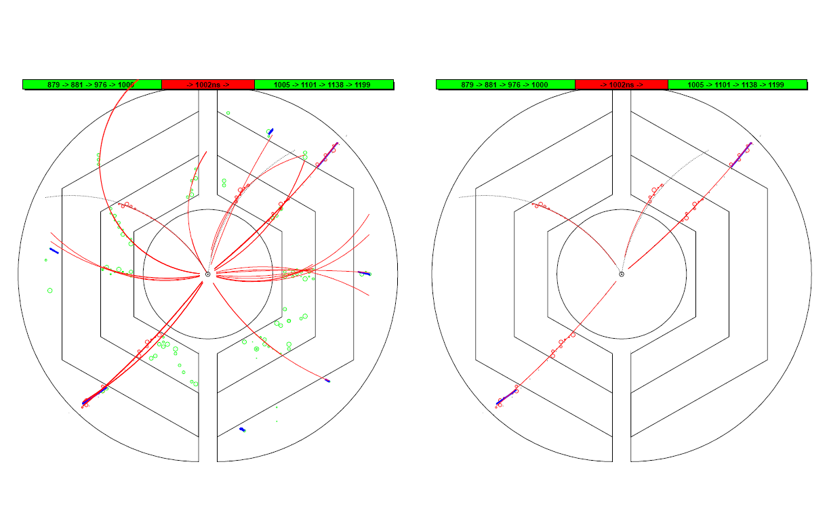
Performance Study -- realistic events, time-based
T₀ information: current event(Red) or other events(Green)
Black dashed line: track by MC truth
Red line: recon. track
Blue: recon. using outer layers
drift circles belong to current event (Red) or other events (Green)
Event #4
Event #4

Slide 12
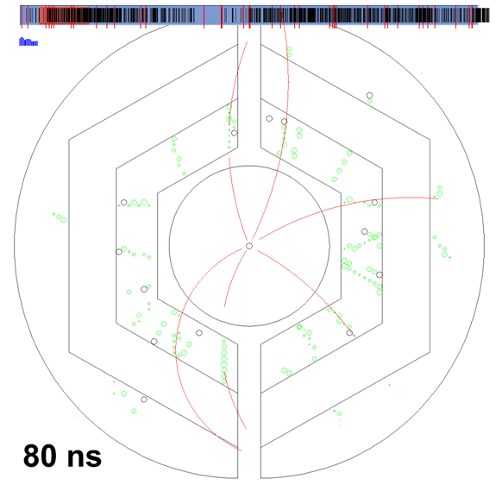
Hitstream and Tracking Display
  15 GeV/c DPM events with 50 ns mean time
  Input:
    STT Timestamps and Straw numbers (220 ns window)
  Running t_{0i} window
  Color code of isochrone:
    Black: Isochrone too large
    Red: Isochrone too small
    Green: Isochrone
  Color code in upper panel:
    Black: Hit position in timestamp
    Red: t₀ from MC truth
    Blue: Running χ² of tracking

Slide 13
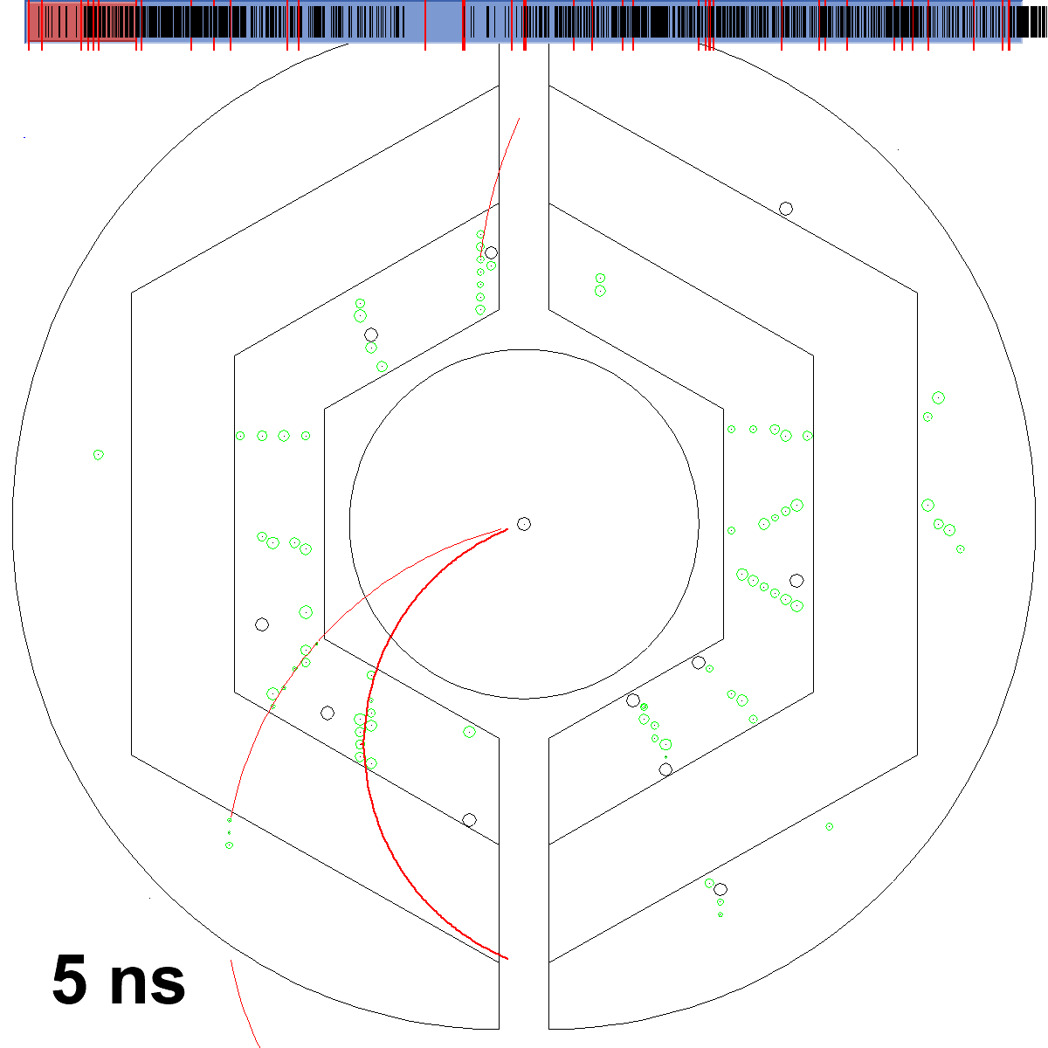

Slide 14
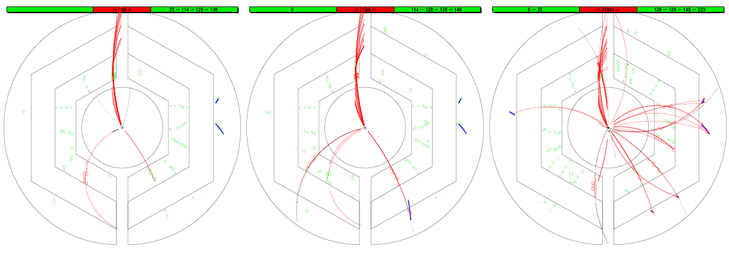
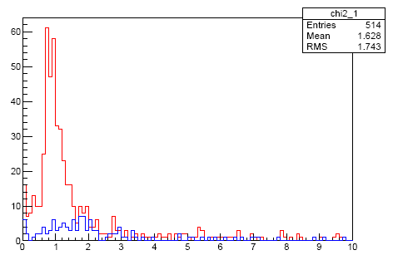
Assign Track to Correct Event
1: Number of hits in the track
2: χ² of the track
χ²

Slide 15
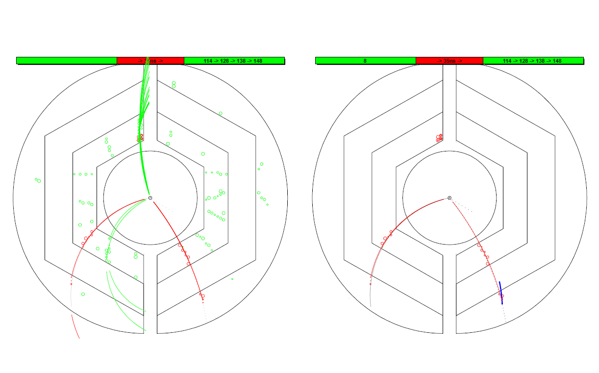
Assign Track to Correct Event
T₀ information: current event(Red) or other events(Green)
Black dashed line: track by MC truth
Red line: recon. track
Blue: recon. using outer layers
drift circles belong to current event (Red) or other events (Green)
Event #1
Event #1

Slide 16
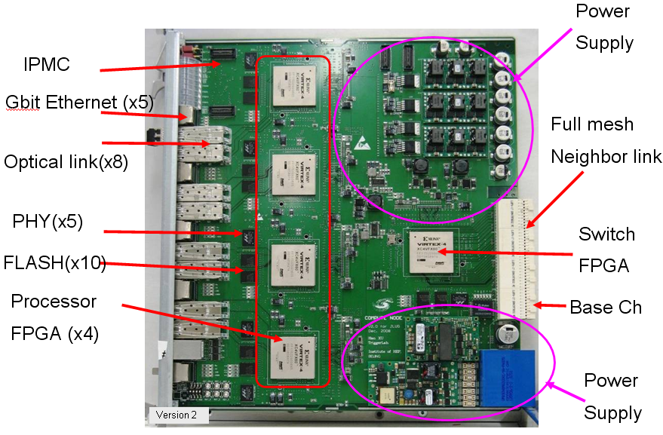
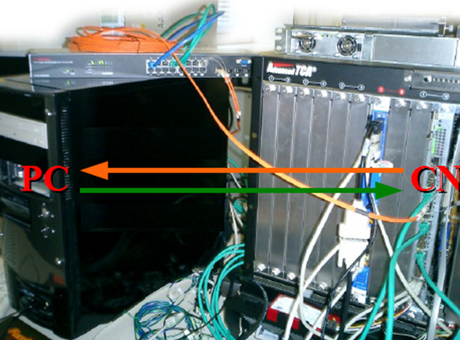

VHDL Implementation
VHDL: Very-high-speed integrated circuits Hardware Description Language.
It’s a dataflow language, unlike procedural computing languages such as C++ which runs sequentially, one instruction at a time.

Slide 17
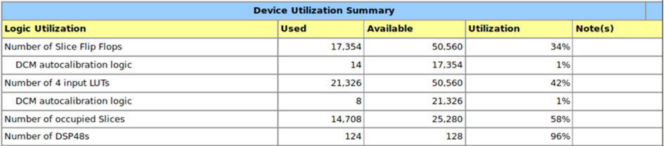
Performance at FPGA
Only 1st iteration is implemented in VHDL
1: Device Utilization Summary:
2: Time per event:
1 burst, 20 MHz, 40 events
→ 260 μs

Slide 18
Tracking at FPGA -- at low event rate
Data flow: Hit information at PC → FPGA, extract helix para. → PC
PC is used to draw hits and helix in the plot. The helix parameters come from FPGA.

Slide 19
Tracking at FPGA -- at low event rate
Data flow: Hit information at PC → FPGA, extract helix para. → PC
PC is used to draw hits and helix in the plot. The helix parameters come from FPGA.

Slide 20
Tracking at FPGA -- at low event rate
Data flow: Hit information at PC → FPGA, extract helix para. → PC
PC is used to draw hits and helix in the plot. The helix parameters come from FPGA.

Slide 21
Tracking at FPGA -- 20 MHz
Data flow: Hit information at PC → FPGA, extract helix para. → PC
PC is used to draw hits and helix in the plot. The helix parameters come from FPGA.

Slide 22
Tracking at FPGA -- 20 MHz
Data flow: Hit information at PC → FPGA, extract helix para. → PC
PC is used to draw hits and helix in the plot. The helix parameters come from FPGA.

Slide 23
Tracking at FPGA -- 20 MHz
Data flow: Hit information at PC → FPGA, extract helix para. → PC
PC is used to draw hits and helix in the plot. The helix parameters come from FPGA.

Slide 24
Summary and Outlook
Performance of this tracking algorithm is studied using C++.
  2nd iteration to improve momentum resolution.
  χ² of track might be used to determine T0.
First VHDL code is working now.
  ~ 6 μs/event.
Next to do:
Optimize the VHDL code.
Include MVD points
Test with PTDAQ.

Slide 25
Thank you

Slide 27
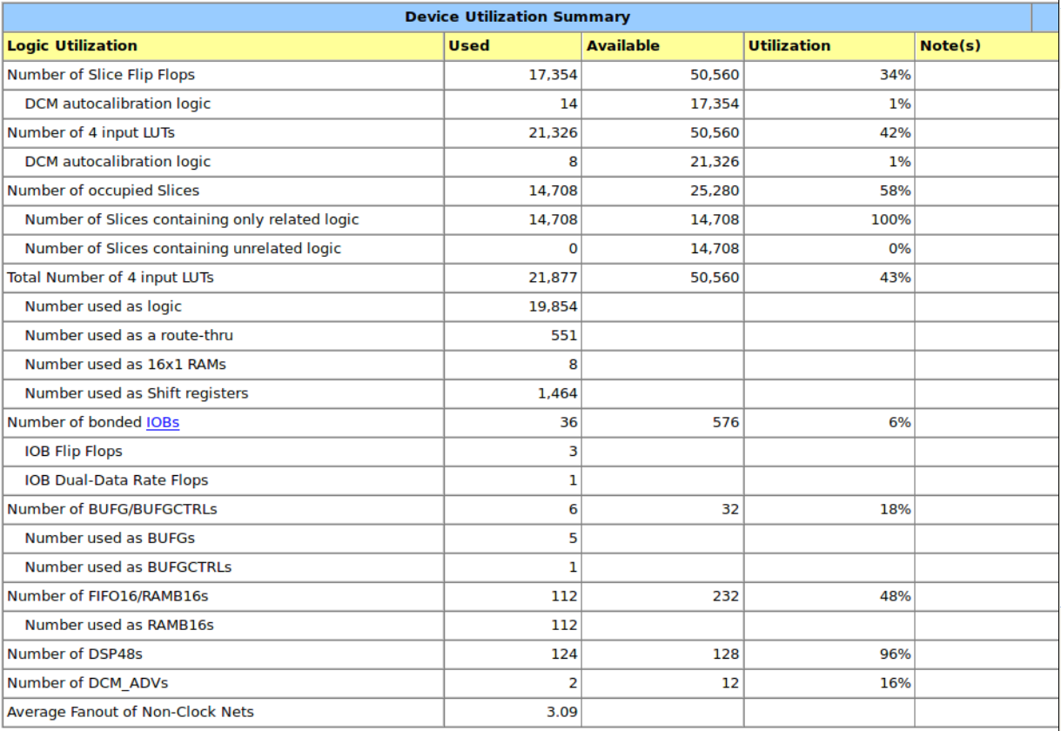

Slide 28
VHDL implementation
T0
T0
..
..
9
..
Hit
Hit
Hit
Hit
8
7
Hit
Hit
Hit
Hit
Hit
Hit
Hit
Hit
5
6
ToT
4
3
1
2
T0
Tracking module
Input Interface
2D Mapping
Form tracklet
Calc Mom
Index
Ring Buffer

Slide 29
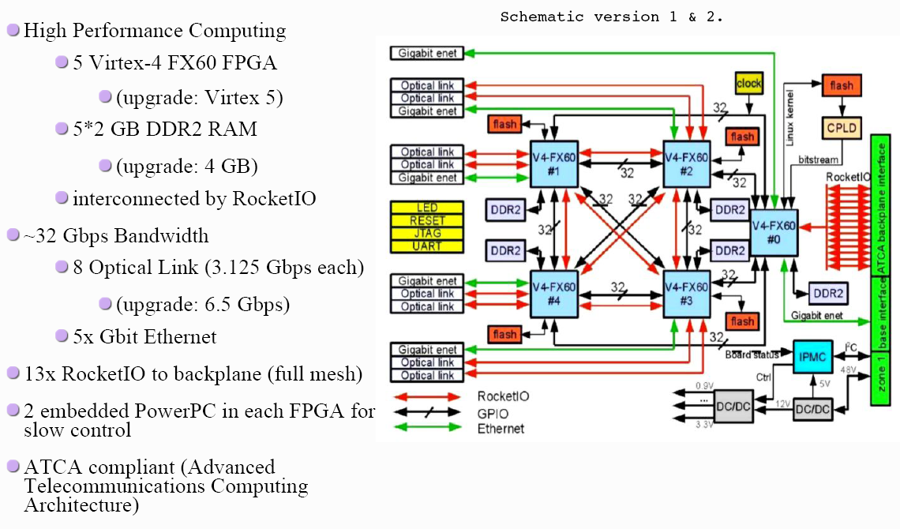
The Compute Node (CN)

Slide 30
Hardware Description Language
VHDL, Verilog, SystemC
VHDL: Very-high-speed integrated circuits Hardware Description Language.
It’s a dataflow language, unlike procedural computing languages such as C++ which runs sequentially, one instruction at a time.
Signal A3_B1 …;
Signal A4_B2 …;
A3 <= A3_B1;
B1 <= A3_B1;
A4 <= A4_B2;
B2 <= A4_B2;
A1
A
A3
B1
B
B3
A2
A4
B2
B4

Slide 31
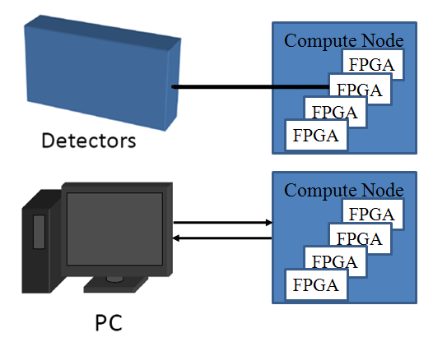
Setup and Test
PC as data source and receiver.
Ethernet.
Optical link (UDP by Grzegorz Korcyl )
(not integrated yet)
Ethernet via
Optical Link
FPGA
FIFO
Tracking algorithm
FIFO

Slide 32
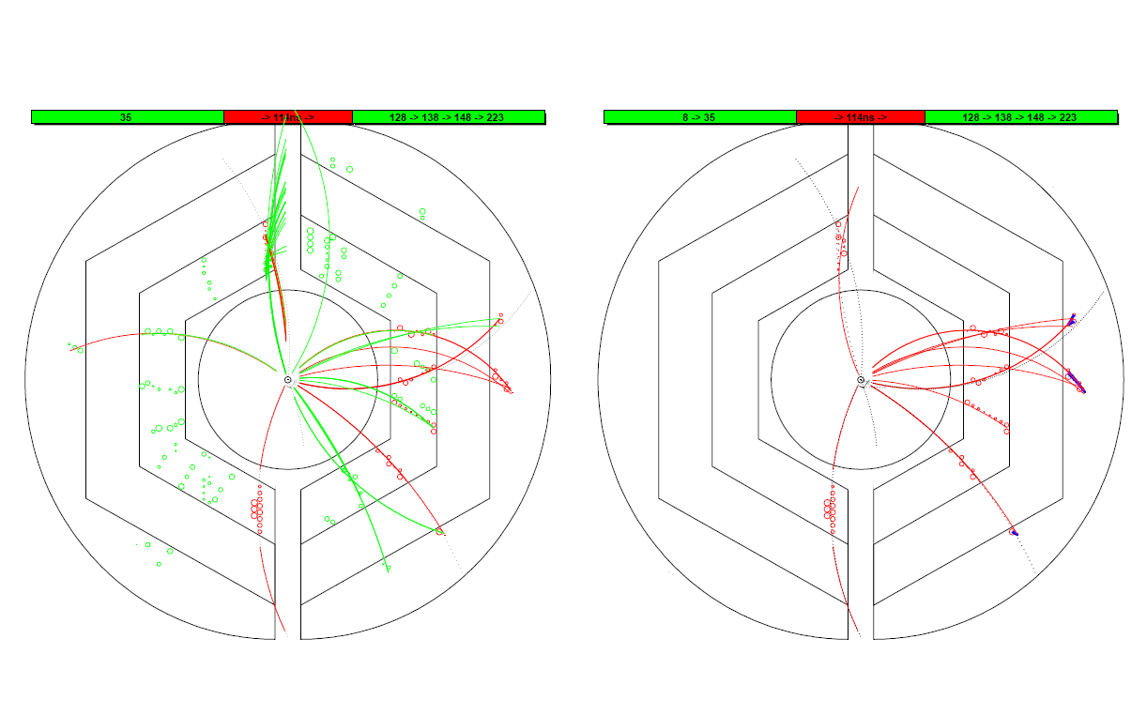
Assign a track to the correct event
T₀ information: current event(Red) or other events(Green)
Black dashed line: track by MC truth
Red line: recon. track
Blue: recon. using outer layers
drift circles belong to current event (Red) or other events (Green)
Event #2
Event #2

Slide 33
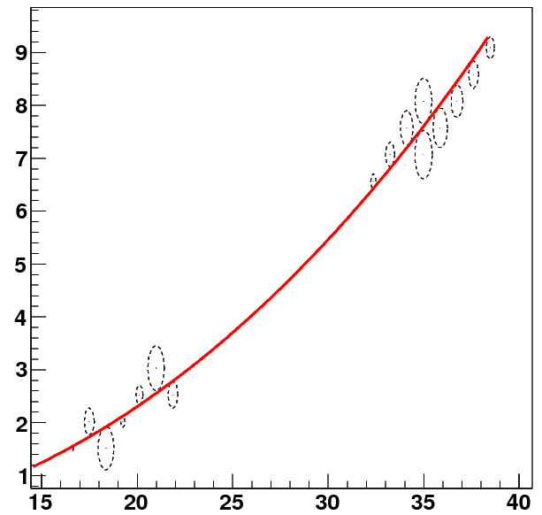
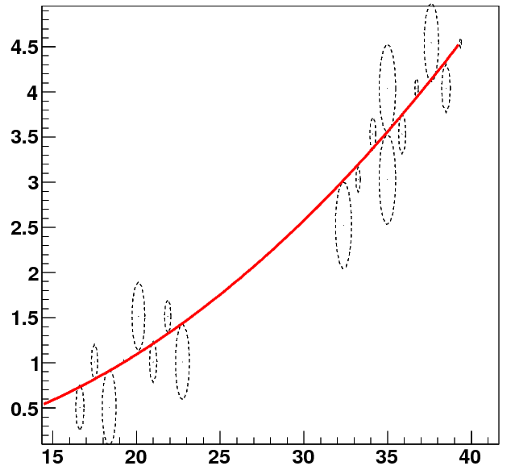
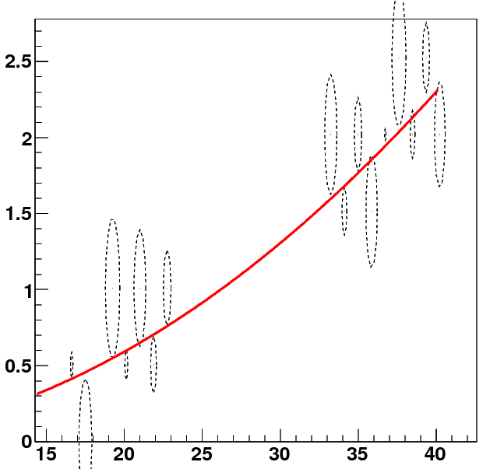
Performance study – single track
y(cm)
0.2GeV
y(cm)
0.5GeV
x(cm)
x(cm)
1GeV
2GeV
y(cm)
y(cm)
x(cm)
x(cm)

Slide 34
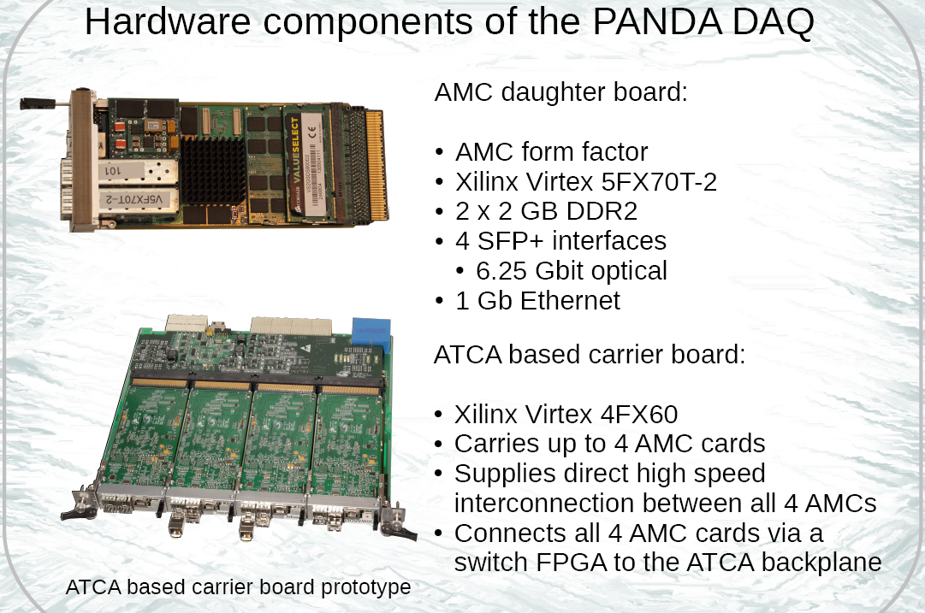

Slide 35
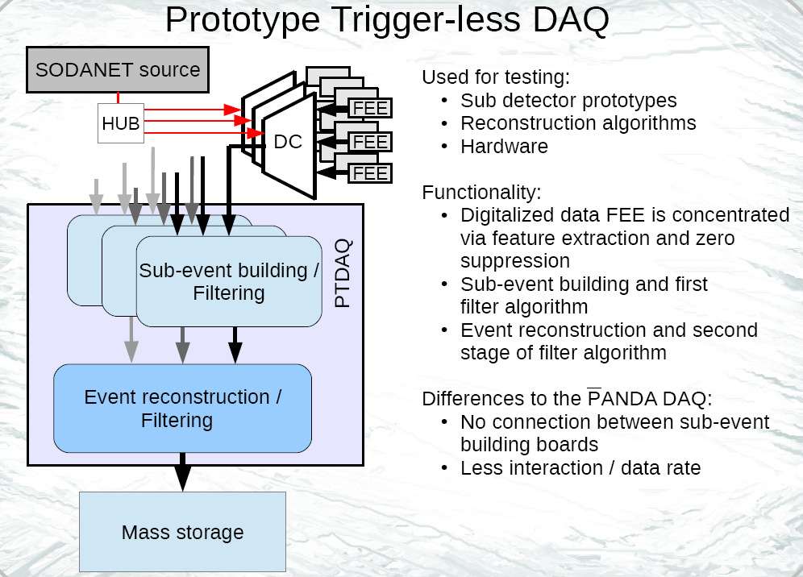

Slide 36
