Slide 1
Hard X-Ray Linear Polarimetry
Günter Weber
Helmholtz-Institut Jena, 07743 Jena, Germany
GSI Helmholtzzentrum für Schwerionenforschung, 64291 Darmstadt, Germany

Slide 2
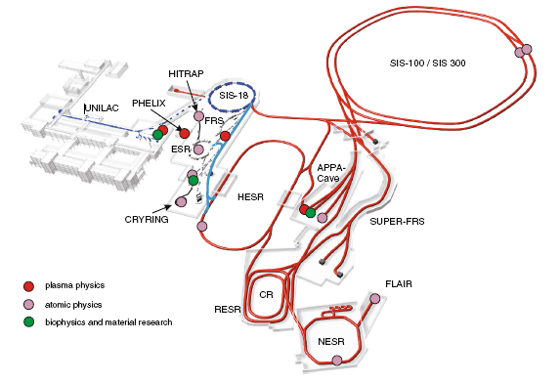
APPA @ FAIR
Atomic Physics:

Slide 3
Outline of the Talk
Motivation and introduction to Compton polarimetry
Recent lineaer polarization measurements
- Radiative electron capture (time-reversed photoionization)
- Bremsstrahlung (spin transfer from electrons to photons)
- U⁹¹⁺ Lyman-α₁ (disentanglement of alignment and multipole mixing)
Summary and additional activities

Slide 4
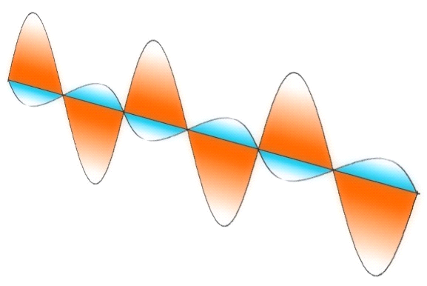
General Motivation: towards “complete” measurements
Ultimate goal: obtain all observables at once.
→ most stringent test of theory
→ maximum information on incident particles
Observables:
(Total) Cross section σ
Angular distribution W(θ)
Spectral distribution E
Polarization P
+
+
+
+
+
+
+
+
+
+
+
+
+
+
E
B

Slide 5
Compton Polarimetry for Hard X-Rays
Linear Polarization Sensitivity
Compton
Scattering
Bragg Reflection
Compton Scattering
ϑ
Liquid Crystals
Photoionization
Crystal Optics
Thomson/Rayleigh Scattering
Pair Production
φ
ϕ
ΔE
E
e⁻
photon energy [ eV ]
E

Slide 6
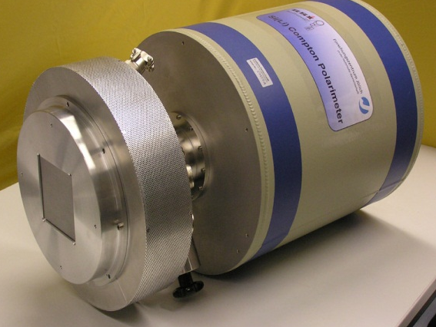
Si(Li) Compton Polarimeter developed within SPARC
Scattering process and absorbing take place inside a double-sided segmented detector crystal.
Angular distribution of scattered x-rays reflects the incident photon linear polarization.
64 mm
ϕ
E
Delievered in 2008
S. Hess, Phd thesis (2010)
E
7 mm

Slide 7
Radiative Processes for Highly Charged Ions
Radiative Recombination (RR)
Radiative Electron Capture (REC)
free-free
e⁻
Bremsstrahlung
free-bound
e⁻
E
Z
E
Continuation of RR for continuum states.
E
L
E
Time-reversal of photoionization.
Z
L
E
B
E
B
B
B
K
B
B
K
dipole
dipole

Slide 8
Radiative Processes for Highly Charged Ions
2p_{3/2}
Characteristic Transitions
bound-bound
E
Determined by alignment of the excited state.
L
E
E
B
B
B
K
1s_{1/2}
dipole

Slide 9
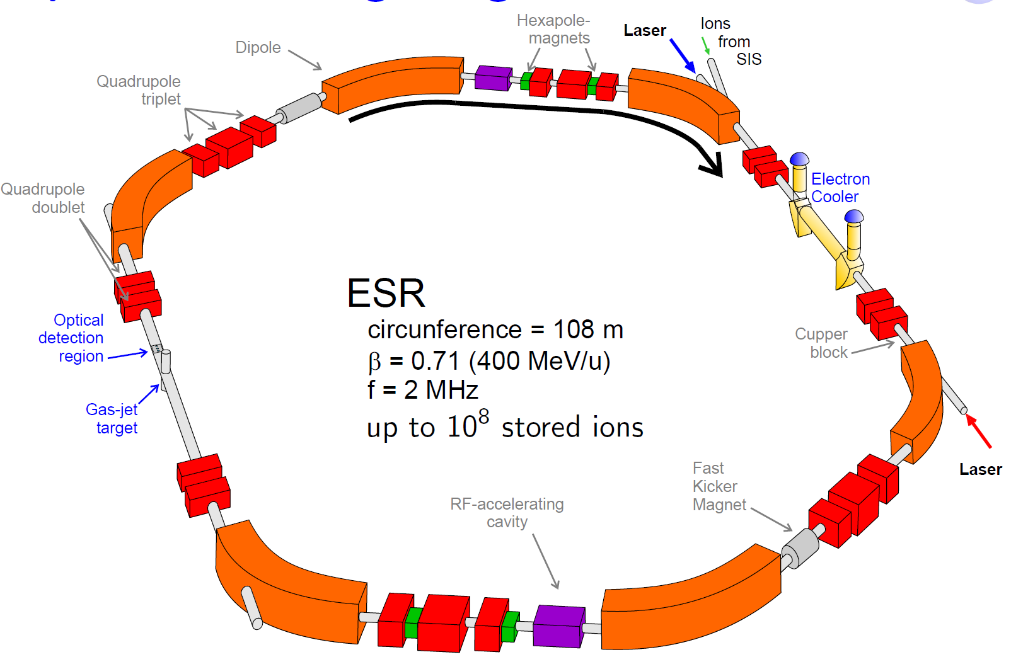
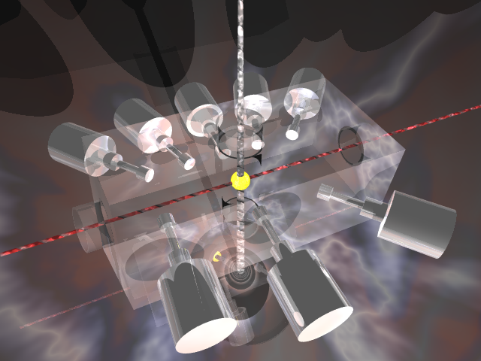
The Experimental Storage Ring (ESR) at GSI
Gas Target
Ions: p⁺ … U⁹²⁺
Intensity: up to 10⁸ stored ions
Energy: 4 – 400 MeV/u (β=0.7)
Circumfence: 108 m
Frequency: up to 2 MHz
Ion Beam
Internal Gas Target

Slide 10
1. Radiative Electron Capture

Slide 11
Radiative Electron Capture Studies (REC) at the ESR Gas Target
Radiative Recombination
(inverse photoeffect)
1
100%
Non-relativistic
scenario
E_{KIN}
Cross section dσ/dΩ
Polarization
L
L-REC
sin² θ angular distribution
100% linear polarization
K-REC
K
0
Gas Target
H
U⁹¹⁺
U⁹²⁺
Projectile Ion

Slide 12
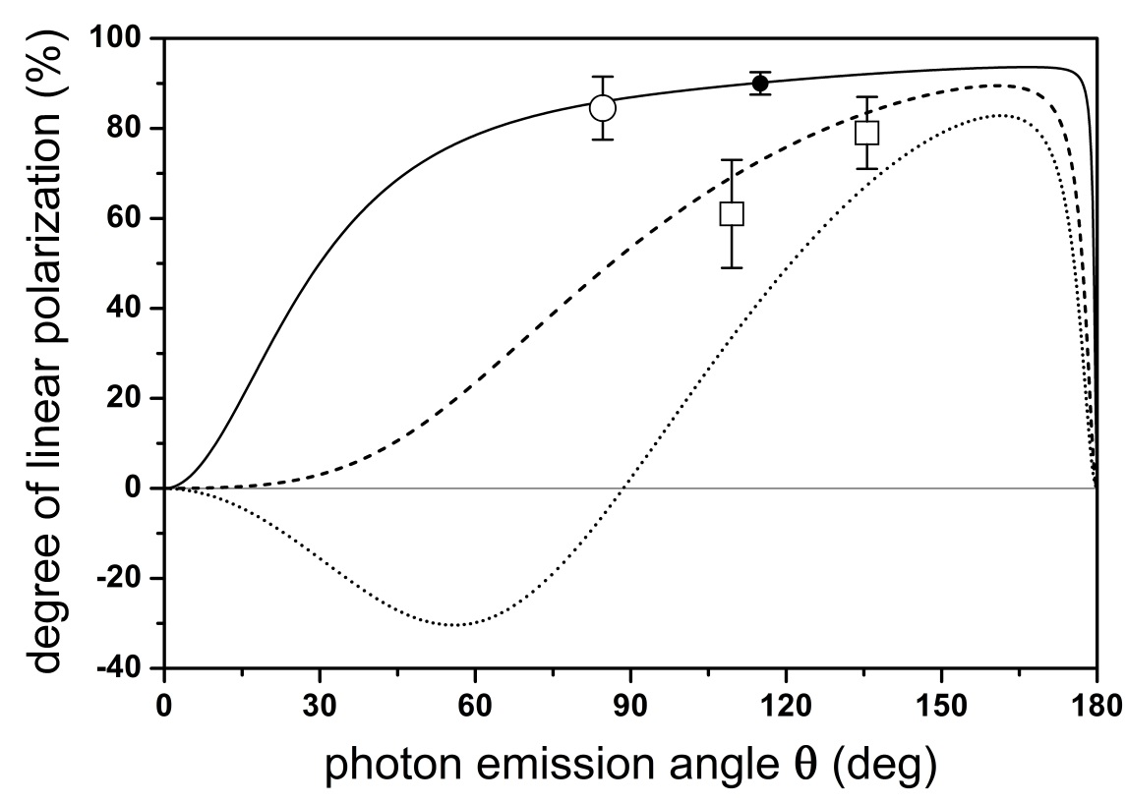
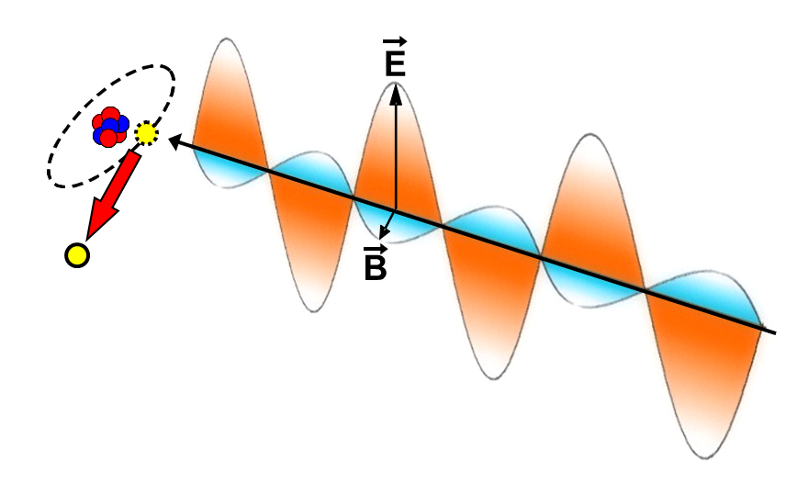
K-REC polarization measurements
mid-Z
high-Z
Photoeffect:
Electron is emitted into the B-field direction
Xe⁵⁴⁺ → H₂ @ 150 MeV/u
U⁹²⁺ → N₂, H₂
100 MeV/u
400 MeV/u
800 MeV/u
preliminary
preliminary
Necessary ion energy range will become experimentally accessible at the HESR at FAIR.
Observation angle ( deg )
Photon emission angle ( deg )
16 pixel Ge(i) detector S. Tashenov et al., PRL 97 (2006)
new Si(Li) polarimeter (> 1000 pixels) S. Hess (2010), H. Ding (2014)
(manuscript in preparation)

Slide 13
2. Bremsstrahlung Studies

Slide 14
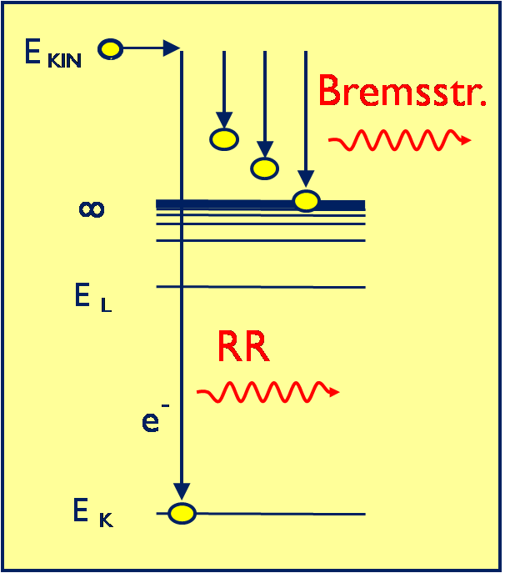
Polarization of electron-nucleus bremsstrahlung
preliminary
Unique advantages at storage rings:
no screening effects (bare projectile)
electrons from the tip region can be observed
(manuscript in preparation)

Slide 15
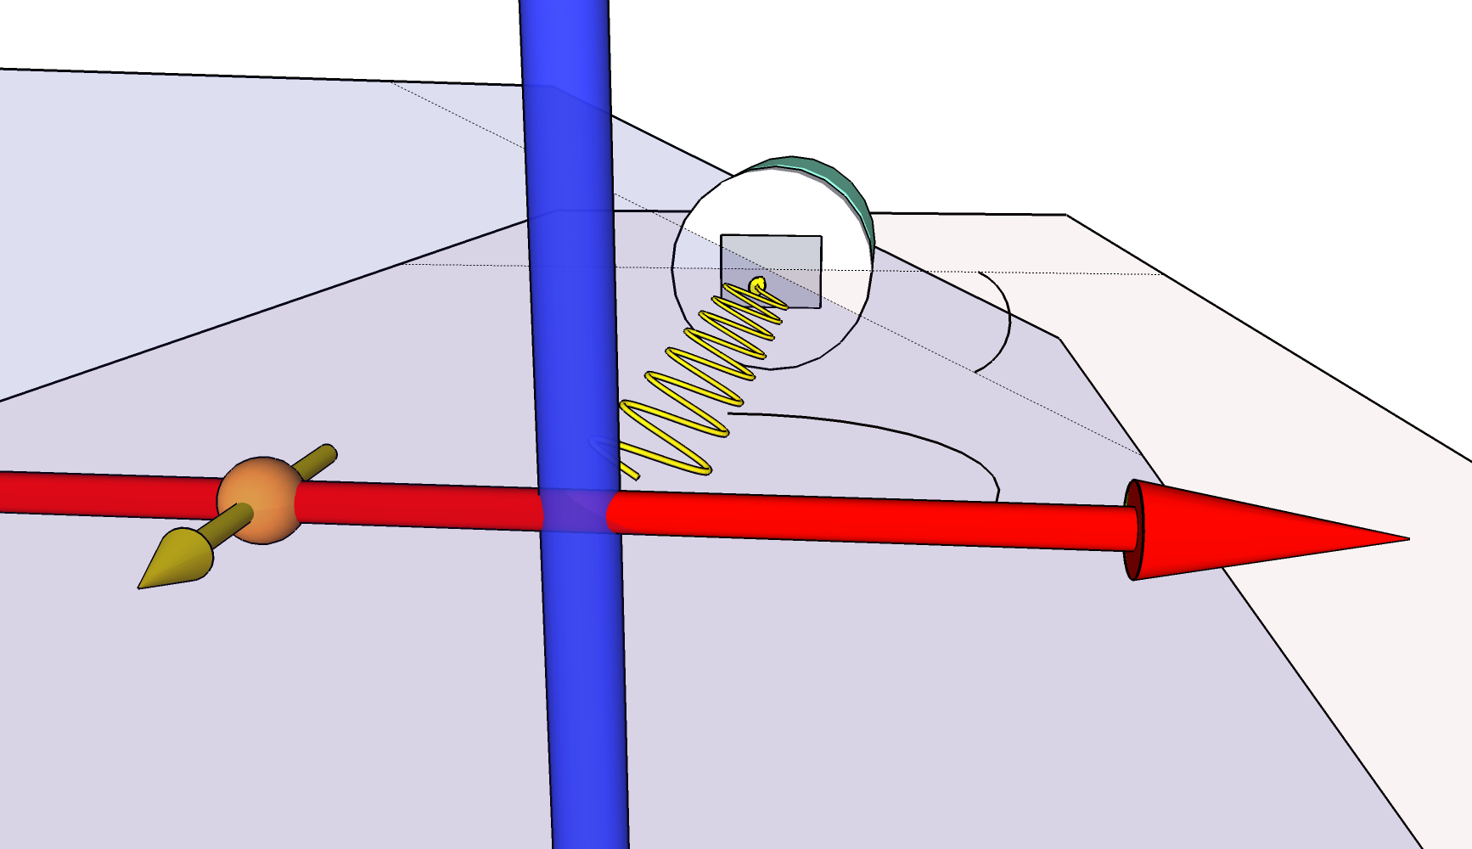
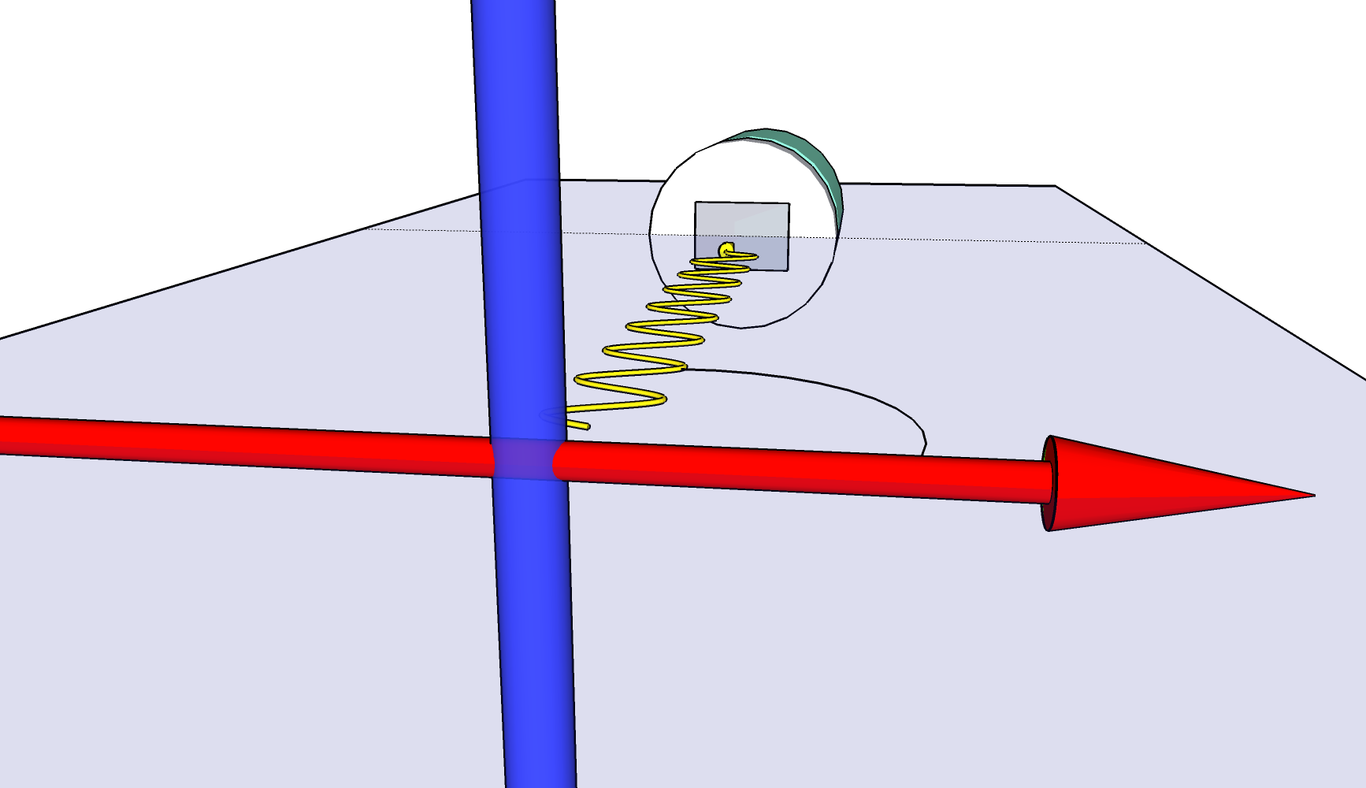
Probing spin-polarized particle beams
by means of Compton polarimetry
target
Collision symmetry broken: Rotation of scattered photon distribution
reaction plane
E
unpolarized ion beam
polarized ion beam
E
Polarized collision system:
Orientation of photon polarization depends on the spin polarization of the colliding particles.
Unpolarized collision system:
Emitted photons are polarized along the reaction plane.
→ Polarization transfer from particles to photons
→ Spin diagnostic !
Proposed for the RR process into spin-polarized ions: A. Surzhykov et al., PRL 92 (2005)

Slide 16
Test case: Spin-Transfer in Electron-Atom Bremsstrahlung
→ unpolarized versus transversely polarized electrons
100 keV e⁻→ Au @ 130 deg
Unpolarized electrons
Kα
Kβ
Transversely
polarized electrons
Reconstructed Compton events
R. Märtin et al., PRL 108 (2012)
See also: S. Tashenov et al., PRL 107 (2011)
Photon energy: 92.5 ± 3 keV

Slide 17
3. Lyman-α₁ Transition in U⁹¹⁺

Slide 18
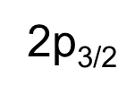
Alignment Studies at the ESR Gas Target:
2p_{3/2} Population by Radiative Electron Capture into bare Ions
Radiative Recombination
Alignment parameter for the 2p_{3/2} state:
L-REC
E_{KIN}
µ=±1/2
μ=+3/2
L-REC
2p_{3/2}
μ=+1/2
Non-statistical population of magnetic substates.
L
µ=±3/2
μ=-1/2
μ=-3/2
K
Collision axis

Slide 19
Alignment analysis by decay photon spectroscopy:
Angular Distribution and Linear Polarization
What is it good for? The alignment parameter reveals subtle details of the population process of an excited HCI state.
Breit interaction in electron impact excitation
Dielectronic recombination in Be-like sytems
Coherence in time-reversed photoeffect (REC)
Non-statistical population of the magnetic sublevels (non-zero A₂)
µ=+3/2
µ=+1/2
µ=-1/2
µ=-3/2
Alignment Parameter
2p_{3/2}
Anisotropic emission pattern:
C. J. Bostock et al., PRA 80 (2009)
A. Gumberizde et al., PRL 110 (2013)
Lyman-α₁
S. Fritzsche et al., PRL 103 (2009)
Z. Hu et al., PRL 108 (2012)
Non-vanishing linear polarization:
1s_{1/2}
S. Tashenov et al., PRL 113 (2014)
Note: Emission characteristics fully determined by A₂ and observation angle θ.

Slide 20
So far only E1 - what about higher multipoles at high Z?
Z scaling for transitions in H-like ions:
Transition rate [ s⁻¹ ]
Nuclear Charge Z
In high-Z systems higher-order multipole transitions come into play.
U⁹¹⁺ Lyman-α₁ → Γ_{E1} ~ 10¹⁶ s⁻¹, Γ_{M2} ~ 10¹⁴ s⁻¹

Slide 21
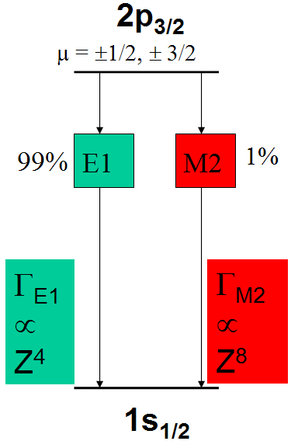
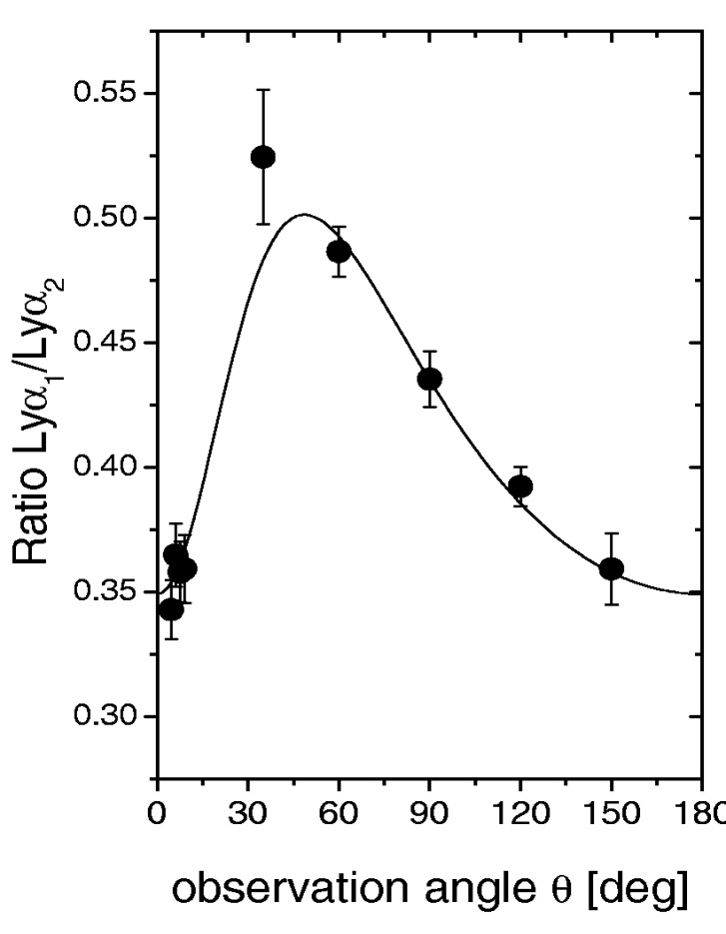
E1-M2 interference:
Enhanced Lyman-α₁ Anisotropy in High-Z ions
Lyman-α₁ angular distribution:
E1 + M2
E1 transition only
A. Surzhykov et al., PRL 88 (2002)
Th. Stöhlker et al., PRL 79 (1997)
Interference between the E1 and the M2 decay branch lead to an increased anisotropy of the Ly-α₁ emission pattern.
So-called “Multipole Mixing”
is well-known for nuclear transitions.

Slide 22
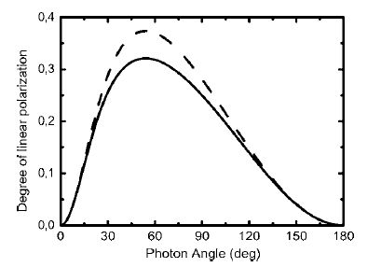
E1-M2 interference:
Decreased Lyman-α₁ Linear Polarization in High-Z Ions
Exact relativistic calculations by A. Surzhykov:
E1-M2 interference in Ly-α₁ leads to
Increased Anisotropy
Decreased Polarization
E1 only
Degree of linear polarization:
E1 & M2
A. Surzhykov, Hyperf. Interact. 146-147 (2003)

Slide 23
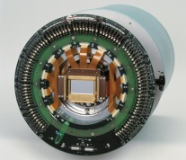
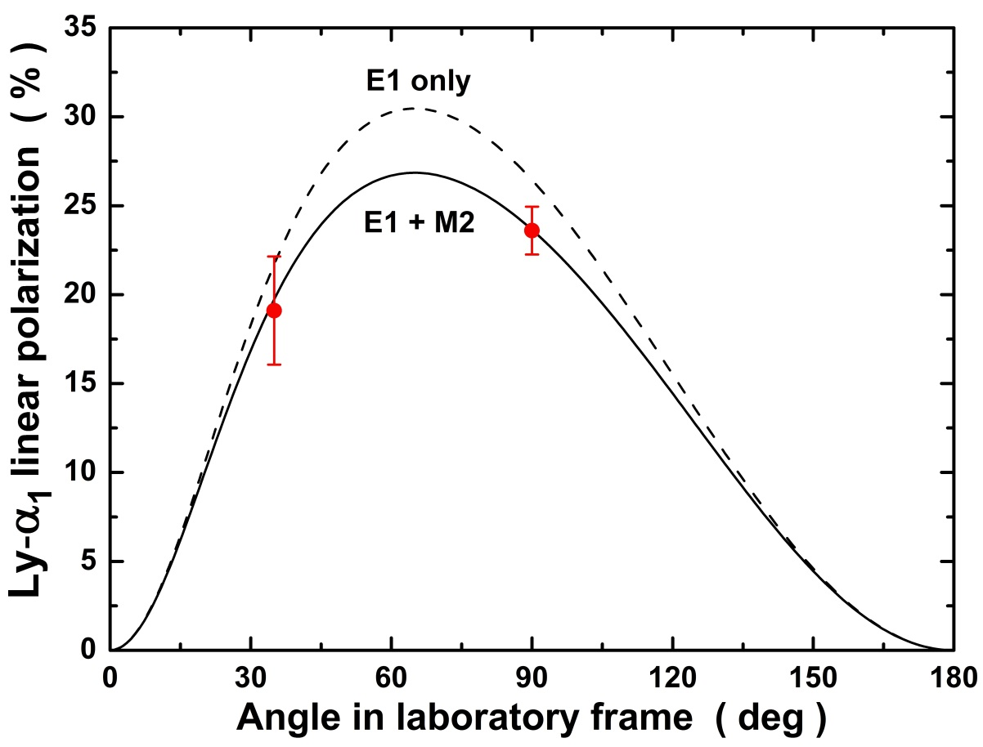
Lyman-α₁ Polarimetry of H-Like Uranium:
Confirmation of reduced Linear Polarization
Standard Ge(i) detectors
Particle detectors
Dipole magnet
U⁹²⁺ → H₂
@ 96.6 MeV/u
Reduction in the degree of
linear polarization due to
E2-M1 interference is confirmed.
G. Weber et al., PRL 105 (2010)

Slide 24
Combined angular distribution and polarization measurements:
A model-independent estimation of the E1-M2 transition ratio
Decoupling of the collision dynamics (alignment parameter A₂) and the
atomic structure (amplitude ratio α = <M2>/<E1>) enables a
model independent estimation of both values:
→ Precise estimation of the E1-M2 transition ratio!
Observable
Equation
Experiment
Theory
only E1
E1 + M2
Amplitude ratio
Theory
Theory
with α = <M2>/<E1>
Ratio of transition rates Γ_{M2} / Γ_{E1} = 0.00689 ± 2.8% Motivated a study of QED contributions by Surzhykov et al.
(manuscript in preparation)

Slide 25
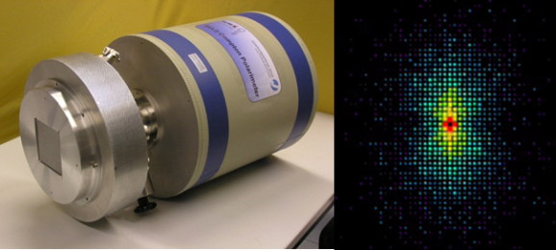
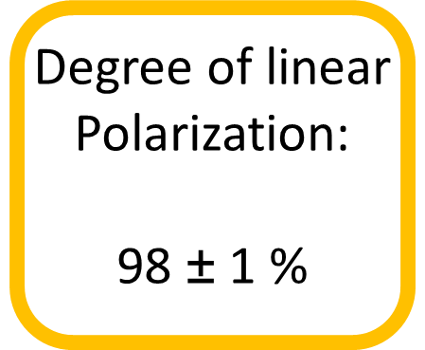
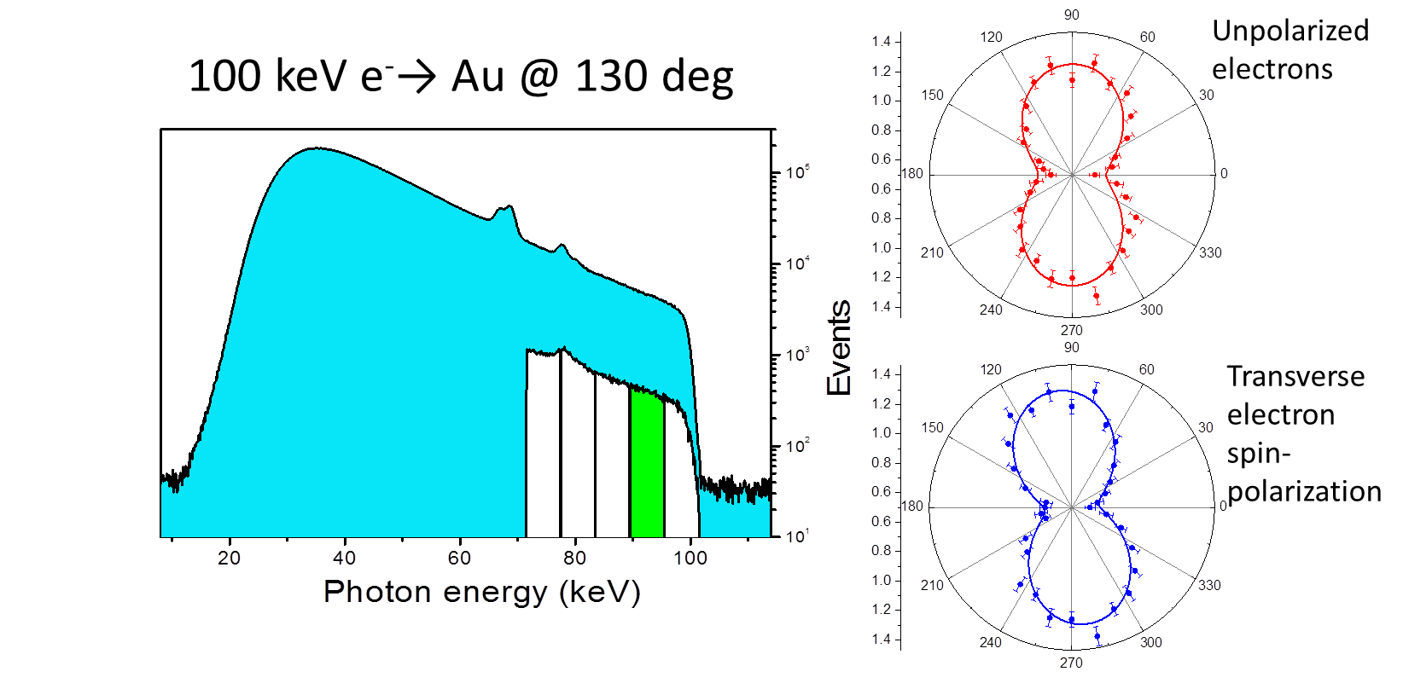
Summary and Outlook
Storage Rings / EBITSs / HCI
Effects of higher multipoles and retardation on the polarization properties of radiative recombination
Combined angular distribution / polarization measurement of the 2p_{3/2} state: precision life time determination
Electron-nucleus bremsstrahlung studies in inverse kinematics
Electron Accelerators
Study of spin-polarization transfer from electrons to photon (bremsstrahlung)
Synchrotrons
Polarization transfer in elastic photon scattering (Rayleigh and Delbrück scattering)
REC for Xe⁵⁴⁺ (150 MeV/u)
S. Hess / H. Ding, to be published
Multipole mixing for 2p_{3/2} → 1s_{1/2}
Ratio of transition rates
Γ_{M2} / Γ_{E1} = 0.00689 ± 2.8%
G. Weber et al., PRL 105 (2010)
Bremsstrahlung of polarized electrons
R. Märtin et al., PRL 108 (2012)

Slide 26
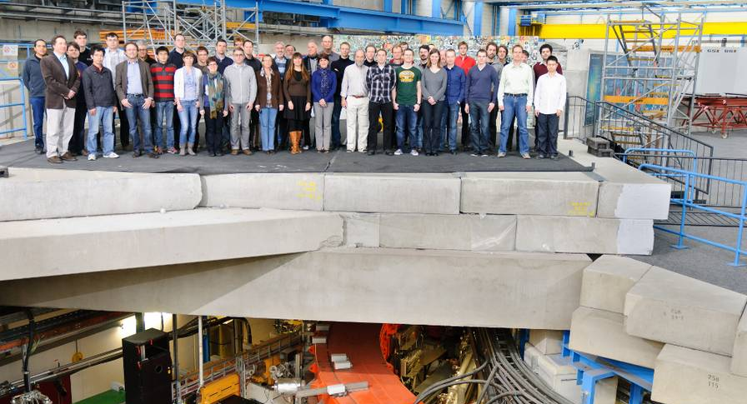
Thank you for your attention !
Atomic Physics Division of GSI – Mille Grazie!

