Slide 1
Welcome to WAO2014!
Michael Bieler, Chair of the IPC
Petra Schütt, Chair of the LOC

Slide 3
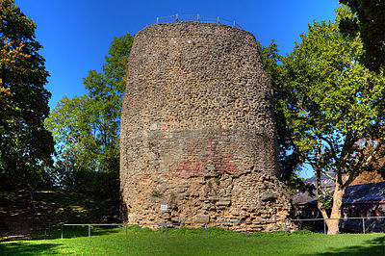
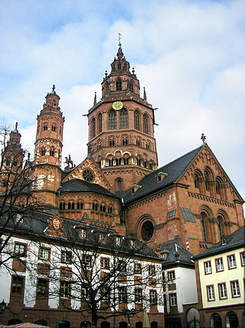
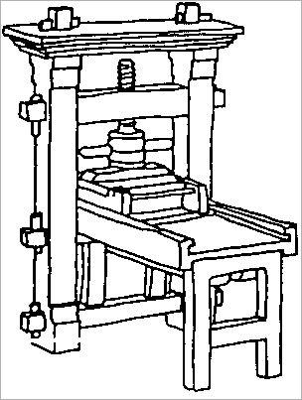
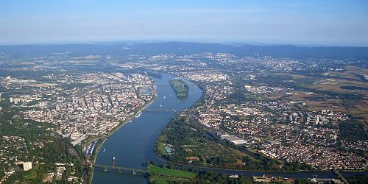
Mainz (Mayence):
13/12 BC: Roman stronghold Mogontiacum, founded by Roman general Drusus
11th century: Mainz Cathedral build in it‘s present form
1450: A major step forward in IT: Johannes Gutenberg invents the movable type printing in Mainz
Today: Population: 200 000 Capital of the German state of Rhineland-Palatinate

Slide 4
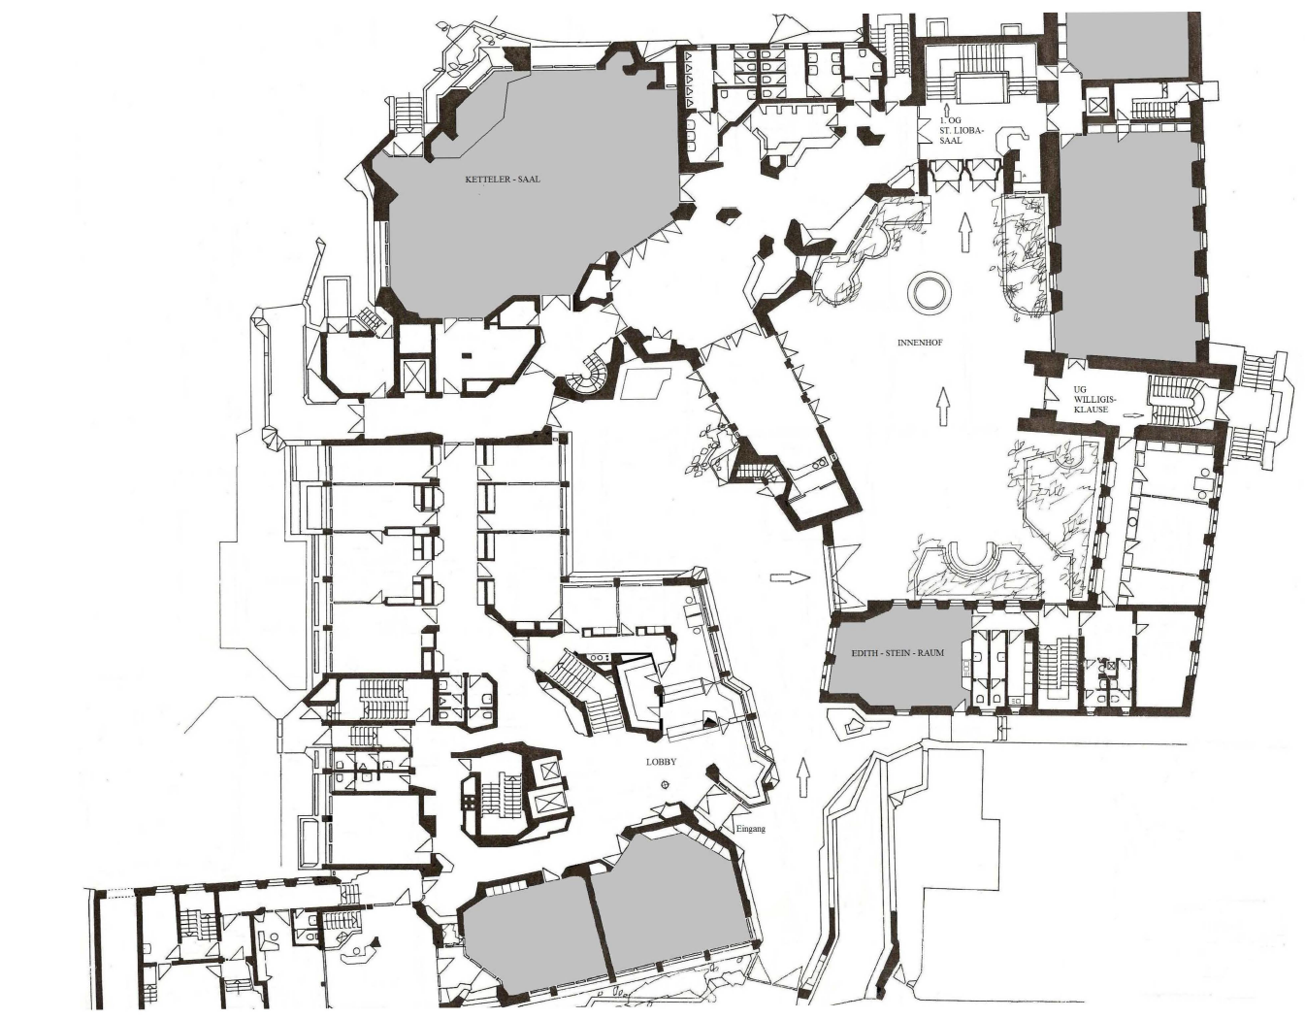
Erbacher Hof:
dating back to the 12th century
conference center of the diocese Mainz of the catholic church since 1988
73 guest rooms
16 conference rooms, 3 conference halls

Slide 5
Poster Session
(upstairs)
Auditorium
WAO2014 office
Dining room
(upstairs)

Slide 6
Erbacher Hof:
WIFI:
Low Bandwidth, not enough for 100 people in the auditorium.
Access codes can be obtained from front desk (12 h in 3 days).
PC with LAN connection in the WAO office.
Breakfast, Lunch and Dinner:
Meals are served upstairs in the main building.
There are 1-2 counters for 100 people.
Expect delays.
Smoking:
Inside all buildings smoking is prohibited.
If necessary, please use the courtyard for smoking.

Slide 7
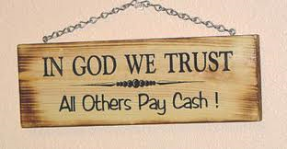
Erbacher Hof:
Payment:
You will have to pay for your drinks at lunchtime in cash.
You will have to pay for your evening drinks in cash.
You will have to pay for your room and for your breakfast at checkout on Friday in cash.

Slide 8
Erbacher Hof:
Payment:
The next ATMs are just around the corner:
Erbacher Hof

Slide 9
Contributions:
Talks, Posters:
Please upload your material to our Indico system half a day before your talk, at latest on Wednesday.
Papers:
In addition the IPC would like to encourage you to summarize your contribution in a paper.
By submitting a paper you can make sure that your ideas presented at WAO2014 can be much better referred to later, as they are available in a written text on the Indico site.
Use any style and layout you know. We suggest to use 3 pages, but this is not a hard limit.

Slide 10
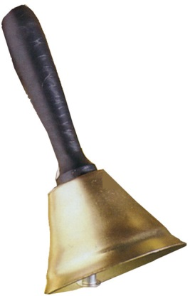
Schedule:
Sessions:
We have a tight schedule.
Every session will start on time.
2 minutes prior to the start of the session the chairman will ring a bell in the foyer.
Talks:
We have a tight schedule.
Speakers are kindly asked to stay within their time limit.
Chairmen will give warnings a few minutes before the end
(and use the bell afterwards).
Bus trips (Heidelberg and GSI):
The Erbacher Hof can not be reached by our buses.
They have to use a bus stop on the main road,
7 minutes walking distance from Erbacher Hof.
Be there on time or you will miss the trip.
No mercy!

Slide 11
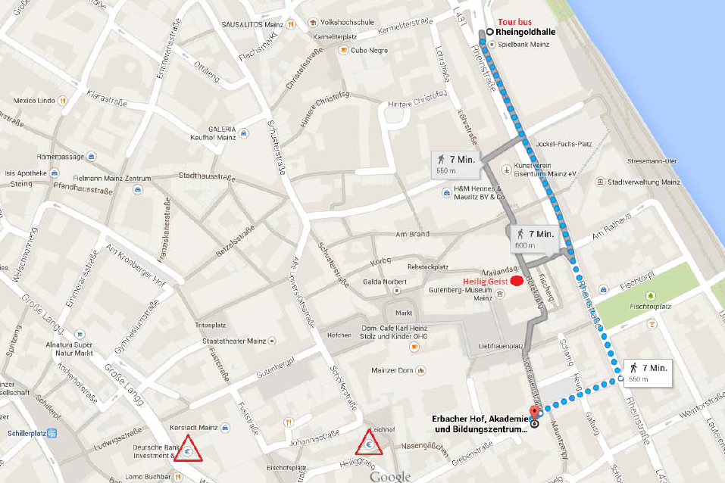
Bus Stop:
Bus Stop
Erbacher Hof

Slide 12
Schedule:
Poster session:
There will be a poster session on Wednesday afternoon,
followed by another session of talks in the auditorium.
Heidelberg tour:
There will be a bus tour to Heidelberg on Thursday afternoon
for a visit to HIT followed by a dinner in Heidelberg.
GSI tour:
There will be a tour to GSI on Friday afternoon.
After the visit to GSI there will be transport to
Frankfurt airport
a local train to Frankfurt Hauptbahnhof
Mainz, Erbacher Hof
DESY tour:
There will be a tour to DESY after WAO2014.

Slide 13
Schedule:
Discussion time:
There will be a (short) discussion time after each talk. Please make use of it!
There will be a ‘discussion style’ session on Tuesday afternoon. Make it a lively session!
Use breakfast, lunch and dinner to extend discussions.
Use the unofficial ‘discussion time’ in the evenings to meet new colleagues, make new friends, learn about other labs and cultures.
And now:
Let’s get started!
Enjoy the workshop, make it a success for yourself and your colleagues.

