Slide 1
Operators and Radiation Safety at the Advanced Light Source
Tom Scarvie
ALS Physics Group
Operations Group Work Lead

Slide 2
Introduction
Operators are the front-line of radiation safety at the Advanced Light Source, a 3rd generation x-ray light source
Accelerator Operator duties and tools
Floor Operator duties and tools
Our biggest challenges
Example of a radiation safety incident

Slide 3
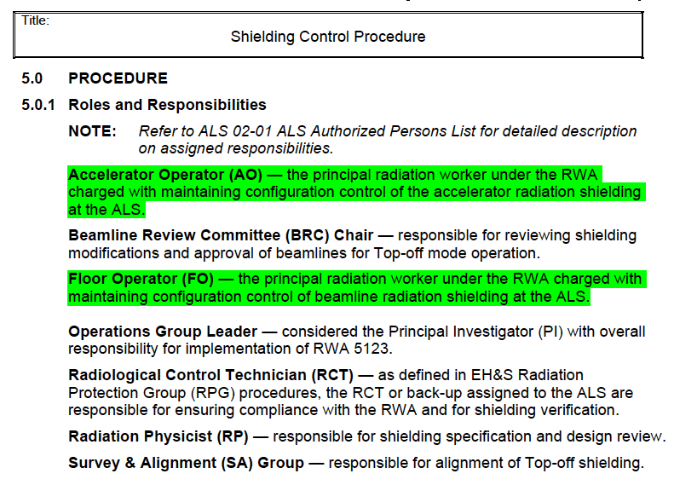
Operators at the ALS

Slide 4
Accelerator Operators
AO’s primary responsibility is safe operation of the accelerator complex
Also must maintain reliable operations and quickly resolve problems
These desires can compete with each other
Radiation Safety: Reacting is not good enough
Operators must also predict elevated radiation levels

Slide 5
AO Rad Safety Duties
Monitor machine operations paying special attention to radiation safety
  bad vacuum, low lifetime, poor injection tuning, etc.
  hand-held monitoring at any sign of trouble
  sharing of knowledge and ongoing training is critical
Control configuration of accelerator shielding
Monthly surveys (compliance more than safety)

Slide 6
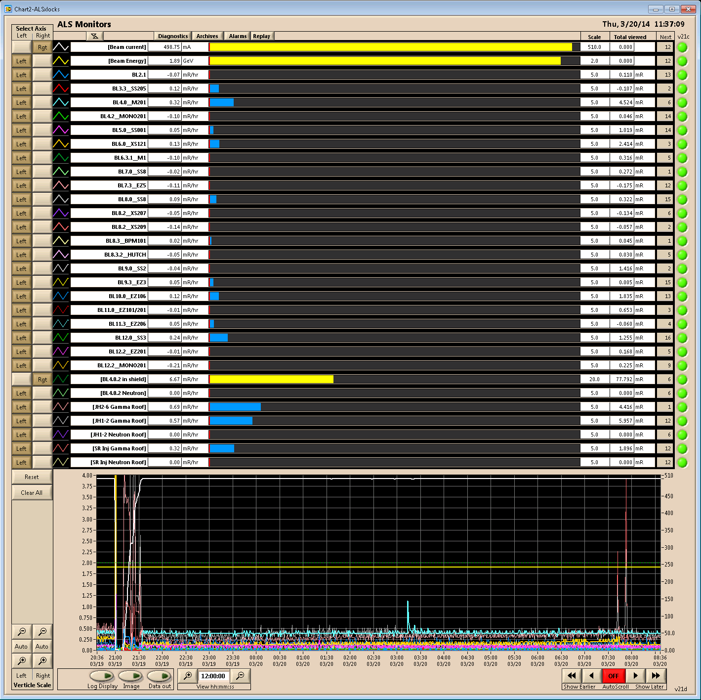
AO’s: Tools of the Job
Beamline radiation monitors app is called RPIX
Instituted when we began topoff operation (shutters-open injection)
Interpretation can be subtle
No substitute for hand-held monitoring

Slide 7
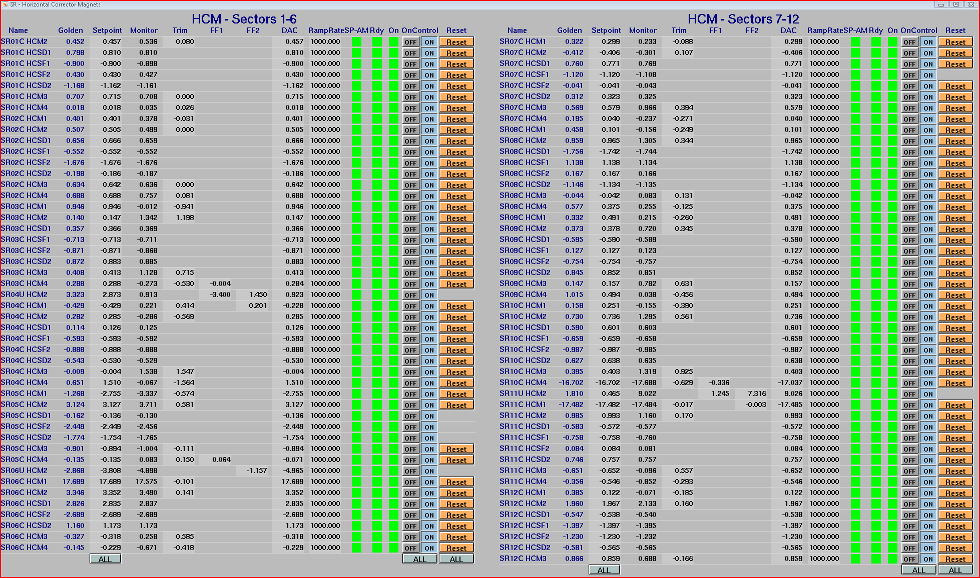
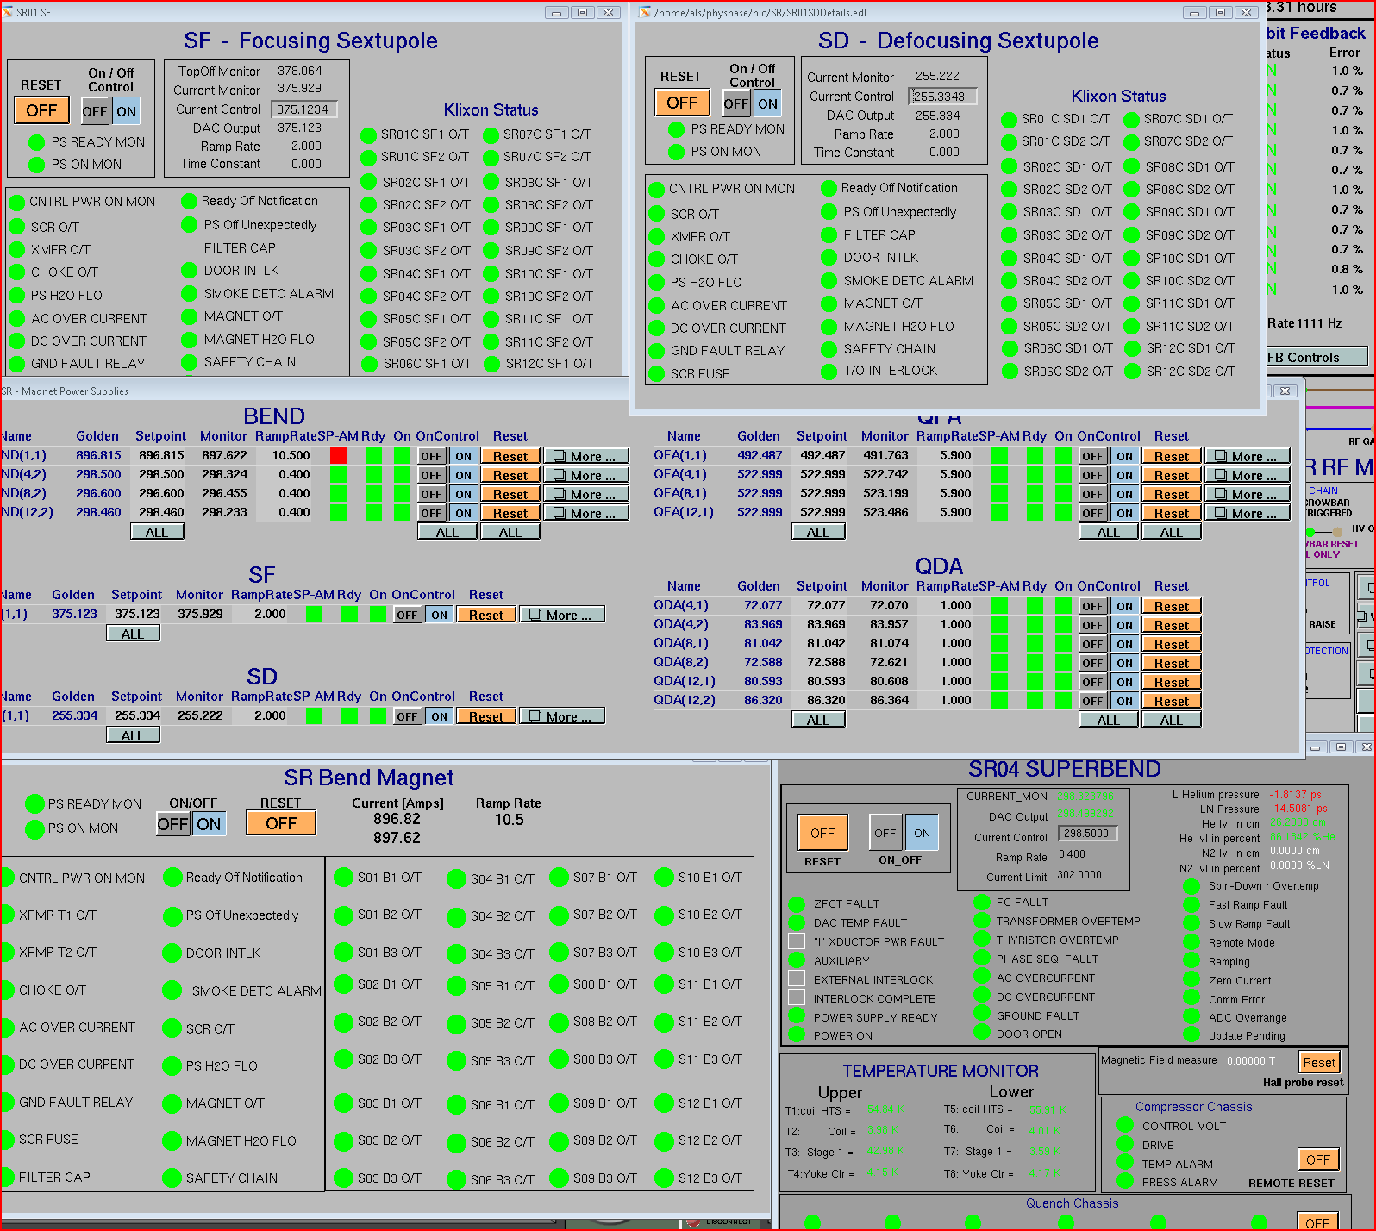
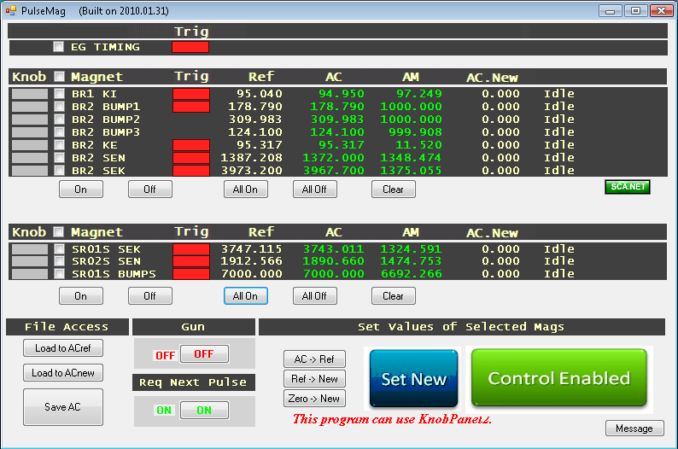
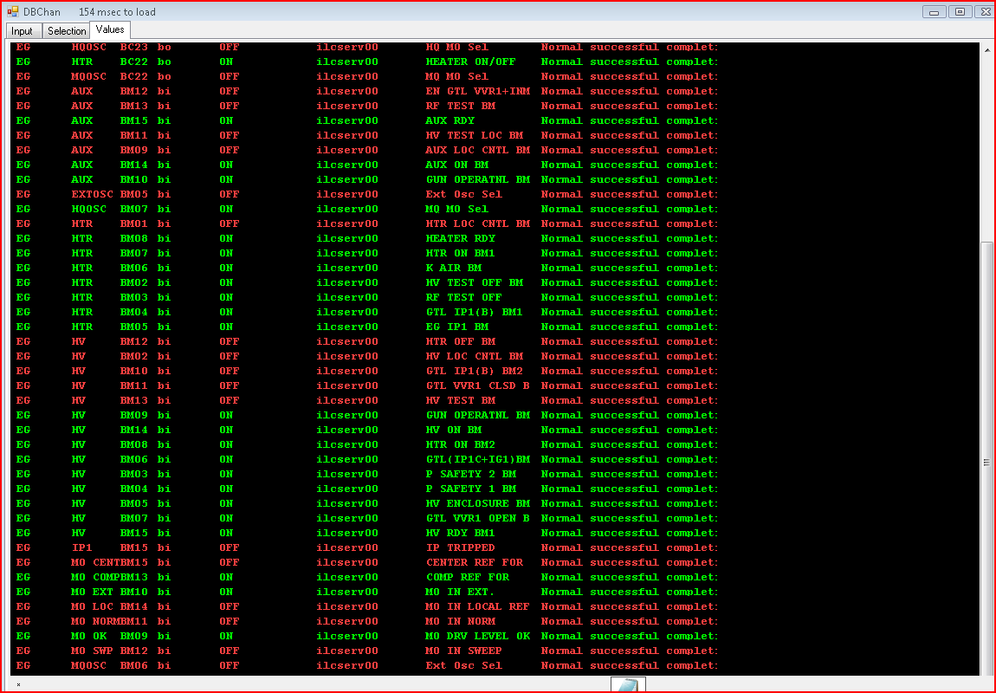
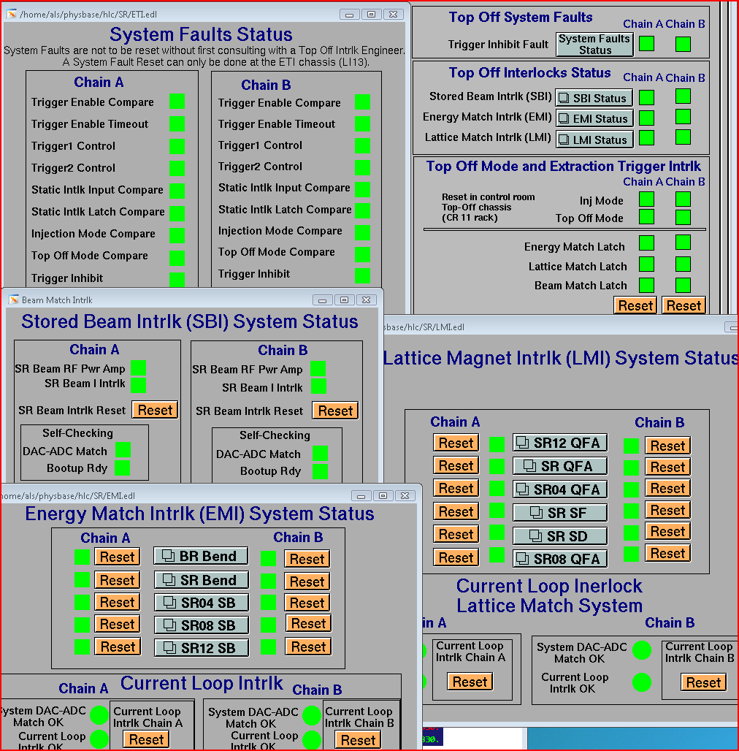
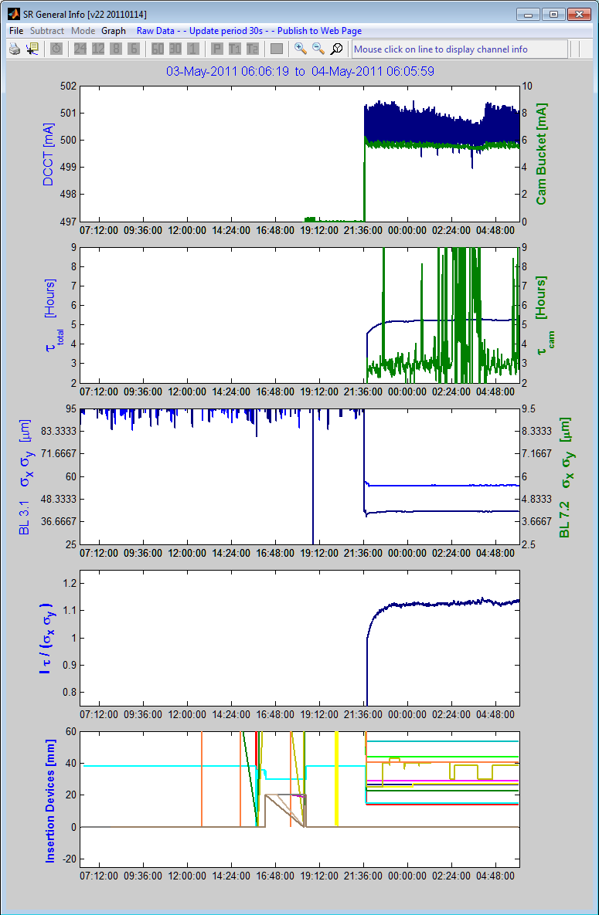
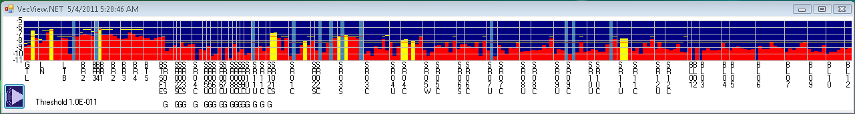
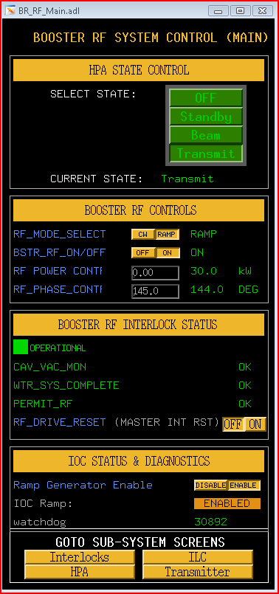
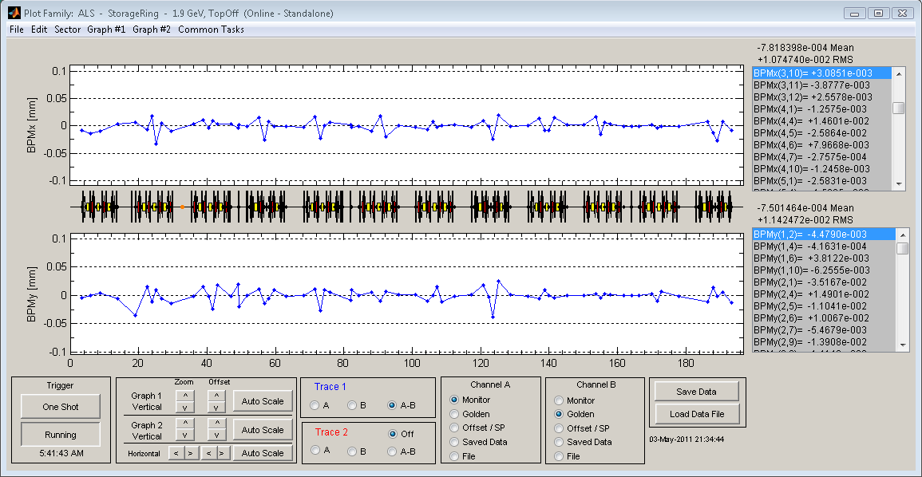
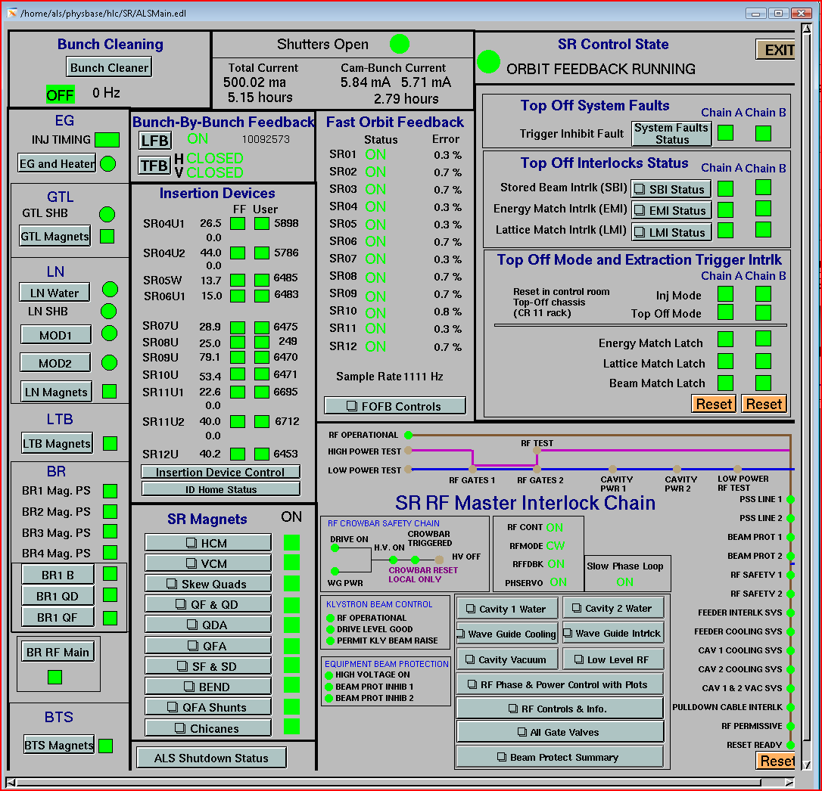
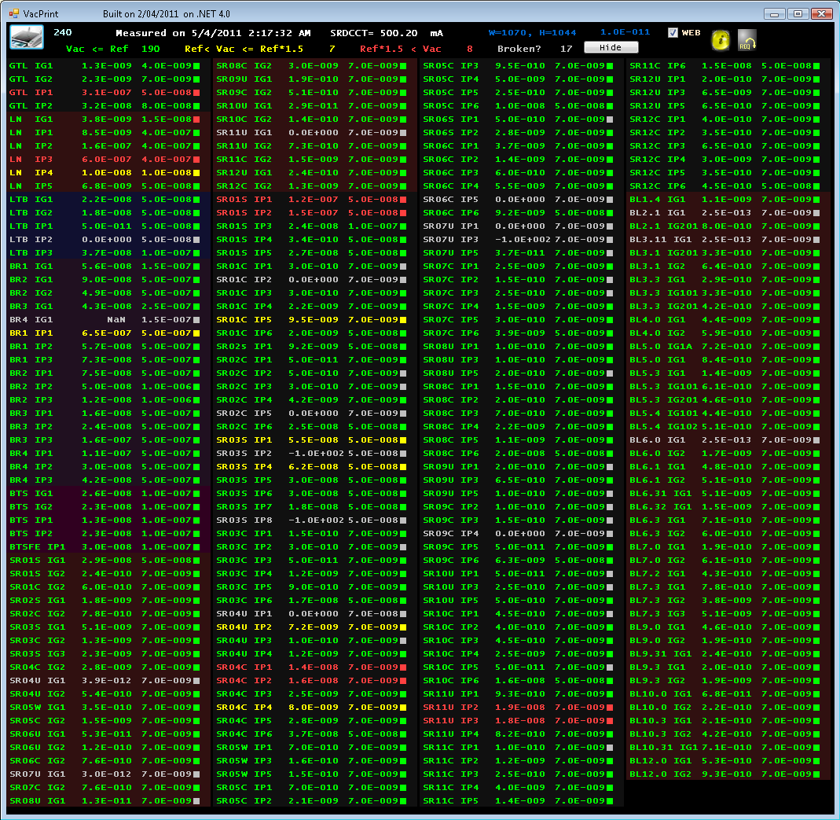
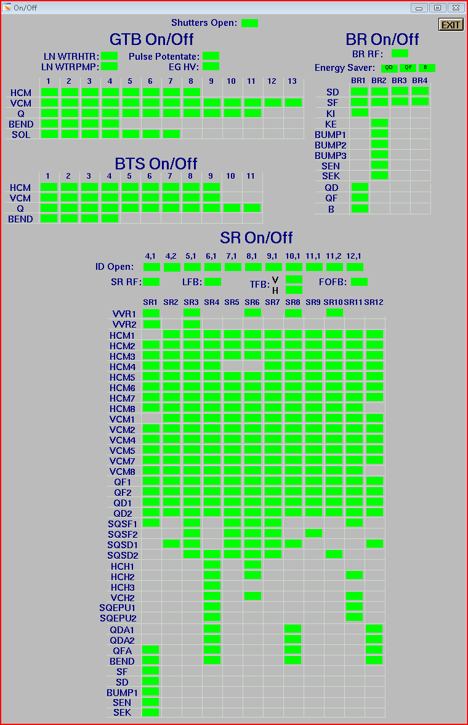
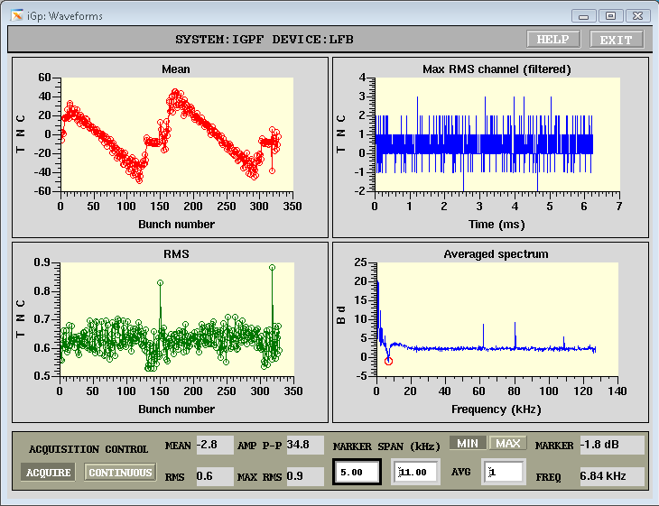
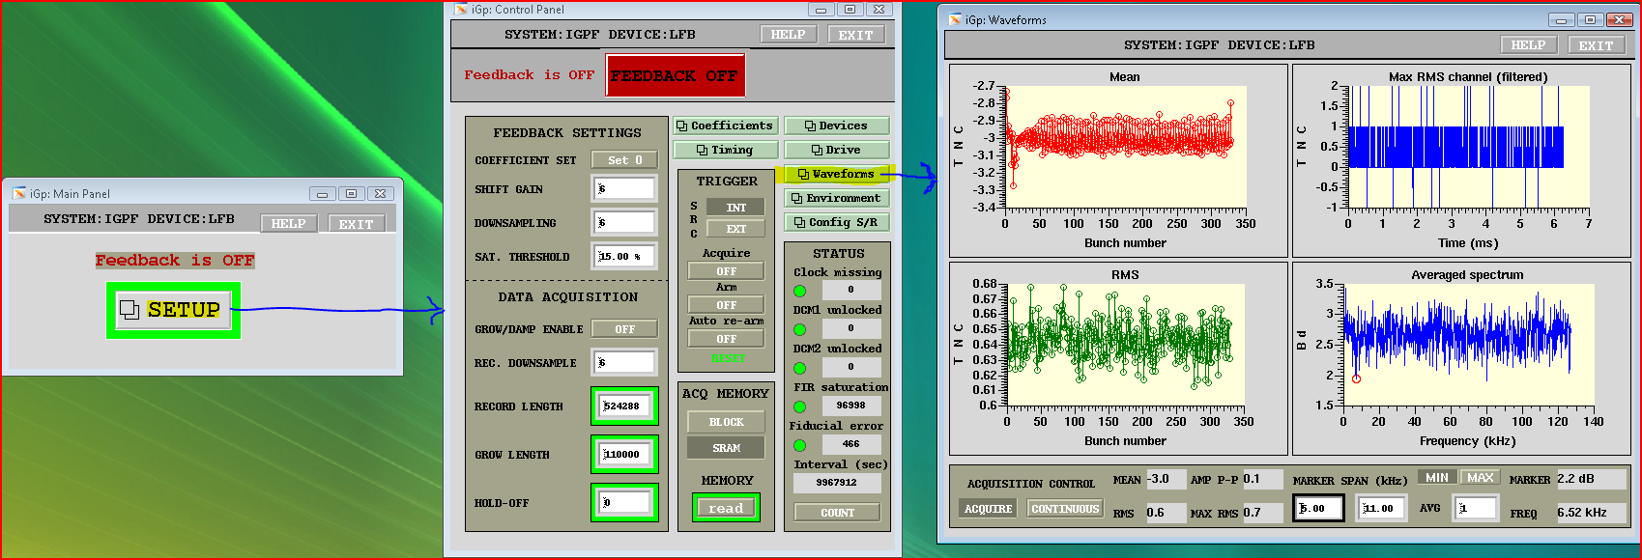
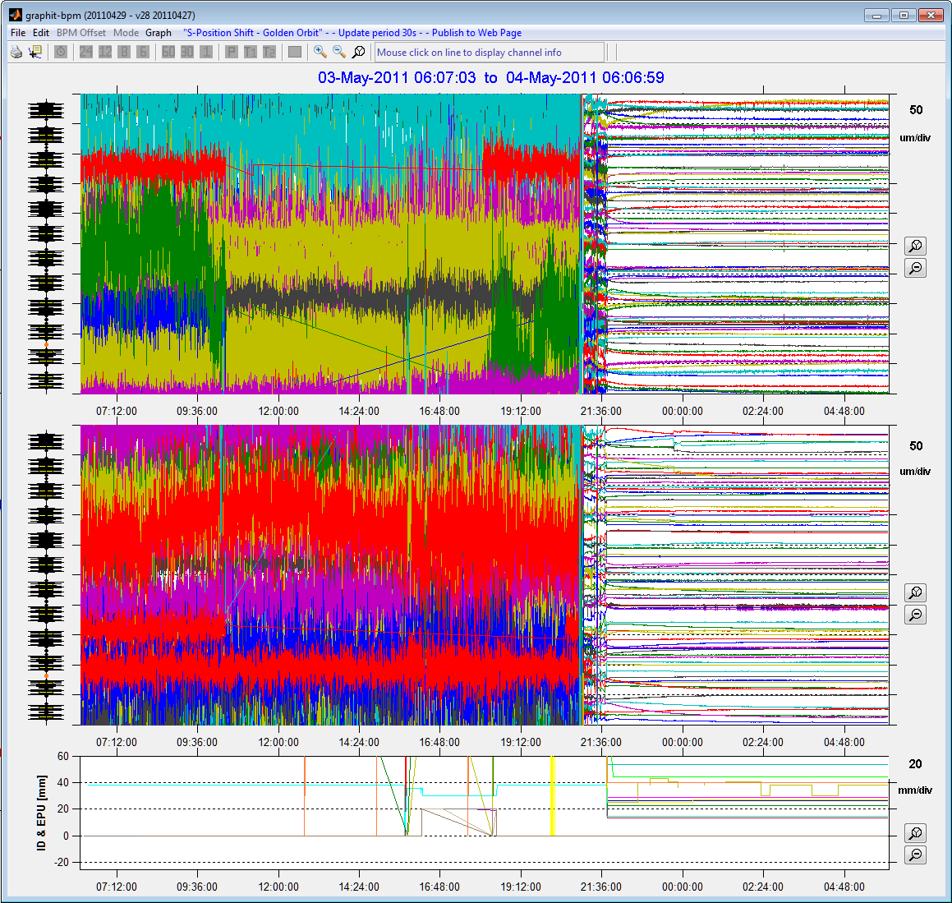
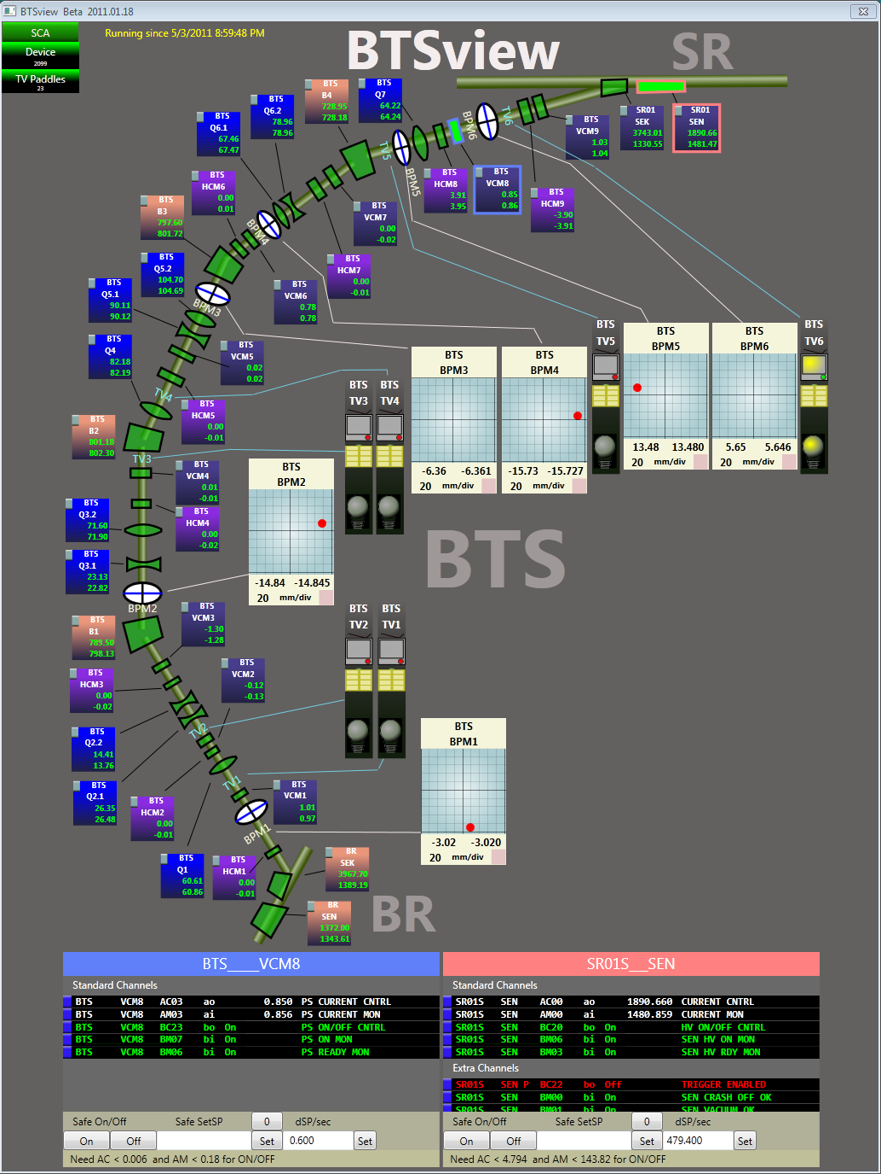
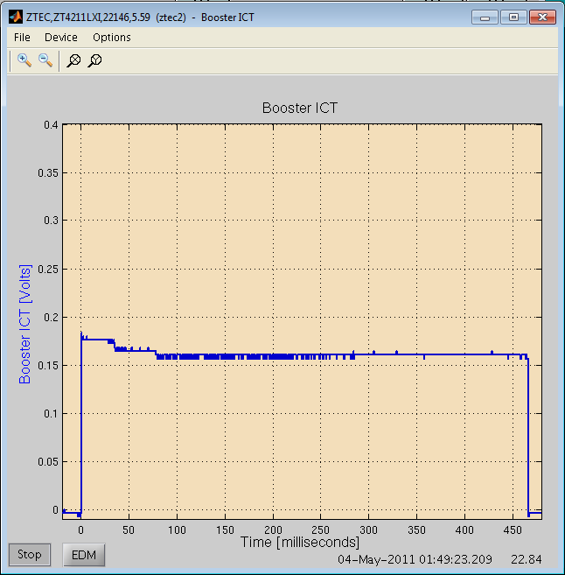
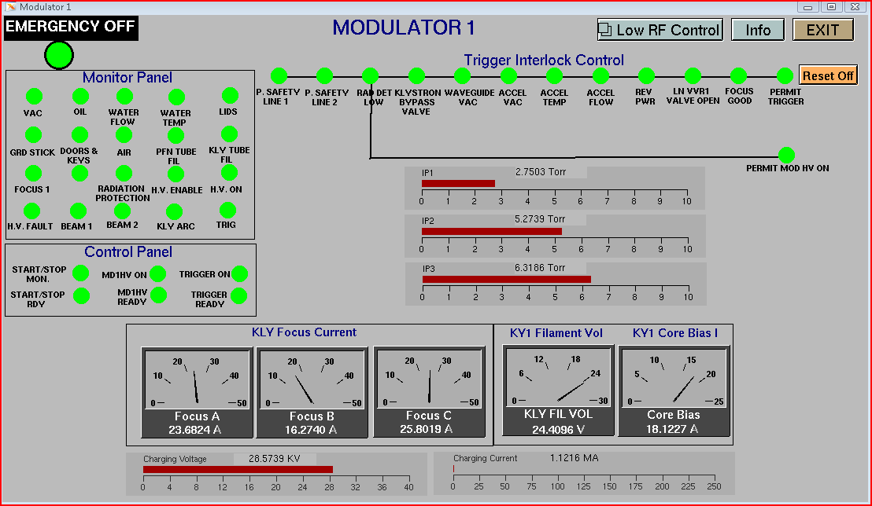
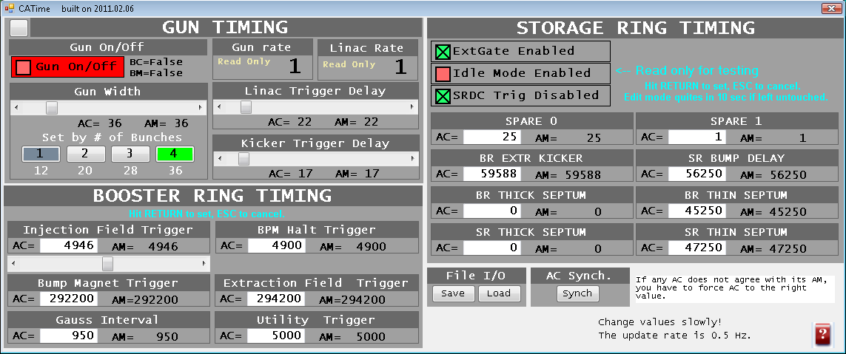
AO’s: Tools of the Job

Slide 8
Floor Operators
Primary responsibility is safe operation of our 40 beamlines
The first contact for any beamline work involving shielding components
Configuration control of beamline shielding
Face-to-face training of all beamline personnel and every new User that comes to the ALS
Beamline review process
  Beamline, Endstation, and Hutch inspections
  Beamline design and modification review process

Slide 9
FO’s: Tools of the Job
Shielding Change Forms
Two flavors:
Accelerator and Beamline

Slide 10
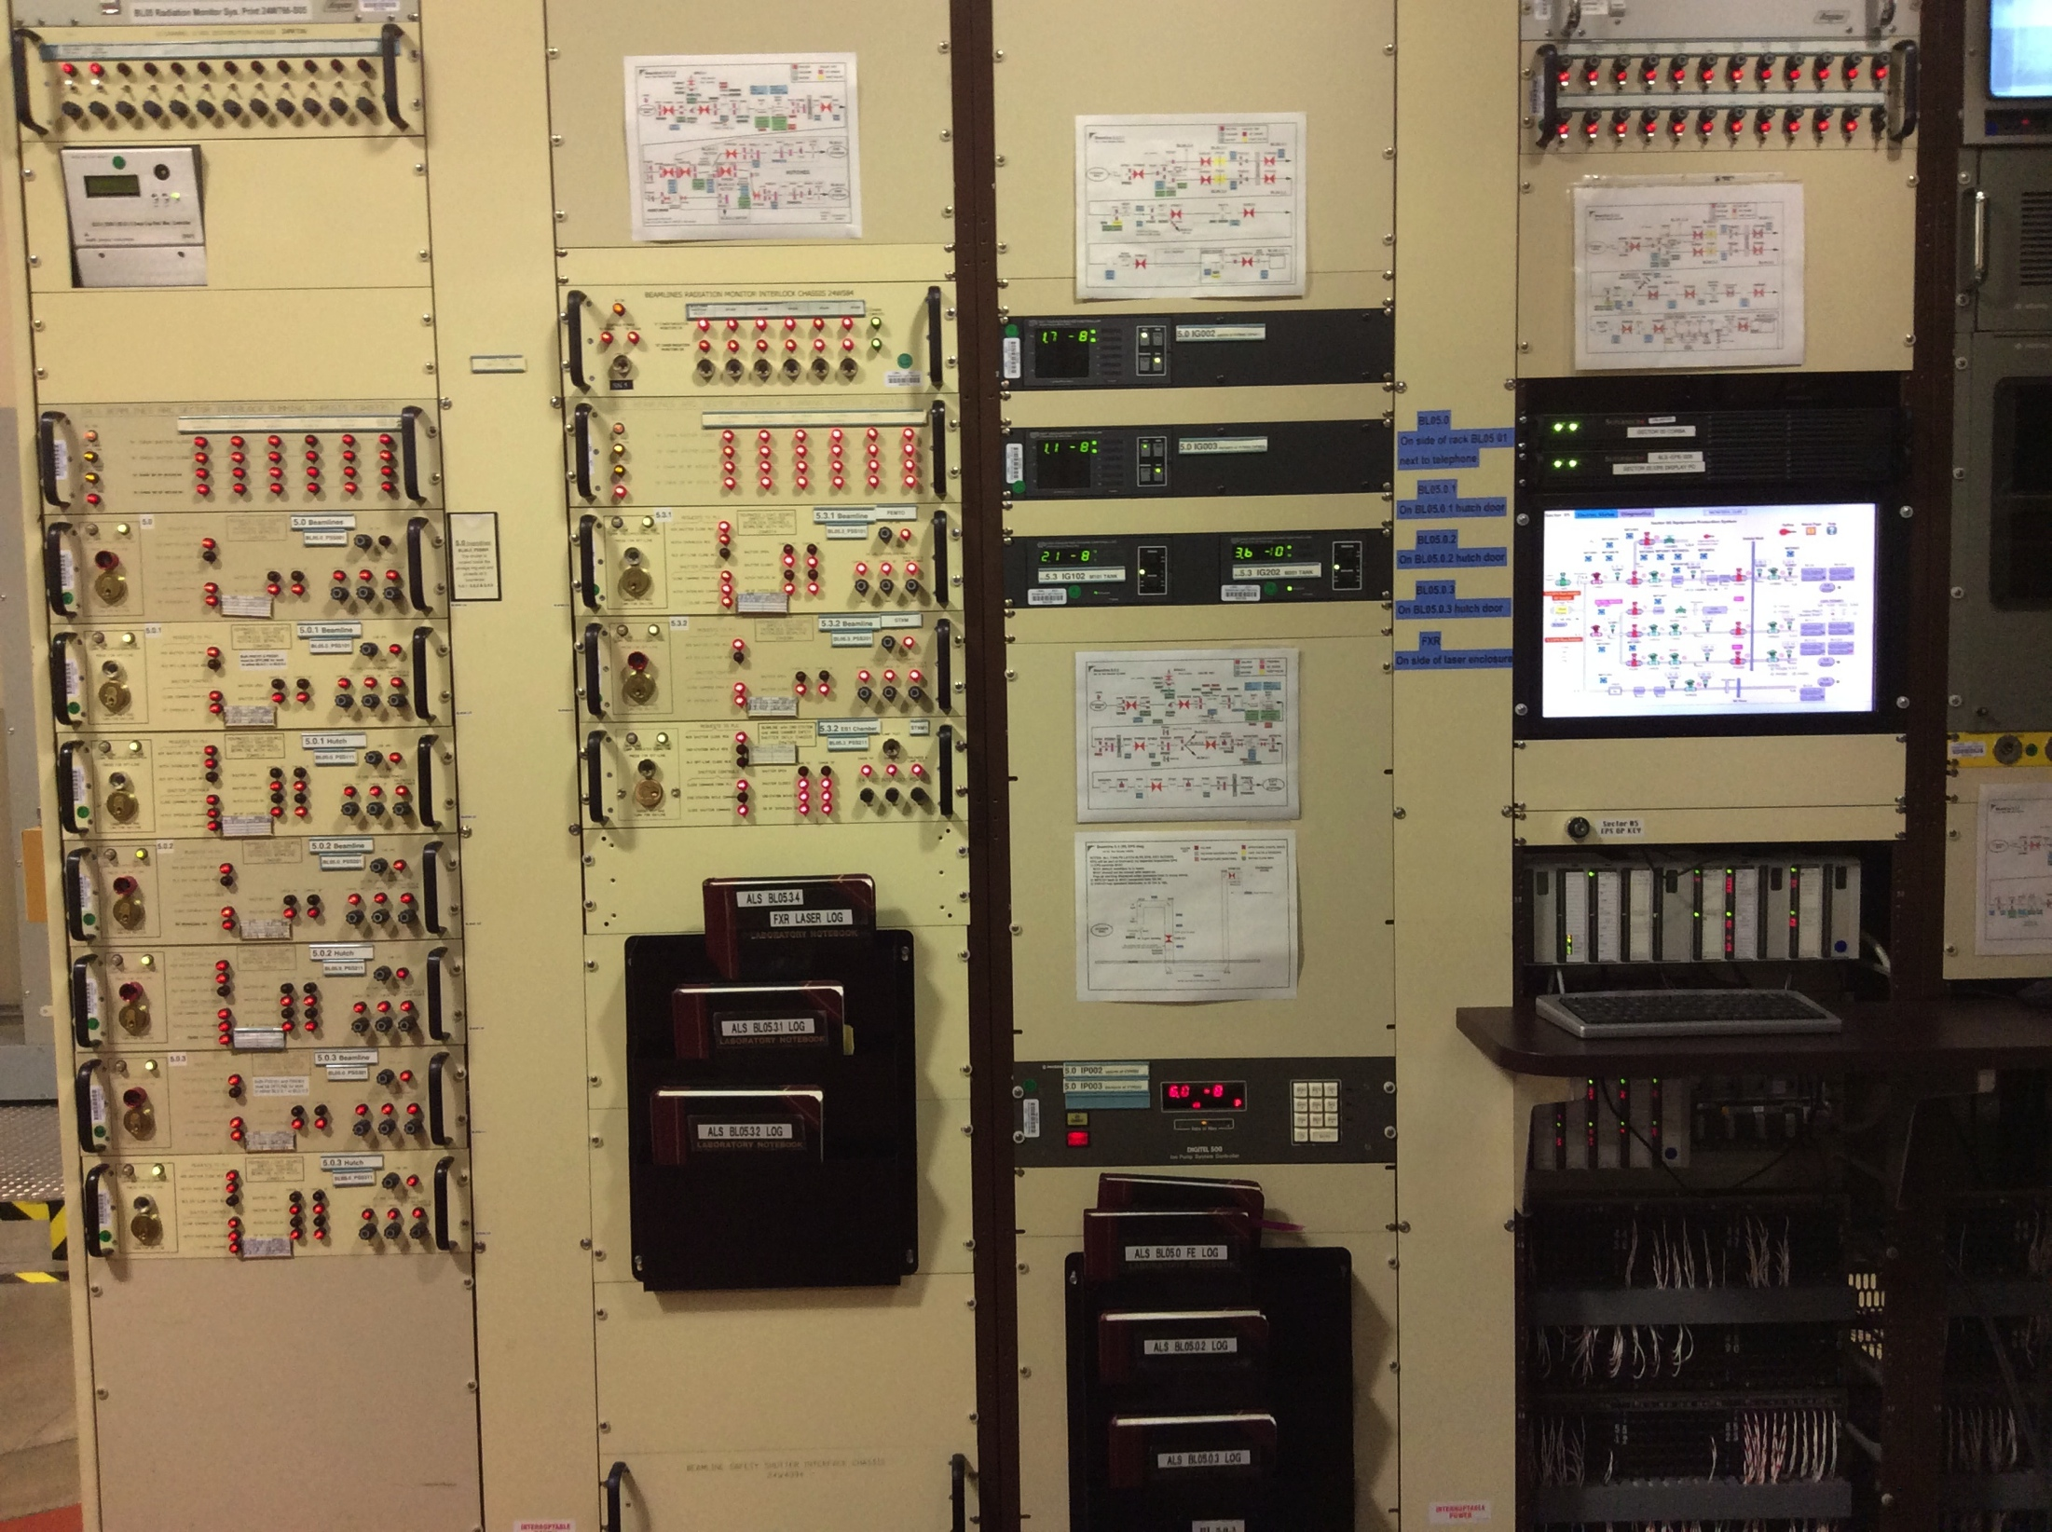
FO’s: Tools of the Job
Equipment Protection System
Radiation
Safety
System
interlocks

Slide 11
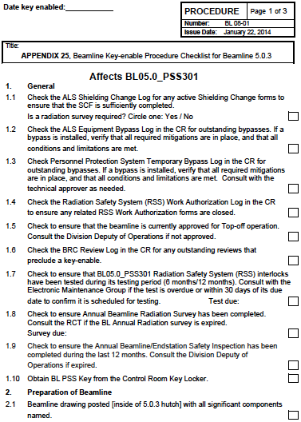
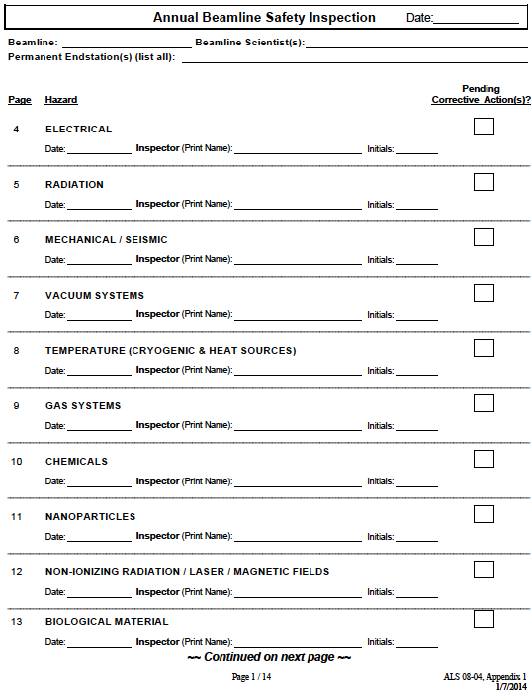
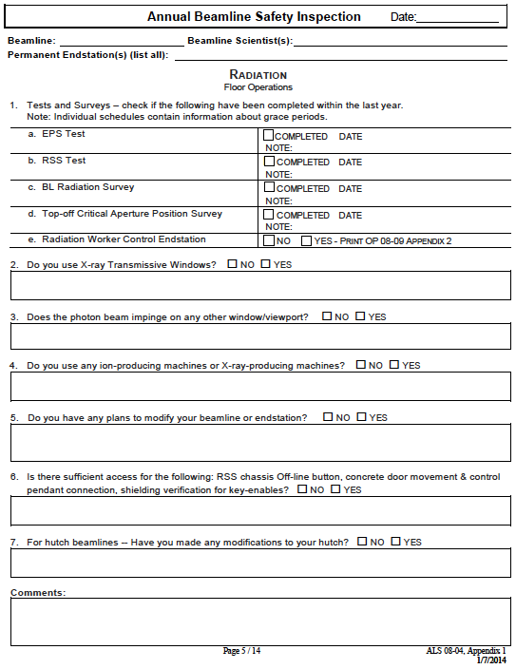
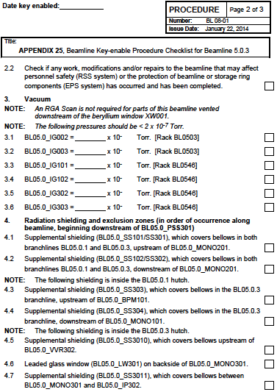
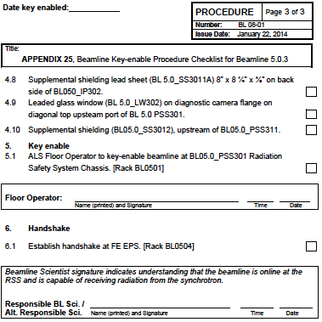
FO’s: Tools of the Job
Key-enable Checklists
Beamline / Endstation
Review Checklists

Slide 12
Interaction with
Radiation Protection Group (RPG)
We inform RPG of any changes related to accelerator or beamline shielding to get their consent
RPG can give us responsibility to perform rad surveys after work is complete
Operators can do commissioning surveys (later backed up by RPG survey)

Slide 13
Challenges
I asked the Operators what their biggest radiation safety challenges were, and this is what they said…

Slide 14
Challenges -1
Radiation Safety and Configuration Control:
It can be difficult to get all stakeholders to agree on who has ultimate responsibility for rad safety
    Our shielding control procedure is out-of-date, has been thoroughly revised, but final agreement on changes is elusive
    This is frustrating for FO’s, who revised the procedure and added many improvements, and who do the actual control work
    Configuration Control is an evolving
    landscape within the DOE complex

Slide 15
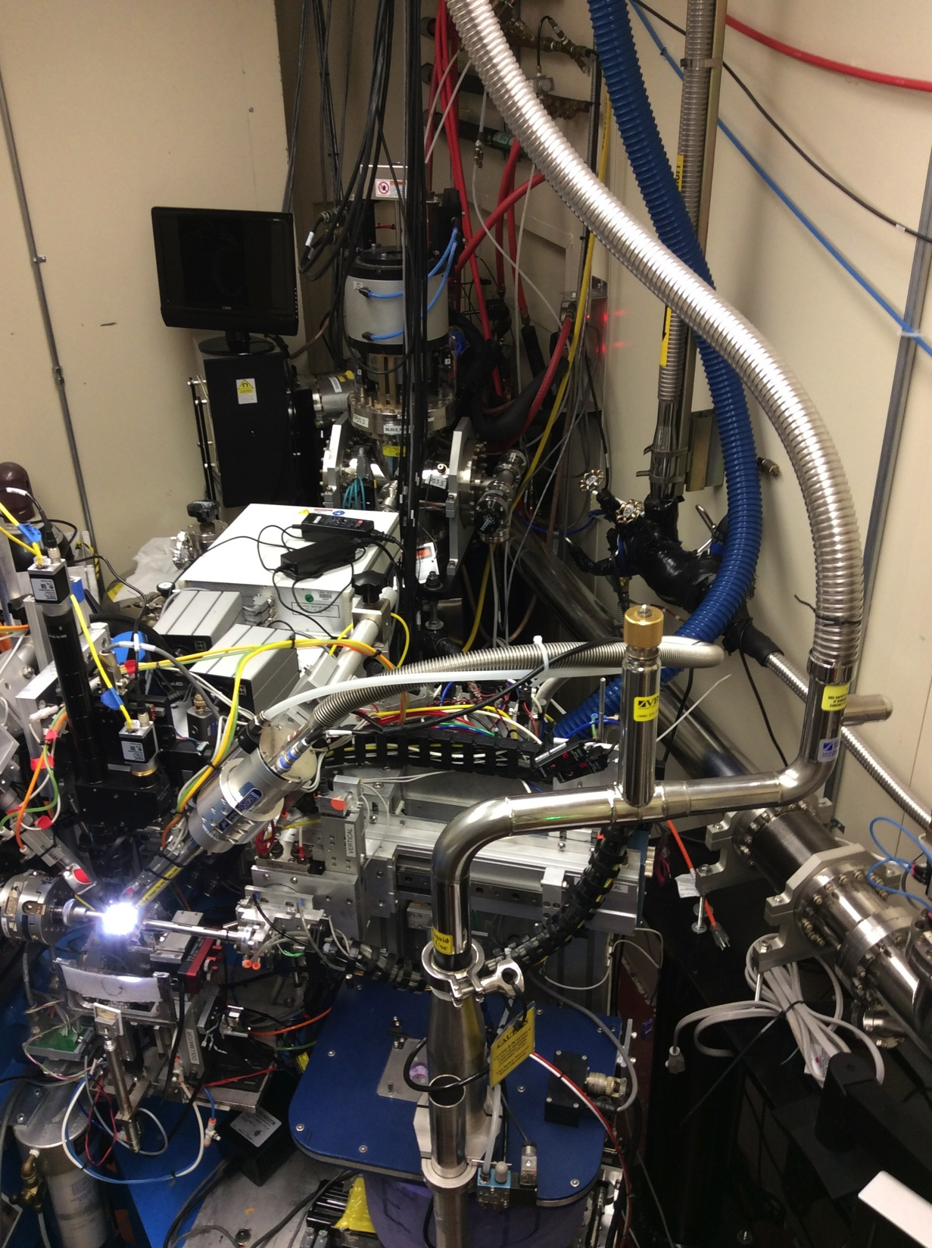
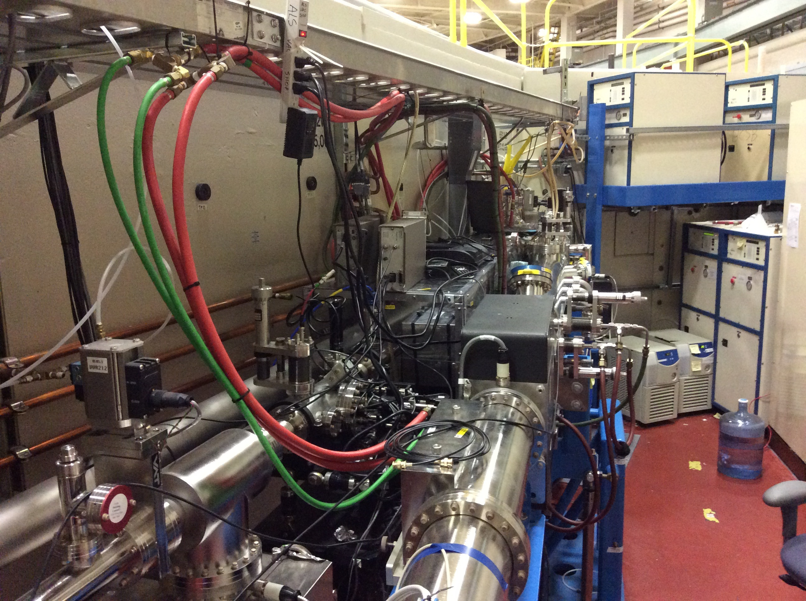
Challenges - 2
Beamlines are complicated!

Slide 16
many Challenges -3
Drawing out the whole story of what a beamline scientist is actually going to do to their beamline
Resisting pressure from scientists-in-a-hurry!
Keeping track of the beamline review process
Face-to-face training with non-English-speakers

Slide 17
a dirty little secret… sometimes things go wrong

Slide 18
Radiation Incident at the ALS
Machine startup – everything looked fine, but could not inject
Tuning went on for 5.5 hours with NO success
Our normal local area monitors did not show anything of concern, so hand-held surveys were discussed but not done
Temporary development monitors measured administratively high levels: up to 15 mrem/hr – 35 mrem total
An invisible software bug corrupted our lattice, making injection impossible
We did an extensive internal investigation to find causes
Operators now go out to survey at first sign of trouble

Slide 19
Summary
Ensuring radiation safety requires good procedures and checklists, but it also takes critical thinking and experience
Operators are instrumental in creating the tools they need, but we depend on training to use them correctly
We constantly try to learn from each other and from unusual situations
When a mistake is made, we don’t blame, we learn from it!

Slide 20
Thanks for your attention

