Slide 1
Re-Commissioning the FNAL Recycler Ring for Proton Operation
Martin Murphy
Workshop on Accelerator Operations
30 October 2014

Slide 2
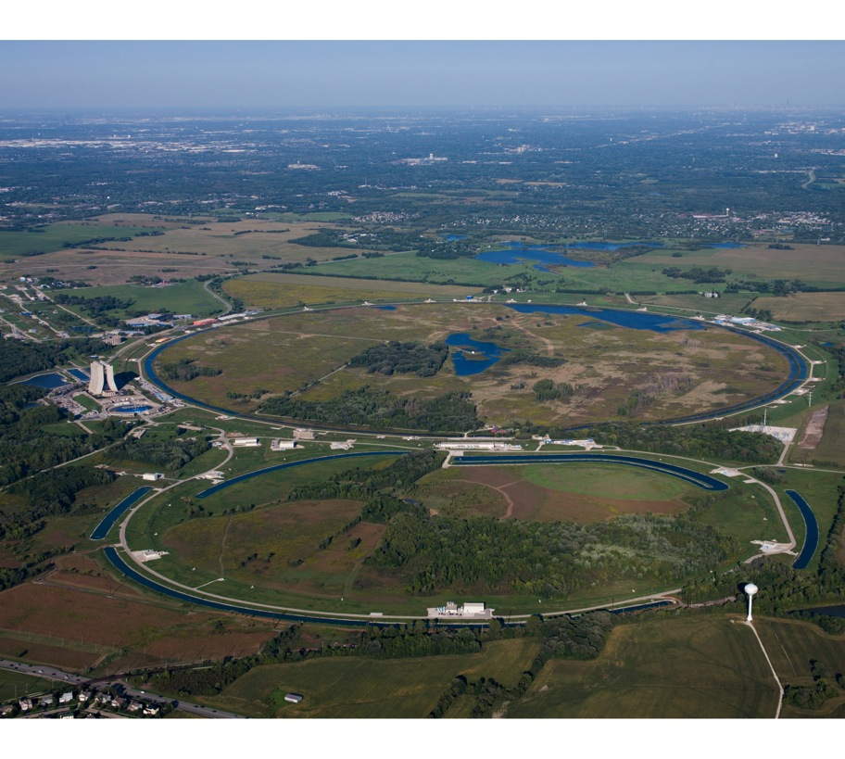
Definition of Terms: Fermilab
Fermilab is a US National Laboratory specializing in high energy physics research & accelerator development.
We are working to become a world leader in Neutrino and Muon physics research.
In parallel we have a top-notch superconducting RF R&D center and we contribute to efforts at the LHC.
This talk will focus on our Accelerator Division’s commitment to the Neutrino program.

Slide 3
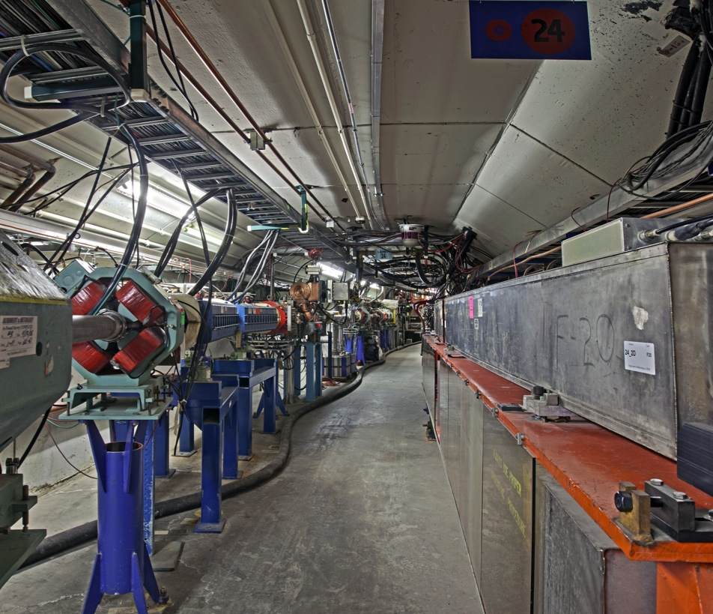
Definition of Terms: The Proton Source
Comprised of an
  H- ion Source.
  400-MeV Linear Accelerator
  8-GeV Booster synchrotron
Produces 8-GeV protons.
Current average duty cycle is 7-Hz.
Striving for duty cycle of 15-Hz.
At right is the Booster tunnel – the Linac injection line on the left and the Booster on the right.

Slide 4
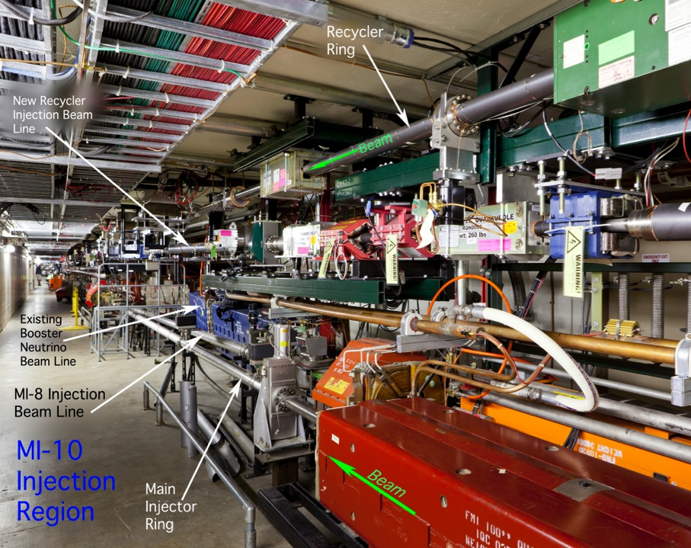
Definition of Terms: The Recycler Ring (RR):
Energy is fixed at 8-GeV.
Shares Tunnel with the Main Injector; 4-km in circumference.
Used as an Antiproton Storage Ring during collider era.
Comprised mostly of permanent magnets.
Powered elements for controlling orbits, betatron tune & chromaticity.

Slide 5
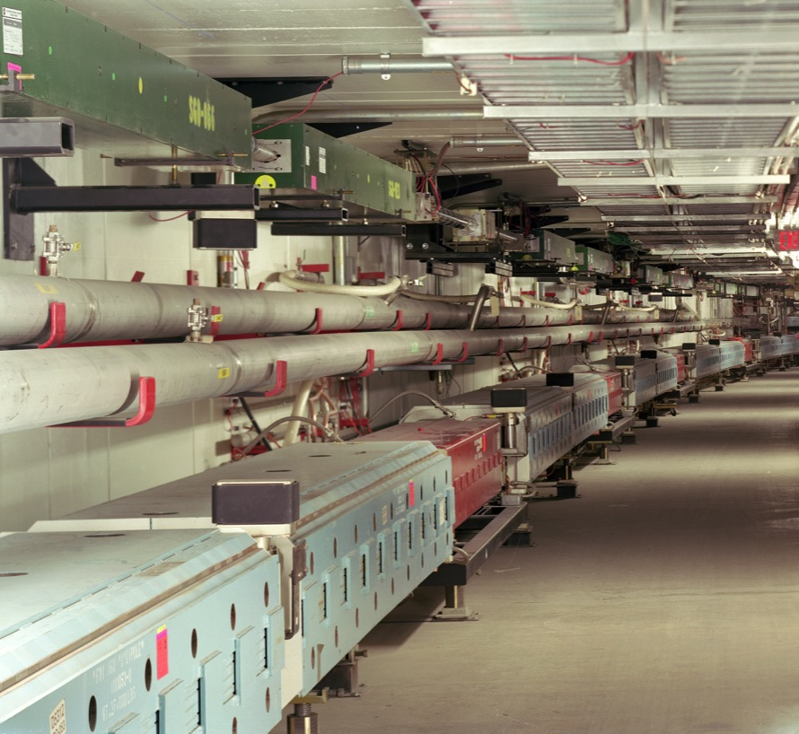
Definition of Terms: The Main Injector (MI)
Synchrotron accelerator
4-km circumference
8-GeV injection energy.
8 or 120-GeV extraction energy.
120-GeV cycle time is 1.33 seconds.
Two beam extraction points.
Provides beam for multiple experiments and a test beam facility.

Slide 6
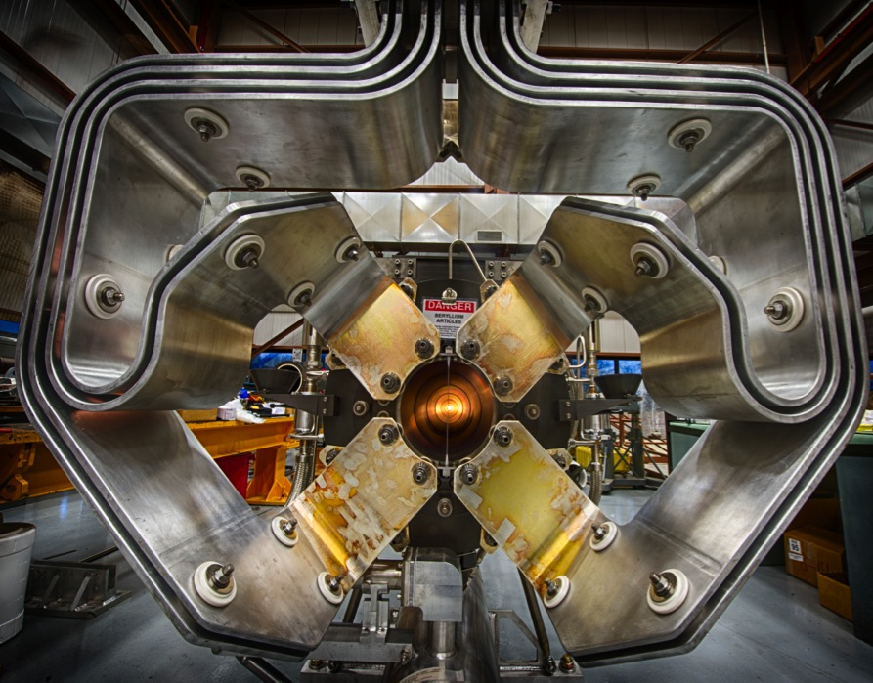
Definition of Terms: NuMI Beam Line
120-GeV protons are extracted from the MI.
Provides beam for three distinct neutrino experiments.
Protons collide with a graphite target and subsequent pions are steered with a high current horn magnet (image at right).
After the horn there is a 600+ meter decay pipe.
After the decay section are a variety of local neutrino detectors (so-called “near detectors”).

Slide 7
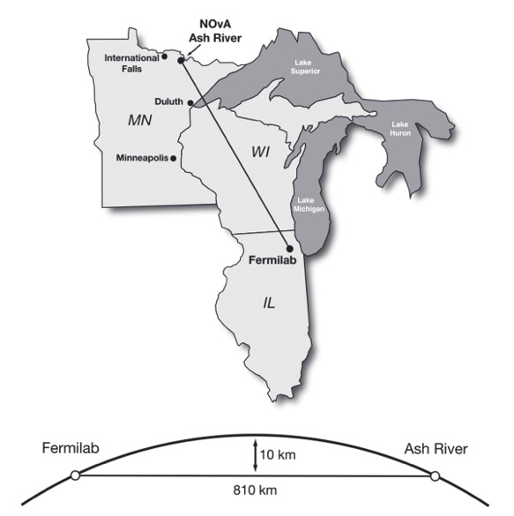
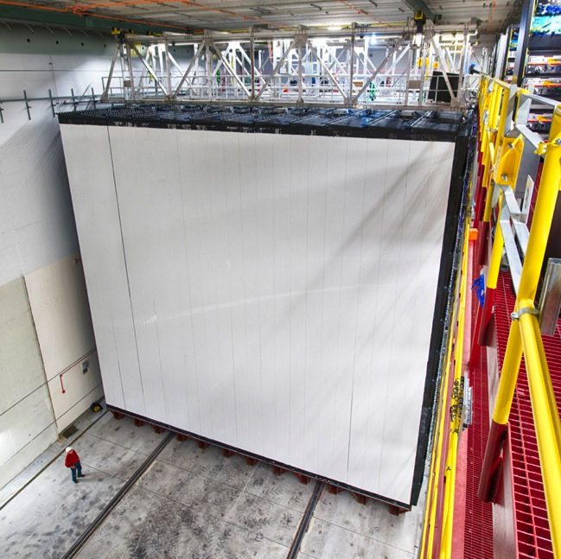
Definition of Terms:
NOνA – studying neutrino mass oscillations
NOνA has Two Detectors:
An on-site “near” detector and a “far” detector near the US-Canadian boarder, 800+ km away.
NOνA Far Detector
Ash River, Minnesota

Slide 8
Motivation
The goal is to establish a 750 KW beam for use by a variety of neutrino experiments that are attempting understand neutrino mass oscillations. Prior to 2012, the peak power was just over 300 KW.
In the bigger picture, the next step will be to create a 1MW beam for the planned Long Baseline Neutrino Facility (LBNF). This step will also require a dramatic improvement of the FNAL Proton Source.
In addition to supporting the neutrino program we must also support a future muon experimental program. All of these experiments demand beam from the Proton Source & Main Injector.
Repurposing the Recycler proved to be the key to meeting these goals!

Slide 9
Situation Circa 2012
The Recycler was designed and built as an 4-km antiproton storage ring.
Arithmetic:
  The Proton Source cycles at a rate of 66 mS and outputs 84 bunches of 8-GeV protons. We call this one Booster Batch.
  The Main Injector can accelerate to 120 GeV and decelerate every 1.33 seconds. It’s Harmonic number, h, is 588.
  How much beam can the MI hold?
    588 [MI Bunches] / 84 [Bunches/Batch] = 7 Batches,
    So in theory one could inject seven batches of Booster beam into the MI. In practice we use six batches, the void allows for kicker magnets to cycle without affecting circulating beam.

Slide 10
Situation Continued
The Proton Source outputs one 8-GeV Batch every 66-mS.
The MI needs six Booster injections to fill it completely.
  6 x 66mS = 0.4 Sec.
  0.4 + 1.33 [sec] = 1.73 second duty cycle
The Proton Source intensity peaks at 5 E12 protons /cycle.
6 x 5.0 E12 protons = 3.0 E13 protons/pulse from MI every 1.73 seconds.
What does this look like?

Slide 11
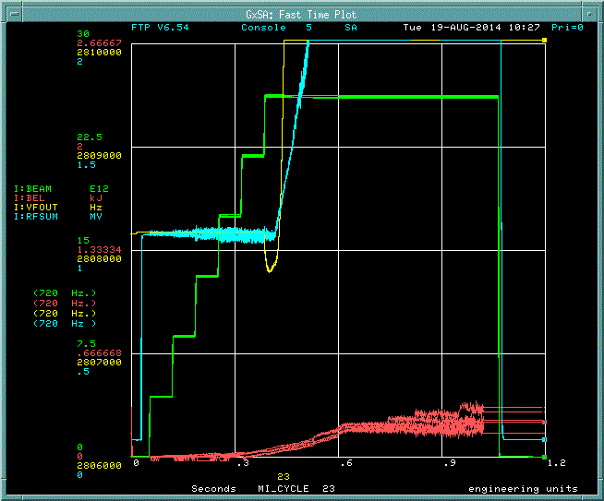
Six Batch Injection to the MI – Cycle Time > 1.7 seconds
The green trace at right is an intensity monitor in the Main Injector.
Each step is the injection of one Booster batch.
The time scale of the plot is 1.2-seconds.
Acceleration starts immediately after the 6th injection.
Beam is extracted at 120-GeV; 1.07 seconds after the first injection.
Another 0.665 seconds are used to ramp down.

Slide 12
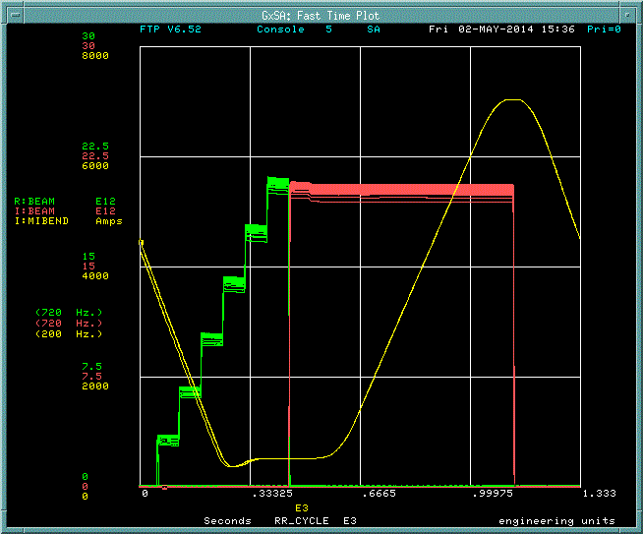
Utilize Recycler (RR) as a Proton Injector While MI Ramps!
Yellow Trace is MI Ramp
Green Trace is RR beam intensity.
Red Trace is MI beam intensity.
By injecting into the RR and then transferring to the MI we can utilize the ramp-down time of the MI to reduce the total cycle time 1.33-seconds – 22% improvement!
What if we could double the beam intensity without changing the fundamental nature of either machine?

Slide 13
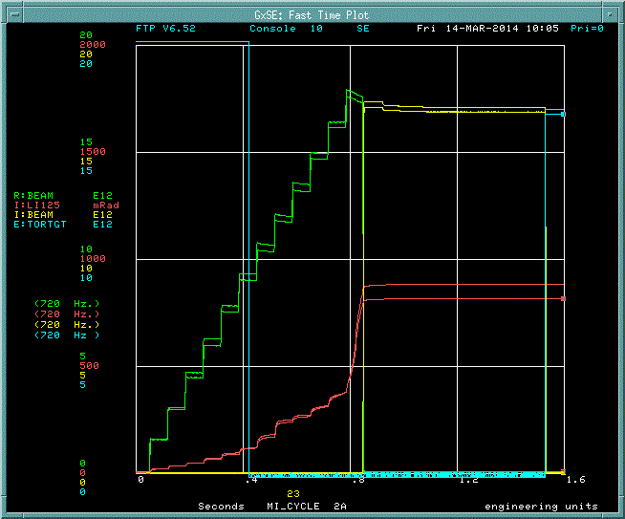
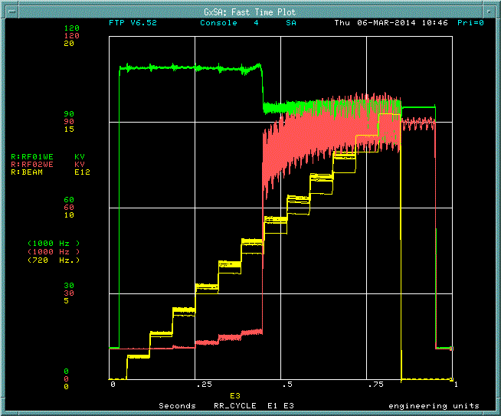
Slip-Stacking Nearly Doubles Beam Intensity
Green – RR Intensity Monitor
Yellow – MI Intensity Monitor
Blue – NuMI Target Toroid
Red – Beam Loss Monitor
Yellow – RR Intensity Monitor
Green – RF01 Gap Voltage
Red – RF02 Gap Voltage

Slide 14
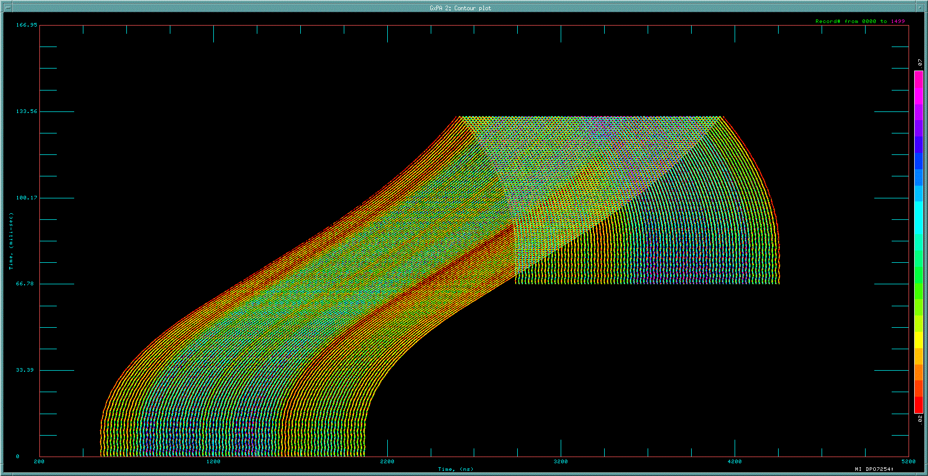
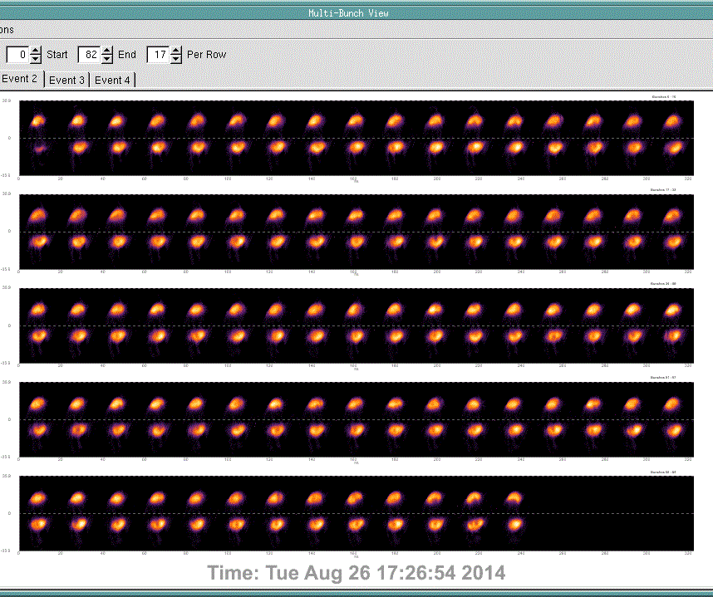
Slip-Stacking Continued
Longitudinal display of slip-stacking two batches.
Bunch-by-Bunch Display of slipped proton batches in the Recycler

Slide 15
Recycler & Main Injector Upgrades & Modifications (an incomplete list)
Repurposing the Recycler required two significant shutdown periods.
The first period went from May 2012 through July 2013.
  New Recycler injection line.
  Removal of antiproton era hardware.
  New RR-to-MI beam transfer line.
  Installed two of three 53 MHz Recycler RF cavities.
  Installed additional RF cavities in Main Injector.
  Installed loss reducing kickers in Recycler.
  Installed new diagnostic instrumentation.
The second period lasted six weeks and ended this past week.
  Installed new Recycler extraction beam line for muon experiments
  Installed third Recycle 53 MHz RF cavity.
  Installed new ion pumps in the Recycler.

Slide 16
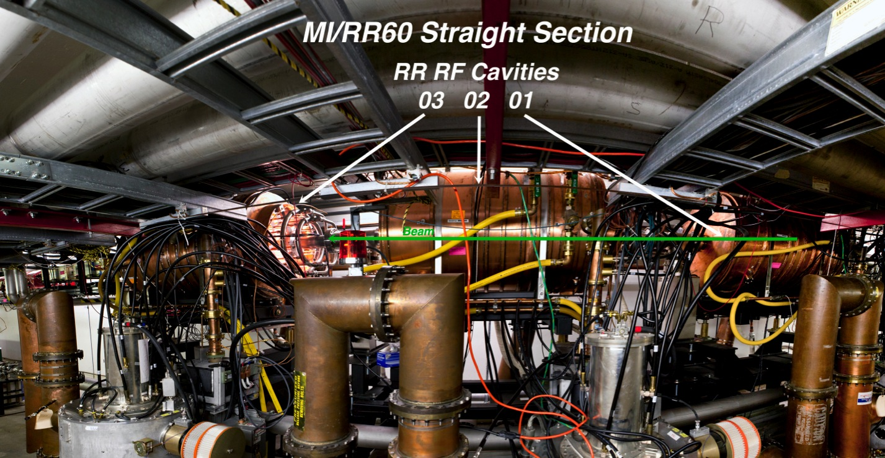
Recycler & Main Injector Upgrades & Modifications
Three new 53-MHz RF cavities were installed in the RR

Slide 17
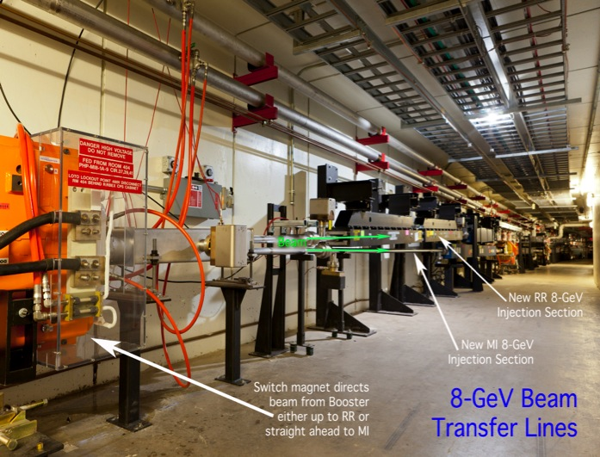
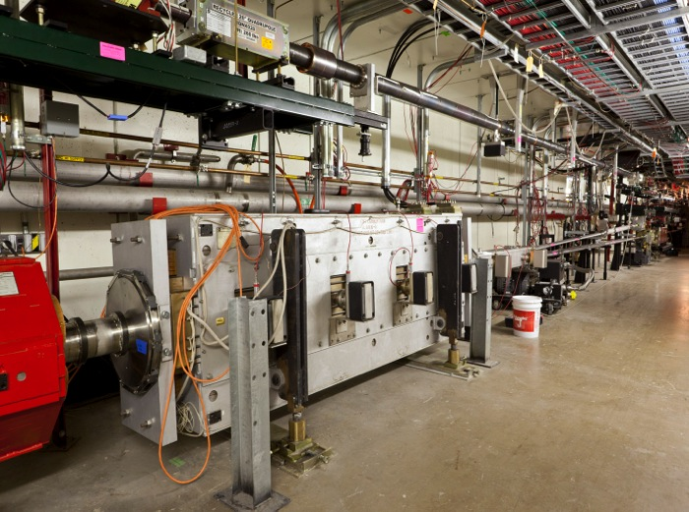
Recycler & Main Injector Upgrades & Modifications
New Booster-Recycler Injection Line
New Recycler to MI Transfer Line

Slide 18
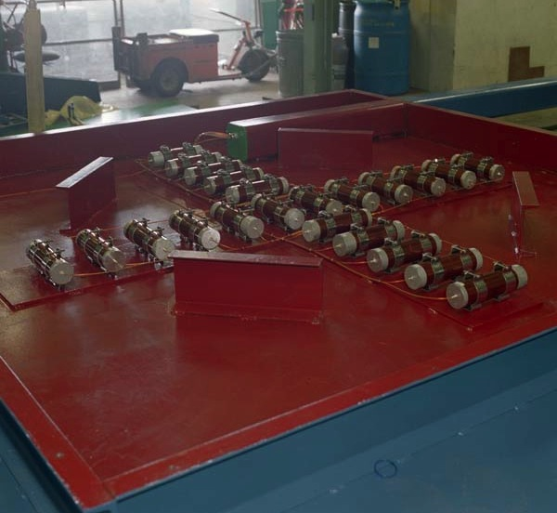
Minimizing Beam Loss
The Problem: Two accelerators in the same tunnel, both running beam at the same time, and only one Beam Loss Monitor (BLM) system.
Answer: It’s all in the timing…

Slide 19
Monitoring for Beam Loss with Two Accelerators in the Same Tunnel with a Single BLM System. How?
Each machine has dedicated BLM parameters fed from common hardware.
Each machine’s BLM parameters are triggered on/off when beam is injected/extracted from each machine.
Independent of the BLM system, a total “beam power lost” number is calculated from the respective intensity monitor inputs.
Trigger RR loss monitors during RR injection.
Trigger MI loss monitoring after MI injection.

Slide 20
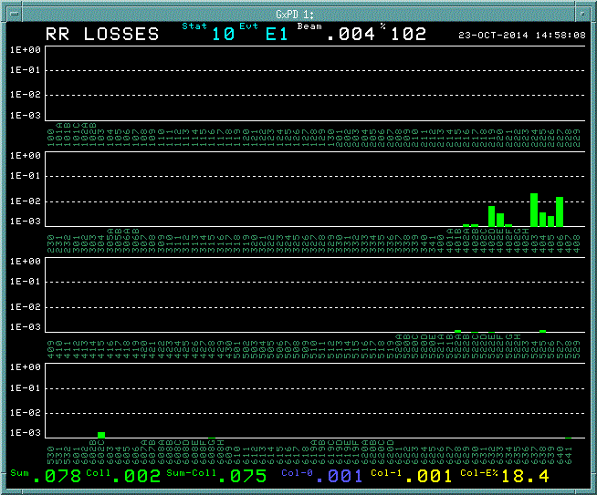
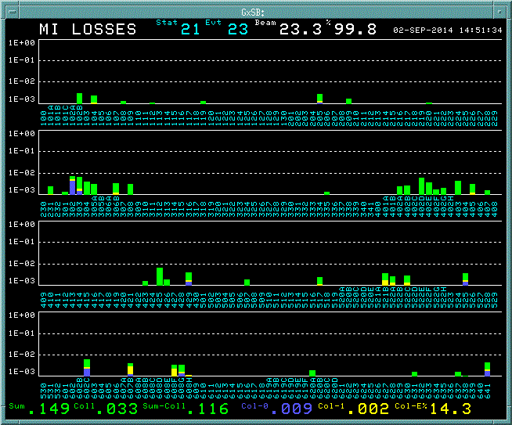
Beam Loss Monitoring – What Operators See…
Recycler Beam Loss Histogram
Main Injector Beam Loss Histogram

Slide 21
Incorporating Recycler into Proton Production for NuMI – the Operators’ Roles (a very incomplete list)
“Dirty” Work During Shutdown:
  Installed RR end shims (213 magnets).
  Dismantled old BPMs.
  Shorted off-plane BPMs.
  Assisted Alignment crews.
  Assisted Mechanical crews.
  Assisted RF and Instrumentation dept.
  Created/edited numerous database entries.
In MCR:
  Written console apps, sequencers, etc. to help optimize operation.
  Aperture scans of MI & RR
  Collecting data to help understand beam loss issues in RR.
  Provide direct support for MI/RR scientists.
  Daily tuning to maximize intensity & reduce losses.

Slide 22
Incorporating Recycler into Proton Production for NuMI
Injecting in the RR reduced cycle time to 1.33 seconds (from 2.0 seconds in 2011).
Adding new RF to RR allows for slip-stacking, which will allow for nearly doubling of beam intensity 6 E13 protons/pulse.
These two effects should more than double the neutrino target power from 330 KW to 750 KW.
Work continues toward this goal.
There are still pitfalls ahead and problems to solve…

Slide 23
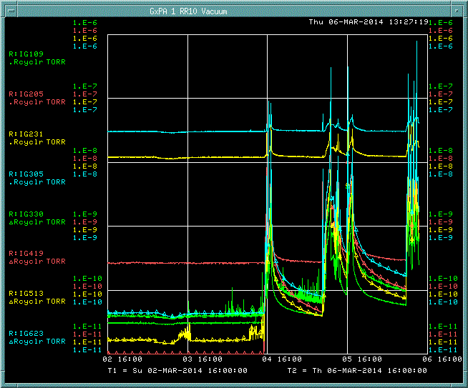
Pit Falls: Recycler Vacuum
At right, ring-wide sample of vacuum response as intensity increased from 1.5 E13 to 2.0 E13 protons per pulse.
Vacuum improves over time with continued increase in beam intensity.

Slide 24
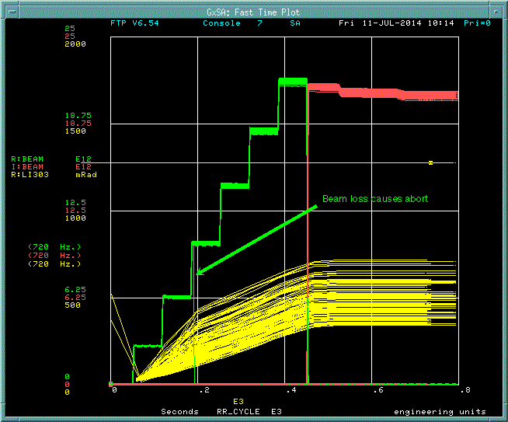
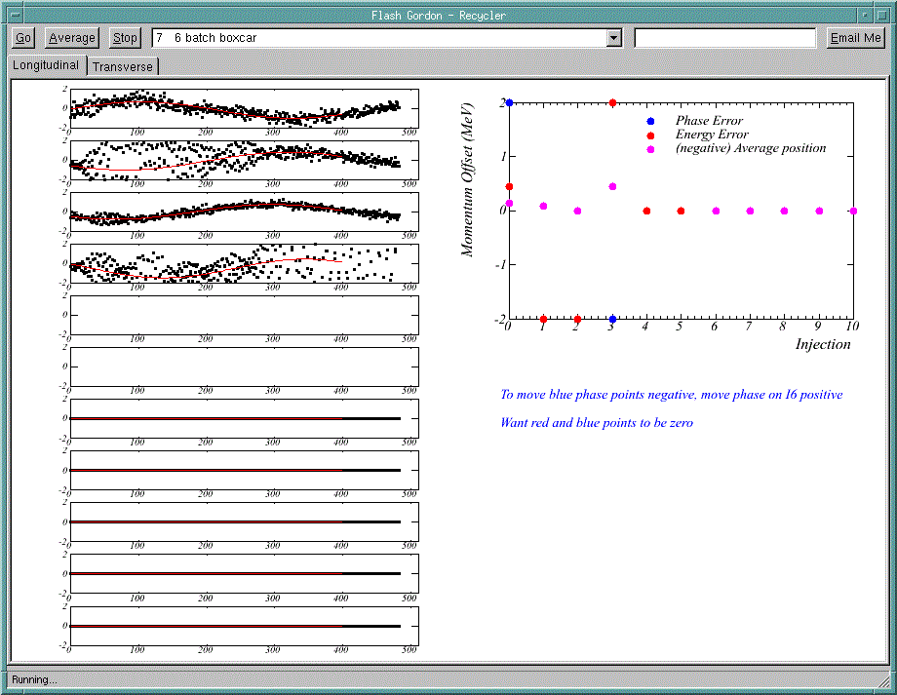
Pit Falls: Recycler Beam Instability
A very fast beam instability is causing losses, which abort the Recycler beam.
Turn-by-turn data sampled at each injection. Note beam aborts after the 4th injection; in this case, there should be six.

Slide 25
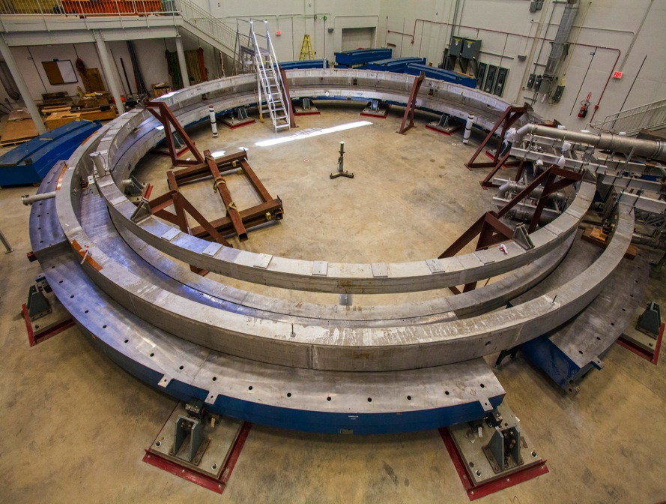
Future Demands of the Recycler
Currently a pair of Muon projects are on Fermilab’s horizon.
Beam will pass through RR, but not MI.
The g-2 experiment looks to complete the most precise measurement of the magnetic moment of the muon (see image at right).
The μ2e experiment looks to study muon-to-electron conversions.
g-2 is expecting beam by Spring of 2017; μ2e in the early 2020’s.

Slide 26
Thanks To:
Every operator in the department.
Denton Morris, Dave Capista, Phil Adamson, Ioanis Kourbonis
Dan Johnson, Duane Newhart & Bob Mau

Slide 27
