Slide 1
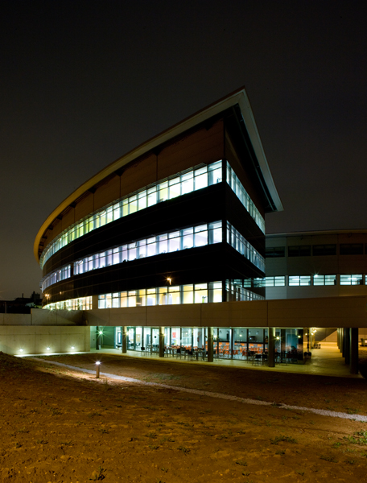
Operators training experience at the ALBA synchrotron light source
Ferran Fernandez
WAO2014

Slide 2
Outline
2
Introduction
  The ALBA synchrotron light source
  How we operate
Training
  Needs
  Steps
  Manpower
Experience and lessons learned

Slide 3
  Introduction – The ALBA synchrotron light source
BOOSTER
100 MeV – 3 GeV
STORAGE RING
3 GeV
LINAC
100 MeV
+ 7 Beamlines
+ 2 BLs in construction

Slide 4
  Introduction – The ALBA synchrotron light source
Booster and SR inst. - 2009
Booster comm. + SR inst. - 2010
SR comm. - 2011
BLs comm. and first Users - 2012
Users - 2013
Users and TopUp - 2014
5 operators
6 new operators to replace and increase up to 7

Slide 5
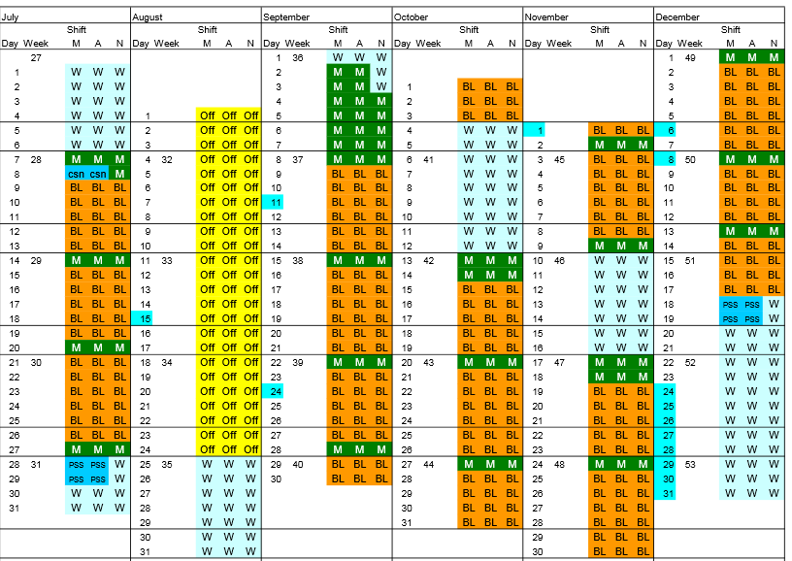
  Introduction – How we operate
6 operators (7 in 2015)
2014 - 5500h
TopUp from July’14
2 people on shift: operator + ACE
OnCall service for critical subsystems
Each operator specialized in one subsystem

Slide 6
  Training – Needs
Basics of accelerators technologies and physics
  RF, PS, Beam Dynamics, Injection, Lifetime,...
Operation procedures
  Startup, shutdown, beam preparation for users, injection,...
First diagnose and intervention in all subsystems
  RF, Power Converters, Water cooling, Diagnostics, Pulsed elements, Vacuum, Device servers,...
Radiation safety
  Radiation zones, radiation detectors, Personal Safety System,...

Slide 7
  Training – Steps
250 h
Lectures on accelerators technologies and physics
200 h
Procedures
FIVE MONTHS
50 h
Hypothetical scenarios
150 h
Radiation safety
150 h
Hands on: Procedures and Fails Simulation

Slide 8
  Training – Steps
Lectures on accelerators technologies and physics
  250 hours
  1 lecture/day with homework
  Given by subsystems experts
  Including:
    Basics of accelerators
    Beam dynamics
    Acc. Subsystems (Linac, RF, Power Conv., Diagnostics,...)
    Equipment Protection System
    Personal Safety Systems
    Controls
    Civil engineering

Slide 9
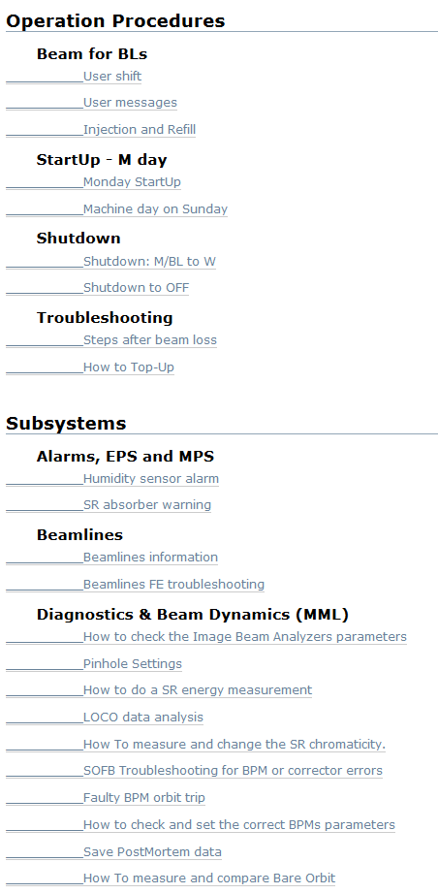
  Training – Steps
OPERATIONS WIKI
Procedures
  200 hours
  Reviewed with Operators and Operators Group Head
  Followed in Control Room and Service Area
  Including:
    Startup and shutdown
    Beam preparation for users
    Injections
    HowTo
    Troubleshootings and reparations

Slide 10
  Training – Steps
Hypothetical scenarios
  50 hours
  Examples
    You do not see any beam in the last fluorescent screen of the Linac. What would you do (flowchart)?
    You are trying to inject in the Booster, but yo do not see any beam in the DCCT. What would you do (flowchart)?
    You have beam in the Booster but you do not accumulate beam in the Storage Ring. What would you do (flowchart)?
  Done with Operators Group Head
  Discussion -> documentation -> discussion -> doc...

Slide 11
  Training – Steps
Radiation safety
  150 hours
  Legal requirement
  Generic course on Radiation Safety
    Given by an external company authorized by Nuclear Safety Council
    Covers: Interaction with matter, detection, dose, radiation zones, law,...
  Specific course on the ALBA synchrotron light facility
    Given by ALBA responsibles of the Accelerators, Safety and Controls
    Approved by the Nuclear Safety Council
    Covers radiation safety issues at ALBA
      ALBA accelerators
      ALBA beamlines
      Personal Safety System
      ... and specific radiation safety issues at ALBA

Slide 12
  Training – Steps
Hands on: Procedures and Fails Simulation
  150 hours
  Injections (when decay mode)
  Startup / shutdown
  Beam preparation
  Participate in failures identification and solving
  Dedicated shifts on Fails Simulation

Slide 13
  Training – Manpower
 | Subsystem Experts [h] | Operators [h] | Head of Operators [h] | Total [h]
Lectures | 90 | - | 30 | 120
Procedures | 10 | 40 | 100 | 150
Hypotetical cases | - | - | 20 | 20
Radiation Safety | 80 | - | - | 80
Hands On | - | 40 | 80 | 120
490 h

Slide 14
  Experience and lessons learned
Hands on As Soon As Possible
  It is when they REALLY understand things
  Many questions arise
Operations Wiki is also very useful for training
It is good to involve existing operators on the training
Hypothetical scenarios good for generating their own documentation
Focus the firsts months only on training

Slide 15
  Questions?

