Slide 1
2nd Generation Electronic Logbook
Presenter: Duane Newhart
Co-Author: Kyle Hazelwood
WAO14 Communications Session
29 10 2014

Slide 2
2nd Generation Electronic Logbook
The Operations Department converted from a paper logbook to an electronic logbook on March 10th, 1998. 15 years 3 months and 12 days later, June 21, 2013, we launched our 2nd Generation of electronic logbook. What prompted the change after so many years?

Slide 3
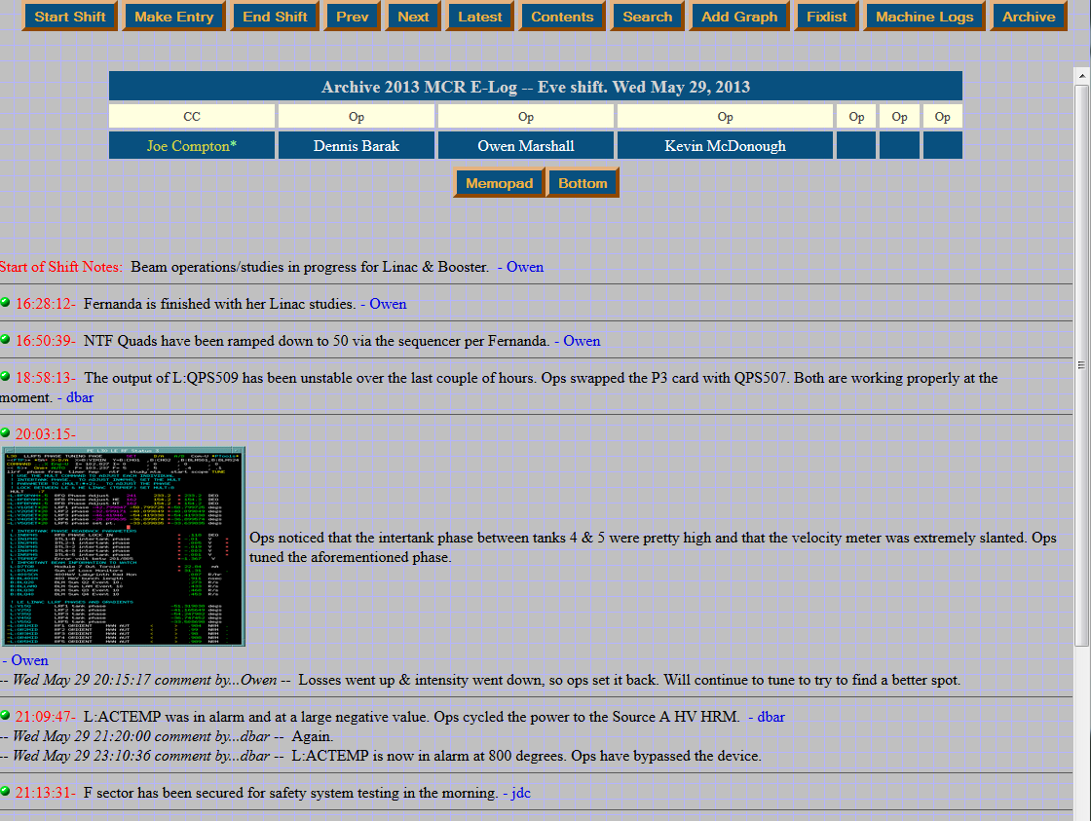
History of Logbook transitions
Bob Mau actually used all of these.

Slide 4
Purpose
What we had
Limitations
What we wanted

Slide 5
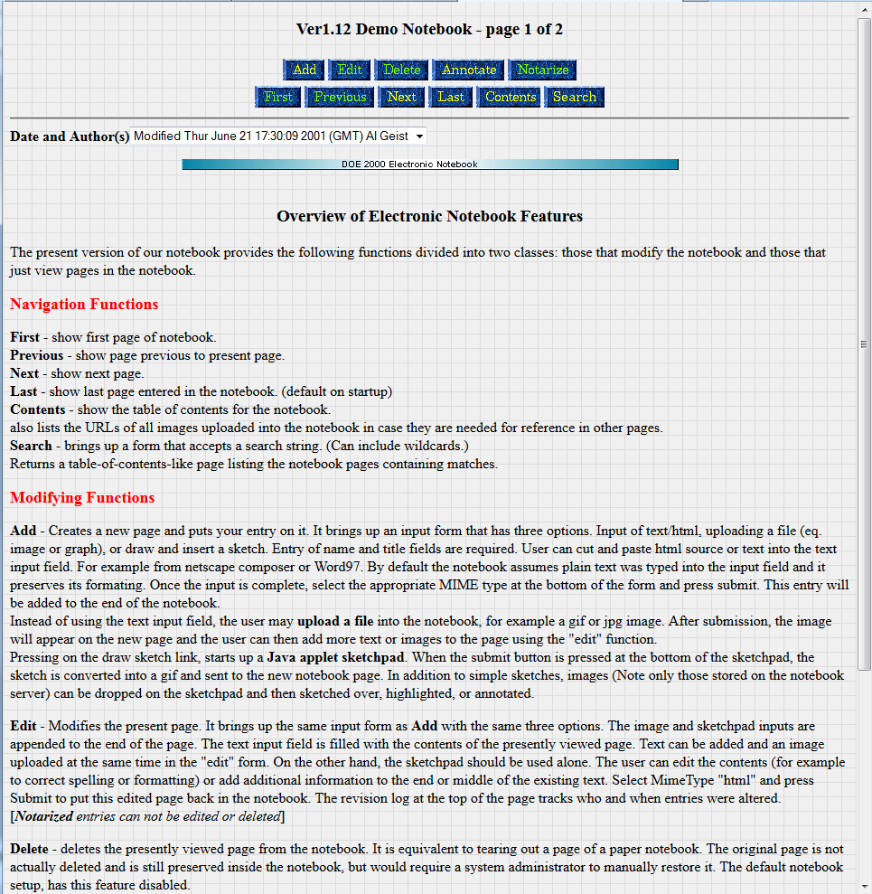
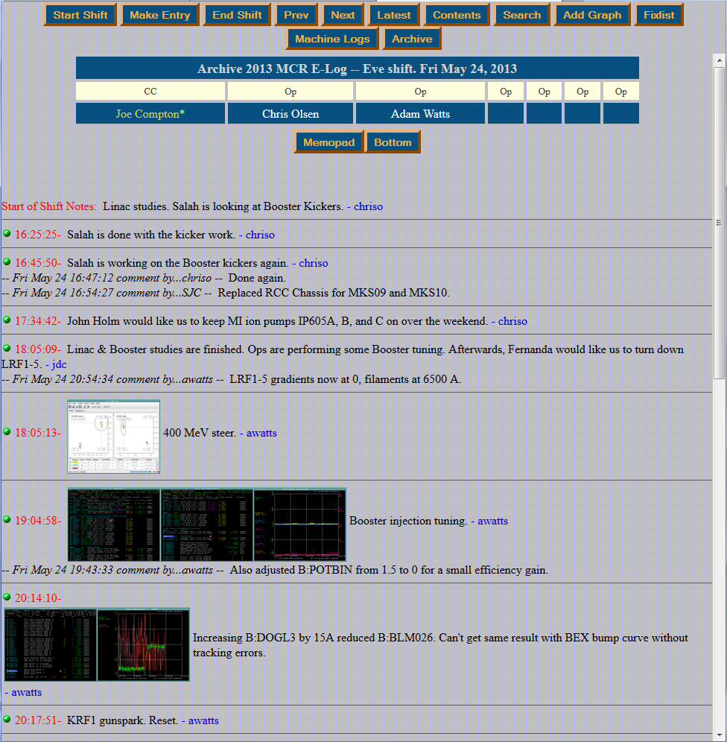
1st Generation Electronic Logbook
Adapted from “Electronic Notebook” created at Oakridge National Laboratory (ORNL)
DOE2000 Collaboration 1998-2008
Implemented March 10th, 1998
Segmented by “Shifts” or “Studies”
Viewed in chronological order of entries
Input Types
Text
Entries & Comments
Files/Objects
images, Word docs, etc.
Custom form entries
Shift Roster
Radiation Survey form
Capable of input from programs and sequencers
Notes:
DOE2000 “Electronic Notebook Project” Collaboration (~1996-2008)
Pacific Northwest National Laboratory (PNNL)
Lawrence Berkley National Laboratory (LBNL)
Oakridge National Laboratory (ORNL)
Adapted from “Electronic Notebook” created at Oakridge National Laboratory (ORNL)
Electronic Notebook was adopted by more than 1000 users

Slide 6
1st Generation Electronic Logbook
Architecture
Browser access
Written in Perl
Producing HTML and JavaScript
Stored HTML documents (flat files) on server hard drive
Objects stored in native format on server
No authentication for onsite write access
Offsite read access through .htaccess using generic password
Offsite write access very limited
Maintained by Operations Department
Notes:
htaccess

Slide 7
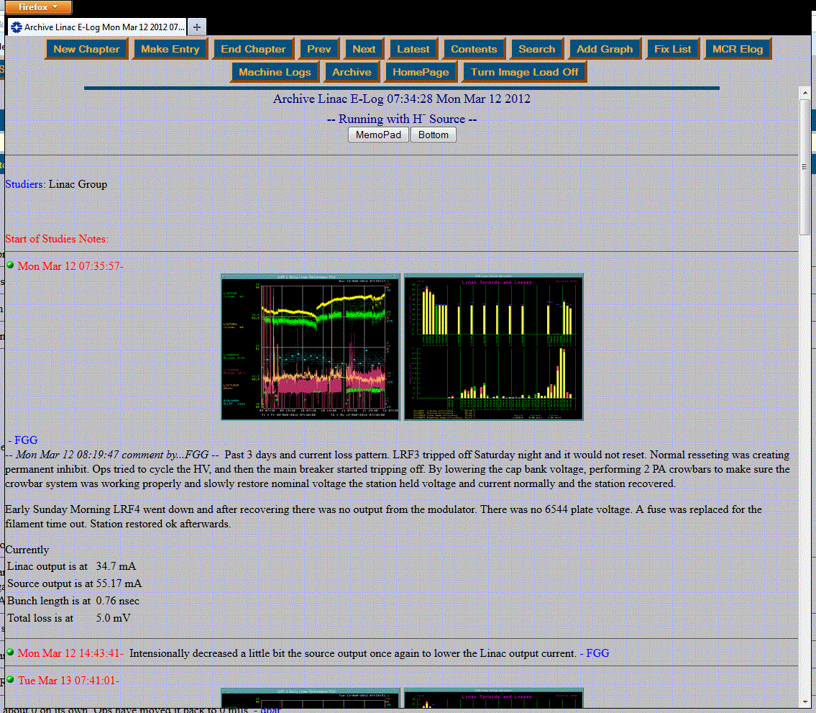
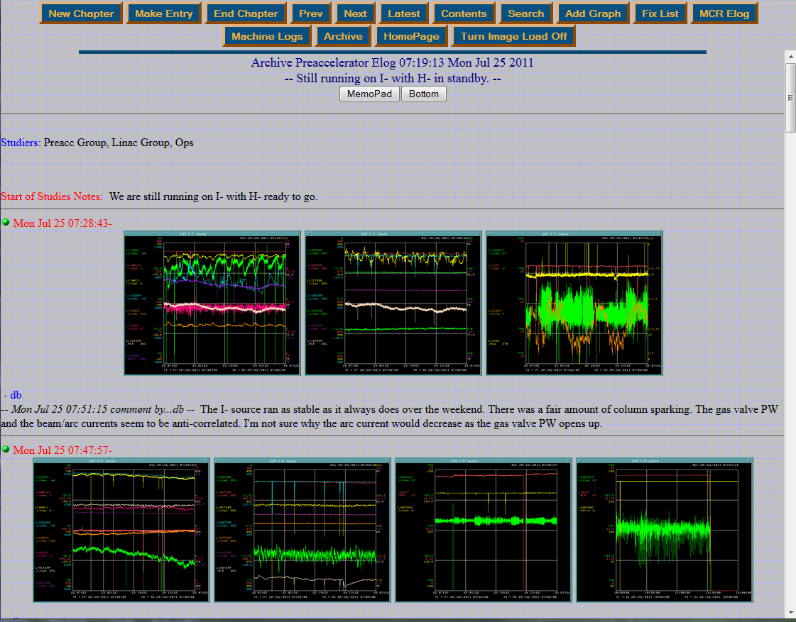
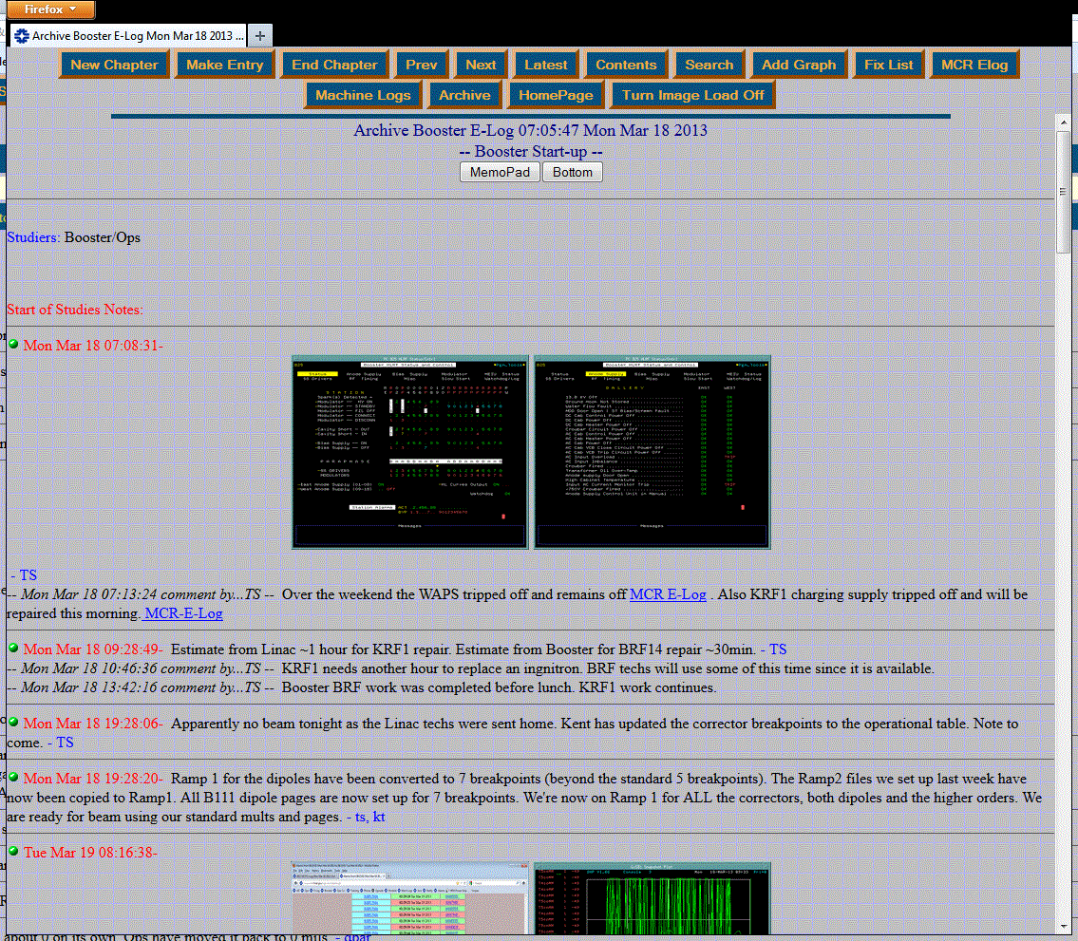
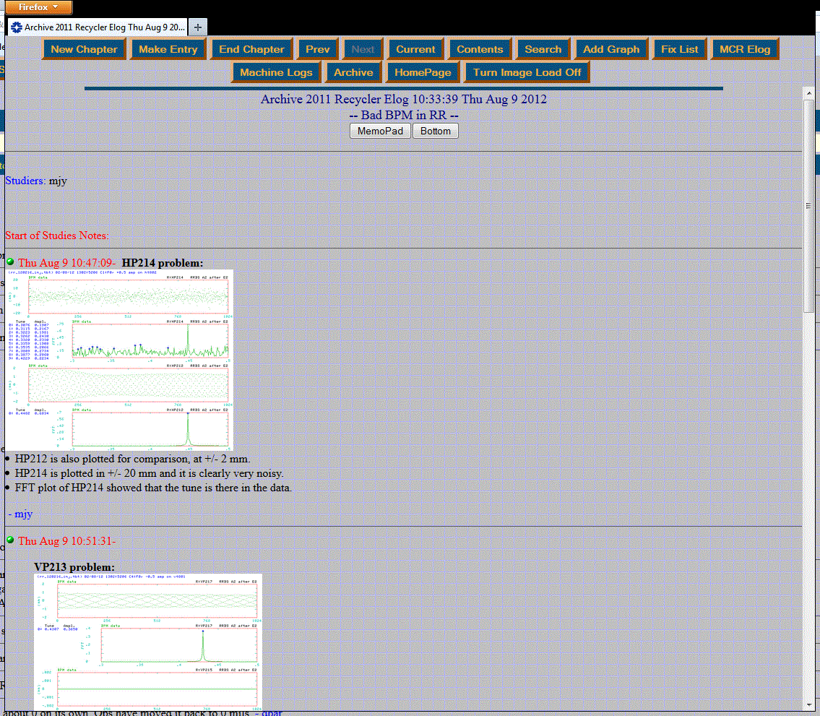
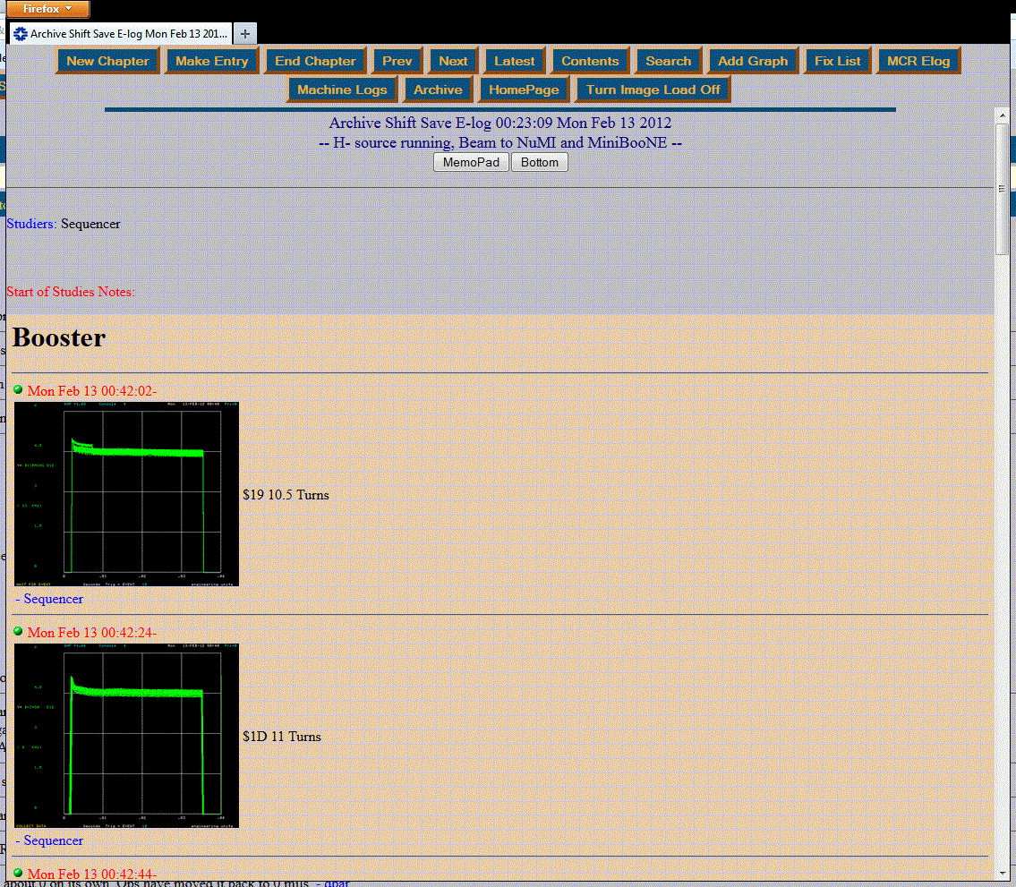
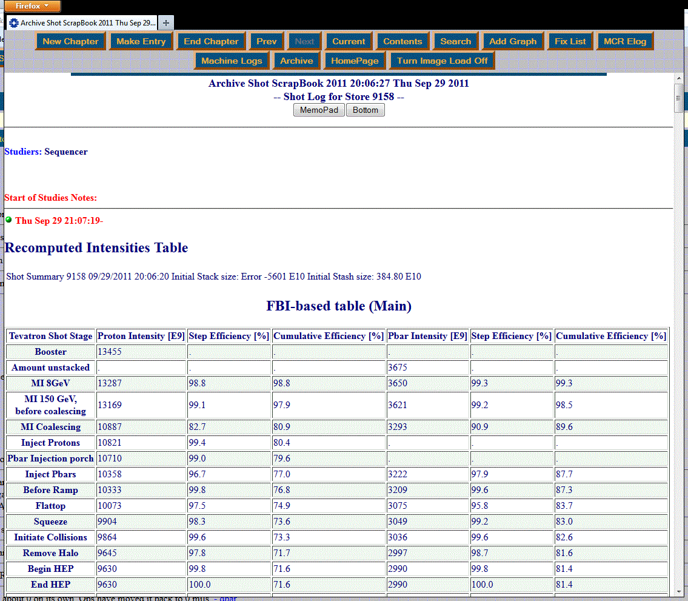
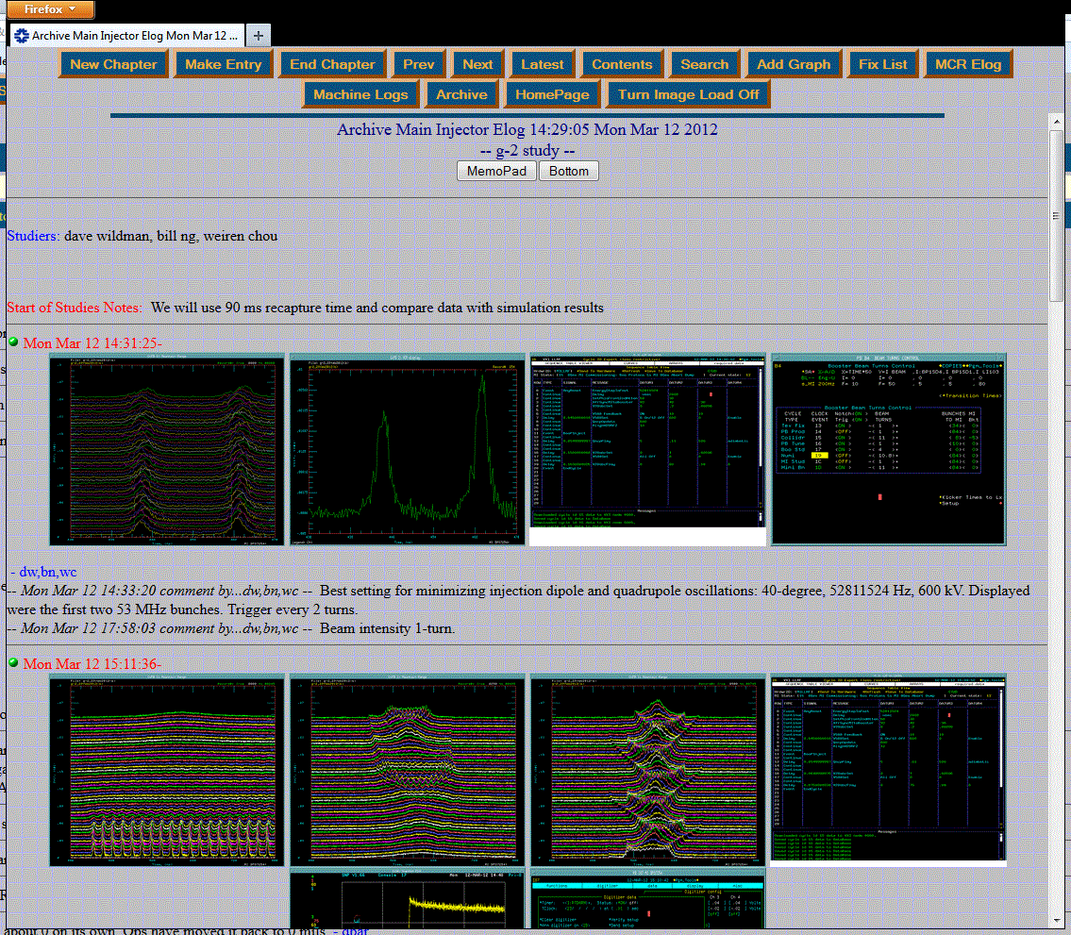
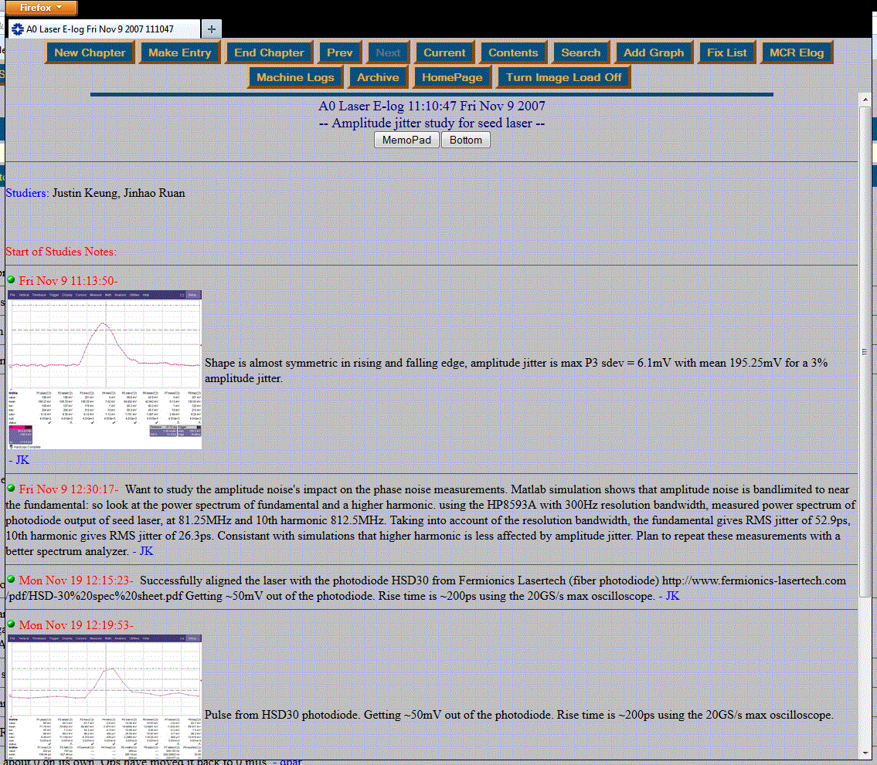
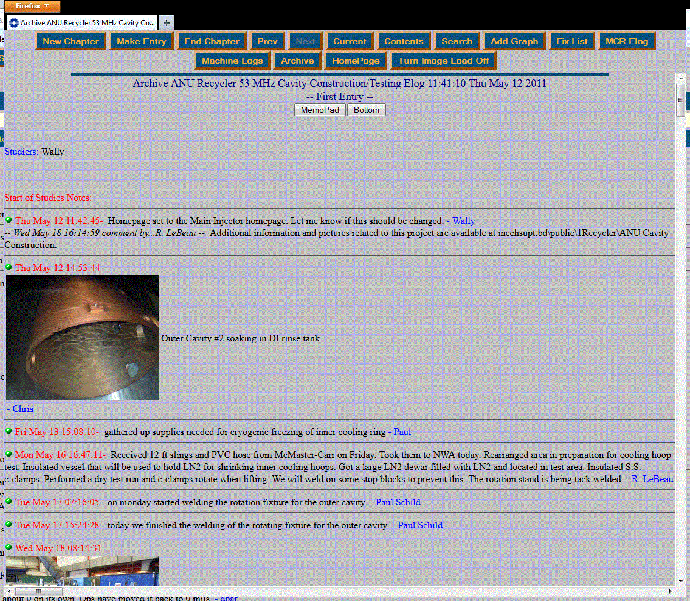
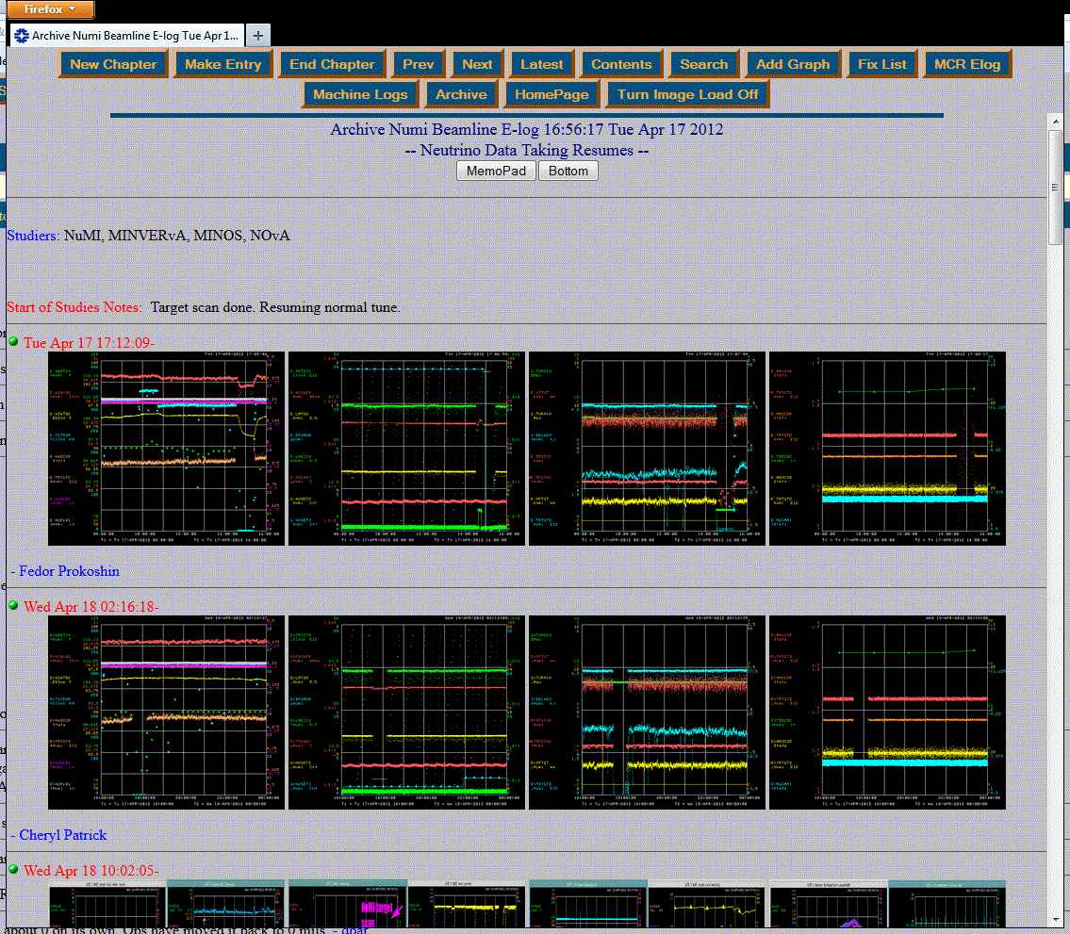
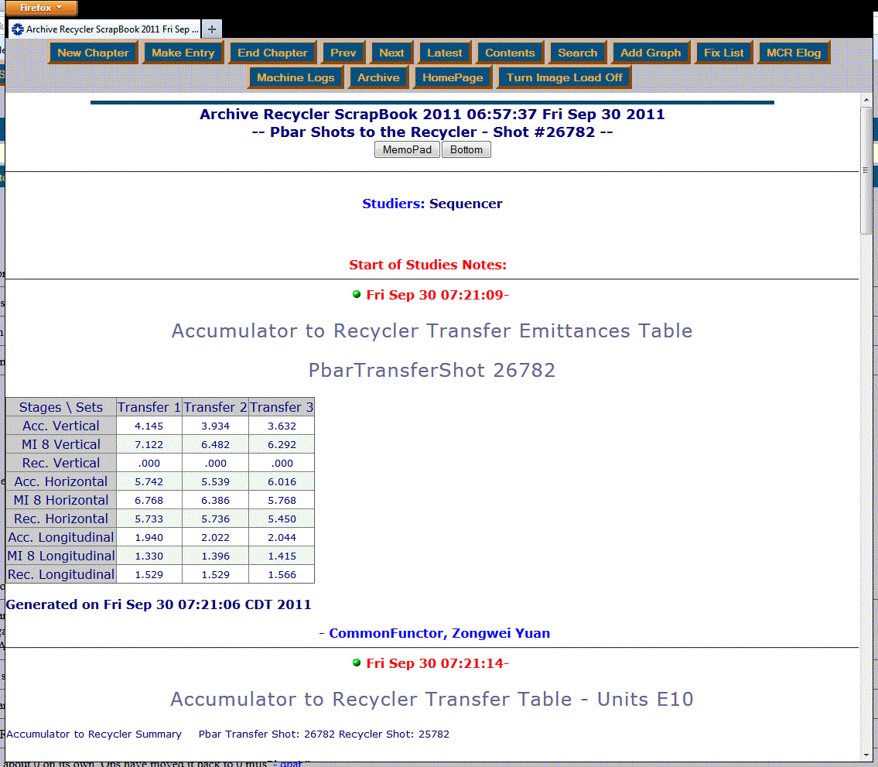
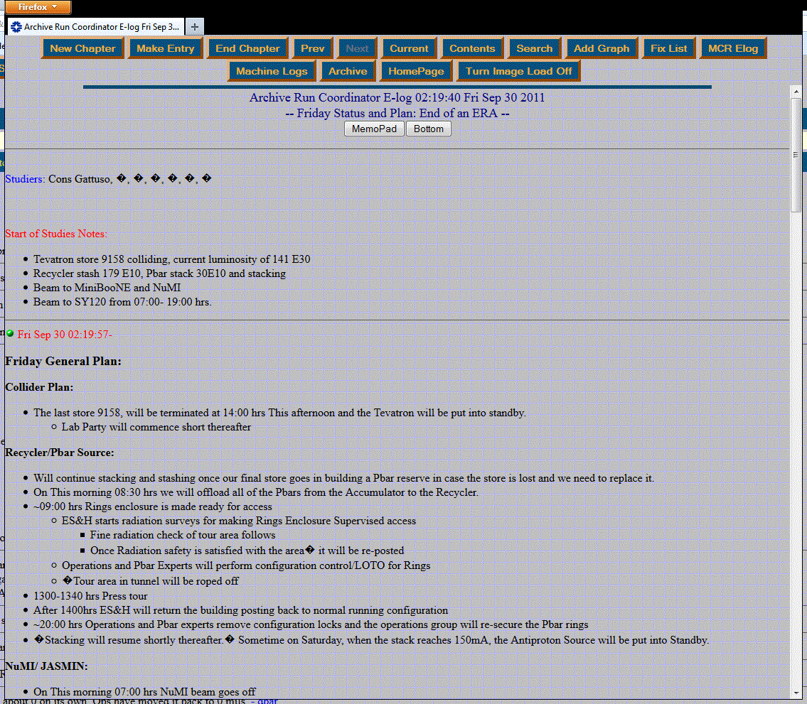
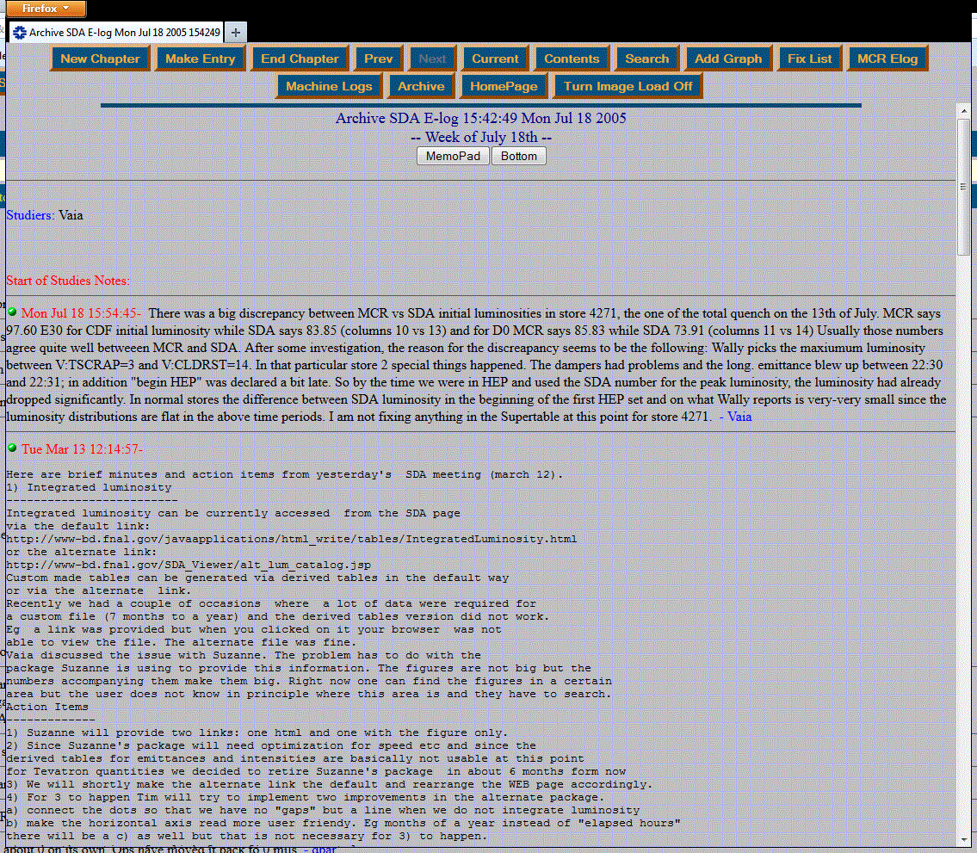
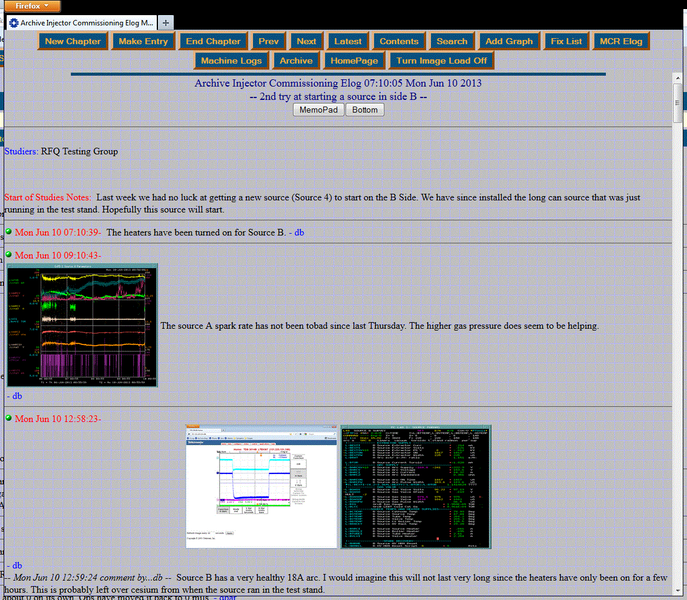
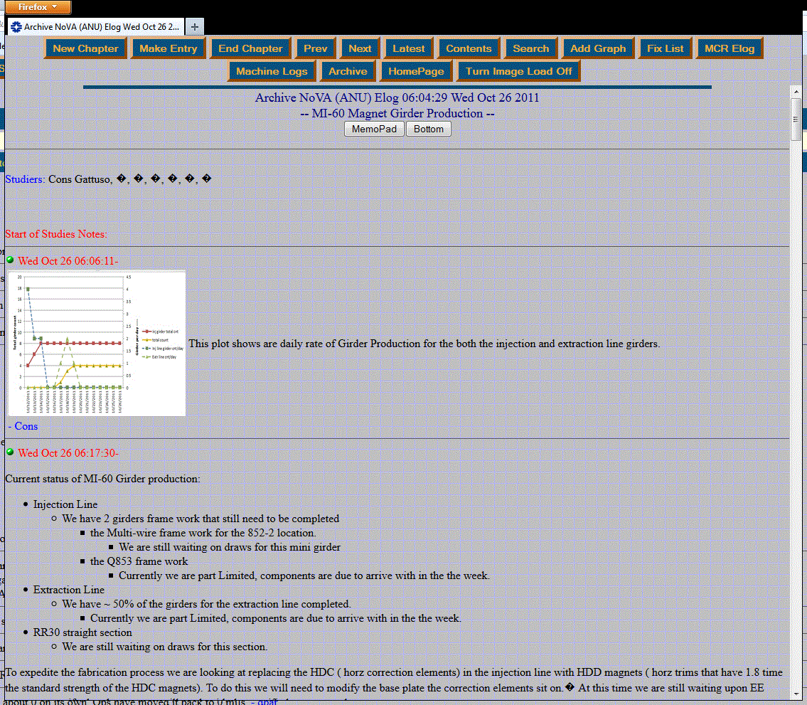
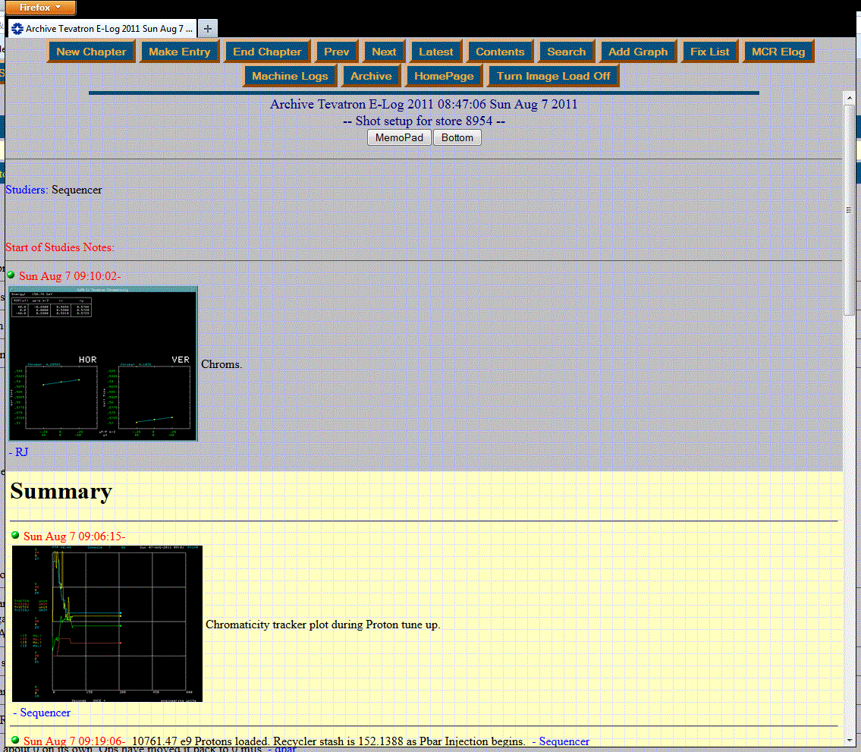
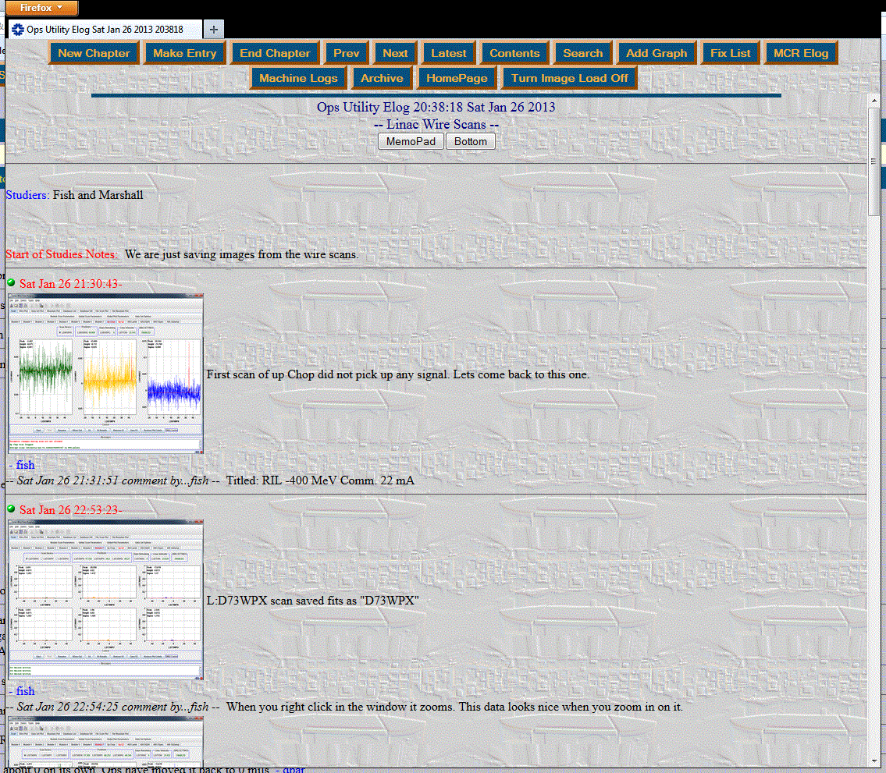
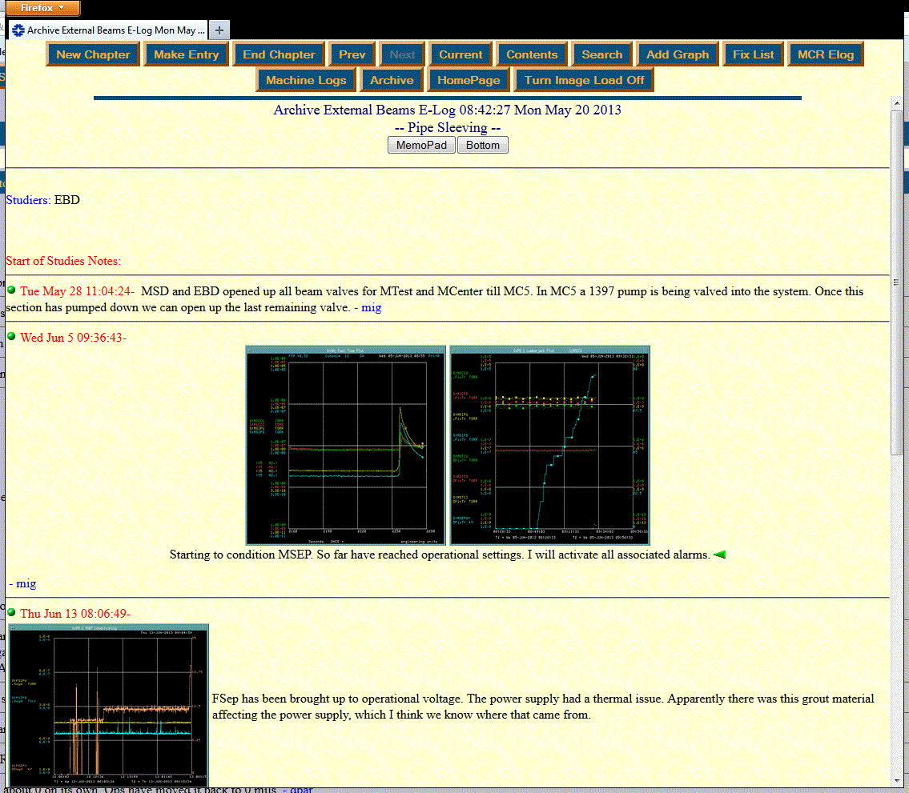
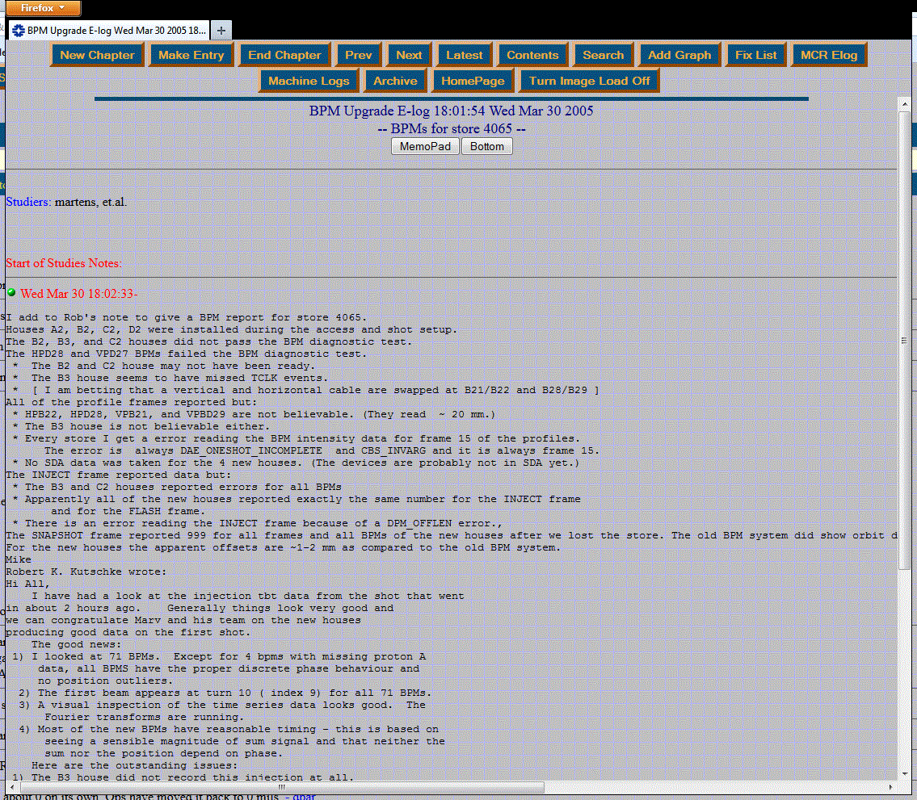
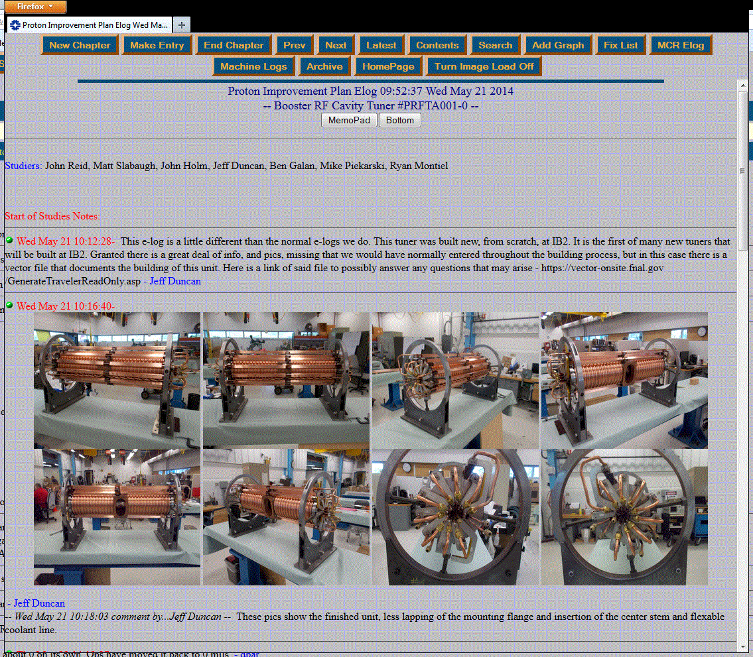
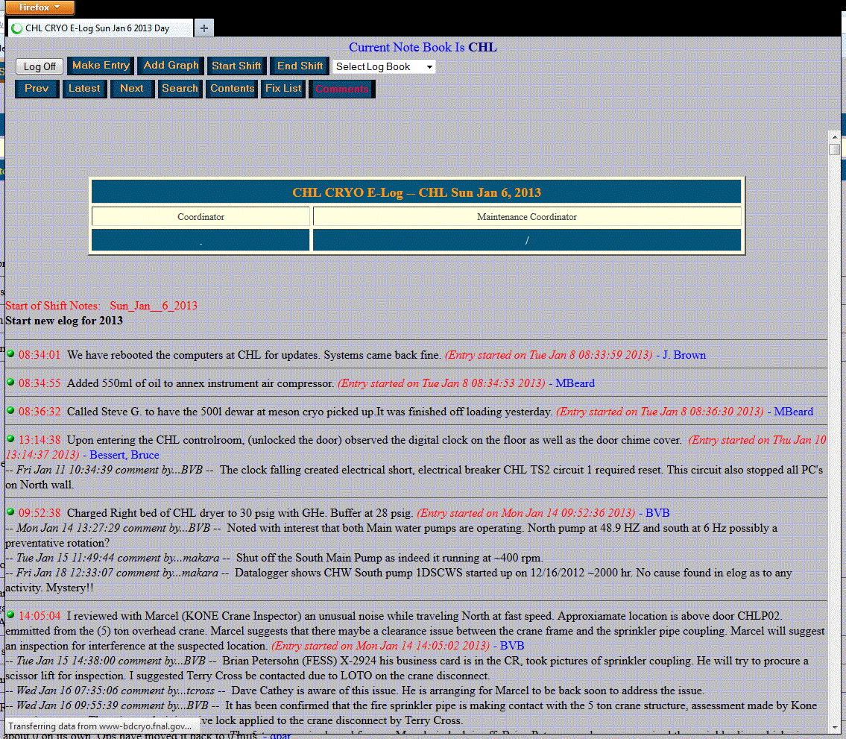
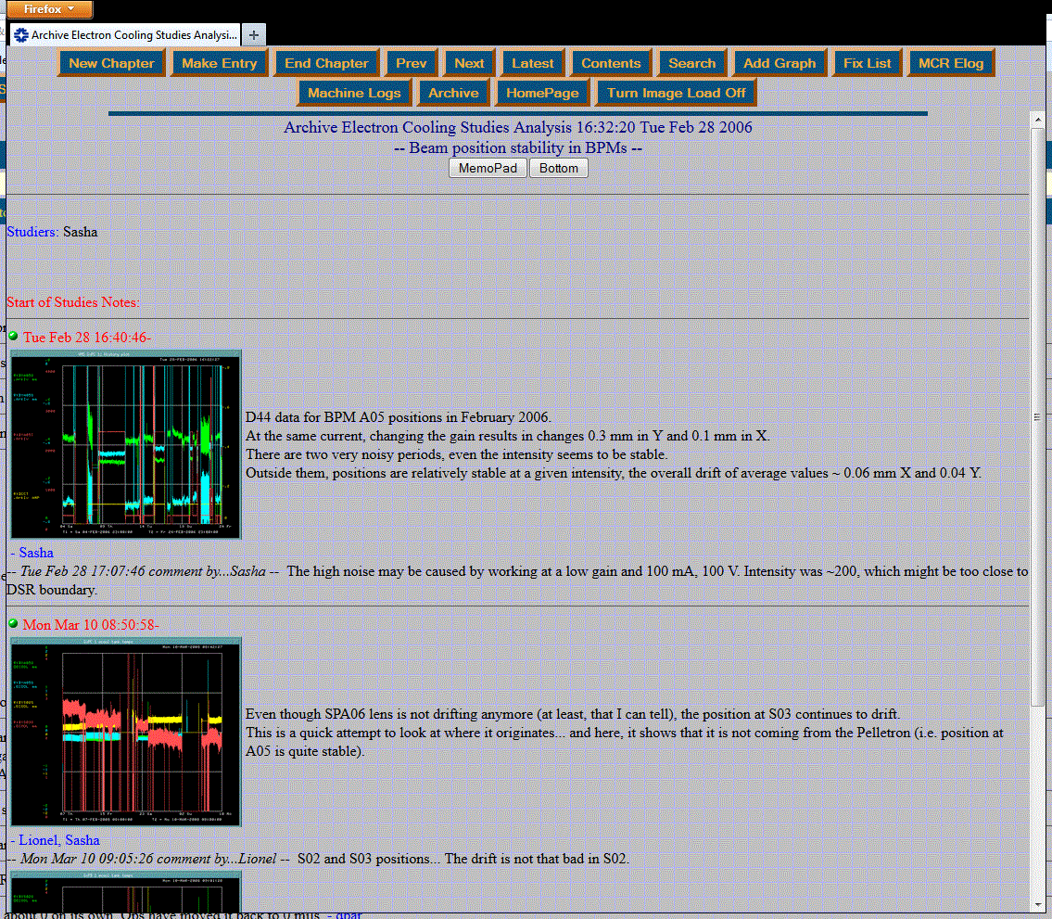
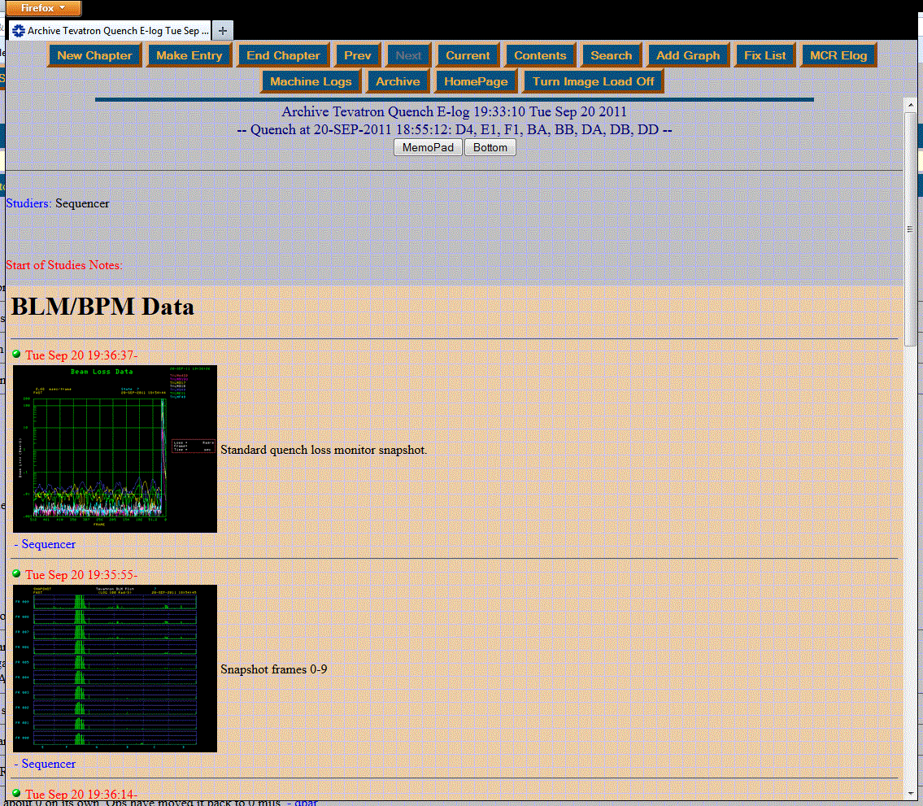
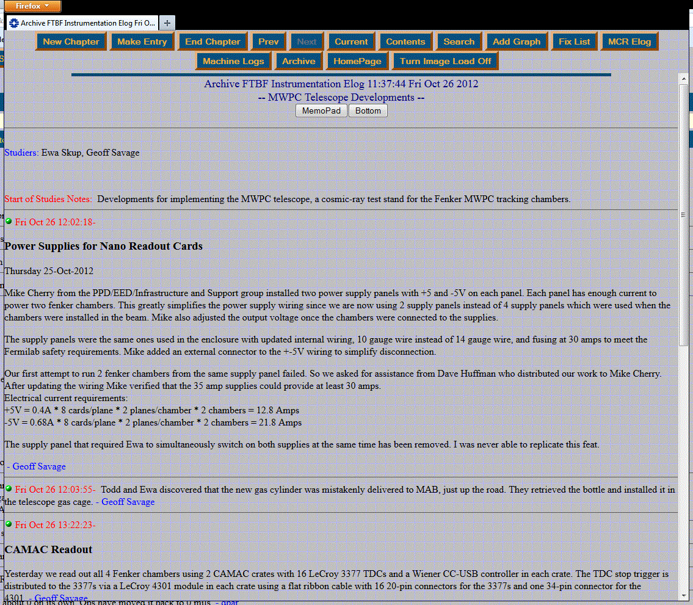
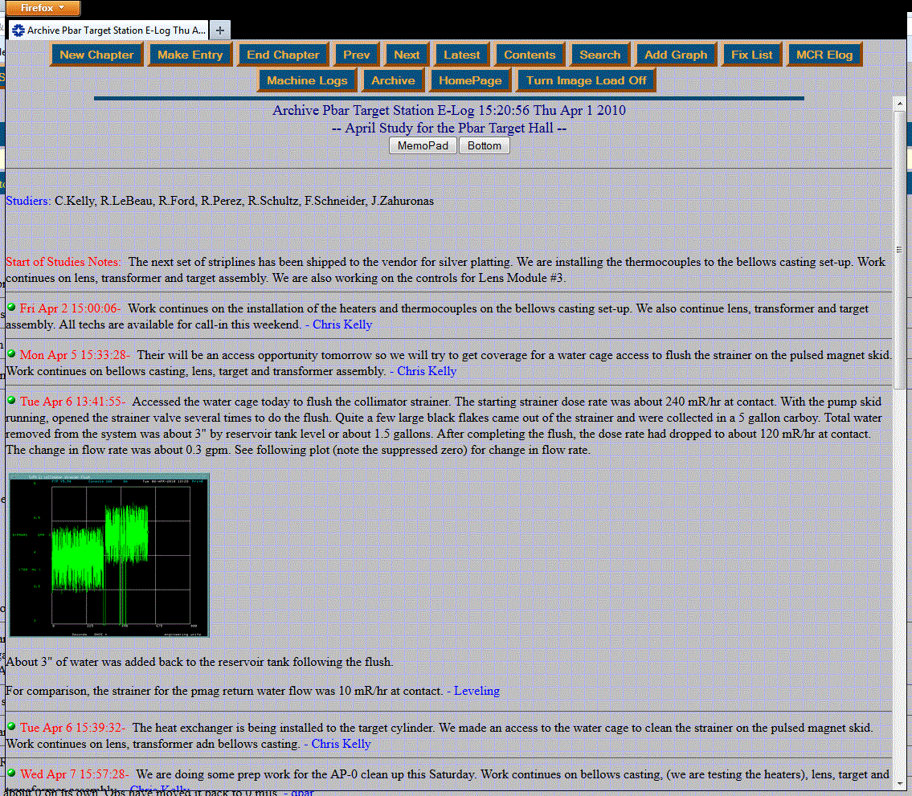
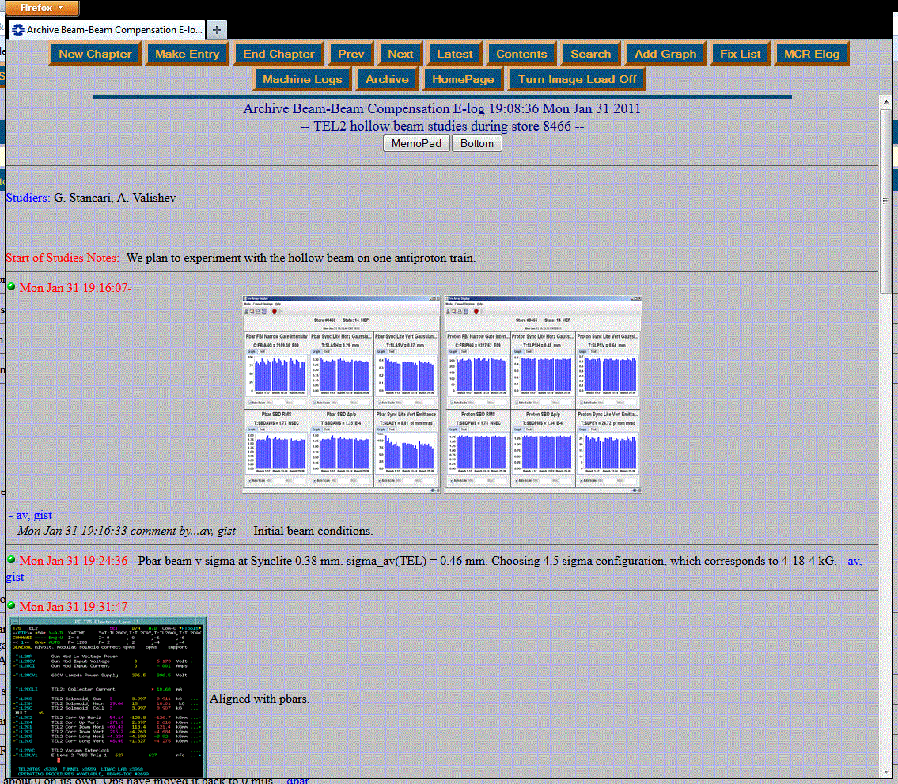
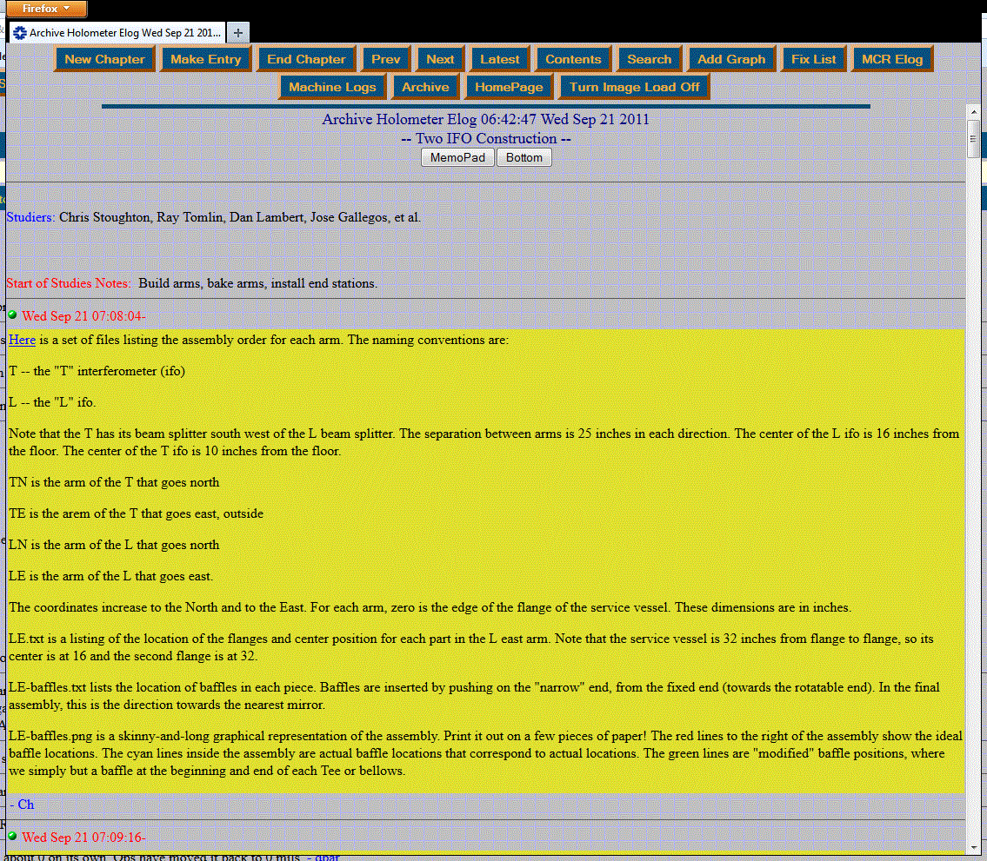
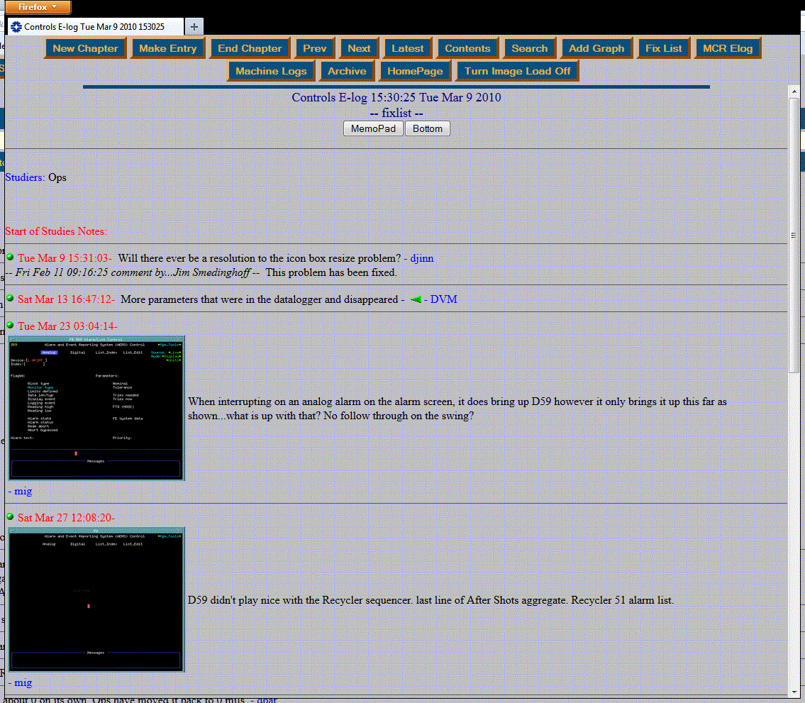
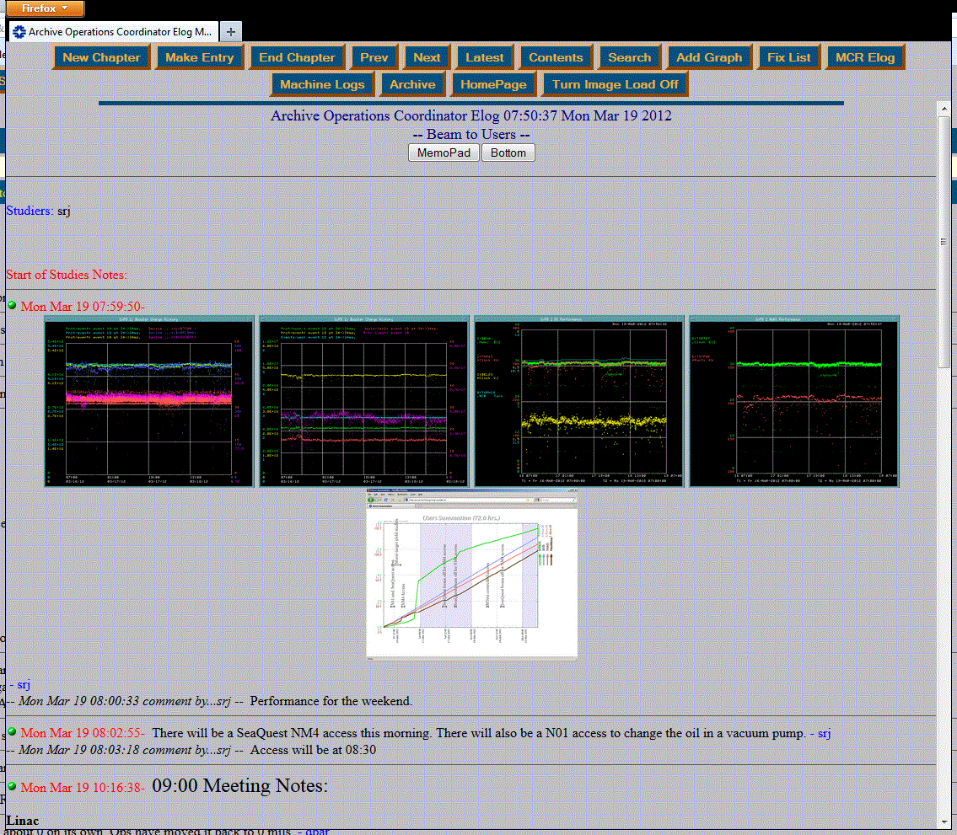
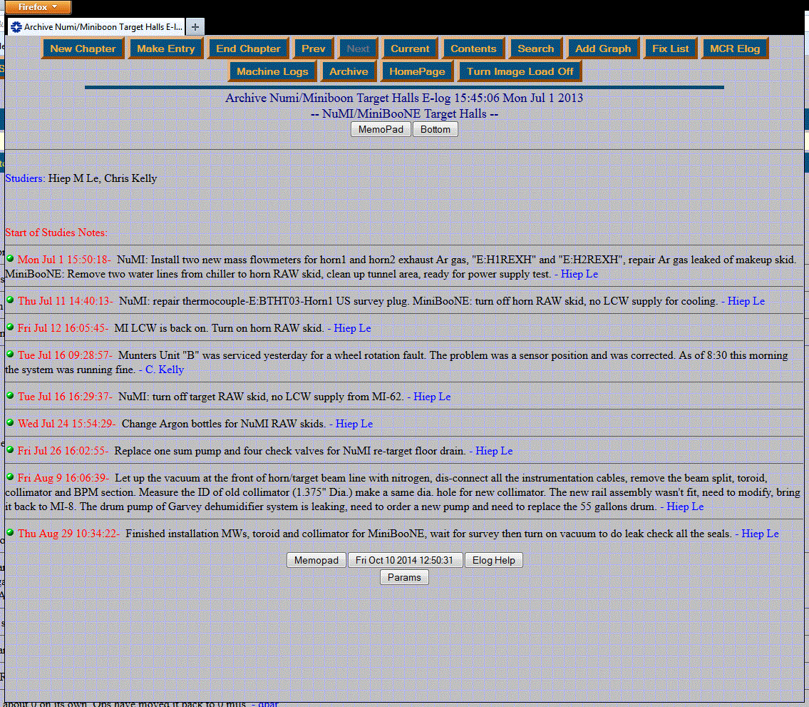
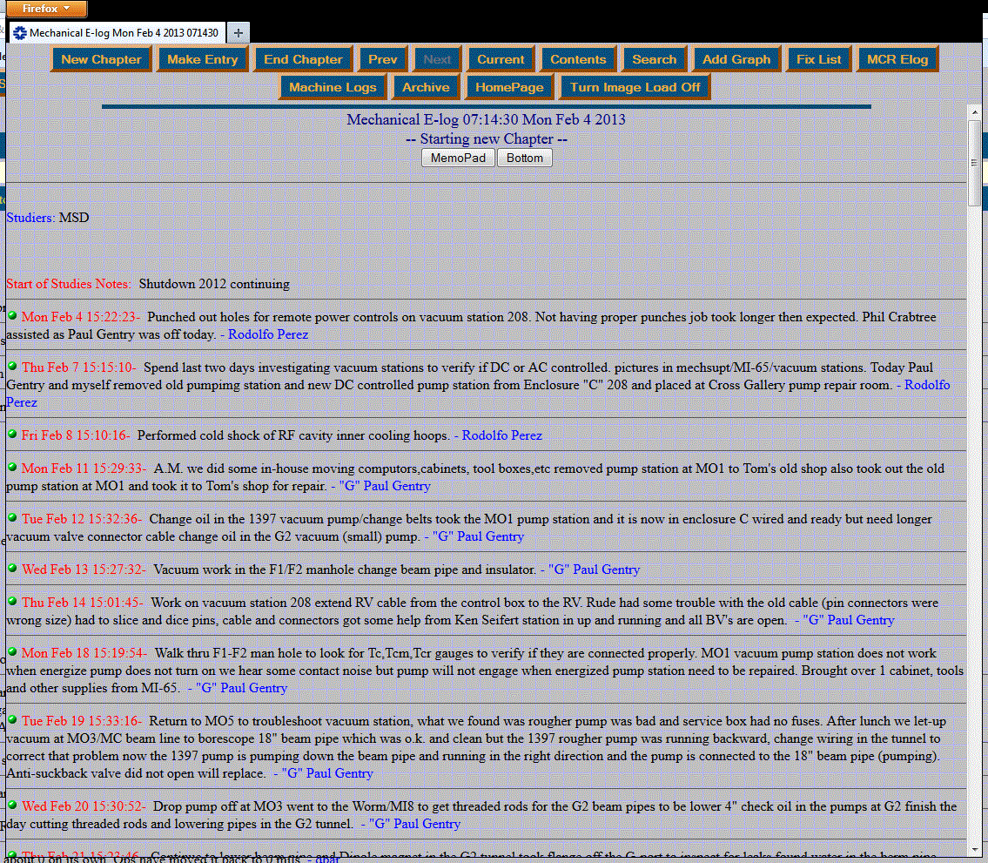
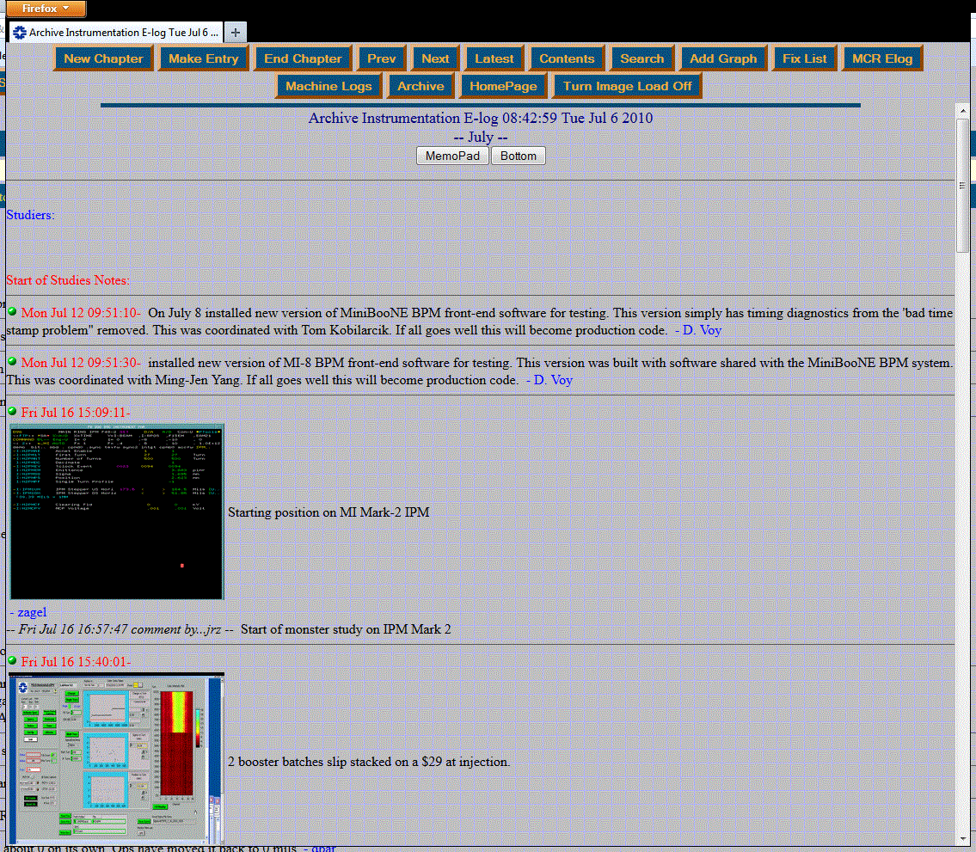
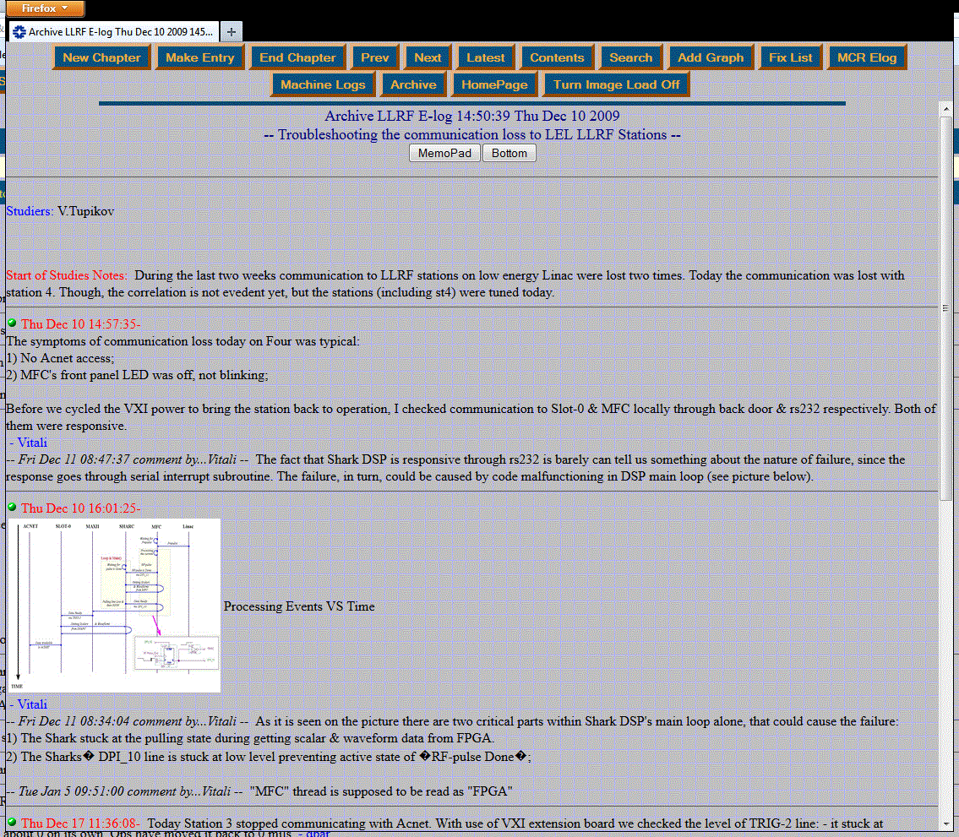
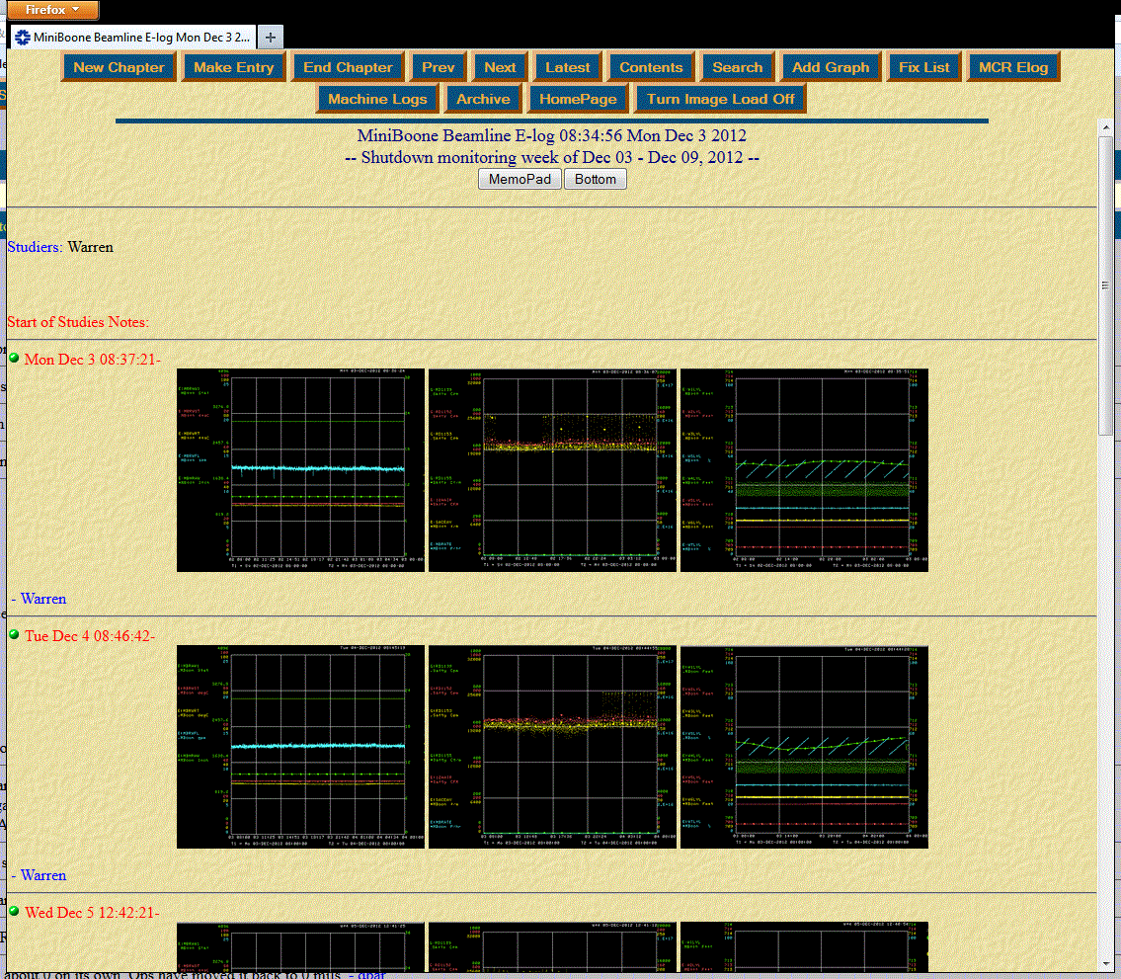
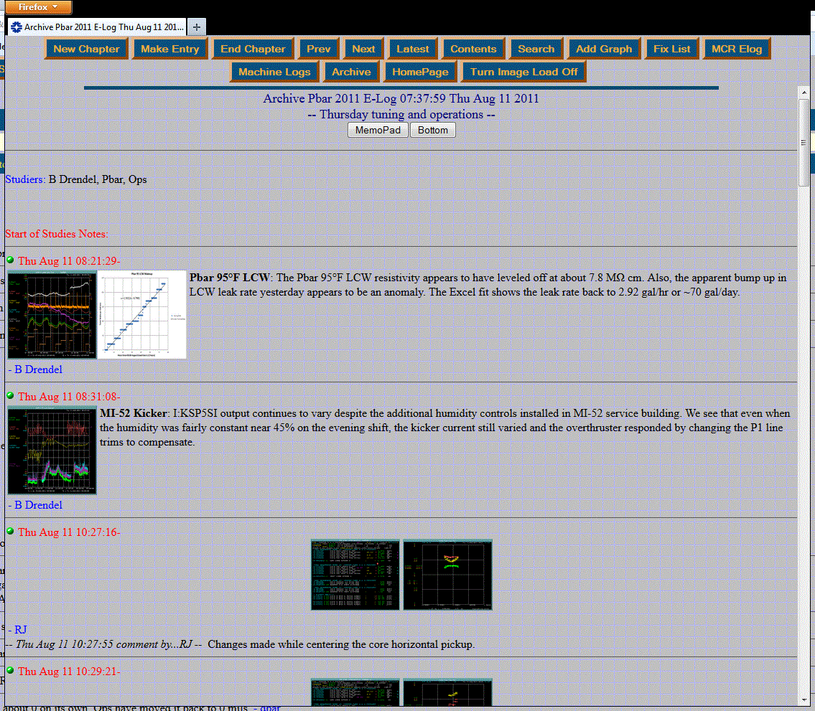
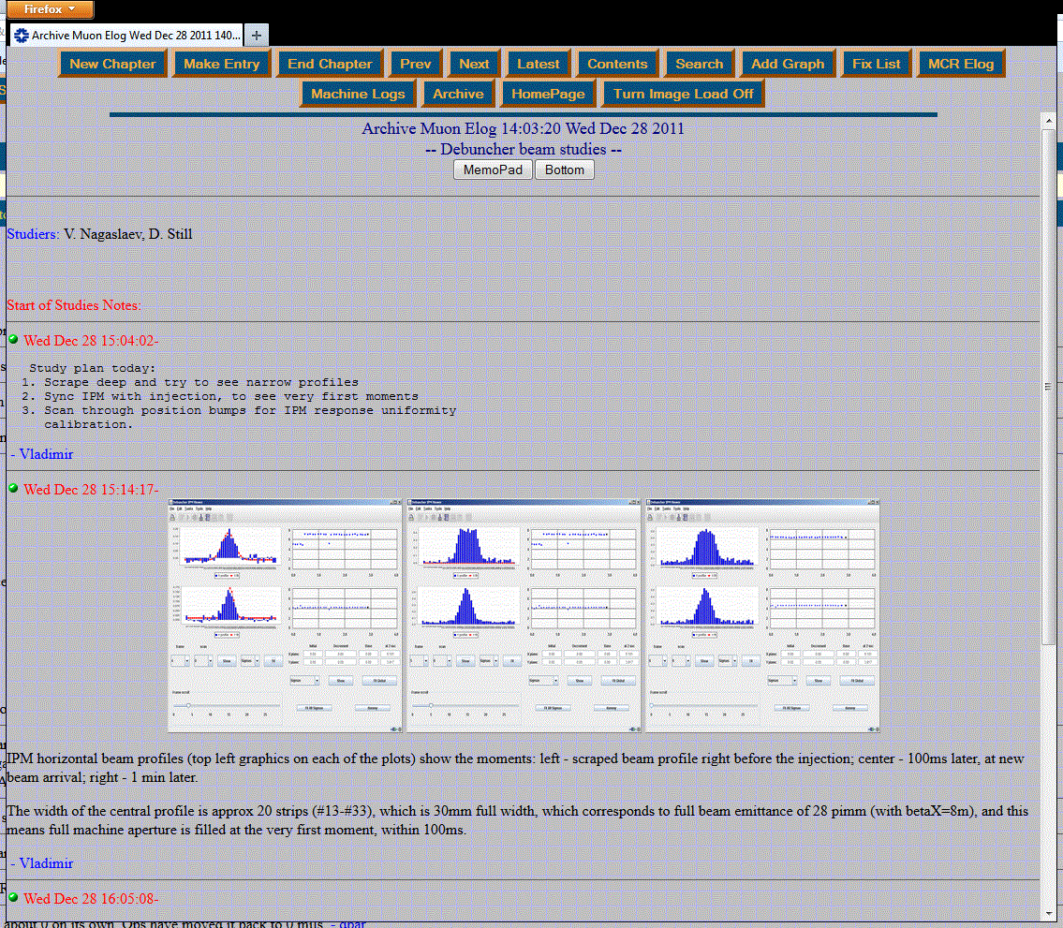
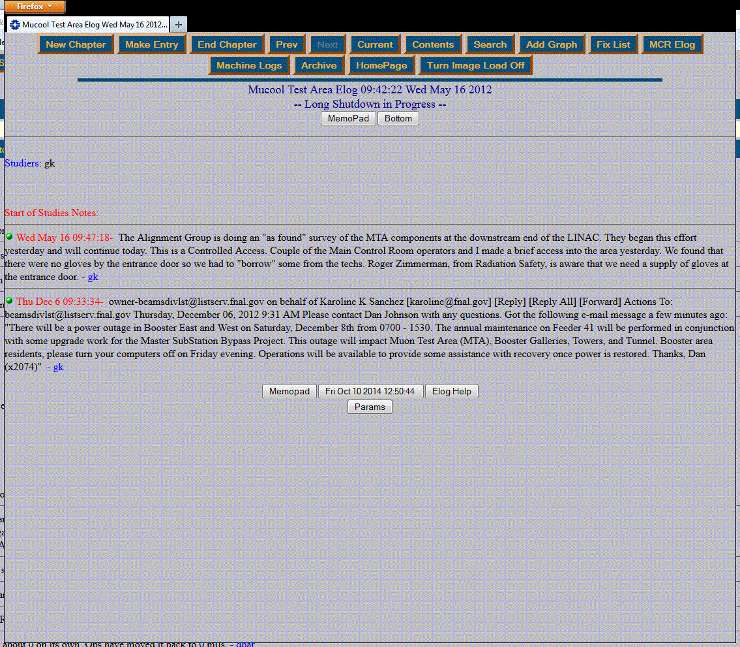
1st Generation Electronic Logbook
It was so successful that every machine department, machine support department, project group, technical group and more wanted their own electronic logbook.
Spawned 64 active electronic logbooks
14 major ones
All maintained by Ops Department.
Main Control Room Elog

Slide 8
Limitations
Search Function
Only basic search capabilities via Perl code
No separation of HTML code and data
Elogs with > 30000 entries had to be archived and a new elog started to keep search speeds reasonable
MCR elog archived annually
Total of 156 archived elogs over 15 years
Too many elogs
Maintenance
65 elogs (14 used heavily)
Custom forms requiring custom code for users
Missed Communication
If information wasn’t put in MCR elog or linked to an MCR entry Operators would miss it.
Security
No user authentication for onsite write access
Off site read access through .htaccess using generic password
Off site write access handled through Elog Caretaker
Functionality
Graphical User Interface (GUI) outdated
User could not edit entries after submitted
Configuration changes required code changes
Poorly formatted HTML code in entries “broke” elog
Notes:
Search - Slow
Too many elogs - Over expanded
Security – non-existent by todays standards
Functionality – not as user friendly as is could be

Slide 9
What we wanted
Sustainable architecture
Fewer individual elogs
Faster more elaborate search of data
Greater sorting / filtering options to view data
Entry and comment author editing privileges
Improve access with better security
Entry categorization
File/Object Tagging
More efficient file/image uploading
Tiered administrative privileges to manage the elog and elog users
Updated Graphical User Interface (GUI)

Slide 10
Product
Architecture
Relational Database
Data filtering
Functionality
Searching

Slide 11
Architecture
Client/API
PostgreSQL Relational Database
Data Storage
Apache / Tomcat
Java Servlets & JSP pages
Provide user interface
Servlets and filters
Handle routing requests, intercept & redirects
Apache Tomcat
Elog1
Elog2 (backup)
Apache Tomcat
Filters
Filters
PostgreSQL (RDB)
PostgreSQL RDB
Real time replication
Servlets/JSP
Servlets/JSP
Beans
Beans
Notes:
First we needed a fundamental architectural change using a relational database.
PostgreSQL is an open source object-relational database management system (ORDBMS)
This architecture is scalable

Slide 12
Graphical User Interface (GUI)
Notes:
You’ll see more as we interface.

Slide 13
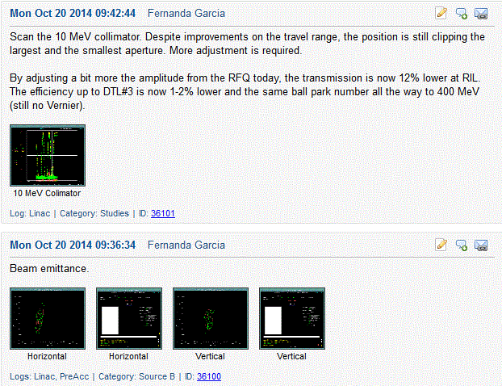
Relational Database
Elog data
Independent from GUI
Log Tags
Giving the new elog the appearance of many logbooks
Category Tags
Allows entries to be categorized
Typically a sub system i.e. Vacuum
Subject Tags
User supplied tags to further identify entries such an on going specific machine study.
Entries
Database capable of millions of entries
These features allow for better data filtering and more elaborate searching

Slide 14
Access and Security
Offsite Access
Fermi Service Account login required
SSL encryption
Onsite Access
Read Access : Default
Write Access : Login required

Slide 15
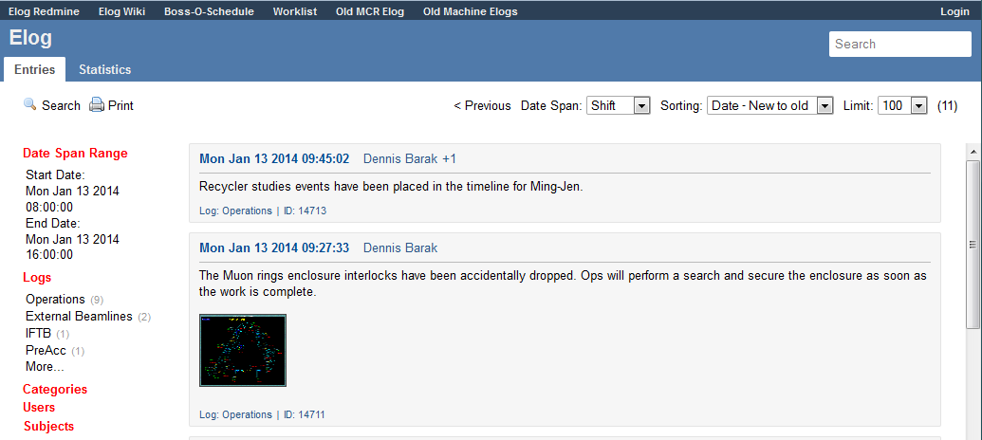
Filtering the Elog: Date Span
Used to emulate the various ways machine groups and Operations viewed their elogs
Options
Shift (AD/Ops shifts)
Hour (beginning of hour)
Day (midnight to midnight)
Week (beginning of week)
None
Default is none (rolling entries)
Can be set via URL

Slide 16
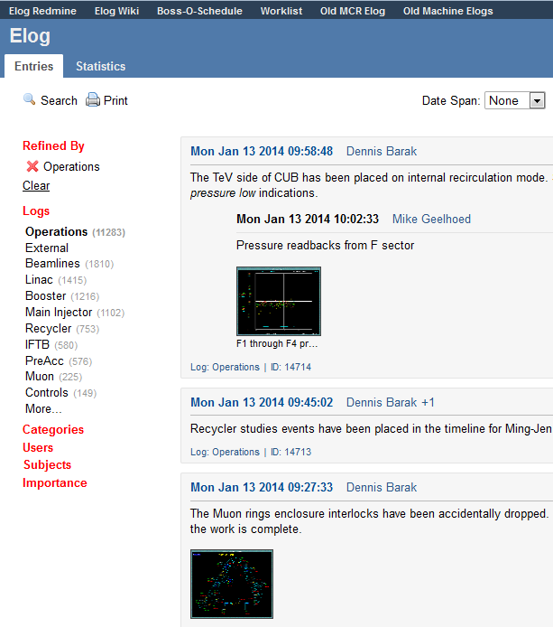
Filtering the Elog: Refinement
Used for logbook selection and refinement.
Can refine by
Log
Category
User
Subject
Importance
Default is none (viewing all logs and not refined)
Can be set via URL

Slide 17
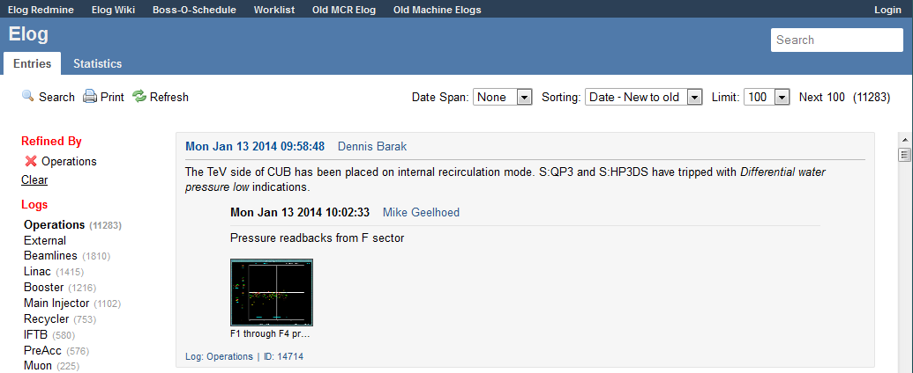
Filtering the Elog: Sorting
Used to sort entries
Currently only supports date sorting
Creation Date
New to old (Default)
Creation Date
Old to new (Legacy)
Modified Date
New to old
Modified Date
Old to new
Comments
New - old
Can be set via URL

Slide 18
Adding entries
Adding entries video:
Must be logged in
Must be an active user with log privileges
Must select at minimum one log
Entry must have text
Optional tags
Category
User
Subject
Importance
Files may be added with captions

Slide 19
Editing entries
Editing entries video:
Must be logged in
Must be
Author of original entry or comment
Super admin privileges
User
12 hours to edit
Super Admin
No limit
Same options of adding entry
May hide the entry
All entries remain in database
Super Admin can see hidden entries

Slide 20
Search Videos
Quick Search
Advanced Search

Slide 21
Performance
Redmine
Uptime
Upgrades
Interesting statistics

Slide 22
Redmine : Input and Tracking
Tracking tool allows authorized users to see what is being developed.
Users can report problems, submit new ideas, or request new features.

Slide 23
Issue tracking
Redmine
Bugs
77 bugs reported
86% resolved
Features
82 requests
81% addressed
Ideas
46 suggestions
76% replied to
Support
7 questions/actions requested
71% answered

Slide 24
Uptime
>99.9% uptime
Only ~30 minutes of unscheduled downtime
Bug having to do with sanitizing bad user input
A few dozen restarts to pick up bug fixes and upgrades
An elog restart takes less than 2 minutes
Only utilized the elog1 server, however elog2 was always ready as a warm spare

Slide 25
Upgrades
Completed Upgrades
Entry subject field
HTTP API
Fermi controls framework API client
Entry linking/searching
Entry email
Sorting by modified date
Additional date spans
Spell checking
Select box searching
Autoscroll upon submission
Image editor
Planned Upgrades
Multiple file uploader
Entry/Comment/Log email subscription
Tagging entries and comments
Expand search
GUI update
Anti-selector
Memos

Slide 26
Comparing Elogs – Operations Log Entries
Notes:
Its only possible to compare the old “MCR” elog entries to the “Operations” log entries of the new elog
The “MCR” elog was the only elog archived yearly
Horizontal blocks represent shutdowns
New “Operations” log portion of the elog is projected to have ~23k entries in 2014 which is average for the past several years
Many past entries in the “MCR” elog were mandated for certain actions/events during collider operation

Slide 27
HTTP Requests
Notes:
HTTP requests are not page “hits”
Any HTTP request to the elog server
Relative comparison between days is fair
Lulls during holidays and shutdowns
Large increase starts in late April
I don’t know what caused the greater interest in the elog starting then
This is not reflected in entry and comment rates so its viewers not users (or at least not active authors)
People view the elog the most Monday
People view the elog the least Sunday

Slide 28
Entries - Sums
Notes:
The most active day for adding entries was September 30, 2013 with 153 entries that day
Mtest users were given access to the elog (This was not appropriate)
Switchyard extraction studies
The elog averages 77 entries per day
The most active hour of the day for adding entries is 08:00–09:00
The least active hour of the day for adding entries is 03:00-04:00

Slide 29
Entries per hour
Notes:
The most active hour of the day for adding entries is 08:00–09:00
The least active hour of the day for adding entries is 03:00-04:00
The most active hour of the week for adding entries is 08:00–09:00 on Wednesday
Notice the fairly uniform pattern over each weekday and also when comparing weekend days to each other
Very active morning
Lull during lunch hours 11:00-13:00
Active afternoon with a sudden drop off in activity at 16:00 (normal work day)
Small spike at 23:00-00:00 for end of Operations shift
Goes to show that despite the randomness of failures that are recorded in the elog, most of the entries are systematic (Shifter call ins, shift changes, summaries…)

Slide 30
Logs – Entries Percentages
Notes:
Entries can be tagged with multiple logs, so the percentages don’t add to 100%
The vast majority of entries are tagged with the “Operations” log

Slide 31
Conclusion
After a year of operation, the 2nd generation electronic logbook is performing very well. It is robust, sustainable, and scalable. The activity levels indicate that it is user friendly and has been accepted by the division.

Slide 32
Credits
Kyle Hazelwood
Proposal for a new Fermilab Accelerator Division Electronic Logbook
Sept. 20, 2011
Elog: Accelerator Division Logbook Upgrade Presentation Basic Users
Powerpoint User Guide
AD Elog First Year Review
Powerpoint report
Denise Finstrom
Database & Hardware support
Michele McCusker-Whiting
Software support
Kyle Hazelwood
Elog author, developer & programmer
Motivated Operator

