Slide 1
THE AUSTRALIAN SYNCHROTRON ELECTRONIC LOG BOOK
How do We Communicate?
Don McGilvery
Joel Trewhella

Slide 2
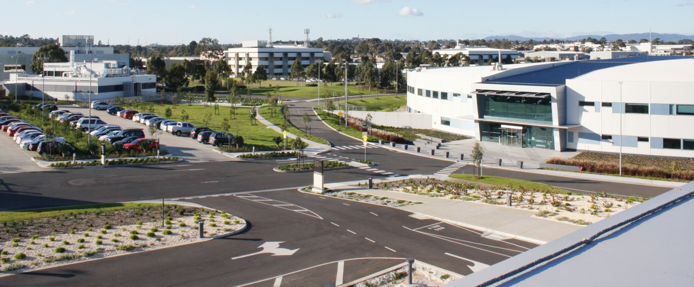
ELECTRONIC LOG BOOK eLog
ASLS in User Operation for 7 years
eLog since Commissioning
Initially used the DESY eLog
Limitations => Operators developed our own
Has become a major communication tool across the facility

Slide 3
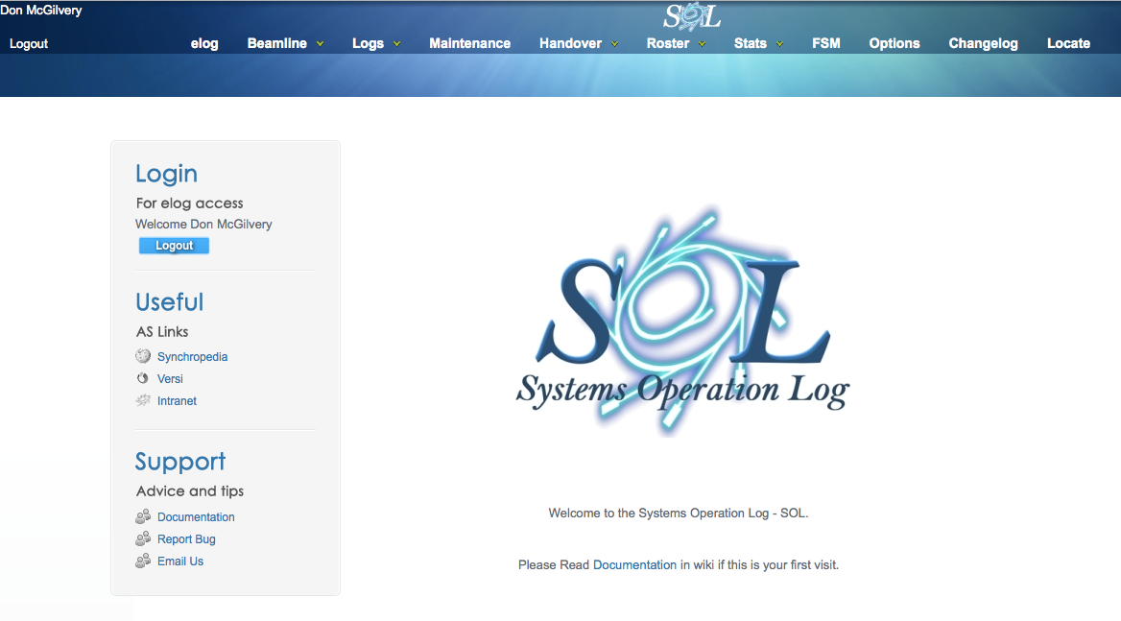
eLog A FACILITY WIDE COMMUNICATION TOOL
Feature rich – not just the Accelerators
Many Users – not just Operations
Facility wide – not just the Control Room

Slide 4
DEVELOPMENT OF ASLS eLOG
Desirable Features
Formatted entries
Standard SQL database
Templates
Embed objects
Fully search-able (+advanced search)
Customisable views
Critical Information
Tagged Comments
Only enter Information ONCE!

Slide 5
ADDED FEATURES
Statistics
Shift summaries
Every beam dump
Every injection (pre topup)
Every Topup dropout
Maintenance Management
Shift Management
Useful Links

Slide 6
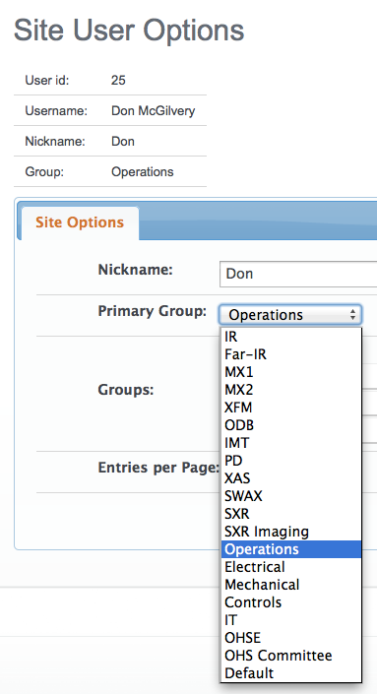
FACILITY WIDE USAGE
Daily Operations
Machine Physics
Technicians and Engineers
Each Beamline
Beamline Scientists
Operator Beamline Support
Beamline Users
Safety Team
Facility Key Performance Indicators (KPIs)
Resources for Management

Slide 7
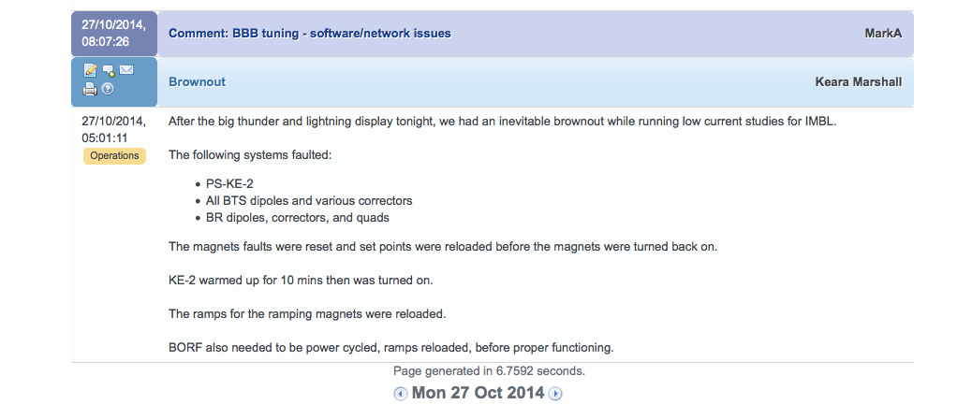
WIDE ACCESS (Everywhere)
WEB based - can be accessed worldwide
Can monitor what is going on remotely
Can provide remote assistance

Slide 8
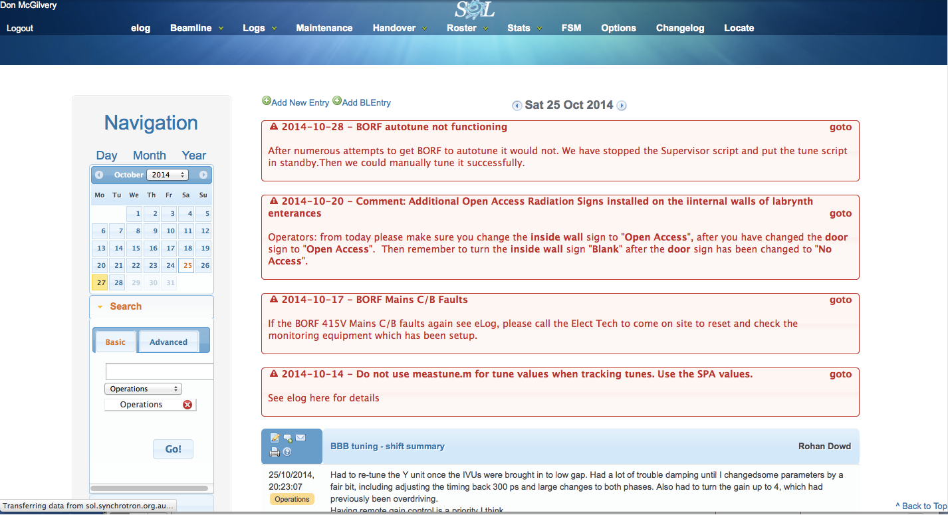
WHAT DOES eLOG LOOK LIKE?
Support

Slide 9
FULL FORMATTED DATA ENTRY

Slide 10
TEMPLATES

Slide 11
Annotation and Comments

Slide 12
ANNOTATIONS HELP FOR CLEAR INSTRUCTIONS

Slide 13
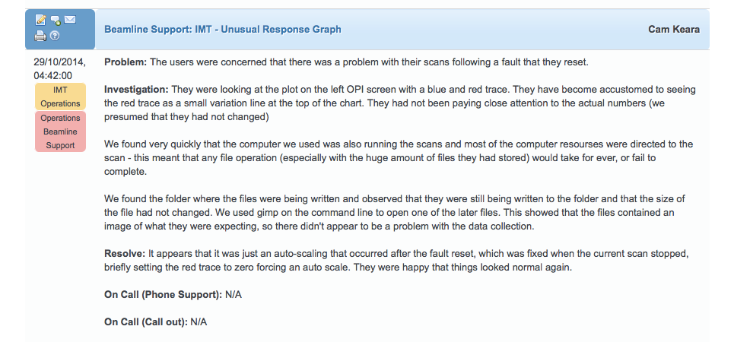
RESPONSE TO BEAMLINE CALLOUT
NOTE: The IMT beamline is still under development.
Operators have had no formal training in its operation!

Slide 14
OHSE

Slide 15
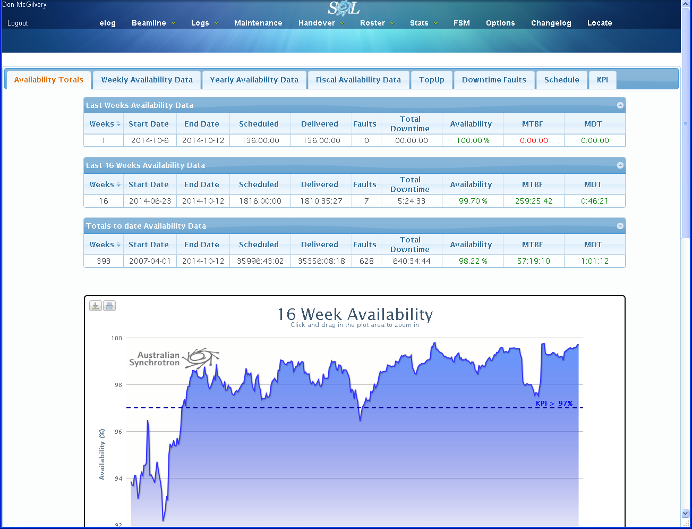
STATISTICS

Slide 16
HISTORY - INITIAL LINAC CONDITIONING

Slide 17
STATISTICS AND FACILITY KEY PERFORMANCE

Slide 18
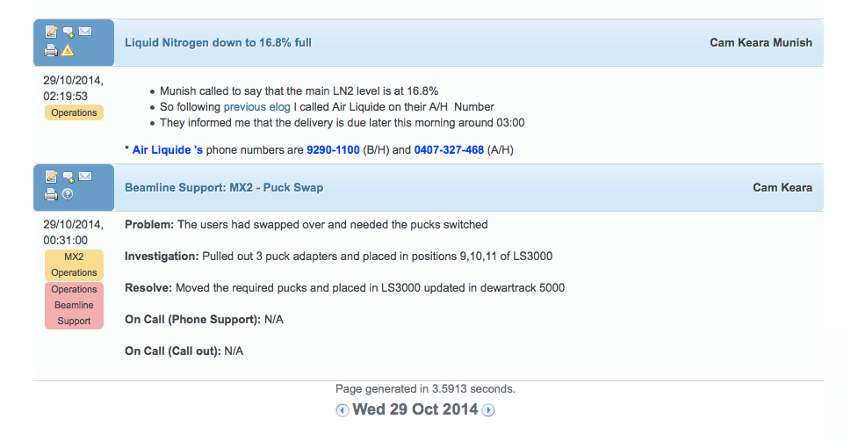
eLog A FACILITY WIDE COMMUNICATION TOOL
Everything – not just the accelerators
Everybody – not just Operations
Everywhere – not just the Control Room

Slide 19
DEMONSTRATION VERSION AVAILABLE SOON
Waiting for our IT group to complete some security checks before allowing us to make a demo version of our eLog available.
Send an email to
Don.McGilvery@synchrotron.org.au
or
Joel.Trewhella@synchrotron.org.au
or
Look for a posting on
http://reliability.forumotion.com/c2-conferences-workshops

Slide 20
Joel Trewhella – main developer
Robbie Clarken
Cameron Rodda
Stephen Martin
IT Services and Controls Group

