Slide 1
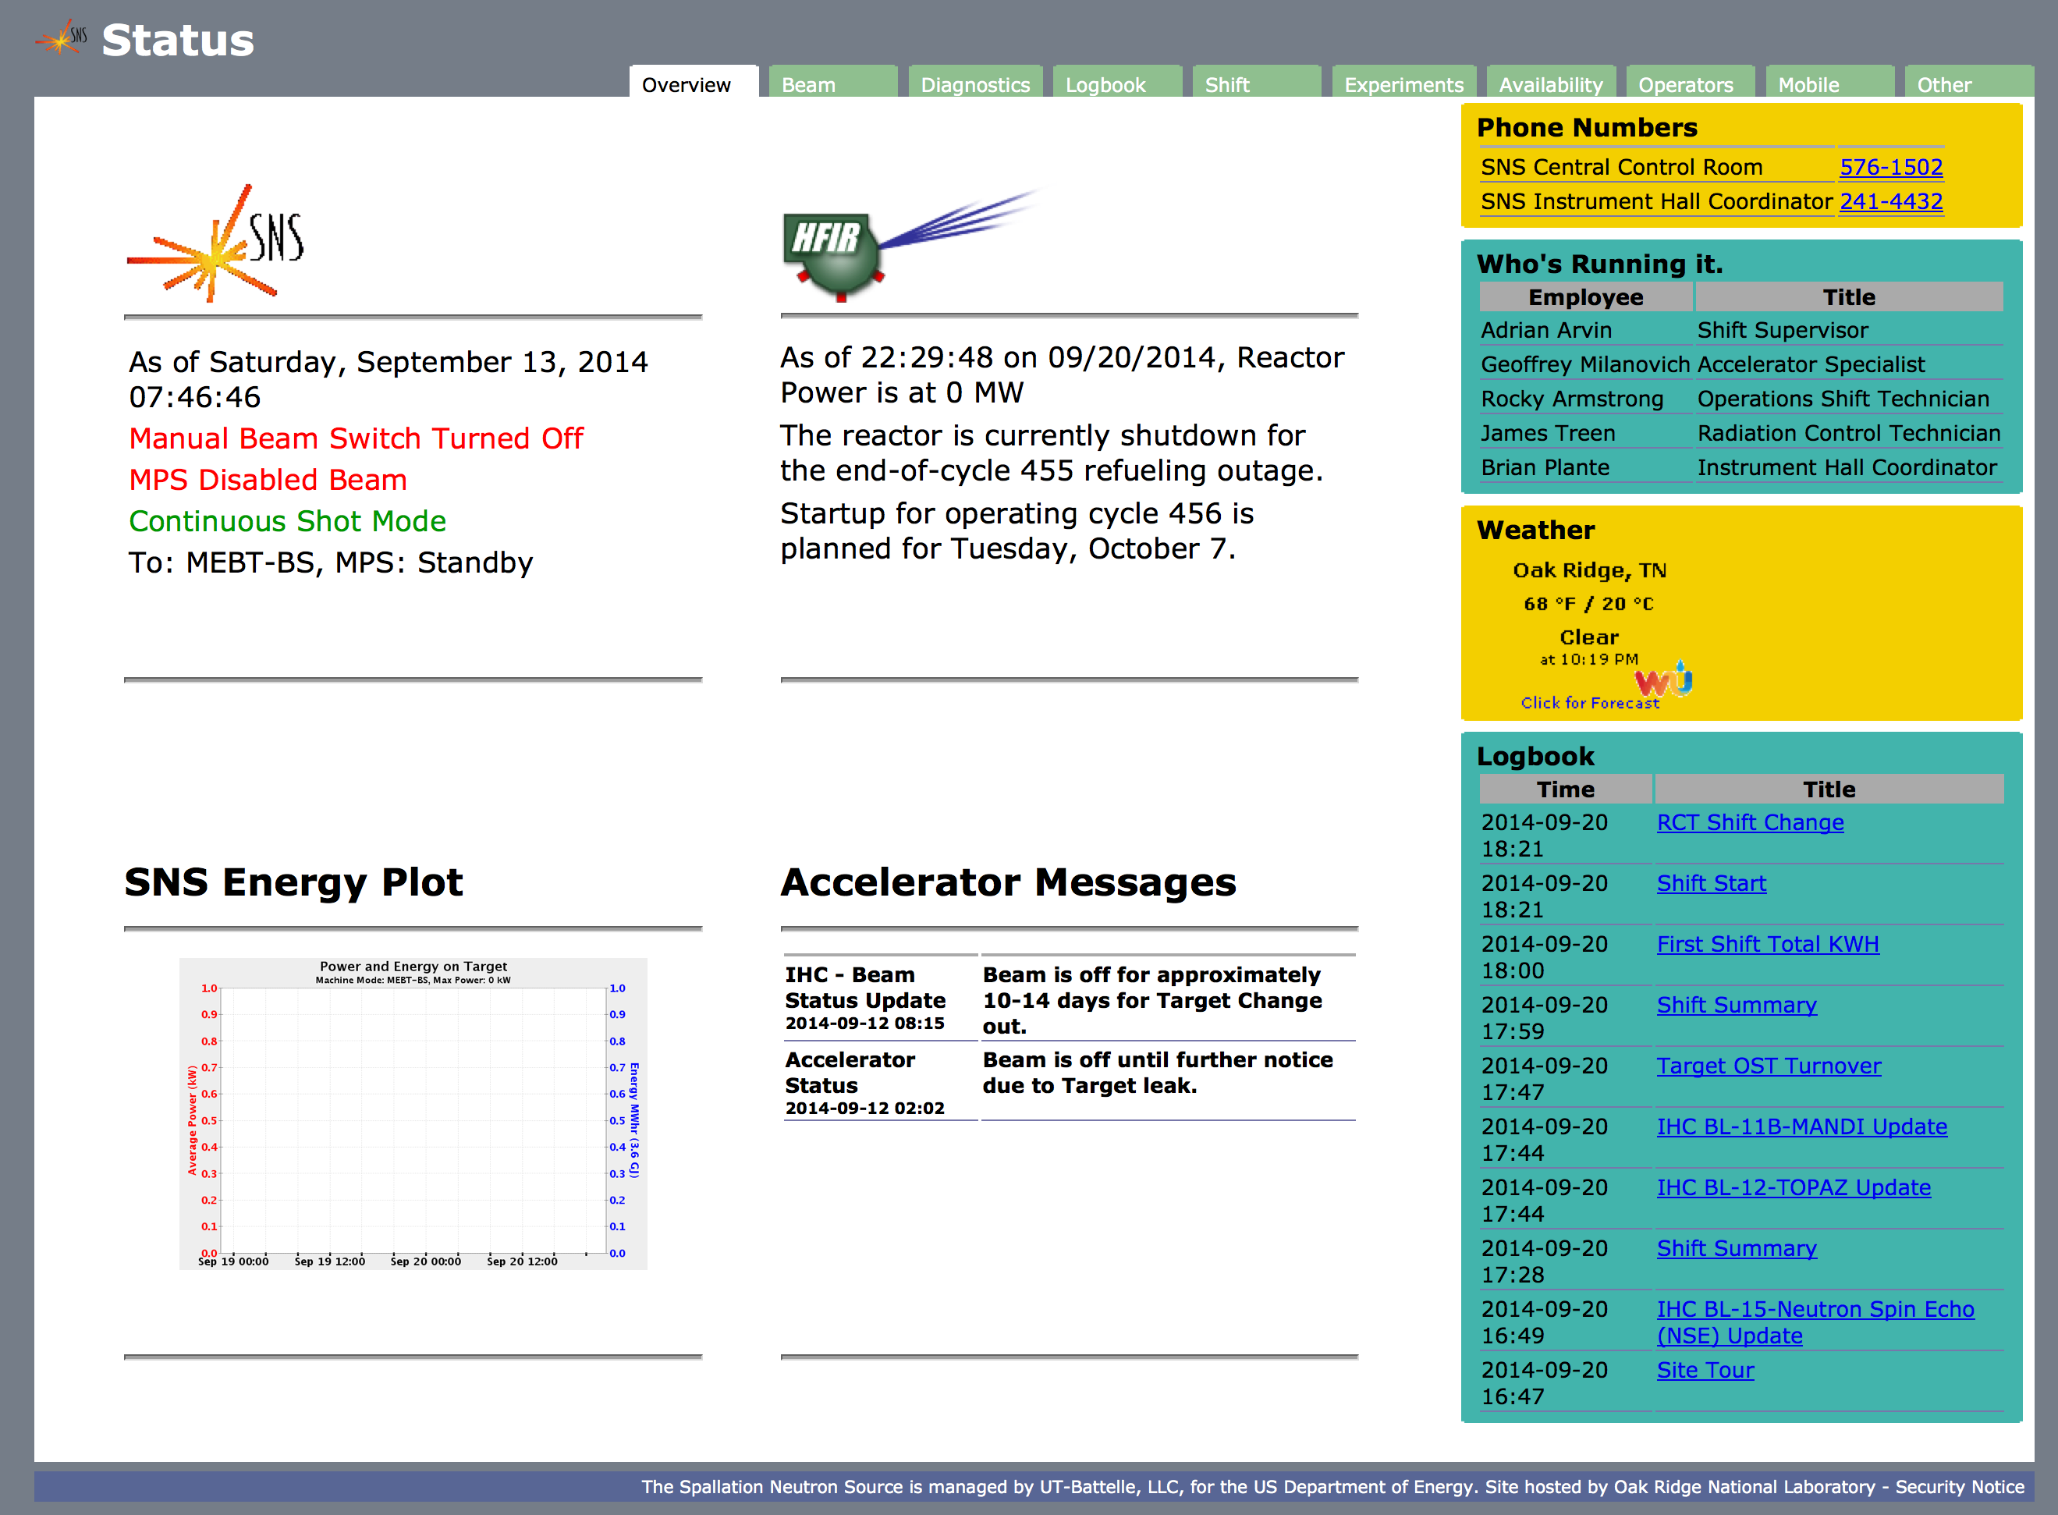
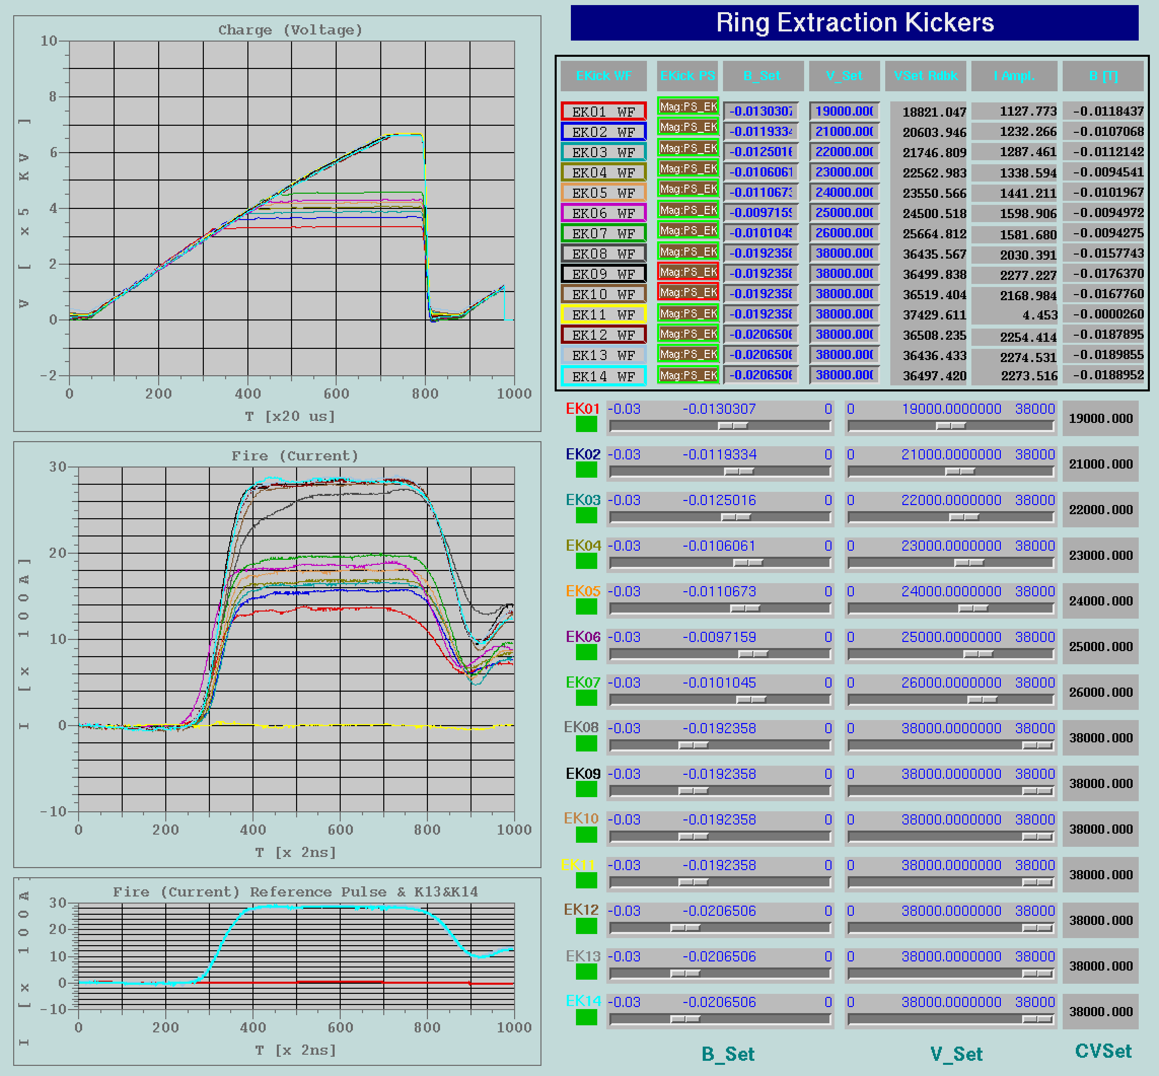
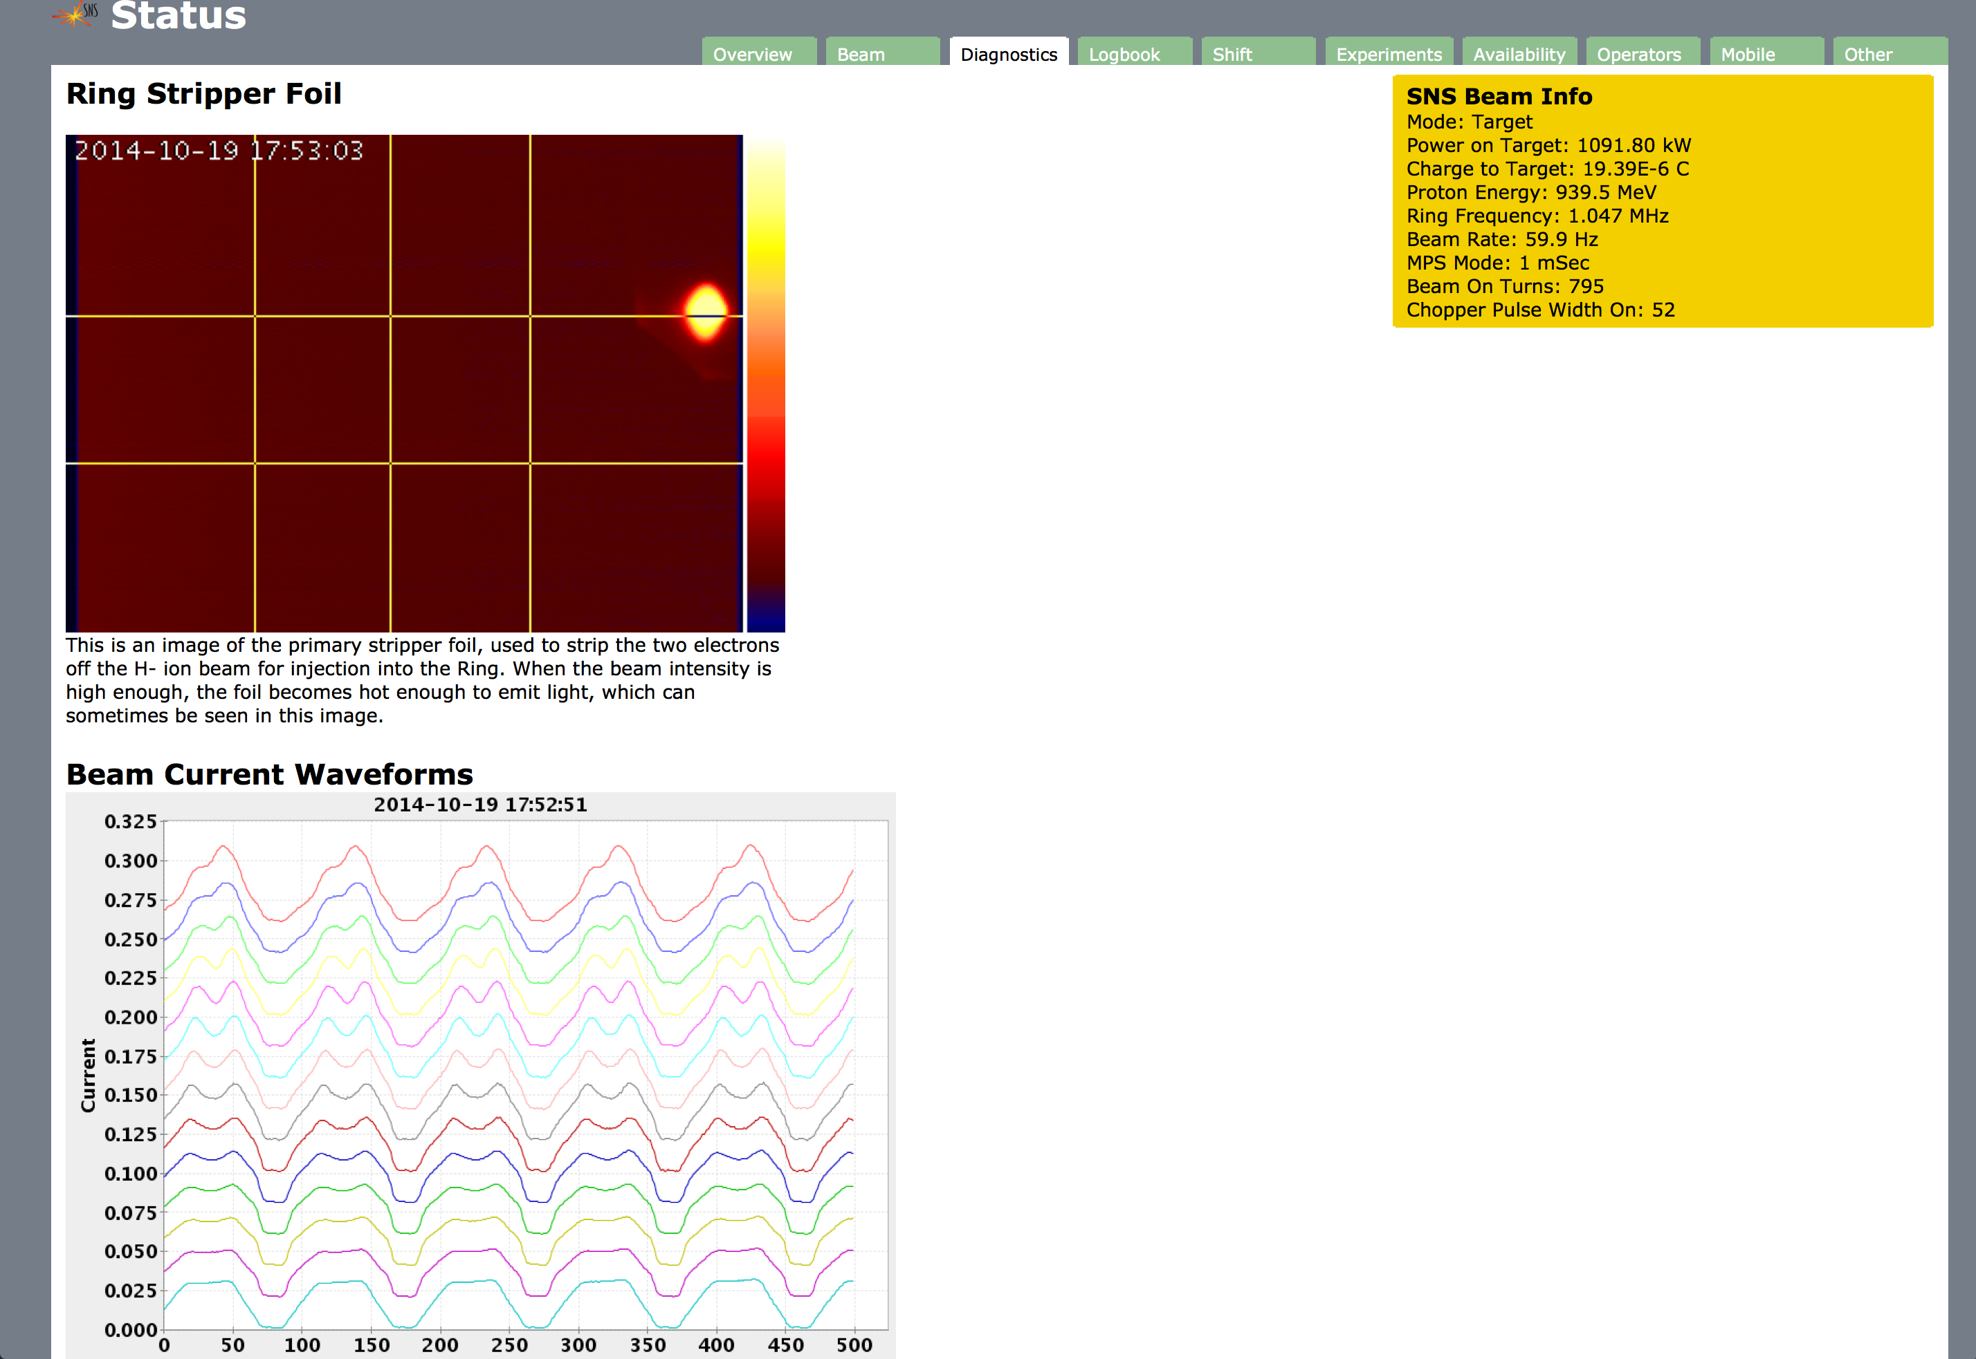
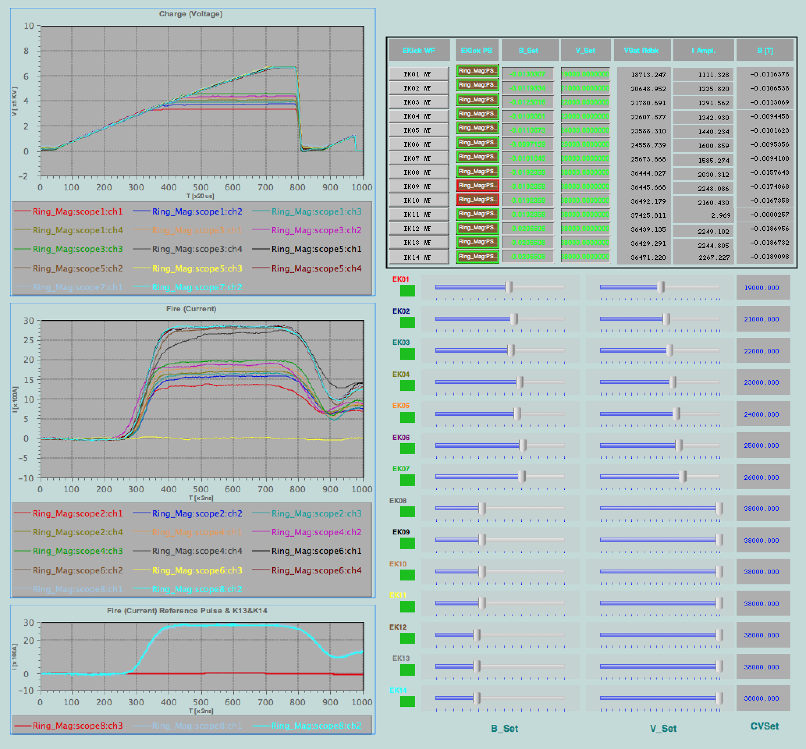
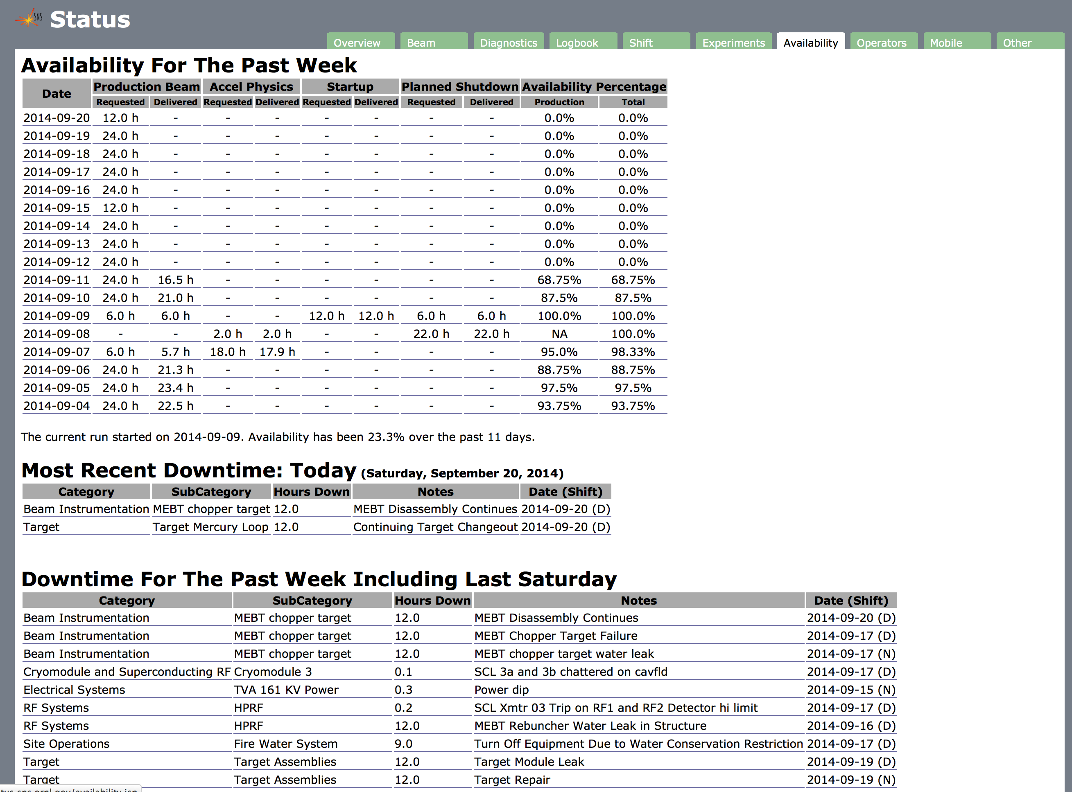
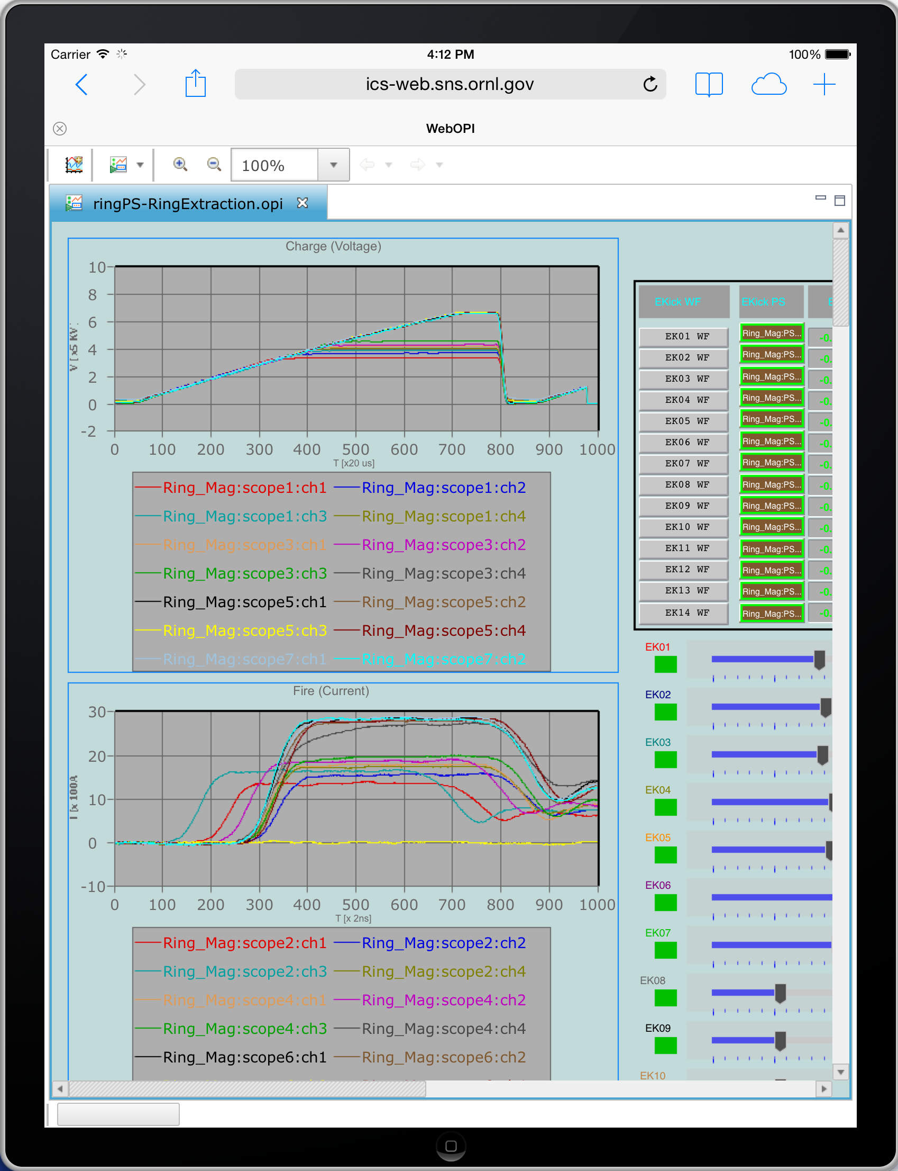
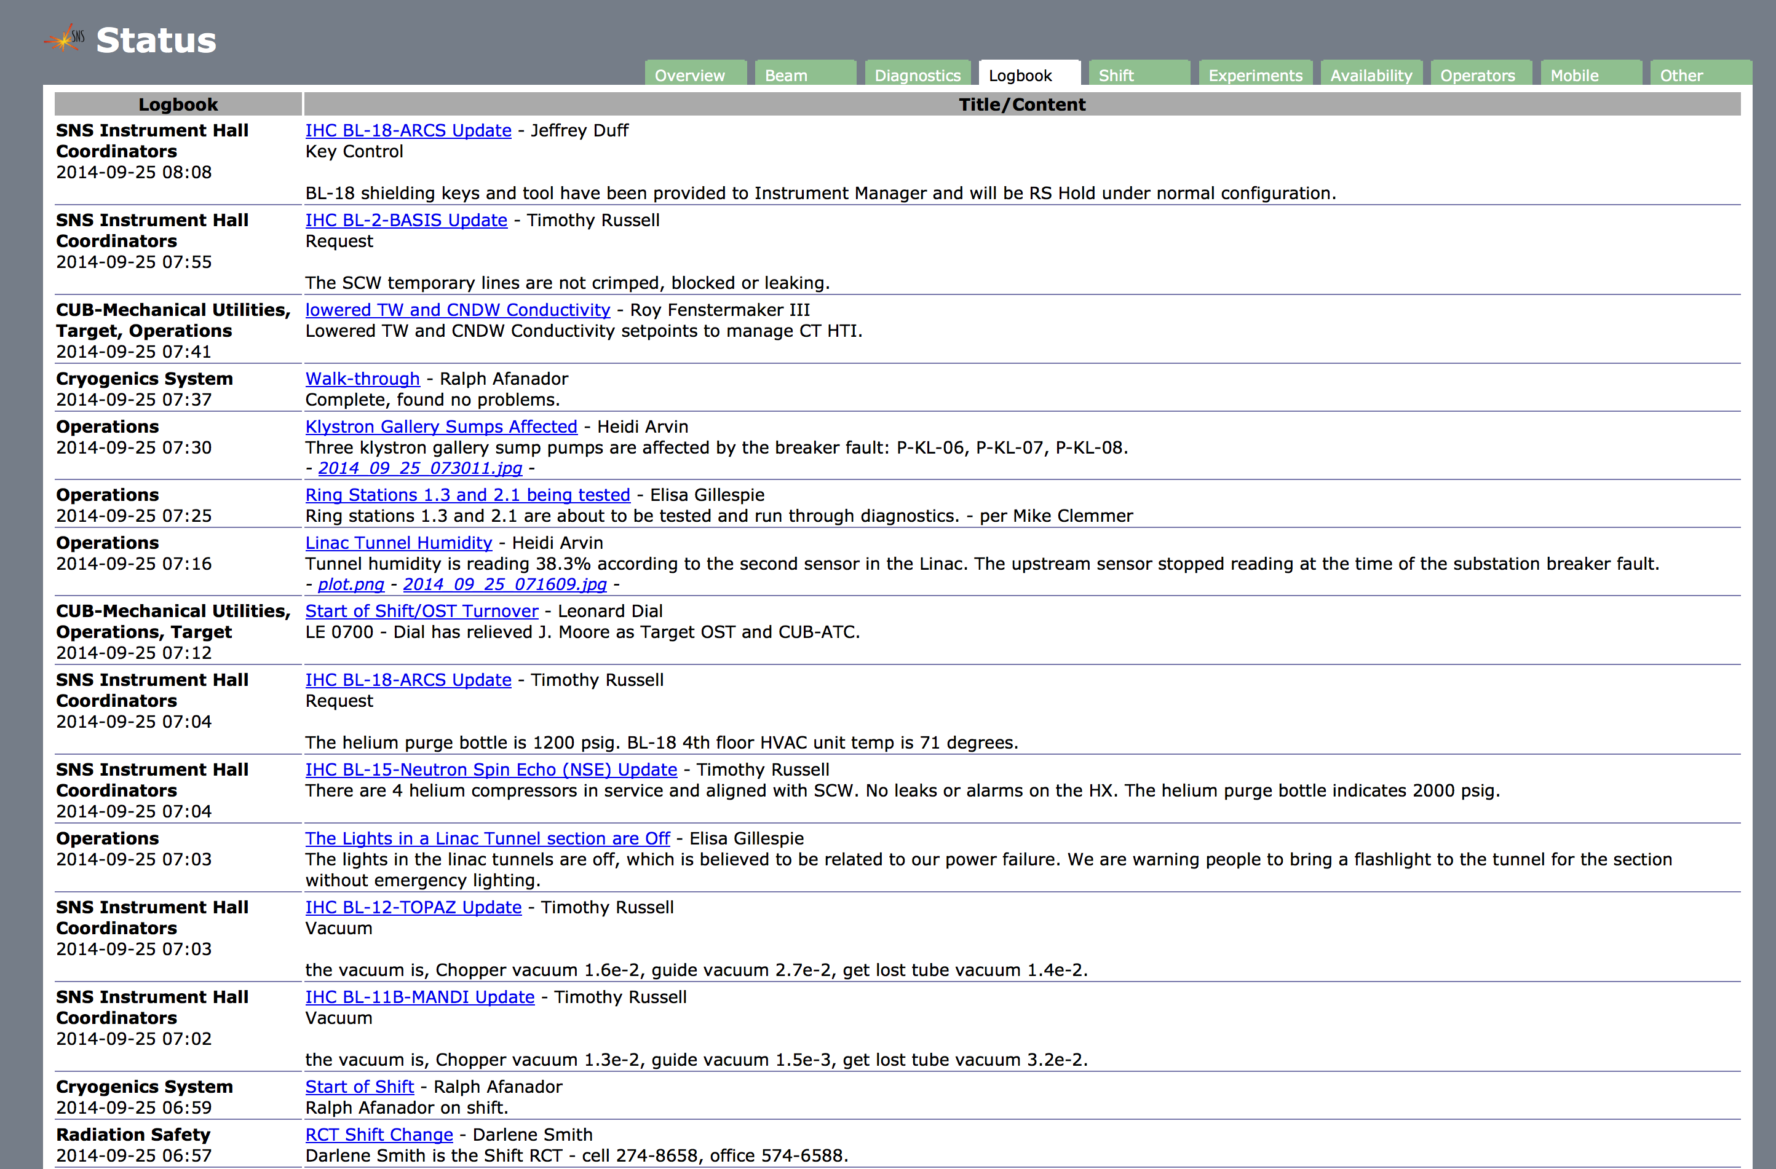
Remote Operation at SNS: Tools for the Modern Interconnected World
Geoffrey Milanovich
Oak Ridge National Laboratory
Summary
The presence of operators in a control room may not ever end, but new tools now make remote monitoring and operation more feasible. High level overviews are provided on a standard web page, and detailed information is now available through the WebOPI interface.
SNS Status Page
The status page was first developed as an alternative to the online logbook. It evolved into a graphically rich page with a focus on machine health.
Evolution from EPICS to the Web
EPICS provides a robust control system, but lacks internet connectivity. BOY, part of Control System Studio (CSS), provides a Java-based GUI to display variables and controls. The WebOPI tool displays BOY screens on the internet. Conversion is easy and accurate.
Overview
The overview page provides at-a-glance information. It is management’s preferred page to check machine status.
EDM
This example of an Epics-based display has buttons, sliders, and waveforms to be converted.
Web Overview
Diagnostics
The diagnostics page shows the most visually interesting images to the public. The stripper foil picture is false-colored by temperature. Current waveforms show beam increasing in the ring.
EDM Display
EDM2BOY
EDM2BOY, a tool provided in CSS, converted the screen with no assistance from the user.
Web Beam Diagnostics
Availability
Availability numbers are generated from data entered by operators into the end-of-shift reports database.
BOY Conversion of Display
WebOPI
Converts BOY OPIs to JSON text which is displayed by Javascript on a browser. This example could be optimized for mobile display if put into production.
Web Availability
Logbook
The logbook overview shows entries from multiple logbooks at once. Also, it embeds pictures, but does not show attachments, which provides some confidentiality.
Web Logbook Overview
iPad displaying WebOPI
Acknowledgements: Kay Kasemir, Xihui Chen
Visit http://controlsystemstudio.org/
ORNL is managed by UT-Battele, LLC for the U.S. Department of Energy under contract DE-AC05-00OR22725

