Slide 1
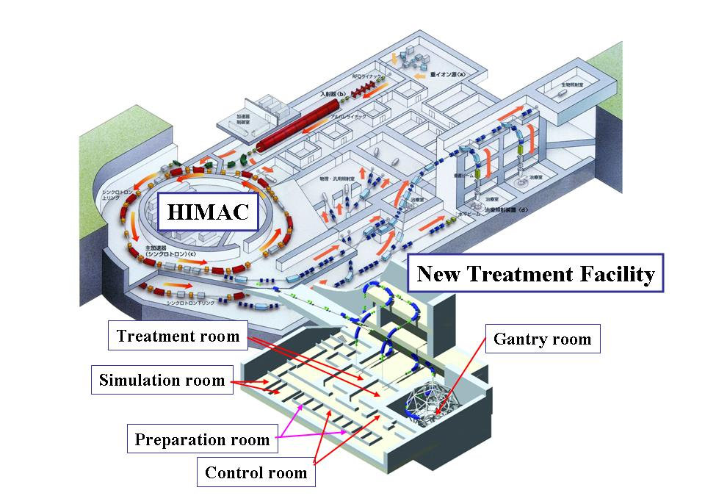
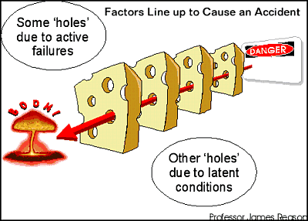
Improvement of the training program
for newcomers by human factor analysis
Hiromi. Inokuchi¹, Shigekazu.Fukuda¹, Katsumi.Okumura¹, Izuimi. Kobayashi²
¹National Institute of Radiological Sciences (NIRS), 4-9-1 Anagawa, Inage, Chiba 263-8555, Japan (Here after called NIRS)
²Accelerator Engineering Corporation, 3-8-5 Konakadai, Inage, Chiba 263-0043, Japan(Here after called AEC)
Introduction
We, NIRS, have experienced a number of troubles that interrupt a beam supply
or therapy treatment by human errors in a year.
The occurrence rate was 0.3 per 100 operating hours every year.
We investigated the cause of human errors and reviewed the training program
for newcomers.
As a result of this review and improvement, we successfully
have reduced errors by 20% in 6 months of this year
Compared to those of last years.
Figure 1 shows the trend of occurrence rate of human errors.
Rate per 100 operation hours
FIG-1. Rate of human error (3 month moving average)
NIRS HIMAC overview
Month
Investigation of human error
Our investigation is performed through the interview to a personnel who made a mistake based on SHELL model.
Figure2 is the Swiss Cheese model which represents the structure of failure or accident by human errors. The holes in the slices represent weaknesses in individual parts of the system.
The SHELL Model is defined as “the relationship of human factors and the aviation environment”
Example of questioner !
Software
☐ Is it easy to understand the manual ?
☐ is there the problem in a procedure ?
Hardware
☐ Is it easy to misunderstand ?
☐ Is there protection to prevent miss ?
Environment
☐ Is time of deadline approaching ?
☐ Is there the problem to access them ?
Live ware (other person)
☐ Is the information conveyed definitely?
☐ Is order clear ?
Live ware (self)
☐ Are you trained ?
☐ Do you understand the procedure ?
It is very important to reveal all factors for investigation.
Fig-2. Swiss cheese model
s
Software
H
m
H
Hardware
s
L
E
E
Environment
L
Live ware（other person）
L
L
Live ware（themselves）
m
Management
Analysis
We analyzed all human errors including near-miss error that occurred last year .
The near miss error was reported by person who made near-miss.
We analyzed those errors by various approach, such as work phase, failure conditions, error factors and experiences.
The work phase analysis
The failure condition analysis
The Error factor analysis
A preparation occupied about 50% in both tasks, therapy support and accelerator operation,.
There was no typical trend in this analysis.
FIG-7 . The analysis by Error factor
Fig-3. The analysis by work phase for therapy support
FIG-5. The analysis by failure condition for therapy support
There was no typical trend.
Preparation(occupy 50%)
The experience analysis
There are lot of work steps, therefore occurrence of error potential is higher than other works.
FIG-6. The analysis by failure condition for accelerator
FIG-8. Human error relating experience
FIG-4. The analysis by work phase for Accelerator
Preparation(occupy 50%)
Presetting data or switch position etc.(occupy 42%)
More than 50% persons were less than 5 years experience.
There are lot of work steps, therefore occurrence of error potential is higher than other works.
Reason same as preparation, FIG-3& -4,.
Conclusion
More than 50% of the errors were caused by the fact that persons having less than five-year experiences lack some prerequisite knowledge. Refer to FIG-9.
As a result of this analysis,
☐ We have reviewed and improved the training program for newcomers.
☐ Also modified the classroom training to be performed by two instructors.
While one instructor is lecturing, the other instructor is taking care of the person who has a poor understanding of the lecture at the same time.
FIG-9. The error factors of personnel within 5 years experience
Focused on person who has within 5 years experience
Year of 2013
Year of 2014
The analysis of error factor below 5 years experience
Lack of knowledge was occupied about 50%
Reduce to about 40%

