Slide 1
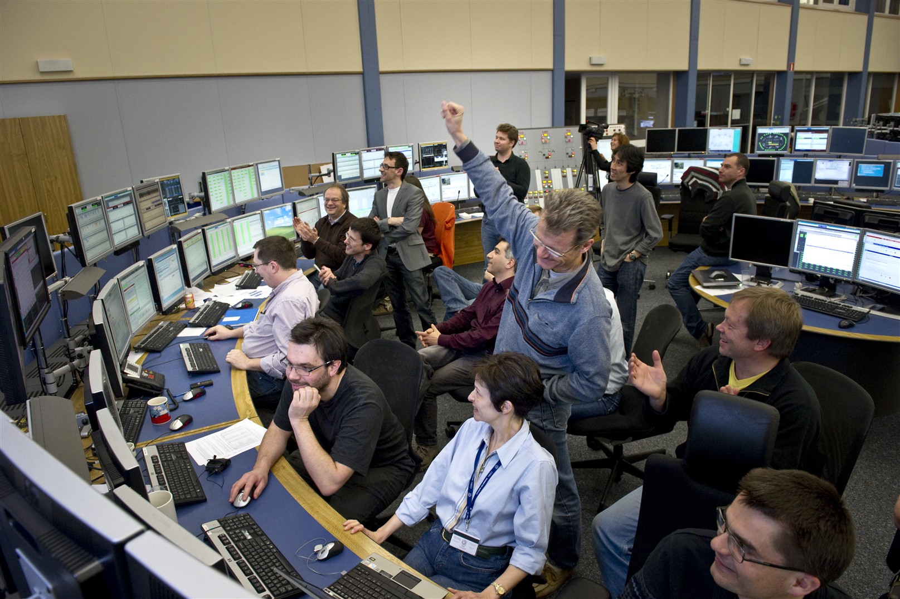
How to maximize LHC
Physics requirements ?
GH Hemelsoet & Rossano Giachino (CERN) WAO 2014
Notes:
How is machine reliability and availability impacted by the user’s requirements? Sometimes the users are happy with any beam as opposed to waiting for “quality” beam. They don’t want the high intensity, high luminosity, brightness, stable spill structure or any of the other parameters used to describe user’s beam quality. What kind of beam quality do they need? What are important parameters to them? What impact does ‘customer satisfaction’ have on typical machine statistics? The availability of a machine is usually considered the % of time that all system will be available to produce physic beams. These systems will have to be reliable to maximize the availability of the beam time. Various topics like Beam Quality metrics, performance statistics or repair tracking will be presented to explain how they will contribute to increase the overall availability.

Slide 2
Outline
CERN & LHC
Luminosity and Integrated Luminosity
Availability and reliability
Special requirements
LHC Run 2
Conclusions

Slide 3
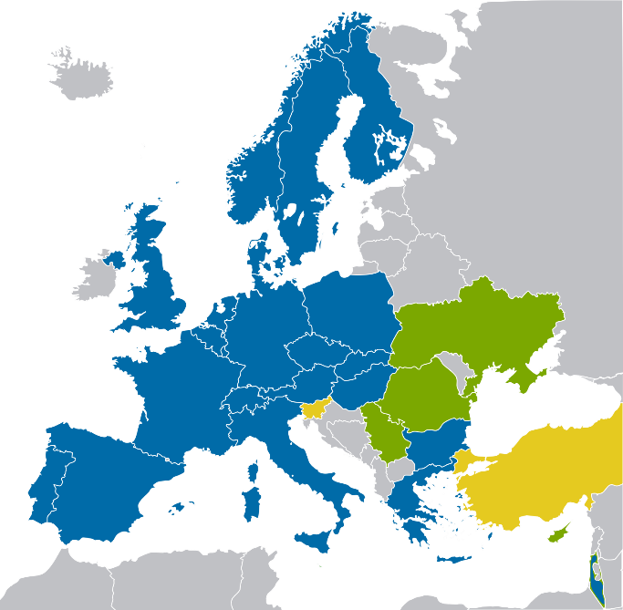

CERN
Annual budget
ca 1000 M$
21 Member States
Austria, Belgium, Bulgaria, Czech
Republic, Denmark, Finland,
France, Germany, Greece,
Italy, Israel, Hungary,
Netherlands, Norway, Poland,
Portugal, Slovakia,
Spain, Sweden,
Switzerland,
United Kingdom
5 Future
Member States
Romania, Serbia,
Ukraine, Slovenia, Turkey
7 Observers
EU Commission,
USA, Russia,
India, Japan,
Turkey, UNESCO
Notes:
CERN’s organization
CERN was founded in 1954 and was one of Europe’s first joint ventures. Today, the laboratory has 21 Member States who provide the delegates to CERN’s Council, which sets the budget and is responsible for all important decisions about the Organization and its activities. CERN employs around 2500 people and has a budget of about 1 billion Swiss Francs per year.
A world-wide collaboration
In addition to CERN’s Member States, many other countries are involved, mainly as Observer States or as holders of a cooperation agreement with the laboratory. Some 10 000 visiting scientists, half of the world’s particle physicists, come to CERN for their research. They represent over 600 universities and nearly 100 nationalities.
Experiments at CERN are run by collaborations of physicists, supported by their funding agencies, from both Member and non-Member states. They are responsible for the financing, construction and operation.

Slide 4
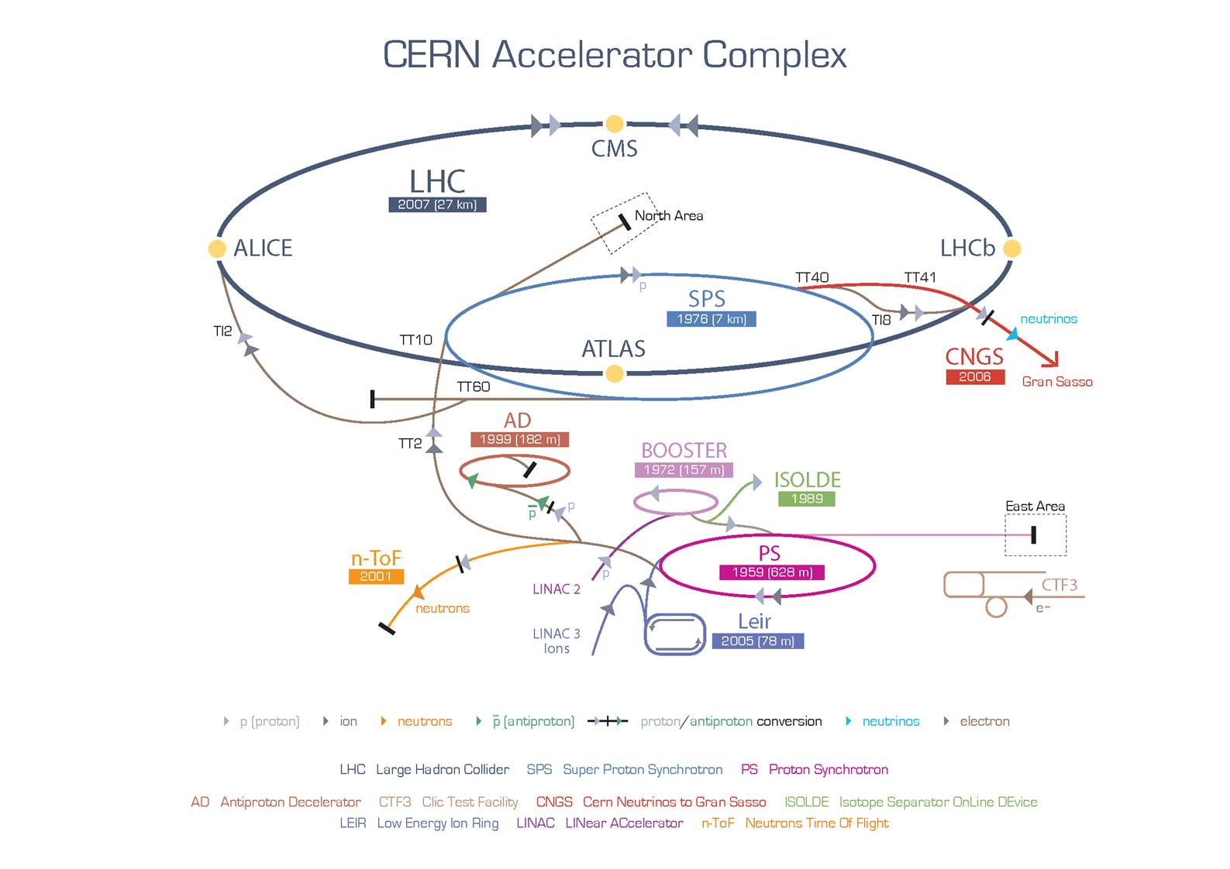
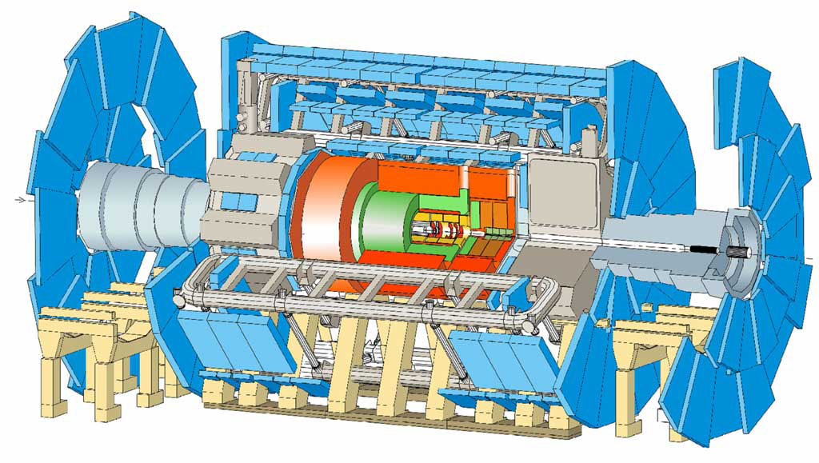
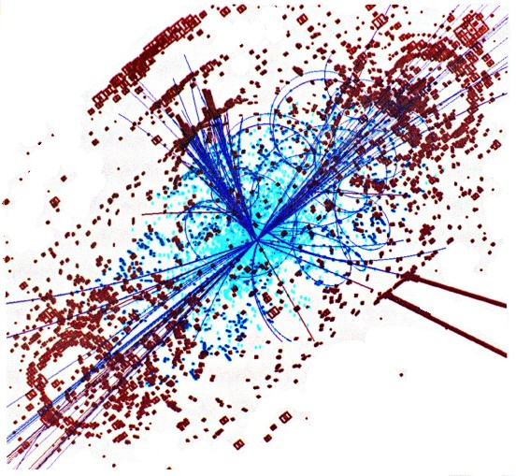
CERN’s particle accelerator chain

Slide 5
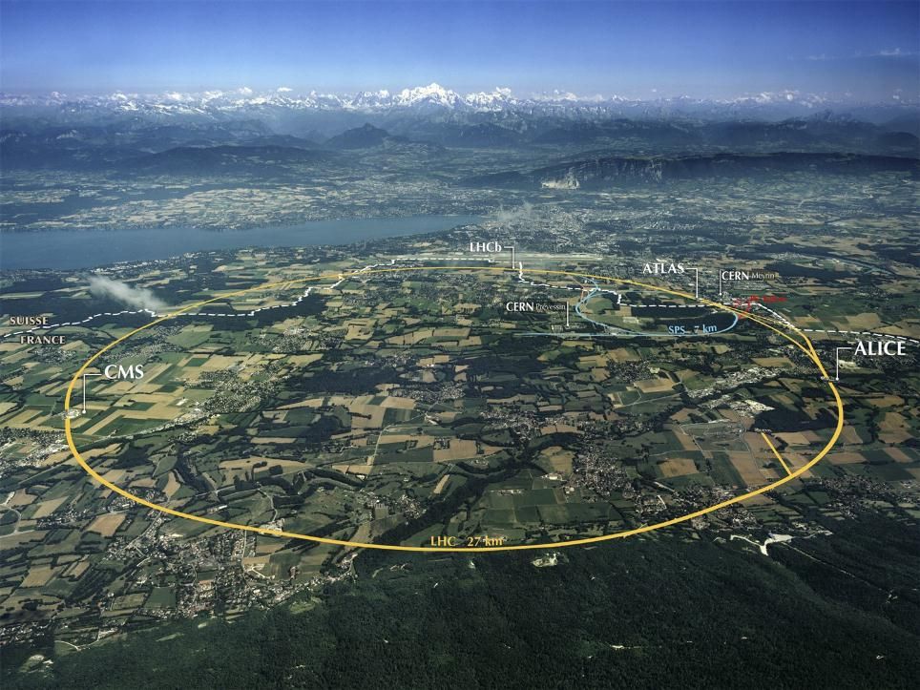
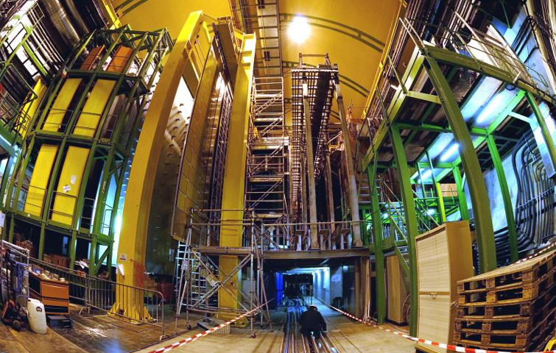


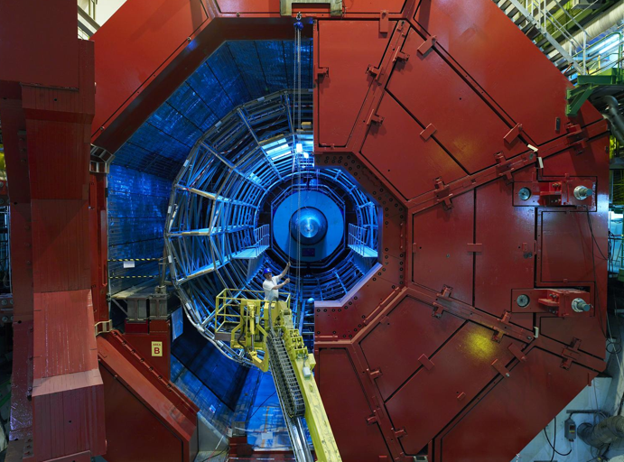
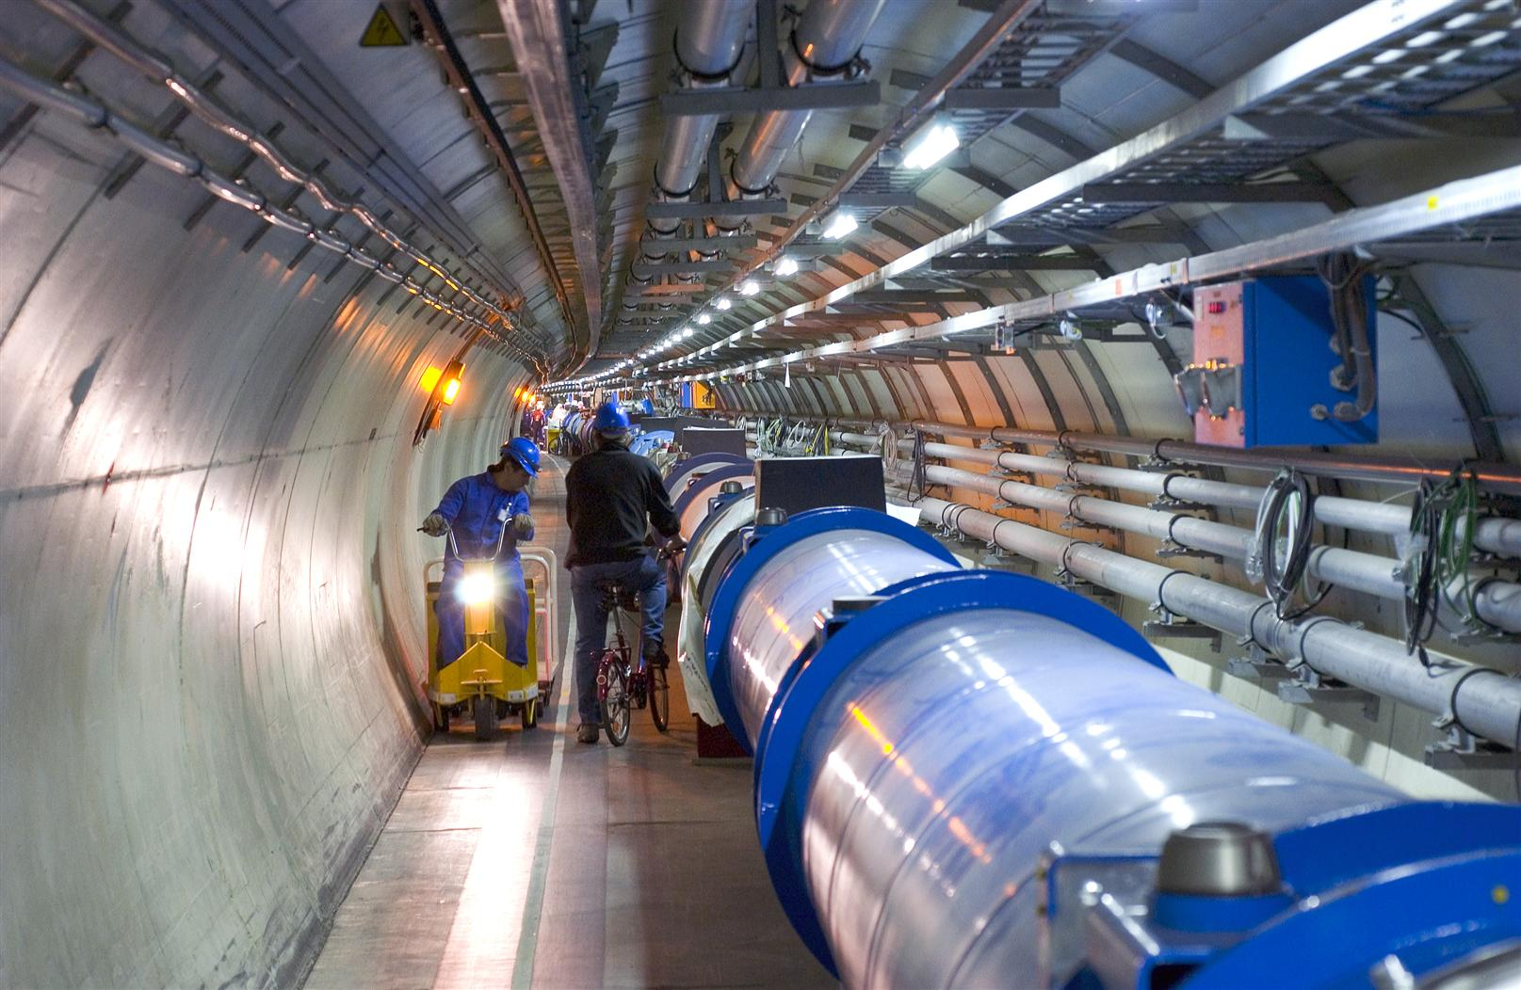

LHC experiments
LHCb
CMS
ATLAS
ALICE
LHC ring:
27 km circumference
Notes:
5
5
The LHC
The Large Hadron Collider (LHC) is the world’s largest and most powerful particle accelerator. In a 27km circular tunnel, 100m below ground, the LHC boosts two particle beams to high energy before colliding them up to 600 million times a second inside giant experiments. These vast particle detectors are built around the four collision points and record the myriad of new particles produced in the collisions. Physicists then sift through the huge quantities of data, looking for clues to understand the fundamental laws that govern our universe.
Since 30 March 2010, the LHC’s experiments have been taking data at a new high-energy frontier, where protons collide at a total energy of 7 trillion electron-volts (7 TeV). In 2015, the energy of collisions will be almost doubled, opening the door to new discoveries.

Slide 6
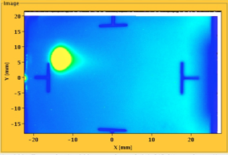




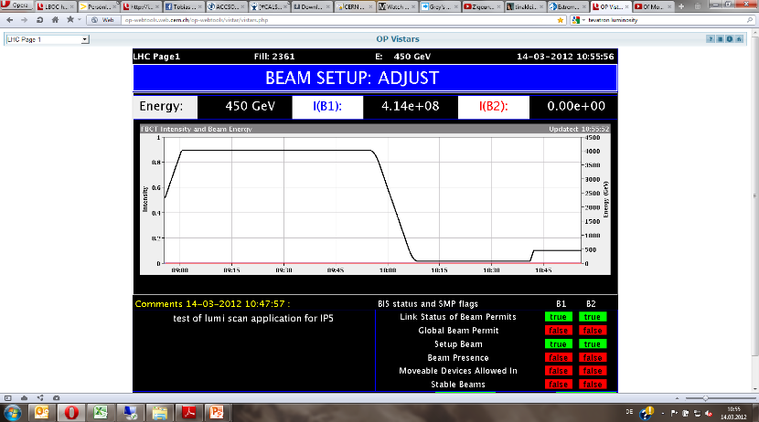
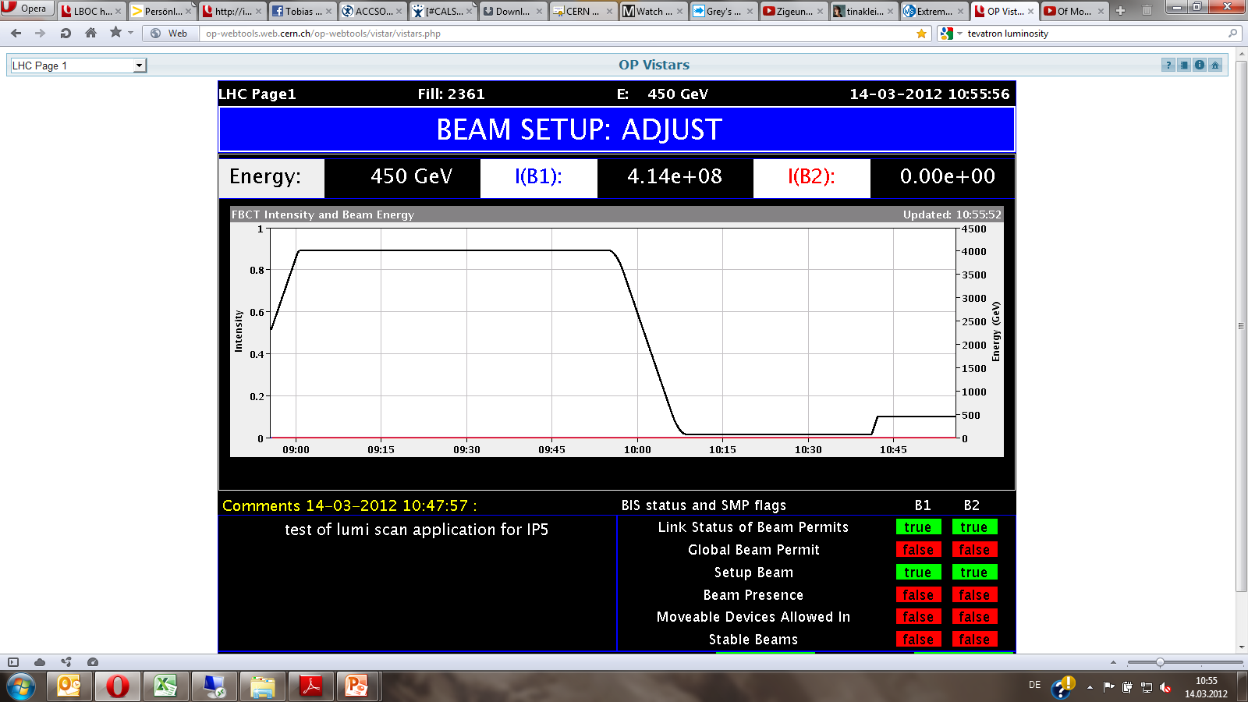


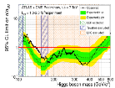
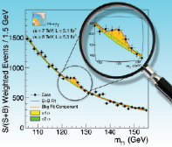

LHC Run 1 timeline
August 2008
First Injection tests
February 21, 2013 LS1
January 2013
Protons & Lead
4 TeV
March 2012
4 TeV
September 10, 2008
Circulating beams
November 20, 2009
Beams back
November 2010
First Lead ion run
2008
2009
2010
2011
2012
2013
September 19, 2008
Incident
June 28, 2011
1380 bunches
July 4, 2012
Higgs Seminar
March 30, 2010
First collisions
at 7 TeV CM
1380
December 2011
5.6 fb⁻¹

Slide 7
Collider particularities
For particle colliders, the most important performance parameters are the beam energy and the luminosity.
High energies allow particle physics experiments to study and observe new events.
The luminosity describes the ability of the collider to produce the required number of useful interactions or events.
The integral of the delivered luminosity over time is called integrated luminosity and is a measure of the collected data size.

Slide 8
Luminosity
Beam intensity
number of events detected (N) in a certain time (t) depends of the interaction cross-section (σ) * Luminosity
Beam size
N Number of particles per bunch
K_{b} Number of bunches
In 2012:
ε_{n} = 2.5 μm
ε = 5.9 x 10⁻⁴ μm
σ* = 18.8 μm
(p = 4 TeV, β* = 0.6m)
ε_{n} Normalized emittance
β* Beta function at IP
f Revolution frequency
F Reduction factor due to crossing angle
Notes:
number of events detected (N) in a certain time (t) to the interaction cross-section (σ):

Slide 9
Luminosity optimisation
Increase number of bunches & bunch intensity
  Decrease the length of the bunches (50 ns to 25 ns)
  Preserve the beam stability (Heat load losses etc…)
  1380 bunches at 1.7e11 ppb ► 2.2e14 Total intensity
Keep the transverse emittance small
  At creation in the injectors, and in the rest of the chain
  ε_{n =} 2.5 μ
Pushing the beta* to the limits
  Without increasing the losses
  β* = 60 cm

Slide 10



$$\int_{time}{\text{Luminosity}}$$
Huge amount of integrated luminosity to make a discovery
Availability
Planning Management
Low turnaround time
Injection chain
Reliability
Critical Equipment readiness
Maintenance program

Slide 11
Availability and reliability
Availability is a measure of the % of time the equipment is in an operable state.
Reliability is a measure of how long the item performs its intended function.
  Cryogenic system, machine protection must be reliable
  Injector chain has to be available during LHC injection

Slide 12
Minimizing the dead time
beam dump
4 TeV
Collisions
Rampdown
Prepareation (access)
Injection
Ramp
Squeeze
Collisions
Turnaround time
~ 2 to 3 hours
450 GeV

Slide 13
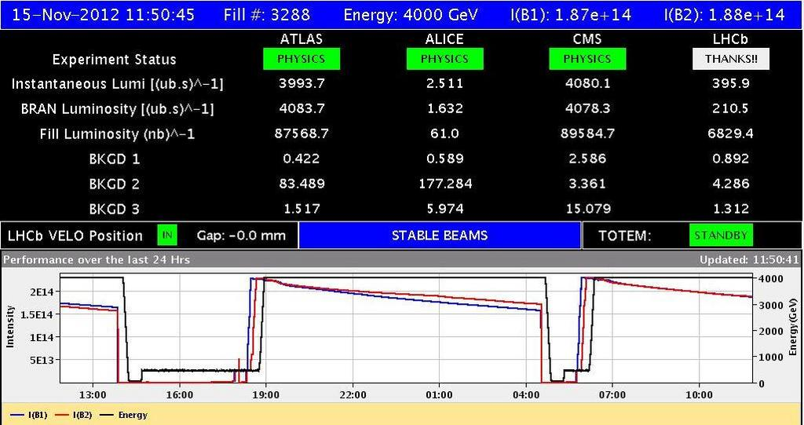
In Reality …

Slide 14
Luminosity production optimisation
Lightness of the fault
(Fault easy to clear)
Availability
Scheduled Time
devoted to physics
Integrated luminosity
Physics
performance
Shorter
turnaround
Machine understanding
& Operator skills

Slide 15
Highly reliable
Lightness of the fault
(Fault easy to clear)
Preventive Maintenance
Scheduled Time
devoted to physics
Integrated
Luminosity
Availability
Shorter turnaround
Physics performance

Slide 16
Highly performant
Lightness of the fault
(Fault easy to clear)
Scheduled Time
devoted to physics
MD
Time
Integrated
Luminosity
Machine understanding
& operator skills
Shorter turnaround
Physics performance

Slide 17
Availability in 2012
Total Run Time 182 days
Cryo Availability 169 days 93.2%
Fault Downtime 44 days 24.3 %
In general – pretty good considering
Issues (SEUs, vacuum, UFOs, cryogenics…) have seen vigorous follow-up and consolidation performed and planned

Slide 18
User’s specific requirements
CMS & Atlas need highest luminosity
Other users do not necessarily need high instantaneous and integrated luminosity
LHCb needs constant luminosity.
  20 times lower
ALICE enjoyed proton collisions between enhanced satellite bunches and the main bunches.
  10 000 times lower
TOTEM & ALFA experiment near Atlas and CMS need a 1 km β∗ run for precise measurements of protons from collisions at small angles
Lead-lead ion and lead proton collisions are also a part of the LHC physics program

Slide 19
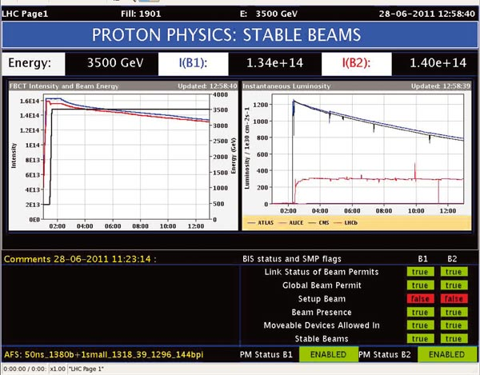
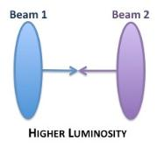
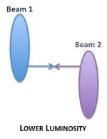
Levelling
Atlas and CMS want the highest available luminosity
LHCb prefers a constant luminosity

Slide 20
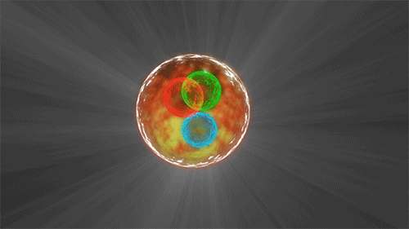

Pushing the limits for 2015
LIMITS

Slide 21
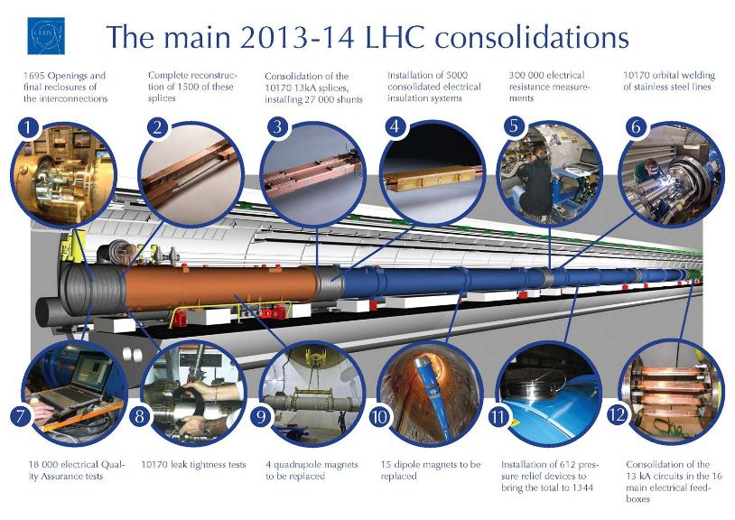

Slide 22
LHC RUN 2
Operate the LHC at 6.5 TeV.
Operate with 25 ns bunch spacing..
Maximize the integrated luminosity.
  Small focusing – β* as small as possible.
  Highest possible efficiency.
Energy increase
  4 ► 6.5 Tev
Number of particles increase
  1380 ► 2590
  50 ns ► 25 ns bunches
Instantaneous Luminosity
  6.8 x 10³³ cm⁻² s⁻¹ ► 1 1.3 x 10³⁴ cm⁻² s⁻¹
Integrated luminosity
  ~28 fb⁻¹ in run 1 ► ~100 fb⁻¹ in run 2

Slide 23
Conclusions
Peak instantaneous luminosity is not everything...
  Record luminosity is often at the expense of stability or reliability
Integrated luminosity is the one which counts.
Beam Instrumentation, Data recording, Performance follow up allowed us to continuously optimize luminosity production.
Excellent team spirit collaboration was vital to achieve these results.
The energy increase on LHC run2 will be a serious challenge to fulfil all physics requirement and possibly leading to new physics.

Slide 24
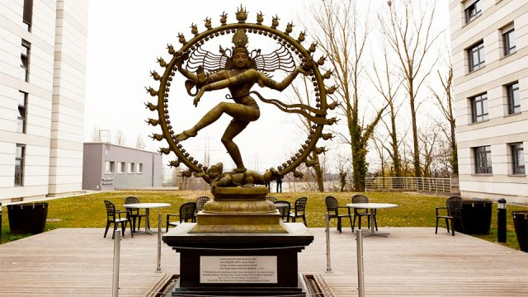
Dealing with the extreme …
Performance
Reliability
Availability
Luminosity Levelling
This statue of Shiva was gracefully offered to CERN by the Indian collaboration
While trying to keep the best between an highly reliable machine delivering the highest luminosity

Slide 25
SPARE

Slide 26
Potential limitations
Electron cloud & high energy & with 25 ns
UFOs at higher energy & with 25 ns
Radiation to electronics – SEU’s
Low emittance
  Risk due to strongly increased energy density - strain on material survival
  Beam dynamics effects: IBS blow-up
  Noise induced emittance growth can take over → often additive components and not multiplicative.
Total beam intensity limits in the LHC…
Will look to trade off emittance, bunch intensity, number of bunches, total beam intensity

Slide 27
50 versus 25 ns
 | 50 ns | 25 ns
GOOD | Lower total beam current Higher bunch intensity Lower emittance | Lower PILE-UP
BAD | High pile-up Need to level Pile-up stays high | More long range collisions: larger crossing angle; higher beta* Higher emittance Electron cloud: need for scrubbing; emittance blow-up; Higher UFO rate Higher injected bunch train intensity Higher total beam current
Expect to move to 25 ns because of pile up

Slide 28
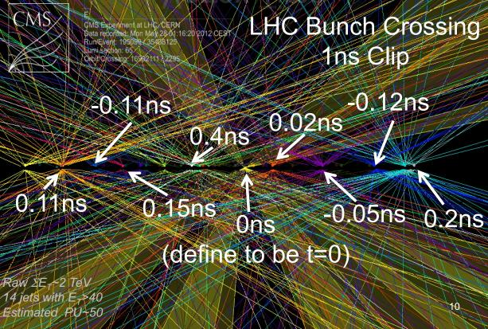
Pile up
The number of collision events that take place for each bunch crossing.

Slide 29
Performance
77% of design luminosity:
- 4/7 design energy
- nominal bunch intensity++
- ~70% nominal emittance
- beta* = 0.6 m (design 0.55 m)
- half nominal number of bunches
Max. luminosity in one fill | 237 pb⁻¹
Max. luminosity delivered in 7 days | 1350 pb⁻¹
Longest time in stable beams (2012) | 22.8 hours
Longest time in stable beams for 7 days | 91.8 hours (55%)
Fastest turnaround | 2 hours 7 minutes

Slide 30
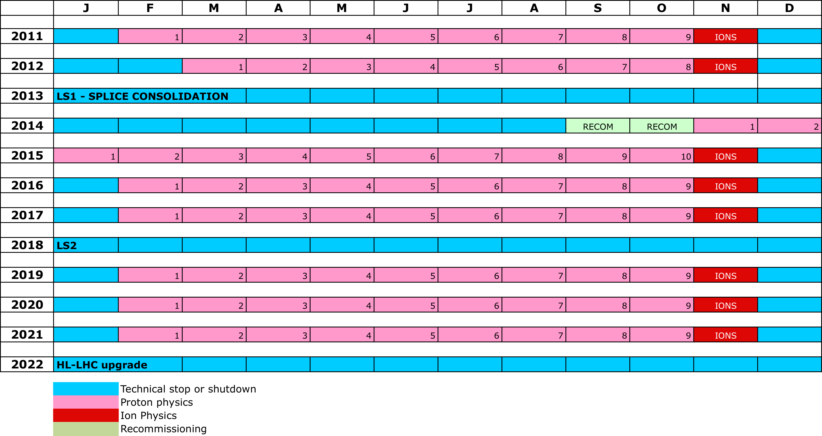
10 year plan
LS1
PHYSICS AT 6.5/7 TeV
LS2
“ULTIMATE” PHYSICS
LS3
HL-LHC
NB: not yet approved

Slide 31
Peak performance – the numbers
Energy [TeV] | 4.0
Beta* [m] IP 1,2,5,8 | 0.6, 3.0, 0.6, 3.0
Bunch spacing [ns] | 50
Normalized emittance [mm.mrad] | ~2.5 start of fill
Bunch intensity | 1.6 – 1.7e11
Number of bunches | 1374
Stored energy [MJ] | ~140/beam
Peak luminosity [cm⁻²s⁻¹] | 7.73e33
Beam-beam tune shift (start fill) | ~0.023

Slide 32
Luminosity and Availability: definitions
integrated luminosity is a function of…
time colliding physics beams
turnaround between successive physics beams
time to clear faults
physics performance during colliding beams
availability!
machine understanding
& operator skill
These are not independent variables
B. Todd & AWG, LMC February 2014

Slide 33
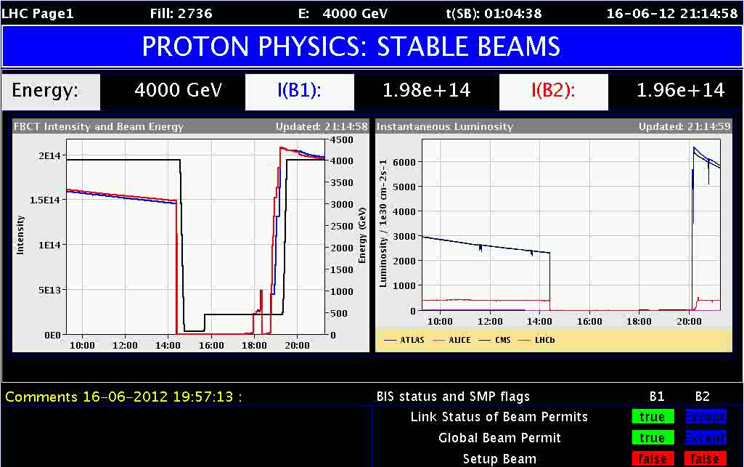
accelerator or collider?
at CERN: many accelerators and one collider
      see P. Collier, “Overview of the CERN Complex”, these lecture series
at high energy to produce heavier particles or probe smaller scales
    lighter particles were studied in older machines
    some events only possible at higher energies
      see P. Sphicas, “Standard Model and Beyond”, these lecture series
particle colliders use two beams
  higher energy by colliding two beams (p₁ = -p₂) than by using a fixed target (p₂ = 0)
      see W. Herr, “Relativity”, these lecture series
need many interactions to explore and prove rare events
  luminosity measures the number of events for the experiments
figures of merit of a collider: energy E_{cm} and luminosity L
LHC
E_{cm} = 14 TeV
L = 10³⁴ cm⁻²s⁻¹

Slide 34
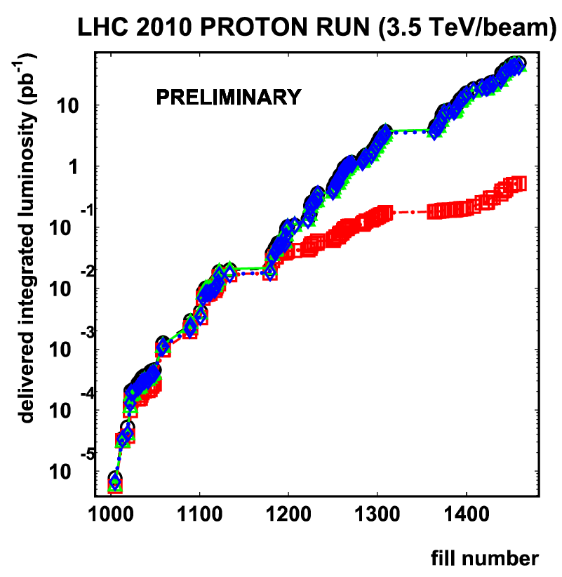
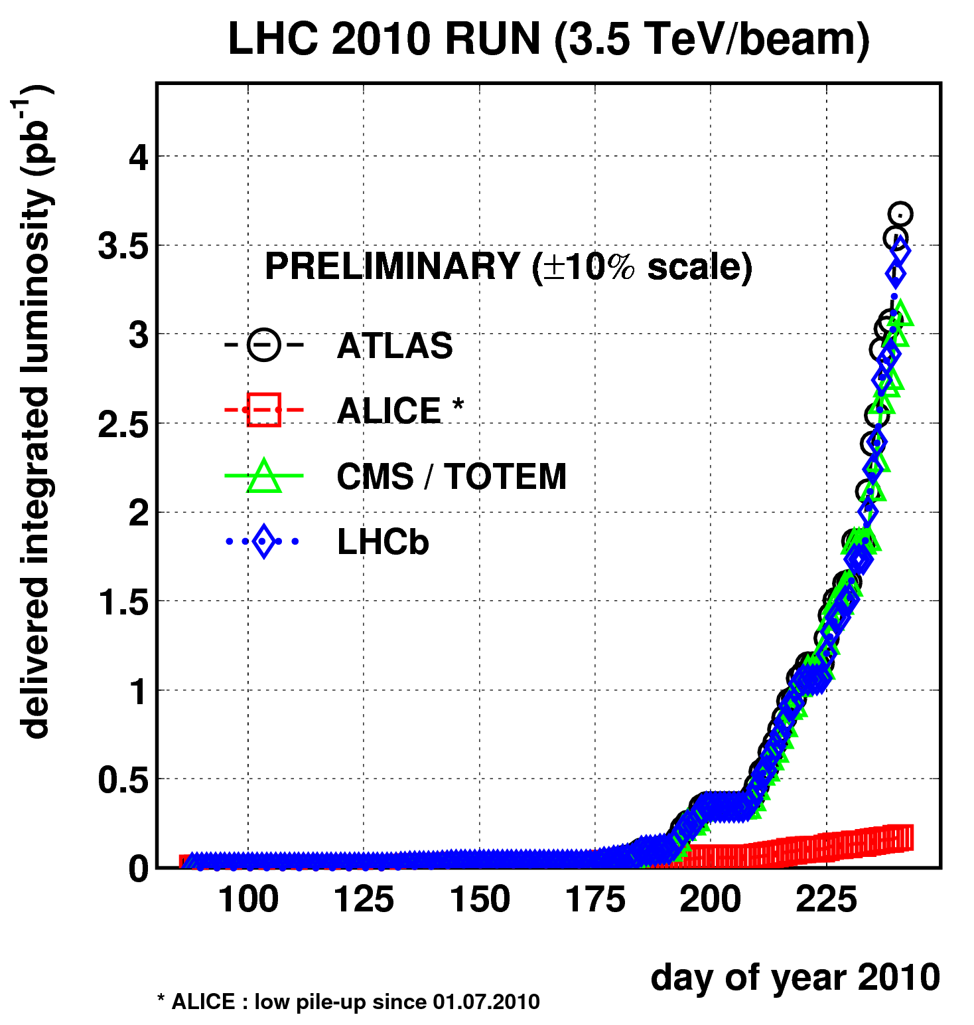

What is it all about?
Event rate is proportional to Luminosity
Integrated luminosity ~ 45 pb⁻¹ (end 2010)
Goal 2010/11:
1 fb⁻¹ of data/exp
Parameters |  | LHC nominal
Number of particles per bunch | Ν | 1.15 x 10¹¹
Number of bunches per beam | k_{b} | 2808
Beam sizes at the collision point | σ_{x} , σ_{y} | 17 μm
Revolution frequency | f | 11.245 kHz
Nominal LHC parameters
Beam energy (TeV) | 7.0
Stored beam energy (MJ) | 362
Transverse emittance (μm rad) | 3.75
Bunch length (cm) | 7.55
Requires in 2011:
L ~ Tevatron Luminosity
~700 bunches of 10¹¹ p each
~30 MJ stored energy (10% of nominal)
Units:
instantaneous L: cm⁻² s⁻¹
integrated L: b⁻¹ (μb⁻¹ , nb⁻¹ , pb⁻¹, fb⁻¹)
(1 barn = 10⁻²⁴ cm²)
- β* = 0.55 m (beam size =17 μm)
- Crossing angle = 285 μrad
- L = 10³⁴ cm⁻² s⁻¹
L(LHC)= 10³⁴ cm-2 s-1 ~ 30*Tevatron (3x10³² cm-2 s-1)
Notes:
1 turn = ca. 90 usec
L = 10³⁴ cm⁻² s⁻¹=10 nb⁻¹s⁻¹
(Tevatron pp 3x10³² cm⁻² s⁻¹)

Slide 35
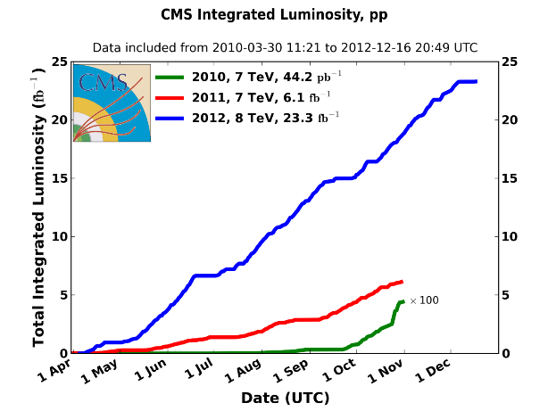
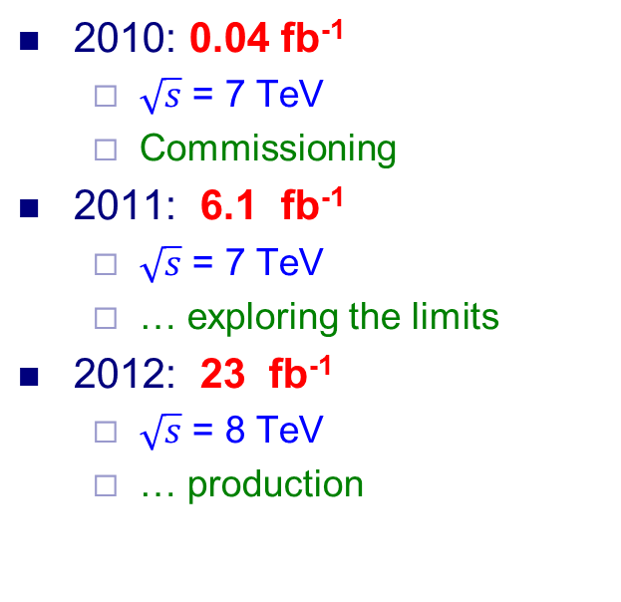
Integrated luminosity 2010-2012

Slide 36
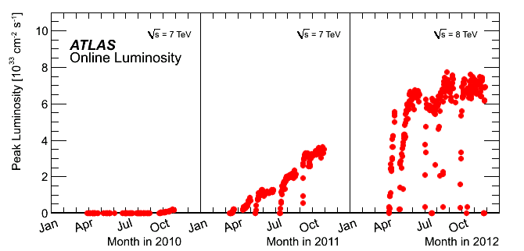
Peak luminosity 2010-2012
2011: average
12 collisions/xing,
with tails up to ~20
2012: ~30 collisions/xing
at beginning of fill
with tails up to ~ 40.
Record peak luminosity: 7.73 x 10³³cm⁻²s⁻¹

