Slide 1
GSI visitation
W. Barth
W. Barth, WAO 2014, Mainz/Germany
31.10.14

Slide 2
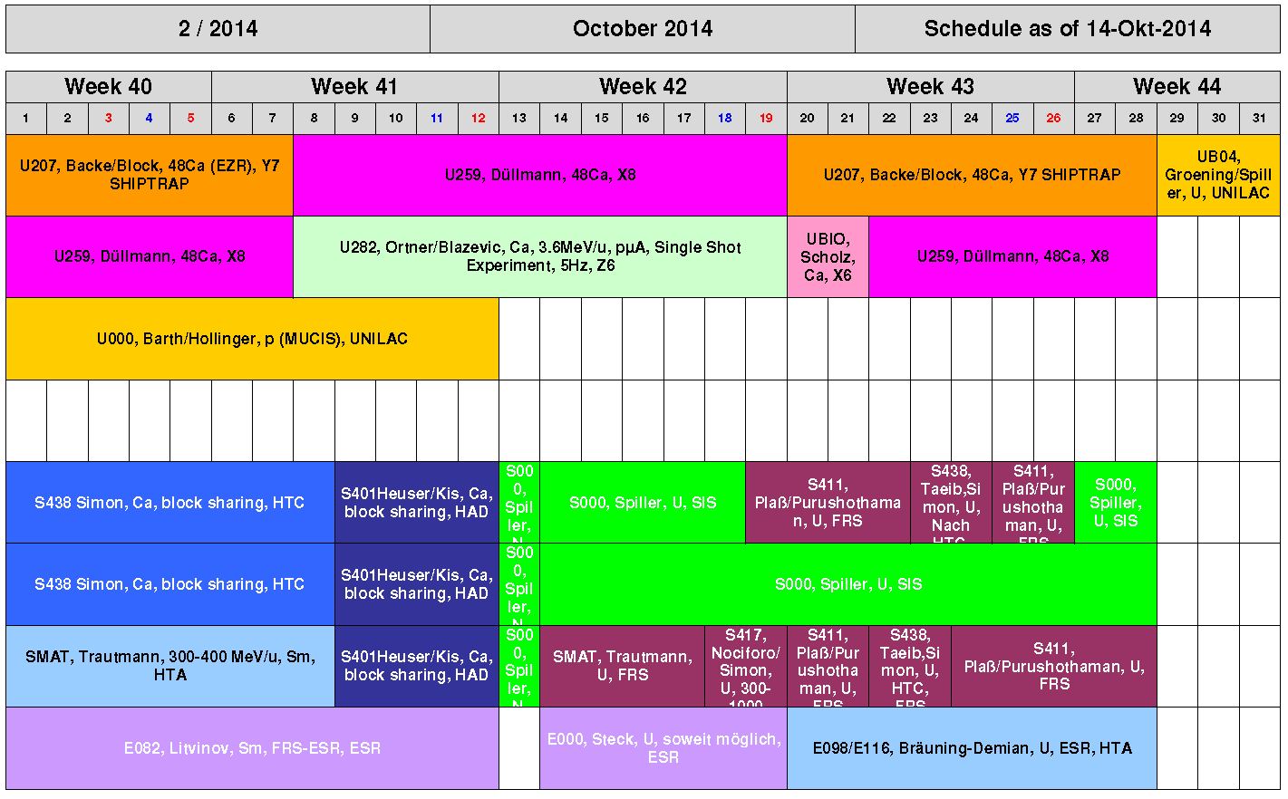
Welcome to...

Slide 3
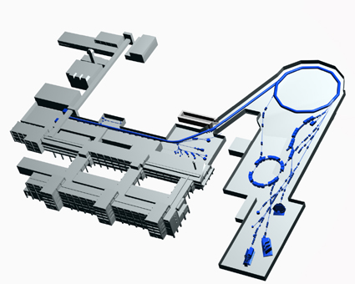
GSI Overview (Status 2006)
Budget: 70 Mio €
(58 Mio € operations,
12 Mio € investments)
Users: about 1100 per year
(200 GSI; 900 external;
500 national / 400 international)
SIS
UNILAC
ESR
Staff: 850 (455 permanent)
250 scientists and engineers
Facilities: Accelerators (Unilac, SIS, ESR)
W. Barth, WAO 2014, Mainz/Germany
31.10.14

Slide 4
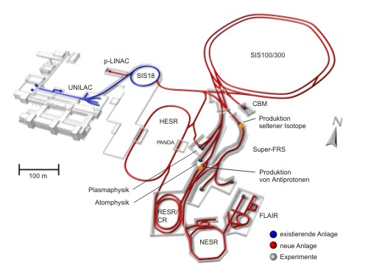
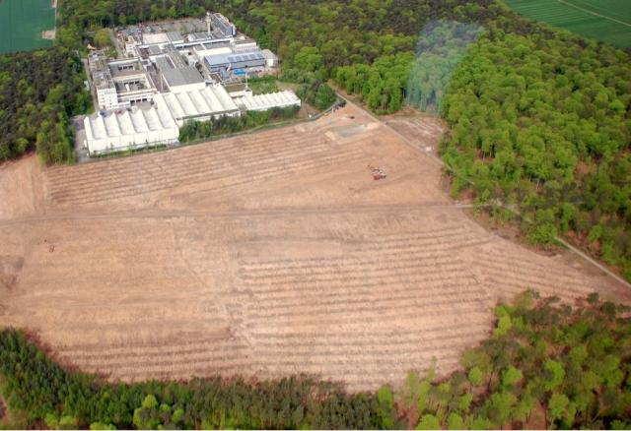
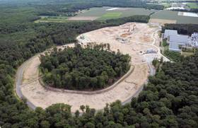
Facility forAntiproton andIonResearch
Upgraded existing facility: provides
ion-beam source and injector for FAIR
Preperation for civil construction
2012
Secondary beams: RIBs, pbars
Primary beams:
protons to ²³⁸U
Accelerator Components & Key Characteristics
Ring/Device Beam Energy Intensity
SIS 100 (100Tm) protons 30 GeV 4x10¹³
²³⁸U 1 GeV/u 5x10¹¹
(intensity factor 100 over present)
SIS 300 (300Tm) ⁴⁰Ar 45 GeV/u 2x10⁹
²³⁸U 34 GeV/u 2x10¹⁰
CR/RESR/NESR ion and antiproton storage and
experiment rings
HESR antiprotons 14 GeV ~10¹¹
Super-FRS rare isotope beams 1 GeV/u <10⁹
5/2014
New future facility: provides ion and anti-matter
beams of highest intensities and up to high energies
W. Barth, WAO 2014, Mainz/Germany
31.10.14

Slide 5
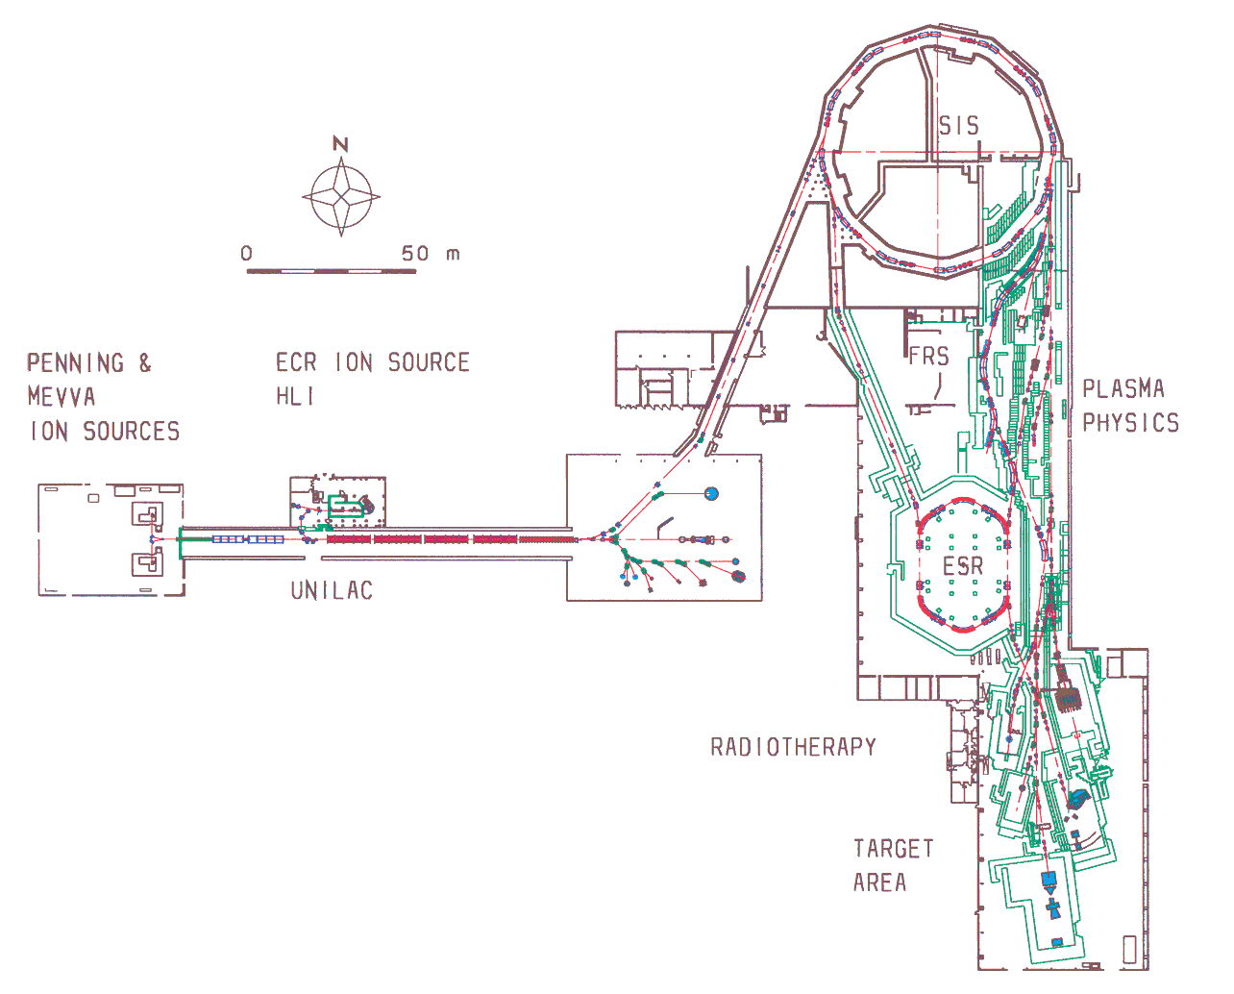
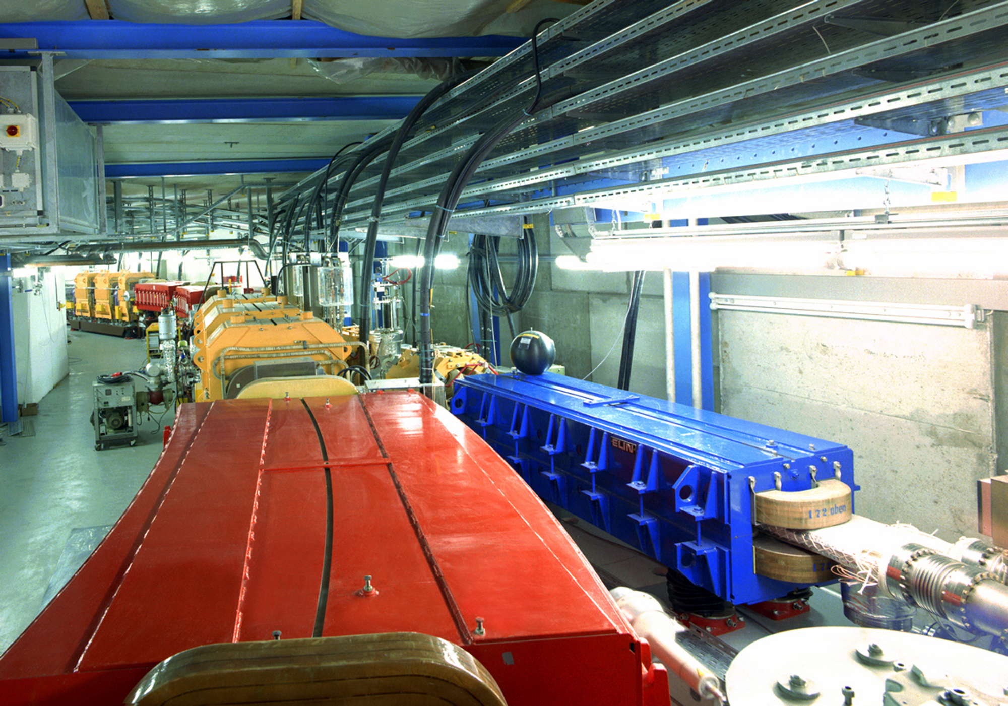
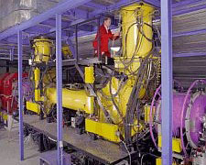
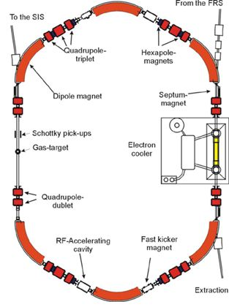
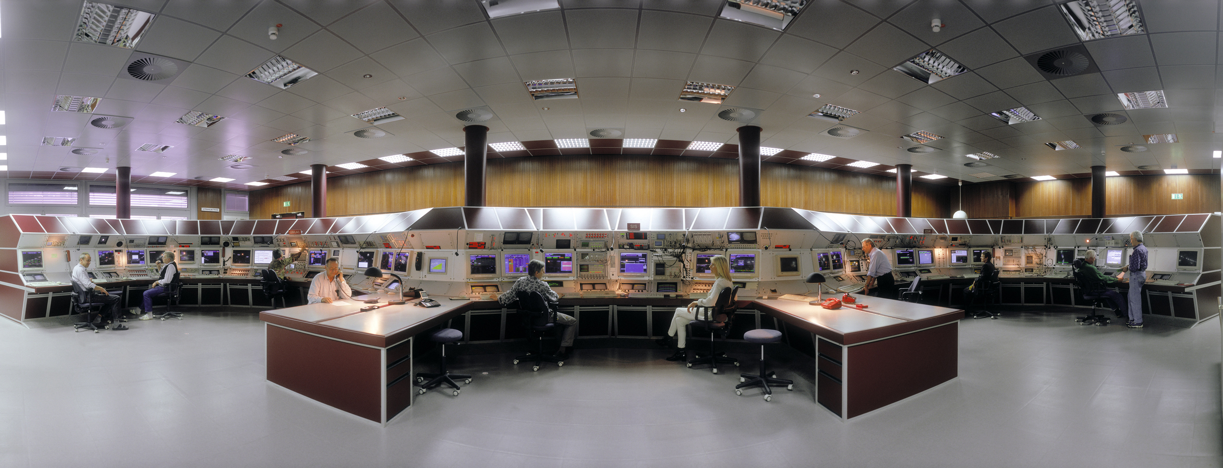
GSI Overview
CLOSED
(after beam time)
in operation!
SIS18
SHIP
ESR
MCR
ESR
in operation!
CAVE M
HADES
CRYRING
W. Barth, WAO 2014, Mainz/Germany
31.10.14

Slide 6
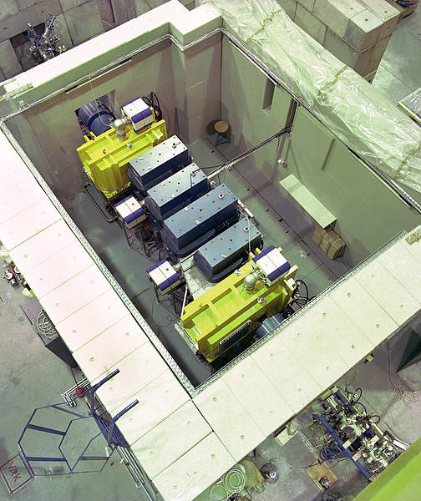
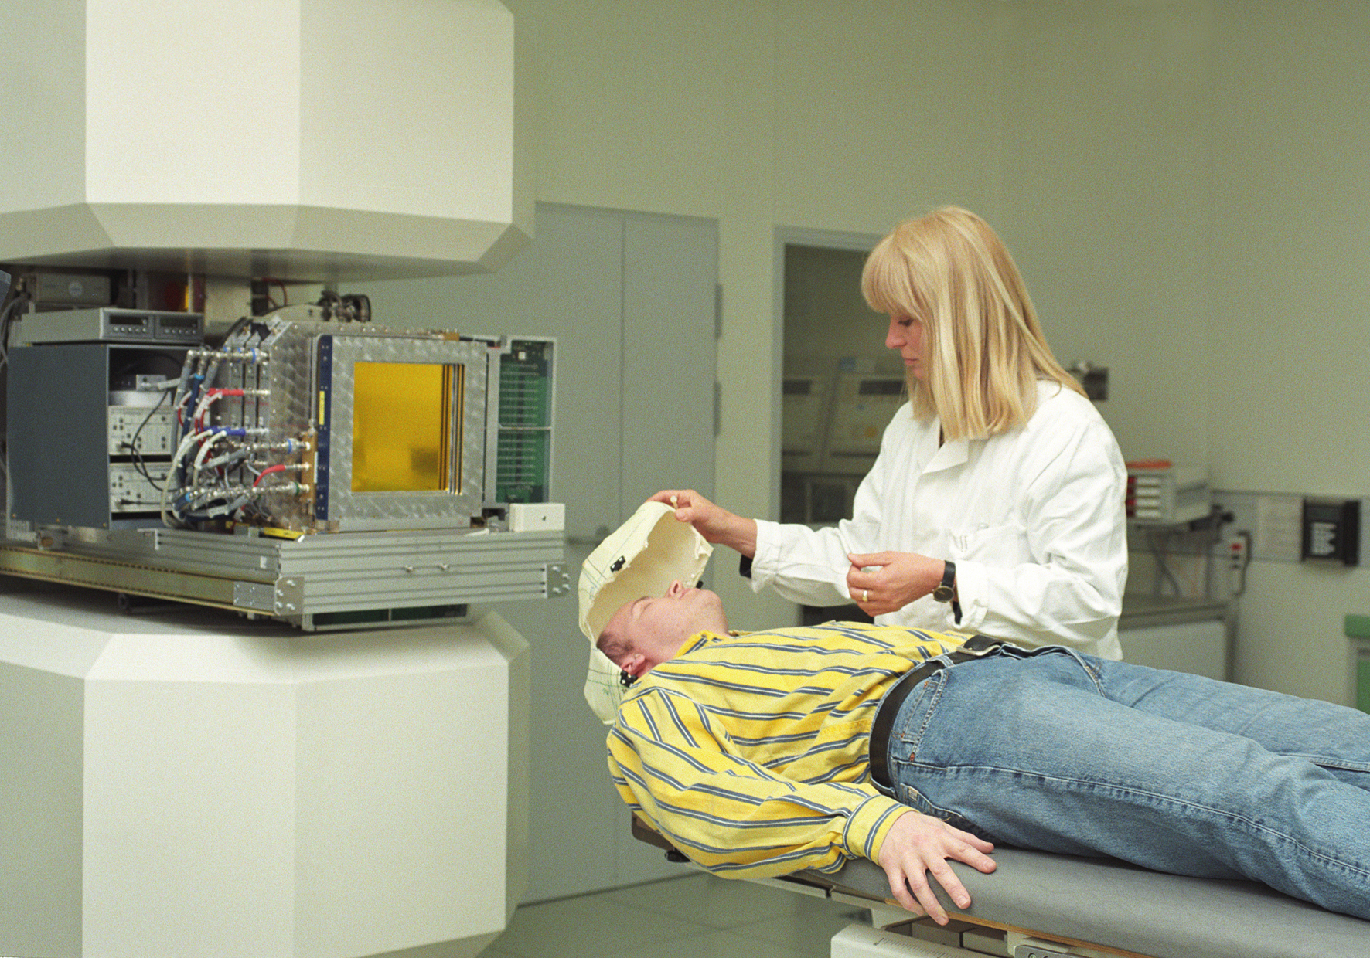
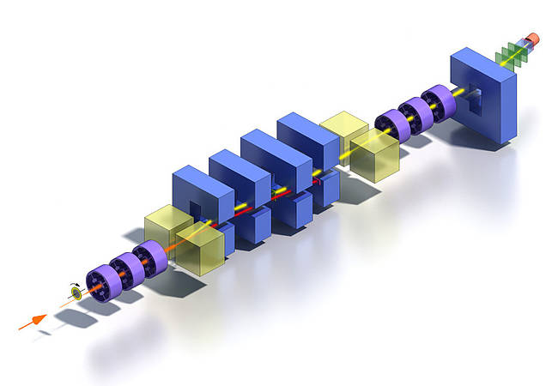
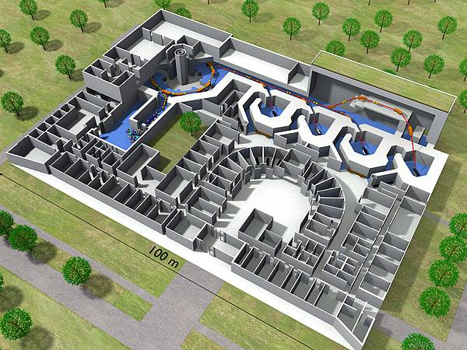
Research@GSI
Radiotherapie Project (Cave M)
Pilot Project@GSI
The SHIP (Separator for Heavy Ion reaction Products) is an electromagnetic separator which has been designed for the synthesis and investigation of superheavy elements. The six heaviest elements with proton numbers 107-112 which are presently comprised in the periodic table have been discovered at SHIP. Further subjects of investigation are the spectroscopy of neutron deficient heavy nuclei, nuclear reaction studies and precision mass measurements. SHIP
Ion Therapy@Marburg

Slide 7
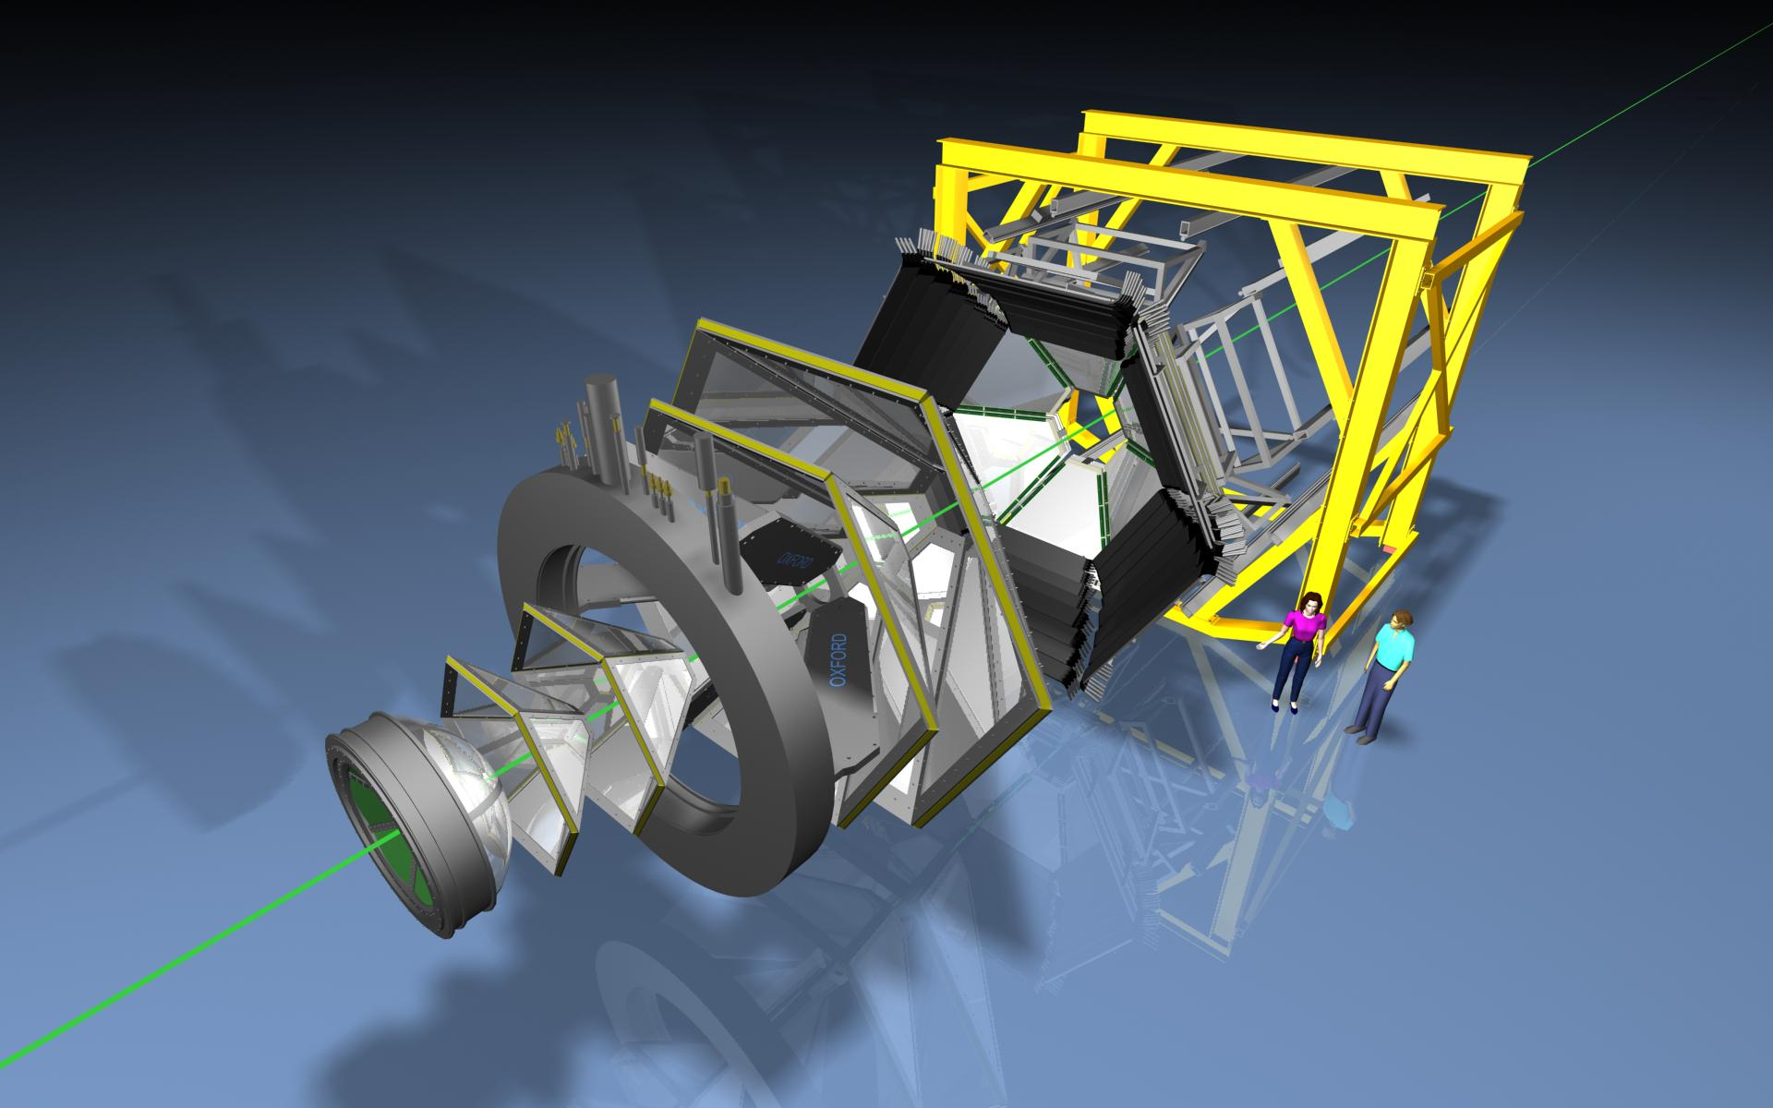
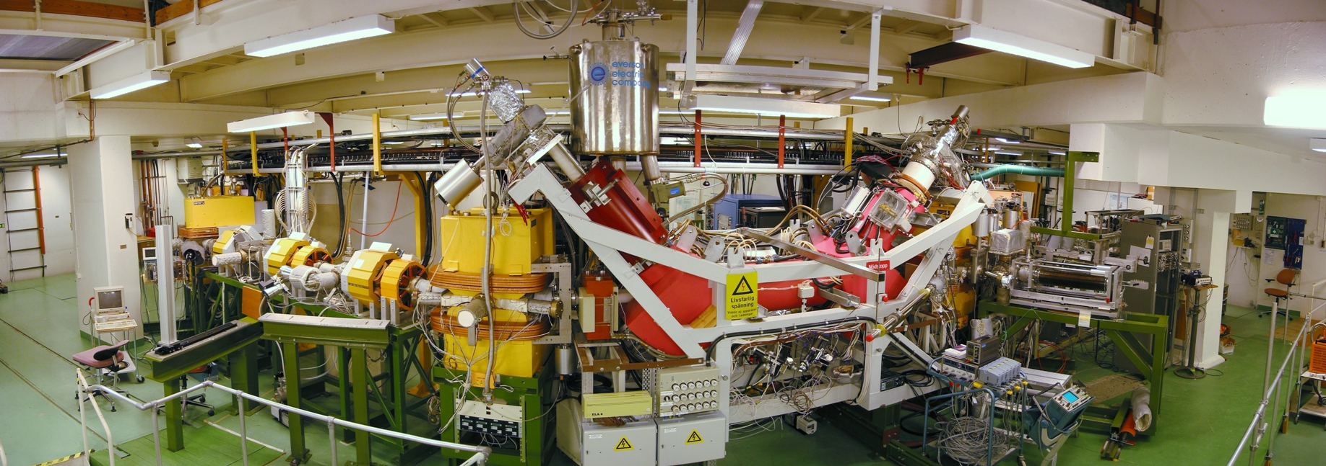
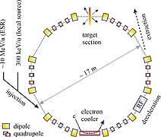
Research@GSI
CRYRING can store, cool and decelerate heavy, highly charged ions down to a few 100 keV/nucleon. It features excellent vacuum conditions to achieve ion beam lifetimes of several seconds to minutes for even the highest charge states of ions. It is equipped with a high performance electron cooler in combination with a gas jet target. Moreover, an independent injector beamline will allow for standalone operation during commissioning and prototyping while the FAIR accelerators are unavailable.
High Acceptance Spectrometer
The specrometer is divided into 6 sectors surrounding the beam axis covering large angular acceptance between 16 and 88 degrees. HADES is comprised of the following components: A diamond START detector, a Ring Imaging Cherenkov (RICH), four sets of Multiwire Drift Chambers (MDC), a superconducting toroidal magnet and a multiplicity/electron trigger array consisting of granular pre-shower detectors at forward angles and two time of flight walls: a scintillator based time-of-flight wall (TOF) and the RPC wall built from resisitive plate chambers.

Slide 8
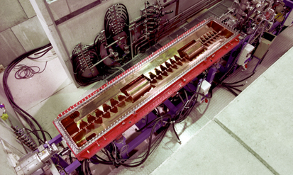
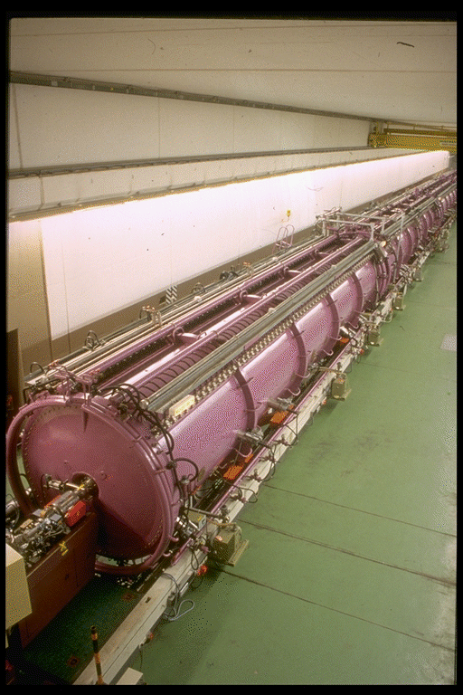
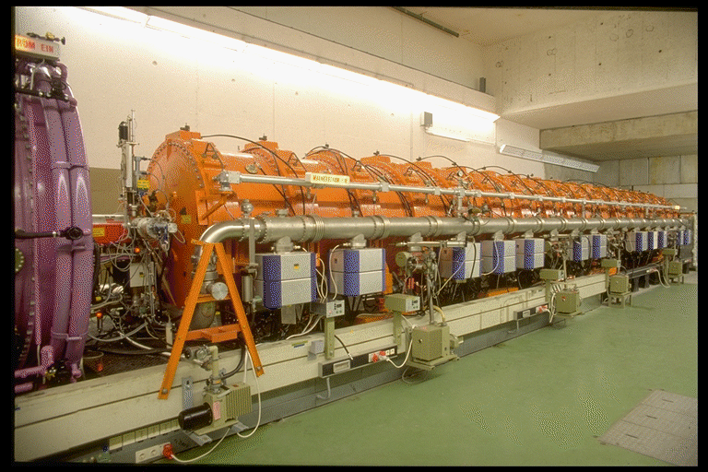
The GSI UNIversal Linear ACcelerator
High Charge State Injector (1991)
High Current Injector (1999)
Alvarez (1975)
Single Gap Resonators (1975)
W. Barth, WAO 2014, Mainz/Germany
31.10.14

Slide 9
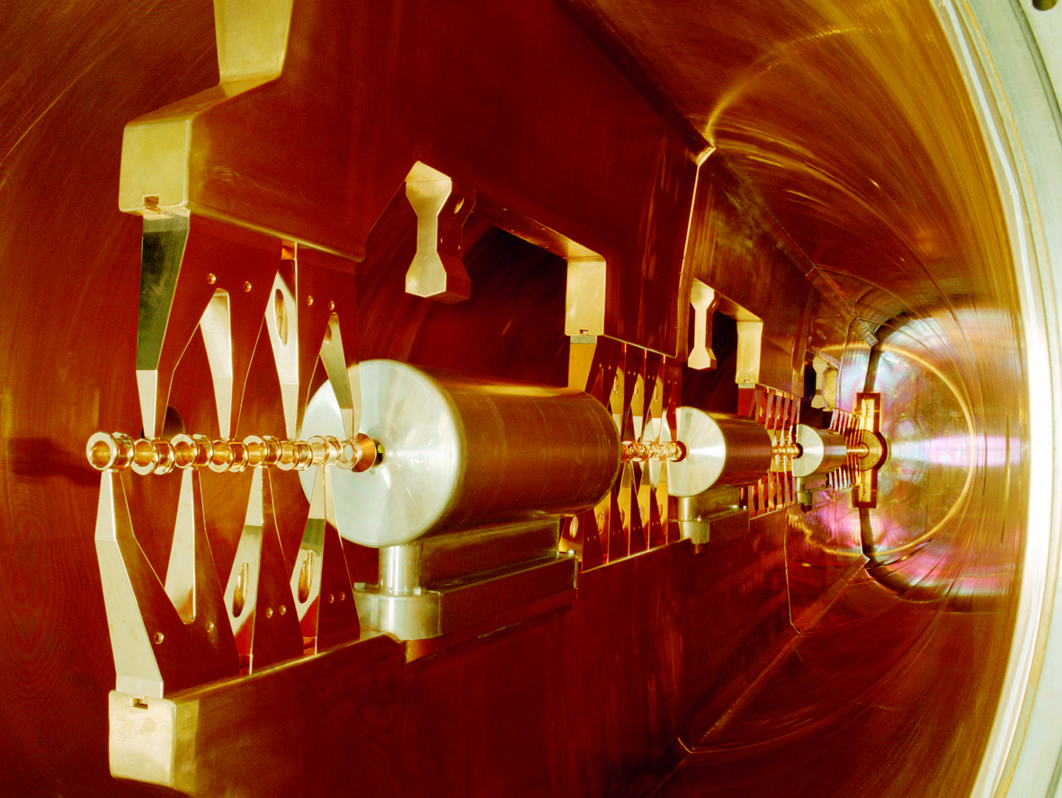
GSI-Interdigital H-Mode Structure

Slide 10
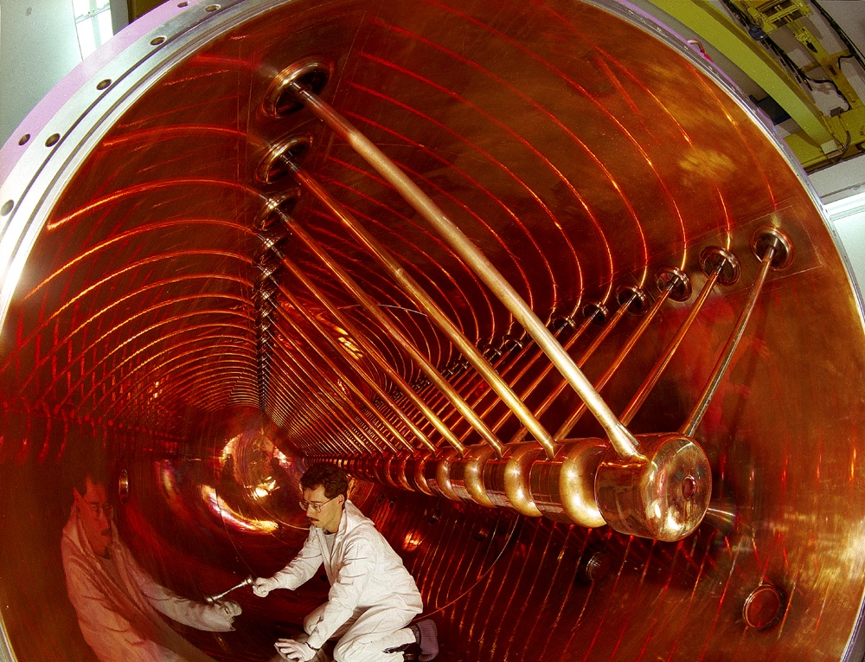
Welcome at GSI and enjoy Your visit...
W. Barth, Injector Upgrade for FAIR, ICST, Worms/Germany
15.10.14

