Slide 1
Operation of GSI and FAIR
David Ondreka
WAO 2014, Mainz, 31.10.2014

Slide 2
Overview
GSI
Facility
Operation
FAIR
Project
Facility
Operation
Outlook

Slide 3
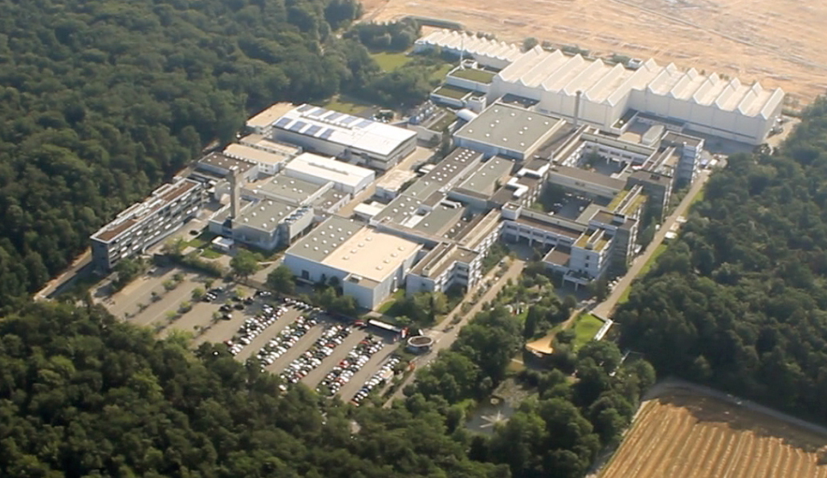
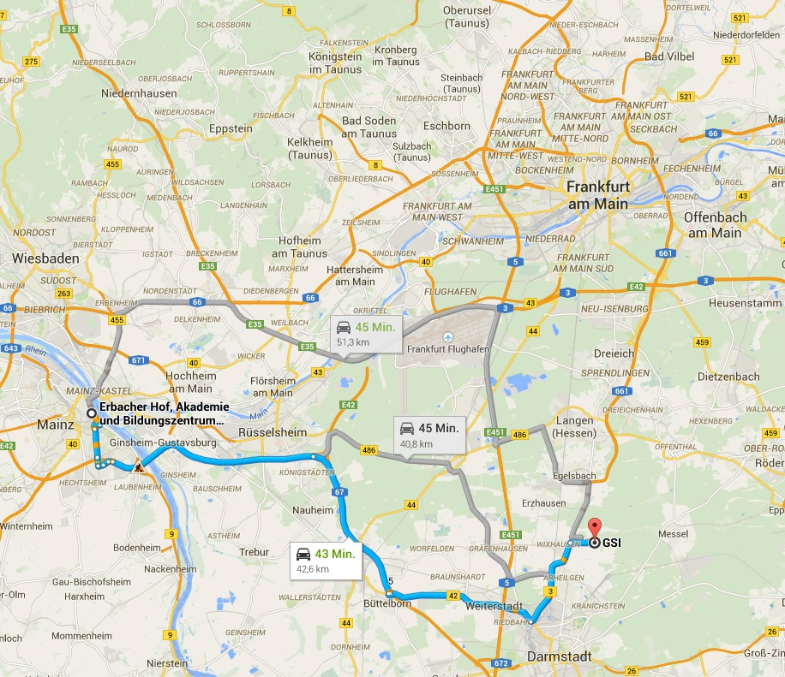
GSI Helmholtzzentrum für Schwerionenforschung GmbH
Your route to GSI...
Facility for research with heavy ions
Scientific program:
Atomic and Plasma Physics
Nuclear and Hadron Physics
Material Sciences

Slide 4
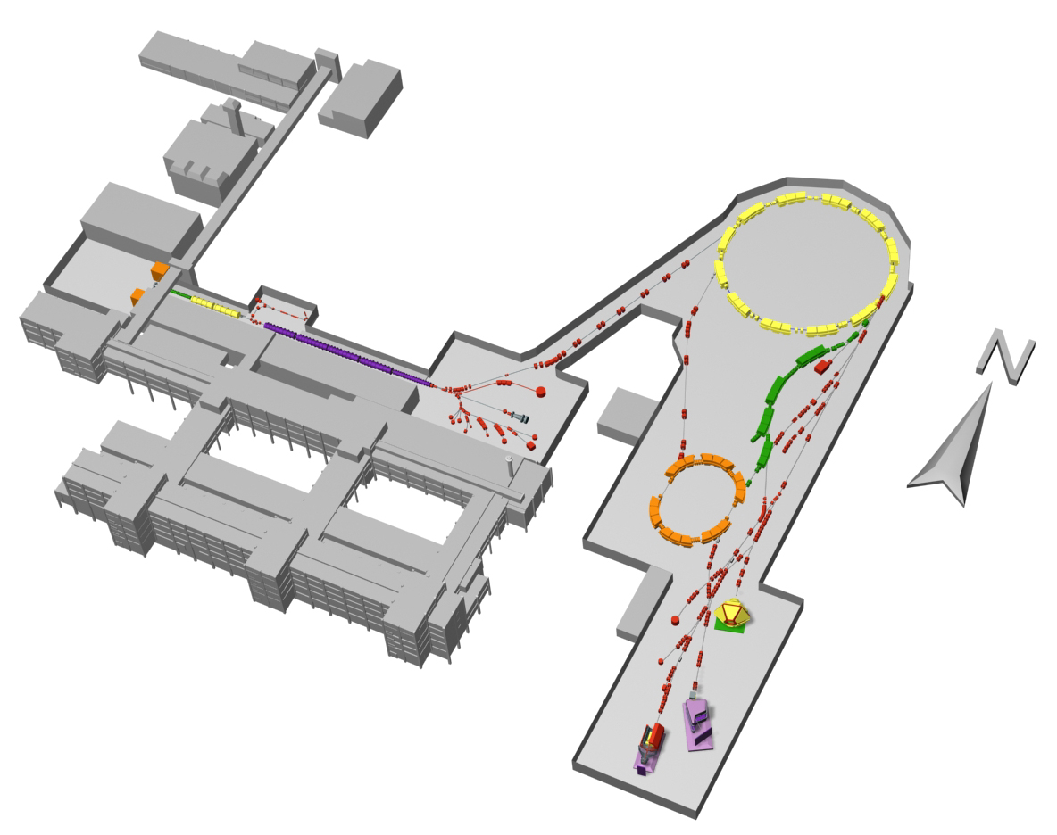
GSI Accelerator Complex
Ion Sources
ECRIS | Gases
MUCIS
CHORDIS
PIG | Gases Metals
MEVVA | Metals
VARIS
UNILAC
Low energy beams
3.6 – 11.4 MeV/u
Pulse length 0.1 – 5 ms
Rep. rate 50 Hz
SIS18
High energy beams
Slow extraction (≤10s)
Fast extraction (1 turn)
Bunch compression
Rep. rate 0.1 – 1 Hz
Ion Sources
SIS18
UNILAC
Max. Energies
p | 4.5 GeV/u
Ne¹⁰⁺ | 2.0 GeV/u
U⁷³⁺ | 1.0 GeV/u
U²⁸⁺ | 0.2 GeV/u
ESR
Max. Intensities
p | 10¹¹
Ne¹⁰⁺ | 5·10¹⁰
U⁷³⁺ | 3·10⁹
U²⁸⁺ | 3·10¹⁰
ESR
Energy 800 – 3 MeV/u
Electron cooling
Stochastic cooling
Deceleration
Single particle detection
Experimental Areas (~20)

Slide 5
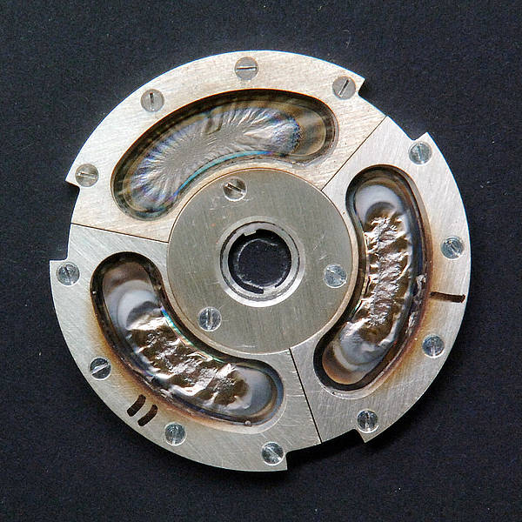
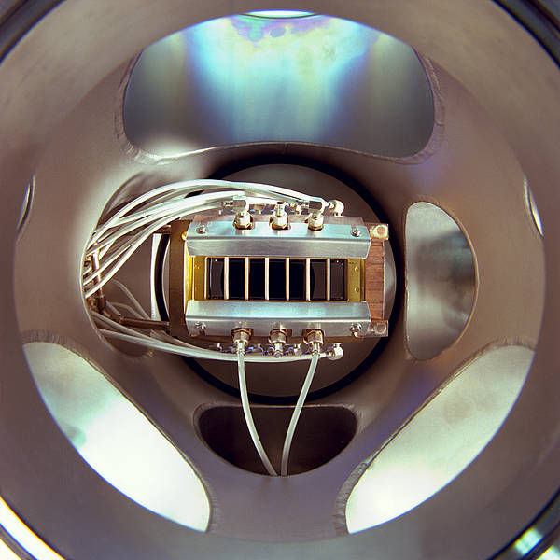
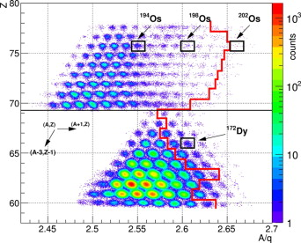
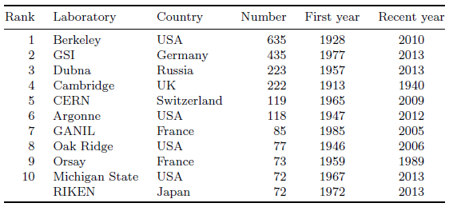
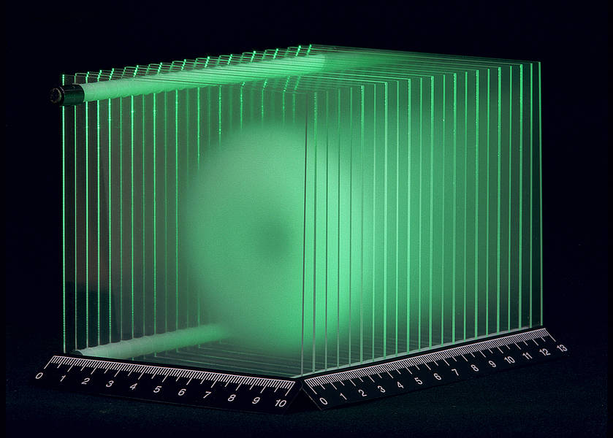
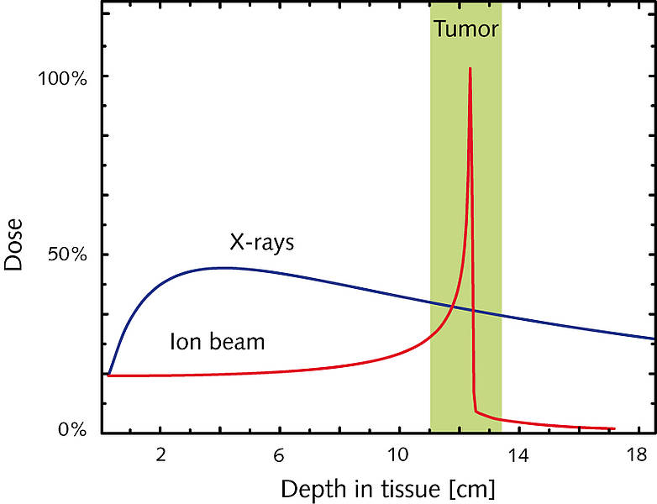
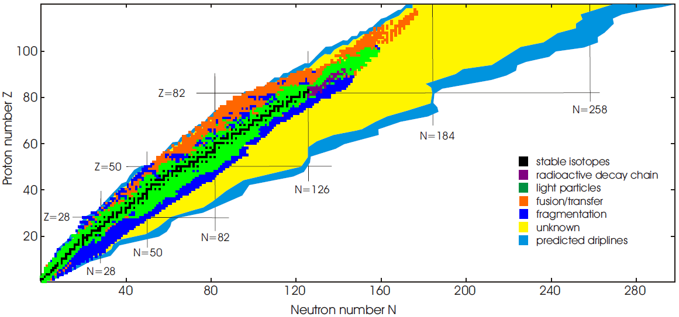
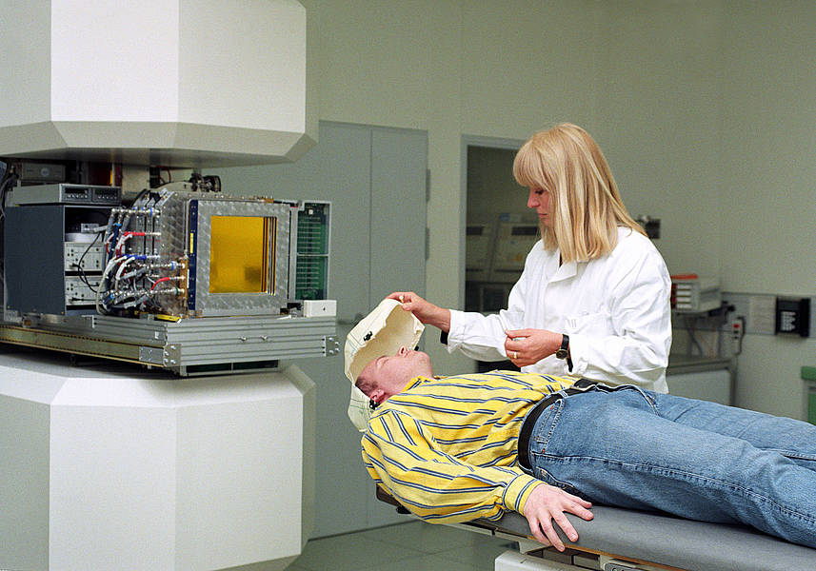
GSI Scientific Highlights
Super Heavy Elements
₁₀₇Bh
₁₀₈Hs
₁₀₉Mt
₁₁₀Ds
₁₁₁Rg
₁₁₂Cp
Exotic Nuclei
SIS18
UNILAC
SHE
FRS
Ion Radiotherapy
ESR
Cave M

Slide 6
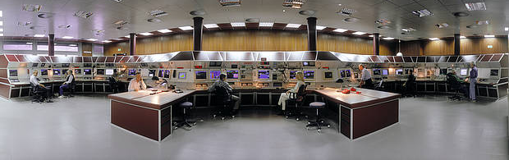
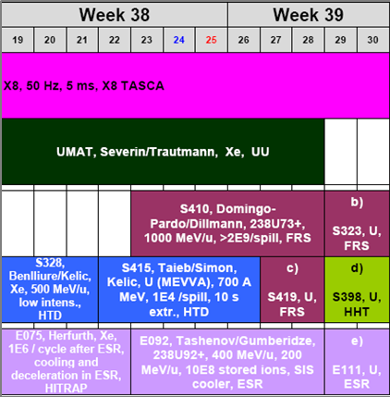
GSI Operation
GSI operating conditions
Operation 24/7
1 shift leader + 2 operators
Support by physicists for set-up
On-call duty for technical problems
Parallel operation
UNILAC, SIS18, ESR independent
3 different ion species
5 parallel experiments
Experiments demand high flexibility
General beam time coordination
Switching of ion species (weekly)
Adjustment of schedule (monthly)
Daily coordination in noon meeting
Variation of beam parameters (E, N, T)
Change of beam sharing
GSI main control room
Typical GSI beam time plan
UNILAC
SIS18
ESR
Parallel Operation in the GSI facility
Success of GSI as research institute is highly linked to this flexible operation!
Unilac
SIS18
ESR

Slide 7
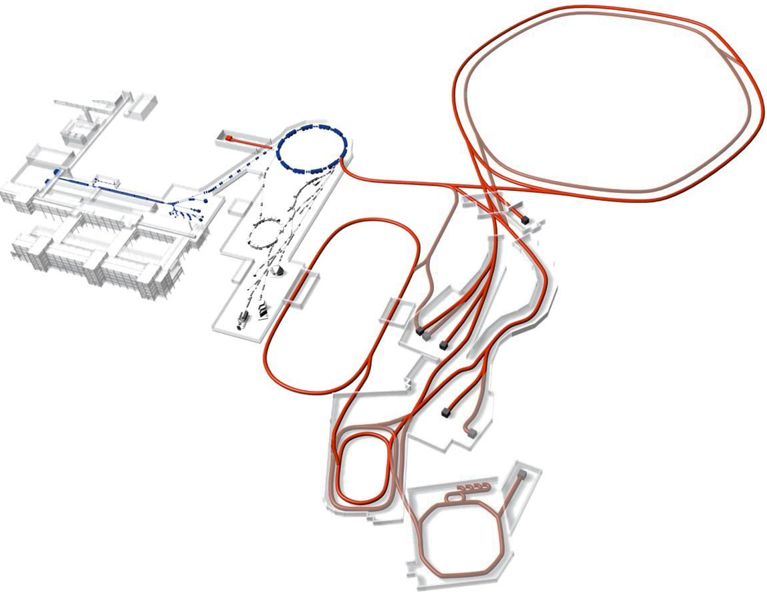
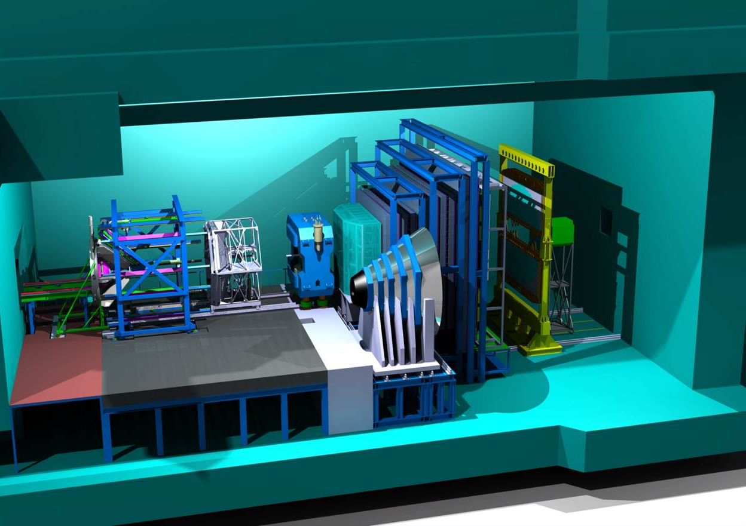
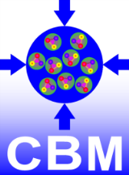
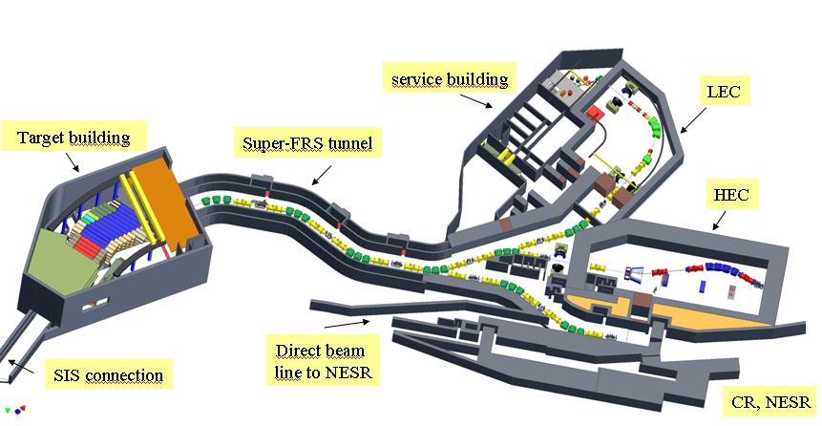
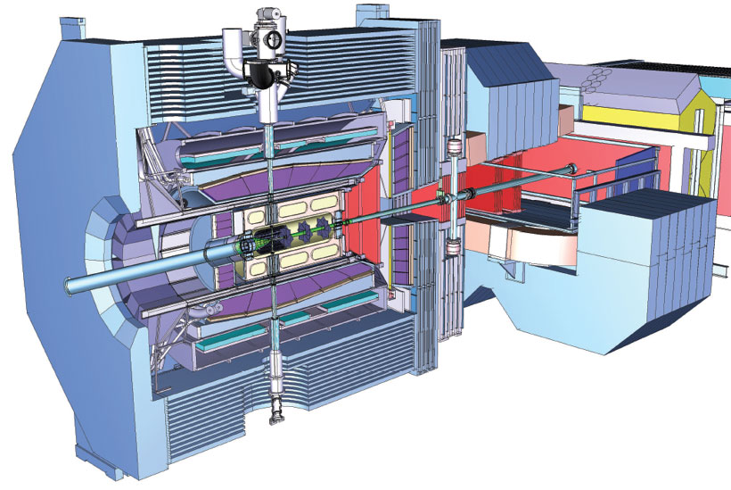
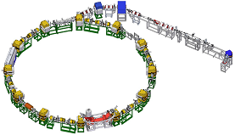
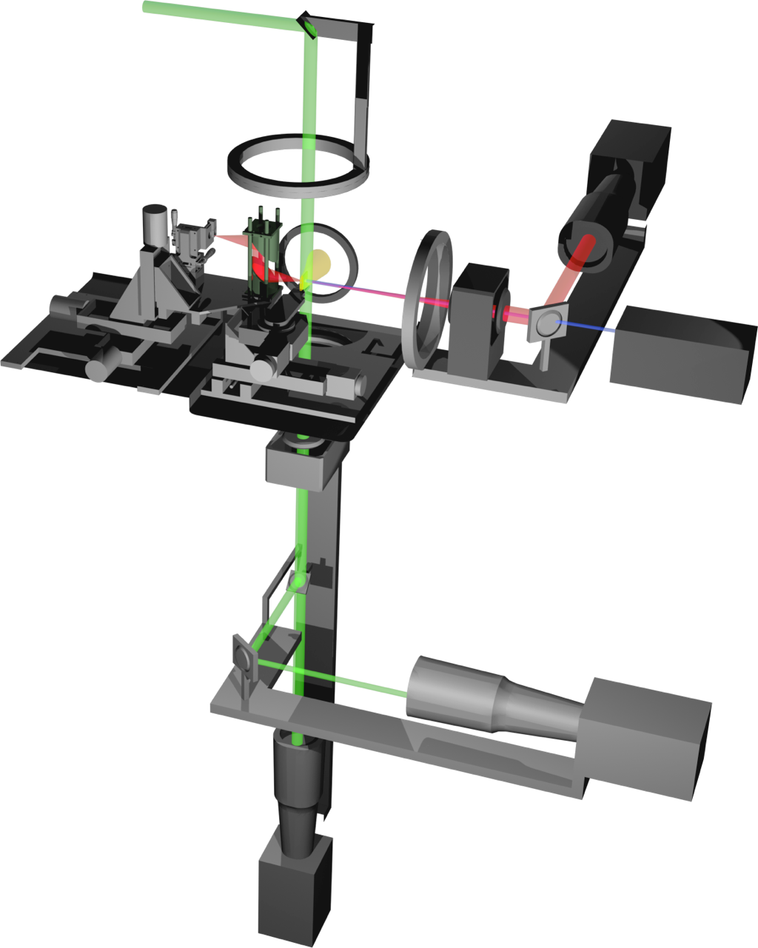
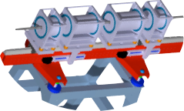
Facility for Antiproton and Ion Research
Nuclear Matter and Hadrons
Scientific Motivation:
Continuation and extension of GSI’s heavy ion research program
Breaking limits of GSI
Primary beam intensities: 100x
Secondary beam intensities: 10000x
Primary beam energies: 10x
Production of Antiprotons
High brilliance through cooling
Scientific questions
Properties of ‘cosmic matter’
Matter in the early universe
Origin of hadron masses
Origin of the chemical elements
Matter under extreme conditions
Nuclear Structure
Atomic/Plasma/Applied Physics
More information: www.fair-center.eu
Strong Interactions

Slide 8
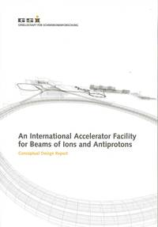
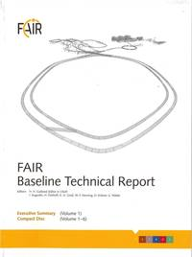
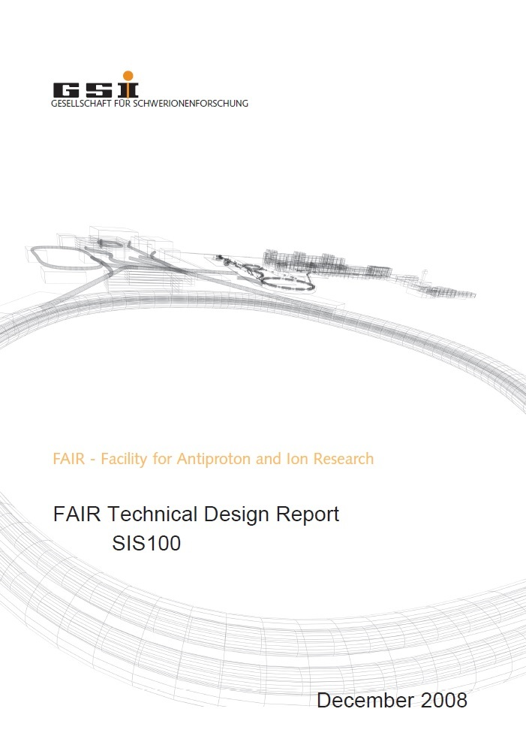
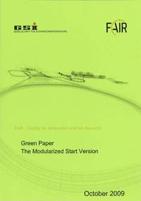
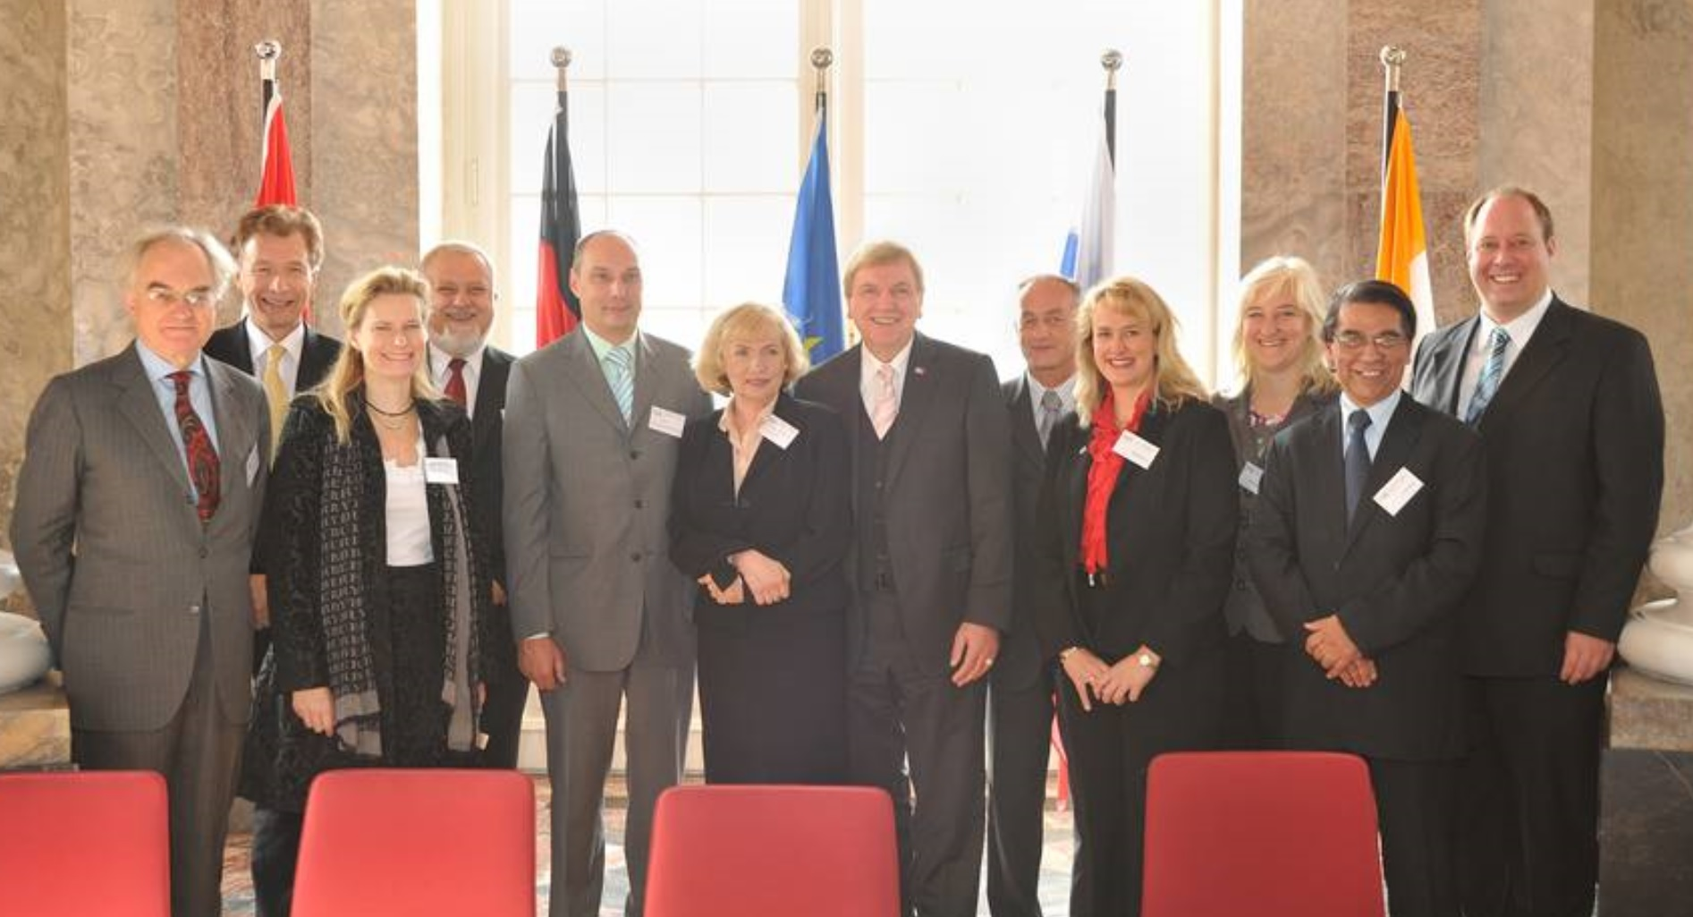
FAIR Project Milestones
2001
FAIR Conceptual Design Report | 11 / 2001
BMBF approval of FAIR | 02 / 2003
Baseline Technical Report | 03 / 2006
Official start of FAIR project | 7.11.2007
Technical Design Report | 12 / 2008
Signing of FAIR convention | 4.10.2010
Foundation of FAIR GmbH | 4.10.2010
Granting of project funds | 6.11.2011
Start site clearance | 12 / 2011
Start Procurement Accelerator | 01 / 2012
Radiation protection permit | 12.06.2012
Construction permit | 29.10.2012
Start pile construction work | 03 / 2013
End pile construction work | 05 / 2014
2014
Start SIS18 upgrade | 11 / 2014
Start construction work | 2016
SIS18 re-commissioning | 2017
FAIR buildings completed | 2019
FAIR accelerators installed | 2019
FAIR facility operational | 2020
2020

Slide 9
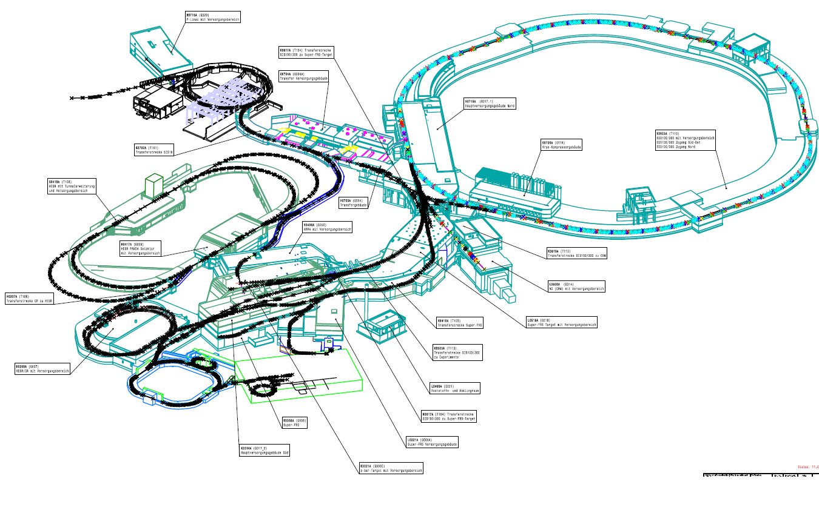
FAIR Facility
p-Linac
SIS100
from Unilac
SIS18
SIS300
HESR
PANDA
RIB
CBM
APPA
SIS100
Primary beams
Slow extraction (1 – 100s)
Fast extraction (1 turn)
Bunch compression
Rep. rate 0.01 – 2 Hz
pbar
SFRS
RESR
CR
NESR
FLAIR
SIS100 beam parameters
 | E_{max} | N_{max}
p | 29 GeV/u | 2.5·10¹³
U⁷³⁺ | 10 GeV/u | 1.0·10¹⁰
U²⁸⁺ | 2.7 GeV/u | 5.0·10¹¹

Slide 10
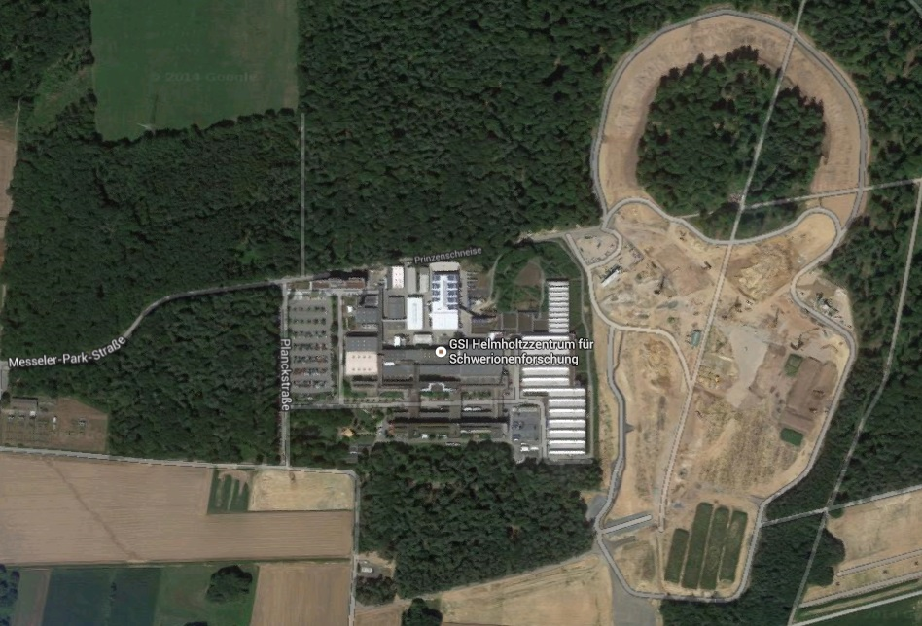
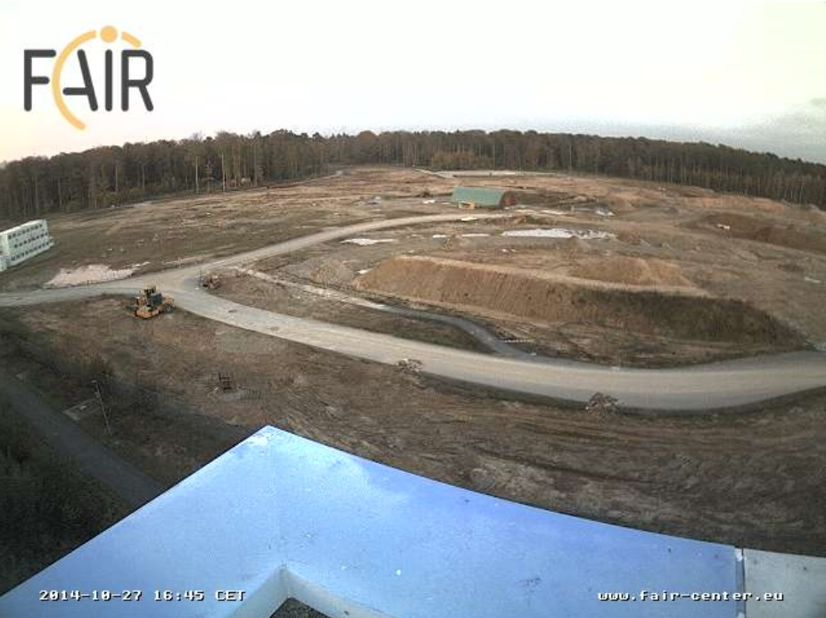
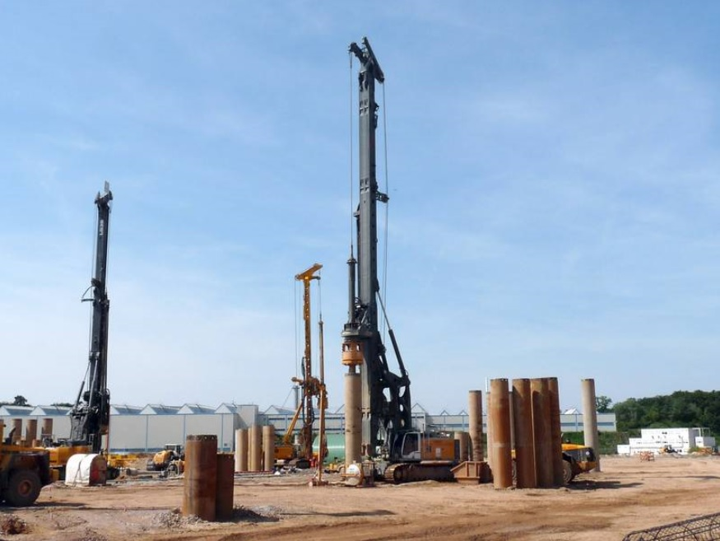
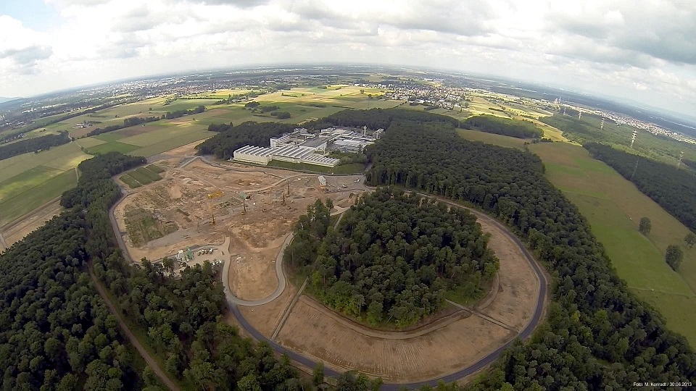
FAIR Site: Construction Work
google.maps
Construction site cleared
Access road constructed
1400 concrete piles implanted
Stabilization of ground
Minimization of settlement
FAIR Webcam
quadcopter

Slide 11
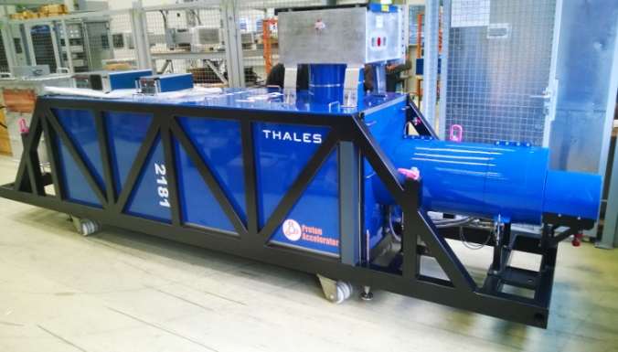
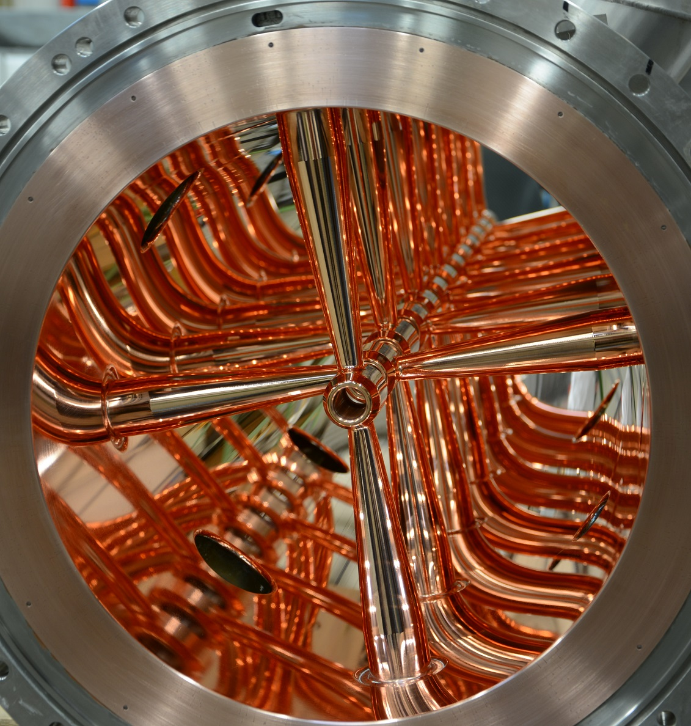
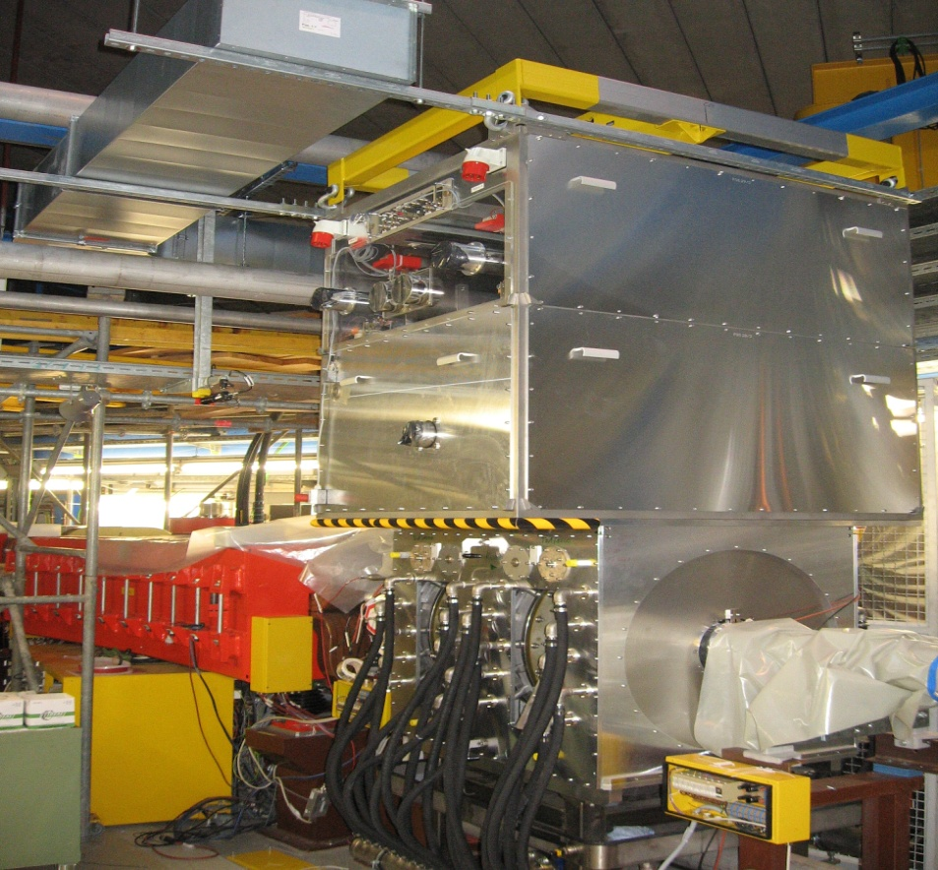
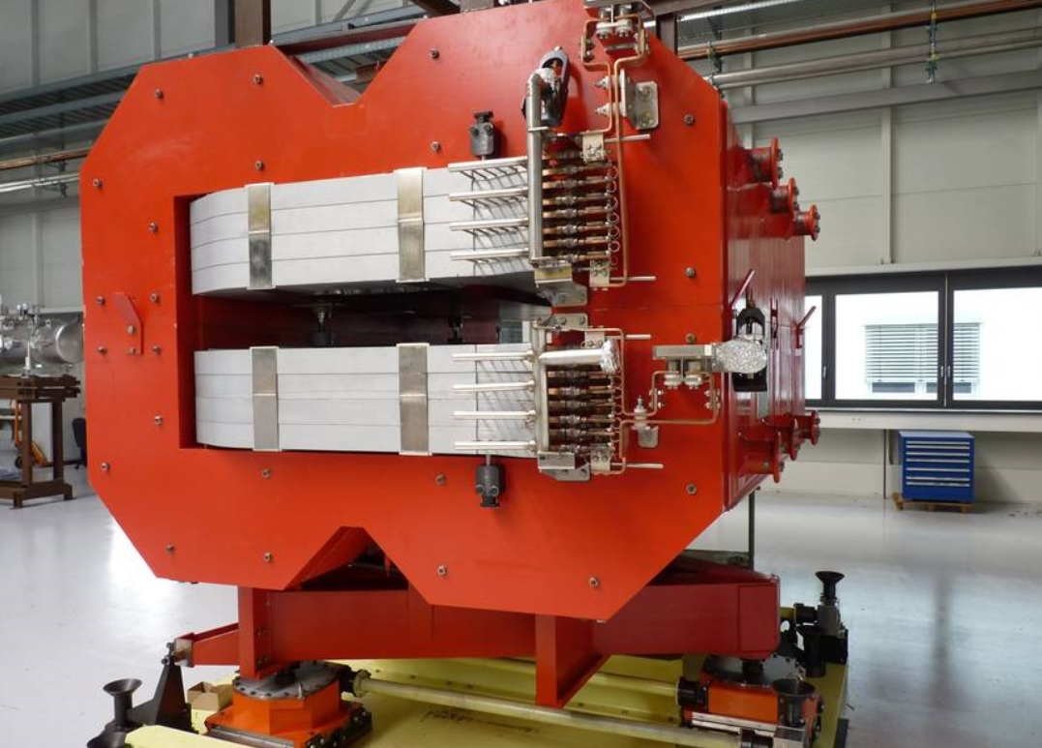
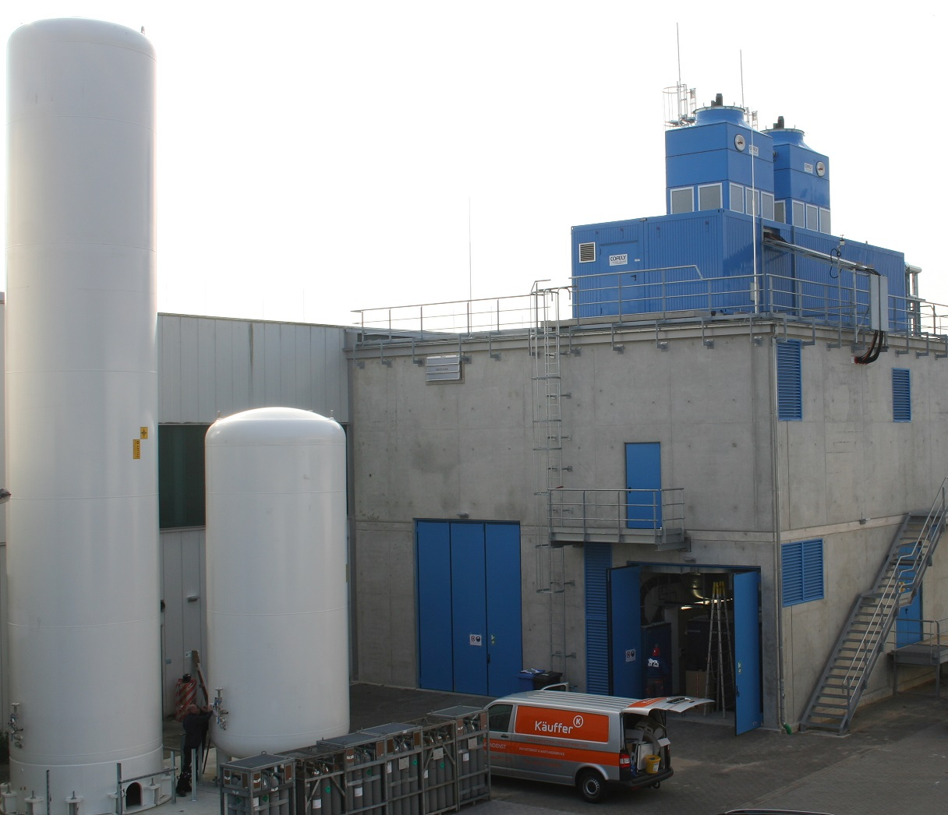
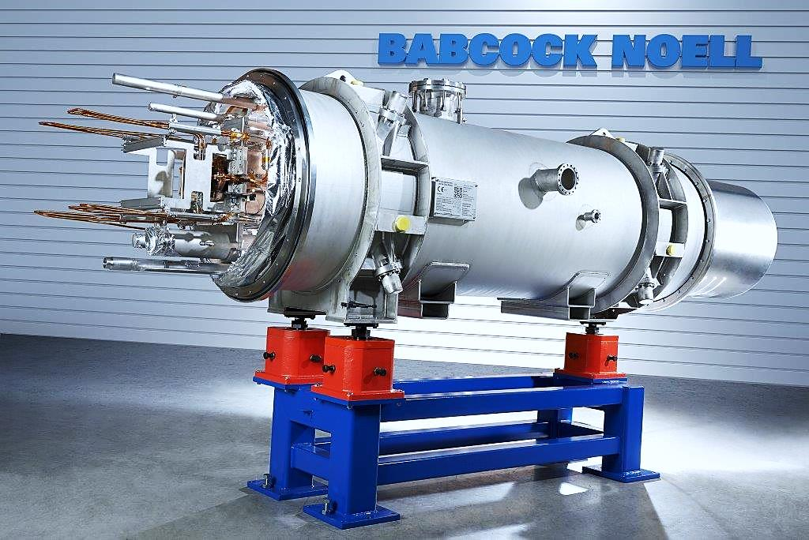
FAIR Procurement Status
p-Linac CH Cavity
Procurement of FAIR components
Several large series started
SIS100 dipoles and RF cavities
HEBT dipoles and quadrupoles
Many pre-series components under testing
Many components to be ordered next year
Bulk will arrive from 2016 on
Consistent with project schedule
Upgrade program for GSI accelerators
SIS18 and UNILAC upgrade programs for FAIR injector mode
Upgrades started, to be completed in 2017
GSI campus infrastructure
Testing areas for site acceptance tests
Cryogenic magnet testing facilities
Prototype test facility for SIS100 dipoles
Serial test facility for SIS100 dipoles and string tests
p-Linac Klystron
Super-FRS Dipole
SIS18 H=2 Cavity
SIS100 Dipole
Serial test facility

Slide 12
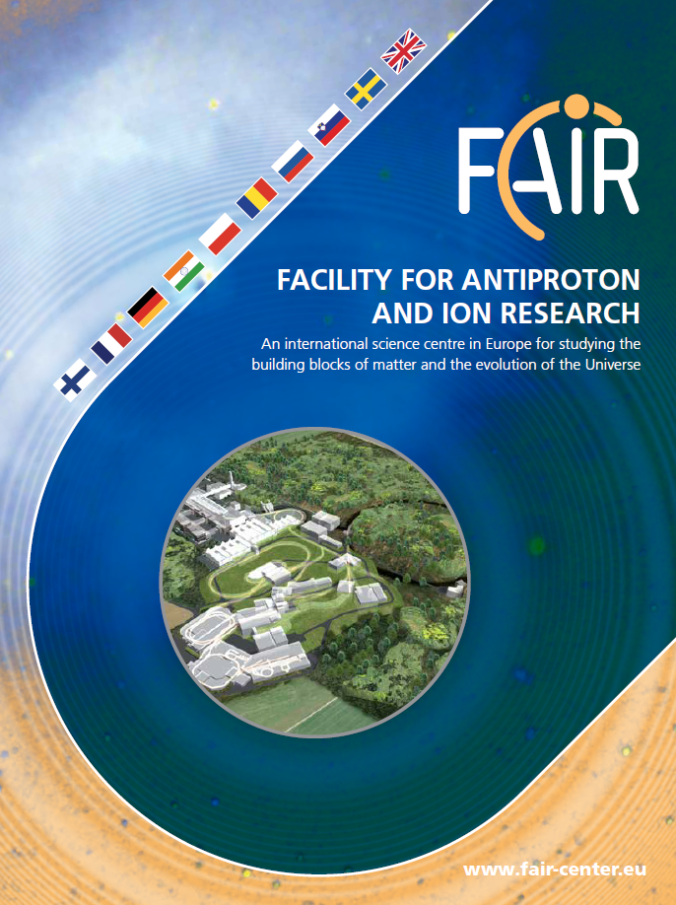
FAIR Operation
Goal: Maximal scientific use
Maximization of beam on target through parallel execution of experiments in FAIR
Requires sophisticated coordination of the various accelerators and transfer lines
Boundary conditions
Similar flexibility requirements as for GSI
Longer beam times for main experiments (statistics, polarity changes)
Still shorter beam times for tests
GSI operation will continue
Operation of GSI/FAIR by 5 operators
4 beam operators, 1 cryo operator
Basis for operating cost estimates
Only two additional operators for FAIR
Requires very good support from the operating environment
Details specified in operating concept
Presently being worked out
“The operation of FAIR will be uniquely versatile in that up to five research programmes with five different particle beams can be carried out at the same time. This will be achieved by coordinating beam operation in both the synchrotrons and adjacent storage and accelerator rings. In this way, each experiment can make maximum use of the highest available beam intensity.”

Slide 13
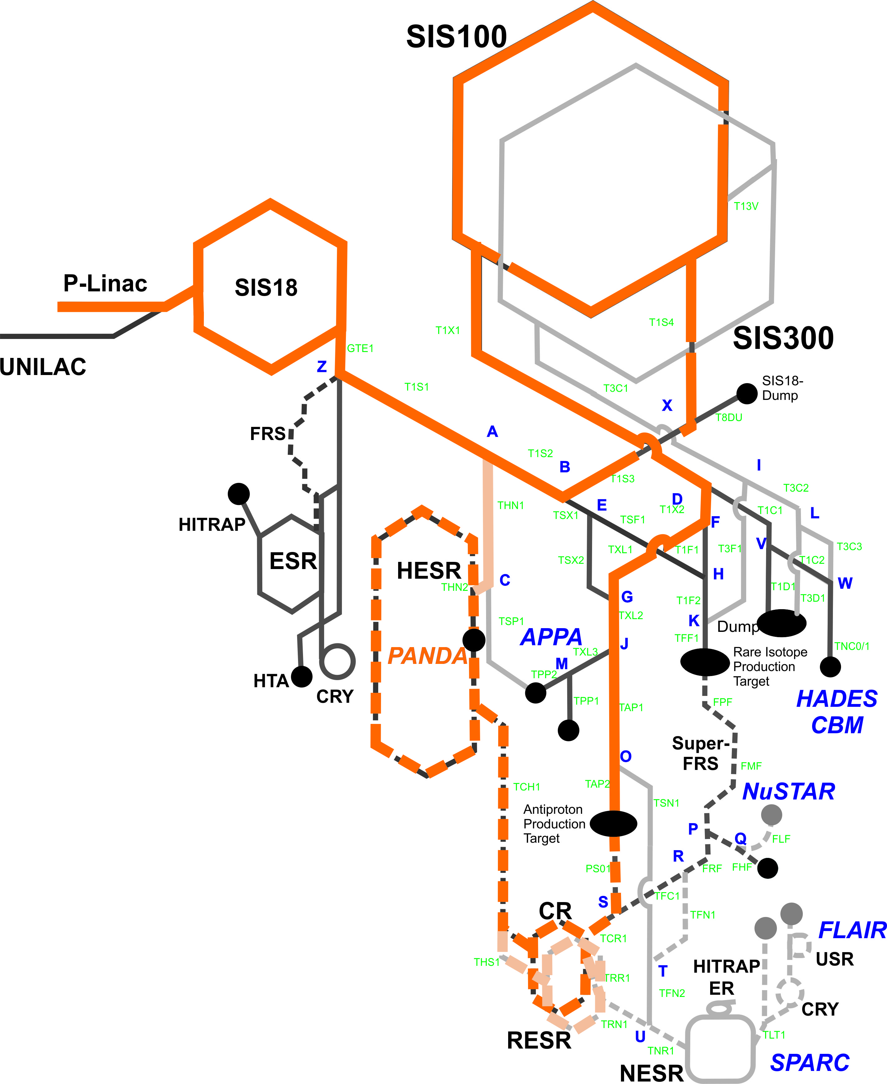
FAIR Operation: pbar Chain
Beam production
p-Linac: 10¹³ p, 70 MeV/u
SIS18: 6·10¹² p, 4 GeV/u, 2.7 Hz
SIS100
4 Injections from SIS18: 2·10¹³ p
Acceleration to 29 GeV/u
pbar-Target
Production of pbar
Conversion efficiency ~10⁻⁵
CR
Stochastic cooling of pbar ~10s
HESR
Accumulation (~10¹⁰ pbar, ~15 min)
Acceleration to 14 GeV/u
Physics experiments ~15 min
Natural gaps to be filled
10 s cooling time in CR
15 min physics time in HESR

Slide 14
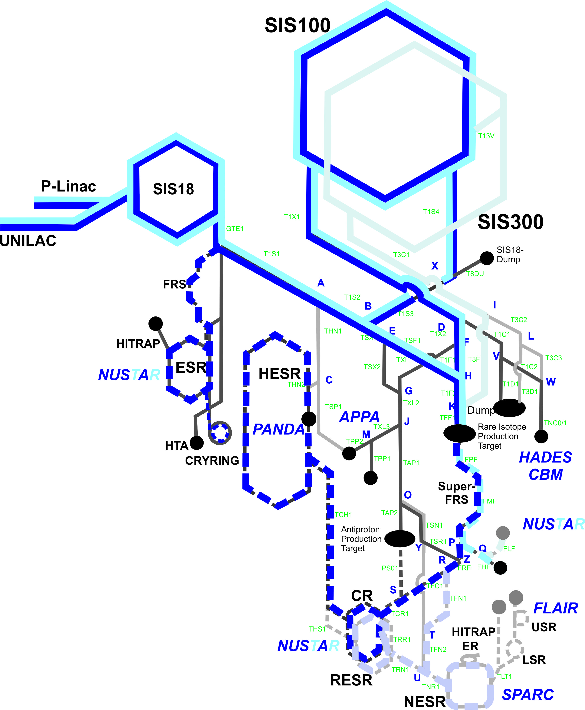
FAIR Operation: RIB Chain (fixed target)
Beam production
Unilac: 2.5·10¹¹ U²⁸⁺, 11.4 MeV/u
SIS18: 1.5·10¹¹ U²⁸⁺, 200 MeV/u, 2.7 Hz
SIS100
4 Injections from SIS18: 5·10¹² U²⁸⁺
Acceleration to 1.5 GeV/u
Slow extraction
SFRS
Target: Production of secondaries
Separator: Selection of goal RIB
Caves: Physics experiments
Leaves gaps for SIS18
Duration depending on extraction time
May be used for beam in GSI TH or ESR

Slide 15
FAIR Operation: pbar/RIB and RIB
pbar production will run over long times due to small conversion efficiency
In MSV, 15 min accumulation followed by 15 min physics
Possible szenario
HESR accumulation: Run RIB during CR cooling time
HESR physics: Run RIB stand-alone
Gaps in SIS18 may also be filled
Short gaps: beam for ESR/CRYRING
Long gaps: slow extraction to GSI TH
Control system requirements
Patterns integral concept of the FAIR CS
Automatic switching between two patterns based on beam request by HESR
FAIR CS must allow simultaneous tuning
Control room architecture
Control system design

Slide 16
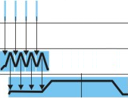
FAIR Operation: Beam Set-up Procedures
Set-up of the pbar/RIB pattern
Initialize complete pattern (no beam)
Switch to set-up pattern for main proton beam
Tune proton beam successively on set-up dumps up to highest intensity
Tune beamlines to target
Add RIB chain, tune similarly
In parallel, set-up CR and HESR
Challenges
Possible influence of RIB on pbar (hysteresis)
Destructive BI for tuning RIB extraction
Parallel exp. may change frequently: How to avoid disruption of pbar chain?
Requirements on CS for patterns:
Creation of patterns from beam time plan
Creation of set-up patterns from real pattern
Execution of set-up procedures

Slide 17
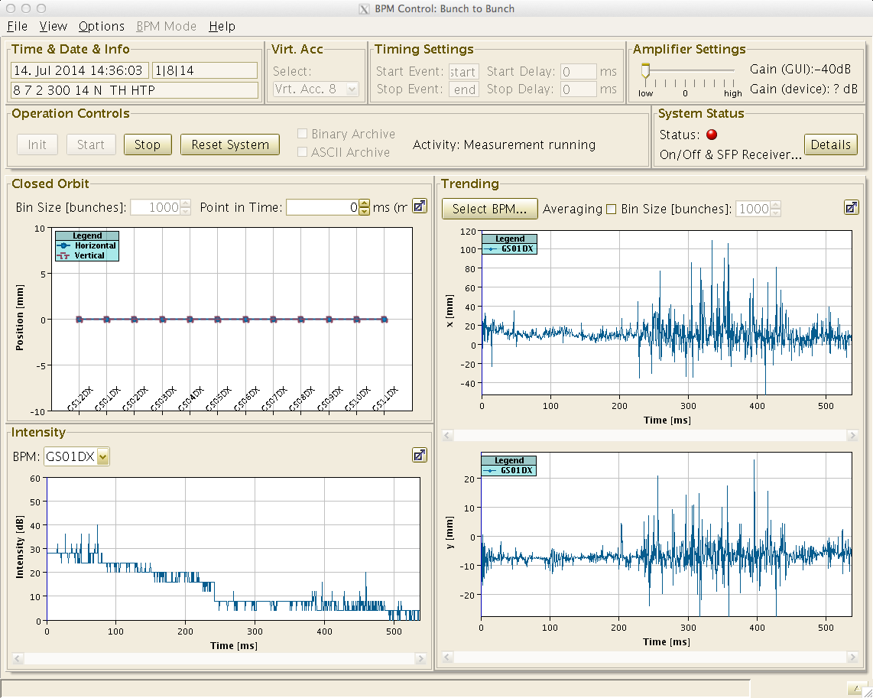
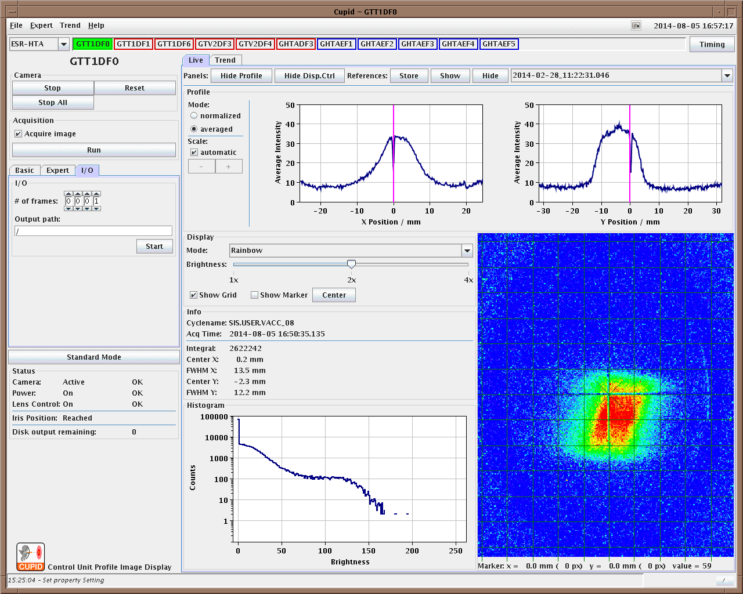
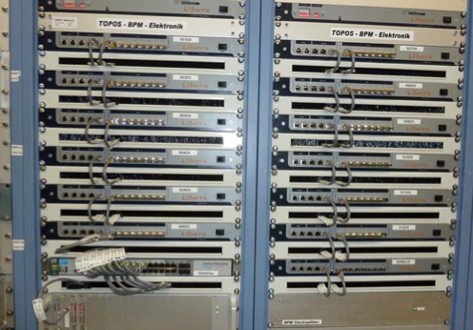
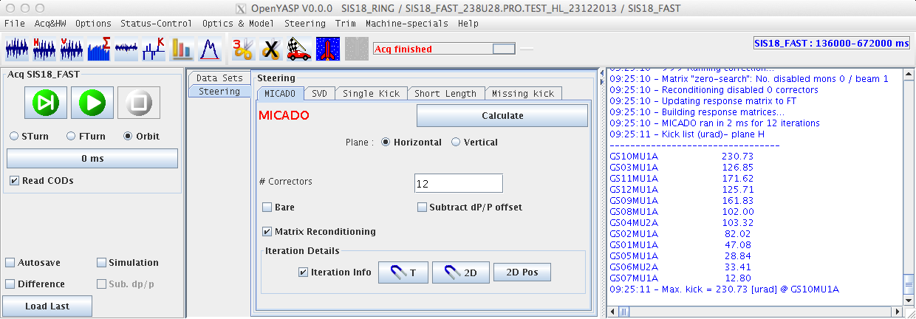
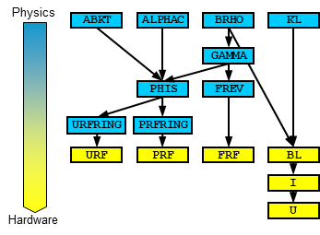
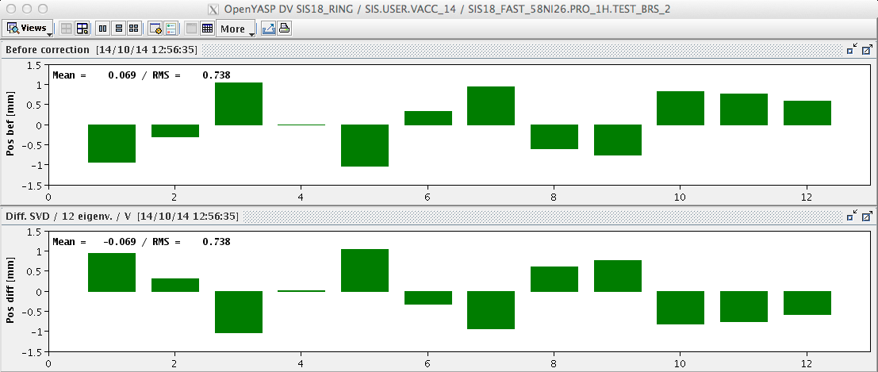
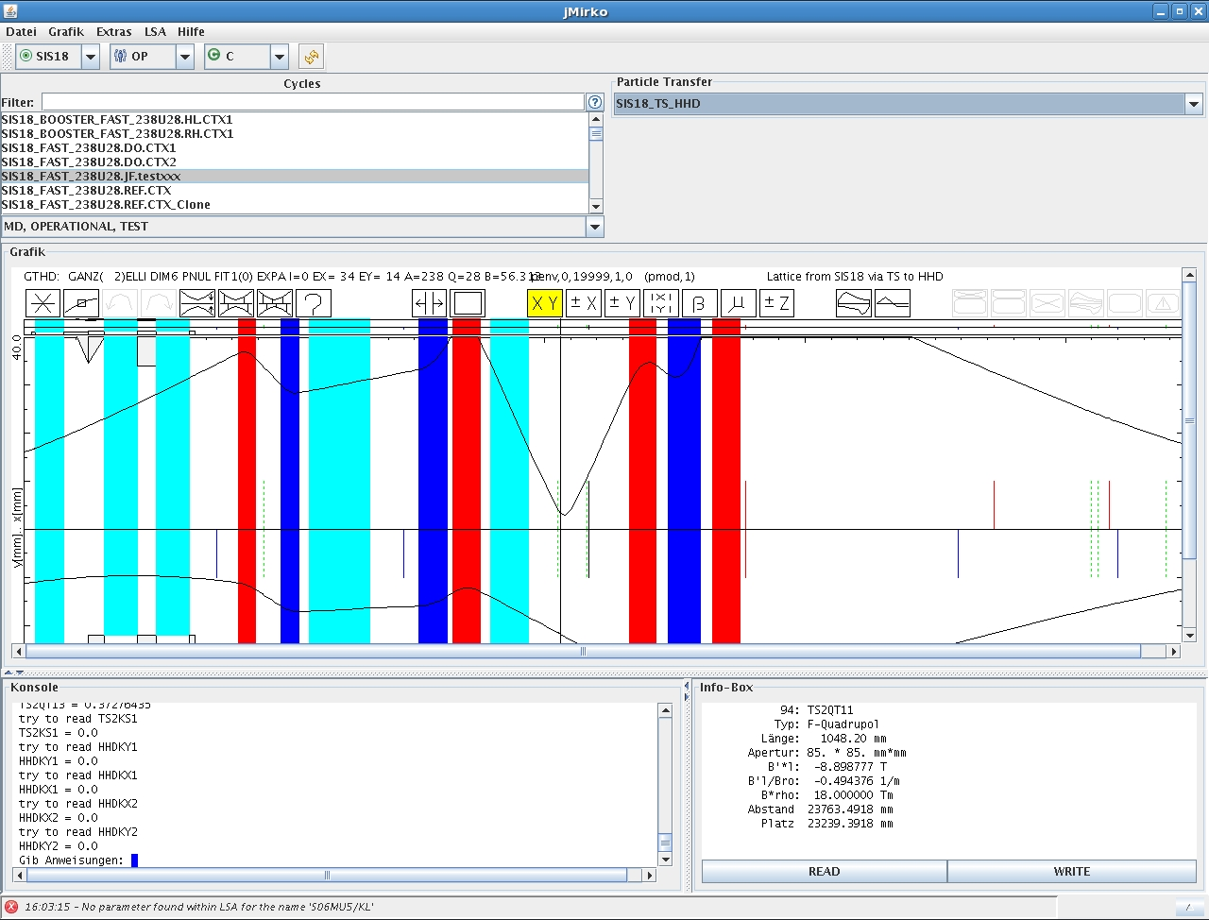
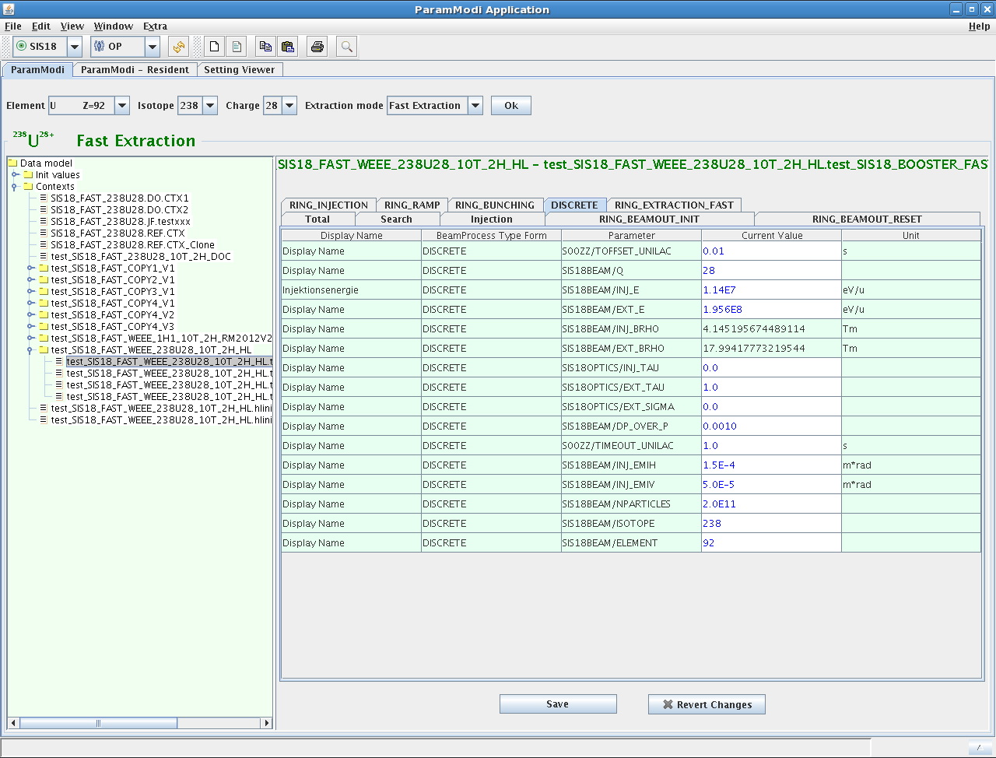
FAIR Control System: Developments
Control system for FAIR
Completely new design
Collaboration with CERN
FESA framework for front-ends
LSA framework for settings management
Timing system (White Rabbit)
User Interfaces
Prototype systems at SIS18
BI: BPMs, Screens
Routine use for orbit correction and steering
Settings: machine model, applications
Commissioning H=2 cavity
Resonance compensation
Operational at CRYRING (2015)
Prototype of FAIR control system
FESA front-ends for
Magnet PCs, RF, HV, RFQ
BPMs, Trafos, Screens, Cups, Grids
Operating applications
Test bench for FAIR operation concepts
TOPOS (SIS18 BPM system)
CUPID (Scintillating screens)
YASP (Orbit control)
SIS18 Hierarchy (Machine model)
jMirko (Online optics)
ParamModi (Settings)

Slide 18
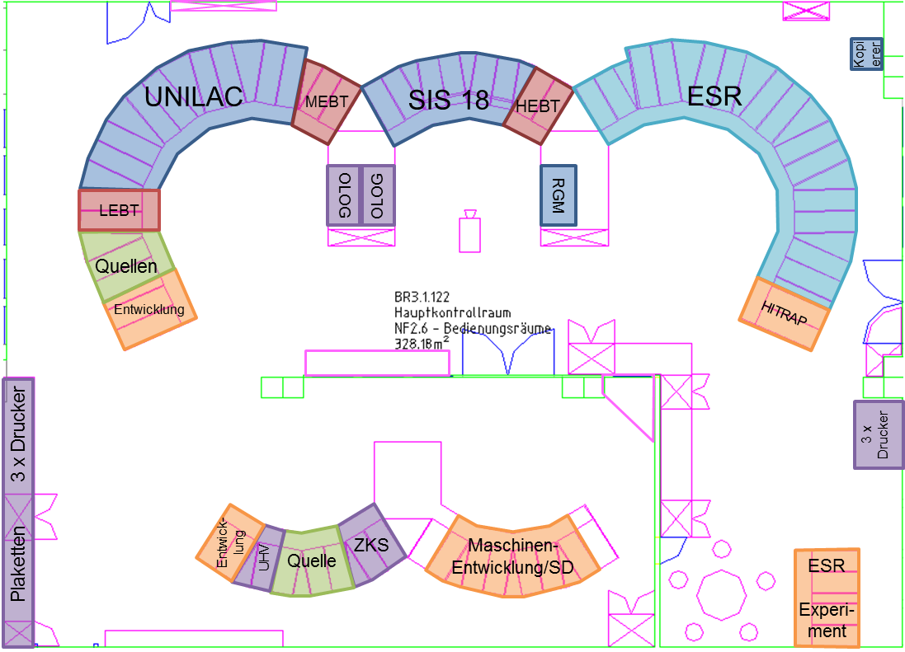
Operation of FAIR: New Main Control Room
New main control room required
More space needed for additional machines and infrastructure (e.g. cryo)
Central console for survey, monitoring, and administrative purposes
Console arrangement to support parallel tuning of independent beams
Acoustic separation of areas
Daylight conditions
Modern, ergonomic equipment
Additional requirements
Integration of meeting room
Representative architecture
Test console
GSI main control room
FAIR main control room (DRAFT)
Details will be worked out by project group “FAIR main control room” based on operating concept

Slide 19
Outlook
Roadmap for operation of GSI and FAIR
GSI
Upgrade measures
Shielding reinforcement
Align- ment
Re- comm.
Physics operation in GSI
Injector comm.
FAIR physics operation
CRYRING commissioning
CRYRING stand-alone operation
FAIR
FAIR civil construction
FAIR accelerator installation
FAIR accelerator comm.
FAIR physics operation
2015
2016
2017
2018
2019
2020
These are exciting times, so stay tuned!

Slide 20
Acknowledgments
Thanks to the colleagues providing material:
P. Kowina, C. Omet, B. Schlei, P. Schütt, P. Schwab, P. Spiller C. Sturm, D. Varentsov, B. Walasek-Höhne, W. Vinzenz
Thanks to all colleagues of FAIR@GSI sharing the big work load of converting the FAIR idea into reality!
Thank you for your attention!

