Slide 1
Dissolved Gas-in-Oil Analysis for Preventative Maintenance of the Los Alamos Neutron Science Center ( LANSCE) High Voltage Systems
Karen Young and Manuelita Rodriguez
Radio Frequency Engineering Group
Accelerator Operations and Technology Division
Los Alamos National Laboratory
Los Alamos, New Mexico USA

Slide 2
Outline
Background
High Voltage Power Supplies for the LANSCE Accelerator
Safety Impacts of a Transformer Failure
Life of a Transformer
Purpose of Analysis
Quantitative and Qualitative Gas Analysis
IEEE standard for dissolved gasses in oil
Quantitative Analysis
Qualitative Analysis
Rate of Rise Analysis
Moisture Analysis
Other Variables to Consider
Results
Summary of Analysis
Rebuild Status
IVR Rebuild History
Conclusion

Slide 3
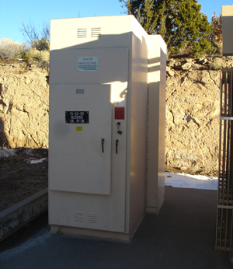
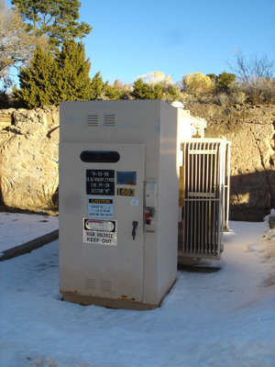
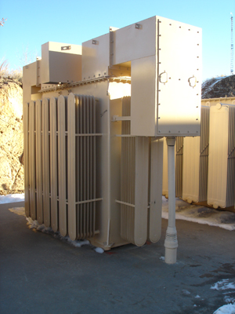
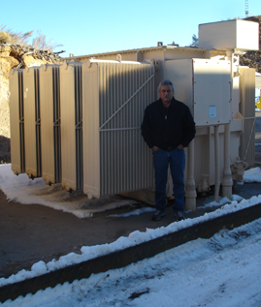
LANSCE High Voltage Power Supply for Radio Frequency (RF) Systems
13.2 KV AC
4160 V AC
Power from Substation
13.2 KV / 4160 V Transformer / Disconnect Switch
Vacuum Breaker Cabinet / Disconnect Switch
Variable output, depending on power required
Up to 90 KV DC
4160 V AC
Power to capacitor room. Each capacitor room feeds 6 to 7 RF systems
Inductrol Voltage Regulator
Transformer / Rectifier

Slide 4
Safety Impacts of a Transformer Failure
Combustible gasses + fuel + spark ➔
Hydrogen, Methane, Acetylene, Ethane, Ethylene, Carbon Monoxide
TRs = 2016 gallons of oil IVRs = 590 gallons of oil
Arcing
We mitigate catastrophic failures by:
Doing annual dissolved gas analysis.
Processing units with increasing gas levels.
Rebuilding units to fix the source of gassing problems.
Taking units out of service if combustible gasses are greater than 10% total gasses.
Catastrophic Failure (not at LANL)

Slide 5
The Life of a Transformer
Transformer failure ➔ Failure of the paper insulating material
Mechanical failures of paper insulation account for 85% of transformer failures.
Paper is weakened by four conditions:
Heat -Operating oil temperatures 8 ˚C above the design temperature (i.e., 95 ˚C at the top of oil and 110 ˚C at hot spots) will half the life of the paper.
Oxygen - Paper with low oxygen (~ 300 ppm) will have 10 times the life time of paper with high oxygen (~ 3000 ppm).
Moisture (Water) - Doubling the percentage of moisture will half the life.
Oxidation Products - Acidity in the oil above 0.05 mg/KOH/g oil from oxidation decay products significantly reduces the strength, thus life, of the paper.
Design Life of Transformers
The design life of large oil filled transformers is typically 25-30 years. After an age of 30 years, the failure probability significantly increases.
The transformers at LANSCE are 45 years old. Older transformers tend to have a longer life because computer codes were not yet available as design tools. Thus, they were designed more conservatively.
➔ Predictive maintenance is critical to keep the units operating reliable.

Slide 6
Purpose – Why do this analysis?
To keep units operating reliably to minimize downtime.
This analysis enables us to do predictive maintenance rather than corrective maintenance.
It costs $60,000 and 3 to 5 days of lost beam time to install and condition a spare unit.
If a good spare is not available, it will take about 9 months to refurbish the unit.
Replacement costs are very expensive:
The cost for a Transformer Rectifier (TR) is about 1 million US dollars (790 Euros)
We cannot buy a replacement Inductrol voltage Regulator (IVR).
The cost to replace the whole power supply would be very expensive because we would also have to replace the capacitor room and crowbar (fault protection) system.
LANSCE-Risk Mitigation Project funded an IVR and TR rebuild for 3 years
This project was initially going to fund 5 TR rebuilds and 7 IVR rebuilds, but funding wasn’t available for this scope.
Funding was obtained for a fourth IVR rebuild in 2015.

Slide 7
IEEE Limits for Dissolved Gasses in Transformer Oil
Gas | IEEE Limit* (ppm) | Interpretation
Hydrogen (H₂) | 100 | Arcing, Corona, Cellulose Degradation
Methane (CH₄) | 120 | Sparking, Local Overheating
Ethane (C₂H₆) | 65 | Local Overheating
Ethylene (C₂H₄) | 50 | Severe Overheating
Acetylene (C₂H₂) | 1 | Electrical Arcing
Carbon Monoxide (CO) | 350 | Severe Overheating
Carbon Dioxide (CO₂) | 2500 | Severe Overheating
Total Dissolved Combustible Gas | 720 | Severe Decomposition
Gasses above the accepted limit are an indication of arcing, paper degradation, corona and thermal heating.
Hydrogen and methane are emitted at 110 °C
Ethane emitted at 150 °C
Ethylene emitted at 300°C
Acetylene emitted at 700 °C
* IEEE Standard C57.104-1991 Revision Draft
Qualitative and quantitative analysis are done annually on the transformer rectifiers (TRs) and Inductrol Voltage Regulators (IVRs).
7
Unclassified

Slide 8
Quantitative Gas Analysis
Method 1
Individual gas levels were compared to IEEE limits ➔ a color cell label and score were assigned to each gas as follows:
Red (1 point) – significantly above IEEE limits
Yellow (1/2 point) – near the limits or on a upward trend approaching IEEE limits
Green (0 points) – below limits
A Health Label is assigned to each unit based on the total score
Method 2
Same as Method 1 except that certain gasses (acetylene, ethylene and CO) were weighted more because these gasses typically indicate more severe problems.
Method 3
Individual gas levels were compared to IEEE limits ➔ Current gas values were divided by IEEE standard to determine a ratio. Points were assigned as follows based on the value of the ratio:
7 < ratio ➔ purple cell label (2 points)
4 < ratio < 7 ➔ red cell label (1 point)
1 < ratio < 4 ➔ yellow cell label (1/2 point)
Ratio < 1 ➔ green cell label (0 point)

Slide 9
Quantitative Gas Analysis - Example

Slide 10
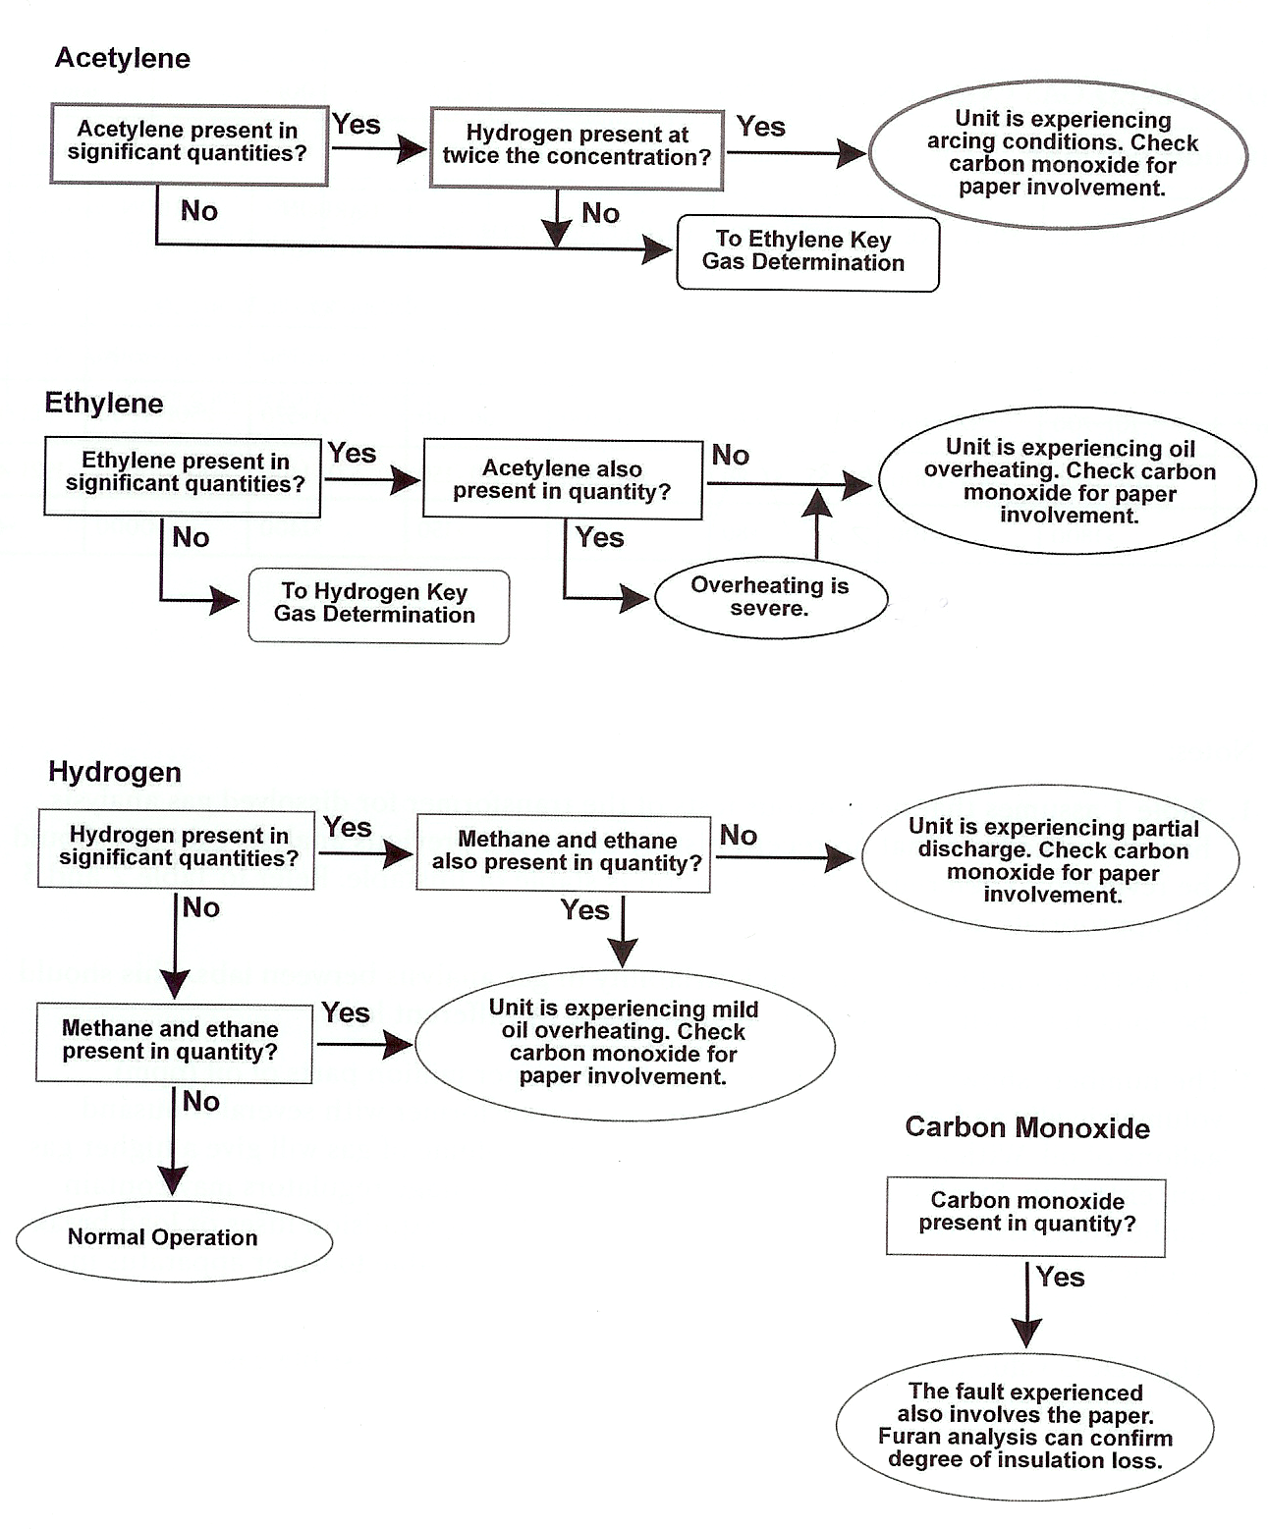
Qualitative Gas Analysis Method

Slide 11
Example of Qualitative Gas Analysis Results
Location | Elevated Gas | Qualitative Analysis Conclusion
Module 2 TR | O₂ and N₂ | Air leak
Module 3 TR | O₂ and N₂ | Air leak
Module 4 TR | O₂ and N₂ | Air leak
Sector B TR | Acetylene, hydrogen, O₂ and N₂ | Arcing (700 Deg C) and air leak
Sector D TR | Hydrogen, CO₂, O₂ and N₂ | Partial discharge and air leak.
Sector F TR | Acetylene, hydrogen, CO₂, O₂ and N₂ | Arcing (700 Deg C) and air leak
Sector G TR | Ethylene, ethane, H₂, O₂ and N₂ | Infrequent mild overheating (300 Deg C)
ETL 201 TR | Acetylene | Arcing (700 Deg C)
Mod 1 IVR | CO, hydrogen | Mild overheating (300 Deg C), paper involvement
Mod 2 IVR | O₂ and N₂ | Air Leak
Mod 3 IVR | O₂ and N₂ | Air Leak
Mod 4 IVR | CO, methane | Mild Overheating (300 Deg C)
Sec B IVR | H₂, methane, ethane, ethylene, CO | Overheating (300 Deg C), paper involvement
Sec C IVR | H₂, methane, ethane, ethylene, CO, O₂ | Overheating (300 Deg C), paper involvement
Sec D IVR | H₂, methane, ethane, CO | Overheating (300 Deg C), paper involvement
Sec E IVR | H₂, methane, ethane, ethylene | Overheating (300 Deg C)
Sec F IVR | H₂, methane, ethane, ethylene | Overheating (300 Deg C)
Sec G IVR | methane, ethane, ethylene | Mild Overheating (300 Deg C)

Slide 12
Rate of Rise Analysis
1) The rate of gas generation (rate of rise) was calculated, in parts per million (ppm) per day.
2) The time it will take the unit to reach the IEEE standard was predicted based on a linear rate of rise.
1 year < time to reach IEEE standard ➔ purple cell label
1 year < time to reach IEEE standard < 3 years ➔ red cell label
3 years < time to reach IEEE standard < 7 years ➔ yellow cell label
time to reach IEEE standard > 7 years ➔ green cell label
3) A rate of rise score was calculated by assigning points to each individual gas as follows:
Acetylene, Ethylene and CO - 2 points
Purple 1 ½ points
Red – 1 point
Yellow – ½ point
Green – 0 point
4) Health Label for each unit was applied based on the score as follows:

Slide 13
Example of Rate of Rise for the IVRs

Slide 14
Moisture Analysis
In 2009 a Drymax unit was purchased to address the moisture issue.
This unit slowly removes the moisture from the oil. (2 gpm flow rate)
An equilibrium of moisture between the oil and the paper is established by removing moisture from the paper.
This process takes 3 to 4 months.
The moisture analysis is used to determine which unit to move the Drymax unit to next.

Slide 15
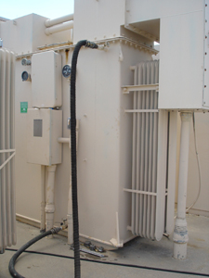
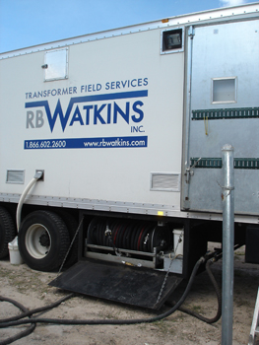
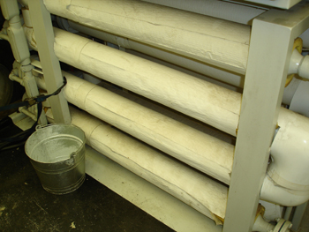
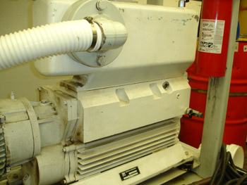
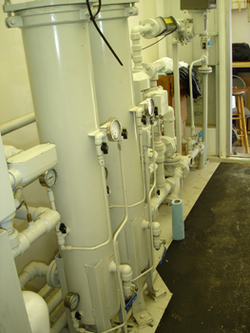
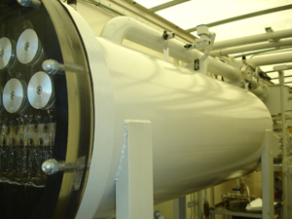
Annual Processing and Repair Work
Every year, a subcontractor is hired to come on site to process units and perform repairs to units as budget allows.
The processing reduces the amount of compostable gasses in units and thus reduces the rate of oxidation.
Repairs focus on reducing air leaks which have the potential to increase oxidation.
Repairs focus on reducing oil leaks with an environmental compliance impact.
Hoses from IVR …
to oil processing rig
Heaters
Oil Processing Unit
Vacuum Pump
Filters
Slide 15

Slide 16
Other Variables Considered: Furans, acid test, interfacial tension and operating temperature
Furans:
Furans, products of paper decomposition, can be an indicator of the % life remaining in the paper.
The total furan levels are not included in the analysis because every time the oil is processed, the furans are removed.
Acid Test:
The acid test and interfacial tension test results are not included in the analysis because all the results were acceptable. (Both of these tests measure the oxidation of oil).
Temperature:
The operating temperature is recorded every other week and trended to verify that no units are operating hot.

Slide 17
Example of Analysis Summary

Slide 18
Summary of Rebuild Priority and Status
IVR Rebuild Priority, Reason for Rebuild and Status:
Sector F IVR (TC#17), Severe Overheating, complete 2012
Sector E IVR (TC#15), Severe Overheating, complete 2014
Sector B IVR (TC#9), Mild Overheating, complete 2013
Sector D IVR (TC#13), Severe Overheating, arcing, candidate for 2016
Sector G IVR (TC#19), Severe Overheating
Sector C IVR (TC#11), Mild Overheating
Sector F IVR (was spare) (TC#23), significant Overheating, scheduled for 2015
Module 1 IVR (TC#2), Mild Overheating
Module 2 IVR (TC#4), Mild Overheating
Module 4 IVR, Mild Overheating, complete 2012
TR Rebuild Priority, Reason for Rebuild and Status:
Module 1 TR spare (TC28/30), Arcing/overheating, suspect history, complete 2012
Sector F TR (TC#12), Arcing, complete 2014
Sector E TR (TC#16), Significant Overheating, Arcing, next rebuild candidate
Sector B TR (TC#10), Arcing, complete 2013
Sector D TR (TC #14), Overheating
Module 2 TR (TC #3), Overheating, possibly FY16
Sector G TR (TC #20), Over heating
Sector F TR, was spare before, (TC#18) Complete 2012

Slide 19
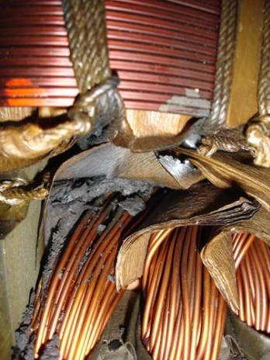
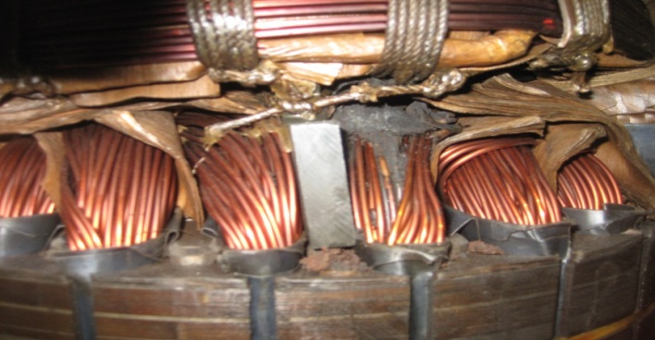
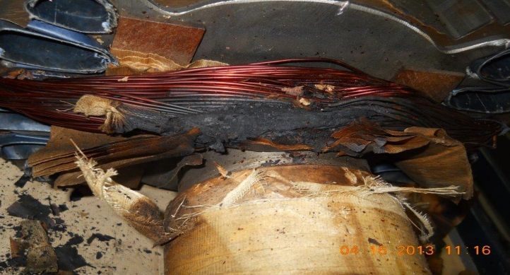
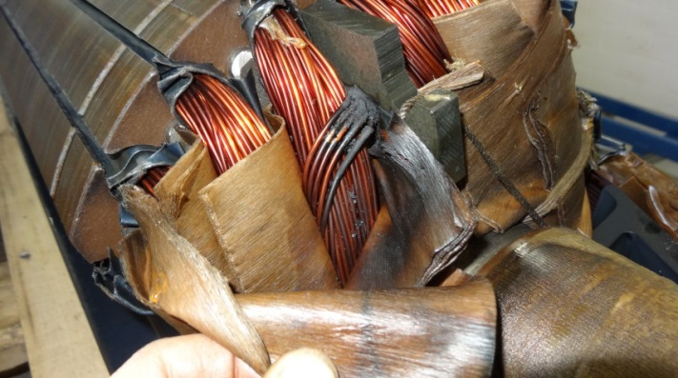
As found condition of IVRs that were rebuilt
The 2009 DGA showed a problem the following IVRs: Sector F, B, E, D, G, C and Spare
We found the following conditions in the IVRs upon tear down at vendor:
The 2013 DGA analysis shows Sectors D, G and C IVRs have VERY similar DGA results! This project is to rebuild Sec D in FY15. Since we have 4 case studies to prove it, we are certain of the failure mechanism and what the inside of the IVR looks like.
Sector H IVR 2007
Sector F IVR 2012
Sector B IVR 2013
Sector E IVR 2014

Slide 20
Conclusions
The DGA analysis has been a correct indicator of a problem in the LANSCE TR and IVRs.
It is critical to carefully monitor the health of the units to ensure high availability of the accelerator.
Even though these units are 45 years old, lifetime can be extended many times through this work.

