Slide 1

The European Spallation Source:
Plans for Commissioning and Initial Operations
WAO 2014
Marc Munoz, on behalf of the whole ESS team
www.europeanspallationsource.se
October, 2014

Slide 2
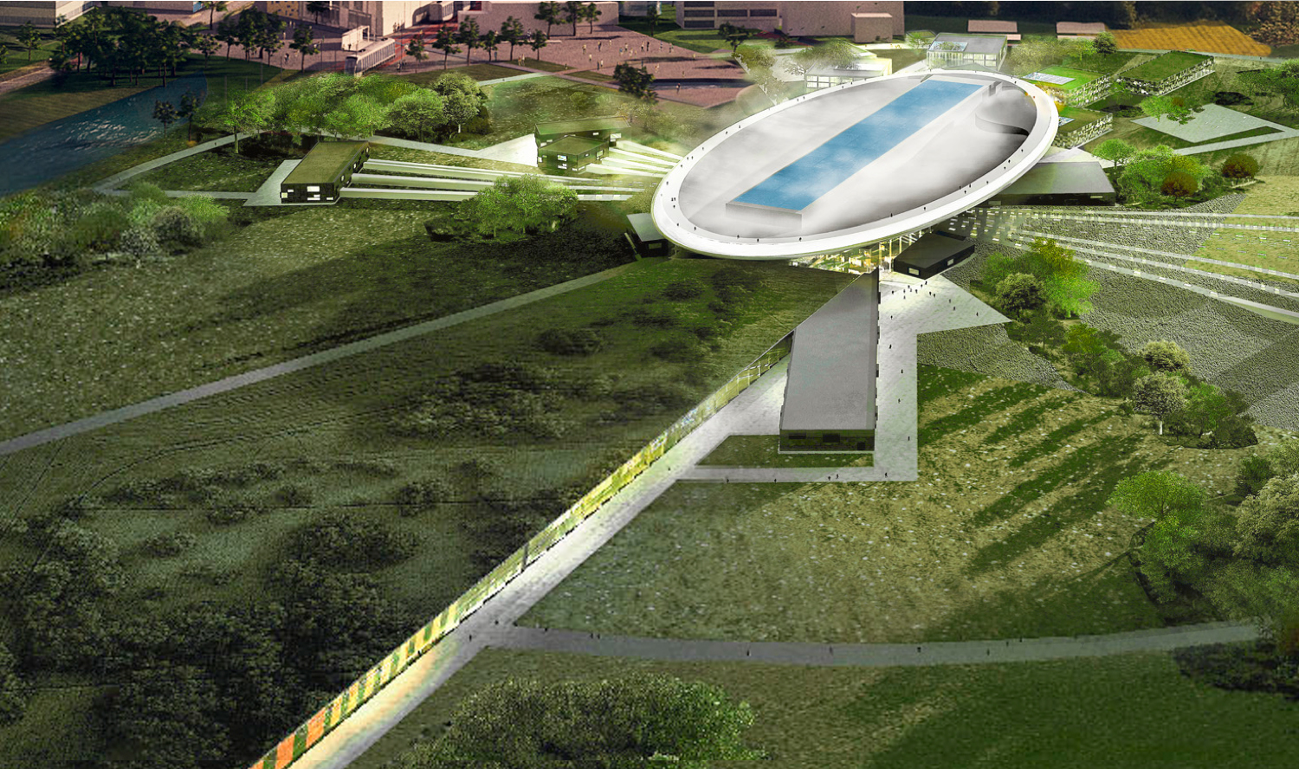
European Spallation Source
Main headlines
The world’s leading
source for slow neutrons
A user facility providing outstanding scientific performance:
High intensity: 30 to 100 times more brightness than ILL,
High reliability
High safety
Environmentally
friendly
Good economy
Technical scope
5 MW long pulse spallation source
2.86 ms, 14 Hz, protons
Target: Rotating wheel,
He gas cooling
22 instruments, bispectral moderators
1.843 B€ to build, 140 M€/y
450 - 500 employees
Receiving 2000-3000
users per year

Slide 3
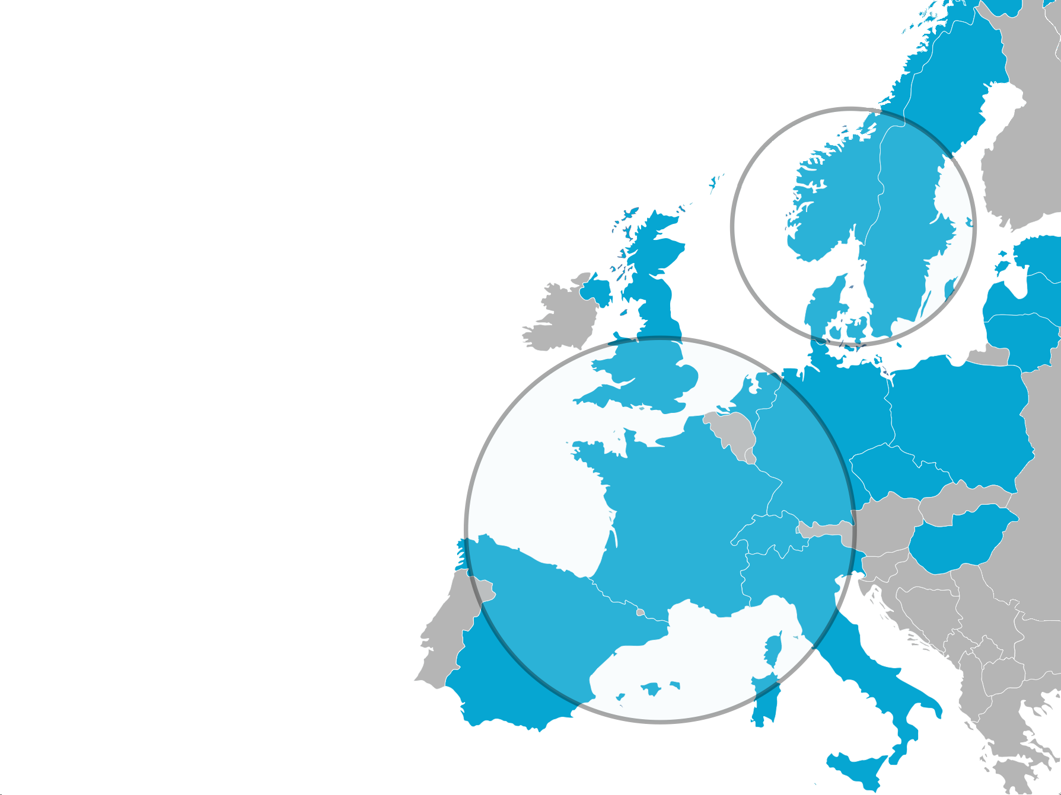

The ESS project
International collaboration
Sweden and Denmark:
47.5% Construction
15% Operations
100% Cash
Partner Countries:
52.5% Construction
85% Operations
~70%/30% In-Kind/Cash

Slide 4
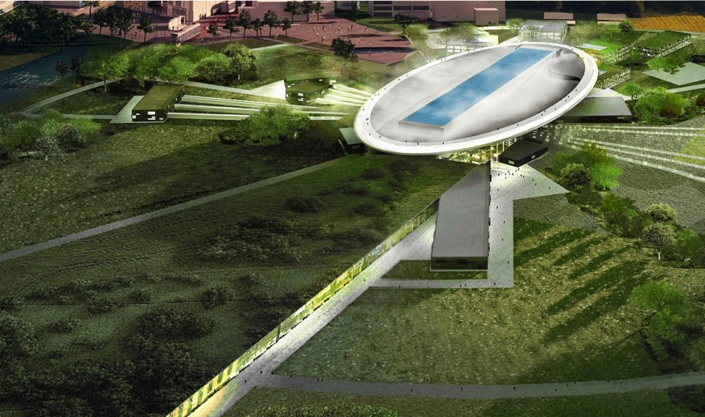
Main milestones of the project
2025
ESS construction complete
2014
Construction work starts on the site
2023
ESS starts
user program
2009
Decision: ESS will be built in Lund
2019
First neutrons on instruments
2012
ESS Design Update phase complete
2003
First European design effort of ESS completed
Notes:
Mention licenses

Slide 5
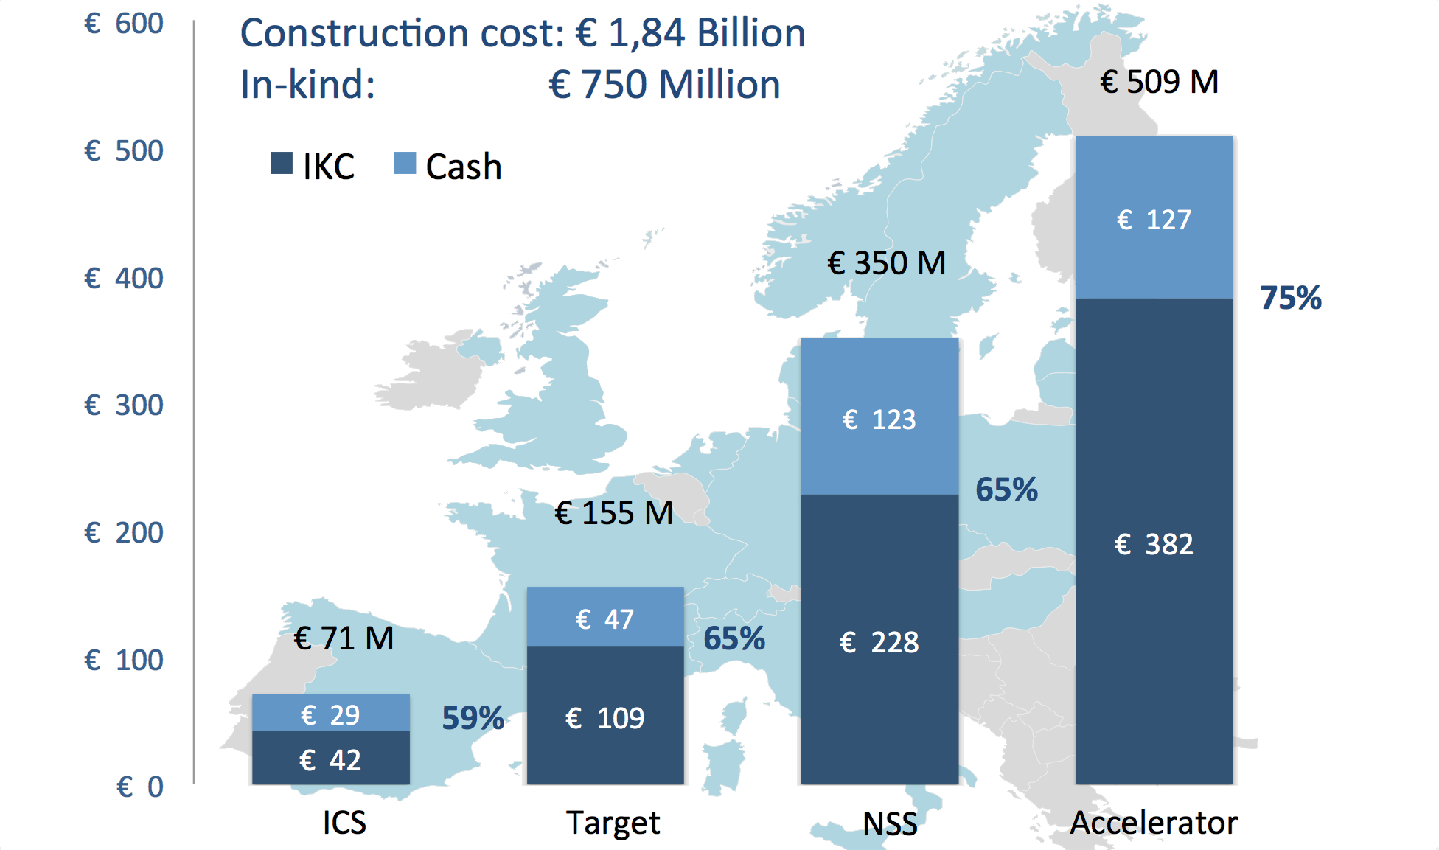
The ESS projects(s)

Slide 6



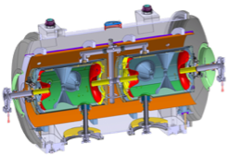
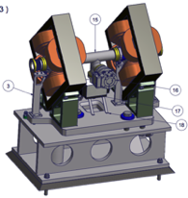




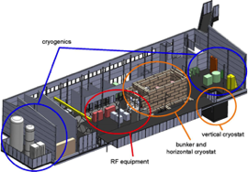

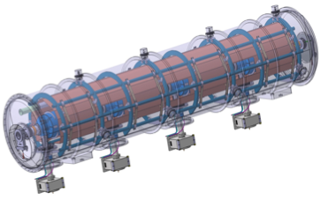



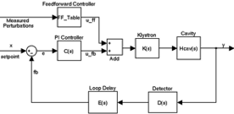

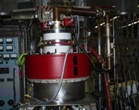


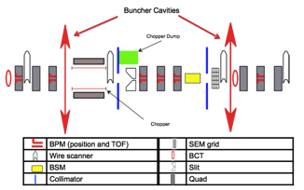
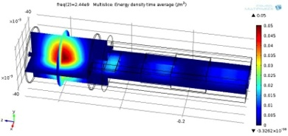
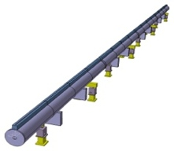



Collaboration During Pre-Construction
Partners for the Accelerator. Similar arrangement for the Target and Neutron Instruments
Sebastien Bousson
Søren Pape Møller
Roger Ruber
Pierre Bosland
Anders J
Johansson
CERN
The National Center for Nuclear Research, Swierk
Roger Barlow
Ibon Bustinduy
Santo Gammino
Notes:
PDM, managing of information, etc

Slide 7
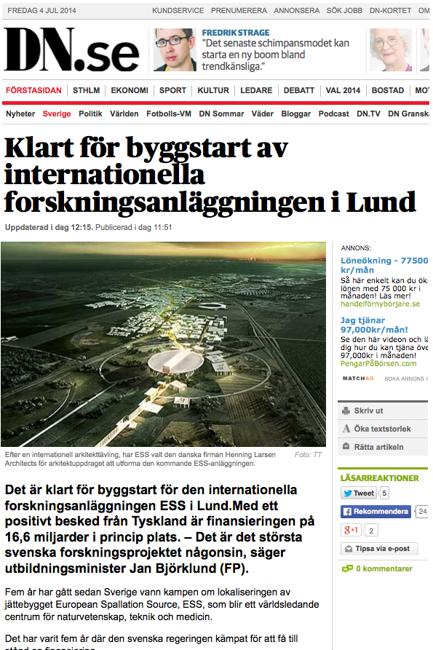
Green Light!
Swedish Minister 4 July 2014: Ready to Build ESS
Groundbreaking:
2 September 2014

Slide 8
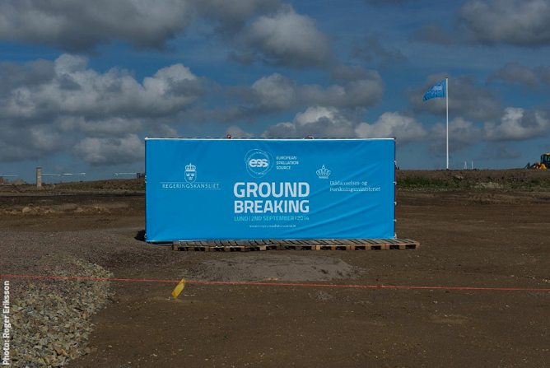
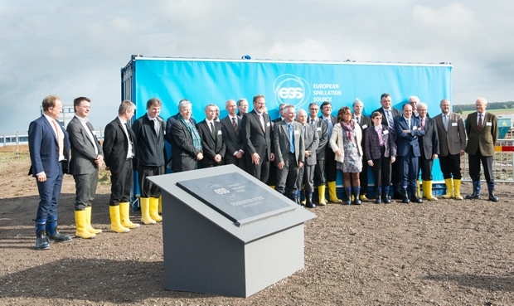
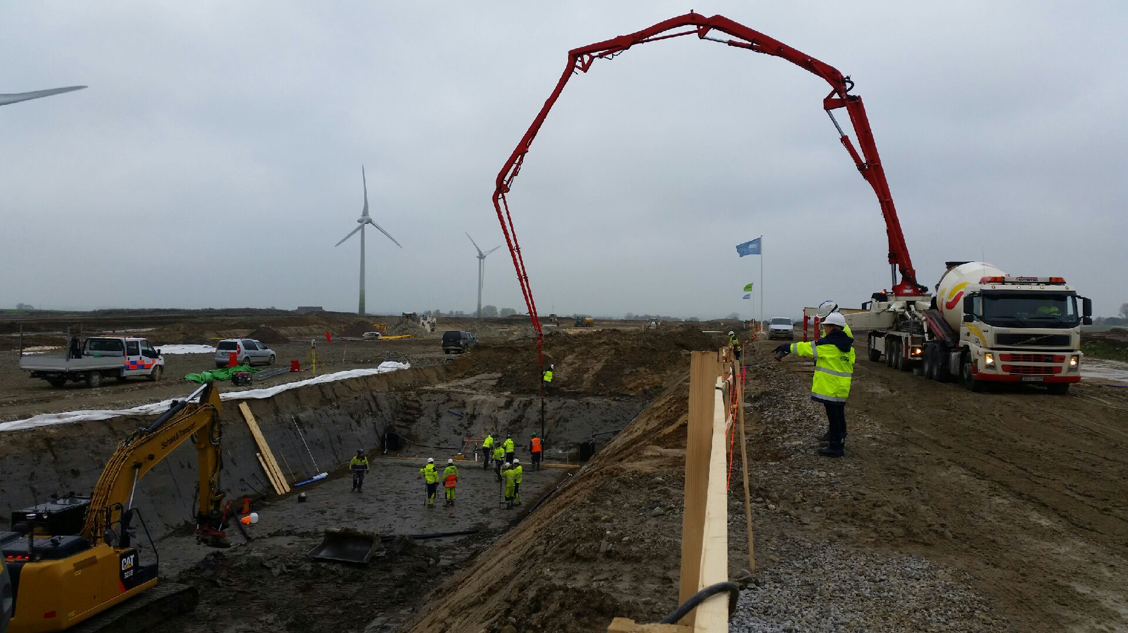
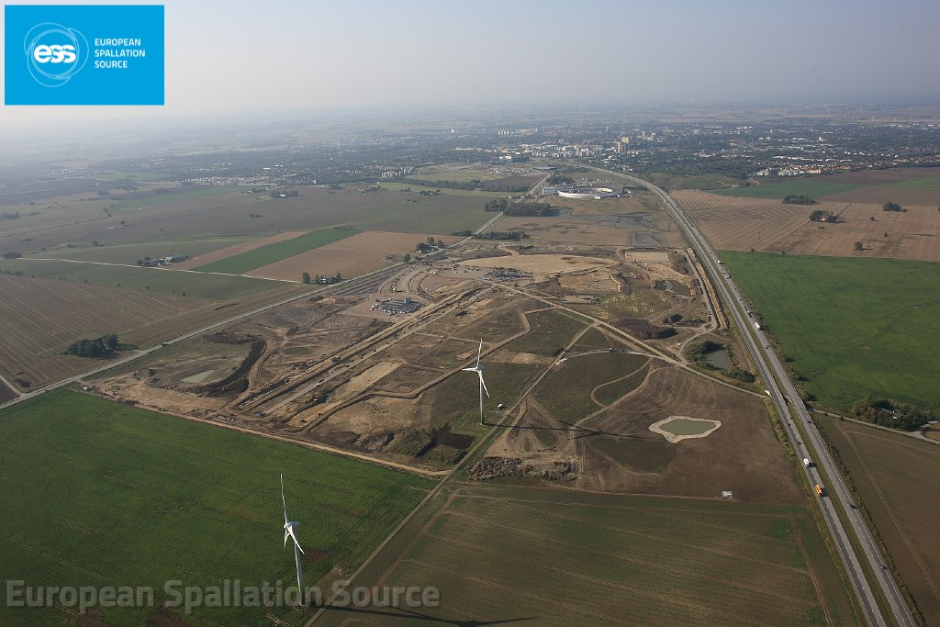
Start of the Construction

Slide 9
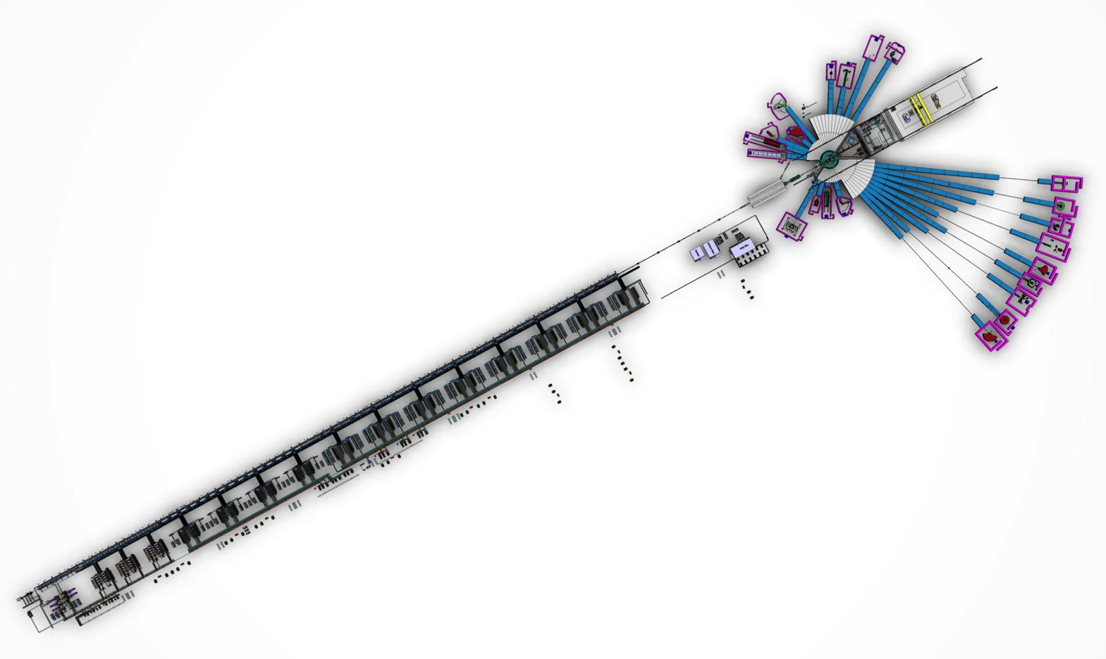
ESS production of neutrons for science
Target station
Neutron science systems
Linear proton accelerator (600 m)
Notes:
Superconducting linac
Solid-state rotating tungsten target
The latest instrument suite

Slide 10
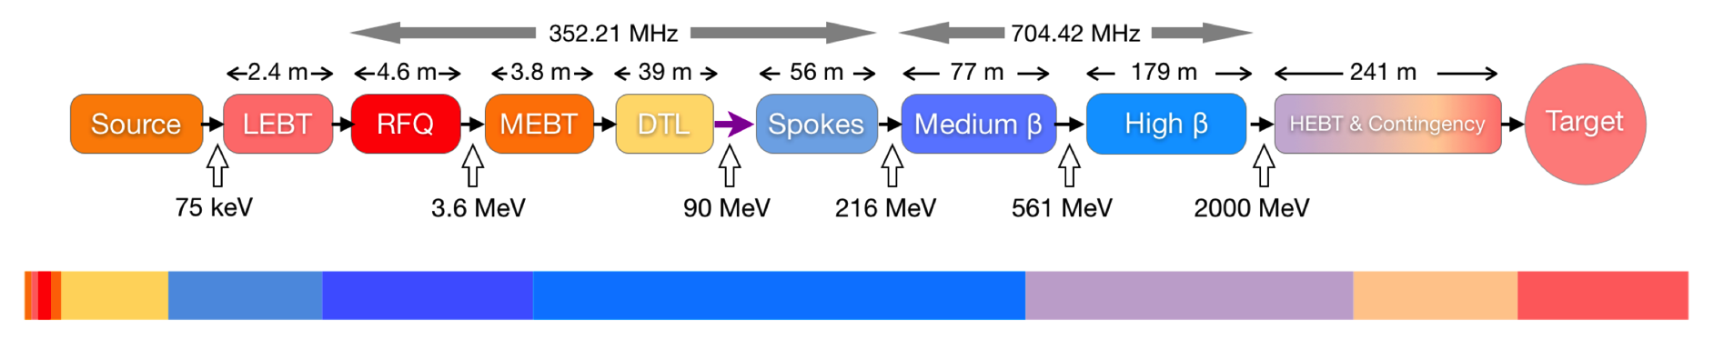
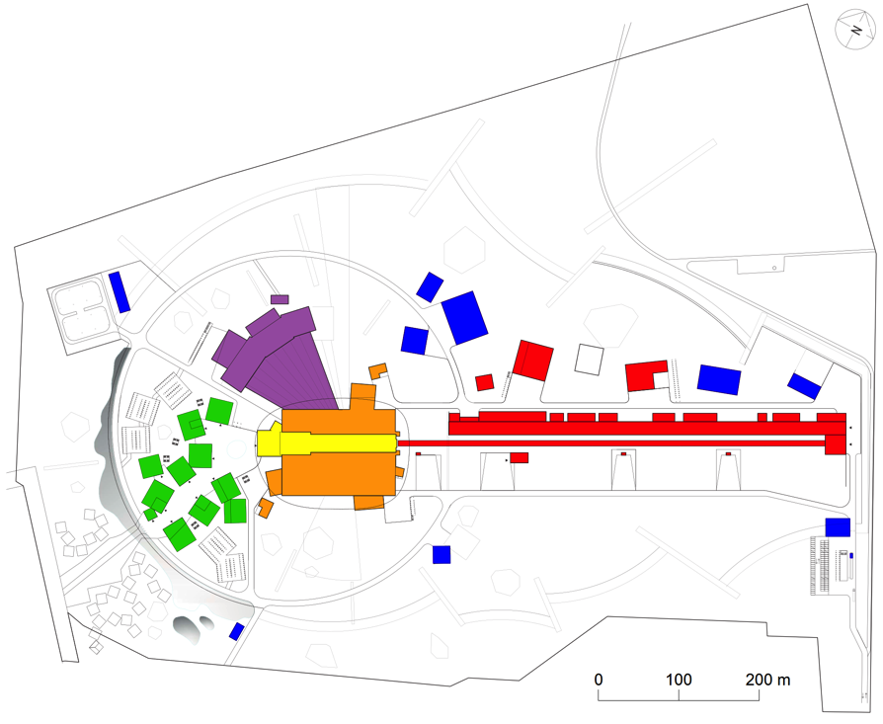
ESS Linac Parameters
Tuning dump
603 m
Particle species p
Energy 2.0 GeV
Current 62.5 mA
Average power 5 MW
Peak power 125 MW
Pulse length 2.86 ms
Rep rate 14 Hz
Max cavity surface field 45 MV/m
Operating time 5200 h/year
Reliability (all facility) 95%

Slide 11
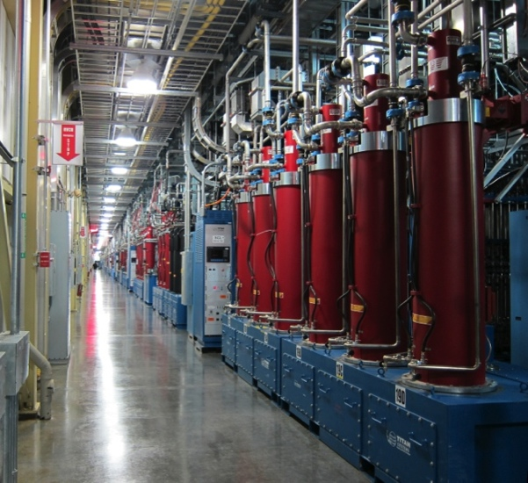
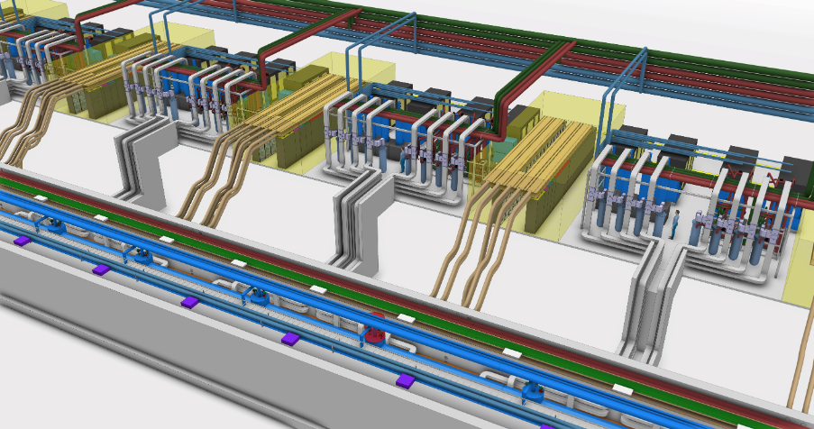
RF systems
Main features:
One RF power source (klystron, IOT, ...) per resonator
Two klystrons per modulator for ellipticals
Pulsed-cathode klystrons for RFQ, DTL
Gridded tubes (tetrodes or IOTs) for spokes
Klystrons for medium-beta ellipticals, and as backup for high-beta
Developments with industry for high-power IOTs
SNS klystron gallery
 | Frequency (MHz) | No. of couplers | Max power (kW)
RFQ | 352.21 | 1 | 900
DTL | 352.21 | 5 | 2150
Spokes | 352.21 | 26 | 350
Medium betas | 704.42 | 32 | 900
High betas | 704.42 | 88 | 1100
Layout of ESS linac tunnel and klystron gallery

Slide 12
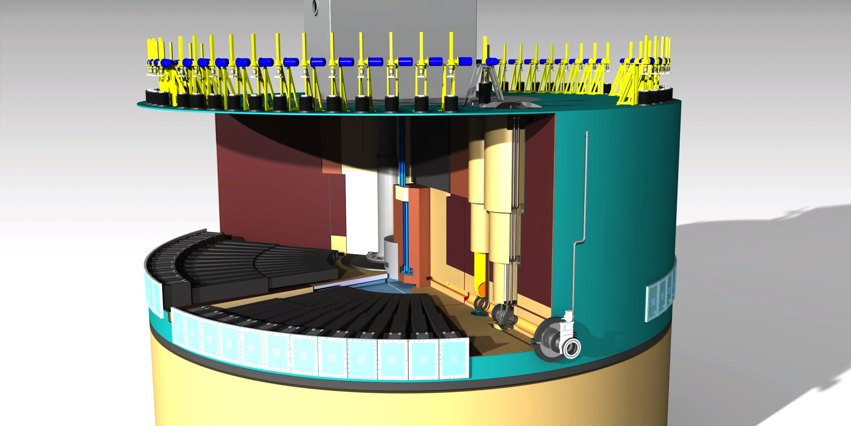

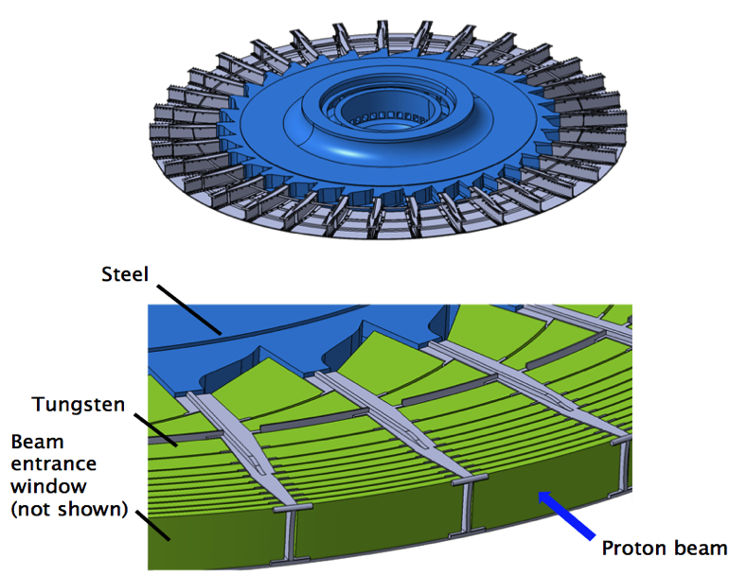
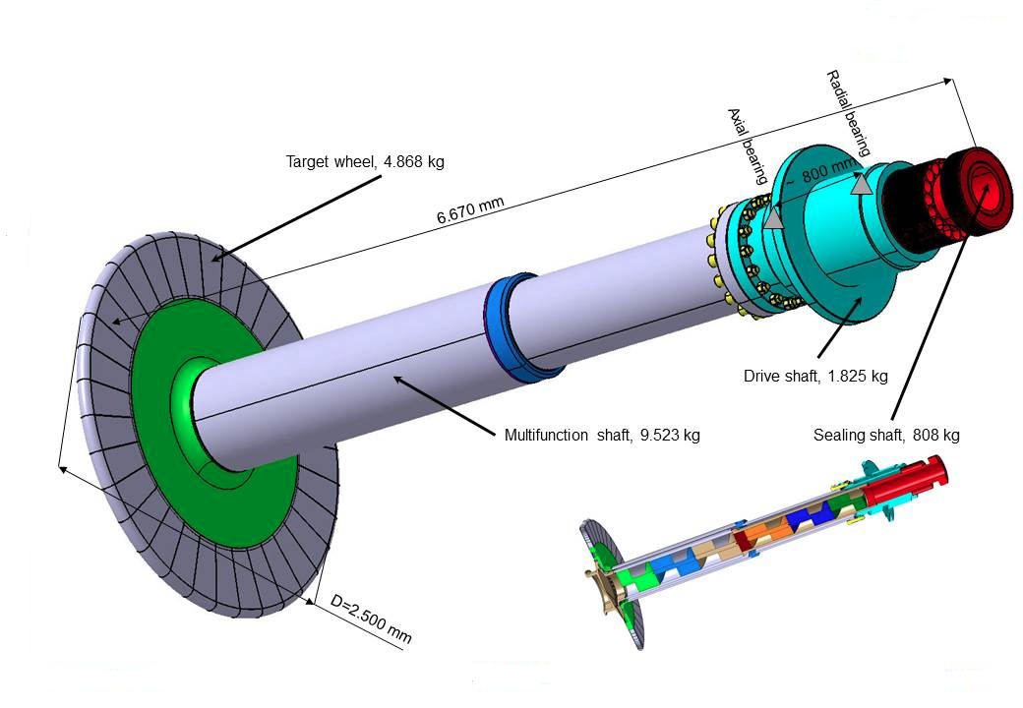
Target
Iron blocks
Moderator
Shutters
Tungsten wheel
Neutron guides
Proton beam window
Proton beam
Tungsten slabs in 33 sectors
Cooled with helium gas, 3 kg/s, 0.3 MPa, 20/200 °C
Rotational speed 25.5 rpm
Wheel diameter 2.5 m
Shaft length > 5 m
Lifetime ~ 5 years (@ 5 MW)

Slide 13
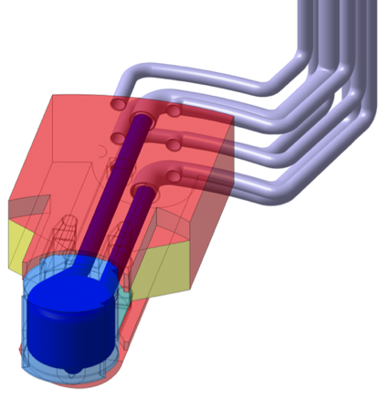
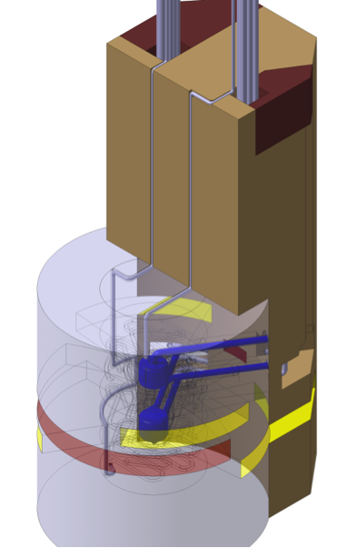
Moderator-Reflector Plug
TDR moderator concept
Cooldown of the MeV neutrons to meV neutrons
Cold moderators
  Super-critical H₂ at 20 K and 1.5 MPa
  Aluminium alloy vessel
  Expected lifetime ~ 1 year @ 5 MW
Water moderator assemblies
Light water-cooled Be reflector
“Flat” moderator concept proposed last summer to significantly increase neutron brightness (factor ≳3)
Moderators
Inner Be
reflector
Outer SS
reflector

Slide 14
Reference Suite of 22 Instruments
Initial plans. 1st set of instruments still under discussion

Slide 15
Activities in construction, Initial and Steady-State Operation phases
The construction phase: Includes design, project management, administration, manufacturing, acceptance tests, installation and cold commissioning (without beam) of systems in the accelerator, target and instruments. It also includes hot commissioning (with beam) of parts of the accelerator. The construction phase will partly overlap with the initial operations phase.
The initial operations phase: Includes the hot commissioning, operation, maintenance and repair of all systems and activities for the ramp-up of beam power. It includes the cold (and hot) commissioning of instruments and systems needed for significant beam powers and steady state operations. It includes the main part of the construction of instruments funded by resources that are additional to the construction funding. It includes the start and operation of a user program.
The steady state operations phase: Include operation, maintenance and repair of all systems. It includes upgrades, cold and hot commissioning of existing instruments and potentially construction of new instruments. It includes a full user programme.

Slide 16
High level plan for Initial Operations
Construction Project completes in 2025
Neutron spallation source construction complete at the end of 2022
16 instruments and user support construction completed at end of 2025
Initial Operations Phase (2019 – 2022, 4 years until spallation source complete)
  Begins with 1st neutrons
  1 year for activities necessary to produce first neutrons in 2019
  3 years to improve accelerator performance and commission initial instruments
Initial User Program Operations (2023 – 2025, 3 years)
  Support necessary for reliable instrument operations for non expert public users and the basis for cost sharing post construction
  Cold commissioning of (16 first) instruments funded within the construction project
Steady State Operations (2026 onwards)
Notes:
Working group different projects
Developing procedures for operation

Slide 17
Time Schedule: Linac point of view
2014: finish of the redesign
July 2014: Approval of the project
Sept 2014: Groundbreaking
2014-2016: Building construction
2016-2019: Installation, except High Beta modules
Jan-Oct 2019: Commissioning warm Linac, Spokes and Medium Beta to target.
End 2019: 1st protons on Target, Neutron production. Start of Hot Commissioning.
2021 Installation High Beta modules 1-11
2022 Installation High Beta modules 12-21
2026 5 MW operation
Notes:
Energy
Climate
Health
Agriculture
Digital society

Slide 18
Linac Commissioning
3 main stages:
Test outside ESS:
  IS+LEBT+RFQ at Saclay. Final agreement currently under discussion.
Systems testing:
  Verification of the various systems without beam: Cryogenics, RF, MPS, etc
Beam commissioning:
  Verification of the system with proton beam.
  Optimization of the parameters of the Linac: energy, power, losses minimization
  Delivery of protons to Target for Target commissioning and neutron production
  Using Faraday cups and Tuning Dump before going to the Target
  Reduced power beam (low current, short pulse, low repetition rate)

Slide 19
Beam Commissioning
Divided in 4 steps (dates are indicatives only, coordination with installation should be done early next year):
Normal conducting: Commissioning Jul 2018-5 February 2019 (not continuous)
  Using Faraday cups along the Linac
Spoke and medium beta: Commissioning April 2019-Nov 2019
  Commissioning to Tuning Dump: April -May 2019
  Commissioning to Target: May 2019-Jul 2019
  Buffer-Late Finish: Sept 2019-Nov 2019
High beta cryomodules 1-11: Commissioning 13 July 2021 to 6 September 2021
High beta cryomodules 12-21: Commissioning 26 August 2022 to 22 September 2022 (installation after the commissioning of modules 1-11, and initial operation started)

Slide 20
Planning
Initial plan of the procedures to follow during beam commissioning finished
Created list of Objectives for each section of the Linac
Created list of Procedures to reach the objectives for each section.
From the procedures list, we are in the process to extract requirements, including::
  Beam Instrumentation required for Beam Commissioning
  Beam mode to be used
  Software needed
  Training needed
  Other resources and personnel needs

Slide 21
Example: MEBT - Objectives
Based in our L3 requirements
MEBT:
Transmission > 99.3%
Output beam current, 6.5 mA → 63 mA
Output beam energy controllable within ±10 keV of design
Flat top length, 5 us → 3 ms
Pulse length (nominal) < 2.860020 ms
Twiss parameters matched throughout flat-top
Transverse 99% output emittance less than that in integrated lattice design
Longitudinal 99% output emittance less than that in integrated lattice design

Slide 22
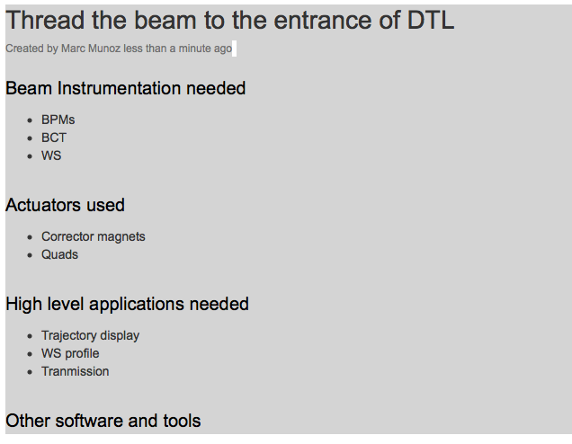
Example: MEBT - Procedures

Slide 23
Next steps in the planning
Integration of the beam commissioning with the installation planning
Definition of the commissioning team
Finishing of requirements for commissioning
Training and licenses
Interface with Target and Neutron Instruments commissioning
How we document the process? For the moment jira+wiki
Crosscheck with the commissioning of similar machines (mainly SNS and Linac4)

Slide 24
Operators
~21 operators needed for operations
Ongoing discussions about:
  Where they belong inside the ESS organization?
  When to hire them?
  Are some of them to be ready for beam commissioning?

Slide 25
Instruments: planning and commissioning
Regular Call for User Proposals
Start of Instrument Construction
1st
Neutrons
Construction Budget
…..
2013 | 2014 | 2015 | 2016 | 2017 | 2018 | 2019 | 2020 | 2021 | 2022 | 2023 | 2024 | 2025 | 2026 | 2027 | 2028
 |  |  |  |  |  | 3 | 6 | 6 | 5 | 4 | 3 | 2 | 2 | 2 | 1
 |  |  |  |  |  |  |  | 3 | 6
 |  |  |  |  |  |  |  |  |  | 9 | 11 | 15 | 17 | 19 | 22
Initial Operations Budget
Steady-Sate Budget
# 1-16
Engineering Design
Construction of Instruments
Plans for
Instruments (1-22)
# 17-22
Engineering Design
Construction of Instruments
Expected Instruments in hot commissioning
Expected Instruments in Initial Science Programme
Expected Instruments in Science Programme
Scheduled Neutron Production
On
Off

Slide 26
Technical plan for Initial Operations
Criteria for start of Initial Operations: Cold commissioning completed for all systems needed for producing and delivering a measurable number of moderated spallation neutrons to an instrument and for detecting them in the instrument.
Technical Strategy
Initially keep radioactivity and doses low to allow hands on maintenance.
Ramp up power quickly to find limitations and increase reliability before user operations start.
Ramping of the power using peak current, energy and repetition rate.
Start with modest operation schedule: 180 days/y for neutron production. Ramp up to 200 days/year when facility has matured

Slide 27
Priorities during Initial Operations
Agreement between the different project of ESS (Accelerator, Target and Instruments) about the priorities during the Initial Operations.
Still under negotiations.
The first priority is always safety of the components. We should minimize losses in the Linac.

Slide 28
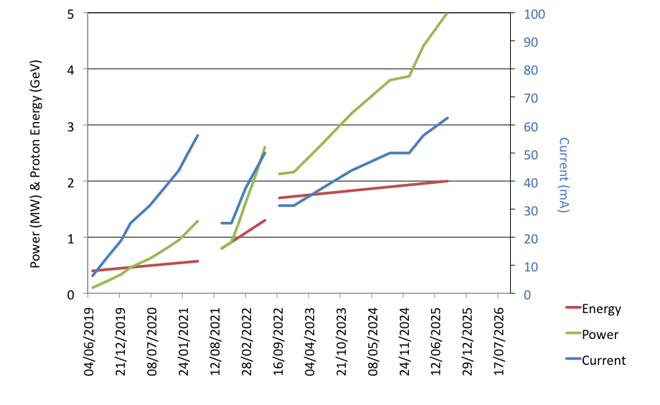
Accelerator commissioning and ramp up
Phase 1: Front end, NC linac, spoke CMs, and medium-ß CM
Phase 2: Installation and commissioning
of high-ß CM
Phase 3: Consolidation
and ramp-up
Pulse length 2.86 ms
to enable instrument
commissioning
Phase 3
Phase 1
Phase 2
Installation cryo 12-21
Installation cryo 1-11

Slide 29
Alternative ramping
The possibility to use a different repetition rate during initial operation is under study.
The consequences on some experiments and in the target is being evaluated.
Reduces the range of currents.

Slide 30
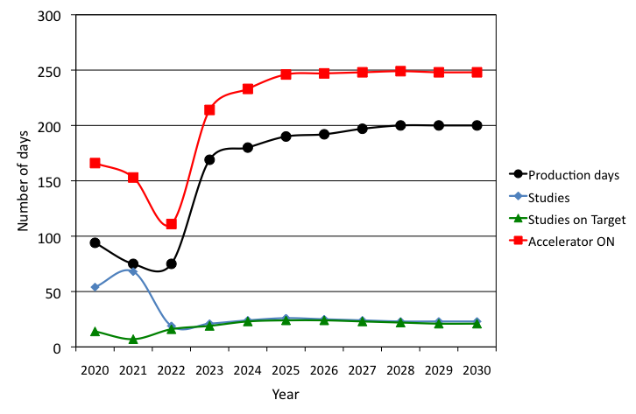
Neutron source modes of operation
Installation of High Beta Cryomodules

Slide 31
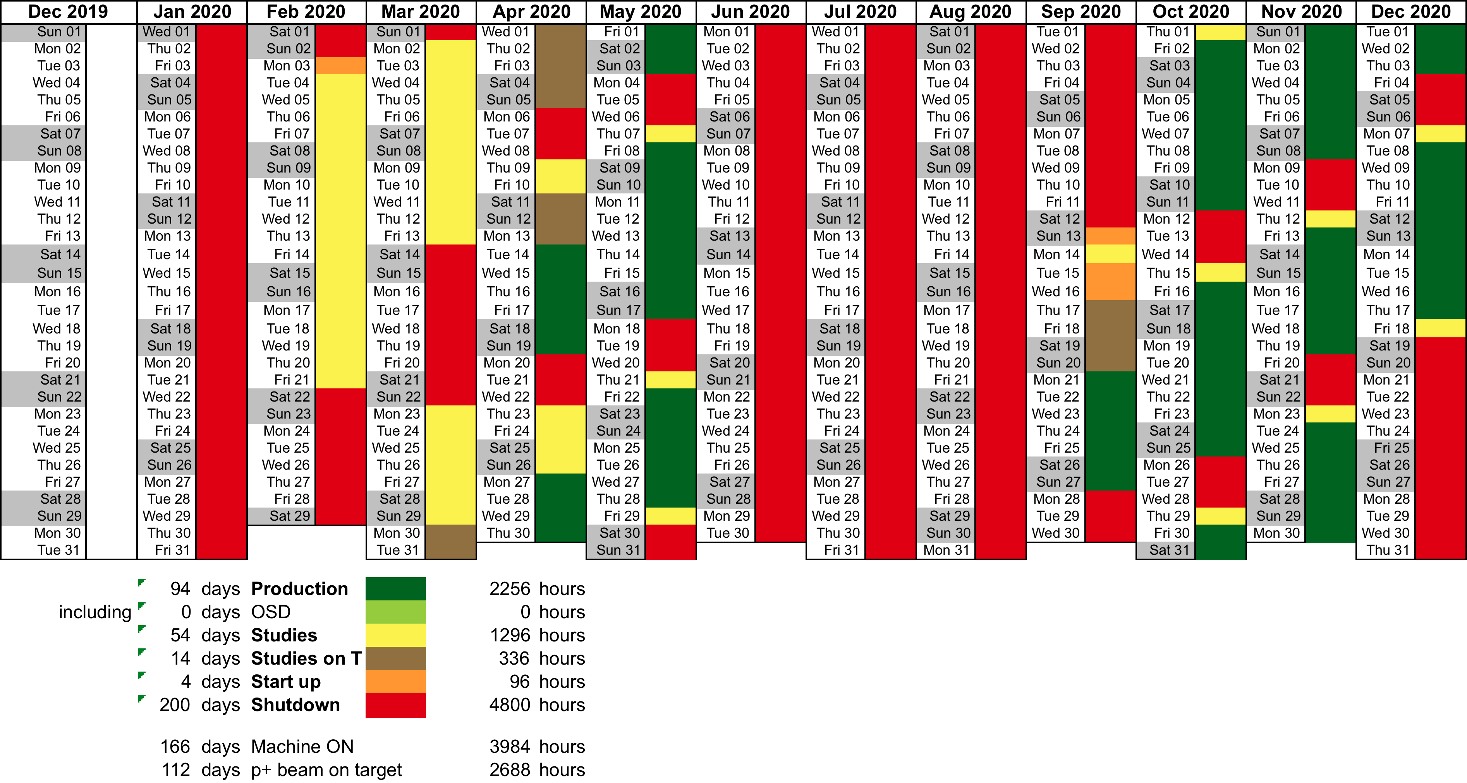
Tentative Operations schedule 2020
Tentative – used as a tool for coherence
in plans

Slide 32
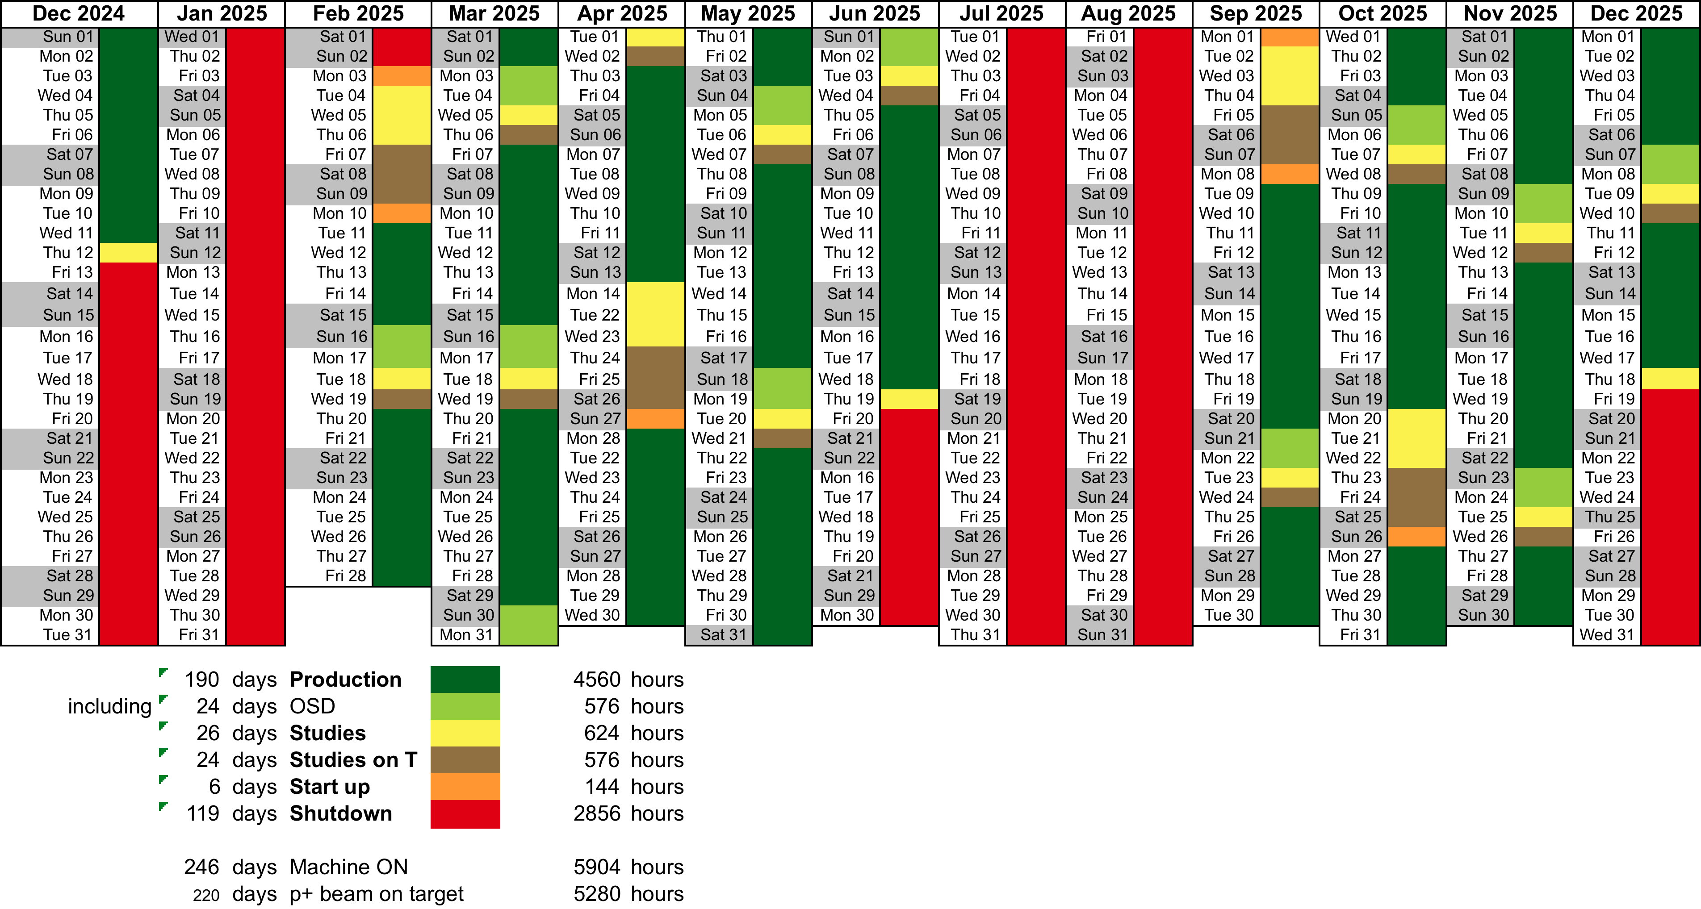
Tentative Operations schedule 2025
Two long shutdowns for maintenance. Other small maintenances possible during OS or studies day.
Tentative – used as a tool for coherence
in plans

Slide 33
Conclusion
ESS looks for a proper balance between early scientific success and safe/reliable ramp-up program.
This requires: adequate commissioning of the neutron source itself and instruments (big difference with reactor based installations), good coordination between all groups involved
Plans are developed along the following lines:
  Accelerator program with a gradual ramping of current and energy to minimize losses and doses, and priority in availability
  Instruments: ambitious construction program (in-kind contributions!!) but reasonable commissioning time, early access for selected demonstration experiments
  Full user program in 2023
  Full power circa 2026
ESS will adapt its strategy to reality
Come and visit us
in 5 years from now!

Slide 34
Extra slides

Slide 35

Evolution of neutron sources
0 1 2 3
10²⁰
Time (ms)
J-PARC
ESS
SNS
MTR
NRU
HFIR
ILL
ISIS
10¹⁵
NRX
HFBR
ZING-P/
IPNS
WNR
KENS
FRM-II
X-10
SINQ
Effective thermal neutron flux n/cm²-s
10¹⁰
CP-2
ZING-P
CP-1
10⁵
Berkeley 37-inch cyclotron
350 mCi Ra-Be source
Steady State Sources
Pulsed Sources
1
Chadwick
1930
1940
1950
1960
1970
1980
1990
2000
2010
2020
(Updated from Neutron Scattering, K. Skold and D. L. Price, eds., Academic Press, 1986)

Slide 36
Initial Operations - main activities for instruments
Initial Operations - Instruments
Follows the “cold” commissioning without beam.
Begins with hot commissioning (with neutrons) and scientific commissioning of first instruments. Requires a few month with beam
Optimisation and corrections, calibration experiments
First calls for “Best effort” experiments in 2022
Ensures reliability before start of regular User Programme
User Programme will include six instruments in 2023,
with 2-3 additional instruments available per year

Slide 37
Plans for initial operations
Plans for initial operations under revision based on the feedback from advisory committees, governing committees, reviews, and internal planning
  Initial Operations should be triggered by activities related to the production of neutrons and not accelerator commissioning (STC);
  The ramp up of the instrument program should be realistic (STC and Ops review);
  Start with modest operation schedule: 180 days/y for neutron production. Ramp up to 200 days/year when facility has matured (Ops Review);
  The transition from construction into operations should recognize the need for continuity in staffing and support (Ops Review); and,
  Operations support should include the capital budgets needed to complete and maintain the 22 public instruments (Ops Review and Internal Plans).

Slide 38



Licensing - Time Schedule
2012-01-01 2013-01-01 2014-01-01 2014-06-01
PSAR
Preliminary
Safety
Analysis
Report
SSM
Swedish Radiation Safety Authority
Radiation Protection Act
SSM
Permit & conditions to construct
Application
EIA
Environmental
Impact
Assessment
Court Hearing
Environ-
mental
Code
EC
Construction
& Operation
Permit
EC
Environmental
Court
Application
Planning &
Building Act
Detail Plan approved
Building
Application
(ESS)
Building Permit
Lund
Municipality
SSM Permit to construct expected before summer 2014. Ground break can start after building permit with execution warranty, expected 12/6 14.00.

Slide 39
Top-Level ESS Project Schedule
2013
2014
2015
2016
2017
2018
2019
2020
2021
2022
2023
2024
2025
ESS Program
Start Of Construction
Construction
End Of Construction
Design
Ground Break
Building
First installations (of Machine Systems)
Installing
First Neutrons
1st Call for User Proposals
Commissioning
Machine 2.0 GeV
Concluding
Initial Operation
Conventional
Facilities
Design
Licensing
Preliminary Design Acccelerator Bldngs
Main Schedule for Licenses and Permits
- 12 June 2014 – Environmental court permit
- 15 July 2014 – SSM license to construct
- 2015 – SSM license to install
- 2016 – SSM license for test operations
- 2019 – SSM license for beam on target
- 2020 – – SSM license for increasing steps in beam power
- 2023 – – SSM license for full operations
Construction
Detailed Design Accelerator Bldngs
Earth Works
Accelerator, Target, Aux, Office, Lab & Instr Bldngs*
G01 Linac Tunnel
G02 Klystron Bldng
Commissioning
Cryo Kompressor Bldng
Accelerator
Design &
Prototyping
Procurement
Medium Beta Fabrication
Spoke Series Procurement
Installation
High Beta Fabrication
570 MeV
Installed for 2.0 GeV
Installation Phase 1
Installation Phase 2
Commissioning
Target
Design
Procurement
Installation
Concept
Devlopment
Commissioning
Neutron
Scattering
Systems
Instrument Selection - Decision
Design
Construction
3 Instruments ready for Comm.
16 Instr
Innstr 16 – Constr & Inst.
Innstr 16 – Cold Comm.
Commissioning
Integrated
Control Systems
Design
Development
Commissioning
CS Network Operational

Slide 40
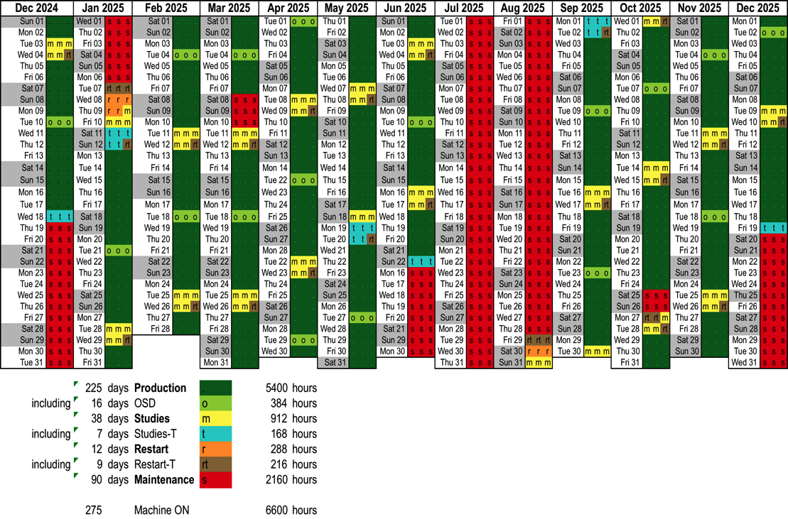
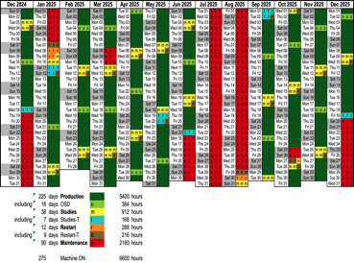
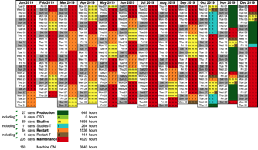
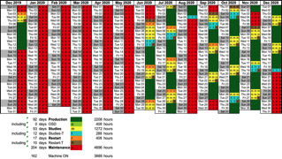
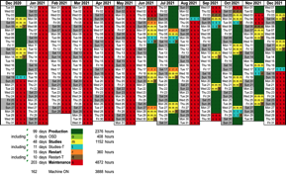
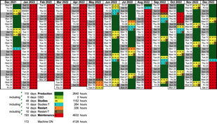
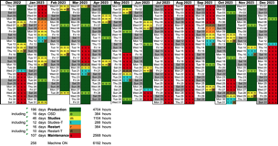
Ramping up to full ops

Slide 41
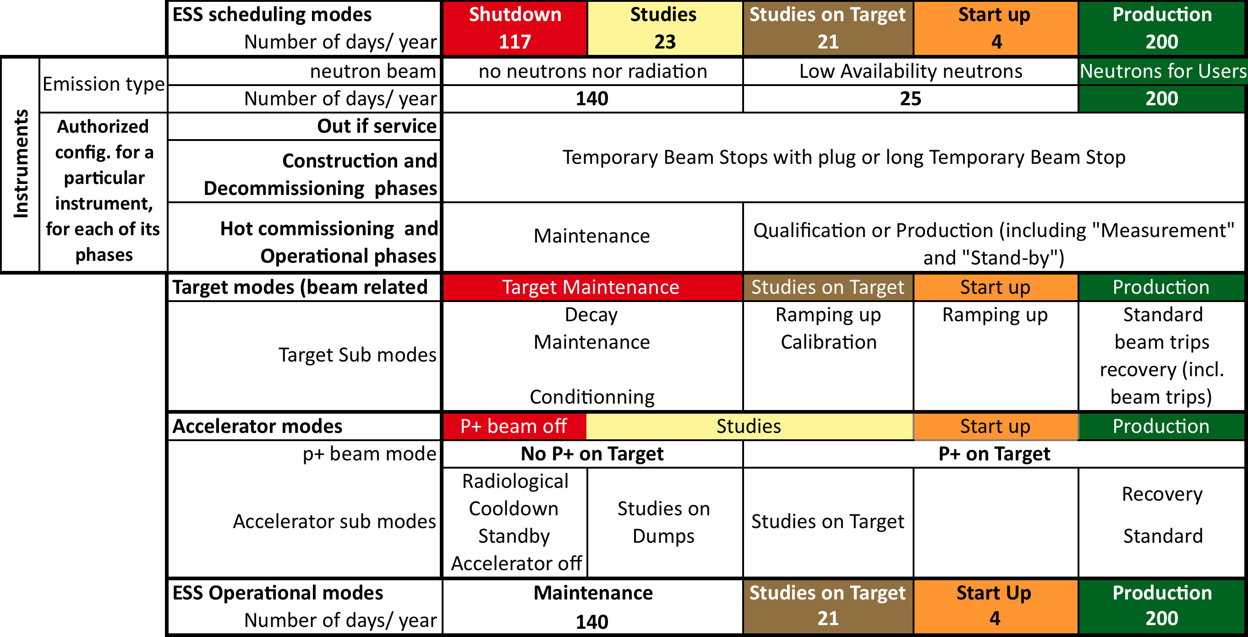
Scheduling modes

Slide 42
Initial Operations planning
At present 916 activities 2019-2023. Detailing and structuring ongoing.

Slide 43
Initial Operations planning

