Slide 1
Summary
Michael Bieler, Chair of the IPC
Petra Schütt, Chair of the LOC

Slide 3
Feedback
Advertising (Poster, mails, #wao2014 ?, …)
Location (Auditorium, rooms, food, …)
Program (Talks vs discussions, topics, …)
Excursion(s)
…
Tell us now or send mail to
wao2014@gsi.de

Slide 4
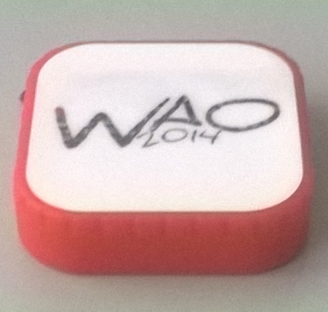
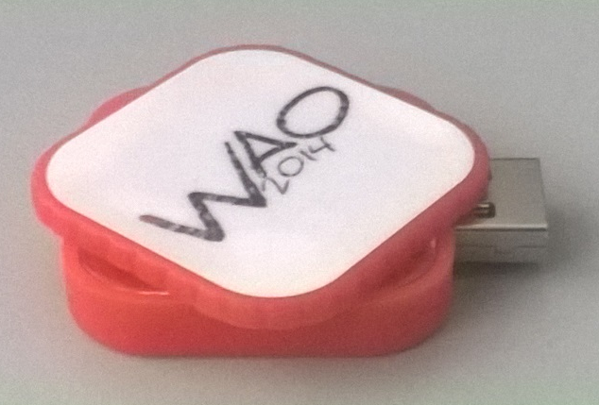
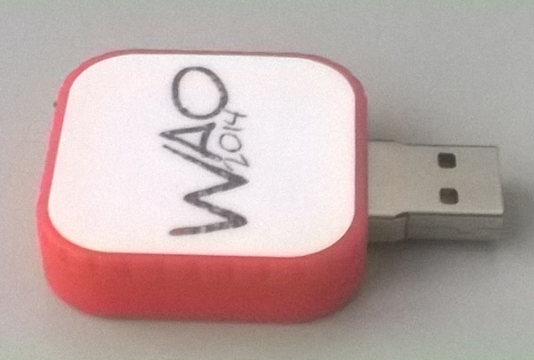
Statistics:
111 attendees from 45 institutions
59% Europe
25% North America
16% Middle East, Asia, Australia
67 abstracts
47 (short) talks
20 posters

Slide 5
Statistics:
111 attendees from 45 institutions
59% Europe
25% North America
16% Middle East, Asia, Australia
67 abstracts
47 (short) talks
20 posters
Quality:
High quality talks
High quality posters
Lively discussions (“It’s a workshop, not a conference!”)
Good networking among the attendees
Special events:
Invited Speaker
Tour to HIT, Heidelberg
Tour to GSI/FAIR

Slide 6
Accelerator Reliability Workshop
ARW2015

Slide 7
Workshop on Accelerator Operations
WAO2016

Slide 8
Special Thanks to:
- Erbacher Hof
- LOC
- Speakers, Poster Presenters
- Chairmen
- You, the Audience

Slide 9
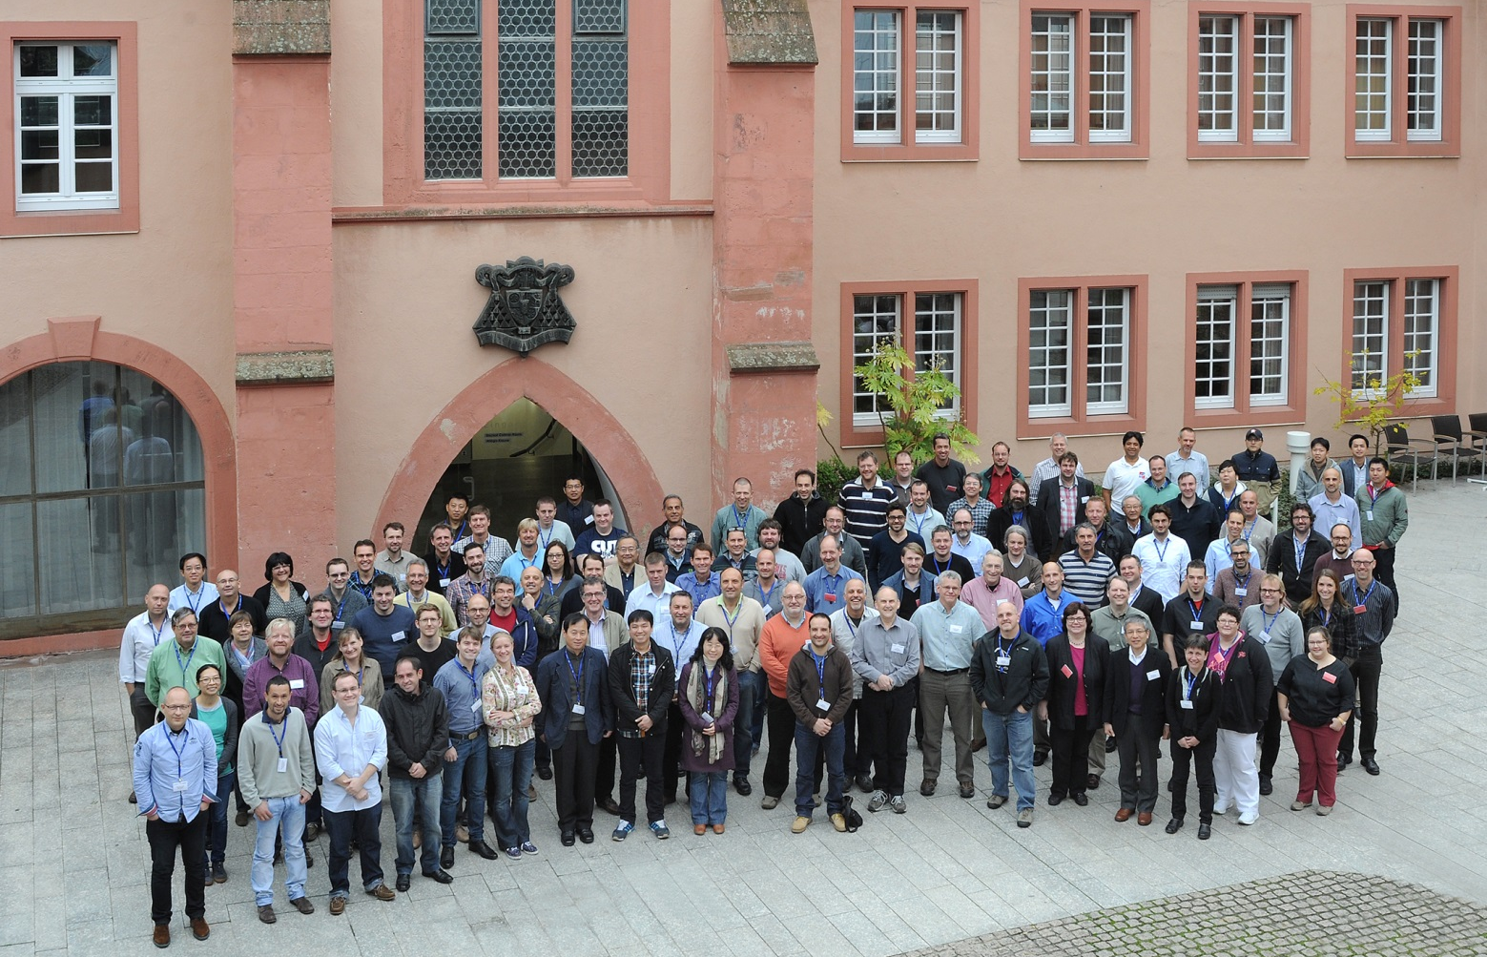

Slide 10
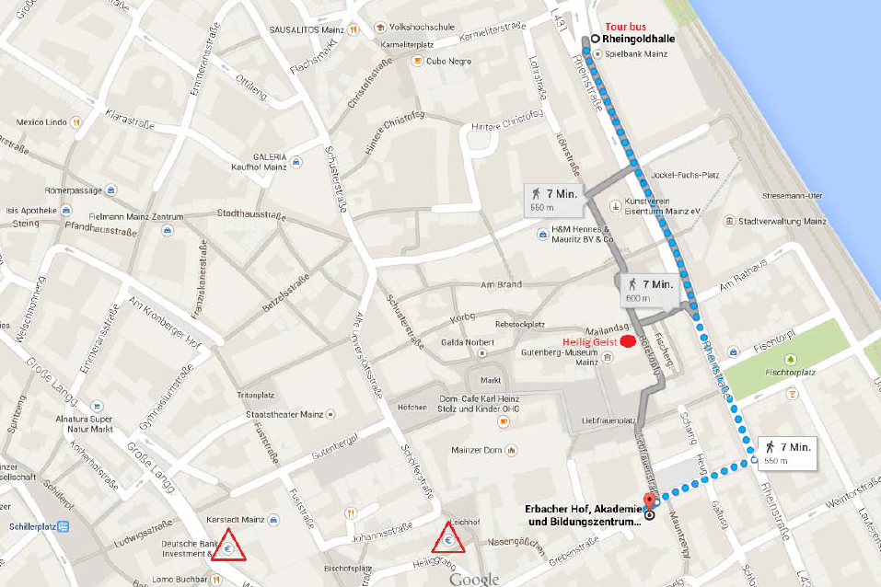
Bus to GSI:
Bus Stop
Erbacher Hof

