Slide 1
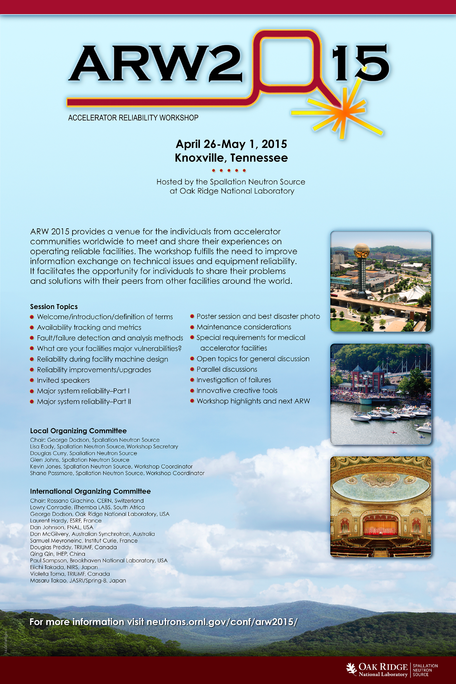

Slide 4
http://www.accelerator-reliability.org/
The first ARW was held in Grenoble in 2002 and since then has been held in Canada, South Africa and Australia. It is normally held every two years. The next ARW will be held in Tennessee in 2015. Follow the link to see all previous workshops.
http://reliability.forumotion.com/

