Slide 1
Progress toward a New Control Room for the SLAC Accelerators
WAO 2014
Michael Stanek
27-October-2014

Slide 2
SLAC National Accelerator Laboratory
A multi-discipline laboratory operated by Stanford University for the US Department of Energy since 1962.
Originally created for high energy particle physics
3 km electron Linac
Fixed target end stations
Colliding beam storage rings (SPEAR, PEP, PEP2)
Linear collider arcs & final focus (SLC)
Synchrotron light source (SPEAR3 - SSRL)
X-Ray FEL (LCLS)
Photon beams for material science, biological science, atomic & molecular physics
Advance electron accelerator physics (FACET, NLCTA)

Slide 3
Facilities operated by Accelerator Operations & Safety Division
1 km Linac for LCLS X-ray FEL
2 km Linac for FACET Accelerator R & D
SPEAR3 for SSRL
Test beams from LCLS Linac to End Station A
Future: LCLS-II
1 km Superconducting RF Linac for X-ray FEL
Goal – Operate all from one control room

Slide 4
Existing Main Control Center Needs more space & more workstations!

Slide 5
MCC during Accelerator Physics studies

Slide 6
A New Accelerator Control Room would help…
More space to operate 3 accelerators
LCLS, FACET, SPEAR3
Space for commissioning and operation of future accelerators (LCLS-II, FACET-II)
Add capacity for monitoring of Conventional Facilities
Future Cryogenic plant (LCLS-II)?

Slide 7
Unique Opportunity…
SLAC Research Support Building and Infrastructure Modernization Project (2010 through 2014)
DOE funding available (Economic recovery “stimulus”)
Renovate 2 large office buildings
Upgrade the 230 kV Electrical infrastructure
Build 1 new office building for the Accelerator Directorate (~300 people)

Slide 8
Can we put a new Control Room in the new building?
Head of Accelerator Directorate (Norbert Holtkamp) advocated for space in the new RSB office building for a future control room.
End of 2010, approval to allocate space.
Proceed with Office building construction, but leave an unfinished “shell” on the first floor. (24m x 13m)
Funding level for Control Room = “to be decided”, based on how much is left from the projects listed above
Start planning!

Slide 9
New Building
Space for New Control Room
Accelerator
Existing Main Control
Center

Slide 10
Design inputs
Existing SLAC Main Control Center was remodeled in 2008
Displays & console design based on ergonomic analysis
New Control Room should preserve popular features
Address remaining problems
Noise
Not enough space for each accelerator
Temperature control & Air flow
Dark ‘cave-like’ room
Lacking Aesthetic appeal
Operations group –
brainstorming & design meetings

Slide 11
Learn from other Labs
Review Past WAO presentations
CERN – Rossano Giachino at WAO 2005
WAO 2012 Control Room overview session – Jim Morel
http://www-conf.slac.stanford.edu/wao2012/agenda.asp
Review other Accelerator Control Room layouts
Brookhaven
TJNAF
SNS at Oak Ridge
Fermilab

Slide 12
Plan, Review, Revise, repeat…
SLAC Internal review (July 2011)
System Managers, Controls Engineers, Accelerator Physicists
External review (August 2011)
WAO 2012 Program Committee meeting
Formal Requirements Document (November 2011)
Rough cost estimates
Refine Design Details & wait (2012)
Wait for main building construction to finish
Coordinate to make sure building services will support control room design
Wait for funding

Slide 13
Control Room ‘shell’ during RSB construction

Slide 14
Conceptual Design

Slide 15
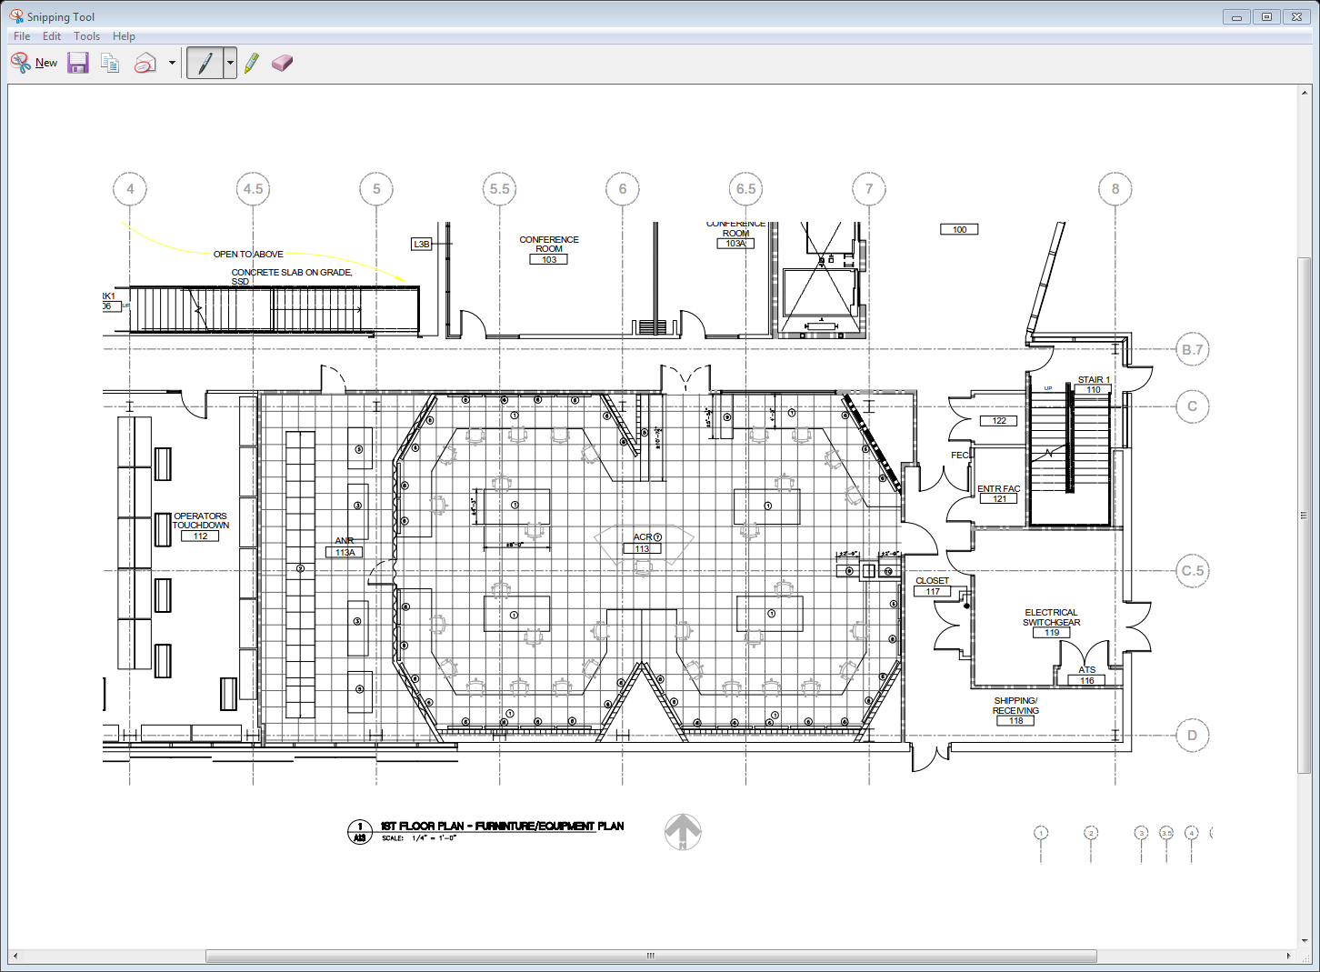
Northeast foyer of 52
Graphic of ACR layout
Window
Network
Room
(ANR)
FACET/LCLS II
Support
(ICD, Facilities)
LCLS
SPEAR 3
Conduits (16) to manhole, then to Bldg 5, 50

Slide 16
Artist Rendering (early 2013)

Slide 17
Key Design Features
Separate Heating, Ventilation & Air Conditioning systems for Control Room & Network Room
Raised computer floor, cable trays, “in-wall” conduits
All power circuits on backup generator
many with UPS
5 adjustable lighting zones
Conduits to existing MCC & SPEAR3

Slide 18
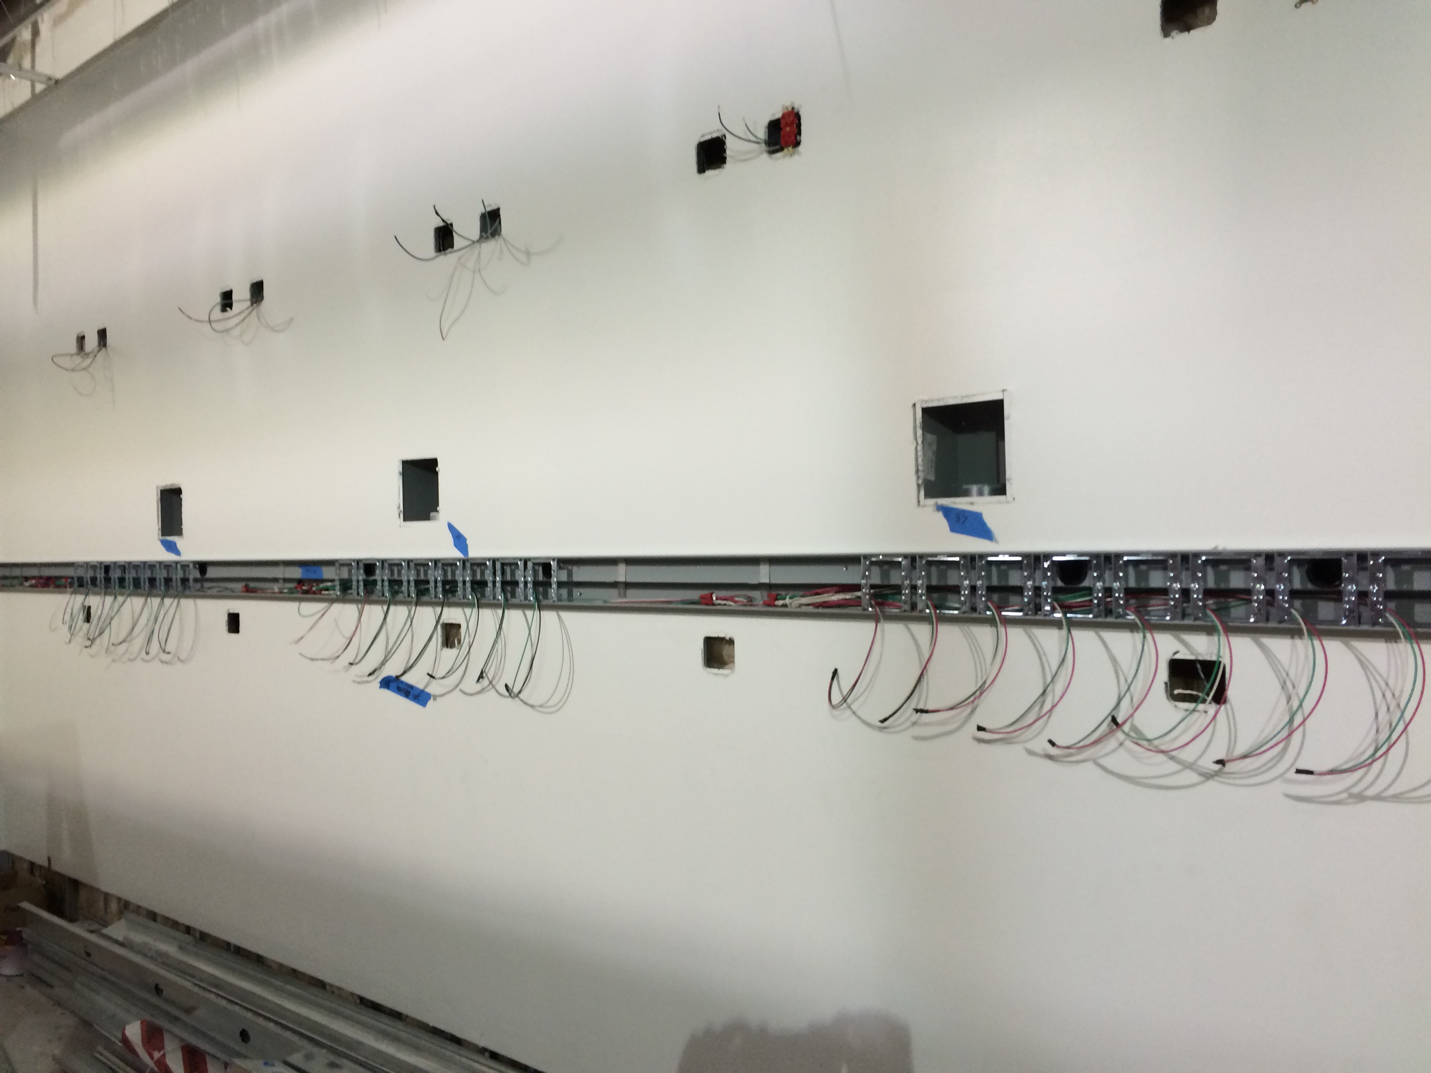
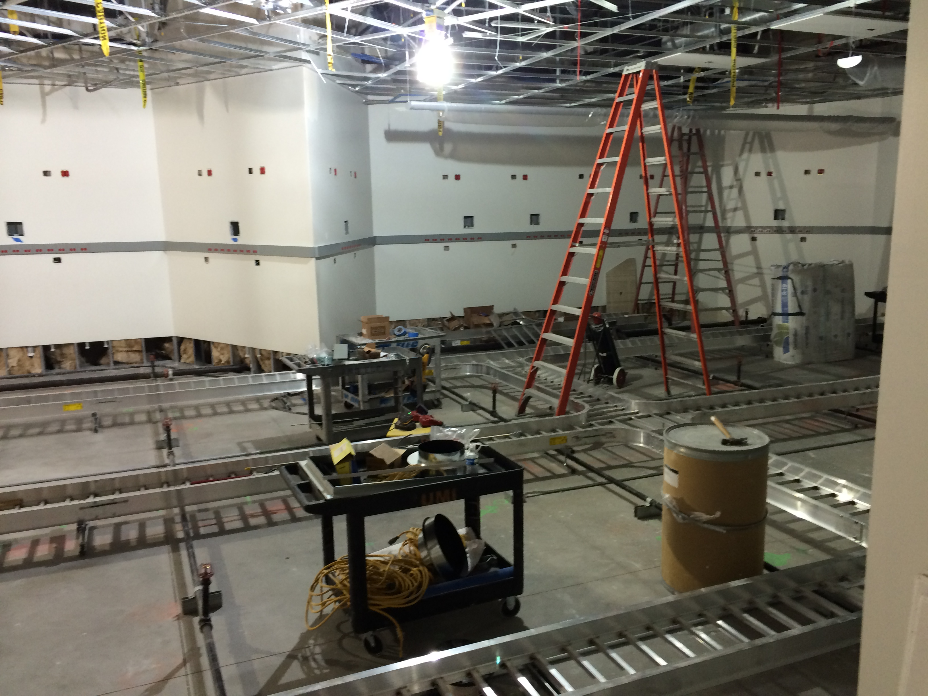
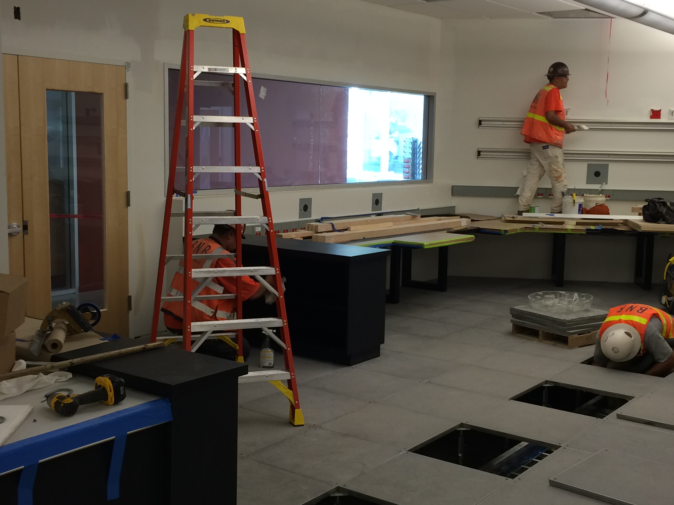
Under Construction (September 2014)

Slide 19
Key features (2)
Separate work areas for 4 Accelerator programs
Workstation computers are rack-mounted in a separate Network room for sound & temperature isolation
KVM extenders (USB) to each keyboard location
DVI video cable repeaters (CAT6) to each monitor
Tested in existing MCC
Overhead Display Monitors mounted on a track system
34 large (55”) monitors, 68 smaller (24”) monitors
Improved Air flow
Supply air in the center of the room, Return on the edges
Large window for tour groups
Allows some direct outdoor light

Slide 20
More than 2 times the space.

Slide 21
Final Design & Construction
End of 2012, initial funds available
Contractor hired to formalize conceptual design & drawings
End of 2013, more funds available
Feb 2014 – Contract signed for ‘Design & Build’ (outside company)
June 2014 Civil Construction started
October 2014 Civil Construction complete
October 2014 – August 2015
Network cables will be installed
IT equipment will be purchased & installed
August 2015 Accelerator shutdown
Move Operations to the new Control Room

Slide 22
Current Status: Civil Construction completed Oct 14, 2014

Slide 23
Adjacent Network room

Slide 24
Ready for SLAC Cable & Controls installation Starting October 27 (today!)

Slide 25
Budget
Civil Construction
Design & Build contract (outside company)
$3.7 Million (US)
IT Equipment, Cabling, Instrumentation & Controls
~$ 0.8 M Materials
~$ 0.3 M SLAC Labor

Slide 26
Concerns
Completion of custom Safety System interface electronics in time for Aug 2015 move-in.
Time window for final migration & testing is short.
6 week Accelerator shutdown Aug-Sept 2015
Difficult to ‘fall back’
New ACR location is more accessible for non-Operations personnel.
Door locks with RF ID Card readers.
Database of persons approved for entry.
Limited Parking!

Slide 27
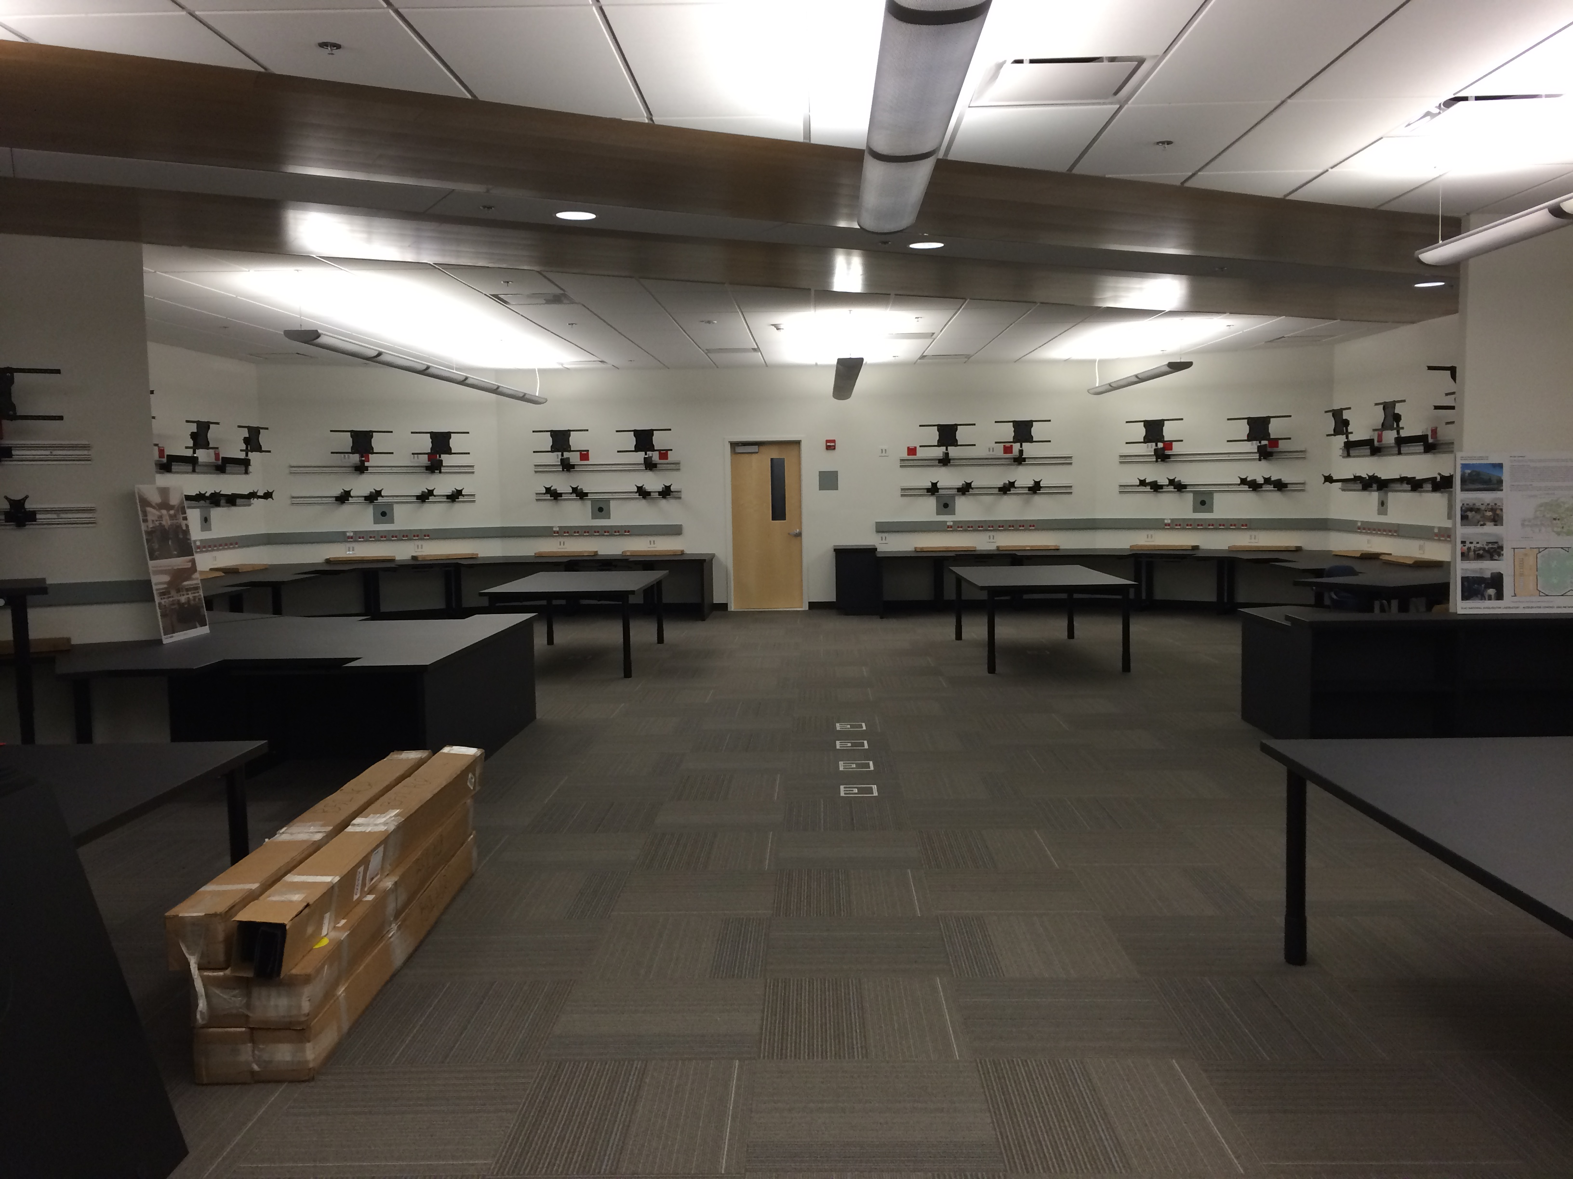
We are very satisfied with the results so far.
Looking forward to Operation in September 2015!
Thank you for your attention.
Questions?

Slide 28
Backup slides

Slide 29
Original Project schedule (completion Aug 2014)
Delays
Oct 2014
Compression

