Slide 1




National Insitute of Nuclear Physics
University of Padova, Italy
(founded 1222)
Dept. of Physics and Astronomy
Lorenzo FORTUNATO
Pairing in 6He, Giant Pairing Vibrations in Carbon and pair-transfer in reactions

Slide 2

Outlook of presentation
I will give a brief account of some of the research in theoretical nuclear physics performed at the Dept. of Physics & Astronomy at Padova University focusing on pairing related phenomena:
Pairing in Borromean 6He system: ground state stability, excited states and
E.M. response [with J.Singh, R.Chatterjee and A.Vitturi, PRC 90 (2014) 064301 ]
Evidence for the existence of Giant Pairing Vibrations in carbon isotopes
[Cappuzzello, F. et al. Signatures of the Giant Pairing Vibration in the 14C and 15C atomic nuclei. Nat. Commun. 6:6743 (2015) ]
Pairing correlations in microscopic two-particle transfer reactions: 112Sn,
32Mg, and 68Ni [J. A. Lay, L. Fortunato, and A.Vitturi, PRC 89 (2014) 034618]

Slide 3
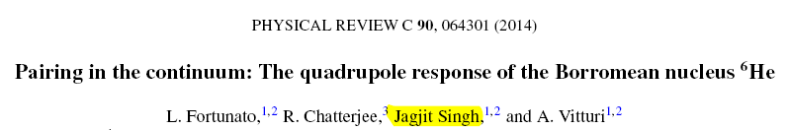
1) Pairing in 6He
Both experimentally and theoretically there are still large uncertainties on the structure of light systems close to the drip-line. The case I want to discuss is ⁶He and its connections with ⁵He.
⁴He is very tightly bound (core exc. are at very high energy)
⁵He is unbound (two low-lying resonances)
⁶He is weakly bound in its g.s. and it has a number of resonances that have been recently re-investigated at GANIL. ⁶He is borromean it has halo features and one would like to understand the role of the pairing interaction in making it bound.
*** X. Mougeot et al., Phys. Lett. B 718, 441 (2012).
p(⁸He,t) reaction
In addition, new and still not very much investigated data claim the existence of a dozen new excited states of 6He:
Highly Excited States of 6He - Yu. B. Gurov, et al. Bulletin of the Russian Academy of Sciences. Physics, 2015, Vol. 79, No. 4, pp. 470–473.
Spectrum of resonance states in 6He. Experimental and theoretical analyses - O.M. Povoroznyk, V.S. Vasilevsky Ukr. J. Phys. 2015. Vol. 60, No. 3

Slide 4
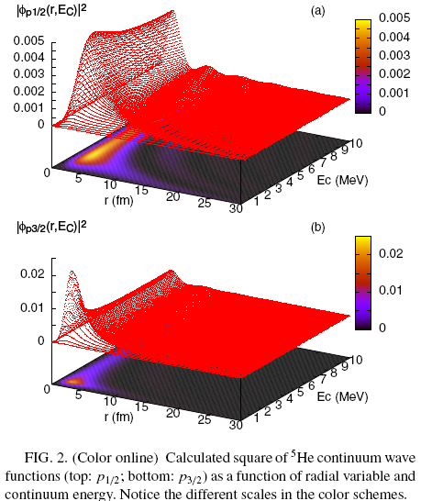
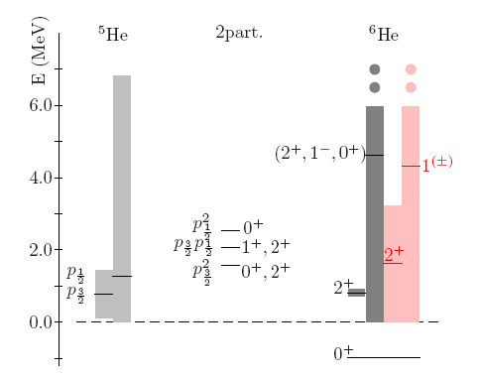
Pairing in 6He
A phenomenological alpha-n potential is adjusted to correctly reproduce the p-resonances of 5He (doublechecked with S-matrix poles analysis)

Slide 5

Two-particle states built out of single-particle continuum states
Each single-particle unbound orbital reads :
The two-particle states can be constructed as :
 | p3/2 | p1/2
p3/2 | 0+, 2+ | 1+, 2+
p1/2 |  | 0+
Total of 5 states built from p² configurations
We are updating our model-space in order to include s- and d- continuum waves that will allow the treatment of electric dipole transitions in 6He and other features (See Back-up slides for complete table).

Slide 6



Procedure
Construct ⁵He p_{3/2} and p_{1/2} states from 0-10 MeV
Construct the two-particle basis states with given J
Calculate the matrix elem. with Pairing interaction
(2.4 Gb each !)
( ~ 9 Gb !! )
Very computationally demanding !!!
(Data storage)
( 0.5 Mb )
Diagonalize the total hamiltonian:
H= ε₁+ε₂+<|V|>
Get eigenvalues and eigenvectors
g
( ~ 9.7 Gb !! )
This needs to be adjusted to available data. Not known a priori.

Slide 7
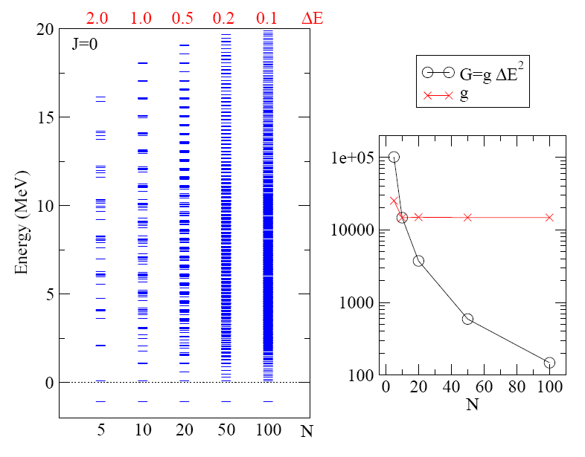
Results for different basis size (=density of states)

Slide 8
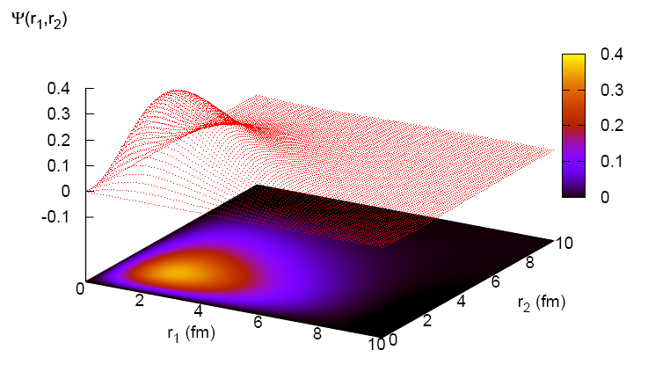
Results : bound ground state
The binding is due to the pairing interaction! The g.s. has a nice exponentially decaying behaviour despite being the superposition of 20000 coupled s.p. continuum states (E_{C}>0)!

Slide 9
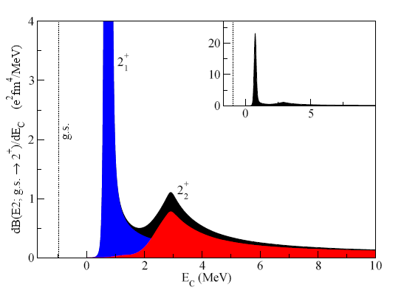
Quadrupole E2+ response to continuum
Centroid ~0.76 MeV
Width ~0.2 MeV
Centroid ~2.91 MeV
Width ~1.8 MeV
The calculation is limited to a reduced model space containing only (p3/2)² configurations (that is 0⁺ and first 2⁺), used to find the appropriate value for the pairing strength that reproduces the narrow 2⁺ resonance.
L. Fortunato

Slide 10
Preliminary results from J.Singh - ρ
About 140° and slightly smaller
About 40° and slightly larger and more diffuse
Plot of density. Virtually identical to the results of Hagino and Sagawa PRC 72 (2005)
L. Fortunato

Slide 11
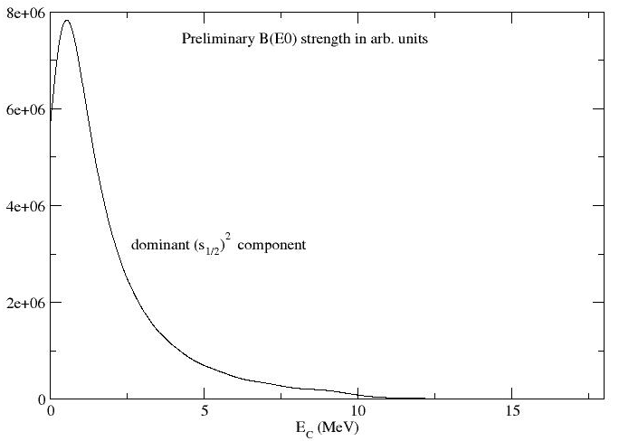
Preliminary results from J.Singh – E0
E0 transition strength, shows a peak at low energies (0.5-0.6 MeV) dominated by s² components. No other excited 0+ strength visible! This suggests that using E0 is not a good way to investigate excited 0+ states!
L. Fortunato

Slide 12
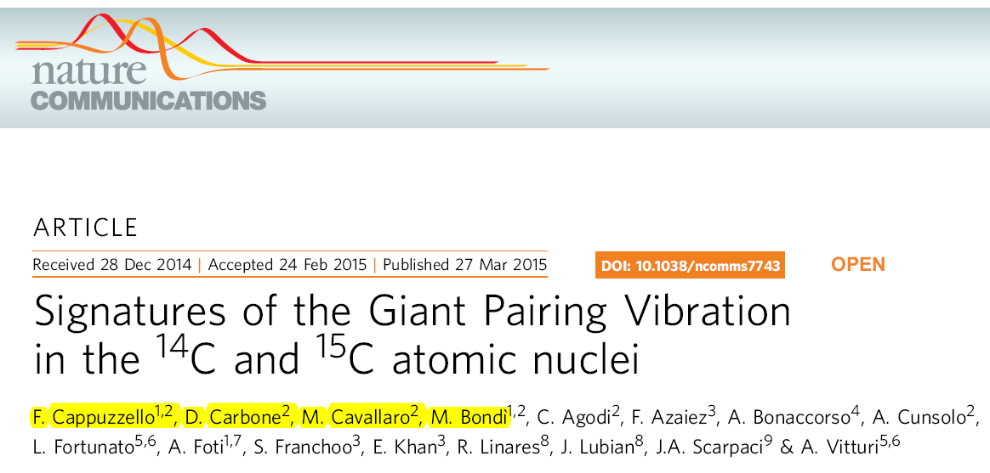
2) Signatures of GPV observed in 14 and 15 Carbon
Catania, Padova, Pisa (ITA)
Orsay (FRA)
Rio de Janeiro (BRA)

Slide 13
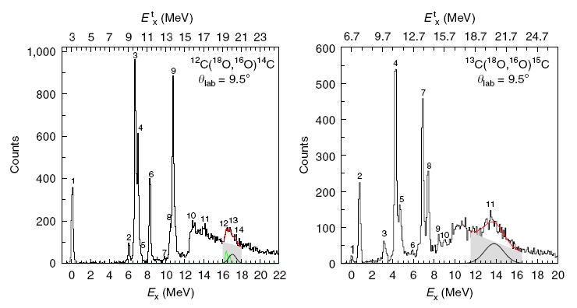
Signatures of GPV observed at MAGNEX-LNS, Italy
Recently F.Cappuzzello and his team at the LNS (Laboratori Nazionali del Sud, Catania, Italy ) using the MAGNEX spectrometer have separated the ejectiles from the 12C(18O,16O)14C and 13C(18O,16O)15C reactions at 84MeV incident lab energy, determining energy spectrum and angular distributions.

Slide 14
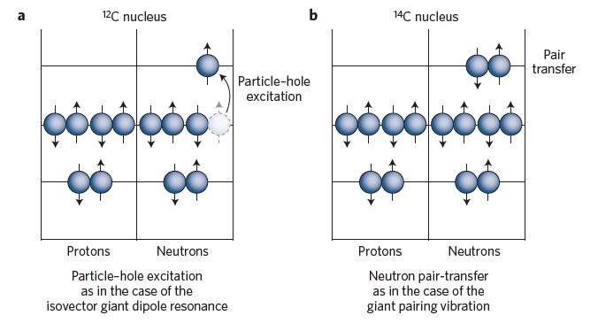
Giant Pairing Vibration or GPV
The elusive Giant Pairing Vibration is predicted (Bes and Broglia, 1977) to be a L=0+ collective excitation mode microscopically made by a coherent superposition of particle-particle (or hole-hole) states in analogy to the experimentally well-established coherent collective modes made of particle-hole states, known as giant (monopole, dipole, quadrupole, ... ) vibrations, or GMR, GDR, GQR, etc. Evidence for the existence of this mode is crucial to demonstrate the assumption of particle-hole symmetry in nuclei.
Figure from J.Piekarewicz, «Two more or less», Nat.Phys. News&Views, Vol.11 (2015)

Slide 15
A number non-conserving breathing mode...
A+2
>R
A
R
A-2
>R
Can be «macroscopically» visualized as a breathing (monopole L=0) oscillation (back and forth) across different mass partitions.

Slide 16
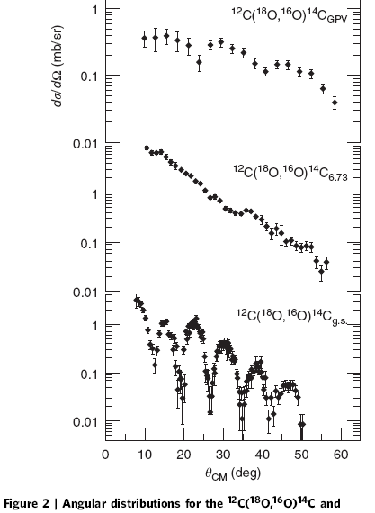
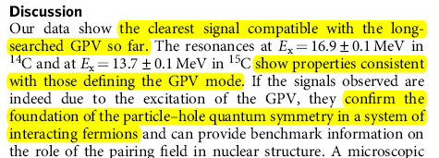
Evidence for a 0+ collective mode
The conclusion of the present investigation is that there is evidence for an accumulation of monopole strength (from the oscillations and from theoretical models) at about 16.9 MeV of excitation energy in 14C
[ and similarly at 13.7 MeV in 15C]
The collective character of this mode is investigated by comparing the extracted transfer probability with that of the L=0 ground state and the ratio is about 3. This is of course a model dependent extraction.

Slide 17
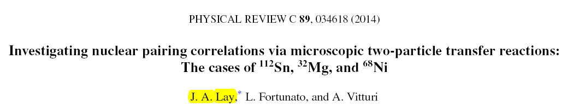
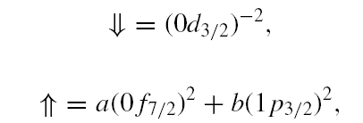
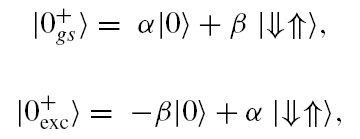
3) Pairing correlations in 2n-transfer reactions
Two-neutron transfer reactions are a wonderful tool to clarify spectroscopic data. We investigate the selectivity of (t,p), (18O,16O), and (14C,12C) reactions in enhancing the population of different states in selected targets : we have taken 112Sn as an
example of superfluid nucleus, and 32Mg and 68Ni to study shell evolution for exotic nuclei.
I will discuss here only the case of 32Mg, that is situated in the island of inversion, where the sequence of single-particle shell-model states is thought to be inverted w.r.t. the «standard».
The g.s. of 32Mg should involve 2n in the 0d_{3/2} shell model state, while a transition to the next excited 0+ state should involve the 0f_{7/2} orbital. We expect pairing correlations to induce mixing of configurations leading to orthogonal mixtures of 0p-0h states (|0>) with 2p-2h states ⇓⇑

Slide 18
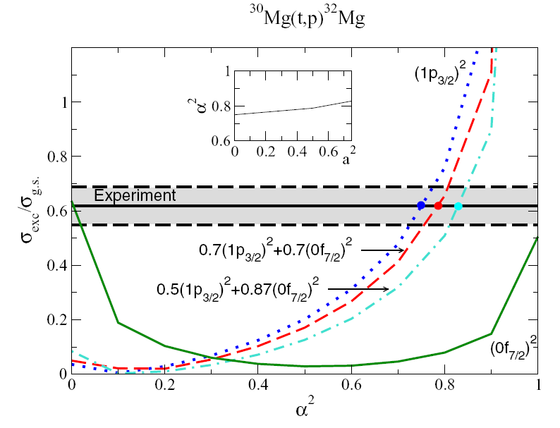
32-Magnesium: ratio of cross-sections in DWBA calcs.

Slide 19
Conclusions
Pairing interactions, collective modes based on pairing, pairing correlations in nuclear reactions are still largely unknown and largely experimentally and theoretically unexplored due to intrinsic difficulties.
Nonetheless they are at the very basis of our understanding of profound concepts like, for instance, the particle-hole symmetry in strongly interacting fermion systems.
They also provide precise tests for spectroscopic data and they allow the extraction of useful information on the microscopic structure of nuclei. This is especially relevant when moving away from beta-stability out to the drip-line in regions where the pairing interaction might turn out to be more than just a part of the residual interaction.
I hope with this talk to have aroused interest in the fascinating series of phenomena based on pairing.
Bedankt voor uwe aandacht !

Slide 20
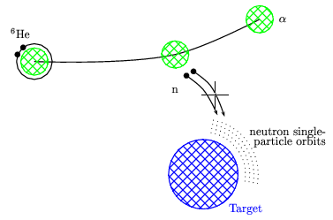
Back-up slides

Slide 21
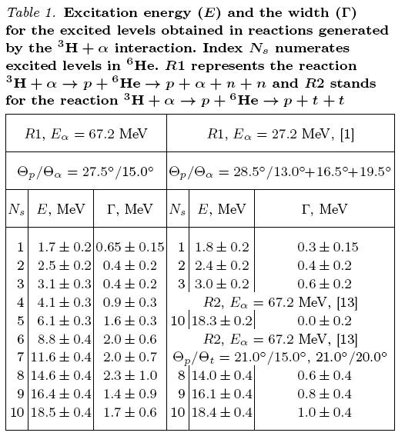
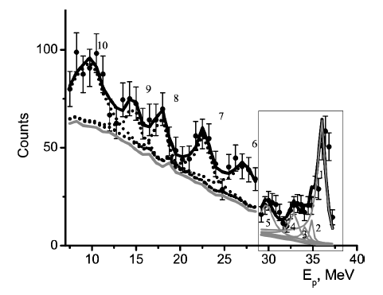
“Spectrum of resonance states in 6He. Experimental and theoretical analyses “
O.M. Povoroznyk, V.S. Vasilevsky Ukr. J. Phys. 2015. Vol. 60, No. 3

Slide 22
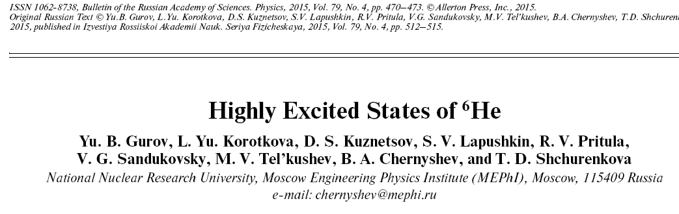
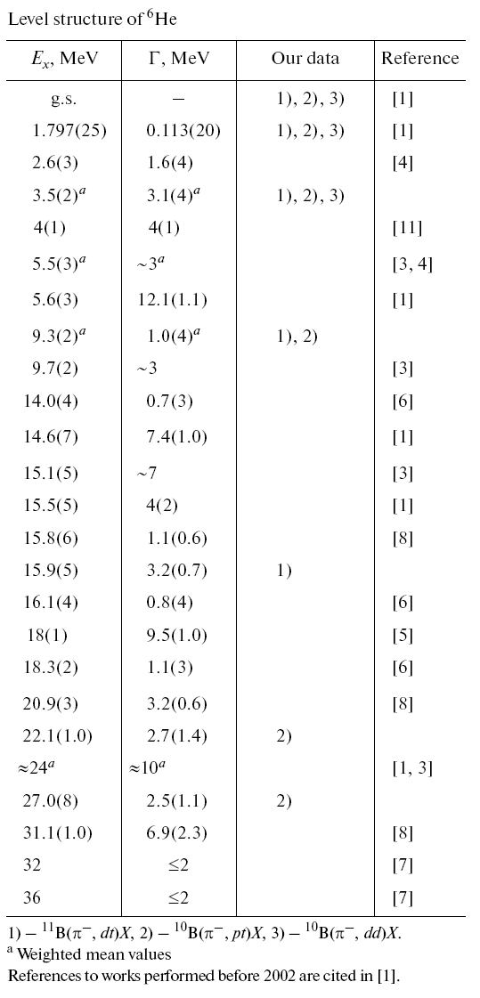
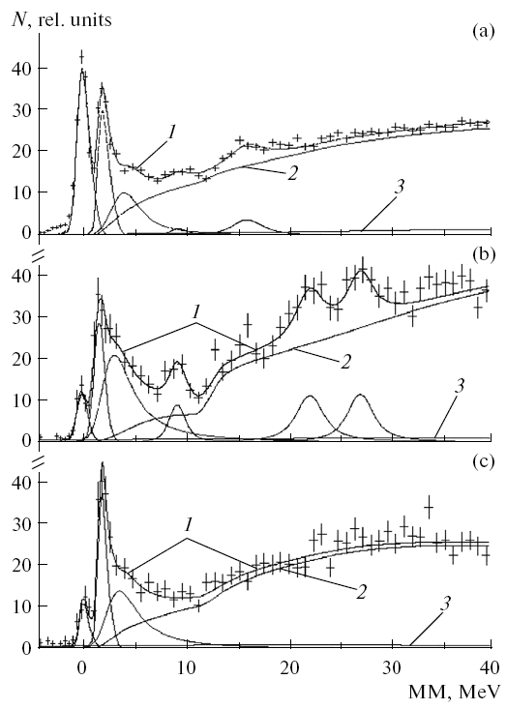

Slide 23
Enlarged model space s- p- d- will allow calculation of E0, E1, E2, E3, M1, among others.
 | s1/2 | p1/2 | p3/2 | d3/2 | d5/2
s1/2 | 0+ | 0-, 1- | 1-, 2- | 1+, 2+ | 2+,3+
p1/2 |  | 0+ | 1+, 2+ | 1-, 2- | 2-, 3-
p3/2 |  |  | 0+,2+ | 0-, 1-, 2-, 3- | 1-, 2-, 3-, 4-
d3/2 |  |  |  | 0+, 2+ | 1+, 2+, 3+,4+
d5/2 |  |  |  |  | 0+, 2+, 4+
0+: 5 states
1+: 3 states
2+: 7 states
3+: 2 states
4+: 2 states
0-: 2 states
1-: 4 states
2-: 3 states
3-: 2 states
4-: 1 state

