Slide 1
Status of the Bucharest ams facility
T. Sava, O.Gâza, I. Stanciu, D. Păceșilă, D. Ghiță, B. Ștefan, C. Simion
Institutul National de Fizica si Inginerie Nucleara – Horia Hulubei
Horia Hulubei – National Institute for Physics and Nuclear Engineering

Slide 2
Contents:
Bucharest AMS (Accelerator Mass Spectrometry) center
- localization
- facility
- ¹⁴C dating method
SIRI (Sixt International Radiocarbon Inter-comparison) test
    - samples
    AMS measurements and calculations
    results

Slide 3
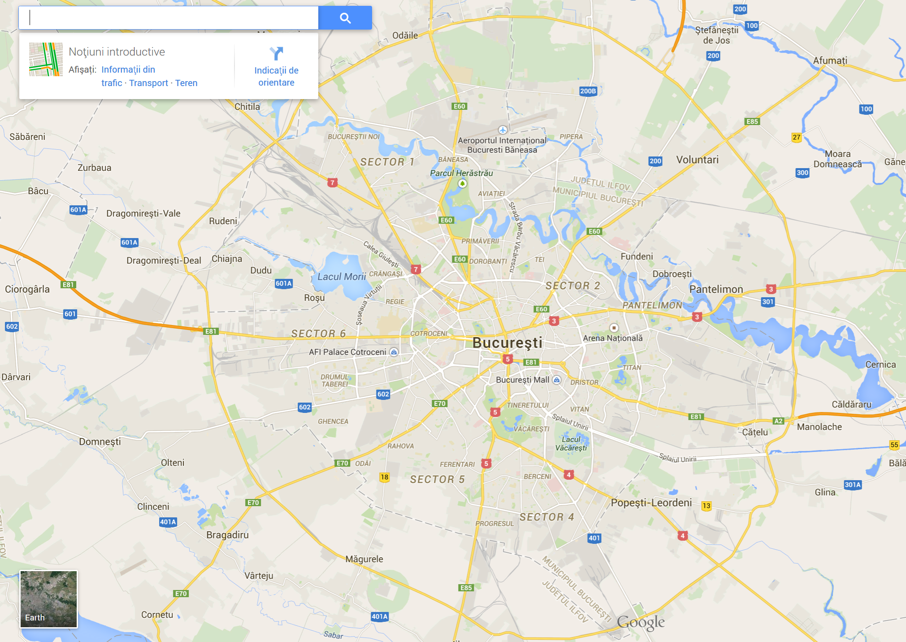
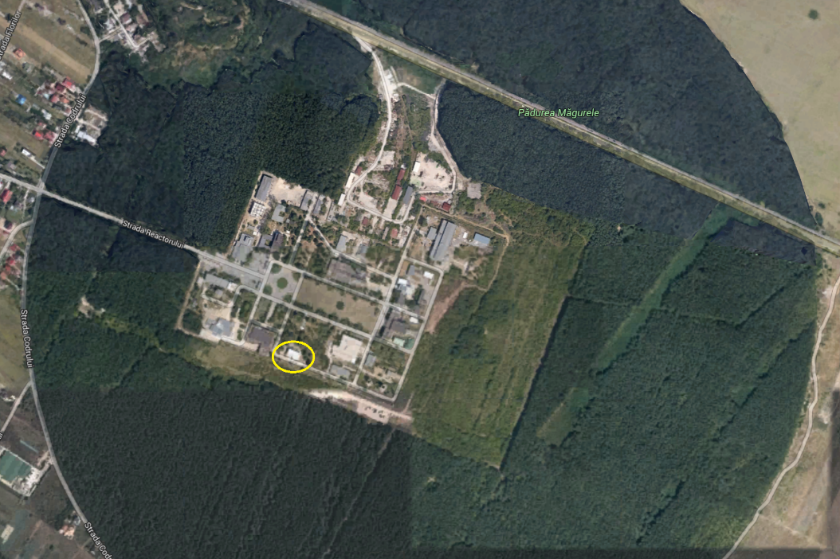
Institutul National De Fizica si Inginerie Nucleara – IFIN-HH

Slide 4
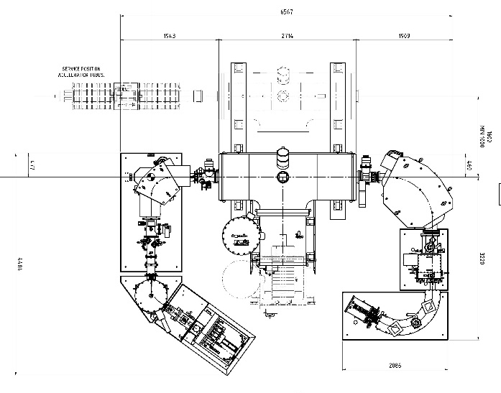
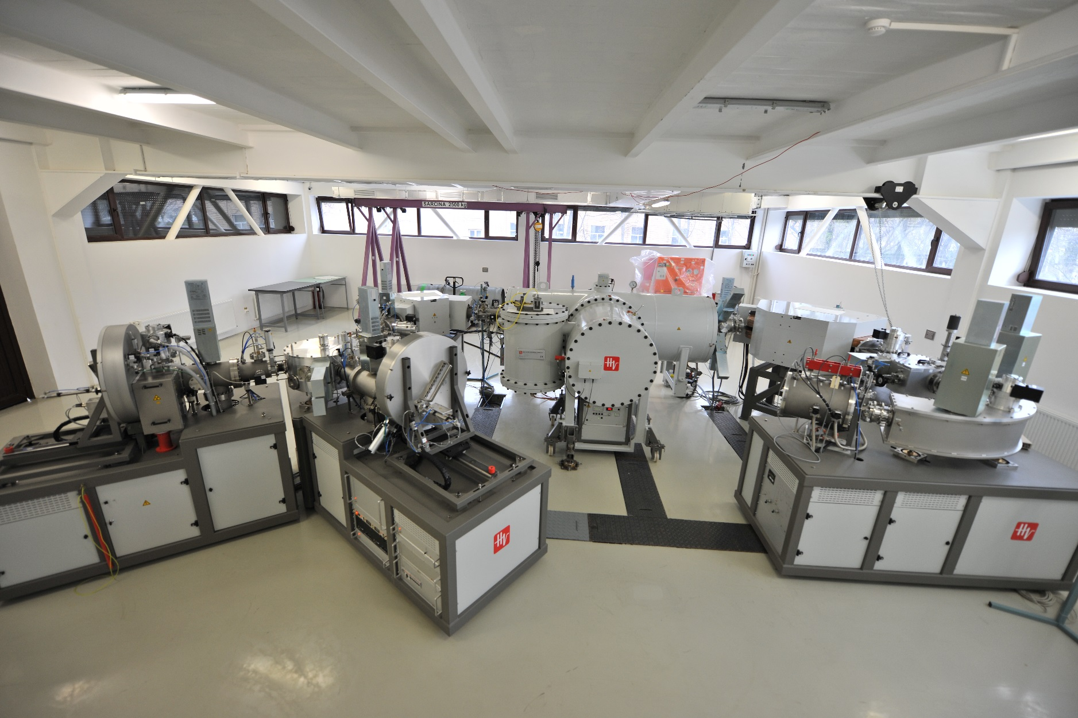
The 1 MV Tandetron – AMS (Accelerator Mass Spectrometry) machine
Courtesy of HVEE Nedherland

Slide 5
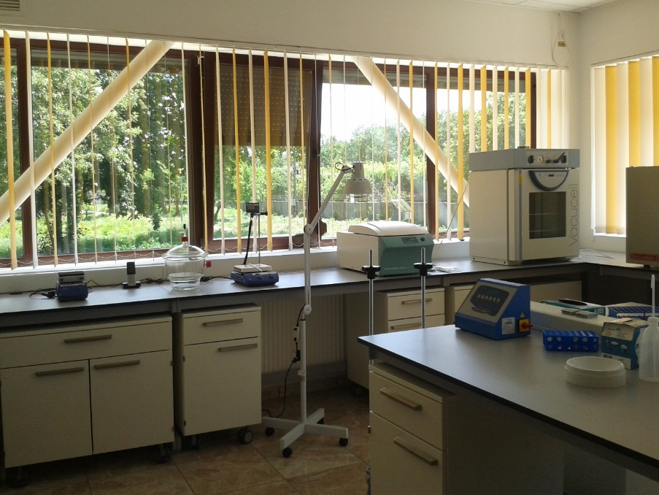
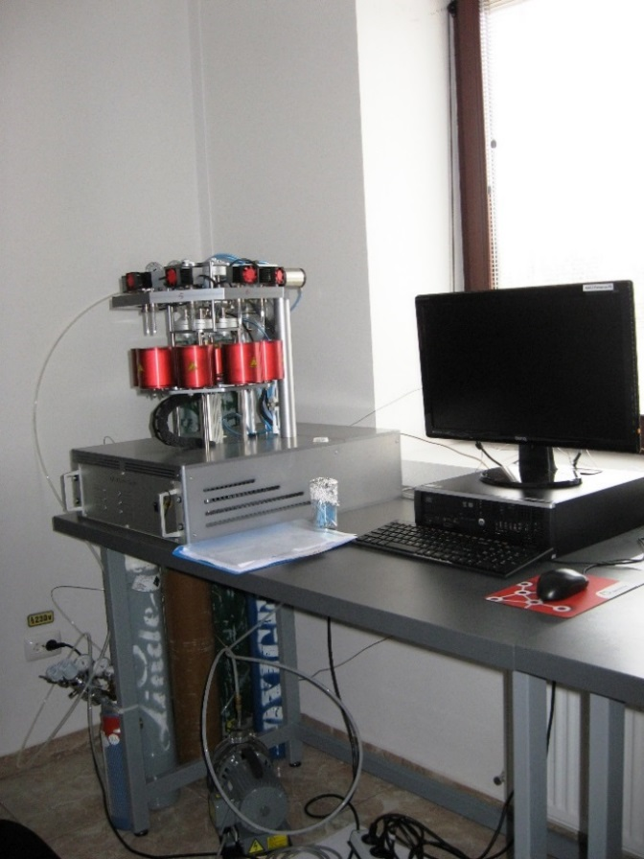
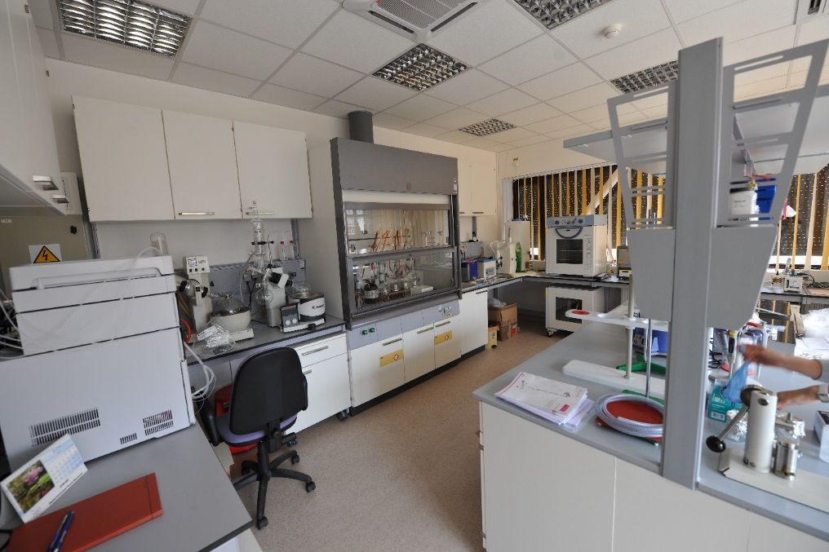
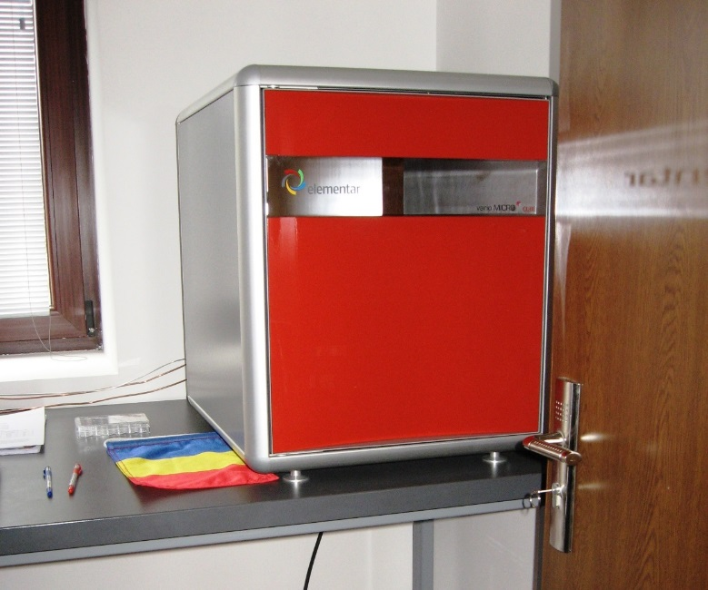
Courtesy of
ETHZ – Ionplus AG
Chemistry laboratories
for sample preparation
Isotope ratios measured for:
Carbon (¹⁴C, ¹³C, ¹²C)
Beryllium (¹⁰Be, ⁹Be)
Aluminum (²⁷Al, ²⁶Al)
Iodine (¹²⁹I, ¹²⁷I), etc.
Applications in:
Cultural heritage preservation
Geology
Environmental studies
Homeland security
Energetics
etc.
Courtesy of
ETHZ – Ionplus AG

Slide 6
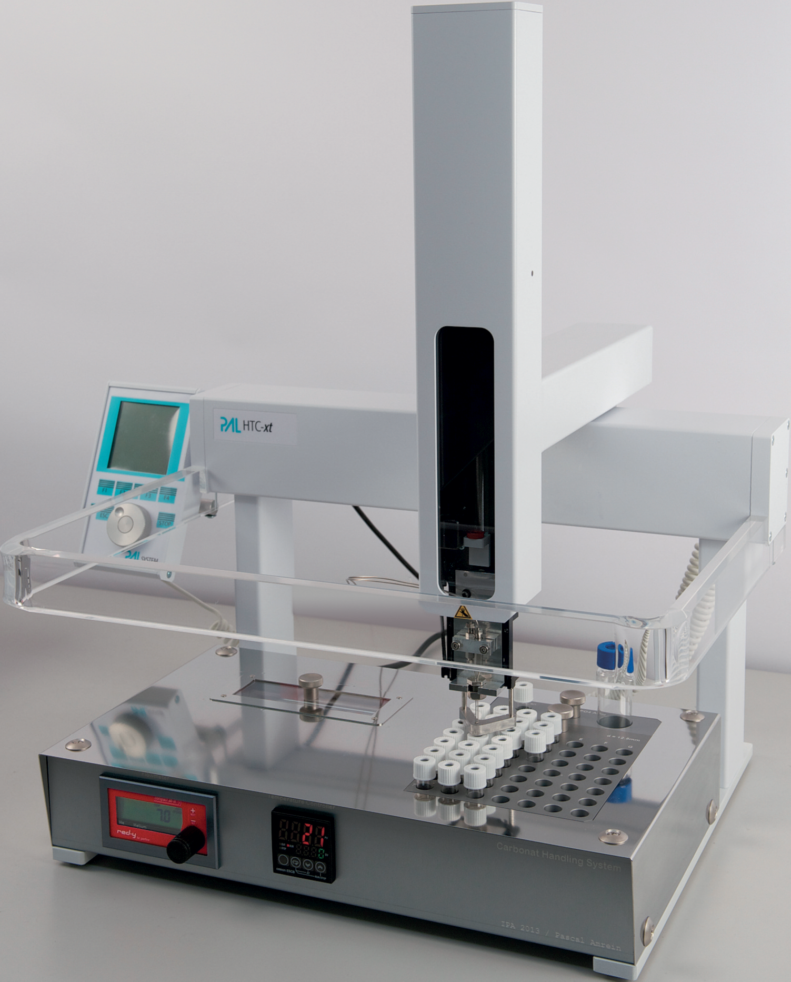

- Necessary quantity of carbon for a ¹⁴C dating – 1 mg
- For shells this is extracted from ~ 10 mg of sample
Procedure
Cleaning by sand-blasting or acid treatment, then sonication in ultrapure water;
Phosphoric acid (75-103%) treatment;
CO₂ is transferred through the water trap to the zeolite trap via helium gas jet;
CO2 is converted to graphite under hydrogen reaction.
Courtesy of
ETHZ – Ionplus AG
Carbonate sample with phosphoric acid

Slide 7
¹⁴C dating method:
¹⁴C dating in a nutshell
¹⁴C dating means to measure de ¹⁴C/¹²C ratio in an object of unknown age and to compare it with a piece of wood of known age, which has the same ¹⁴C content

Slide 8
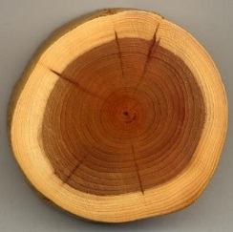
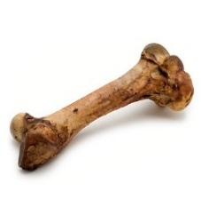
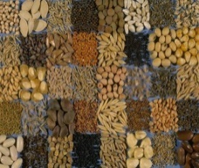
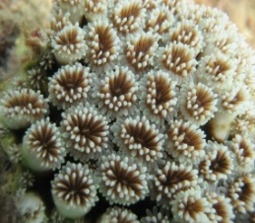
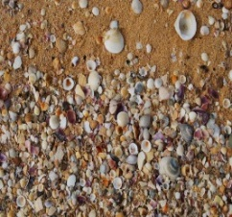

¹⁴C dating:
Types of samples that can be dated via ¹⁴C:
Bones
Wood
Seeds
Corals
Shells
Sediments
Textiles
Mortars
Alloys
Water
Paper

Slide 9
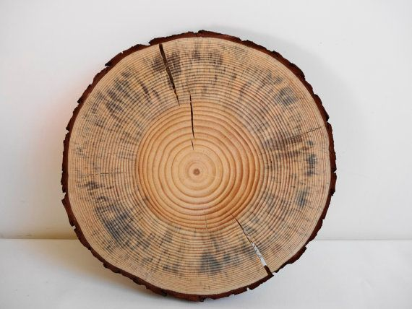
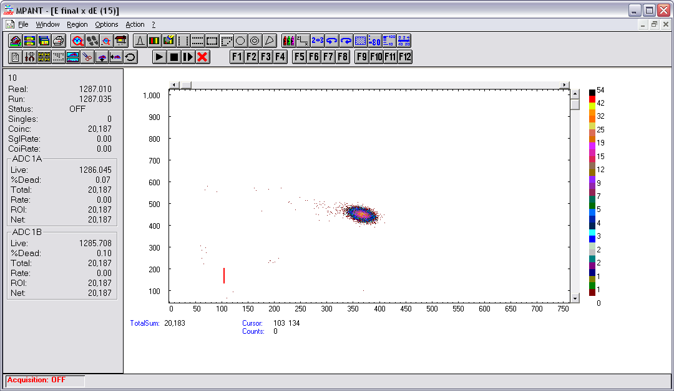
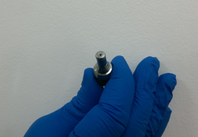
Measuring sensitivity →10⁻¹⁵ / Method limit ~ 10 x T_{1/2} ~ 55000 Years

Slide 10
SIRI (Sixt International Radiocarbon Inter-comparison) proficiency test
- Coordinated by Marian Scott (University of Glasgow) -
Code | Type | Sample description | Provider
Sample A | Wood | Reichwalde 3 (Miocene) | Univ. of Hohenheim
Sample B | Bone | Mammal bone (Pleistocene) from North Sea | Prof. Hans van der Plitcht
Sample C | Bone | Mammoth bone (Marine Isotope Stage 7; background sample) | Dr. Alex Bayliss (English Heritage) Dr. Katharine Scott (St. Cross College)
Sample D | Barley mash | Scottish whisky distillery
Sample F | Wood | Medieval period (floor joist) | Queens University of Belfast
Sample G | Wood | Medieval period (floor joist) | Queens University of Belfast
Sample H | Wood | Medieval period (floor joist) | Queens University of Belfast
Sample I | Wood | Tree ring from Lake Gribben | Irina Panyushkina, University of Arizona
Sample J | Charcoal | Paleolithic site
Sample K | Carbonate | Doblespar from Island | Prof. J. Heinemeier
Sample L | Wood | From Oregon, background sample | Irina Panyushkina, University of Arizona
Sample N | Humic acid | < 1 half-life from peat deposit, Scotland

Slide 11
SIRI (Sixt International Radiocarbon Inter-comparison) proficiency test
- Coordinated by Marian Scott (University of Glasgow) -
Code | Type | Sample description | Pre-treatment
Sample A | Wood | Reichwalde 3 (Miocene) | Cellulose extraction (acid-base-acid)
Sample B | Bone | Mammal bone (Pleistocene) from North Sea | Collagen extraction (demineralization-ultrafiltration)
Sample C | Bone | Mammoth bone (Marine Isotope Stage 7; background sample) | Collagen extraction (demineralization-ultrafiltration)
Sample D | Barley mash | Scottish whisky distillery | Sonication
Sample F | Wood | Medieval period (floor joist) | Cellulose extraction (acid-base-acid)
Sample G | Wood | Medieval period (floor joist) | Cellulose extraction (acid-base-acid)
Sample H | Wood | Medieval period (floor joist) | Cellulose extraction (acid-base-acid)
Sample I | Wood | Tree ring from Lake Gribben | Cellulose extraction (acid-base-acid)
Sample J | Charcoal | Paleolithic site | Direct AMS measurement
Sample K | Carbonate | Doblespar from Island | Acid dissolving and graphitization
Sample L | Wood | From Oregon, background sample | Cellulose extraction (acid-base-acid)
Sample N | Humic acid | < 1 half-life from peat deposit, Scotland | Direct graphitization

Slide 12
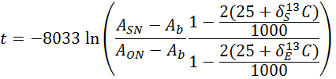
Some units and calculations
A_{SN}= sample ¹⁴C/¹²C ratio
A_{ON}= standard ¹⁴C/¹²C ratio
A_{b}= background ¹⁴C/¹²C ratio
δ¹³C = measure of isotope
fractionation
Background corrected;
Fractionation corrected;
Beam current corrected.

Slide 13
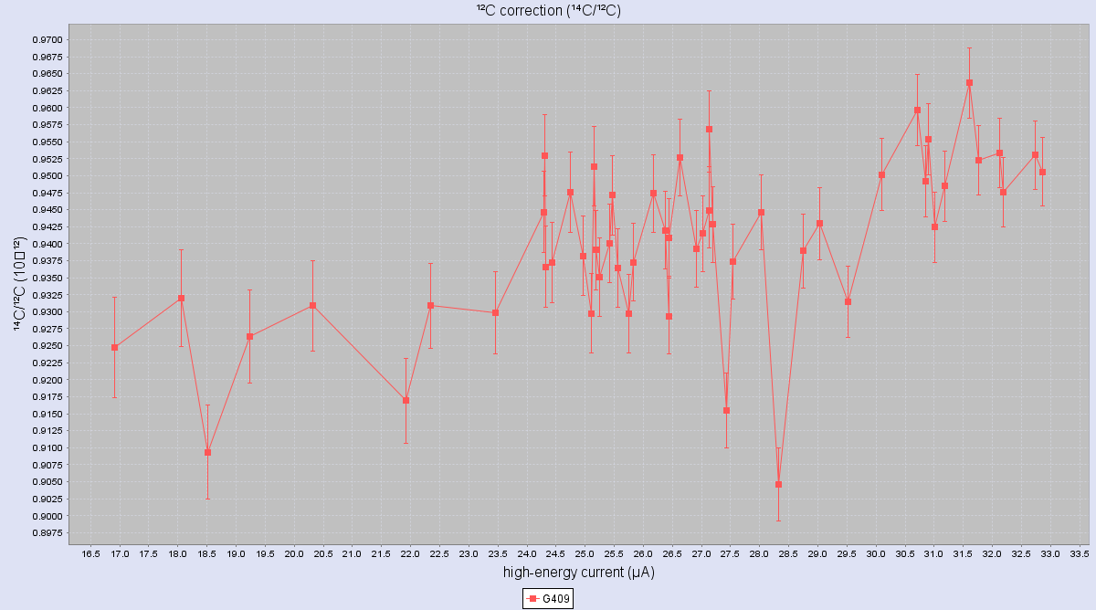
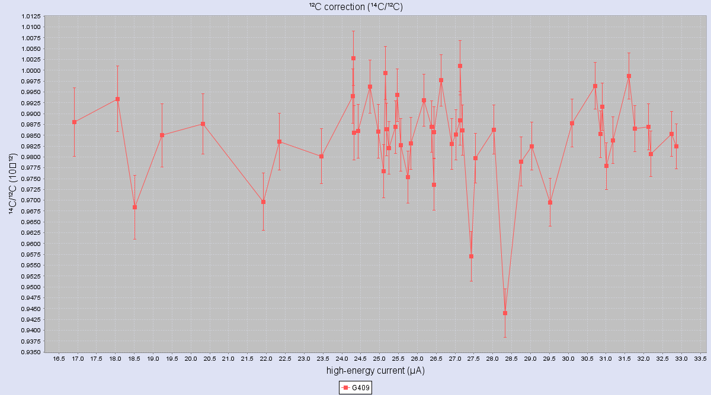
¹⁴C/¹²C ratio is depending by the ¹²C current → an additional correction
Correction is made on the standard material OXA2

Slide 14
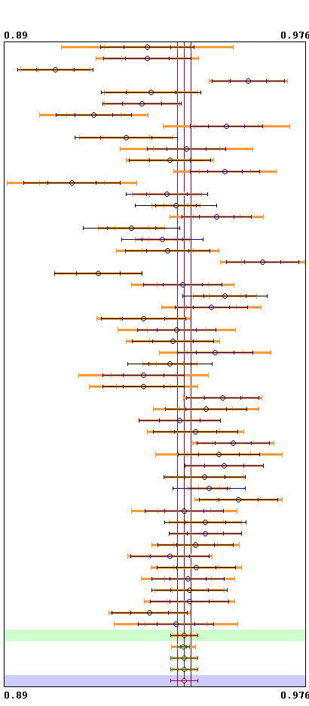
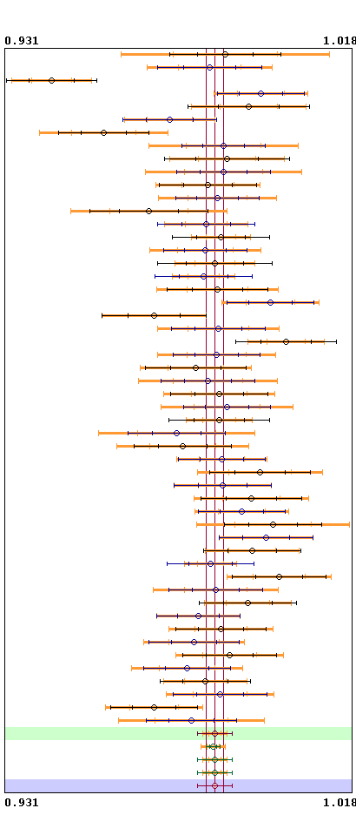
Without
¹²C current correction
With¹²C current correction

Slide 15
Code | Type | Sample description | Age info | Age measurement
Sample A | Wood | Reichwalde 3 (Miocene) | background | Background (> 55000 years)
Sample B | Bone | Mammal bone (Pleistocene) from North Sea | ~ 40,000 years | 40,403 (366) BP
Sample C | Bone | Mammoth bone (Marine Isotope Stage 7; background sample) | background | Background (> 55000 years)
Sample D | Barley mash | Scottish whisky distillery, collected 2013 | pMC ~ 103% | pMC = 103,1% (0,2)
Sample F | Wood | Medieval period (floor joist) | ~ 1487 AD | 1548 (28) AD
Sample G | Wood | Medieval period (floor joist) | ~ 1479 AD | 1557 (30) AD
Sample H | Wood | Medieval period (floor joist) | ~ 1475 AD | 1578 (29) AD
Sample I | Wood | Tree ring from Lake Gribben | ~ 11,300 -11,170 cal BP | 10109 (36) BP
Sample J | Charcoal | Paleolithic site | Paleolithic | 32570 (156)
Sample K | Carbonate | Doblespar from Island | background | Background (> 55000 years)
Sample L | Wood | From Oregon, background sample | background | Background (> 55000 years)
Sample N | Humic acid | < 1 half-life from peat deposit, Scotland | < 1 half-life | 3377 (27)

Slide 16
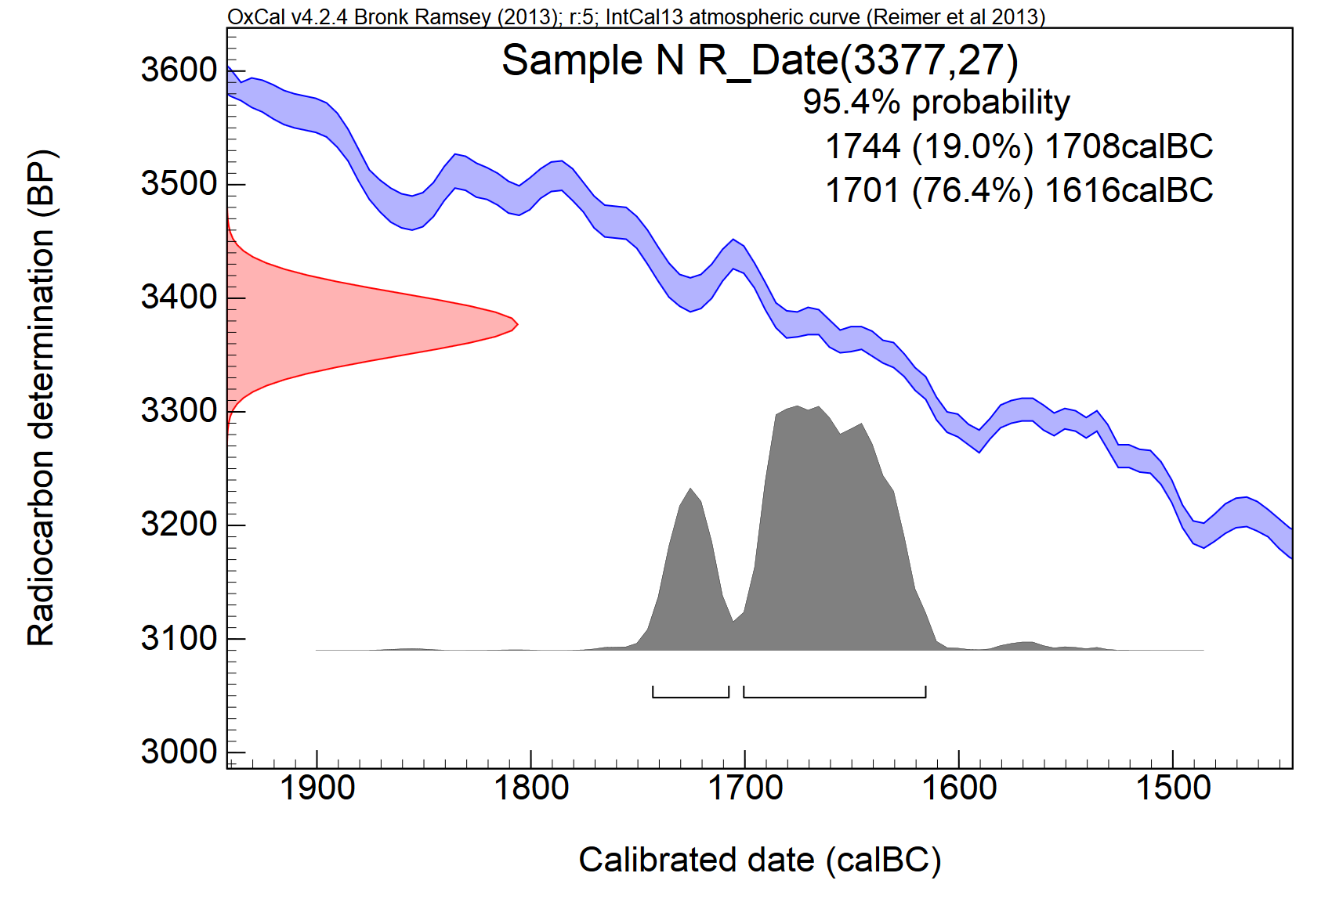
Age calibration with OXCAL online:

Slide 17
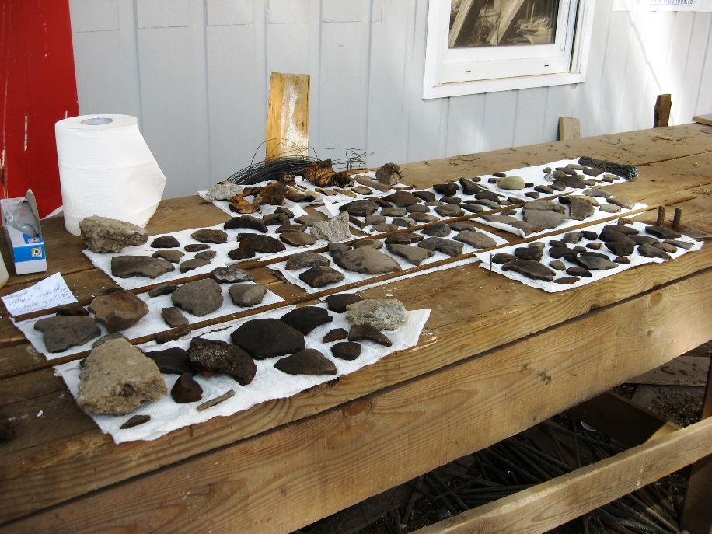
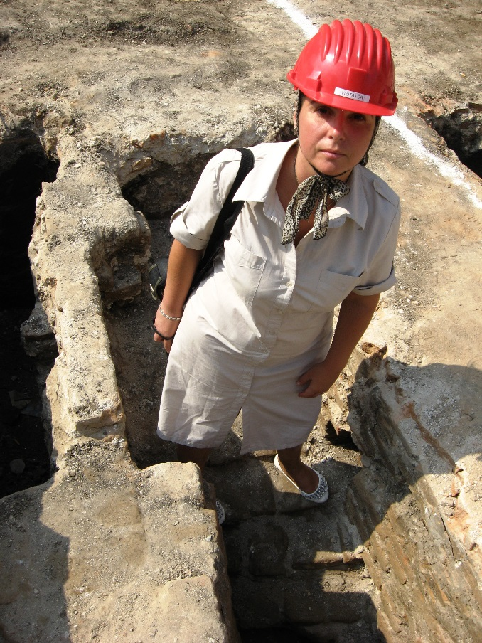
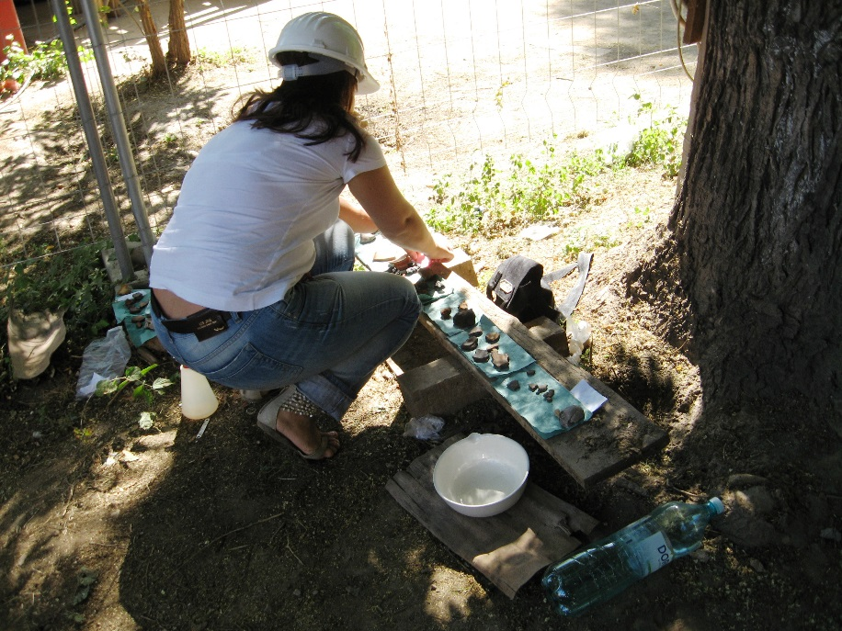
Colleagues @ work
Clients:
Museums;
Various faculties ie: mineralogy and geology, archeology;
Research institutes;
Work art owners;
Mineral water bottlers;
Etc.

Slide 18
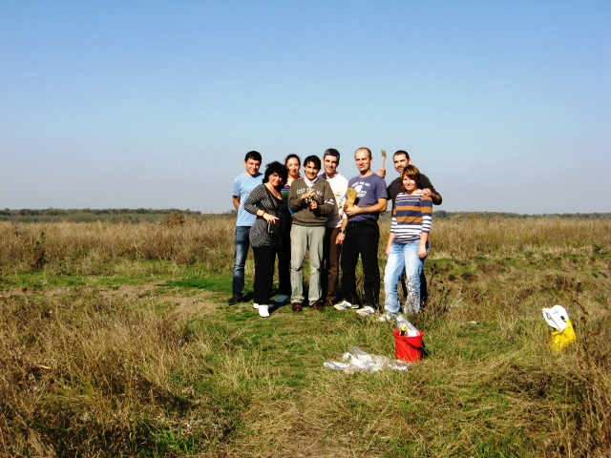
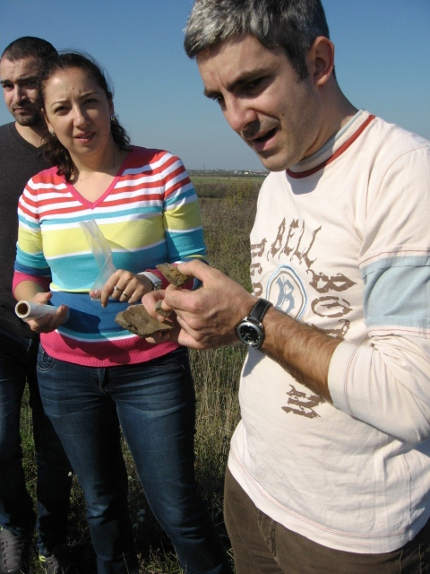
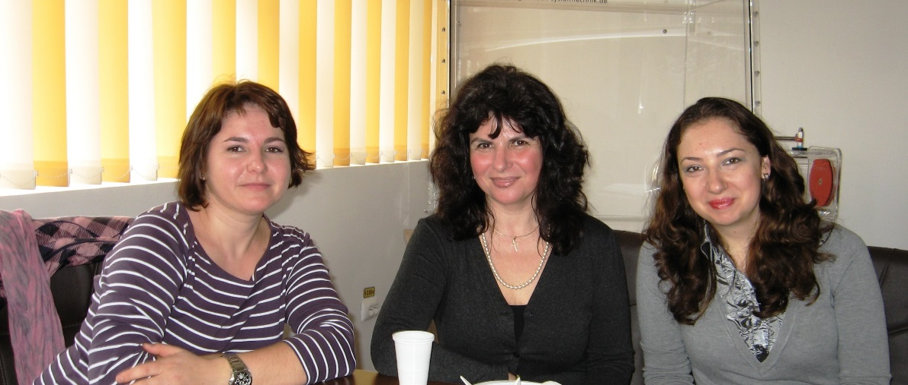
Radiocarbon Dating Team - Bucharest AMS
Thank you!

