Slide 1




Sectoral Operational Programme
„Increase of Economic Competitiveness”
“Investments for Your Future”
Extreme Light Infrastructure – Nuclear Physics (ELI-NP) - Phase I
Project co-financed by the European Regional Development Fund
EUROPEAN UNION
GOVERNMENT OF ROMANIA
Structural Instruments
2007-2013
Preparation for future photoneutron experiments at ELI-NP
Dan Filipescu
EUNPC, Groningen
31 August – 4 September 2015

Slide 2
Outline
Future experiments at ELI-NP – Gamma Above Neutron Threshold
Discrepancies between existing photoneutron cross section measurements
Experimental challenges for neutron multiplicity sorting
Design of a flat-efficiency neutron detector
Experiment: ²⁰⁹Bi(g,xn) cross sections at NewSUBARU synchrotron radiation facility

Slide 3
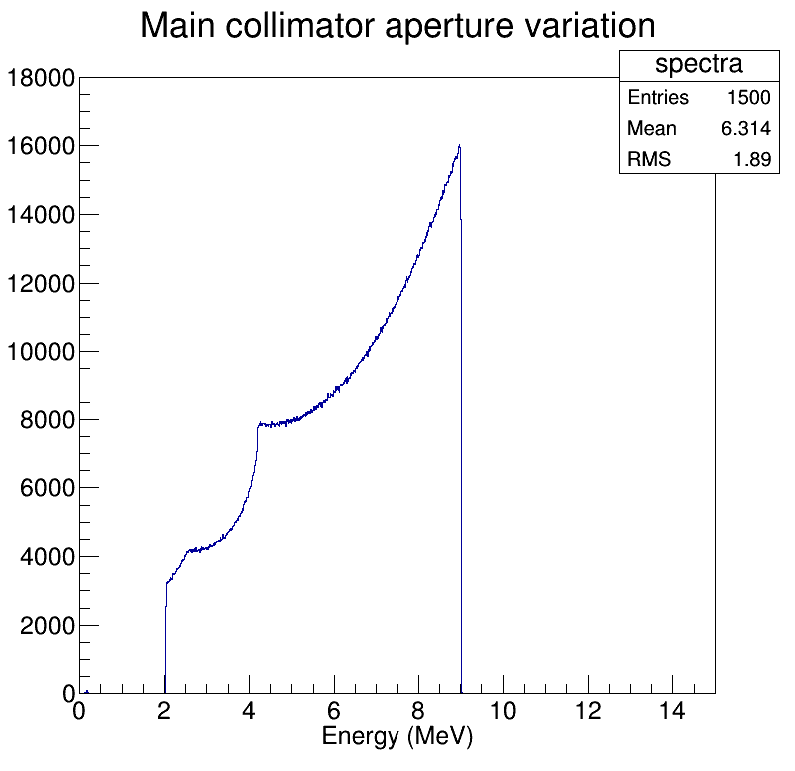
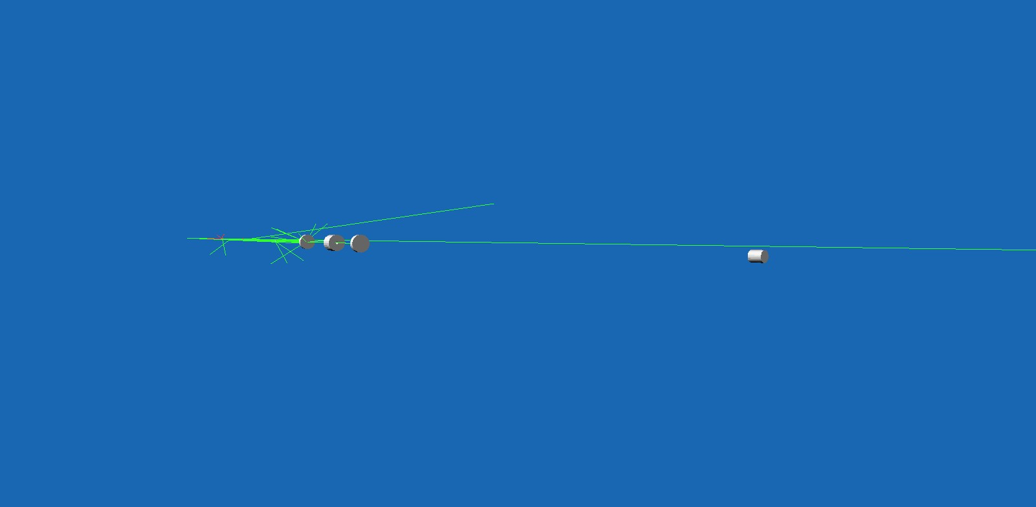

Laser Compton Scattering (LCS) gamma ray sources
Main concepts
$$E_{γ}\sim 4γ^{2}ε_{L}$$

Slide 4
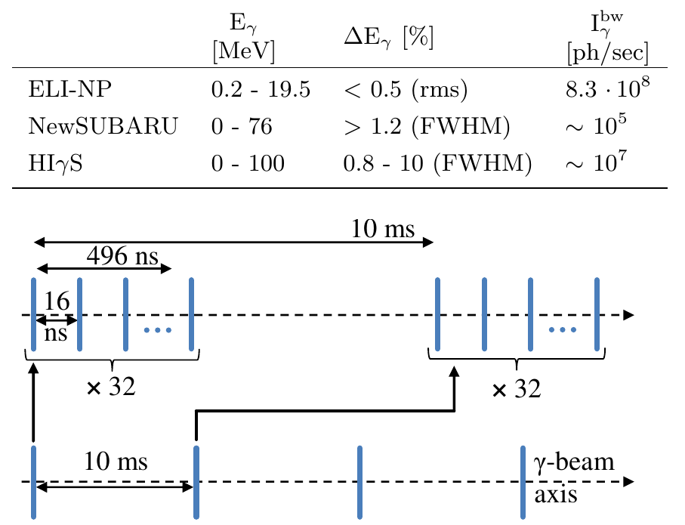
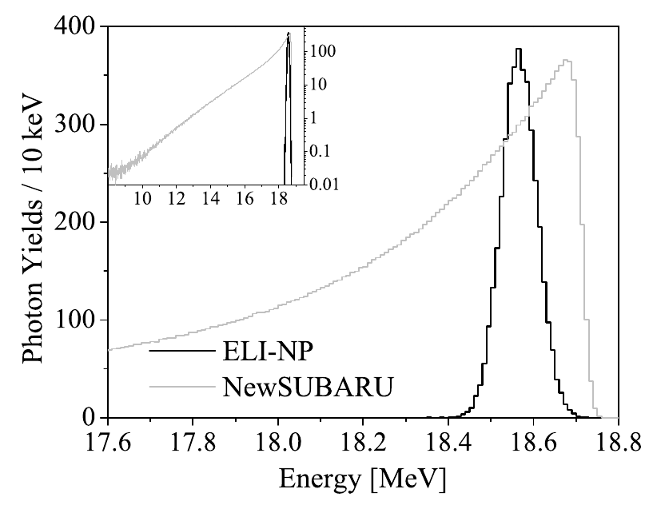
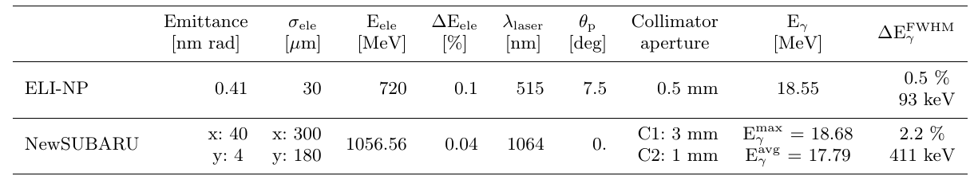
ELI-NP γ-ray beam expected parameters

Slide 5
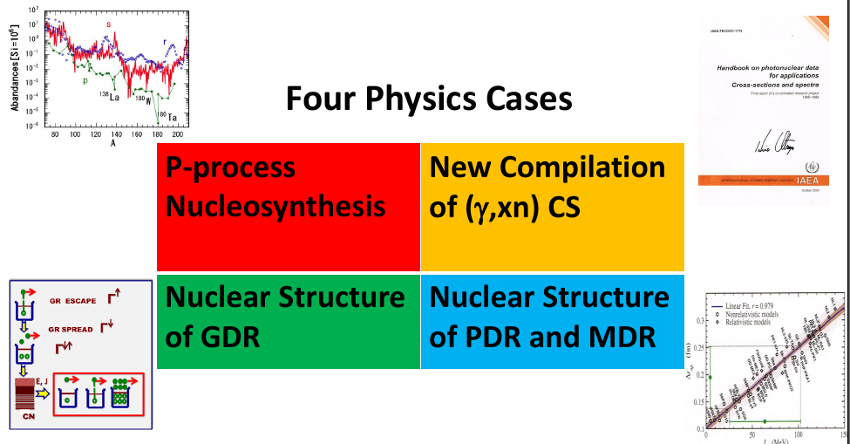
ELI-GANT – Physics program

Slide 6
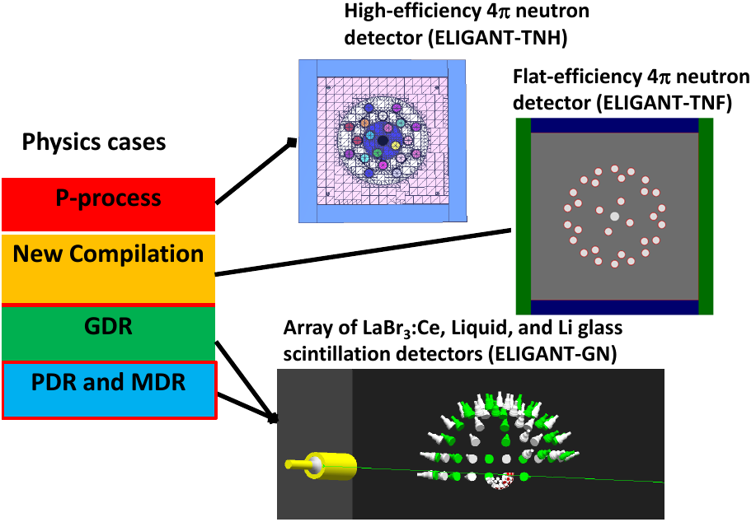
ELI-GANT – Physics program

Slide 7
Purpose of present study - Measurements of partial and total photoneutron cross sections for ²⁰⁹Bi
Most of the photoneutron cross section measurements were performed using quasi-monochromatic annihilation – QMA photons using positron in flight annihilation at two major facilities:
  Saclay (France)
  Lawrence Livermore National Laboratory (USA)
Large discrepancies in (γ,xn) c.s. measured at the two facilities:
  (γ, 1n) c.s. are generally noticeably larger at Saclay than at Livermore
  (γ, 2n) c.s. are generally larger at Livermore than at Saclay.
Other - 10
No systematic way to resolve the discrepancies:
New and reliable measurements are required!
Livermore - 84
Both – 42
Saclay - 80
Many bremsstrahlung
data
Main problem

Slide 8
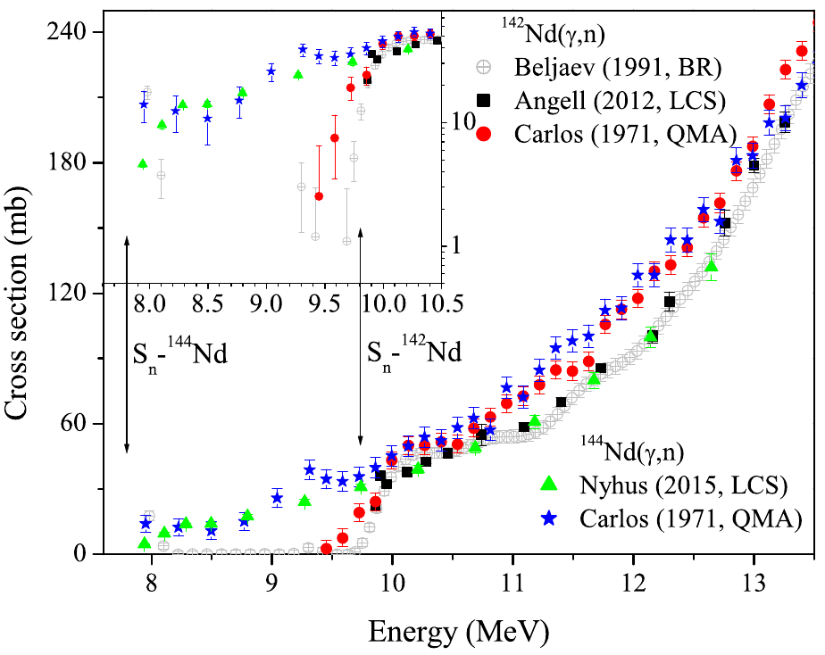
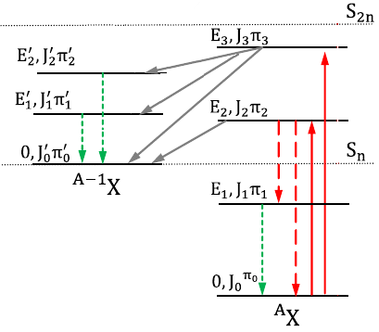
For (γ,1n) cross sections – measurements using LCS γ-ray beam and the
high efficiency neutron detector developed at GACKO offer the required precision and reliability
E_{γ}<S_{2n} ⇒ (γ,1n)
Average energy E_{avg} determined using the ring ratio method

Slide 9
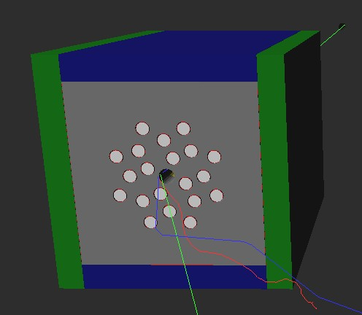
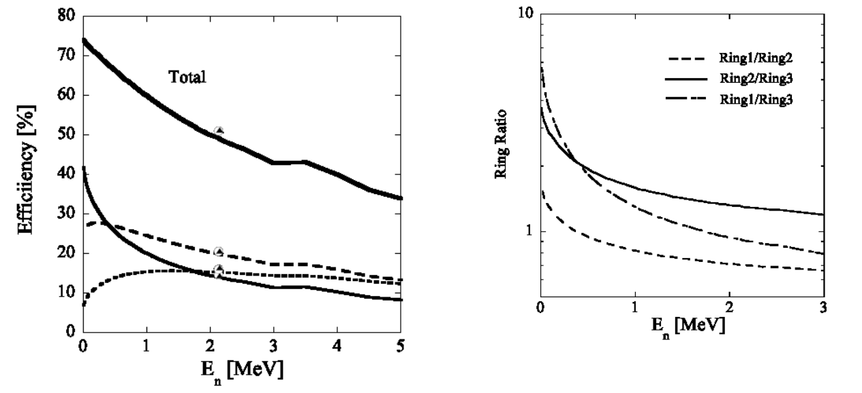
For (γ,1n) cross section measurements
Average neutron energy and neutron detection efficiency determined using the ring ratio technique

Slide 10
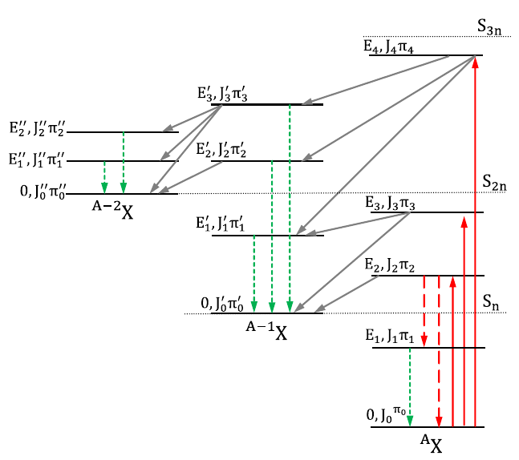
For (γ,2n), (γ,3n), … cross sections
Example:
E_{γ}<S_{3n} ⇒ (γ,1n) + (γ,2n)
Neutrons from (g,1n) reactions
Average energy E₁
Energy range: 0 to E_{g}-S_{n}
Neutrons from (g,2n) reactions emitted by the:
^{A}X nucleus
  Energy range: ~( 0 to E_{g}‒S_{2n})
^{A-1}X nucleus
  Energy range: ~( 0 to E_{g}‒S_{2n})
Average energy E₂
E₁ ≠ E₂ ⇒ ε(E₁) ≠ ε(E₂)

Slide 11
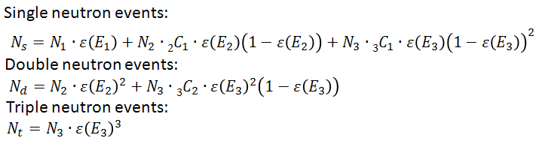
Let us assume E_{γ}<S_{4n} ⇒ (γ,1n), (γ,2n), (γ,3n) induced reactions
N_{1,} N_{2 ,} N₃ = number of (g,1n), (g,2n), (g,3n) induced reactions
E_{1,} E_{2 ,} E₃ = average energy of (g,1n), (g,2n), (g,3n) neutrons
N_{s,} N_{d ,} N_{t} = number of single, double and triple neutron events
Adjust experimental conditions to have maximum one reaction per γ-ray beam pulse
N_{s,} N_{d ,} N_{t} - we measure directly
N_{1,} N_{2 ,} N₃ - we must determine to obtain the cross sections
E_{1,} E_{2 ,} E₃ - ? Can not be determined using the ring ratio method PROBLEM
A neutron multiplicity sorting technique with
a flat efficiency neutron detector is required!

Slide 12

Let us assume E_{γ}<S_{4n} ⇒ (γ,1n), (γ,2n), (γ,3n) induced reactions
N_{1,} N_{2 ,} N₃ = number of (g,1n), (g,2n), (g,3n) induced reactions
E_{1,} E_{2 ,} E₃ = average energy of (g,1n), (g,2n), (g,3n) neutrons
N_{s,} N_{d ,} N_{t} = number of single, double and triple neutron events
Adjust experimental conditions to have maximum one reaction per γ-ray beam pulse
Single neutron events:
$$N_{s}=N_{1}∙ε\left(E_{1}\right)+N_{2}∙{2C}_{1}∙ε\left(E_{2}\right)\left(1−ε\left(E_{2}\right)\right)+N_{3}∙{3C}_{1}∙ε\left(E_{3}\right){\left(1−ε\left(E_{3}\right)\right)}^{2}$$
Double neutron events:
$$N_{d}=N_{2}∙{ε\left(E_{2}\right)}^{2}+N_{3}∙{3C}_{2}∙{ε\left(E_{3}\right)}^{2}\left(1−ε\left(E_{3}\right)\right)$$
Triple neutron events:
$$N_{t}=N_{3}∙{ε\left(E_{3}\right)}^{3}$$
N_{s,} N_{d ,} N_{t} - we measure directly
N_{1,} N_{2 ,} N₃ - we must determine to obtain the cross sections
E_{1,} E_{2 ,} E₃ - ? Can not be determined using the ring ratio method PROBLEM
A neutron multiplicity sorting technique with
a flat efficiency neutron detector is required!

Slide 13
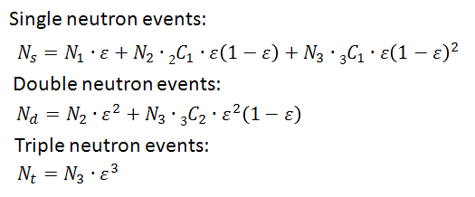
Considering a flat efficiency neutron detector and E_{γ}<S_{4n} we have:
N_{s,} N_{d ,} N_{t} - we measure directly
ε - known by direct measurement and by simulation
N_{1,} N_{2 ,} N₃ - we determine to obtain the
(γ,1n), (γ,2n), (γ,3n) cross sections

Slide 14


Considering a flat efficiency neutron detector and E_{γ}<S_{4n} we have:
Single neutron events:
$$N_{s}=N_{1}∙ε+N_{2}∙{2C}_{1}∙ε\left(1−ε\right)+N_{3}∙{3C}_{1}∙ε{\left(1−ε\right)}^{2}$$
Double neutron events:
$$N_{d}=N_{2}∙ε^{2}+N_{3}∙{3C}_{2}∙ε^{2}\left(1−ε\right)$$
Triple neutron events:
$$N_{t}=N_{3}∙ε^{3}$$
N_{s,} N_{d ,} N_{t} - we measure directly
ε - known by direct measurement and by simulation
N_{1,} N_{2 ,} N₃ - we determine to obtain the
(γ,1n), (γ,2n), (γ,3n) cross sections

Slide 15
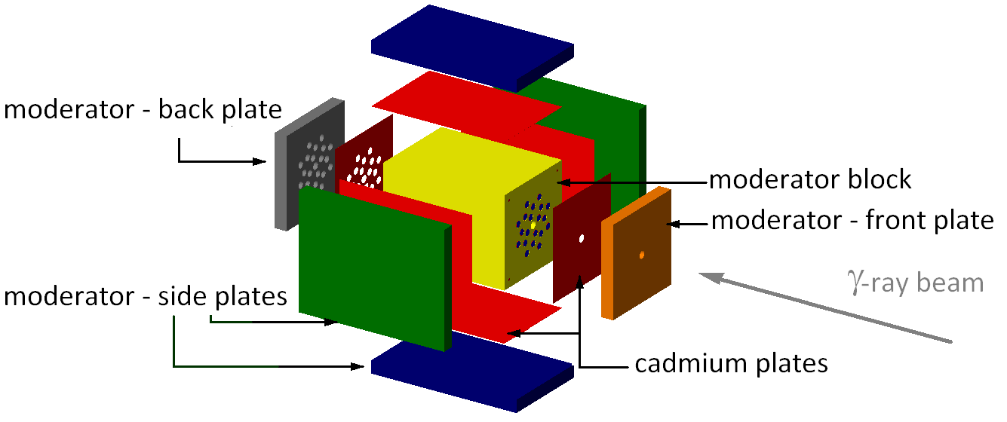
Neutron multiplicity sorting with a 4π neutron detector
Search for a flat efficiency 4π neutron detector:
- number of rings
- distance between beam axis and center of each ring
- number of detectors per ring
- size of moderator
GEANT simulations for ~50 possible configurations during 2 months on 36 cores

Slide 16
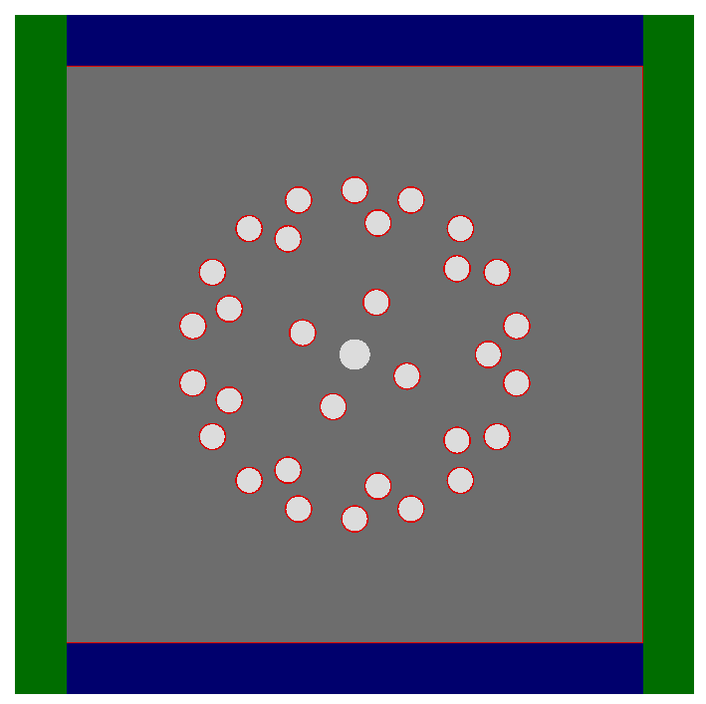
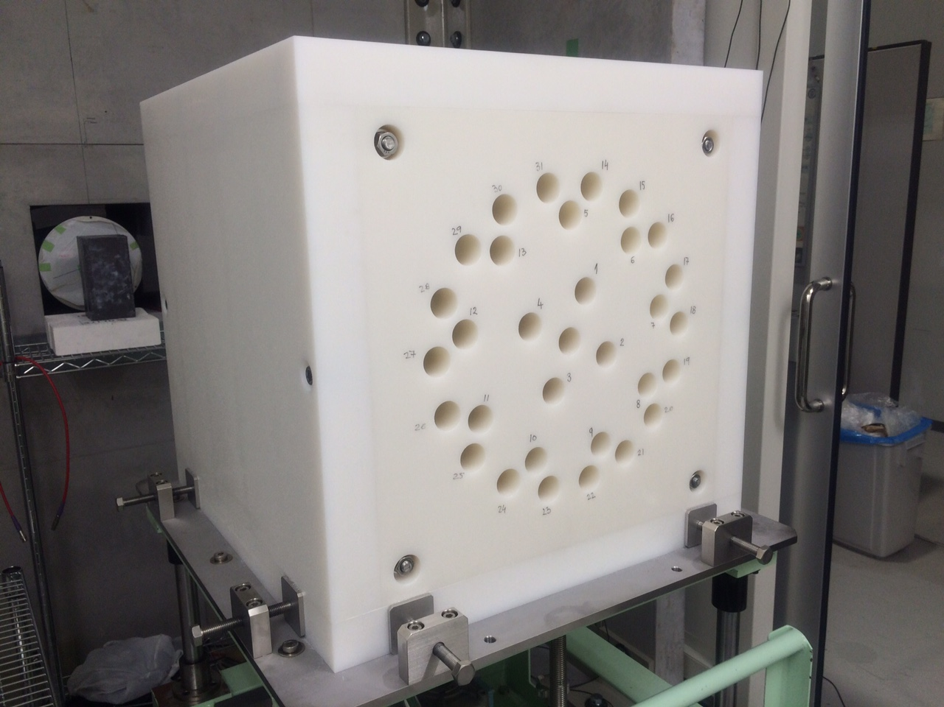
Neutron multiplicity sorting with a 4π neutron detector
Flat-efficiency 4π neutron detector -> ε(E_{n}) no longer depends on E_{n}
Configuration | ³He counters | Distance
Inner ring | 4 | 5.5 cm
Middle ring | 9 | 13 cm
Outer ring | 18 | 16 cm
Total | 31
Moderator size: 46 cm

Slide 17
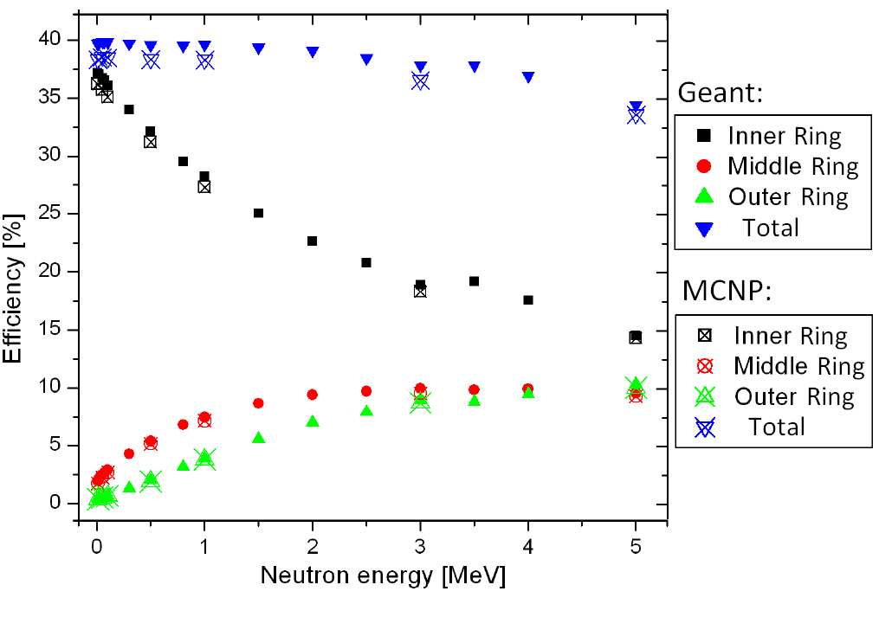
Neutron multiplicity sorting with a 4π neutron detector
Detection efficiency:
(γ,n) neutrons:
ε = 40%
(γ,2n) neutrons:
Both neutrons detected:
ε² = 16%
Only one neutron detected:
ε(1- ε) = 24%
(γ,3n) neutrons:
3 neutrons detected:
ε³ = 6.4%
2 neutron detected:
ε² (1- ε) = 9.6%
Only one neutron detected:
ε(1- ε)² = 14.4%

Slide 18
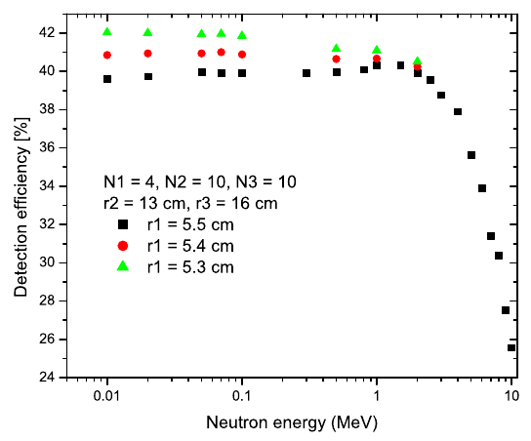
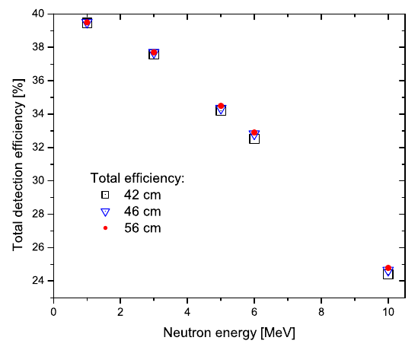
Neutron multiplicity sorting with a 4π neutron detector
Sensitivity test
Sensitivity to displacements of counters from the inner ring.
Sensitivity to moderator size.

Slide 19
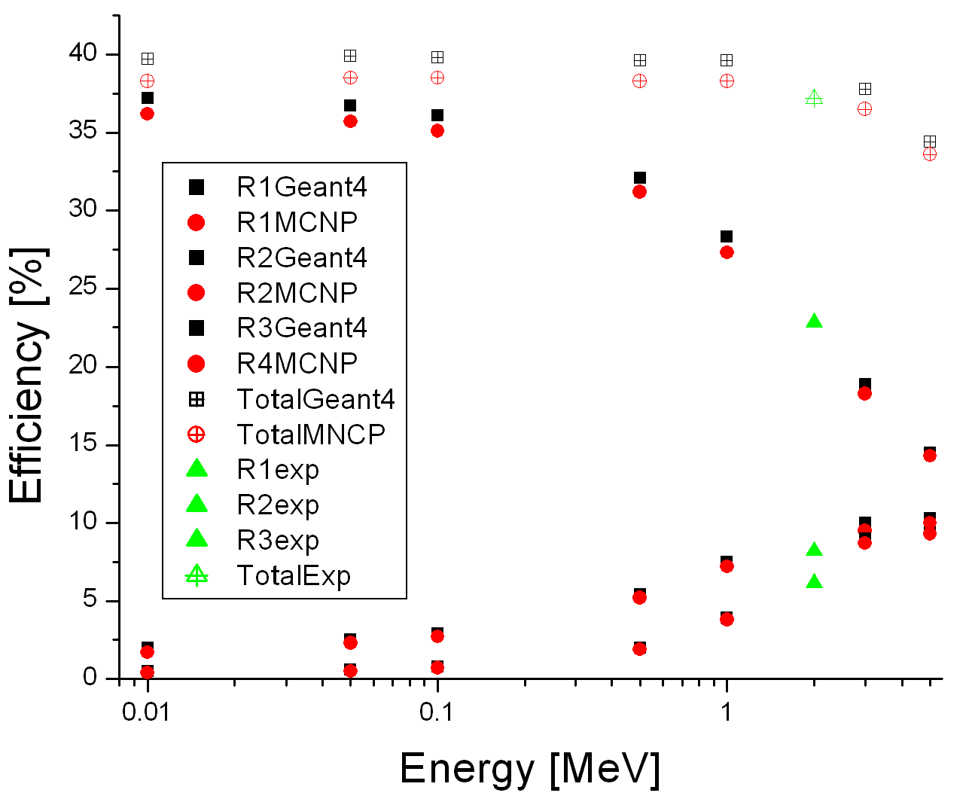
Neutron multiplicity sorting with a 4π neutron detector
Comparison with calibration source
Calibrated ²⁵²Cf source obtained from NIST Japan

Slide 20
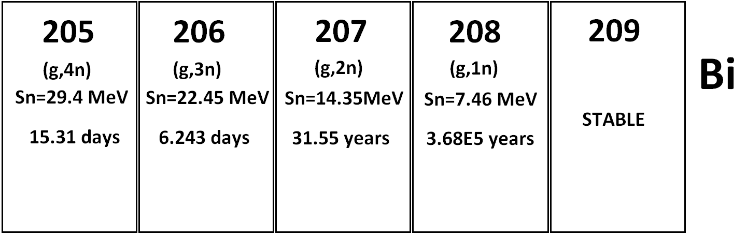
Partial and total photoneutron cross sections for ²⁰⁹Bi
  (g,1n) measurements:
  7.5 to 14.35 MeV γ-ray beams
  Nd:YVO₄ laser INAZUMA
  – 1st harmonic (1064 nm)
  Electron energies - 600 to 900 MeV
  (g,2n), (g,3n), (g,4n) measurements:
  14.5 to 40 MeV γ-ray beams
  Nd:YVO₄ laser INAZUMA
  – 2nd harmonic (532 nm)
  Electron energies - 640 to 1100 MeV
  Flat efficiency 4π neutron detector
  LaBr₃ detector for energy monitor
  100% NaI-Tl detector flux monitor
  Monoisotopic thick ²⁰⁹Bi target

Slide 21
The neutron multiplicity sorting technique relies on the following assumptions, so that we can assume that x neutrons recorded between 2 consecutive gamma bunches are in fact coming from the same reaction:
(1) one gamma ray bunch incident on the target generates no more than one (g,xn) reactions
  perform count rate estimates to find convenient target thickness values depending on the cross section and beam intensity and also beam time estimates for statistics.
(2) the reaction neutrons have enough time between two consecutive gamma bunches to be moderated and recorded by the neutron counters
modify the laser frequency to have at least ~500 us moderation time (2 kHz frequency).
As the laser used at NewSUBARU can not be used at frequencies lower than 15 kHz we had to introduce into the optical setup two additional optical elements:
- a Pockels cell (a crystal that changes the polarization angle of the wave that passes it as a function of the high voltage applied on it)
- and a polarizer.
The polarizer and the Pockels cell were set as to allow passage of laser bunches only if specific high voltage was set on the Pockels cell. We operated the laser using an external trigger signal with 60 us period (~16 kHz frequency). The same trigger signal was downscalled to 480 us (~2 kHz frequency) and sent to the Pockels cell.

Slide 22
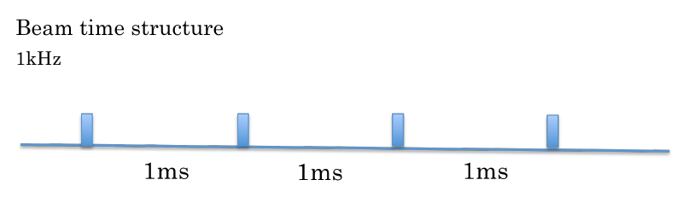
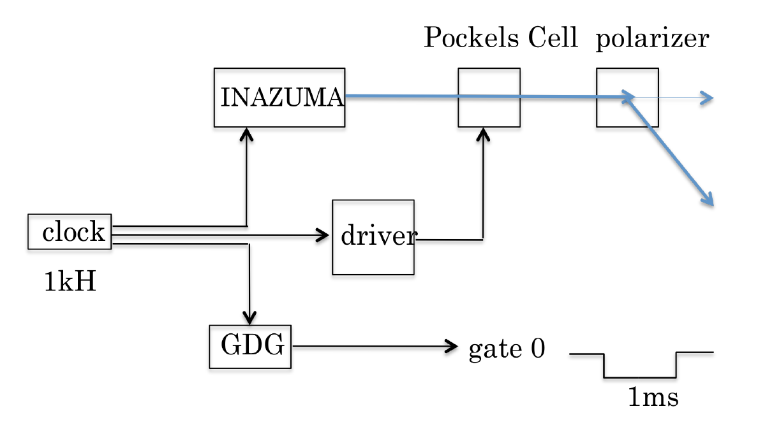

Slide 23
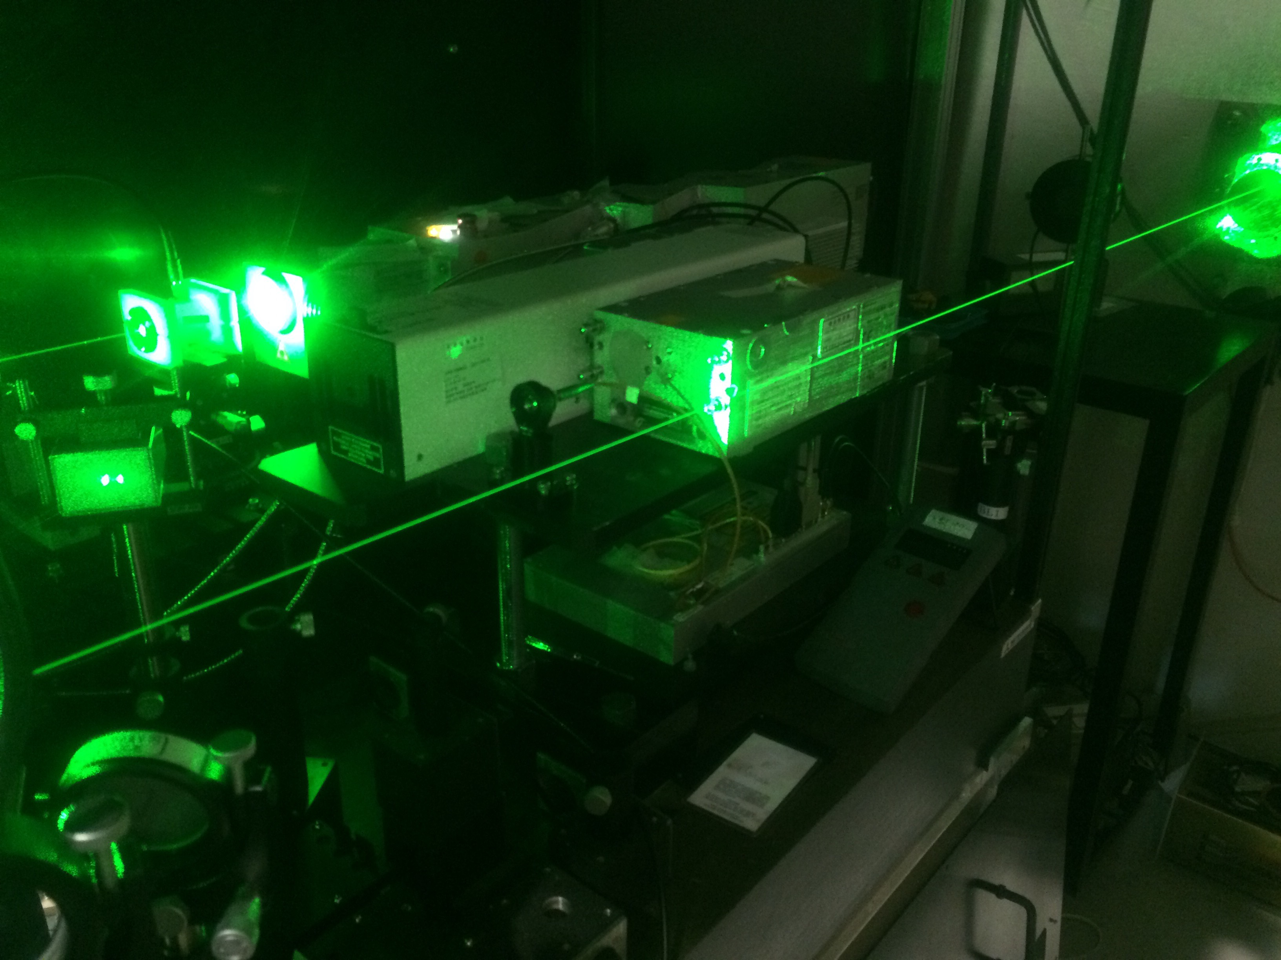
INAZUMA Laser
1064 nm first harmonic – 40 W maximum power
532 nm second harmonic – 15 W maximum power

Slide 24
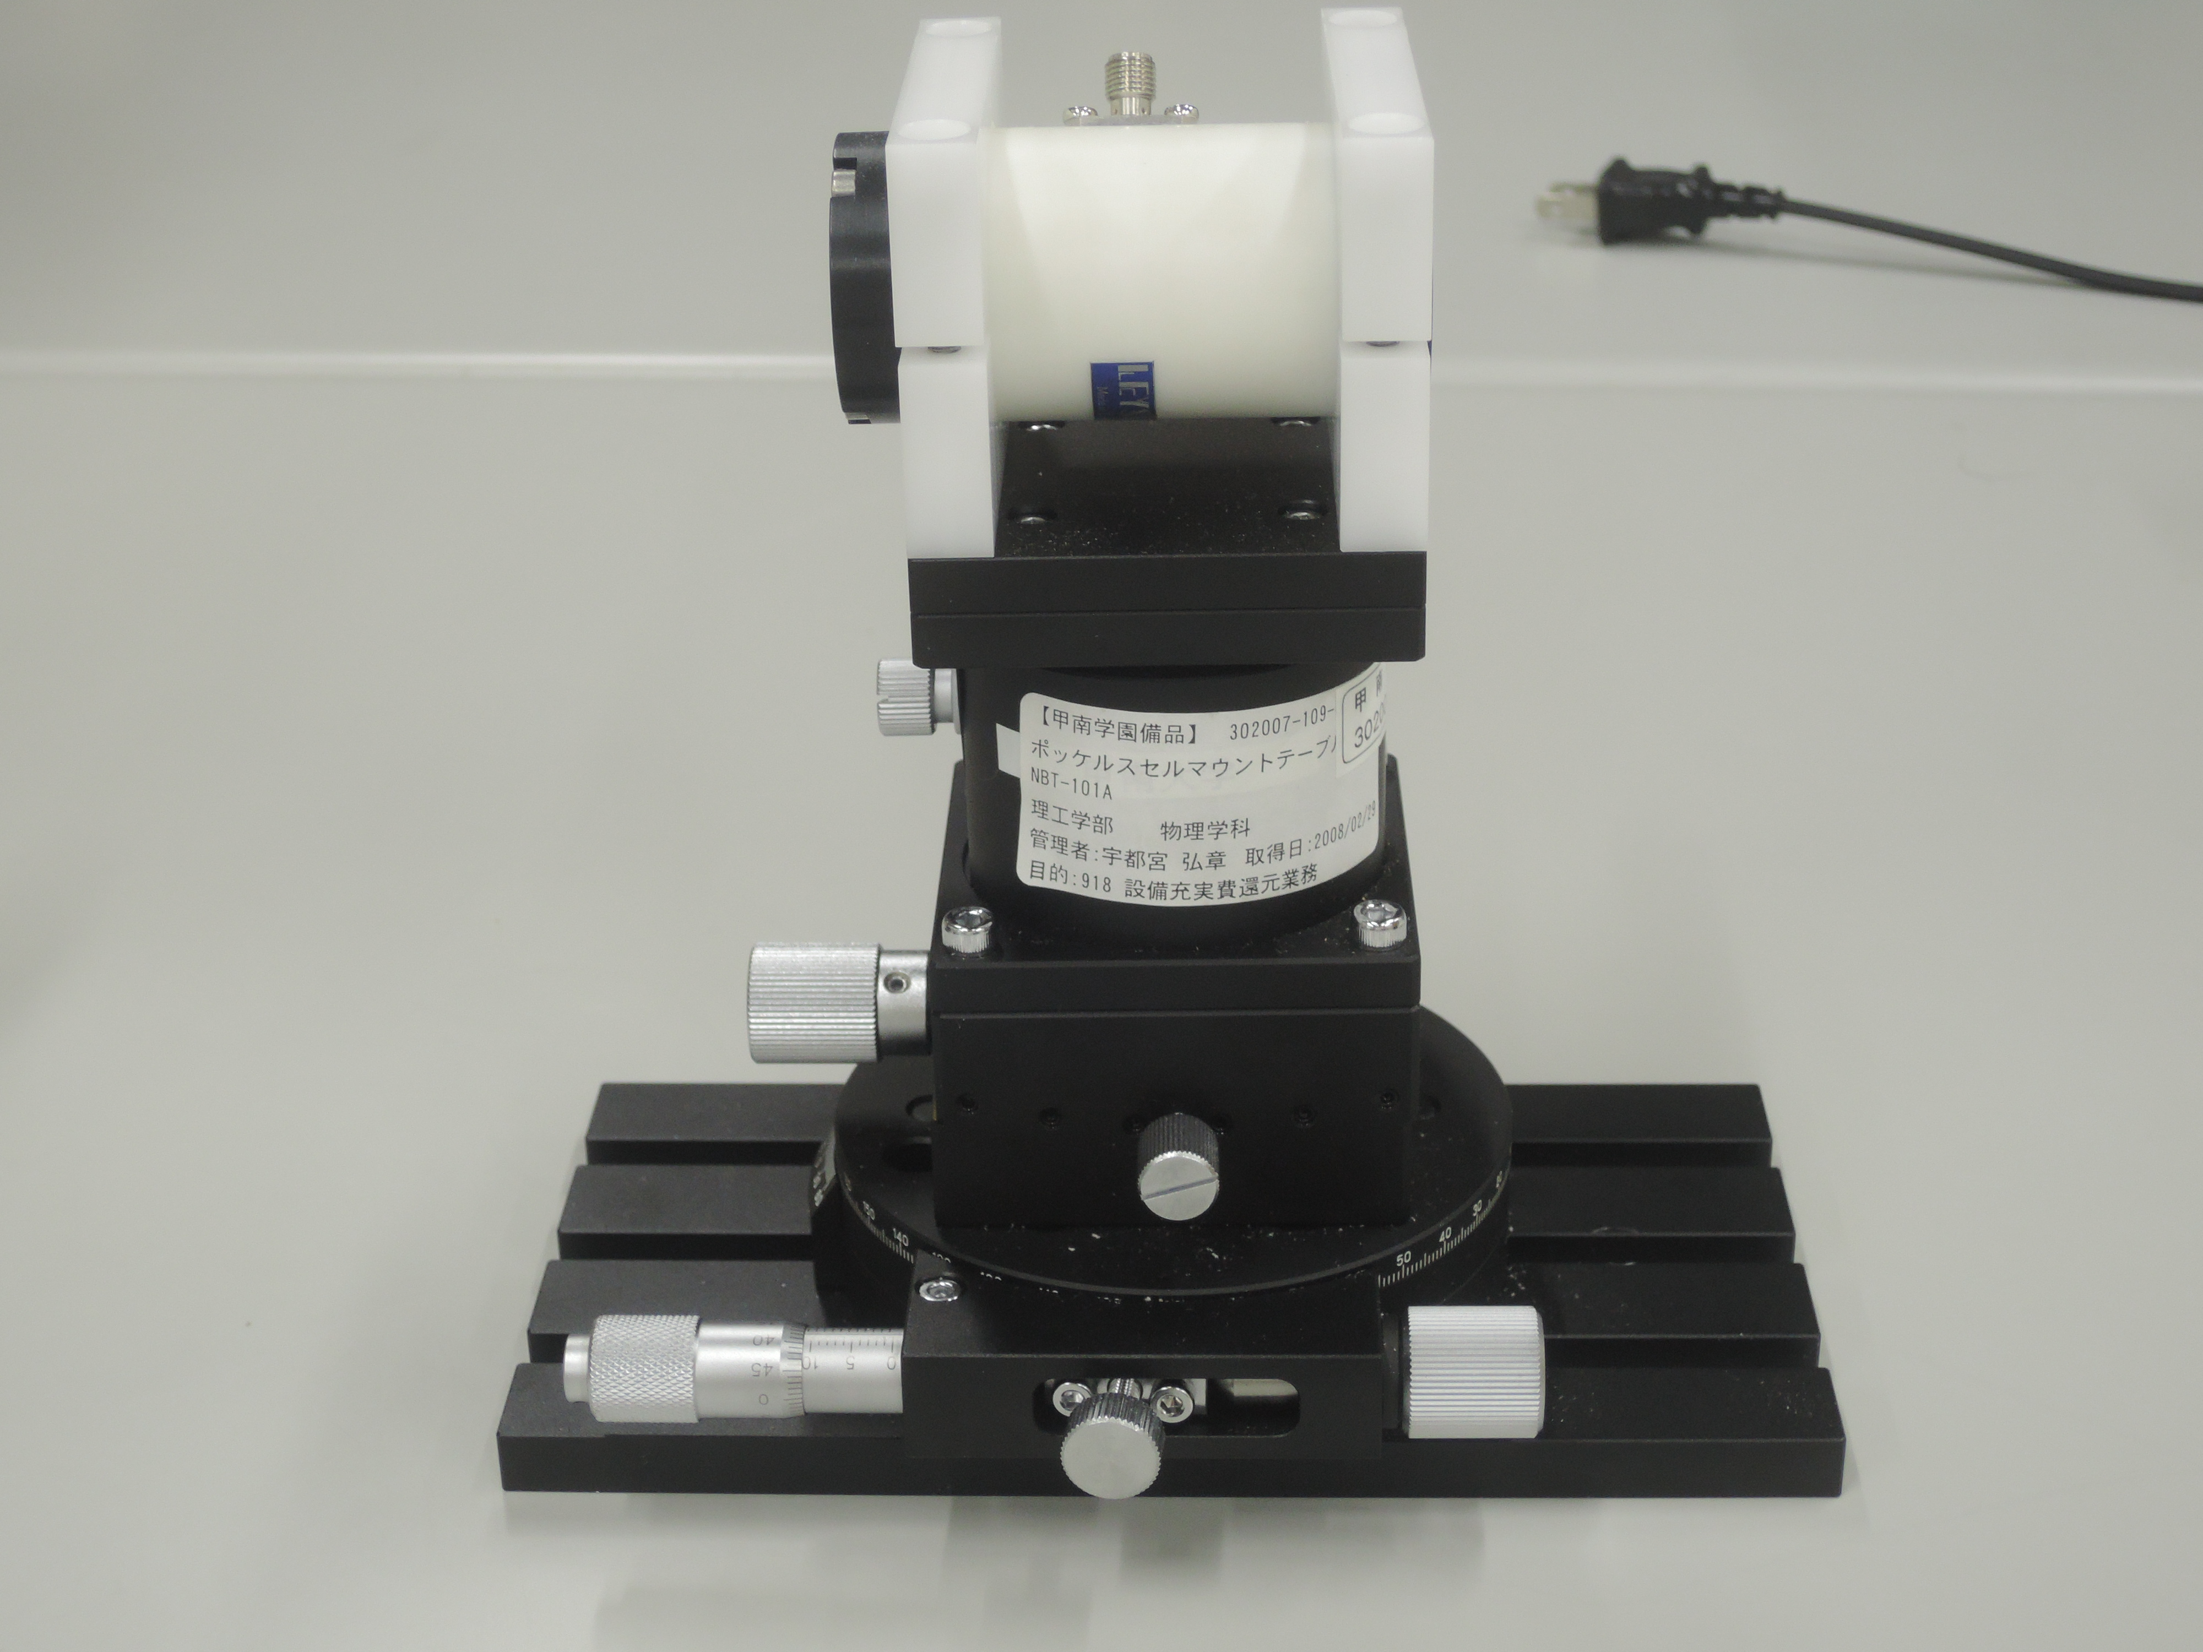
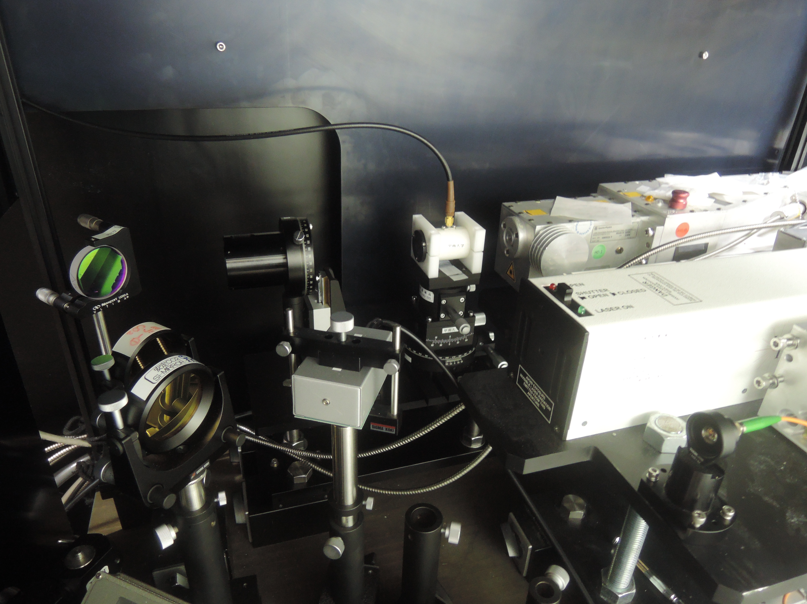
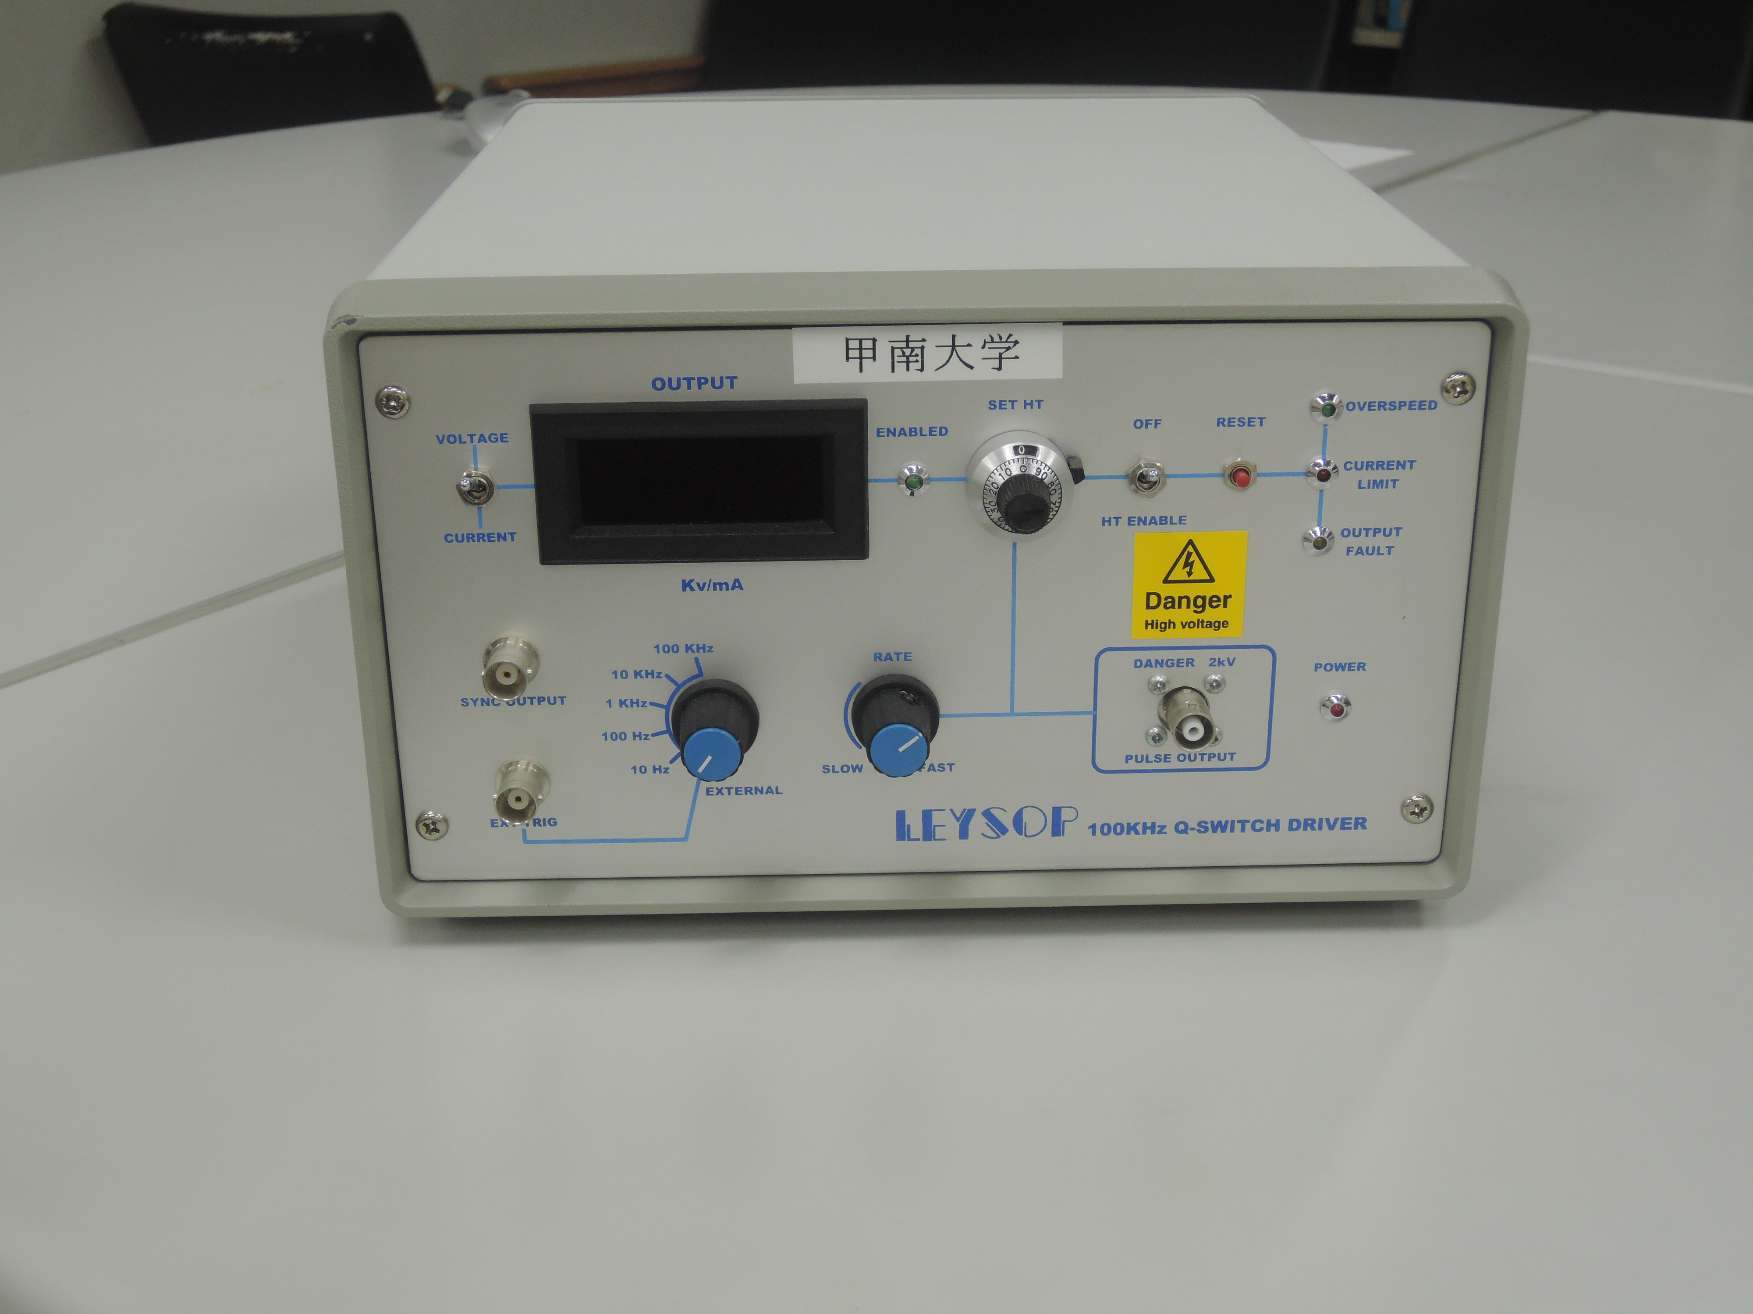
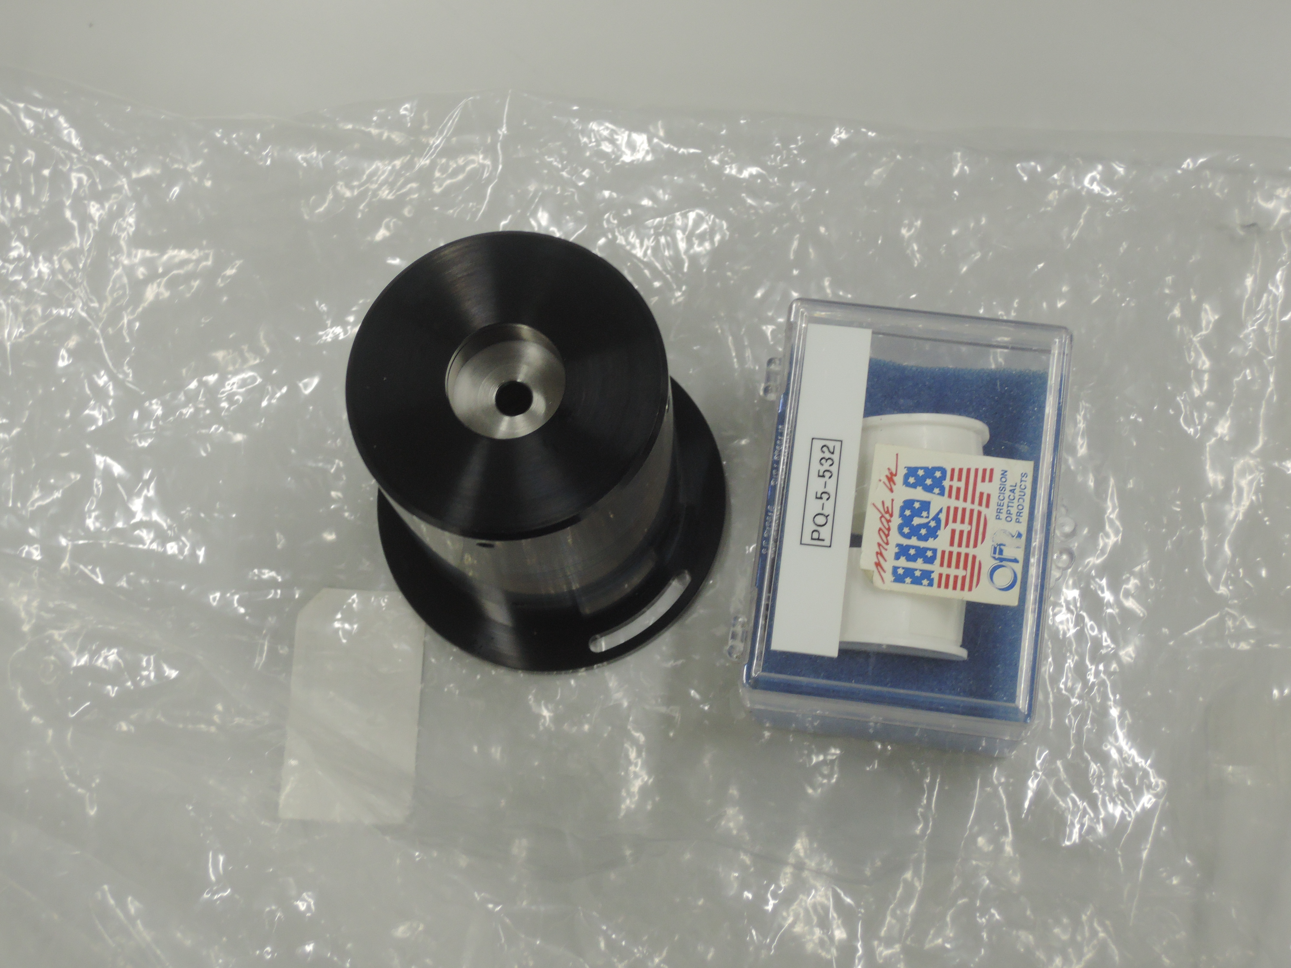
Pockels Cell and Polarizer

Slide 25
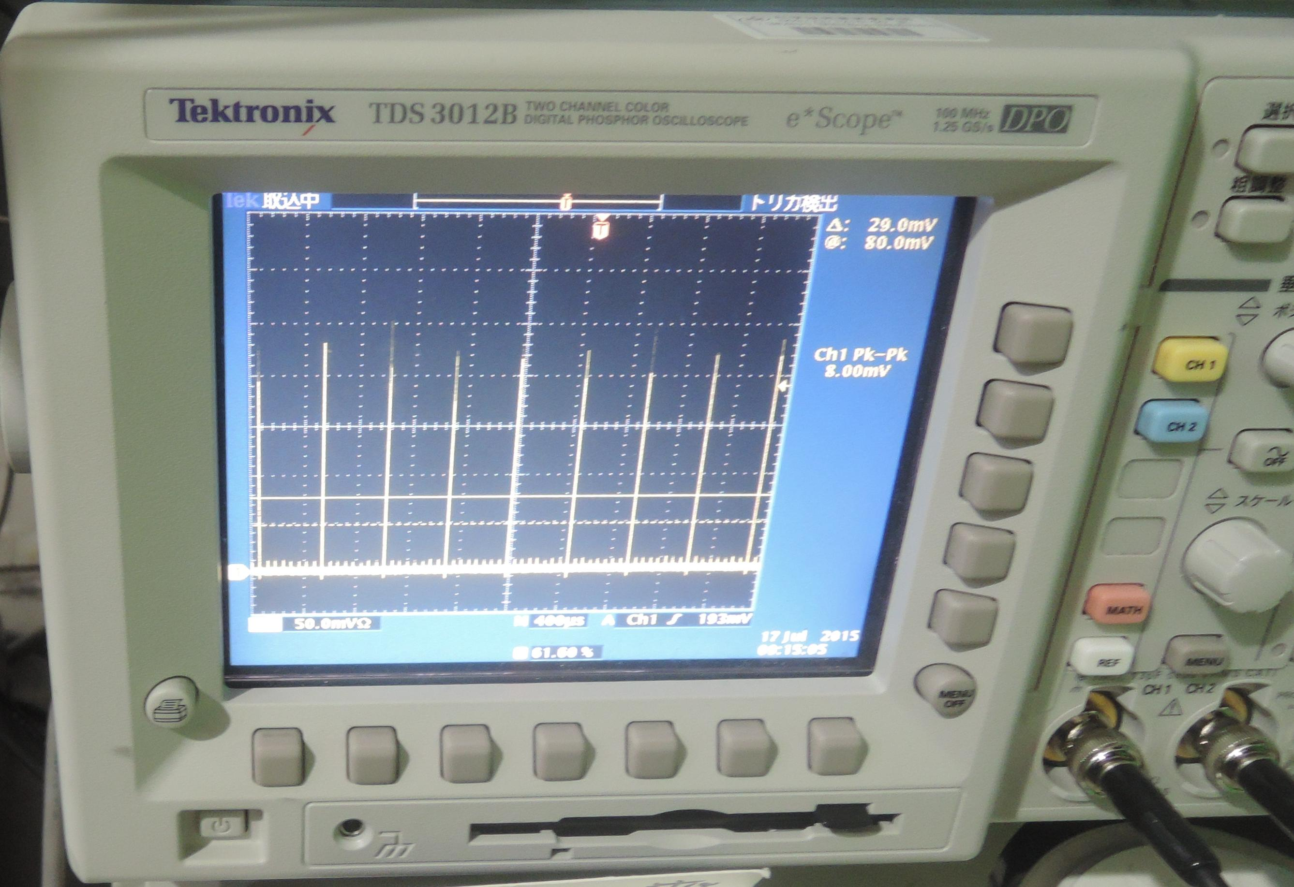
Laser power

Slide 26
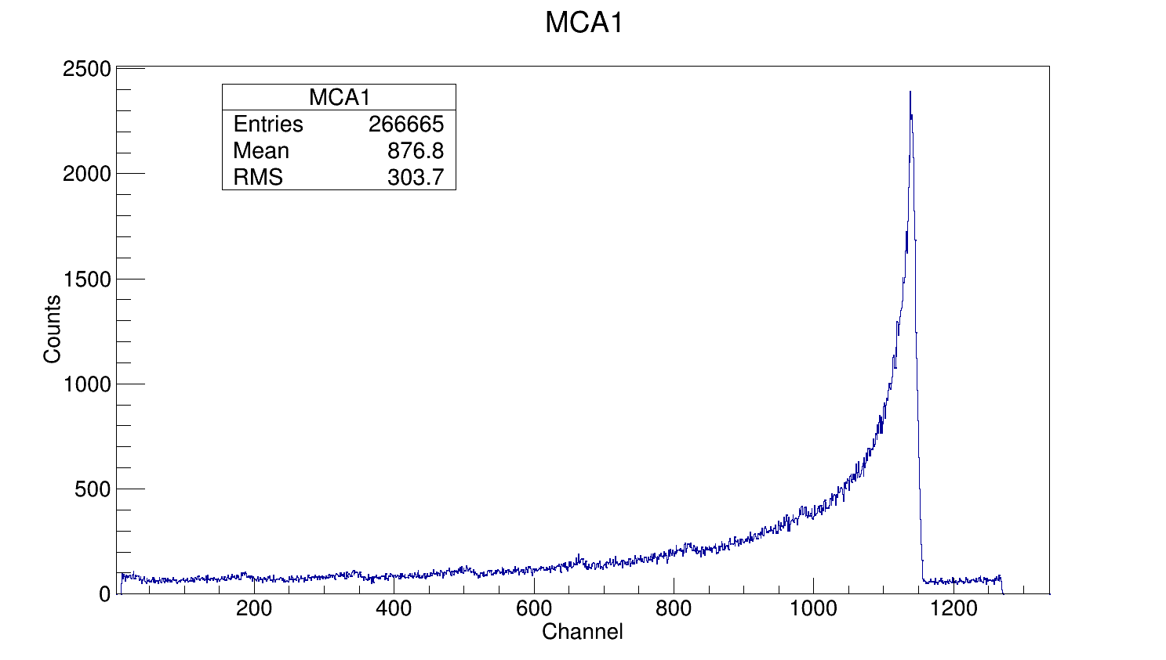
TAC spectrum for the first neutron

Slide 27
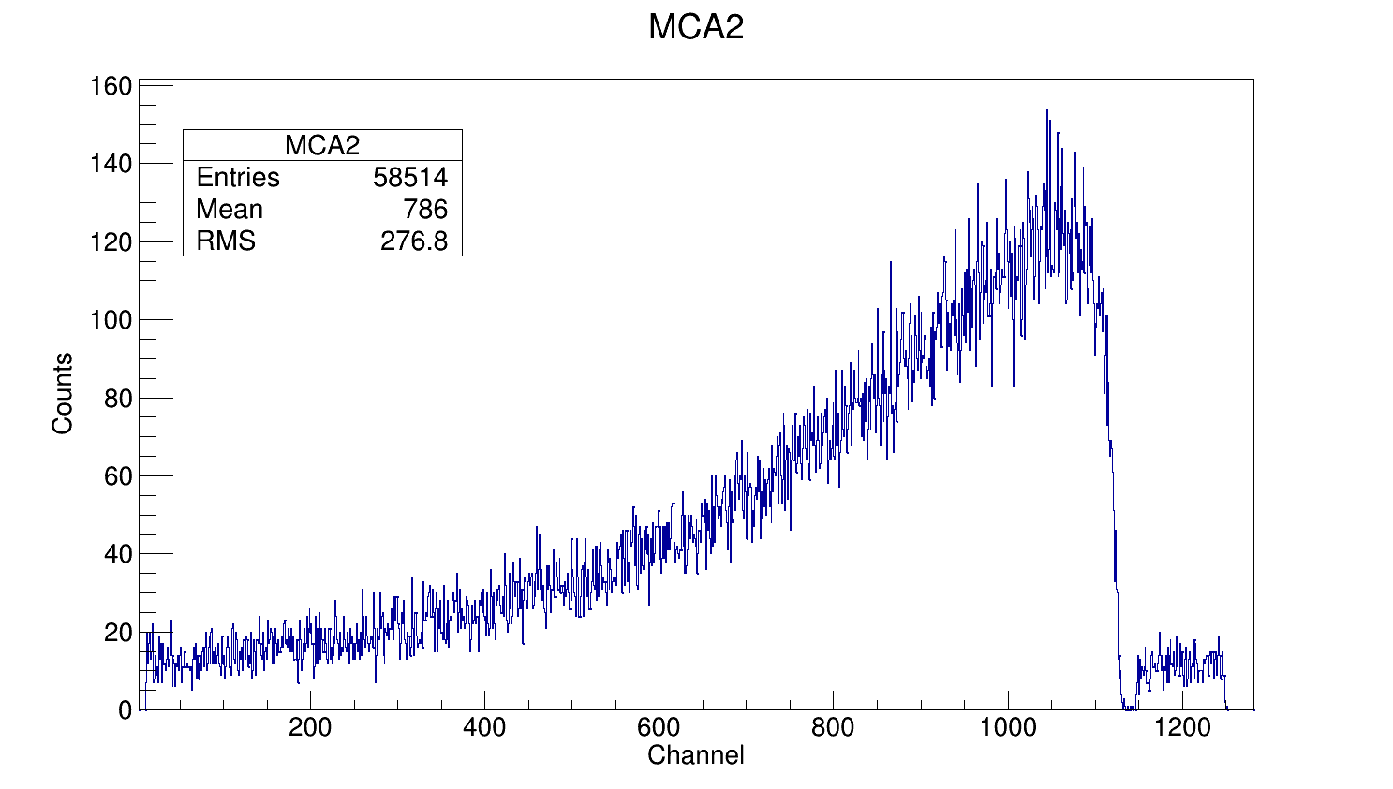
TAC spectrum for the second neutron

Slide 28
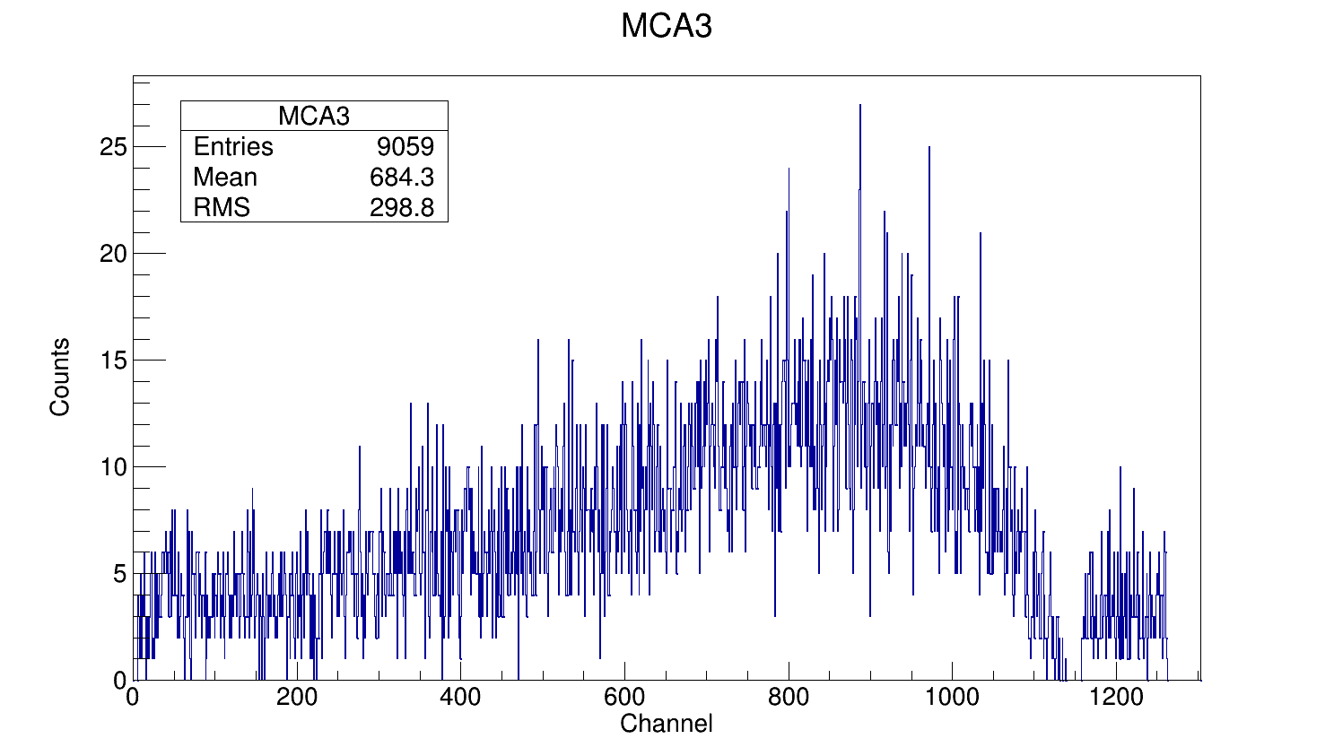
TAC spectrum for the third neutron

Slide 29
Collaboration
D. Filipescu ^{1,2}, H. Utsunomiya³, Vladimir Varlamov⁴, F. Camera^{5,6}, I. Gheorghe ^{1,3,7}, S. Belyshev⁴, S. Katayama³, T. Shima⁸, K. Takahisa⁸,S. Miyamoto⁹, S. Amano⁹, T. Glodariu², M. Sin⁷
¹Extreme Light Infrastructure – Nuclear Physics (ELI-NP) / Horia Hulubei National Institute for R&D in Physics and Nuclear Engineering (IFIN-HH), 30 Reactorului St., Bucharest-Magurele, 077125, Romania.
²Horia Hulubei National Institute for R&D in Physics and Nuclear Engineering, Bucharest-Magurele, 077125, Romania
³Department of Physics, Konan University, Okamoto 8-9-1, Higashinada, Kobe 658-8501, Japan
⁴Lomonosov Moscow State University, Department of Physics, Moscow, 119991 Russia
⁵Dipartimento di Fisica, Università degli Studi di Milano, via Celoria 16, I-20133 Milano, Italy
⁶INFN, Sezione di Milano, via Celoria 16, I-20133 Milano, Italy
⁷Faculty of Physics, University of Bucharest, 077125, Bucharest, Romania
⁸Research Center for Nuclear Physics, Osaka University, Suita, Osaka 567-0047, Japan
⁹Laboratory of Advanced Science and Technology for Industry, University of Hyogo, 3-1-2 Kouto, Kamigori, Ako-gun, Hyogo 678-1205, Japan

Slide 30

Experimental team

Slide 31


ELI-NP Team, March 5, 2013
Thank you!

Slide 32
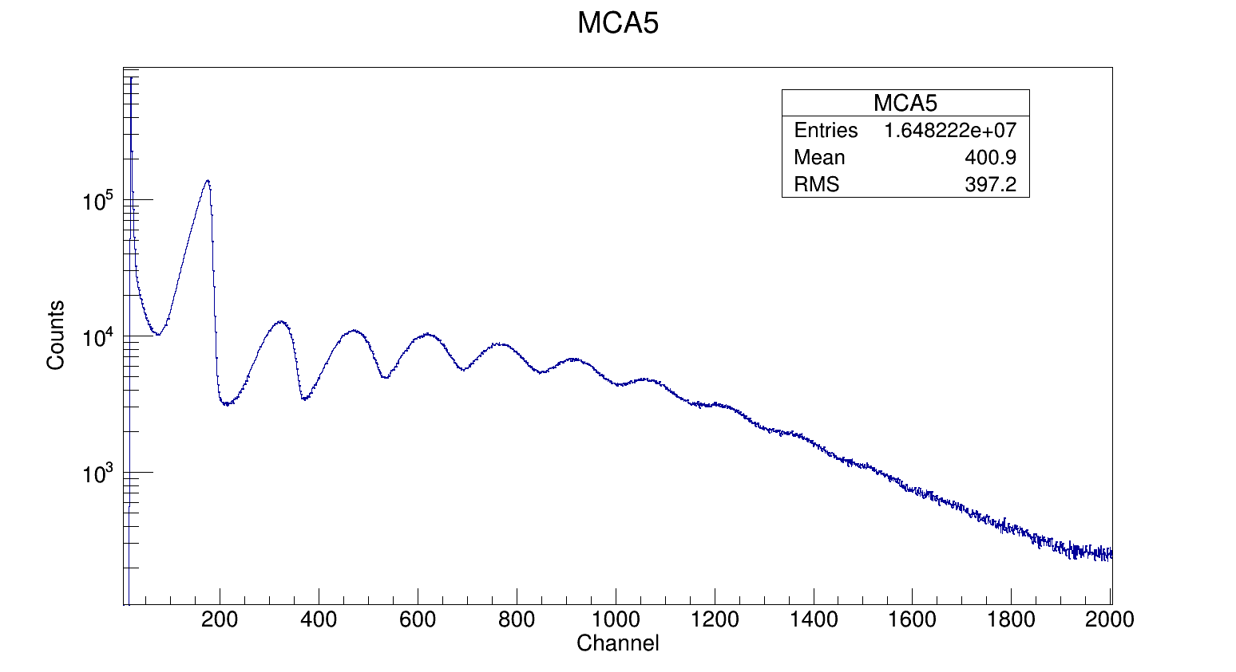
Large NaI gamma flux monitor detector pile-up spectrum

Slide 33
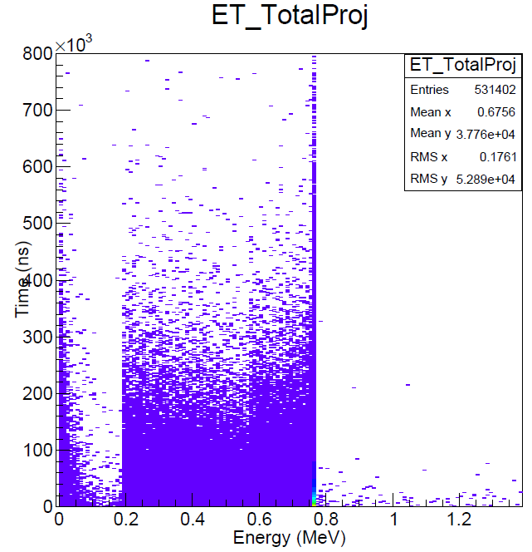
Counters Enery-Time response for 1 MeV neutrons as predicted by GEANT4

Slide 34
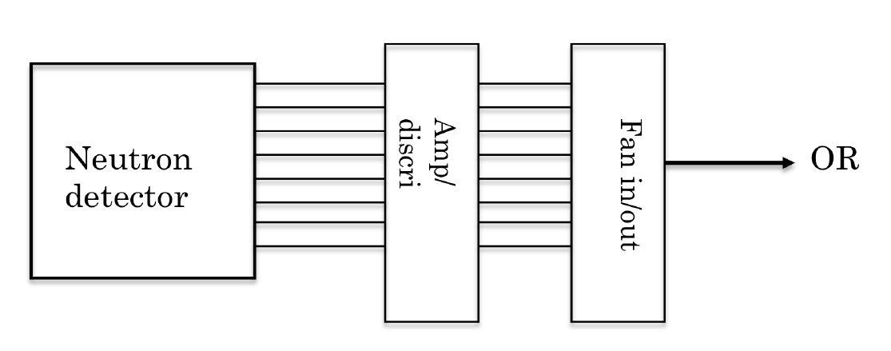
All neutron counters are ORed

Slide 35
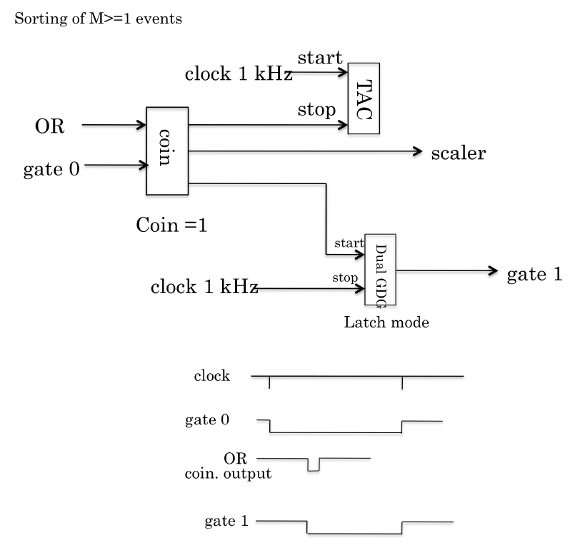
Electronic signals treatment for the first neutron

Slide 36
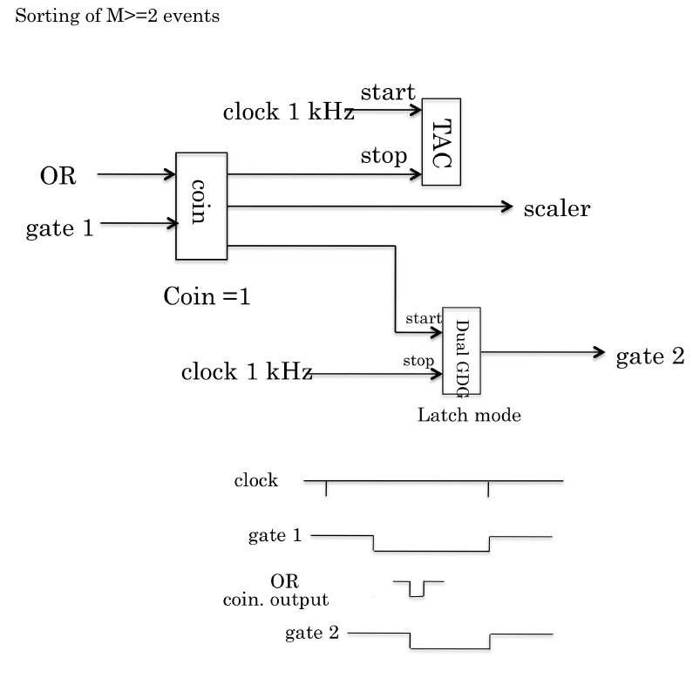
Electronic signals treatment for the second neutron

Slide 37
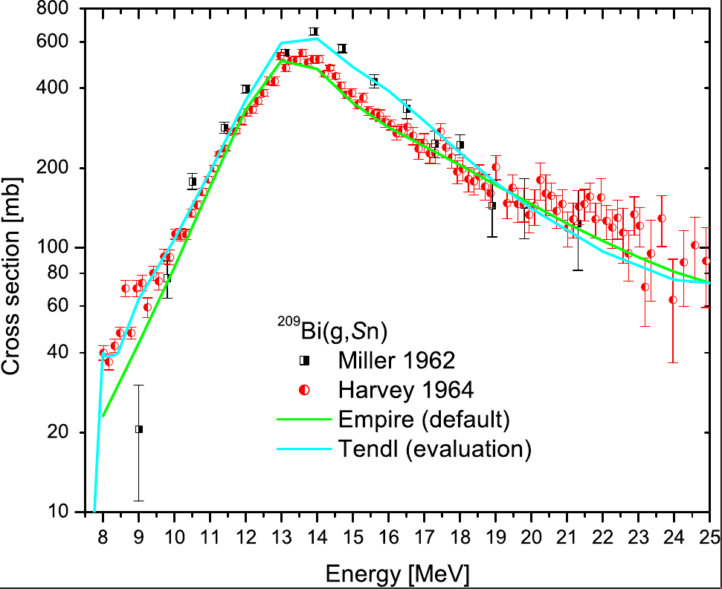
Calculations of ²⁰⁹Bi(g,Sn) cross section using the Empire code
Gamma strength function:
Modified Lorentzian 1 (MLO1) – taken from RIPL
GDR parameters - taken from RIPL
- first choice - deduced from experimental data
- second choice - parametrizations.
Default Level density - Enhanced Generalized Superfluid Model (EGSM) from RIPL.
Default optical potential for neutrons and protons is Koning-Delaroche regional potential.
Preequilibrium model - the exciton model implemented in PCROSS.

Slide 38
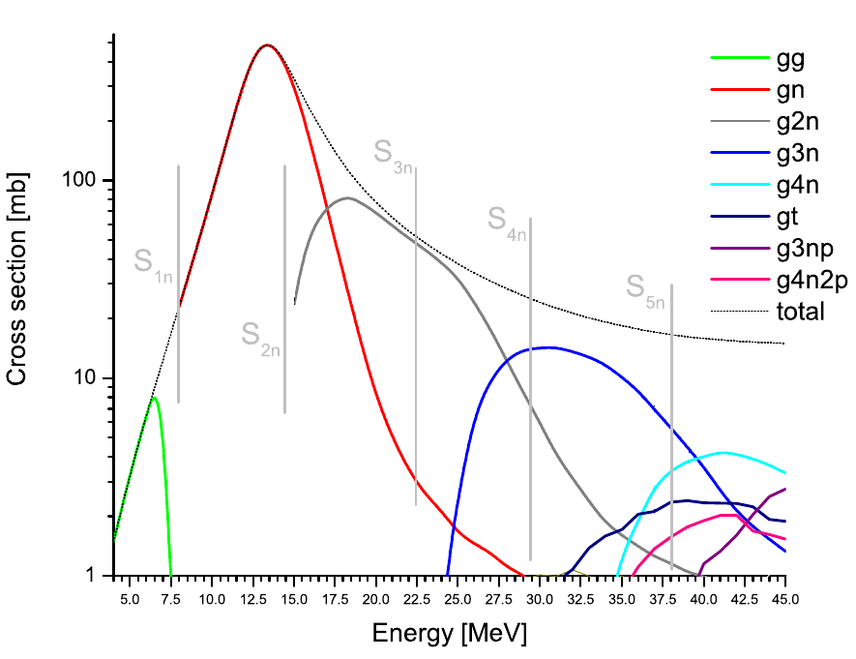
Calculations of ²⁰⁹Bi(g,xn) cross section using the EMPIRE code

