Slide 1
Lifetime measurements to study the nature of excited states beyond N=50 AGATA + VAMOS @ GANIL
Andrea Gottardo
EUNPC2015
Aug 30 - Sep 4, 2015

Slide 2
The N=50 region
Zr90
Zr91
Zr92
Zr93
Zr92
Zr93
Zr94
Zr95
Zr96
Y89
Sr84
Sr86
Sr87
Sr88
Rb85
Rb87
Kr78
Kr80
Kr82
Kr83
Kr84
Kr86
Br79
Br81
Br85
Se76
Se77
Se78
Se80
Se82
Se84
As75
As83
Ge74
Ge76
Ge82
the case of the light N=51 odd isotones
Ga81
Zn80
Cu79
Ni70
Ni71
Ni72
Ni73
Ni74
Ni75
Ni76
Ni77
Ni78
50
Courtesy of D. Verney

Slide 3
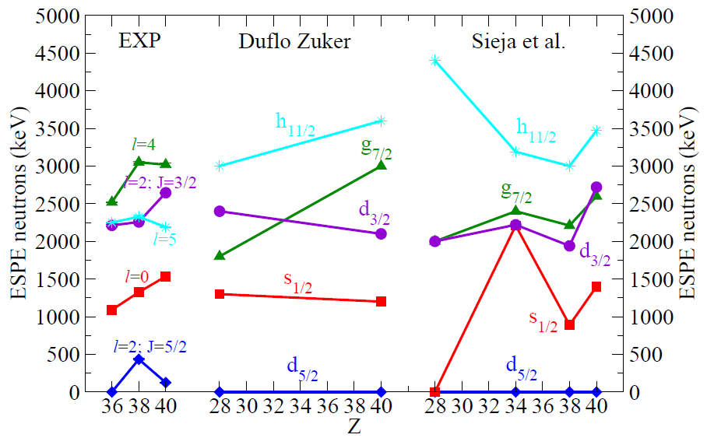
EVOLution of s.p. shells
D. K. Sharp et al., PRC 87, 014312 (2013)
From Duflo Zuker
PRC 59, R2347 (1999)
SM calculations in valence space above ⁷⁸Ni
K. Sieja et al. PRC 79, 064310 (2009)
Input to the calculation
(necessarily taken from experimental indications)
Courtesy of D. Verney

Slide 4
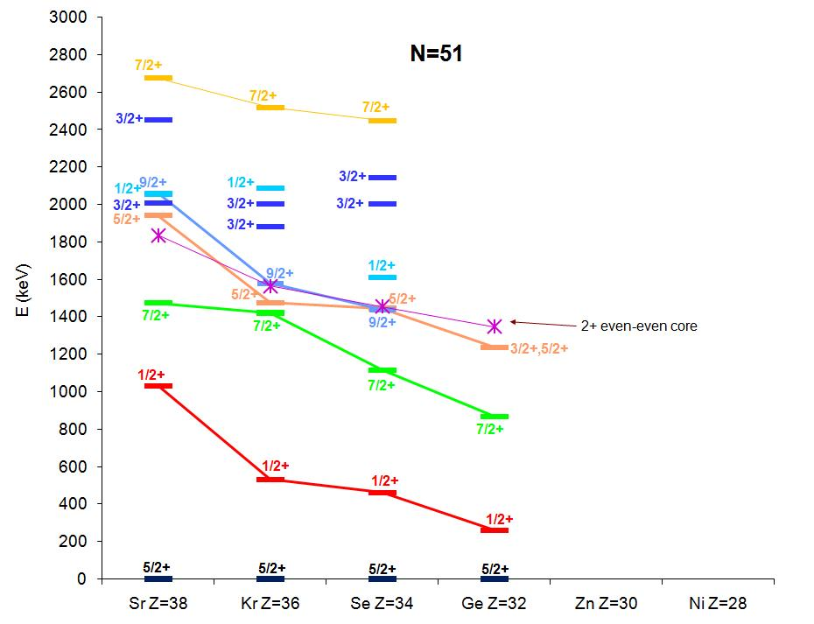
lowering of the g_{7/2} shell ?
Structure of the odd N=51 nuclei:
natural laboratory for the study of the neutron structure above N=50
(1/2+)?
β-decay at Orsay
O. Perru et al. Eur. Phys. J. A 28, 307 (2006)
2⁺ d_{5/2}
from (d,p) Oak Ridge : J. S. Thomas et al. PRC 76, 044302 (2007)
and βn-decay at Orsay : M. Lebois PRC 80, 044308 (2009)
0⁺ s_{1/2}
d_{5/2}
Courtesy of D. Verney

Slide 5
AGATA – vamos at GANIL
Fusion-fission reaction ²³⁸U + ⁹Be
Excitation energy ~45 MeV
Y(⁸³Ge)=0.009/200=4.5 10⁻⁵
from M. Caamaño et al., Phys. Rev. C 88, 024605 (2013) and erratum
fission rate ≈ 10⁵ /s
AGATA (24 capsules) at “semi closed” distance 233 mm – 52 mm= 181 mm
⇒ ε_{1 MeV} ≈ 4.5%
Target
⁹Be
1,85 mg/cm² (10 µm)
Degrader
²⁴Mg 5 mg/cm²
θ>28°
Beam
²³⁸U 6.2 MeV/u
I≈0.5 pnA
d
Quadrupoles
Dipole
MWPPAC - ToF
Drift chambers – x,y,θ,φ
Ionisation chambers- ΔE
25000 to 35000 γ/s/crystal
3 distances
3 days each
E_{res}
~2600 evt/s on focal plane
Courtesy of D. Verney

Slide 6
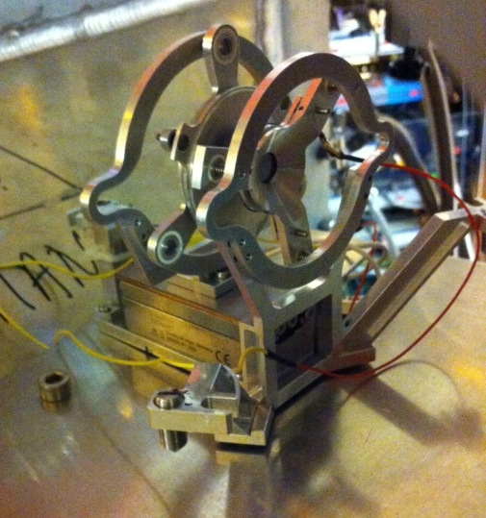
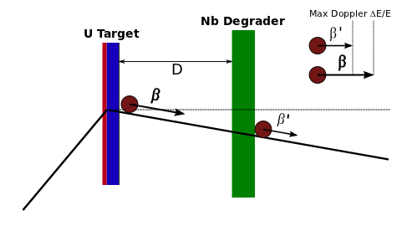
The Plunger device
Mg degrader stretched
Mg degrader
Be target
$$γ_{S}$$
$$γ_{U}$$
Micrometric Motor
Be target stretched
Modified from V. Modamio

Slide 7
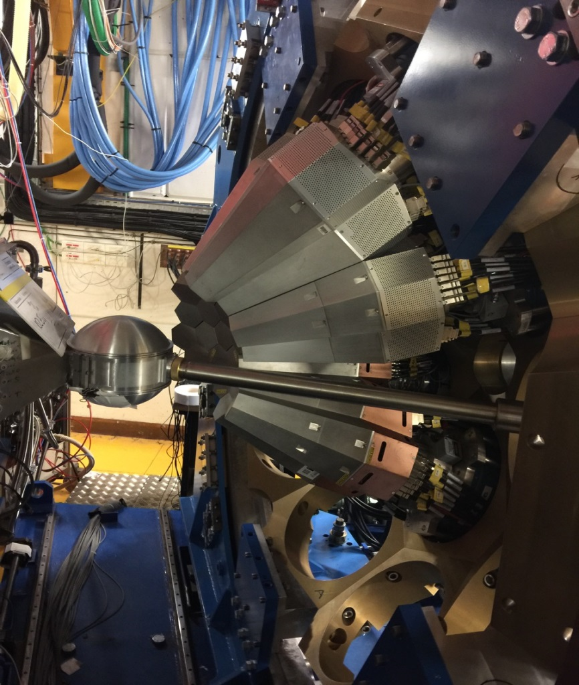
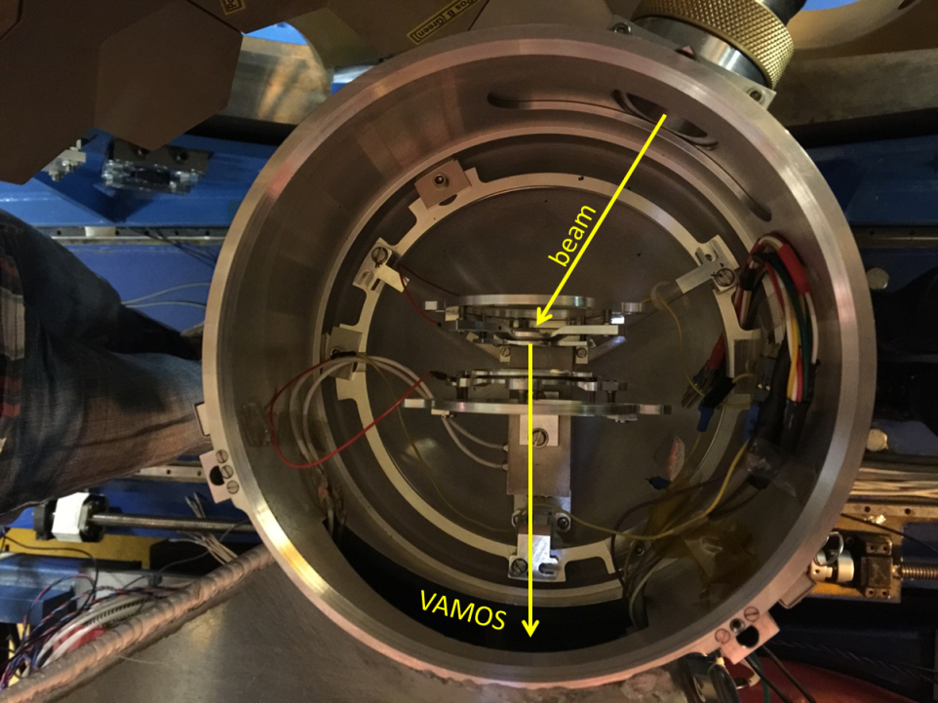
Pictures of the setup

Slide 8
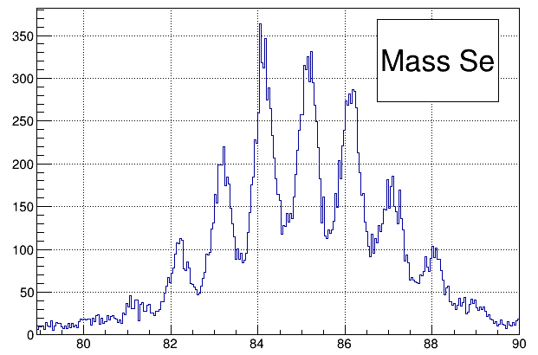
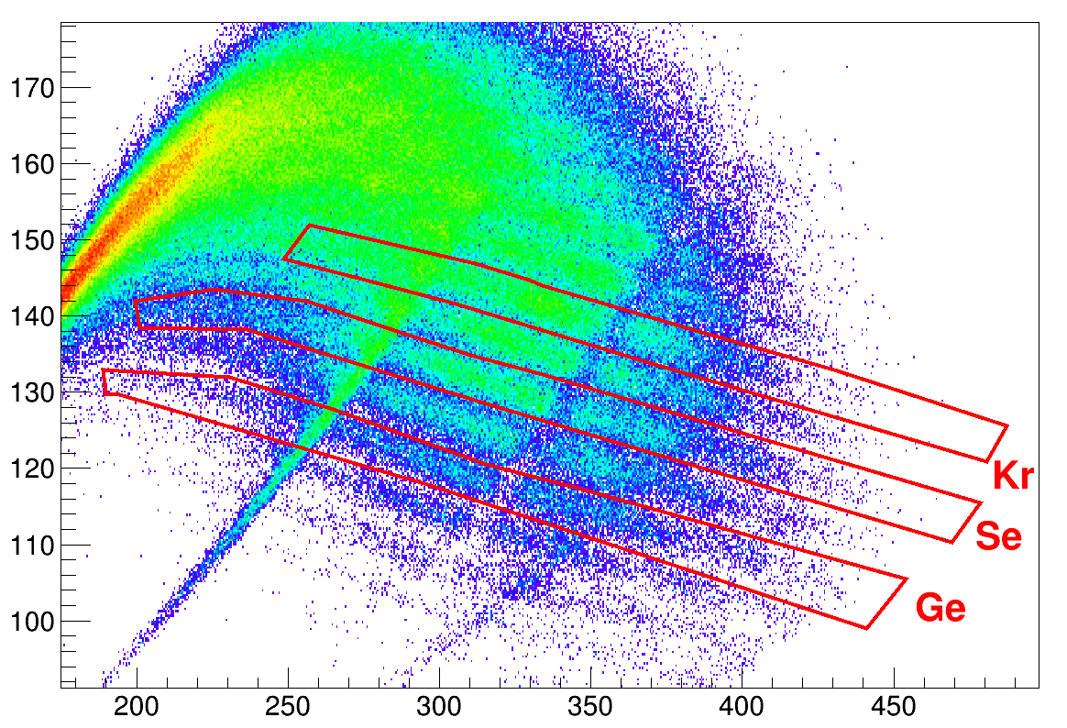
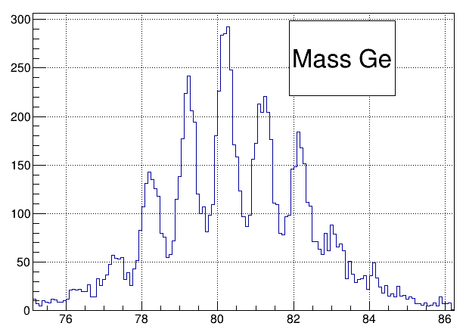
Vamos mass identification
ΔE
E
Atomic number and mass near line !

Slide 9
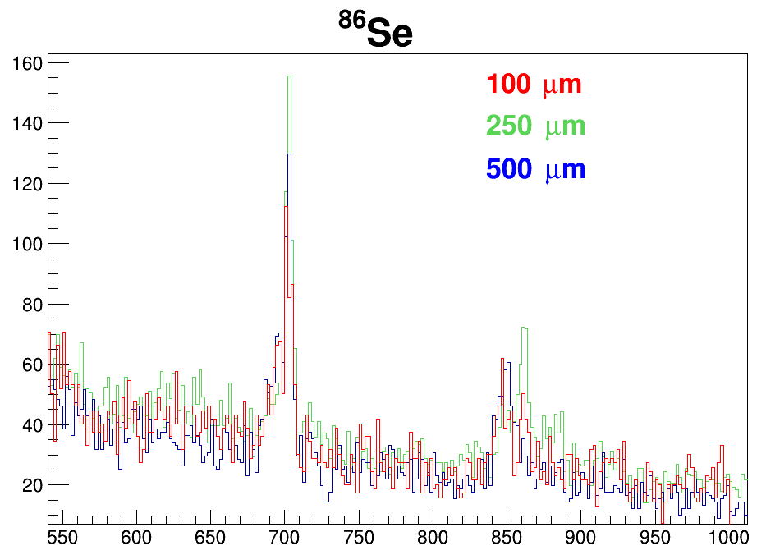
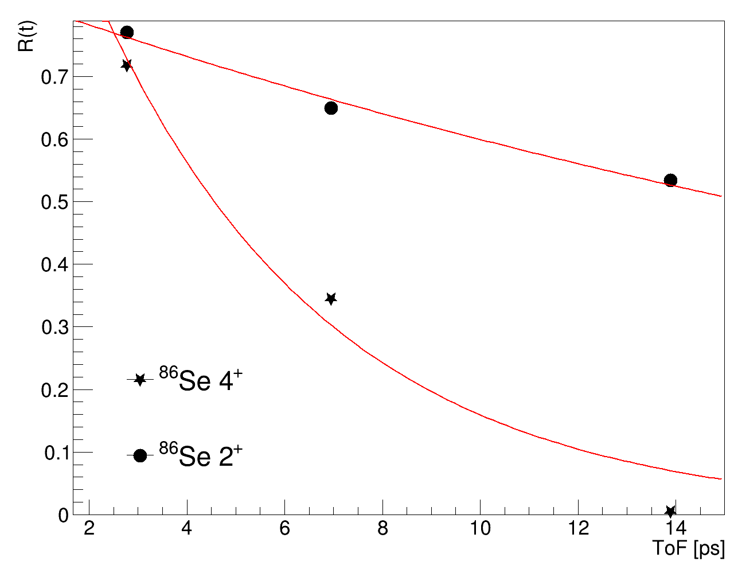
The example of ⁸⁶Se
⁸⁶Se (no half life yet published)

Slide 10
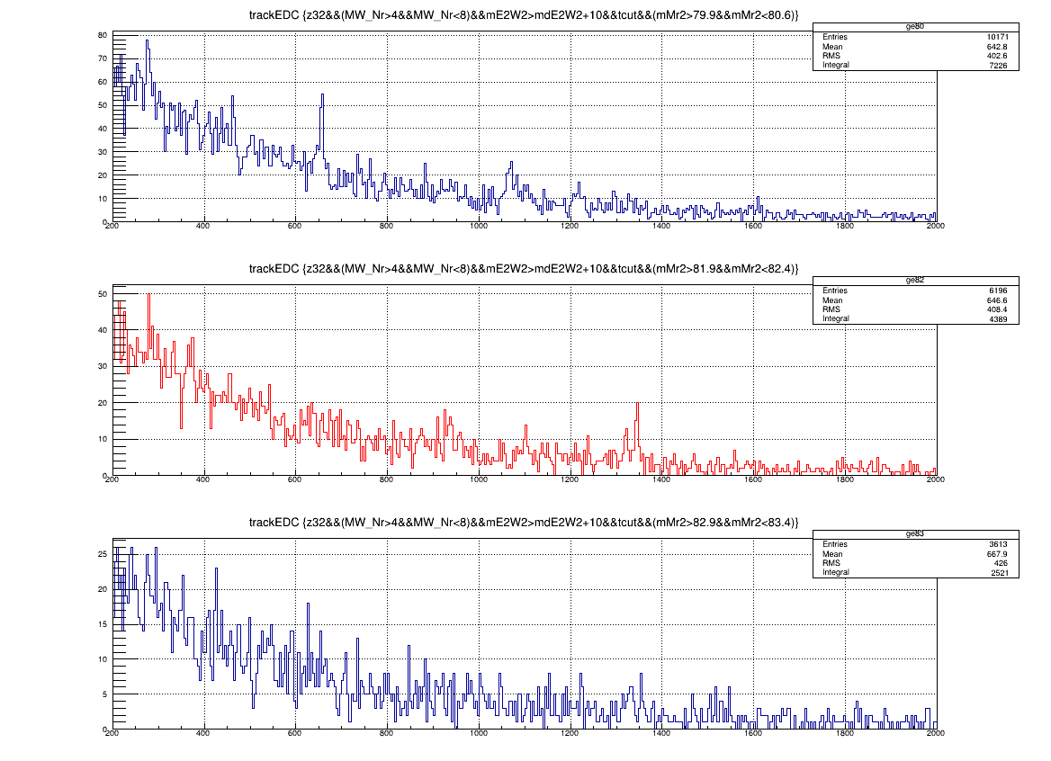
The N = 51 ⁸³Ge
250 μm
2⁺ -> 0⁺
⁸⁰Ge
4⁺ -> 2⁺
⁸²Ge
2⁺ -> 0⁺
⁸³Ge

Slide 11
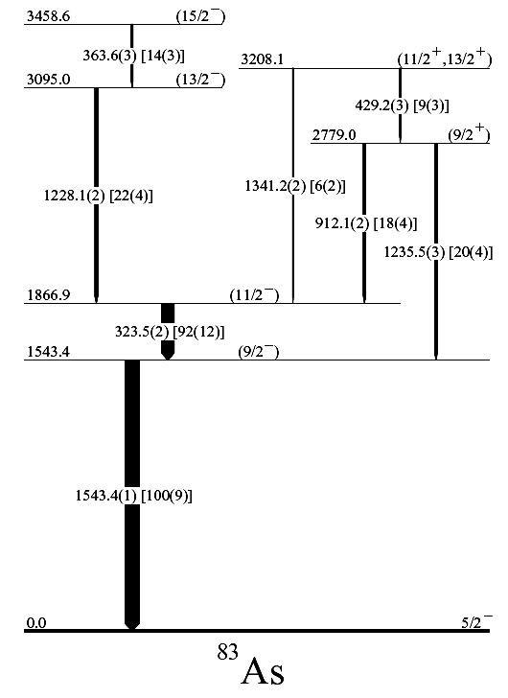
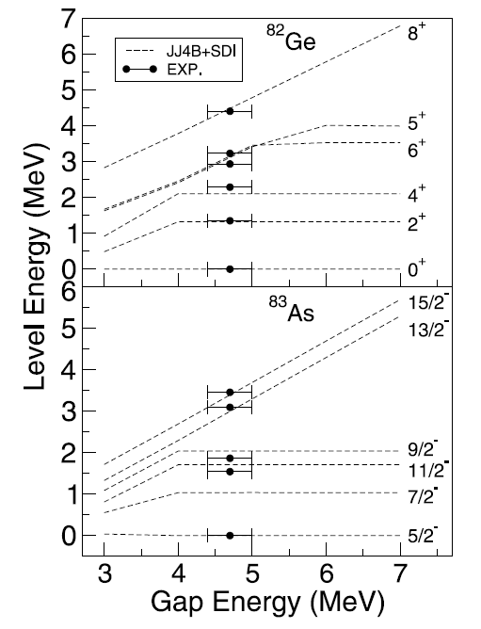
The case of ⁸³As
Neutron-proton gap evolution towards N = 50
Br85
Se84
As83
Ge82
Ga81
Zn80
Cu79
Ni78
50
EXILL; Phys Rev C 91, 047302 (2015)
CLARA-PRISMANucl. Phys. A 893 (2012) 1–12

Slide 12
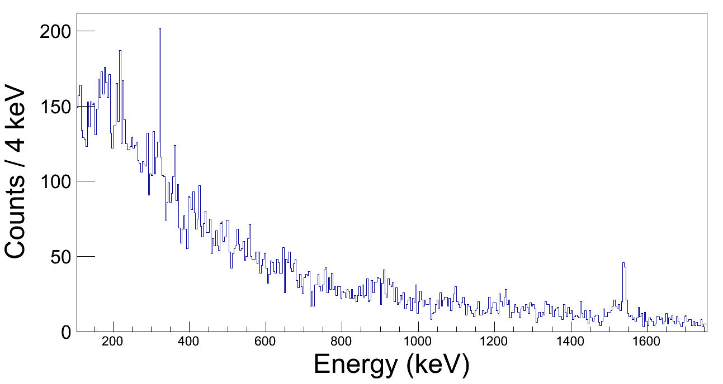
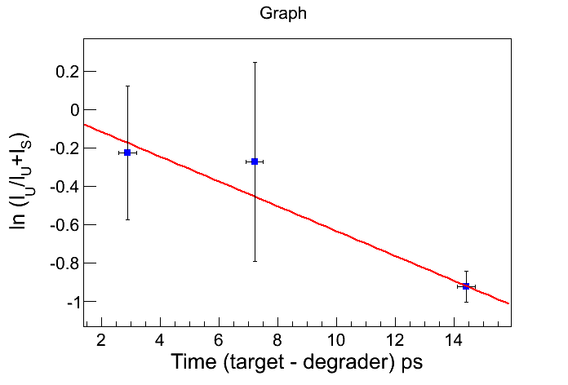
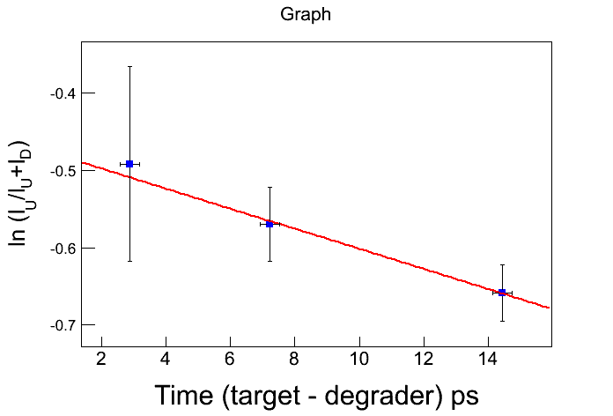
⁸³As: prelimary results
11/2⁻
⁸³As
Gamma spectrum at 100μm distance:
Improving Doppler correction
Cleaning background
15/2⁻
9/2⁻
13/2⁻
323 keV
1543 keV
t_{1/2} = 77(10) ps
The premilinary lifetime anlysis shows long-living low-lying states: feeding as expected !
Comparison with shell-model calculations

Slide 13
CONCLUSIONS
Stable ²³⁸U beam from GANIL accelerator
Analysis on going with promising results even in the most exotic (poor statistics) channels
VAMOS excellent selectivity for the fusion-fission channels (viable mechanism towards the Ni region)
Sensitivity (efficiency and peak-to-total) of the AGATA + OUPS setup crucial for weak channels

