Slide 1
A new technique to produce and study the most exotic neutron-rich nuclei LICORNE @ IPN Orsay
Andrea Gottardo
on behalf of Jon Wilson and Matthieu Lebois
EUNPC2015
Aug 30 - Sep 4, 2015

Slide 2
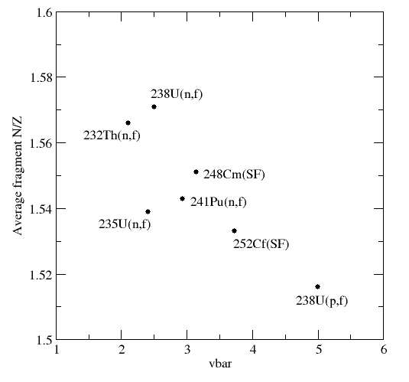
Fission and large γ arrays
Spontaneous Fission ²⁵²Cf(SF), ²⁴⁸Cm(SF)
(Gammasphere, Euroball)
Exoticité
Fission by thermal neutrons
²³⁵U(n_{th},f) ²⁴¹Pu(n_{th},f) (EXILL Exogam@ILL)
Fission by fast neutron ²³⁸U(n,f), ²³²Th(n,f)
(LICORNE, IPN Orsay)

Slide 3
Neutron production in inverse kinematics
Sample
H target
γ
n
n
n
100nA ⁷Li
13-17 MeV
n
10⁷ n/s/cm²
γ
Lithium Inverse Cinematiques ORsay NEutron source
p(⁷Li,⁷Be)n reaction in inverse kinematics
Focused source of fast neutrons between 0.5 and 4 MeV
Notes:
The last type of experiment is about capture for fission isomers studies.
It is now known that thei exist Extremely deformed isomers: that prefer to undergo fission because outter barrier is smaller than the inner barrier to go back to a less deformed state
Observed for Pu or in actinides.
Usually this type of experiment is performed by Detecting transfer reaction with a charged particle in coinc with delayed fission to get the isomer lifetime.
Unfortunately the Extremely weak population of these isomers makes that for some of them no gamma decay mode was measured. Except when the fissility parameter gets reasonnably law: the inner barrier can become small enough to favorise the slow electromagnetic process through vs the fission

Slide 4
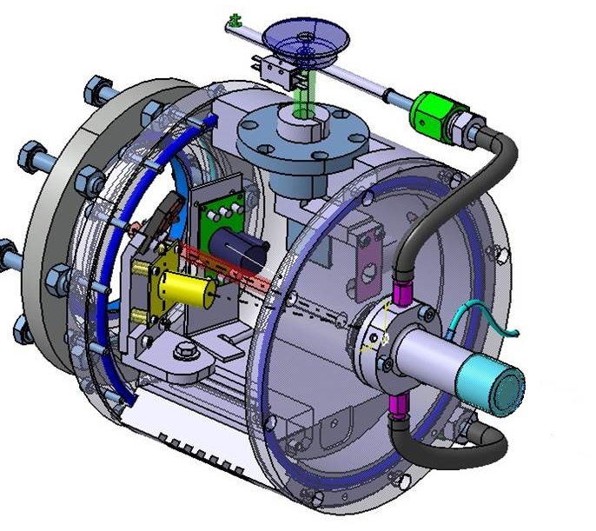
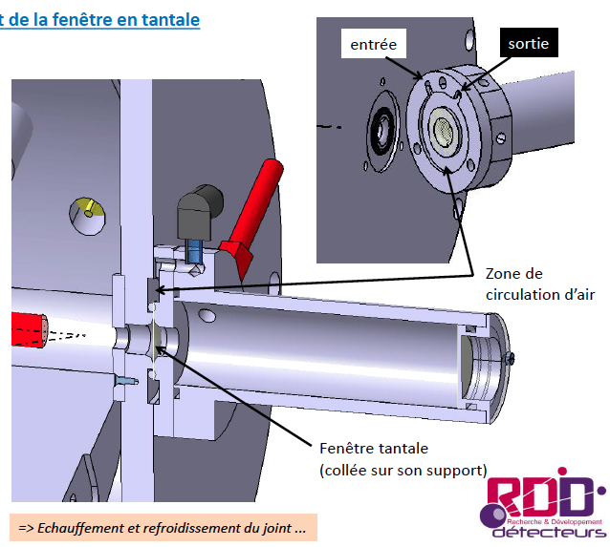
Development of a gas target for LICORNE (commissionning performed nov. 2014)
??
Parasitic fusion evaporation reaction of ⁷Li on ¹²C
Ge
n
Need to change the PP target ➔Gas target
n
n
n
Elements with Z > 73 required in the beam path
In air
Out air
Air circulation
Tantalum window
Target cooling

Slide 5
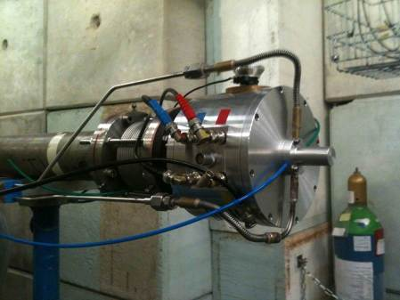
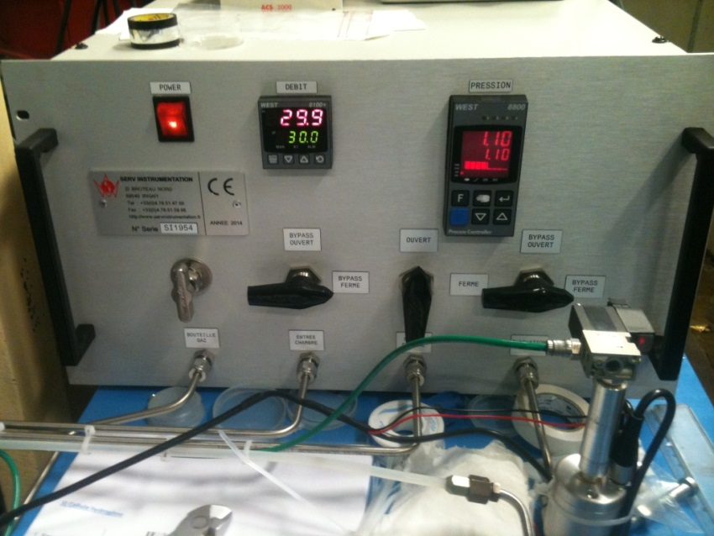
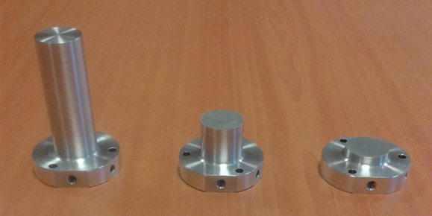
LICORNE setup (i)
H₂ pressure and flow control system
Hydrogen gas cells
Development of a kinematically focused neutron source
with the p(⁷Li,n)⁷Be inverse reaction
M.Lebois, J.N. Wilson et al.,
Nucl. Instrum. Meth. A 735 145 (2014)
Notes:
The last type of experiment is about capture for fission isomers studies.
It is now known that thei exist Extremely deformed isomers: that prefer to undergo fission because outter barrier is smaller than the inner barrier to go back to a less deformed state
Observed for Pu or in actinides.
Usually this type of experiment is performed by Detecting transfer reaction with a charged particle in coinc with delayed fission to get the isomer lifetime.
Unfortunately the Extremely weak population of these isomers makes that for some of them no gamma decay mode was measured. Except when the fissility parameter gets reasonnably law: the inner barrier can become small enough to favorise the slow electromagnetic process through vs the fission

Slide 6
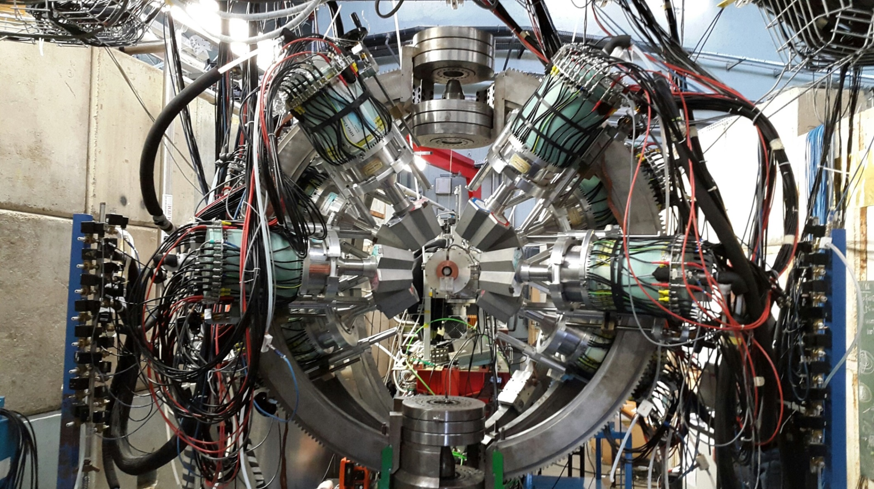
LICORNE setup (iI)
Notes:
I’ll start this presentation with an explanation about the LICORNE neutron source and why is it unique compare to the other ones.
Usually to produce high fluxes of neutrons, e use brute force with a very intense primary beam of a light particle sent on a heavier target. The choice of couple (projectile/target) will give the range of energy for the neutron production. On this figure, most used reaction cross section vs neutron energy for mono energetic neutron sources are given.
This type of source have a major drawbacks: first 99% of the neutrons are lost, and these lost neutrons will participate to the room background! But most of all, the fact that this type of source is isotropic make almost impossible the placement of a detection setup around a sample without a very heavy shielding.

Slide 7
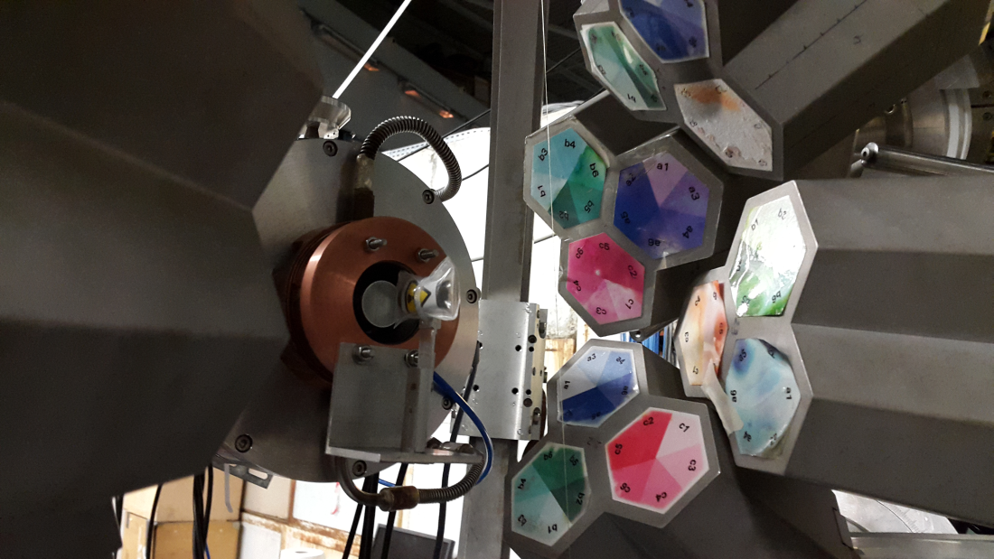
LICORNE setup (IiI)
(p,p’) gamma shieldr
²³⁸U
metallic

Slide 8
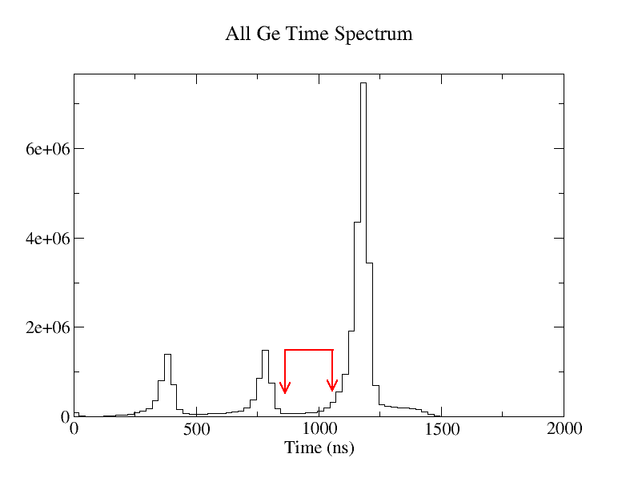
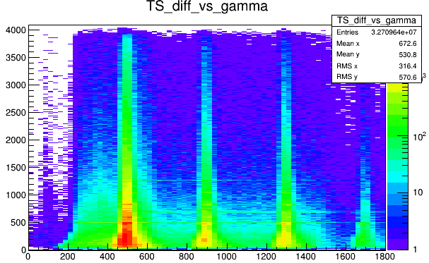
Pulsed neutron beam
Prompt peak
2 prompt γ selection
400 ns
Energy (keV)
1 delayed γ selection
Possibility of: 1) isomer tagging
2) cleaning the β background
Time (ns)

Slide 9
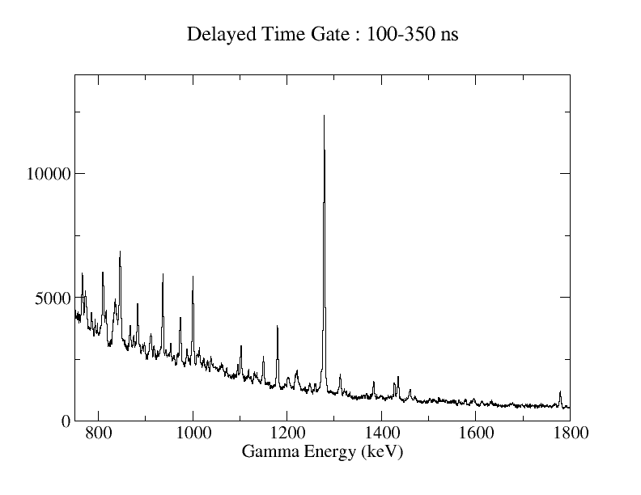
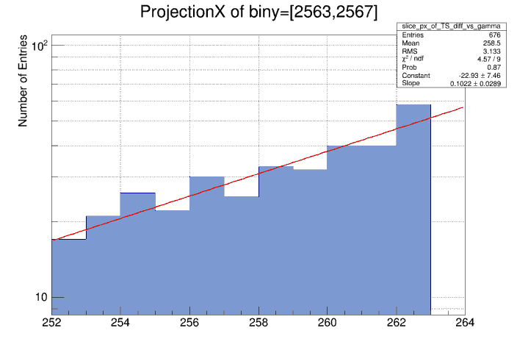
ISOMERS
¹³⁴Te 2⁺
T_{1/2} ~ 170ns

Slide 10
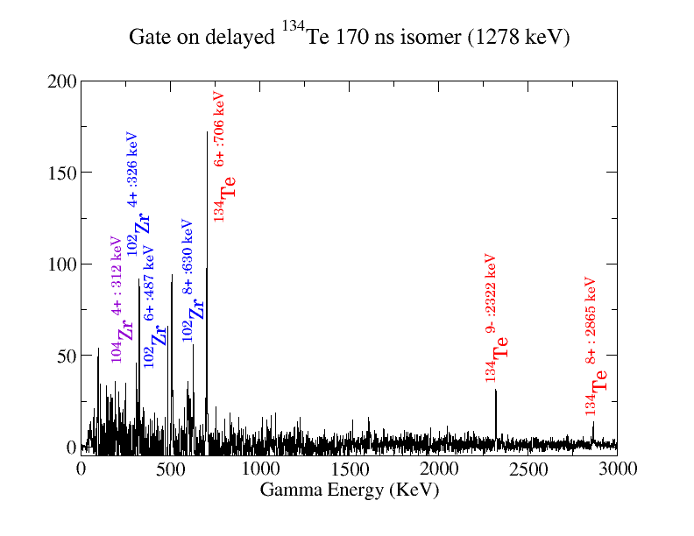
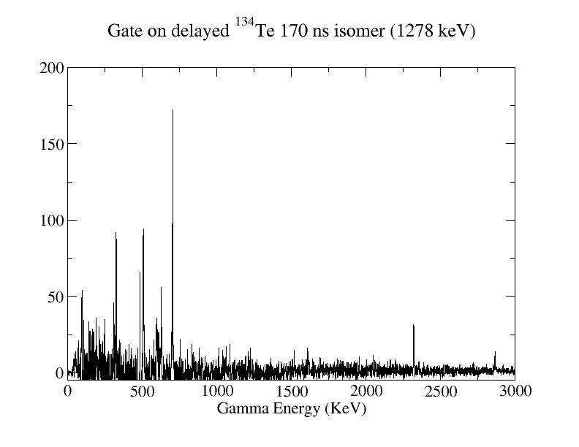
Prompt-delayed γ coincidences
Notes:
At test experiment was performed in september 2012 to prove the feasability of such a source. From this experiment, we were able to build a dedicated reaction chamber for neutron production. This chamber was commissionned in june 2013.
In between we proposed to experiments at the ALTO advisory committee. One was performed in july.

Slide 11
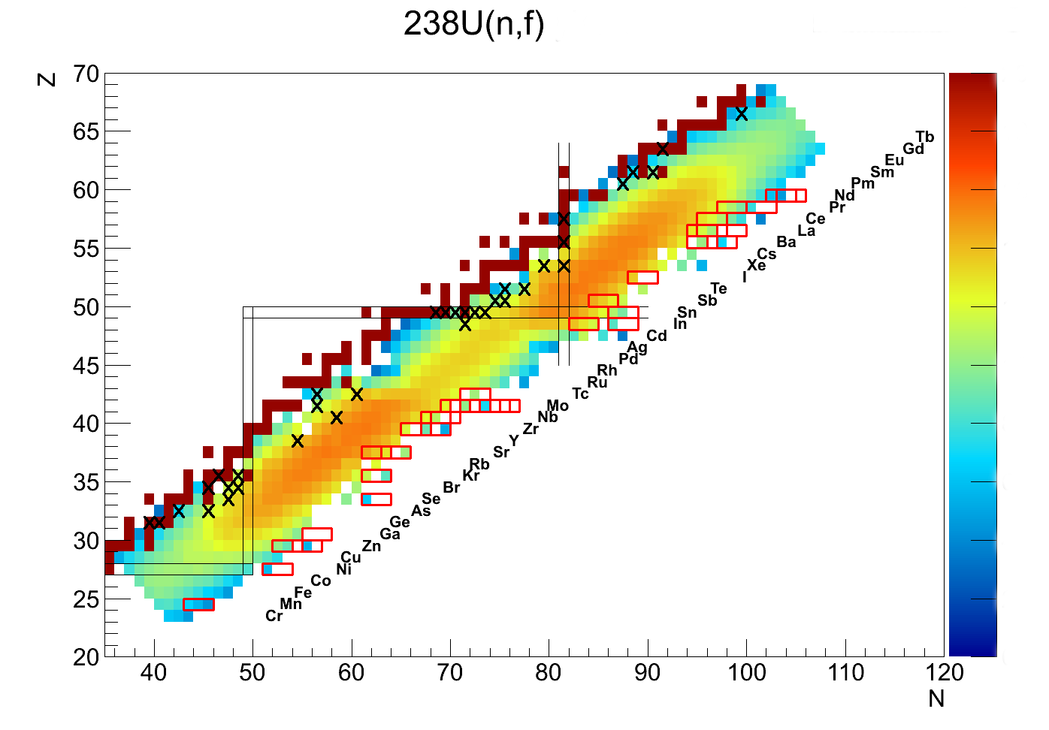
TIPS – Tagging Isomer PartnerS

Slide 12
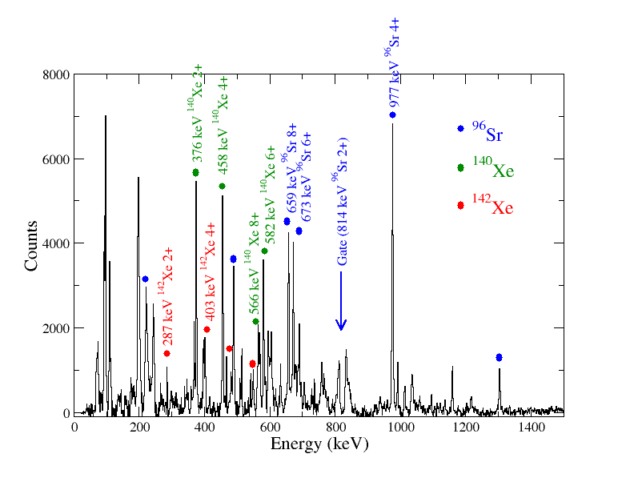
γ γ prompt: gate on ⁹⁶sr 2⁺

Slide 13
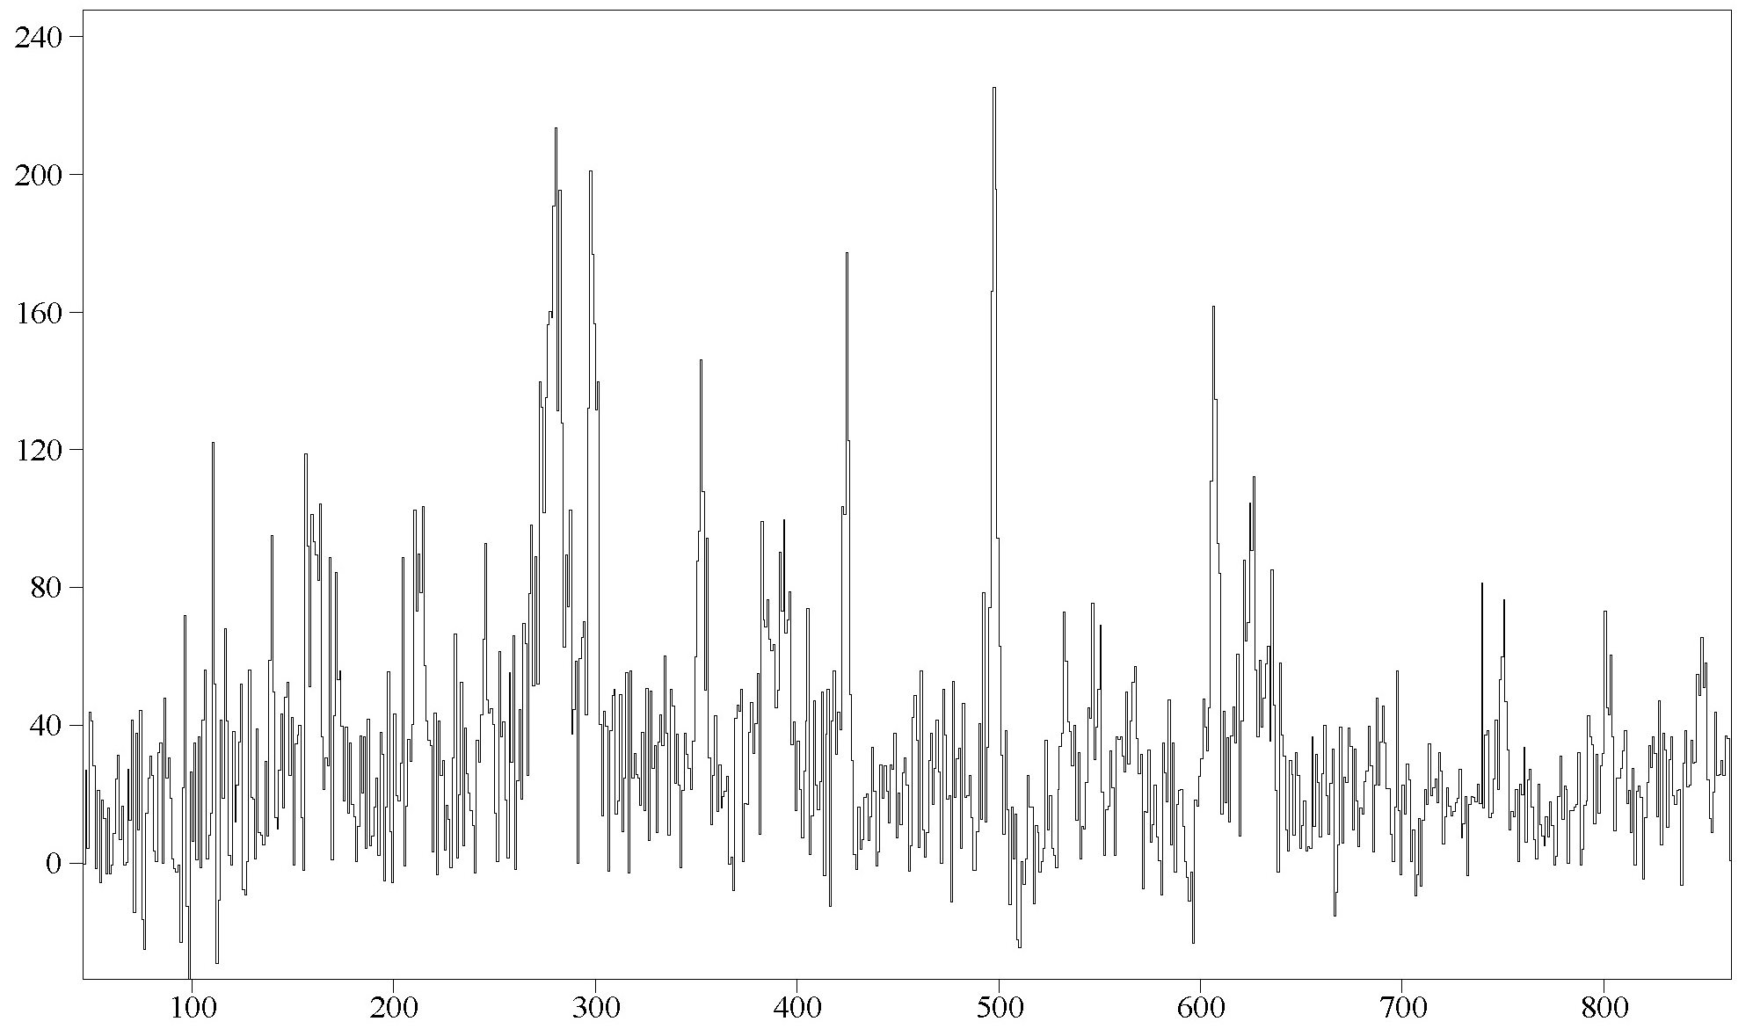
γ CUBE (prompt): gate on ¹⁰⁰Zr 2⁺, 4⁺
¹³⁶Te + ¹⁰⁰Zr = ²³⁹U - 3n
¹⁰⁰Zr: 6⁺
¹³⁶Te: 2⁺
¹³⁶Te: 4⁺
¹³⁶Te: 6⁺
¹⁰⁰Zr: 8⁺
¹⁰⁰Zr: 10⁺
¹⁰⁰Zr: 12⁺
¹³⁶Te: 8⁺

Slide 14
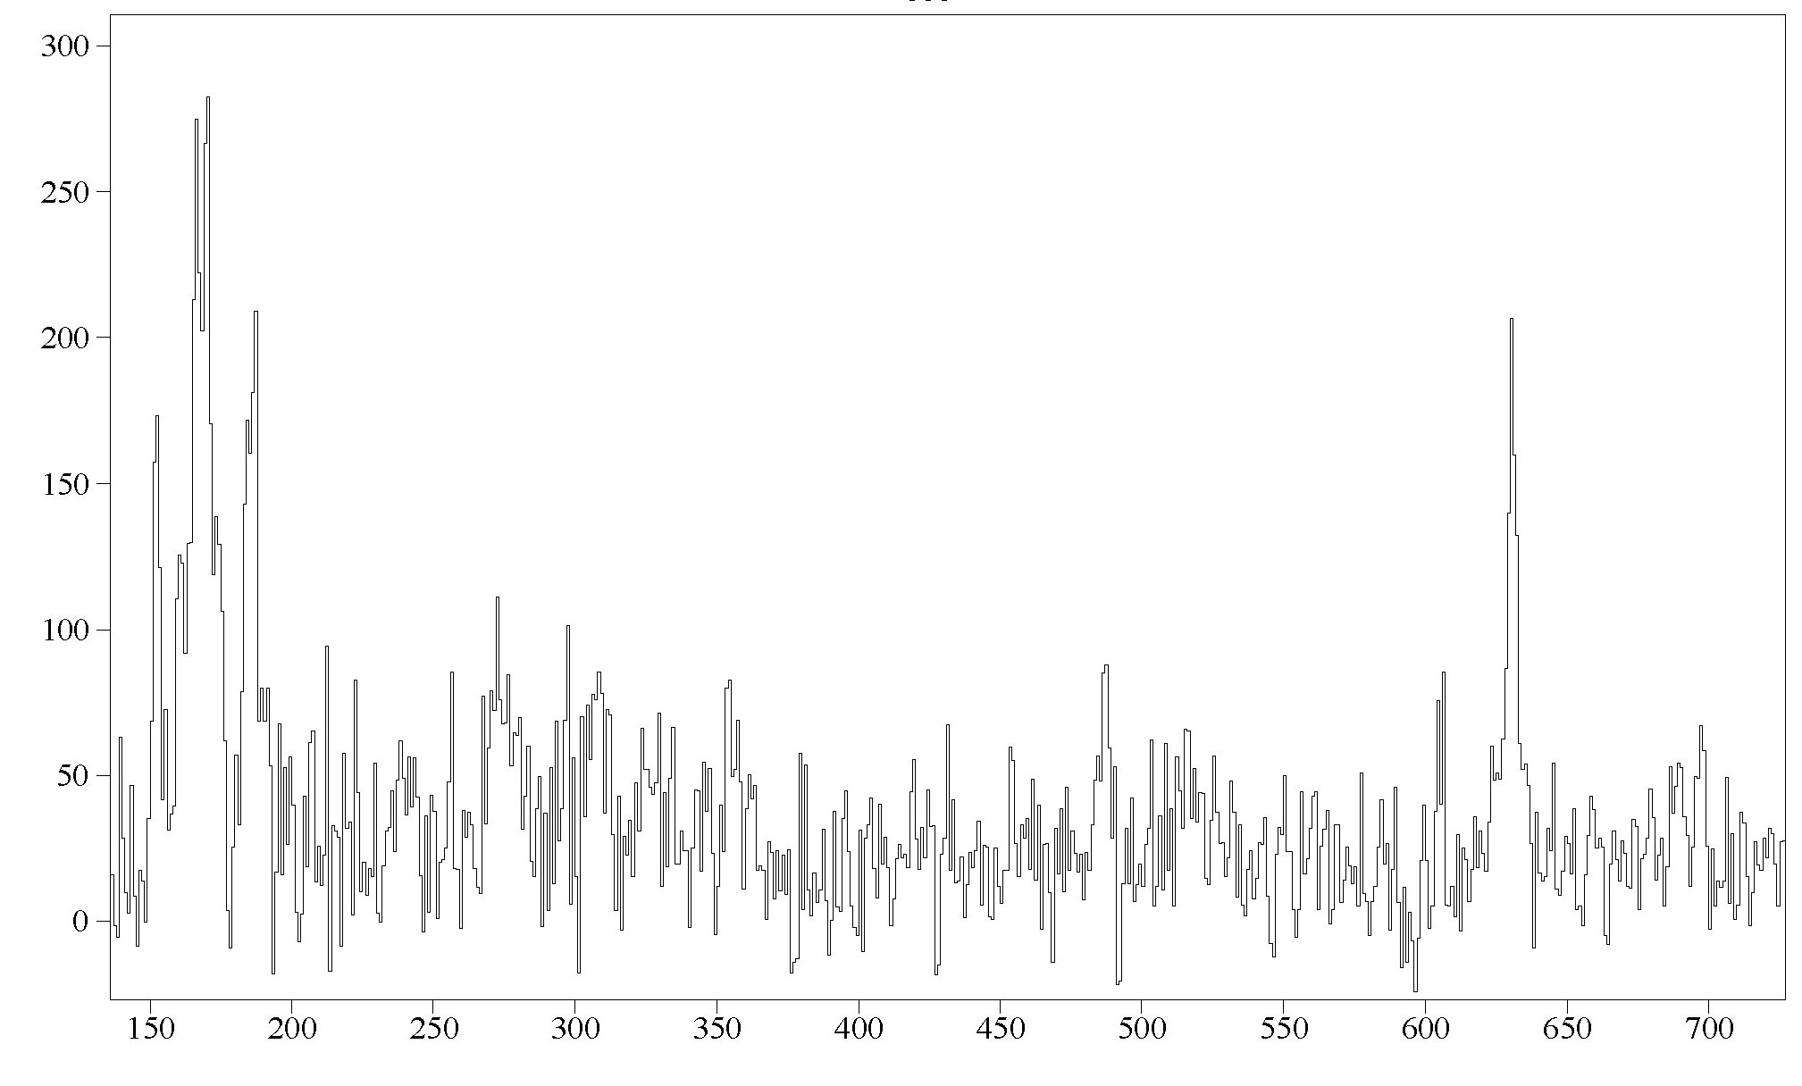
γ CUBE (prompt): gate on ¹⁰²Zr 4⁺, 6⁺
¹⁰²Zr: 2⁺
¹³⁴Te has a 6⁺ isomer: no prompt γs !
¹⁰²Zr: 8⁺

Slide 15
COnclusions
LICORNE is an efficient method to produce very cold fission of the most neutron-rich system possible (²³⁹U): 2.6·10⁹ coincidence events of Mγ >= 3 over 3 weeks
With pulsed beams possiblity of isomer tagging and better cleaning of standard prompt γ γ γ matrices by beta-background rejection
Future devolopements: Fast-timing, applications. ν-ball project for IPN Orsay.
Complementarity to other in-beam fission studies

Slide 16
Background slides

Slide 17
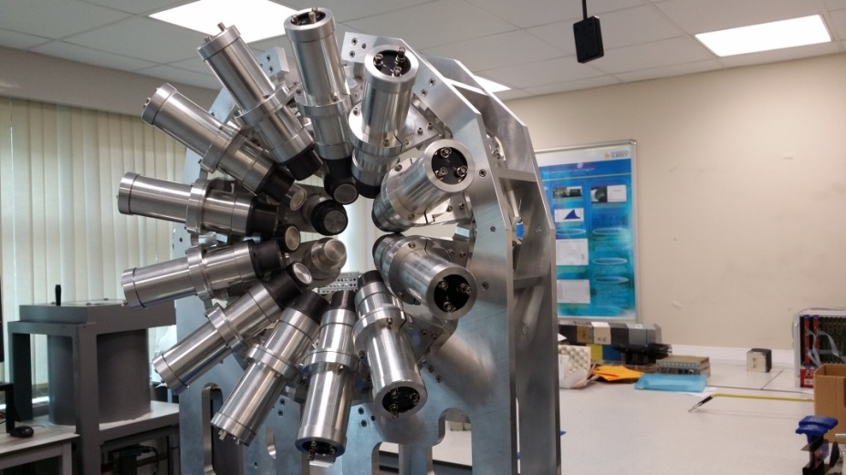
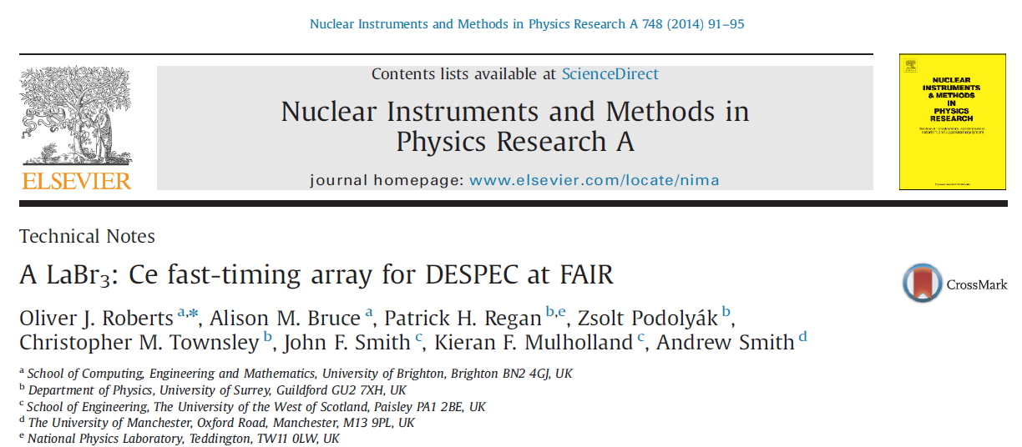
The Future: FATIMA for DESPEC
FATIMA = FAst TIMing Array = State of the art gamma-ray detection array for precision measurements of nuclear structure in the most exotic and rare nuclei. Part of the ~ £8M STFC NUSTAR project grant (runs 2012-16).
Good energy resolution (better than 3% at 1 MeV).
Good detection efficiency (between than 5% Full-energy peak at 1 MeV).
Excellent timing qualities (approaching 100 picoseconds).
Use to measure lifetimes of excited nuclear states & provide precision tests of theories of nuclear structure, uses a fully-digitised Data Acquisition System.
Collaboration with NPL (Radioactivity group) through NMO project on ‘Nuclear Data’ (Judge, Jerome, Regan et al.,) on parallel development of NPL-based array for use in traceable radioactive standards and traceability to the Bq.

Slide 18
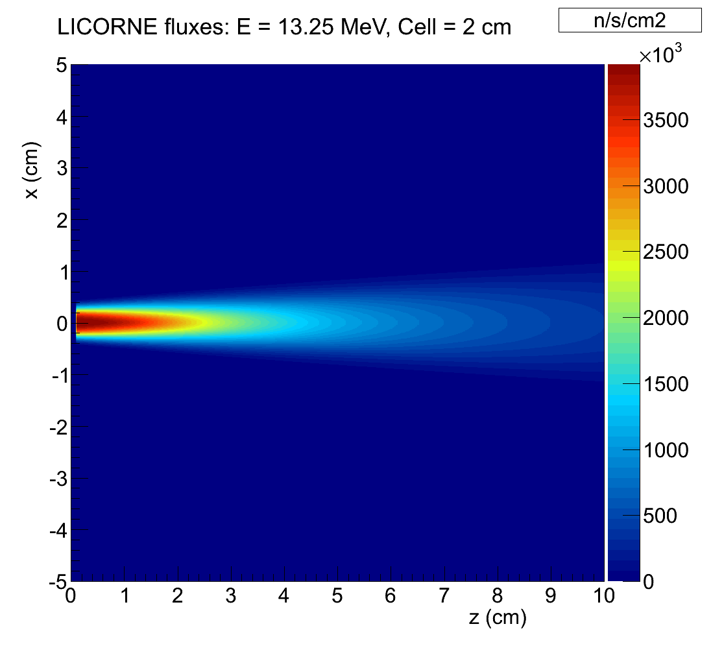
Available Fluxes

