Slide 1



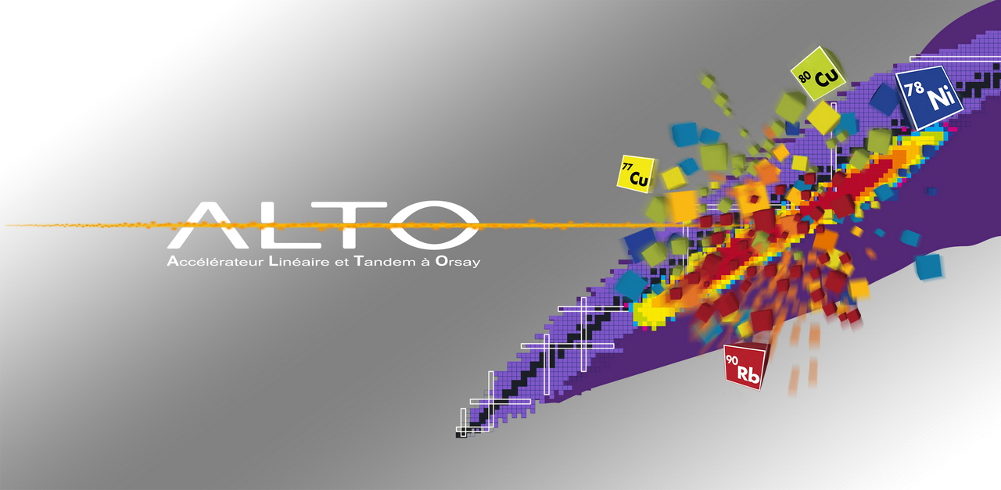
ALTO – a facility for stable and
radioactive beam studies
Georgi Georgiev, CSNSM, Orsay, France

Slide 2
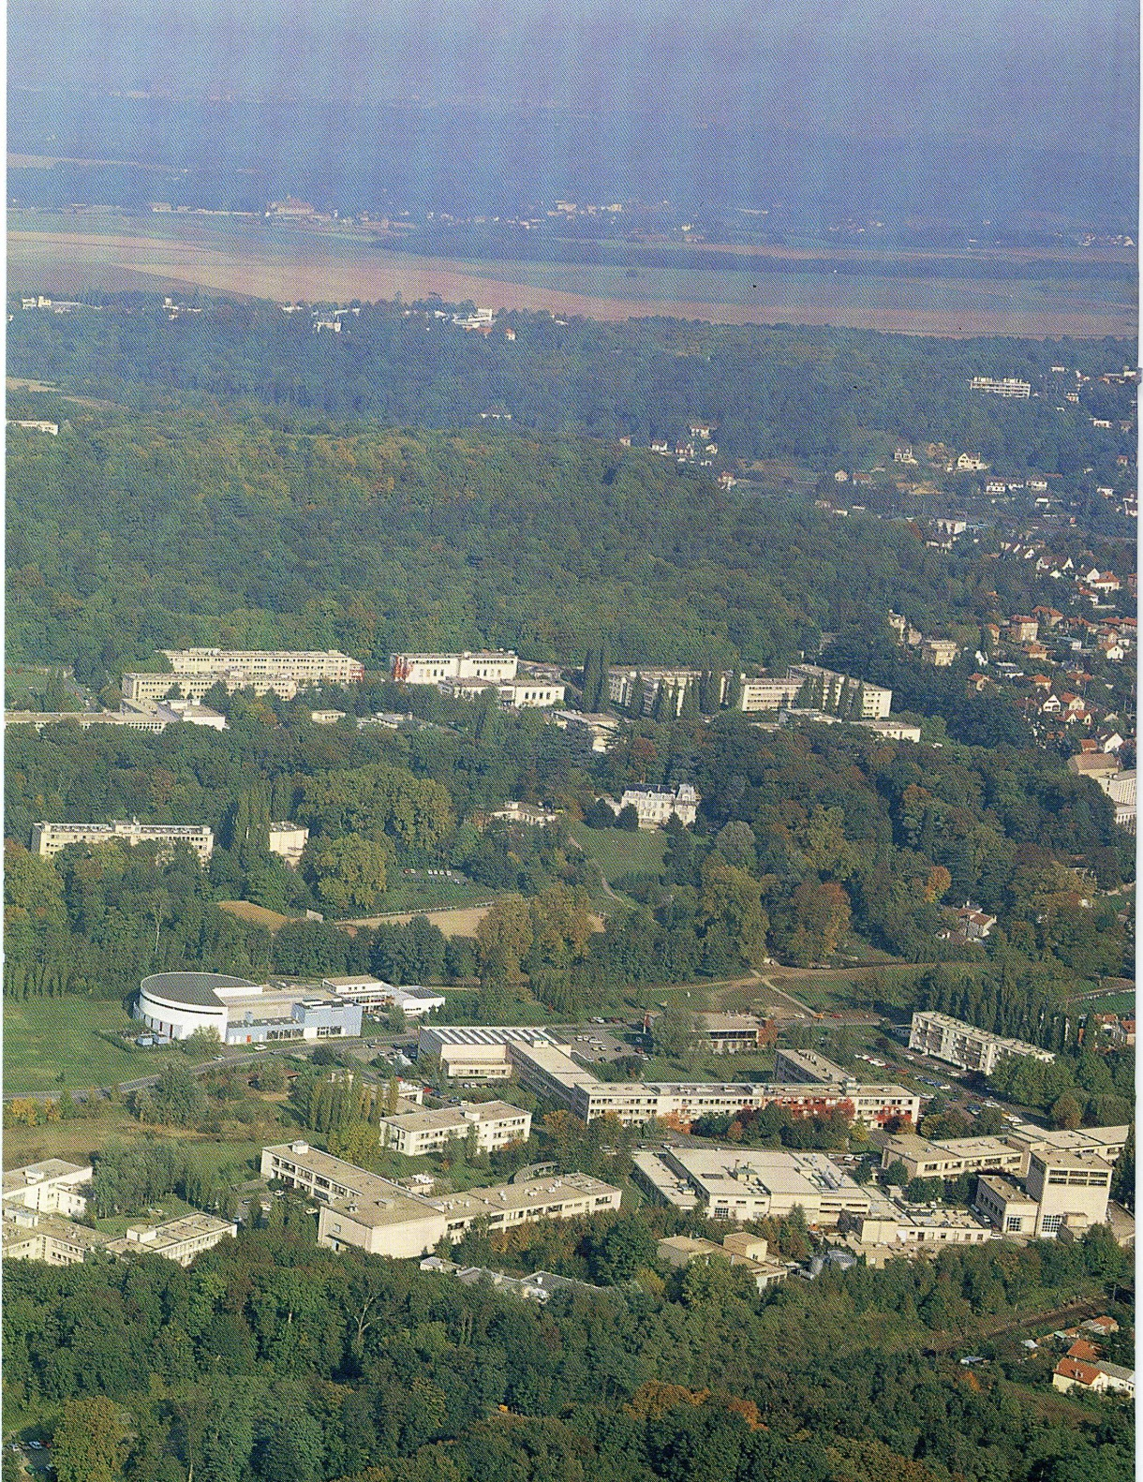
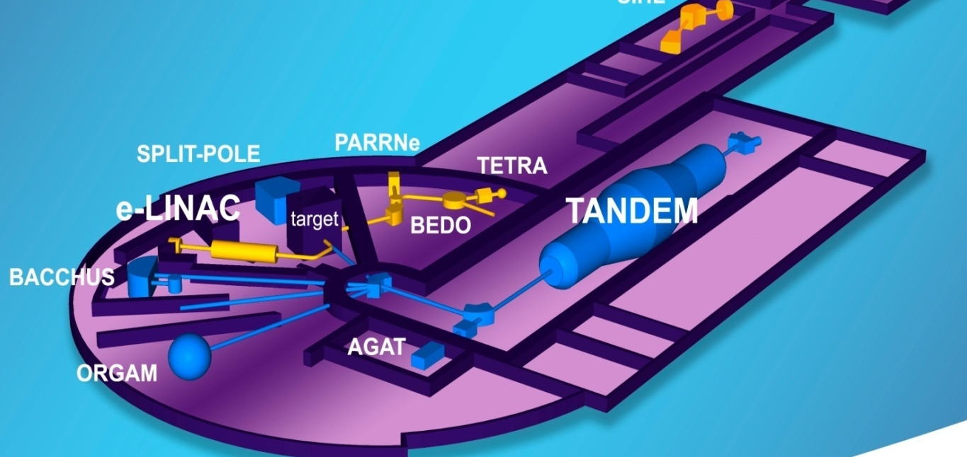



The ALTO facility
50 MeV
15 MV
2013 2014 2015
Users 200 135 >120
Beam-time 2983 h 2297 h 2736 h
373 UT 287 UT 342 UT

Slide 3
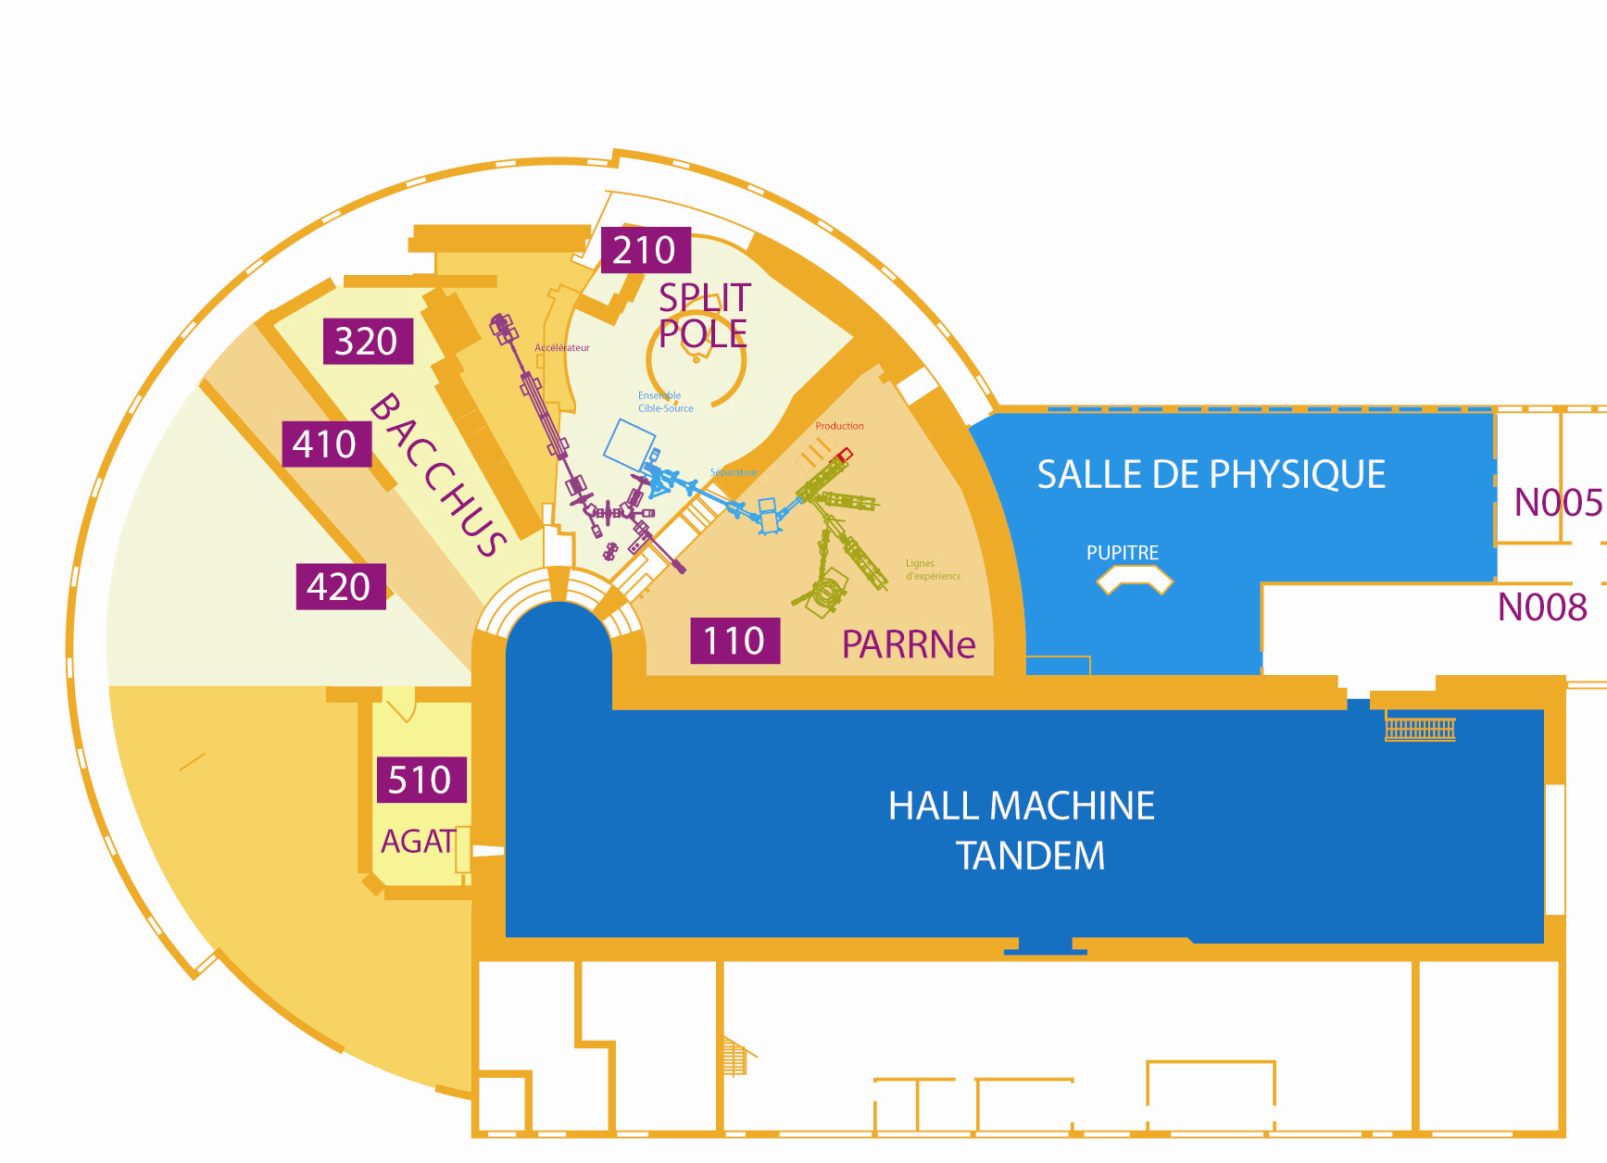
Experimental areas
Split-Pole
spectrometer
ISOL
production cave
Bacchus
ISOL installation
ISOL
mass separator
experimental lines
Licorne
e LINAC
γ-spectrometers ORGAM
MINORCA
PARIS
cluster,
molecular &
droplets beams
Radioactive beam lines
Stable beam w/o spectrometer
Stable beam with spectrometer

Slide 4
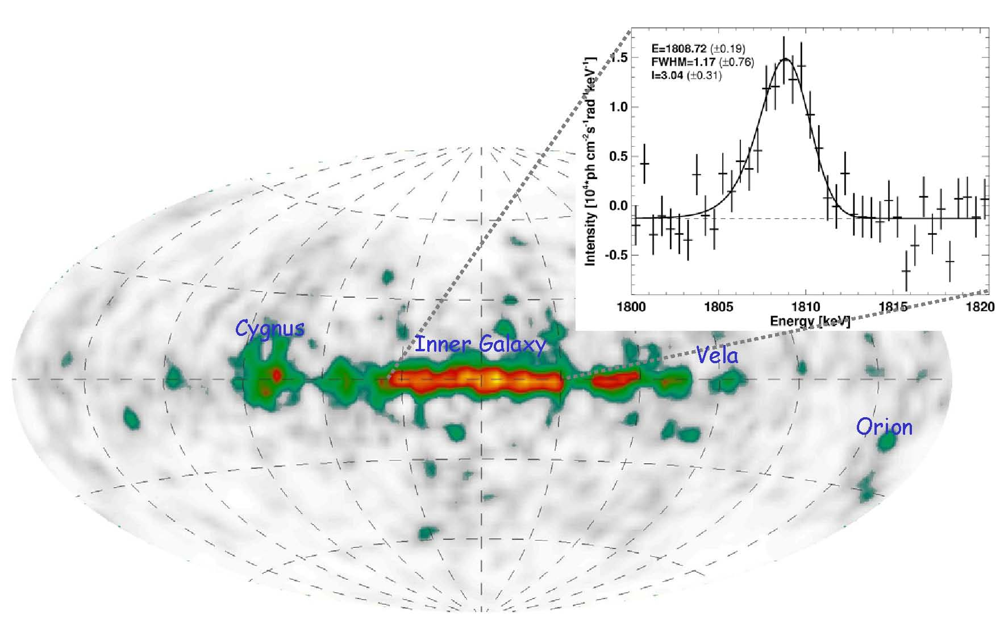
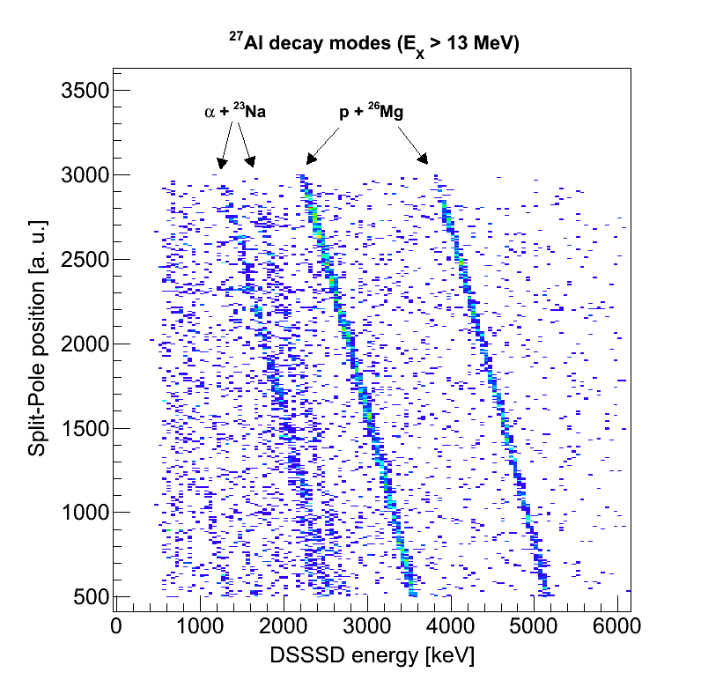
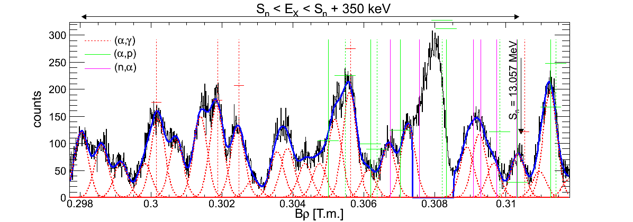
²⁶Al nucleosynthesis in massive stars
N. de Séréville & A. M. Laird N-SI-36
Astrophysical motivation:
  Gamma-ray emission associated with ²⁶Al observed in our galaxy.
  ²⁶Mg coming from ²⁶Al decay observed in presolar grains
  ²⁶Al yields depends strongly on reactions ²⁶Al(n,p)²⁶Mg and ²⁶Al(n,α)²³Na
  Need for better ²⁷Al spectroscopy (E_{R}, Jπ, Γ_{p}, Γ_{α}) above neutron threshold (S_{n} = 13 MeV)
Credit: MPE Garching / R. Diehl
²⁶Al(n,p)²⁶Mg and ²⁶Al(n,α)²³Na in massive star
→ Populating resonances with the ²⁷Al(p,p')²⁷Al* reaction
Split-Pole spectrometer (ALTO) + DSSSDs in reaction chamber
Adsley et al. to be submitted
30 new states above neutron threshold in ²⁷Al
S. Benamara, N. de Séréville et al, PRC 89, 065805 (2014)
Notes:
The 26Al radioisotope is of great importance for understanding the chemical and dynamical evolution of our galaxy. Among the possible stellar sources, massive stars are believed to be the main producer of this radioisotope. Understanding 26Al nucleosynthesis in massive stars requires estimates of the thermonuclear reaction rates of the 26Al(n,p)26Mg, 26Al(n,α)23Na, and 23Na(α,p)26Mg reactions. These reaction rates depend on the spectroscopic properties of 27Al states above the neutron and alpha thresholds. In this context, the 27Al(p,p)27Al* reaction was studied at 18 MeV using a high-resolution Enge Split-Pole spectrometer.

Slide 5
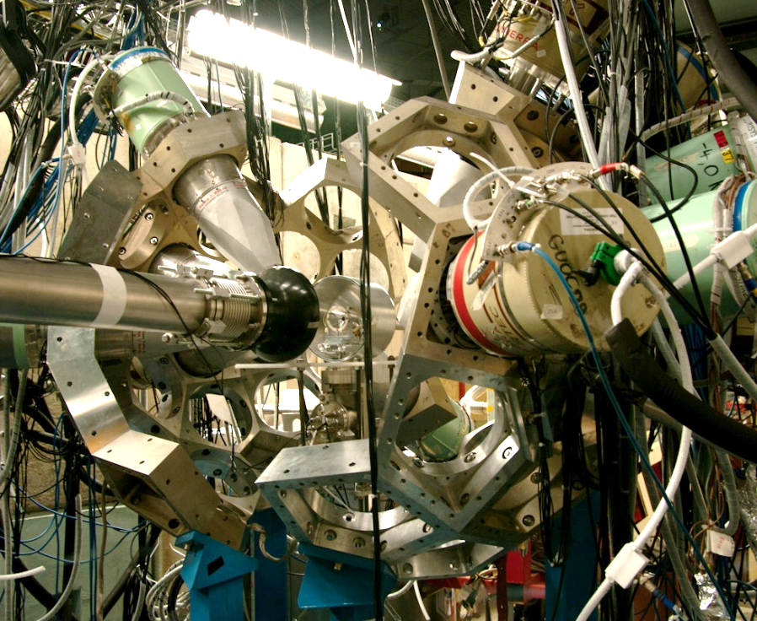
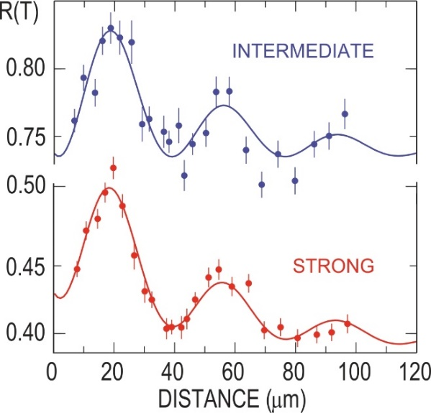
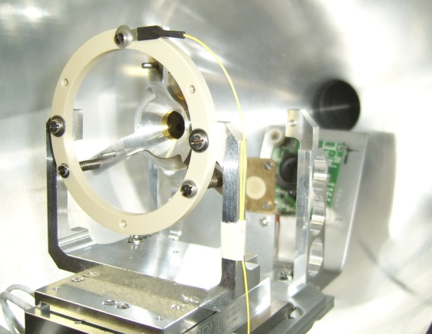
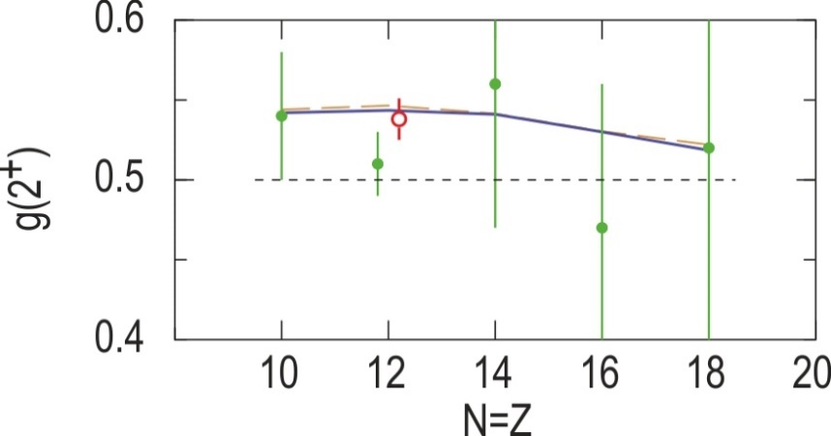
TDRIV on H-like ions: ²⁴Mg
beam: ²⁴Mg @120 MeV (5 MeV/u)
target: 2.4 mg/cm² ⁹³Nb
reset Foil: 1.7 mg/cm² ¹⁹⁷Au
ORGAM
OUPS
Previous measurement:
|g(2⁺)| = 0.51 (2)
R.F. Horstman et al., NPA 248, 291 (1975)
Our result:
|g(2⁺)|= 0.538 (13)
A. Kusoglu et al. PRL 114, 062501 (2015)
²⁴Mg 2⁺ state USD shell model: g(2⁺)=0.544
High-accuracy g-factor measurements are
essential for constraining the theories!

Slide 6
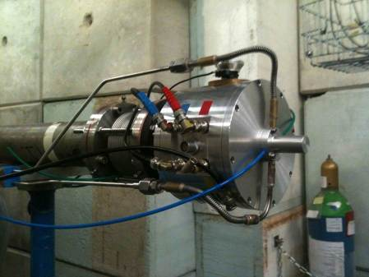

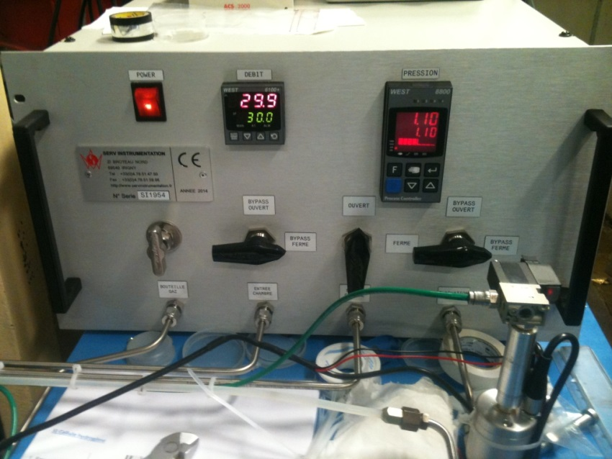
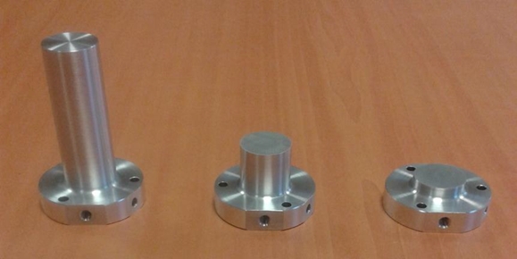
LICORNE II – fast-neutron source
H₂ pressure and flow control system
Hydrogen gas cells
Development of a kinematically focused neutron source
with the p(⁷Li,n)⁷Be inverse reaction
M.Lebois, J.N. Wilson et al., Nucl. Instrum. Meth. A 735 145 (2014)

Slide 7
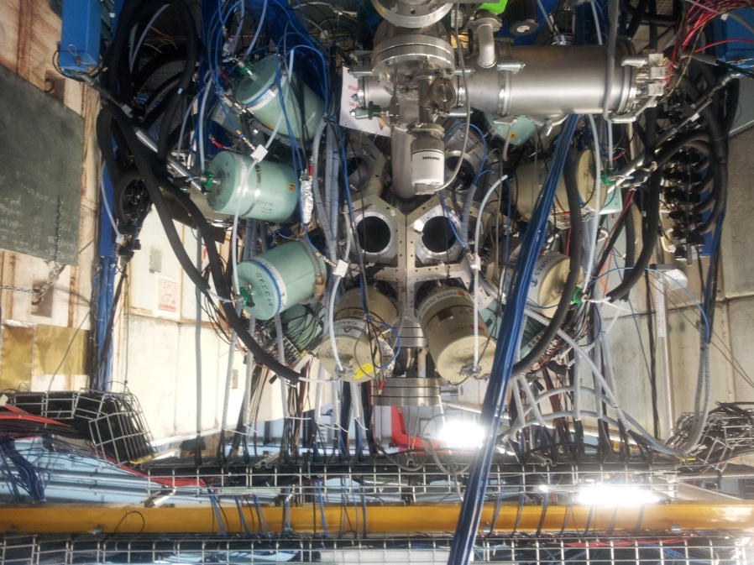
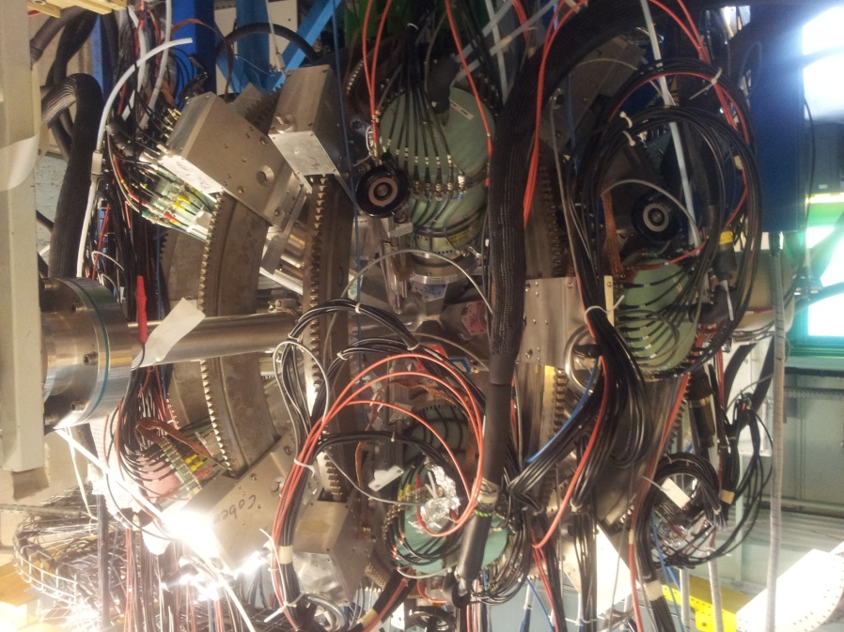
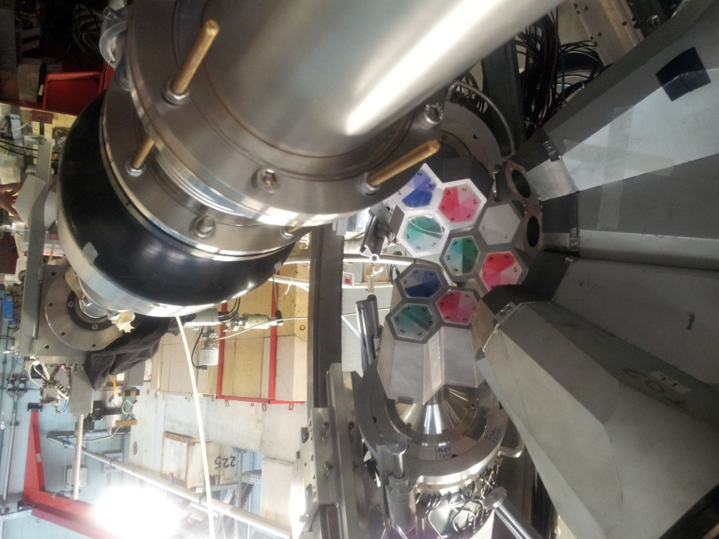
MINORCA @ ALTO (June 2014 – March 2015)
12 ORGAM CS HPGe x 0.1%
8 Miniball TC at ~14 cm from target
7.3% efficiency @ 1.33 MeV
ancillary detectors:
- Orsay plunger (OUPS)
- particle detector
- DSSD

Slide 8
MINORCA – experiments performed
Time dependent recoil in vacuum for Na-like ⁵⁶Fe ions
  - spokespersons: A. Stuchbery, D. Balabanski
Shape coexistence in ⁷⁴Se studied through complete low-spin spectroscopy after Coulomb excitation
  - spokespersons: M. Zielinska, K. Wrzosek-Lipska
Measurement of octupole collectivity in Nd, Sm and Gd nuclei using Coulomb excitation
  - spokespersons: P.A. Butler, M. Zielinska
Spectroscopy of the neutron-rich fission fragments produced in the ²³⁸U(n,f) reaction
  - spokespersons: J. Wilson, M. Lebois
Evaluation of the Angular Momentum Dependence of the ⁹⁶Mo γ Strength Function
  - spokesperson: B. Goldblum
Lifetime Measurement of ¹⁰⁰Ru: A possible candidate for the E(5) critical point symmetry
  - spokesperson: Th. Konstantinopoulos
Lifetime measurements in ¹¹³Te: Determining Optimal effective charges approaching the N=Z=50 doubly-magic shell closure.
  - spokesperson: D.M. Cullen

Slide 9

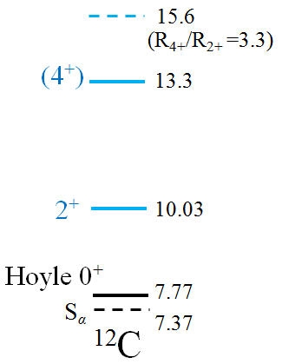
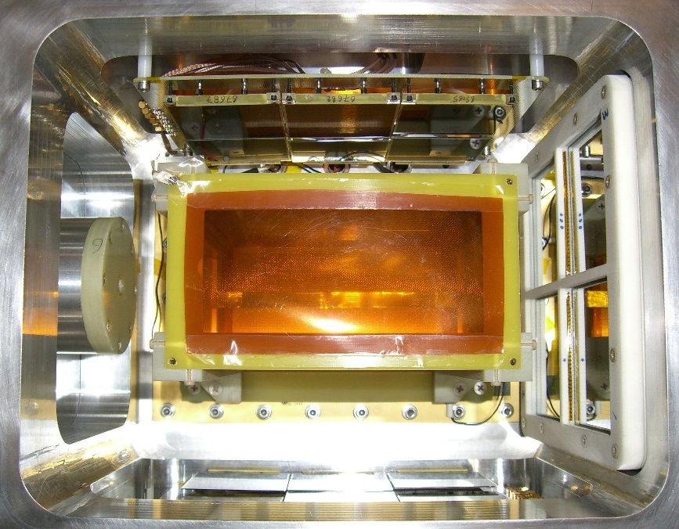
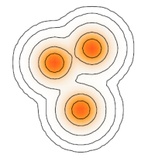
Most-recent results _{D. Suzuki et al.}
First in-beam experiments of Demonstrator
  2,048 Micromegas pads
  4 DSSDs + 12 Pad Si integrated
  Newly-made GET electronics to take data
2 successful runs (June to July ’15)
  ¹²C @80 MeV + He gas
  ⁶Li @11 to 23 MeV + He gas
35 visitors (16 domestic, 19 international)
bacchus
 |  |  | ¹²C stable
 |  | ¹⁰B stable | ¹¹B stable
 | ⁸Be 5.6 eV | ⁹Be stable | ¹⁰Be 1.5 My
⁶Li stable | ⁷Li stable
4⁺ ?
α resonant scattering
?
[MeV]
α
p
α
n
d
Micromegas
Pad Si
DSSD
Hoyle like
molecular like

Slide 10
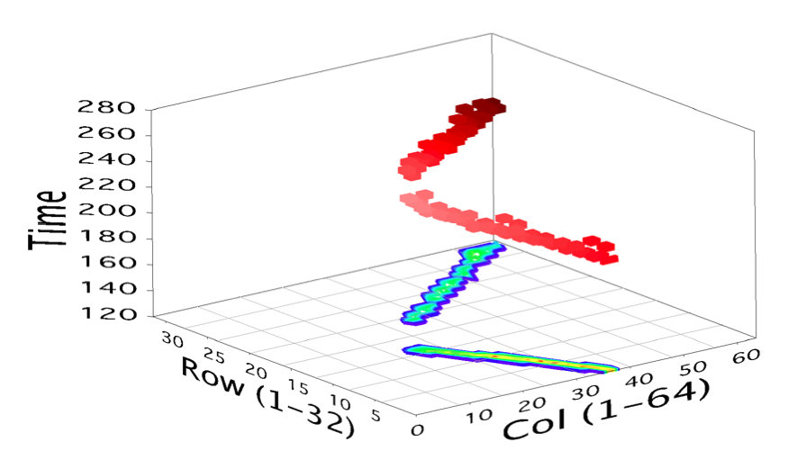
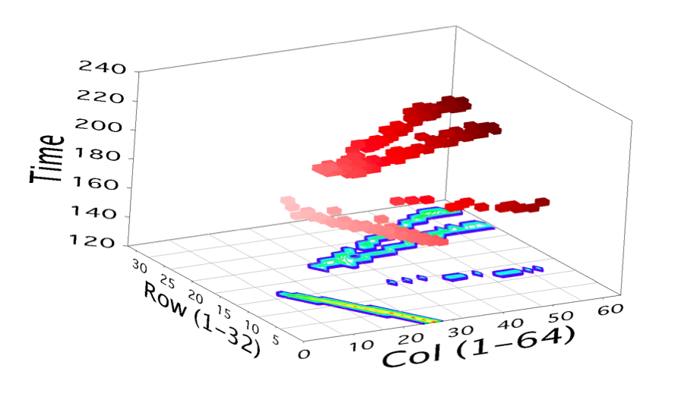
¹²C @ 80 MeV → He:C₄H₁₀ 90:10 gas
2-particle event
4-particle event

Slide 11
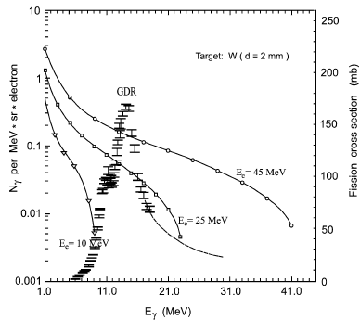
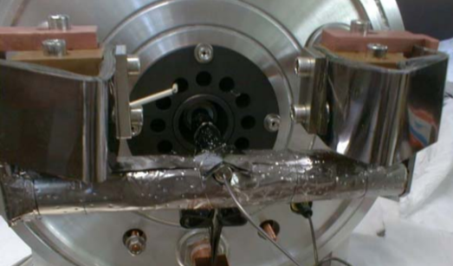
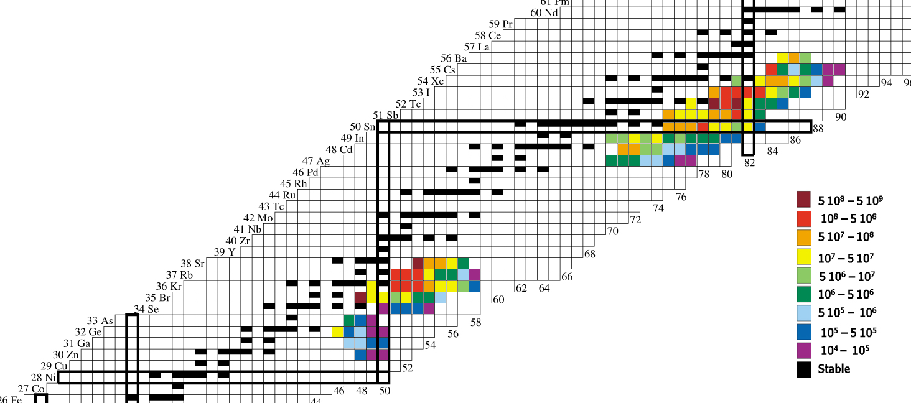
ALTO - RIB
First operational RIB facility based on photo-fission
→populating the GDR of ²³⁸U
Y. Oganessian et al., NPA 701 (2002) 87c
standard ISOLDE target
∅ = 14 mm; L = 140 mm
ρ = 3.2 g/cm³; T ≤ 2100º C
→ Estimated yields for
10 µA, 50 MeV e⁻ beam

Slide 12
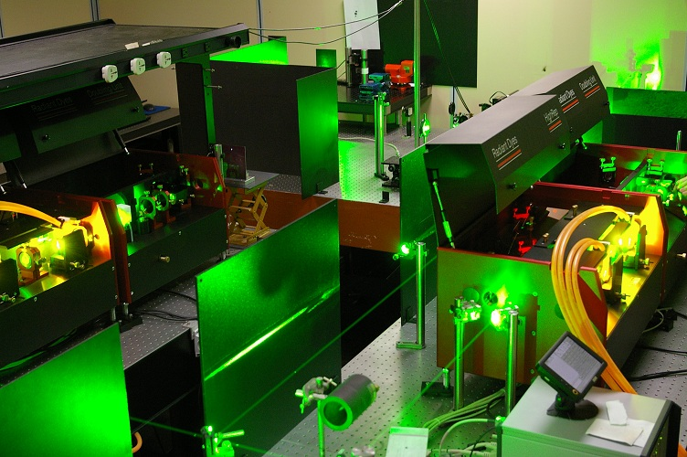
Rialto: Resonant laser ionisation at Alto
S. Franchoo et al.
Mezzanine of the mass separator/RIB zone
Nd:Yag pump laser (532 nm, 90 W)
2 dye lasers (540-850 nm, 8W @ 30W pump, 10 ns pulse width, 3 GHz line width)
BBO doubling units (270-425 nm, >100 mW)

Slide 13
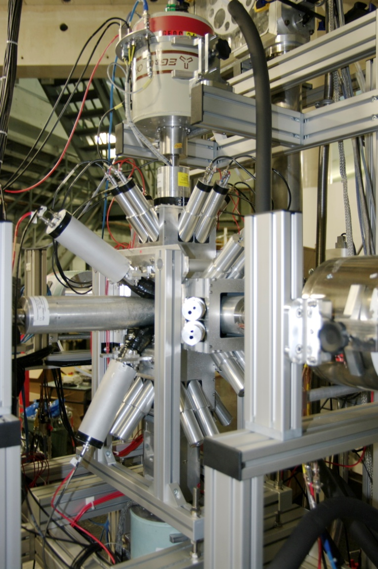
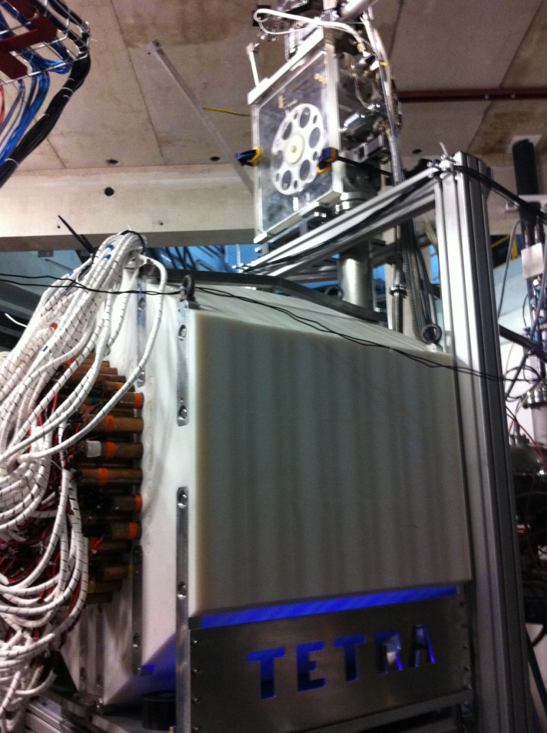
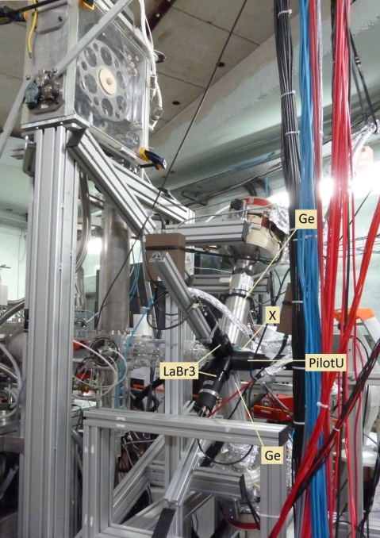
Nuclear structure in β-decay
BEDO setup
neutron detection
TETRA
fast timing
LaBr3
up to 5 Ge detectors (ε = 5-6%)
4π β trigger
80 ³He tubes ε(²⁵²Cf) = 53%
borated polyethylene shielding
Fast-timing studies using
LaBr₃ detectors

Slide 14
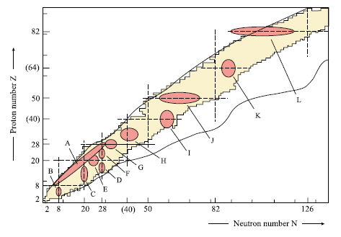
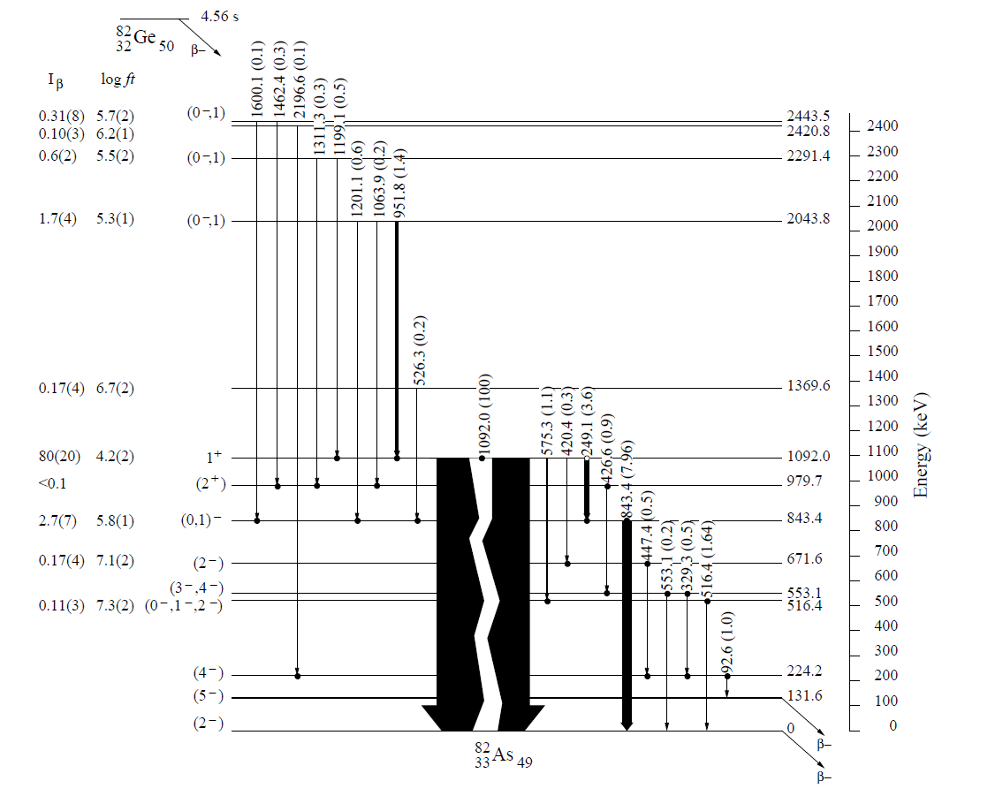
Results from BEDO in β-delayed γ-spectroscopy mode
(2) ubiquitous presence of intruder states of the type 1p-2h → signature of shape coexistence
⁸²Ge→⁸²₃₃As₄₉
shape coexistences:
a general phenomenon?
(1) problem of the spectral distribution of 1⁺ states in the N=50 region
(→ responsible for the half-life of the mother nucleus, possible consequences on the r-process)
interpreted by the theoretical work of Severyukhin… Giai et al. (influence of couplings to 2p-2h and tensor interaction)
50
?
[Heyde & Wood,
Rev. Mod. Phys. 83 (2011)]
1+
50
Though this phenomenon seems to concern all shell-closure regions: not a single study at N=50 for more than 3 decades!
(Z=50 a textbook case)
νd_{5/2}
conclusion: an «island of inversion» is « missed » at N=50 by 0.5 MeV only !
50
1p-2h
νg_{9/2}
A. Etilé et al., Phys. Rev. C 91, 064317 (2015)
Notes:
the sudden increase, from 82As to 80Ga, of the number of low-lying 1+ states and the corresponding Gamow-Teller fragmentation are naturally reproduced by the inclusion of tensor correlations and couplings to 2p-2h excitations.
- the strong energy lowering of intruder states in N = 49 isotones at mid proton (28-40) shell dominates also the low lying structure of the odd-odd nuclei.

Slide 15
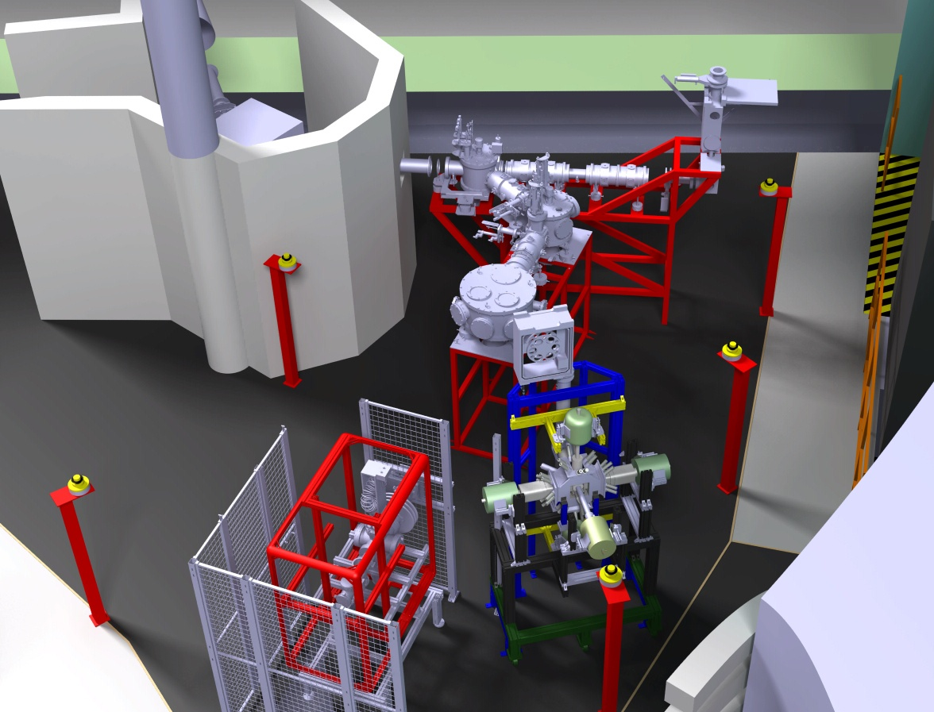





Present setups and near-future projects
Parrne mass separator
Identification station
TETRA
(existing)
LTNO
(³He/⁴He)
POLAREX
(project)
TAS
(project)
MLL Trap
(project)
Mass
measurements
BEDO/TETRA
(existing)
LINO
(project)
Laser-Induced nuclear orientation
(µ,Q, J^{π})

Slide 16

► Stable and Radioactive beam facility
► R&D on ISOL & RIB
► low-energy physics program based on photo-fission
► R&D and physics at ALTO pave the way to Spiral-2 at Ganil:
initiate physics program, train new generation of ISOL physicists, develop instruments and methodologies

Slide 17
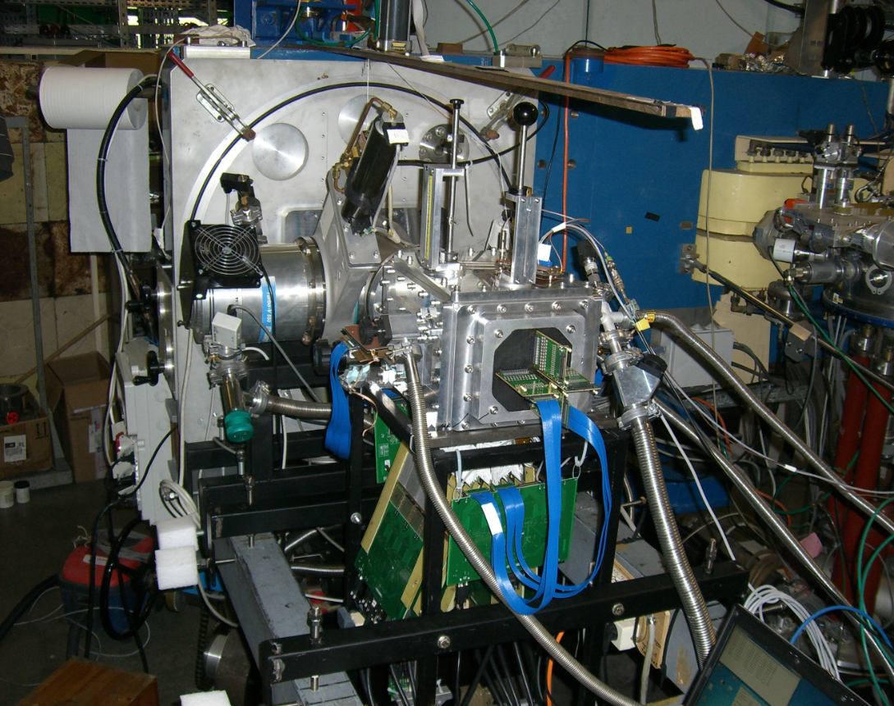
April 18, ’15
Bacchus
ACTAR
GET

Slide 18
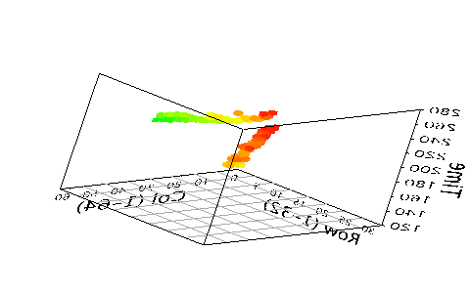
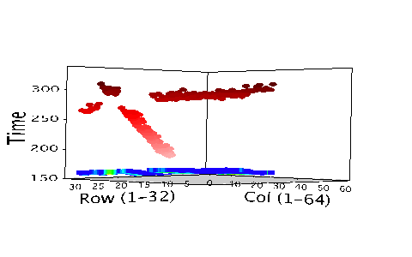
Animations
Use « diaporama » to view

Slide 19
Backup

Slide 20
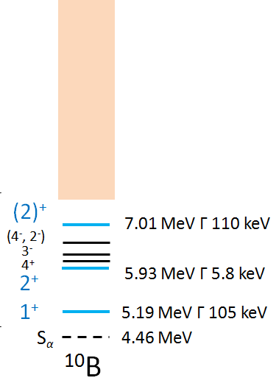
Evolution of α clustering at N = Z
 |  |  | ¹²C stable
 |  | ¹⁰B stable | ¹¹B stable
 | ⁸Be 5.6 eV | ⁹Be stable | ¹⁰Be 1.5 My
⁶Li stable | ⁷Li stable
4⁺ member?
M. Freer et al., PRC 83, 034314 (’11)
¹²C(γ, α)⁸Be
W.R. Zimmerman et al., PRL 110, 152502 (’13)
Bosonic condensation ?
?
A. Tohsaki et al., PRL 87, 192501 (’01)
M. Chernykh, et al., PRL 98, 032501 (’07)
p
[MeV]
α
n
α
d
Search 7.5 – 12 MeV for 3⁺
via ⁶Li + α resonant scattering
Known states
D.R. Tilley, J.H. Kelley et al.,
Nucl. Phys. A 745, 155 (’04).

Slide 21
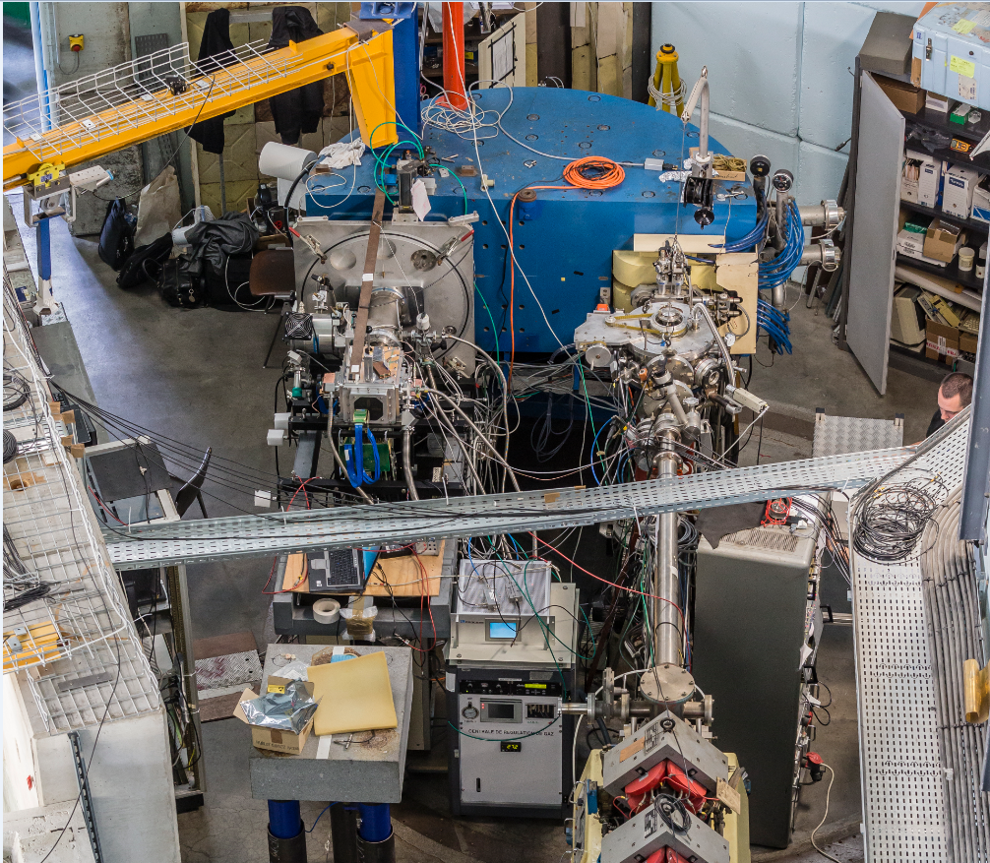
April 21, ’15
Bacchus
April 18, ’15
Demonstrator
Reaction chamber
µTCA rack
Gas handling

Slide 22
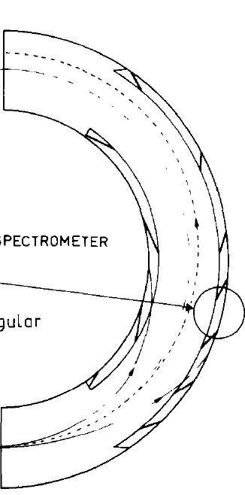
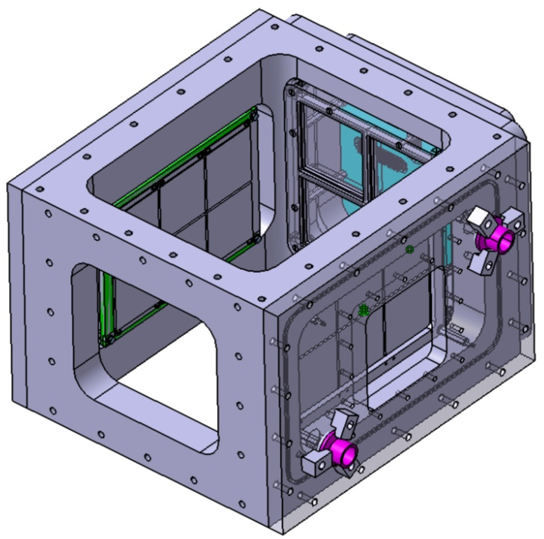
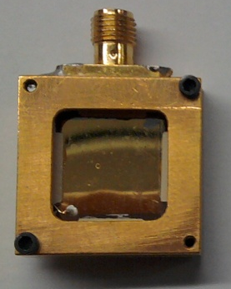
Leuven DSSD
Micron BB7-1500
1.5 mm, 6.4 x 6.4 cm²
32 x 32 strips
Full depletion at +300 V
Maya-Si
Pad type
0.3 mm, 5 x 5 cm²
-140 V (nominal)
50 cm
Bacchus
Demonstrator
ACTAR TPC
Gate valve
Beam
Target
Micromegas
6 x 12 cm²
2,000 pads of 2 x 2 mm²
beam
diamond detector
(in front of DSSD wall)
Reaction
chamber
-300 V
Slits/ Gate valve
Si(Li)
Mars83
24 mm
2.70 cm²
1.5 mm, 1.3 cm² (circular)
+250 V
At 10 cm from the target, 20°
24 mm

Slide 23
Stable and radioactive installations within a unique facility
Program Advisory Committee
• R.F. Casten (Chairman)
• E. Balanzat – Caen
• D. Balabanski – Bucharest
• S. Grévy - Bordeaux
• E. Khan – Orsay
• A. Maj - Krakow
• P. Regan – Surrey
• P. Reiter – Cologne
• B. Rubio – Valencia
• J.-C. Thomas – GANIL
• A. Tumino – Catania
• C. Trautmann - GSI

Slide 24
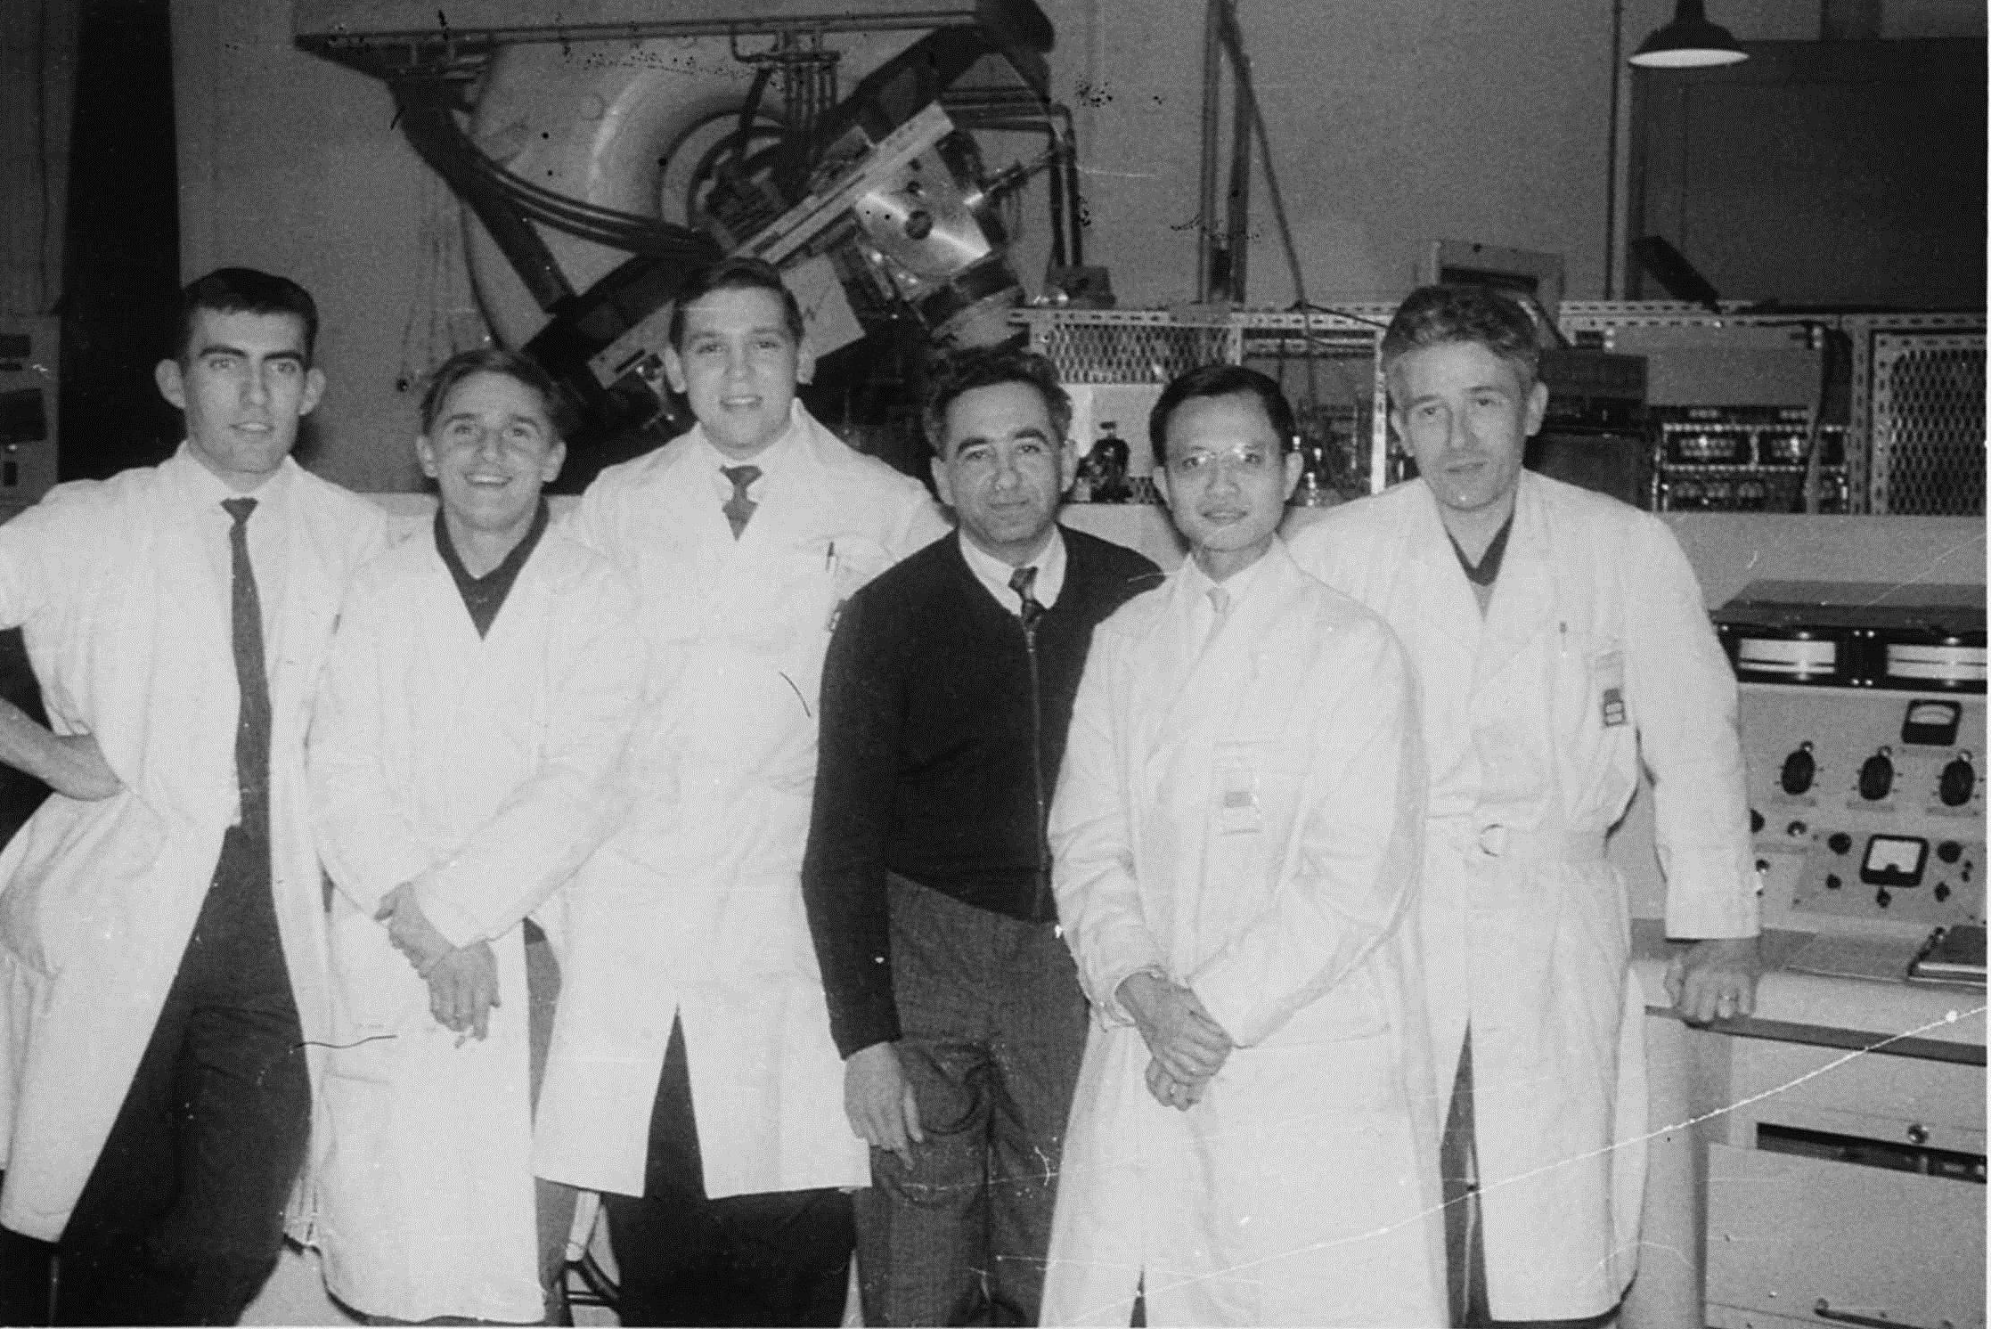
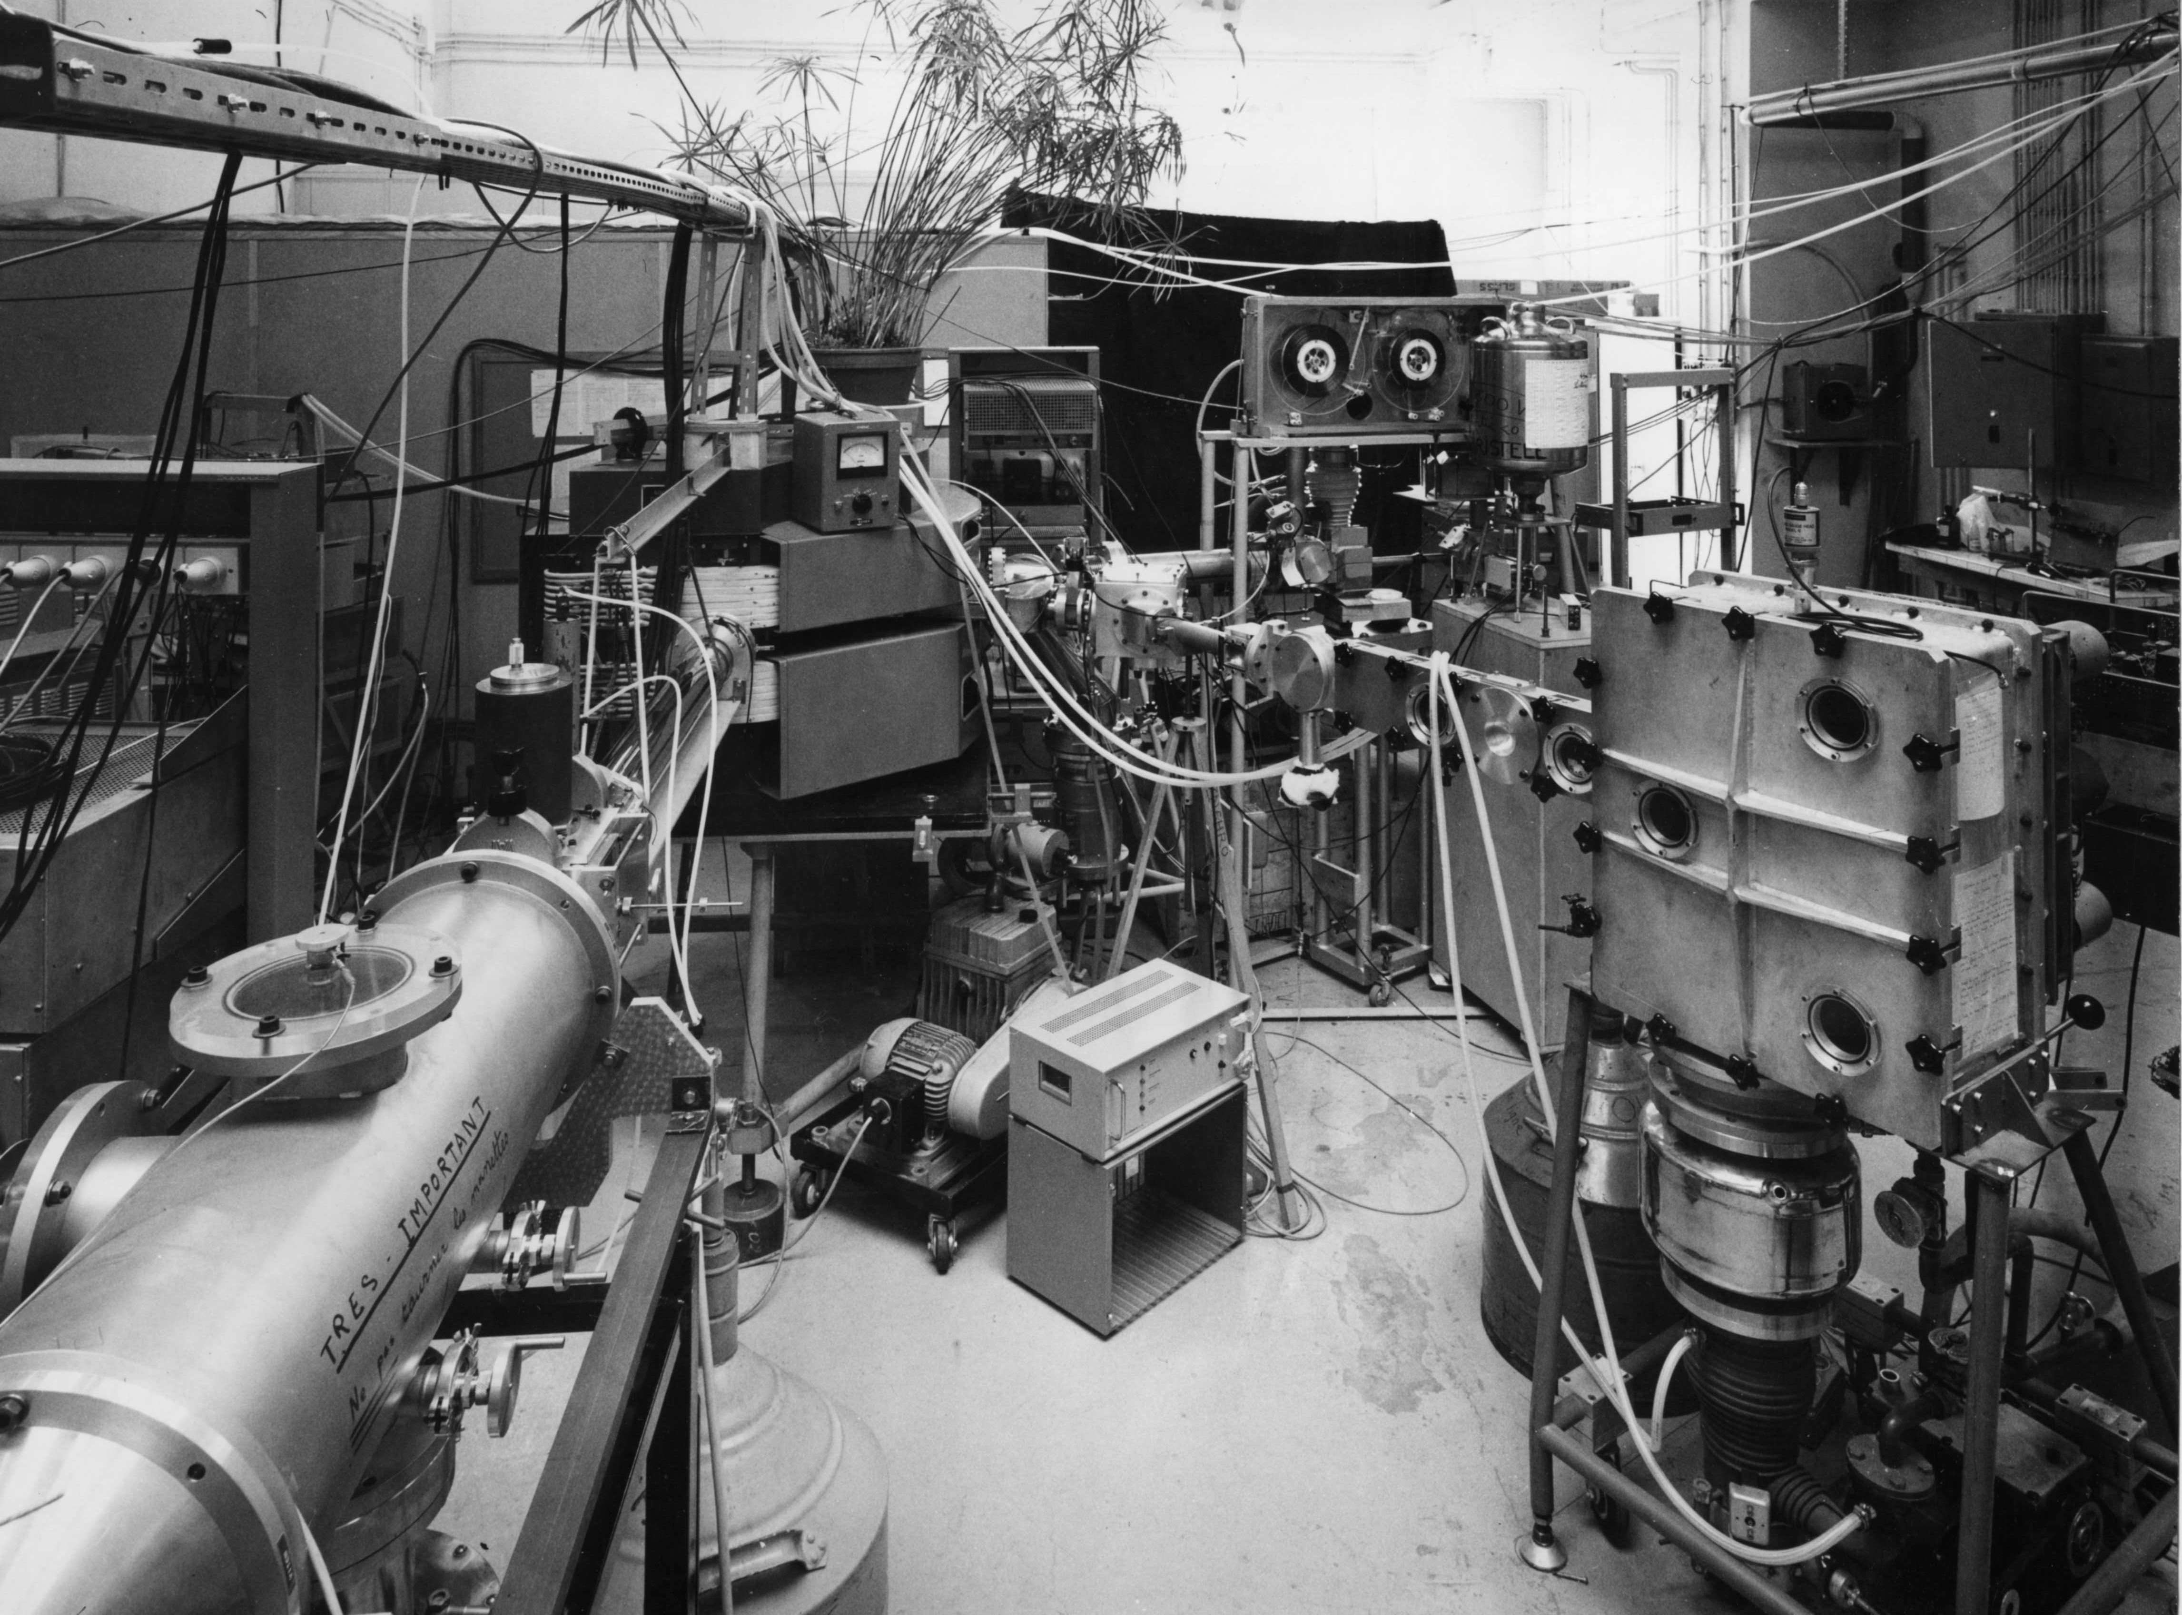
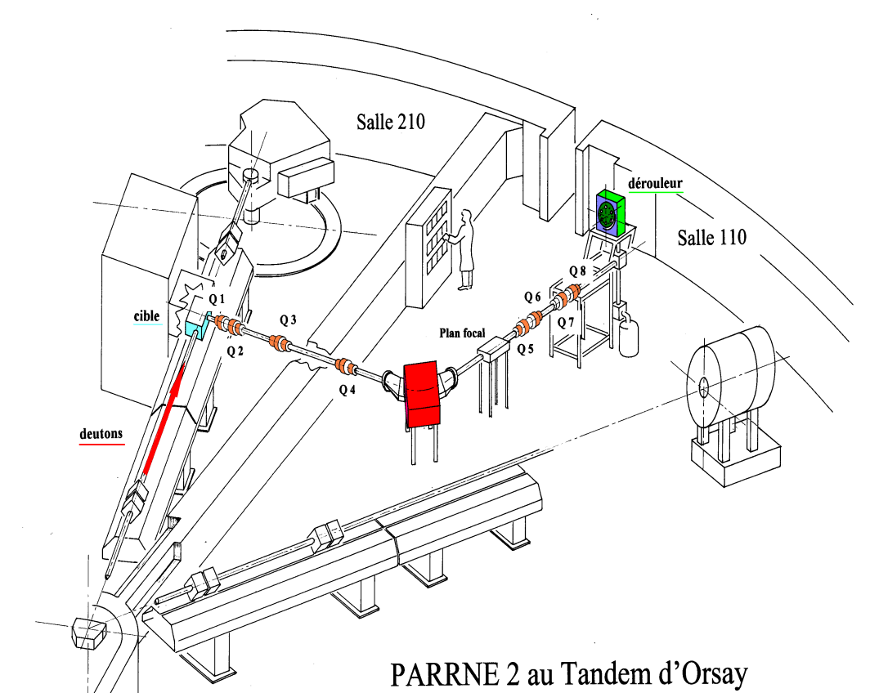
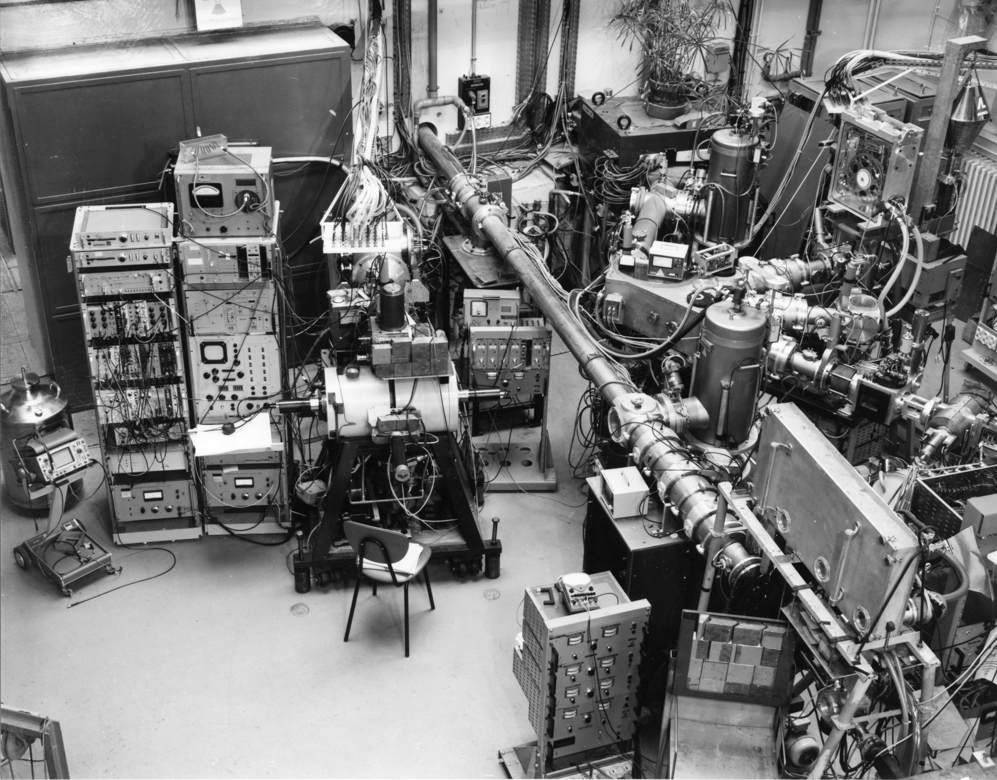
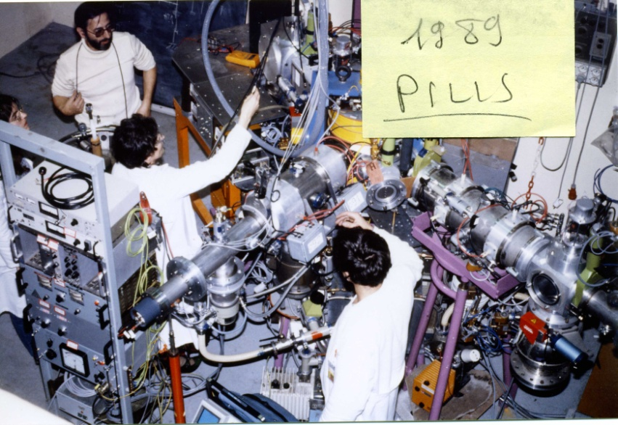
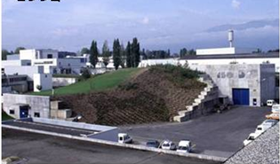
A bit of history
mid - 90’s SPIRAL project
SPIRAL2 : increase the mass range
introduction of the ISOL technique at GANIL
d vs e⁻ driver option
ca 1964 : mass spectrometry activities in Orsay
beginning of the 70’s :
the ISOCELE ISOL setup
at the Orsay SC
(now proton therapy center)
End 90’s, beginning 2000’s → ISOL activity back at IPN: PARRNe
end 70’s/beginning 80’s, upgrade of the SC ⇒ ISOCELE2
end 80’s, first online laser ion source at IPN: PILIS
beginning 90’s PILIS activity moves to ISOLDE/CERN
→ COMPLIS setup

Slide 25


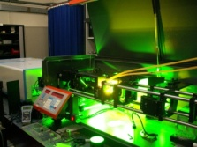
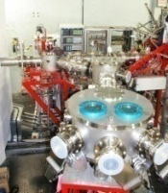
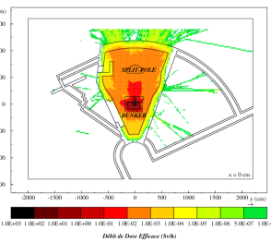
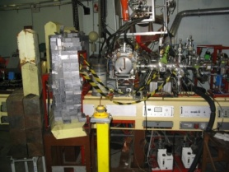




INAUGURATION
2013
BEDO commissioning
green light from French nuclear safety authorities
2012
2011
first laser ionized RIB
2010
building of the low energy beam lines + laser ion source
2009
Commissioning : tests
and radiation safety measurements
TIS vault
2008
84Ga -> 84Ge β-decay
2007
UCx target on line with e-beam
– production yields measurements
2006
First e-beam extracted
2005
RF system
2004
construction of the LINAC bunker
2003
arrival of the LINAC cavity from decommissioned LEP injector
2002
81Zn -> 81Ga β-decay
2001
83Ga -> 83Ge β-decay
exploratory photo-fission experiment at CERN
2000
1999
initial idea of a R&D test bench for the SPIRAL2 project at the Orsay Tandem
1998

Slide 26



Photofission
First proposed RIB facility based on photo-fission:
William T. Diamond, Chalk River, 1998
20 µA 25 MeV e⁻ + 40 g/cm² ²³⁸U
1.5 10¹¹ f/s
²³⁸U(γ,f) cross section from
J.T.Caldwell et al., PRC 21 (1980) 1215
figures from
Y. Oganessian et al., NPA 701 (2002) 87c

Slide 27


Photofission at Alto
measured mass-separated yields for 100 nA 50 MeV e⁻
similar to 1 µA 26 MeV d
therefore projected gain of 100x at 10 µA of e⁻
Production pps /10 µA e-
5 10⁸ – 5 10⁹
10⁸ – 5 10⁸
5 10⁷ – 10⁸
10⁷ – 5 10⁷
5 10⁶ – 10⁷
10⁶ – 5 10⁶
5 10⁵ – 10⁶
10⁵ – 5 10⁵
extrapolation from the systematic yield measurements made in June 2006 at 100 nA primary intensity
10⁴ – 10⁵
Stable
(excursions up to 10µA was possible during the commissioning phase)
F Ibrahim et al, International Topical Meeting on Nuclear Research Applications and Utilisation of Accelerators, Vienna (2009)

Slide 28



Photofission at Alto
electron linac
10 µA, 50 MeV
target & ion source
10¹¹ photofissions /s
Parrne mass separator

Slide 29



Rialto: Resonant laser ionisation at Alto
First step
2011, 2012: Gallium with two ionisation schemes
2013: Zinc with frequency tripling
2014: Off-line chamber for development of laser schemes
Collaboration IPN Orsay, Isolde,
Univ. Manchester, Univ. Mainz
Second step
electron multiplier
ohmic heating
Zn: 4s4p ¹P₁ → 4s4d ¹D₂
laser

Slide 30

Approved experiments to be scheduled
¹³²Sn region
β-γ and β-n experiments
● Penionzhkevich et al.
● Didierjean et al.
● Lozeva et al.
● Gottardo et al.
● R. Li/M. Ramdhane
et al.
mid-shell Ln’s
β-γ fast-timing
● Roussière et al.
TAS measurements program
● A.Algora/M. Fallot/A. Porta/B.Rubio/J.L.Tain et al.
n-rich Se
β-γ and β-n experiments
● Kurtukian Nieto et al.
n-rich Ge
β-γ and β-n experiments
● Duchêne et al.
N=50
β-γ experiments
● Etile – Verney et al.
● Astier et al

Slide 31



Tetra: Beta-delayed neutron emission
⁸²Ge
⁸³Ge
βn
⁸³Ga
T_{1/2}=0.312s
P_{n} = 85(4)%
this work
N=50
βγ
βnγ
laser-ionised ⁸³Ga beam
4π neutron detector
4π β & 1 Ge detector
D Testov et al., submitted to NIM

Slide 32

LINO: Laser-induced nuclear orientation
β-delayed spectroscopy of laser-polarized beams
ground and isomeric state properties of ¹¹⁰⁻¹²⁶Ag and ¹²⁸⁻¹³³In
β-decay of polarized ¹²¹⁻¹²⁶Ag and ¹²⁸⁻¹³³In
¹⁰⁰Sn
¹³²Sn
rp process
r process
more accurate theoretical lifetimes of the N=82 isotones below ¹²⁹Ag
shell quenching vs deformation
shell effect in radii
D. Yordanov et al.
French ANR funding scheme requested

Slide 33

LINO: Laser-induced nuclear orientation
polarisation by optical pumping
µ & Q from nuclear magnetic resonance
β-delayed spectroscopy of laser-polarized beams

Slide 34



Polarex: Nuclear Orientation On-Line
CSNSM off-line validation
Rejuvenation of dilution cryostat
Preparation at Alto
Structural integration & beam-line design
CSNSM Orsay
LPSC Grenoble
IPN Orsay
INM Paris
University of Tennessee
University of Maryland University of Oxford
University of Novi Sad

Slide 35

Tas: Total Absorption Spectroscopy
Proposed roadmap at Alto:
Phase 1: install Valencia-Surrey TAS@ALTO (12 BaF₂) at existing beam line, for nuclei of interest that could be easily selected
Phase 2: more challenging cases with laser ion source for selection, in parallel with development of dedicated TAS beam line
Phase 3: synergy with Bedo and Tetra for βn emitters and more exotic isotopes. Common measurement campaigns with complementary beam lines?
in parallel, new detector developments combining higher resolution with efficiency such as LaBr₃ or CeBr₃ for Alto then Spiral-2
IFIC, Valencia
Subatech, Nantes
University of Surrey, Guildford
University of Jyväskylä
Ciemat, Madrid

